Slide 1


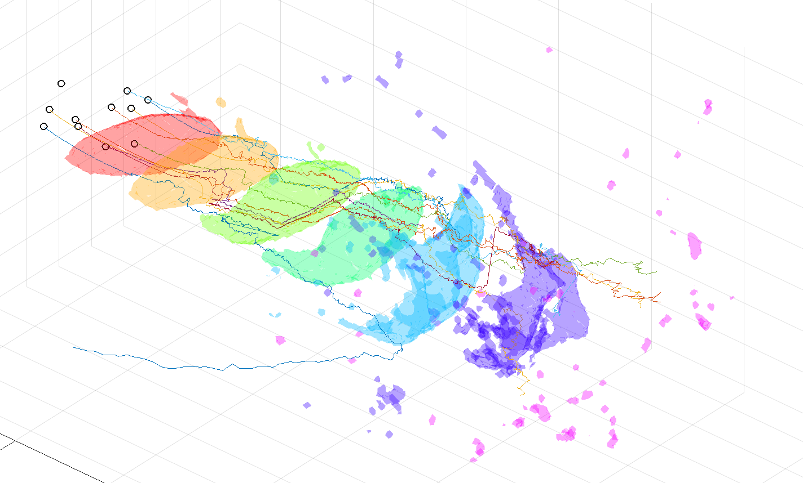

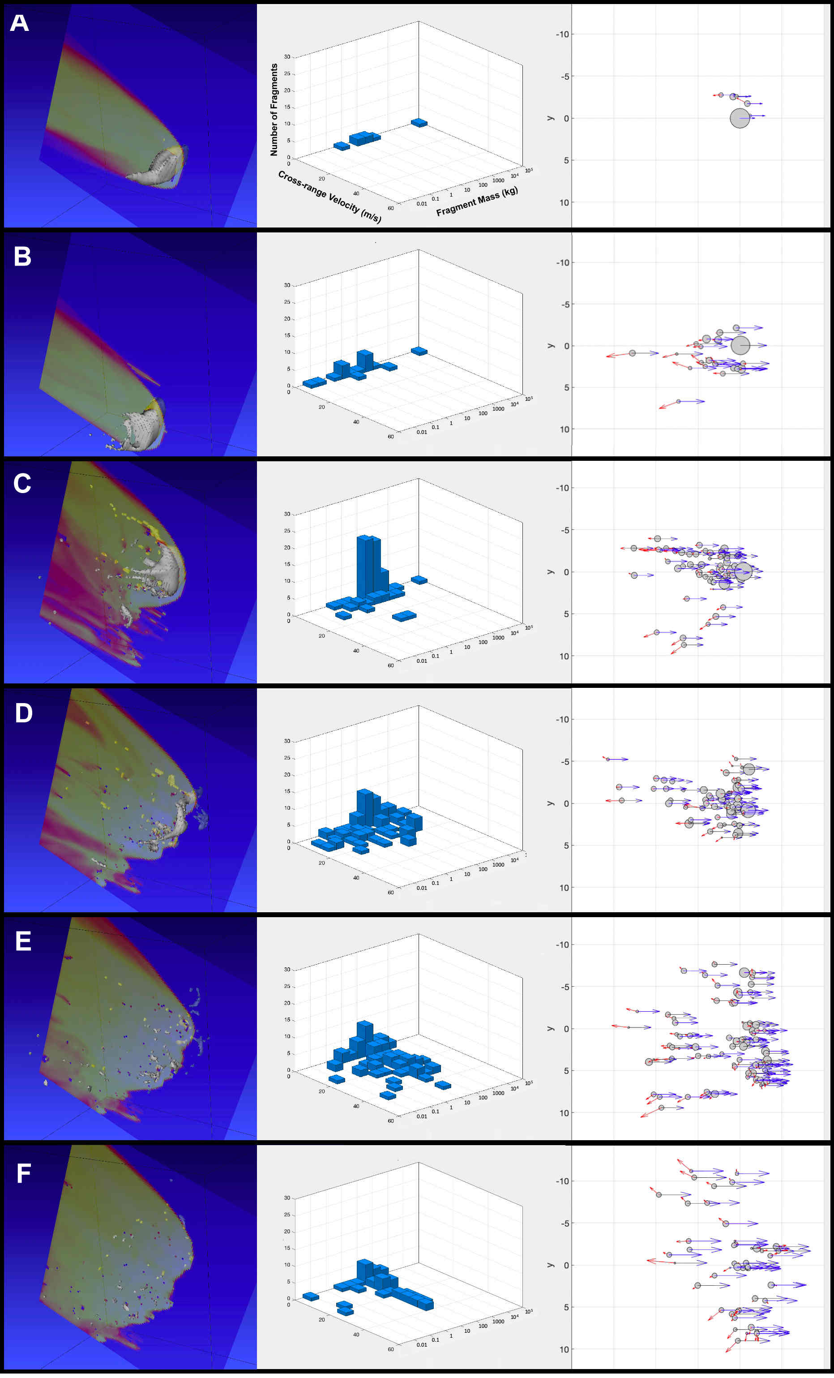
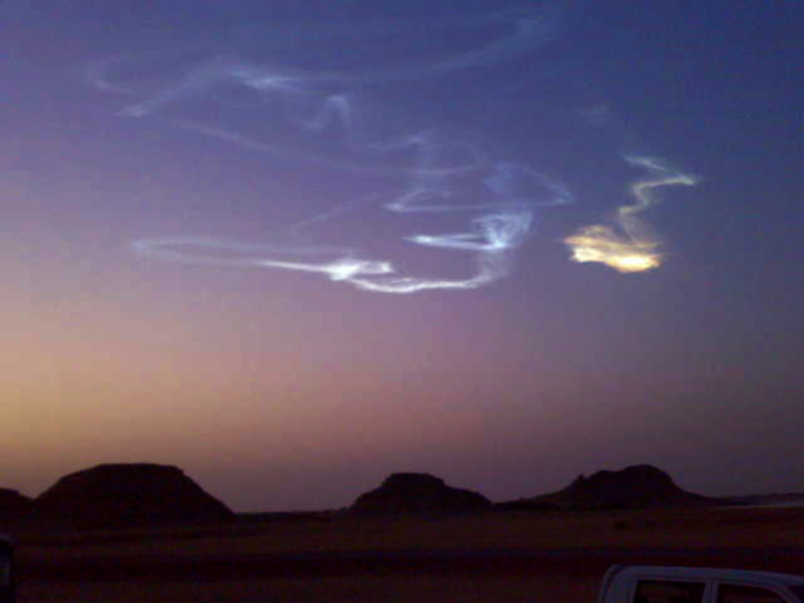
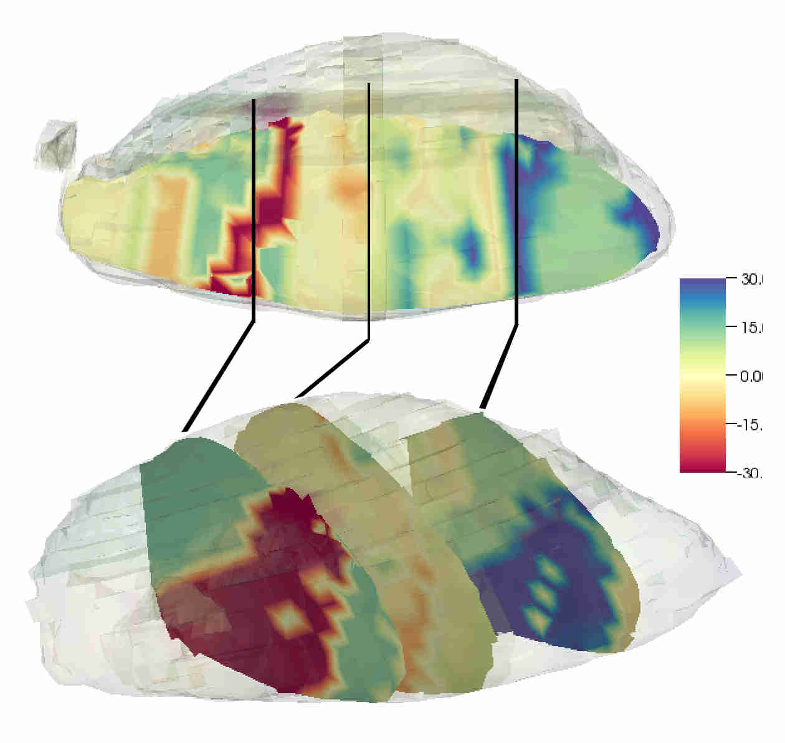
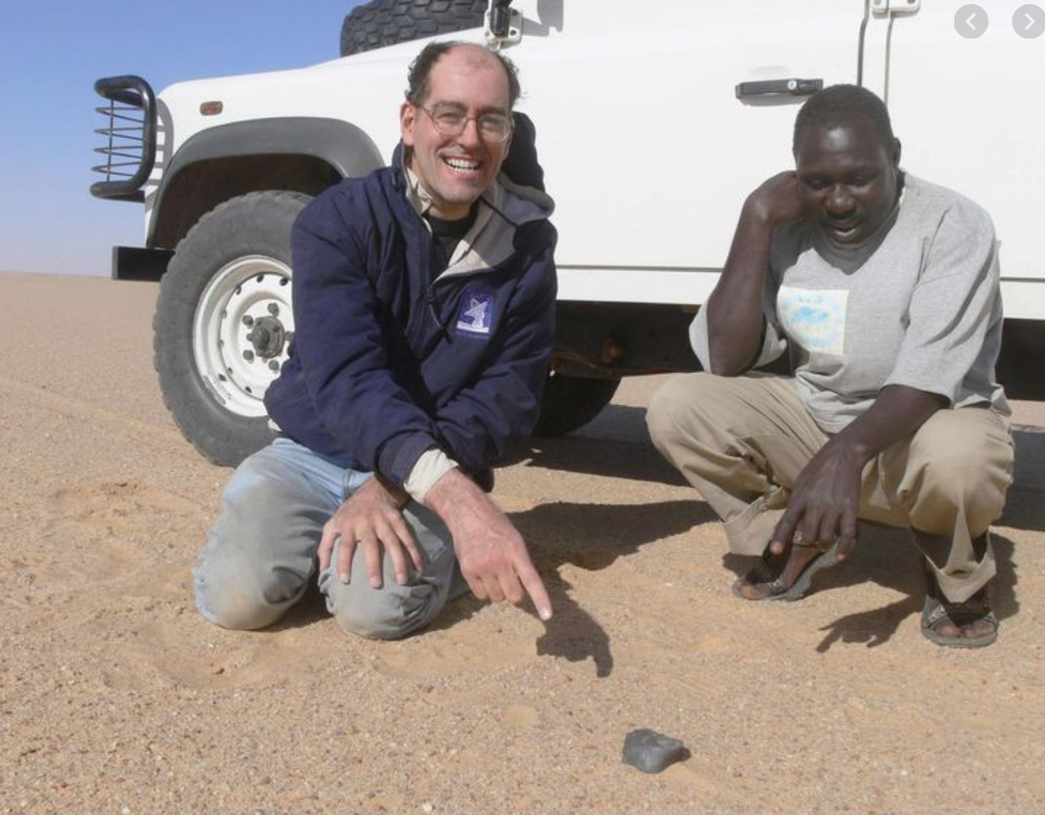
Meteorite Strewn Fields from Asteroid Airbursts
FALL
MEETING
NH037-0007
Darrel Robertson, NASA Ames Research Center, Moffett Field, CA
Online Everywhere | 1–17 December 2020
Peter Jenniskins, SETI Institute, 189 Bernardo Ave, Mountain View, CA
Wednesday, 16 December 2020. 04:00 - 20:59 PST
AMES RESEARCH CENTER
NASA in Silicon Valley
N20.85°
Wadi Halfa
INTRODUCTION
The Almahatta-Sitta meteorites (named after Station Six on the railroad from Wadi Halfa to Khartoum) from the break-up of asteroid 2008-TC₃ show a somewhat counterintuitive effect where the larger meteorites found near the end of the ground track (shown in the background image) were spread over a wider cross-range distance than the smaller meteorites found further up-range. In general it would be expected that smaller meteorites are easier to accelerate cross-track due to their low inertia and more susceptible to winds at altitude blowing them off track.
SIMULATION
The observed brightness in space, and the fireball brightness suggest TC₃ had a relatively low density of 1.8 g/cc and a low albedo. Using the known shape and orientation at entry, the low albedo size of 5.4 x 4.3 x 3.4m was used in the simulation using the ALE3D hydrocode from Lawrence Livermore National Laboratory. A cylindrical mesh was set up 20m long and 20m diameter, with 0.2m resolution, which followed the asteroid down through the atmosphere. A single strength of 10 MPa was selected with is fairly strong for meteors but very weak compared to terrestrial rocks.
Initially in the simulation, at high altitudes, the asteroid only slightly changes orientation due to the aerodynamic forces on the asymmetric shape. Early mass loss occurs near the tips of the asteroid because of the high aspect ratio of the asteroid providing a greater obstruction to the air in that direction. Liberated fragments are mostly in the 1 – 100 kg range, in part due to the limited resolution (20cm) of the simulation. However, shed fragments will continue to ablate and further fragment before they are sufficiently slowed in the atmosphere to reduce aerodynamic forces below the strength of the meteorites.
As the meteor progresses deeper in the atmosphere, shedding spreads over the entire front face, and fragments are shed from systematically deeper slices inside the meteor from front to back. The fragments are shed at low cross-range velocities so many enter into the vacuum in the wake of the meteor. Fragments in this area form a train behind the main meteor and are intimately mixed. Shock-shock interactions between the fragments in the wake cause them to oscillate in and out of the wake, but most remain captured in the wake until the main meteor shatters and main shock is no longer present. The low cross-range velocity of these fragments will cause them to fall along the meteor ground track, barring any significant winds pushing them off-course. During this period of shedding, some fragments are scattered out of the main shock, but again with relatively low cross-range speeds. These fragments will be found furthest from the ground track and do retain some memory of their original location inside the asteroid, with fragments ~45° from the stagnation point on the left side, falling to the left, and those on the right falling to the right. In general fragments further uprange come from the tips and front of the meteor and fragments further downrange come from further back in the meteor, but deceleration is inversely proportional to diameter, so small fragments are decelerated very quickly whereas large fragments are decelerated more more slowly. For example a 2cm diameter fragment is typically decelerated to dark flight speeds within a few kilometers, but a 10cm fragment requires a few tens of kilometers, assuming that it does not further fragment.
Prior to the final burst fragments have been shed a low cross-range velocities. The final burst however, occurs when the damaged layer at the front penetrates to the back of the asteroid, and the remaining meteor at this point is no longer able to withstand the shear forces. Fluid instabilities in the crushed meteor cause it to pancake into a much larger diameter than the original body and rip it apart. The large shock waves from the large burst fragments drive the fragments apart at high speed creating high cross-range velocities as the fragments move radially away from what was the velocity vector of the main mass prior to burst. All of these fragments are originally from the back (upwind) side of the original meteor, and fragments from the left side fall to the left, and those from the right side to the right. Without a remaining main mass creating a large wake, there is no entrainment or mixing of the fragments flung out during the final burst.
Asteroid 2008-TC₃ was discovered by the Catalina Sky Survey just 20 hours before impact with Earth, and was the first meteor to be discovered prior to atmospheric entry. Observations by the Clay Center Observatory provided a light-curve which showed the object was tumbling and allowed a shape to be derived. Atmospheric entry over the Nubian desert in Sudan, at 5:46 AM local time on 7th October, 2008 was recorded by the Meteosat 8 satellite, infrasound detectors in Kenya, and was observed as a bright flash up to 1500 km away. The energy was estimated as equivalent to 1 – 2 kilotons of TNT.
The asteroid entered the atmosphere at 12.4 km s⁻¹, 21° above the horizon, and broke up in the atmosphere creating a light-curve with 3 peaks spanning 3.5 seconds, with the majority of the energy was in the middle pulse at 37 km altitude. The break-up left a dust train in the atmosphere, and deposited 39 kg of meteorites in a 30 km long strewn field. Over 600 meteorites were recovered in searches led by the University of Khartoum. Most meteorites are ureilites, which is a rare type of stony meteorite containing a high percentage (~3%) of carbon in the form of nano-diamonds. Other meteorites are ordinary, enstatite, and carbonaceous chondrites. Enstatite chondrites are another rare type of meteorite, high in enstatite (MgSiO₃) but most iron as metal or sulfide, not oxide. Carbonaceous chondrites are also quite uncommon and often contain significant quantities of organic compounds. The diverse mix of meteorite types makes TC₃ a very interesting asteroid.
N20.8°
Meteorite mass (g)
Beyond TC₃, risk and hazard models currently produce damage regions for blast hazards but neglect meteorite debris strike hazard areas. Asteroids smaller than the Chelyabinsk meteor (Ø20m) may burst high enough in the atmosphere that the blast wave is not hazardous by the time it reaches the ground, but there may still be significant hazard from the meteorites. TC₃ in particular shows that large meteorites might be spread over a much wider area than would be typical of smaller meteors.
2008 TC3
100
N20.75°
10
N20.7°
Khartoum
1
CONCLUSIONS
Ispsum lorem
10.4 km
Nubian Desert, Sudan
Image Landsat/Copernicus
Image ©2020 CNES / Airbus
Image ©2020 Maxar Technologies
N20.65°
E32.25°
E32.3°
E32.35°
E32.45°
E32.5°
E32.55°
0.1
Google Earth

