Slide 1
Synergies Between ECLSS and ISRU
Paul Hintze
Moon Village Architecture Working Group Workshop

Slide 2
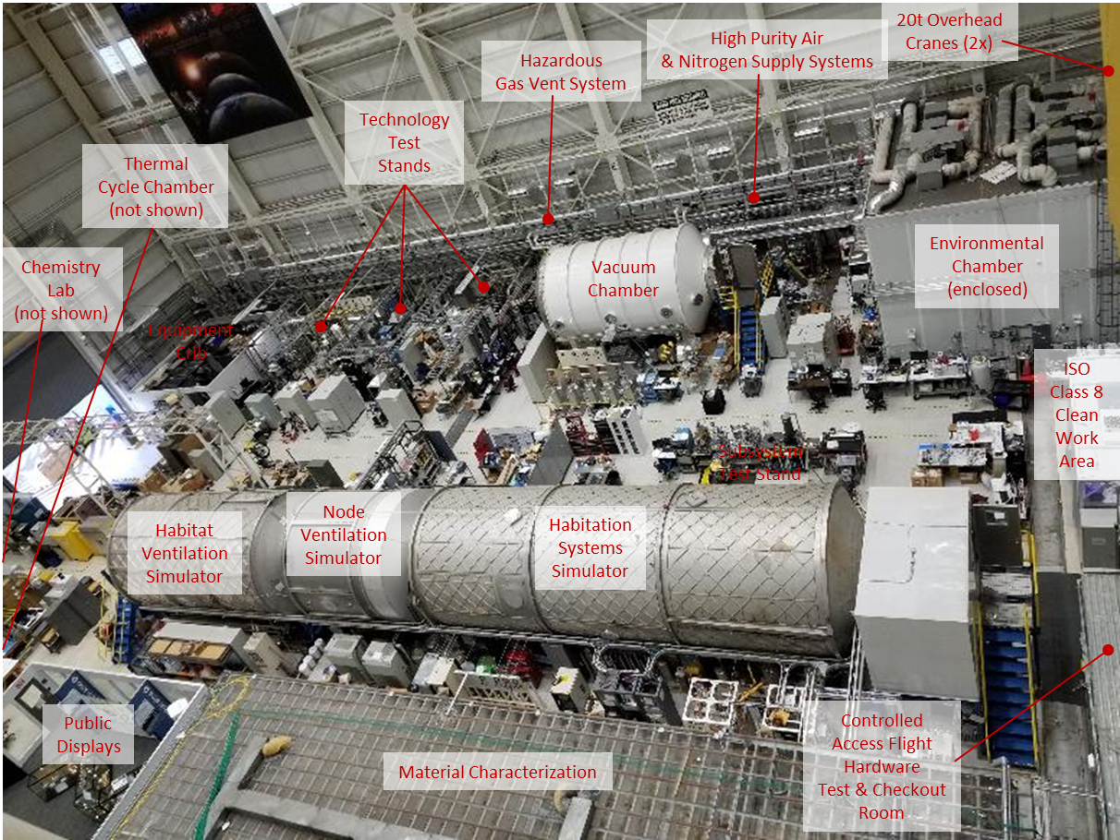
About me
17 years at Kennedy Space Center
  Last 10 years in ISRU
6 Months at Marshall Space Flight Center
  Branch Chief – Environmental Control and Life Support Systems
MSFC ECLSS High Bay

Slide 3
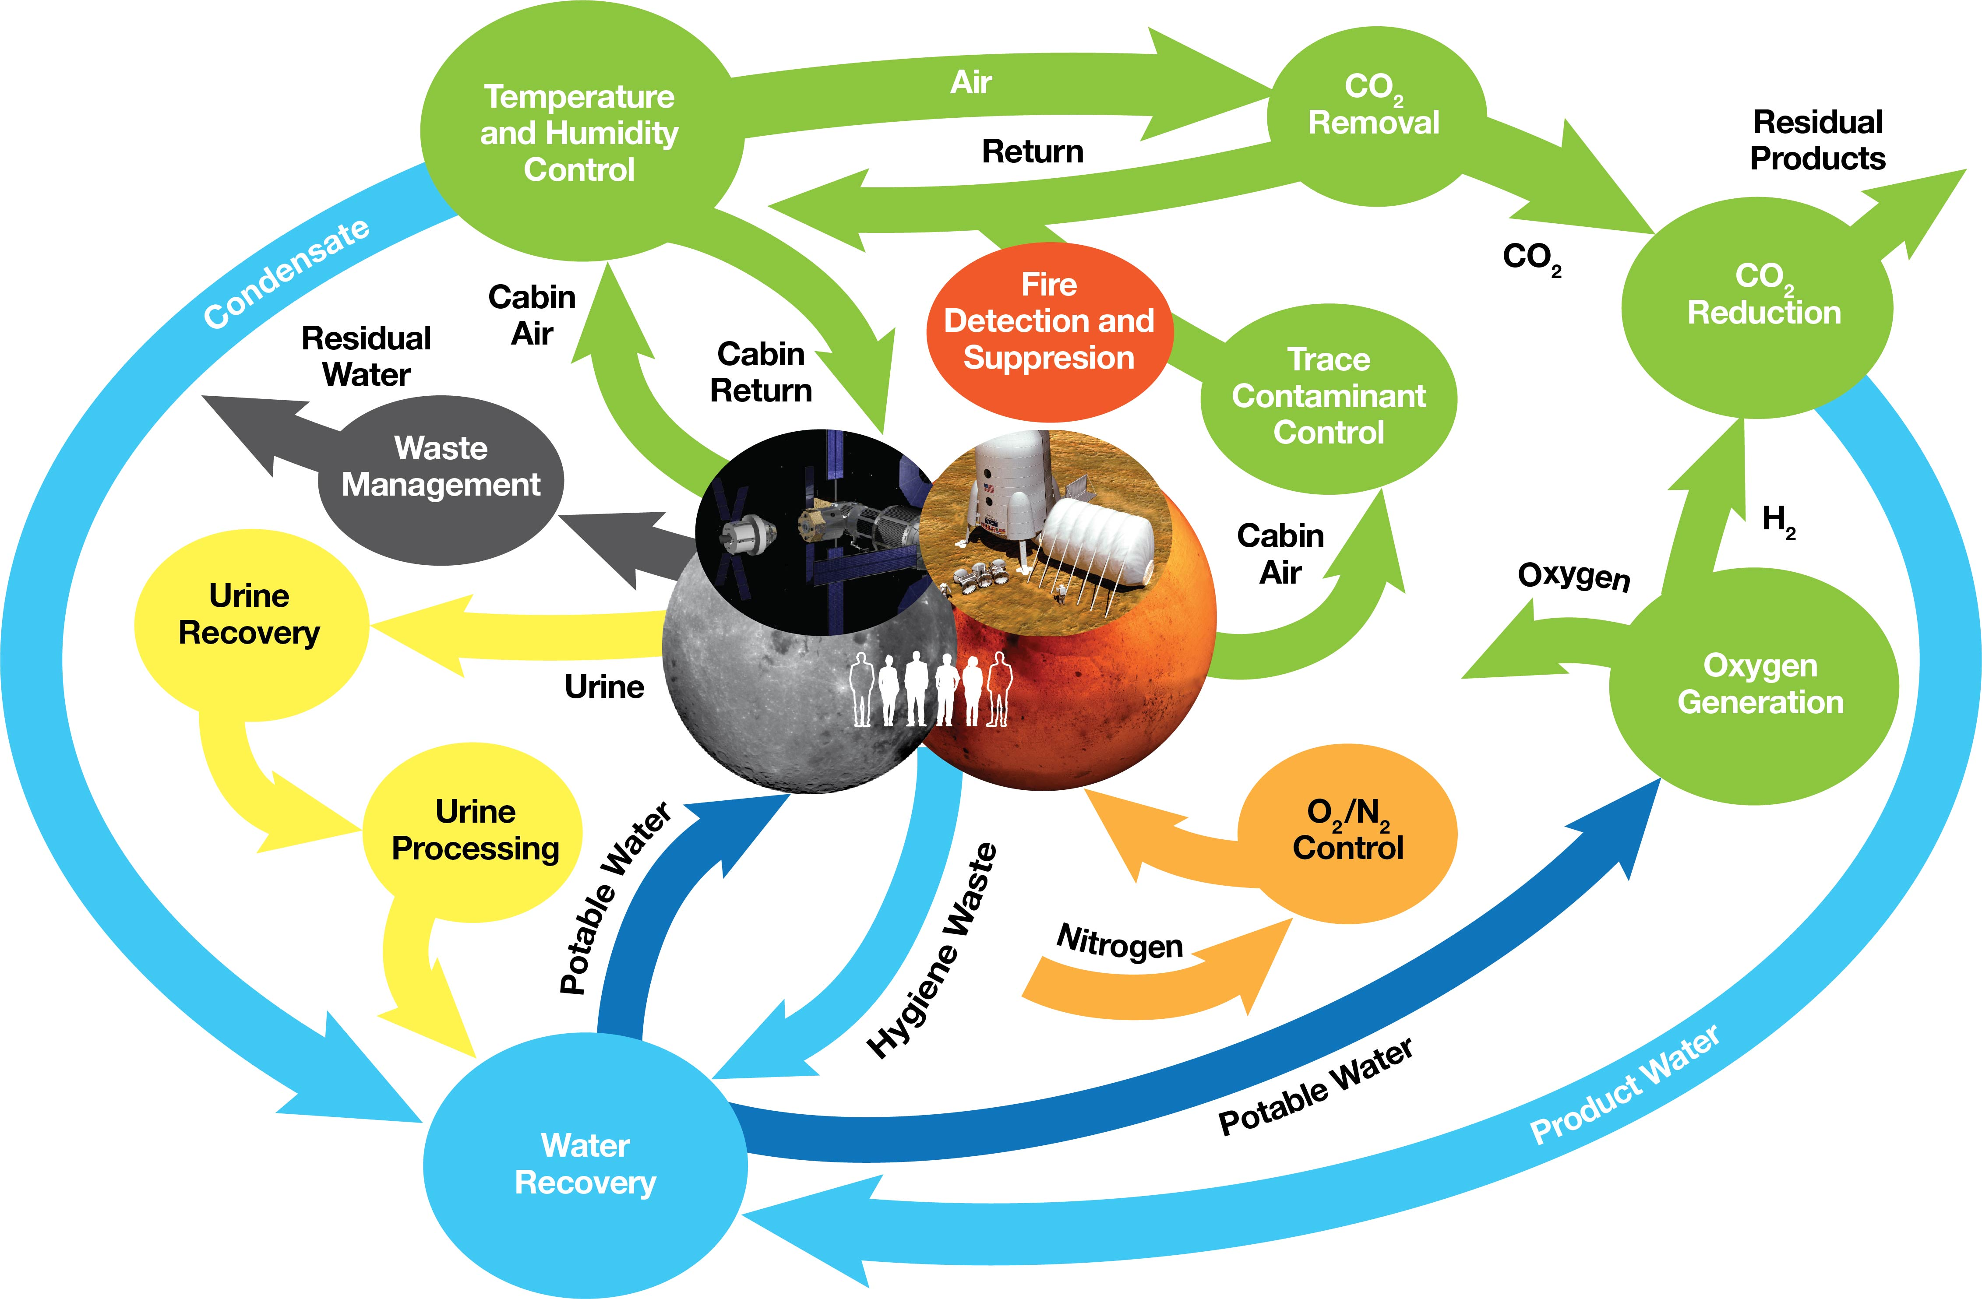
ECLSS Overview
ISRU Overlap

Slide 4
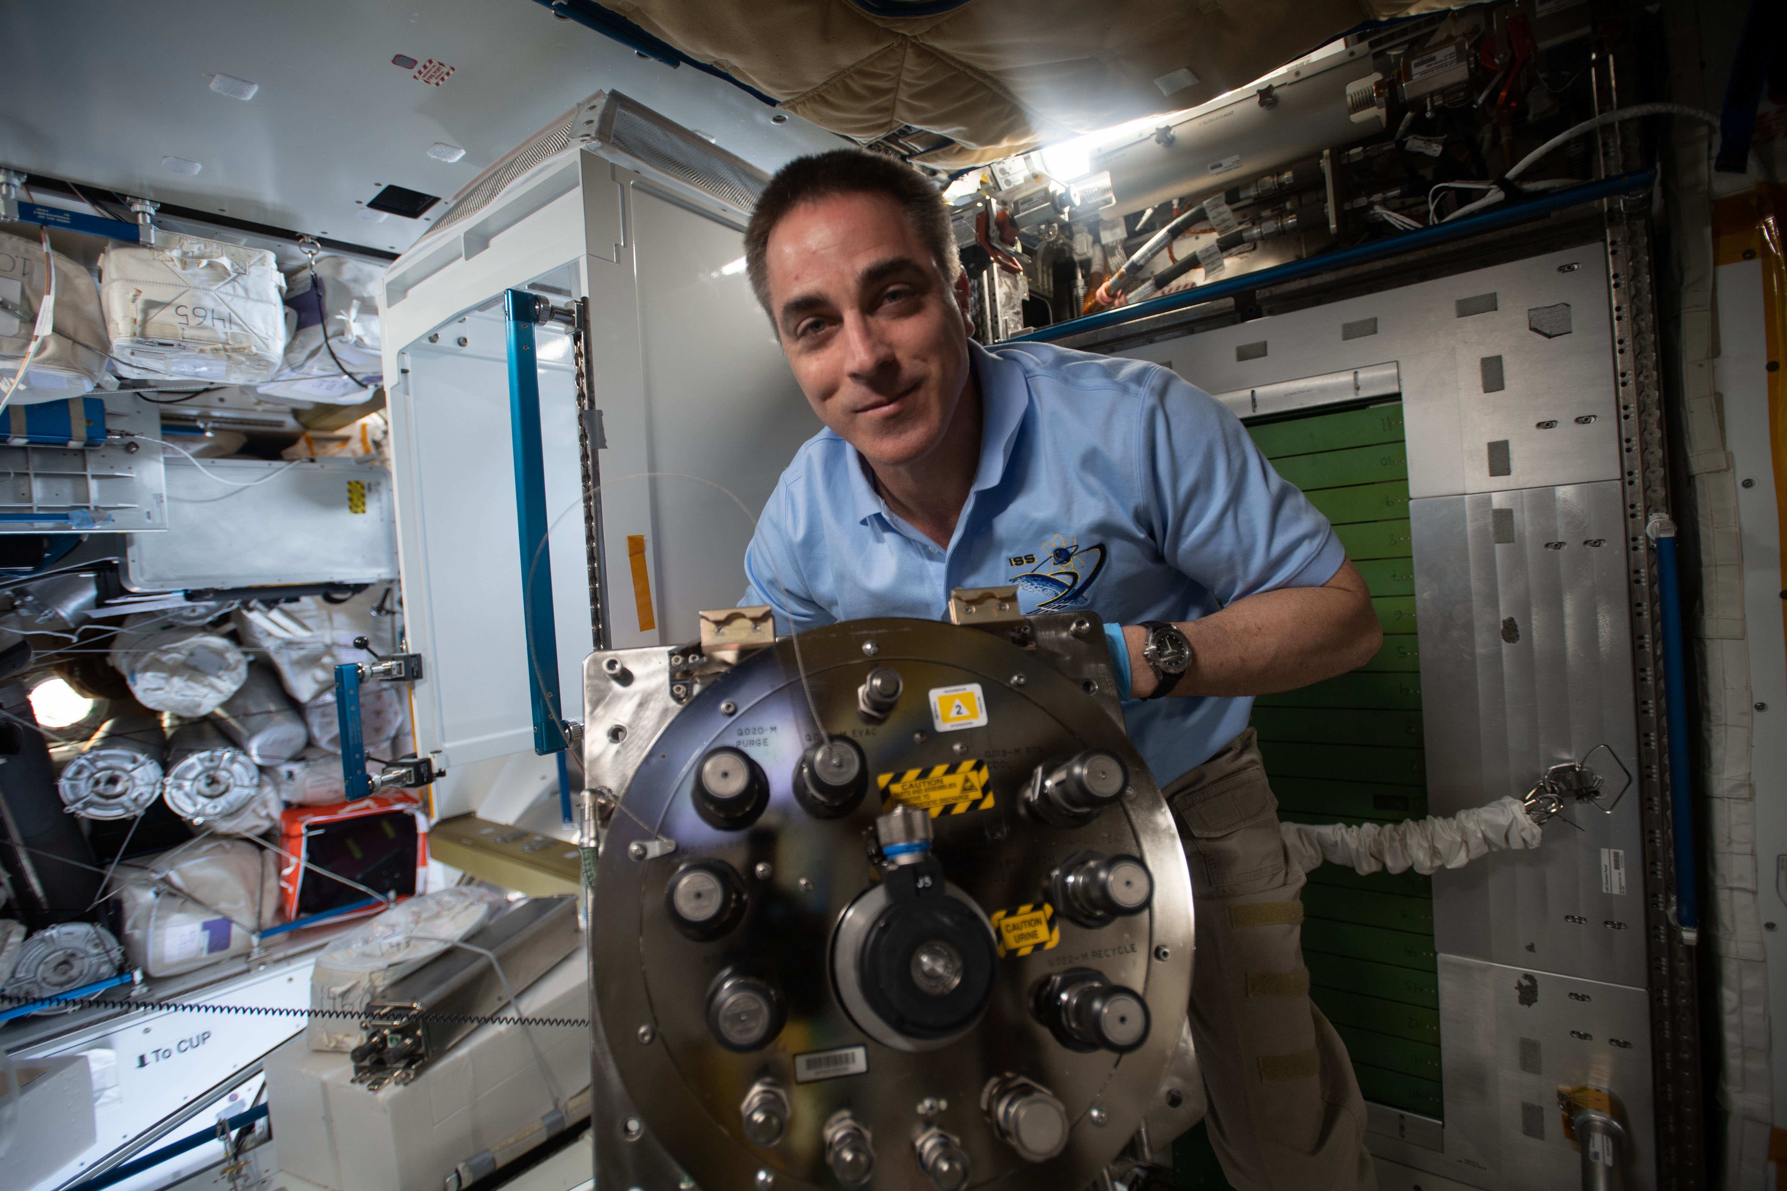
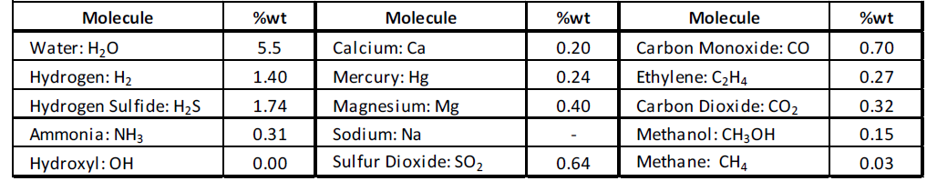
Water
Current State of the Art: About 85% of water is recovered on the International Space Station
ISS Goal – recover water
ISRU Goal – recover everything!
Contaminants are different
Dormancy - If you combine ISRU and ECLSS water recovery systems, you will have biological growth
Make Fertilizer!
International Space Station Expedition 63 Commander Chris Cassidy installs the new Urine Processing Assembly’s distillation assembly in Node 3.
Credits: NASA
LCROSS volatile estamites as given in recent NASA LuSTR proposal call

Slide 5
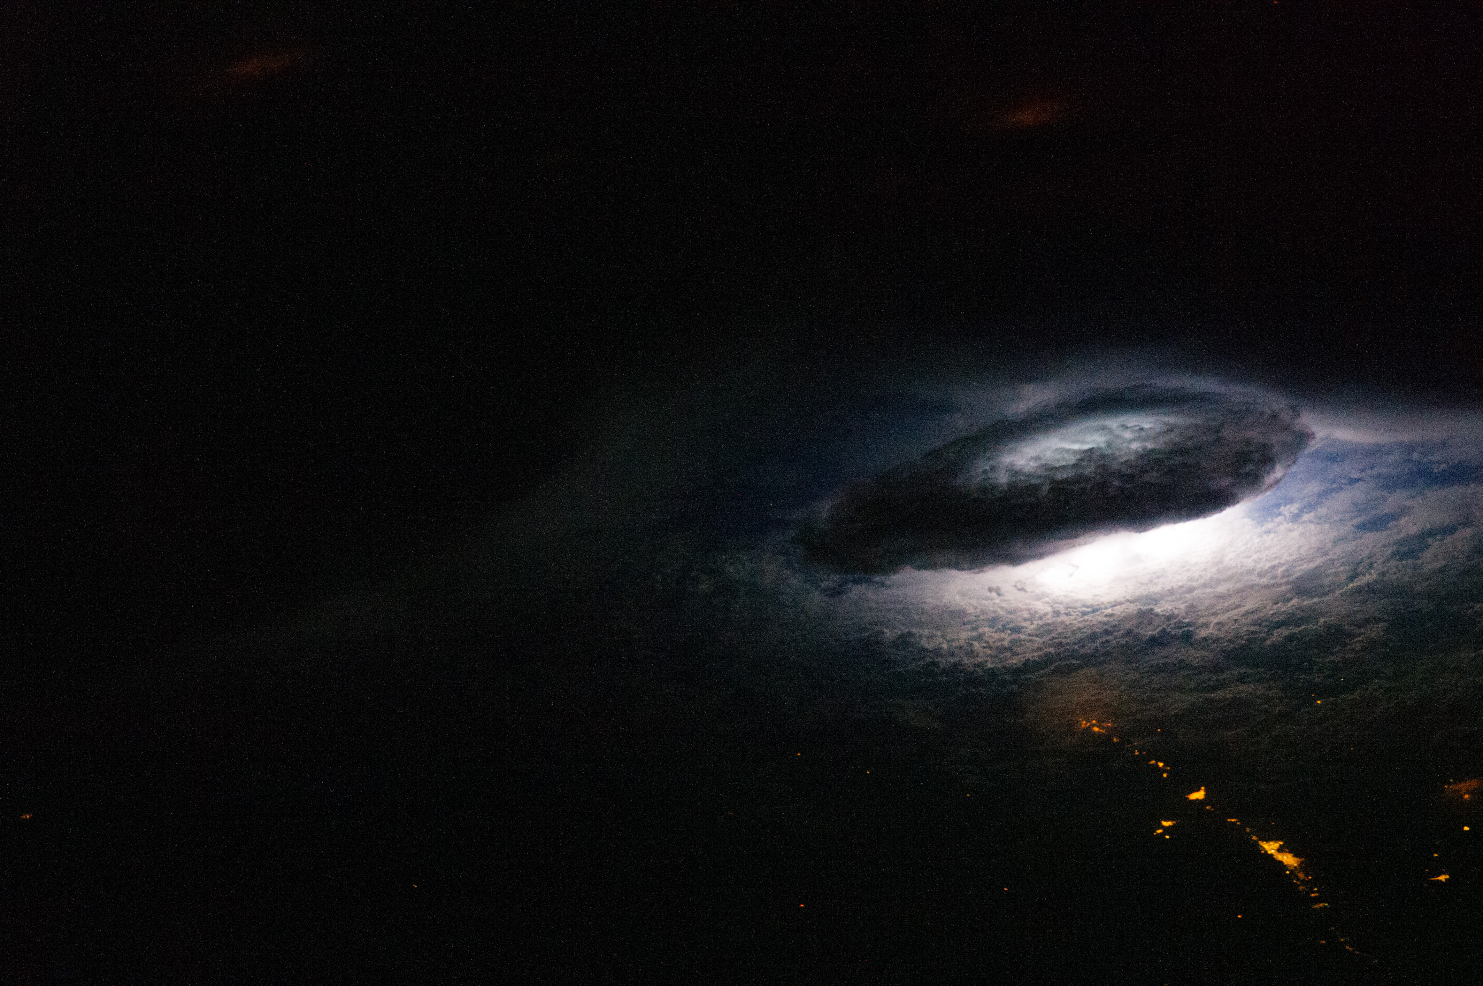
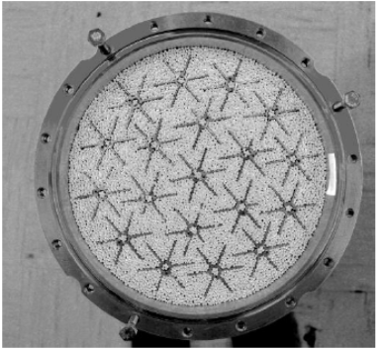
Air
Trace Contaminant Control
  Remove/mitigate hazardous compounds
CO₂ Removal
  Sorbent materials become obsolete
Can regolith or other ISRU products be used as sorbents?
Can you recover/make useful products from air?
  Plasmas?
Astronaut photograph ISS026-E-16488 was acquired on January 9, 2011, with a Nikon D3S digital camera using a 180 millimeter lens. The image was taken by the Expedition 26 crew. Both images are provided by the ISS Crew Earth Observations Facility and the Earth Science and Remote Sensing Unit, Johnson Space Center.
Partially filled prototype sorbent bed for the 4Bed CO₂ removal system

Slide 6
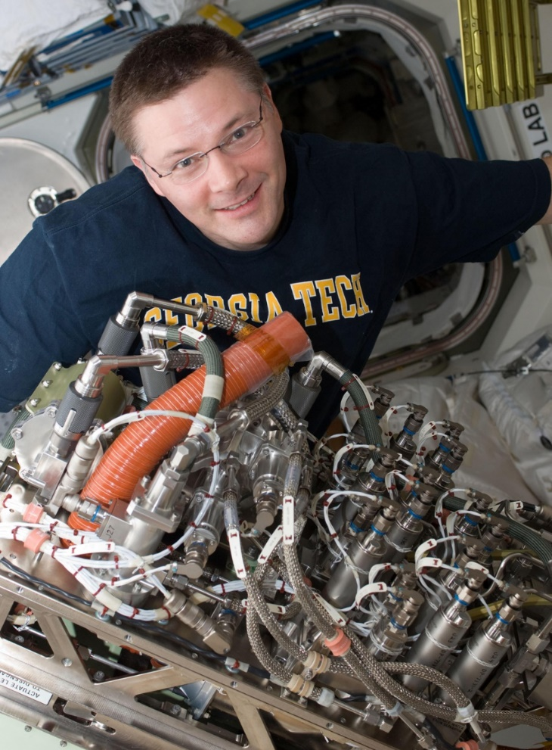
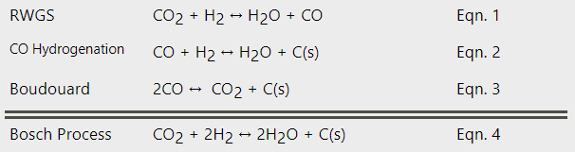
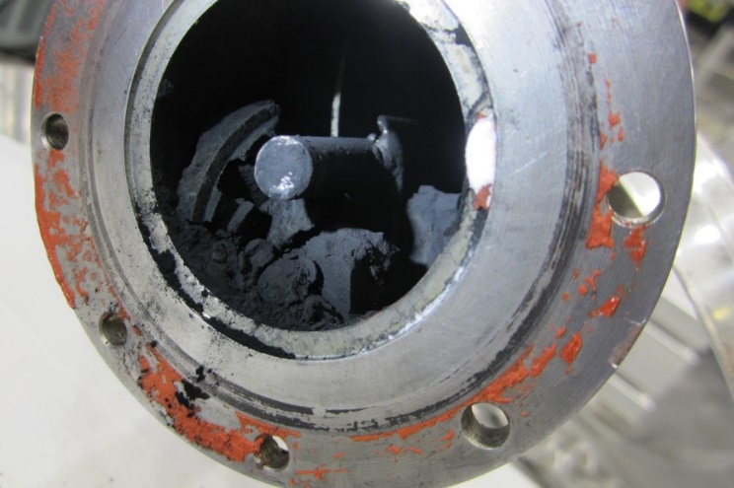
Air
CO2 Reduction
ECLSS ISRU Overlap
Produces useful products
Regolith as catalyst has been demonstrated!
Astronaut Doug Wheelock installs the SOA Sabatier CO₂ Reduction Assembly (CRA) on ISS. The CRA was recently returned to Earth. No oxygen recovery capability is currently operational on the ISS.
Carbon formed within Continuous Bosch Reactor EDU. Attritor shaft is visible at center.

Slide 7
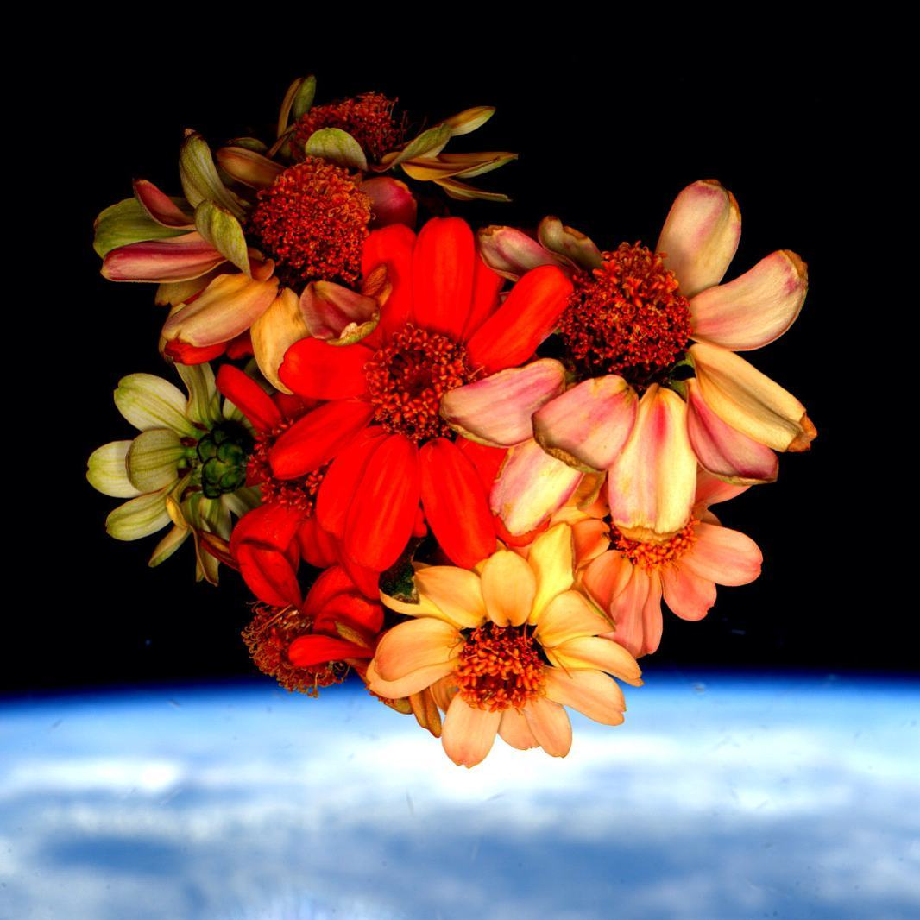
Plants
Need water and fertilizer
Give off VOCs
Inedible biomass
Astronaut Scott Kelly nursed dying space zinnias back to health on the International Space Station. He photographed a bouquet of the flowers in the space station's cupola against the backdrop of Earth and shared the photo to his Instagram for Valentine's Day 2016.
Credits: NASA/Scott Kelly

Slide 8
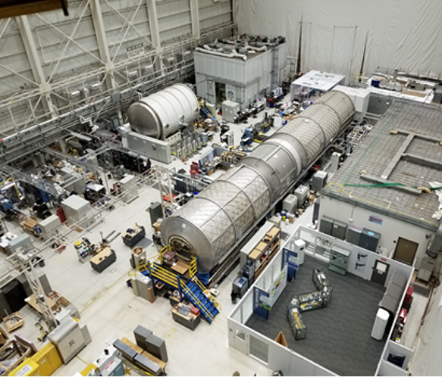
Questions?

