Slide 1

Exploring Multimodal Interactions in Human-Autonomy Teaming Using a Natural User Interface
Lisa R. Le Vie, Bryan A. Barrows,
B. Danette Allen, and Natalia Alexandrov
AIAA SciTech, January 2021
Notes:
Shorten examples

Slide 2
Outline
ATTRACTOR
Motivation
AMELIA
Procedures
Results
Future Work

Slide 3
ATTRACTOR
Autonomy Teaming & TRAjectories for Complex Trusted Operational Reliability (ATTRACTOR) mission
  Establishing a basis for certification of autonomous systems via metrics of trust and trustworthiness
  Exploring multi-asset Search And Rescue (SAR) technologies, supported by the Convergent Aeronautics Solutions (CAS) project
Human Machine Interface (HMI) Team
  Create intuitive, multi-modal interface utilizing natural interaction to facilitate multi-asset teaming
    Human Informed Natural-language GANs Evaluation (HINGE)
    Autonomous Mission Experimental Logistics Interactive Assistant (AMELIA)

Slide 4
Goal
Objective: Develop a human/multi-agent teaming interface to improve mission performance and efficiency and to enable trust of the system
AMELIA multi-modal data collection tool
  Speech
  Touch
  Speech combined with touch – conversational interface capability to allow a user to say “Place three drones here” (touching a location in the interface to place the three drones)

Slide 5
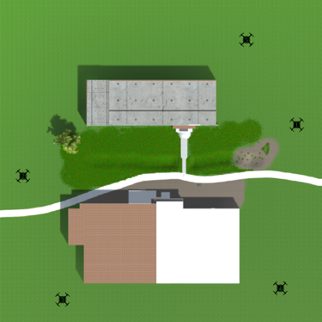
AMELIA Procedures
24 participants
  Volunteers from NASA
  11 females, 13 males
  Aged between 18-74
Participants were assigned the role of “Mission Commander” and instructed to place 5 drones, equally spaced, to cover the area where a sensor went missing.

Slide 6
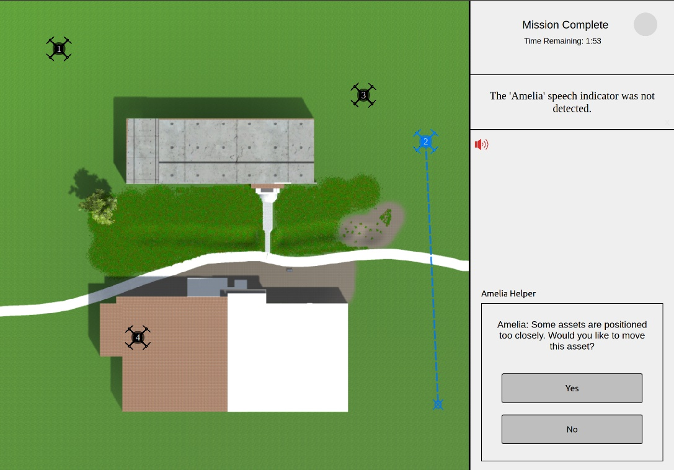
AMELIA Procedures
3 scenarios –randomly assigned
  Touch only
  Speech only
  Positional Touch with Speech
Final scenario
  Full Touch and Speech capabilities
AMELIA Helper
  Touch/Speech modality
  Yes/No

Slide 7
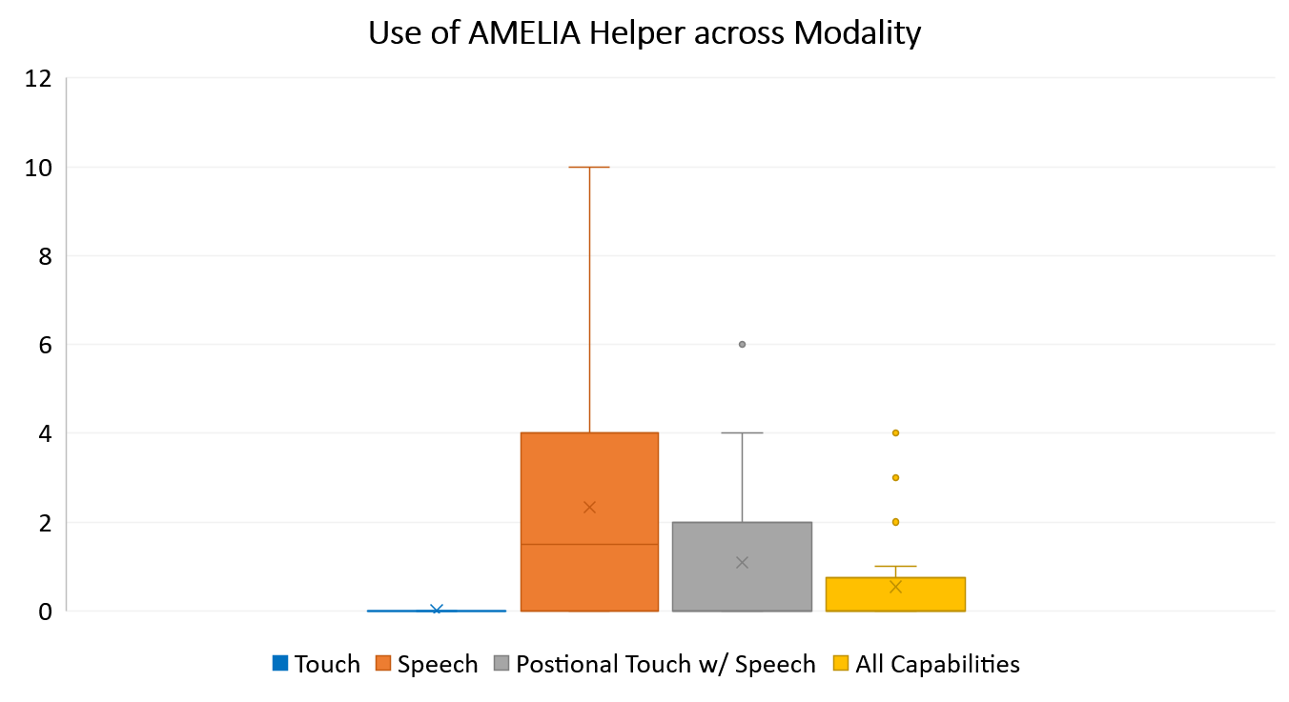
Average use of AMELIA Helper
Modality
Touch
  0
Speech average
  2 (0,10)
Positional Touch w/Speech
  1 (0,6)
All Capabilities
  .5 (0, 4)
Number of Interactions

Slide 8
Other Data Collected
Average Time to Complete Each Scenario
  Touch 42s (10, 93)
  Speech 259s (46, 727)
  Positional Touch w/ Speech 127s (32,382)
  All Capabilities 64s (11, 362)
System Usability Scale Ratings
  Touch - Excellent
  Speech - Ok/Fair
  Positional Touch w/ Speech - Good
Communication Strategies

Slide 9

Future Work
Transitioned into Autonomous Systems activity under NASA’s Transformative Tools and Technologies (TTT), Revolutionary Aviation Mobility Subproject.
  Communication Strategies
  Multi-modal interface interaction
  Trust

Slide 10
Questions?
Ms. Lisa R. Le Vie
NASA Langley Research Center
Autonomous Integrated Systems Research Branch
lisa.r.levie@nasa.gov
Mr. Bryan A. Barrows
NASA Langley Research Center
Autonomous Integrated Systems Research Branch
bryan.a.barrows@nasa.gov
Dr. Danette Allen
NASA Langley Research Center
Autonomous Integrated Systems Research Branch
danette.allen@nasa.gov
Dr. Natalia Alexandrov
NASA Langley Research Center
Autonomous Integrated Systems Research Branch
n.alexandrov@nasa.gov

