Slide 1
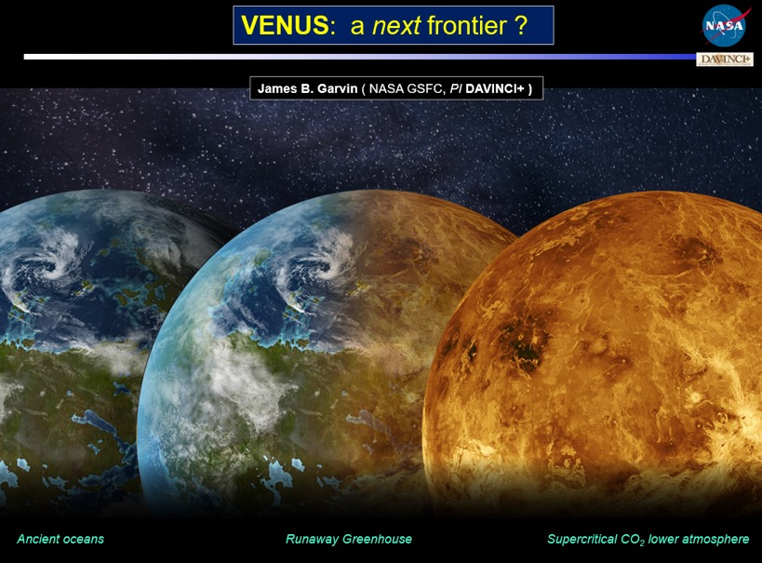
Dr. James Garvin, NASA GSFC Principal Investigator
Drs. Stephanie Getty and Giada Arney, NASA GSFC Deputy PIs
Dr. Natasha Johnson, NASA GSFC Project Scientist
Dr. Erika Koehler, NASA GSFC Deputy Project Scientist
Ken Schwer, Project Manager and Arlin Bartels, Deputy Project Manager Michael Sekerak, Project Systems Engineer
and our entire Discovery Phase A team!
Ancient oceans
Evolution of habitability
Venus-like exoplanets
Notes:
Our team has the right experience to execute this mission

Slide 2
Venus holds the key…
What is the origin of the Venus atmosphere and how has it evolved?
How and why is Venus different or similar to Earth, Mars, and exoplanet analogues?
Was there an early ocean on Venus? If so, when and where did it go?
What is the rate of volcanic activity on Venus?
What exactly are the tessera highlands?
How do the tessera compare with other major highlands (e.g. Ishtar Terra)?
Notes:
DAVINCI+ will build upon past orbital, probe, and lander missions to close the gaps in our understanding of Venus’s origin, evolution, and habitability that have been lingering for decades

Slide 3
The mission
Ancient oceans
Evolution of habitability
Venus-like exoplanets
Notes:
Our team has the right experience to execute this mission

Slide 4
Mission Phases

Slide 5
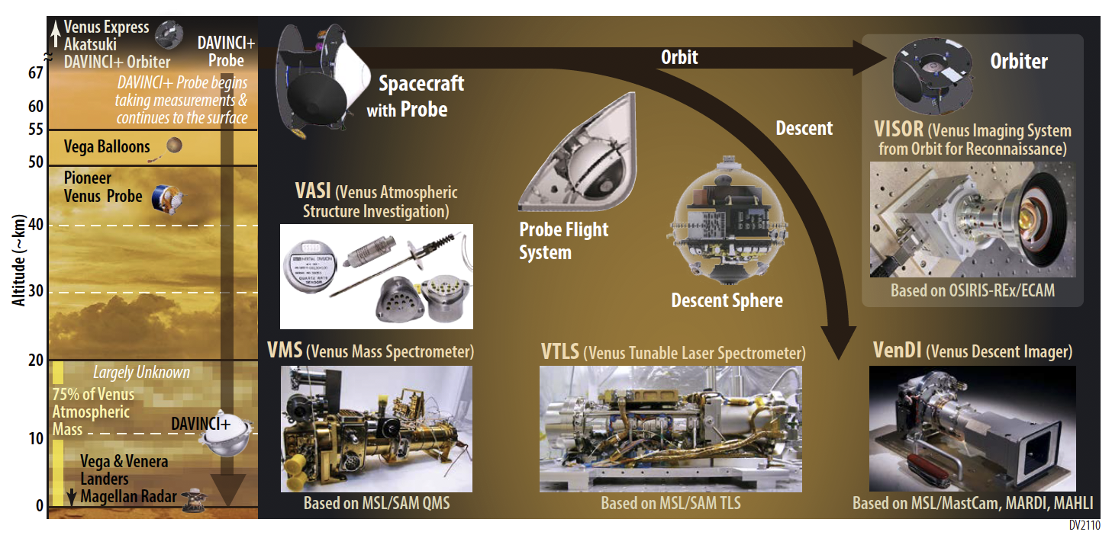
Mission and Payload Architecture
Critical science delivered with four probe-based
instruments plus a flyby-orbiter camera suite
Notes:
The spacecraft carries four mature, well characterized instruments on its descent sphere, and a suite of cameras on the orbiting spacecraft after the probe phase.

Slide 6
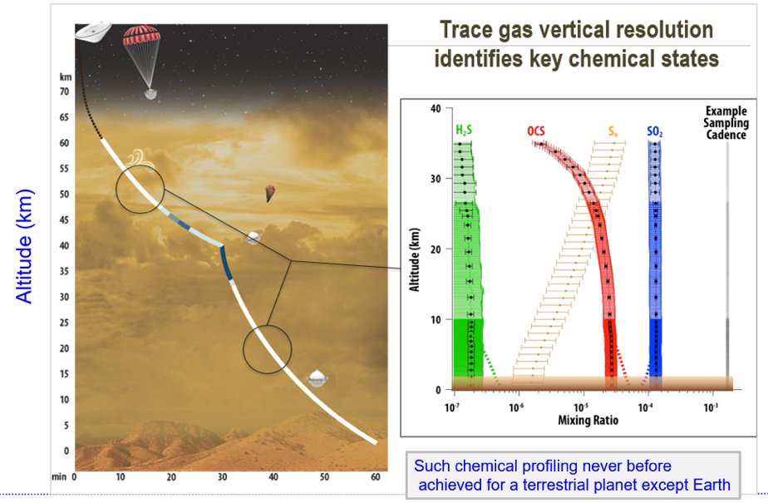
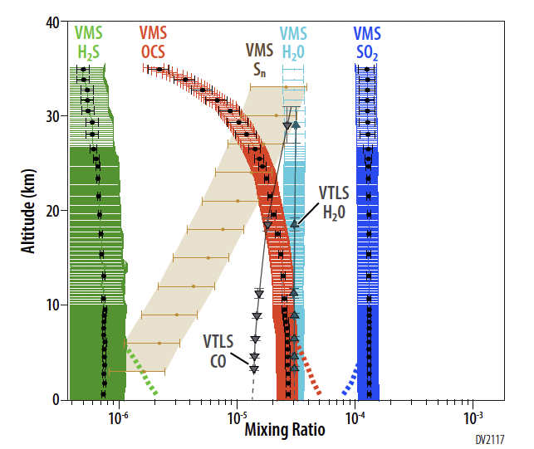
Descent Probe trace gas chemistry:
every ~ 200 m
Descent probe measures
key chemical species
Noble gases & isotopes
measured in well mixed region
Altitude (km)
Unexplored chemically
Detailed chemical profiling never before achieved for a terrestrial planet except Earth
Notes:
How do we accomplish these goals? With a probe that survives nearly an hour as it descends through the benign upper atmosphere, through the sulfur-rich cloud deck, to the lower atmosphere. This hardy probe is optimally designed to answer these remaining questions about Venus in a streamlined sequence of in situ measurements of ingested atmosphere as the probe finds its way to the surface.

Slide 7
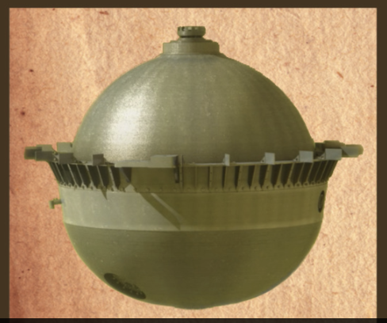
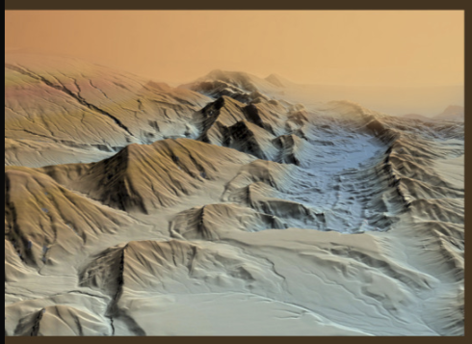
Descent Imaging for
topography and composition
Alpha Regio
landing ellipse
ALPHA
Meter-scale DEMs and morphology
Distinguishing granitic surfaces
Notes:
The descent region targets these folded, ridged geological features on Venus that may have preserved terrain from an ancient Venus era, and DAVINCI+ will acquire images down to the tens of cm scale to provide unprecedented views of Alpha Regio as an archetypical tessera.

Slide 8
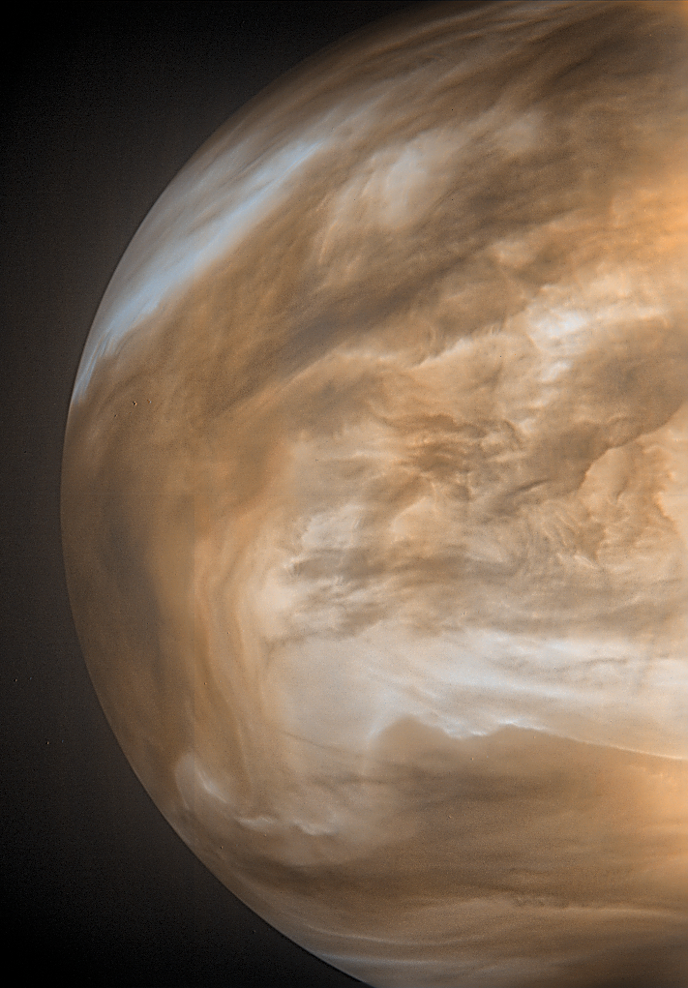
Orbital Mission to explore UV reflection
And Nightside Emission
UV (dayside)
NIR (nightside)
Dayside UV for cloud mapping &
nightside NIR for surface emissivity

Slide 9
Putting new Discoveries into Context

Slide 10
Connections
Beyond Venus
Ancient oceans
Evolution of habitability
Venus-like exoplanets
Notes:
Our team has the right experience to execute this mission

Slide 11
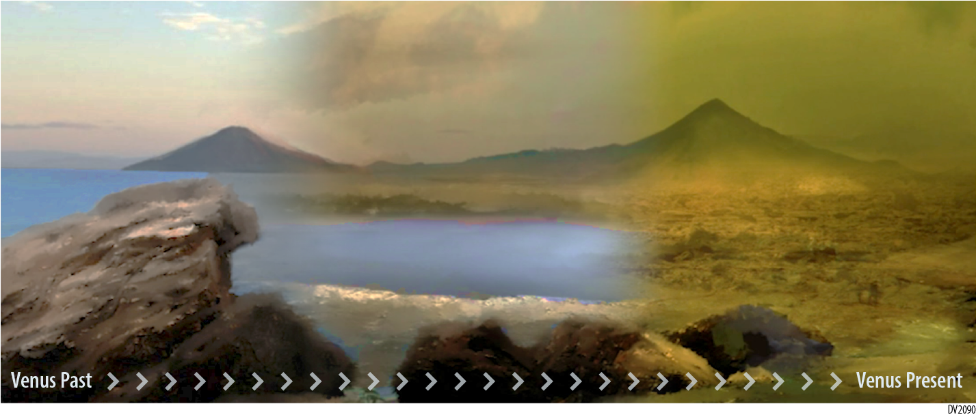
The Life and Death of Habitability
“Ultimately, the assessment of whether or not a planet is habitable will need to be embedded in the context of the outcomes of terrestrial exoplanet evolution.” - 2018 Exoplanet Science Strategy report
Notes:
Fundamentally, the story of how a planet that once harbored oceans came to look like this at its surface is a scientific question that bears upon the very boundaries of habitable environments – and the potential for us to encounter them in solar systems beyond our own.

Slide 12
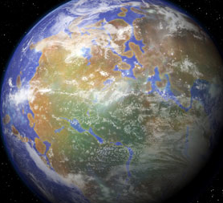
Ancient Venus: Extended Habitability?
If Earth and Venus were habitable for most of our solar system’s history…
what does this mean for the frequency of habitable exoplanets?
The many faces of Earth through time
today
4500
4000
3500
3000
2500
2000
1500
1000
500
0
Precambrian
Phanerozoic
Eons
Hadean
Archean
Proterozoic
life
atmospheric oxygen
Macroscopic life
…and Venus too!
Habitable period?
Non-habitable?
Notes:
…but so is Venus. Could Venus have been habitable for most of Earth’s history? Could our solar system have had two habitable planets – three depending on Mars’s history – for most of its history? What does that mean and how does that change the way we see Earth in relation to its planetary neighbors?

Slide 13
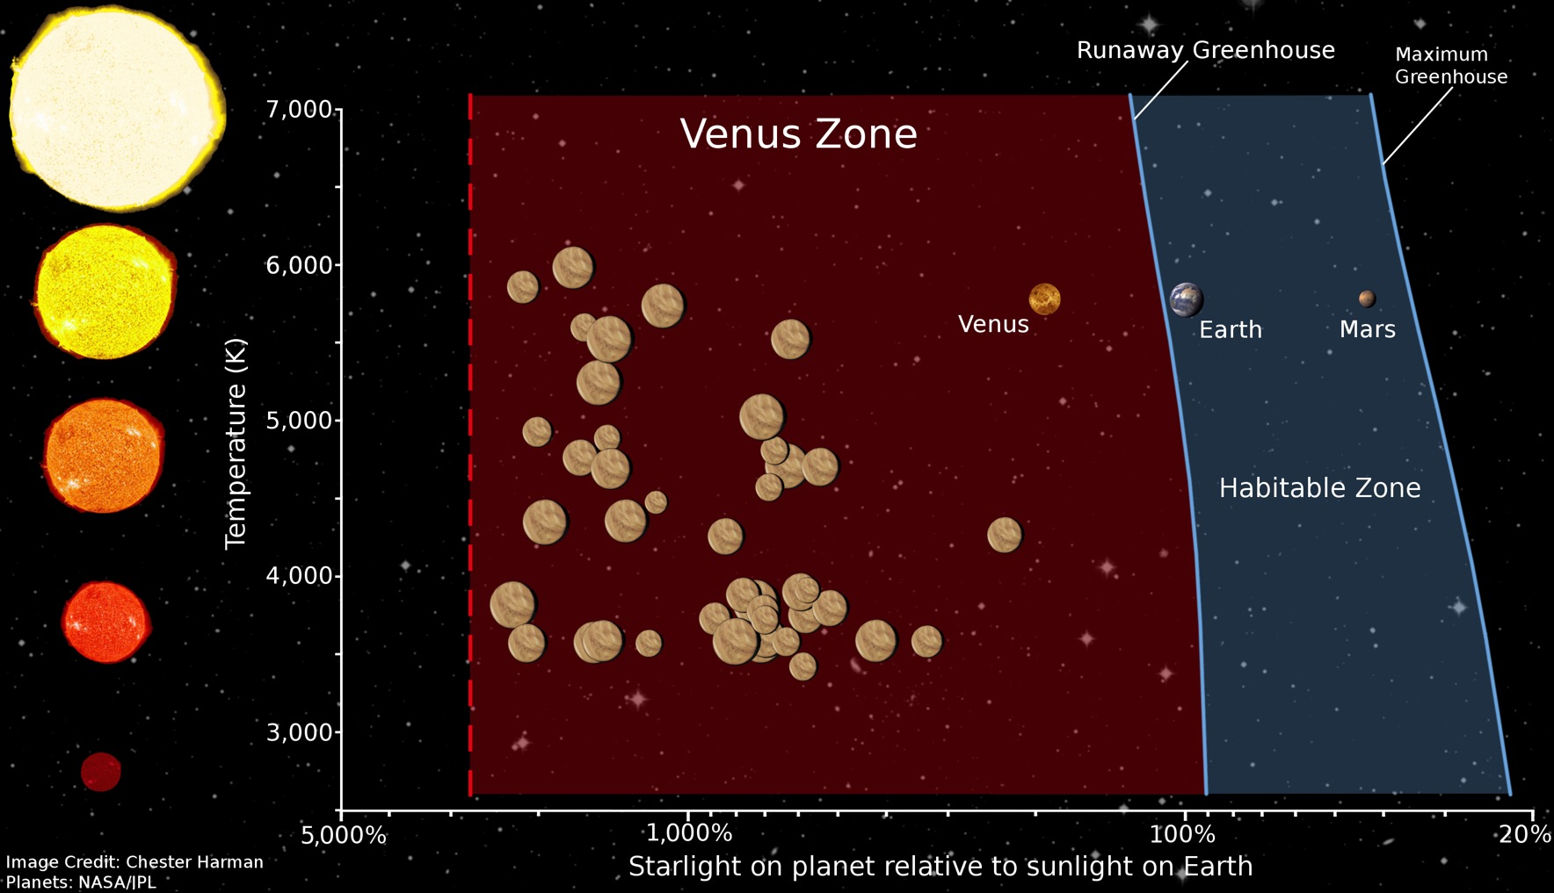
Connections beyond the Solar System
JWST is biased toward observing Venus Zone exoplanets
Kane et al. (2014)
Image credit: Sonny Harman NASA (Ames)

Slide 14
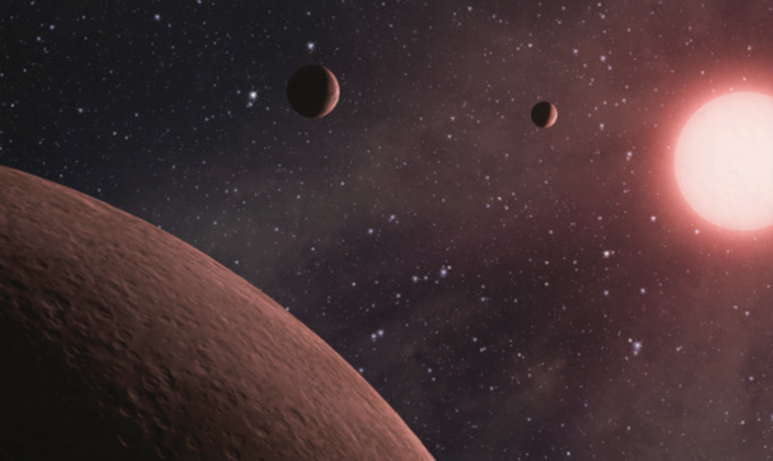
Venus in the Context of Exoplanets
Venus can teach us about processes that
shape exo-Venus environments & observable features
Exoplanets may show us processes that shaped the climate on Venus in the past
Notes:
Because Venus is believed to represent a common type of planet within reach of near-future exoplanet observatories, DAVINCI+ dataset will not only close major gaps in our knowledge of our planetary neighbor – but it will pave the way for the discovery and interpretation of exoplanetary observations in the future era of exoplanetary spectroscopy.

Slide 15
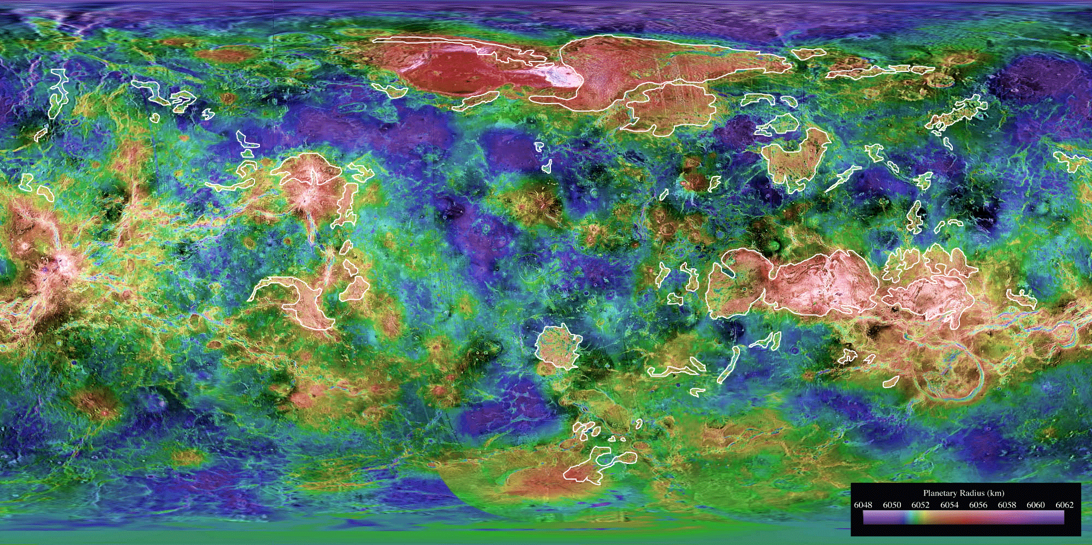
The Clues are Waiting
white outline = tessera regions
Alpha Regio
landing site
DAVINCI+ will find the clues within the atmosphere and on the surface
Notes:
By descending through the atmosphere on its way to Alpha Regio, and mapping cloud and mysterious nightside surface features at the northern latitudes, DAVINCI+ is the long-overdue next step in the exploration of Venus and will help us understand the evolution and current state of Venus in the context of Earth, Mars, and planets orbiting billions of other stars.

Slide 16
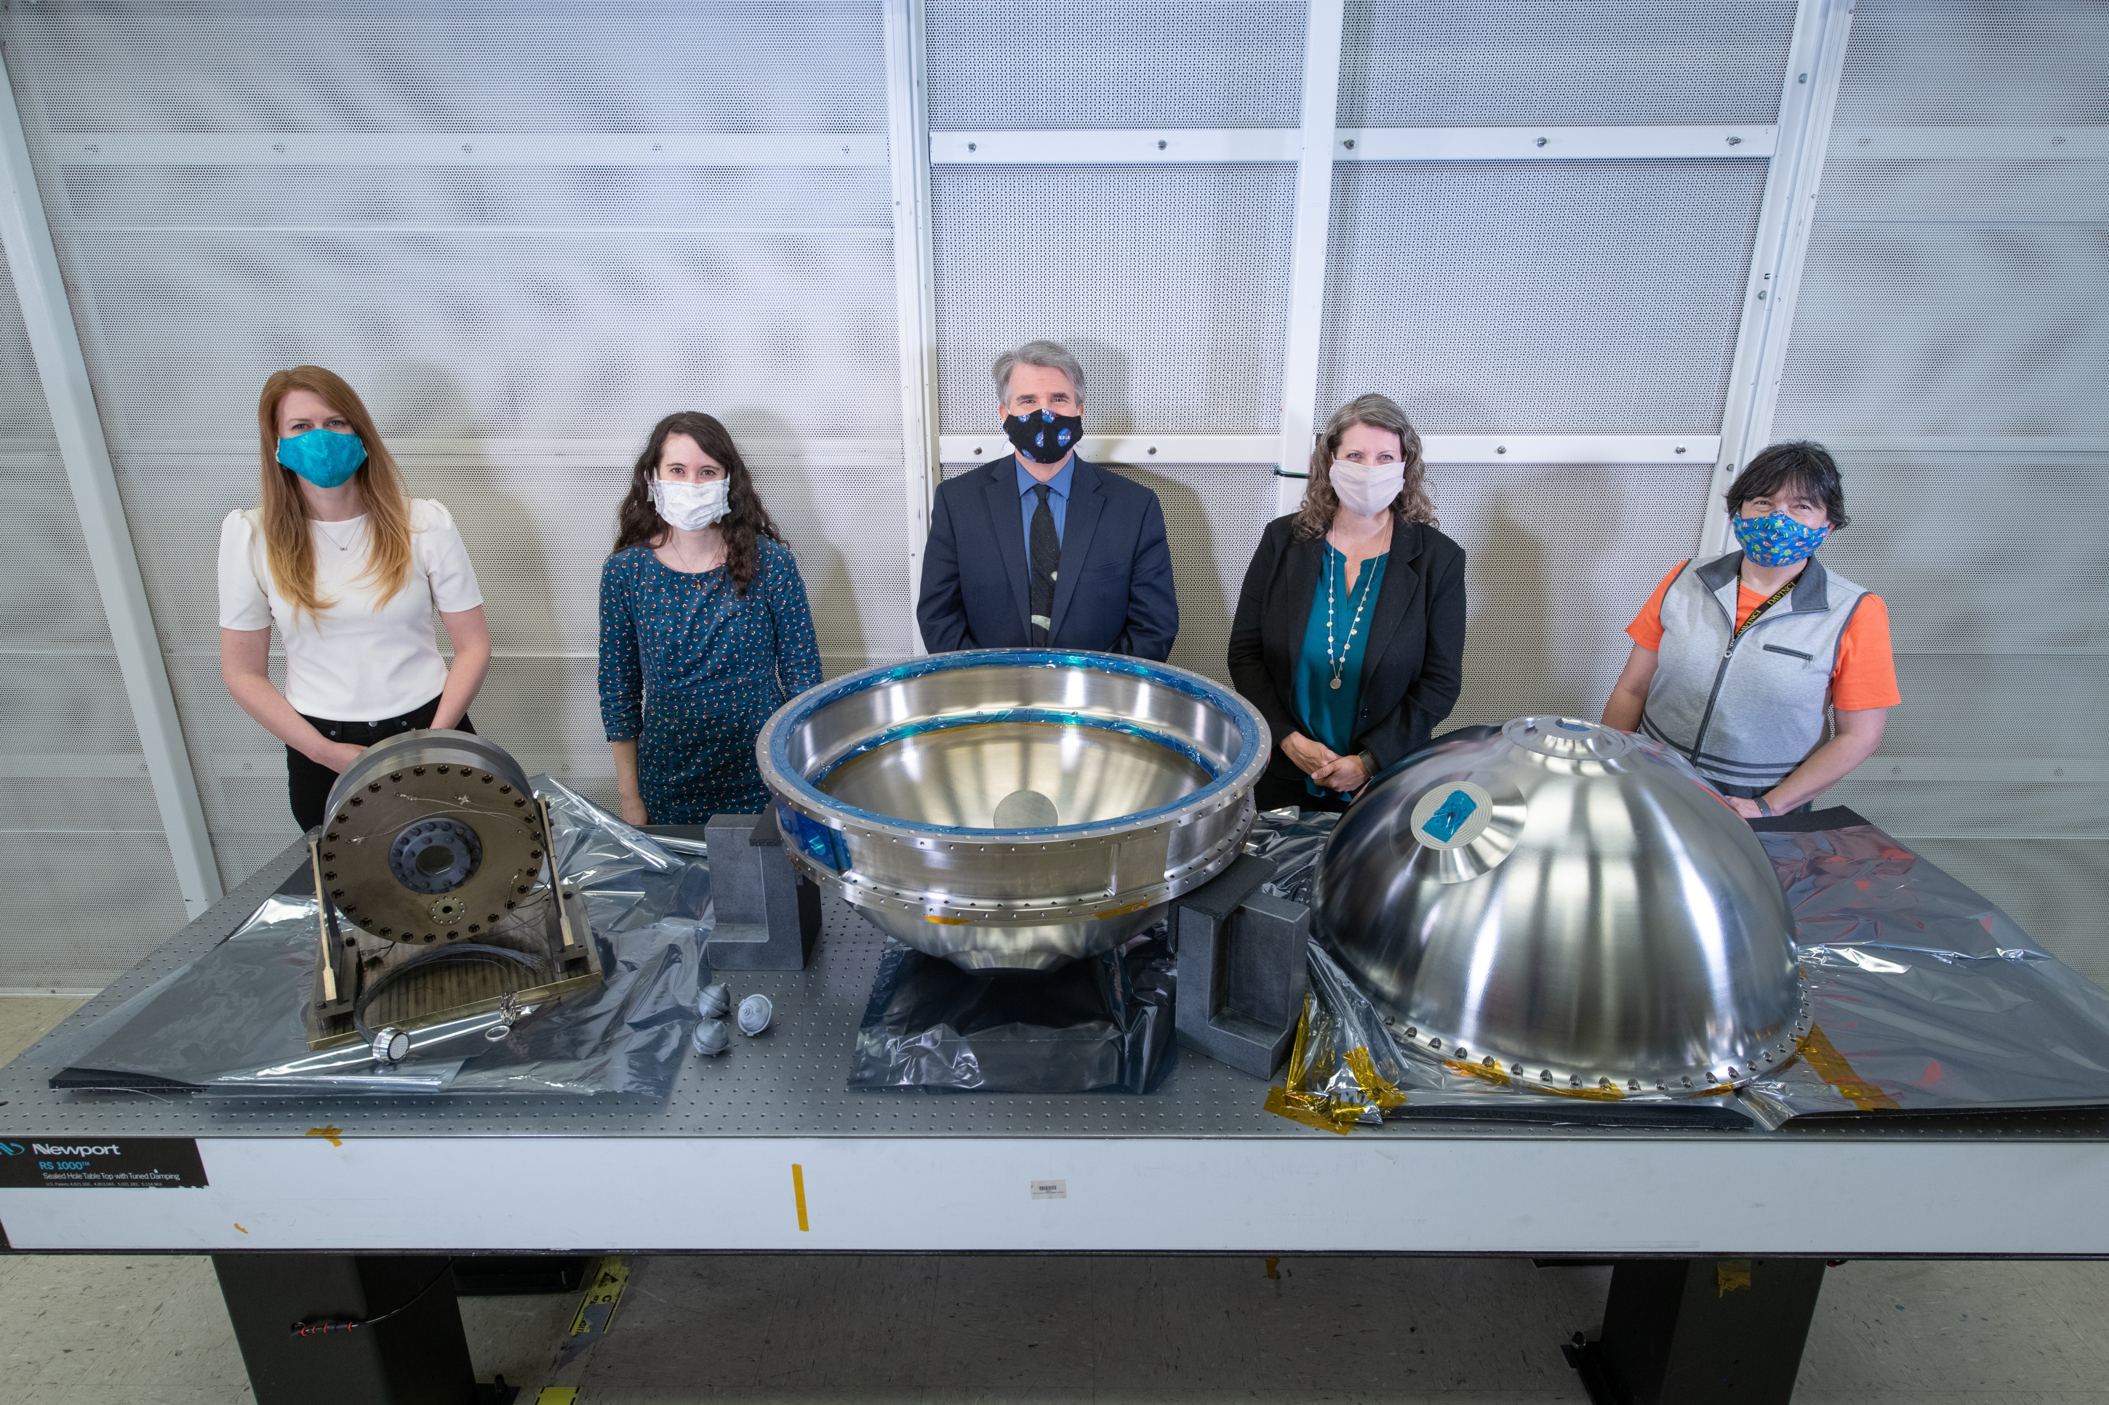
Venus is Waiting & DAVINCI+ is ready
Notes:
Venus is waiting, and DAVINCI+ is ready to explore.

