Slide 1

Synthetic Data Generation for 3D Mesh Prediction and Spatial Reasoning During Multi-Agent Robotic Missions
James Ecker, Benjamin Kelley, Danette Allen
AIAA SciTech, January 2021
Notes:
Shorten examples

Slide 2
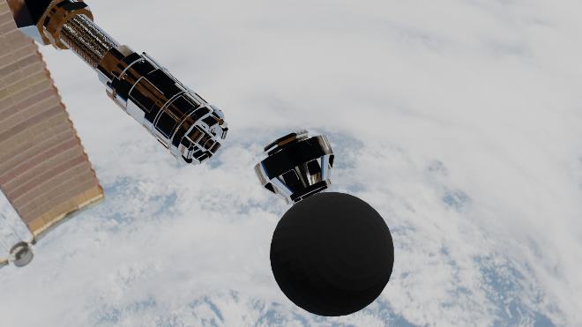
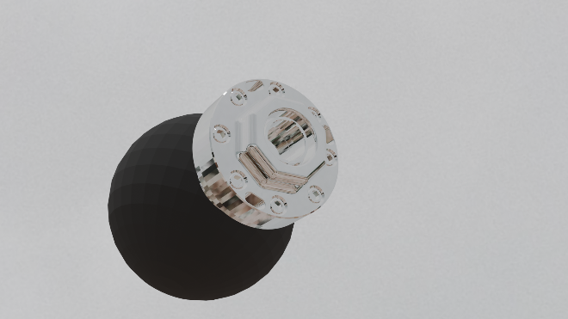
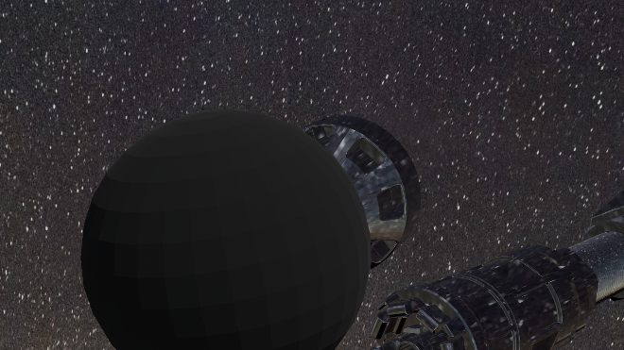
Computer Vision During In-Space Assembly
Difficulties
  Illumination
  Angle
  Orientation
  Movement
Constraints
  Energy
  Mass

Slide 3
Computer Vision During In-Space Assembly
Difficulties
  Illumination
  Angle
  Orientation
  Movement
Constraints
  Energy
  Mass
High Degree of Variation Requires More Information

Slide 4
Computer Vision During In-Space Assembly
Difficulties
  Illumination
  Angle
  Orientation
  Movement
Constraints
  Energy
  Mass
High Degree of Variation Requires More Information
More Sensors = More Information = More Energy Use & More Mass

Slide 5
Mitigating the Constraints
High Degree of Variation Requires More Information
More Sensors =
More Information =
More Energy Use & More Mass

Slide 6
Mitigating the Constraints
High Degree of Variation Requires More Information
Maximize
More Sensors =
More Information =
More Energy Use & More Mass

Slide 7
Mitigating the Constraints
High Degree of Variation Requires More Information
Maximize
More Sensors =
More Information =
More Energy Use & More Mass
Minimize

Slide 8
Mitigating the Constraints
High Degree of Variation Requires More Information
Maximize
Predict 3D Mesh from Single View
More Sensors =
More Information =
More Energy Use & More Mass
Minimize

Slide 9
Mitigating the Constraints
High Degree of Variation Requires More Information
Maximize
Predict 3D Mesh from Single View
More Sensors =
More Information =
More Energy Use & More Mass
Minimize
Single Camera

Slide 10
Related Work
[1] He et al – Mask R-CNN
[2] Gkioxari et al – Mesh R-CNN
[3] Sonawani et al - Assistive Relative Pose Estimation for On-orbit Assembly using Convolutional Neural Networks
[4] Pal et al - 3D Point Cloud Generation from 2D Depth Camera Images using Successive Triangulation
[5] Valsesia et al - Learning Localized Representations of Point Clouds with Graph-Convolutional Generative Adversarial Networks
[6] Ramasinghe et al - Spectral-GANS for High Resolution 3D Point Cloud Generation

Slide 11
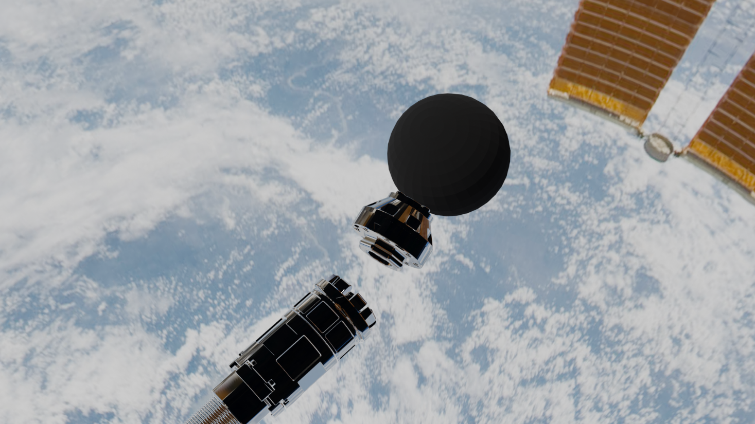
Synthesizing Data
3D model of objects projected over 3D background in Blender
  Can be extended to full simulation environments
    ROS, Gazebo, Mujoco, etc
Variations in observations
  Orientation of camera and light source
  Relative orientation between objects
  Number of objects in scene
  Background
Sim to Reality Problem
  Domain Randomization

Slide 12
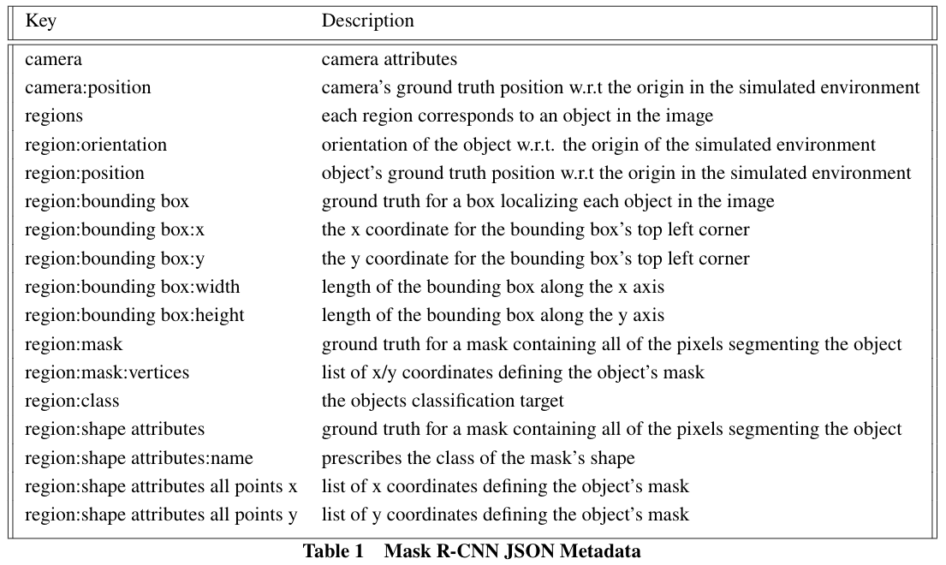
Metadata for Training Mask R-CNN

Slide 13
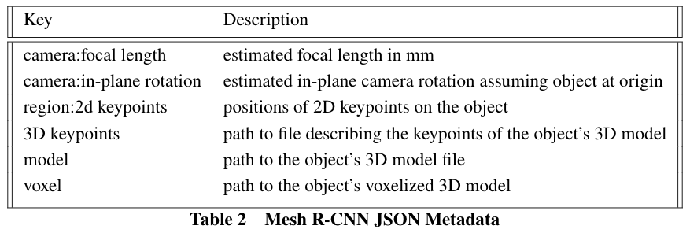
Metadata for Training Mesh R-CNN

Slide 14
Building the Dataset
Generate a parent pool of data
  20,000 image/metadata pairs
For each sample generated
  Extract/Calculate ground truth to build metadata
  Configure metadata to conform to model
Sample training set from parent pool
  Sample –n (default: 1500) instances from parent pool randomly
  Split into training and validation sets
    --training-split (default:0.75) / 1 - --training-split (default: 1 – 0.75 = 0.25)
Merge all training/validation set metadata into one JSON, respectively

Slide 15
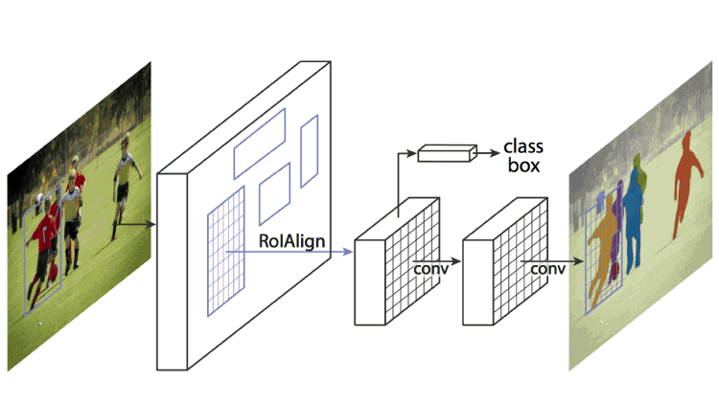
Mask Prediction – Mask R-CNN
Backbone
  Resnet-50-FPN
Region Proposal Network
  Applies a sliding window over a convolutional feature map to generate proposed bounding boxes for likely objects
  Proposed regions are aligned to the feature map and sent to fully connected layer to classify a bounding box (regressor) and the object itself (soft max)
Mask Prediction
  Generate a binary mask for pixels in proposed region using the aligned features
The Mask R-CNN Architecture [1]

Slide 16
Mask Prediction – Mask R-CNN Advantages
Transfer Learning
  Use a pretrained network (Resnet) to initialize weights instead of training from scratch (random initial weights)
  Lowers training time and generalization error
Region of Interest Alignment
  Each region of interest is fed into a fixed-size input fully connected (FC) layer
  Need to account for all pixels in ROI while conforming to fixed input size of FC
  Bilinear Interpolation instead of Quantization
The Mask R-CNN Architecture [1]

Slide 17
Mask Prediction – Mask R-CNN Advantages
Transfer Learning
  Use a pretrained network (Resnet) to initialize weights instead of training from scratch (random initial weights)
  Lowers training time and generalization error
Region of Interest Alignment
  Each region of interest is fed into a fixed-size input fully connected (FC) layer
  Need to account for all pixels in ROI while conforming to fixed input size of FC
  Bilinear Interpolation instead of Quantization
The Mask R-CNN Architecture [1]
Masks provide a measure of visual explainability

Slide 18
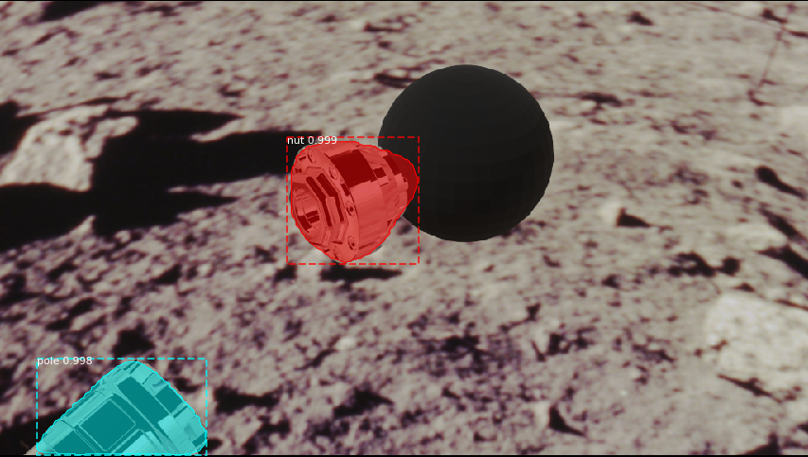
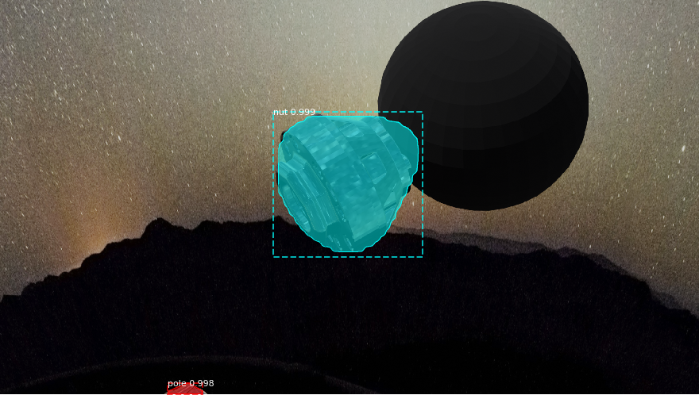
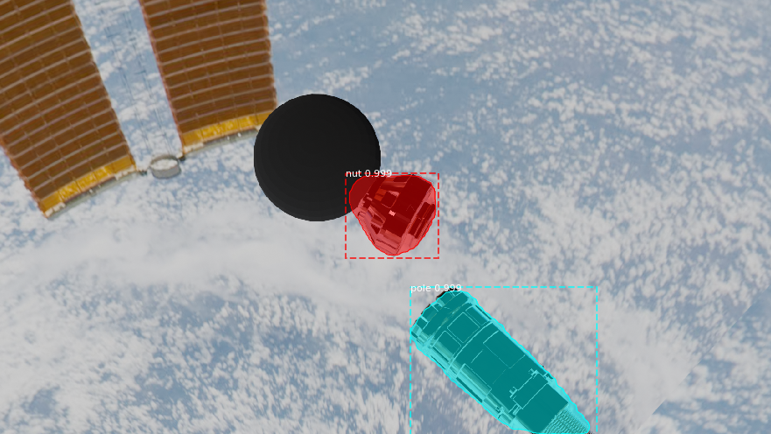
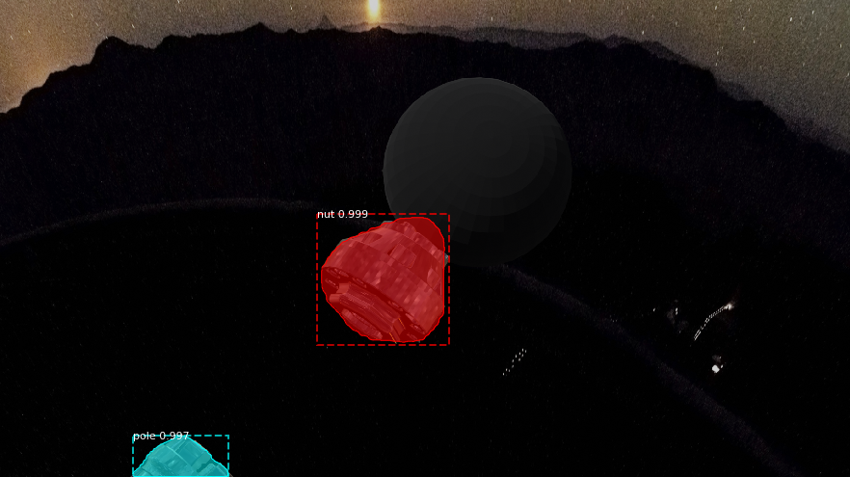
Mask Prediction – Mask R-CNN Performance
98% instance segmentation accuracy
  object
  bounding box
  mask

Slide 19
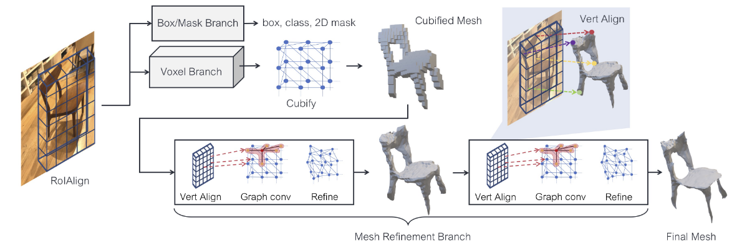
Mesh Prediction
Extends Mask R-CNN
  Mesh Predictor
    Voxel Prediction
    Mesh Refinement
The Mesh R-CNN Architecture [2]

Slide 20
Mesh Prediction
Extends Mask R-CNN
  Mesh Predictor
    Voxel Prediction
      Predicts a voxel occupancy grid
      Cubify function binarizes voxel occupancy probabilities according to a threshold and generates a cuboid triangular mesh for each likely voxel
    Mesh Refinement
The Mesh R-CNN Architecture Voxel Branch[2]

Slide 21
Mesh Prediction
Extends Mask R-CNN
  Mesh Predictor
    Voxel Prediction
      Predicts a voxel occupancy grid
      Cubify function binarizes voxel occupancy probabilities according to a threshold and generates a cuboid triangular mesh for each likely voxel
    Mesh Refinement
      2 passes
        Vertex alignment
        Graph convolution
        Vertex refinement
The Mesh R-CNN Architecture Mesh Refinement Branch[2]

Slide 22




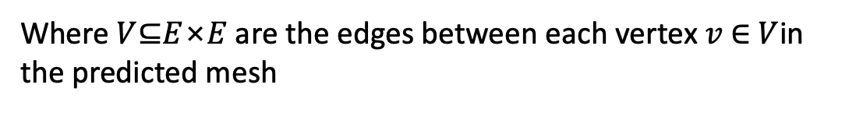
Metrics
Chamfer distance
  Where point $q$ is the closest neighbor to $p$ in point cloud $Q$
Normal distance
  Where $u_{p}$ is the unit normal to point $p$ in point cloud $P$
Edge loss
Where$V$⊆$E$×$E$are the edges between each vertex $v$∈ $V$in the predicted mesh

Slide 23
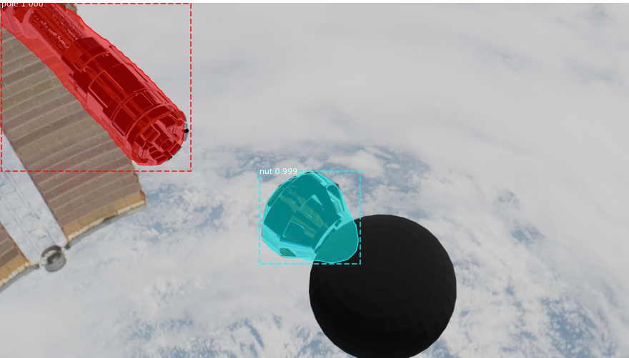
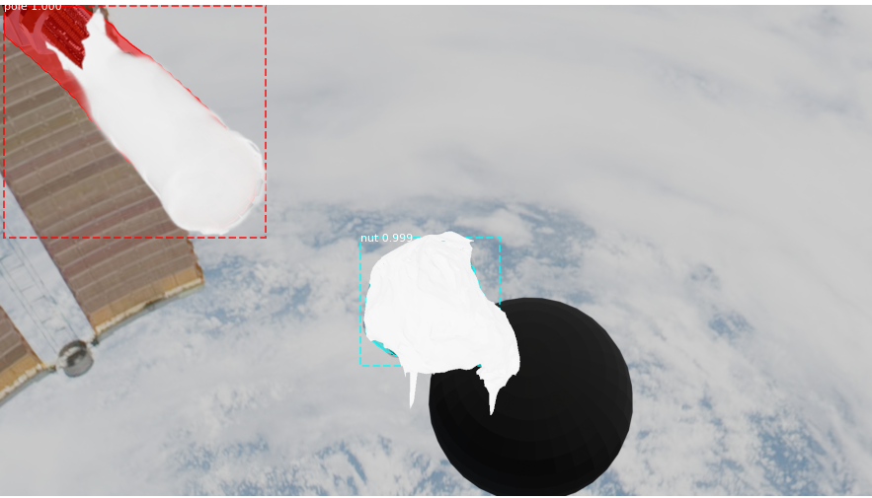
Results
Ours (Custom Synthetic Data)
  Chamfer (lower is better)
    0.621
  F1 (higher is better)
    47.51
Theirs (Mesh R-CNN trained on Pix3D)
  Chamfer (lower is better)
    0.306
  F1 (higher is better)
    74.84

Slide 24
Results
Ours (Custom Synthetic Data)
  Chamfer (lower is better)
    0.621
  F1 (higher is better)
    47.51
Theirs (Pix3D)
  Chamfer (lower is better)
    0.306
  F1 (higher is better)
    74.84
2 Quadro 6000 RTX GPUs
8 Tesla V100 GPUS
Requires hyperparameter tuning specific to hardware configuration

Slide 25
Conclusion
Generated a synthetic dataset capable of training state of the art 2D mask and 3D mesh prediction models
Can train each model end-to-end from no data to trained model
Future work
  Hyperparameter tuning
  Further domain randomization
    Randomize object’s rendered skin
  Extending Mesh R-CNN to use a Generative Adversarial Network to generate point clouds instead of voxel model
    Higher resolution 3D mesh prediction

Slide 26
References
He, K., Gkioxari, G., Dollár, P., and Girshick, R., “Mask R-CNN,”2017 IEEE International Conference on Computer Vision(ICCV), 2017, pp. 2980–2988. https://doi.org/10.1109/ICCV.2017.322.
Gkioxari, G., Johnson, J., and Malik, J., “Mesh R-CNN,”2019 IEEE/CVF International Conference on Computer Vision(ICCV), 2019, pp. 9784–9794. https://doi.org/10.1109/ICCV.2019.00988.
Sonawani, S. D., Alimo, R., Detry, R., Jeong, D., Hess, A., and Amor, H. B., “Assistive Relative Pose Estimation for On-orbitAssembly using Convolutional Neural Networks,”ArXiv, Vol. abs/2001.10673, 2020.
Pal, B., Khaiyum, S., and Kumaraswamy, Y. S., “3D point cloud generation from 2D depth camera images using successivetriangulation,”2017 International Conference on Innovative Mechanisms for Industry Applications (ICIMIA), 2017, pp. 129–133.https://doi.org/10.1109/ICIMIA.2017.7975586.
Valsesia, D., Fracastoro, G., and Magli, E., “Learning Localized Representations of Point Clouds with Graph-ConvolutionalGenerative Adversarial Networks,”IEEE Transactions on Multimedia, 2019.
Ramasinghe, S., Khan, S. H., Barnes, N., and Gould, S., “Spectral-GANs for High-Resolution 3D Point-cloud Generation,”CoRR, Vol. abs/1912.01800, 2019. URL http://arxiv.org/abs/1912.01800.
Tobin, J., Fong, R., Ray, A., Schneider, J., Zaremba, W., and Abbeel, P., “Domain Randomization for Transferring Deep NeuralNetworks from Simulation to the Real World,”CoRR, Vol. abs/1703.06907, 2017. URL http://arxiv.org/abs/1703.06907.
He, K., Zhang, X., Ren, S., and Sun, J., “Deep Residual Learning for Image Recognition,”CoRR, Vol. abs/1512.03385, 2015.URL http://arxiv.org/abs/1512.03385.

