Slide 1
HLPW-4: Turbulence Model Verification Study
Nash’at Ahmad, Chris Rumsey

Slide 2
Code Description
FUN3D (Fully Unstructured Navier-Stokes 3D)
  Uses unstructured grids
  Node-centered finite volume scheme
  Second-order accurate
  Computation of viscous fluxes on tetrahedral meshes is based on the Green-Gauss theorem and on nontetrahedral grids, an edge-derivative augmentation is employed to avoid odd-even decoupling
  Roe’s approximate Riemann solver was used for the inviscid flux with no flux limiting in all simulations
  Time integration toward a steady state is based on a backward-Euler scheme with local time-stepping to accelerate convergence
  https://fun3d.larc.nasa.gov
Several SA variants used in the verification study
  SA-neg, SA-neg-RC, SA-neg-QCR2000, SA-neg-RC-QCR2000 (https://turbmodels.larc.nasa.gov/)

Slide 3
Test Case: 2D Multielement Airfoil (TMR website)
Reference Conditions
Grids
Parameter | Value
Ma | 0.2
Re_{u} | 5,000,000.0
T_{ref} | 272.1 K
α | 16°
Grid Level | Nodes
1 | 173,958
2 | 294,161
3 | 508,099
4 | 930,671
5 | 1,679,982
6 | 3,227,904
7 | 5,980,721
Value of κ in UMUSCL set to 0.5
Grids from the TMR website were
used in the convergence study.

Slide 4
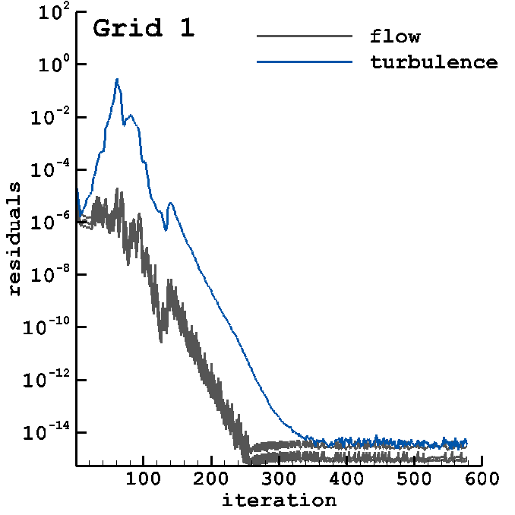
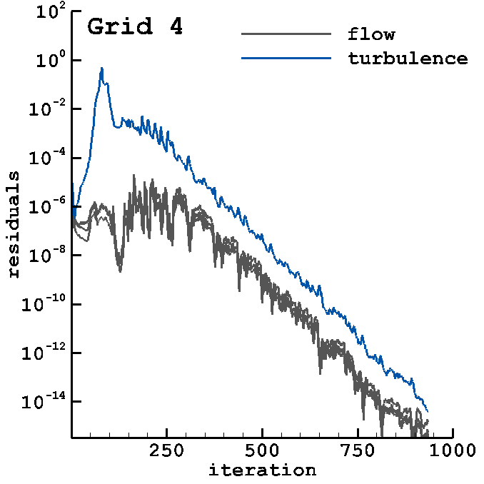
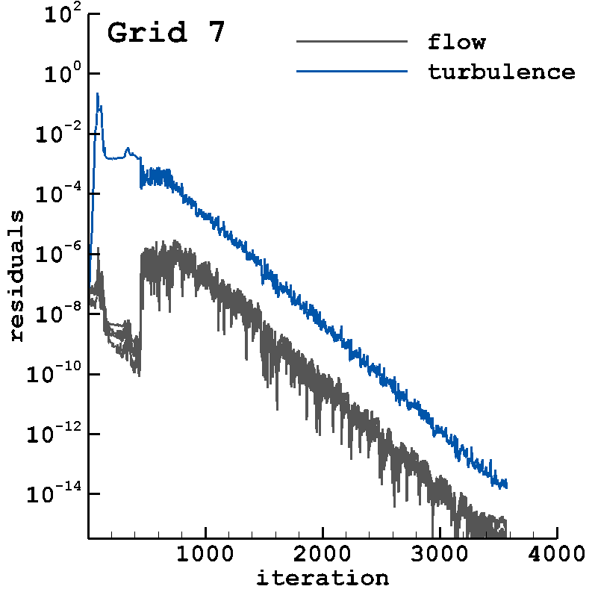
Example of Iterative Convergence (SA-neg)

Slide 5
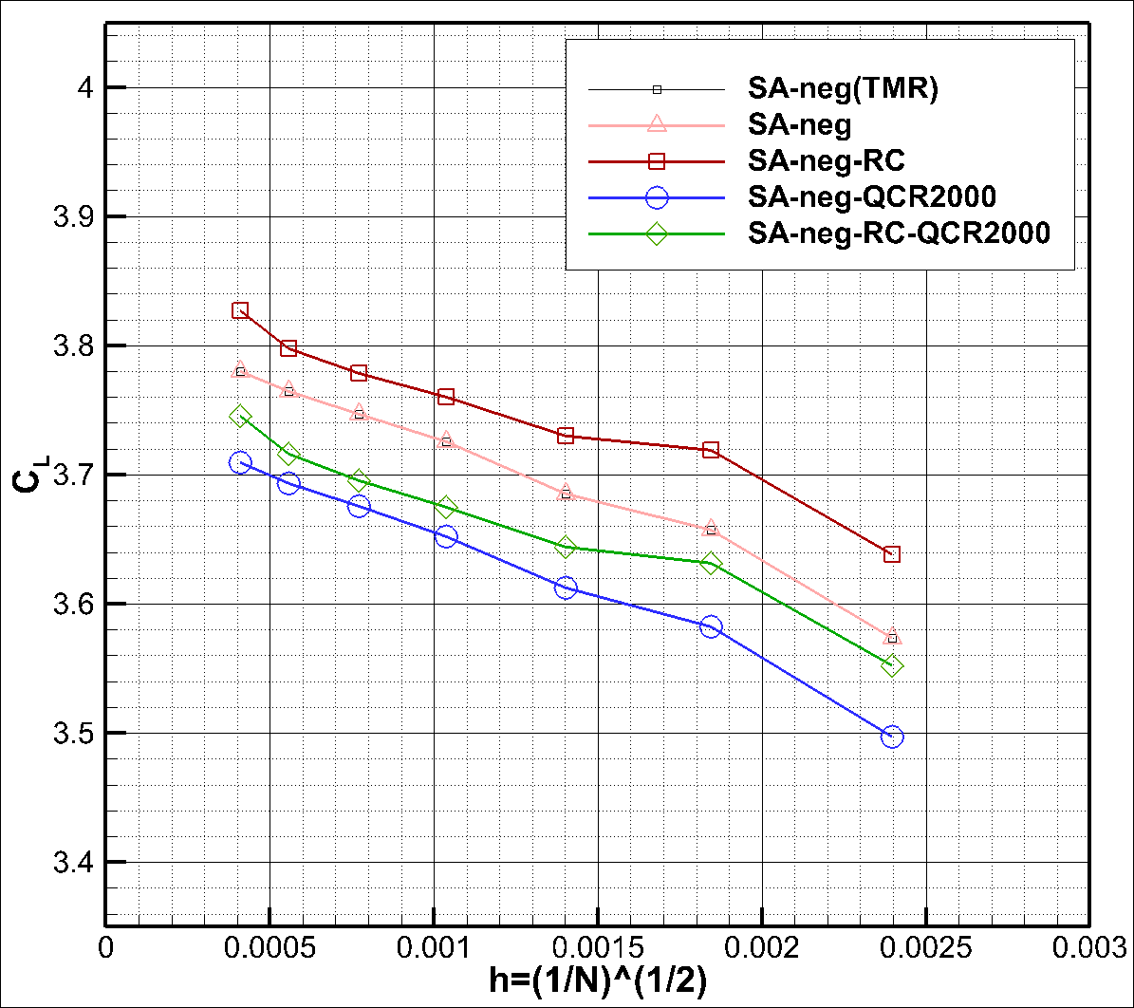
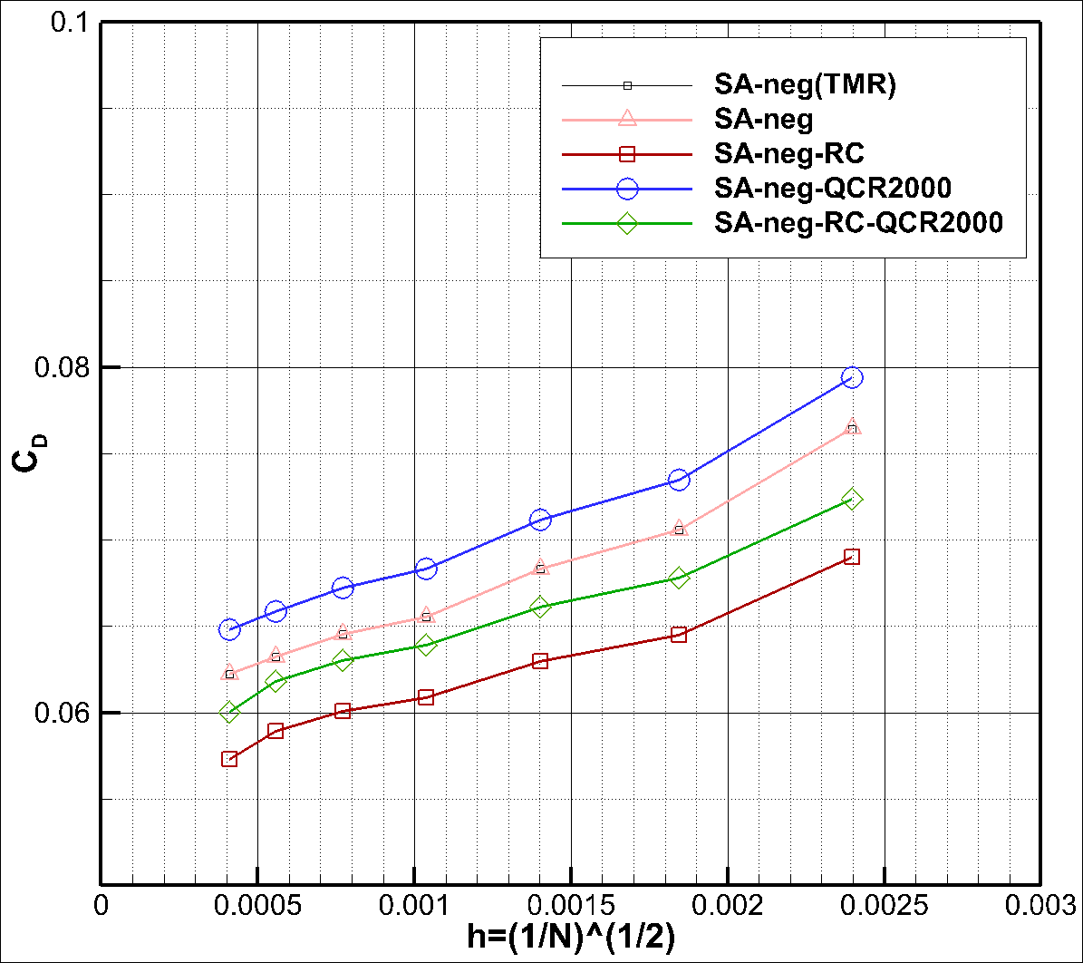
Results (Grid Convergence of Lift and Drag)

Slide 6
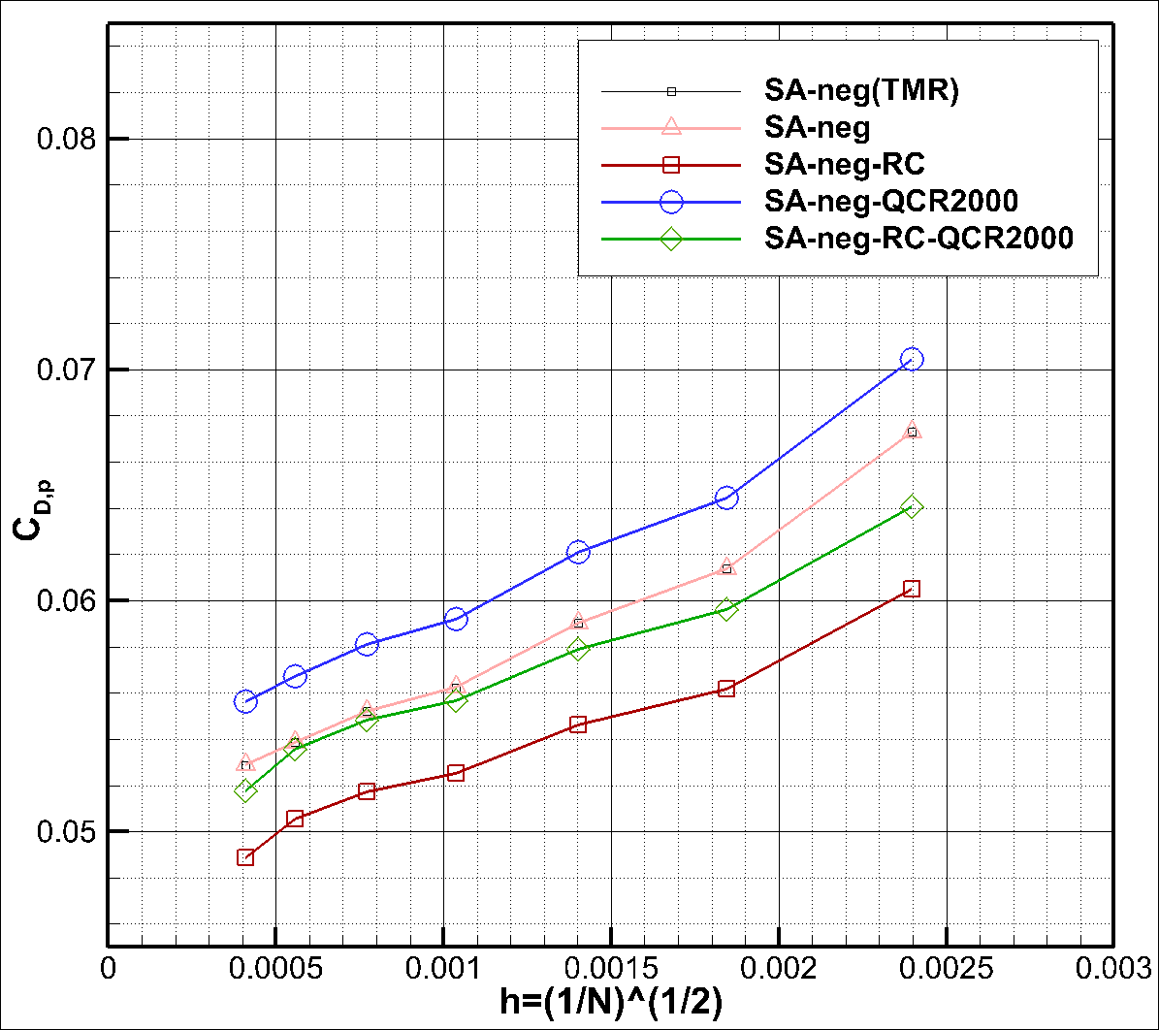
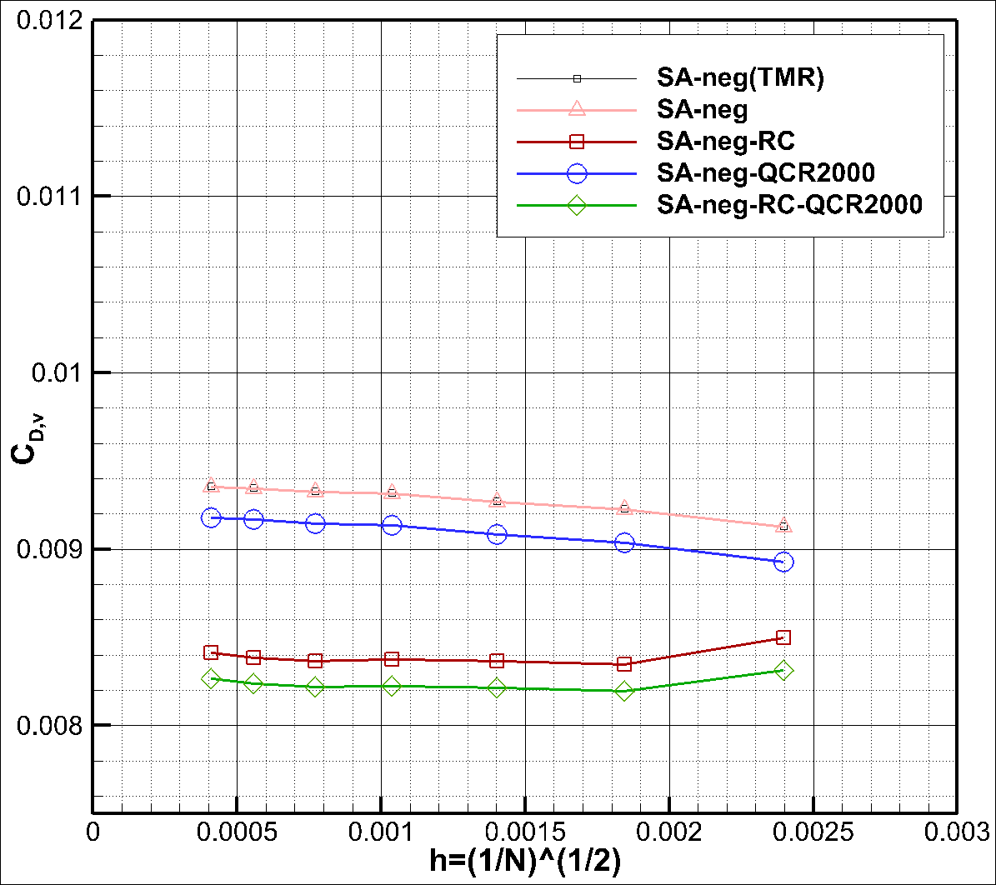
Results (Grid Convergence of Drag)

Slide 7
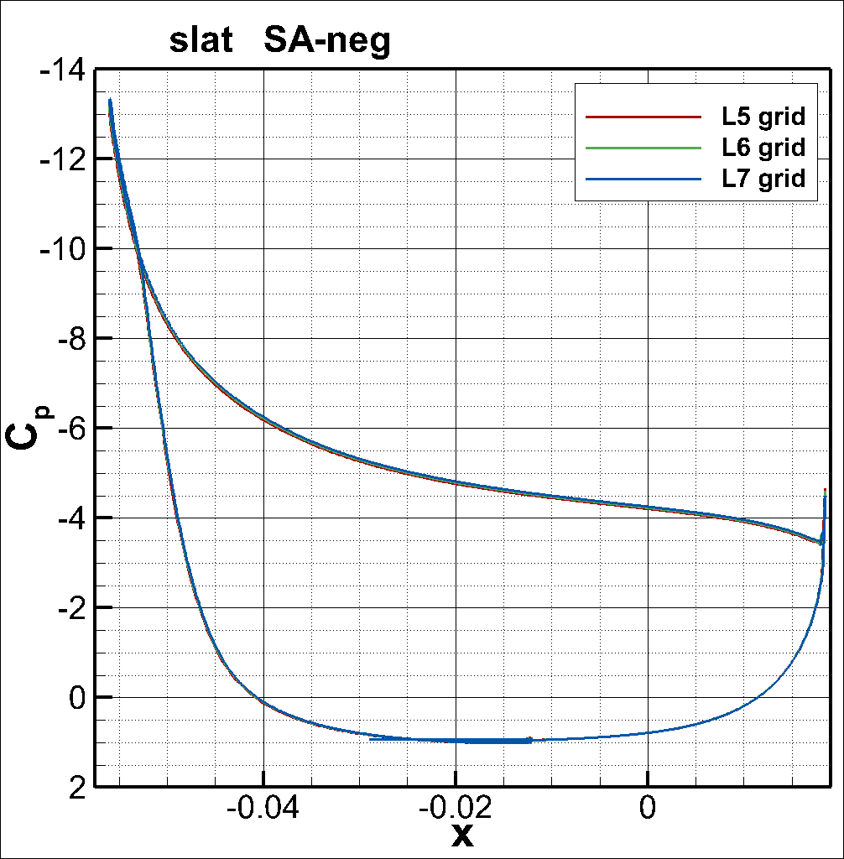
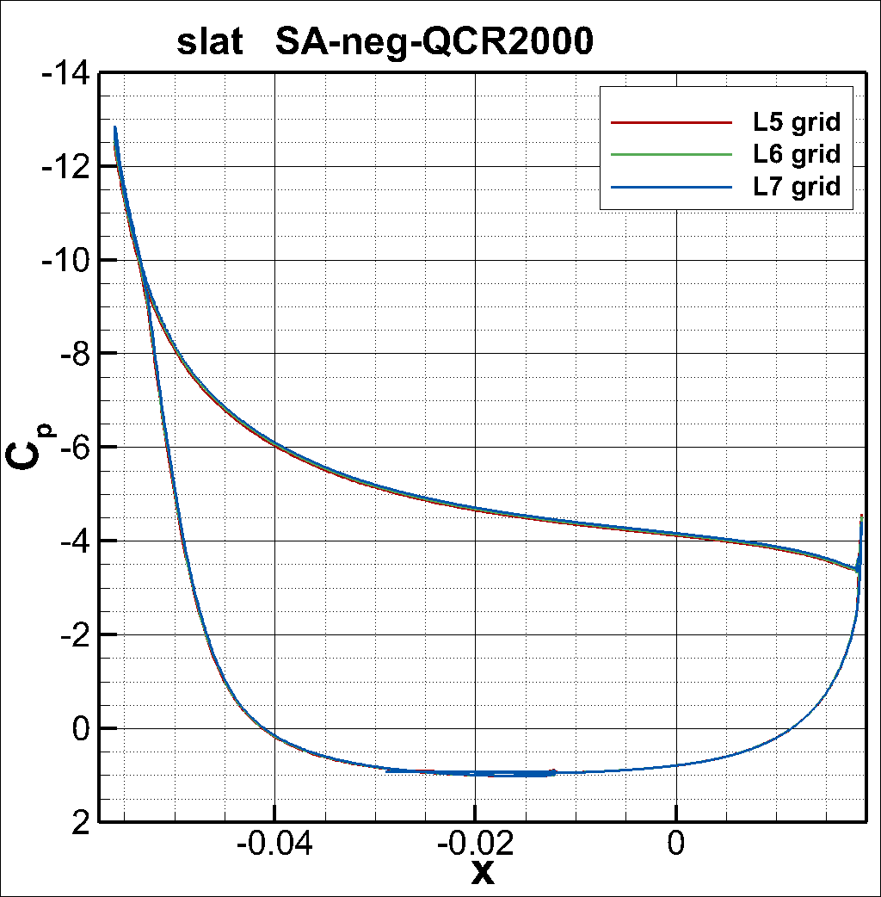
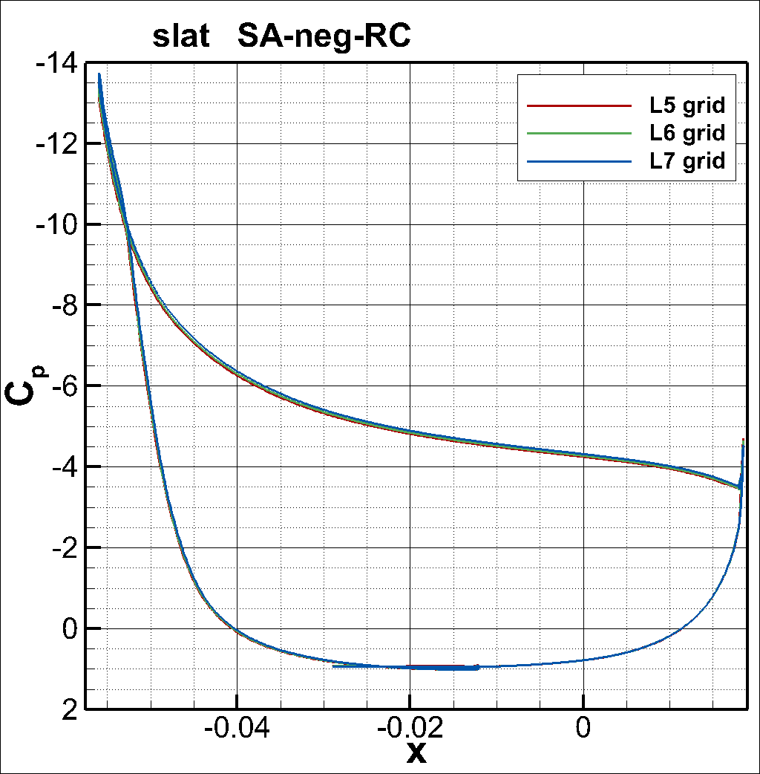
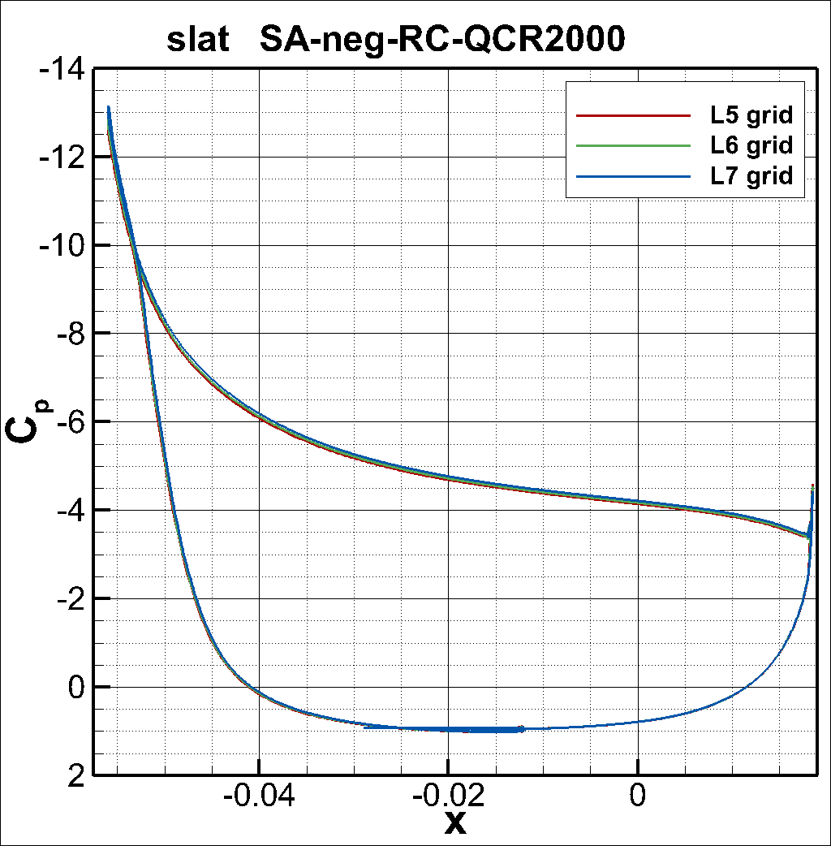
Results (C_{p}; slat; L5-7 grids)

Slide 8
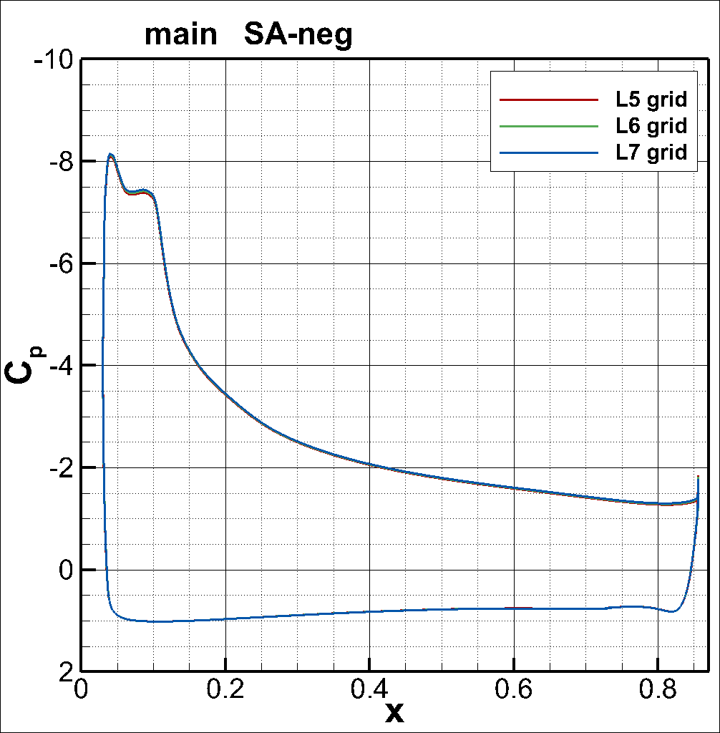
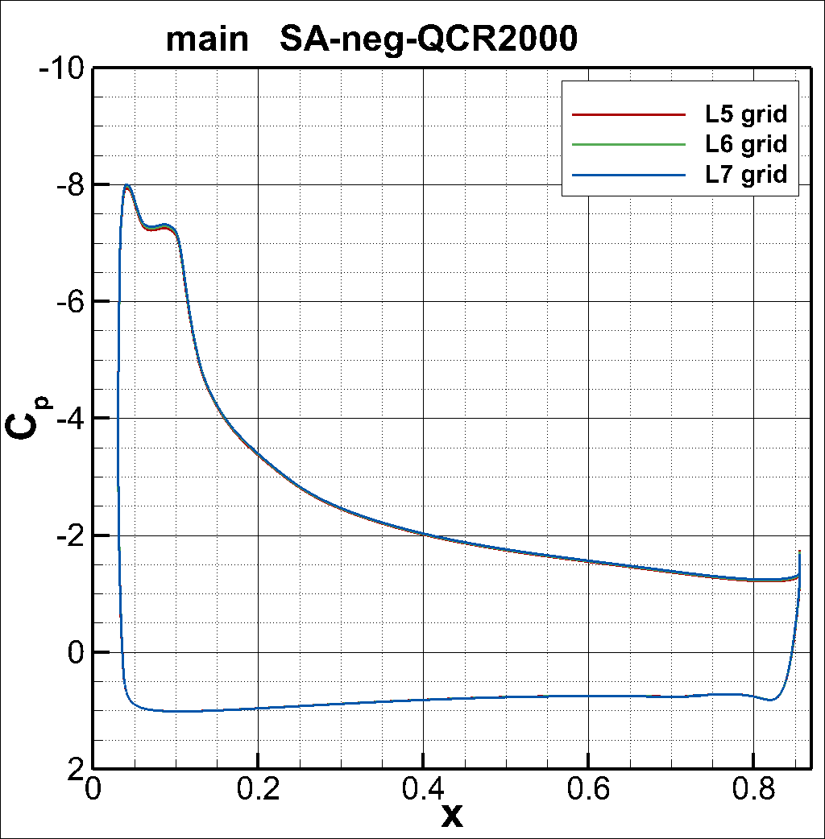
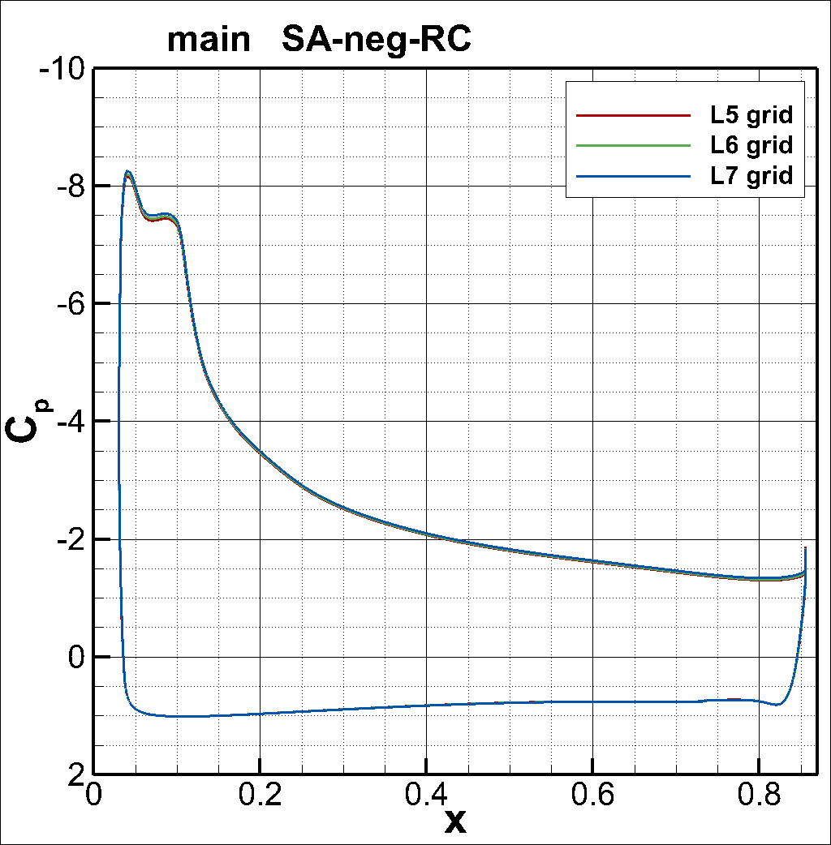
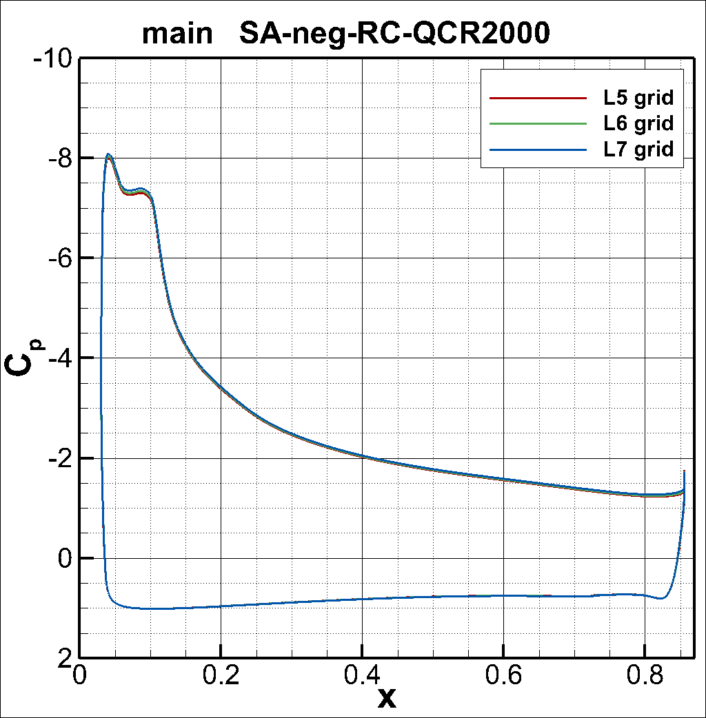
Results (C_{p}; main; L5-7 grids)

Slide 9
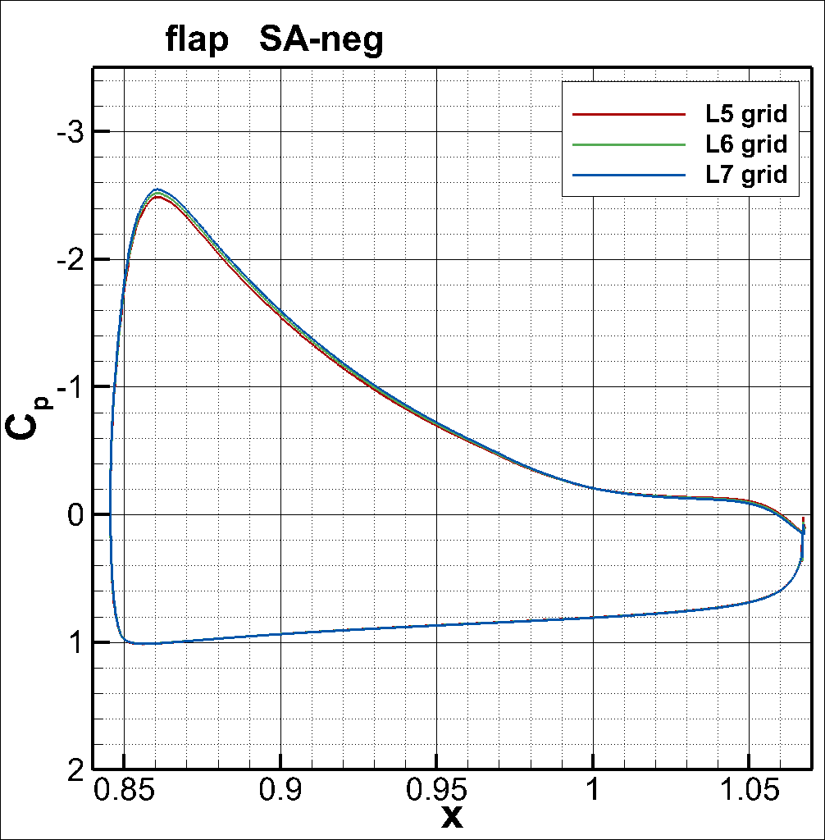
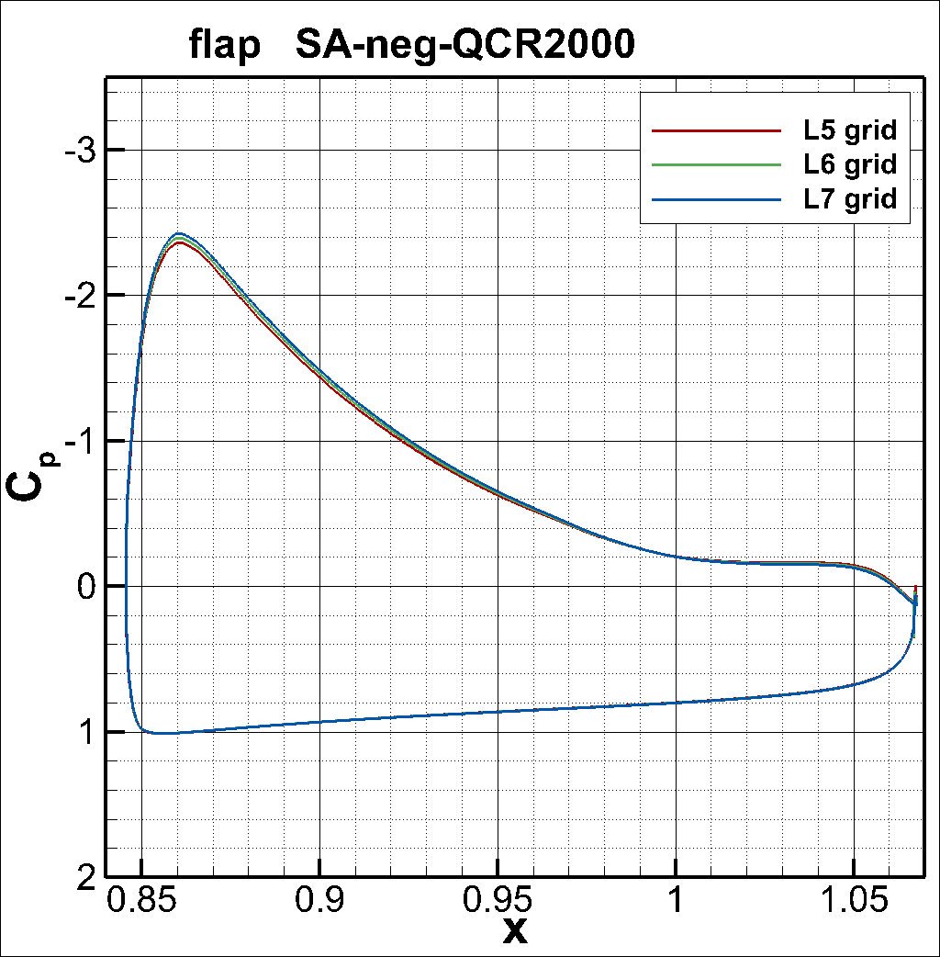
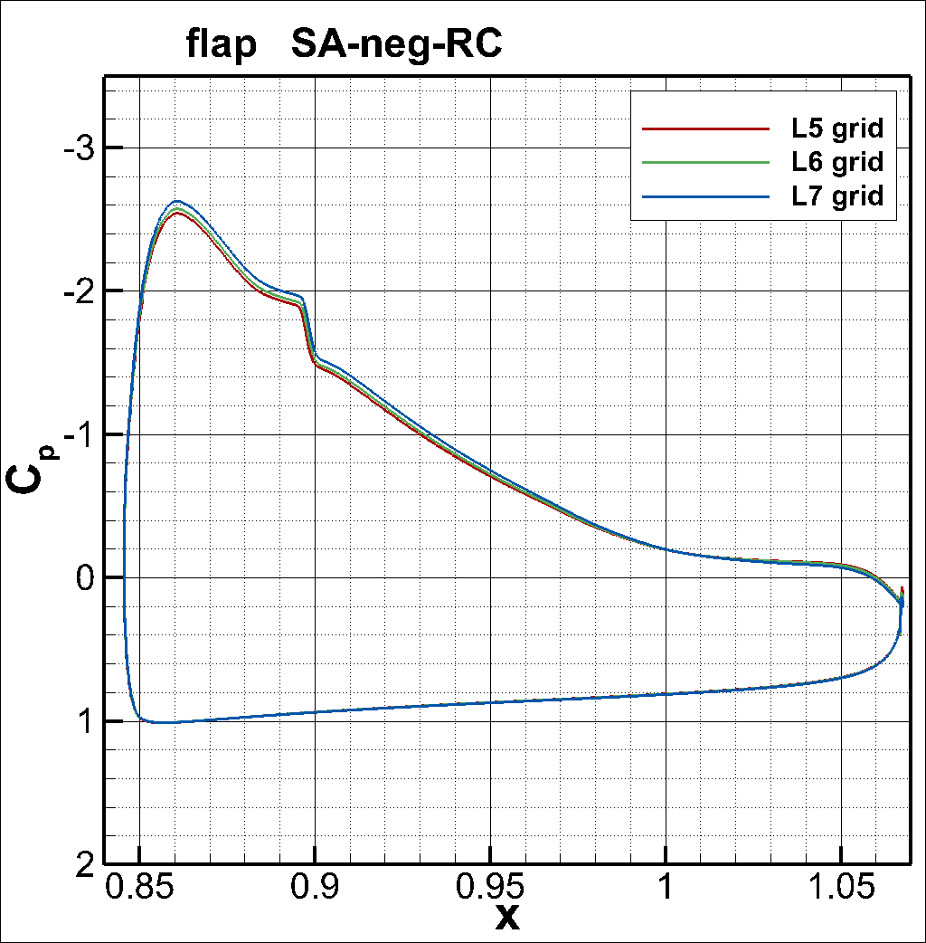
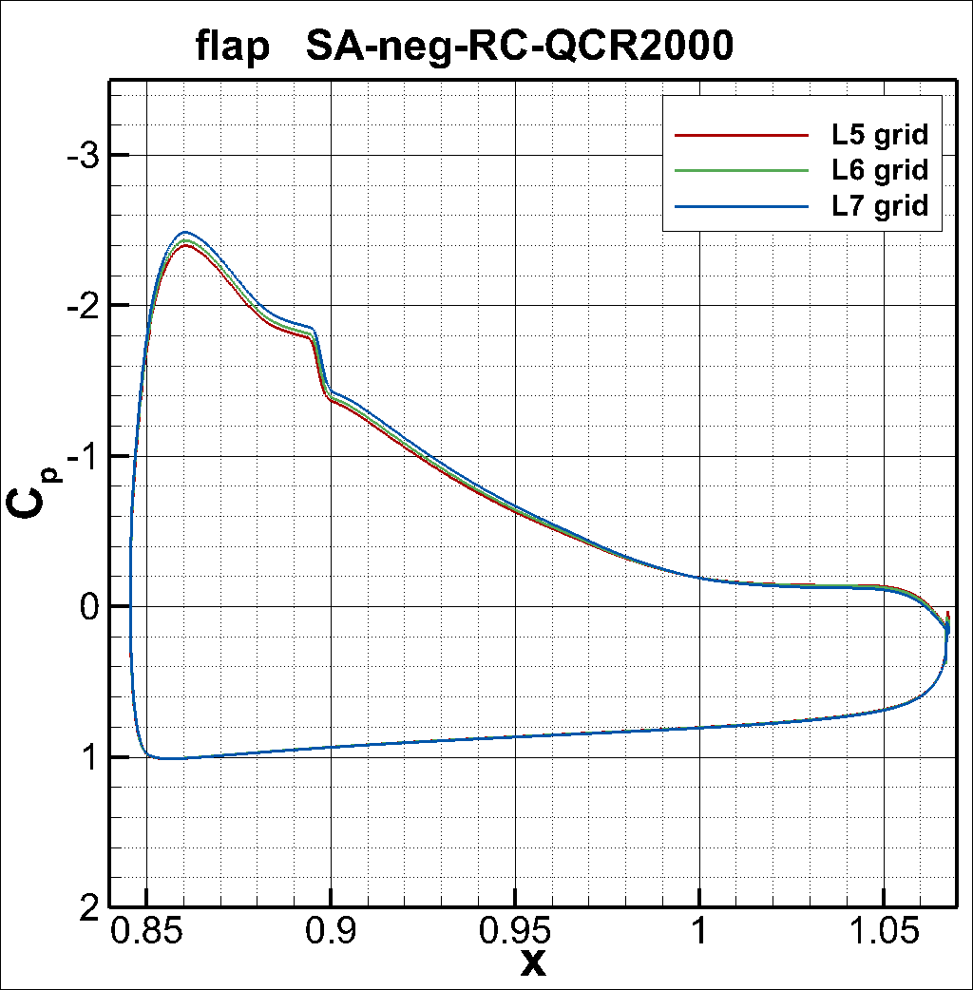
Results (C_{p}; flap; L5-7 grids)

Slide 10
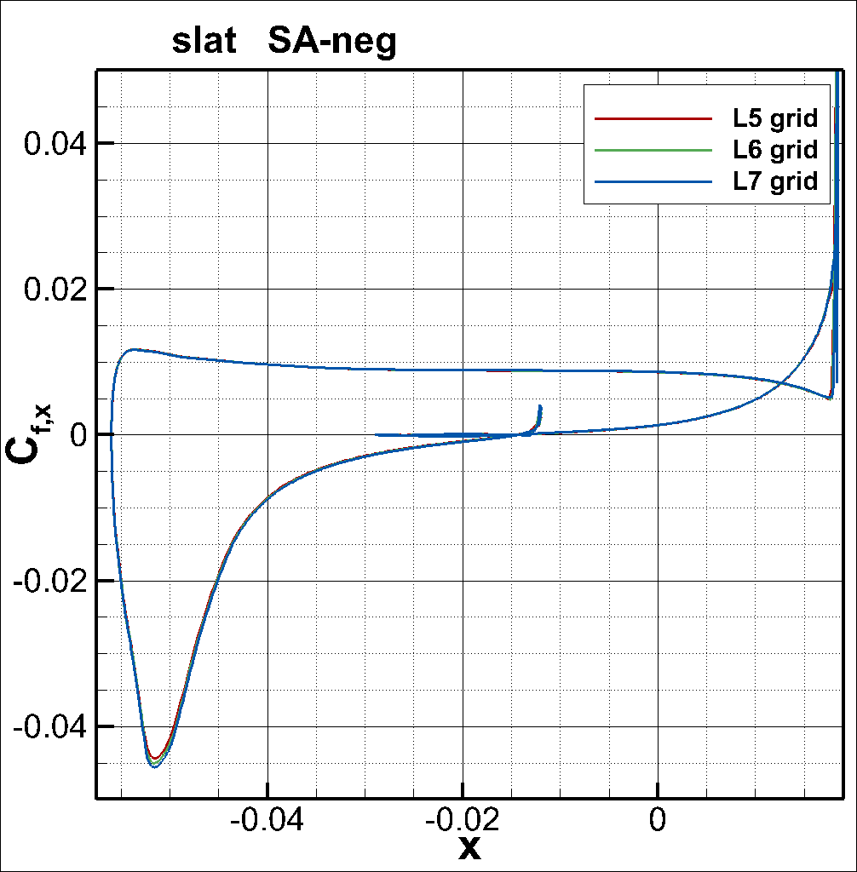
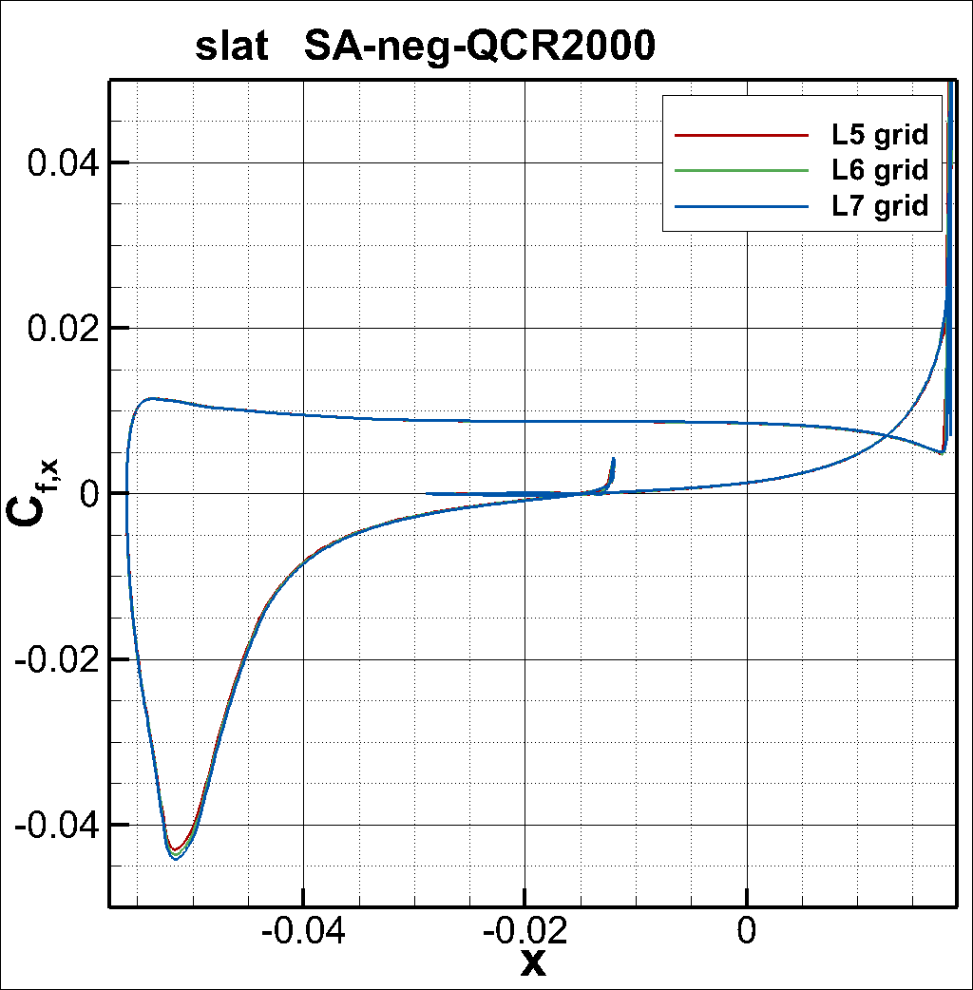
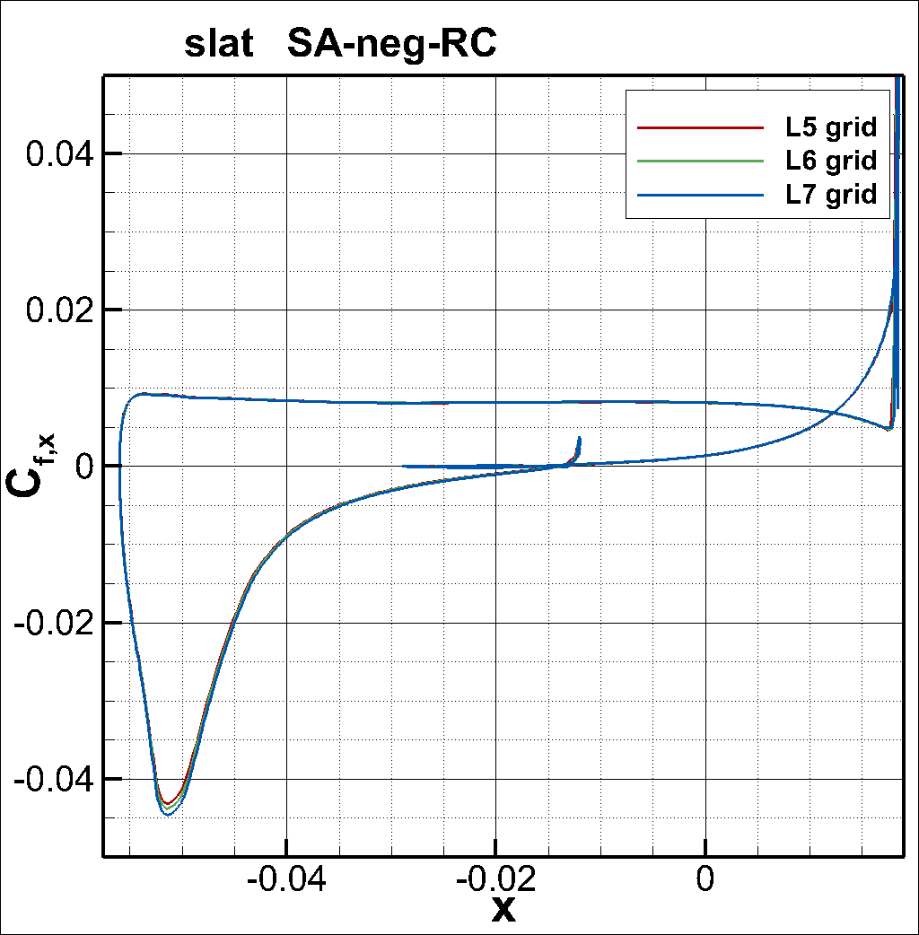
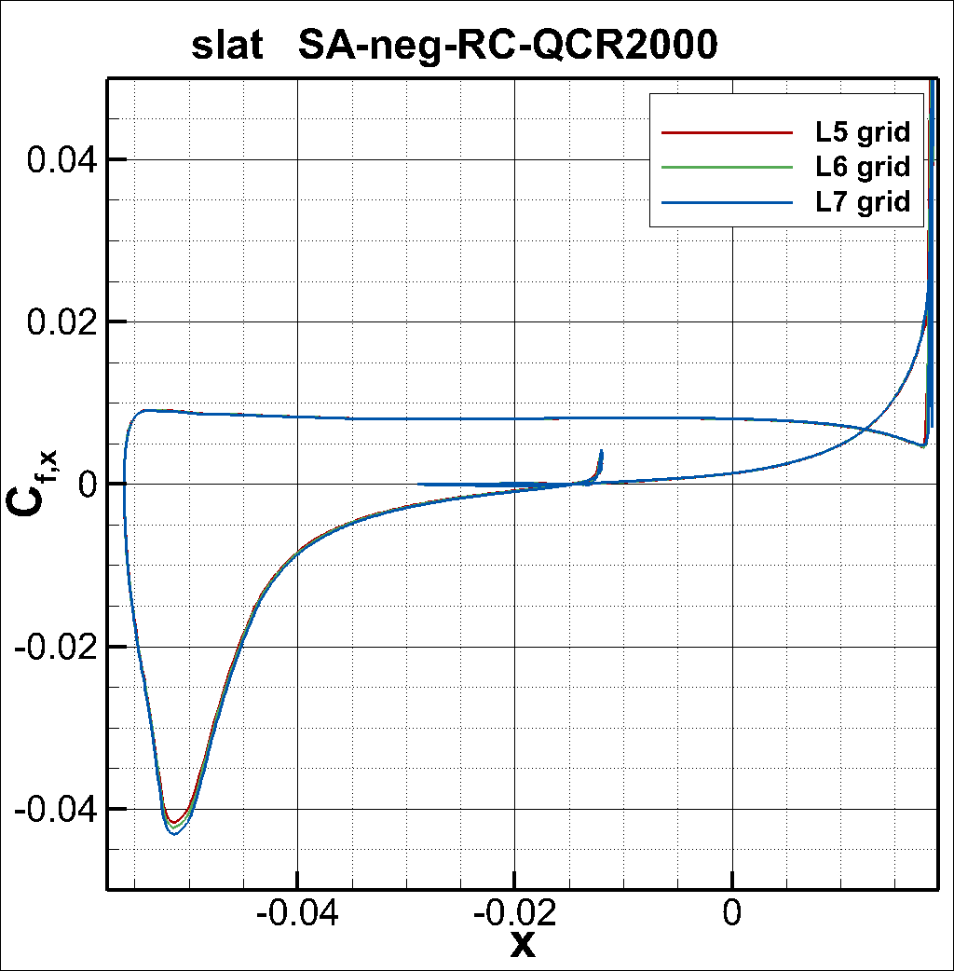
Results (C_{f,x}; slat; L5-7 grids)

Slide 11
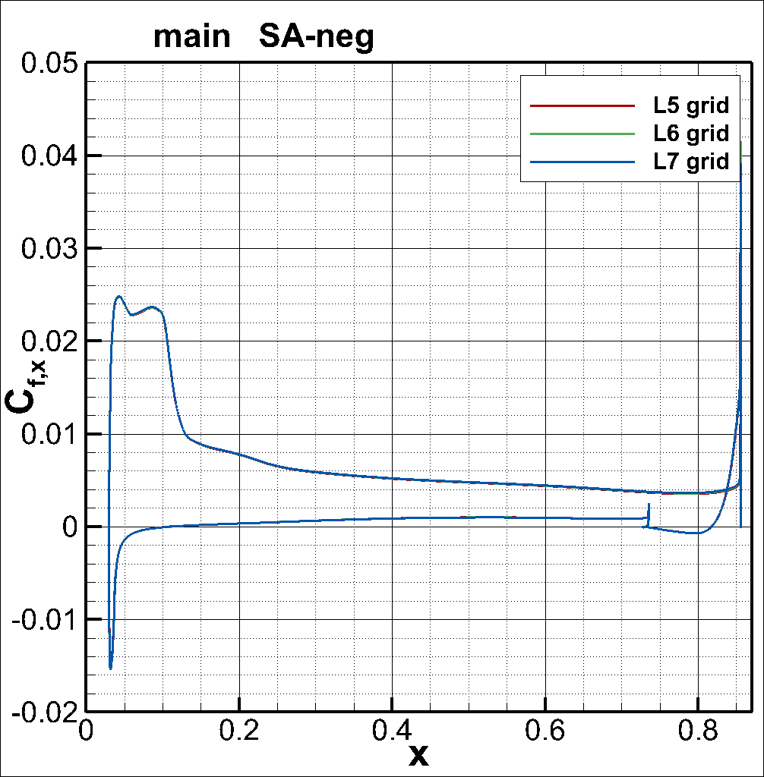
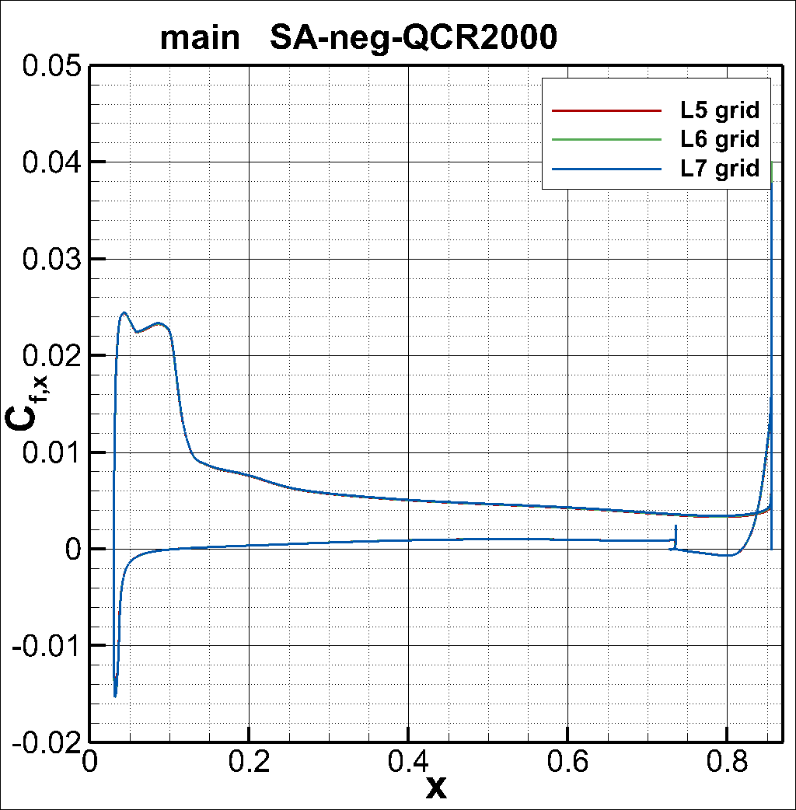
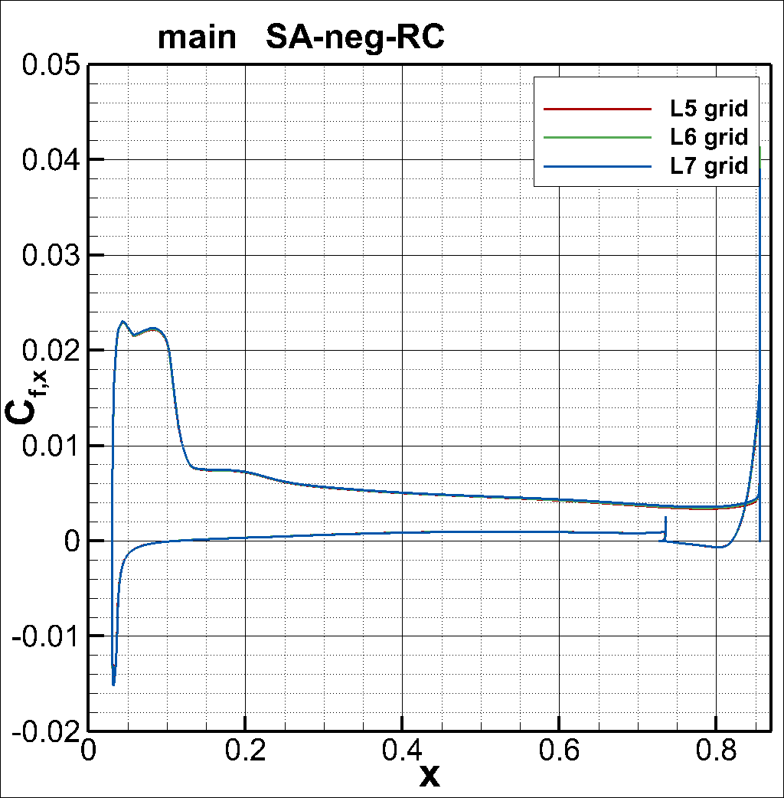
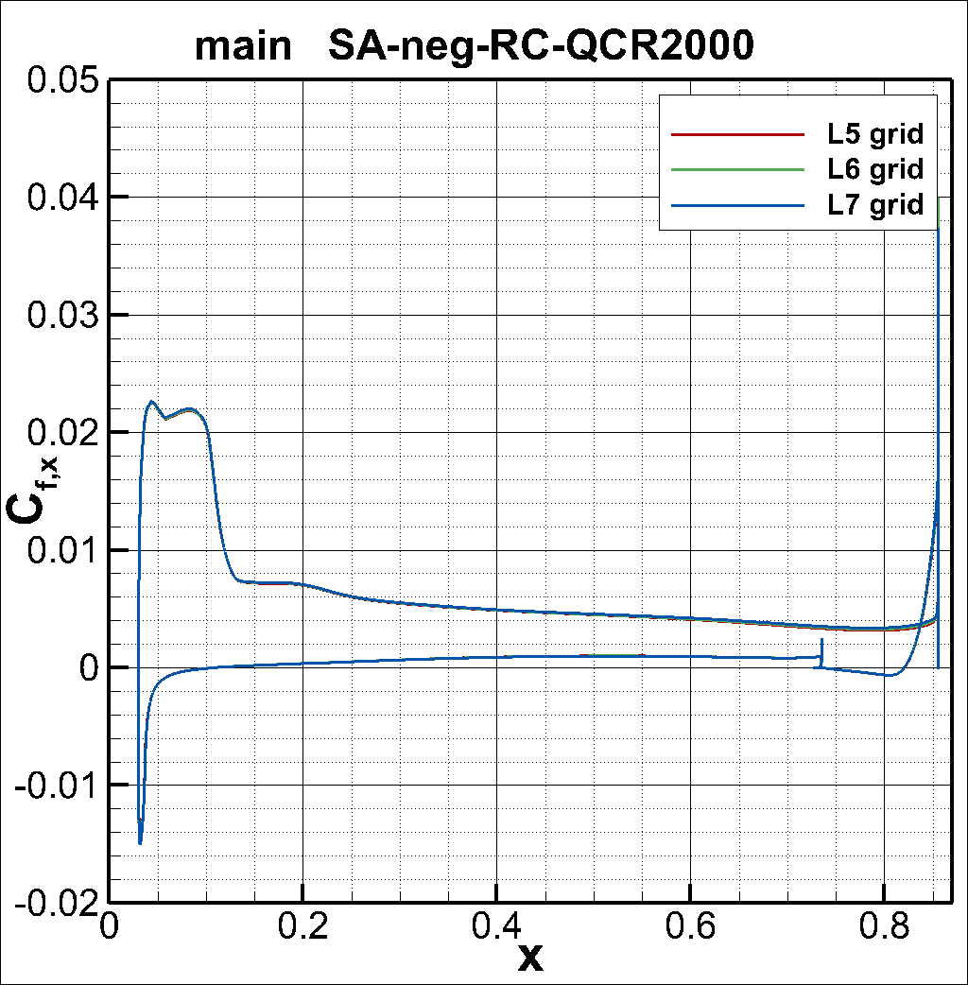
Results (C_{f,x}; main; L5-7 grids)

Slide 12
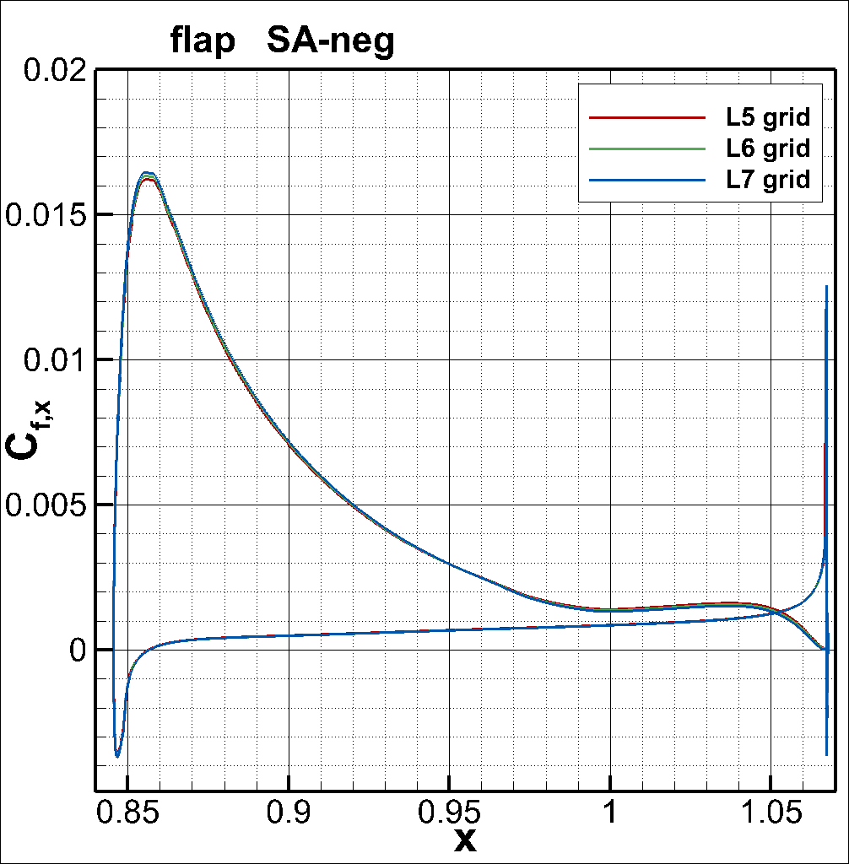
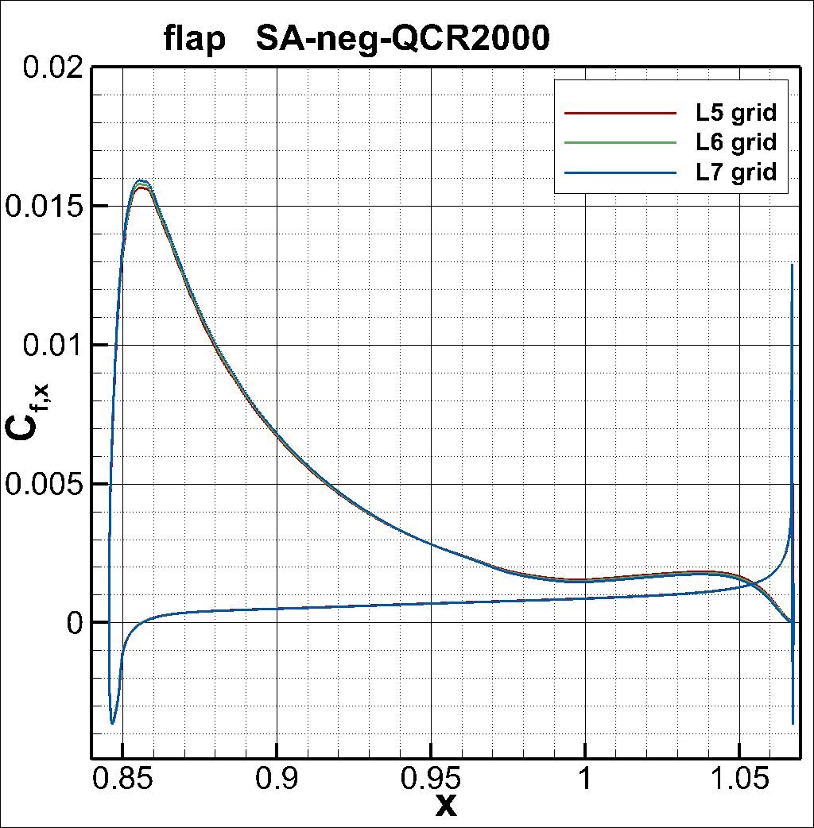
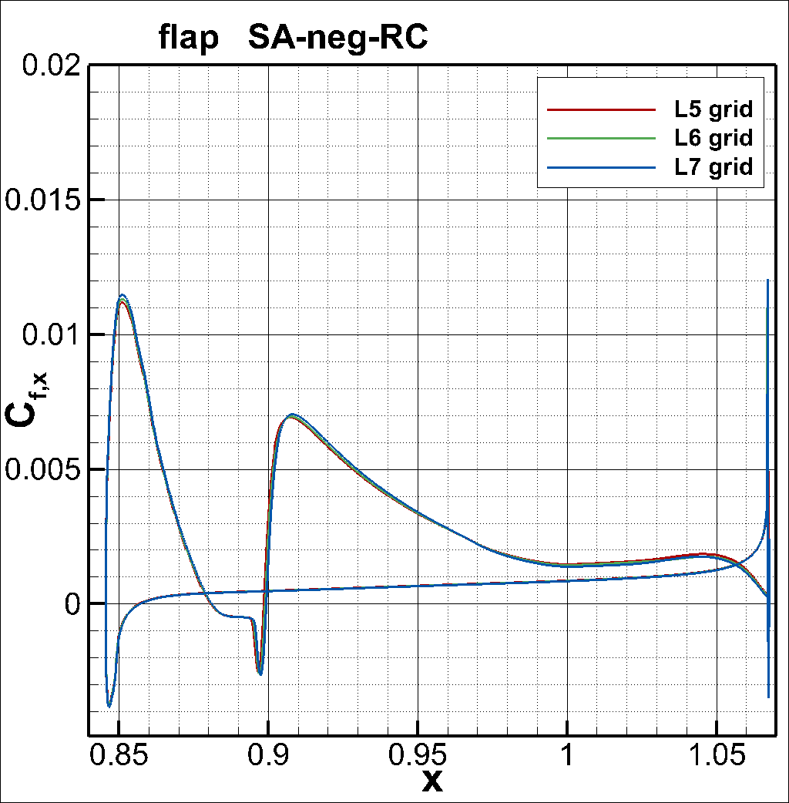
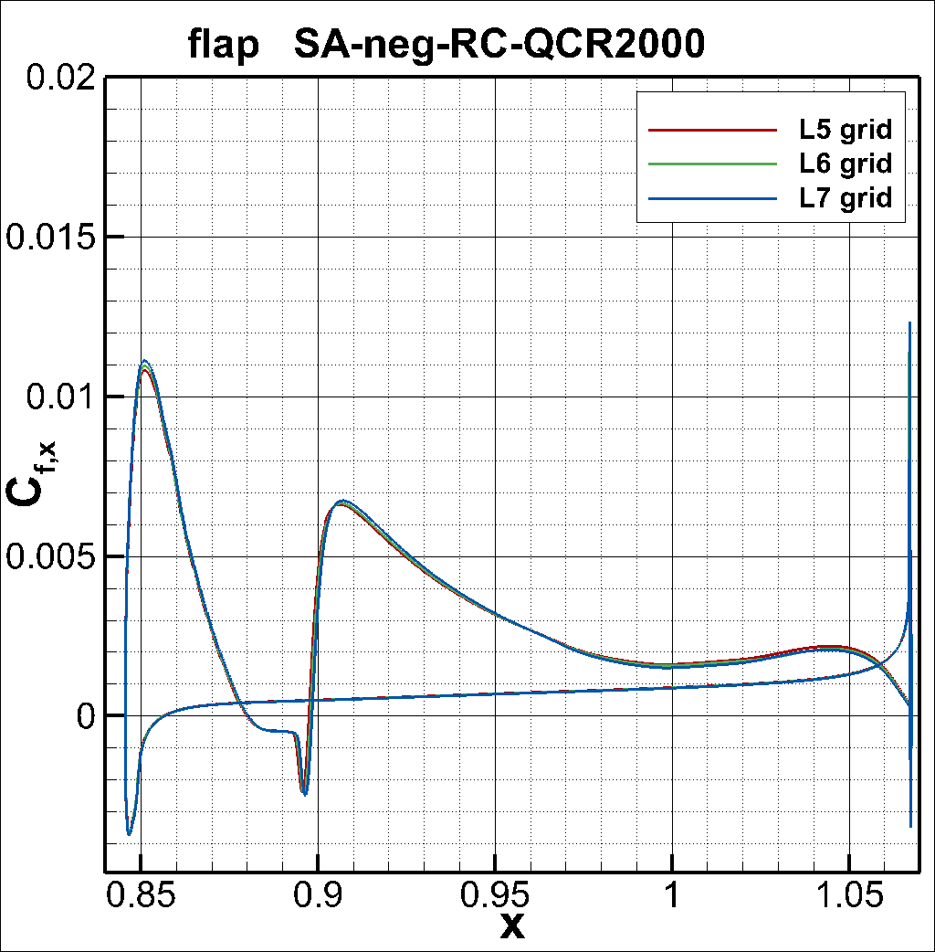
Results (C_{f,x}; flap; L5-7 grids)

Slide 13
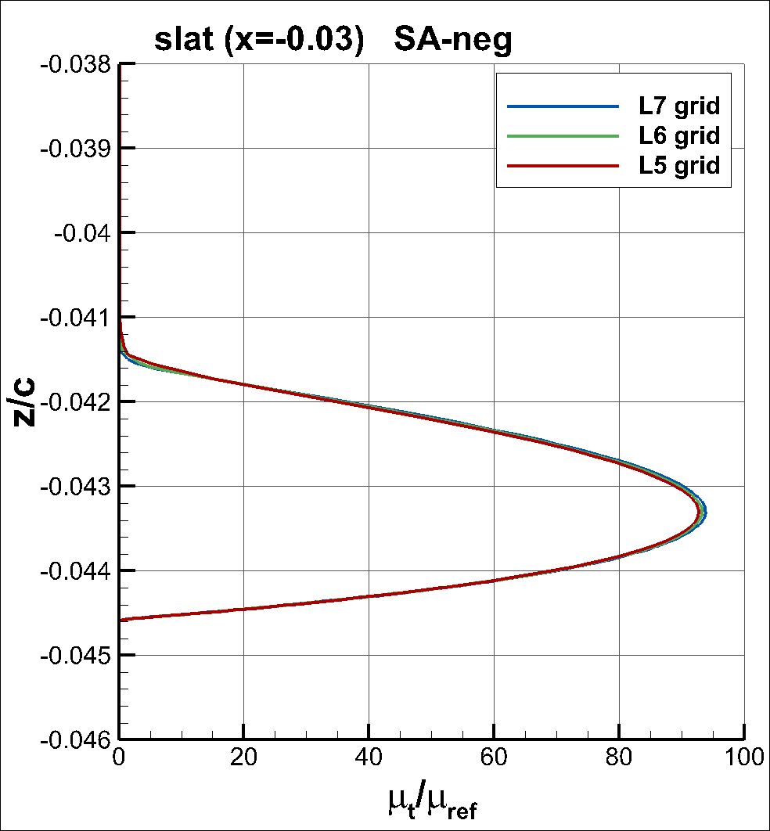
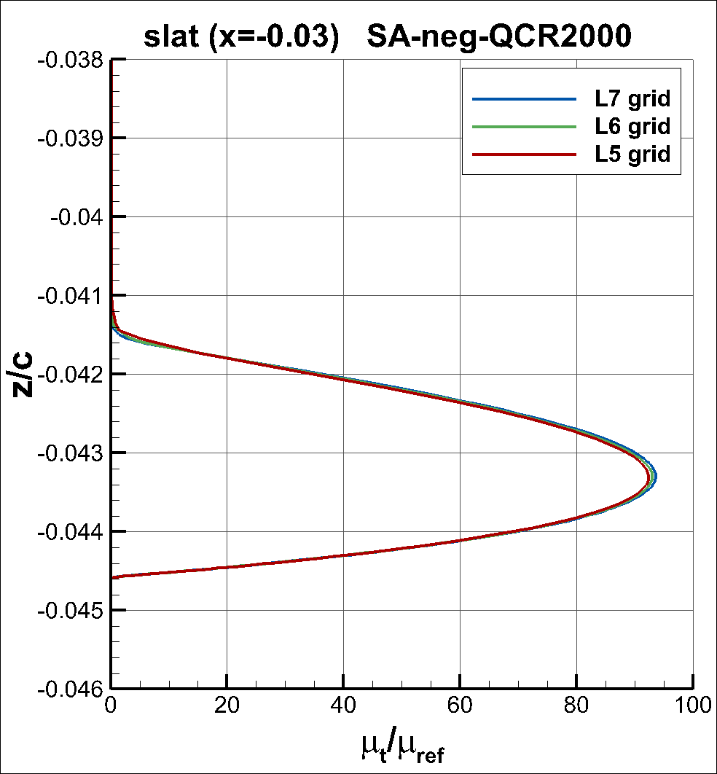
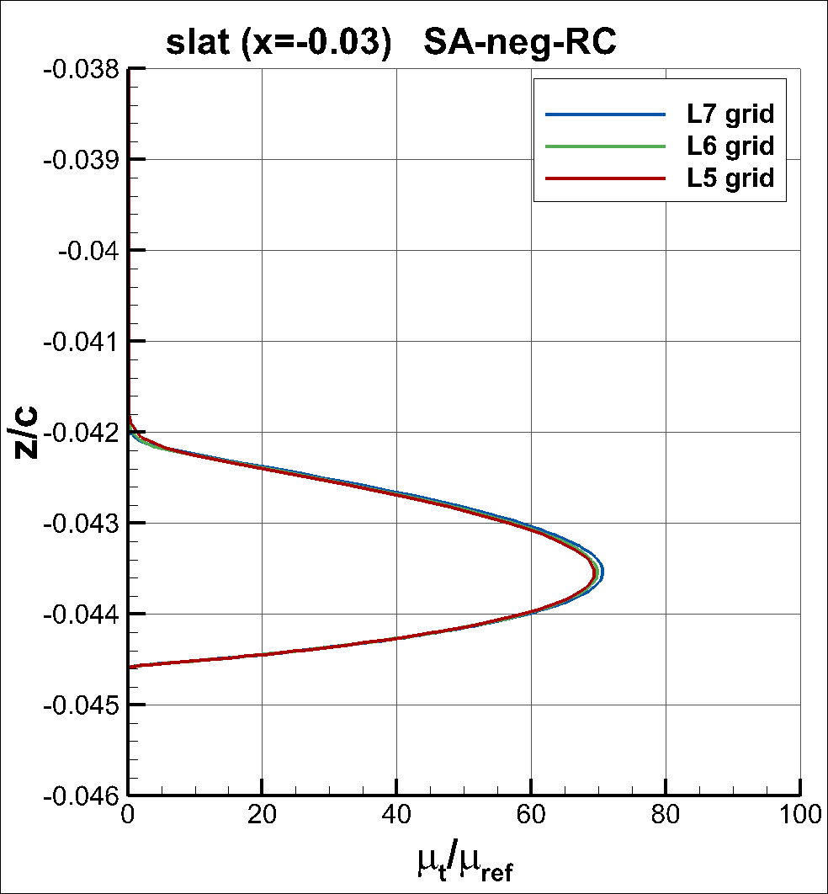
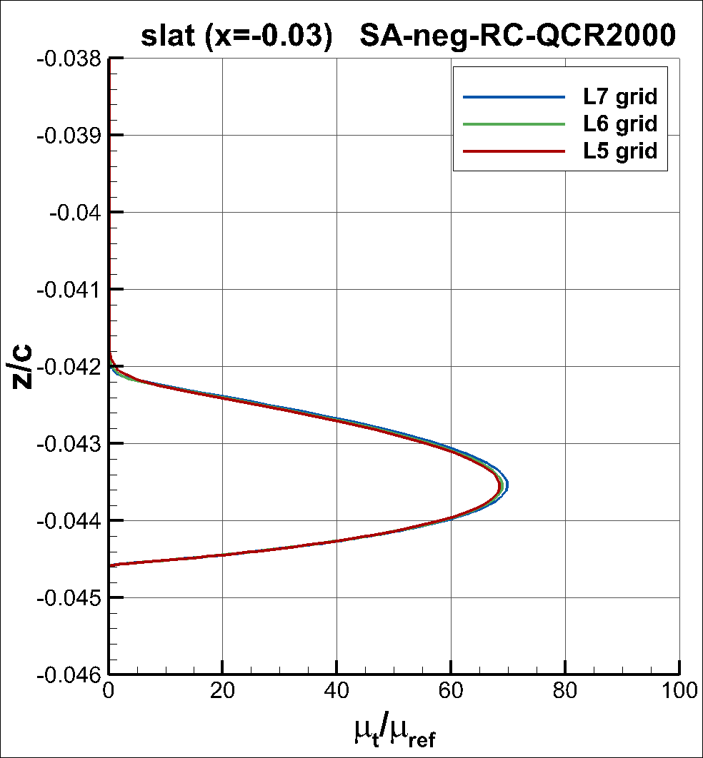
Results (Profiles; slat; L5-7 grids)

Slide 14
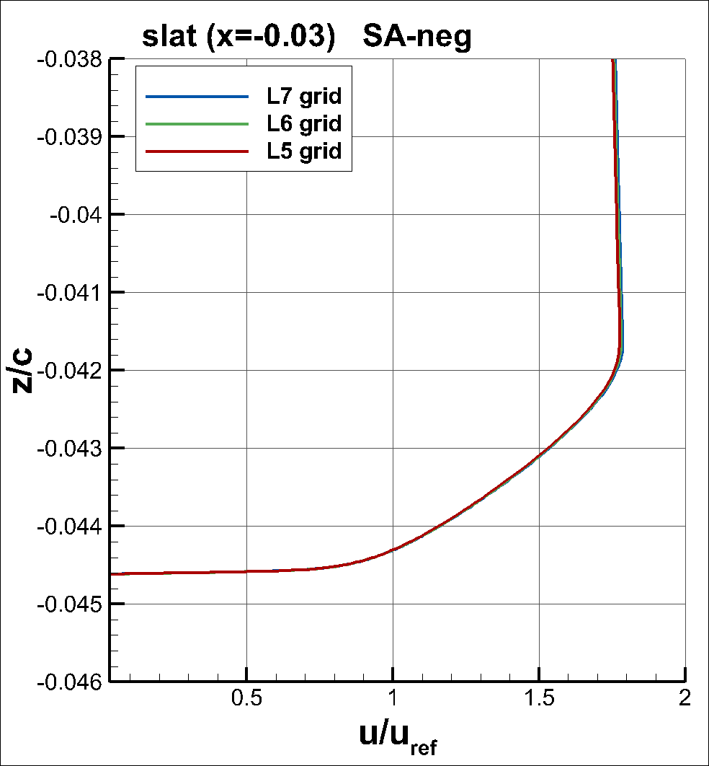
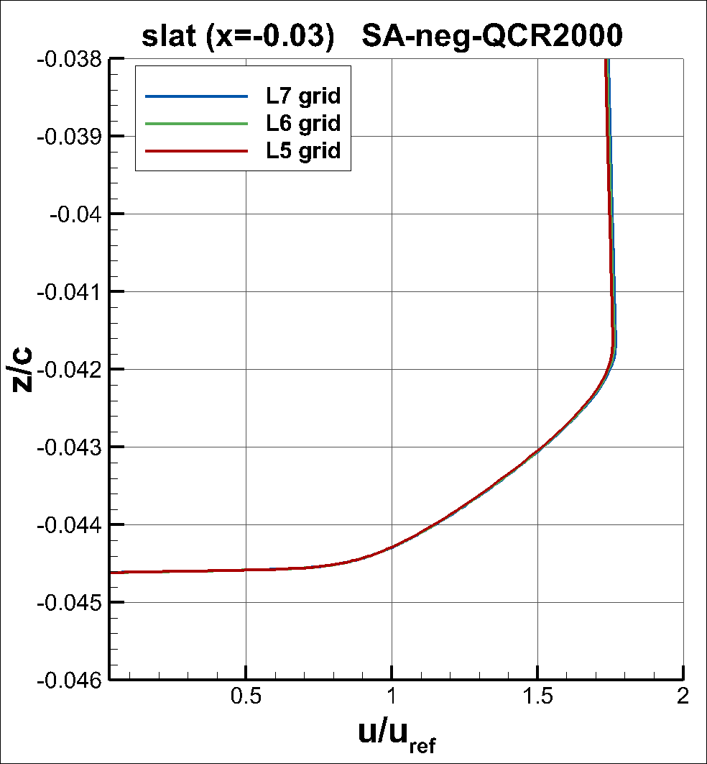
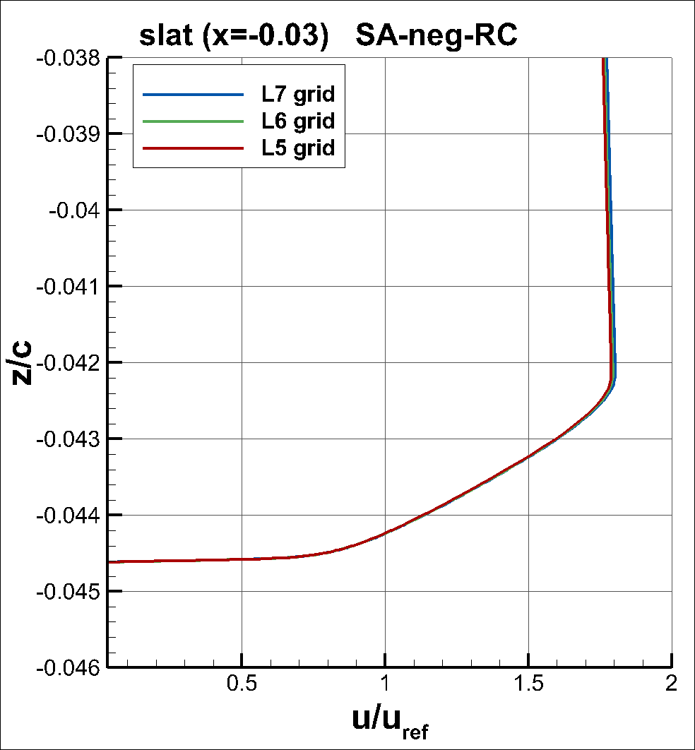
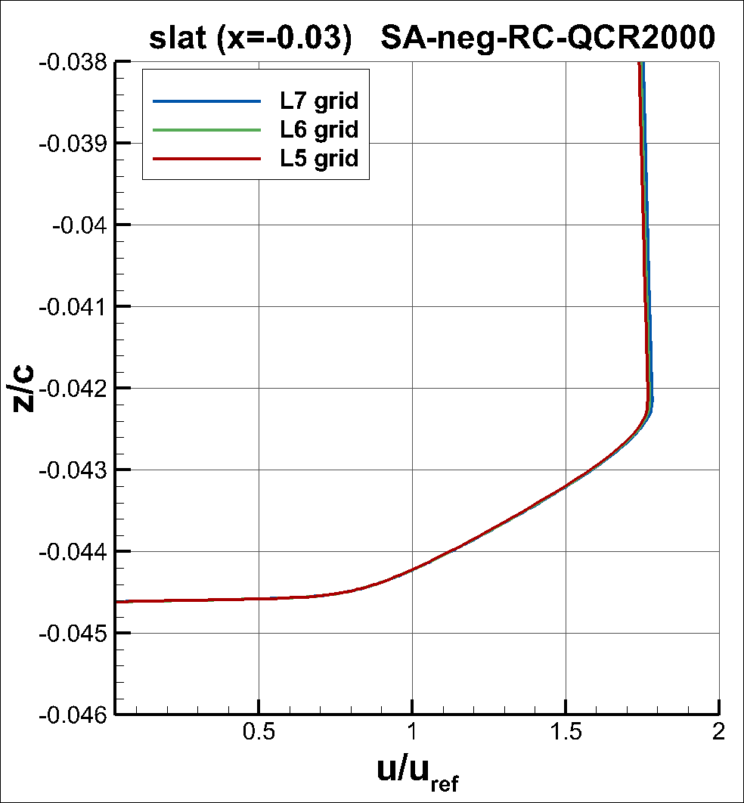
Results (Profiles; slat; L5-7 grids)

Slide 15
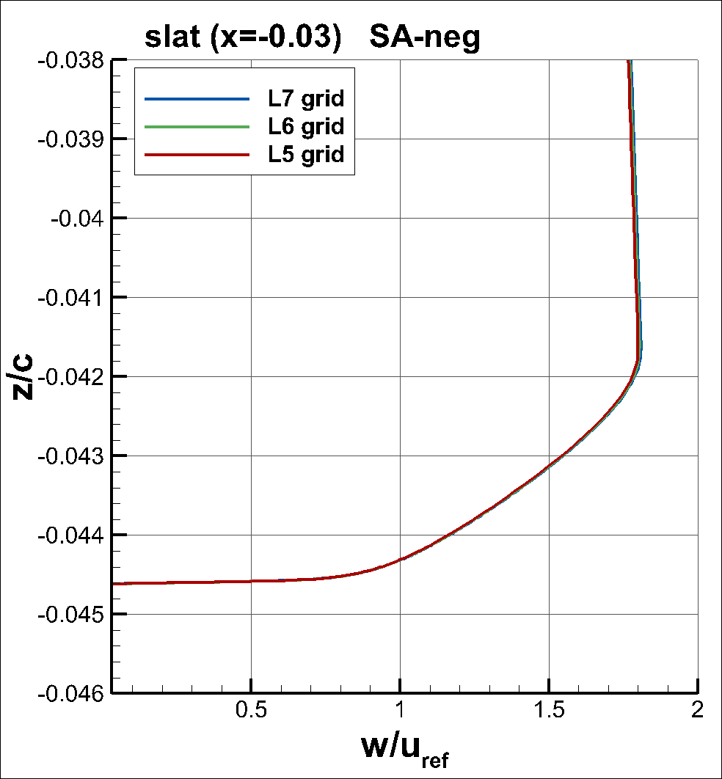

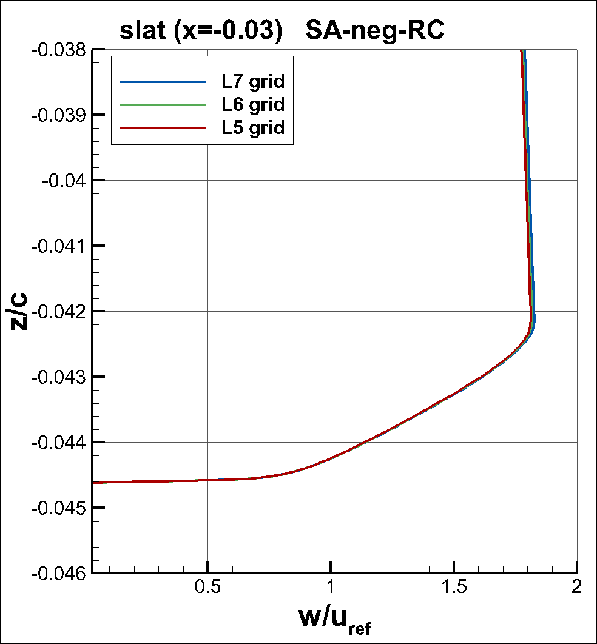
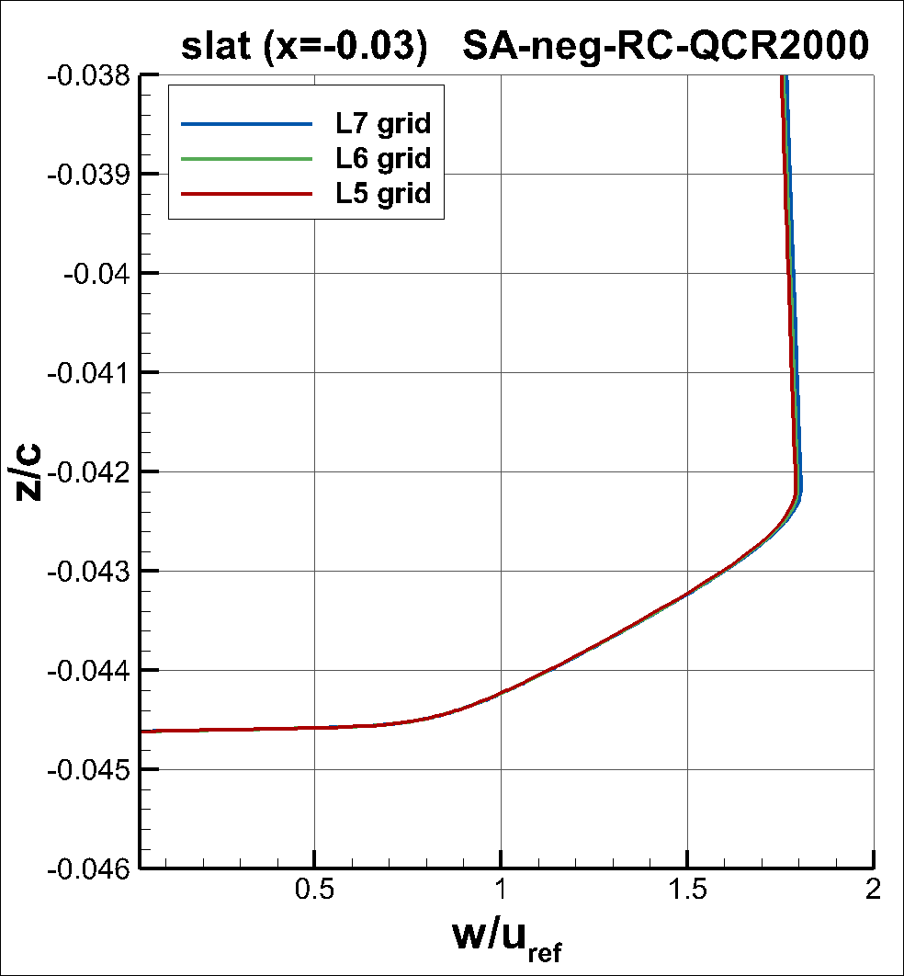
Results (Profiles; slat; L5-7 grids)

Slide 16
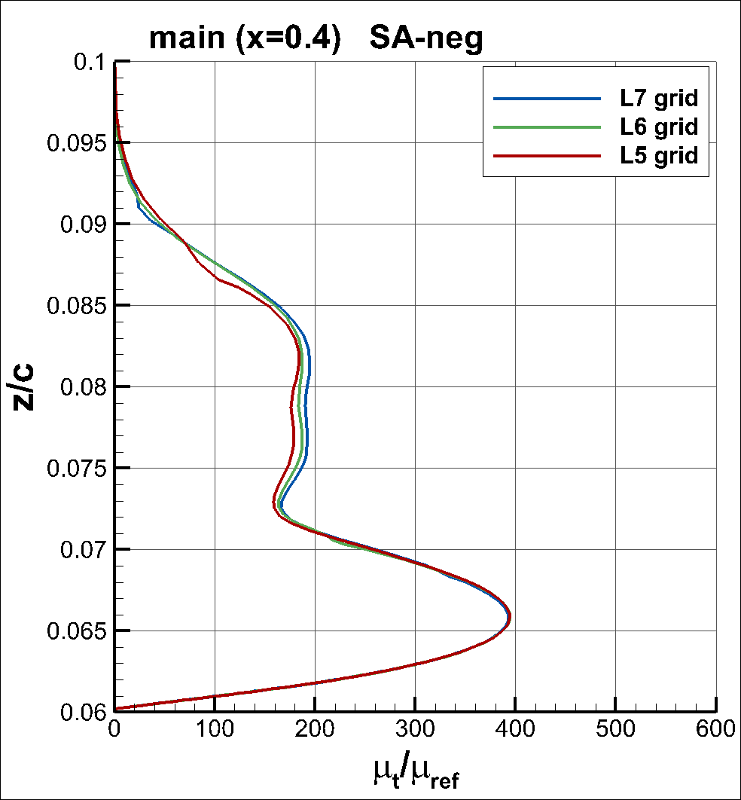
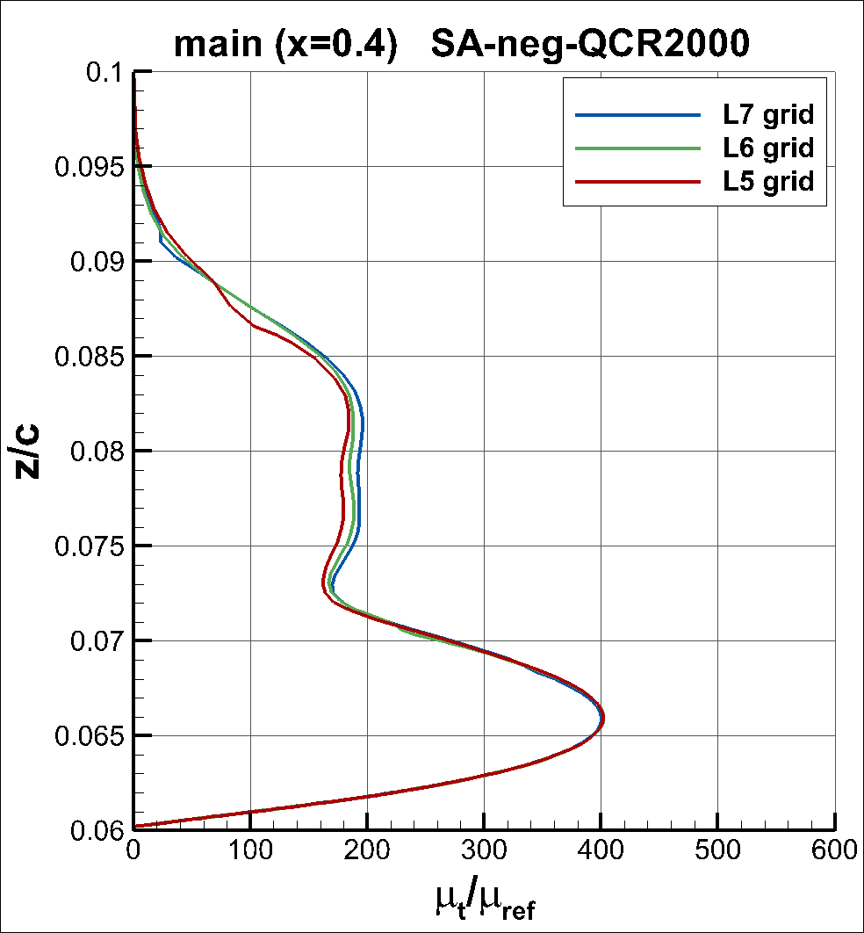
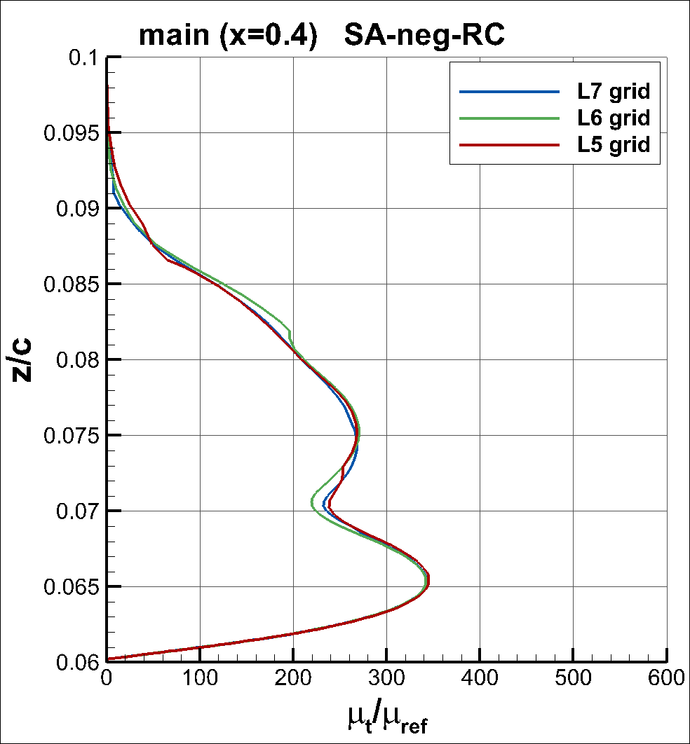
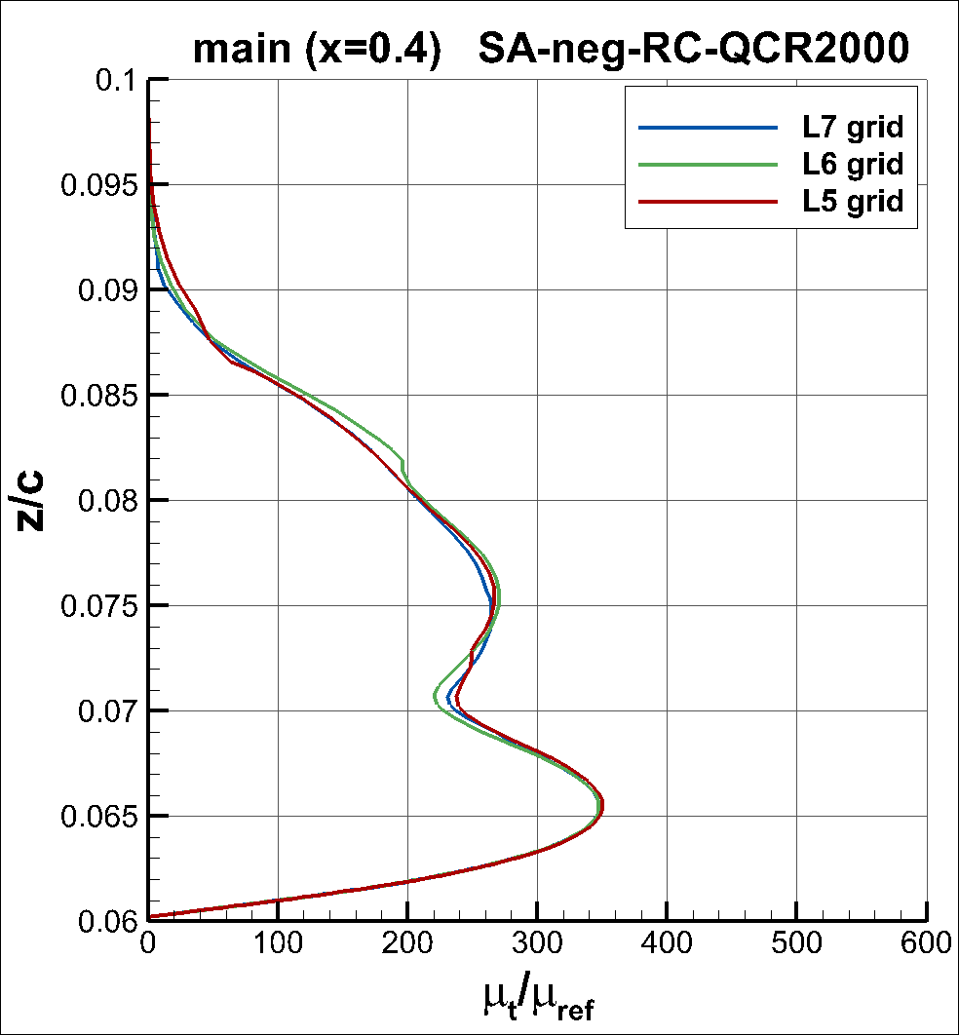
Results (Profiles; main; L5-7 grids)

Slide 17
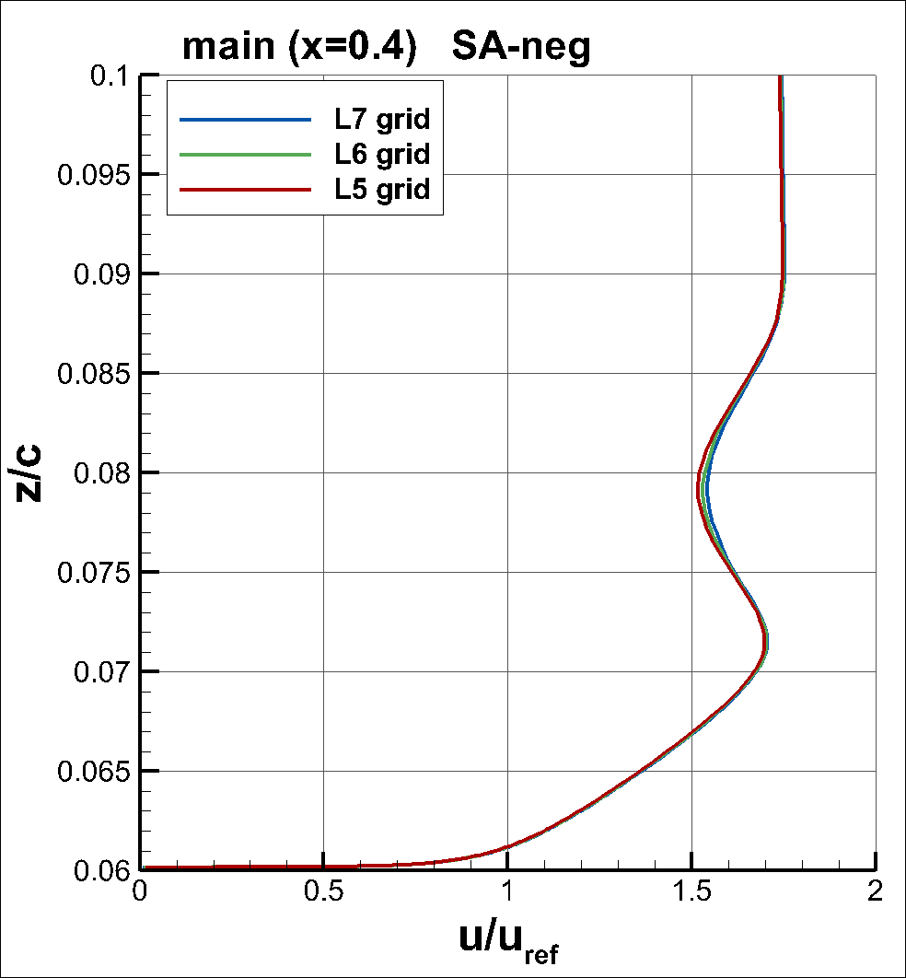
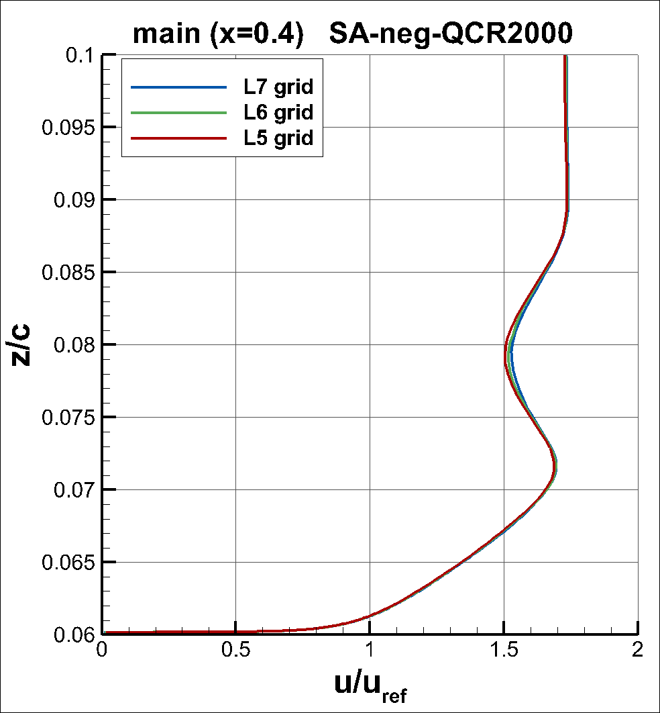
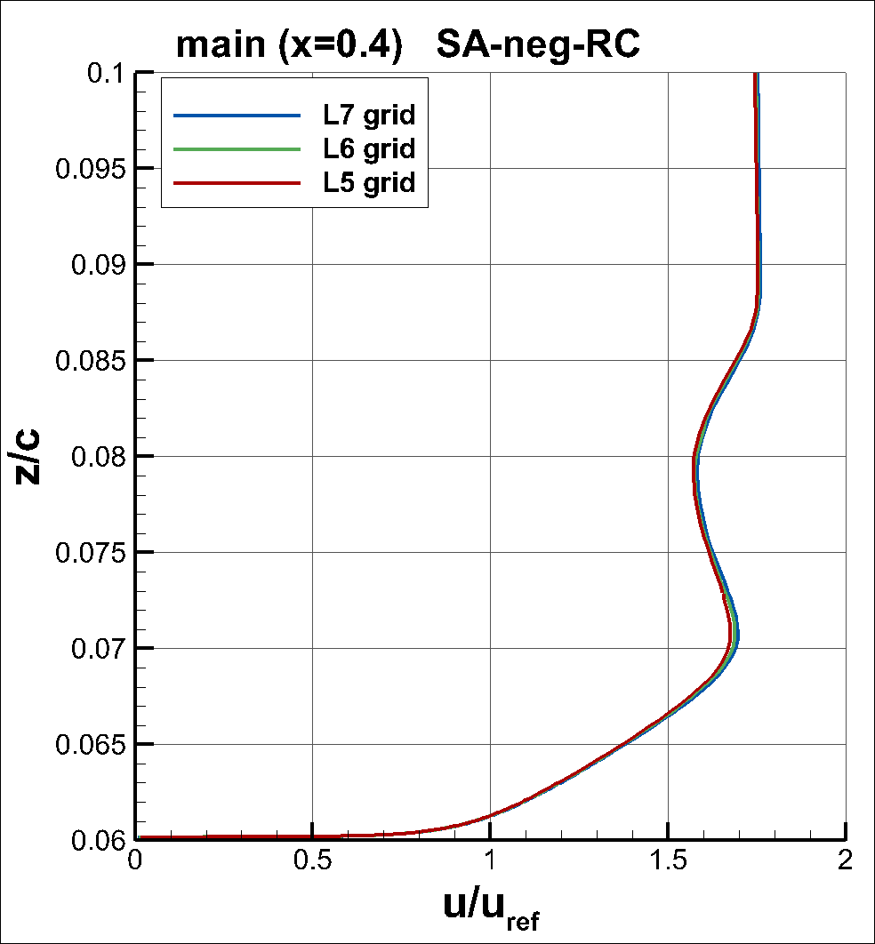
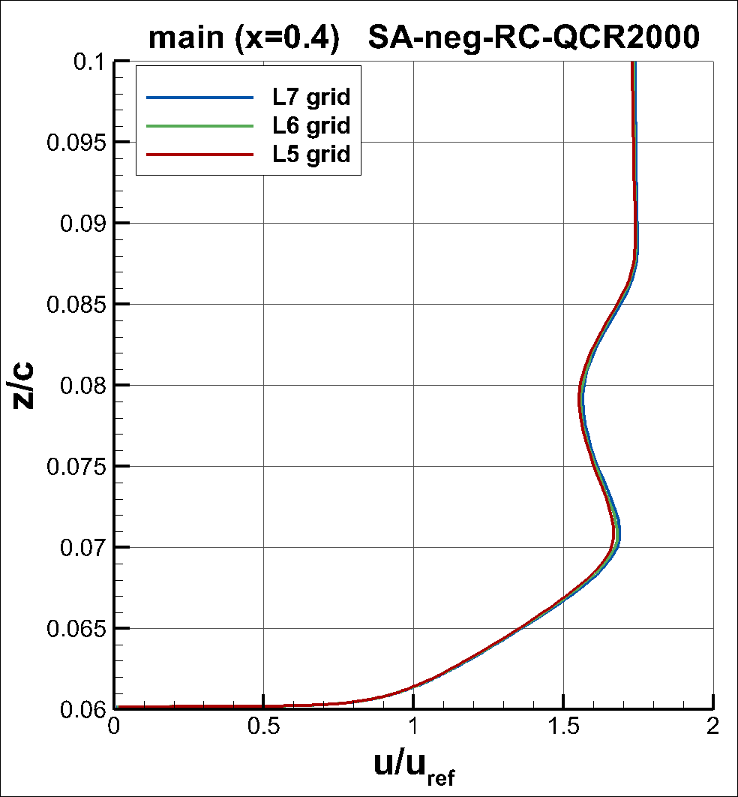
Results (Profiles; main; L5-7 grids)

Slide 18




Results (Profiles; main; L5-7 grids)

Slide 19




Results (Profiles; flap; L5-7 grids)

Slide 20




Results (Profiles; flap; L5-7 grids)

Slide 21




Results (Profiles; flap; L5-7 grids)

Slide 22


Results (Mach contours; L7 grid)

Slide 23


Results (Mach contours; L7 grid)

Slide 24




Results (μ_{t}/μ_{ref}; L7 grid)

