Slide 1
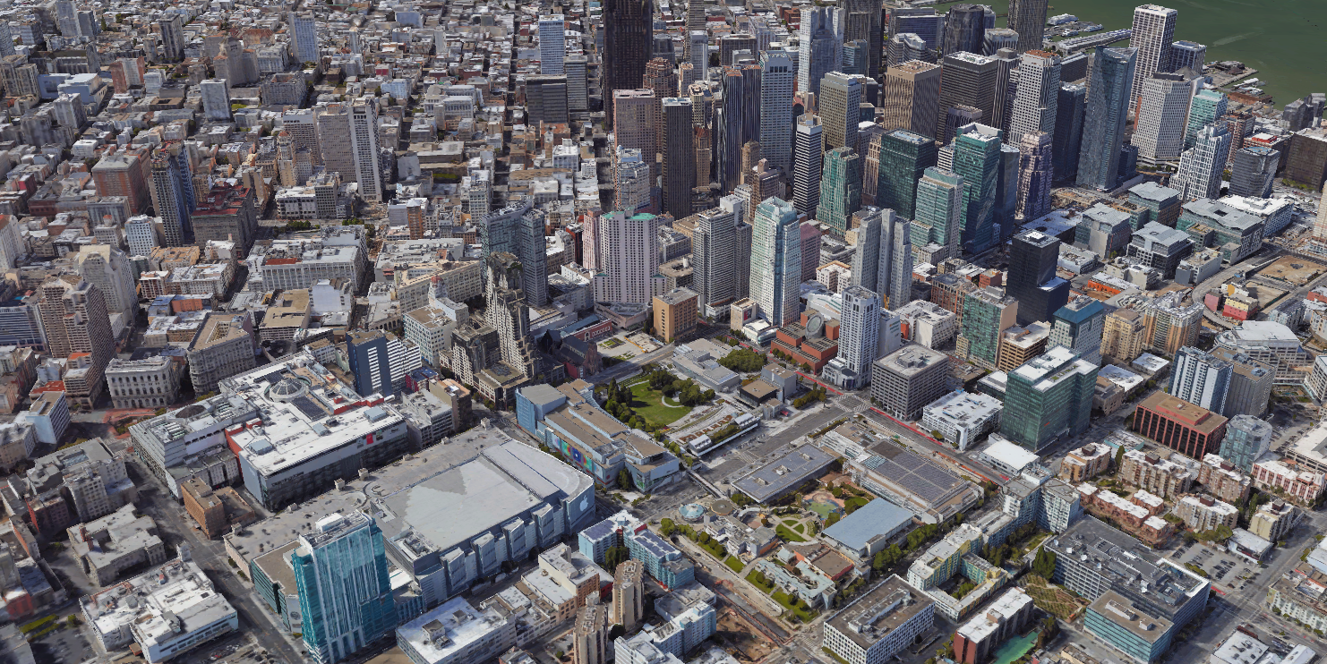

Towards An Autonomous sUAS Operating in UTM TCL4+ and STEReO Fire Scenario
Joshua Baculi and Corey Ippolito
NASA Ames Research Center
19 January 2021
AIAA Science and Technology Forum and Exposition 2021
Notes:
Hello. My name is Joshua Baculi. I am part of the SAFE50 team at NASA Ames. The SAFE50 team previously work on autonomous sUAS for the UTM project and are currently continuing this work in the STEReO project. Here, I will present our work focusing on developing payloads that enable autonomous sUAS flight for UTM TCL4+ and the STEReO fire scenario.

Slide 2
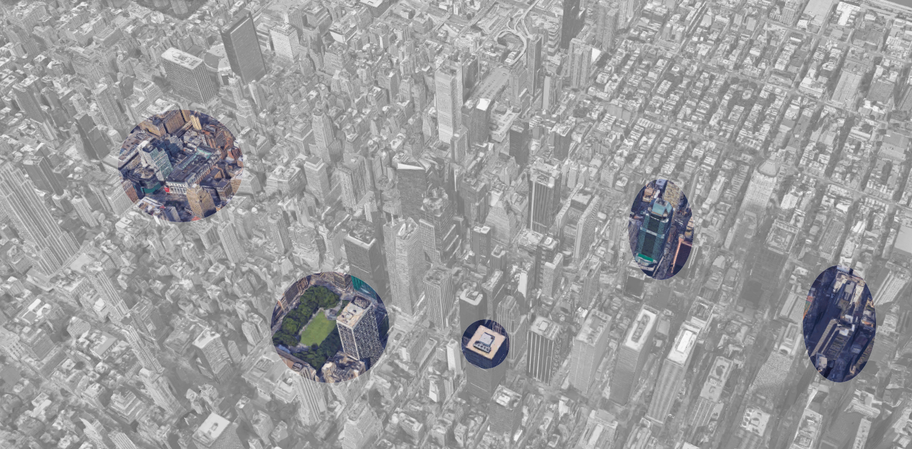
Mission Concepts
Use case 1: point-to-point
Take-off
Climb out
Use case 2: Emergency
(High-priority Flight)
Store
(Operator)
Cruise
4
Off-nominal cases
Fire dept.
Emergency
Landing
Approach
Descent
Landing
1
2
Airspace conflict
3
Park
Pull-outs
Theater (customer)
Notes:
While our autonomy work has been a part of the UTM and STEReO projects, most of our contributions so far have been towards the UTM project. The UAS Traffic Management infrastructure enables airspace allocation for a range of Technical Capability Levels (TCL). The highest TCL is TCL4+, which aims to enable beyond visual line of sight flight in densely operated urban environment. Our work in TCL4+ has centered around the figure shown here, where we implement autonomy into our sUAS as means to enable autonomous take-off, cruise, and landing as well as off-nominal replanning and emergency landing.
The Scalable Traffic Management Emergency Response Operations (STEReO) project is a sequel project to UTM that leverages the UTM infrastructure for wildfire and hurricane emergency response. Our payload autonomy components focus on both the urban TCL4+ and fire STEReO scenarios.

Slide 3
Contribution
Gen 2.1 Payload
Gen 3 Payload
LIDAR SLAM
Path planning
GPS-free navigation and mapping in constrained environments
Gen 2.1 capabilities +
Dynamic ground risk mitigation
Powerline and fire detection
V2V communication
Landing clearance detection
Notes:
Our main contribution is the development of two payloads working towards enabling autonomous flight. The first payload, the Gen 2.1, enables LIDAR SLAM, path planning, and GPS-free navigation and mapping in constrained environments. This payload has been tested in simulation and in basic flight tests.
The Gen 3 payload is the continuation of the Gen 2.1. Although still in development, its components were selected to build upon the Gen 2.1 capabilities and add dynamic ground risk mitigation, powerline and fire detection, V2V communication, and landing clearance detection.
Both payloads are designed for integration with DJI sUAS and autopilots.

Slide 4
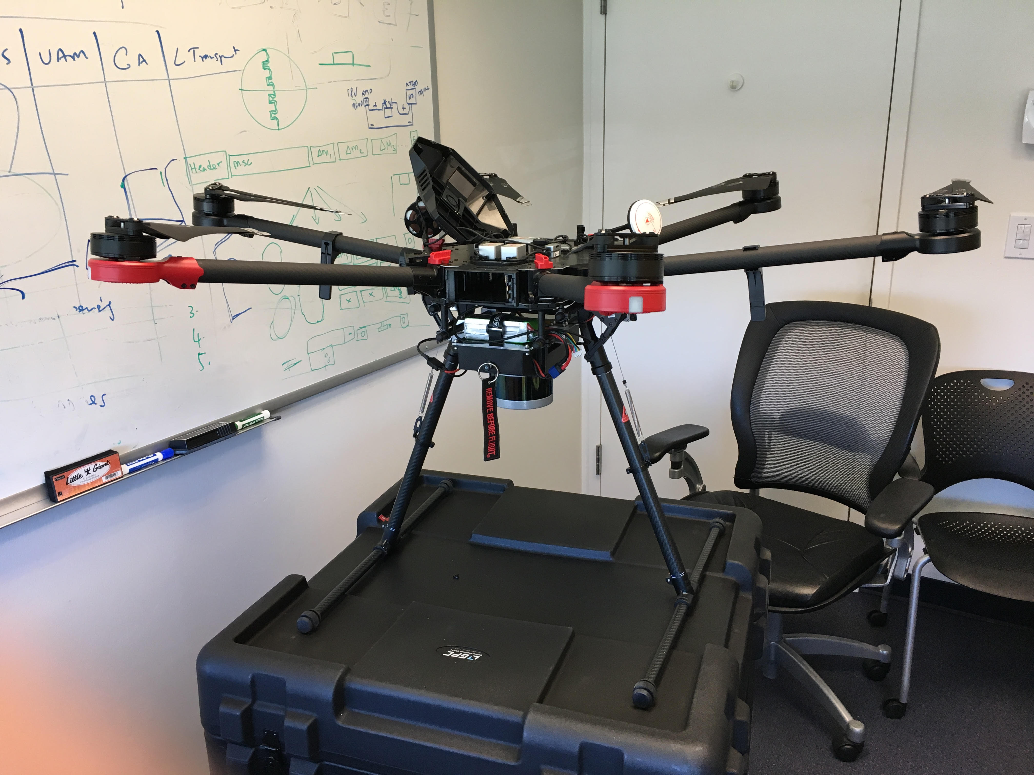
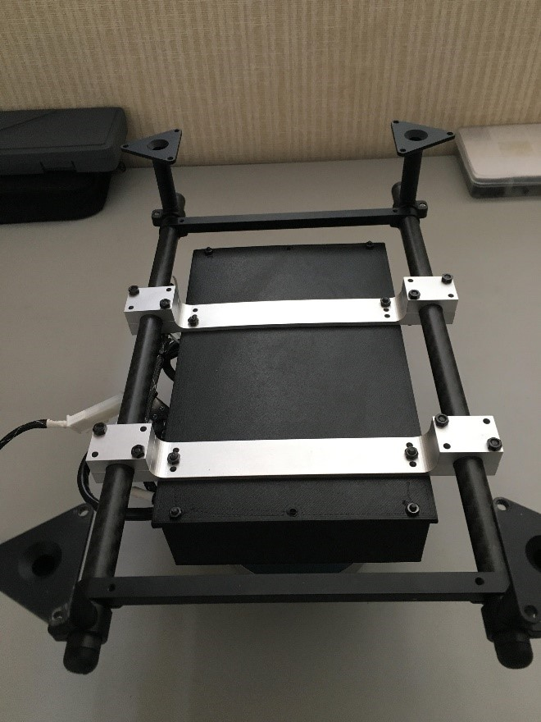
Airframe
Gen 2.1 payload mounted on the DJI M600 Pro
Gen 2.1 payload mounting rails on the DJI M600 Pro payload rack
Notes:
The payloads are designed for integrating with the DJI M600 Pro hexacopter. The M600 Pro can hover for 18 minutes at the 5.5 kg max payload capacity. The aircraft flies using the DJI A3 Pro autopilot that includes three GPS and IMUs for redundancy and is controlled via remote controller and the DJI iOS apps.
The figure on the left shows the Gen 2.1 payload mounted under the aircraft. Payloads are mounted to the aircraft using the carbon fiber payload rack shown on the right. Payloads clamp around the carbon fiber rods and can be slid forward and back to align with the aircraft center of mass.

Slide 5
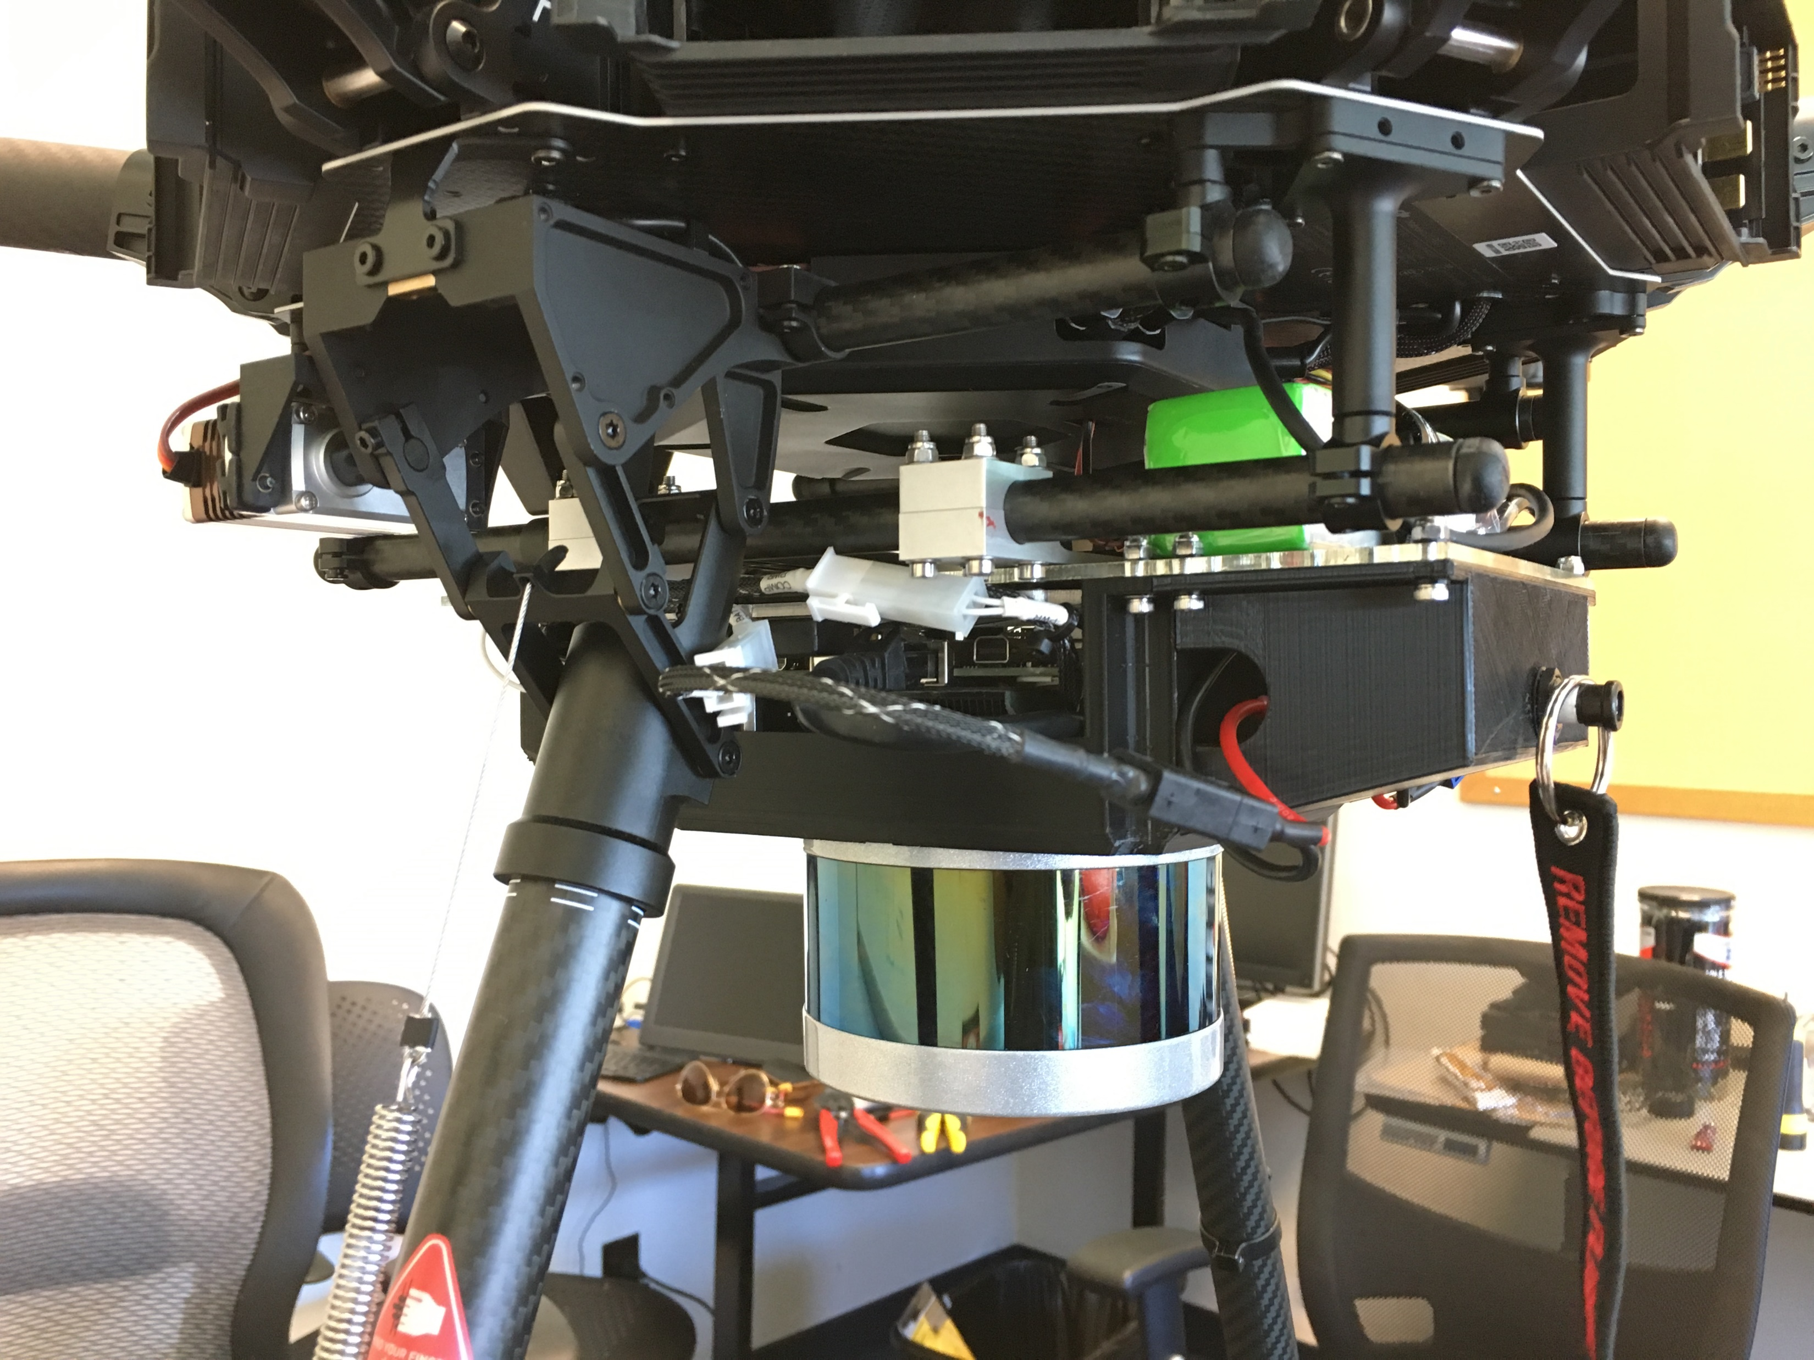
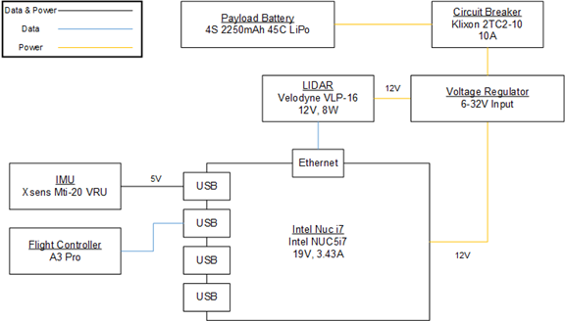
Gen 2.1 Payload
Fully enclosed and mounted Gen 2.1 payload
Gen 2.1 payload block diagram
Notes:
The Gen 2.1 payload consists of an onboard computer, LIDAR, IMU, voltage regulator, circuit breaker, and LiPo battery. The figure on the left shows a closer look at the mounted Gen 2.1 payload. The block diagram on the right shows the power and data connections for the payload. The payload is powered separately from the aircraft and is electrically isolated except for the connection to the A3 Pro autopilot. The onboard computer enables the autonomy processing to be handled by the aircraft rather than downlinked to the ground station. The LIDAR is capable of SLAM that enables GPS-free navigation in urban canyons. The IMU is a legacy component from a previous payload and is unused in this configuration.

Slide 6
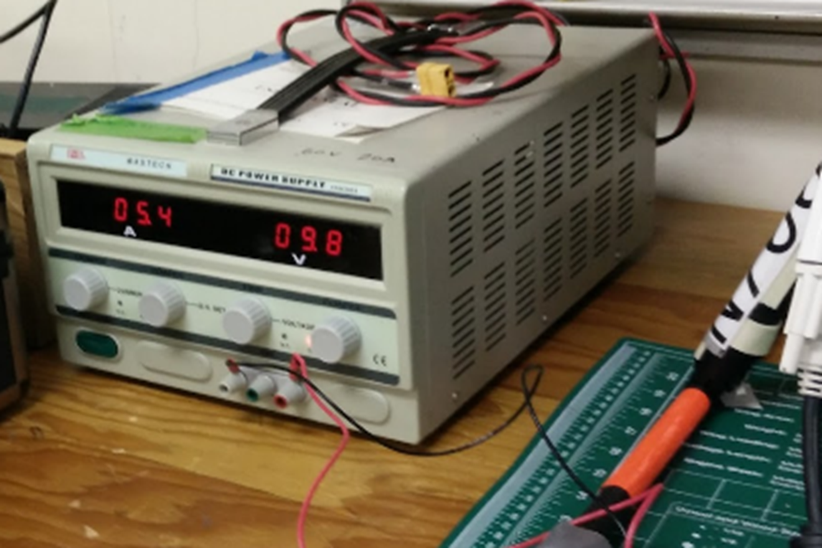
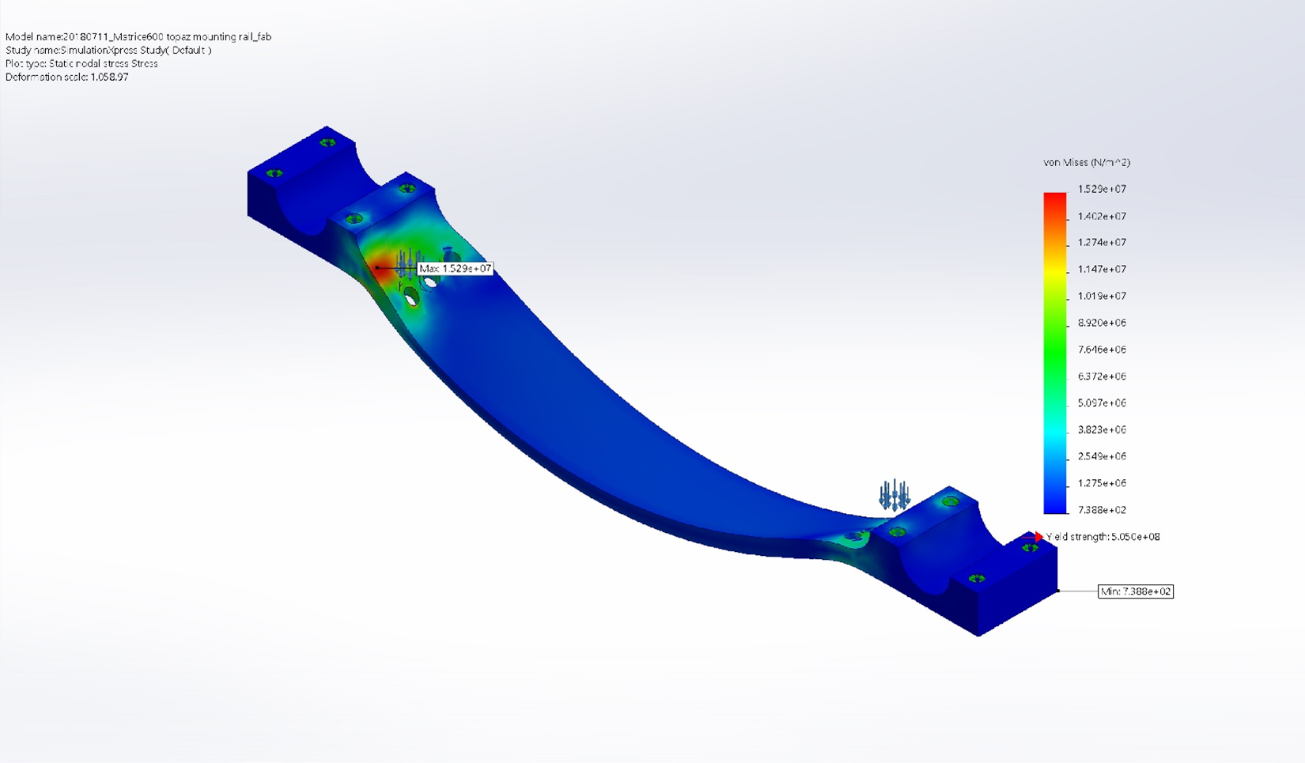
Gen 2.1 Payload—Power and Stress
Gen 2.1 payload power consumption test
Payload drew 53 W during nominal operation
Voltage regulator has 100 W max output
Gen 2.1 payload mounting rail stress analysis
Fixed at clamp fastener holes
Two 67.38 N loads applied
Minimum factor of safety of 33
Notes:
The figure on the left shows the Gen 2.1 payload’s power consumption while running LIDAR SLAM. The test showed the payload drew 53 W, which is consistent with the estimated consumption based on the component specifications. The 53 W is well below the 100 W max output of the voltage regulator.
The Gen 2.1 payload mounts to the M600 Pro payload rack using two mounting rails machined out of 7075-T6 aluminum. The figure on the right shows the stress analysis conducted on the rail. To test the worst case scenario, a 5.5 kg max payload undergoing a 5 G maneuver is assumed. This results in a 67.38 N load at each rail connection point. The stress analysis shows a minimum factor of safety of 33, more than strong enough for the Gen 2.1 payload whose actual mass is around 1.7 kg.

Slide 7
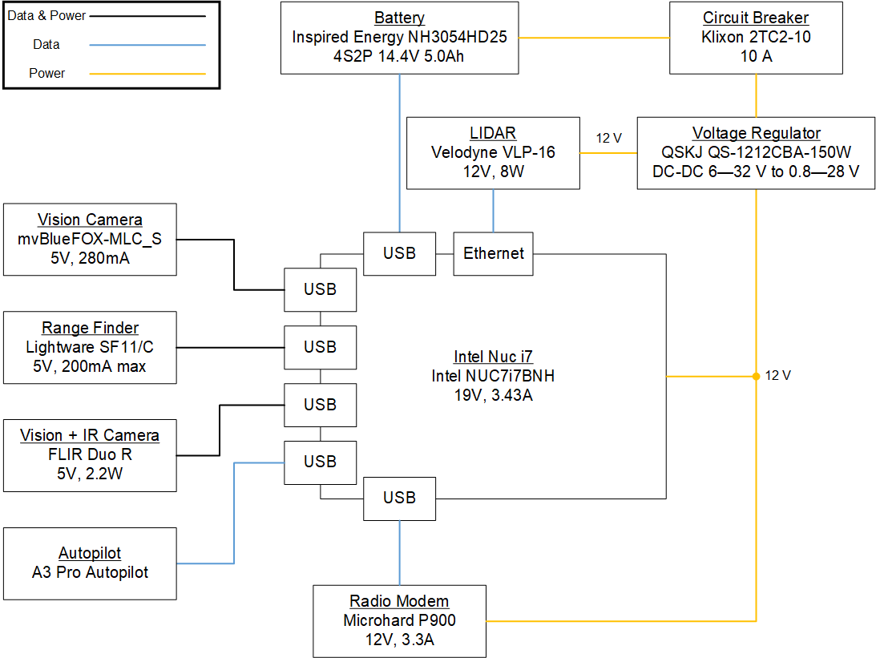
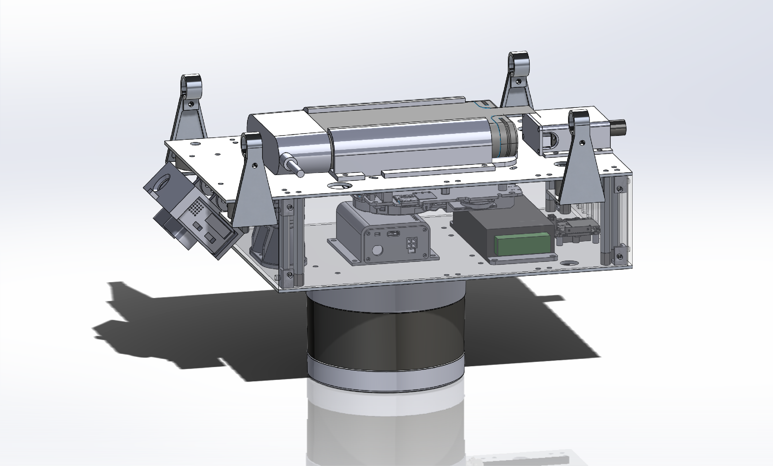
Gen 3 Payload
Gen 3 payload CAD assembly
Gen 3 payload block diagram
Notes:
The Gen 3 payload has the same autonomy components as the Gen 2.1, but adds a Vis-IR dual camera for ground risk mitigation and fire detection, a laser range finder altimeter for accurate AGL altitude, a downward facing monocular camera for safe landing clearance, and a V2V radio modem for cooperative collision avoidance. The payload data and power connections are shown in the block diagram on the right. At the time of this study, the Gen 3 payload is still in development so a CAD rendering is shown on the left instead of a physical payload. Until the Gen 3 payload is fully assembled, the Gen 3 components are tested in simulation and individual HITL tests.

Slide 8
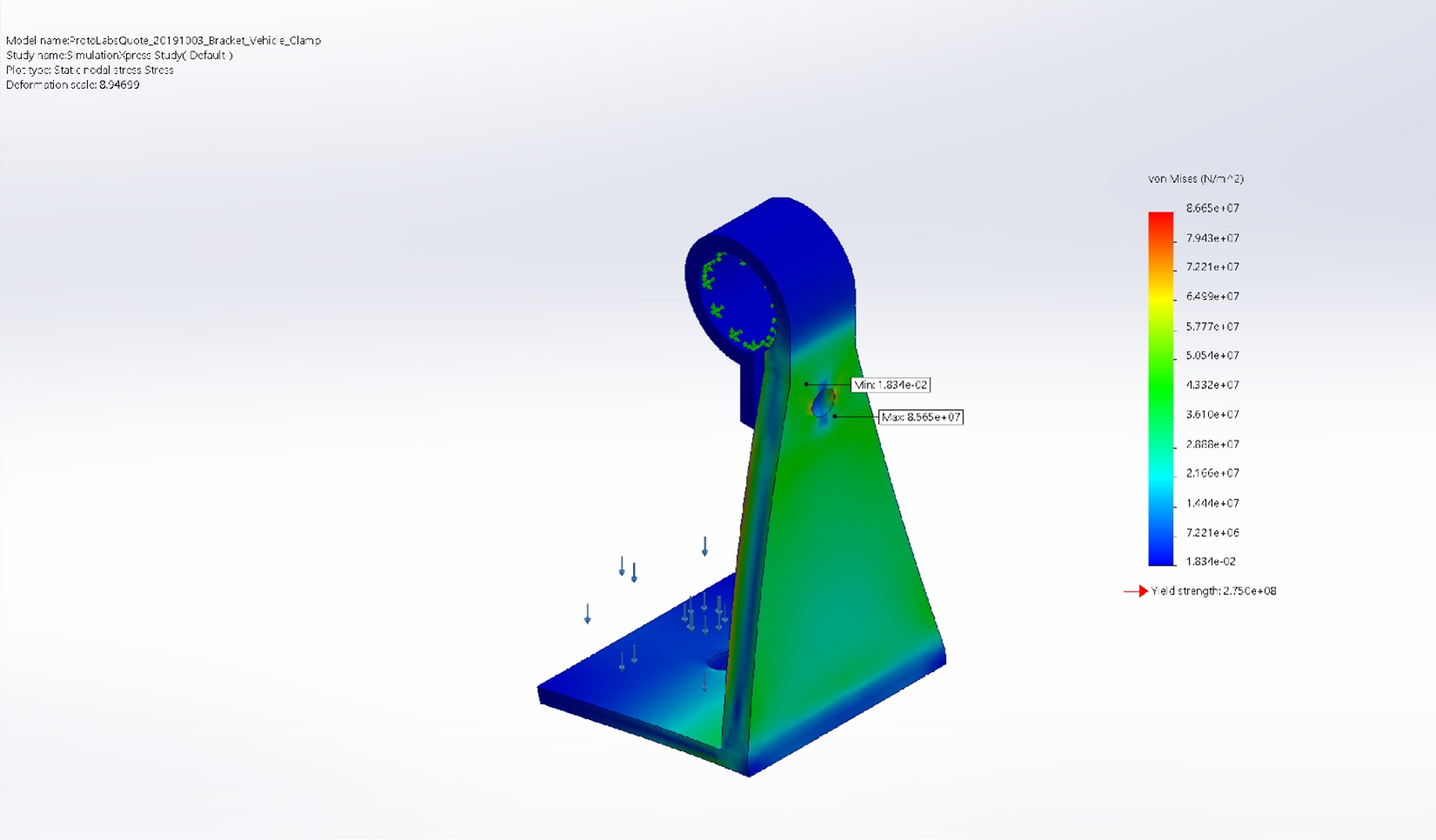
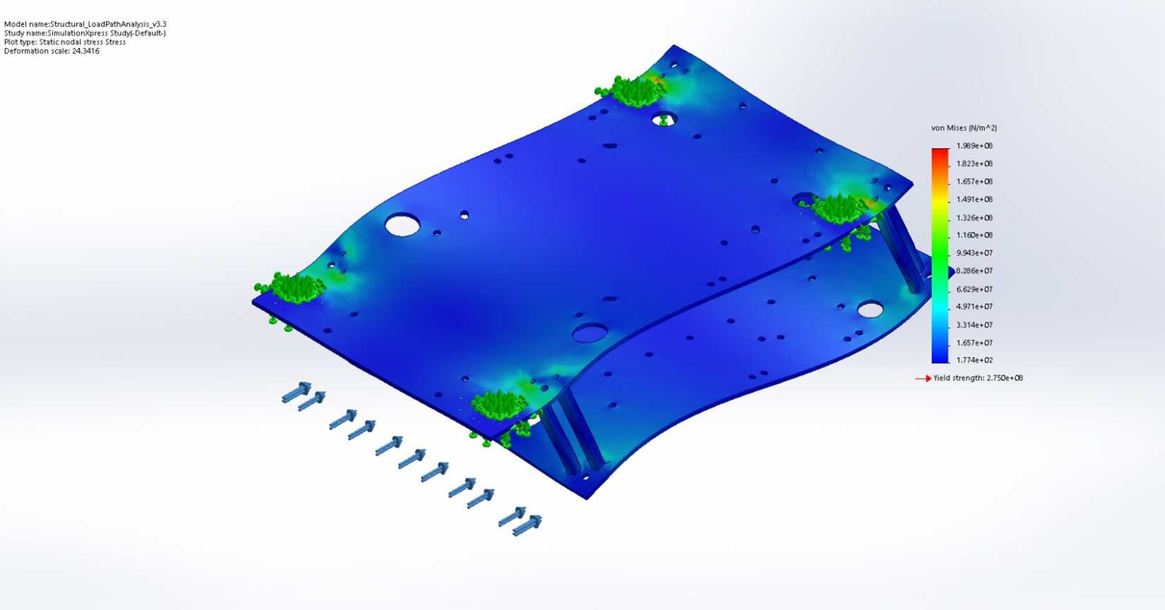
Gen 3 Payload—Stress
Gen 3 mounting rail clamp stress analysis
Fixed at clamp surface
One 67.38 N load applied
Minimum factor of safety of 3.17
Gen 3 structural frame stress analysis
Fixed at vibration damper mounts
One 269.5 N load applied
Minimum factor of safety of 1.38
Notes:
The Gen 3 payload connects to the M600 Pro payload rack via the bracket clamp shown on the left. The clamp fastens around the carbon fiber payload rack and connects to the Gen 3 payload with vibration damping sandwich mounts. The bracket clamp was machined from 6061 aluminum. The stress analysis shown uses the same 67.38 N applied load as the Gen 2.1 and results in a minimum factor of safety of 3.17.
The figure on the right shows the Gen 3 structural frame consisting of two 6061 aluminum plates connected by eight 6mm hex aluminum standoffs. The stress analysis applies the full 269.5 N load from the 5.5 kg 5G maneuver, resulting in a minimum factor of safety of 1.38. Both of these factors of safety are above the desired 1.1 factor of safety.

Slide 9
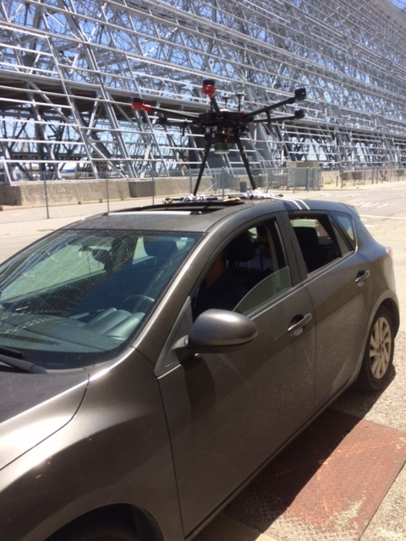
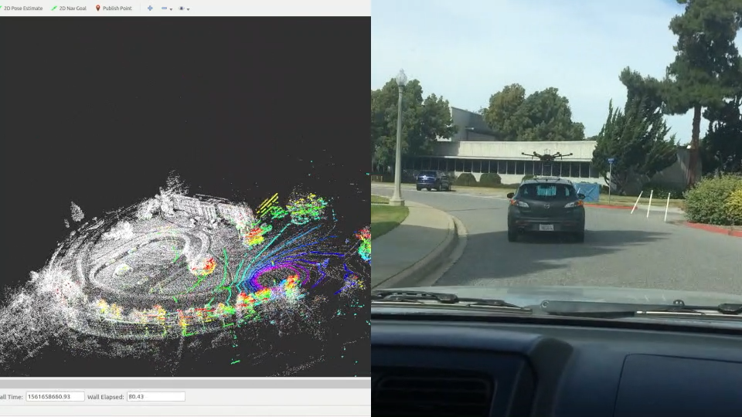
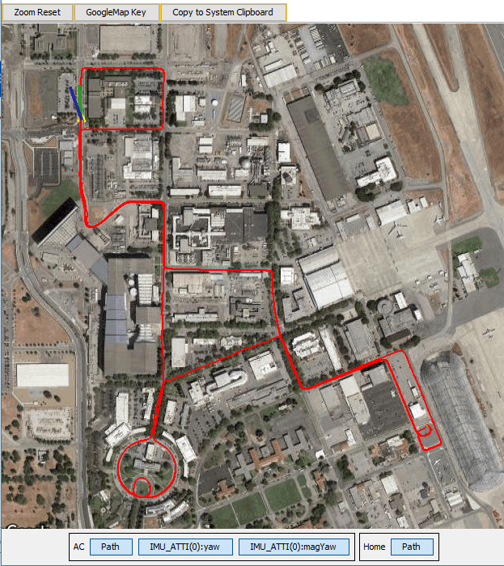
Drive Test
M600 Pro + Gen 2.1 payload mounted to car
LIDAR SLAM and follow cam
Drive path from telemetry data
Notes:
The Gen 2.1 payload’s data collection capability was testing by strapping the M600 Pro with the Gen 2.1 payload to the top of a car and driving through the NASA Ames campus. Point cloud and telemetry data were logged to build a map of Ames post-process. The figure on the left shows the payload-aircraft car setup. The video in the center shows the point cloud map with the corresponding follow-cam footage. The figure on the right shows the drive path calculated from the A3 Pro telemetry data.

Slide 10
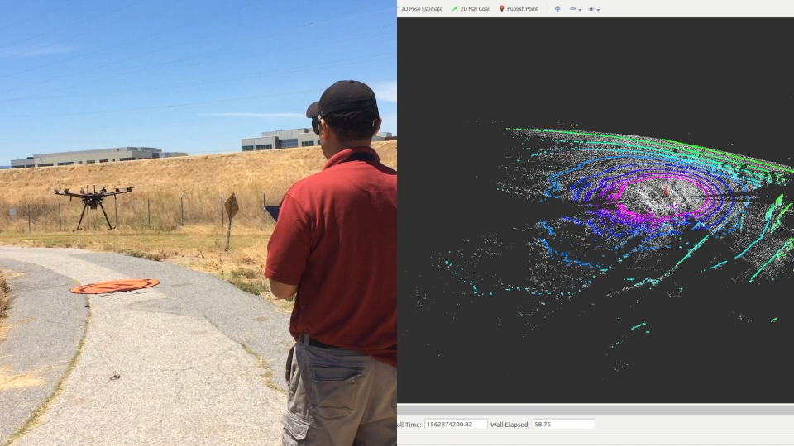
Flight Tests
Initial flight test (left)
  Controlled using DJI RC
  Gathered point cloud data
Autonomy architecture integration with DJI SDK
  Sent velocity commands to the DJI A3 autopilot
  Guided sUAS along straight path
LIDAR SLAM during flight
Notes:
The video on the left shows the initial Gen 2.1 payload flight readiness test where the M600 Pro was piloted via RC while the LIDAR collected point cloud data from the air.
Not shown is the autonomy architecture integration flight test where the Gen 2.1 payload’s onboard computer sent velocity commands to the DJI A3 autopilot via the DJI Onboard SDK. By sending velocity commands to the autopilot, we absolve the autonomy architecture from interacting with the autopilot inner loop controls. The M600 Pro was controlled to follow a straight path. The onboard path planner is capable of generating the velocity commands that are sent to the A3 to enable autonomous flight.

Slide 11
Conclusion & Future Work
Conclusion:
  Presented payloads designed to enable autonomous sUAS flight
  Payloads were designed for integration with the DJI M600 Pro
  Autonomy components build off past SAFE50 simulation work
  Gen 2.1 payload demonstrated flight readiness
  Gen 3 payload is still in development
Future work:
  Leveraging UTM infrastructure for airspace allocation
  Demonstrating global and local path planning
  Airborne fire detection and tracking
  V2V communication tests with cooperative sUAS
Notes:
In conclusion, we have presented two payload designs that work towards enabling autonomous sUAS flight in UTM TCL4+ and STEReO using the DJI M600 Pro as the testing platform. The payloads build off of autonomy components that have been tested in simulation and past flight tests. The Gen 2.1 payload has demonstrated flight readiness through data collection and autonomy architecture integration flight tests. The Gen 3 payload components have individually been tested and are currently being integrated.
Future work includes flights leveraging the UTM infrastructure, demonstrating global and local path planning, detecting and tracking fire edges, and V2V communication with cooperative sUAS

Slide 12


Questions?

