Slide 1
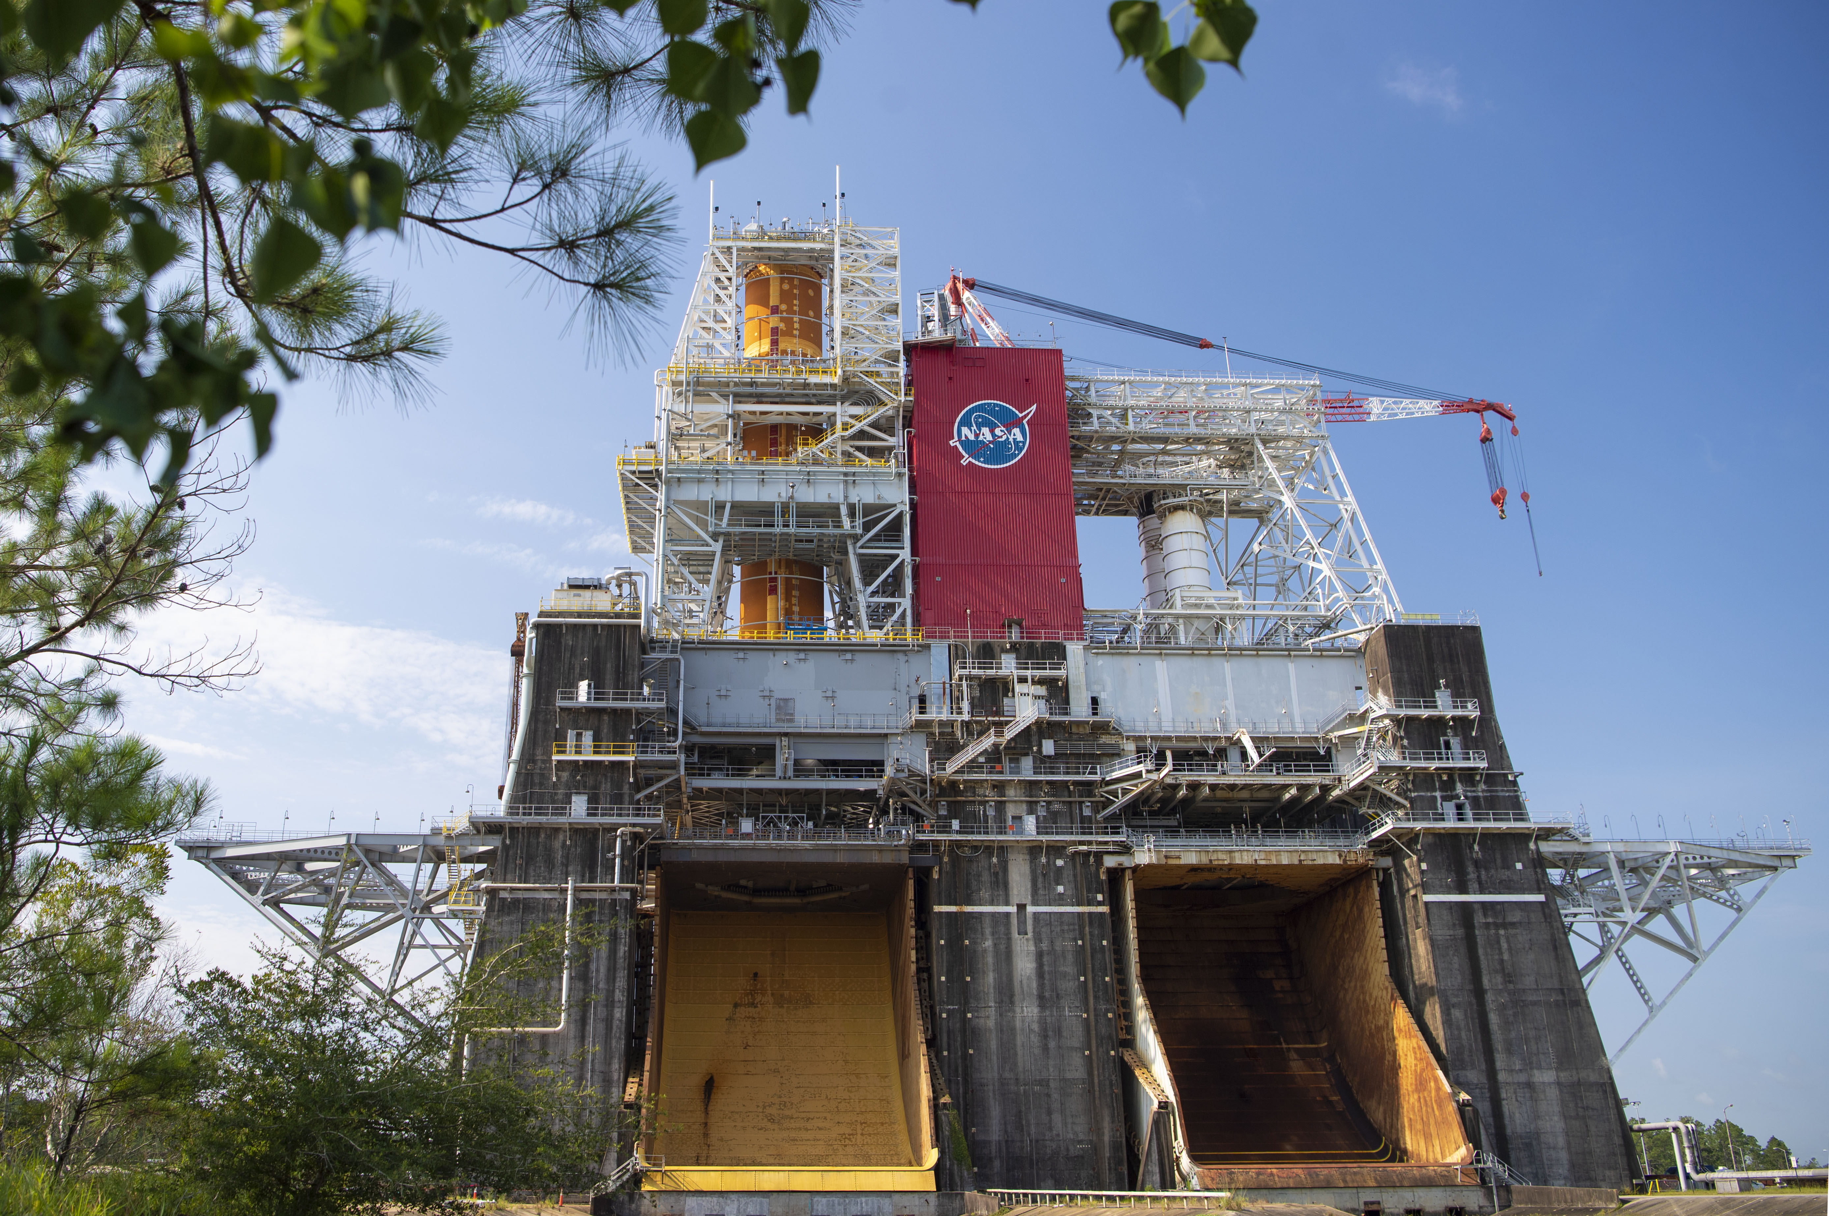

Fall 2020 - Rocket Propulsion Test Design and Analysis
By: John Paul Ortiz Mentor: Dr. Armando Delgado
Stennis Space Center
Engineering and Test Directorate, EA32
Source: NASA Image and Video Library

Slide 2
Private Rocket Engine Database
Abstract
Stennis Space Center
As the small satellite launch vehicle (SSLV) market grows and NASA continues to prepare for upcoming missions in the Artemis program, John C. Stennis Space Center’s (SSC) testing facilities must adapt to the increasing demand in liquid rocket engine testing. The Rocket Propulsion Test Design and Analysis Project for this rotation focused in both of this areas through two separate subprojects, the creation of a Private Rocket Engine Database and the automatization of the A1-Set Point Prediction Model. To identify the testing requirements of future Stennis Space Center (SSC) costumers, an excel spread sheet was commissioned as a database to collect technical and non-technical features of over one hundred privately developed liquid and hybrid rocket engine. Similarly, The A-1 Set Point Sheet Model is used to satisfy Aerojet Rocketdyne’s testing requirements of Net Positive Suction Pressure (NPSP) for the RS-25 staged combustion cycle engine. To expand the capabilities of this prediction model, a feed back loop was programmed to automate the search of setpoints using Excel Visual Basic for Applications (VBA).

Slide 3
Rocket Propulsion Test Design and Analysis
Overview
Stennis Space Center
Rocket Propulsion Test Design and Analysis
Private Rocket Engine Database
  Overview
  Spreadsheet Contents
  Data tab
  Acronyms tab
  Analysis
  Rev History Tab
Automation of Set Point Sheet Prediction Model
  Overview
  Data Flow of Prediction Model
  Automation Approach
  Closed Loop
  Future Work

Slide 4
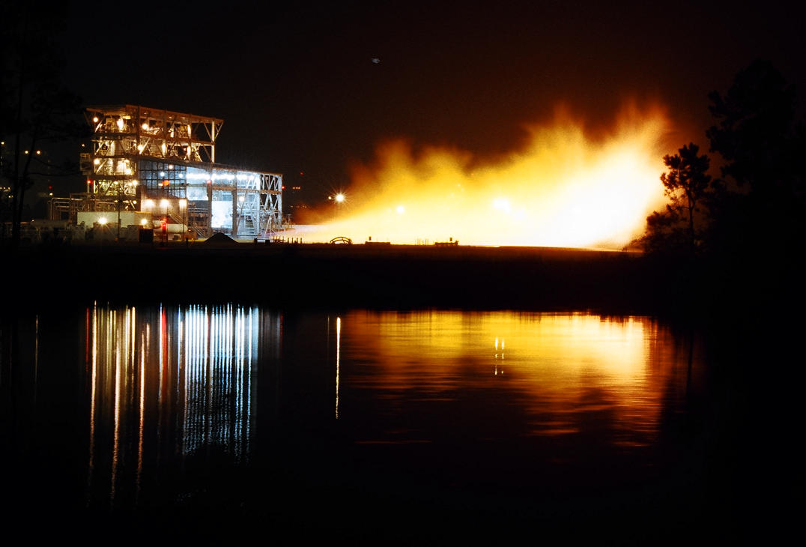
Source: NASA Image and Video Library
PRE SHEET
Private Rocket Engine Data Base
Stennis Space Center
October 1, 2020
By John Paul Ortiz
Engineering and Test Directorate, EA32

Slide 5
Private Rocket Engine Database
Overview
Stennis Space Center
The PRE Sheet is an updatable databased of Liquid/Hybrid Rocket Engines privately developed in the last ten year from public available information.
The objective of this database is to provide a source of rapid access for analysis of the private rocket engine market for the development of new testing facilities to accommodate future market needs.
The Database consist of Excel Spread Sheet with a list of engines with key features of the engine development and testing campaigns including technical and non-technical attributes.

Slide 6
Private Rocket Engine Database
PRE Sheet - Content
Stennis Space Center
The PRE Sheet is divided into four different excel tabs:
PRE Sheet
Acronyms:
Describes the
meaning of each
acronym used in
Data tab.
Data:
Contains a filterable database table with all engines and their corresponding key features.
Metrics:
Plots thrust of engines in Database table in selected order.
Rev History:
Database Revision
and Modification
history log.
Figure 1. PRE subroutines

Slide 7
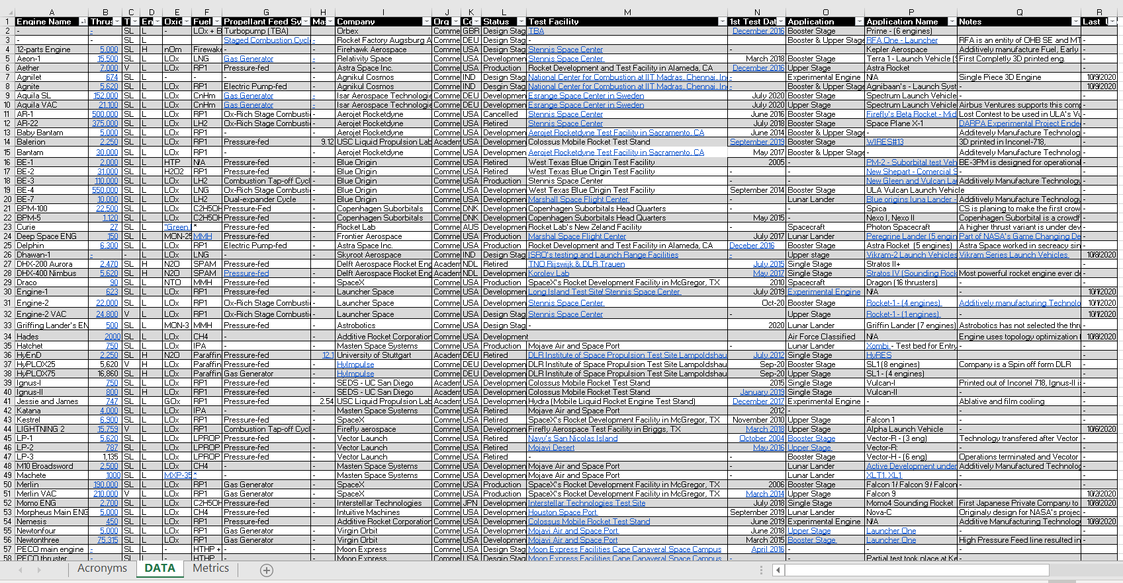
Private Rocket Engine Database
Data Tab - Overview
Stennis Space Center
The Database holds an expandable list of over 100 different engines in an Excel’s Table.
The Database resides in the
Data tab of the PRE Sheet.
Each row is an “Engine Data Point”.
Each column is a feature of the
each engine.
Underline-Blue text holds the
link to the reference the data
was retrieve from.
Figure 2. Snapshot of Engine Database

Slide 8
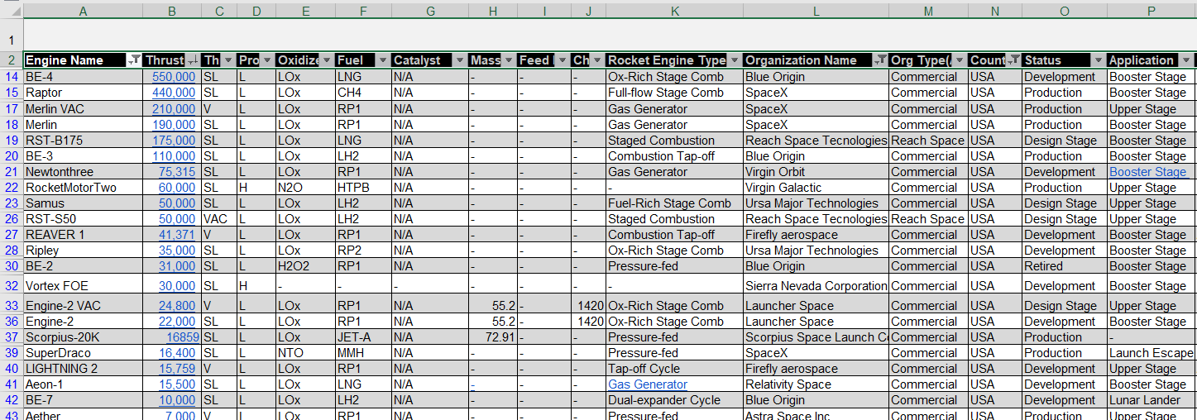
Private Rocket Engine Database
Data Tab - Features
Stennis Space Center
Each “Engine Data Point” point has 24 different engine features, each corresponding to a column of the Excel Table found on the DATA tab:
Figure 3. Zoom in Engine Database 1

Slide 9
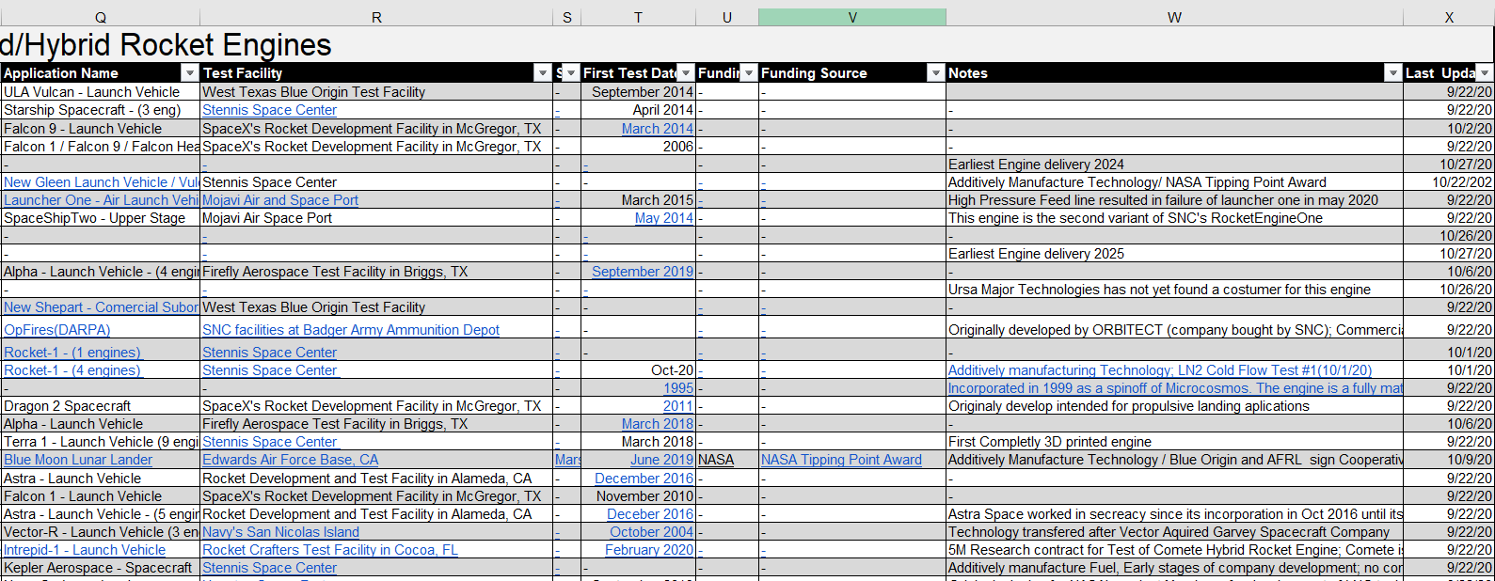
Private Rocket Engine Database
Data Tab - Features
Stennis Space Center
Each “Engine Data Point” point has 24 different engine features, each corresponding to a column of the Excel Table found on the DATA tab:
Figure 4. Snapshot of Engine Data Base 2

Slide 10
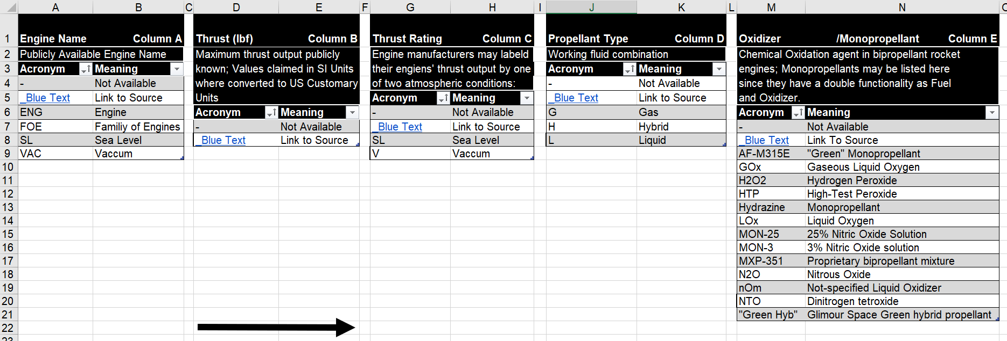
Private Rocket Engine Database
Acronyms Tab - Overview
Stennis Space Center
Detailed Description of each engine feature
Each acronym is stored in a table corresponding with the name of the features the acronyms is on the database:
Figure 5. Snapshot of Acronyms Tab

Slide 11
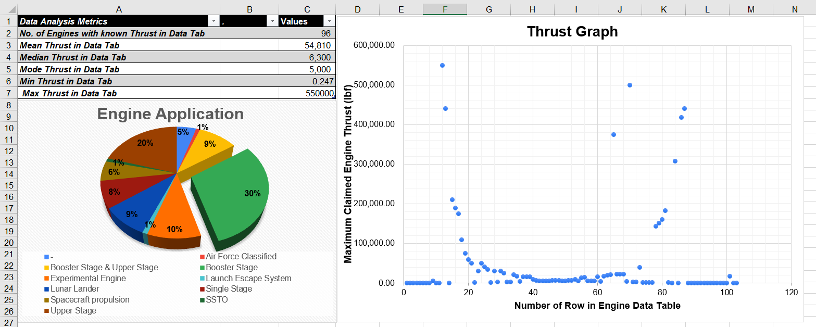
Private Rocket Engine Database
Analysis Tab - Overview
Stennis Space Center
Analyses and displays metrics of adjustable subsets of database
Plots Engine Thrust as a function of selected criteria through filtered tables
Displays Application distribution of all engines in database
Figure 6. Snapshot of Metrics Tab

Slide 12
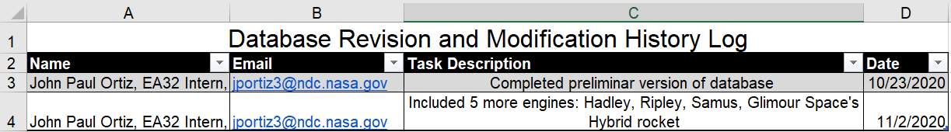
Private Rocket Engine Database
Rev History Tab - Overview
Stennis Space Center
Database Modification and History log to track updates, correct errors and contract contributors.
Figure 7. Snapshot of Rev History Tab
Results:
Over 70 percent of engines investigated have a thrust output lower than 80, 000 lbf
A trend for the development of LCH4-LOX Engines is rising.
Additive manufacturing technology is growing in the production of turbomachinery and thrust chambers.

Slide 13
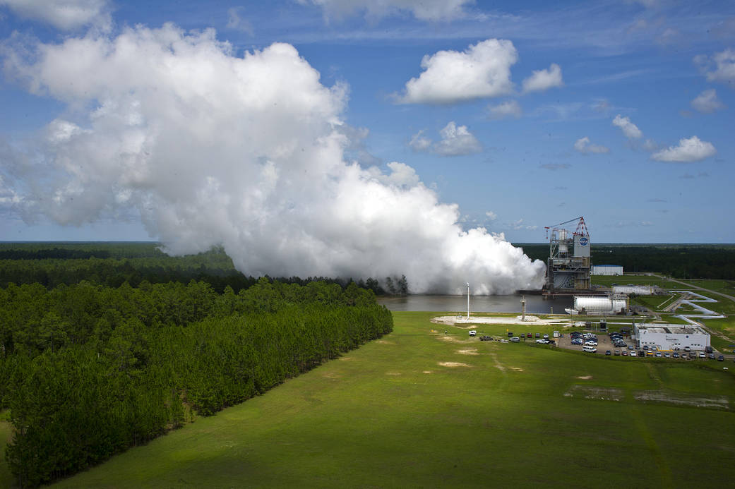
Source: NASA Image and Video Library
A1 Set Point Sheet
Autonomation of Set Point Prediction Model
Stennis Space Center
December 12, 2020
By John Paul Ortiz
Engineering and Test Directorate, EA32

Slide 14
Autonomation of Set Point Prediction Model
A-1 Set Point Sheet - Overview
Stennis Space Center
The A-1 Set Point Sheet is a predictive model which calculates LOX and LH2 engine inlet Net Positive Suction Pressure (NPSP).
The objective of this Prediction model is to facilitate the estimation of the Set Point Values to satisfy the test requirements of RS-25 engines tests in test stand A-1.
Internally, the spreadsheet uses a combination of past test data, flow simulations, pump curves, and thermodynamic and fluid mechanic equations to calculate the predicted NPSP.

Slide 15
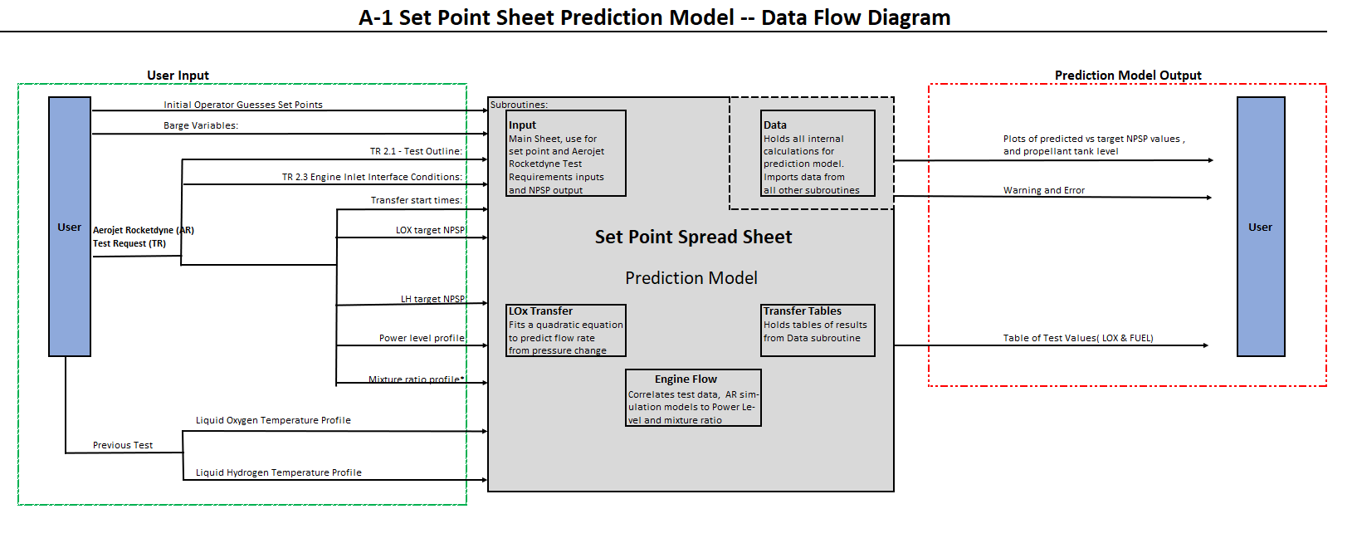
Autonomation of Set Point Prediction Model
A-1 Set Point Spread Sheet - Diagram
Stennis Space Center
Control Variable: Tank Bottom Pressure -> Set Points
Model Output: Net Positive Suction Pressure (NPSP)
Figure 8. Set Point Prediction Model Diagram

Slide 16
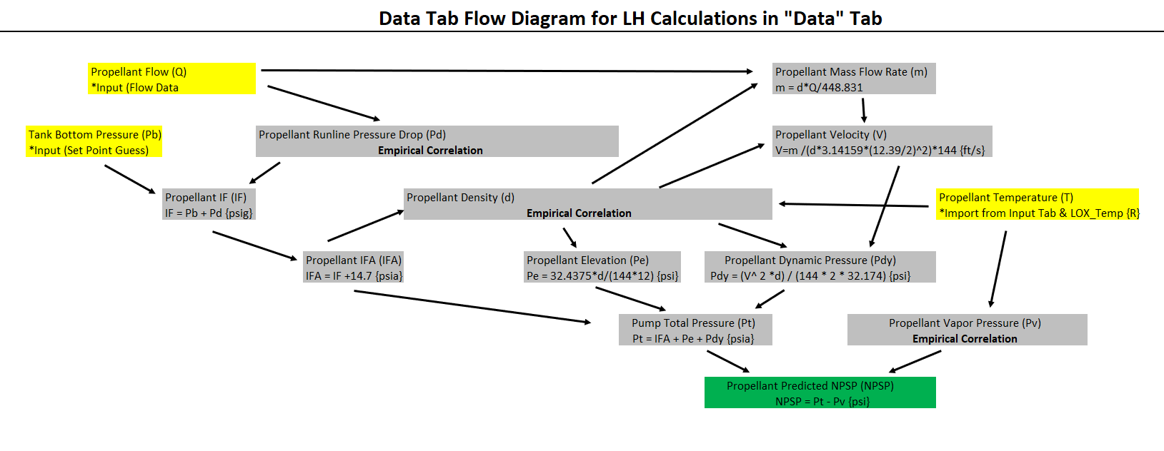
Autonomation of Set Point Prediction Model
NPSP as a function of Tank Bottom Pressure
Stennis Space Center
Net Positive Suction Pressure (NPSP) is a function of three independent variables(Q,T, Pb)
Only Tank bottom Pressure, Pb, can be control to adjust NPSP
At any time, t:
* Q(test requirements)
* T(ground support eq)
* Pb(Control Valves)
Figure 9. Data Subroutine Diagram

Slide 17
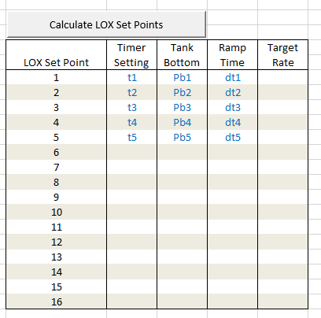
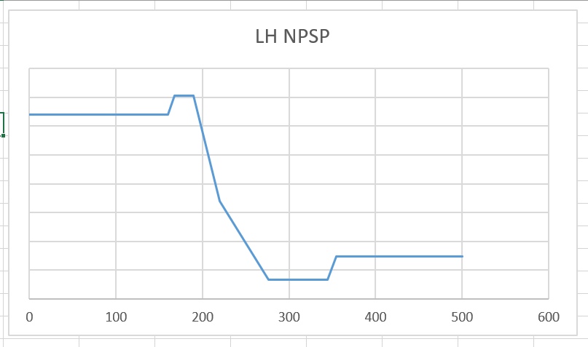
Autonomation of Set Point Prediction Model
Input Set Points
Stennis Space Center
Even though time bottom pressure is an independent degree of freedom, it is only adjustable at discrete times with finite valve opening rates.
Valves in the bottom of the propellant tanks are adjust through the duration of an engine test, these adjustments in valve exit pressure are know as Set Points.
Figure 10. Set Point Control Table and Target NPSP

Slide 18
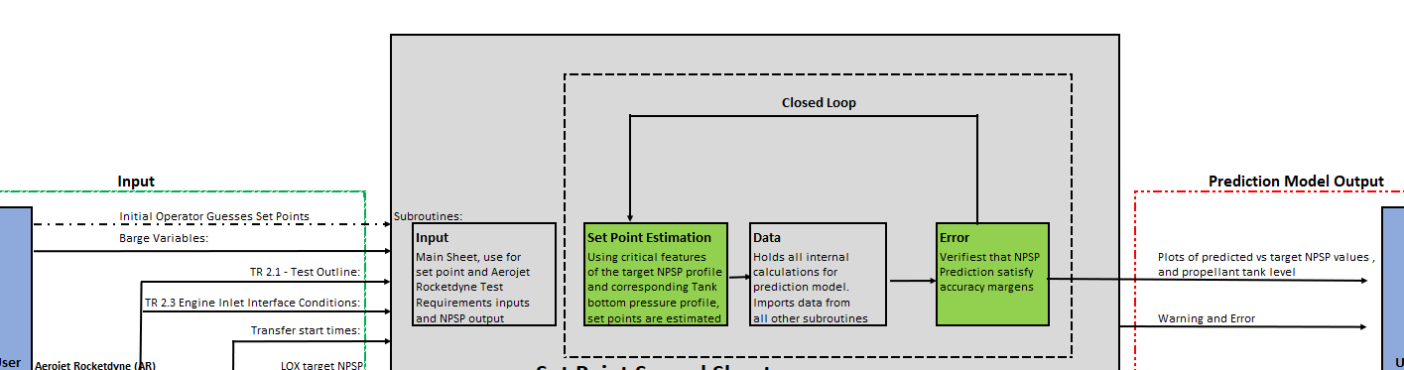
Autonomation of Set Point Prediction Model
Closed Loop - Overview
Stennis Space Center
Instead of using an iterative, trail-and-error process to estimate the Set Points that converge the Predicted NPSP to the target NPSP, a system approach is implemented through an add-on tab in the prediction model named Closed Loop.
Closed Loop does not required Initial Operator Guesses.
Figure 10. Set Point Prediction Model Diagram with Closed Loop

Slide 19
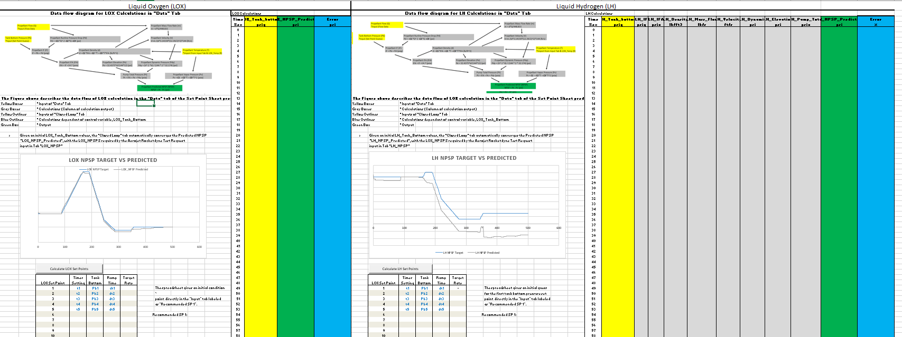
Autonomation of Set Point Prediction Model
Closed Loop – Graphical User Interphase
Stennis Space Center
The Closed Loop procedure was program in a stand alone VBA Macro, and can be executed through a graphical user interphase in the newly added Closed Loop tab.
No changes were made to any other tab in the Set Point Sheet.
Figure 11. Closed Loop Tab Graphical User Interphase (Data hidden)

Slide 20
Autonomation of Set Point Prediction Model
Closed Loop – Algorithm
Stennis Space Center
Check Propellant Type (LOX/LH)
Read Target NPSP, Flow rate and Temperature & determine Avg NPSP
Make Tank Bottom Pressure equal to Target NPSPS
Estimate Setpoints from Tank Bottom Pressure
Convert Setpoints, Target Tank Bottom Pressure and Temperature to time domain
Evaluate NPSP using prediction model from t = 0 to t = test duration
Evaluate Error between NPSP target and NPSP predicted for inflection points
If Error > 0.01*Avg NPSP; Apply differential optimization for Tank Bottom Pressure and return to step 6
Else; exit
10. Estimate Setpoint from Tank Bottom Pressure
11. Write Setpoints to Tank Bottom Pressure

Slide 21
Rocket Propulsion Test Design and Analysis
Future Work
Stennis Space Center
Private Rocket Engine Database
  Update rocket engines development stage and testing
  Include more tools for analysis
  Include engine development and testing campaign funding Source
  Change Analysis tasks to work using VBA Macros.
Autonomation of Setpoint prediction model
  Add setpoints for segments give with different NPSPS rates
  Validate Closed Loop performance against 1034, 1036, 1037, and 1039 tests.
  Completely closed the loop by eliminating the operating executions bottom
  Shift to an object oriented approach
  Apply an alternative optimization approach

Slide 22
Rocket Propulsion Test Design and Analysis
Acknowledgments
Stennis Space Center
Engineering and Test Directorate, EA32 :
  Armando Delgado, SSC
  Thomas E. Jackson
University Space Research Association, USRA:
  Charity C. Potter, SSC
  Mitch, Krell, SSC
  Kelsey H. Bickett, MSF/SSC

