Slide 1

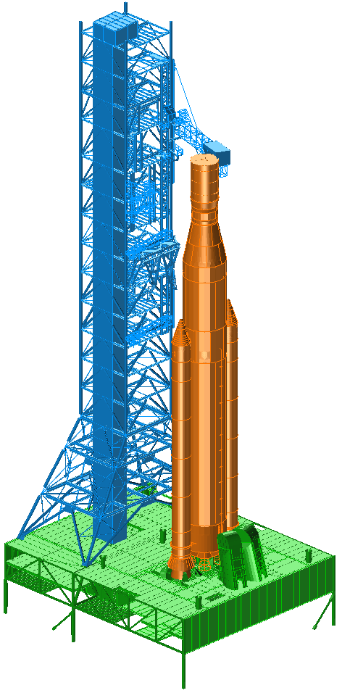
SLS Integrated Modal Test Uncertainty Quantification using the Hybrid Parametric Variation Method
IMAC-XXXIX
2021 (10482)
Daniel Kammer
Paul Blelloch
Joel Sills
February 8-11, 2021

Slide 2
Goals of IMT UQ Analysis
Develop uncertainty models for each IMT component based on component modal test results.
Use Hybrid Parametric Variation (HPV) method to propagate component uncertainty into system level results.
Predict uncertainty that can be expected in IMT target mode shapes and frequencies.
Predict uncertainty in frequency response.
Compute probability that IMT target modes will be sufficiently excited and separated by sensor/shaker configuration.

Slide 3
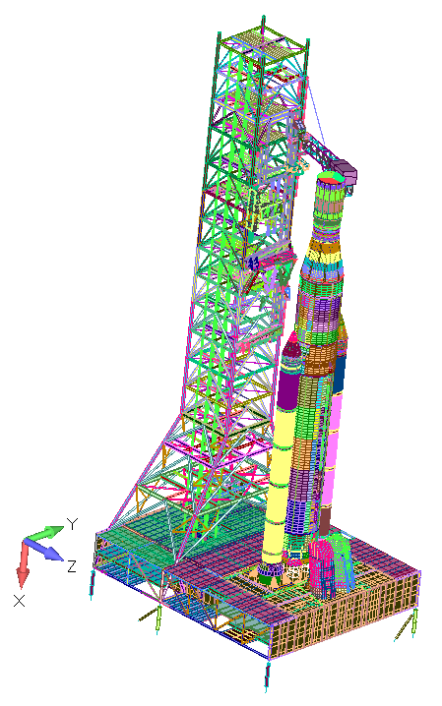
IMT Components used in UQ Analysis
IMT FEM on Vehicle Assembly Building (VAB) supports divided into components and reduced to Hurty-Craig/Bampton (HCB) representations, component modes to 15Hz:
MSO - Mass Simulator for Orion
ICPS/LVSA - Interim Cryogenic Propulsion Stage / Launch Vehicle Stage Adapter
CS - Core Stage
LSRB - Left Solid Rocket Booster
RSRB - Right Solid Rocket Booster
ML - Mobile Launcher

Slide 4


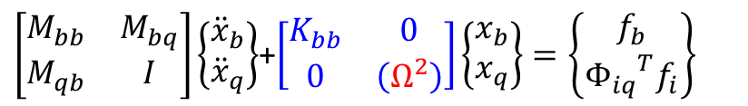
Basis for HCB Component Uncertainty Model
Select HCB component dispersion values:
Fixed-interface eigenvalues - Gaussian Process Model - “Parametric”
HCB stiffness matrix - Wishart (ME) - Non-parametric
Basis:
Engineering judgment.
Past test results and experience.
SLS integrated system component test-analysis correlations results.
Can preserve:
Rigid body mass
Rigid body motion
Slosh modes
$\left[\begin{matrix}M_{bb} & M_{bq} \\ M_{qb} & I\end{matrix}\right]\left\{\begin{matrix}{\ddot{x}}_{b} \\ {\ddot{x}}_{q}\end{matrix}\right\}$+$\left[\begin{matrix}K_{bb} & 0 \\ 0 & \left(Ω^{2}\right)\end{matrix}\right]\left\{\begin{matrix}x_{b} \\ x_{q}\end{matrix}\right\}=\left\{\begin{matrix}f_{b} \\ {Φ_{iq}}^{T}f_{i}\end{matrix}\right\}$

Slide 5
Two Step Process for Identifying HCB Uncertainty
Never a 1-to-1 correspondence between test and flight configurations,
but assume level of modal correlation is comparable.
Identify HCB fixed-interface (FI) frequency uncertainties
  Use Modal Effective Mass (MEM) to put HCB FI modes in uncertainty bins.
  Use mode descriptions to directly match test configuration frequency errors to HCB mode uncertainties.
2. Apply assigned FI frequency uncertainty dispersion.
  Identify stiffness matrix dispersion – based on:
  DCGM = rms (diagonal T/A X-Ortho matrix)
  Sweep over stiffness dispersion values to get best fit of test value.

Slide 6
IMT Component Uncertainty Models based on Component Test Results
IMT system uncertainty model
Component | Uncertainty Level | Assigned HCB FI Freq Dispersion % | Stiffness Dispersion % | Normalized Stiffness Dispersion %
MSO | Updated | Modes: 3.91, 2.42; RVs: 3.83 | 21 | 3.11
ICPS/LVSA | Updated | 3-Bins: 2.02, 4.72, 1.95 | 15 | 1.78
FRAC CS | Updated | Table 5.2‑6 | 8.5 | 0.88
LSRB | Updated | 3-Bins: 2.02, 4.72, 1.95 | 2.5 | 0.75
RSRB | Updated | 3-Bins: 2.02, 4.72, 1.95 | 2.5 | 0.75
ML | Updated | Table 5.5-3 | 4 | 1.16
HCB FI eigenvalues represented using Gaussian Process Modeling (GPM) – correlation based on Euclidean distance
Component T/A eigenvalue error assigned as standard deviations in GPM
Mixed-boundary approach used on ICPS/LVSA (fixed-base), CS (free-free), ML (fixed-base)

Slide 7
22 IMT Primary Target Modes
No. | Mode | Description
1 | 1 | SLS Rocking XZ Plane
2 | 2 | ML Tower 1st Bending XZ Plane
3 | 3 | SLS 1st XY Bending
4 | 4 | ML Tower 1st Bending XY Plane
5 | 6 | Core 1st Torsion
6 | 7 | SLS 1st XZ Bending
7 | 8 | SLS 2nd XZ Bending
8 | 9 | SLS 2nd XY Bending
9 | 10 | SRB 1st Bending
10 | 11 | SLS 3rd XY Bending
11 | 12 | ML Tower Torsion
12 | 13 | ML Tower 2nd XZ Bending
13 | 14 | ML Tower/SLS 2nd XY Bending
14 | 15 | ML Trampoline
15 | 16 | CAA Vertical/SLS Bending
16 | 17 | CAA Vertical/SLS Bending
17 | 18 | CAA Vertical
18 | 19 | ML Twisting/Tower Torsion
19 | 21 | SLS 2nd Torsion
20 | 22 | ML Tower Bounce/3rd Bending
21 | 23 | ML Tower 3rd XZ Bending
22 | 27 | SRB 2nd XY Bending/CAA lateral

Slide 8
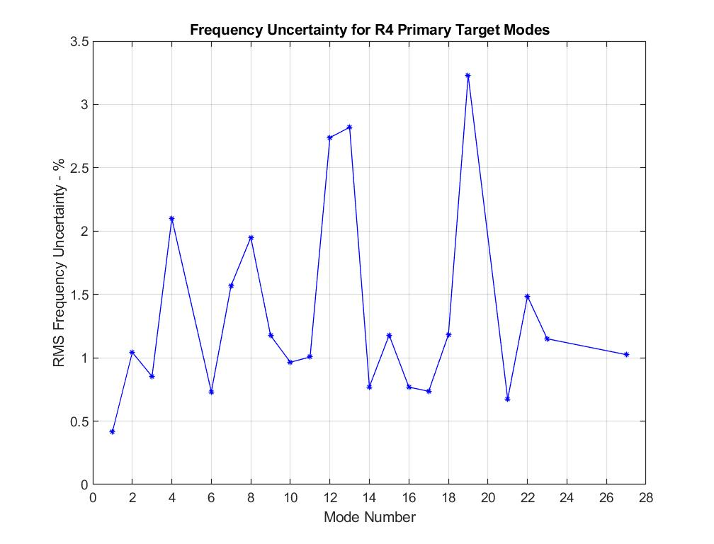
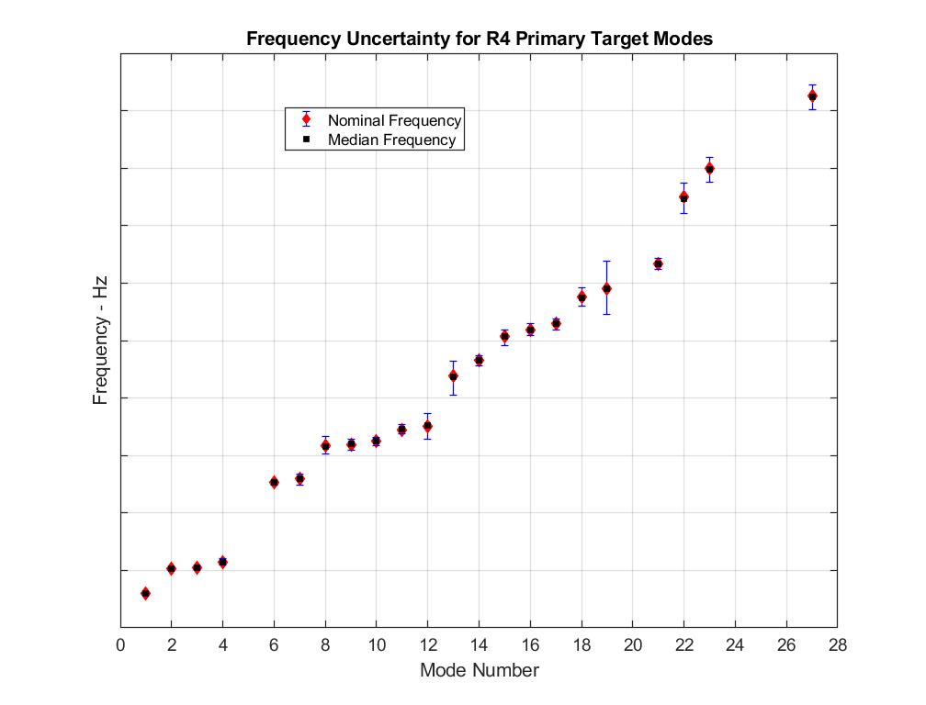
IMT Target Mode Frequency Uncertainty
10,015 Ensemble Members
RMS Frequency Uncertainty
P98/90 Enclosure Intervals
ML Twisting/Tower Torsion
Greatest RMS frequency uncertainty 3.23% in mode 19.

Slide 9
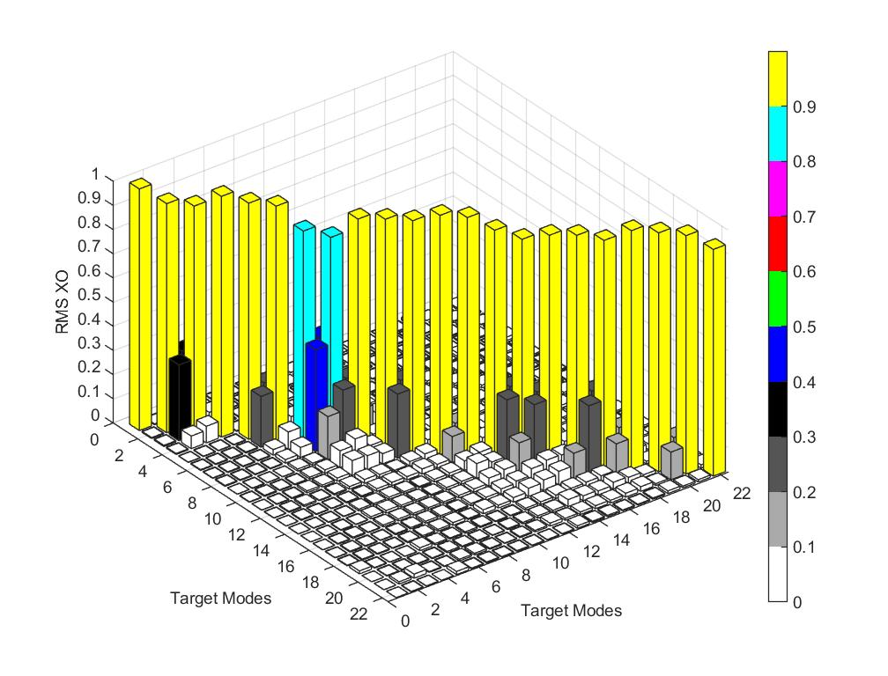
IMT Target Mode Shape Uncertainty
RMS Cross-Orthogonality
20 modes with RMS XO > 0.90

Slide 10
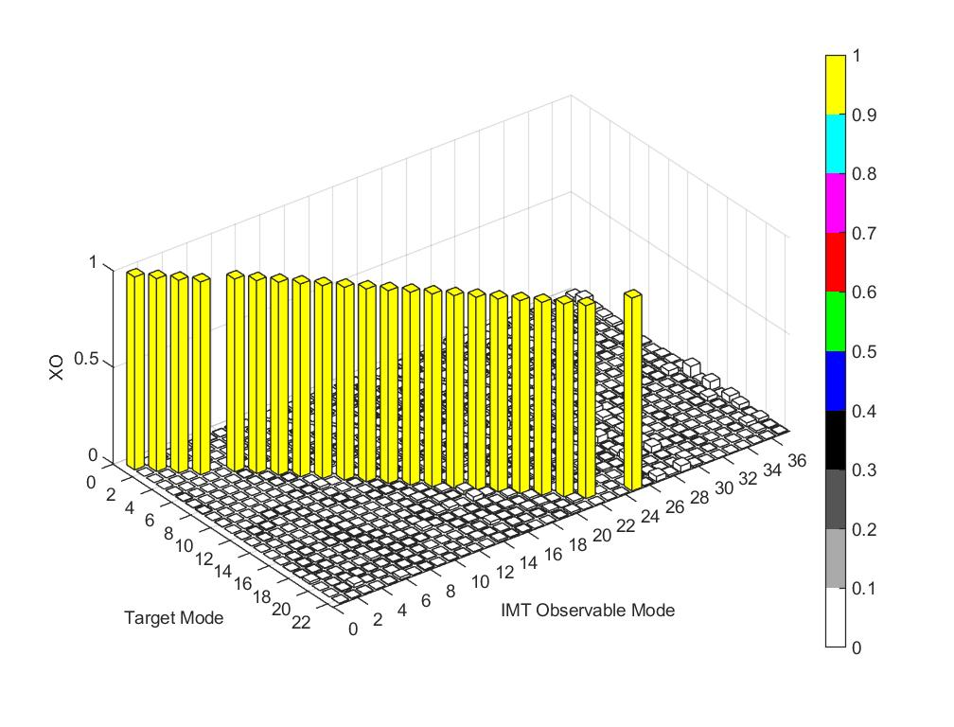
XO Between Target Modes and First 37
Observable Modes
IMT modes 20, 24, and 32 are not observable with 195 sensor configuration
Sensor configuration produces decoupled target modes

Slide 11
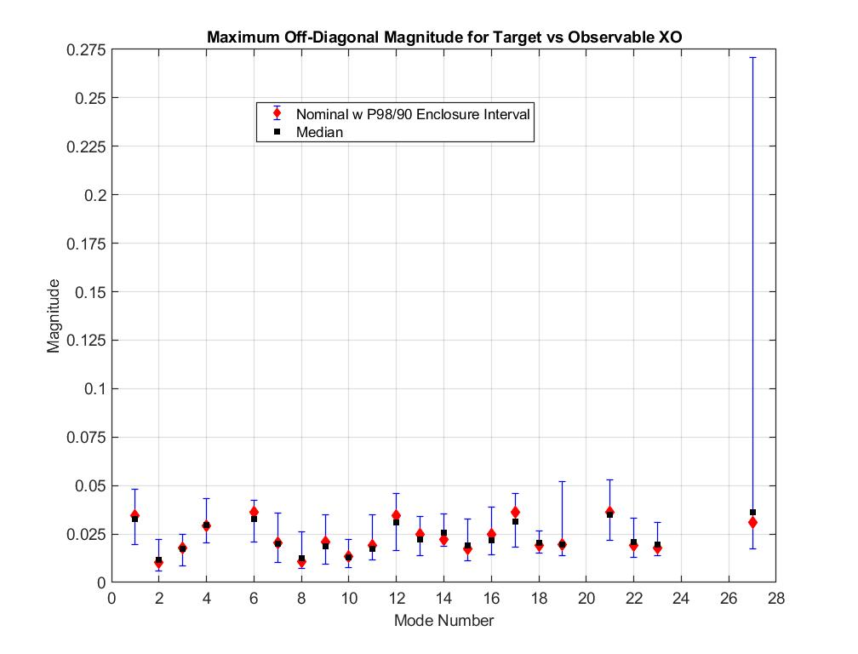
Maximum Off-Diagonal Statistics for XO Between Target Modes and First 37 Observable Modes
92% probability maximum OD < 0.10 for mode 27

Slide 12
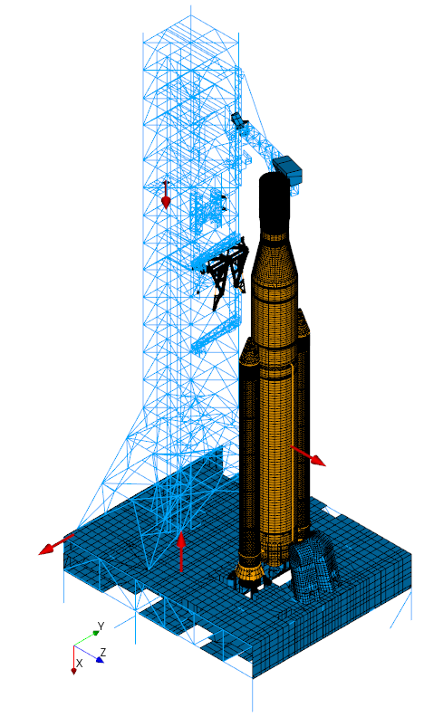
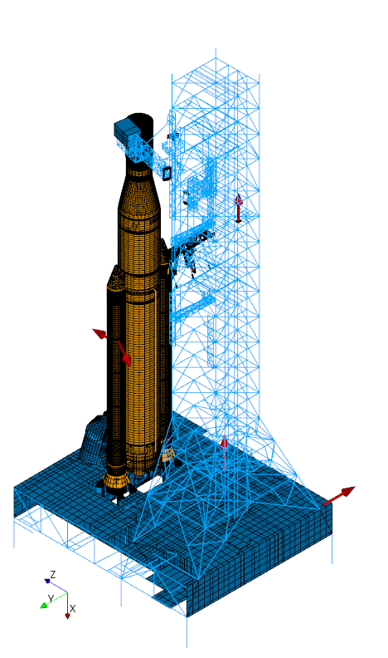
Simulate Acceleration Frequency Response to Shaker Input
1% modal damping
Modes to 16 Hz.
7 shakers – IMT R4
195 accelerometers
Shakers S32 and S40 on ML zero deck not shown
S38
S38
S36
S35
S36
S50
S51
S51
S50

Slide 13
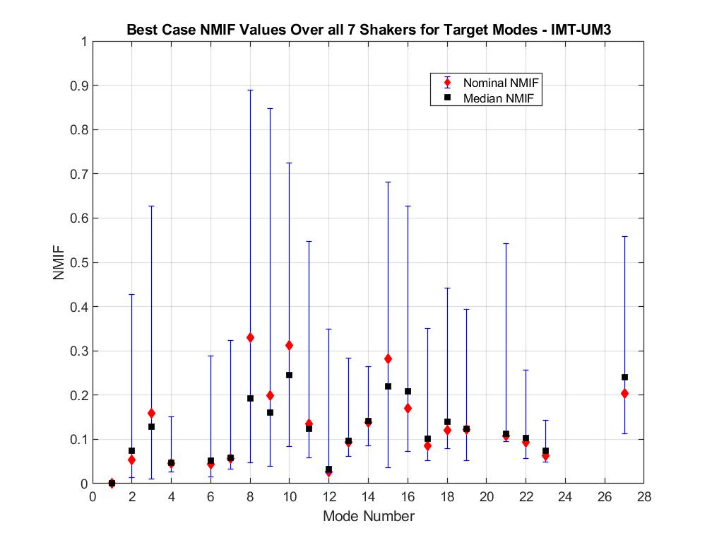
Uncertainty in Normal Mode Indicator Functions
Minimum Values over all Shakers
7 shakers sufficiently excite 20 of 22 target modes in nominal case, all target modes sufficiently excited with 50% probability - NMIF ≤ 0.30

Slide 14
Conclusions
There is high probability and confidence that the first 21 target modes can be separated from the observable modes, and a significant probability that target mode 27 can also be separated during the IMT.
There is at least a 50% probability that NMIF < 0.30 for all 22 target modes during the IMT.
An accurate ML model will facilitate the success of the IMT.

