Slide 1
Comparing Deep Neural Network Architectures using Transfer-Learning to Predict Cognitive States
Mudit Paliwal, Victoria Rodrigues, Nicholas J. Napoli,
Industrial and Systems Engineering, University of Florida, Gainesville, FL, 32611, USA
Angela R. Harrivel, Kellie D. Kennedy, and Chad L. Stephens
NASA Langley Research Center, Hampton, VA 23681
AIAA SciTech 2021

Slide 2
Contents
Introduction
Prior Work
Challenges and Insights
Data Collection and Methodology
Research Questions
Results

Slide 3

Introduction
Cognitive State – State of Mind
Cognitive states are not directly measurable, but can be inferred through physiological and behavioral data such as -
  Eye movement - Eye Tracking
  Brain Waves - Electroencephalography (EEG)
  Heart Dynamics - Electrocardiogram (ECG)
  Galvanic Skin Response(GSR)
But why do we need to study cognitive states ?
Objectively evaluate Human-Machine Interaction and assess associated workload
Learn what the human does for safety and inform models of human strategies for handling risk
Allocate functions dynamically in Human-Autonomy Teams for optimally safe and efficient operations, to let an 80/20 or 50/50 system know “what the human is doing now.” (LAR-19051, Provisional patent application filed, https://technology.nasa.gov/patent/LAR-TOPS-301)
Model and scale emerging operators’ impact for realistic future urban and NAS simulations
The ability to understand and measure cognitive states and their underlying physiological correlates can improve training for vehicle operators and pilots.

Slide 4
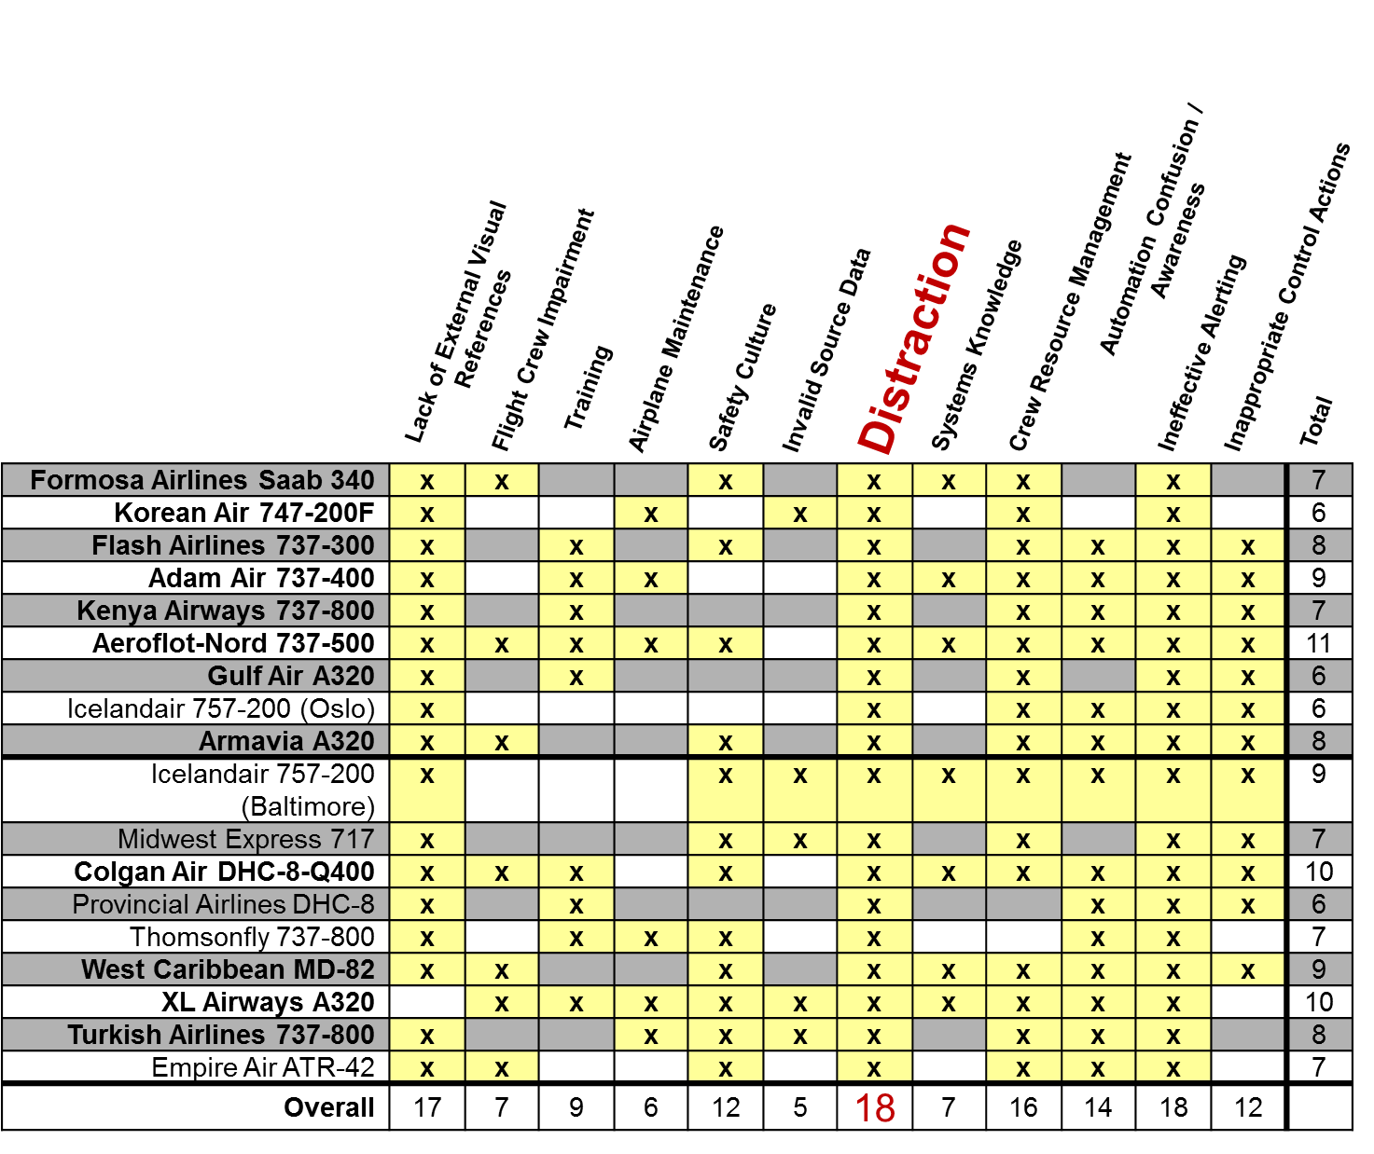
Introduction- Commercial Aviation Safety Team Report
CAST
Airplane State Awareness Joint Safety Analysis Team Report 2014
Commercial Aviation Safety Team, “Airplane State Awareness (ASA) Joint Safety Analysis Team (JSAT) Report,” 6-17-2014, http://skybrary.aero/bookshelf/content/bookDetails.php?bookId=2999

Slide 5
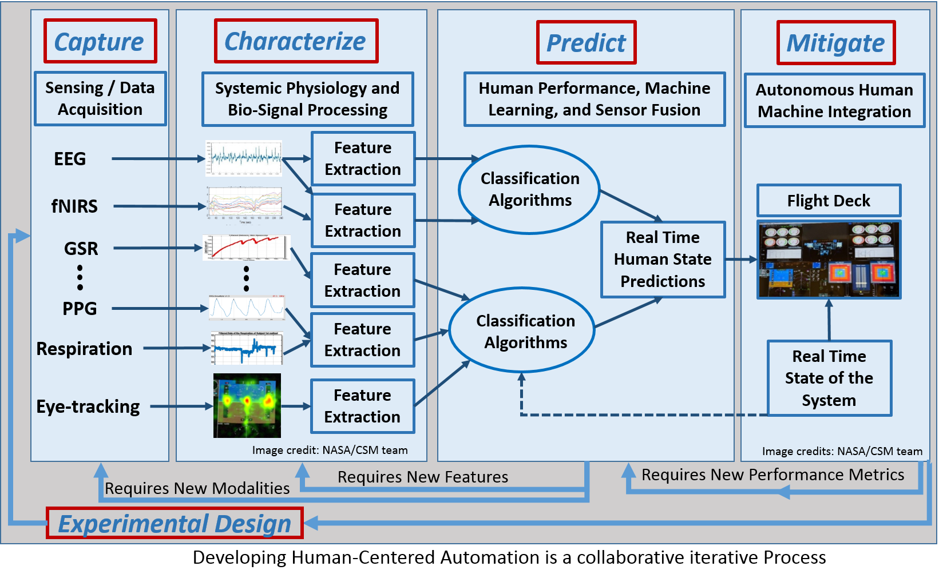
Introduction- Cognitive State Detection
Data Acquisition
Signal Processing
Data Synchronization
Feature Extraction
Machine Learning Algorithm
Prediction
Feedback
Figure adapted from: Harrivel, A., Liles, C., Stephens, C., Ellis, K., Prinzel, L., and Pope, A., (2016). Psychophysiological Sensing and State Classification for Attention Management in Commercial Aviation, Presented at AIAA SciTech 2016, Novel Sensor Systems and Sensing Techniques session, January 6, 2016, San Diego, California.

Slide 6
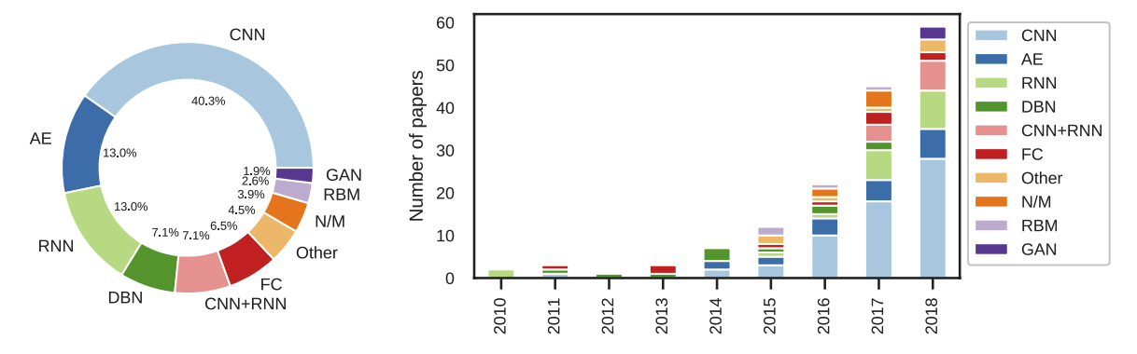
Prior Work
Deep learning has attained great popularity and its ability to extract features based on visual-learning (e.g., convolutional neural networks) has accelerated its growth in different domains.
Below figures shows the amount of deep learning architecture that have played role since its rise, in the field of analysis of EEG based data
Image adopted - https://iopscience.iop.org/article/10.1088/1741-2552/ab260c/pdf

Slide 7
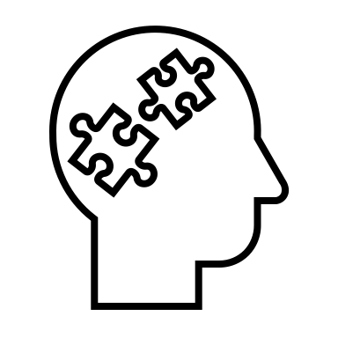
Limitations - Prior Work
There is much research on using deep learning architectures to classify physiological sensing data, there is little work that focuses on comparing different model architectures and how deep learning performs in parallel to machine learning models on the same set of data for cognitive state detection.
Vulnerability of models based on low numbers of samples (i.e. Subject’s data) is not clear, as is how it plays an important role in accuracy and stability.
The research until now only focuses on two class problems. But human performance is not limited to two attentional human performance limiting states (AHPLS)(e.g., only high and low workload)
The use of one modality(e.g. EEG) has forced previous work to be limited and a reliance on a single source of physiological sensing has limited feature selection for Neural Nets.
The absence of exploring the use of transfer learning to reduce time to train the optimal weights for the network.

Slide 8

Challenges
The high dimensionality (multiple modalities) of this data makes it difficult to estimate the decision boundaries, which requires an increased amount of data to reduce the confidence boundary of the estimated parameters.
Increased number of classes(4 states) in AHPLS again puts a big challenge for physiological sensing data with noise to be discriminated compared to two class problem.
How should the quantification of huge class imbalance in samples for each class be modelled and increase generalization power of the model ?
Is combining two different datasets with same experimental setup from different times help us reduce the problem of insufficient data.
AHPLS | Task
Channelized Attention * | Tetris
High Workload | MATB High Workload
Low Workload | MATB Low Workload
Startle/Surprise | Movie Scene Observation
Harrivel, et al. (2016)

Slide 9



Insights
Deep Learning in the form of transfer learning using pretrained architectures reduces hypermeter selection time, training time for weights and removes the requirement of a skilled analyst for feature selection.
Splicing the dataset according to the number of samples. For e.g. Startle/Surprise instances were maximum and therefore only at the instant of surprise was the data slit.
Combining more than one architecture to involve more number of sensors in parallel and exponentially increasing the data for prediction at the end of sequence layers.
Comparing the architecture performance with classical machine learning algorithms to look for performance parameters of the architecture.

Slide 10
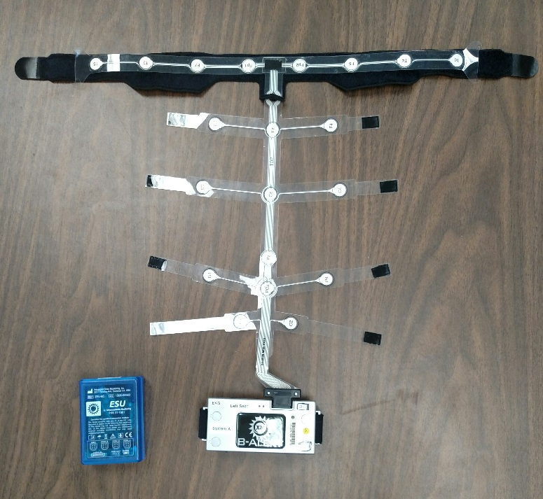
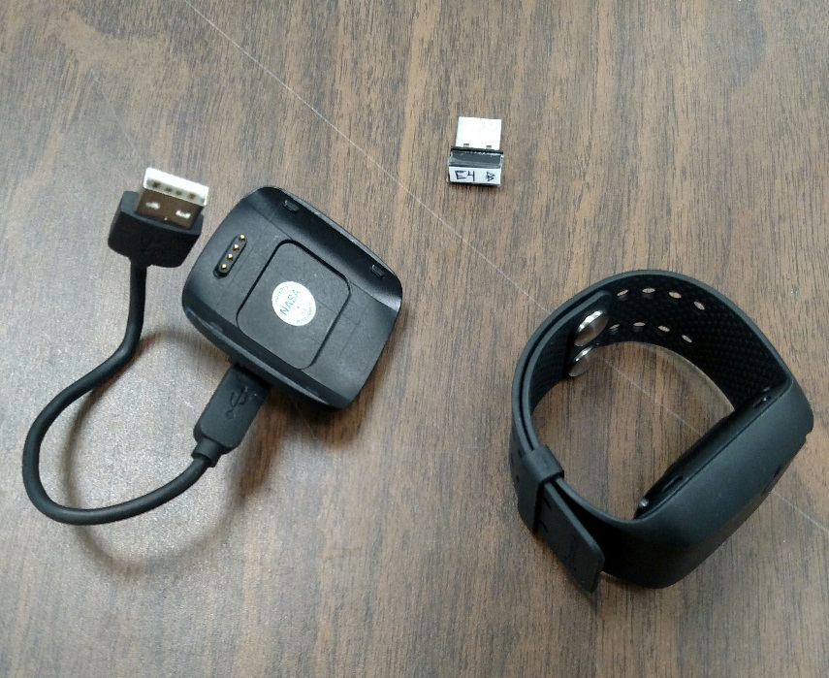
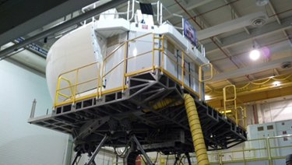
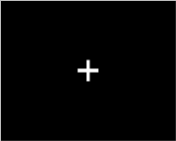
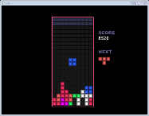
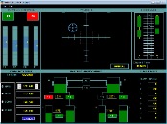
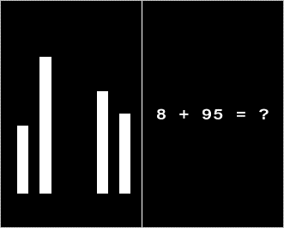
Data Collection and Methodology
Induce AHPLS under controlled conditions
for 6 minutes each
  Startle/Surprise: movie scene observation and detail recall
  Channelized Attention: focus only on playing
  the game Tetris (Fairclough and Gilleade, 2012)
  High and Low workload: high and low workload versions of a complex multi-task used to simulate nominal flight under high workload and in an optimal attentional state (Multi-Attribute Task Battery (MATB) at http://matb.larc.nasa.gov/)
Electroencephalogram data which was 256 Hz using Advanced Brain Monitoring’s
B-Alert X24 e
ABM B-Alert
wrist-worn, for GSR
Empatica was used to collect blood volume pulse at 24 Hz, galvanic skin response and skin temperature at 4 Hz, heartrate at 1.3 Hz, and acceleration of the sensor at 32 Hz.
Empatica E4
Simulated Flight
Performance
Benchmark Task Performance
Harrivel, H., Heinich, C., Milletich, R., Comstock, J., Stephens, C., Last, M., Napoli, N., Abraham, N., Toro, K., Kennedy, K., and Pope, A. (2018). Comparative EEG Sensor Analysis for Attentional State Prediction. Presented at AsMA 2018, Sensors and Symptoms: Research in Physiological Events, May 7, 2018, Dallas, Texas

Slide 11
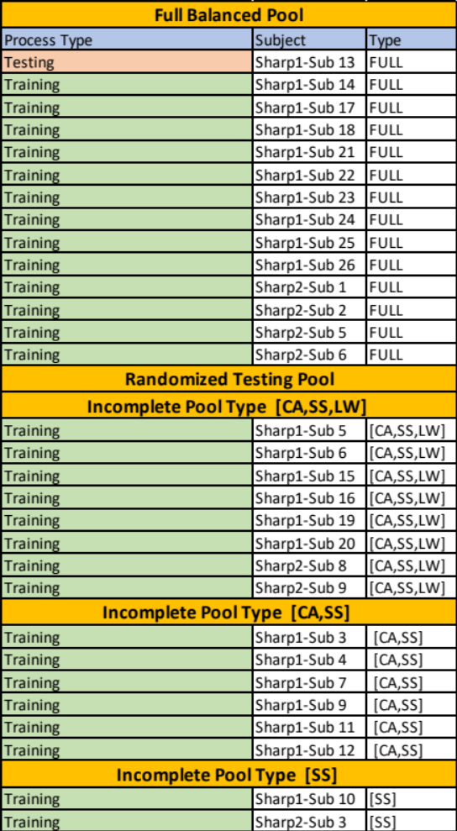

Data Collection and Methodology
Scenarios for Human Attention Restoration using Psychophysiology (SHARP)
  SHARP-1 Motion-base simulation study with 12 two-pilot crews in 2016 including realistic LOFT scenario events and full physiological data
  SHARP-2 Fixed-base simulation Comparative Analysis study with 13 pilots in 2017
  Both data sets contains subjects with all the four states of AHPLS and subjects with 3 or two states which brings up a challenge of great imbalance in training and testing sets.

Slide 12
Data Collection and Methodology - Transfer Learning
Load Pretrained Network
Initial layers learn low level features
Modify the Layers
New layers to learn data specific features and classes
Train Network
Train the network with train options using your own dataset
Predict and Asses
Asses and the trained network on test set or cross validate
Deploy Results
Improve Network
Network | Depth | Size | Parameters(Millions) | Image Input Size
Squeeze-net | 18 | 5.2mb | 1.24 | 227 by 227
Google-net | 22 | 27mb | 7.0 | 224 by 224
Resnet101 | 101 | 167mb | 44.6 | 224 by 224
Inceptionv3 | 48 | 89 | 23.9 | 299 by 299
Alex-net | 8 | 227mb | 61.0 | 227 by 227

Slide 13
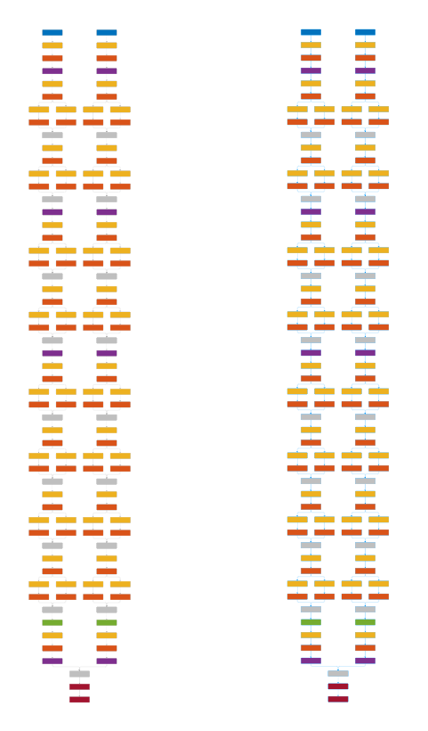
Data Collection and Methodology – Squeeze Net
Data-1
Data-2
conv1
fire2
fire3
fire4
Maxpool/2
fire5
fire6
fire7
fire8
maxpool/2
fire9
conv10
global avgpool
softmax
classification
Microarchitectural view of Squeeze net architecture
……………..
Fusion of different sensors and modalities using parallel networks with multiple inputs
Image created using -MATLAB

Slide 14
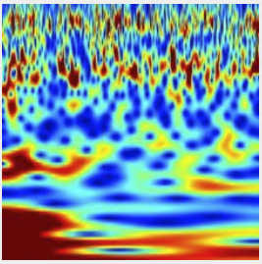
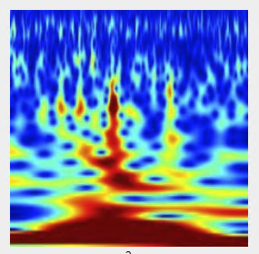
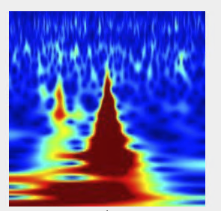
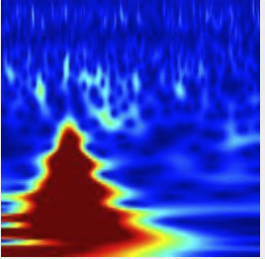
Data Collection and Methodology – Input
SS
CA
LW
HW
Squeeze-net architecture (Sensor-1)
AHPLS
Channelized Attention
High Workload
Low Workload
Startle/Surprise
Squeeze-net architecture (Sensor-2)
Concatenation
Classification
Squeeze-net architecture (Sensor-3)
Squeeze-net architecture (Sensor-N)
4 classes Scalograms (Image Size-227 by 227) extracted from different sensors(FP1,FP2…etc)
Notes:
The scalogram is the absolute value of the continuous wavelet transform (CWT) of a signal, plotted as a function of time and frequency. The scalogram can be more useful than the spectrogram for analyzing real-world signals with features occurring at different scales
An addition layer adds inputs from multiple neural network layers element-wise.

Slide 15
Research Questions
RQ1
Does Transfer learning eliminate the need for feature extraction and perform better than classical machine learning algorithms? (On-Going Research)
RQ2
Can the parallel networks be used for fusing different sensors and modalities of the physiological sensing data? (On-Going Research)
RQ3
Does these networks perform better in more than two class problems ? (On-Going Research)

Slide 16
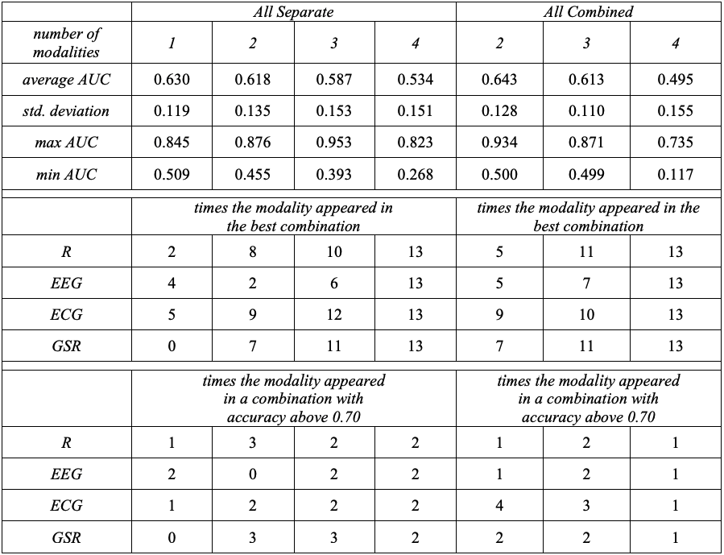
Results- RQ 1
Does Transfer learning eliminates the use of feature extraction and perform better than classical machine learning algorithms?
Hypothesis -1
The transfer learning using parallel networks tunes the network relative to each sensor in case of one modality. When more than one modalities is included, the network is better able to extract the features using individual network training for each modalities. This independent capability of using networks in parallel prevents the risk of network bias on one modality or a combination of them preventing biasing of weight parameters. The parallel networks are then concatenated using the addition layer and used in classification.
It is believed that this individuality will improve the prediction accuracy and will better extract features instead of pumping everything into one network.
This result help in selecting the best network with fine tuning of state-of-the-art architectures discussed previously.
Harrivel, A. R., Stephens, C. L., Milletich, R. J., Heinich, C. M., Last, M. C., Napoli, N. J., Abraham, N., Prinzel, L. J., Motter,M. A., and Pope, A. T., “Prediction of cognitive states during flight simulation using multimodal psychophysiological sensing,”AIAA Information Systems-AIAA Infotech@ Aerospace, 2017, p. 1135.

Slide 17
Results- RQ 2
Can the parallel networks be used for fusing different sensors and modalities of the physiological sensing data?
Hypothesis -2
Fusing different sensors into parallel networks improves the performance of the architecture by individually extracting feature from each sensor and combination of sensors.
The fusion of different modalities will help boost the performance of the network in classifying the cognitive states. The modalities will again be concatenated with a different network in parallel. The combination of different modalities in the network will also be the method of experimental analysis.
The fusion will also help the network overcome the need of less data requirement for physiological sensing of cognitive states through different non-invasive measuring.
Recognizing and addressing the best modality combination and weak combinations which affects the network performance which will potentially find the root causes of network selection.

Slide 18
Results- RQ 3
Does these networks perform better in more than two class problems ?
Within Subject CV
Inter-Independent Subject CV
2-Class Problem
95.77%
3-Class Problem
90.08%
4-Class Problem
85.47%
2-Class Problem
70.77%
3-Class Problem
52.08%
4-Class Problem
40.47%
Hypothesis – 3
The network will be evaluated on two class problem first and then the probable combination while increasing the state one at a time.
The assumption is that the binary class problem will perform much better but with increased classes of AHPLS the network performance is expected to decrease as per previous results show in RQ1.
But with four classes of AHPLS and fusion of parallel networks the performance is expected to be same or better. We believe that individual networks design to fuse parallel features using transfer learning extract features discretely and this will boost the performance of the model network.
This research question will address the limiting points of feature extraction when class dimensions are increased and will potentially resolve the issue of combining them in machine learning algorithms
Notes:
At the end I would i like to say that this is a part of an ongoing research as we speak and we are further experimenting the different class and modalitty combinations for best performing parameters . The computation time for single sensor is found to be 30 hours for interindependent subbject cross validation of 29 subjects which leads to a time consuming selection of hyper parameters. But is still saves almost 50% computation time when compared to training a network from scracth.

Slide 19
Thank you for your time!
Questions?
Notes:
LF24736

