Slide 1
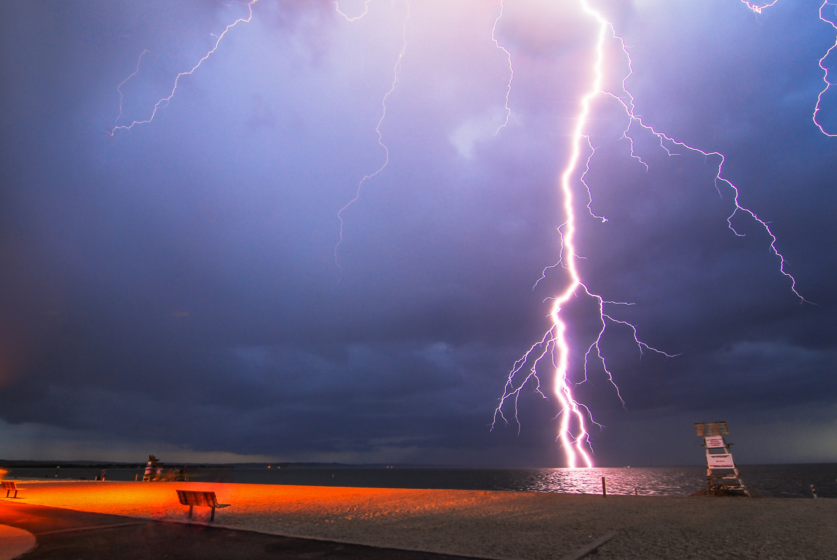
A Spatiotemporal Lightning Risk Assessment Using Lightning Mapping Data
1
2
3
Kelley Murphy, Dr. Eric C. Bruning, Dr. Christopher J. Schultz
Earth System Science Center, UAH, Huntsville, AL
Department of Geosciences, Texas Tech University, Lubbock, TX
Earth Science Branch, Marshall Space Flight Center, Huntsville, AL
1
2
3
Picture by Dan Linek, IG: keepaneyetothesky

Slide 2
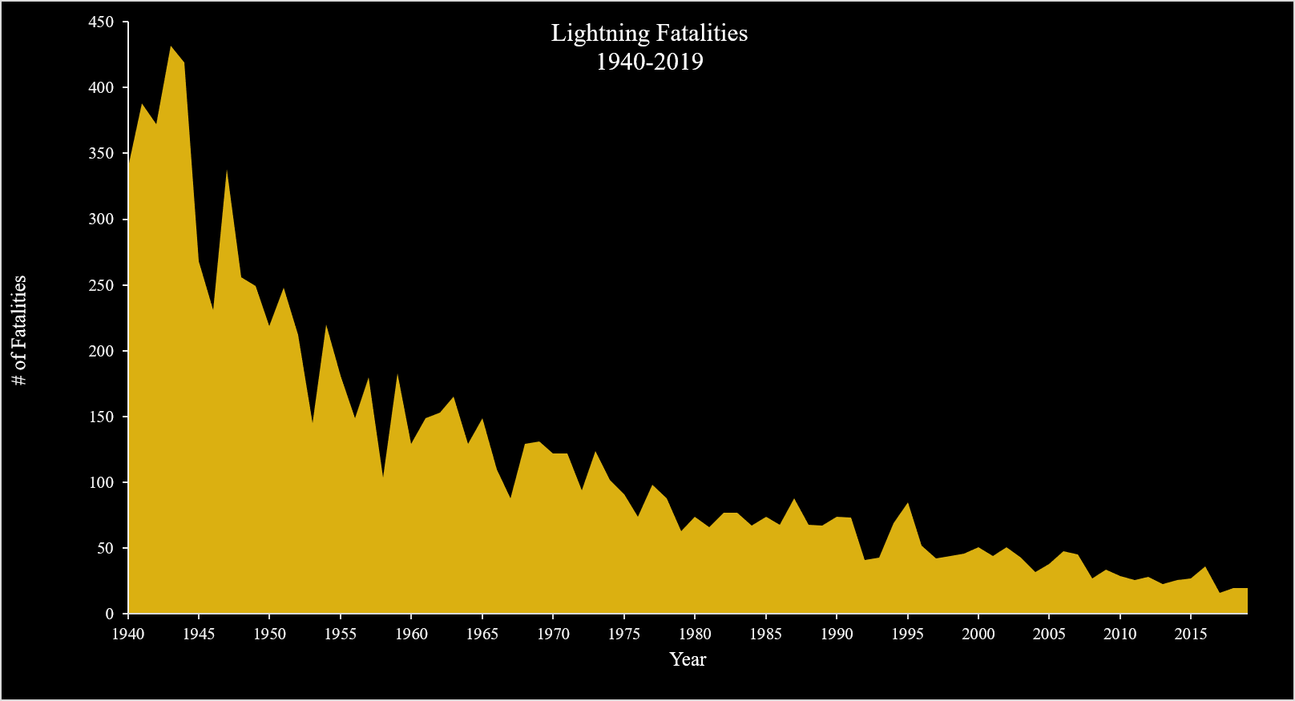
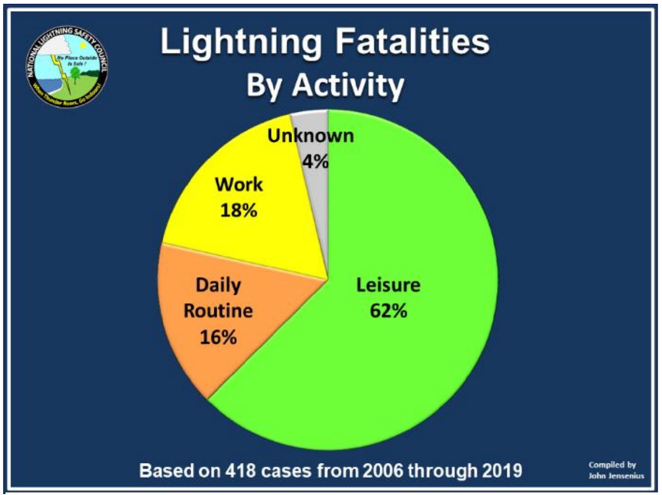
Background
Lightning fatalities & injuries still occur every year in the US, but numbers have greatly decreased over the last 40 years*
Outdoor leisure activities contribute to the greatest number of fatalities*
Most often occur in June, July, and August on Friday, Saturday, and Sunday*
Unorganized convection is the most commonly associated storm mode^
*Jensenius (2020)
^Ashley and Gilson (2009)

Slide 3
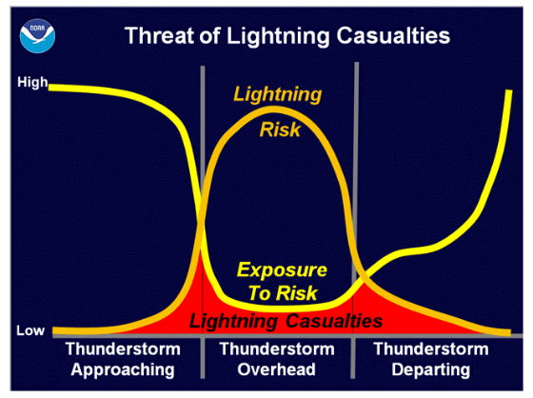
Background
Lightning Risk
Consider objective and subjective hazards surrounding lightning incidents
  Objective: exists regardless of a person’s presence
  Subjective: human behavior that puts people at greater risk of objective hazards
Lightning risk fluctuates on the storm scale. How do we model this?
Gookin (2010)
Create a lightning risk assessment methodology to calculate and monitor changing lightning risk associated with thunderstorms

Slide 4
Methods – Part 1: Risk Assessment Creation
Lightning Risk Assessment
Modeled after the structure of the International Electrotechnical Commission Standard for Lightning Protection, Part II (IEC 62305-2:2010)
  Outlines a lightning risk assessment procedure – it is modified for application to humans
  This produces a numerical value of risk that can be compared to tolerability thresholds

Slide 5
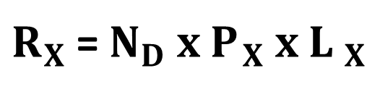
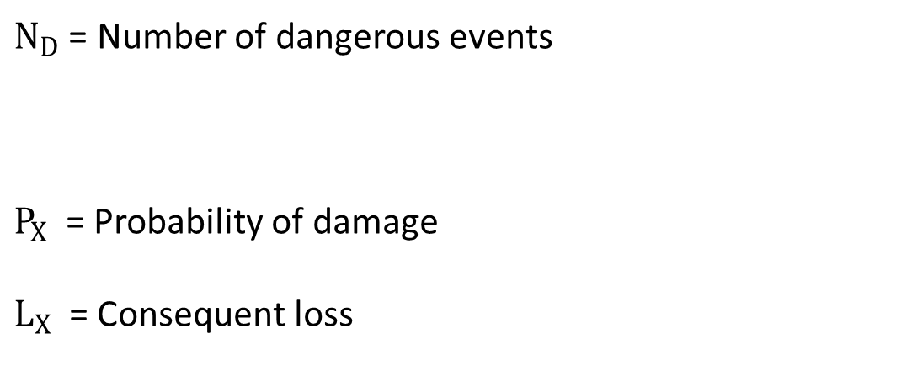
Methods – Part 1: Risk Assessment Creation
Lightning Risk Assessment
Modeled after the structure of the International Electrotechnical Commission Standard for Lightning Protection, Part II (IEC 62305-2:2010)
  Outlines a lightning risk assessment procedure – it is modified for application to humans
  This produces a numerical value of risk that can be compared to tolerability thresholds
Use a collection area that represents a 100 ft* radius surrounding the human
Input total lightning mapping data instead of annual ground flash density
* Assumed distance over which a CG strike could be fatal used in Hinkley et al. (2019)

Slide 6
Methods – Part 1: Risk Assessment Creation
Lightning Risk Assessment
Modeled after the structure of the International Electrotechnical Commission Standard for Lightning Protection, Part II (IEC 62305-2:2010)
  Outlines a lightning risk assessment procedure – it is modified for application to humans
  This produces a numerical value of risk that can be compared to tolerability thresholds
Add distance dependence concept used in range ring lightning studies (examples: Holle et al. 2016; Roeder et al. 2017, Sanderson et al. 2020)
  For this research, consider lightning within a 40 km radius surrounding the human at risk
  Flashes further away from the center contribute less to risk than flashes near the center

Slide 7
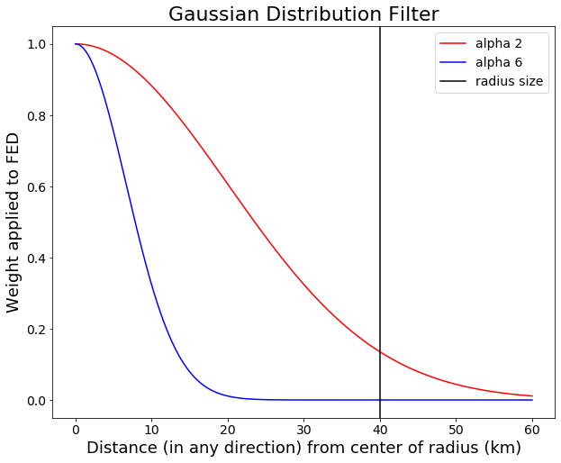
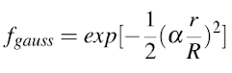
Methods – Part 1: Risk Assessment Creation
Lightning Risk Assessment
Modeled after the structure of the International Electrotechnical Commission Standard for Lightning Protection, Part II (IEC 62305-2:2010)
  Outlines a lightning risk assessment procedure – it is modified for application to humans
  This produces a numerical value of risk that can be compared to tolerability thresholds
Add distance dependence concept used in range ring lightning studies (examples: Holle et al. 2016; Roeder et al. 2017)
  For this research, consider lightning within a 40 km radius surrounding the human at risk
  Flashes further away from the center contribute less to risk than flashes near the center
  R = 40 km
  r = distance from center of radius

Slide 8
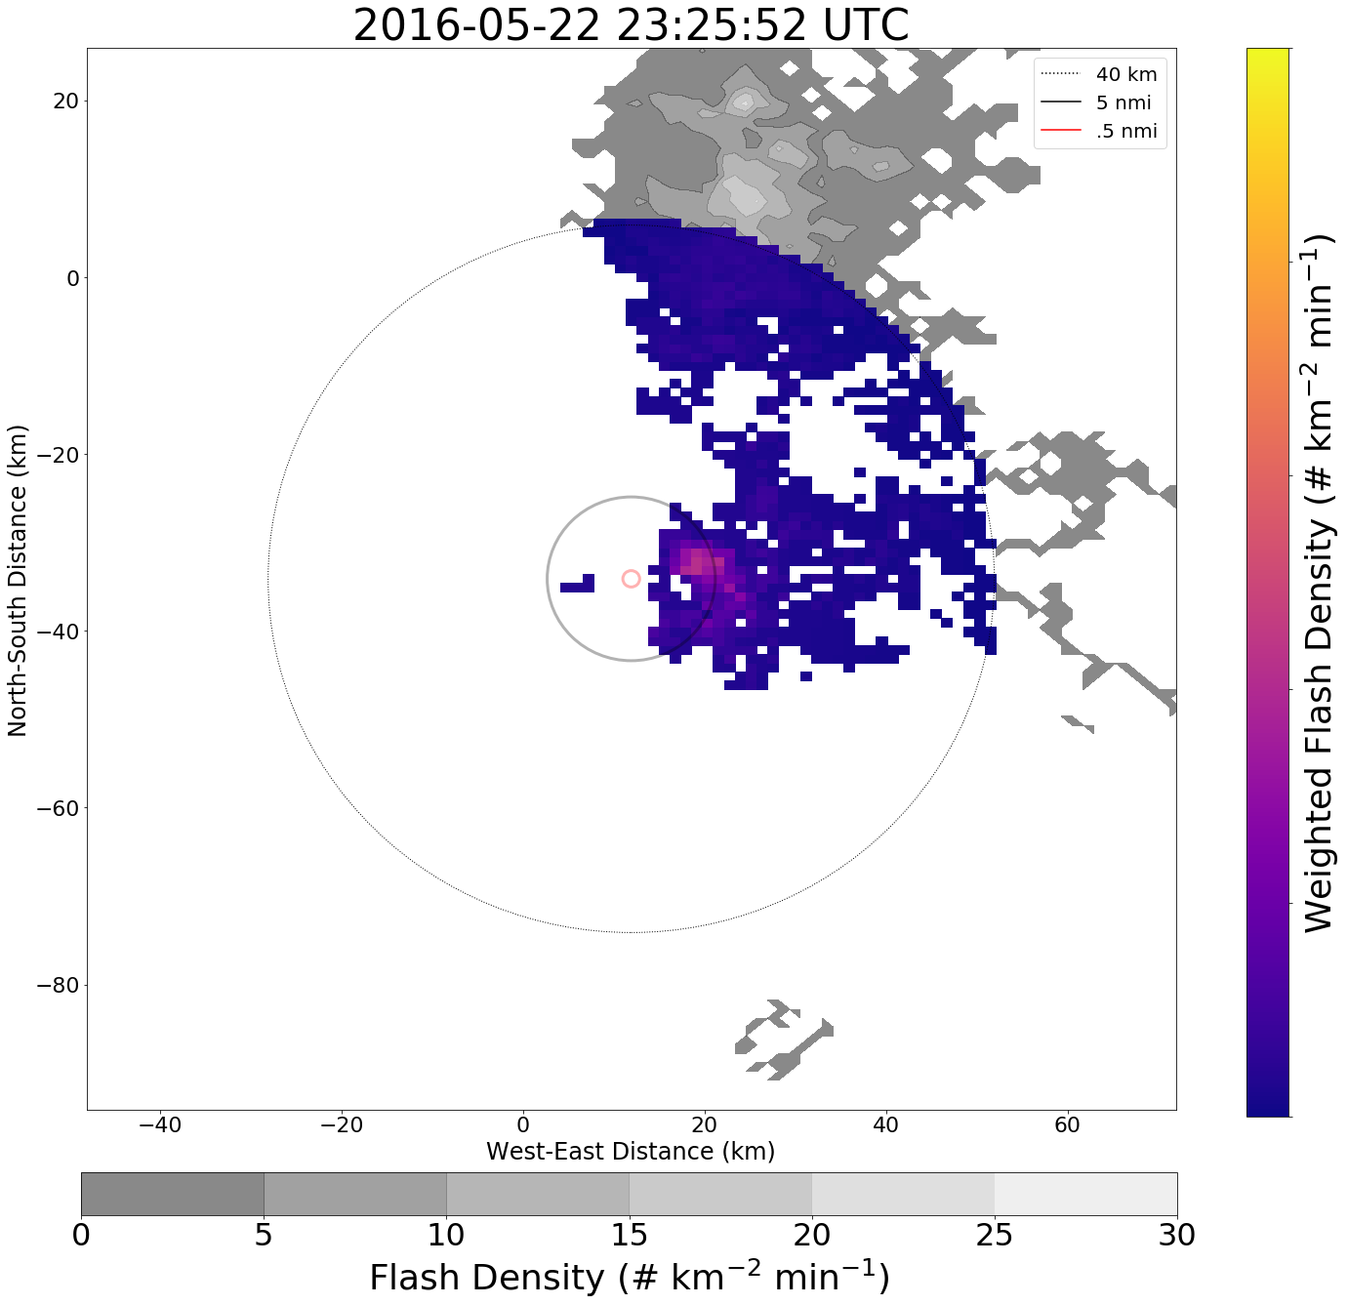
Methods – Part 1: Risk Assessment Creation
Lightning Risk Assessment
Modeled after the structure of the International Electrotechnical Commission Standard for Lightning Protection, Part II (IEC 62305-2:2010)
  Outlines a lightning risk assessment procedure – it is modified for application to humans
  This produces a numerical value of risk that can be compared to tolerability thresholds
Add distance dependence concept used in range ring lightning studies (examples: Holle et al. 2016; Roeder et al. 2017)
  For this research, consider lightning within a 40 km radius surrounding the human at risk
  Flashes further away from the center contribute less to risk than flashes near the center
Use a total lightning mapping dataset (West Texas Lightning Mapping Array (WTLMA))
  Uses flash extent density (FED)
  Captures the spatial extent of lightning flashes within the set radius

Slide 9
Methods – Part 1: Risk Assessment Creation
Lightning Risk Assessment
Modeled after the structure of the International Electrotechnical Commission Standard for Lightning Protection, Part II (IEC 62305-2:2010)
  Outlines a lightning risk assessment procedure – it is modified for application to humans
  This produces a numerical value of risk that can be compared to tolerability thresholds
Add distance dependence concept used in range ring lightning studies (examples: Holle et al. 2016; Roeder et al. 2017)
  For this research, consider lightning within a 40 km radius surrounding the human at risk
  Flashes further away from the center contribute less to risk than flashes near the center
Use a total lightning mapping dataset (West Texas Lightning Mapping Array (WTLMA))
  Uses flash extent density (FED)
  Captures the spatial extent of lightning flashes within the set radius
Calculate moving risk of varying time units: risk per minute, 10 minutes, 30 minutes, etc.

Slide 10
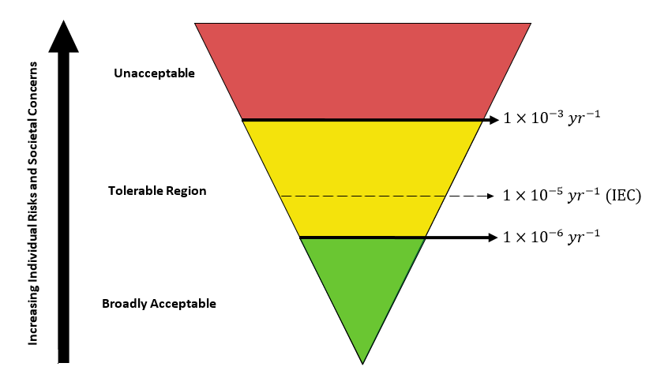
Methods – Part 1: Risk Assessment Creation
Lightning Risk Assessment
Tolerability thresholds
  Health and Safety Executive (2001) “tolerability of risk” framework
  Values are scaled to match appropriate risk unit
Figure adapted from Health and Safety Executive (2001)

Slide 11
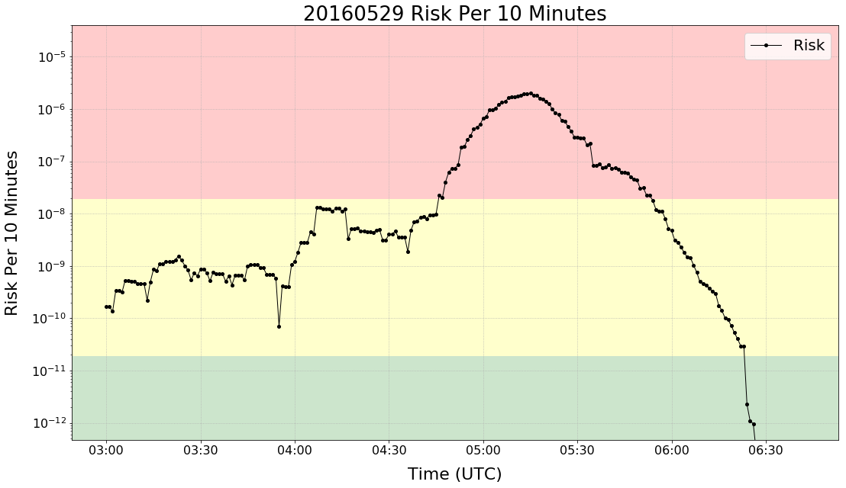
Results – Part 1: Risk Assessment Creation

Slide 12
Methods – Part 2: Compare to Standard Lightning Safety Method
How to assess new risk methodology performance?
Create lightning warnings using National Lightning Detection Network total lightning data within range of radius centerpoint
  5 nautical mile (nmi) warning radius – lightning at or within this radius = lightning warning
  Warning ends once 30 minutes has passed since the last flash within 5 nmi

Slide 13
Methods – Part 2: Compare to Standard Lightning Safety Method
How to assess new risk methodology performance?
Create lightning warnings using National Lightning Detection Network total lightning data within range of radius centerpoint
  5 nautical mile (nmi) warning radius – lightning at or within this radius = lightning warning
  Warning ends once 30 minutes has passed since the last flash within 5 nmi
Compare these warnings to those issued using the risk assessment framework
  A lightning warning is issued when risk is unacceptable
  Warning ends once risk is back in the tolerable or broadly acceptable range

Slide 14
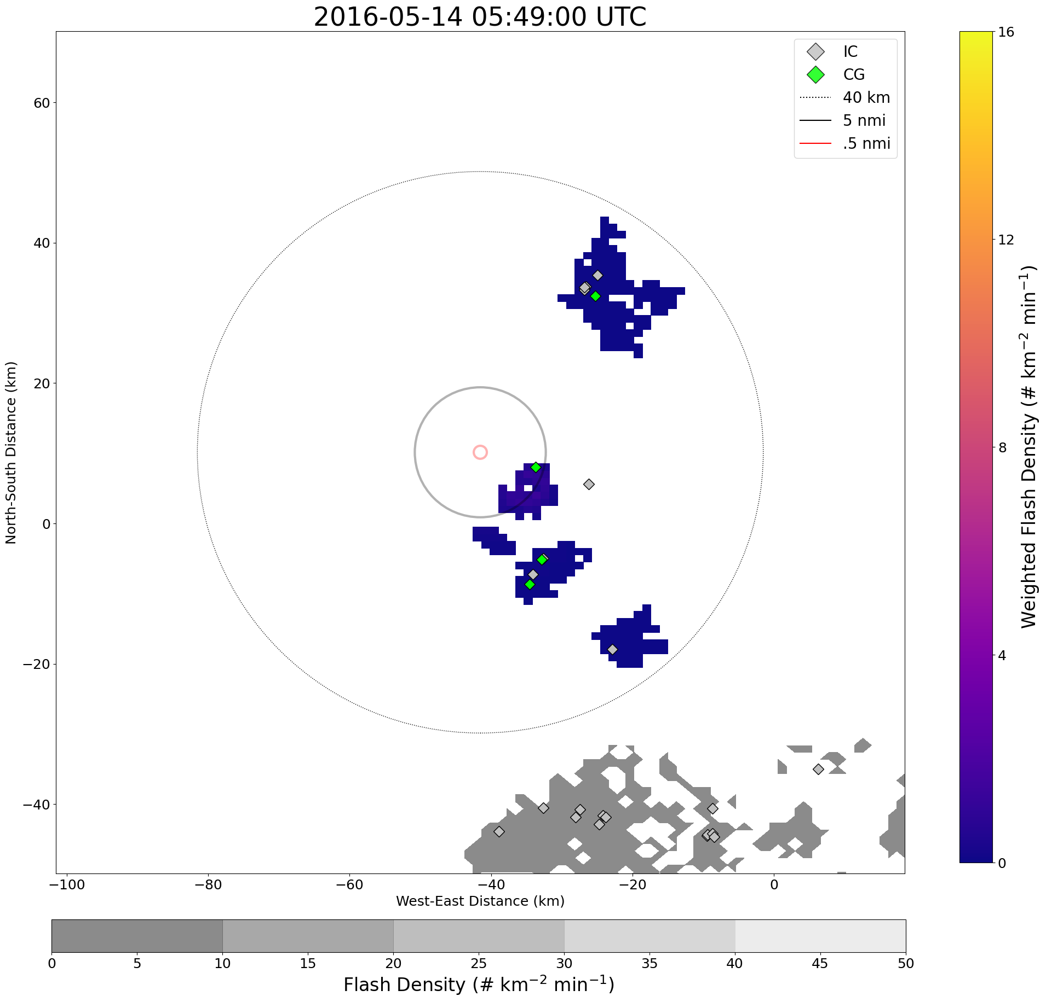
Methods – Part 2: Compare to Standard Lightning Safety Method
How to assess new risk methodology performance?
Create lightning warnings using National Lightning Detection Network total lightning data within range of radius centerpoint
  5 nautical mile (nmi) warning radius – lightning at or within this radius = lightning warning
  Warning ends once 30 minutes has passed since the last flash within 5 nmi
Compare these warnings to those issued using the risk assessment framework
  A lightning warning is issued when risk is unacceptable
  Warning ends once risk is back in the tolerable or broadly acceptable range
Gather statistics for comparison between methods:
  # of warning periods, # of false alarms, total time spent under warnings, average warning duration, etc.
Murphy, K. M., C. J. Schultz, E. C. Bruning, and J. K. Vanos (2021): Introduction and Evaluation of a Spatiotemporal Lightning Risk Assessment Using Lightning Mapping Data. Weather, Climate, and Society, conditionally accepted pending revision

Slide 15
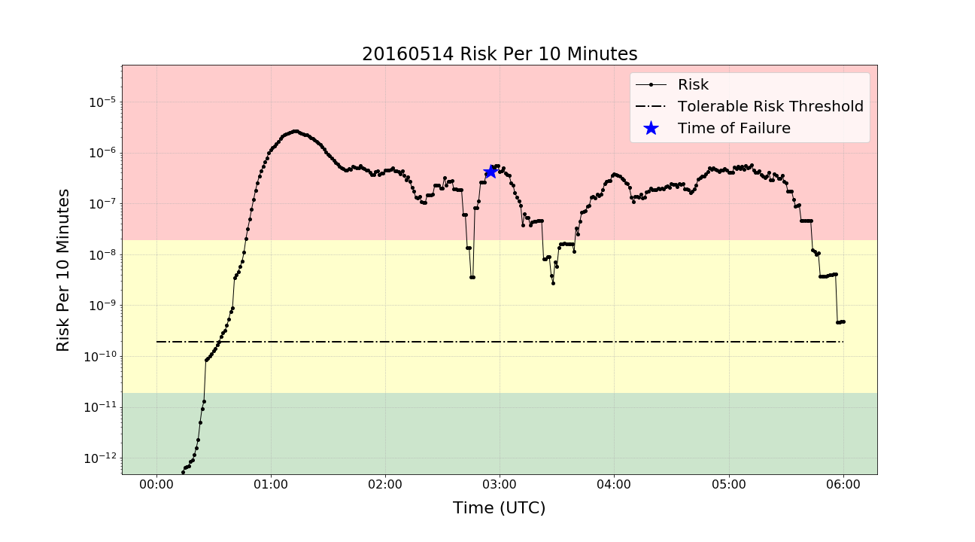
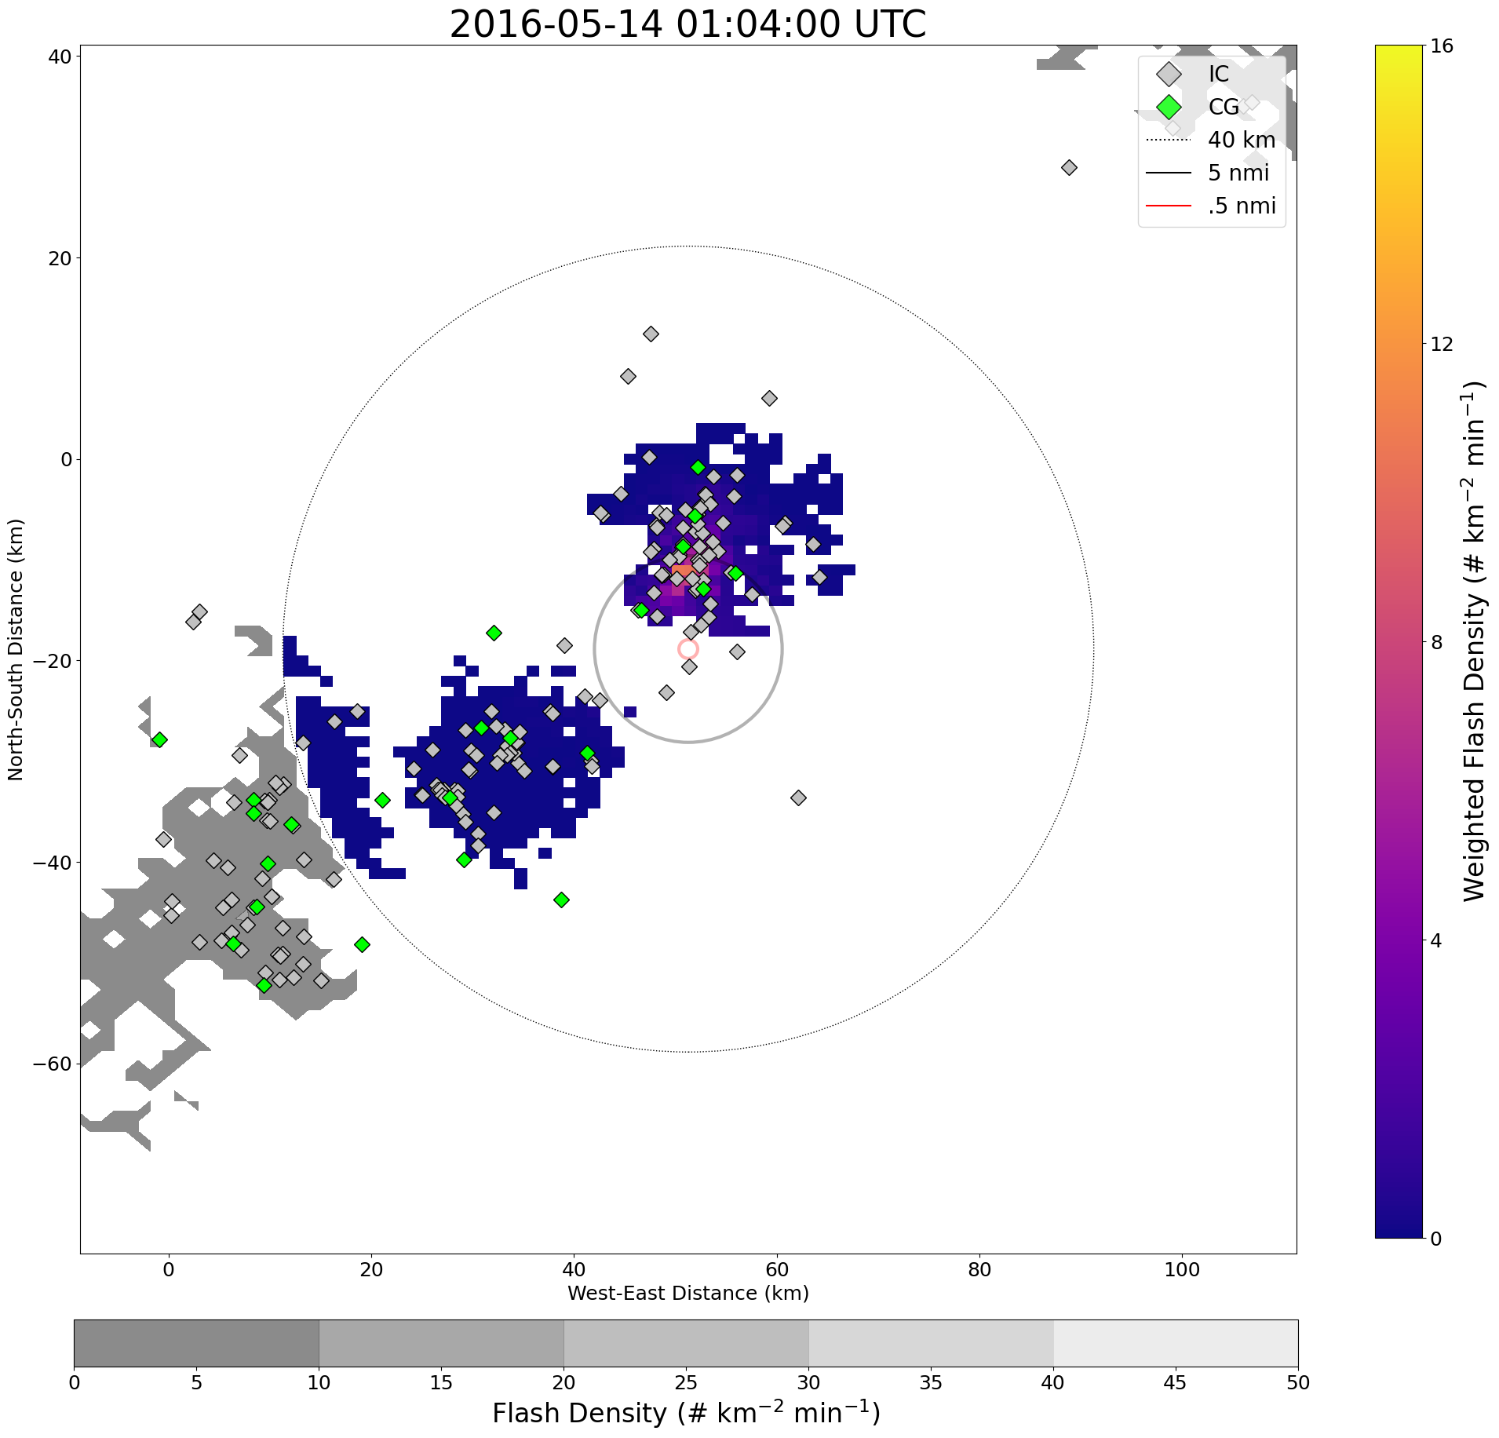
Results – Part 2: Compare to Standard Lightning Safety Method
Case Info
Location: 33.3304, -101.6272
Date: 20160514

Slide 16
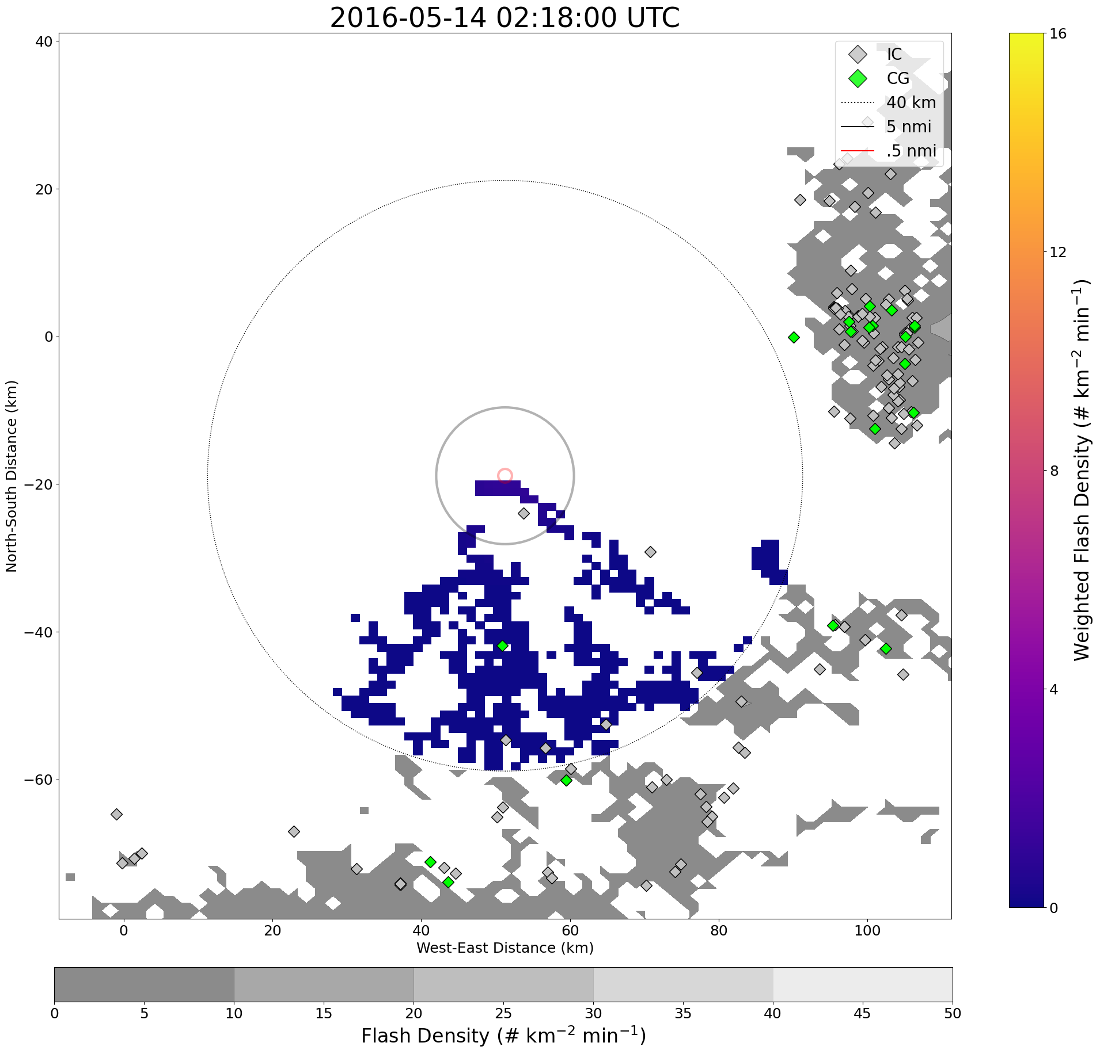
Results – Part 2: Compare to Standard Lightning Safety Method
Case Info
Location: 33.3304, -101.6272
Date: 20160514

Slide 17
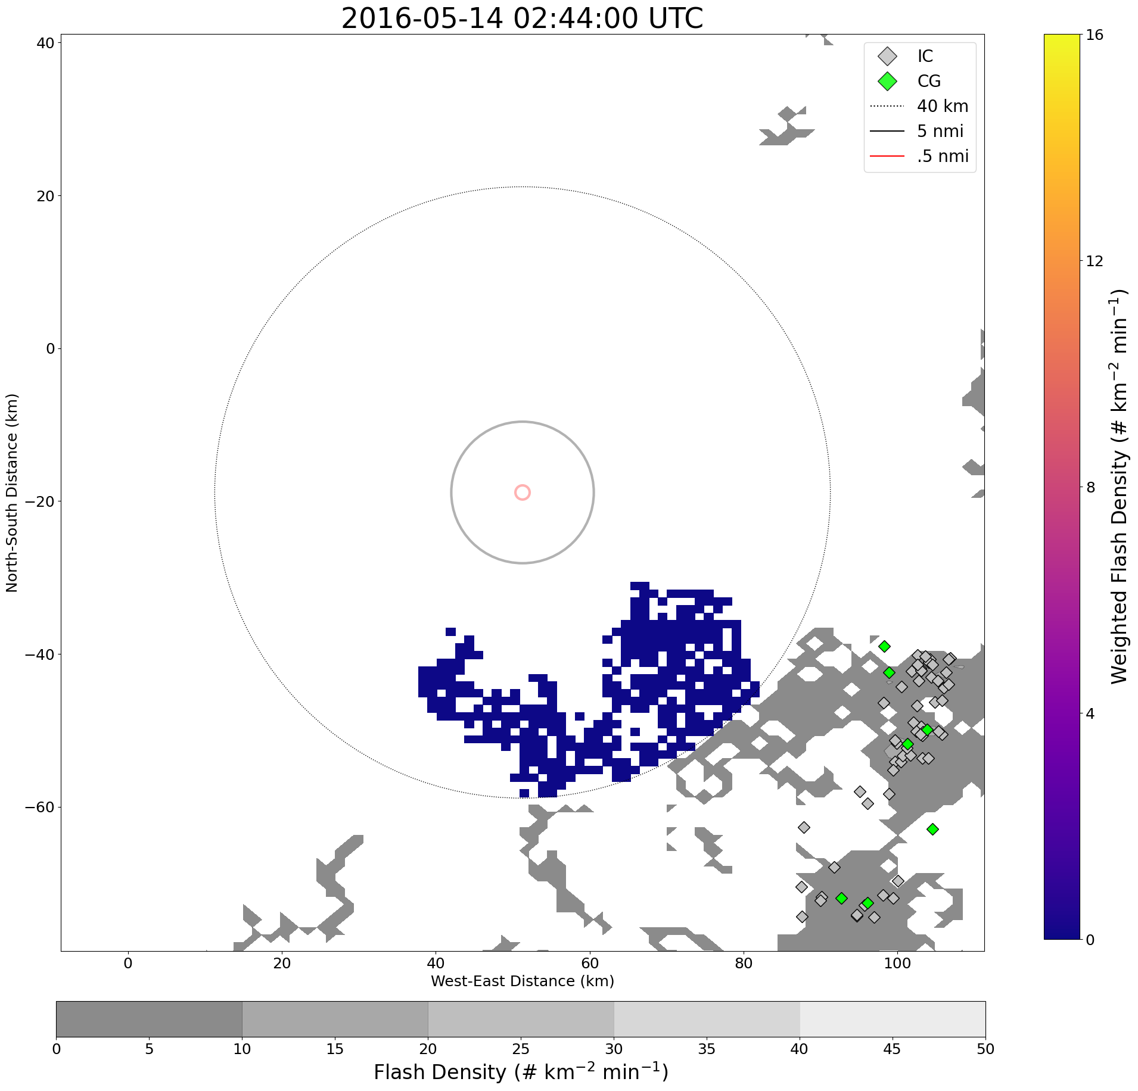
Results – Part 2: Compare to Standard Lightning Safety Method
Case Info
Location: 33.3304, -101.6272
Date: 20160514

Slide 18
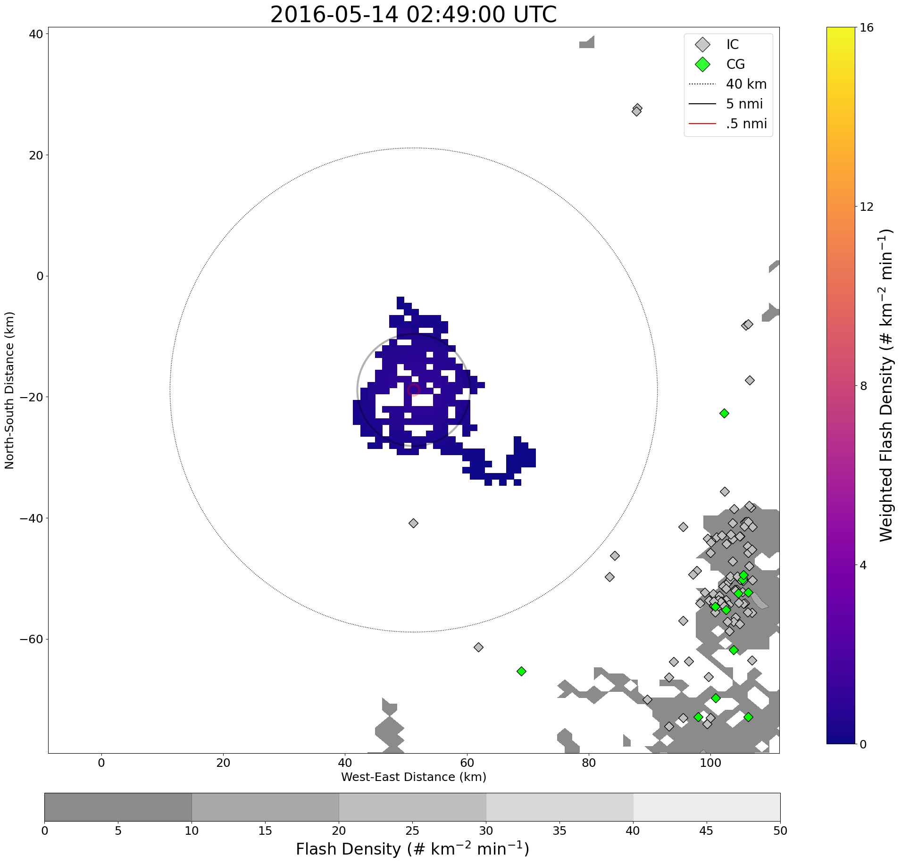
Results – Part 2: Compare to Standard Lightning Safety Method
Case Info
Location: 33.3304, -101.6272
Date: 20160514

Slide 19
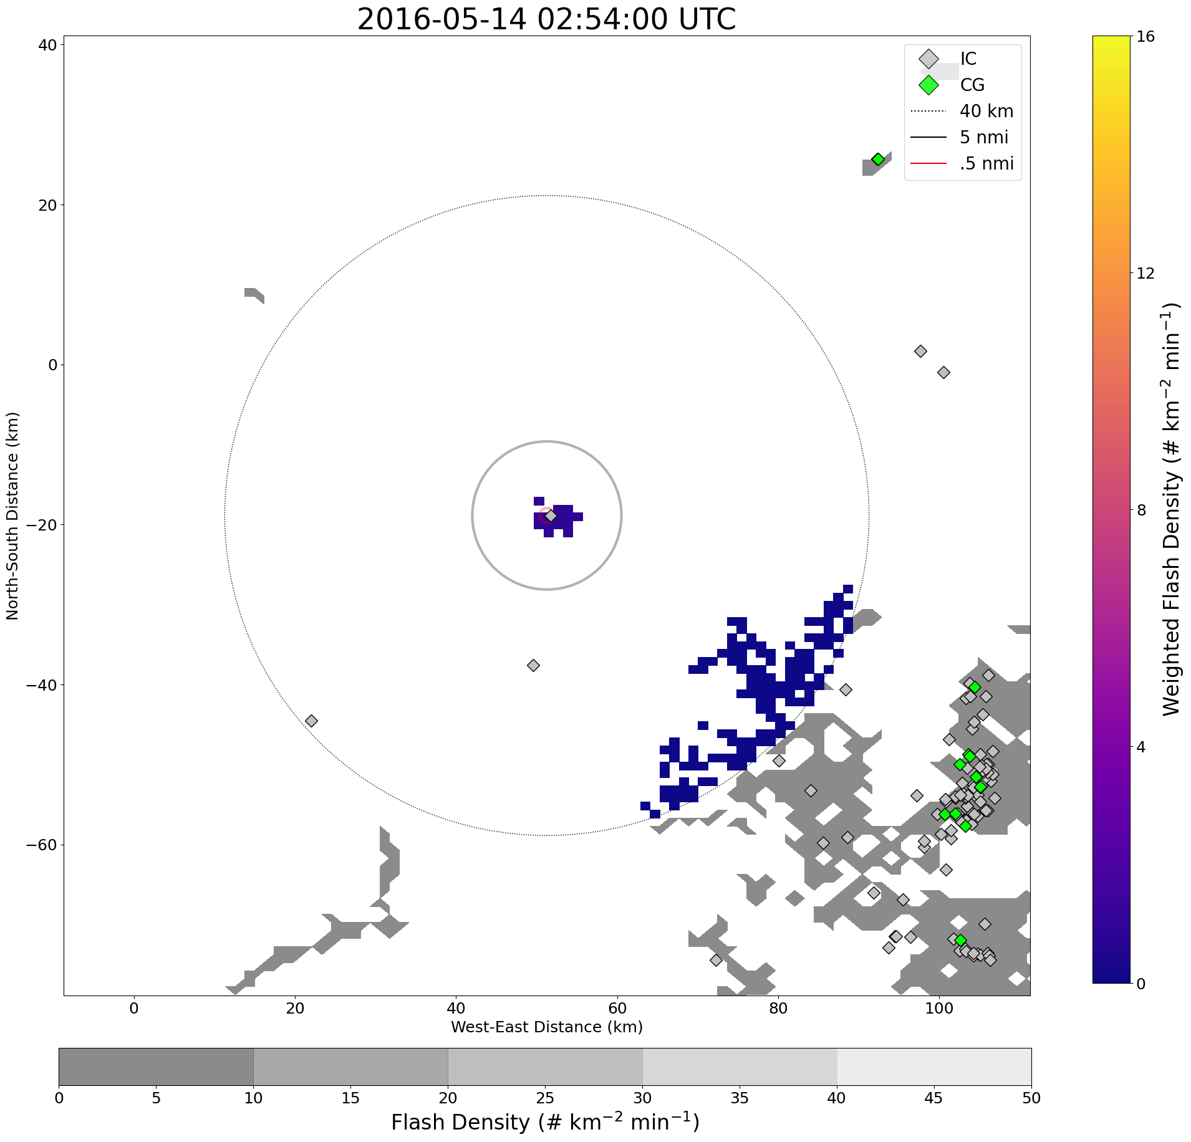
Results – Part 2: Compare to Standard Lightning Safety Method
Case Info
Location: 33.3304, -101.6272
Date: 20160514

Slide 20
Results – Part 2: Compare to Standard Lightning Safety Method
Risk/20min
00:49:00 to 03:33:00
03:40:00 to 03:41:00
03:42:00 to 05:54:00
06:05:00 to 06:25:00
06:35:00 to 06:38:00
06:41:00 to 07:28:00
Risk/30min
00:50:00 to 05:58:00
06:05:00 to 06:07:00
06:13:00 to 06:35:00
06:41:00 to 06:43:00
06:48:00 to 07:34:00
Warning Periods for Location 4, 14 May 2016
Standard Method
00:50:00 to 02:18:00
02:19:00 to 02:49:00
02:55:00 to 03:47:00
03:48:00 to 05:19:00
Risk/10min
00:47:00 to 02:43:00
02:47:00 to 03:23:00
03:40:00 to 05:44:00
06:05:00 to 06:15:00
06:18:00 to 06:23:00
06:35:00 to 06:45:00
06:48:00 to 07:22:00
08:01:00 to 08:03:00
Failure

Slide 21
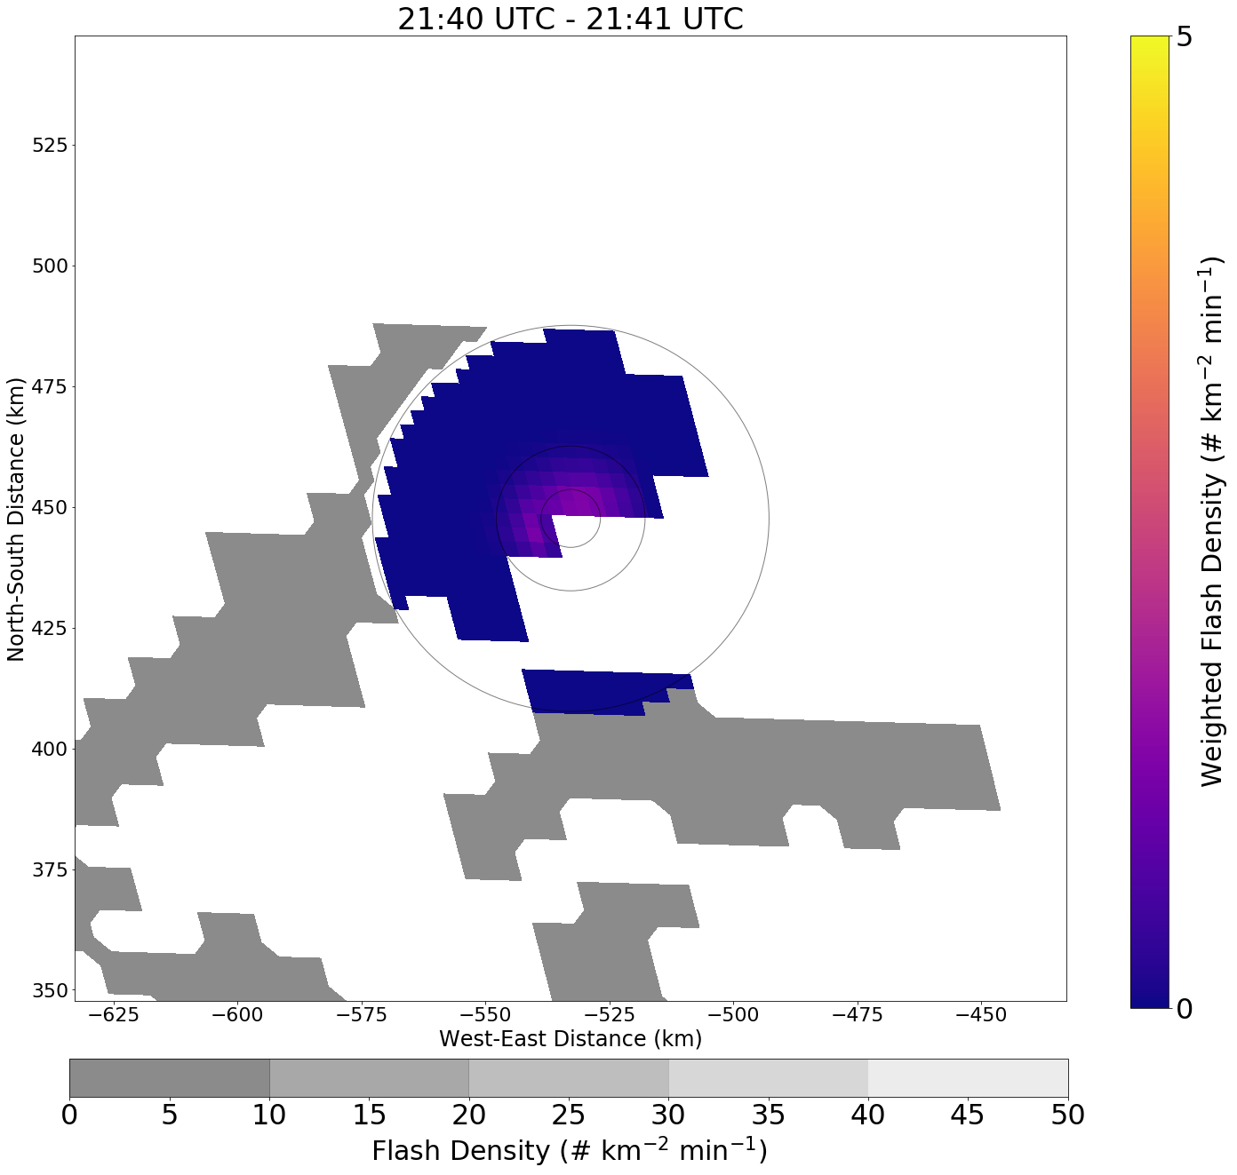
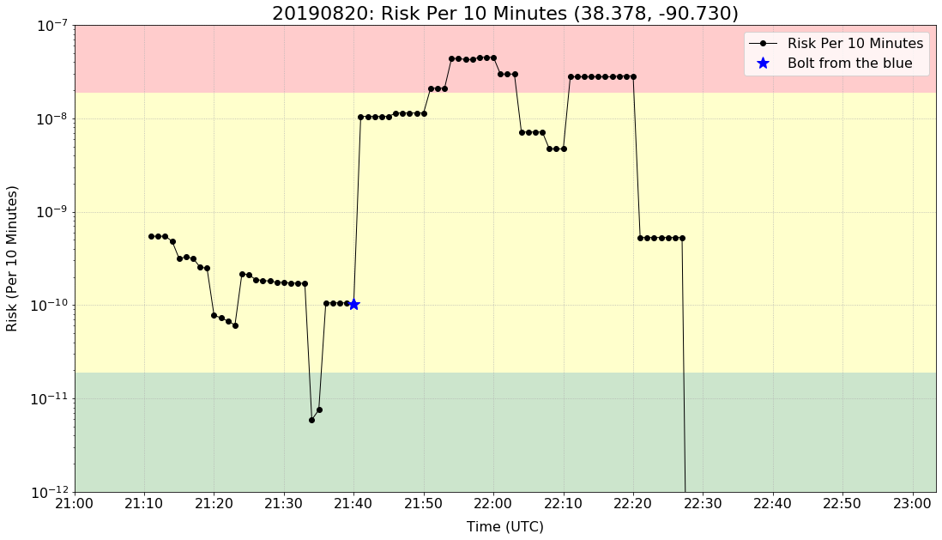
Future Work
Apply methodology using Geostationary Lightning Mapper (GLM) data
Case below is a bolt from the blue scenario on 20190820
Schultz, C. J., R. E. Allen, K. M. Murphy, B. S. Herzog, S. A. Weiss, and J. S. Ringhausen (2021): Investigation of cloud-to-ground flashes in the Non-Precipitating Stratiform Region of a Mesoscale Convective System on 20 August 2018 and Implications for Decision Support Services. Wea. Forecasting, conditionally accepted pending revision

Slide 22
Summary
The lightning risk methodology provides a baseline framework to quantify the changing lightning hazard on the storm scale
Could provide a useful tool for forecasters to aid in lightning decision support scenarios
  Monitor lightning trends with respect to tolerability thresholds
  Use in conjunction with viewing real time lightning imagery
Additional testing needed/apply the methodology in varying scenarios and geographical regions
  The ability to configure the risk method adds flexibility for application to different regions
Consider implementation of cloud-to-ground strikes to enhance risk calculation
Expansion of the methodology with GLM would allow for risk to be calculated anywhere within the GLM field of view
  Calculate risk surrounding past lightning fatalities

Slide 23
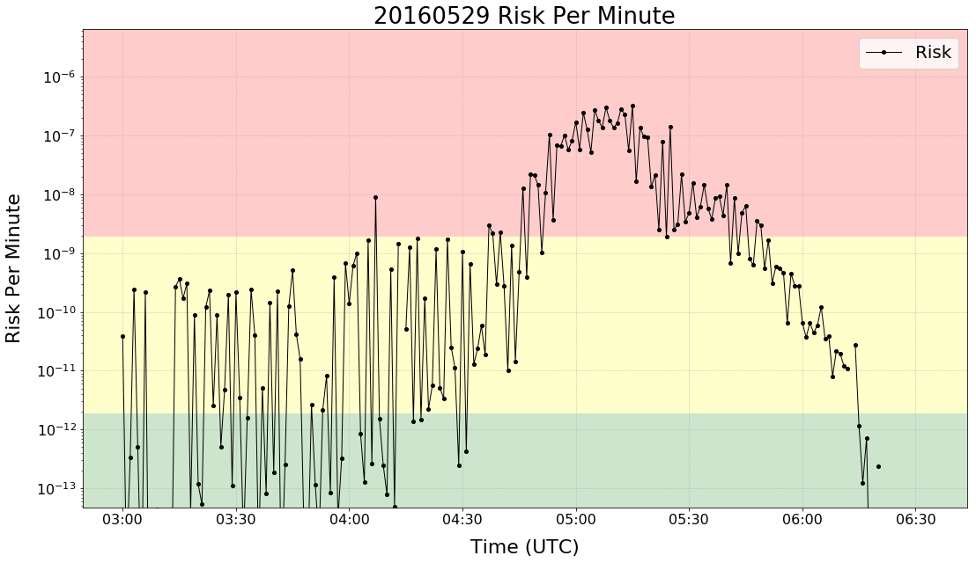
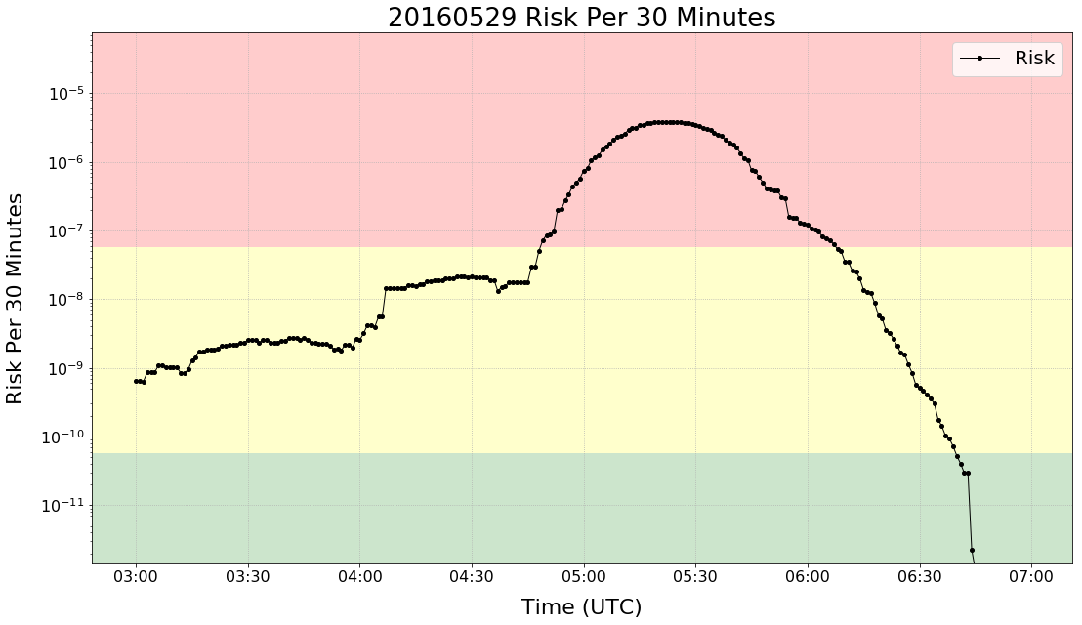
Results – Part 1: Risk Assessment Creation

