Slide 1
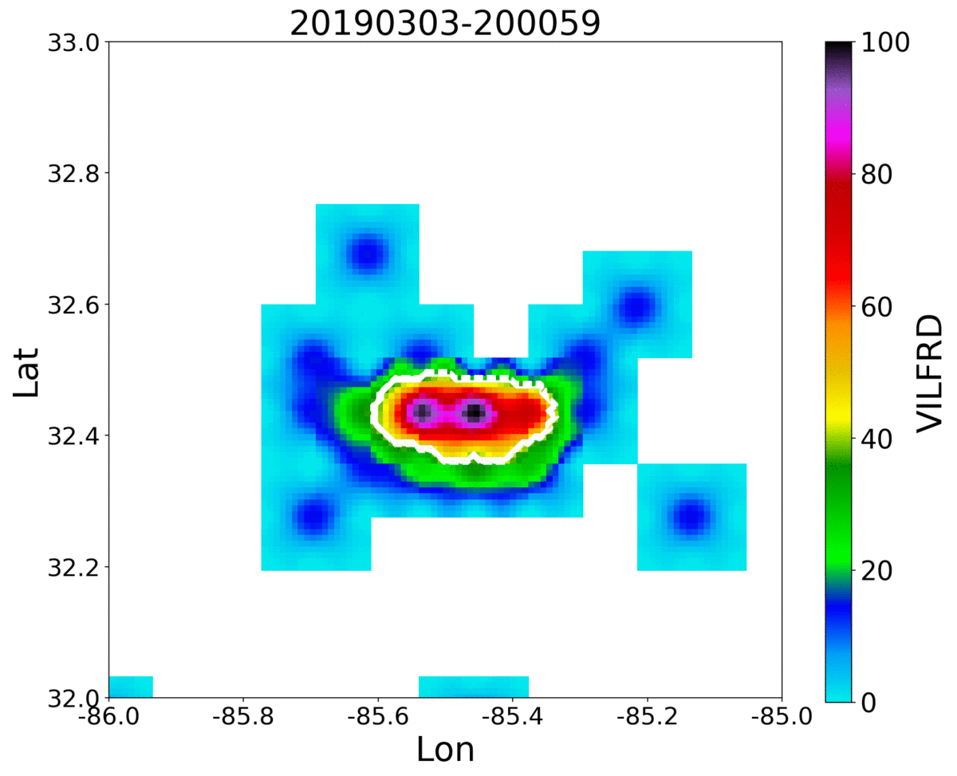
Automated and Objective Thunderstorm Identification and Tracking using Geostationary Lightning Mapper (GLM) Data
1
2
3
4
Kelley Murphy, Dr. Christopher J. Schultz, Dr. Kristin M. Calhoun, and Dr. Lawrence. D. Carey
1
Earth System Science Center, UAH, Huntsville, AL
Earth Science Branch, Marshall Space Flight Center, Huntsville, AL
National Severe Storms Laboratory, Norman, OK
Department of Atmospheric Science, UAH, Huntsville, AL
2
3
4

Slide 2
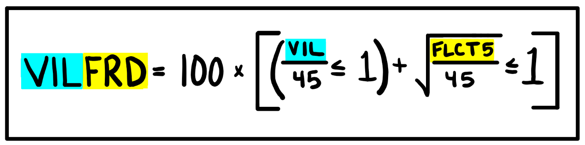
VILFRD - Original
• Schultz et al. (2016) created a new method for objectively identifying and tracking thunderstorms using a
combination of radar & lightning data
Vertically Integrated Liquid (VIL)
&
Flash Rate Density (FRD)
are combined to define storm features
• FLCT5 = averaged 5 min FRD
• Values can range from 0 – 200 and are unitless
• Unique ability in the duality of VILFRD; it will track as long as either VIL or FRD is available

Slide 3
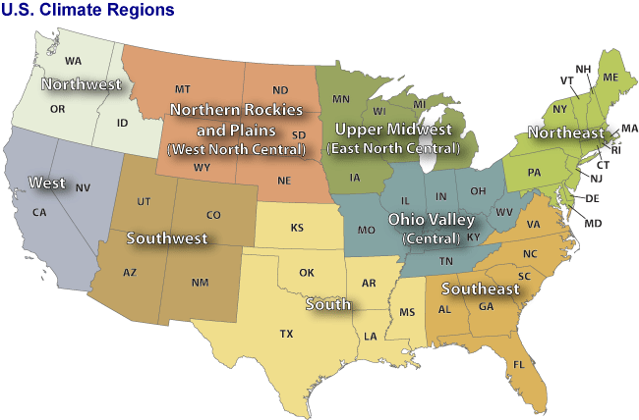
VILFRD - Original
Large Sample Analysis
• 15 case days, 273 hours tracked
• all in 2018
• A single case day could have anywhere
from ~20 – 200 tracked features
• Use this database to evaluate algorithm
performance
What could be added?
• Expand database to include more regions
• Classifications of storm modes
• Storms from the previous two years

Slide 4
VILFRD – Lightning Only
• Test how the algorithm operates when no radar information is available
• Lightning only tracking
0
• Values can range from 0 – 100 and are unitless

Slide 5
VILFRD – Lightning Only
Subset of Larger Database
• 6 case days, 1 in each region
• 129 hours tracked
Central:
North Plains:
Northeast:
Southeast:
South:
Upper Midwest:
20180614
20180616
20180618
20180615
20170617
20180617

Slide 6
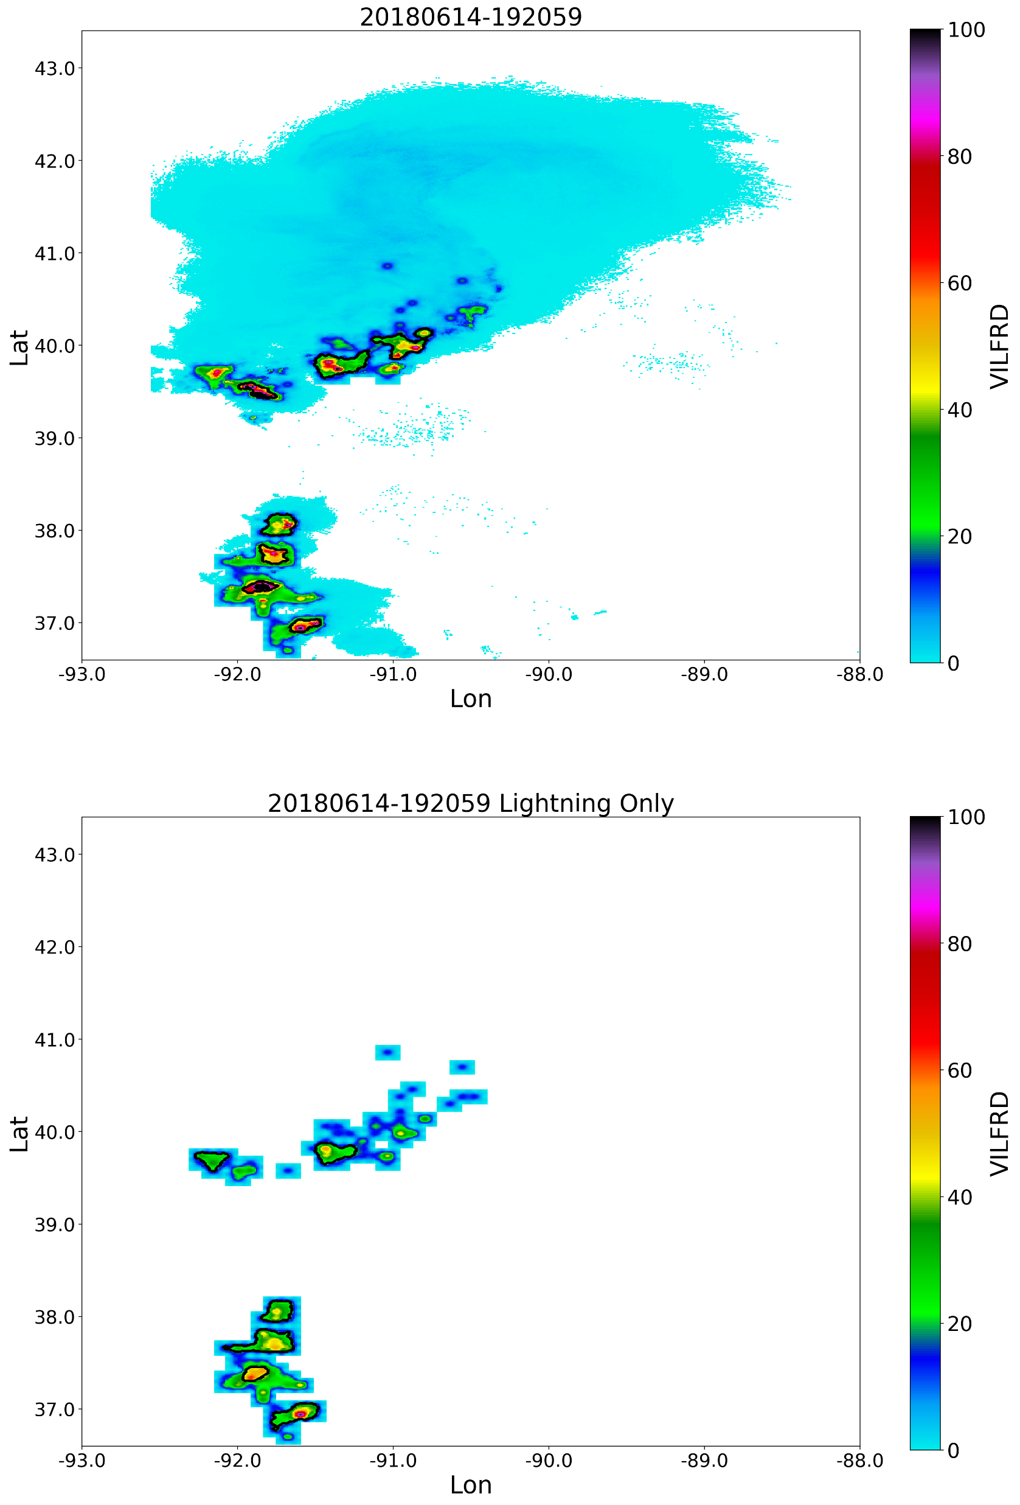
Lightning Only Tracking
• 20180614, central region case

Slide 7
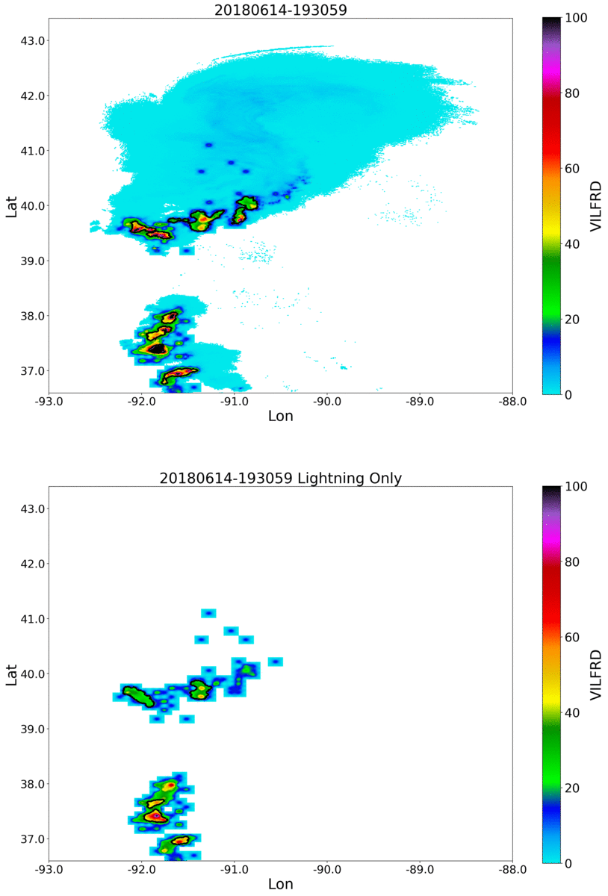
Lightning Only Tracking
• 20180614, central region case
insert a GIF, loop

Slide 8
Results: Comparing Original to Lightning Only
• Lightning only tracking captures less features overall than original
~ 60% of the total # of features found by original VILFRD
Original
Lightning Only
Central:
North Plains:
Northeast:
Southeast:
South:
Upper Midwest:
32
110
32
38
9
56
20
67
24
23
6
23
Total: 277 tracked features
Total: 163 tracked features

Slide 9
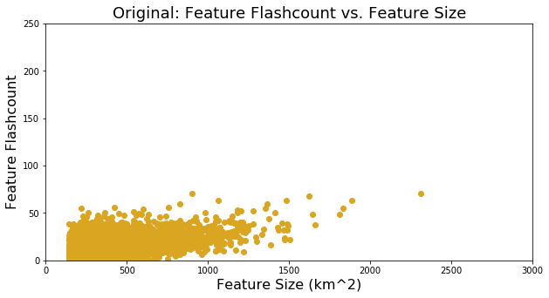
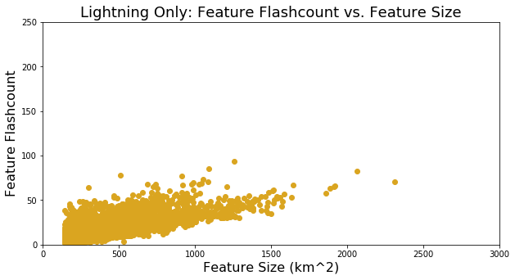
Results: Comparing Original to Lightning Only
• Statistics
Original
Lightning Only
Avg. Feature Size (km²):
Avg. Feature Duration (mins):
Avg. # Flashes/min:
Avg. Flash Density (%):
% Change in Size/min:
Change in Flashes/min:
319.5
60.3
11.4
3.85
19.2
3.8
364.6
56.2
16.6
4.95
19.9
4.9

Slide 10
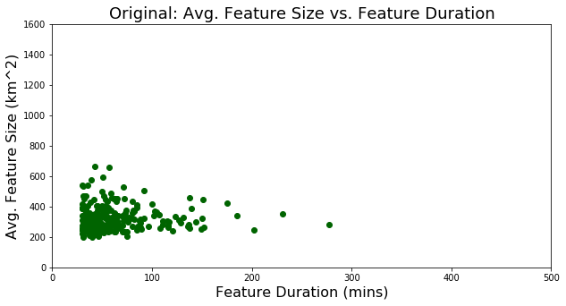
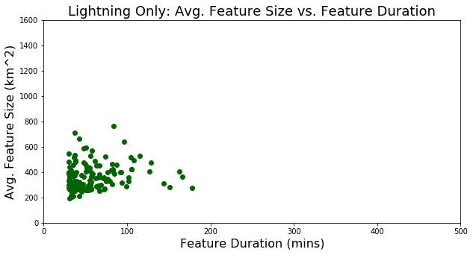
Results: Comparing Original to Lightning Only
• Statistics
Original
Lightning Only
Avg. Feature Size (km²):
Avg. Feature Duration (mins):
Avg. # Flashes/min:
Avg. Flash Density (%):
% Change in Size/min:
Change in Flashes/min:
319.5
60.3
11.4
3.85
19.2
3.8
364.6
56.2
16.6
4.95
19.9
4.9

Slide 11
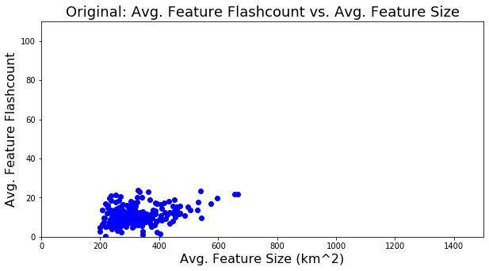
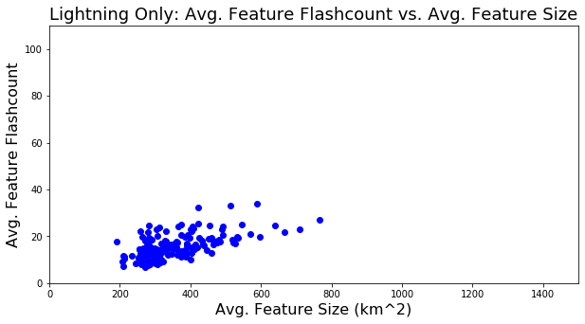
Results: Comparing Original to Lightning Only
• Statistics
Original
Lightning Only
Avg. Feature Size (km²):
Avg. Feature Duration (mins):
Avg. # Flashes/min:
Avg. Flash Density (%):
% Change in Size/min:
Change in Flashes/min:
319.5
60.3
11.4
3.85
19.2
3.8
364.6
56.2
16.6
4.95
19.9
4.9

Slide 12
Results: Comparing Original to Lightning Only
• Statistics
Original
Lightning Only
Avg. Max VIL:
Avg. Max MESH:
Standard deviation VIL:
Standard deviation MESH:
24.04
11.76
13.74
9.90
21.86
10.74
13.90
9.16

Slide 13
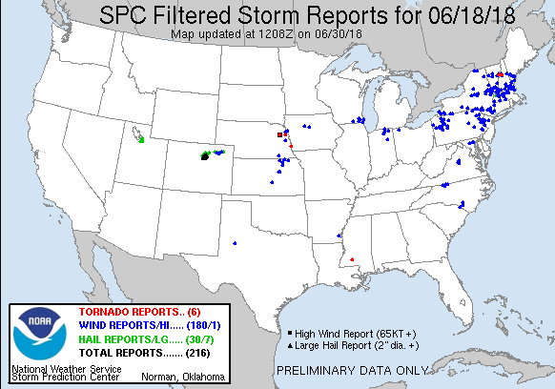
Results: Individual Storms
• Northeast (20180618)
- same storm produced two tornado reports in N NH

Slide 14
Results: Individual Storm Example
• Northeast (20180618)
- same storm produced two tornado reports in N NH
Original
Lightning Only
Feature Duration (mins):
Avg. Feature Size (km²):
Avg. # Flashes/min:
Avg. Flash Density (%):
% Change in Size/min:
Max VIL:
Max MESH:
136
269.2
10.1
4.01
17.4
24.38
11.15
82
306.1
13.7
4.59
15.5
24.38
11.15

Slide 15
Conclusions & Future Work
• Lightning only version of VILFRD creates comparable storm tracks to original VILFRD configuration, but captures less tracked storms overall.
- Why are less storms captured?
- Grab a subset of storms from original VILFRD that are not captured by lightning only tracking to determine
the characteristics of these storms.
- What are the types of storms being missed by lightning only VILFRD?
• MESH and VIL statistics were comparable between original tracking and lightning only.
• Lightning only tracking statistics showed larger average storm size, shorter durations, larger #flashes/min, and larger average flash density.
- Apply the lightning only tracking to the entire storm database.
Benefits regions where poor/non-existent radar coverage exists by tracking precipitation features through processes that exist below cloud top.

