Slide 1

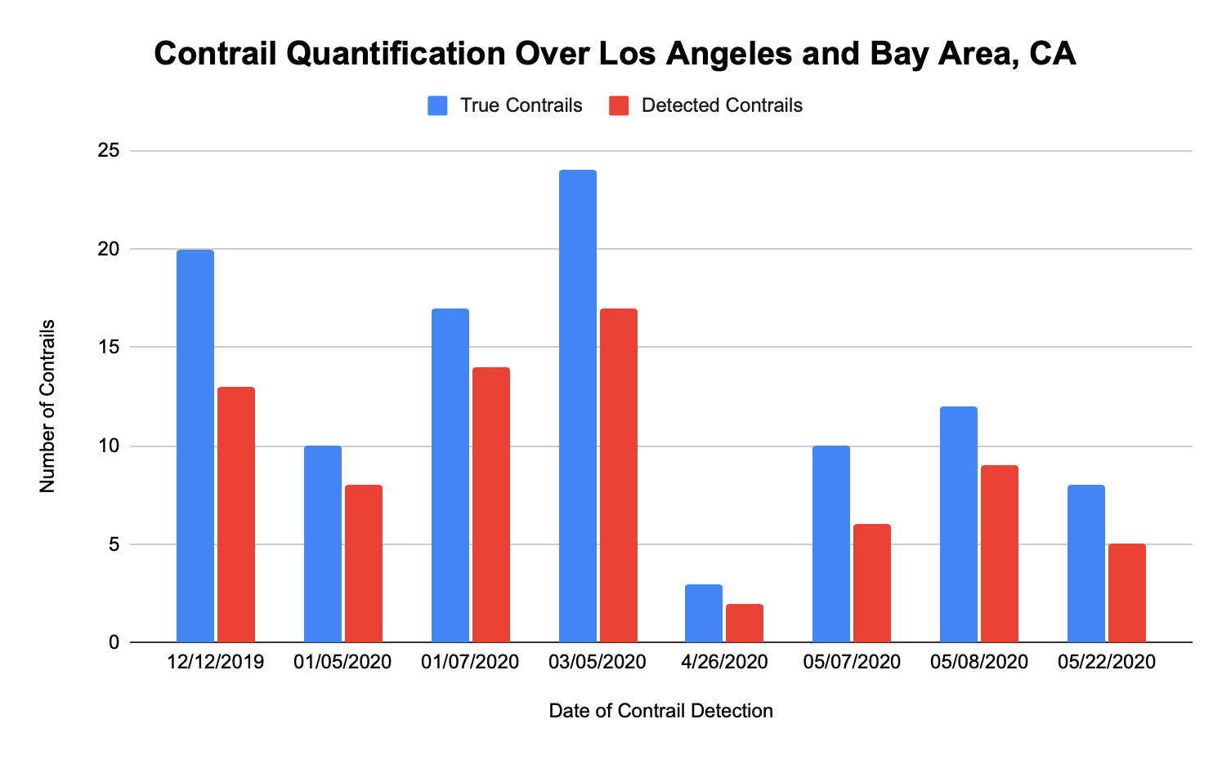

Comparing Two Automated Contrail Detection Algorithms on Terra MODIS Imagery
Ankur Shah (1), Hassan Muhammad (1), Iksha Gurung (1), Manil Maskey (2), Rahul Ramachandran (2)
1 – The University of Alabama in Huntsville, 2 – NASA Marshall Space Flight Center
Introduction
Methods
The second algorithm is a modified version of the Contrail Detection Algorithm (CDA) developed by Duda et al. in 2010 and originally created by Mannstein in 1999. The modified Mannstein CDA implements thresholds using additional binary masks using Band 27 (6.8 um), Band 29 (8.6 um), and Band 33 (13.3 um) along with the previous combination of Bands 31 and 32.
Conclusion
Contrails are vapor condensation trails created by aircrafts in the upper troposphere. These artificial linear clouds can cause positive radiative forcing, leading to atmospheric warming. Estimates suggest that contrails may be responsible for nearly 50% of all warming caused by aviation emissions (Kärcher, 2018). Therefore, automated detection of contrails for large-scale analyses is useful as manual detection is prone to human error and extremely time consuming. Multiple algorithms for contrail detection have been created. Two algorithms, one using line detection and the other using binary masks are presented in this work.
A sequential combination of phase congruency and the Hough transform is used for automated contrail detection on MODIS Terra satellite imagery. Each step of the algorithm is noted in the diagram below.
The loss of detection accuracy is primarily due to the Hough transform recognizing edges of clouds and land-water boundaries as lines leading to false positives in contrail detection. Furthermore, short, diffused, and broken contrails are not identified as lines by the phase-Hough algorithm.
Future work involves conducting further tests over different geographical areas over a longer range of time. There is a need to further improve the results of the phase-Hough method on MODIS imagery. Experimentation on the various parameters of phase congruency and explore thresholding methods to detect faint and possibly broken contrails. In conclusion:
It is challenging to isolate contrails from cirrus clouds using parameters such as brightness, shape index, and width.
The metrics on the neural network will be calculated to determine whether it is the best approach
Each step of the algorithm is explained briefly according the sequence in the diagram:
  Brightness temperature data for bands 31 and 32 is extracted from the MODTBGA HDF files.
  Band 31 is subtracted from band 32 to generate a Brightness Temperature Difference (BTD) image.
  Phase congruency, an edge detection technique using Fourier transforms, is applied on the BTD image (Kovesi, 2000). An example output is shown below.
  Hough transform is applied on the phase congruency output to detect lines. The Hough transform checks if features in an image fit a line equation (Padmanabhan, 2018). The combination of phase congruency and Hough transform is powerful to detect linear features on satellite imagery. An example final output is shown below.
The specific details of each step are described in Duda et al, 2010. A preliminary analysis was done over the Bay area in California. While results from this method are still pending, the modified Mannstein algorithm is more complicated and computationally intensive than the phase-Hough algorithm as it requires more memory for implementation.
Data Products
The MODTBGA Version 6 Moderate Resolution Imaging Spectroradiometer (MODIS) Level 2 Gridded Lite (L2G-lite) Thermal Band product of the Terra instrument was used for contrail detection. The MODTBGA v006 product consists of brightness temperature data from MODIS bands 20, 31, and 32. This data product has a temporal resolution of one day and a spatial resolution or pixel size of 1 km. For the modified Mannstein algorithm, the MODIS L1B MOD021KM dataset was used. It consists of the calibrated radiances of all 36 bands of MODIS which were converted into brightness temperature values for contrail detection. Both data products were stored as Hierarchical Data Format (HDF) files.
Figure A: neque dignissim, and in aliquet nisl et umis.
Results
The phase-Hough algorithm was preliminarily tested over Los Angeles and the Bay area in California for specific dates before and after the pandemic lockdowns. The detection accuracy is defined as the number of algorithmically detected contrails divided by the total number of manually validated contrails on a satellite image.
The overall detection accuracy was calculated to be 70.3% over 8 brightness temperature difference images from the MODTBGA v006 product.
References
1. Burkhardt, U., Kärcher, B. Global radiative forcing from contrail cirrus. Nature Clim Change 1, 54–58 (2011). https://doi.org/10.1038/nclimate1068
2. Kärcher, B. Formation and radiative forcing of contrail cirrus. Nat Commun 9, 1824 (2018). https://doi.org/10.1038/s41467-018-04068-0
3. Padmanabhan, Viveknarayanan. (2014). Automatic Contrail Detection and Segmentation in Polar-orbiter Satellite Images [Unpublished Master's thesis]. Penn State University.
4. Duda, D. P., Minnis, P., Khlopenkov, K., Chee, T. L. and Boeke, R. (2013), Estimation of 2006 Northern Hemisphere contrail coverage using MODIS data, Geophys. Res. Lett., 40, 612– 617, doi:10.1002/grl.50097.
5. Kovesi, P. Phase congruency: A low-level image invariant. Psychological Research Psychologische Forschung 64, 136–148 (2000). https://doi.org/10.1007/s004260000024
6. Han, Qi & Zhao, Kai & Xu, Jun & Cheng, Mingg-Ming. (2020). Deep Hough Transform for Semantic Line Detection.
This research is supported by NASA Grant NNM11AA01A as part of the Interagency Implementation and Advanced Concepts Team (IMPACT) program
Contact: aas0024@uah.edu
Mauris orci mi, varius id diam id, egestas auctor enim.

