Slide 1
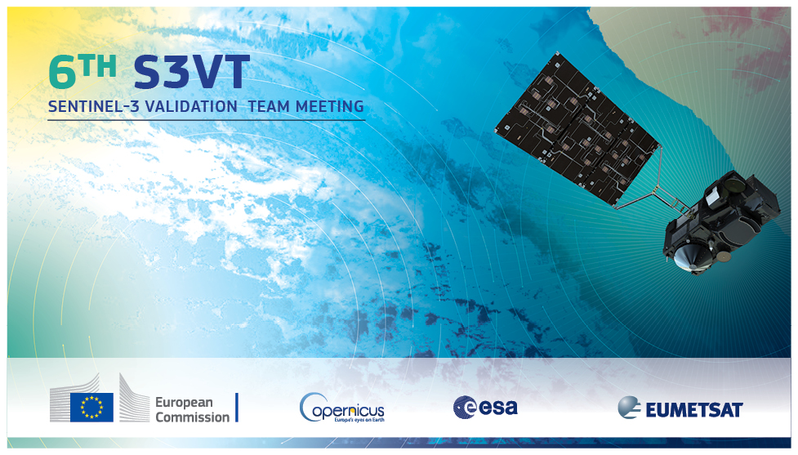
-
CLOUD TOP PRESSURE RETRIEVALS FROM OLCI AS A PROXY FOR FUTURE PACE OCI
Andrew M. Sayer^{1,2}, Brian Cairns³, Amir Ibrahim^{2,4}, Kirk Knobelspiesse², Jeremy Werdell²
1: USRA, Columbia, MD, USA; 2: NASA GSFC, Greenbelt, MD, USA; 3: NASA GISS, New York, NY, USA; 4: SSAI, Lanham, MD, USA

Slide 2
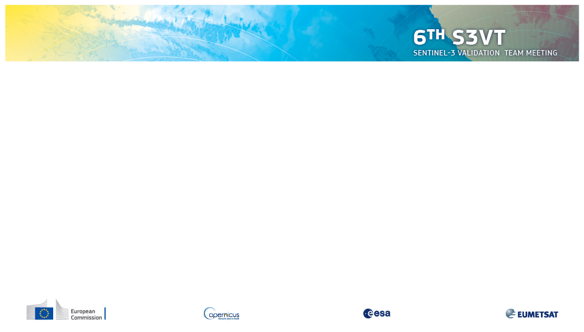
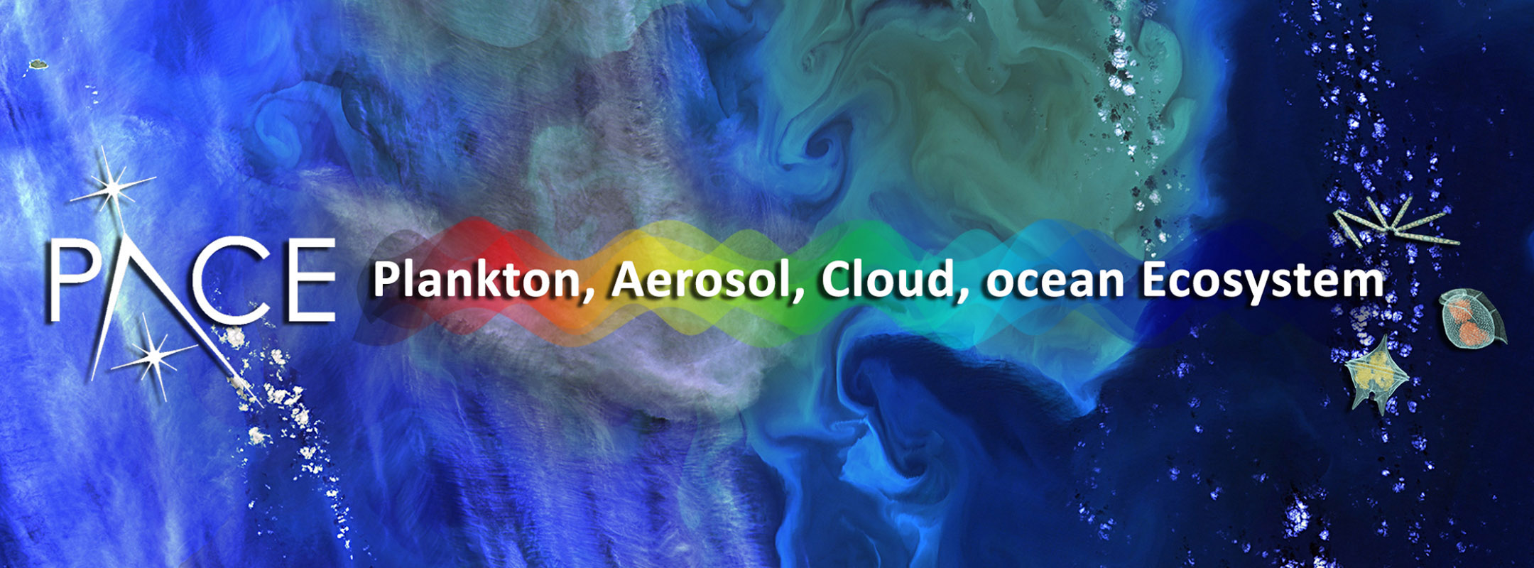
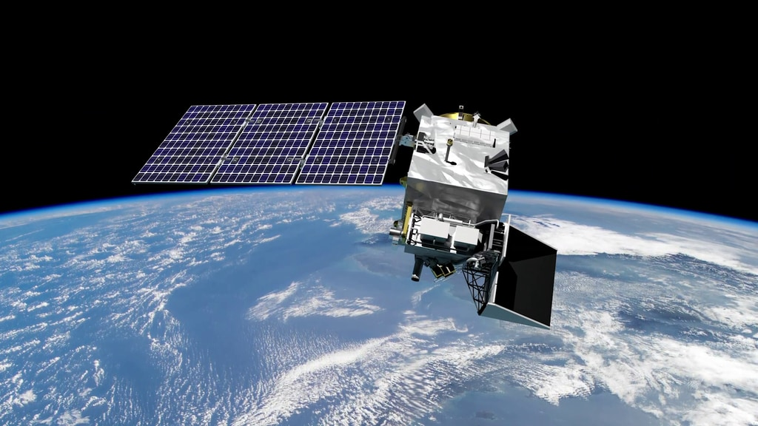
The PACE mission
PACE will continue and enhance ocean colo(u)r, aerosol, and cloud data records
  Launch ~2023
  3 year nominal mission; fuel for 10
  Polar orbit, 1 pm local solar Equatorial crossing time
Three instruments:
  Ocean Color Imager (OCI)
    Tilted to decrease glint, ~2663 km swath
  Multi-angle polarimeters:
    HARP2 (UMBC)
    SPEXone (SRON)
https://pace.gsfc.nasa.gov/

Slide 3
PACE required data products
OCEAN
Water-leaving reflectances from 350-710 nm
Concentration of chlorophyll-a
Spectral diffuse attenuation coefficients
Spectral phytoplankton absorption
Spectral non-algal particle plus dissolved organic matter absorption
Spectral particulate backscattering coefficient
Fluorescence line height
ATMOSPHERE
Aerosol optical depth from 380-675 nm
Fine mode fraction of aerosol optical depth over oceans at 550 nm
Cloud mask
Cloud top pressure
Cloud optical thickness
Cloud effective radius
Cloud liquid/ice water path
Required products must be produced routinely, globally from OCI for the mission to be a success
  ~1 x 1 km² pixel area (at nadir) with several hours latency
Advanced products (OCI and/or polarimeter) are not required, but we hope to generate many
  Latency and coverage may be more limited
  https://pace.oceansciences.org/data.htm

Slide 4
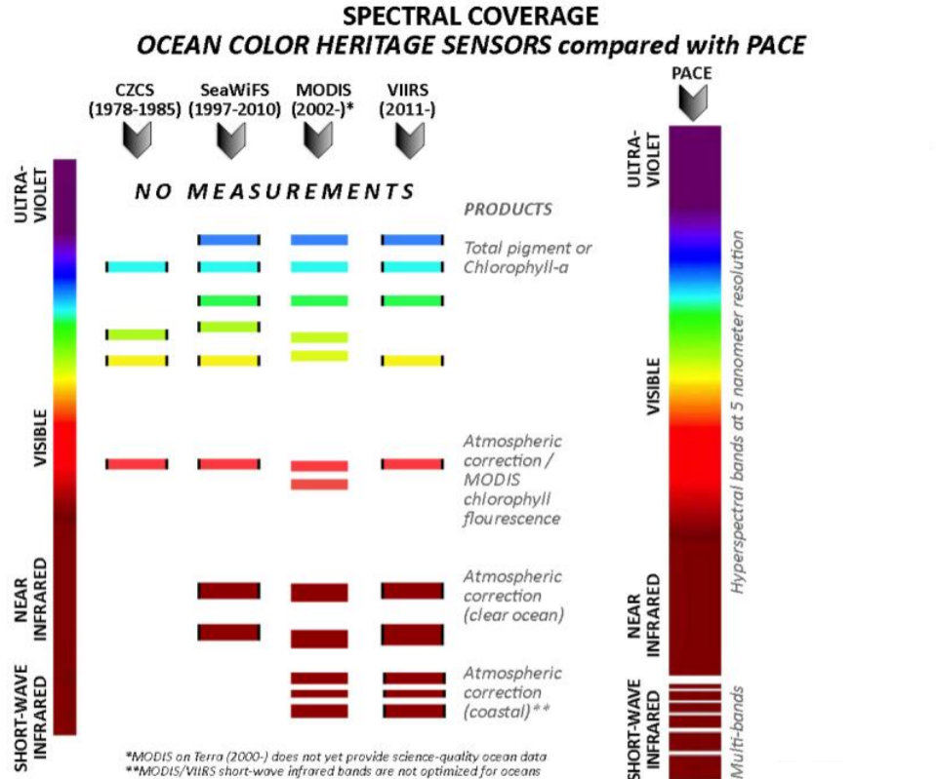
The OCI sensor
OCI will have continuous spectral coverage from the UV to nIR (2.5 nm spacing, 5 nm FWHM) plus 7 discrete swIR bands
There is no perfect OCI proxy
  O₂ A-band is needed for OCI cloud top pressure
  OLCI has several channels plus similar spatial resolution
  So, prototype cloud top pressure retrieval with OLCI
  Only used S3A Reduced Resolution products
Through PACE development we can help to evaluate the OLCI sensor, and collaborate with researchers on ESA/EUMETSAT atmospheric products

Slide 5
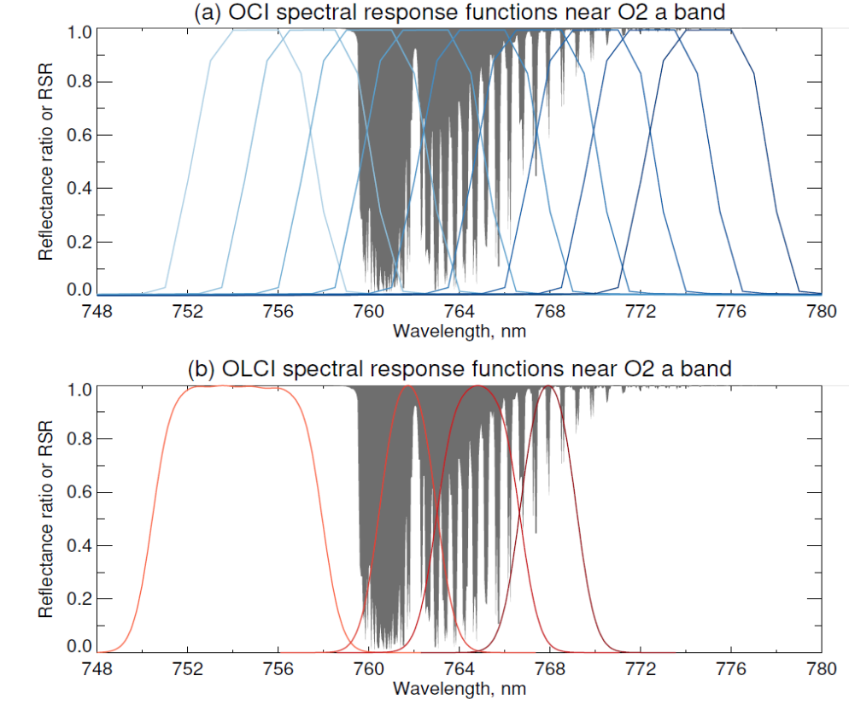
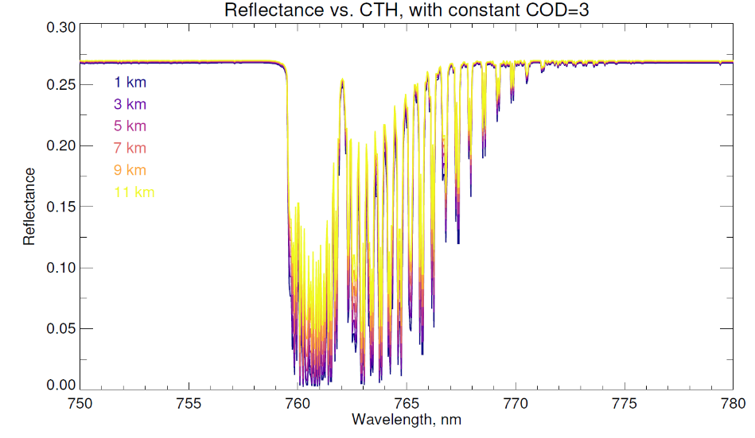
OCI and OLCI have similar A-band sampling

Slide 6
Cloud top pressure retrieval algorithm
Optimal Estimation approach provides uncertainty estimates; choose phase and quality flags based on retrieval cost
Priors:
  COD, CTP unconstrained
  Surface albedo (MERIS climatology, Popp et al. 2011)
Covariance matrix components:
  Random error
  Systematic calibration uncertainty
  Spectrally-correlated forward model uncertainty
Ancillary data/assumptions:
  Surface pressure (MERRA2)
  Cloud mask (from SNAP toolbox)
  Cloud profile (single homogeneous layer, halfway from cloud top to surface, fixed effective radius and variance)
MEASUREMENT VECTOR
All scaled by 0.975 (C. Mazeran)
Band OA12 (753 nm)
Band OA13 (761 nm)
Band OA14 (764 nm)
Band OA15 (767.5 nm)
STATE VECTOR
Cloud optical depth (COD)
Cloud top pressure (CTP)
Surface albedo in A-band

Slide 7
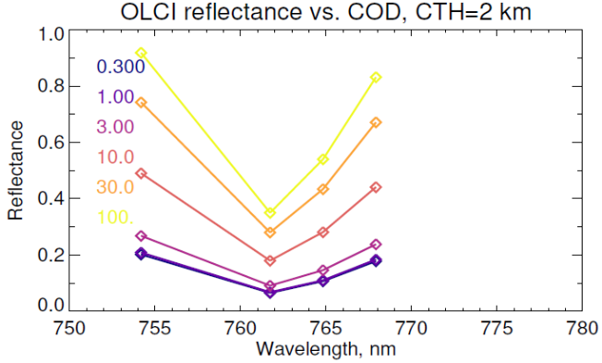
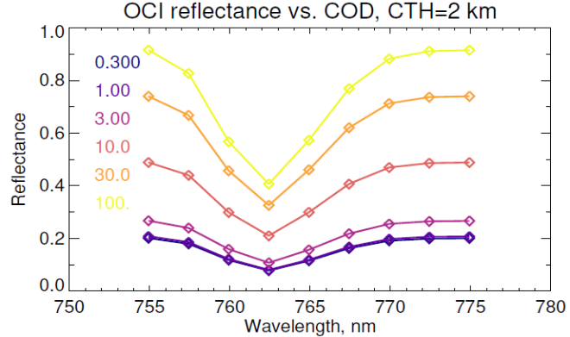
Radiative transfer notes
Solver:
  Libradtran implementation of DISORT with 16 hemispherical streams
Cloud and aerosol:
  Liquid clouds from Mie theory
  Ice clouds from Yang et al. (2013) data base (severely roughened column aggregates as in MODIS)
  Shettle & Fenn aerosols (AOD ~0.07 at 750 nm)
Gas:
  Lines from HITRAN 2012 (will update to 2020 when available)
  CIA continuum from MT-CKD v3.3
  Surface pressures from 1050-600 mbar, standard atmosphere, 300 DU O₃
Spectral:
  Run at ~0.015 nm resolution and convolve with OLCI RSR
  LUT includes smile distortion dimension (0.15 nm spectral shift step size)

Slide 8
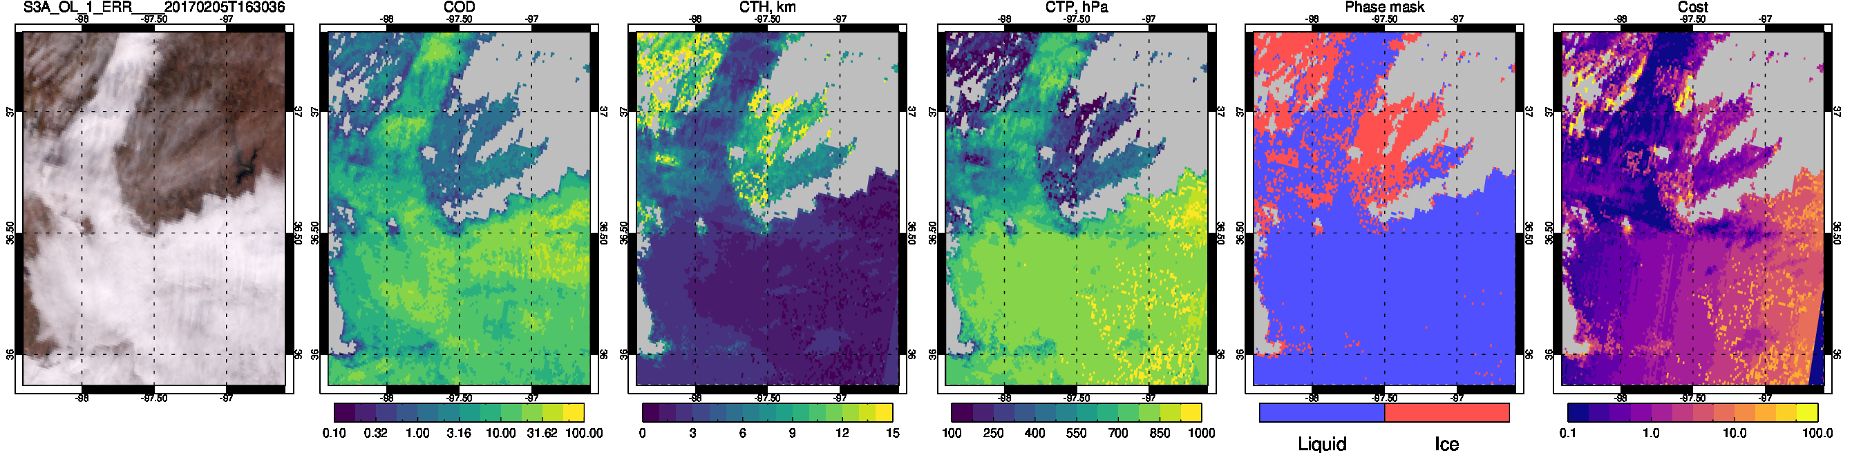
Example granule at ARM Southern Great Plains (SGP) facility
COD
CTH (km)
CTP (hPa)
Phase
Cost
SGP site location

Slide 9
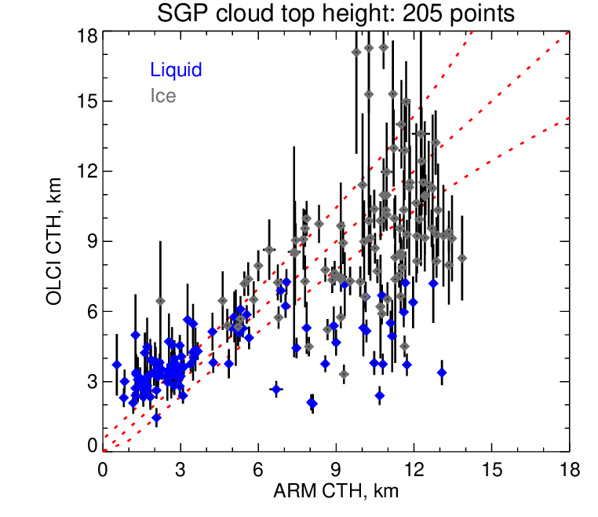
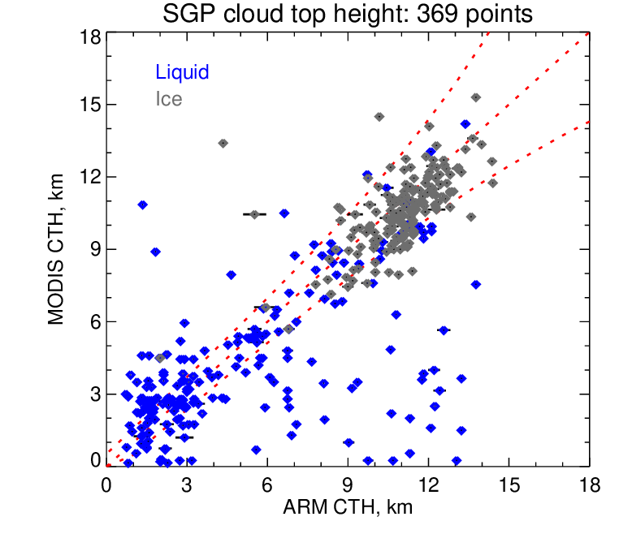
Validation at SGP: all clouds

Slide 10
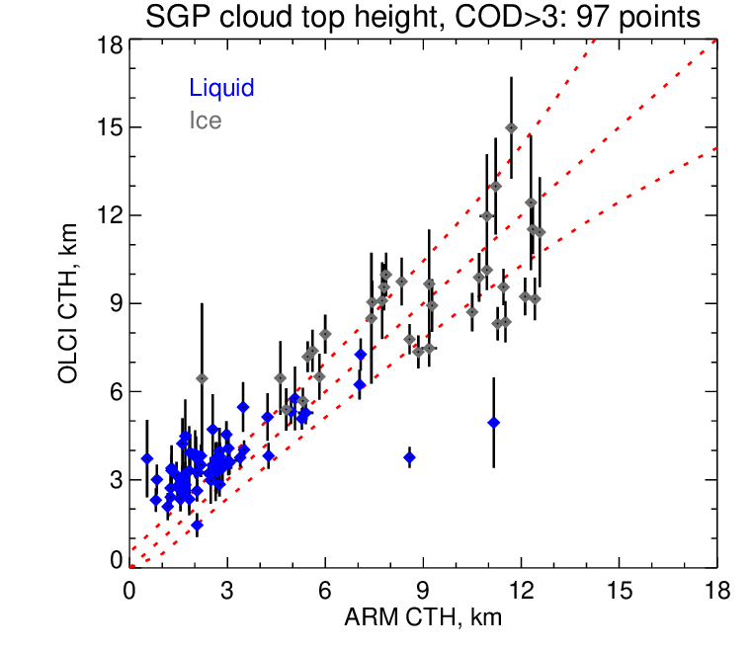
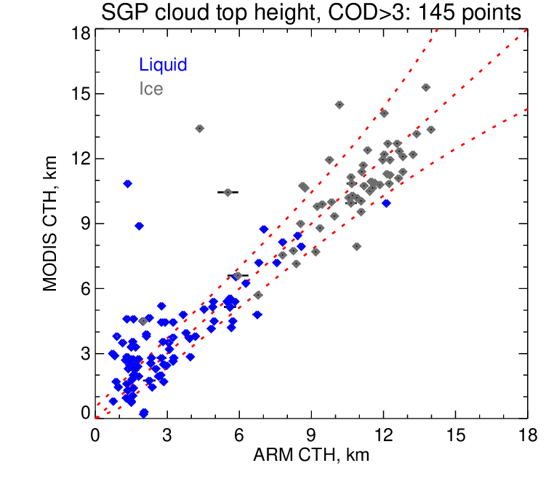
Validation at SGP: single-layer opaque clouds

Slide 11
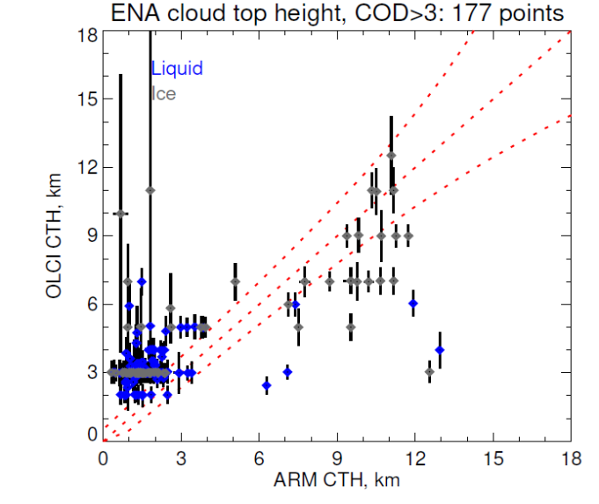
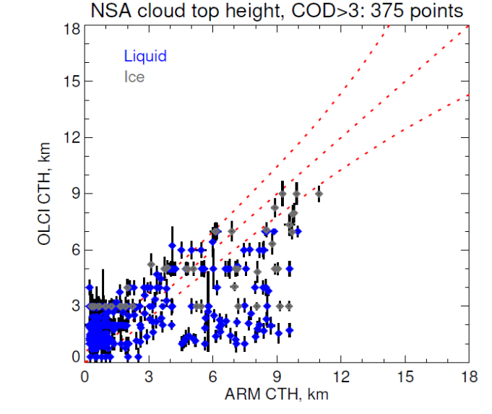
Validation at ENA and NSA
ARM East North Atlantic (ENA) has lots of water, North Slope of Alaska (NSA) has lots of snow
  More extreme albedo conditions
Still have the positive offset for low clouds
Retrieval often sits on node points
Cost functions also higher
Not as good performance as MODIS here (not shown)

Slide 12
What’s next?
Algorithm works (yay) but not as well as it should (boo)
  Positive offset in low level clouds, module-dependence of cost
Why?
  Code bug(s)?
  Treatment of O₂ A-band insufficient?
  OLCI spectral response/smile/calibration issues?
2021 plans:
  Test and update assumptions
  Extend validation to CloudNet, airborne field campaigns, spaceborne lidar
  Large-scale MODIS comparisons
Would like to collaborate with others working on OLCI O₂ A-band retrievals!
  Email me: andrew.sayer@nasa.gov

