Slide 1
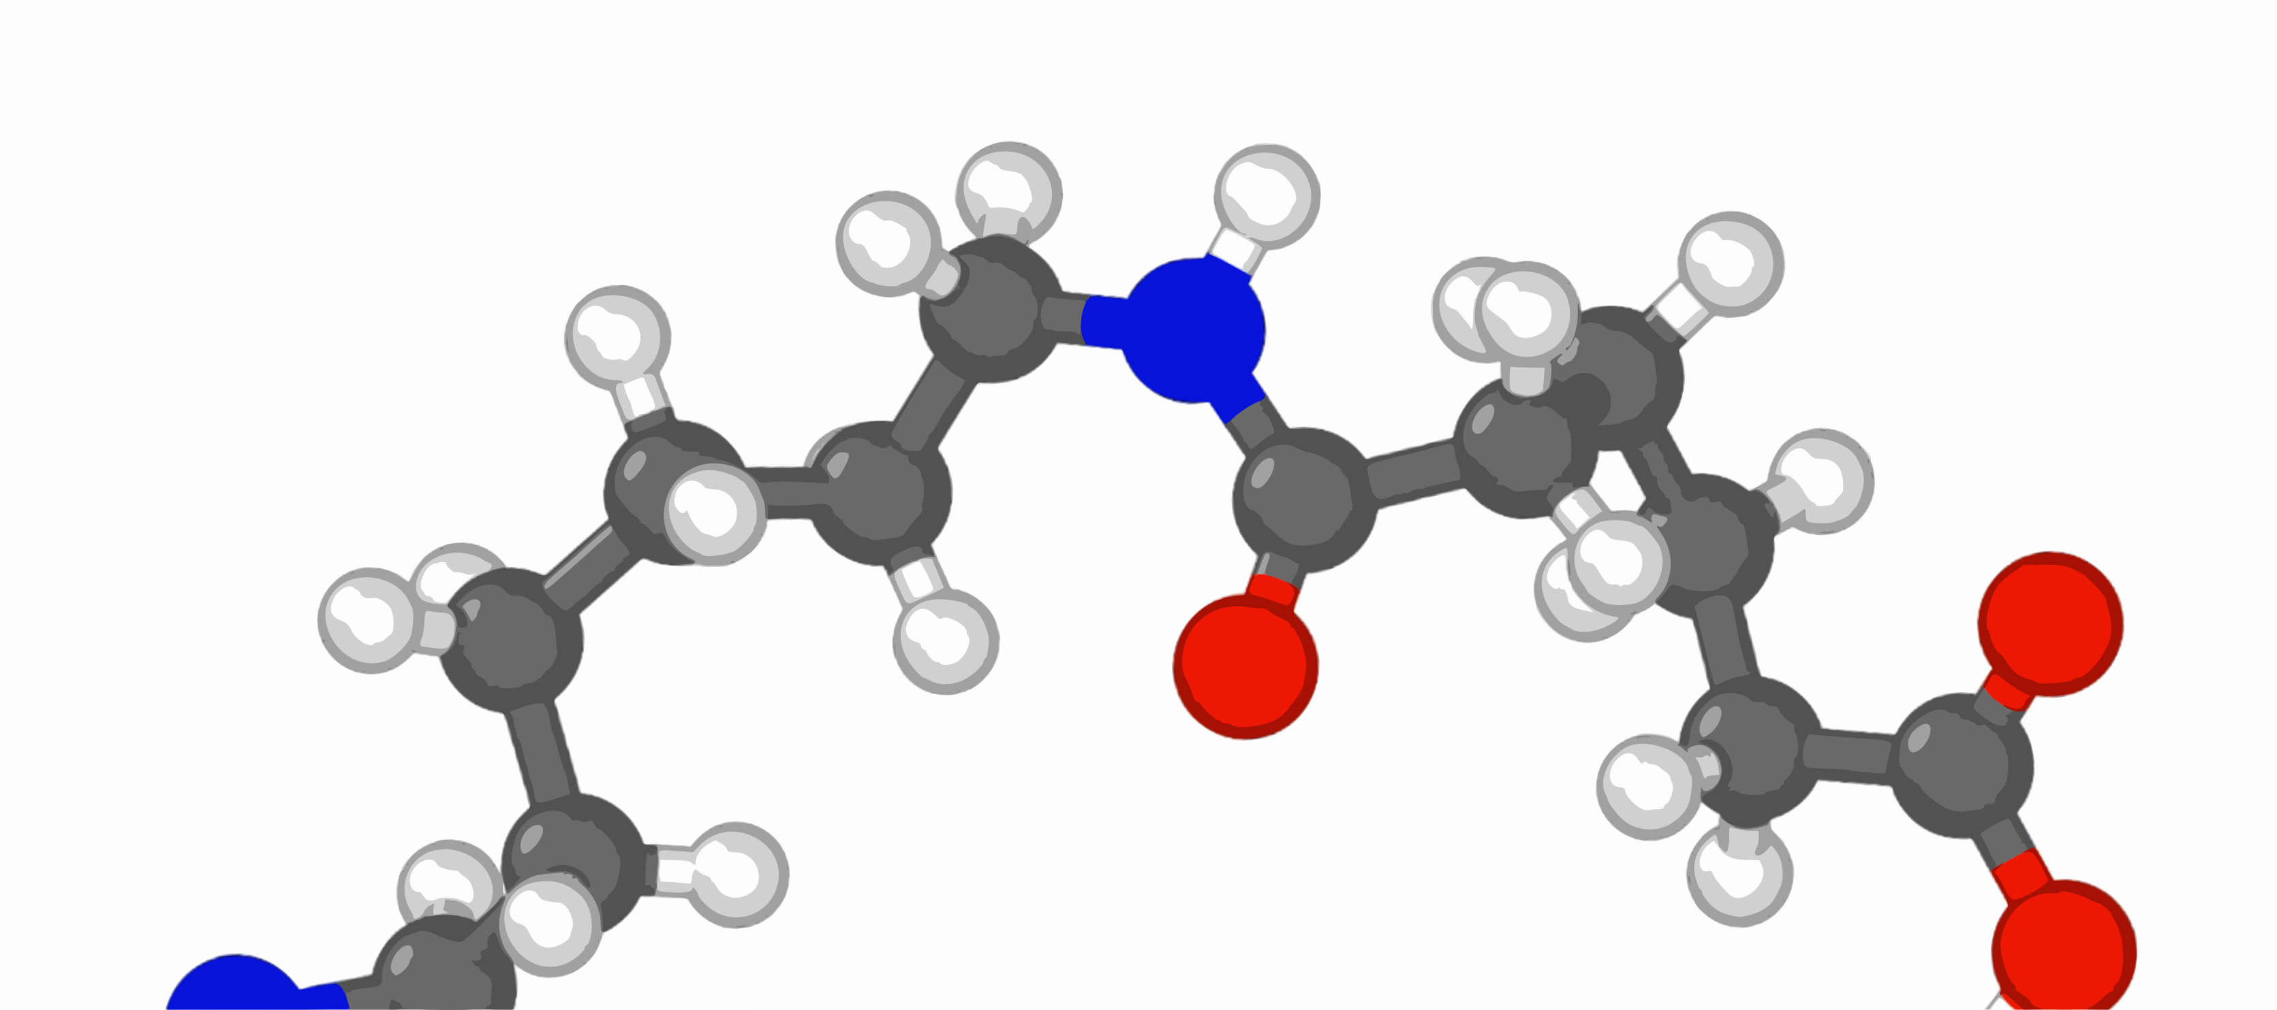


Reactive Molecular Dynamics using REACTER
Jacob Gissinger
NASA Langley Research Center
US-COMP
Jan 6, 2021
jacob.gissinger@nasa.gov
newly polymerized

Slide 2
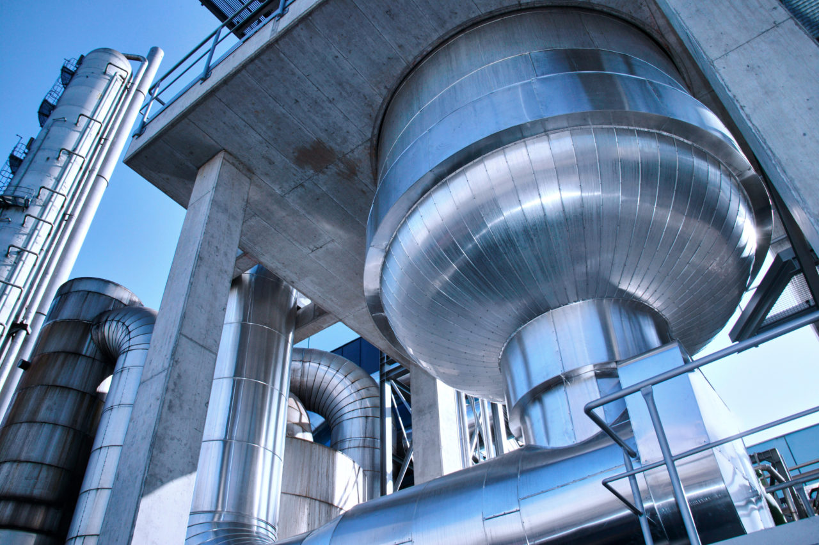
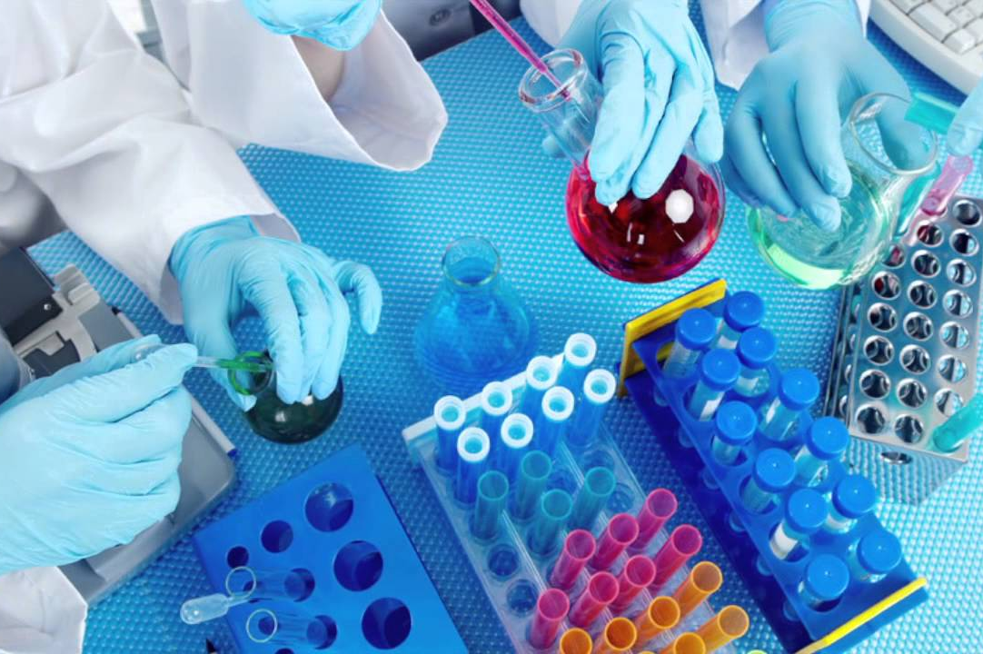
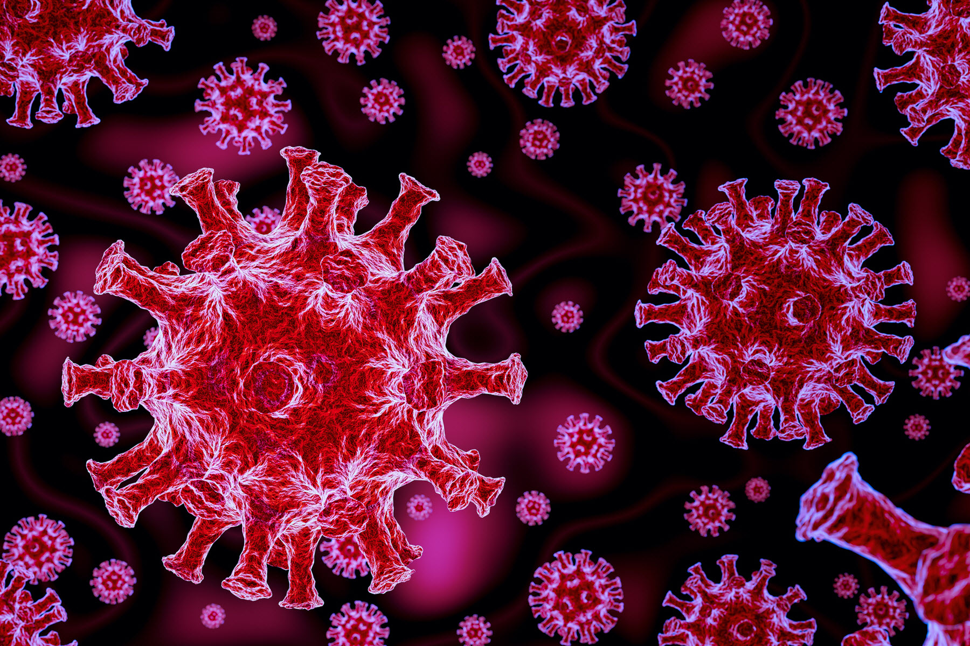
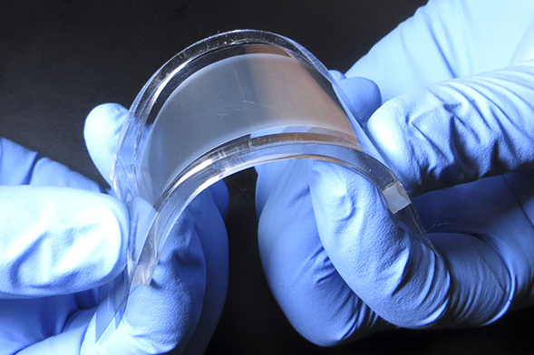
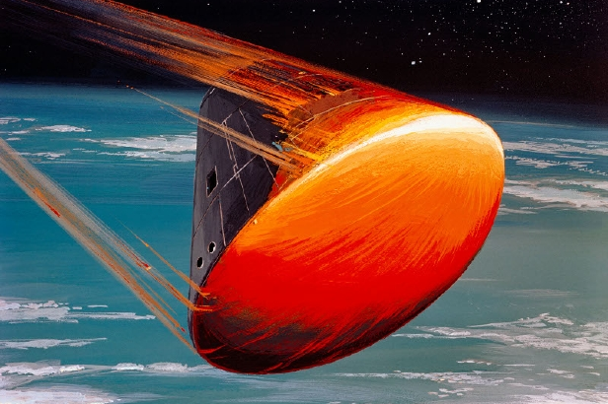
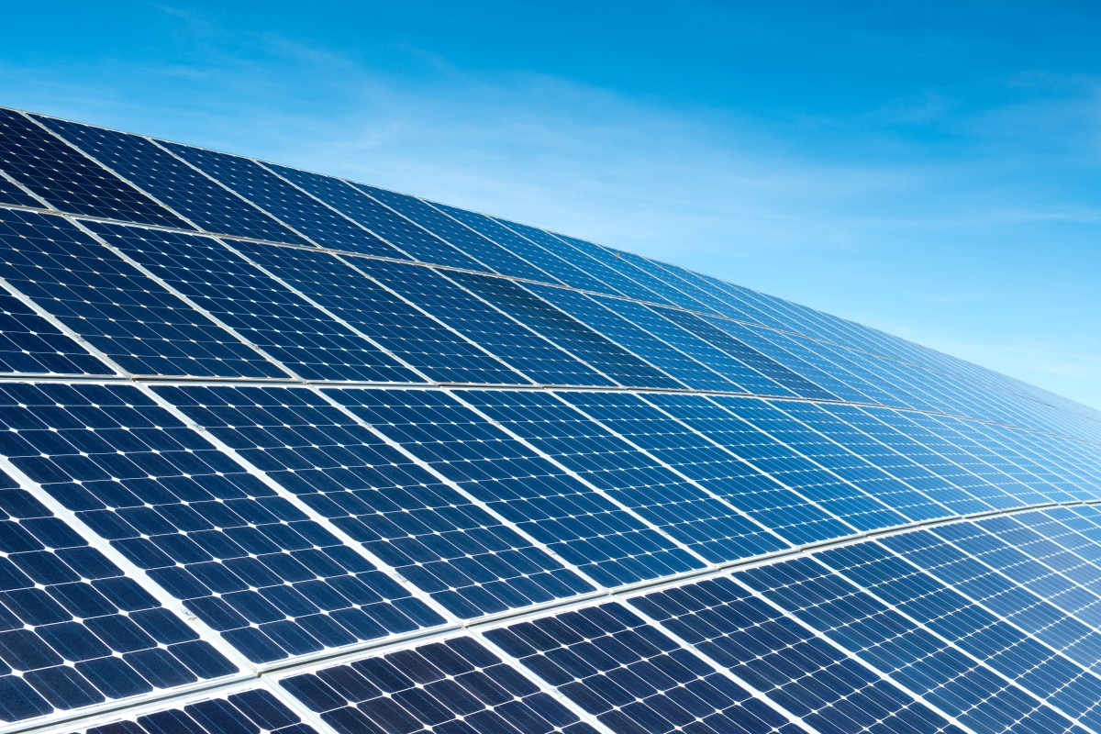
Chemical Reactions are Everywhere
Industrial Processes
Pharmaceuticals
Biological Systems
Polymers
Extreme Materials
Energy

Slide 3
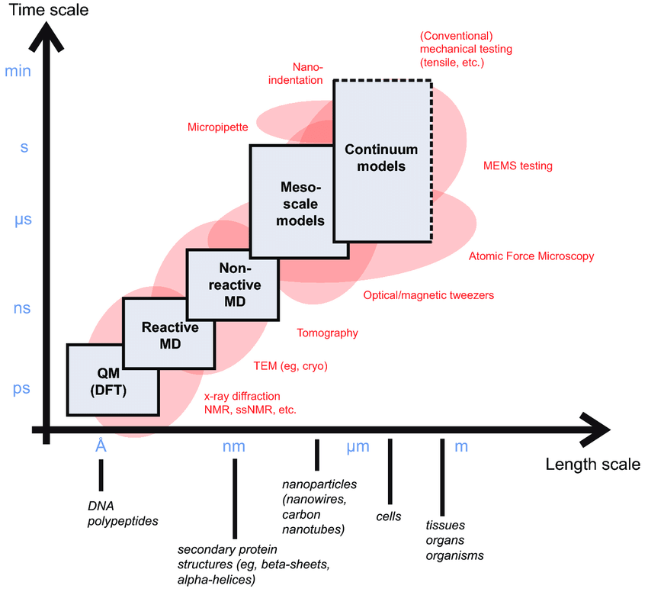
Missing Scale for Reaction Modeling
Quantum mechanics can model reactions from first principles
Levels of abstraction come with a tradeoff: accuracy vs. speed
Reactive force fields can achieve near-DFT accuracy
  Much faster than DFT, much slower than classical MD
Can a heuristic description of reactions allow for reactive modeling at much greater scales?
Reactive models?
Jancar et al. Current issues in research on structure-property relationships in polymer nanocomposites. Polymer 51(15) (2010).

Slide 4
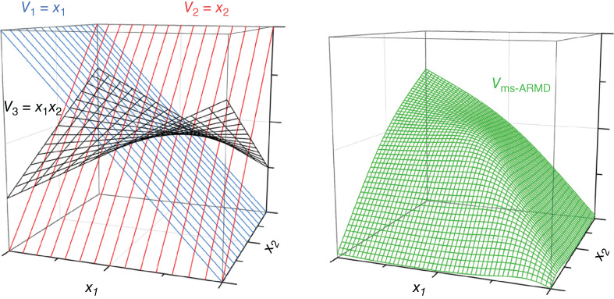
Related Prior Work
Empirical Valence Bond (EVB) – Hamiltonian calibrated using known reaction dynamics
MS-ARMD (CHARMM) – Multistate Adiabatic Reactive Molecular Dynamics
  Potential energy surface created by weighted mixing of force field parameters
ReaxFF – Reactive Force Field
Path Integral Molecular Dynamics
QM/MM – Multiscale Simulations
Meuwly. Reactive molecular dynamics: From small molecules to proteins. Wiley Interdisciplinary Reviews: Computational Molecular Science, 9(1), e1386. (2019).

Slide 5
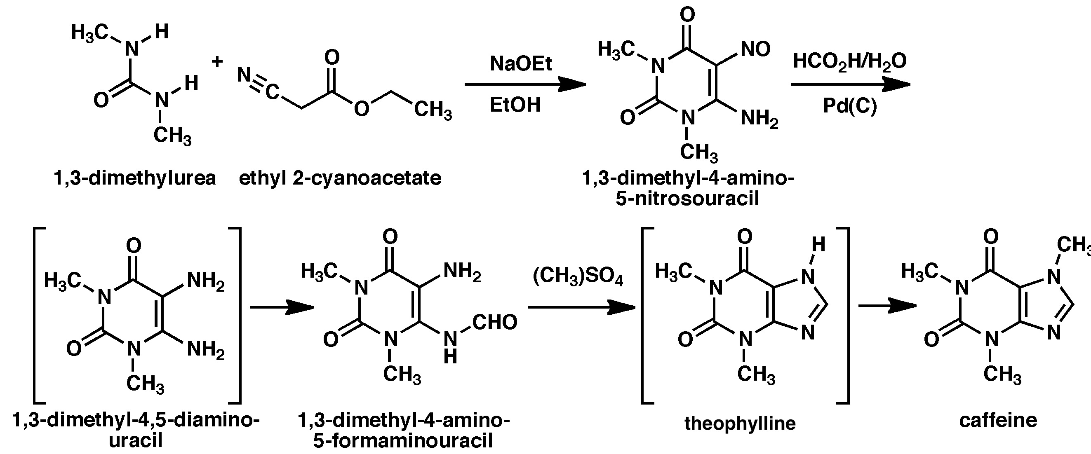
There is Much Heuristic Knowledge in Chemistry
Many relevant reaction pathways are already well characterized
  Polymer chemistry, organic chemistry, materials science
  Reaction pathways available in literature, textbooks, and online databases
Dynamic modeling of products forming from reactants allows:
  Creation of realistic initial configurations for further study
  Large-scale, computationally-efficient simulations of reactive systems
Example of a sequence with complex but well-characterized reactions (artificial synthesis of caffeine).
Temple NJ, Wilson T (2003). Beverages in Nutrition and Health. Totowa, NJ: Humana Press. p. 172.

Slide 6
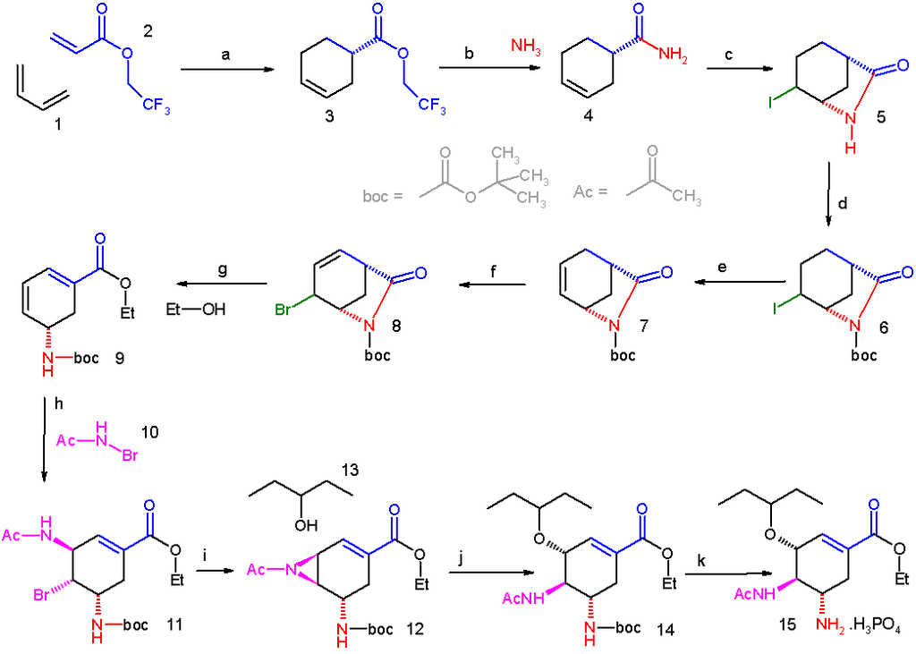
A ‘Reaction’ Option for Classical MD was Overdue
Previous Options (in LAMMPS):
Create or break a single bond
based only on interatomic distance
No specificity with respect to
topology near reactive site
Alternatives: ReaxFF (or QM/MM)
Needed for probing mechanisms
Large number of energy parameters
Slower and less mature than classical MD
Many researchers still use ad hoc scripts to
adjust bond connectivity between MD runs
An important organic synthesis: Tamiflu.

Slide 7
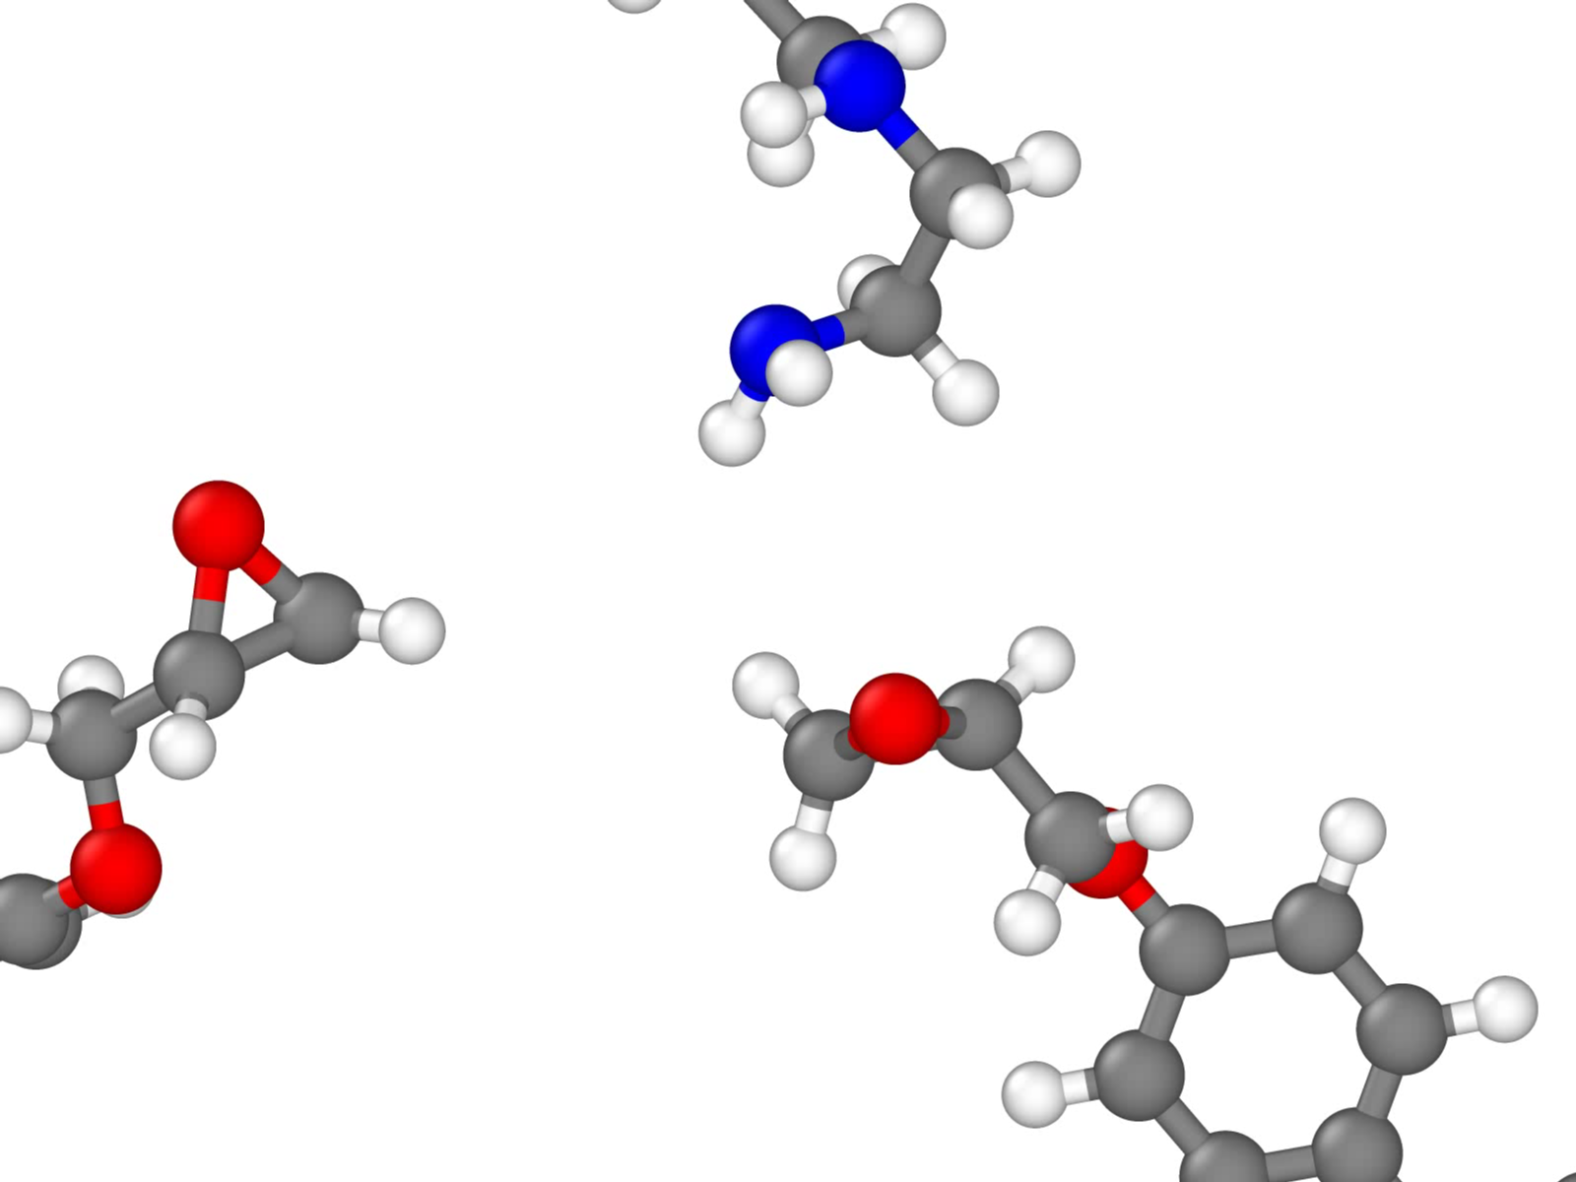
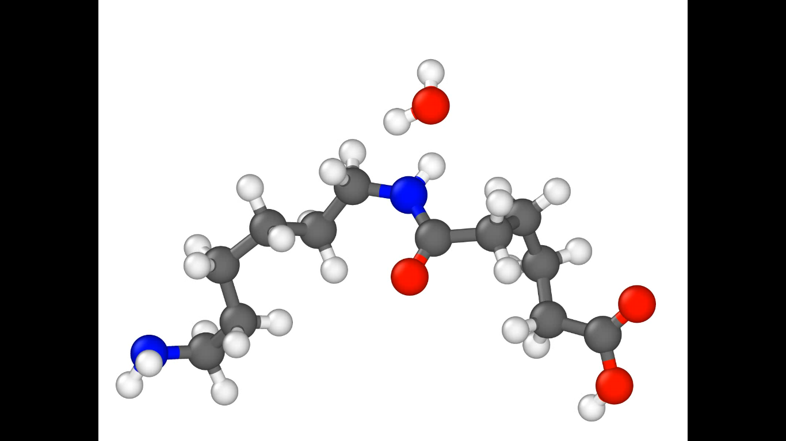
What is REACTER?
A protocol for adjusting topology during classical MD
  Add/remove specific bonds, angles, dihedrals, and impropers
  Modify all force field types as well as atomic charges
  Supports any fixed-valence force field (PCFF, OPLS, etc.)
  Reaction stabilization
Parallel implementation in LAMMPS as fix bond/react
  User inputs: molecule templates of pre- and post-reaction topology
  A map file relating atoms before and after the reaction
REACTER: A Heuristic Method for Reactive Molecular Dynamics.
Gissinger, Jensen & Wise. Macromolecules 53, 22, 9953–9961 (2020).
www.reacter.org

Slide 8
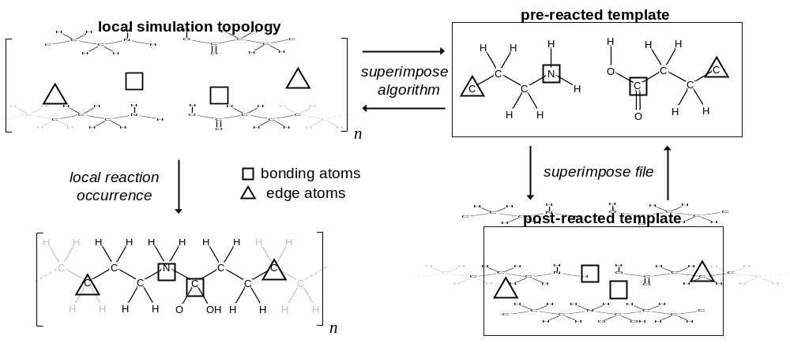
How does REACTER work?
running MD simulation
user inputs
mapping file
The Superimpose Algorithm locates all instances of local reaction site
Local site is related atom-by-atom and updated to reacted template

Slide 9
REACTER: Standard Features
REACTER supports:
  Arbitrary reactions, any classical force field, on-the-fly minimization
Useful capabilities:
  Support for coarse-grained systems
  Limit total occurrences of a given reaction
    Use case: Stop reactions after a certain percentage of crosslinking
  Use variables for inputs (reaction cutoff, probability and frequency)
    Use case: define reaction cutoff as a function of extent of reaction
Additional options:
  Reaction constraints
  Delete user-specified atoms, based on topology

Slide 10
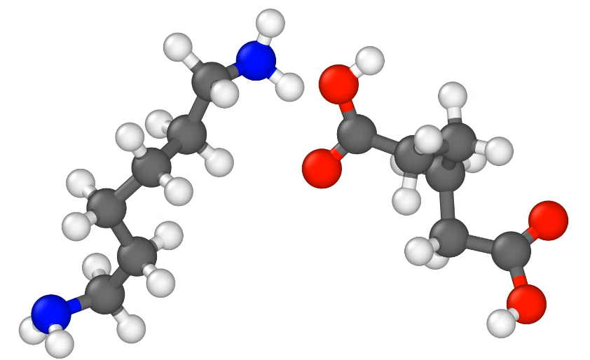
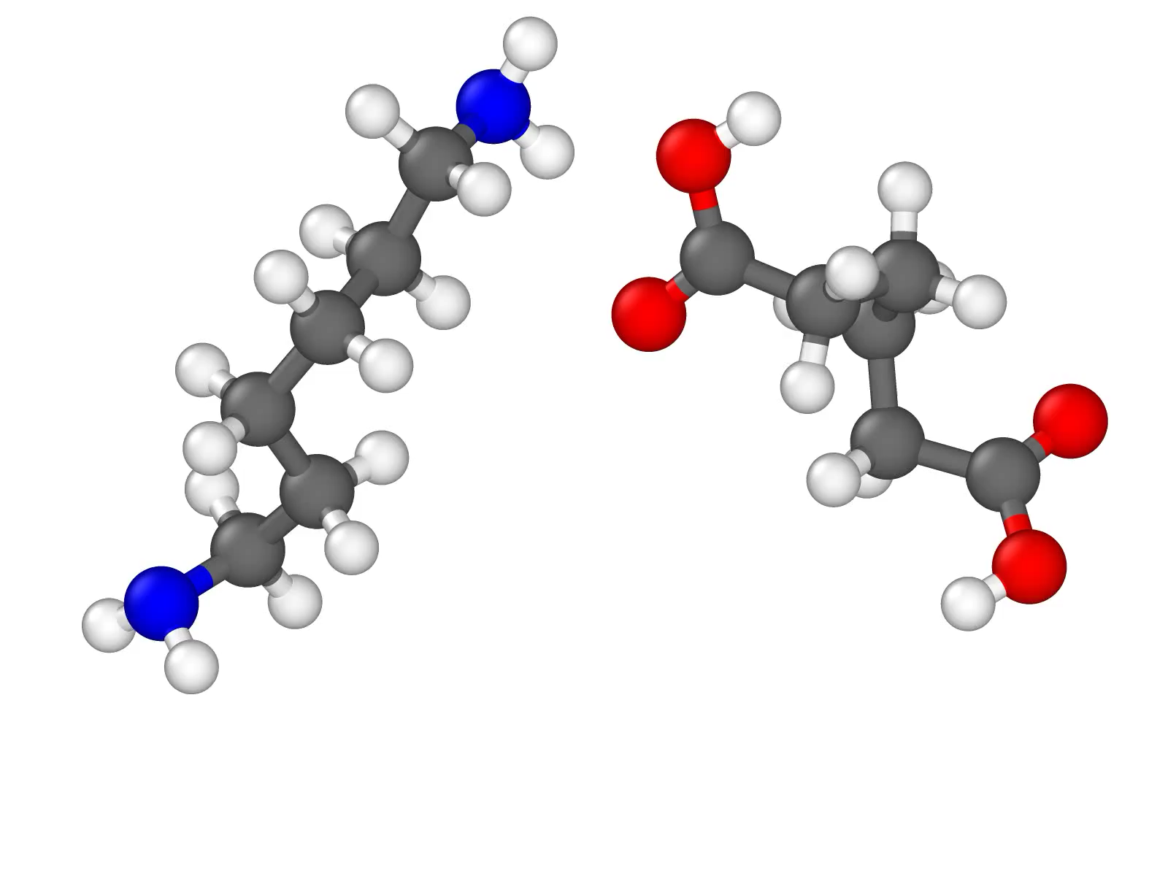
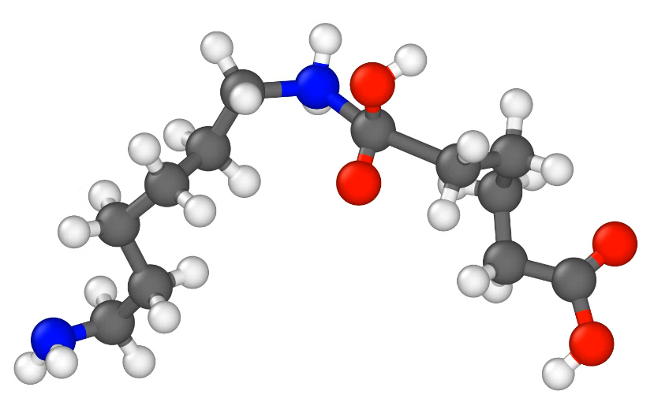
Delete Atoms Based on Topology
1) Delete unwanted reaction by-products
2) Remove specific molecules based on topology (such as small rings)
deletion of condensed water molecule
nylon polycondensation

Slide 11
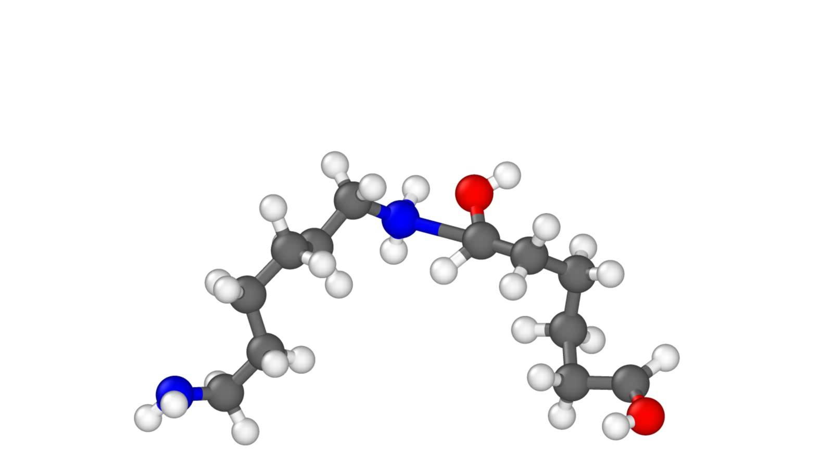
Bond-Breaking Reaction Trigger
Simple criterion for mechanically-induced chain scission
Or, if using custom criteria, REACTER can be used to reorganize topology

Slide 12
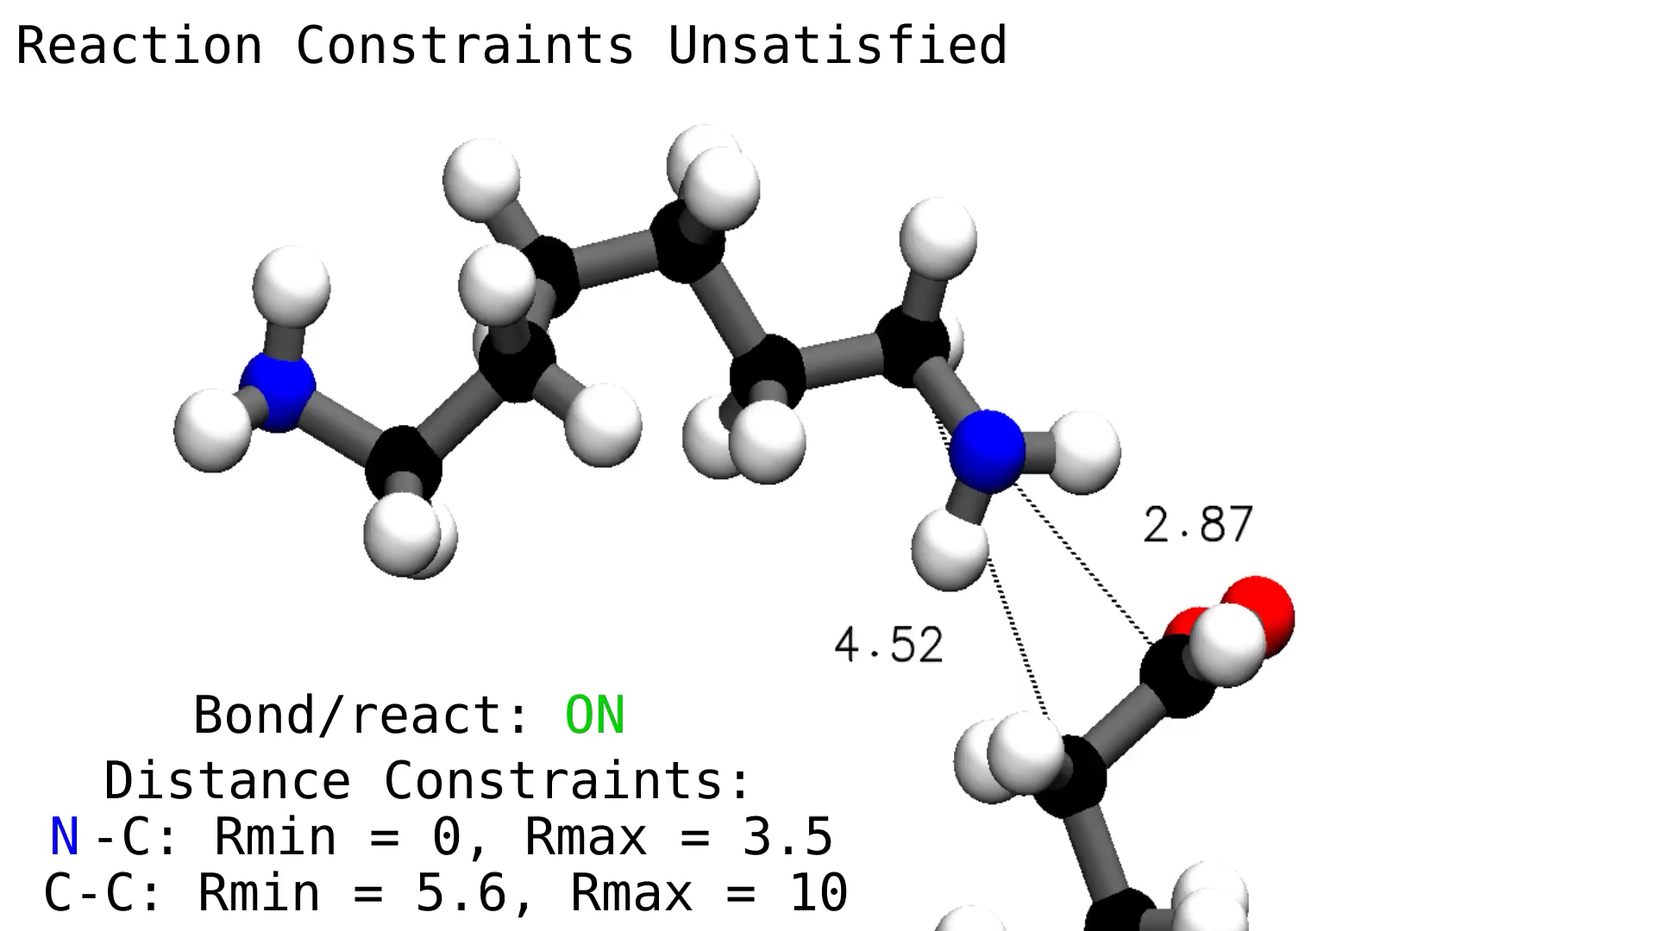
Reaction Constraints
Currently five constraints: Arrhenius, RMSD, distance, angle, dihedral
  Can be used to enforce a relative orientation between reacting molecules
Demo: two distance constraints enforce a certain molecular orientation

Slide 13
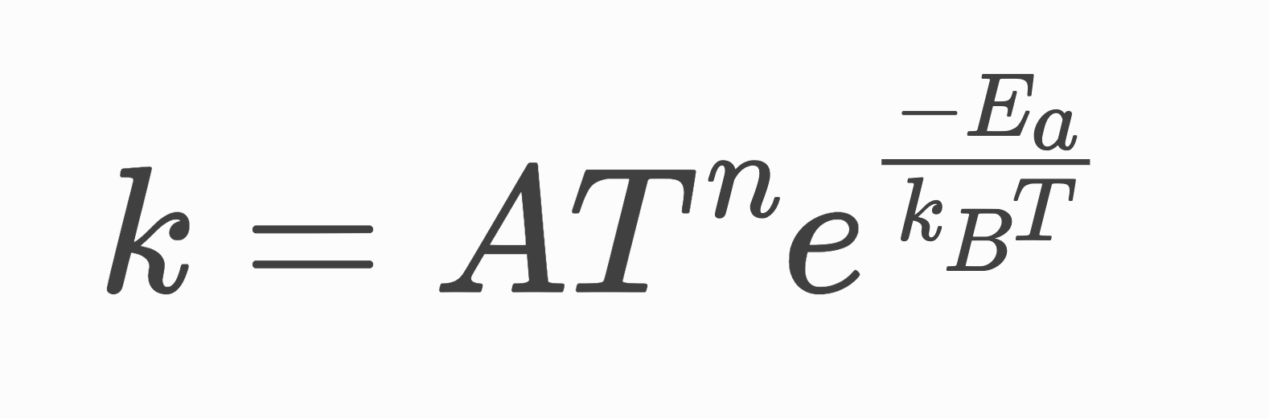
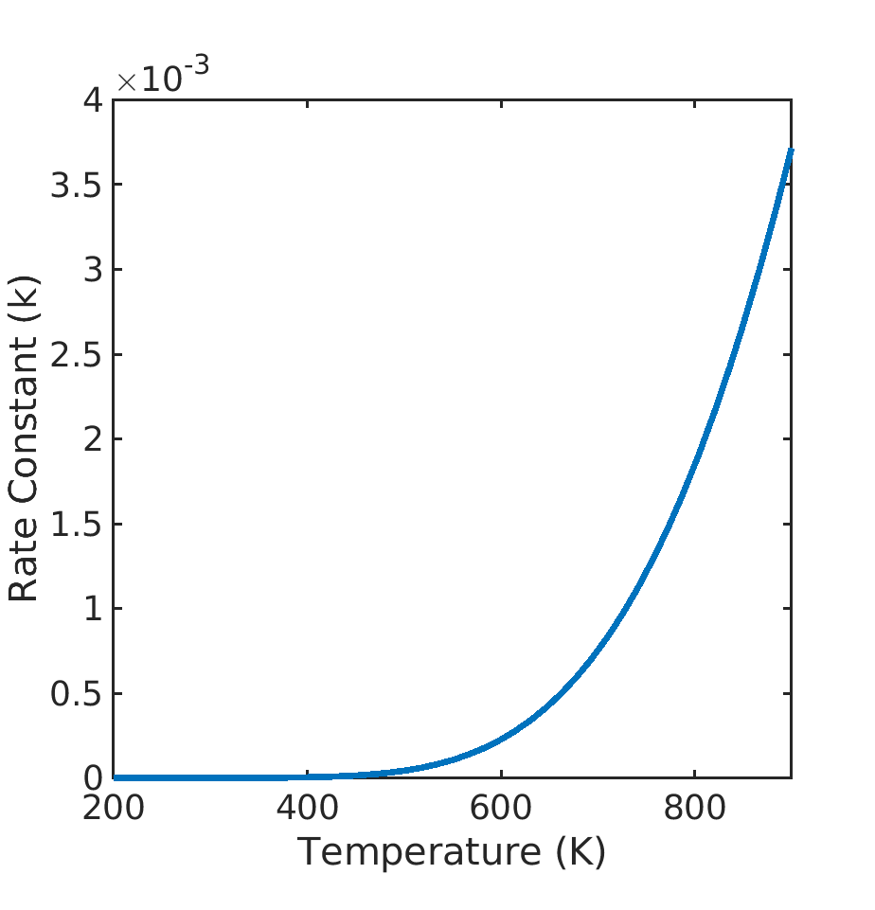
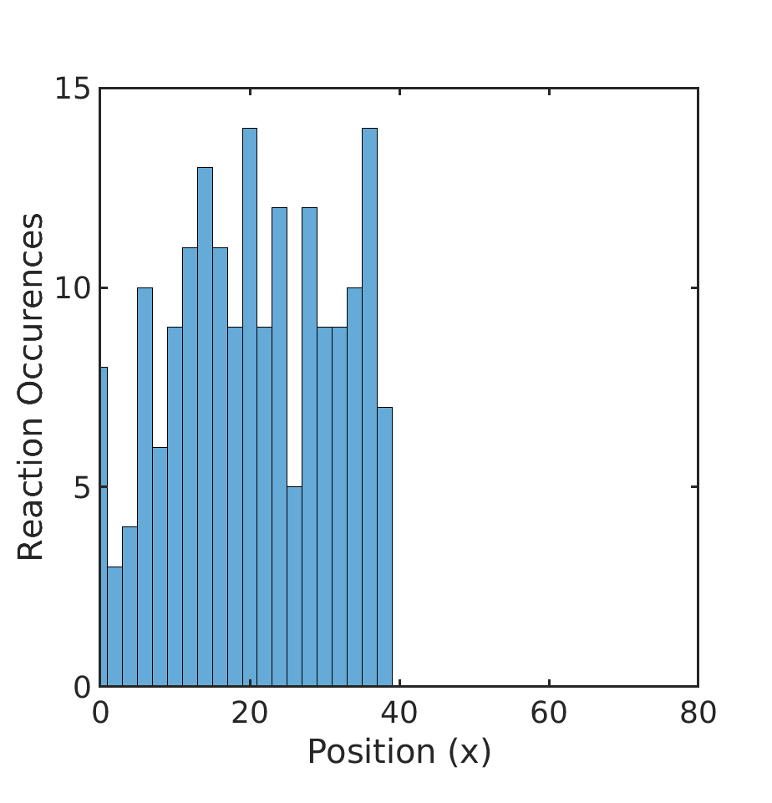
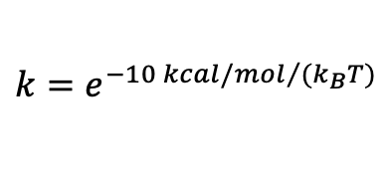
Arrhenius Reaction Constraint
Uses local temperature to enforce effective activation energy
  Temperature-dependent Arrhenius equation:
  Reaction probability is proportional to calculated rate constant
800 K
300 K
Nylon melt with Arrhenius constraint:
80x80x80 Å
35,000 atoms
10,000 fs
Reaction cutoff: 3.5 Å
Simulation box thermostated with a hot half and a cold half
$$k=e^{{−10 kcal/mol}/{(k_{B}T)}}$$

Slide 14
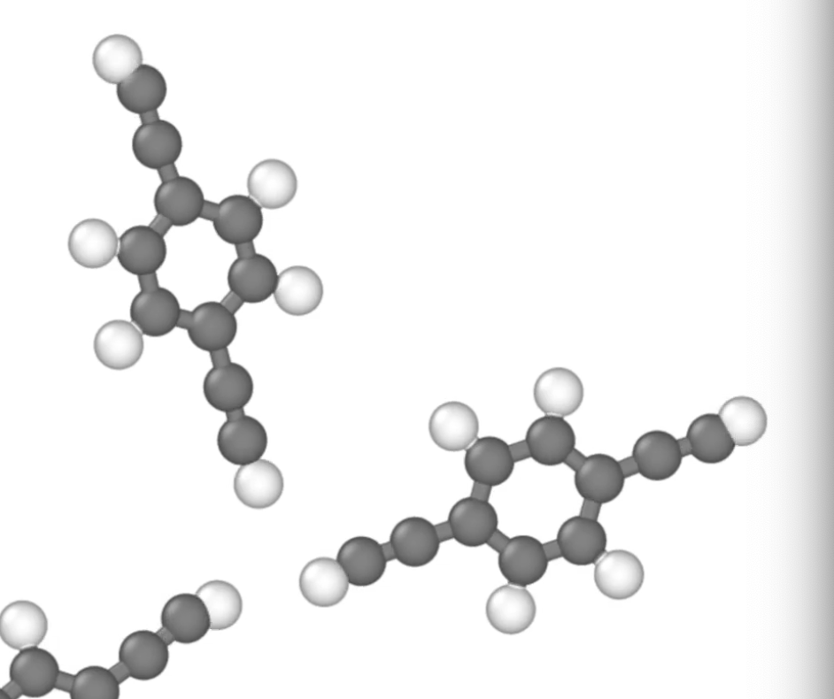
RMSD Reaction Constraint
Root-mean-square deviation (RMSD): a metric for similarity of molecular structures
Enforce a maximum RMSD between template and local reaction site atoms
  Calculated after optimal translation/rotation of pre-reaction template
Orientation that allows reaction can be empirical or based off QM results
A step toward more complex energy surfaces for reactive sites
Simulation Atoms
r_{c}
RMSD_{max}
Pre-reaction Template

Slide 15
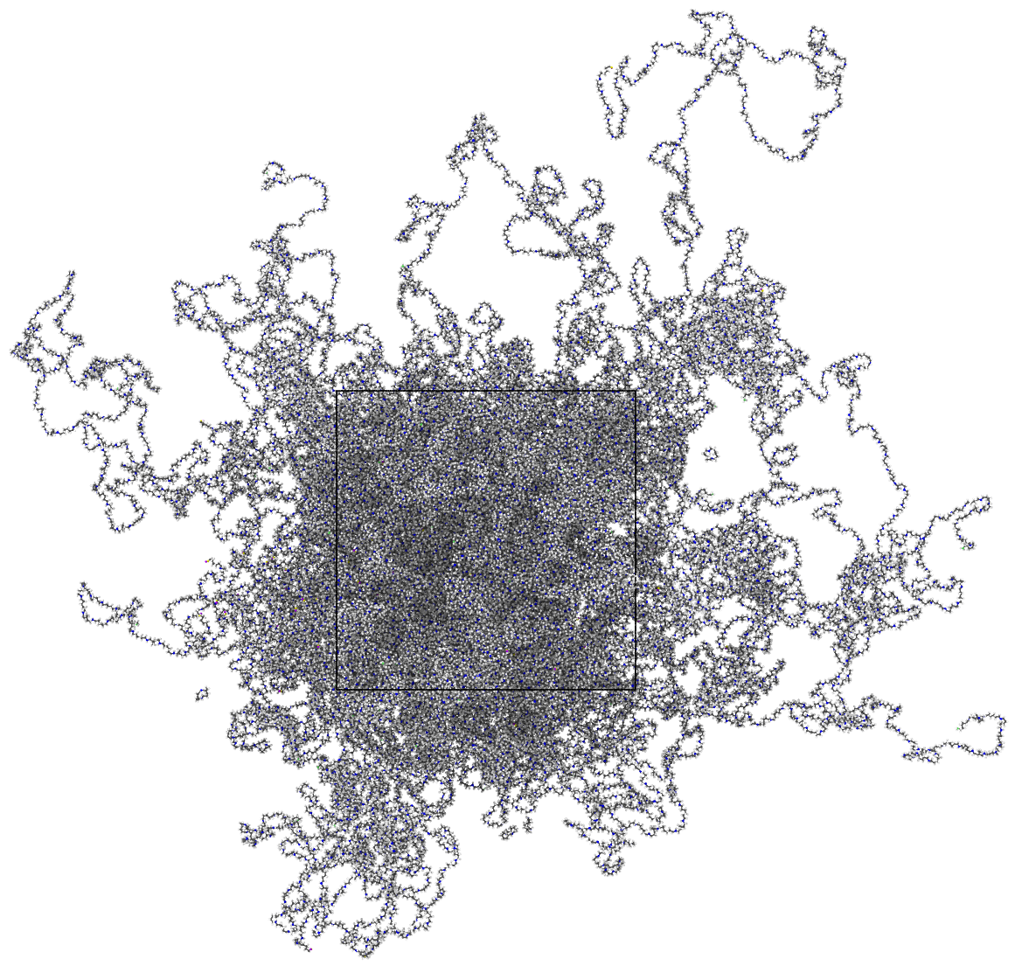
Large-scale Nylon 6,6 Demo
Setup: 5,000x adipic acid
5,000x hexamethylenediamine
220,000 atoms
Temperature: 530 K
(actual synthesis temp)
Final density: 0.9 g/cm³
Side length: 13.3 nm
3-5 Å reaction cutoff
>99% polymerized
condensed water molecules removed

Slide 16
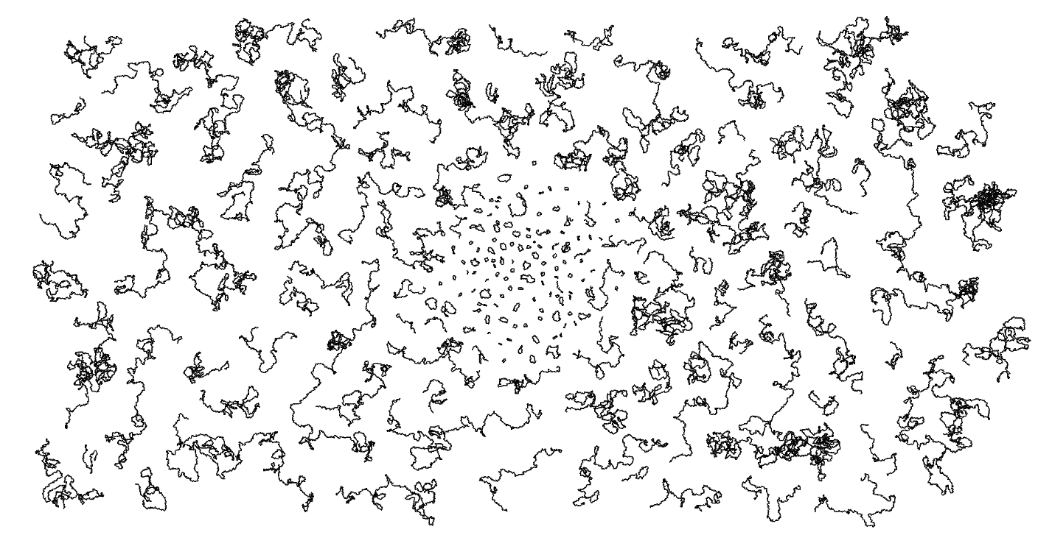
Chain PDI ≈ 2 Overall PDI (with cycles) ≈ 3.9*
(nylon 6,6)
265 repeat units
>7,400 backbone
atoms
only backbone atoms shown
*Experimental PDI ≈ 4.
Solid-state modification of polyamide-6,6. Jeyakumar, A. Eindhoven: Technische Universiteit Eindhoven. 2012.

Slide 17
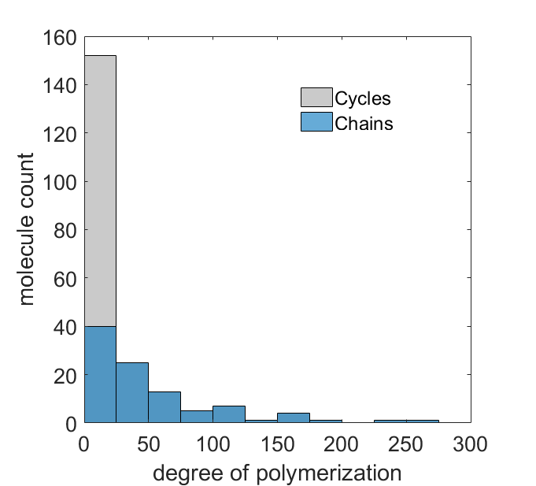
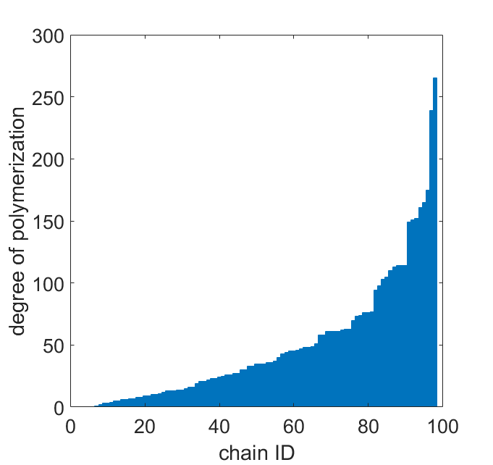
>99% Polymerized Nylon 6,6: Chains vs. Cycles
Cycles
Chains
>250 repeat units
(>500 reactant molecules)
weight % cycles:
simulation: 3.7%
experiment: 1-5%¹
molecule count
degree of polymerization
degree of polymerization
chain ID
¹Endgroup-based separation and quantitation of polyamide-6,6 by means of critical chromatography. Mengerinka, et al. Journal of Chromatography A 949, 337. 2002.

Slide 18
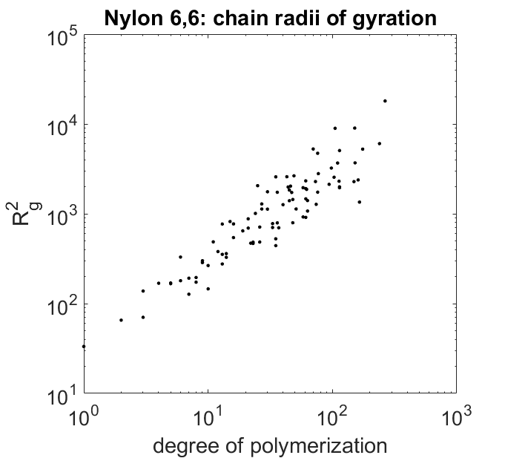
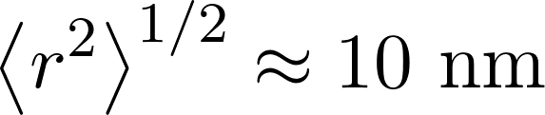
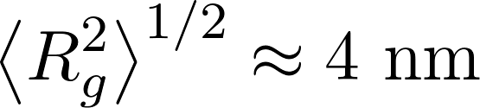
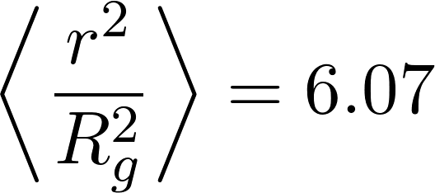
Nylon 6,6: Chain Morphology
Nylon 6,6: chain radii of gyration
end-to-end distance
R_{g}² ~ N^{1.1}
# repeat units
(Å)
radius of gyration
Value for a Gaussian chain:
degree of polymerization

Slide 19
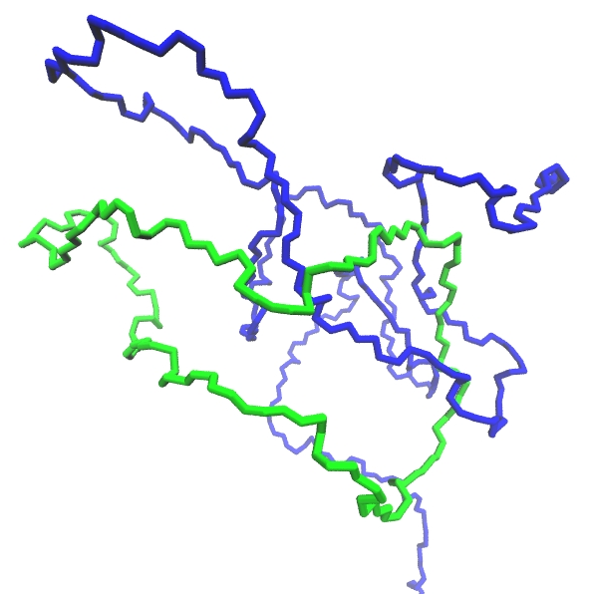
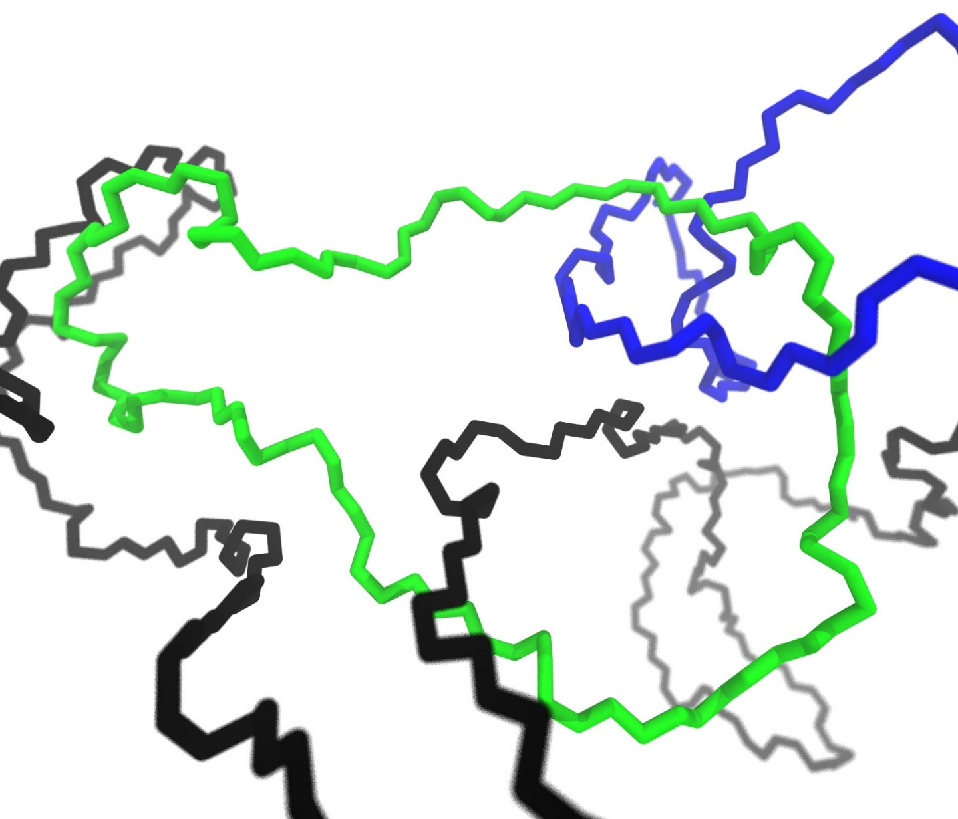
Chain Growth vs. Ring Formation
Nylon 6,6
cycle
cycle
single topologically-constrained cycle
cycle constraining two chains:
physical ‘slip-link’

Slide 20
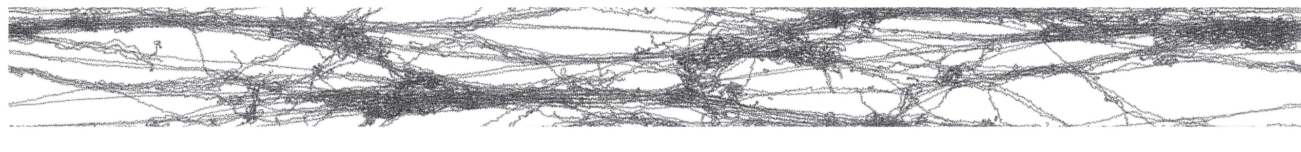
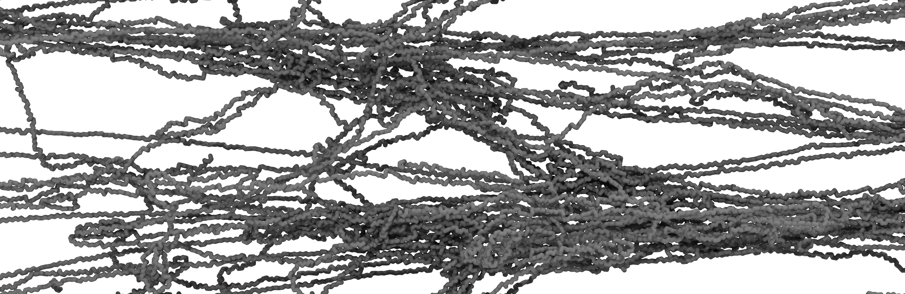
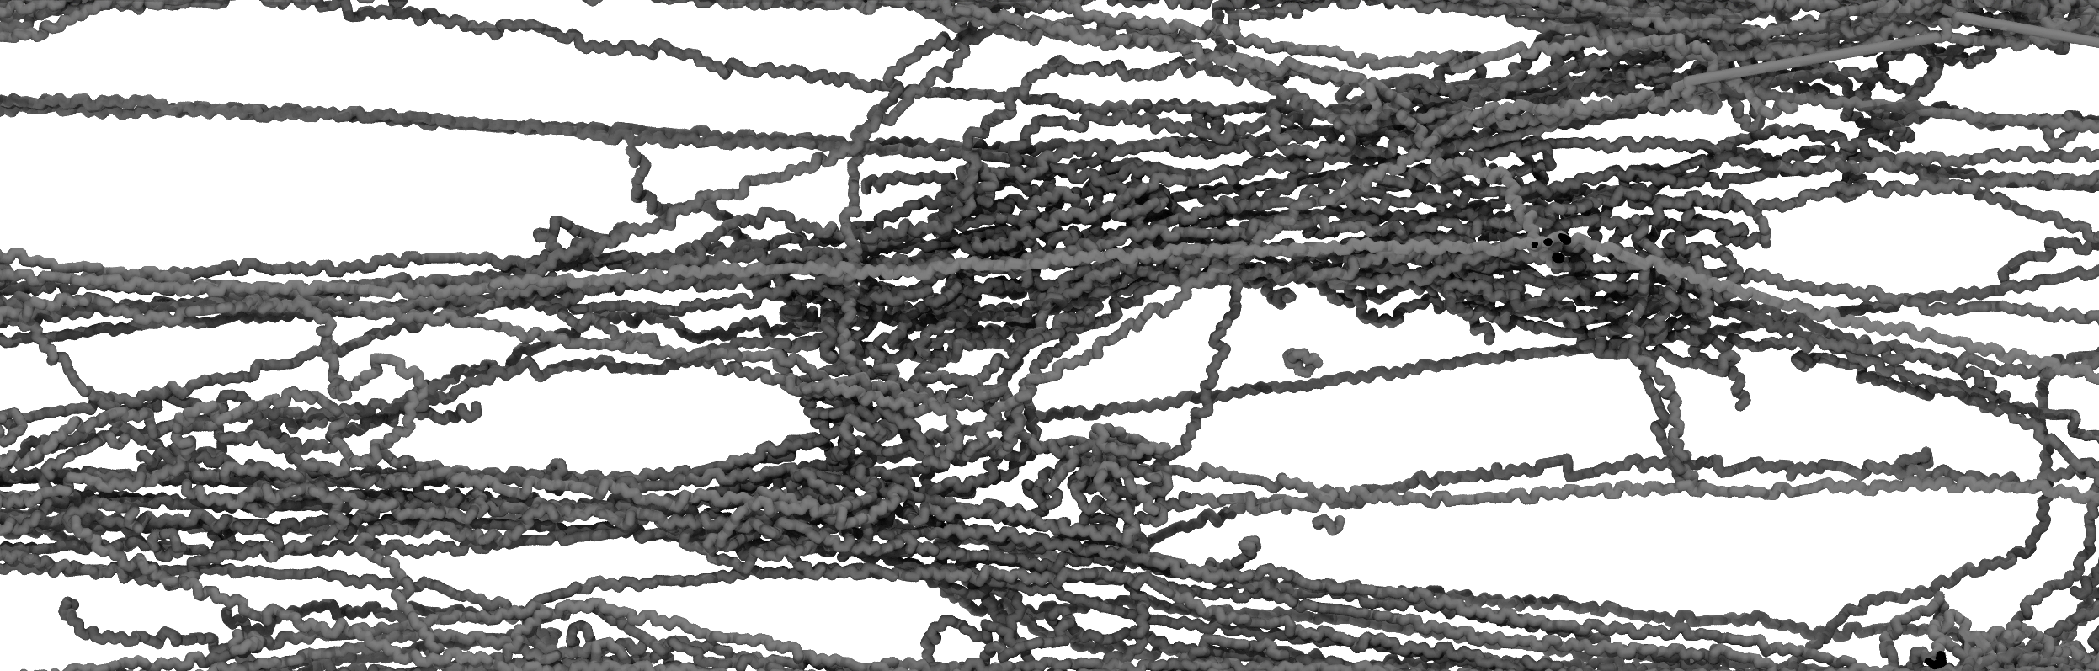
Uniaxial Extension with Chain Scission
130 Å
(nylon 6,6)
1435 Å (~11:1 aspect ratio)
Uniaxial strain
  Highly entangled system
  Craze formation
Chain scission reaction
  Relieve topological constraints
  Activated if C-N bond > 1.67Å
    Chosen empirically
  Only 6 chain scissions occurred

Slide 21
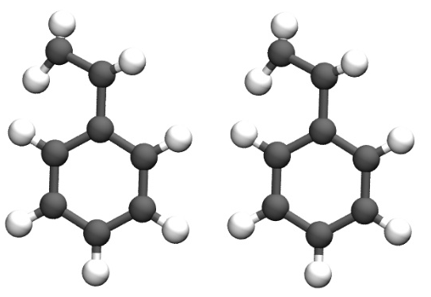
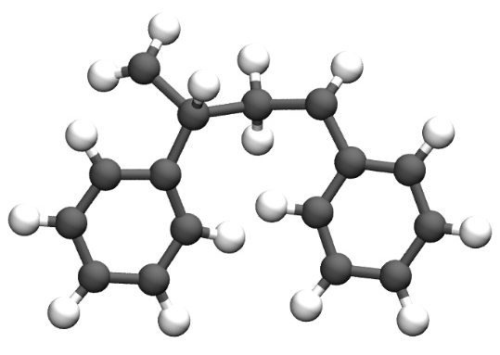
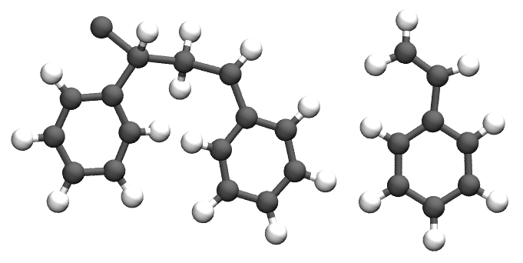
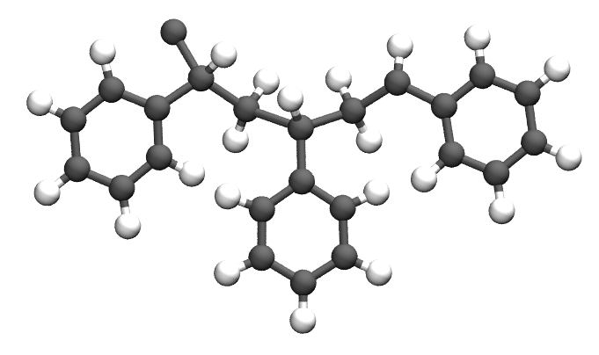
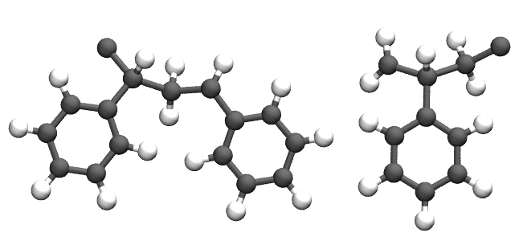
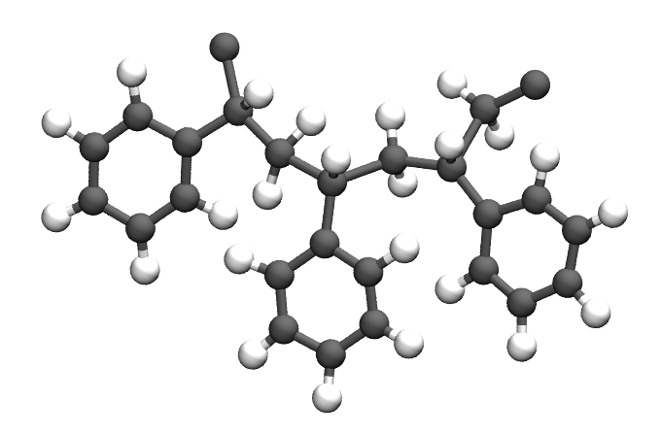
Polystyrene Setup
pre-reacted
post-reacted
Serves as Initiator
r_{c}
edge atom
(can be limited with ‘max_rxn’ option)
two-monomer
Chain Growth
(number of growing chains specified by first step, above)
chain-monomer
Not active for chain-growth polymerization
chain-chain
Notes:
Schematic of the three sets of pre- and post-reaction templates used to build the polystyrene model
Synthesis method:
free radical vinyl polymerization
Chain-growth mechanism simply satisified via REACTER protocol, edge atoms…
mechian
Talking points: only three sets of reaction templates necessary, despite two-backbone-atom monomer undergoing step growth
Bulky side chain could lead to difficulty reaching high degrees of polymerization, or formation of unfavorable dihedral angles…

Slide 22
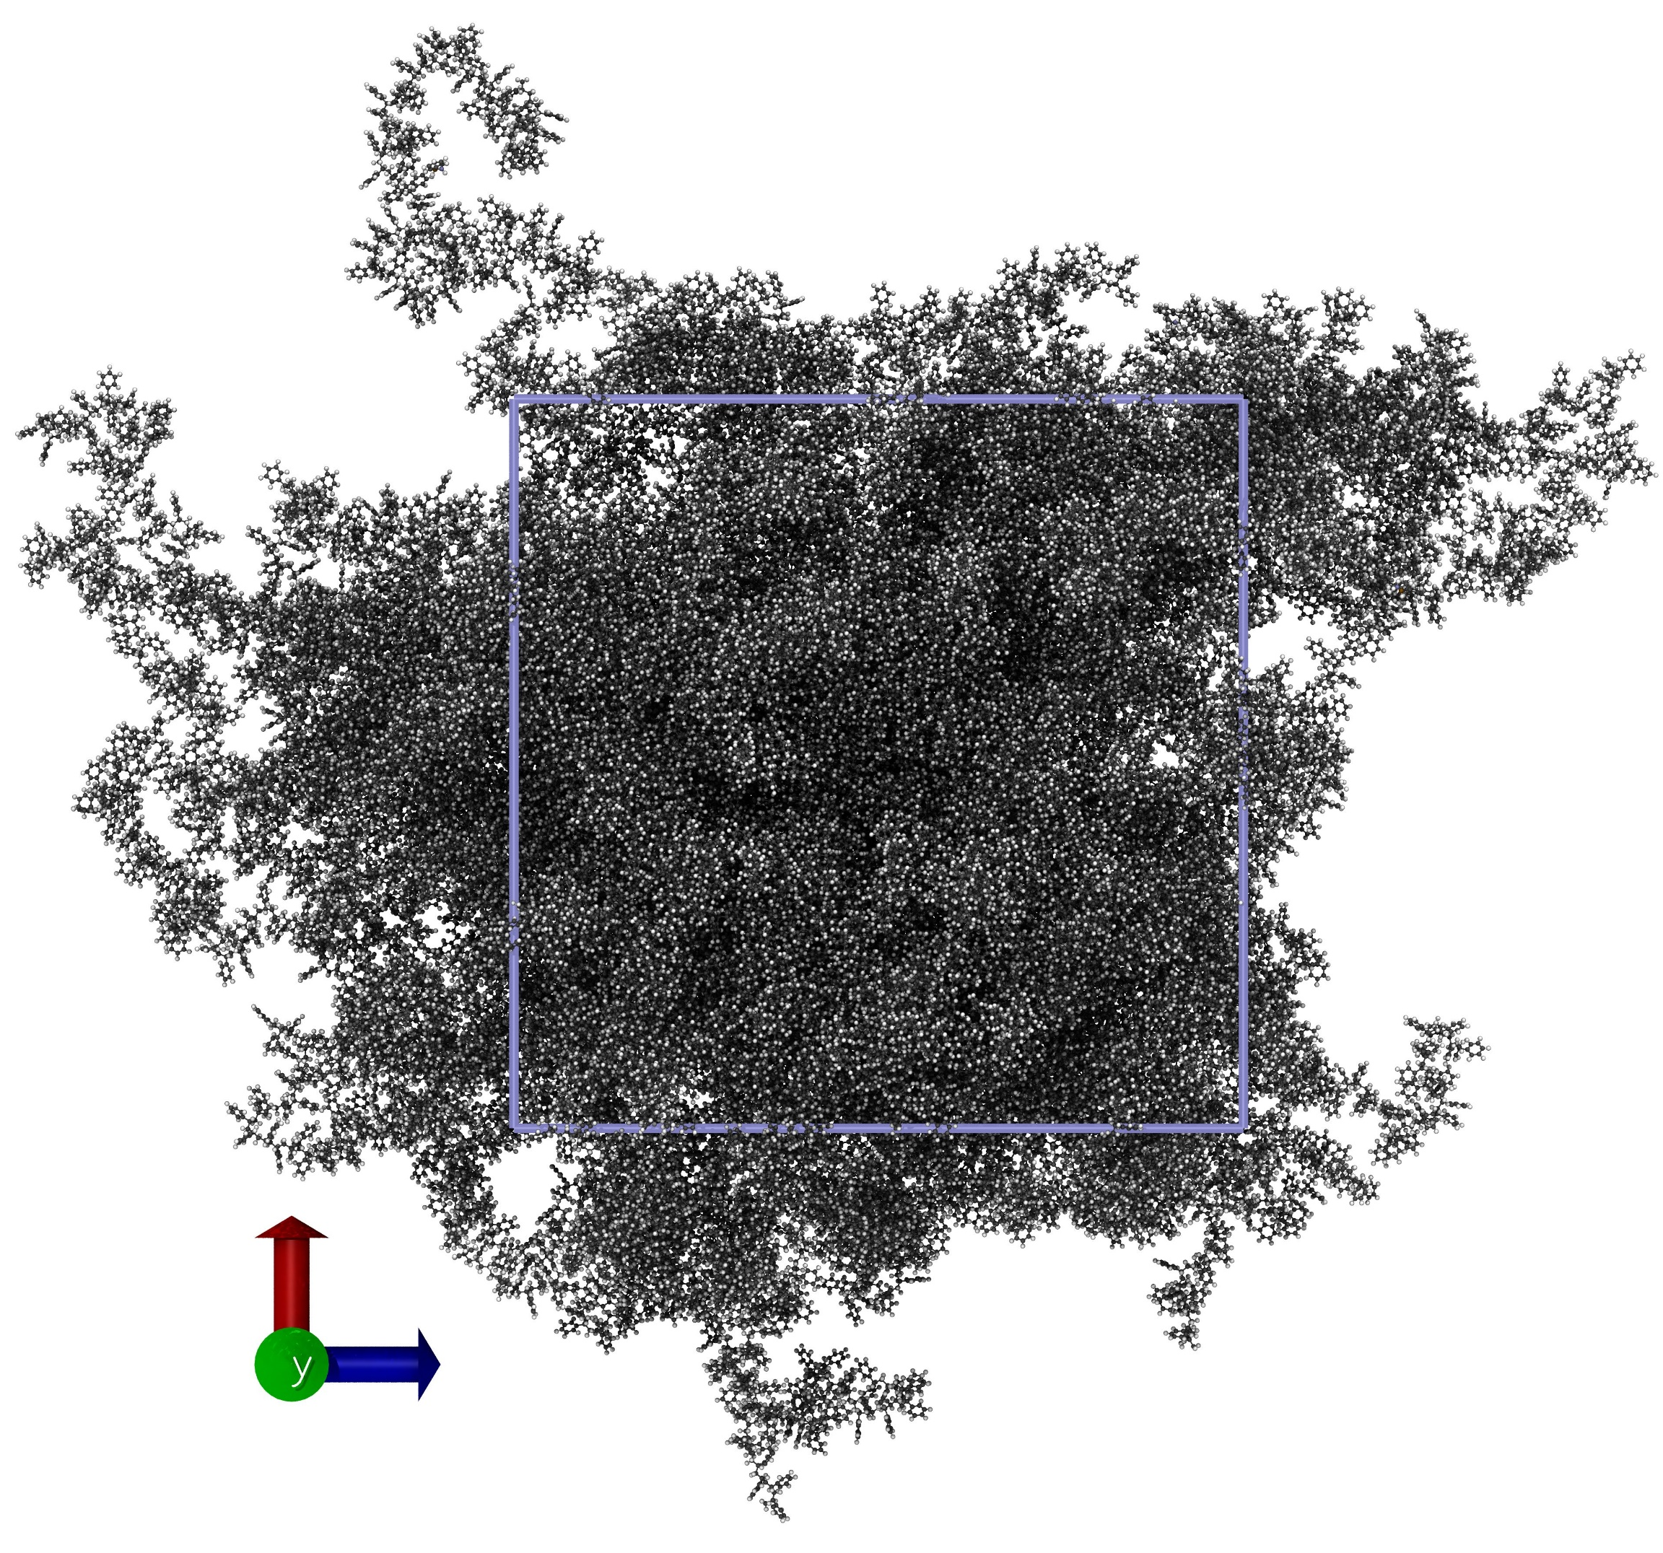
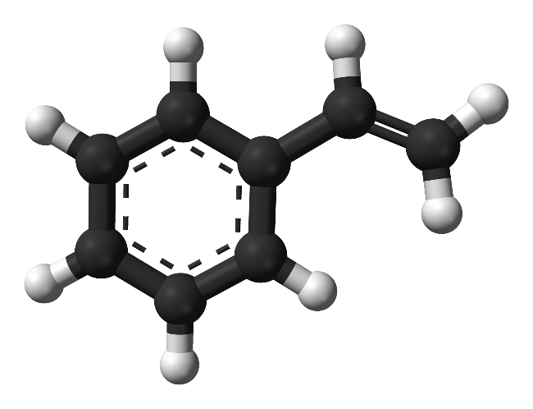
Polystyrene Case Study
>99% polymerized polystyrene
200,000 atoms (12,500x styrene)
>98.5% polymerized with 3.0 Å distance cutoff, before switching to 3.5 Å
Conclusion: REACTER can handle small monomers with bulky side groups
530 K
13.7 nm box
REACTER: A Heuristic Method for Reactive Molecular Dynamics.
Gissinger, Jensen & Wise. Macromolecules 53, 22, 9953–9961 (2020).

Slide 23
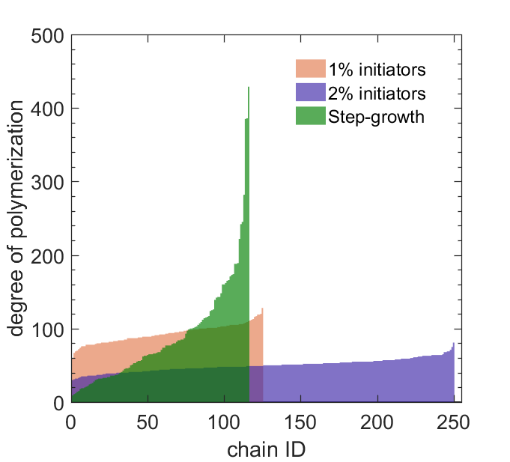
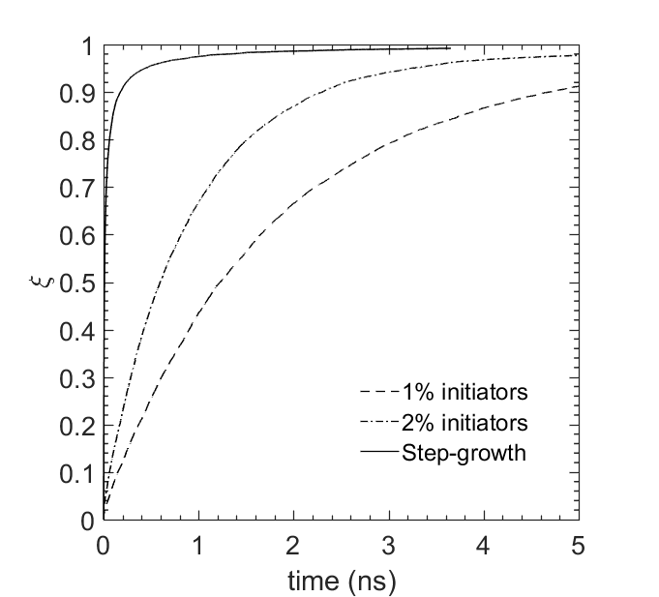
Step- vs. Chain-Growth Polymerization
Chain-Growth PS: Nearly Monodisperse Chains, Slower Rate of Polymerization

Slide 24
Epoxy Crosslinking
Simple cross-linking mechanism of an amine to two epoxy molecules

Slide 25
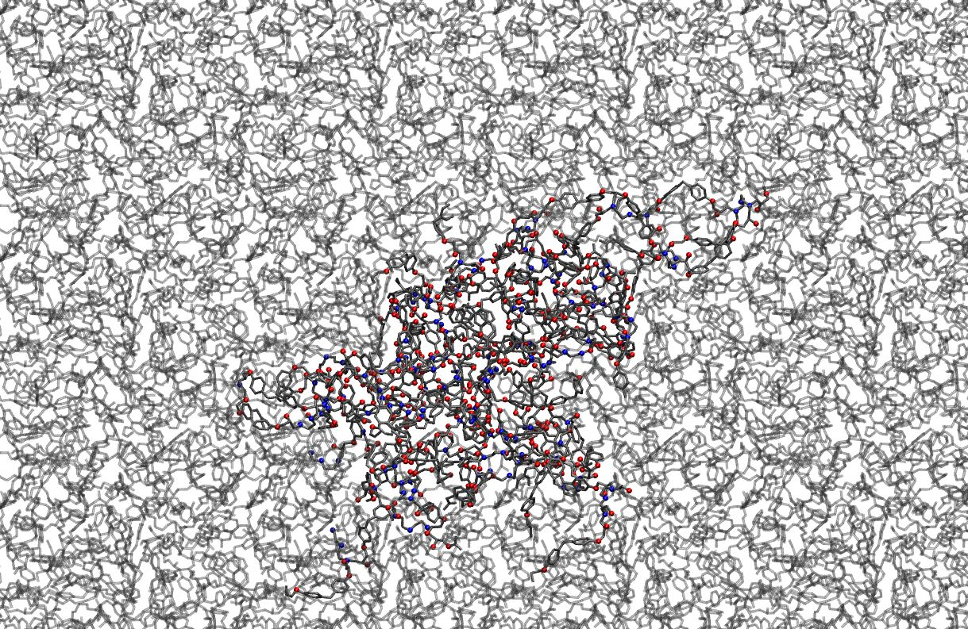
Final Epoxy Morphology
96% cross-linked
Distance cutoffs:
rxn 1: 3.5 Å, rxn 2: 5.0 Å
100 diepoxy molecules,
50 diamine molecules
Run: 200 ps at 800 K
Modeling chemical reactions in classical molecular dynamics simulations. Gissinger, Jensen & Wise. Polymer 128, 211-217. 2017.

Slide 26
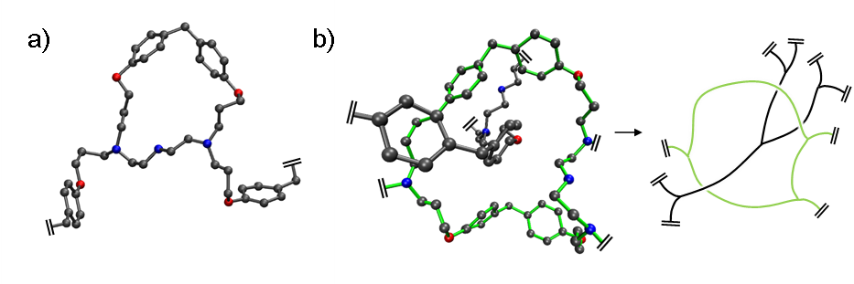
Some Interesting Epoxy Topologies
a)
b)
hash marks indicate connectivity with rest of matrix
a) Small loops are detrimental to mechanical properties
b) Part of matrix passing through larger loop (in green)

Slide 27
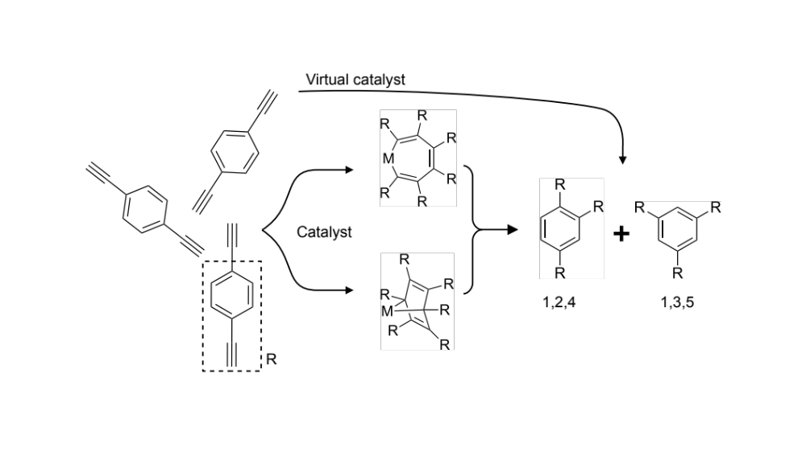
PAA: Metal-Catalyzed Cyclotrimerization
Poly(arylacetylene) formation from p-diethynylbenzene
Catalyst-stabilized intermediates can be skipped using reaction constraints

Slide 28


Modeling the Cyclotrimerization Reaction
1,3,5 trimerization
1,2,4 trimerization

Slide 29

Using Constraints as a Virtual Catalyst
a) Angle constraints determine 1,2,4 vs. 1,3,5 regioselectivity
b) An additional dihedral constraint prevents excessive ring strain

Slide 30

Large-scale Polymerization of PAA
12,500 p-diethynylbenzene (200,000 atoms), 1.0 g/cm^3
Highly reactive with the reaction parameters described previously
More than 99.5% of the ethynyl groups had reacted after 80 ps

Slide 31

What else can REACTER be used for?
Model:
In silico step-growth polymerization of polyethylenimine
Linear vs. highly-branched polymer
Validation:
Linear chains followed Flory-Schulz distribution
Application:
Heat transfer in polymers
Kawagoe et al. Construction of polydisperse polymer model and investigation of heat conduction:
A molecular dynamics study of linear and branched polyethylenimine. Polymer, 180, 121721 (2019).

Slide 32


What else can REACTER be used for?
Modeling polymerization of photopolymer resins
Reactive MD revealed the dependence of gel points and cyclic content on various poly- and difunctional acrylates
Karnes et al. On the network topology of cross-linked acrylate photopolymers:
A molecular dynamics case study. The Journal of Physical Chemistry B, 124(41), 9204-9215 (2020)..

Slide 33

What else can REACTER be used for?
Modeling the in situ polymerization of the matrix in nanocomposites
The properties of the interface between polyimides and flattened CNTs depend on the polyimide chemistry (fluorinated vs non-fluorinated)
Patil et al. Interfacial characteristics between flattened CNT stacks and polyimides:
A molecular dynamics study. Computational Materials Science, 185, 109970 (2020).

Slide 34

New Feature: Create Atoms (and their Bonds)
Example:
Dynamic growth of polystyrene by creating monomers
Features:
Place new atoms using best-fit between template and reaction site
Prevent created atoms from overlapping with existing atoms

Slide 35



Where to learn more?
Visit
www.reacter.org
for up-to-date features,
tutorials,
videos and links to related material

Slide 36

Summary and Outlook
REACTER is a useful tool for building complex morphologies
The REACTER protocol scales well
  10,000 nylon precursors true temp. (≈260 C)
  12,500 styrene molecules low cutoff 3-5 Å
Correctly predicts cyclic content, polydispersity and chain morphology
What’s next?
  More predictive reaction constraints
    Potential energy surfaces?
  Features in progress
    Additional reaction constraints
    Option to insert atoms
>99% polymerization

Slide 37

Acknowledgements
Thanks to my co-authors:
Kristopher Wise
Benjamin Jensen

Slide 38


Thank You!
www.reacter.org

