Slide 1
What’s Up in the Sky: Conjunctions and Calendars
A Presentation for the
Central American Integration System
(Sistema de la Integracion Centroamericana)
December 18, 2020
Mitzi Adams, Solar Scientist
NASA/Marshall Space Flight Center

Slide 2
How Does It Look?

Slide 3
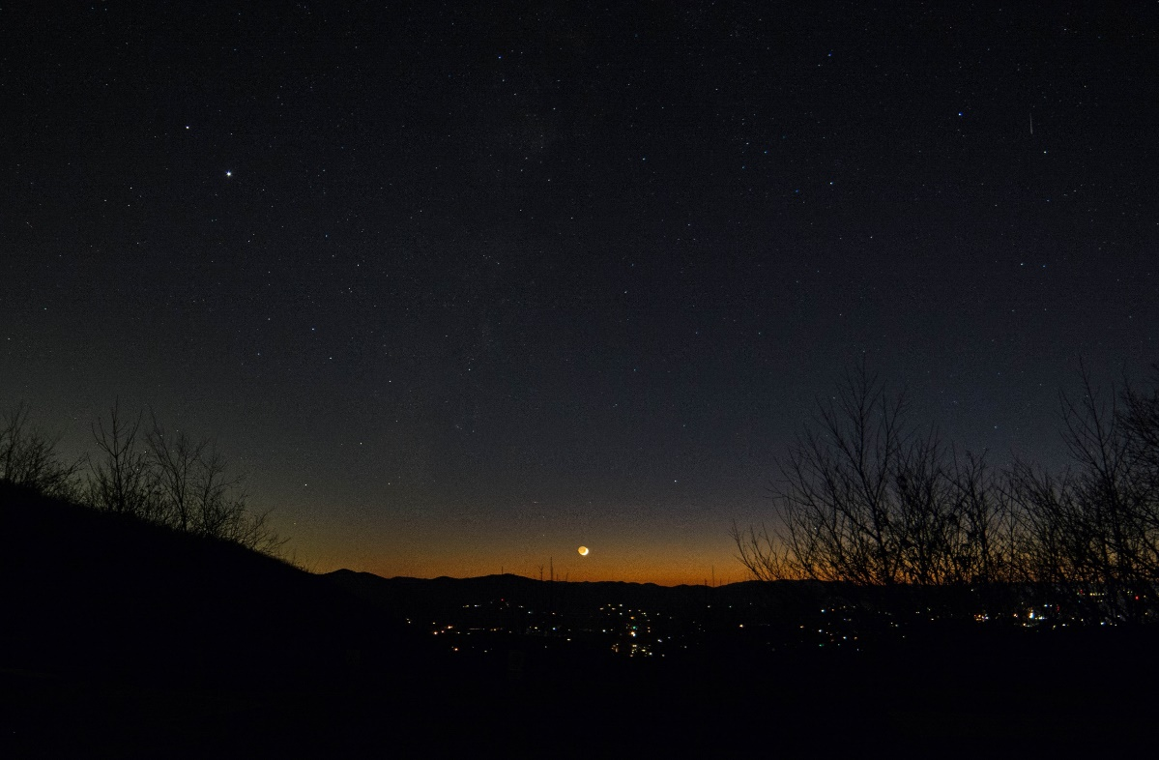
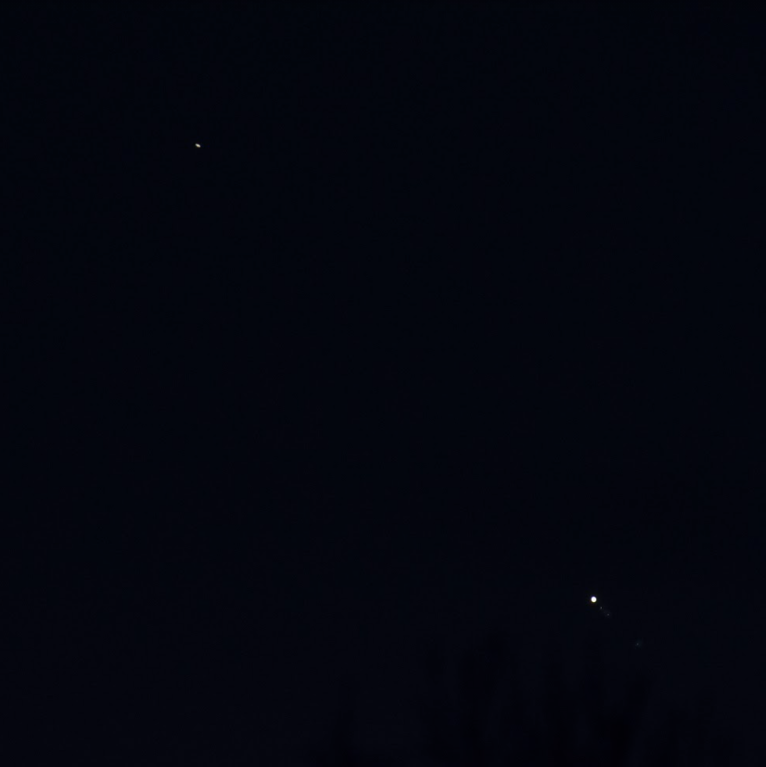
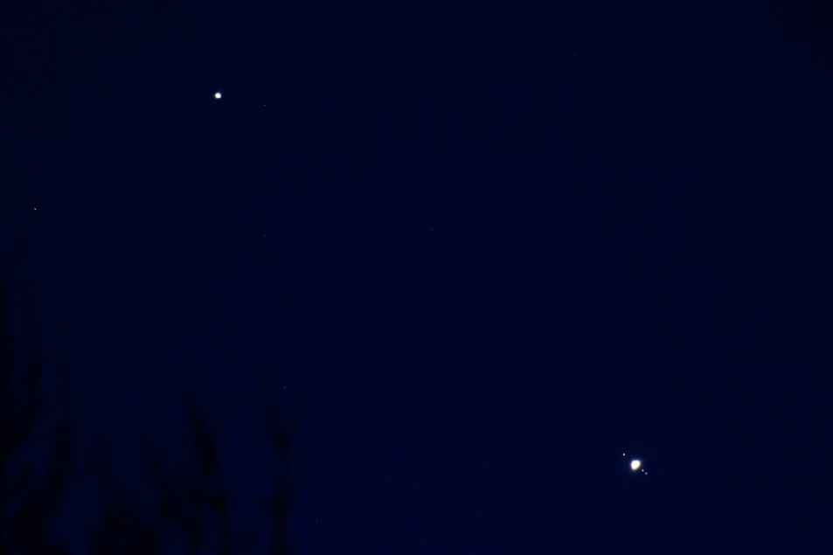
Do I Need a Telescope?
Saturn (top)
Jupiter
Top Image by Joe Steed,
Brasstown Bald, Georgia, USA
approximately 4,400’ elevation
16 November, 2020
Photo details: Nikon D7100, f/4
5 sec, ISO-1250,
14 mm
(image used with permission)
Saturn
Saturn
DSLR
ISO 400
420 mm
DSLR f/7.1
1/15 sec
ISO 400
460 mm
December 6, 2020
December 10, 2020
Jupiter
Bottom Photos by
Karen Smale, Maryland, USA
(used with permission)
Jupiter
moons

Slide 4
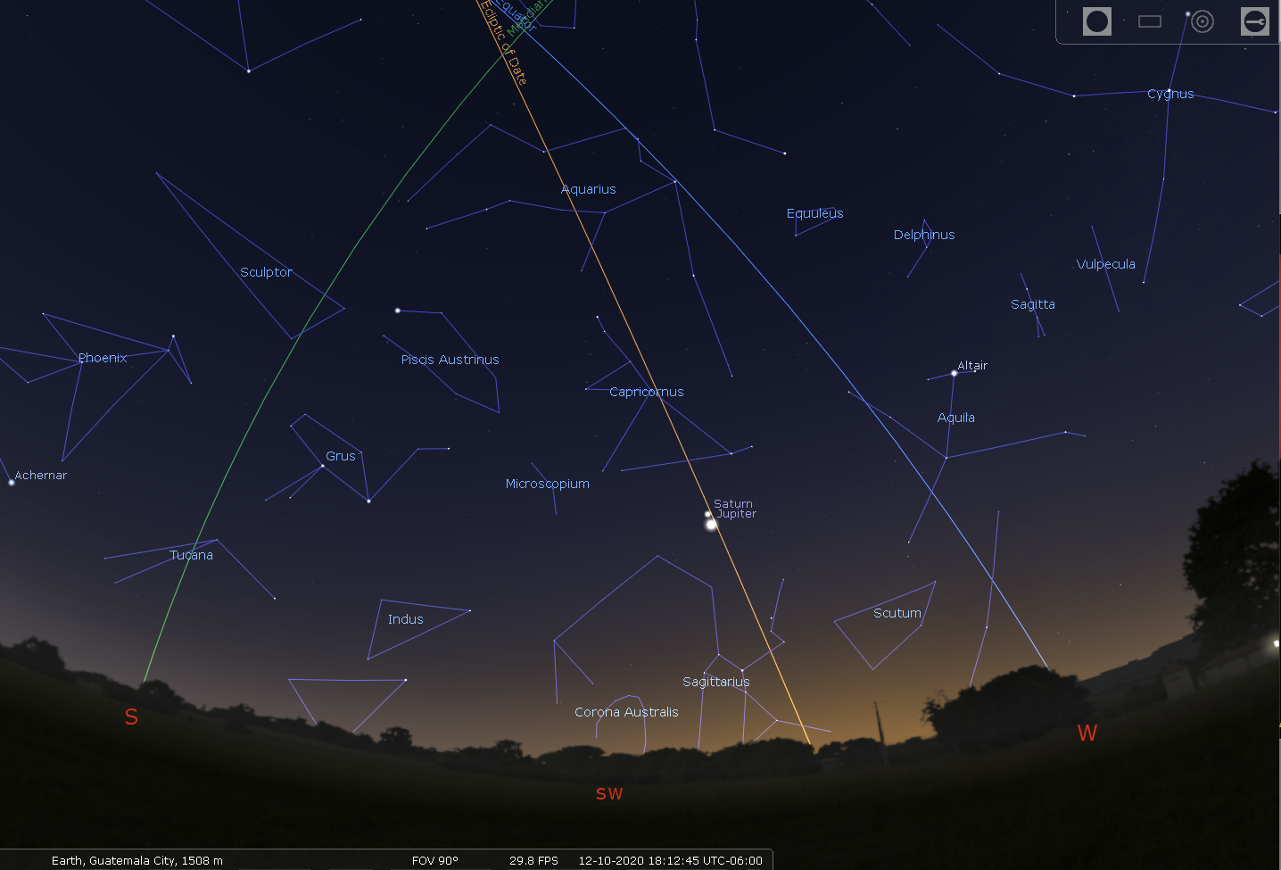
At Sunset December 10, 2020

Slide 5
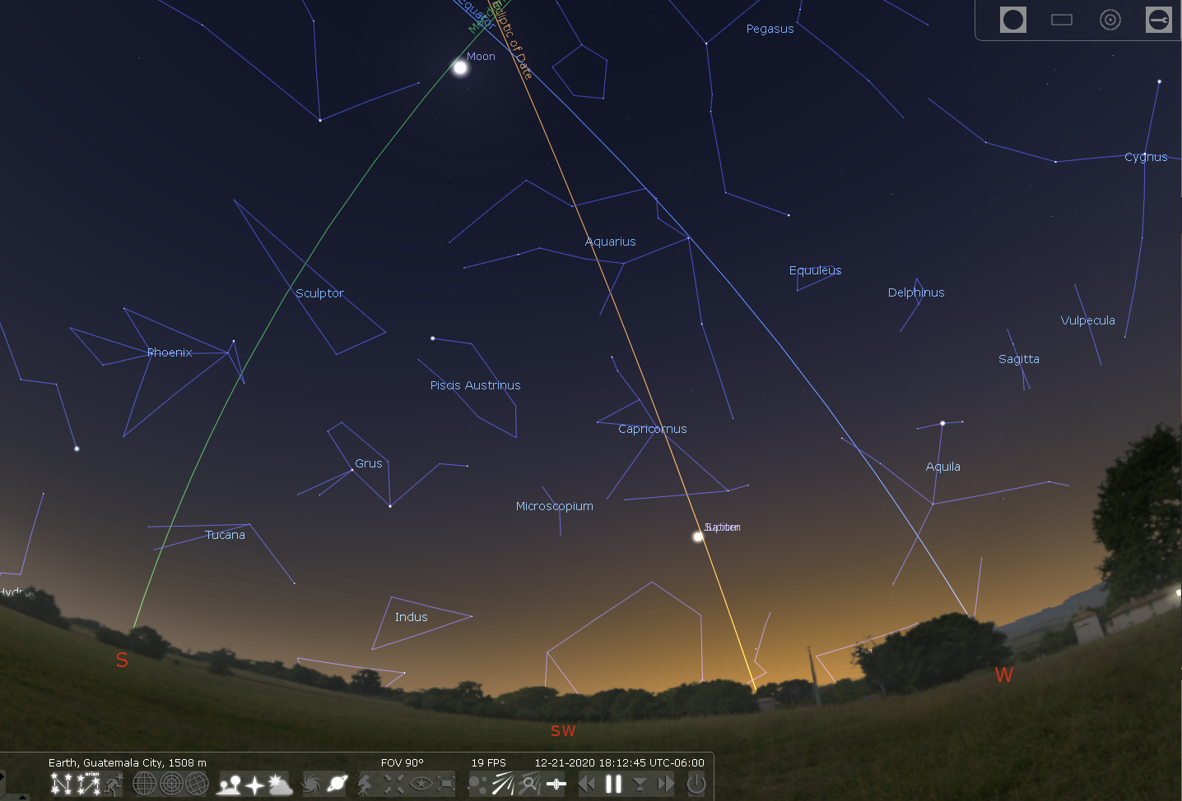
At Sunset December 21, 2020

Slide 6
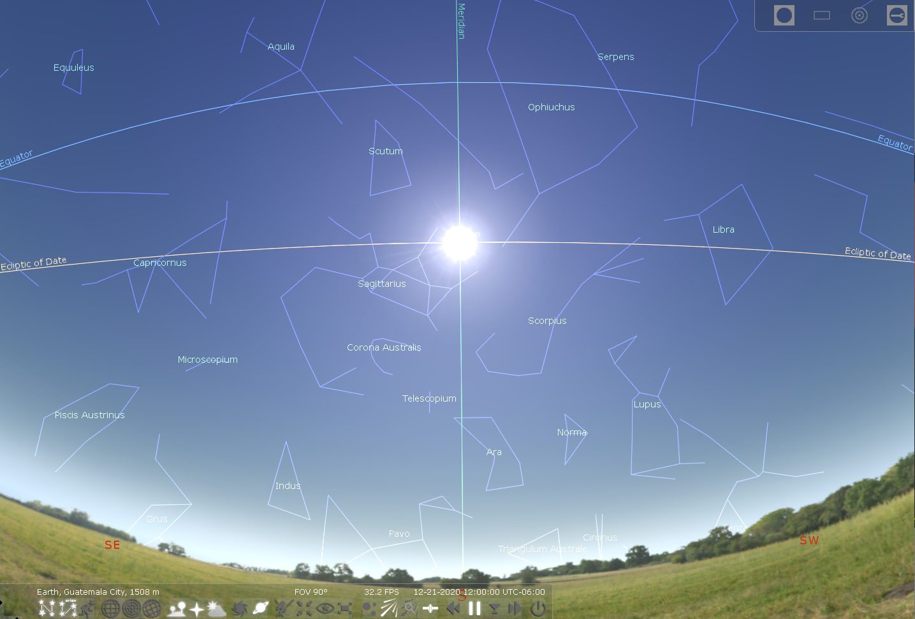
Day of Winter Solstice
At Noon December 21, 2020

Slide 7
Why Do These Things Happen?

Slide 8
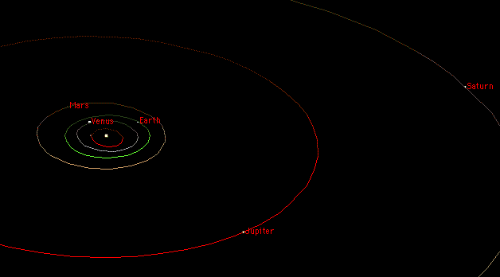
Planetary Orbits
29 Years – one orbit
12 Years – one orbit
If aligned, Jupiter returns to same position in 12 years, but Saturn won’t be there!
After another Jovian “Year” (24 Earth years), Saturn needs another 5 years to return to the same position

Slide 9
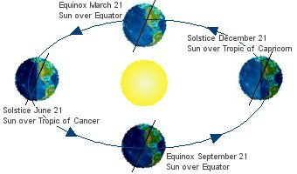
The Reason for Seasons
Demonstrate it: http://www.spacescience.org/eduresources/kinesthetic.php

Slide 10

The Galileo Mission to Jupiter
Launched: 18 October, 1989
Mission End: 21 September, 2003
in Jupiter’s atmosphere
Mission: Study Jupiter and its moons.
Results: First spacecraft to visit asteroid – Gaspra and Ida
Directly observed a comet colliding with a planet
Found evidence of a saltwater ocean beneath Europa’s surface
Discovered magnetic field generated by Ganymede

Slide 11
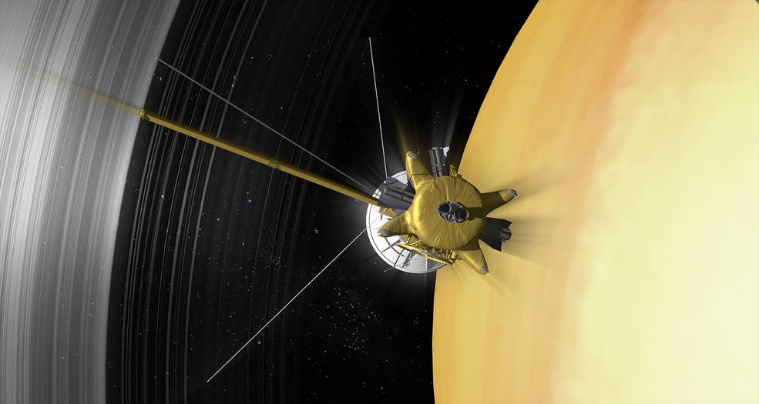
The Cassini Mission to Saturn
Mission End: 15 September, 2017
in Saturn’s atmosphere
Launched: 15 October, 1997
Mission: Study Saturn, its moons, especially Titan.
Results: Prime mission ended 2008
Huygens Probe parachuted to Titan in 2005
Explored Saturn’s rings
Found evidence of ocean inside Enceladus

Slide 12
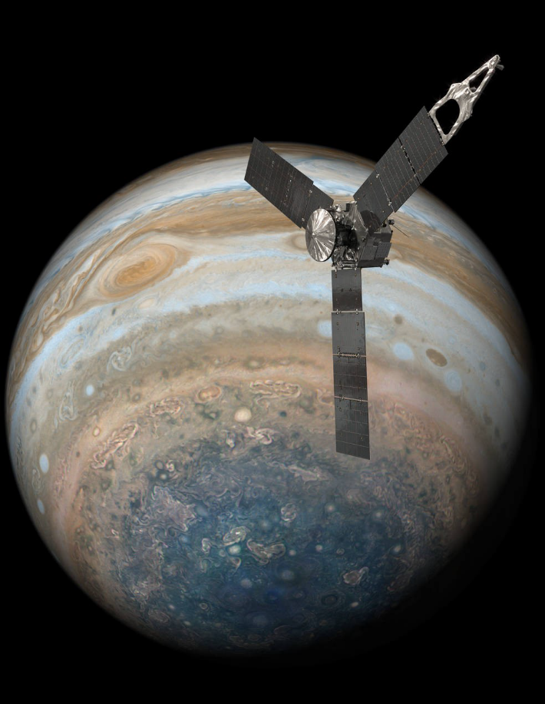
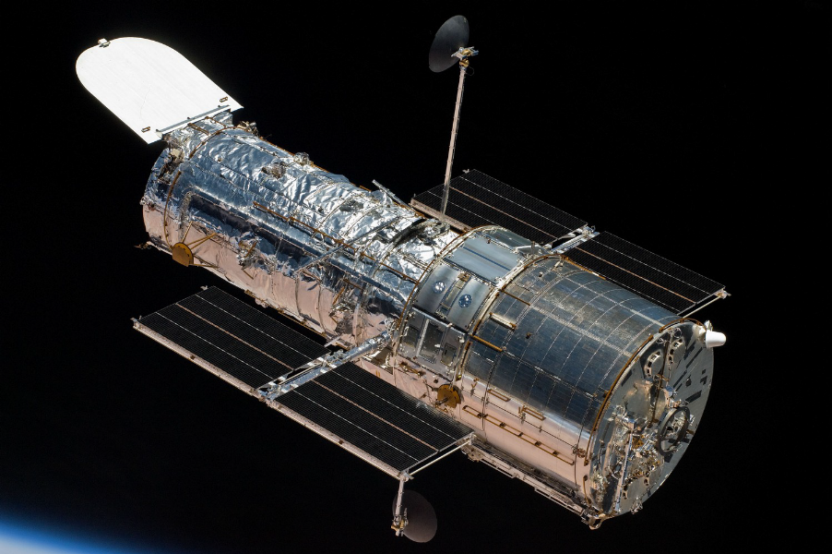
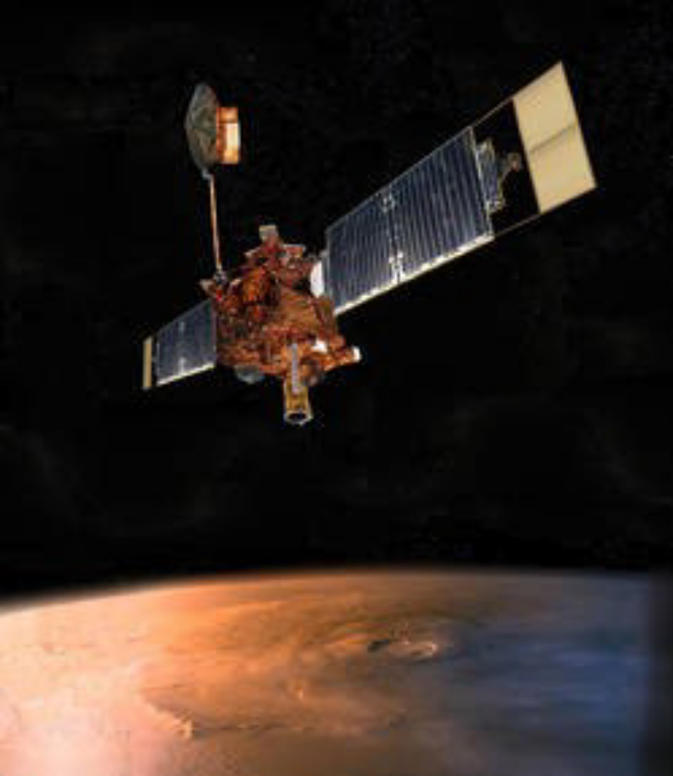
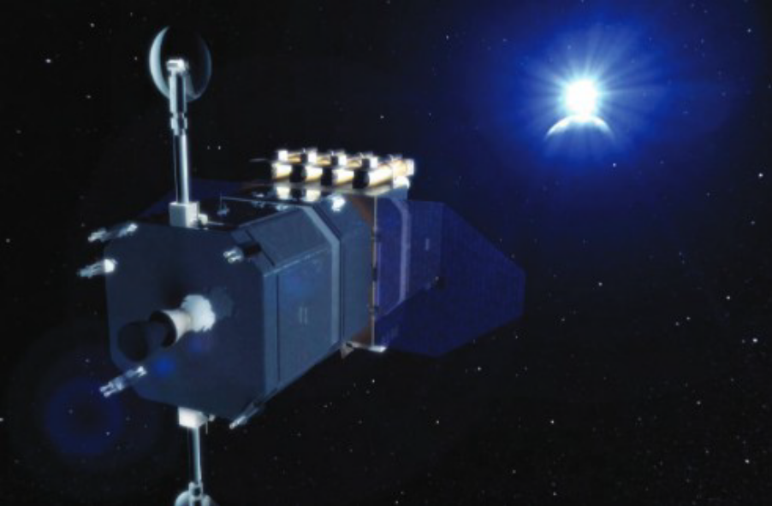
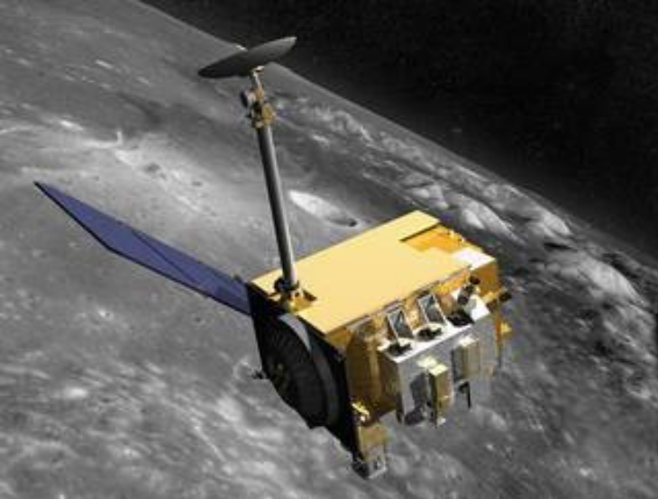
The Solar System: Through the Eyes of NASA
https://ww.nasa.gov/missions
Mitzi Adams: mitzi.adams@nasa.gov
Hubble Space Telescope
Juno at Jupiter
Solar Dynamics Observatory (SDO)
Lunar Reconnaissance Orbiter
Mars Global Surveyor

Slide 13
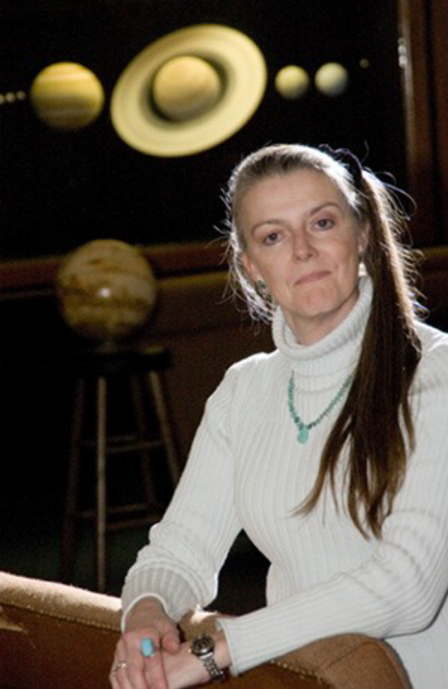
Who Am I ?
Mitzi Lynn Adams
From Atlanta, Georgia
In high school, was an observatory/planetarium assistant at Fernbank Science Center, Atlanta
Bachelor of Science in physics with a mathematics minor from Georgia State University, Atlanta
Master of Science in physics from University of Alabama in Huntsville, in co-op program with NASA/MSFC
Have been a NASA Solar Scientist since 1988, currently Assistant Manager, Heliophysics and Planetary Science Branch, Marshall Space Flight Center, Huntsville, Alabama
Was planetarium director (volunteer) of the Von Braun Astronomical Society's planetarium from 1988-2006
Completed five marathons, observed five total solar eclipses
Like to visit Peru and Guatemala
Like languages, Spanish, Latin, and German

