Slide 1

User Experience
Human Research Program (HRP)
Exploration Medical Capability Element
2021 HRP Investigators’ Workshop
February 2021
Authors:
Natalia Russi-Vigoya, KBR- NASA JSC
Jennifer Amador, NASA GRC
Samuel Santiago, NASA ARC
James Fenbert, Analytical Mechanics Associates, Inc
Delmar Foster, Data Mining USA INC
Travis B. Mosher, NASA LaRC
William Thompson, NASA GRC
“Expanding the Boundaries of Space Medicine and Technology”
Notes:
Good [morning], My name is Natalia Russi Vigoya, and today I will be presenting our work on the “IMPACT” User experience. On the bottom right of this slide, you will see the names of the people who worked on this project

Slide 2
Presentation Overview
Iterative research approach used for IMPACT prototype development
A summary of the human factors research findings and how they influenced IMPACT development
IMPACT Prototype evolution and future plans
IMPACT is a tool suite that aims to help users with systematic trade study evaluations and to inform research prioritization
Notes:
You will see today, a sneak peek of the IMPACT evolution through user centered research, and human factors feedback.
First, I will walk you through the user centered approach and some general factors that influenced the final development of the prototype
I will give you a quick overview of the IMPACT interfaces.
We hope to provide you today with an overall overview of the IMPACT development evolution into the current prototype experience,
and talk about our future plans to continue learning about IMPACT and improve the user experience.
So what is impact?
IMPACT is a tool suite that aims to help users with systematic trade study evaluations and to inform research prioritization. IMPACT Version 0.1 or prototype, is based on the IMPACT concept of operations that was developed last year by Jennifer Amador, Kerry McGuire, Michelle Urbina, & William Thompson, 2019).

Slide 3
Methodology
Human Centered Design Approach
Interviews with different types of users
Human Factors feedback based on heuristic evaluations
Agile testing on wireframes and output files
Adjust easily to shifting demands
Representative users Representative tasks
Observation and detection
Survey during the IMPACT 0.1 Prototype demonstration
Multidisciplinary meetings to develop wireframes
Requirements
Analysis and design
Planning
Implementation
System maturity
Innovation
Adaptation
Initial planning
Deployment
Testing
Evaluation
Notes:
HF feedback was provided for 10 main interfaces. These interfaces included feedback for the IMPACT Desktop interfaces, IMPACT Run interface, and Output results dashboards.
Today, I will not talk about all of the interfaces, but give you some highlights of our work
In general HF practitioners aim to design human systems interactions factoring human capabilities and limitations to improve human performance, improve safety, and enhance user satisfaction.
We used the Human-Centered Design (HCD) approach. The Human-Centered Design (HCD approach is commonly used in design and management frameworks that develops solutions to problems by involving the human perspective in all steps of the problem-solving process. Human involvement typically takes place in observing the problem within context, brainstorming, conceptualizing, developing, and implementing the solution.
This approach is a 360 degrees usability approach. It has a beginning and end, but the internal processes revolved in a cycle that we hope continue as we expect IMPACT to mature. With this approach we aim to put the user at the heart of decision making.
Some of the methodologies used to inform IMPACT about the user experience were:
Interviews with different types of users that is stakeholders, Clinicians, and potential operators
Human Factors feedback based on heuristic evaluations. If you are not familiar with what are heuristic evaluation, they were basically a inspection method that helps to identify usability problems based on recognized usability principles
Agile testing on wireframes and output files
Surveys at the IMPACT 0.1 demonstration
And multidisciplinary meetings to develop wireframes
The international standard ISO 9241-210:2019(E) defines Human-centered design as an approach to interactive systems development that aims to make systems usable and useful by focusing on the users, their needs and requirements, and by applying human factors/ergonomics, and usability knowledge and techniques.
Why is HCD important
This approach enhances effectiveness and efficiency, improves human well-being, user satisfaction, accessibility and sustainability; and counteracts possible adverse effects of use on human health, safety and performance.
It help us to get better understanding of our customers and their needs and desire
Reduce risk by designing for agile development, that is environments that move quickly and easy
It is Known to increase the productivity of users and the operational efficiency of organizations
It is well known that systems that are easier to understand and use, reduce training and support costs
They also reduce discomfort and stress
Provide a competitive advantage
Overall, it improves the user experience

Slide 4
Stakeholder(s) expectations
Stakeholder(s) expectations were defined from ConOps, TIM, and Interviews. Expectations included:
Main Expectations
Increased system capabilities
Shorter timelines
Improved collaboration capabilities
Access to a product and a service
IMPACT
is a product
IMPACT is a
product and a service
IMPACT
is a service
Notes:
Stakeholder(s) expectations were defined from ConOps, Technical interchange meetings, and Interviews.
Main Expectations were
Increased system capabilities of the current capabilities that IMM has
Shorter timelines
Improved collaboration capabilities between all people involve in a request
And Access to IMPACT as a product, but also as a service
Expectations included:
Increased system capabilities such as:
Ability to break missions segments (i.e., Orion, Gateway, HLS) into sequential segments with unique evidence, unique resources and unique resource mapping to conditions for each segment
Ability to tie resources together to form a collective capability (i.e., capability bundles and absolute bundles )
Ability to identify discrete Removal to Definitive Care windows
Ability to quantify the medical component of the overall Loss of Mission risk
Ability to track shelf lives of resources, accounting for reduced efficacy, increased toxicity or both
Ability to account for expertise levels of crew members in using specific resources, with supporting evidence
Ability to map outputs of specific resources used to specific conditions
Shorter timelines
Defining the query, performing a simulation, analysis, and report should not take more time that IMM currently needs
Current IMM has about 5-6 service request and data request per year. It is expected that as services become cheaper, IMPACT will be able to be used more
Collaboration capabilities
The report should be written in a more collaborative way. Some requestor stakeholders want to be a part of the team to define the query, set the simulation parameters, and be part of the analysis before the final report.
- Project teams have people with different levels of expertise
- Improve the flow of ideas.
- Improve understanding of model capabilities and limitations
Other general expectation were:
To be able to access to a product and service. Some would like to use the actual product when they can afford more uncertainty
Expectations of adequate documentation, clear understanding of the limitations, assumptions, caveats of the simulation
Results supported with the best available evidence
Identify clear methodology and assumptions used to get to the analysis, and results
Shorter timelines increase capabilities
A more collaboration environment were teams can help each other and have more awareness of the status of their request
We learned some system capabilities were
To have a system able to use specified resources by the requestor (e.g., Orion resources)
To have available standard DRMs for current programs
Knowledge of the maximum combinations that IMPACT can handle to set optimization parameters
Easy access to all data from the run to help make better decisions
An available represented example of real people in the crew profile
Clear path mapping conditions to resources
Be able to add activities (e.g., crew will not be doing any docking)
Able to align medical conditions (included vs excluded) to the specific DRM in the vehicle
Show tabular or graphic representation of crew life or crew health index
Gather information on comparisons and changes to risk (e.g., time of mission, activity time, and durations)
Carry exploration medical conditions that have been previously modeled
Ability to update the system based on new findings (e.g., SAM condition and evacuation)
A system that is flexible and allows the user to set its own parameters (i.e., DRM, medical conditions, etc.)
Provide a foundation to make trades
If requesting a condition should be excluded, the system should ask for a rationale for condition exclusion, and inform the requestor if a bad assumption was made
Help to define requirements
Access to a product and service
Service:
Ability to have consulting time with people to design and maintain the model
Avoid misinterpretation of results and obtain the latest space research information that may not be in the model
Product:
IMPACT should not need a entire team to fulfill a request
Product can be used when a user can tolerate more uncertainty and error, and service when a medical office or administrator needs all levels of vetting and there is a need to make sure they are getting it right
Some sort of approval if the solutions are going to high level management
Ability to help with requestor’s goals
Determine what are the program medical needs (i.e., hardware, medical kit, medical conditions, medical training etc.)
Ability to define, assess, and understand, and communicate the risk factors that affect the mission
Ability to map out system capabilities that affect the risk posture
Ability to perform quantitative analysis of the risk
Ability to explore medical conditions that have not been modeled
Ability to inform different commercial missions
Other expectations
Able to document the decisions made
Feedback on the state of the request
Provide a clear understanding of the limitations, assumptions, caveats of the simulation
Enhance the user ability to explain the results
Awareness of the IMPACT capabilities available
Ability to select generic parameters based on experts knowledge

Slide 5
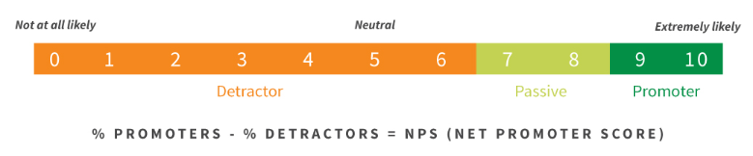
IMPACT 0.1 Demo feedback
Over 68+ participants in the demo
Stakeholders
Team members
Potential Operators
Others
Respondents count:
Scenarios:
Identify the condition likelihoods with level of care definitions
Mass and Volume allocation
2a. Identify the amount of resources for conditions
3. Compare research proposals
Scenario 1 | Scenario 2 | Scenario 2A | Scenario 3 | Final Feedback
7 | 9 | 4 | 2 | 5 respondents 1 email 1 MS Team chat Demo chat
How likely are you to recommend IMPACT 0.1 to a friend or colleague?
Scenario 1 - NPS: -14
5
8
8
7
6
7
*10
Scenario 2 – NPS: -22.22
10
4
8
6
6
7
8
1
9
Scenario 2A – NPS: -22.22
5
4
8
7
Scenario 3 – NPS:-50
5
8
6
6
6
Promoters (score 9-10) are loyal enthusiasts who will keep buying and refer others, fueling growth.
Passives (score 7-8) are satisfied but unenthusiastic customers who are vulnerable to competitive offerings.
Detractors (score 0-6) are unhappy customers who can damage your brand and impede growth through negative word-of-mouth
Notes:
During the demos we solicited some feedback. We braked it into 3 categories. Promoters, passives, and detractors.
From this slide you can see we do have some detractors. We also have many people who are satisfied but unenthusiastic customers, who are vulnerable to competitive offerings. It does not mean that they do not like impact, but they could go with another product if available. These teach us that we still have some work to do, to find more opportunities to enhance the impact product
Scenario 1:
From detractors.
The condition definitions must be a part of this report. Problematic assumptions could be made about what these probabilities mean if you do not understand the definitions of best and worst case. This is important, given that this report may be given to parties without access to the Evidence Library dataset.
From Passive:
ExMC needs to have a better definition of how knowing the likely conditions help to identify the level of care for a given mission.
If the user/operator is unfamiliar with navigating tableau dashboards, additional training, or mention of specific functions that the user might find helpful would be good.
From Promoter:
It was not clear how a user could do a trade using this scenario. For example, they may want to look at two or more DRMs. Or cases where EVAs are in there or not. Or a crew size of 4 vs 6. Can the user do these types of trades on Scenario 1 within a request, or do they need to enter multiple requests. If so, how do they compare multiple requests in Tableau?
Scenario 2:
From detractors:
how do you know if its passed clinical face validation from the report?
IMPACT will help in the system selection process, but in a limited way:
- as there are many other pieces involved in the decision. In order to help select a medical set that meets volume and mass targets, the figures of merit will also be needed by the decision maker (it looks as though IMPACT should be able to do this, but was not demonstrated for this scenario). It would be difficult to make a decision base on just mass and volume optimization.
If the requirements that are impacted are also understood, then a decision could not be made until discussion with the requirement owners (medical operations clinical and engineering teams). (This scenario showed metrics for impacts to requirements, but did not show the list of requirements and what the next step would be in order to rectify the numerous affected requirements.
If there are requirements that are affected, then the system is not a good candidate as it doesn't meet the requirements, even if it appears to be "optimized" to certain parameters. After consultations are done, the resulting candidate system will then need to be validated against the full set of requirements by the systems engineering team. Only then will a candidate medical system option be chosen as the end item system product.
From Promoter:
It may help future users to have a wizard for making an N-point curve with this scenario. The wizard could be invoked with a button and a special popup could capture the factor against which the value is plotted (i.e., mass, or volume, or both) as well as how many target allocation points the user wants to plot. Then a control appears to capture that number of targets. So if the user wants 7 points, they enter 7 and then a control appears prompting them to enter 7 allocation target values.
Scenario 2A:
From detractors:
How will a reviewer know that the content presented in Tableau has been clinically validated? What about exported files?
From Passive:
Recommendations on significant digits to be in decimals and with max 3 decimal places. displayed as (for example) 0.001 vs. 1 x 10(-3)
We have at least one detractor in all scenarios,
We have respondents who are satisfied but unenthusiastic customers who are vulnerable to competitive offerings.
Scenario 3:
From detractors:
How will a report reviewer know the expertise that was used to inform the inputs to the runs (given they need expert opinion to adjust the input data)?

Slide 6
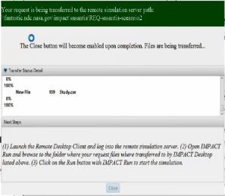
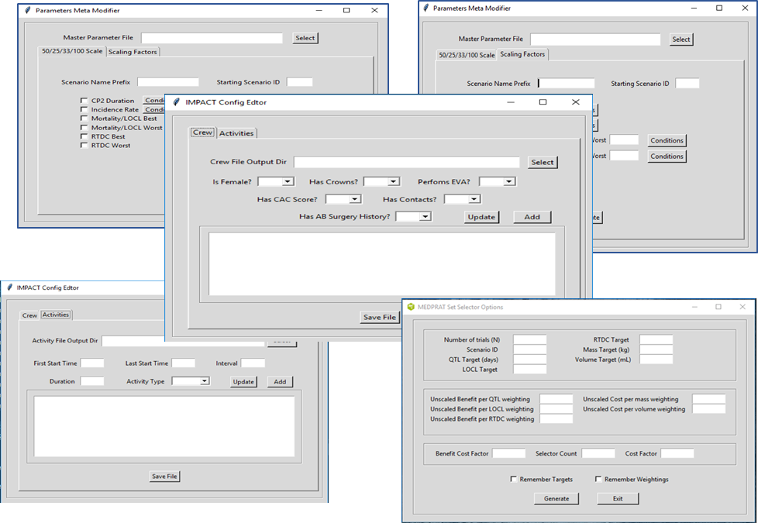
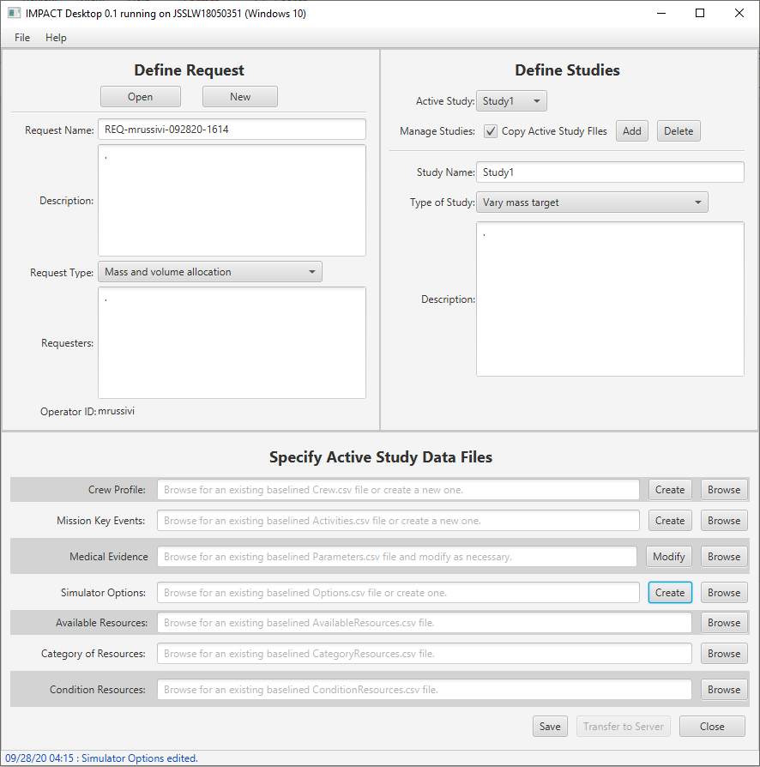
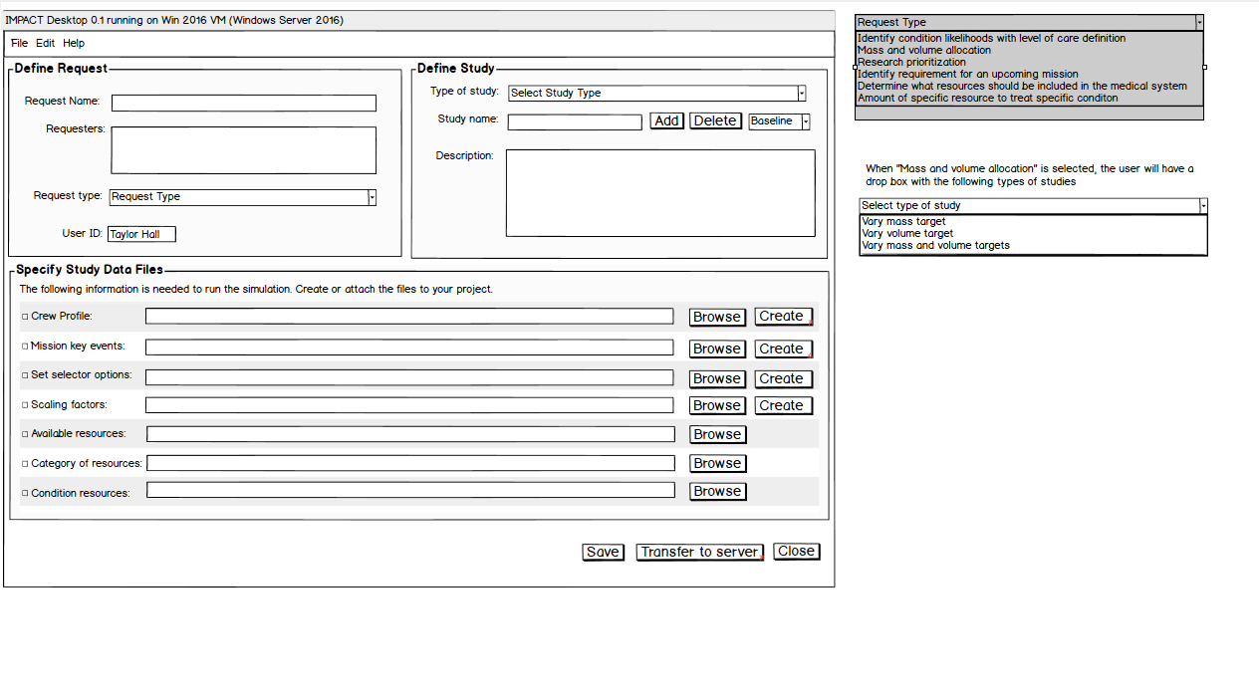
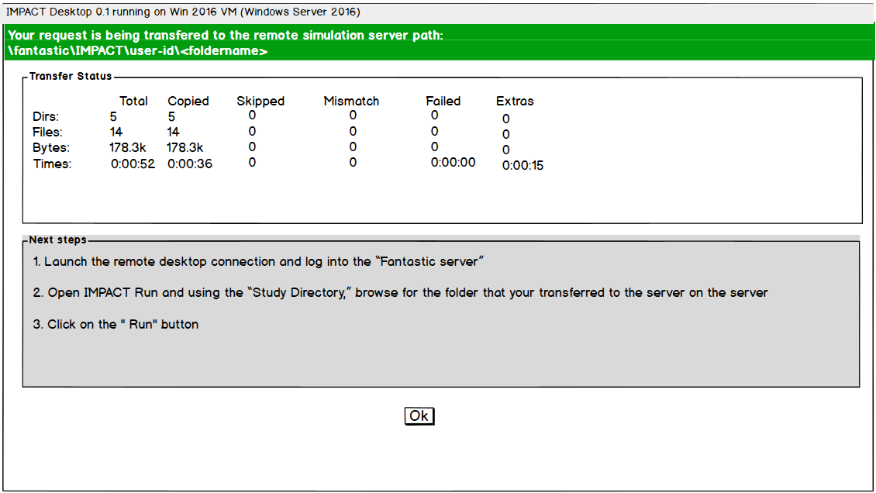
IMPACT Desktop – Home Screen Evolution
Iteration 1
Iteration 3
Iteration 2
Note: Pending Agile User Study
Notes:
The 1st iteration did not have a way to integrate all the information. There were 5 pop up dialog boxes. We developed a prototype based on the interviews feedback an multidisciplinary teams feedback. We gathered user feedback on the wireframe research, shared findings with the team. An the prototype was born.
The prototype had significant changes:
It has now a main interface for IMPACT desktop.
There is a place to open previous studies
You can enter the information of multiple requestors
- You can define different studies inside of a request and copy crew profiles, mission key events or other important data that may need to be similar in your studies
- It now has active buttons that after you create a crew profile, it allows you to edit it.
-It disable the transfer bottom until it ensures that you have all the information you need for an specific request.
It only allows you to transfer the files after you have save them.
Deleting or closing has now a confirmation

Slide 7
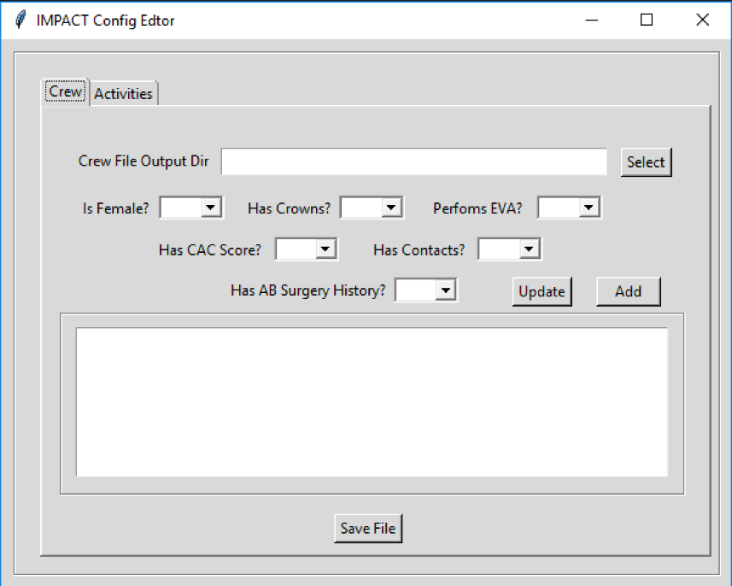
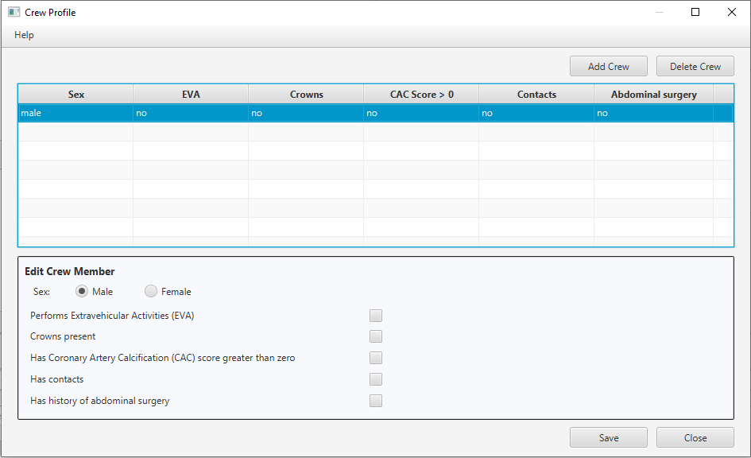
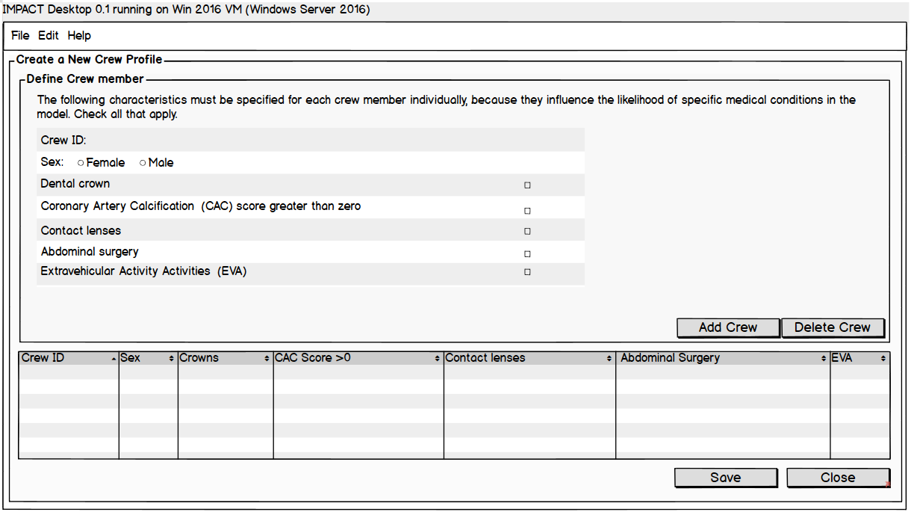
Crew Profile Evolution
Iteration 1
Iteration 3
Iteration 2
Note: Pending Agile User Study
Note: Wireframe developed with multidisciplinary inputs
Notes:
From the first iteration of the crew profile we learned:
That we needed to have descriptive labels and make some changes to the layout to facilitate readability
Also, the interface seemed to be targeted to females. Some wondered why is it only asking for females?
Crowns and contacts have multiple meaning across practitioners
It was unclear how to edit or delete a crew members.
People wondered – why are we updating something the first time we use it?
Some people did not know what all acronyms meant
Based on the questions asked, it seemed to provide an incomplete crew profile. Some clinicians wondered why is this not asking for preexisting conditions and current medications

Slide 8
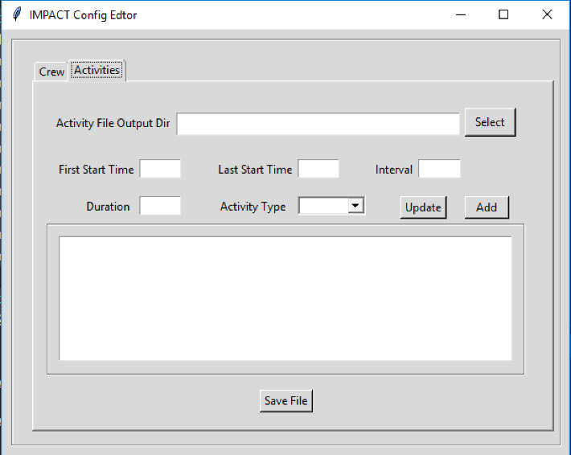
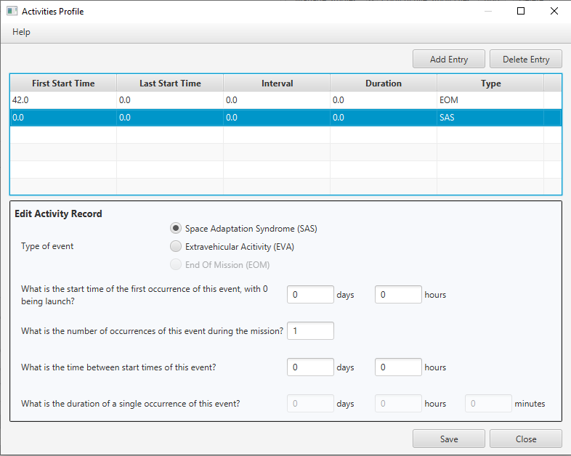
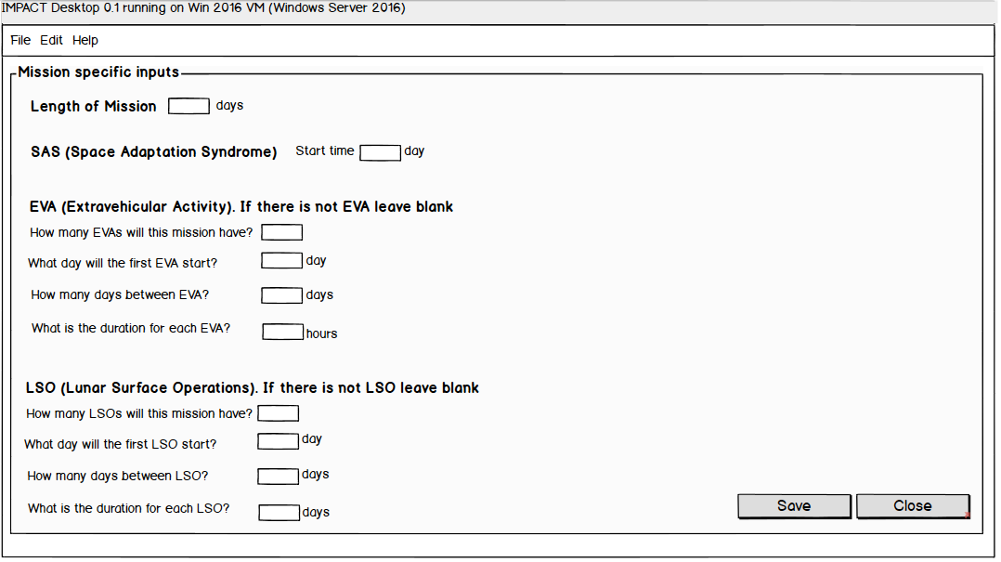
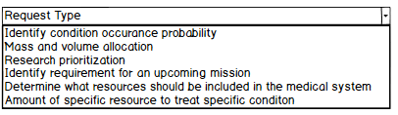

Activities and Mission Key Events Evolution
Iteration 1
Iteration 3
Iteration 2
Note: Pending Agile User Study
Notes:
The activities and mission key events interface also had 3 iterations.
From the first iteration we learned:
You should ask for the type first, and then for the details of the activity or event
Labels needed to be more descriptive, people did not understand what was the last start time or the first start time
No everyone was familiar with acronyms
There were not units
It was not clear how to use this interface

Slide 9
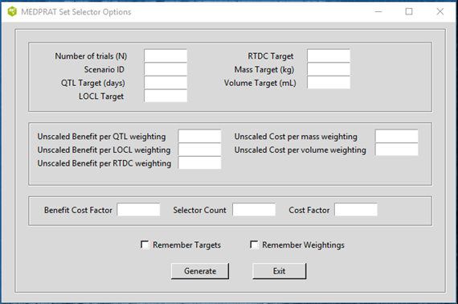
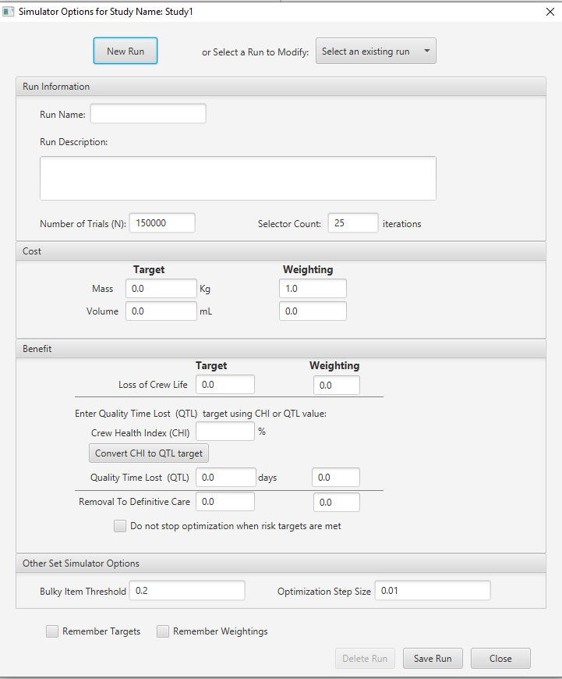
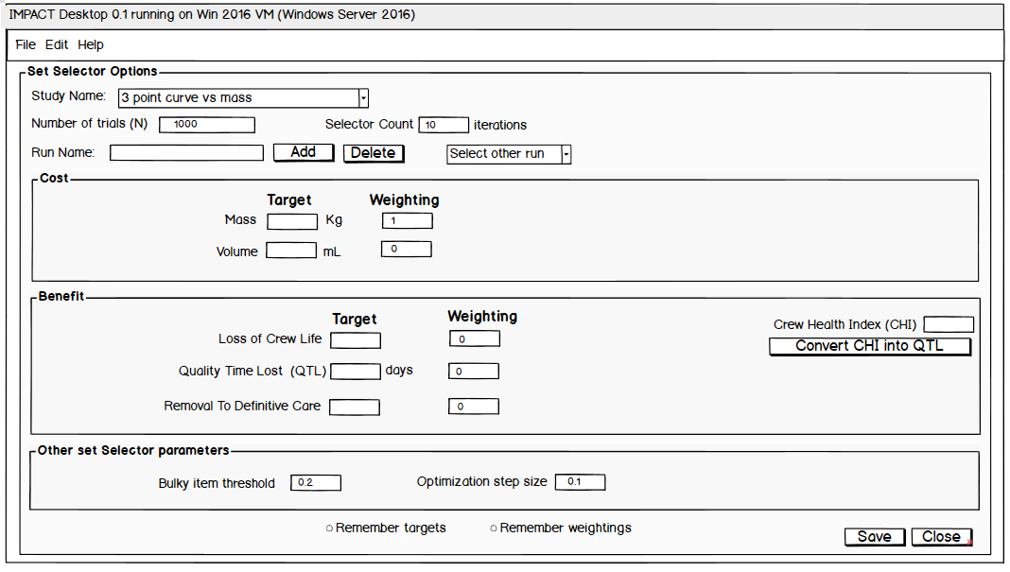
Simulator Options Evolution
Iteration 1
Iteration 3
Iteration 2
Note: Pending Agile User Study
Notes:
The simulator option interface also had 3 iterations
From the first one we learned:
This interface was very difficult to understand, benefit cost factors, selector count, and benefit factors were not commonly known terms
Unscaled benefits and unscaled cost was labels were hard to understand.
Acronyms were not commonly known
Some people was more familiar with the crew health index than with the quality time loss
Information about cost and benefit was mixed. Labels were not understood
Not everything had units

Slide 10
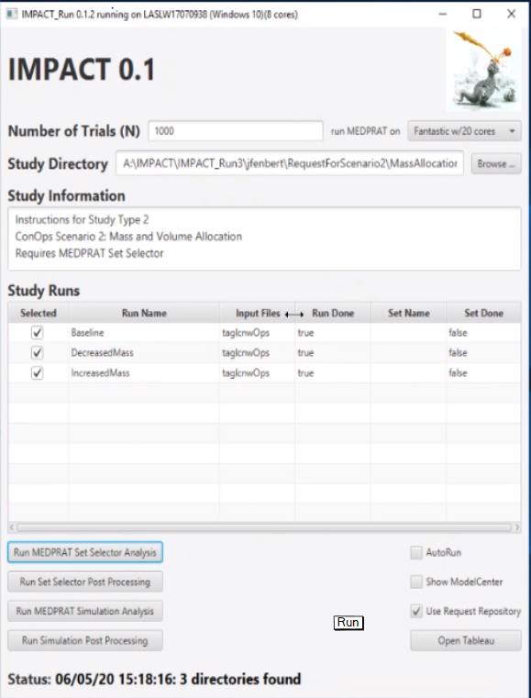
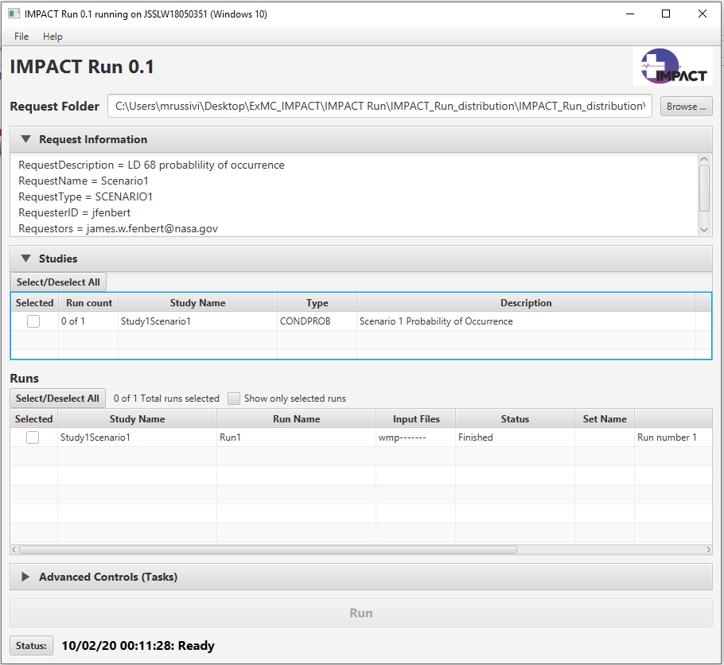
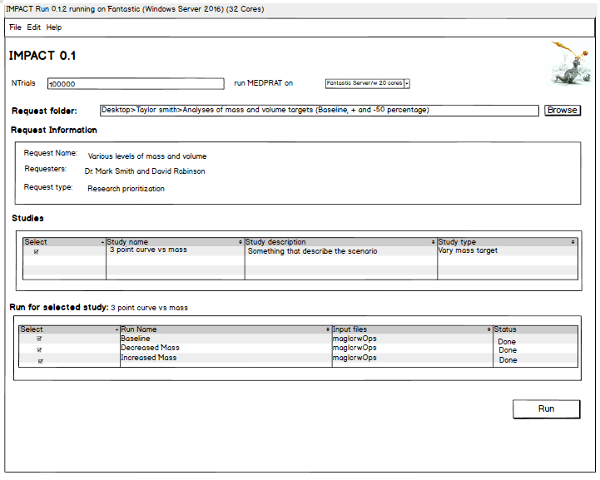
IMPACT Run Evolution
Iteration 1
Iteration 3
Iteration 2
Note: Pending Agile User Study
Notes:
IMPACT run also had 3 iterations
In the first one, we noted that the labels and information from impact run was not in sync to the information coming from IMPACT desktop. For example, it asked for a study directory, when it needed a request folder
Study information did not related to the information entered for the study in IMPACT desktop
The auto run box allow would allow you to run studies as soon as you selected the folder, so if you selected the incorrect folder by mistake you would have to wait
No all labels were clear

Slide 11
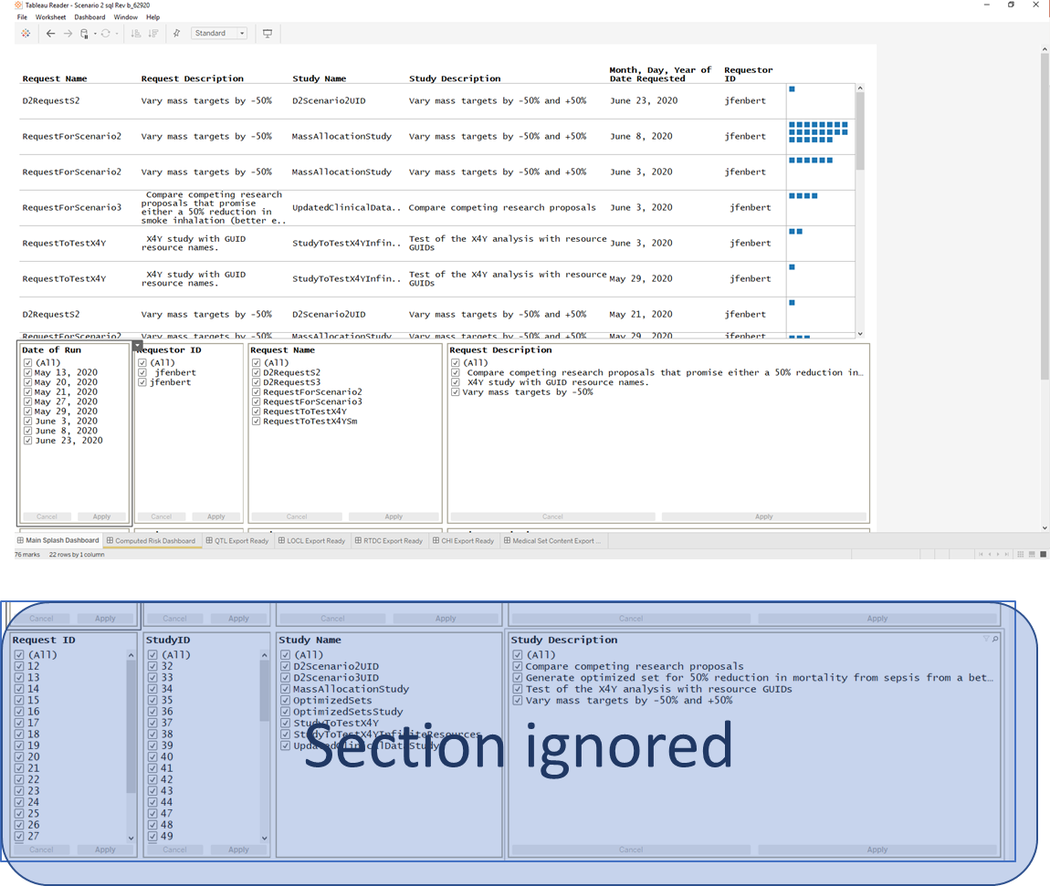
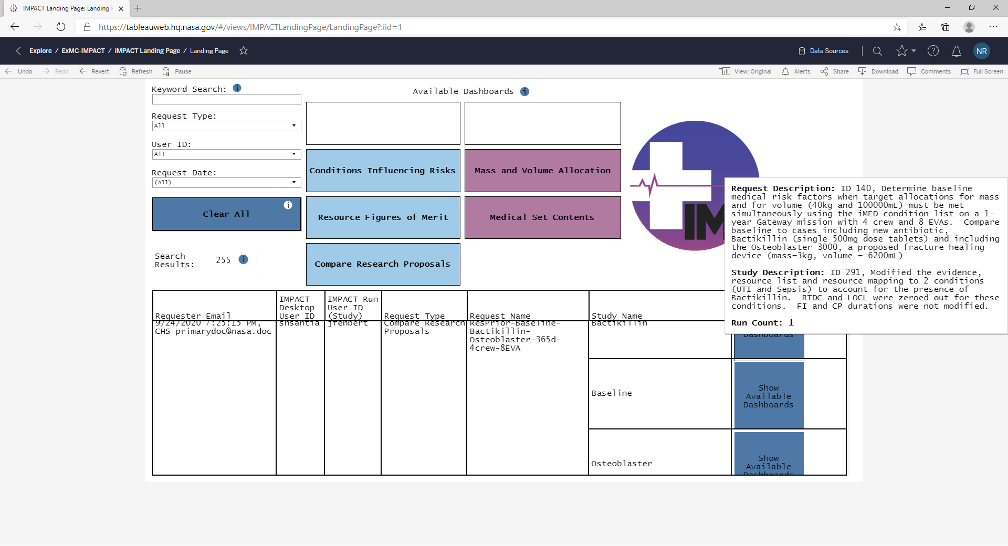
Output Results – Searching for requests
Iteration 1
Iteration 2
Note: Pending Agile User Study
Notes:
IMPACT uses tableau to present the output results
The main interface allows you to find your studies. There were only two main iterations for this interface
It was hard to find studies here. There were two vertical scrolling features that most people missed. Which means that they were not able to find the study.
Apply buttons were hard to discern. There were at least 8 buttons available to find a study. All participants forgot to click on “Apply at least once”
Unfamiliarity with Tableau made it difficult to know the short cuts to clear filters
It was not clear if there were multiple studies in one request. There was a need to streamline the labels

Slide 12
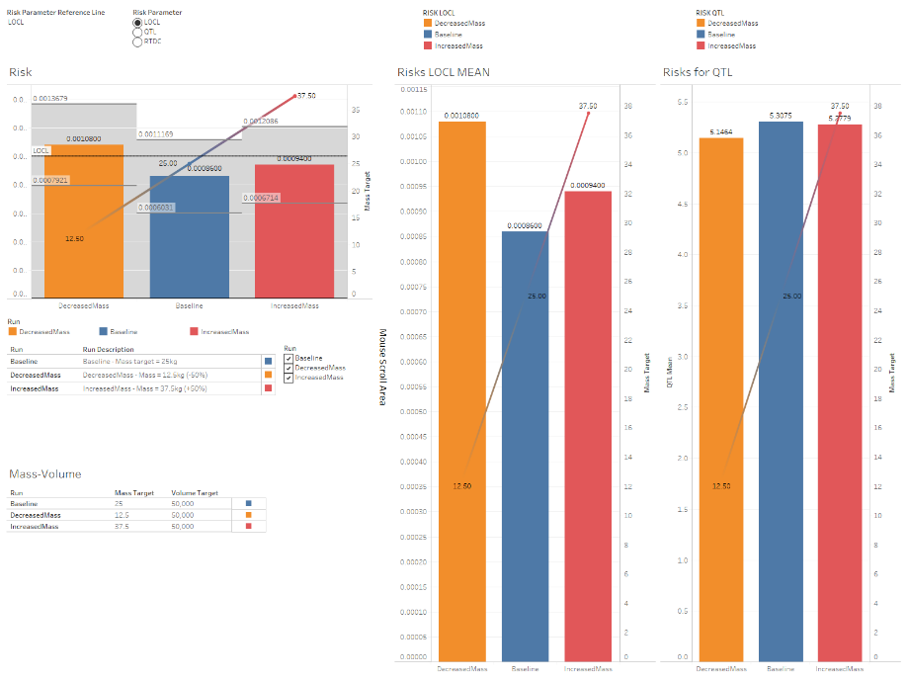
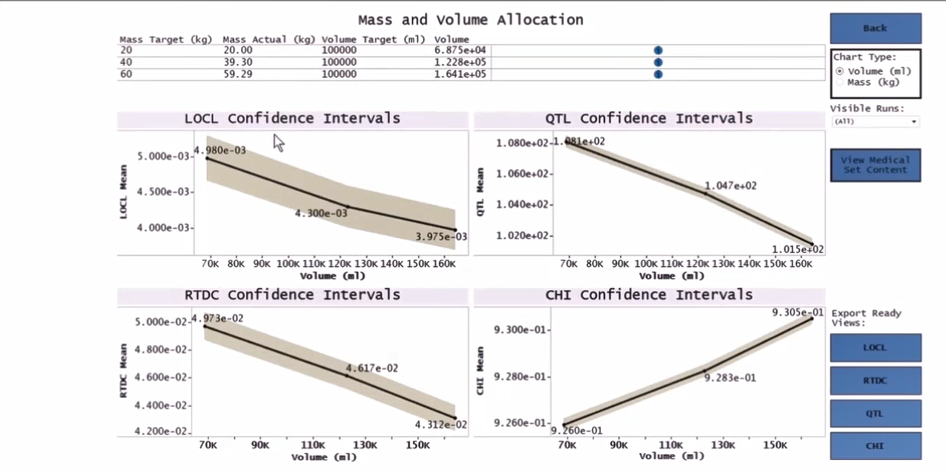
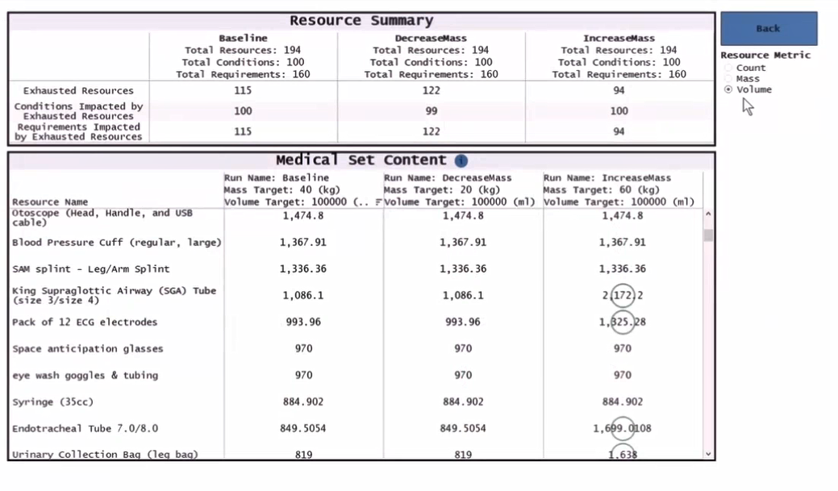
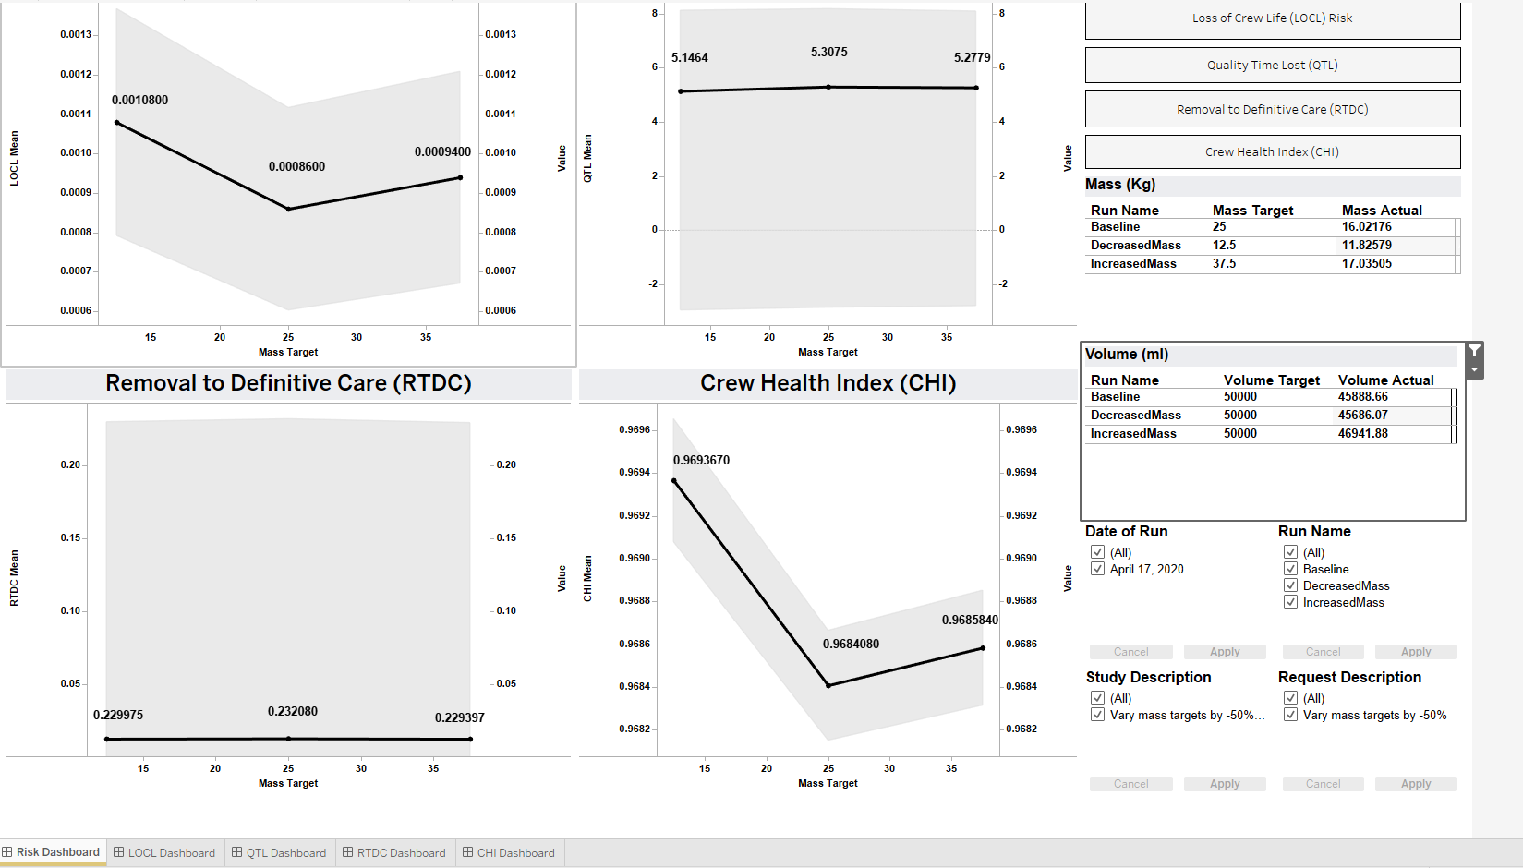
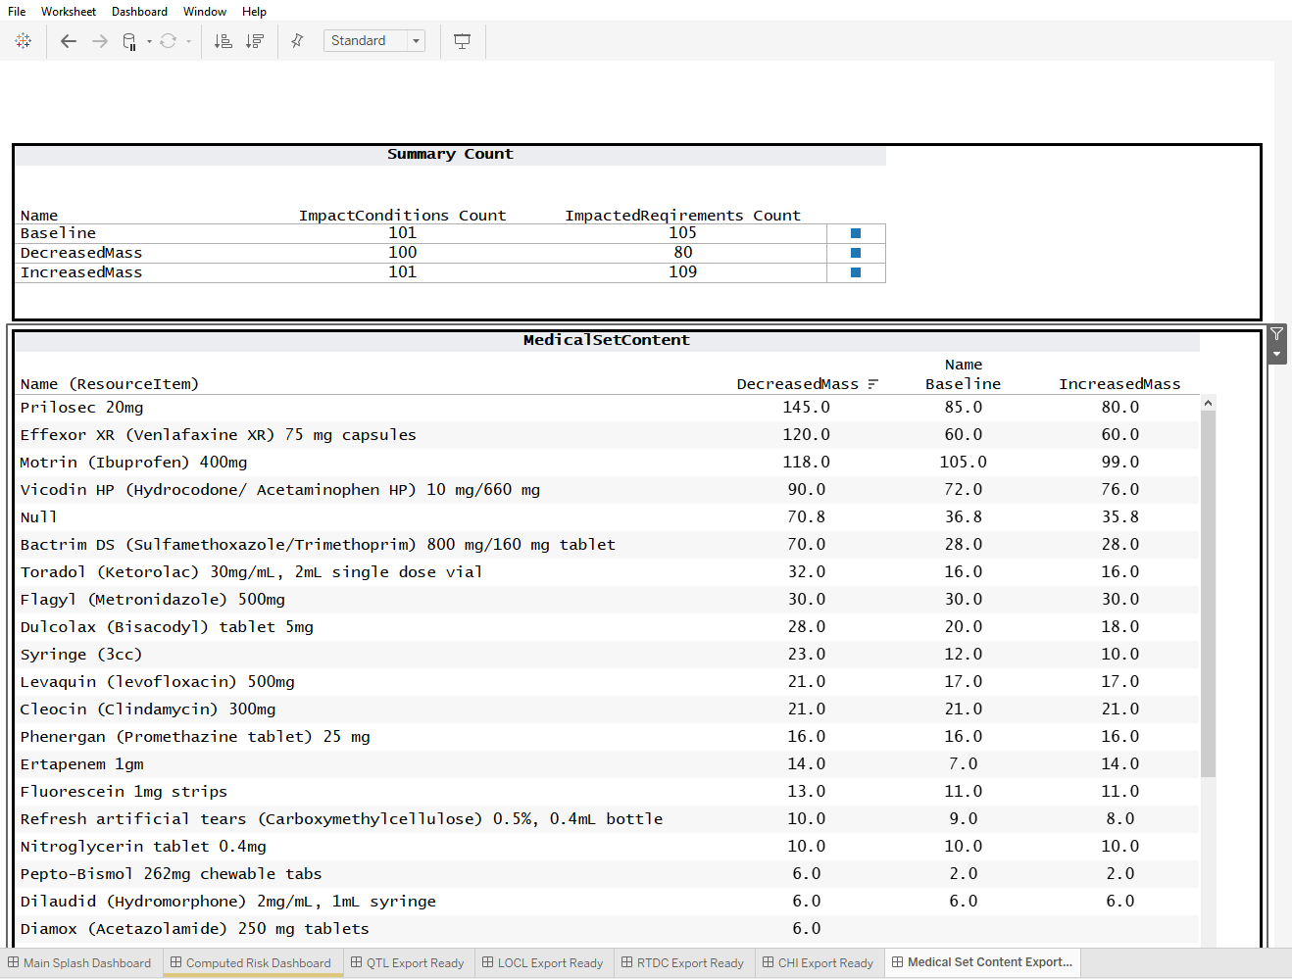
Output Results for Scenario II Evolution
1st Iteration
3rd Iteration
2nd Iteration
Note: Pending Agile User Study
Notes:
The scenario 2 had 3 iterations
Initially, some information was shown in multiple places with the same data. There was not list of resources. And it was hard to visualize what all of the risk parameters were for the different mass and volume targets.
Axis were not clear
There was not consistency in the order of choices
In the current prototype, we see that
There is one place to see all the graphs
The medical content can be seen by mass, volume , or quantities
there are direct links to expand the graphs and now the graphs do not have a size 8 font text
The main page has buttons with direct links to view the medical content
The interface signals when changes in the risk parameters are beneficial
The target values match the number given by the requestor and not the numbers assigned by the operator

Slide 13
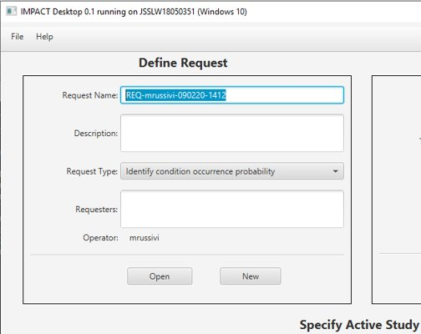
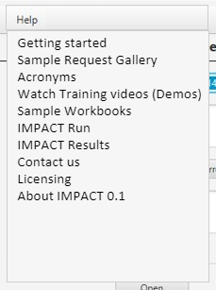
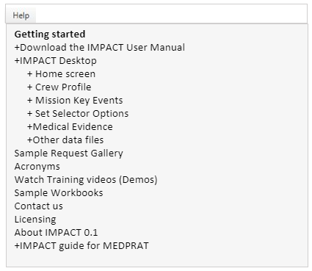
On screen help Evolution
Iteration 0
Iteration 1
?
Notes:
There is a feature that we are adding. We are working on the onscreen help. Information listed here are based on the information displayed by other software use for analysis.
Hf recommended to add sample of requests, list of acronyms, Possibilities to see videos, Sample workbooks with the files needed to run different request, Information about the impact tools suite information that developers may need when working with MEDPRAT, information that could help the user to learn about each interface

Slide 14
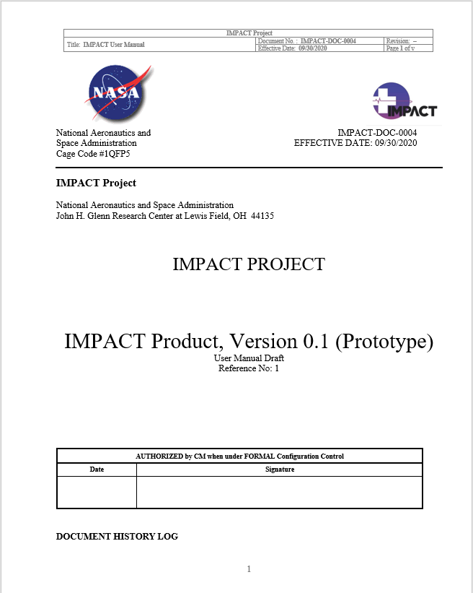
IMPACT 0.1 User Manual
Covers aspects of IMPACT (IMPACT Desktop interfaces, IMPACT Run interfaces, and some of the output files)
Worked with different developers to define labels and interactions of the current state of the prototype and add examples
Identified potential guidelines that will help people who are not as familiar with Tableau and guidelines for MEDPRAT experts
By Natalia Russi-V, Jennifer Amador, and William Thompson
Notes:
Created a initial document
It covers almost all aspects of IMPACT 0.1
It defines current labels and interactions of the current state of the prototype and add examples
It provide a list of short cuts to help people who are not as familiar with Tableau and guidelines for MEDPRAT experts

Slide 15
IMPACT 0.1 Demo Overall comments
Good
Its fast
Tableau outputs are dynamic
Seems to fill a real need…
Allows you to export output files and images to excel and PowerPoint to easily share
Not as good
Hard to know how valid the outputs are, or if they are comparable to similar studies done by IMM
The number of entry boxes to fill out before running trials
They were some suggestions labels, prompts, and to streamline the interface
There is a need to identify ways that allows IMPACT to continuously learn about the user experience
Notes:
Good things
Its fast
Tableau outputs are dynamic
Seems to fill a real need. Seems to tie together medical evidence, probabilities of conditions occurring, and engineering factors very well
Allows you to export output files and images to more familiar formats and formats for presentations
Not as good
Hard to know how valid the outputs are, or if they are comparable to similar studies done by IMM
The number of entry boxes to fill out before running trials
They were some suggestions labels, prompts, and to streamline the interface
There is a need to identify ways that allows IMPACT to continuously learn about the user experience

Slide 16
Next Steps
Research to identify information architecture of the IMPACT service
Perform usability studies to gather requesters and analyst feedback on the IMPACT tool suite results
Perform usability studies to gather operators feedback on the IMPACT tool suite
Work together to identify the user stories for the next scenarios that IMPACT plans to accomplish
Integrating the Medical Data base interface with the IMPACT interface
Notes:
So what is next?
We will be working on research studies to identify information architecture of the IMPACT service
Perform usability studies to gather requesters and analyst feedback on the IMPACT tool suite results
Perform usability studies to gather operators feedback on the IMPACT tool suite
Work together to identify the user stories for the next scenarios that IMPACT plans to accomplish
Work with new HF researchers on how to integrate the Medical Data base interface with the IMPACT interface

Slide 17

Thank you!
Do you have any questions?
Notes:
This is all we have for today. Thank you for listening to this presentation. Do you have any questions?

Slide 18
Learning from IMM
Positive
Experience
Results validation
Helpful
8 Requesters Interviews
Educational
Informative
Limited Functionality
Rigid interface
Pain Points
(Negative
Experience)
Request format
There are no opportunities for team collaboration
Current system is expensive and takes a long time
Notes:
In the first 8 interviews, we learned about the Current IMM system, and how it was often described as helpful and educational, but a system that takes a long time and is expensive
To give you a little be more of context. I want to share with you an story. Imagen that you are a requester. It takes you couple of days to talk with the different parties to understand what will be needed for the simulations (e.g., emails about charge codes, emails for the request form, and information needed for the simulation)
Then the operator takes an hour or so, to run the simulation
And the review process takes 6 months
When you get the results, you realized that you did not think in gender as a factor. You forgot to add females to your simulation. You do not have the time and the money to wait for other full analysis, so you now want to get the data to make some additional analysis with your team, but you will need to make another request for the data
Another pain point was the rigid interface.
IMM is based on ISS and other programs that may need adaptation
Not all IMM capabilities and limitations are commonly known or clearly listed
Request format was also a pain point
Service request form is not easily understood
Some assumptions do not fit all program teams
Limited Functionality
Report is limited. Not all data is provided in the same request
Afraid of project taking data and using it out of context
Opportunities for team collaboration
A disconnect between management and the requester’s team can generate useless results
There is a lot of back a forth from medical and engineering
I going to talk about one that may help you to picture their experience
Gender example

Slide 19
IMPACT 0.1 Human Factors Support
User Experience Research and preliminary feedback
10 main interfaces
  some interfaces have multiple pages
Worked with each application lead and developers
Crew profile
Mission Key Events
Simulator Options
Medical Evidence
IMPACT Desktop
Home Screen
IMPACT Run
Main Dashboard
Output Results 1
Output Results 2
Output Results 3
Post-Processing
Output Results
Developed materials
User Manual
For all user interfaces
On Screen Help
Notes:
Even though we performed research on two previous iterations of the design. We did not get a change to gather user feedback from the prototype.
Just to let you know, some design decisions were made based on the understanding that there will be a general training.
Additionally to provide human factors support, we helped with the development of the user manual and hope to use it in future user centered documentation studies and for training

Slide 20
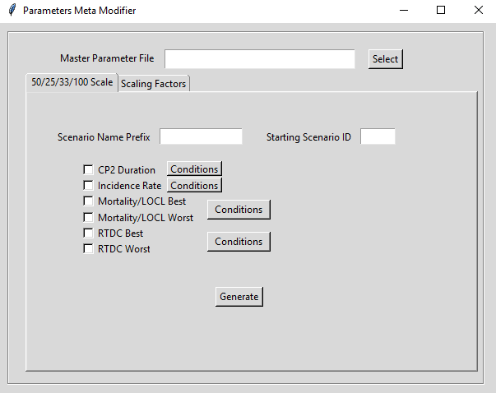
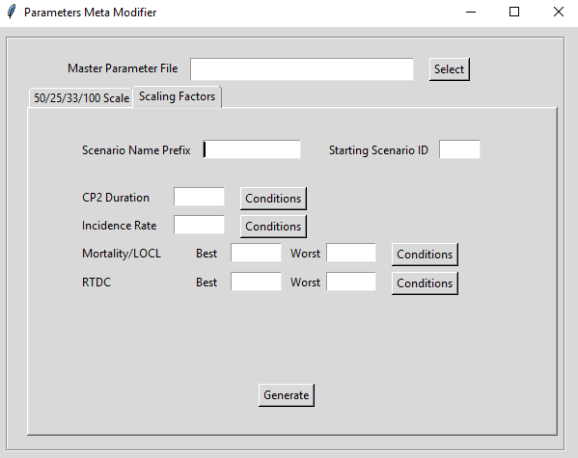
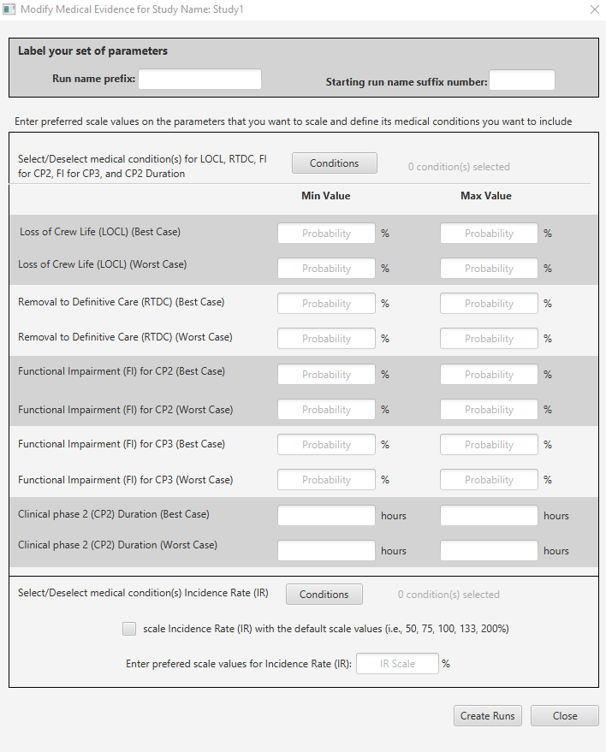
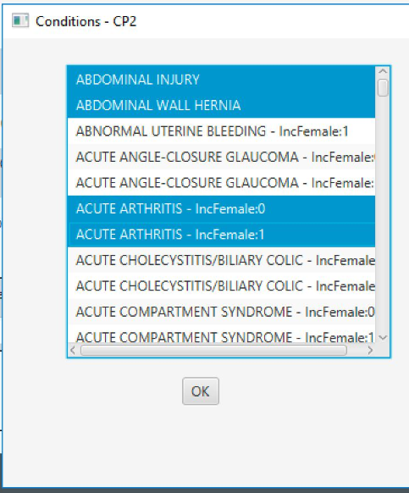
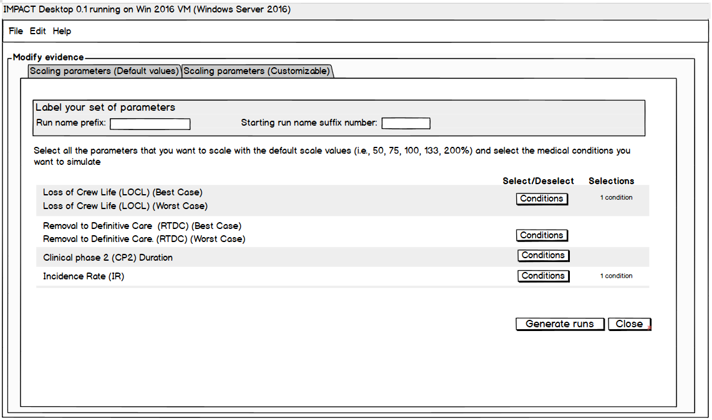
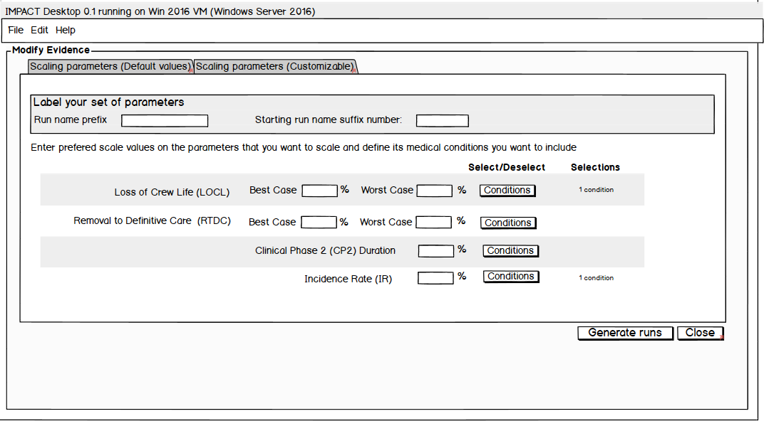
Medical Evidence Evolution
Iteration 1
Iteration 3
Iteration 2
Note: Wireframe developed with multidisciplinary inputs
Note: Pending Agile User Study
Notes:
The medical evidence interface will probably have more changes as we expect to be able to sync with the work that IMPACT MD is doing with the evidence library. This interface also had 3 iterations.
The prototype looks quite different than the wireframes. However, some changes that we see, is that now, we are asking for the type first, before asking for the details of the type of event. we have units, we have active buttons that cross check that you enter information that makes sense. For example, that the EVA does not take more time that the length of the mission.
It disables the boxes that are not required to be fill out for the type of event
It also has messages that asked you to save before closing

Slide 21
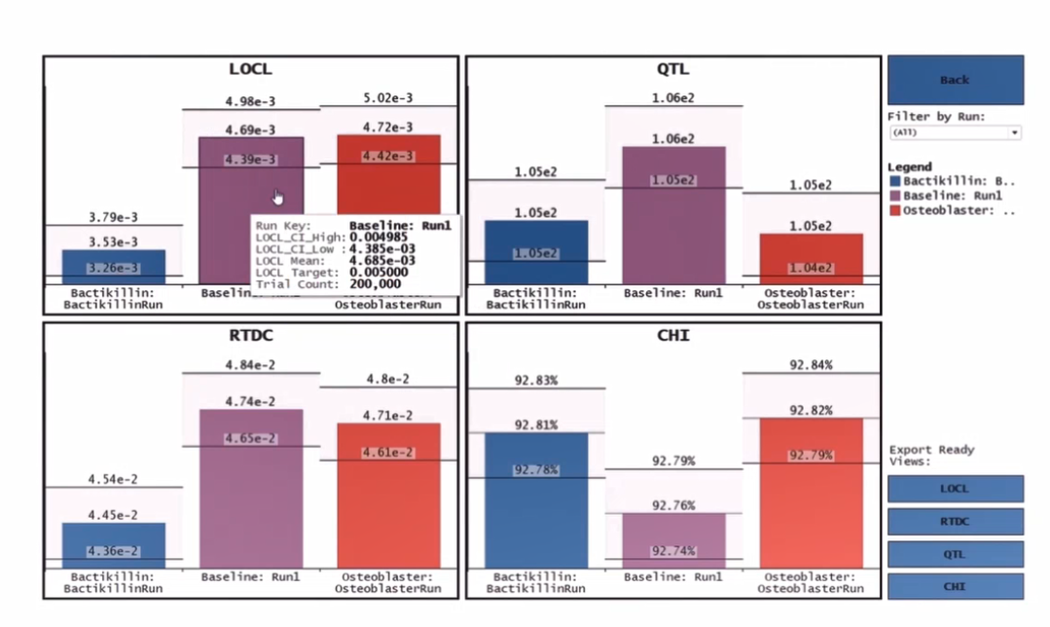
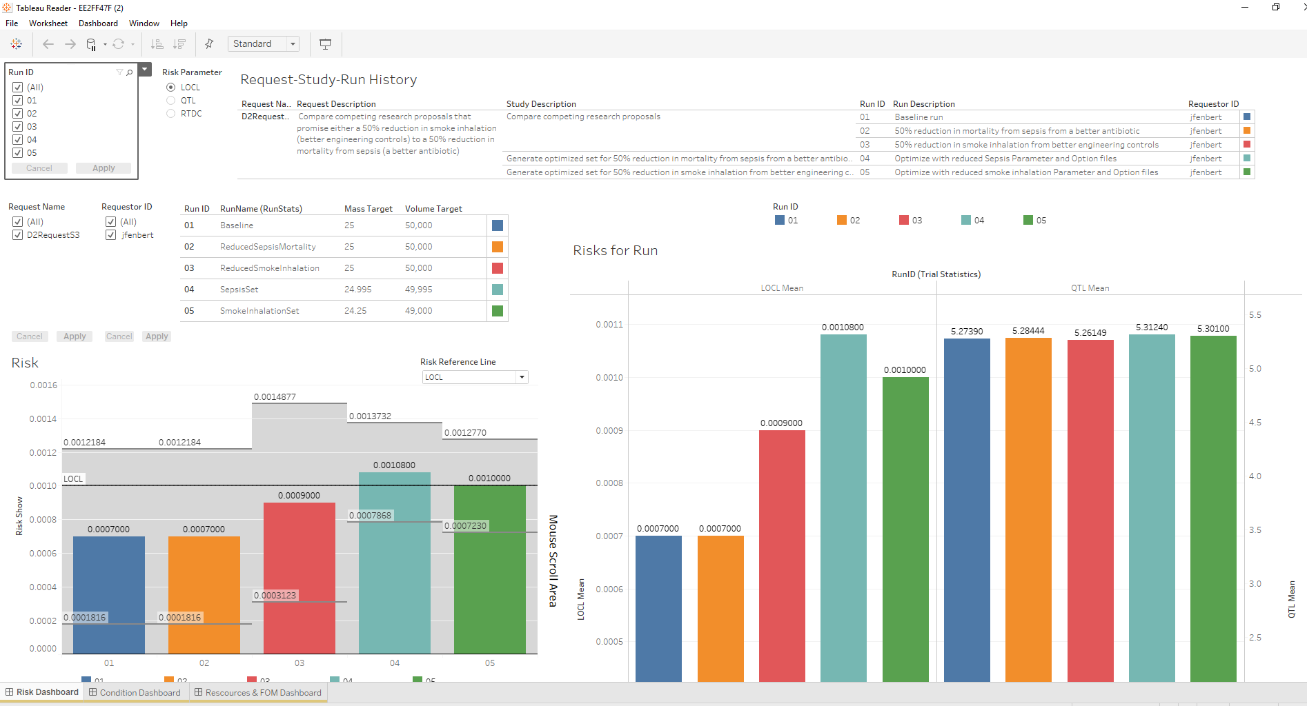
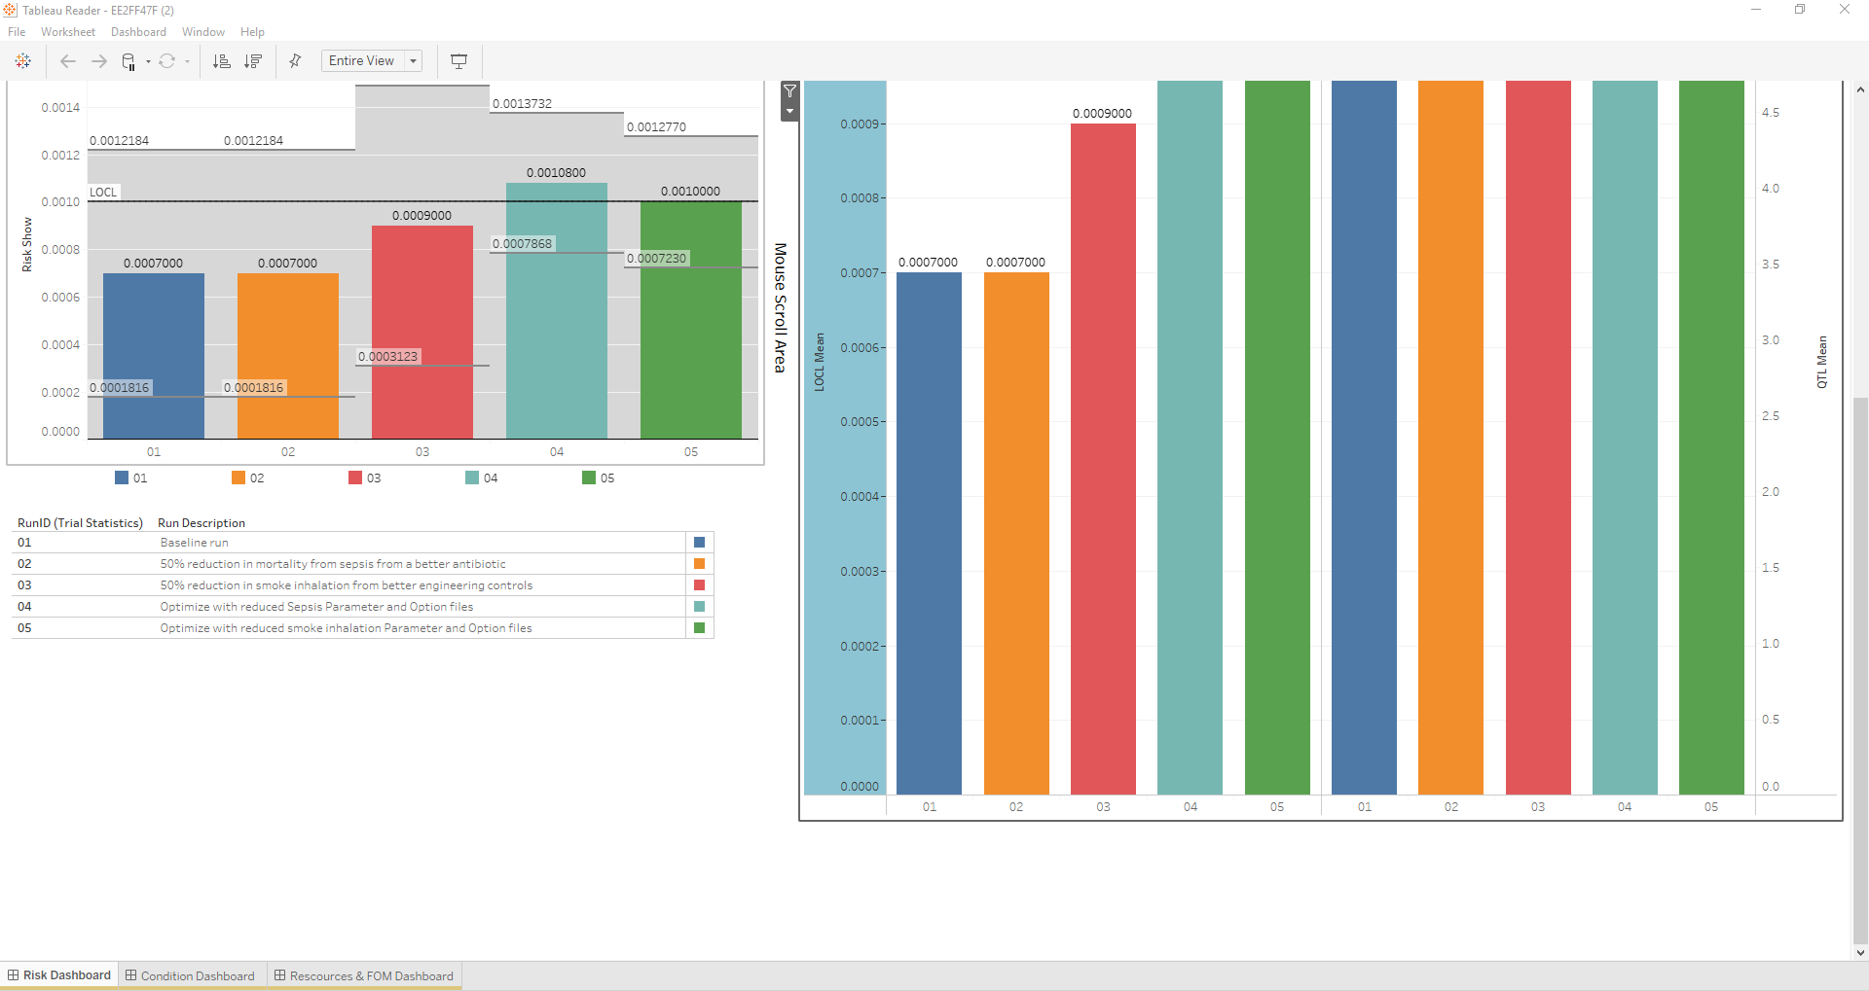
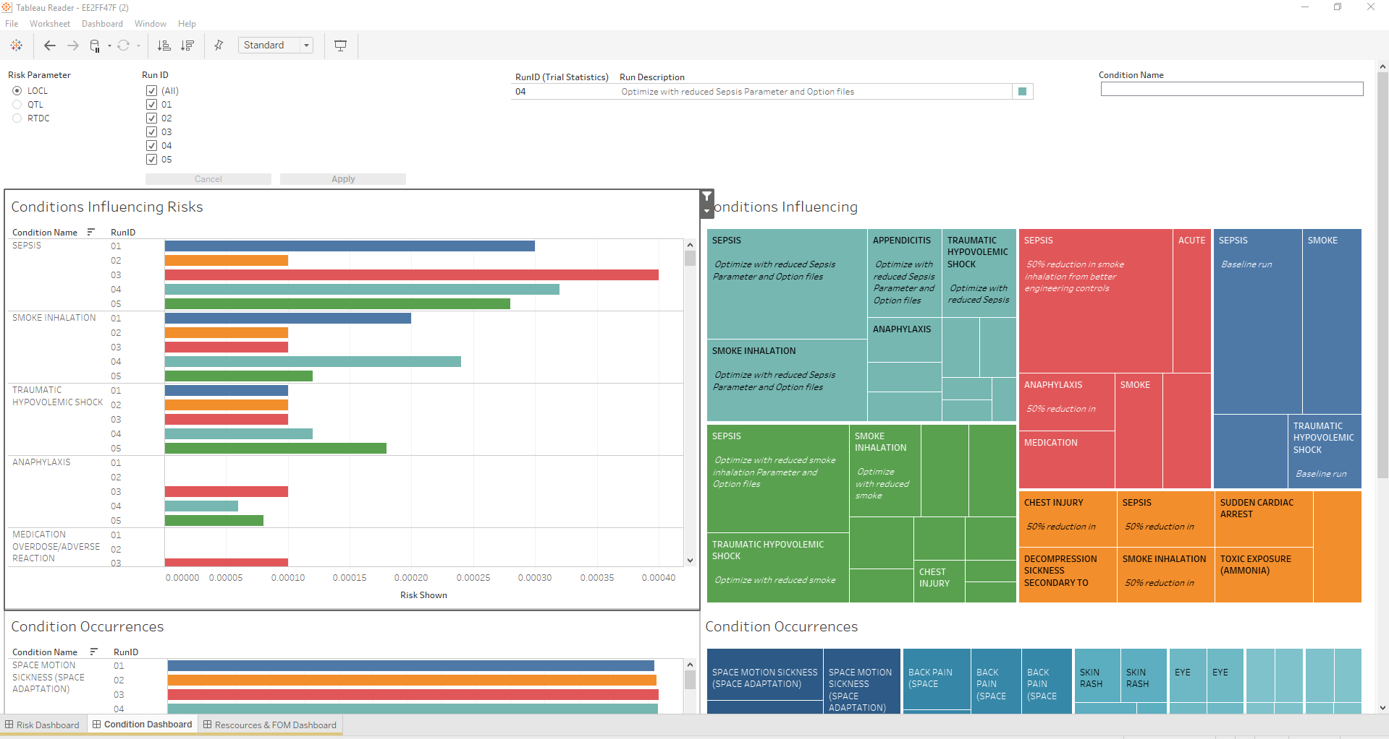
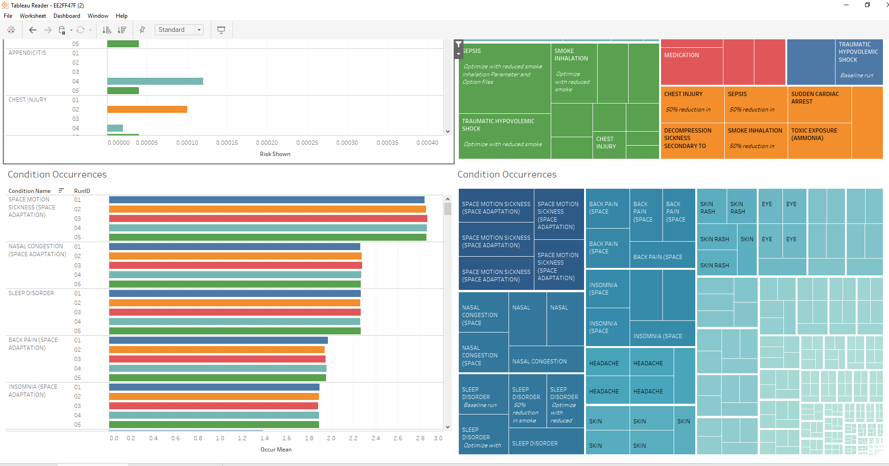
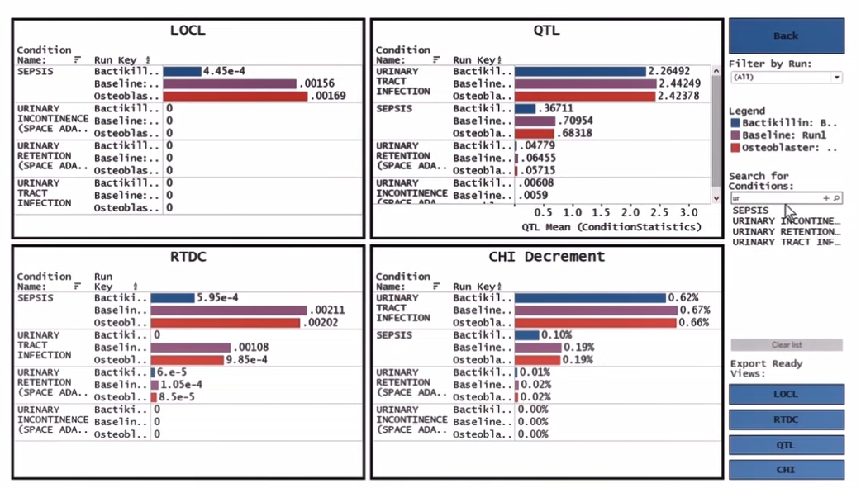
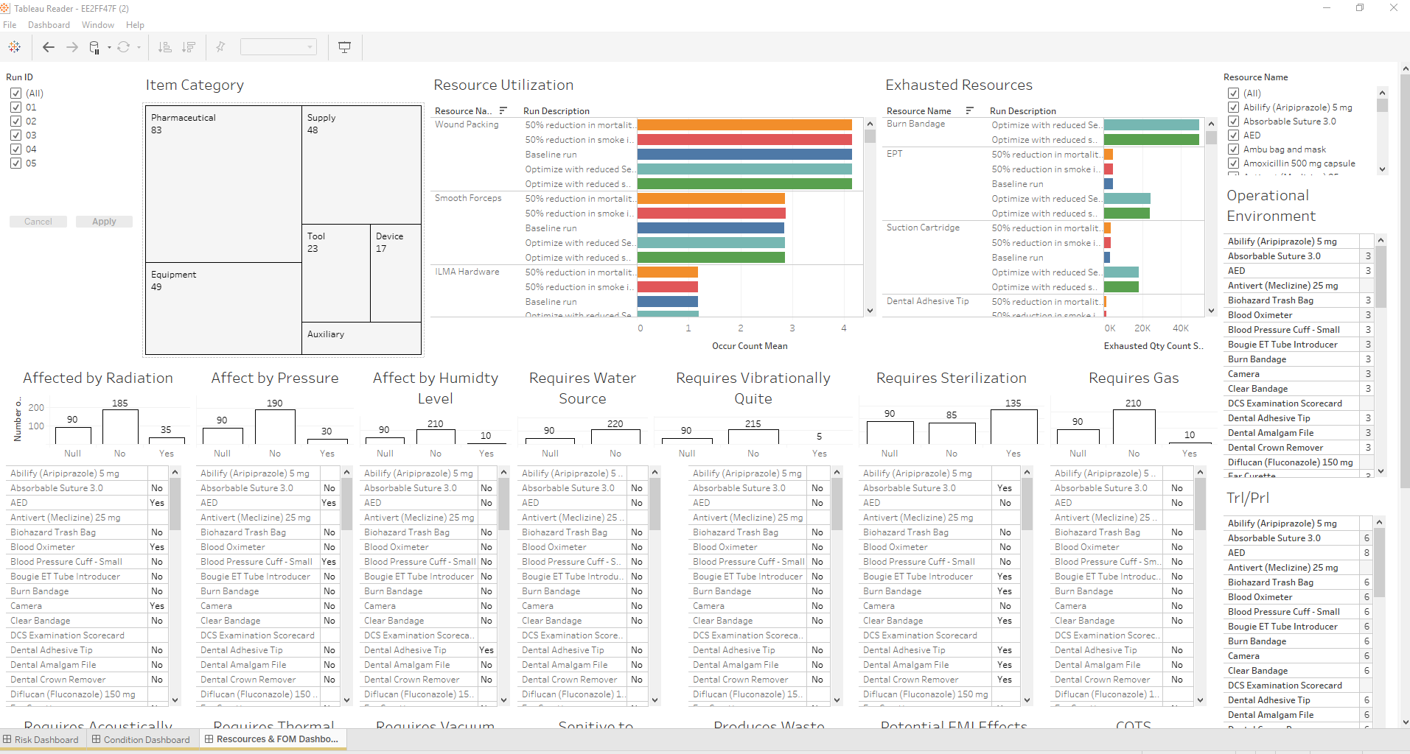
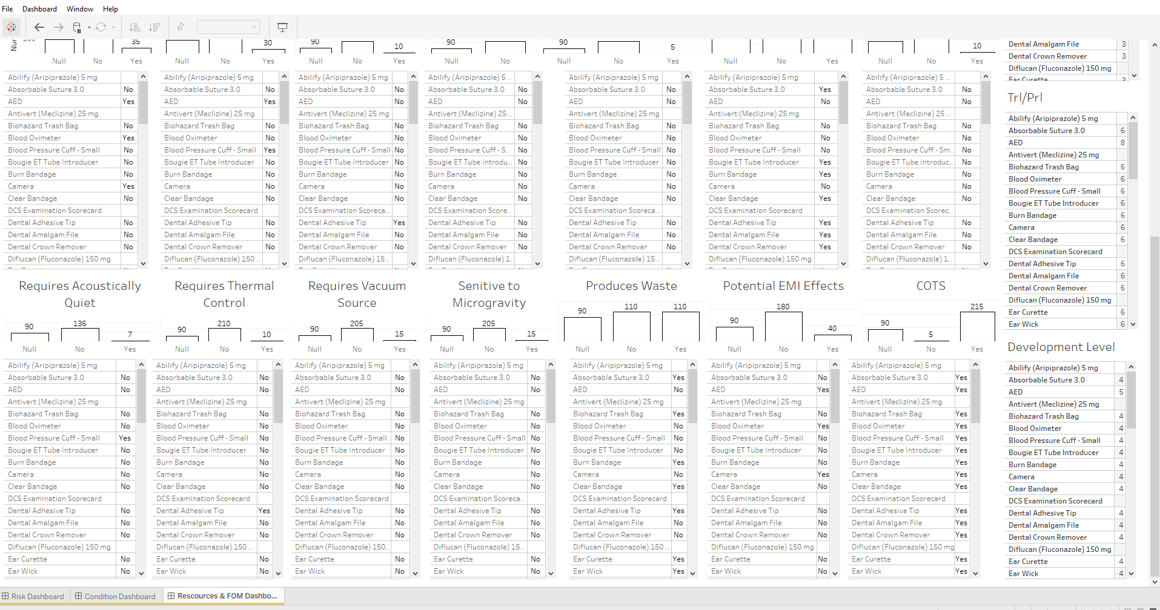
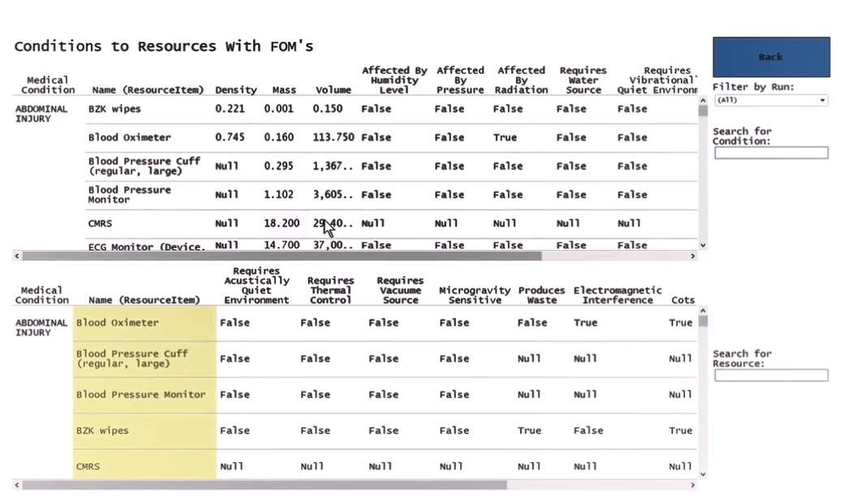
Output Results for Scenario III Evolution
Iteration 1
Iteration 2
Note: Pending Agile User Study
Human Factors Preliminary Feedback
Notes:
The output results for scenario III had two iterations. The first iteration did not have a full user study, but we did gather preliminary feedback based on heuristics and feedback based on quick requestors overview of the interface
There was a lot of information
The current prototype divides the information into3 main dashboards. Axis are labeled and information is categorized. One to identify the conditions influencing risk, one with the resource figures of merit, and one that help us to compare the research proposals.

