Slide 1
On the nature of the Arctic’s positive lapse rate feedback Cause or Symptom of Arctic Amplification
Patrick C. Taylor, NASA LaRC

Slide 2
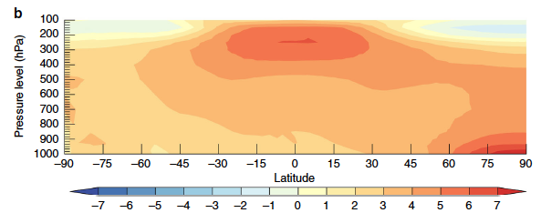
Defining the Lapse Rate Feedback (LRF)…
LRF exists in the conventional top-of-atmosphere (TOA) feedback analysis framework due to the sensitivity of outgoing longwave radiation at the TOA to the vertical tropospheric temperature structure.
Negative LRF: atmosphere outpaces surface warming
Positive LRF: surface outpaces atmosphere warming
Ensemble Mean Air Temperature Change between 2006 and 2100 (K)
Notes:
The definition of the lapse rate feedback indicates that process contributions to the vertically inhomogeneous warming response are a key consideration.

Slide 3
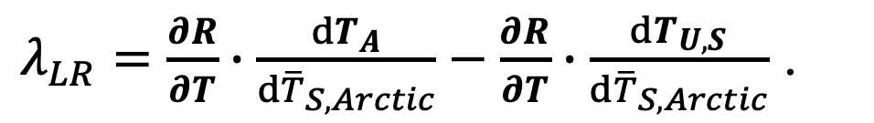
Methodology: CMIP5 output and Radiative Kernels
The temperature contributions to TOA radiative cooling can be decomposed into two feedbacks:
Planck Feedback radiative changes caused by vertically uniform warming
Lapse Rate Feedback radiative changes due to non-vertically uniform warming
HadGEM2-ES (Smith et al. 2018) radiative kernels are used:
Climate response
$λ_{LR}=\frac{∂R}{∂T}∙\frac{dT_{A}}{d{\overline{T}}_{S,Arctic}}−\frac{∂R}{∂T}∙\frac{dT_{U,S}}{d{\overline{T}}_{S,Arctic}}$ .
Radiative kernel
Climate model output: RCP8.5 forcing scenario from 24 CMIP5 models, interpolated onto a common 1ºx1º grid.
Climate Response: Differences between the average of the last 20 years of the 21st Century (2081-2100) and the first 20 years of the simulation (2006-2025, present-day)

Slide 4
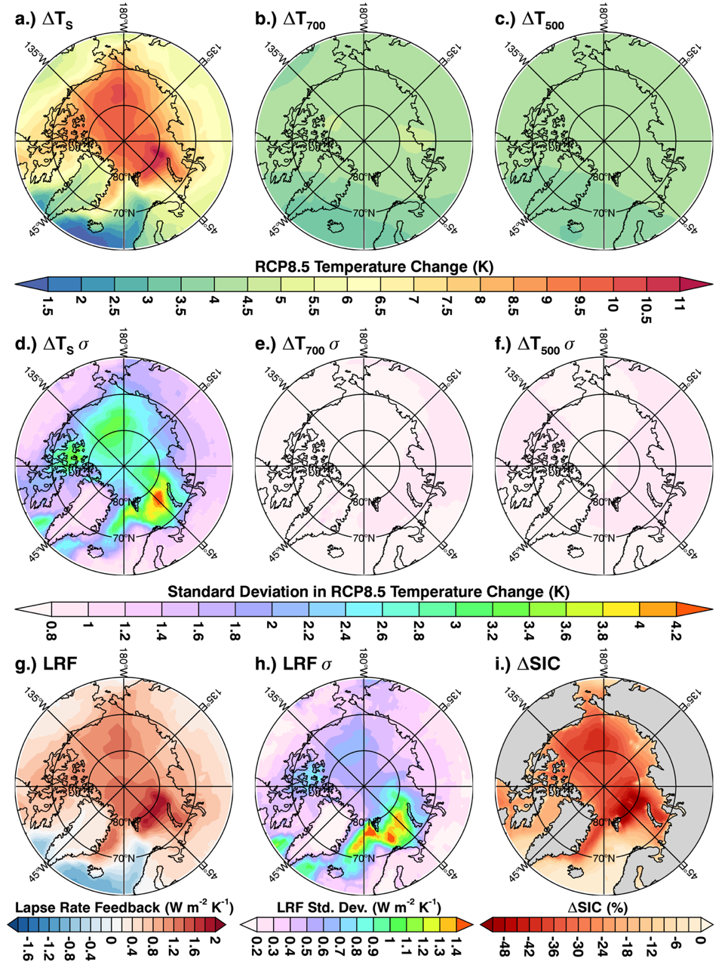
Surface temperature change pattern dictates the spatial pattern of the lapse rate feedback.
The lapse rate feedback is strongest over sea ice and in regions of sea ice retreat (Boeke, Taylor, and Sejas (in press; GRL).
~1 < ΔTs < 11K
~3 < ΔTa < 4.5 K
Notes:
Again these are important clues to the processes that we need to understand (surface temperature not air temperature)

Slide 5
The lapse rate feedback inter-models spread results from differences in surface warming.
Processes responsible for the inter-model spread of surface warming and sea ice retreat are related to the inter-model spread in the lapse rate feedback (Boeke, Taylor, and Sejas (in press; GRL).
~1 < ΔTs σ < 4 K
ΔTa σ < 1.0 K
Notes:
Why is surface warming maximum in sea ice and sea ice retreat regions? Surface albedo feedback is maximum there.
Why is the LRF most positive in sea ice regions and in fall and winter…this is related to the maximum surface warming occurring in these regions (since atmospheric warming is the same everywhere) and this occurs because the largest sea ice loss and surface albedo feedback occurs in these regions, the temperature does not warm as much in summer because of the storage of energy into the OML and due to melting ice. The energy stored in the OML is transferred to fall when it keeps the surface warmer than that atmosphere, delays sea ice formation, and released STFs to the atmosphere.
The SIC concentration would be important to this mechanism to determine how much of the energy in a grid box is stored in the ocean vs. used to melt ice.
Need to find a way to “normalize” for sea ice change differences to explain the model differences in the LRF.

Slide 6
Lapse Rate Feedback seasonality and surface-type dependence
Land annual mean:
+0.21±0.13 W m⁻² K^{‑1}
Ocean annual mean:
-0.11±0.19 W m⁻² K^{‑1}
The lapse rate feedback is most positive in fall and winter and negative in summer.
Sea ice annual mean:
+0.25±0.28 W m⁻² K^{‑1}
Annual mean:
+0.66±0.35 W m⁻² K^{‑1}
Sea ice and sea ice retreat regions exhibit the stronger lapse rate feedback strengths.
(Boeke, Taylor, and Sejas (in press; GRL)
Notes:
The arctic is warming faster than the rest of the planet because it is accumulating energy at a faster rate.

Slide 7
Lapse Rate Feedback seasonality and surface-type dependence
Regions with larger declines in sea ice concentration have a more positive lapse rate feedback.
(Boeke, Taylor, and Sejas (in press; GRL)
Notes:
The arctic is warming faster than the rest of the planet because it is accumulating energy at a faster rate.

Slide 8
Does the degree of stratification influence Lapse Rate Feedback strength?
Weaker inversion
Stronger inversion
Outgoing
LW
Outgoing
LW
warming
warming
height
height
LW down
LW down
Ts
Ts
CO2 Forcing, warming, and stronger stratification
More downwelling LW to the surface than to space
Enhanced surface warming
Bintanja et al. (2011): Arctic winter warming amplified by the thermal inversion and consequent low infrared cooling to space. doi: 10.1038/NGEO1285
Notes:
The arctic is warming faster than the rest of the planet because it is accumulating energy at a faster rate.

Slide 9
Lapse Rate Feedback, stratification, and differential atmospheric cooling…
Differential atmospheric cooling defined as OLR minus LW down at the surface.
Lapse Rate Feedback
OLR minus LW down, surface
Lapse Rate Feedback inter-model spread
The lapse rate feedback and differential atmospheric cooling for shows a weak dependence on the degree of stratification.
Notes:
The arctic is warming faster than the rest of the planet because it is accumulating energy at a faster rate.

Slide 10
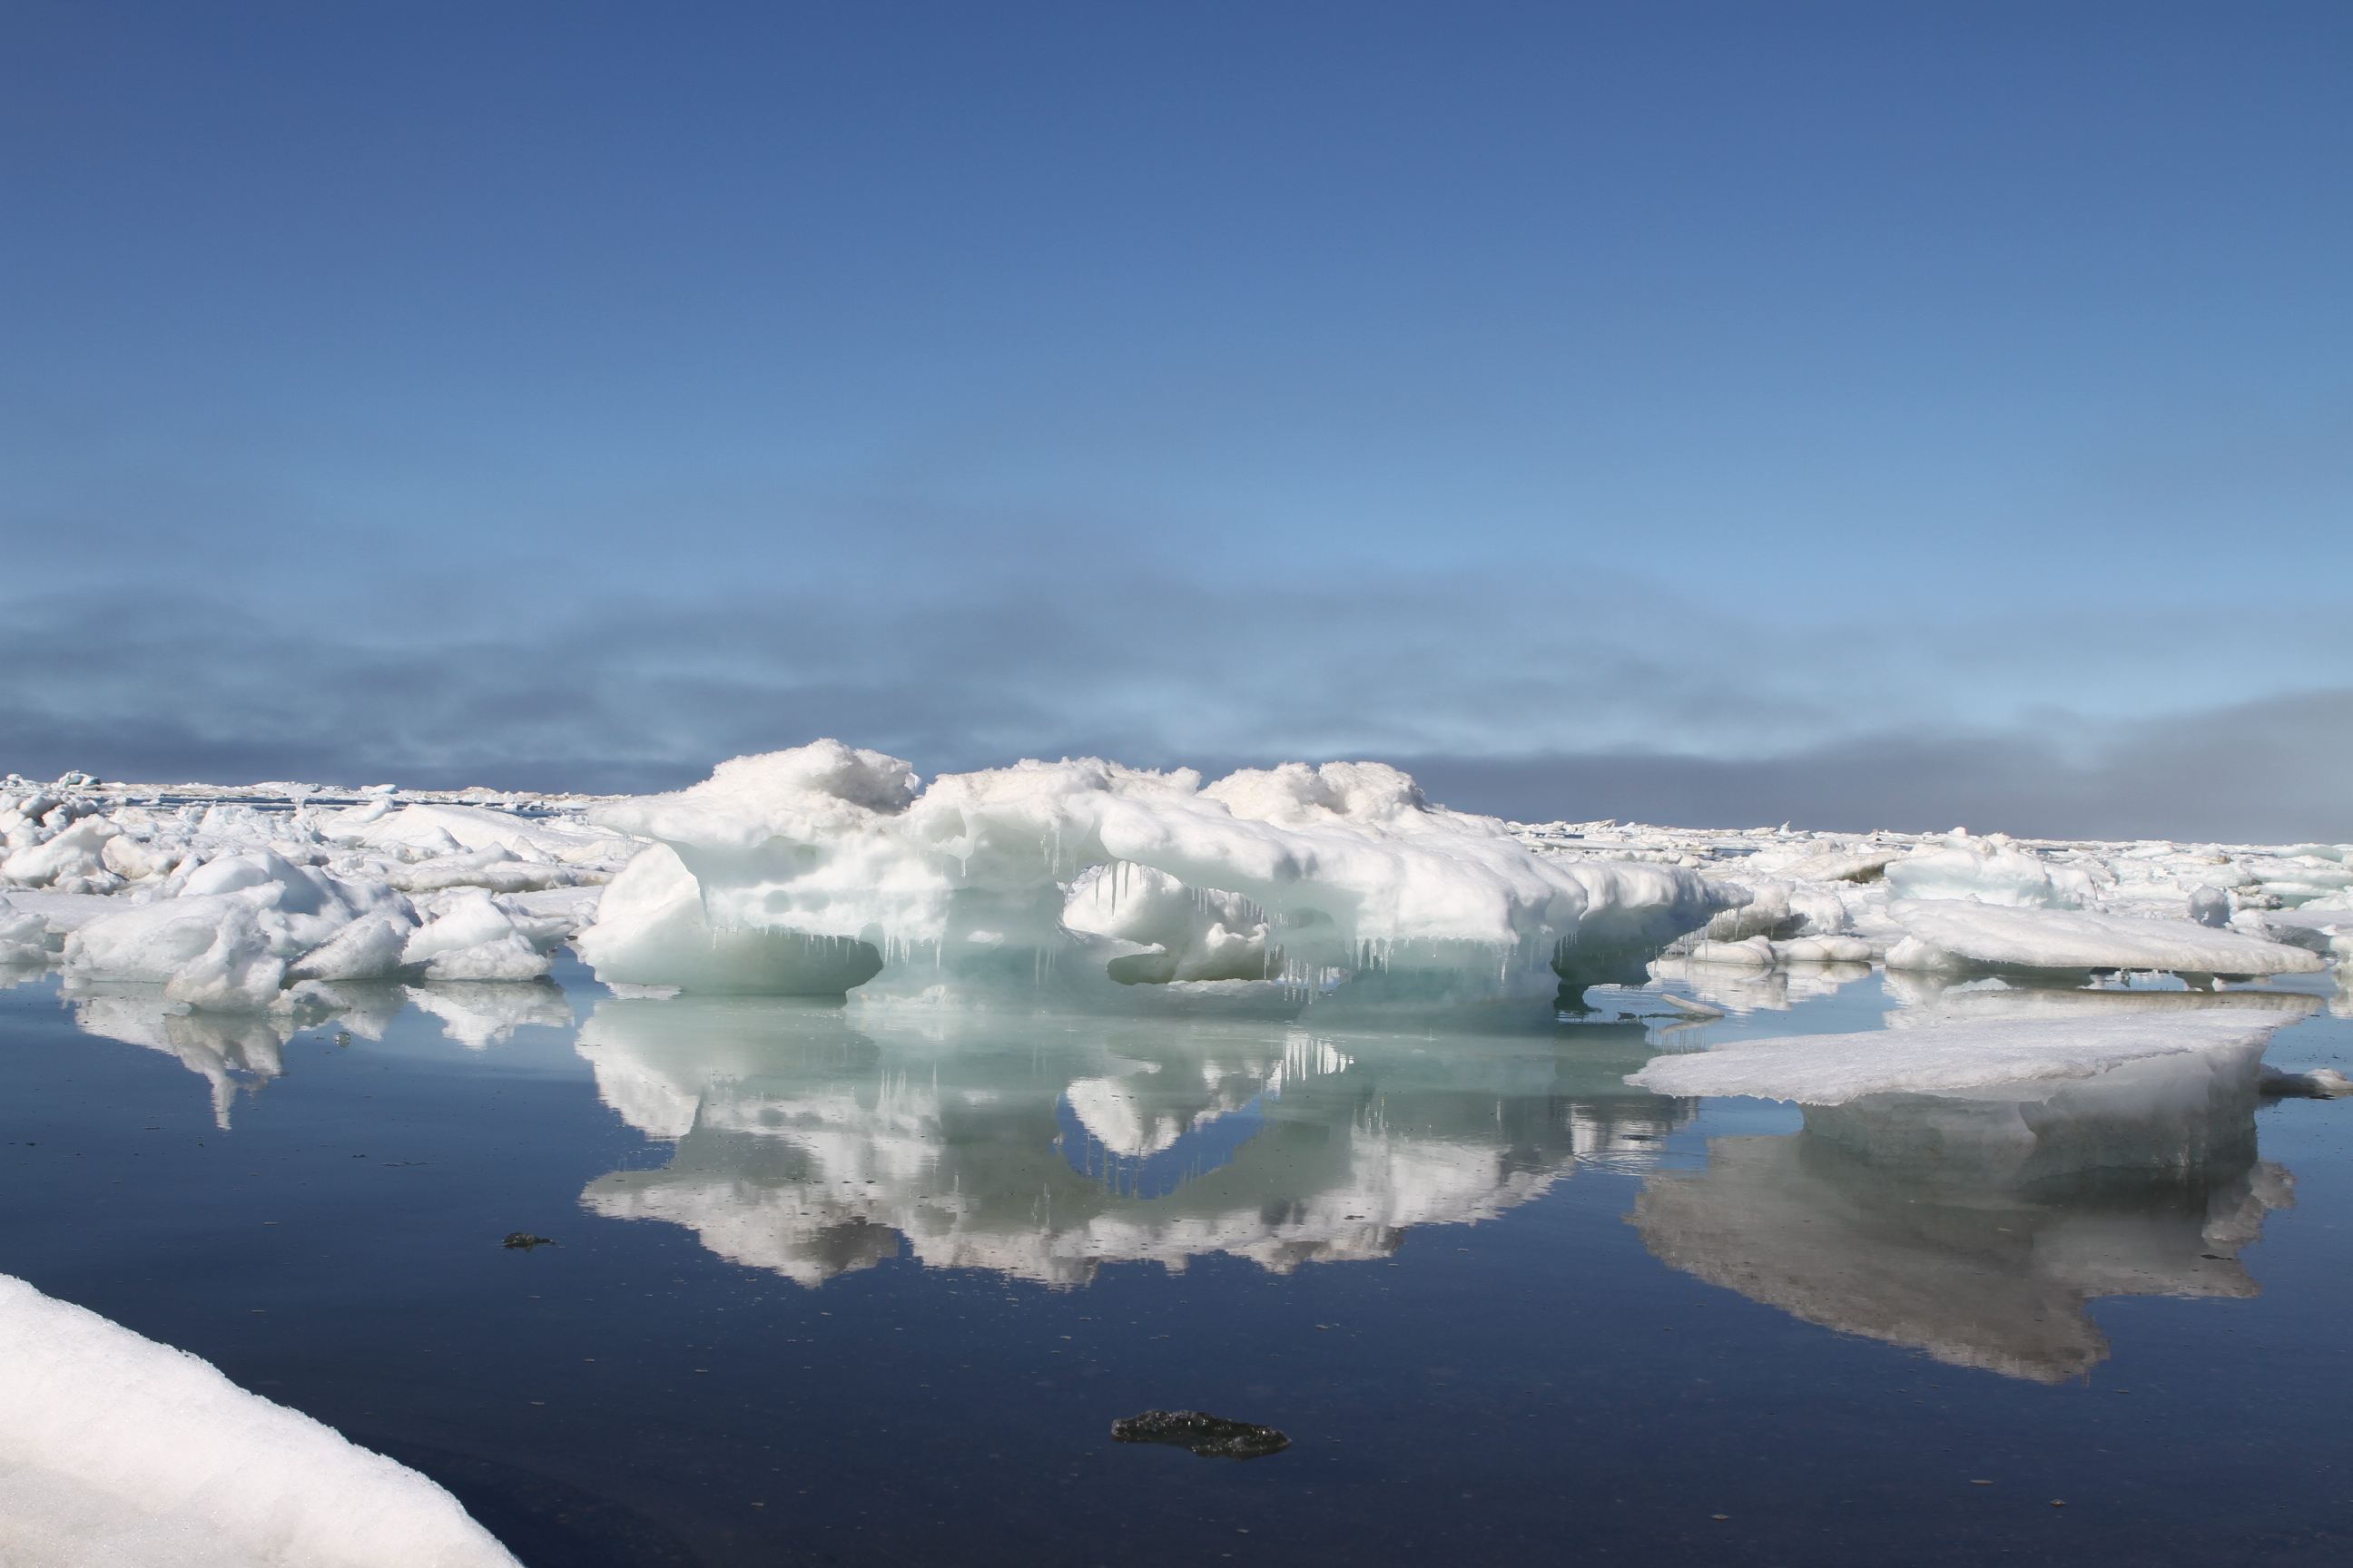
Closing thoughts…
What is the Arctic lapse rate feedback?
  It is the positive TOA radiative perturbation due to the non-uniform vertical warming profile result from a collection of radiative and non-radiative processes.
We know about the Arctic lapse rate feedback is…
  Most positive in fall and winter, negative in summer
  Most positive in sea ice and sea ice retreat regions
  Not strongly mediated by stratification
  The magnitude and inter-model spread in the Arctic LRF is tied to surface temperature and sea ice.
Future considerations:
We should attribute Arctic Amplification and its inter-model spread to the physical processes responsible for the non-uniform warming profile, rather than the lapse rate feedback.
Future analysis to decompose the process contributions to the lapse rate feedback and diagnose contributions to the inter-model spread.
Picture Credit: NASA Operation IceBridge
Notes:
One focus would be to improve satellite retrievals of cloud properties to create a multi-decadal time series that can be used to diagnose Arctic cloud feedbacks.
Maybe the only key to modeling Arctic Amplification may be to get the sea ice cover decline right.

