Slide 1
Clinical Decision Support – ConOps
B. Russell, M. Krihak, S. Shetye, K. Martin and T. Shaw
2021 NASA Human Research Program Investigators' Workshop
February 2021

Slide 2
Outline
Clinical Decision Support (CDS) background
Defining a Clinical Decision Support System (CDSS) for exploration
Technology Development Plan – how Concept of Operations (ConOps) are used in the process
Example ConOp
Investigate the questions of operation, implementation and validation of CDS in long duration exploration missions
Research
  clinical workflow and user interaction for different scenarios
  models and datasets required
  architecture required to incorporate third party models and apps
  inter-dependency of CHP domains
Notes:
BACK GROUND:
The CDS project address the need for crew to operate independently during long duration space exploration missions investigating level of care and increased crew autonomy in the domains of crew clinical, health and performance.
The project investigates the various implementation challenges for select scenarios associated with LevCare IV and V, requiring long duration autonomous missions.
The project uses software prototypes to generate requirements and identify impacts to CHP architecture and systems.
The goal of the CDS project is to recommend requirements for an in vehicle system addressing mass, volume, power, crew time and medical capabilities.
CDS FOR EXPLORATION:
The role of a CDS is to augment KSA for all crew in various scenarios related to CHP.

Slide 3
Need for Crew Self-Reliance
NASA-STD-3001 presents the need for crew members to operate independently during long duration space exploration missions that require medical Level of Care V
  Interpretation of NASA-STD-3001 Levels of Care for Exploration Medical System Development (NASA/TM-2017-219290):
    Maintains ‘autonomous’ in the description of capabilities and definitions that pertain to medical Level of Care V.
Computational and data resources will play an important role in maintaining crew health, wellness and performance where the crew will need to be more self-reliant.
  Communication lags (~20min each way on a Mars mission)
  Communication blackouts, planned and unplanned

Slide 4
Clinical Decision Support Background
ExMC Element Risk:
Risk of Adverse Health Outcomes & Decrements in Performance due to Inflight Medical Conditions
Clinical Decision Support (CDS) Project Need:
ExMC Gap Medical-701: Enhance medical capabilities within an exploration medical system.
CDS Project Goal:
The aim of the CDS project is to develop and provide recommended requirements for an in-vehicle CDS System (CDSS) that acts as an assistant for delivering optimal health and performance and medical care during exploration missions.
Notes:
The CDS project addresses medical risk and identified gaps.
Clinical care includes clinical scenarios and prevention to maintain crew health and performance.

Slide 5
CDS Technology Development Plan
Start with Evidence
  Risk based gaps
    Tasks to close gaps
      Deliver requirements
Reference Documents
Liaison - Industry and Agency’s
Liaison - HRP Projects
Liaison - R&D Funding
Datasets
Autonomy approaches
Additional evidence types…
Tech Risks
Datasets
Models
Architecture (library)
Interoperability
Clinical
Work flow
Model validity
Scientific
Testbed
Documentation
Requirements
Demonstrations
SysML Model
Evidence
Gap
Tasks
Deliverables
Process to be implemented starting FY21
Source:
ExMC Clinical Decision Support Project Exploration Medical Capability Clinical Decision Support Technology Development Plan Doc. No. 7868
Notes:
The TDP starts by collecting evidence including AMCL, HRP Risks, medical knowledge, datasets and similar approaches in the diff fields.
Con Ops are developed and gaps are identified that are defined as use Cases with implementation guidance to the SW team to maximise coverage of various categories, maximising the utilisation of various categories including, work flow, user interface, instruments to fly and models.
EXAMPLE:
The example Con Op toady will be for Kidney Stone, which is an identified medical risk.

Slide 6
FUNCTIONALITY OF CLINICAL DECISION SUPPORT
GUIDANCE
CLINICAL ALGORITHM
VITAL SIGNS
ALERTS
IMAGE ANALYSIS
INSTRUMENT GUIDANCE
DIAGNOSIS
High Acuity
Low Acuity
Scenarios
CONTEXT AWARE SYSTEM
Emergency
Symptom
Scheduled
Alert
Inquiry
CLINICAL AND PERFORMANCE MANAGEMENT
RESOURCES
Pharmacy, Consumables
MISSION TIME
Predicted remaining conditions
TREATMENT
KNOWLEDGE BASED
CARE GIVER/
CONTEXT BASED
PREVENTION
PERFORMANCE OPTI
KNOWLEDGE BASED
SCHEDULING
MEDICAL HISTORY
Existing conditions
DIAGNOSTICS
PROBABILISTIC CDSS
HEURISTIC - PERSON
Training
SENSORS
INSTRUMENTS
LAB TEST
DERIVED DATA
CLASSIFICATION/
REGRESSION
DATA
Notes:
A CDS system
is used in difference scenarios
must be context aware to change how it interacts with the user to maximum their cognition and performance
is made up of an architecture of data and algorithms to perform diagnosis, treatment and prevention

Slide 7
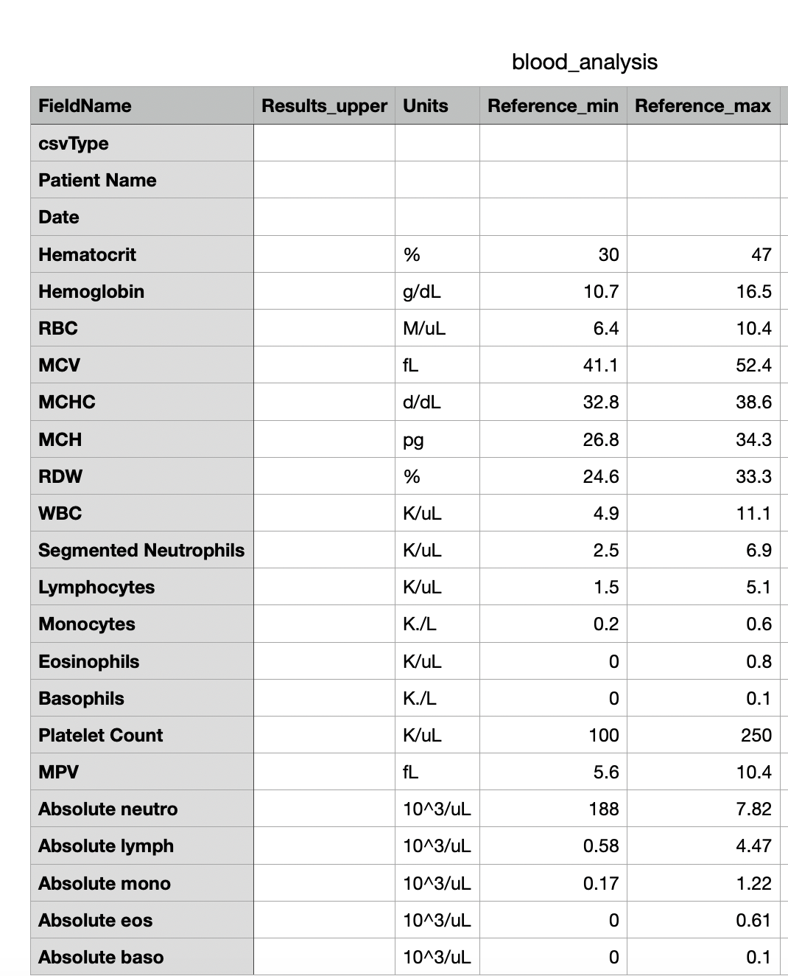
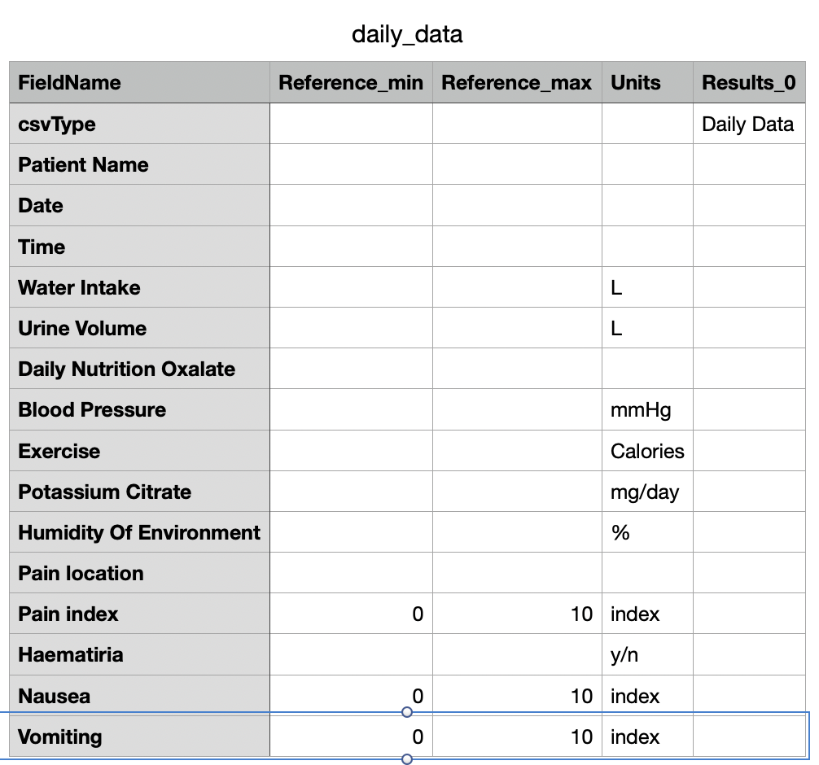
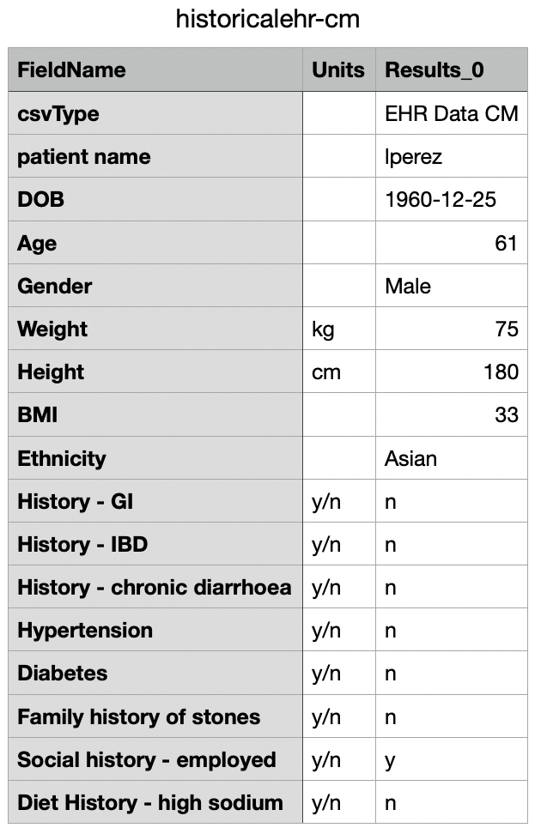

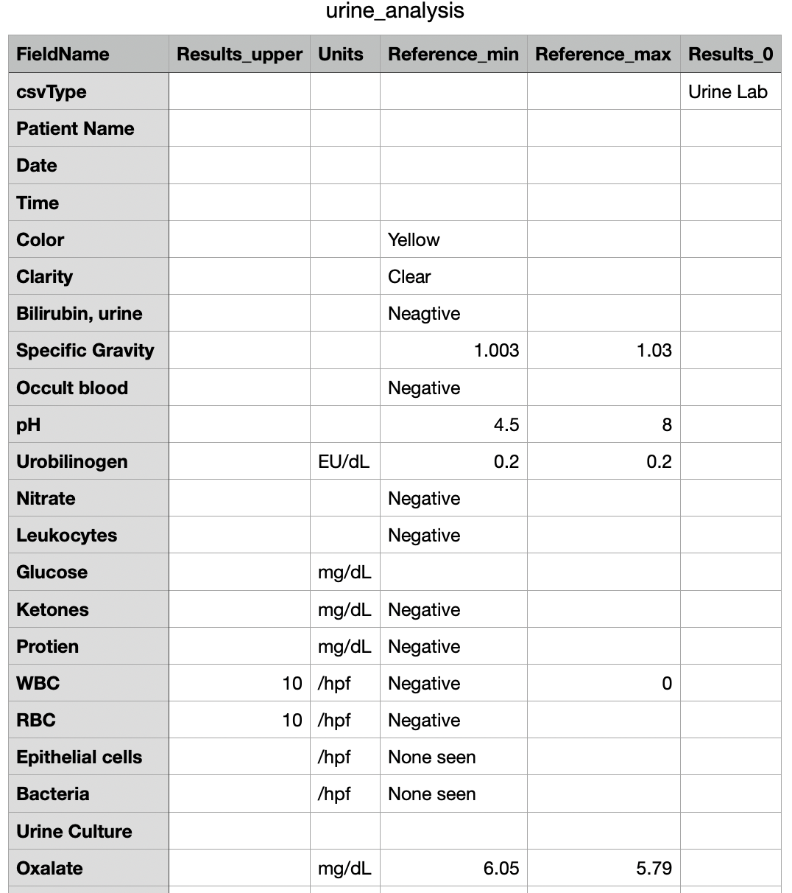

Datasets, Models and UI/UX
CLINICAL
3. Graphical interface takes CMO through diagnosis
with automated suggestions
User Interface
2. Kidney Model
calculates probability
Model
Model
Kidney
Model
Decision
Model
Drag and drop patient history, daily data, blood and urine
Data Bus
Medical Data
Architecture
Database
Database
Clinical Decision Support System
Notes:
A CONOP scenario is broken down into three main groups, user interface, models and data.
Firstly the workflow is developed, then datasets and models identified to enable the scenario.
The development process works through a user workflow, then addresses the datasets required, which models can be used, any API updates and external models from collaborators.

Slide 8
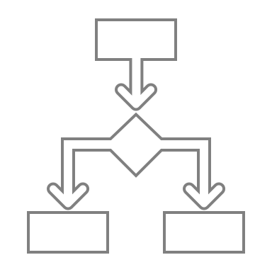
Kidney Stone from Symptom ConOp
HOME
CLINICAL
SCHEDULE
USER
INTERFACE
LAYER
LOGIN
Kidney Diagnosis Probability
Enter Symptoms
Enter Dara
1
LOGIN.
2
4
EXTRA INFO
SELECTION.
3
8
CLINICAL
SCHED EXAM
Request Info
user trigger
5
Reference Model
6
PROBABILISTIC ANALYSIS
Data
Ingestion
Engine
0111001
Kidney Model
Decision
Engine
DECISION
SUPPORT
LAYER
7
UPDATE EHR
Precipitation model
event trigger
time trigger
MDA Infrastructure Bus
MEDICAL
DATA
ARCH
1
0
1
1
DATASETS
DATASETS
Medical
History
Nutrition
Plan
Exercise
Plan
Before mission
Lab
Tests
Symptoms
Sensors
During mission
Notes:
The ConOps to diagnose kidney stones requires a clinical diagnostic.
The diagnosis implementation starts with a chief complaint, diagnosis using interactive probabilistic model based decision making supported by physics based models determining risk
When a crew member presents with a symptom of ‘lower flank pain’, the inference engine determines possible diagnosis by referring to the models and determining the ‘next best question’ to determine the probability of each condition.

Slide 9
Diagnostic Flow Chart
GUI
Screen, mouse, keyboard
Model
Inference engine + knowledge base
Data
Medical Resources
Chief complaint
Find related diseases
History QnA
Ask related history
EHR
Symptom QnA
Ask related symptoms
Procedural Guides
and
Diagnostic updates
Disease
probability,
severity,
prediction confidence
vitals
needed?
Y
N
Measure vital signs
Vital signs
Instruments
Exam
needed?
Y
N
perform physical exam
Y
prediction data
available?
N
Request prediction data
Kidney model data
Blood lab
needed?
Y
N
Request blood data
Blood report
Lab Equipment
Urine lab
needed?
Y
N
Request urine data
Urine report
Lab Equipment
Diagnosis
Final Diagnostic
Treatment
Diagnosis is updated and displayed after each step. Some steps and GUI operations are omitted for simplicity.
Notes:
Here is a swim lane diagram for the clinical algorithm in the context of the CDS system interacting with the crew via the GUI and referring to available and relevant data in the data base, while the inference engine determines the best questions to ask to increase the confidence of its diagnostic prediction.

Slide 10
Sequence Diagram
GUI
Inference Engine
Knowledge Base
Instruments
Predictions
system actors
Chief complaint
Find related diseases
Ask related history
Find related history
Update Prediction
CDS
Ask related symptoms
Diagnosis
Find related symptoms
Update Prediction
Request related prediction data
Find related prediction data
Kidney Model
Update Prediction
Request vital signs
Find related vital signs
Instrument Data
Update Prediction
Request blood report
Find related blood data
Blood Report
Update Prediction
Request urine report
Find related urine data
Blood Report
Diagnosis
Update Prediction
Treatment
Notes:
A sequence diagram enables us to understand how different parts of the system communicate. This is important to develop API interfaces and processes ti enable modellers to supply their models in a way that the CDS architecture can utilise them.

Slide 11
ConOps and Use Cases – Coverage of Architecture
Process Lab Reports
Kidney Model
Cognition Test Protocol
Patient History
Kidney clinical algorithm
Daily Data
Heart Rate
Sensor
Kidney Diagnosis
Calculate
Calories
Historical
Blood Labs
Urine Labs
Cognition Test
VOLT config + images
Analyse
Historical
Data
Perform
Live
Exercise
Schedule
Exercise
Event
Store data
CMO vs CM view of data
Store data
CMO vs CM view of data
Key: Color is used to show each Use Case
VOLT Test
Response Times
Diagnosis
Workflow
VOLT Test
Kidney Stone Diagnosis
Cognitive
Exercise from Epic 2
Exercise
Neuroscience
Clinical
←Domain
Notes:
This slide shows the systematic approach to use case scenarios to cover broad functionality based on ConOps scenarios. This an important aspect of the CDS project researching implementation approaches.
The AMCL has 140 conditions so any approach we take must scale to cover at least this many conditions.

Slide 12
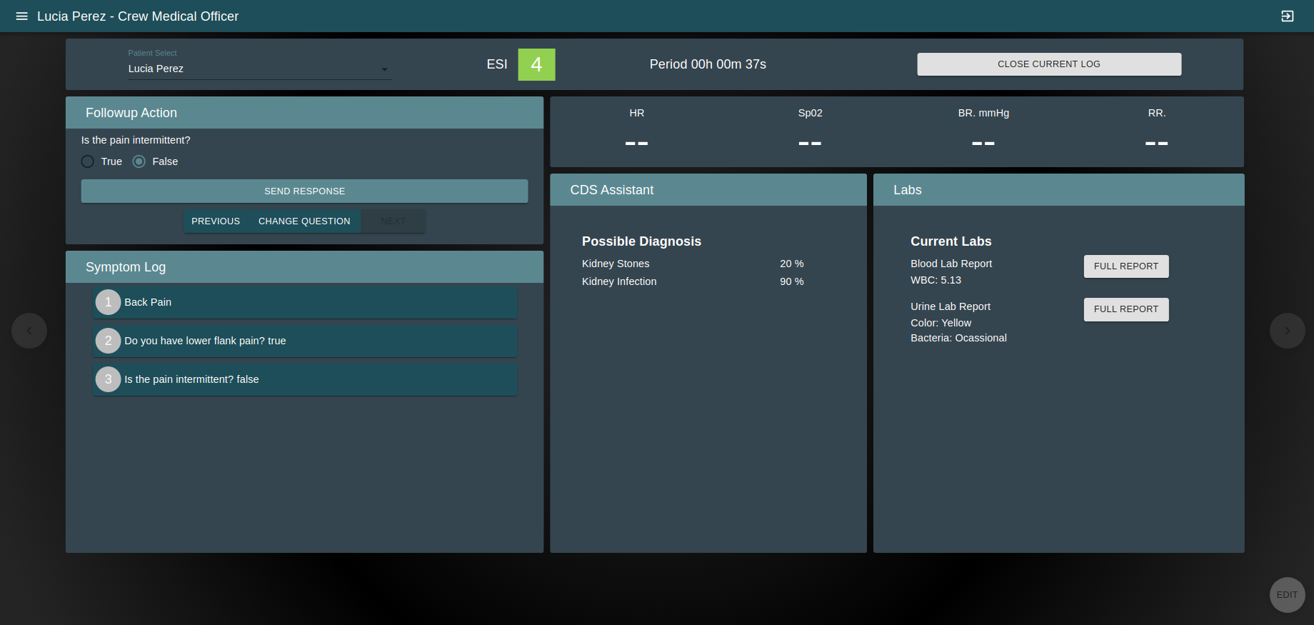


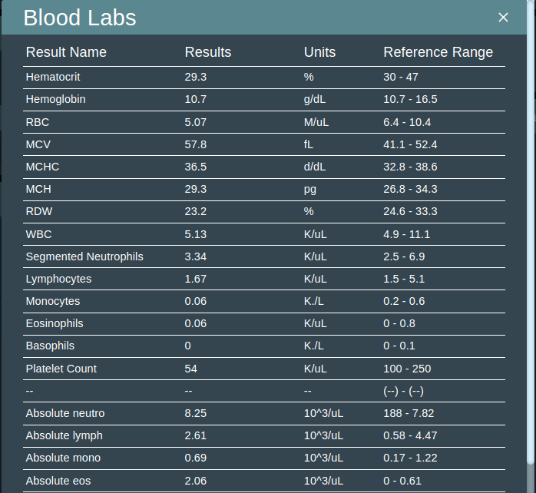
CDS Screenshot – Kidney Stone Diagnostic
Questions
Vital Signs
# | DISEASE | P R O B | S E V | CON
1 | Kidney Stones | 75 | 50 | 80
2 | Pyelonephritis | 22 | 50 | 70
3 | ACS | 11 | 90 | 40
4 | Anxiety | 15 | 20 | 55
5 | Atrial Fib | 05 | 80 | 43
6 | Heedache CO2 | 10 | 30 | 80
7 | Space Motion Sickness | 13 | 10 | 40
Lab Reports
Blood report
Log
Diagnostic Report
1. 2. 3. 4. 5. 6. 7.
Diagnosis screen
Notes:
CDS is a research project to explore HOW to do this work as there is no standard approach at present data, decision tools and workflow can assist the clinician in their decision making.
Here is an example screenshot from the kidney stone ConOps for the GUI during the diagnostic process.

Slide 13
Summary
CDS development in ExMC develops test beds and requirements
Focus is LevCareV for exploration missions to increase crew autonomy
HRP gaps and evidence are used to determine ConOps. Use Cases develop further detail to answer implementation questions including:
  Context aware user interfaces
  API based architecture for to incorporate models from different groups
  Validation on model approach and accuracy
  Determine what datasets are required
  Determine a validation strategy
  Uncover and address process challenges

