Slide 1
Exploration Medical Capability
Systems Engineering Overview and Update
Kerry McGuire, PhD
Michelle Urbina, MS
2021 NASA Human Research Program Investigators' Workshop
February 1 – 4, 2021
www.nasa.gov
Notes:
JM: mod title

Slide 2
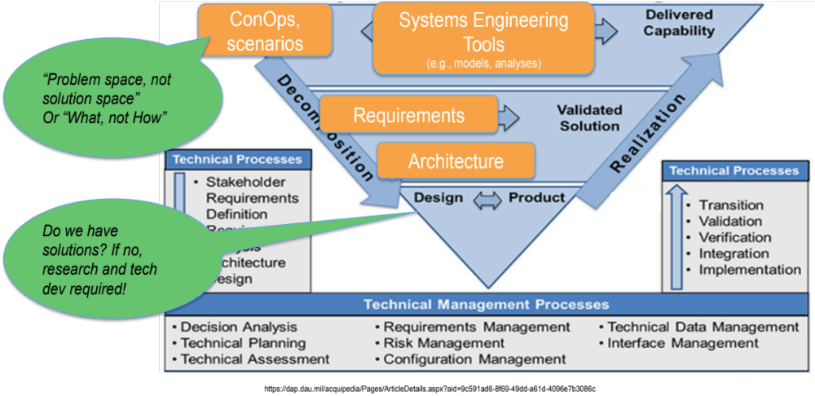
Charge since IWS 2020
Complete Level of Care IV Short Duration Lunar Orbit Medical System Foundation
IMPACT Prototype 0.1 User Testing and Delivery
MIAMI Partnership + NESC Webinar
Developing Level of Care IV Long Duration Lunar Orbit and Surface Medical System Foundation
Notes:
1. Habitat medical system, habitat data system,

Slide 3
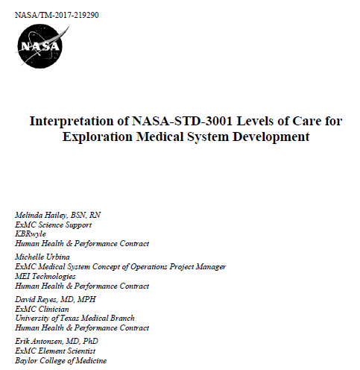
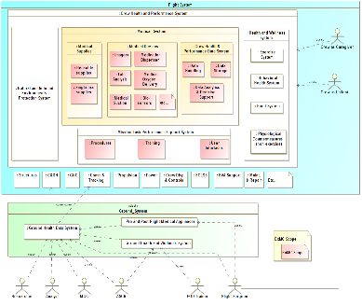
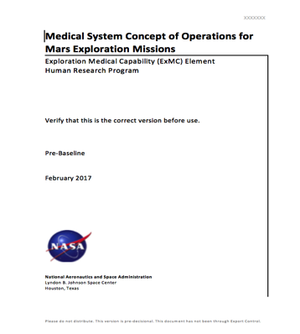
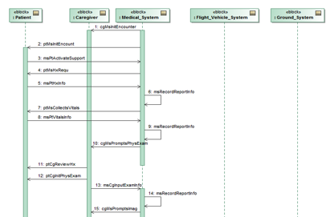
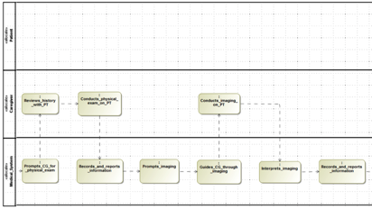
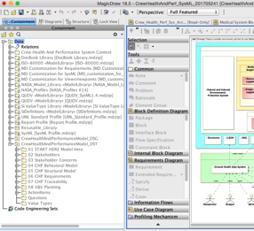
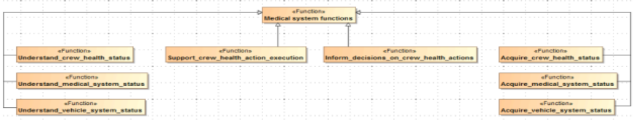
Developing Foundations: SE Approach to Get There
Stakeholder needs, goals
NASA Standards
Program requirements & architecture
System functions & behaviors
System requirements & architecture
Using Model-Based Systems Engineering:
Subsystem requirements & architecture
Characterize system
Do we have the capabilities to meet the needs?
Do we need altered allocations?
Analyze & trade
Design & Build
The needs identified by this work will drive future ExMC research
Notes:
“Problem space, not solution space” Or “What, not How”
Do we have solutions? If no, research and tech dev required!

Slide 4
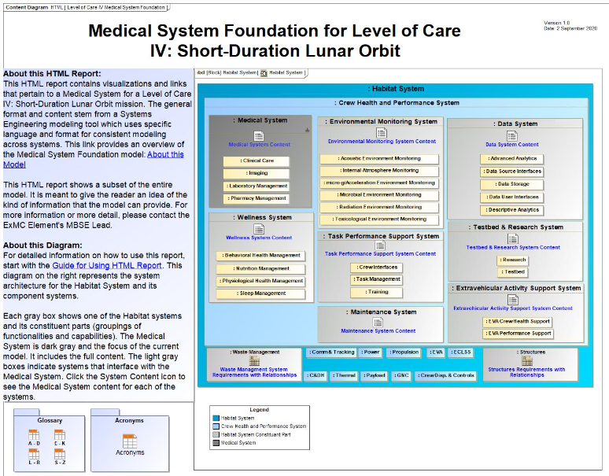
Level of Care IV Short Duration Lunar Orbit Medical System Foundation
Notes:
Clinical content referred to in presentation represents content in the medical system, shown in graphic as a subcomponent to Crew health and wellness system inside the CHP system of the habitat

Slide 5
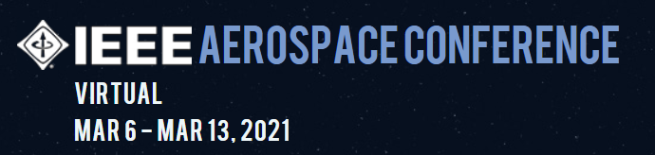

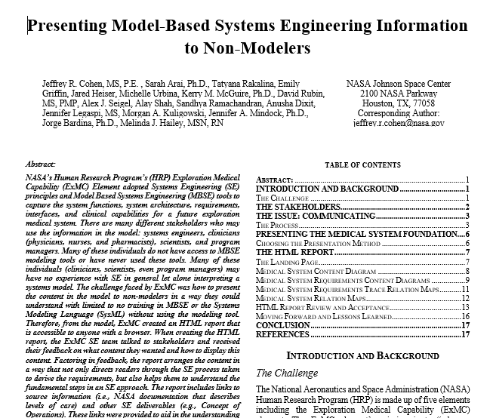
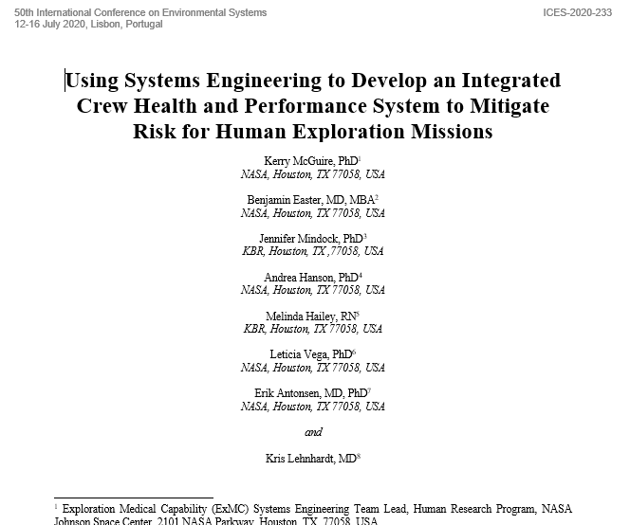
Publications: IEEE Aerospace 2021 and ICES 2021
Notes:
“Problem space, not solution space” Or “What, not How”
Do we have solutions? If no, research and tech dev required!

Slide 6
IMPACT 0.1, 1.0 and BEYOND!
ExMC Need:
  Provide a data-driven means to inform human health and performance risk mitigation
  During resource-constrained exploration mission development
  Enabling systematic trade studies to evaluate options
Clinician* SME
Provides Consultation
(if applicable)
Clinician* SME
Provides Consultation
(if applicable)
Provides Query
Requester
Operator
Provides Input
IMPACT
Provides Output
Operator
Provides Reports
*for some use cases of IMPACT, Clinician/SME consultation may be imperative; for others it may be completely optional

Slide 7
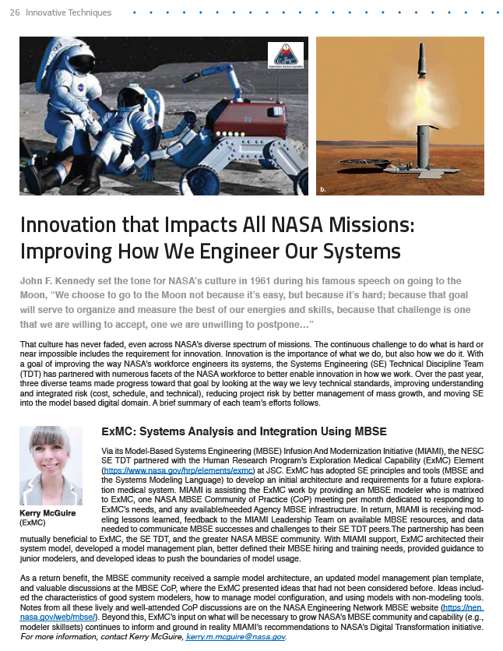
MIAMI Partnership + NESC Academy Webinar
Date | Title | Presenter
June 8th | How to Get Started Using MBSE: The Basics of What, How and Who | Trevor Grondin
July 20th | Systems Engineering and Model Based Systems Engineering Stakeholder State of the Discipline | Jessica Knizhnik
August 17th | An Innovative Jump Start for MBSE Tooling, NTL Results | Samantha Infeld
October 14th | MBSE to MIAMI to Implementation An Overview | Jessica Knizhnik
October 26th | Future Model-Based Systems Engineering Vision and Strategy Bridge | Karen Weiland
November 4th | Using MBSE on a Working Project | Kerry McGuire and Jeff Cohen
NESC Academy: Systems Engineering Webinar Series
https://nescacademy.nasa.gov/series/25339d3ecac0450b88f089d1cc0ab9814d
Using MBSE on a Working Project
https://mediaex-server.larc.nasa.gov/Academy/Play/727a192a50614d41b5a61788536fecae1d
MBSE Community of Practice minutes
Notes:
Model Based Systems Engineering (MBSE) Community of Practice minutes: https://nen.nasa.gov/web/mbse/wiki?p_p_id=com_liferay_wiki_web_portlet_WikiPortlet&p_p_lifecycle=0&p_p_state=normal&p_p_mode=view&_com_liferay_wiki_web_portlet_WikiPortlet_mvcRenderCommandName=%2Fwiki%2Fview_page&p_r_p_http%3A%2F%2Fwww.liferay.com%2Fpublic-render-parameters%2Fwiki_nodeId=2934183&p_r_p_http%3A%2F%2Fwww.liferay.com%2Fpublic-render-parameters%2Fwiki_title=2020-04-16+ExMC+-+Agile

Slide 8
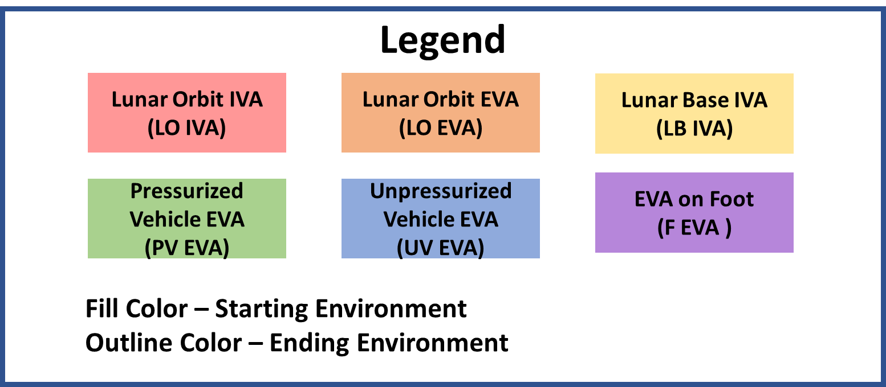
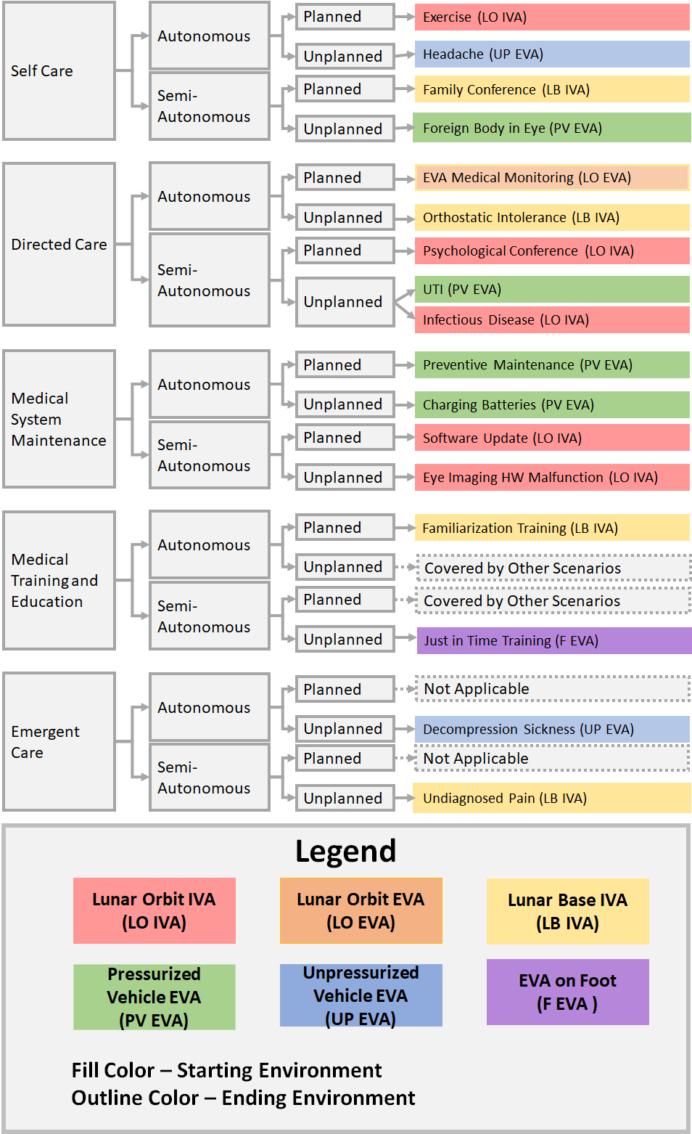
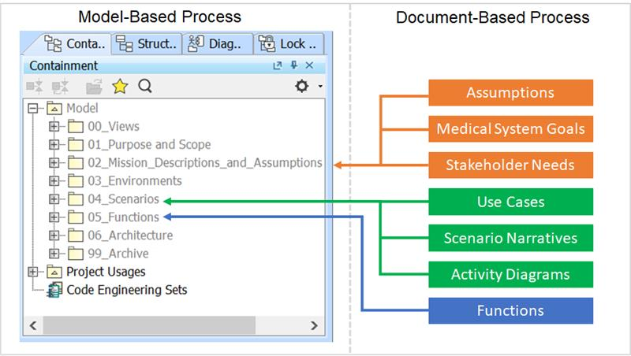
Concept of Operations Development for a Level of Care IV Long Duration Lunar Orbit and Surface Medical System Foundation

Slide 9
In summary, ExMC has:
Continued to establish a Systems Engineering team, processes, and products to integrate with exploration programs
Built a bridge across medical and engineering domains
Created and delivered a capability to provide traceable, defensible system development products
Disseminated and gained Systems Engineering knowledge to and from the agency

Slide 10
Backup

Slide 11
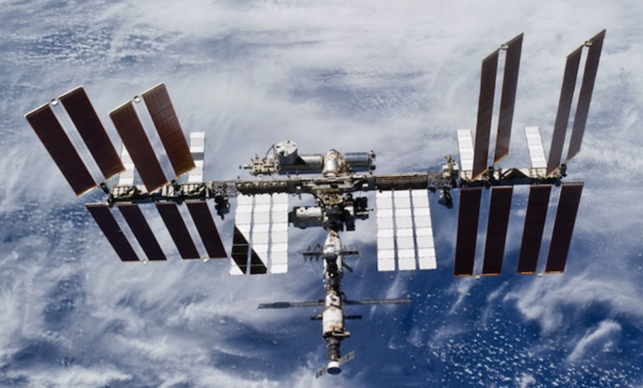
Challenges and Design Approach
Deep space exploration missions present new challenges to crew health and performance:
  Effects of hazards on crew health and performance are not completely known for long durations or deep space
  Communication delays, blackout periods
  No resupply, prepositioning at best
  No medical evacuation
Deep space will be different…
Photo credit: NASA
Limited flight resources (e.g., mass, power, volume, data)
We are applying systems engineering within HRP to better integrate with exploration offices that are in formulation.
Canga, M., Shah, R., Mindock, J., Antonsen, E. A Strategic Approach to Medical Care for Exploration Missions. 67th International Astronautical Congress (IAC), Guadalajara, Mexico, Sept. 2016
Antonsen, E., Hanson, A., Shah, R., Reed, R., Canga, M. Conceptual Drivers for an Exploration Medical System. 67th International Astronautical Congress (IAC), Guadalajara, Mexico, Sept. 2016

