Slide 1
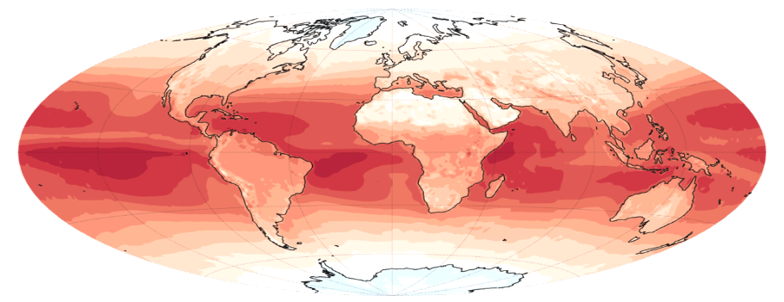
GEWEX SRB Release 4: Public Release
American Meteorological Society Annual Meeting
Jan 12, 2021
Stephen J. Cox – SSAI
Paul W. Stackhouse, Jr. – NASA LaRC
J. Colleen Mikovitz, Taiping Zhang – SSAI

Slide 2
Introduction:
The NASA/GEWEX Surface Radiation Budget (SRB) project has produced a 30+ year time series of 3-hourly Top-of-Atmosphere (TOA) and surface radiative flux components at a 1x1 degree resolution.
Release 3.0, based on 1983-2007 ISCCP DX data, has been in public use for 10 years. Here we present Release 4-Integrated Product (R4-IP), available from gewex-srb.larc.nasa.gov in late January 2021.
SRB R4-IP is derived using GEO/POES AVHRR imager data products from the cross-calibrated ISCCP (International Satellite Cloud Climatology Project) “H Series” radiance, cloud and surface property data products.
Full shortwave data is produced from July 1983-June 2017.
Longwave land-only data is produced from July 1983-December 2009 (relies on LandFlux)
Longwave ocean-only data is produced from January 1988-June 2017 (relies on SeaFlux v2.0)
Other input changes include ISCCP nnHIRS atmospheric temperature and moisture dataset (used for ISCCP cloud retrievals) and Max Planck Institute Aerosol Climatology aerosol history (MAC v1; consistent with ISCCP HX).
Total solar irradiance is now variable and consistent with SORCE measurements. Trace gas variability O3 and CO2 over the 30 year time period is also considered.
Numerous algorithmic improvements

Slide 3
Why GEWEX SRB Release 4 Integrated Product?
Artifacts in SRB Rel 3
  Anomalous satellite calibration artifacts
  Long-term SW artificial trends
  LW TOVS anomalies
New inputs from GEWEX global data products
  ISCCP nnHIRS/snow&ice
  ISCCP HXS
  MAC v1 aerosol history
  LandFlux LST and SeaFlux SST
  Revised snow/ice/vegetation maps
  Long-term trace gas histories (i.e., ISCCP O3, CO2)
  Longer time series through June 2017 & beyond
Improved radiative algorithms for SRB
  Updated SW Look-up-tables; SW & LW microphysics
  Additional output data products
  Improved metadata and data quality control flags

Slide 4
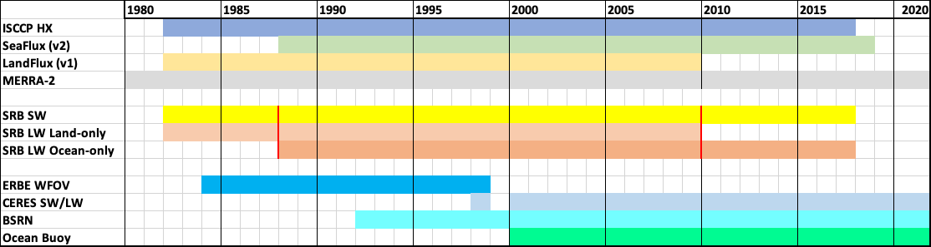
GEWEX SRB Release 4 Integrated Product Time Span
Time spans of GEWEX SRB Release 4 Integrated Product (R4-IP), key inputs and comparison data products.

Slide 5
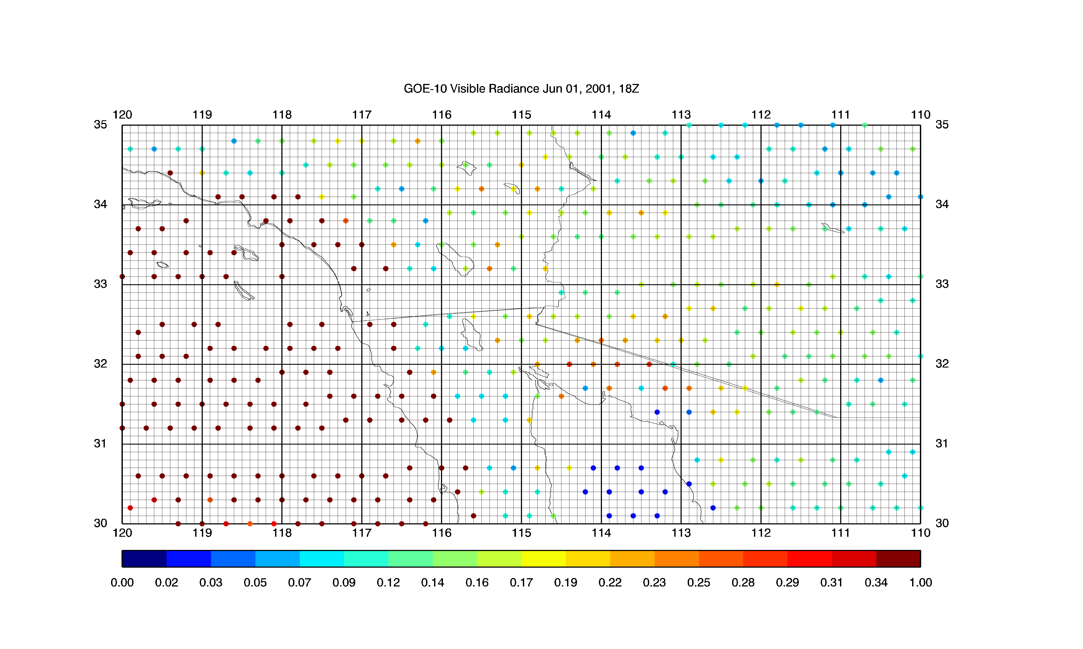
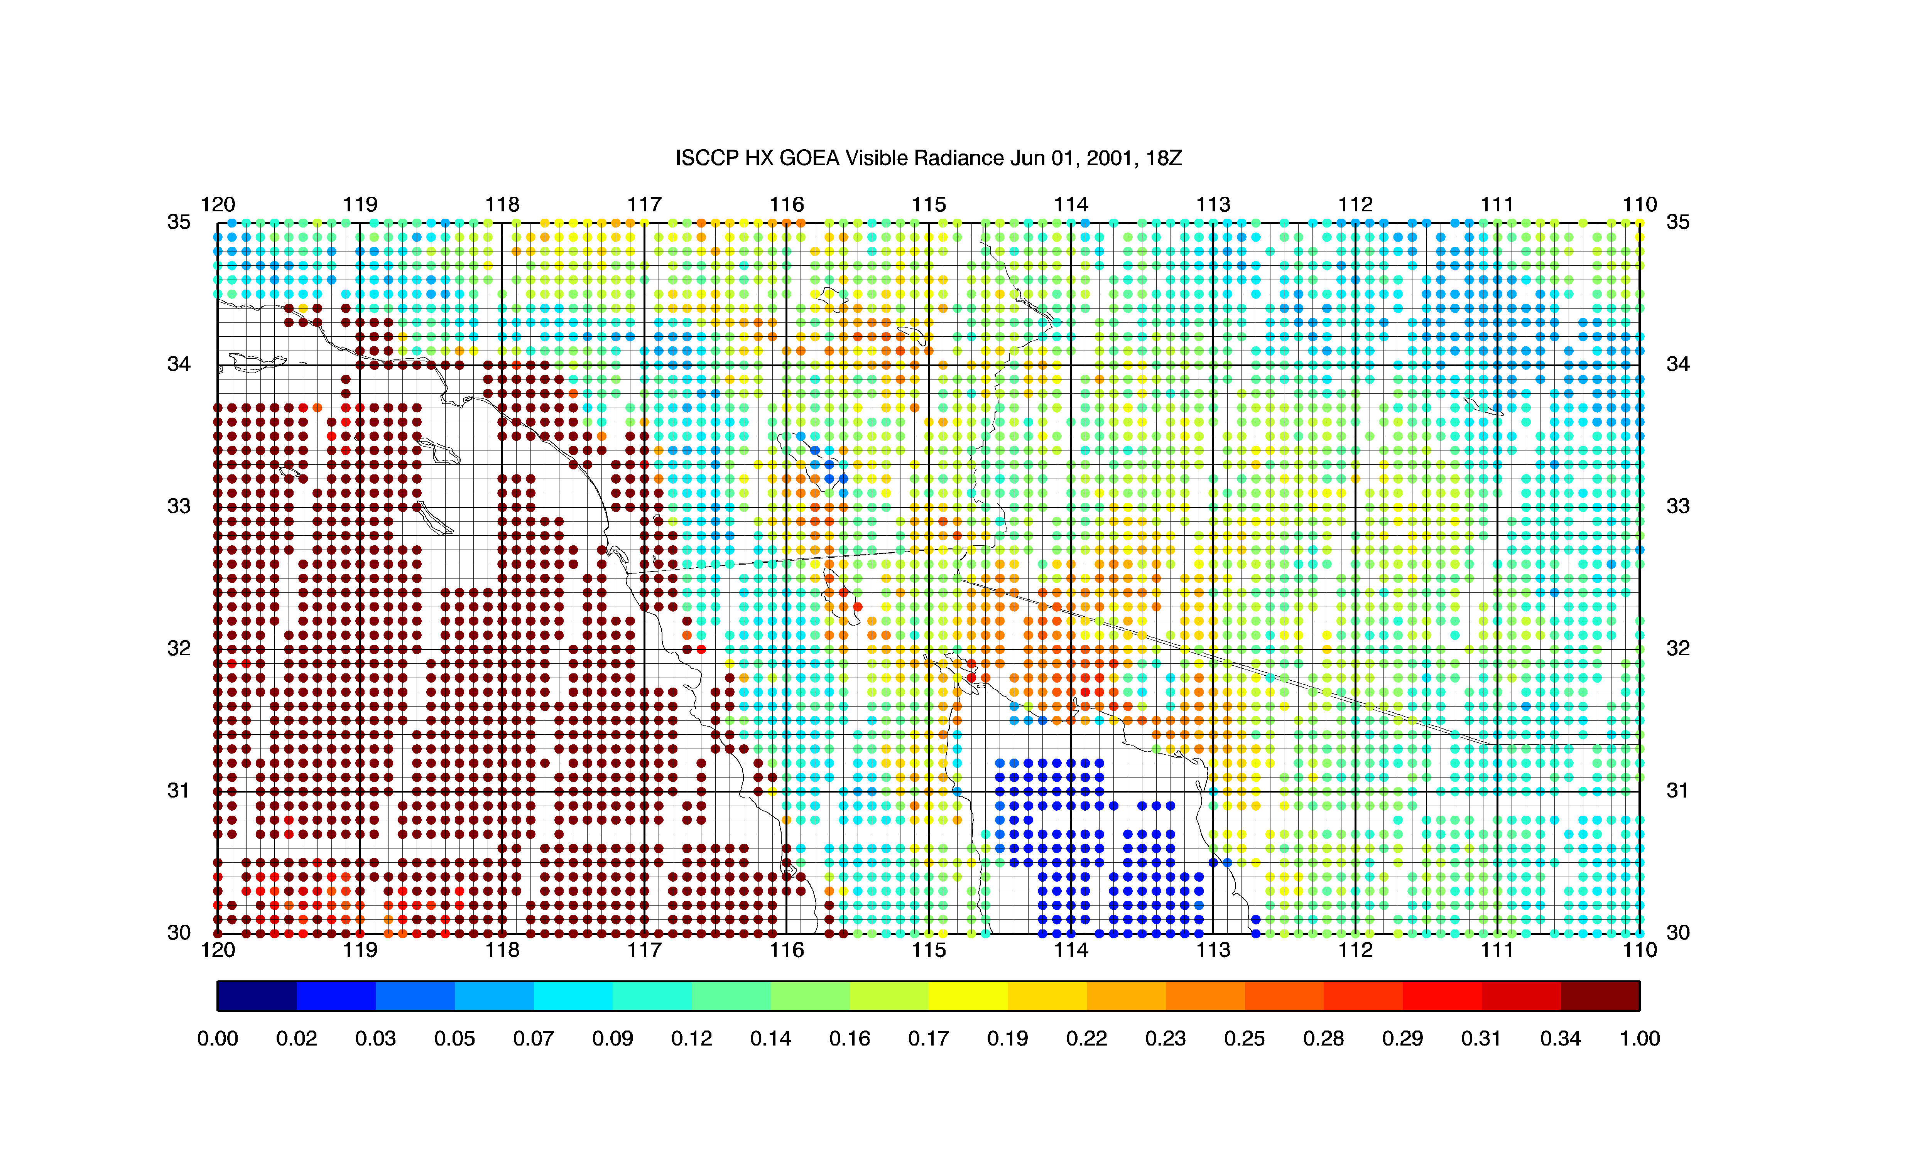
ISCCP HX (production based at NCEI through June 2017)
A: ISCCP DX
Uses all 10 km pixels with no
subsampling, 3-hourly by satellite (Young et al., 2018)
Revised calibration and
cloud retrieval algorithms
nnHIRS: Gridded & filled T, q data set using HIRS neural net retrieval (Shi et al., )
New surface vegetation type maps; emissivity corrections
Revised & extended snow/ice
Extended O3
Max Planck aerosol climatology (Kinne et al., )
B: ISCCP HX
Example of visible radiance showing the sampling characteristics of (A) ISCCP DX and (B) ISCCP HX.

Slide 6
SW Algorithm improvements for Release 4.0 Integrated Product
 | Release 3.0 | Release 4.0 IP (GSW with HXS v1)
Radiative bands | 5 | 18 (from CERES LFL05 model; Fu/Liou based)
Spectral Albedo | Original | New expanded albedo from MODIS and ASTER, Jin (2004) ocean, ice, and snow albedos
Aerosol Radiative Properties | One land aerosol, one ocean | Variable asymmetry parameter and single scatter albedo permitted with expanded LUT
Input aerosol | MATCH modal optical depth, monthly climatology | Max-Planck Aerosol Climatology, with variable optical depth and composition through product time period (1983-present)
Clouds | ISCCP DX; Liquid clouds assumed | ISCCP HXS; Liquid and ice clouds supported, use Water/Ice temperature threshold.
TSI | 1367 | WRC/SORCE (all normalizing to SORCE)
Run Period | 1983-2007 | July 1983 – June 2015

Slide 7
LW Algorithm/Input updates for Release 4.0 Integrated Product.
 | Release 3.0 | Rel. 4.0
Aerosol Inputs | None | MAC v1 Aerosols (Kinne et al., 2013)
Ice Cloud Properties | Original ice cloud radiative properties | Updated ice cloud radiative properties (Rose et al. 2015); scaled to ISCCP Tau VIS/IR
Water Cloud Properties | Assumed no water clouds above 440 mb | Add high water cloud; modified cloud overlap to treat high water clouds; scaled to ISCCP Tau VIS/IR
T, q profile | GEOS-4 | ISCCP nnHIRS (Shi et al); MERRA-2 based oceanic inversion layer correction
Tskin | GEOS-4/ISCCP Ts blend | Blend SeaFlux SST (CDR R2) / LandFlux Ts (Coccia et al) /ISCCP HX Ts; emissivity correction to desert/sparsely vegetated surface types
Data Product Changes | TOA and surface flux only; UT; Clear and all-sky | Pristine-sky (no aerosols), local time, atmospheric levels.
Years Run | 1983-2007 | Global 1988 – 2009; Land-only 1983-2009; Ocean-only 1988 - 2017

Slide 8
SRB (R4-IP) SW Global Annual Averages Fluxes for 2001-2007 compared to CERES Ed4.1 EBAF and SYN1Deg “Initial” computed fluxes.
Flux Component | Rel 3.0 (2001-2007) | Rel 4_IP (NEW algorithm, NEW inputs nnHIRS, HXS) | CERES Syn1Deg (Ed. 4A) | CERES EBAF (Ed 4.1)
Surface total down | 187.8 | 185.8 | 185.4 | 186.8
Surface down diffuse | 104.4 | 99.7 | 102.0 | --
Surface clear-sky down | 248.0 | 240.9 | 242.9 | 241.2
Surface pristine-sky down | 258.5 | 252.8 | 253.1 | 256.3
Surface albedo | 0.127 | 0.130 | 0.134 | 0.142
Surface net | 165.7 | 163.7 | 164.1 | 165.9
Surface Cloud Radiative Effect | -60.2 | -55.2 | -58.6 | -54.4
TOA Up | 102.4 | 100.2 | 101.0 | 99.3
Global annual averaged fluxes for 2001-2007

Slide 9
Annual Average LW Fluxes for 2001-2007 compared to CERES Ed4.1 EBAF and SYN1Deg “Initial” computed fluxes.
 | Rel 3.1 | Rel 4-IP | EBAF 4 | SYN 1 Deg
All-sky TOA Up | 238.0 | 239.6 | 240.3 | 238.2
Clr-sky TOA Up | 265.2 | 262.6 | 266.3 | 262.5
Pristine TOA Up | 265.2 | 263.8 | -- | 262.9
All-sky Sfc Down | 344.3 | 347.3 | 345.4 | 347.6
Clr-sky Sfc Down | 311.0 | 316.5 | 317.5 | 317.9
Pristine Sfc Down | 311.0 | 315.0 | -- | 316.1
Surface Up | 398.0 | 399.3 | 398.7 | 398.1
All-sky Sfc Net | -53.7 | -52.1 | -53.2 | -50.5
Sfc CRE | 33.2 | 30.8 | 27.9 | 29.7
TOA CRE | 27.2 | 23.0 | 26.0 | 24.3
Sfc ARE | -- | 1.4 | -- | 1.7
TOA ARE | -- | 1.3 | -- | 0.46
Global annual averaged fluxes for 2001-2007

Slide 10
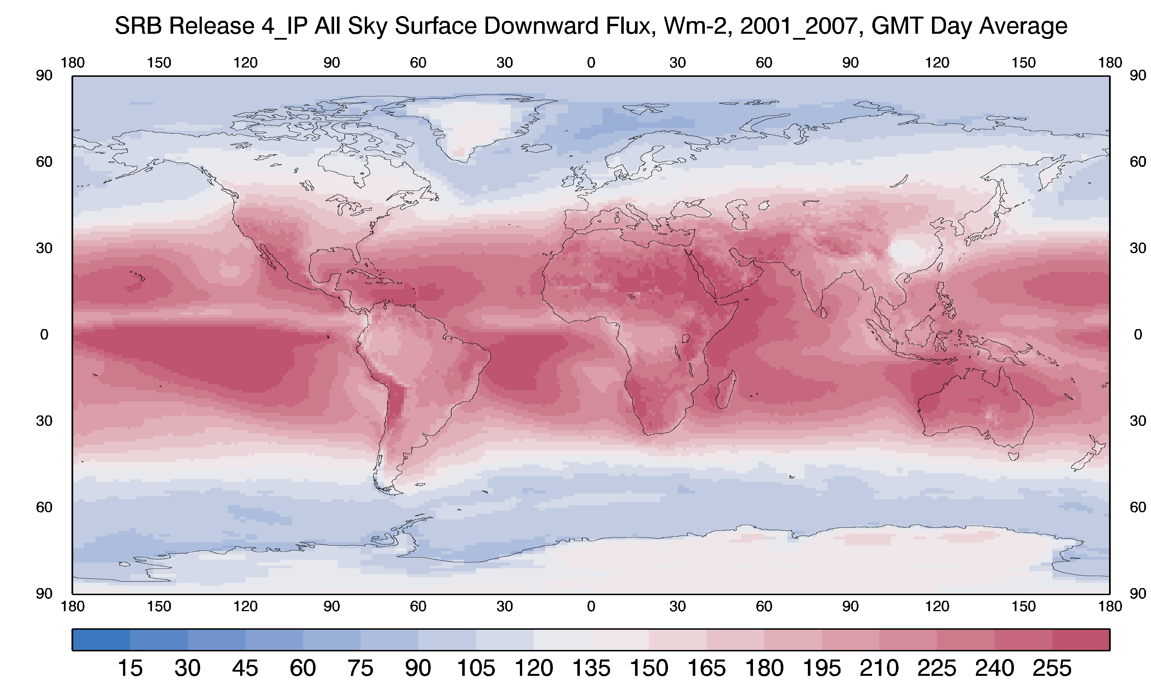
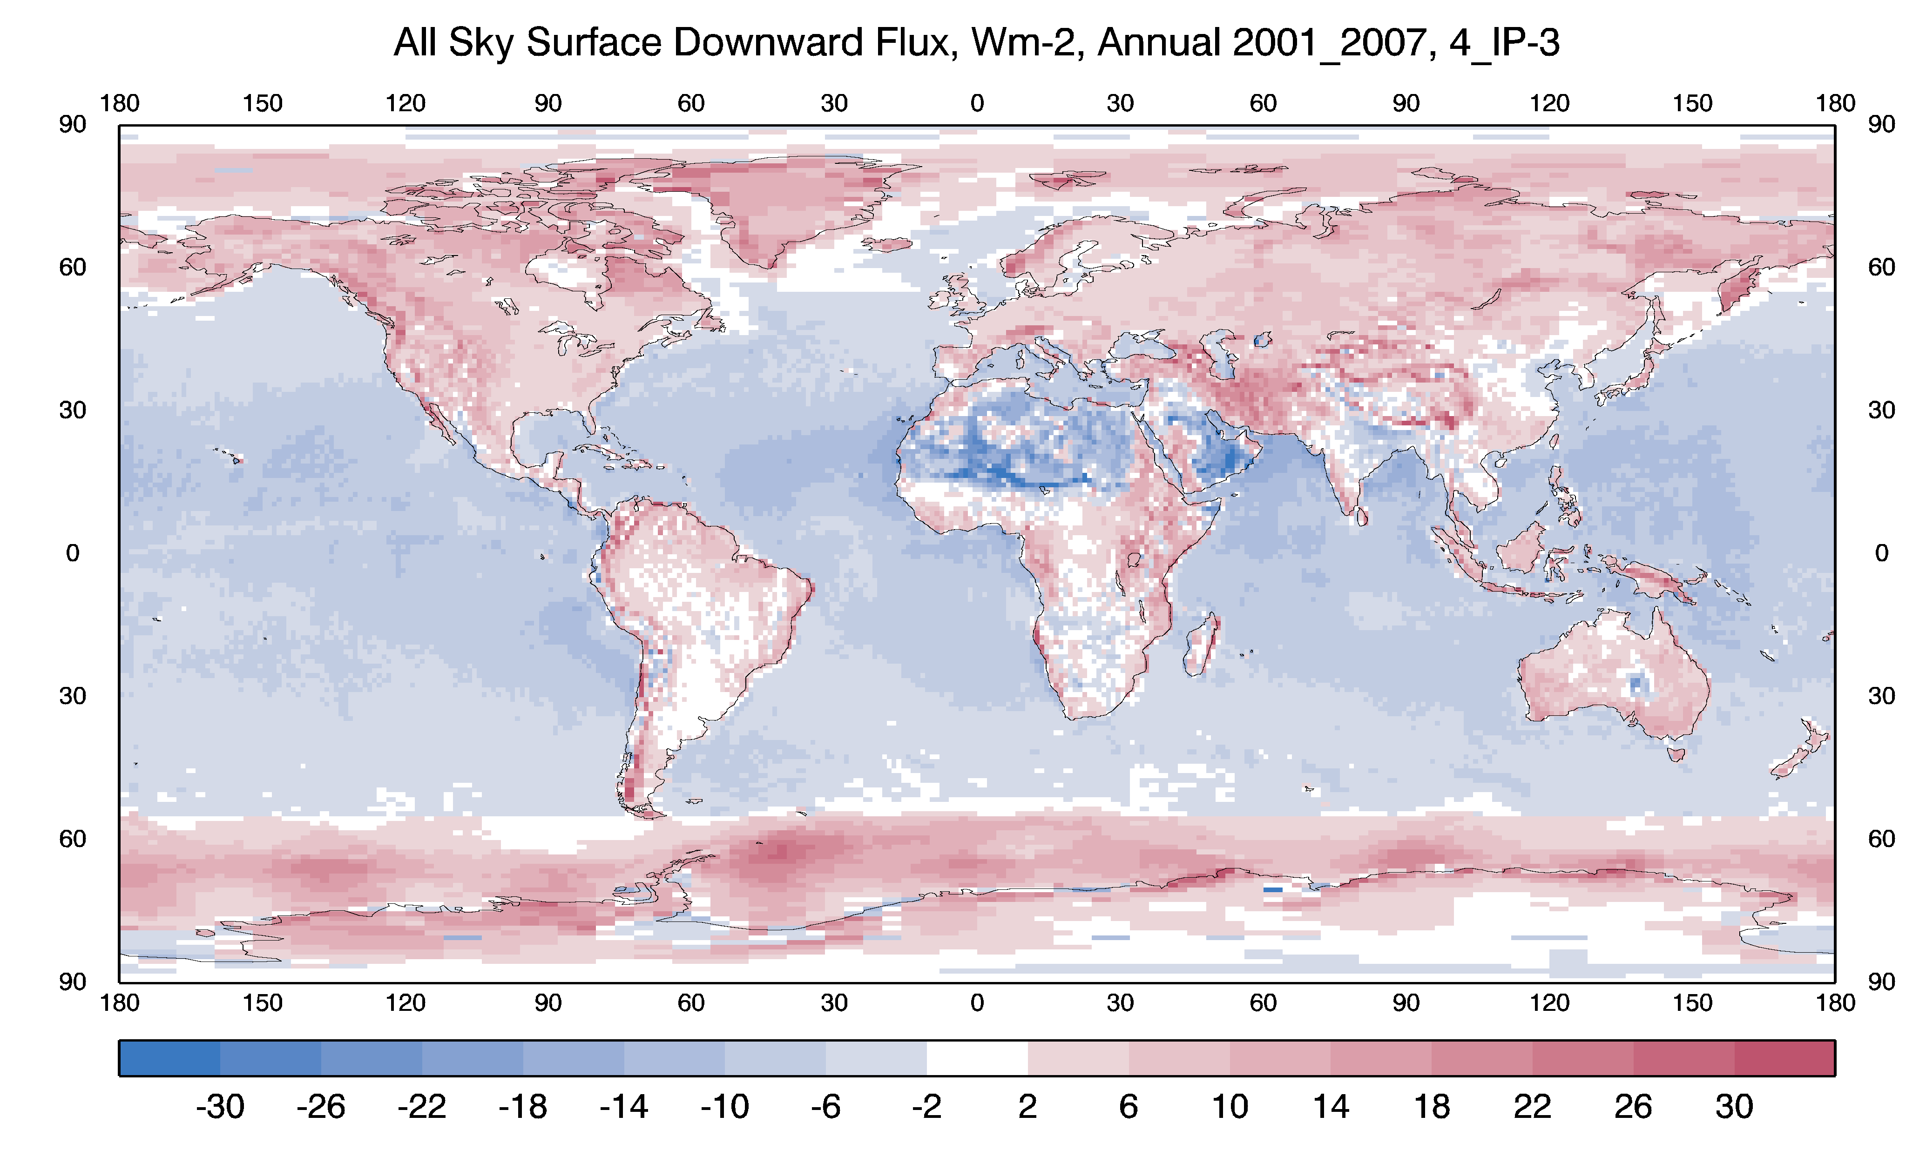
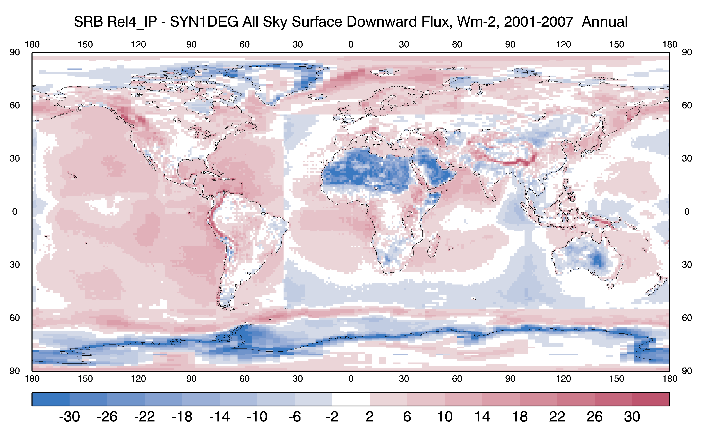
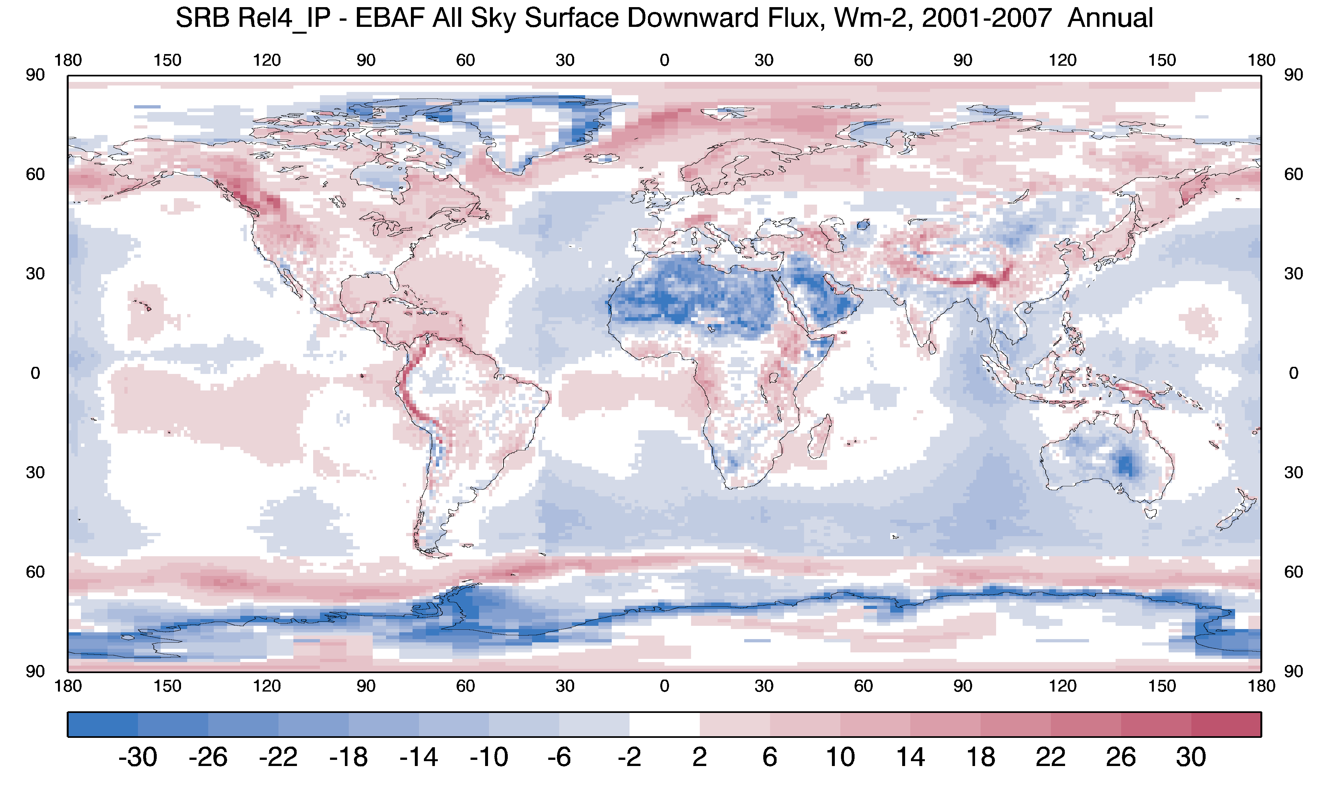
Global Mean Surface SW Down Flux for 2001-2007 for SRB 4-IP (a), and the differences between R4-IP – R3 (b), CERES SYN1Deg (c) and EBAF (d).
a
b
R4-IP
-
R3
Mean SW Down
R4-IP
-
SYN1-Deg
(Ed 4.1)
c
d
R4-IP
-
Surf. EBAF (Ed 4.1)

Slide 11
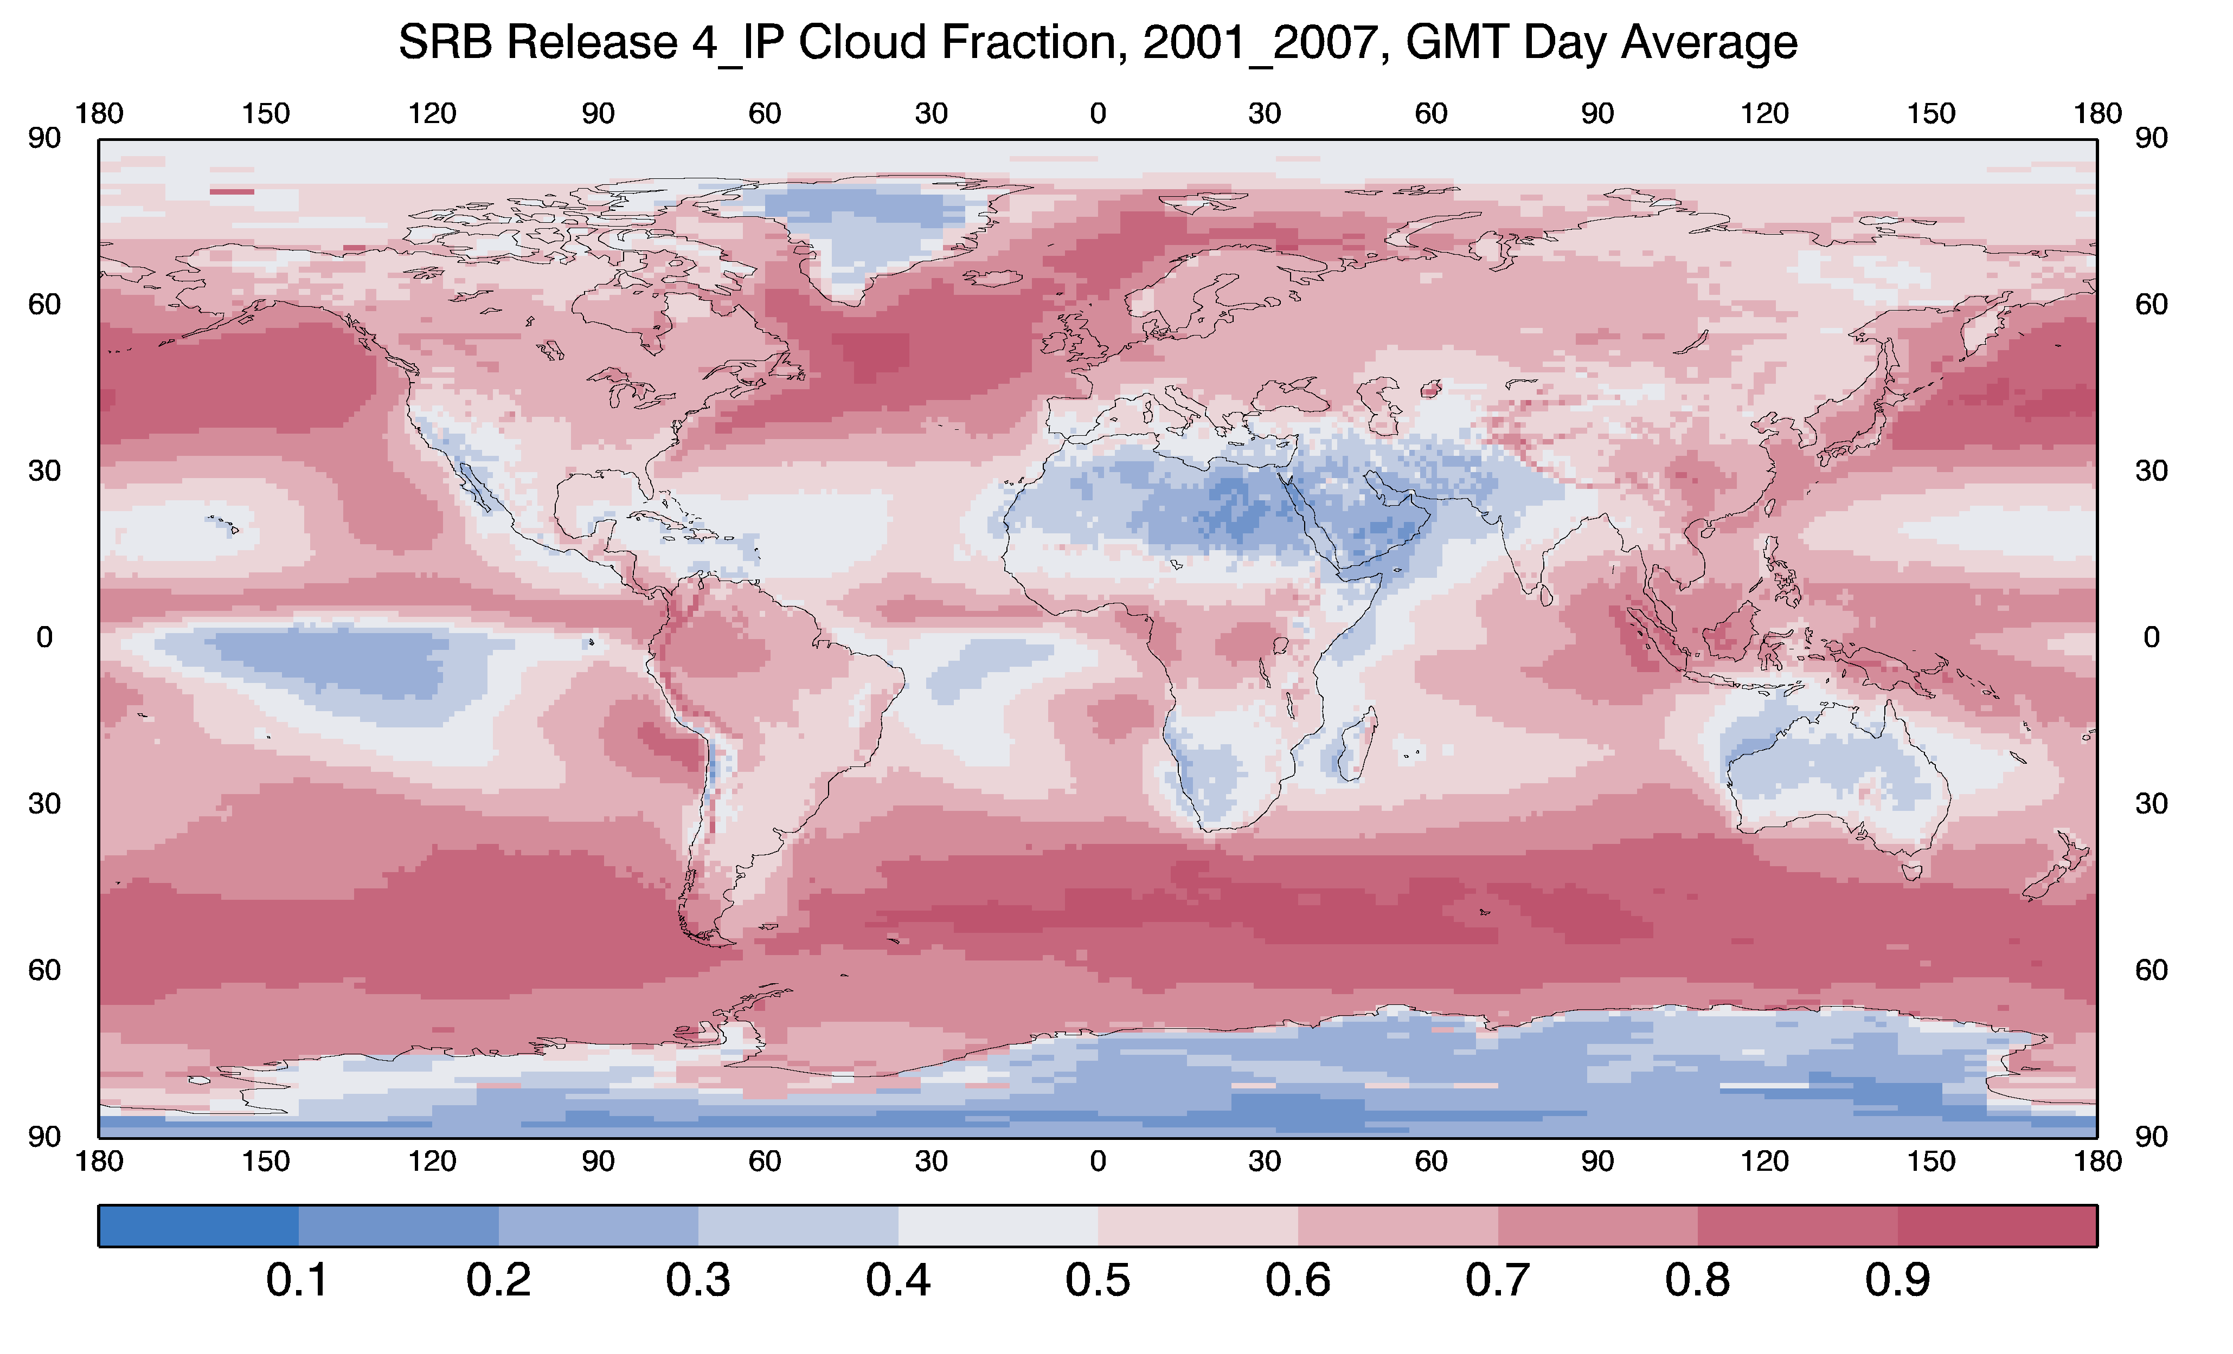
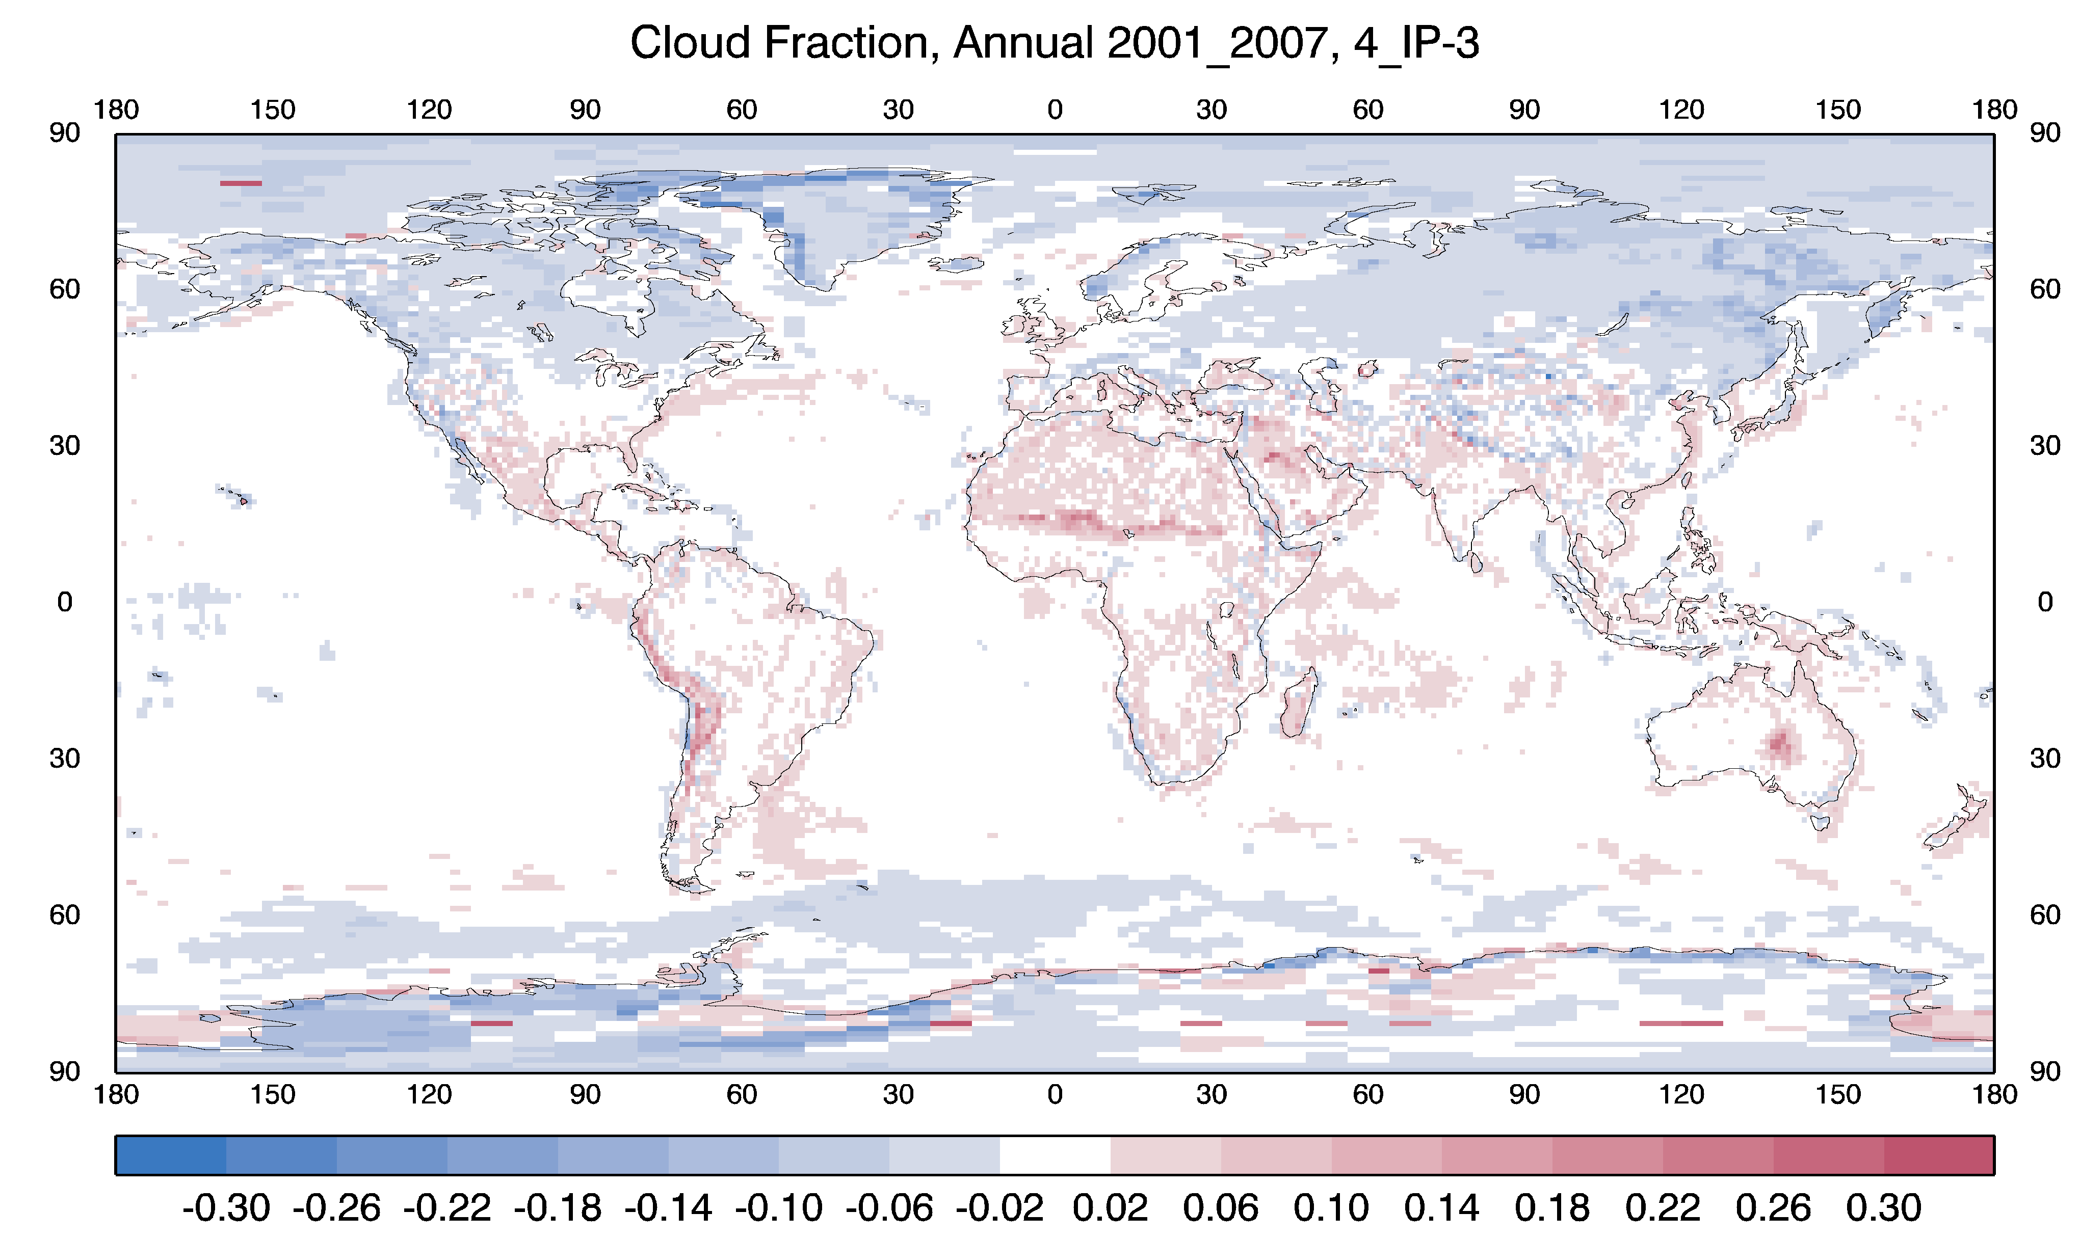
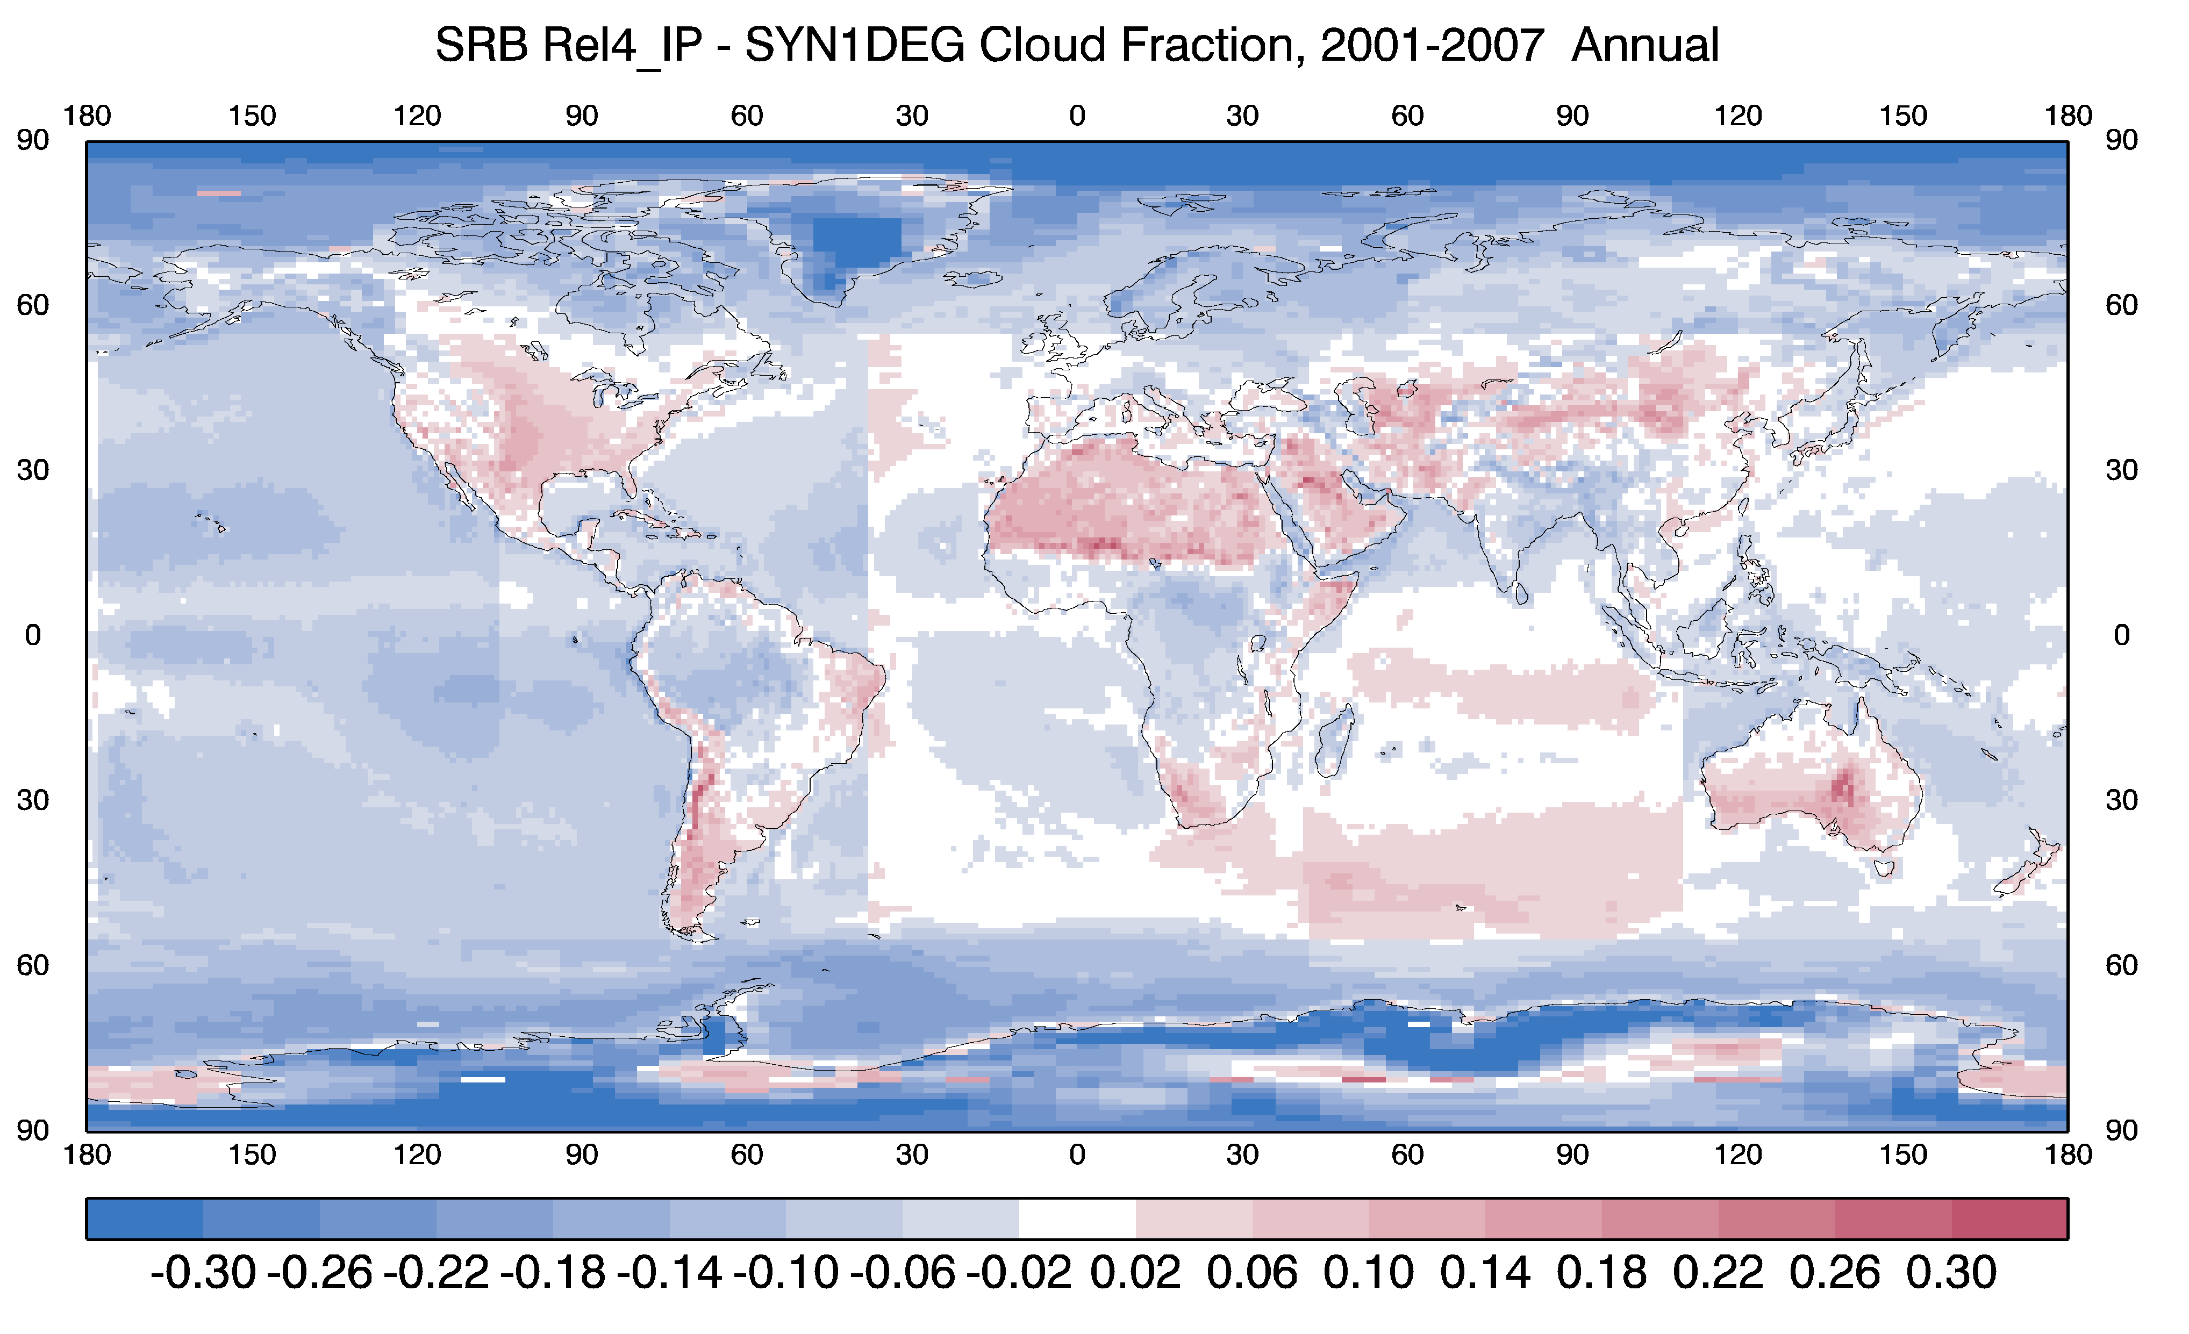
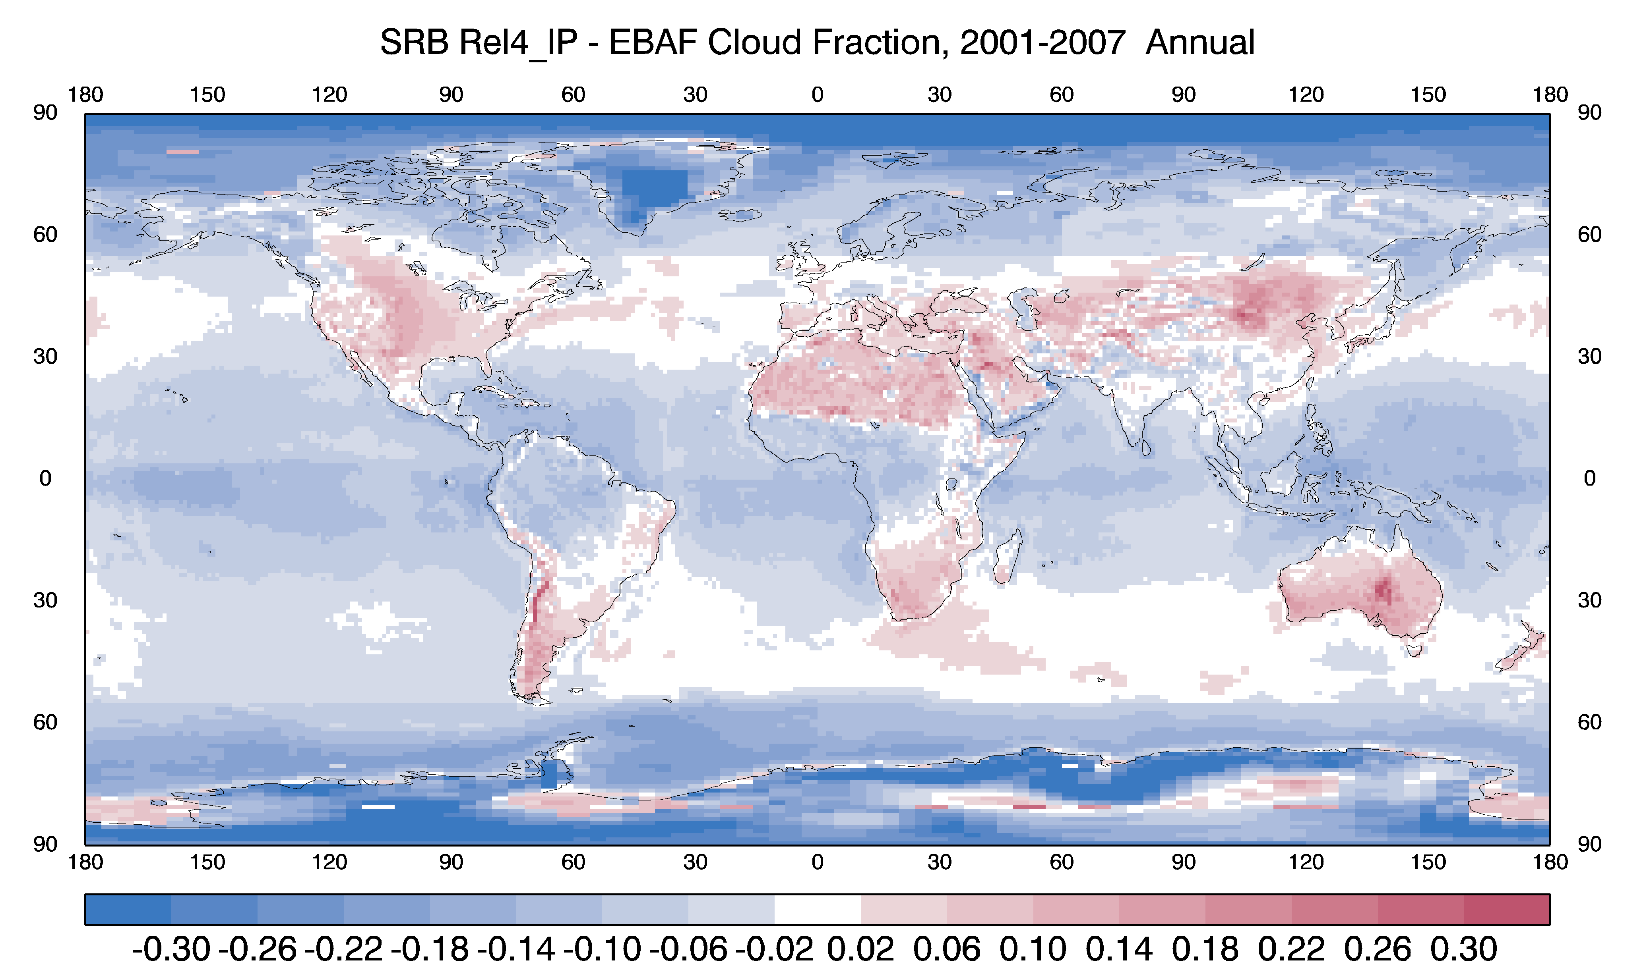
Global Annual Mean Cloud Fractions for 2001-2007 for SRB 4-IP (from ISCCP; a), and the differences between R4-IP – R3 (b), CERES SYN1Deg (c) and EBAF (d).
a
b
Mean CF
R4-IP
-
R3
R4-IP
-
SYN1-Deg
(Ed 4.1)
c
d
R4-IP
-
Surf. EBAF (Ed 4.1)

Slide 12
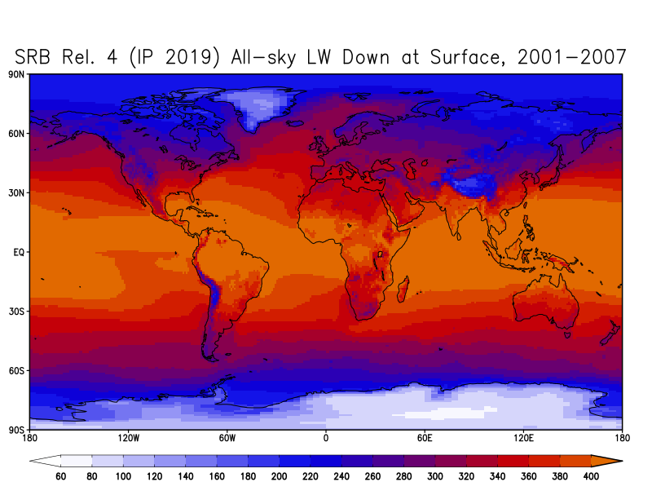
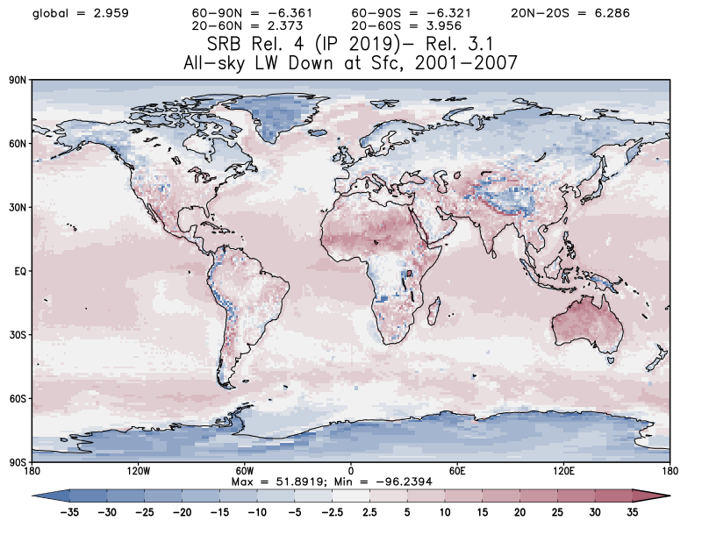
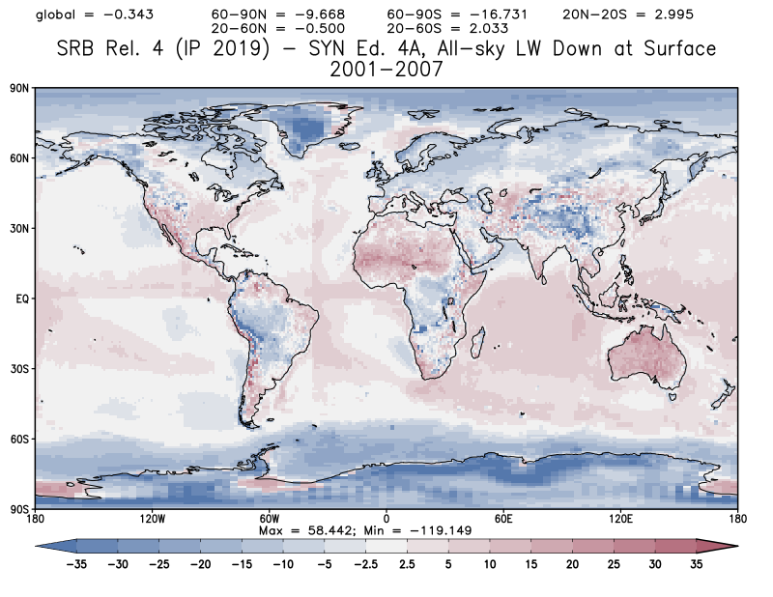
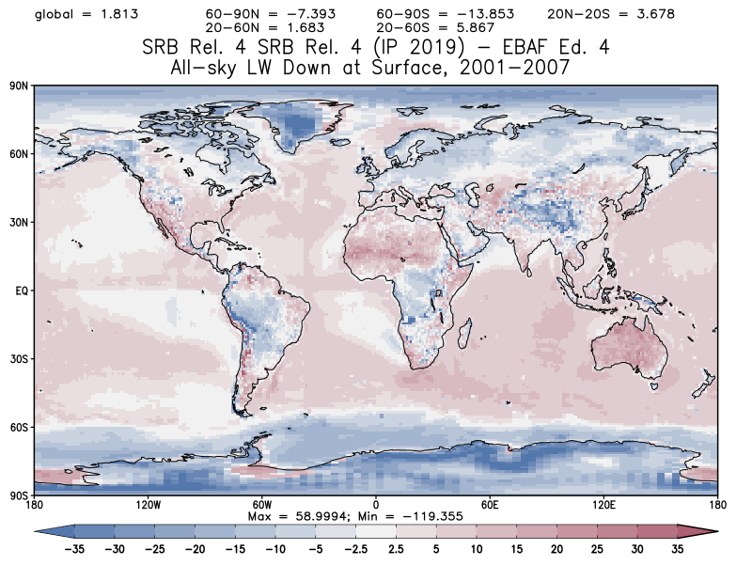
Figure 5: Global Mean Surface LW Down Flux for 2001-2007 for SRB 4-IP (a), and the differences between R4-IP – R3 (b), CERES SYN1Deg (c) and EBAF (d).
Mean LW Down
R4-IP
-
LW R3
R4-IP
-
SYN1-Deg
(Ed 4.1)
R4-IP
-
Surf. EBAF (Ed 4.1)

Slide 13
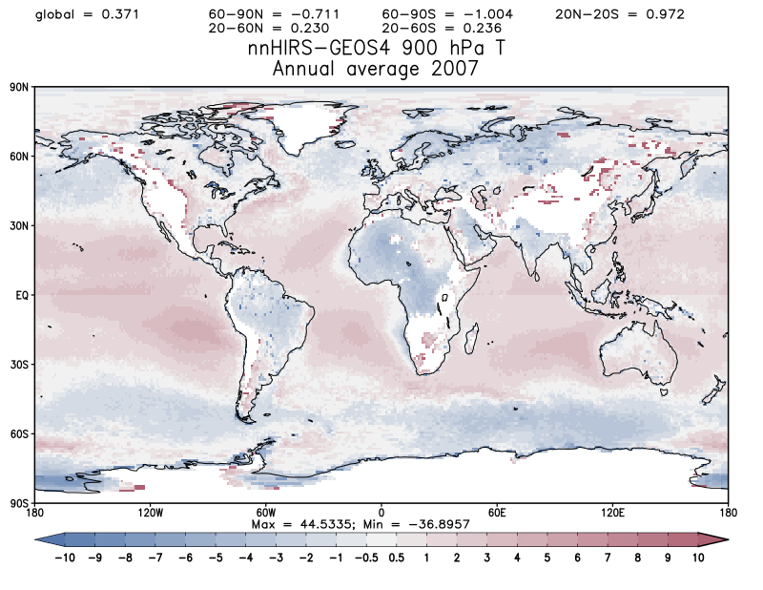
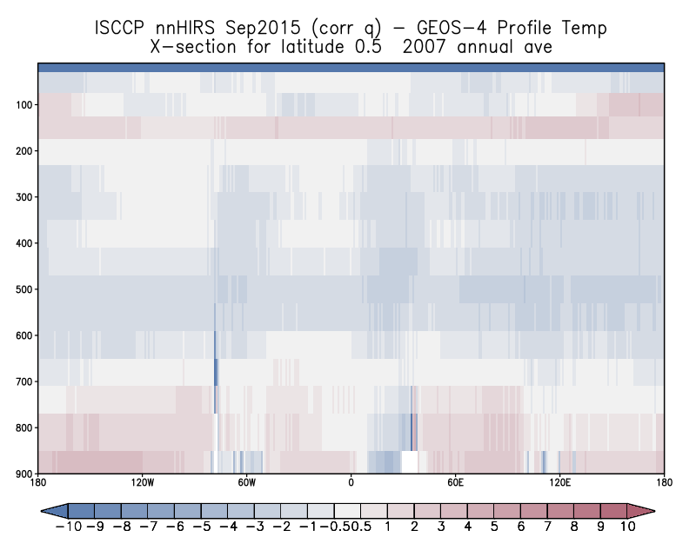
nnHIRS (SRB R4-IP) and GEOS-4 temperature(SRB R3) differences for the 2007 annual mean (a) spatial map at 900 hPa and (b) vertical profile cross-section of specific humidity at 0.5 N. GEOS-4. Temperature and humidity maps are consistent with LW difference maps

Slide 14
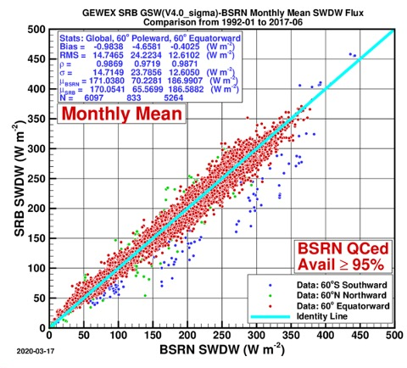
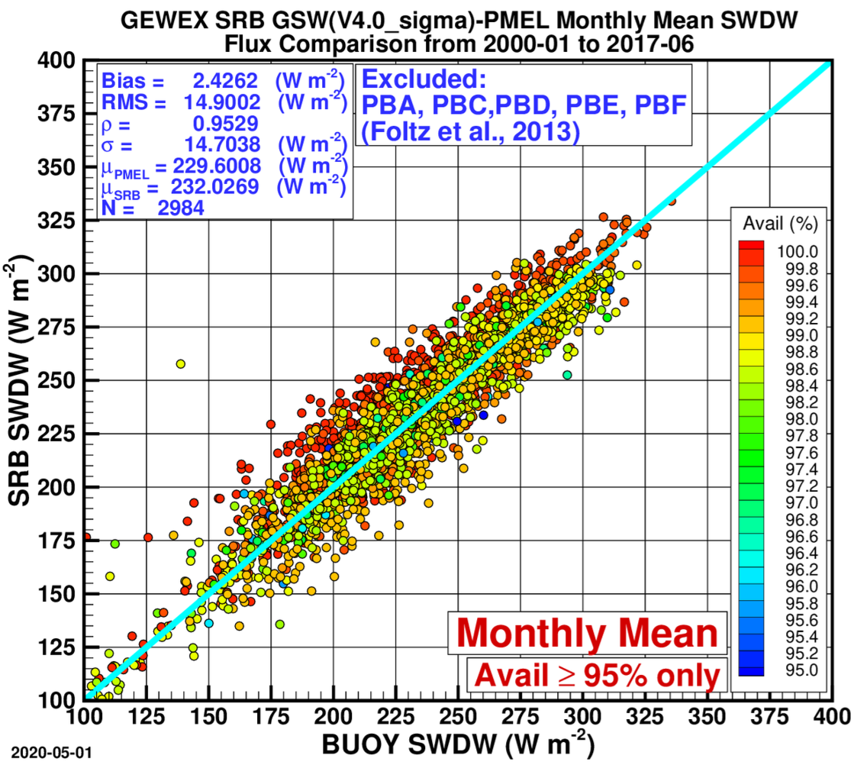
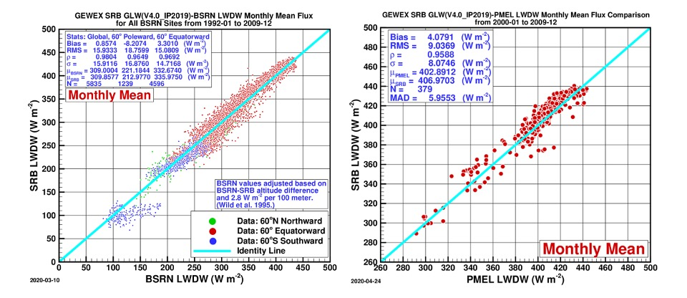
GEWEX SRB Validation
BSRN Land Measurements
PMEL Ocean Buoy Measurements
Surface downward fluxes assessed against surface measurements from BSRN for (a) SW fluxes and (c) LW fluxes and (b) from the PMEL ocean buoy networks for (b) SW and (d) LW fluxes. One-to-one lines are given in light blue. The overall statistics are given in the boxes. Observing sites for BSRN network are colored as indicated. Biases in SW and LW fluxes occur in polar conditions when cloud properties are difficult to determine from ISCCP HX 2 channel algorithm (blue points). Note that oceanic buoys from some regions are excluded based upon the recommendation of Foltz et al., 2013.
b
a
SW
c
d
LW

Slide 15
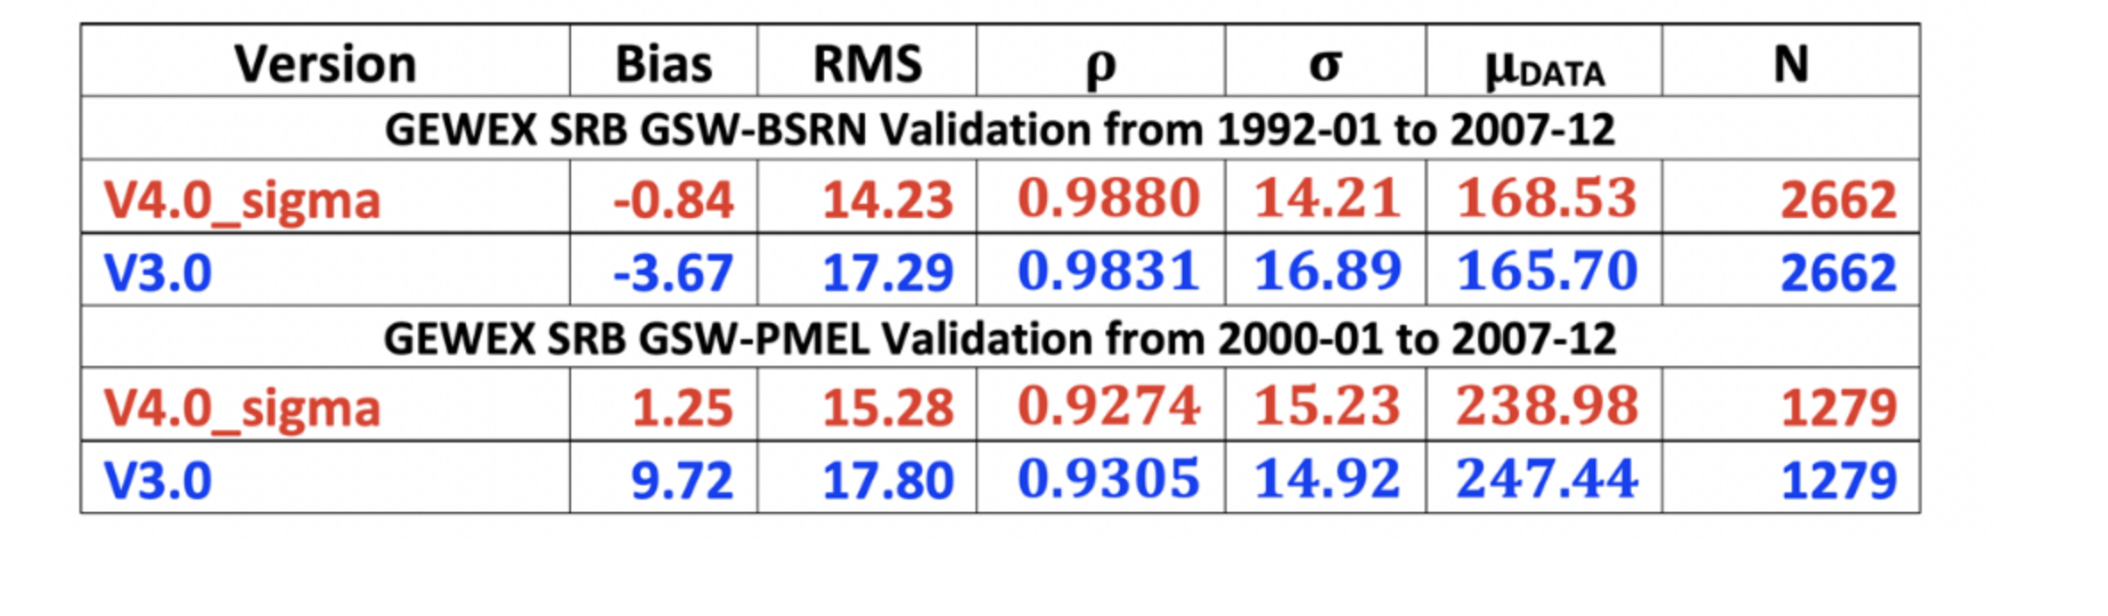
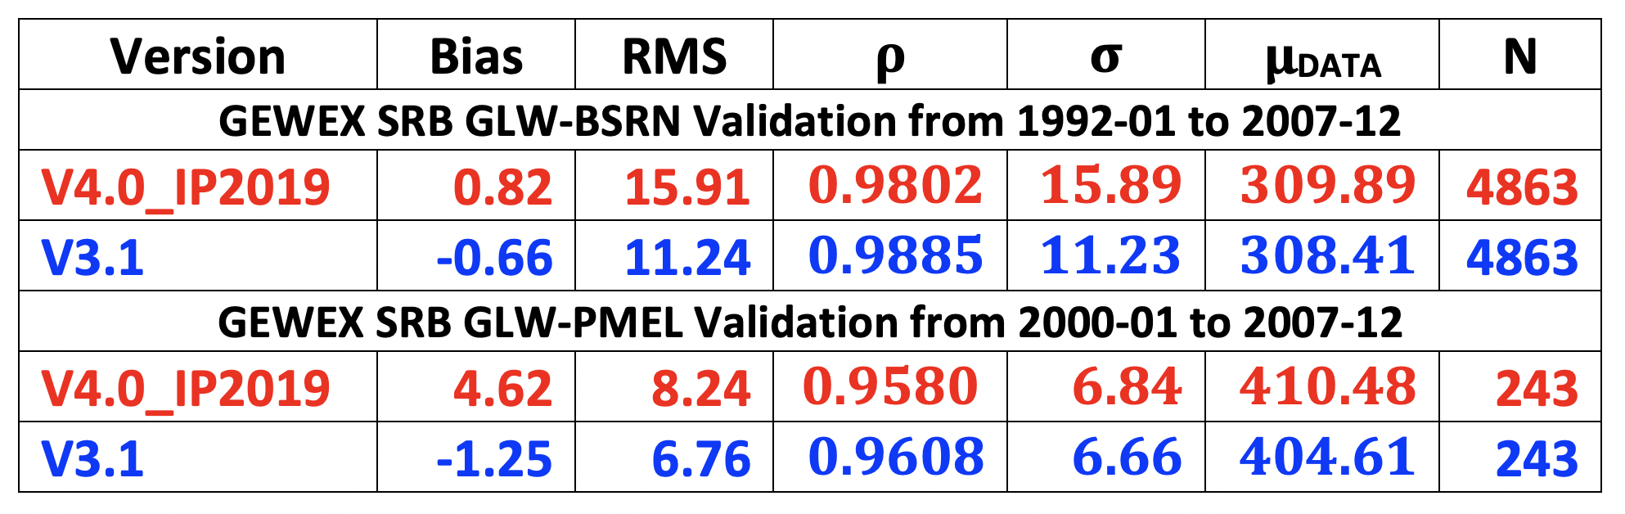
Comparison of Surface SW fluxes compared to indicated observations
Comparison of Surface LW fluxes compared to indicated observations

Slide 16
Global Annual Averaged TOA and Surface Radiation Budget Components (1988-2009). Global annual averaged TSI is 340.3 W m⁻². The annual averaged Std Dev is given in parentheses).
Level | Flux Component | Rel 4 IP Shortwave | Rel 4 IP Longwave | Level | Flux Component | Rel 4 IP Shortwave | Rel 4 IP Longwave
Surface | Surface total down | 185.6 (1.23) | 347.0 (1.07) | Top-of-Atmosphere | TOA cloud radiative effect | -46.3 (0.68) | 22.9 (0.46)
 | Surface clear-sky down | 240.3 (1.10) | 315.6 (1.08) |  | TOA total up | 100.1 (1.22) | 239.2 (0.49)
 | Surface pristine-sky down | 252.4 (0.62) | 314.2 (0.90) |  | TOA clear-sky up | 53.8 (1.18) | 262.2 (0.43)
 | Surface up | 22.1 (0.42) | 398.5 (0.76) |  | TOA pristine-sky up | 48.8 (1.11) | 263.5 (0.43)
 | Surface net | 163.5 (1.57) | -51.5 (1.14) |  | TOA Net | 240.2 (1.22) | 239.2 (0.49)
 | Surface cloud radiative effect | -54.7 (0.82) | 31.5 (0.83) | Whole Atmosphere | Atmospheric absorption | 76.7 (0.60) | -187.7 (0.93)
Global Annual Averaged TOA and Surface Radiation Budget Components from Wild et al., 2015 (uses CERES and observations; uncertainty in the average is given in parentheses)
Level | Flux Component | Wild et al (2015) SW | Wild et al (2015) LW | Level | Flux Component | Wild et al (2015) SW | Wild et al (2015) LW
Surface | Surface total down | 185 (179 - 189) | 342 (338 - 348) | Top-of-Atmosphere | Down | 340 (340 - 341) | 0
 | Surface up | 25 (22 - 26) | 398 (394 - 400) |  | Up | 100 (96 - 100) | 239 (236 - 242)
 | Surface net | 160 (154 - 166) | -56 (46 - 62) |  | Net | 240 (240 - 245) | 239 (236 - 242)
 |  |  |  | Whole Atmosphere | Net | 80 (74 - 91) | -183 (-174- -196)

Slide 17
Hemispheric Annual Averaged TOA and Surface Radiation Budget Components (1988-2009)
Level | Flux Component | Rel 4 IP Shortwave |  | Rel 4 IP Longwave |  | Level | Flux Component | Rel 4 IP Shortwave |  | Rel 4 IP Longwave
 |  | NH | SH | NH | SH |  |  | NH | SH | NH | SH
Surface | Surface total down | 185.8 (1.63) | 185.4 (1.13) | 348.7 (1.31) | 345.3 (1.00) | Top-of-Atmosphere | TOA cloud radiative effect | -43.1 (0.73) | -49.6 (1.04) | 22.8 (0.61) | 23.1 (0.42)
 | Surface clear-sky down | 235.7 (1.29) | 244.8 (0.95) | 319.4 (1.20) | 311.7 (1.10) |  | TOA total up | 99.8 (1.37) | 100.5 (1.22) | 240.4 (0.79) | 238.1 (0.41)
 | Surface pristine-sky down | 251.6 (0.61) | 253.1 (0.66) | 317.3 (1.24) | 310.9 (1.10) |  | TOA clear-sky up | 56.7 (1.08) | 50.9 (1.36) | 263.2 (0.60) | 261.2 (0.32)
 | Surface up | 23.9 (0.47) | 20.3 (0.56) | 403.2 (1.10) | 393.9 (0.54) |  | TOA pristine-sky up | 50.4 (0.97) | 47.2 (1.34) | 264.8 (0.59) | 262.1 (0.32)
 | Surface net | 161.9 (1.80) | 165.1 (1.47) | -54.5 (1.62) | -48.5 (0.87) |  | TOA Net | 240.2 (1.39) | 240.1 (1.21) | 240.4 (0.79) | 238.1 (0.41)
 | Surface cloud radiative effect | -49.9 (0.88) | -59.4 (1.07) | 29.3 (0.89) | 33.6 (0.78) | Whole Atmosphere | Atmospheric absorption | 78.4 (0.63) | 75.1 (0.59) | -185.9 (1.23) | -189.6 (0.79)

Slide 18
Land-only vs Ocean-only Annual Averaged TOA and Surface Radiation Budget Components (1988-2009)
Level | Flux Component | Rel 4 IP Shortwave |  | Rel 4 IP Longwave |  | Level | Flux Component | Rel 4 IP Shortwave |  | Rel 4 IP Longwave
 |  | Land | Ocean | Land | Ocean |  |  | Land | Ocean | Land | Ocean
Surface | Surface total down | 186.0 (0.98) | 185.8 (1.53) | 310.0 (2.00) | 362.7 (0.85) | Top-of-Atmosphere | TOA cloud radiative effect | -33.9 (0.71) | -51.5 (0.82) | 21.6 (0.55) | 23.5 (0.45)
 | Surface clear-sky down | 227.0 (0.64) | 246.1 (1.37) | 280.1 (1.90) | 330.5 (1.01) |  | TOA total up | 111.4 (1.35) | 95.5 (1.34) | 231.9 (0.82) | 242.4 (0.44)
 | Surface pristine-sky down | 248.0 (0.67) | 254.5 (0.64) | 277.6 (1.98) | 329.6 (1.03) |  | TOA clear-sky up | 77.4 (1.04) | 43.9 (1.49) | 253.5 (0.79) | 265.9 (0.31)
 | Surface up | 44.0 (0.90) | 13.0 (0.38) | 379.0 (1.42) | 406.9 (0.54) |  | TOA pristine-sky up | 71.3 (1.14) | 39.3 (1.36) | 255.3 (0.78) | 267.0 (0.31)
 | Surface net | 141.9 (1.44) | 172.8 (1.83) | -69.0 (2.42) | -44.3 (0.80) |  | TOA Net | 214.2 (1.37) | 251.4 (1.33) | 231.9 (0.82) | 242.4 (0.44)
 | Surface cloud radiative effect | -41.0 (0.94) | -60.4 (0.91) | 29.9 (0.89) | 32.1 (0.82) | Whole Atmosphere | Atmospheric absorption | 72.3 (0.49) | 78.7 (0.71) | -162.9 (1.92) | -198.2 (0.71)

Slide 19
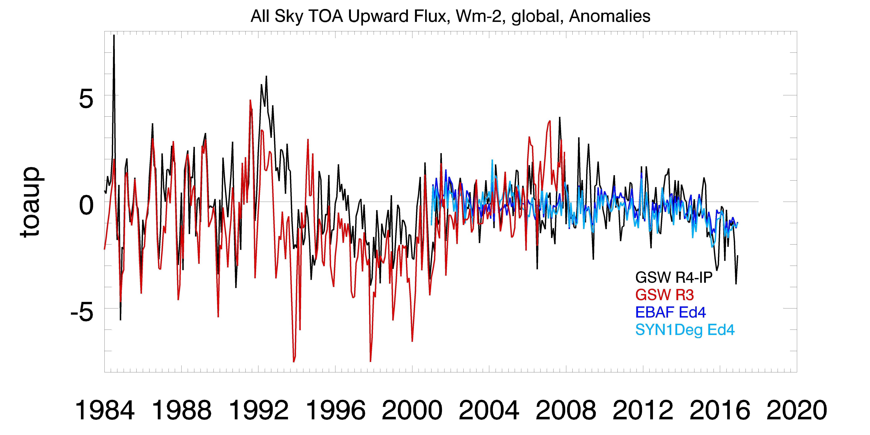
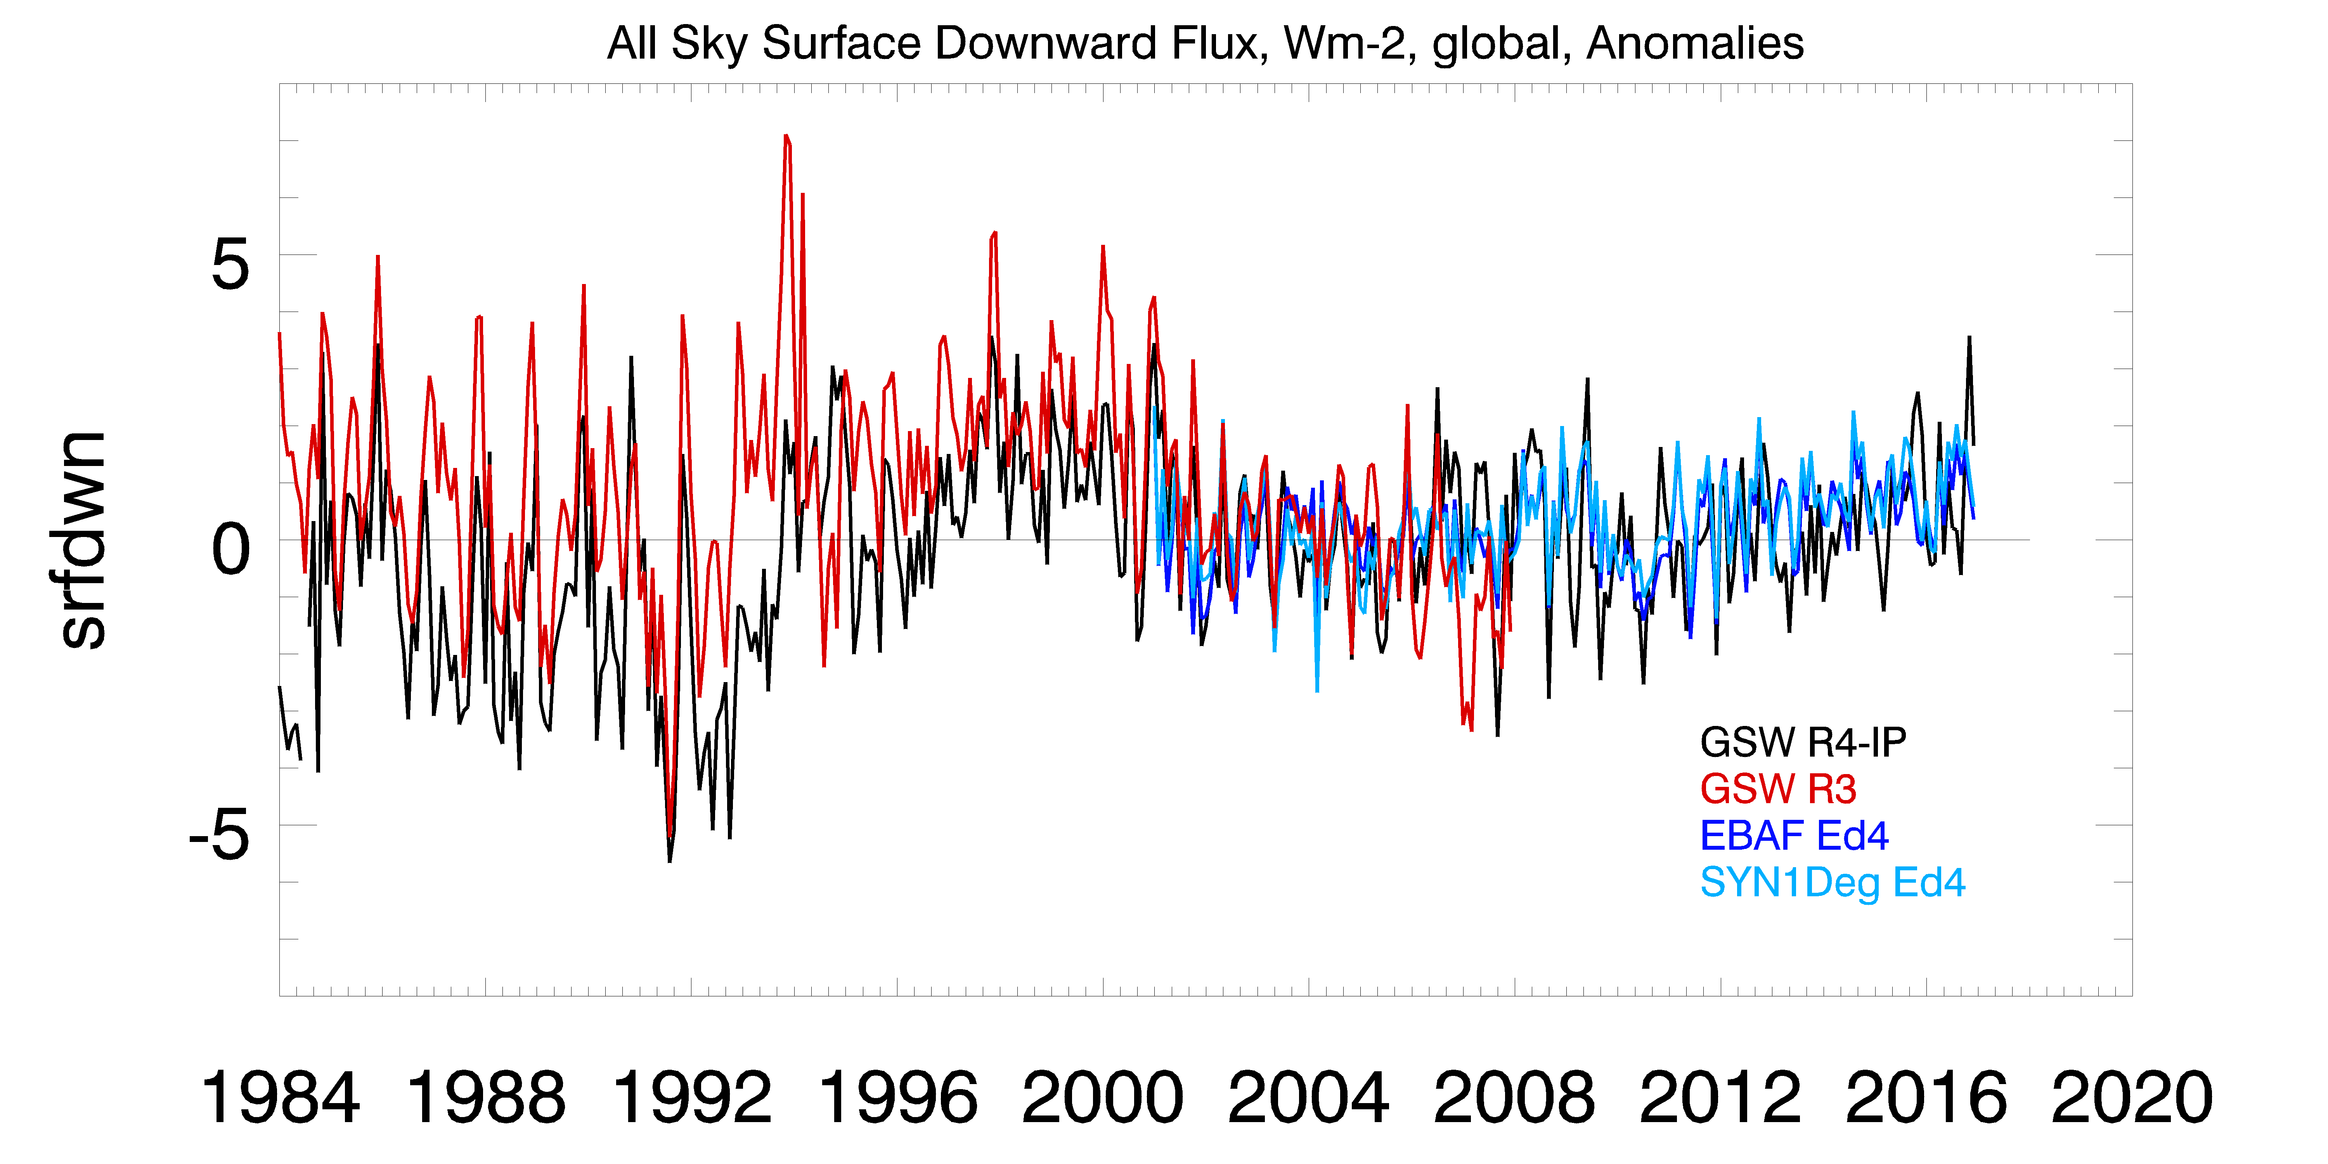
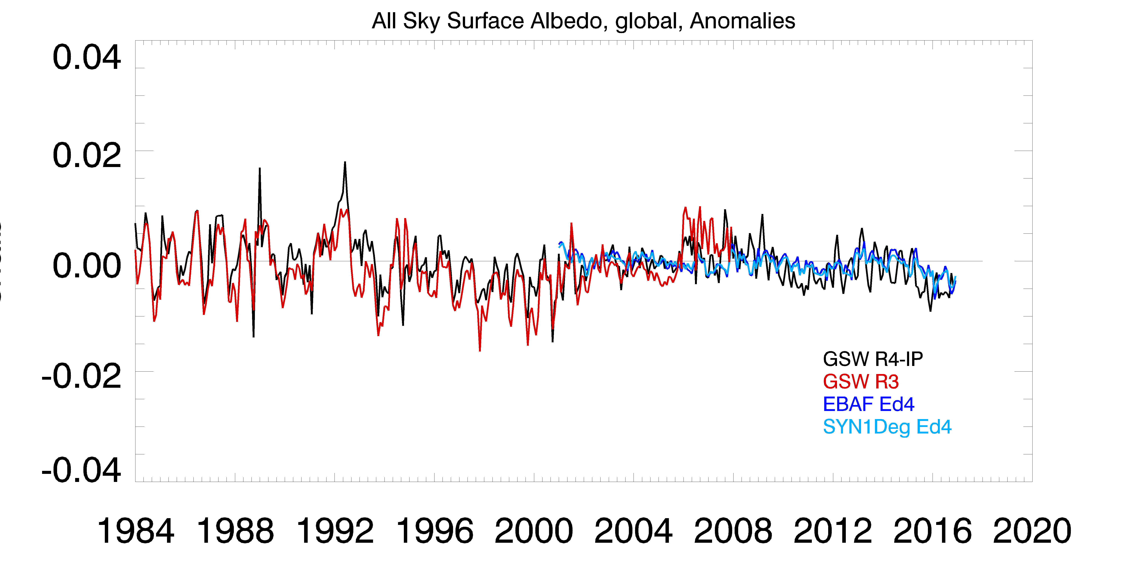
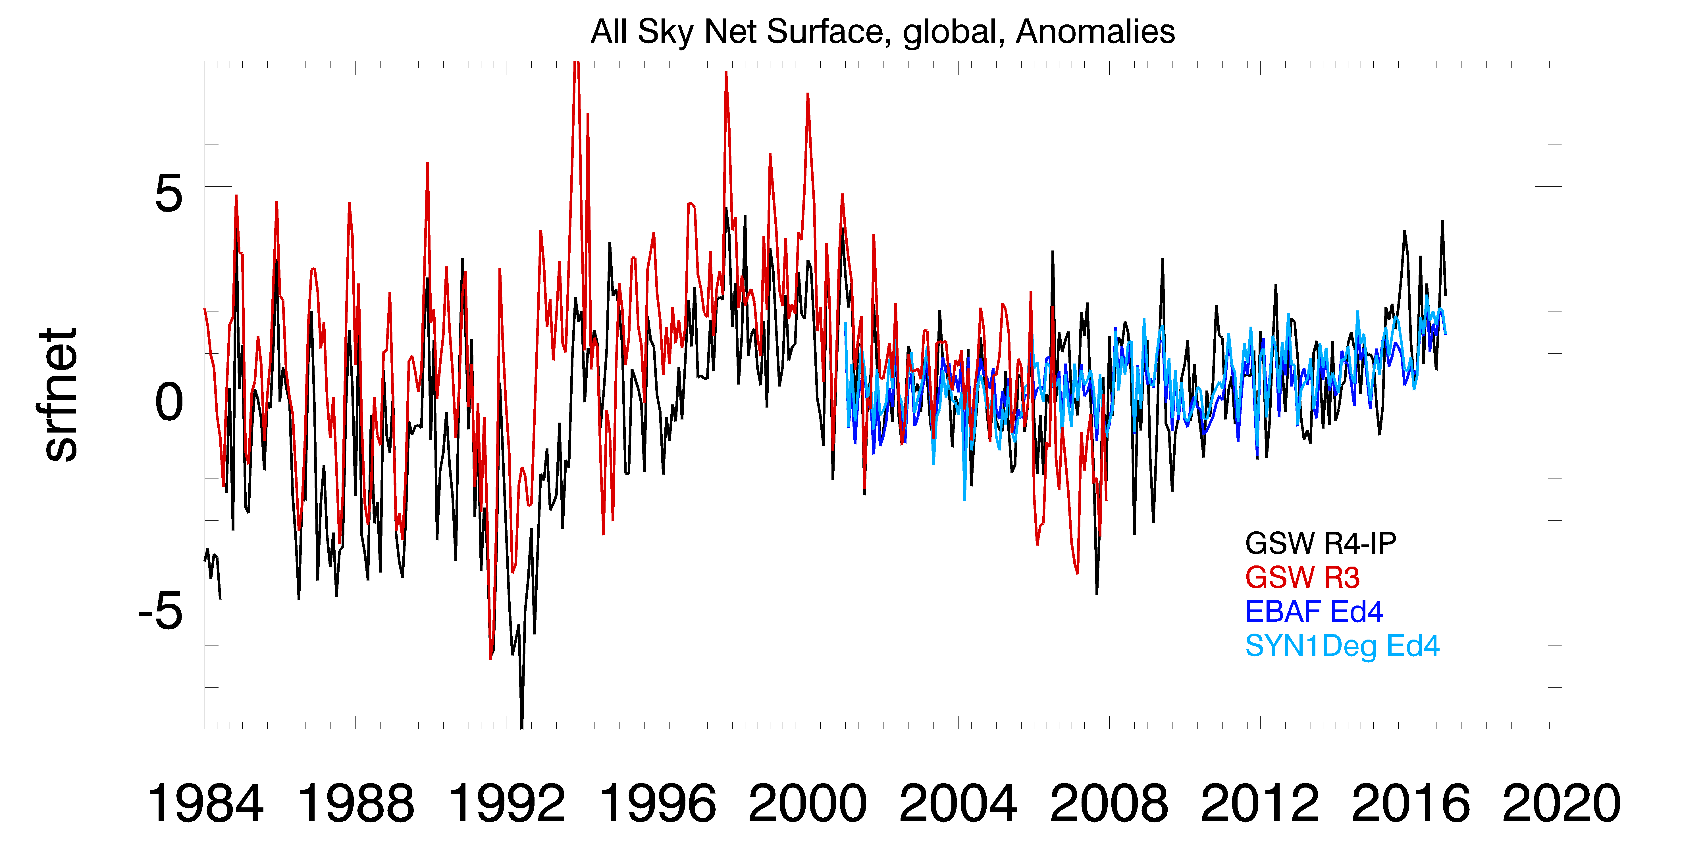
SW TOA Up
SW Surface Down
Flux (W m⁻²)
Flux (W m⁻²)
Surface Albedo
SW Surface Net
Albedo
Flux (W m⁻²)
SW global all-sky monthly averaged radiative flux component anomalies spanning July 1983 through June 2017 (uses base period 2001-2007 that overlaps with CERES). The time series show very good agreement with CERES TOA/Surface down/upward change anomalies at end of time series; note increase in net surface absorbed fluxes toward end of the time series.

Slide 20
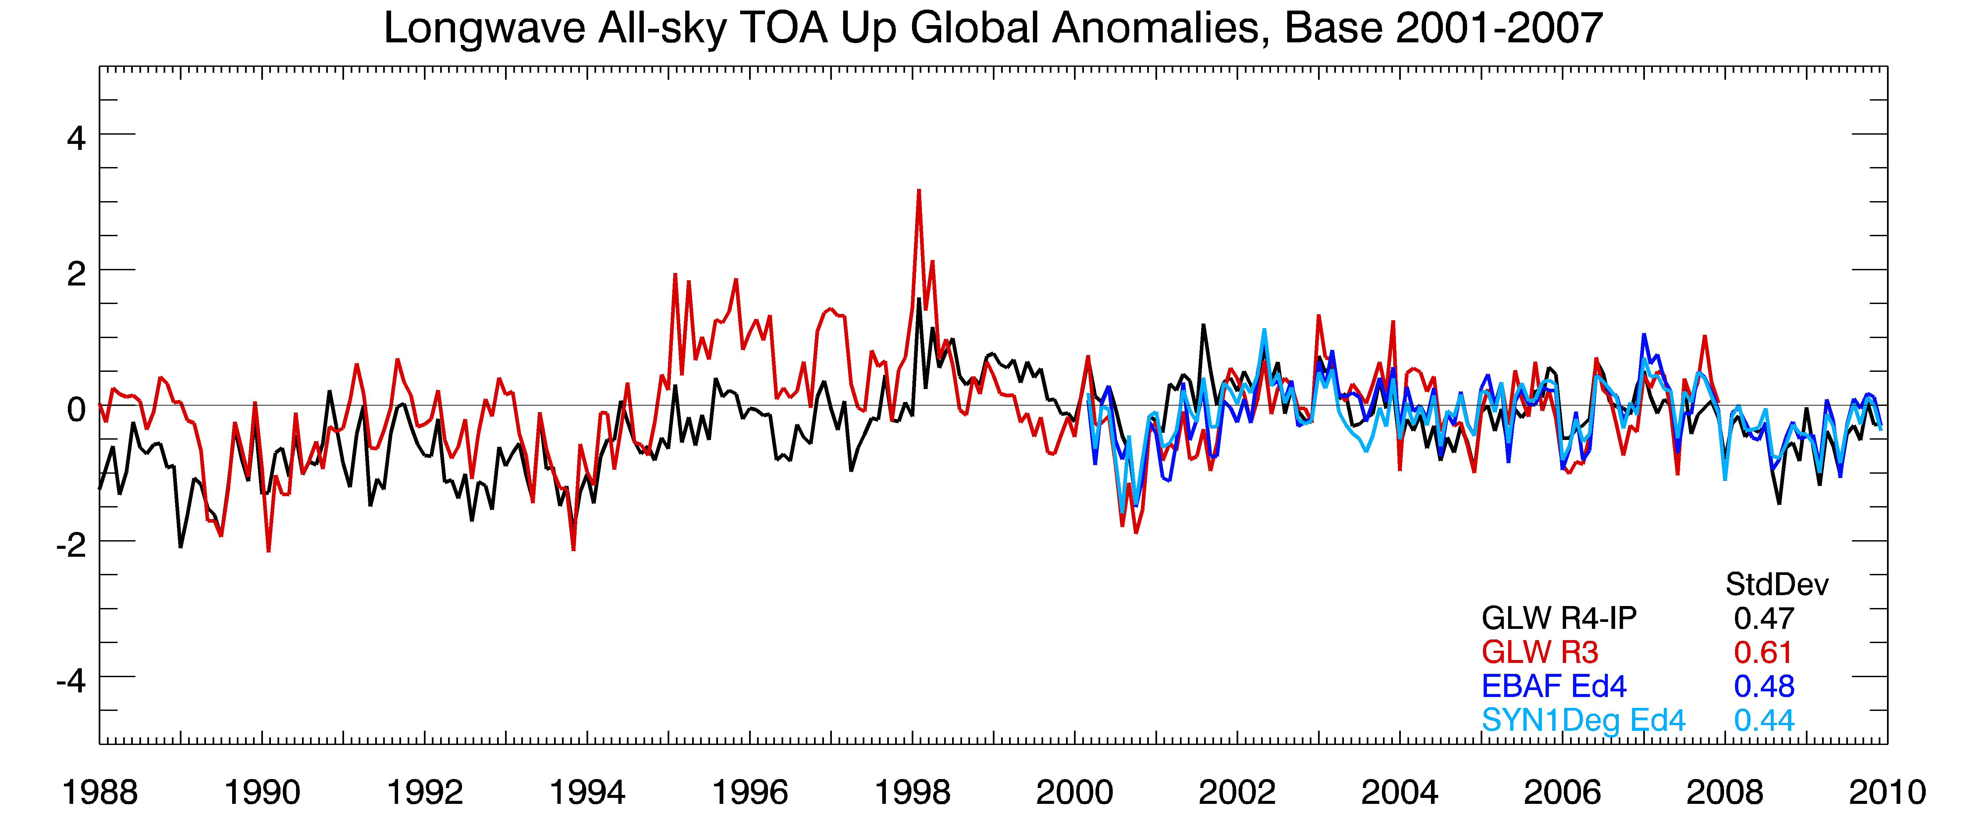
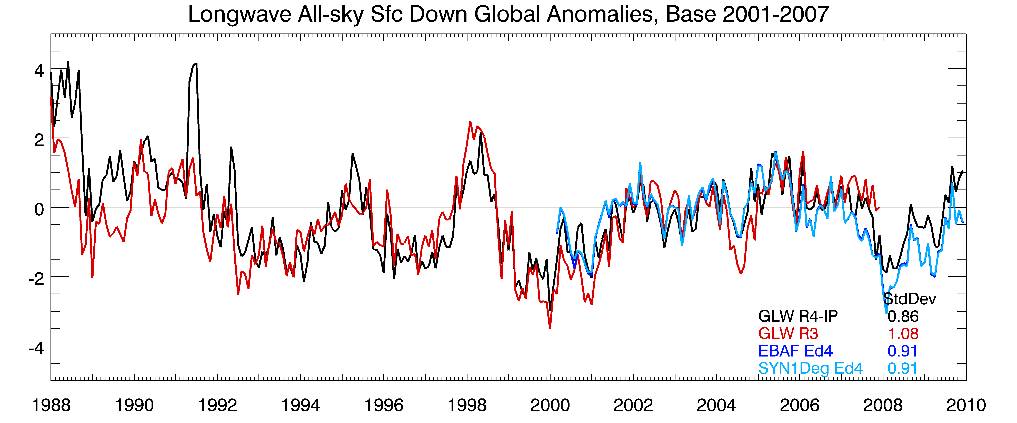
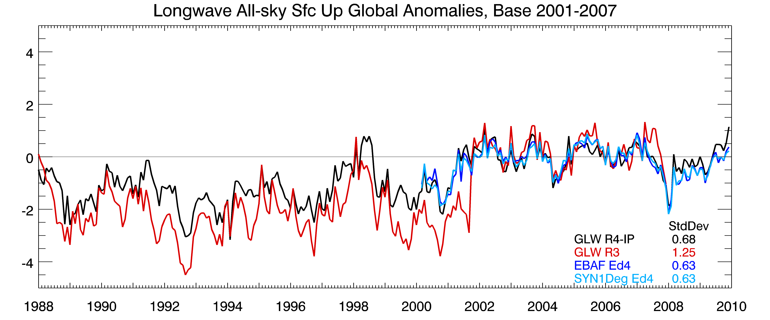
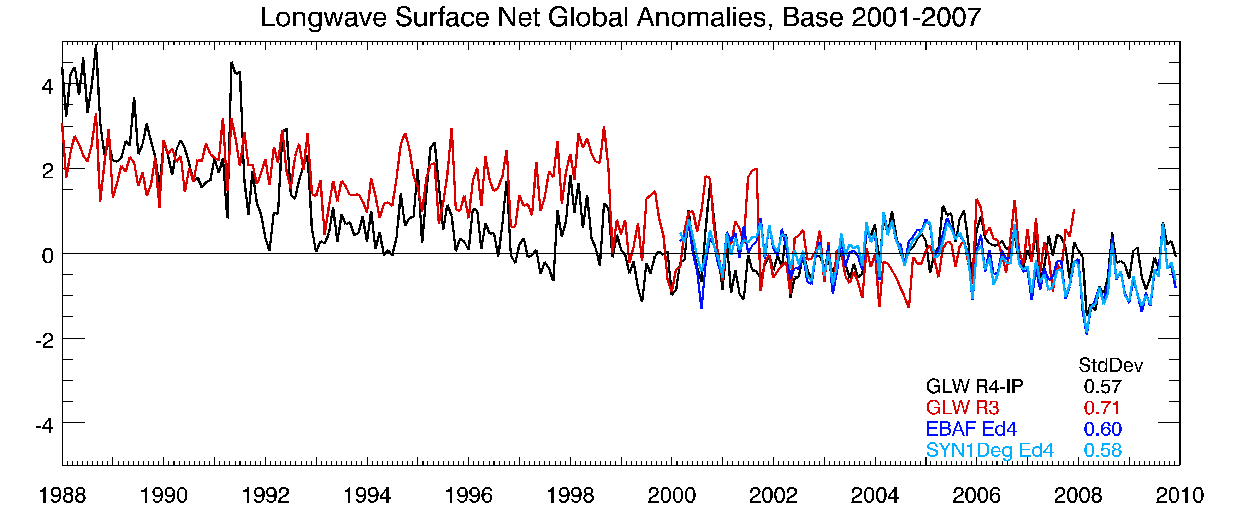
Flux (W m⁻²)
Flux (W m⁻²)
Flux (W m⁻²)
Flux (W m⁻²)
LW global all-sky monthly averaged radiative flux component anomalies spanning Jan 1988 through Dec 2009 (uses base period 2001-2007 that overlaps with CERES). The time series shows very good agreement with CERES TOA/Surface down/upward change anomalies at end of time series; note variations in the downward LW surface fluxes toward end of the time series. The LW surface upward flux between SRB R3 and SRB R4 is partially indicative of the TOVS discontinuity from ISCCP in R3.

Slide 21
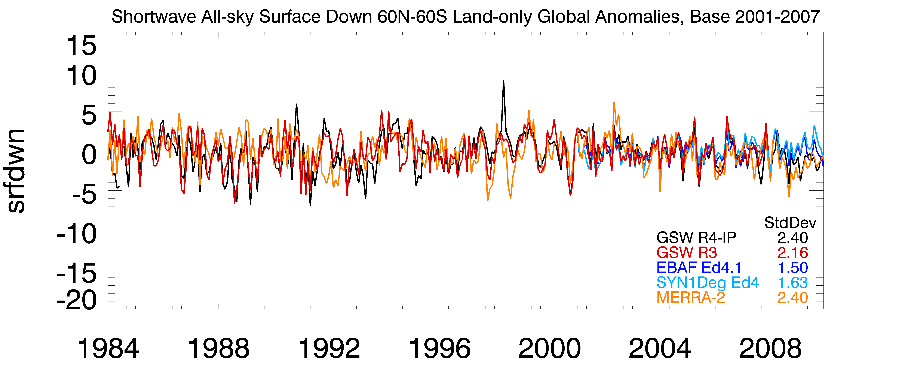
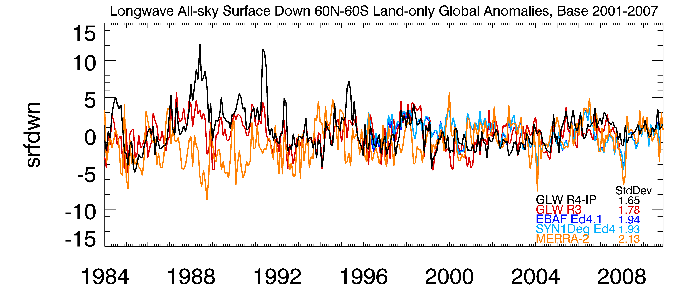
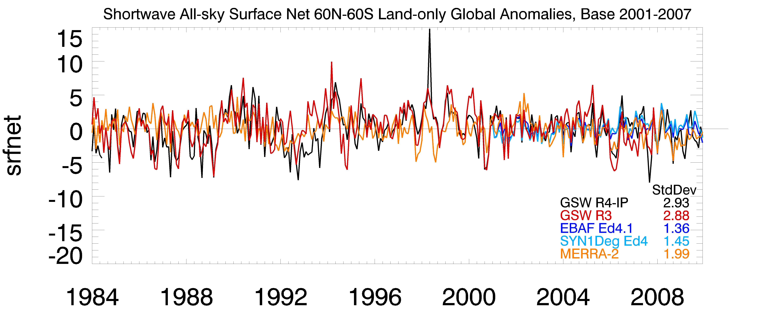
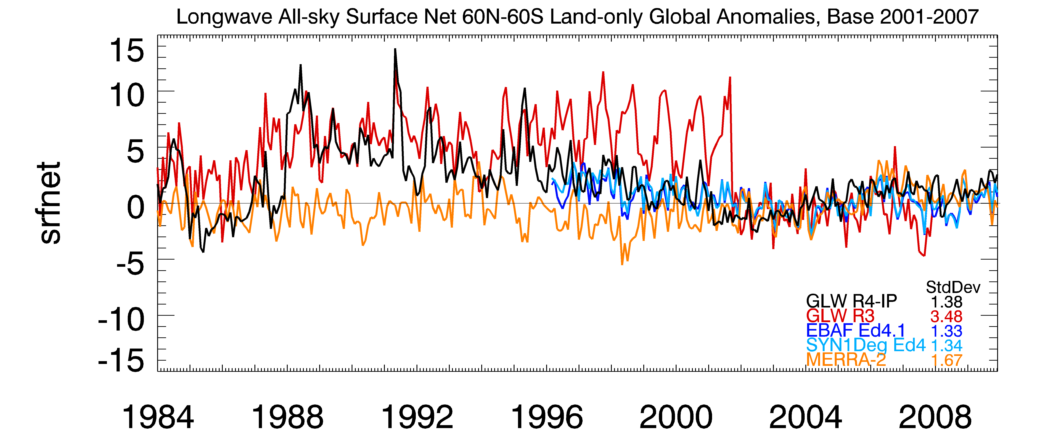
Land-only, 60N-60S, flux anomalies for the all-sky SW down, SW net, LW down and LW net as indicated (uses base period 2001-2007 that overlaps with CERES) spanning Jan 1984 through Dec 2009 (GEWEX LANDFlux). Compared are flux anomalies from R—IP (denoted GSW or GLW), CERES EBAF Ed 4.1, CERES SYN1Deg Ed 4.1 and MERRA-2. The standard deviations over the period as a measure of variability.
SW down
LW down
Flux (W m⁻²)
Flux (W m⁻²)
SW net
LW net
Flux (W m⁻²)
Flux (W m⁻²)

Slide 22
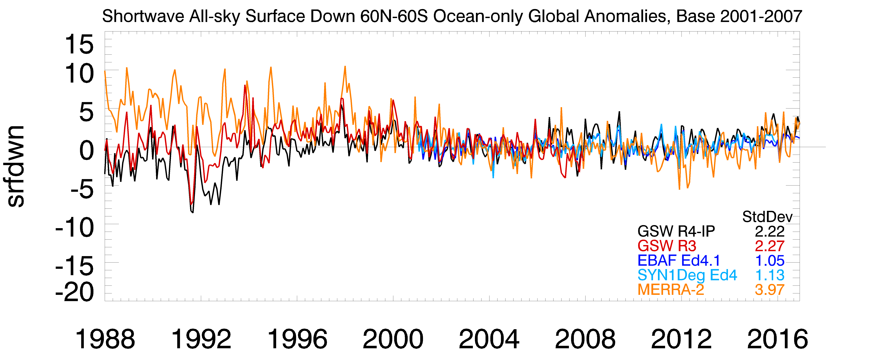
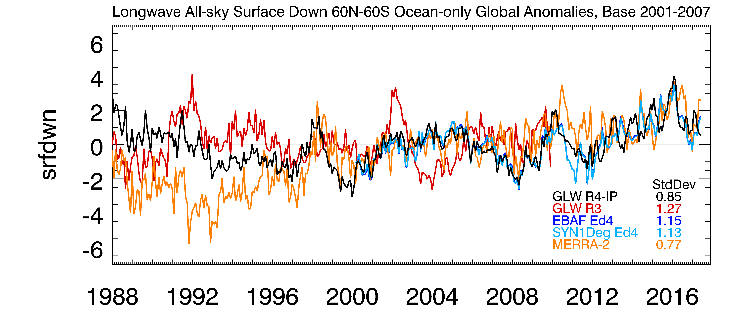
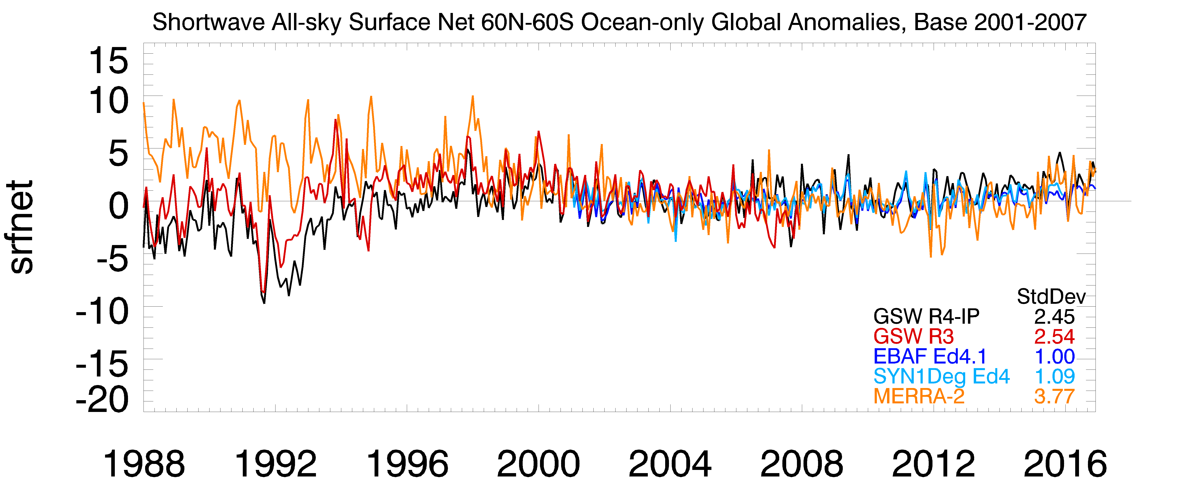
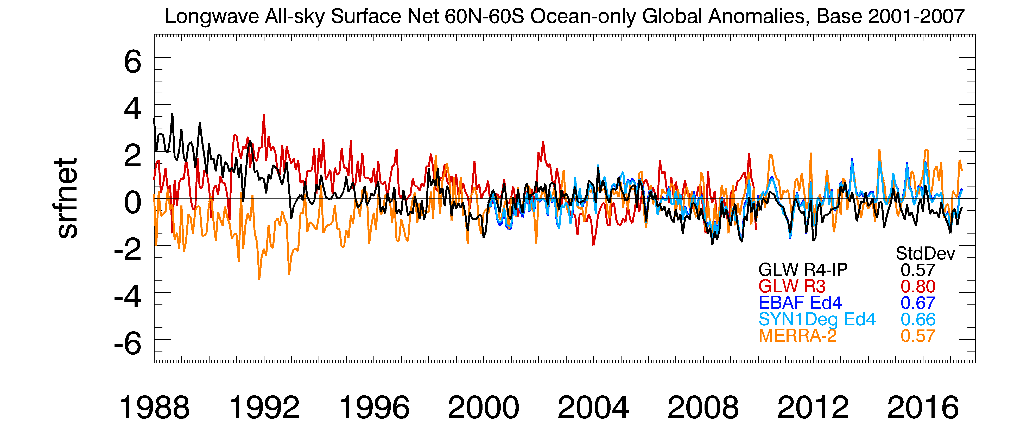
SW down
LW down
Flux (W m⁻²)
Flux (W m⁻²)
SW net
LW net
Flux (W m⁻²)
Flux (W m⁻²)
Open ocean-only, 60N-60S, flux anomalies for the all-sky SW down, SW net, LW down and LW net as indicated (uses base period 2001-2007 that overlaps with CERES) spanning 1988 through 2017 (GEWEX SeaFlux v2). Compared are flux anomalies from R—IP (denoted GSW or GLW), CERES EBAF Ed 4.1, CERES SYN1Deg Ed 4.1 and MERRA-2. The standard deviations over the period as a measure of variability.

Slide 23
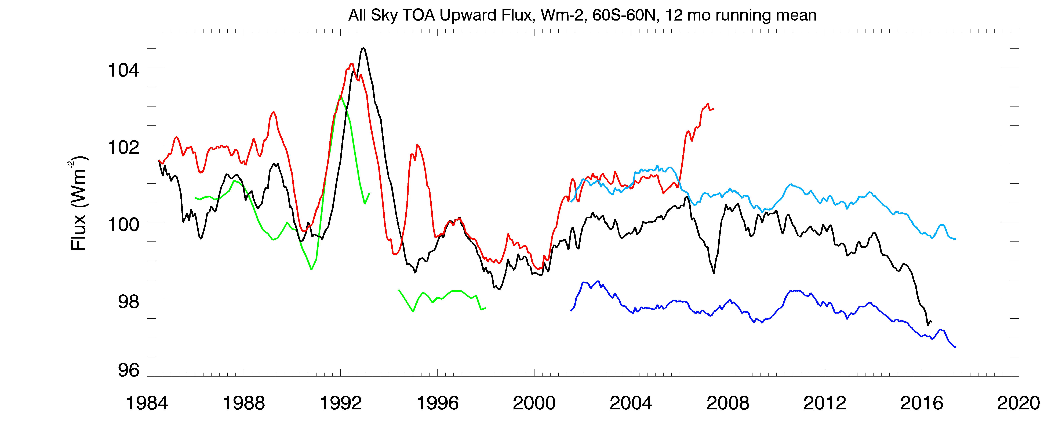
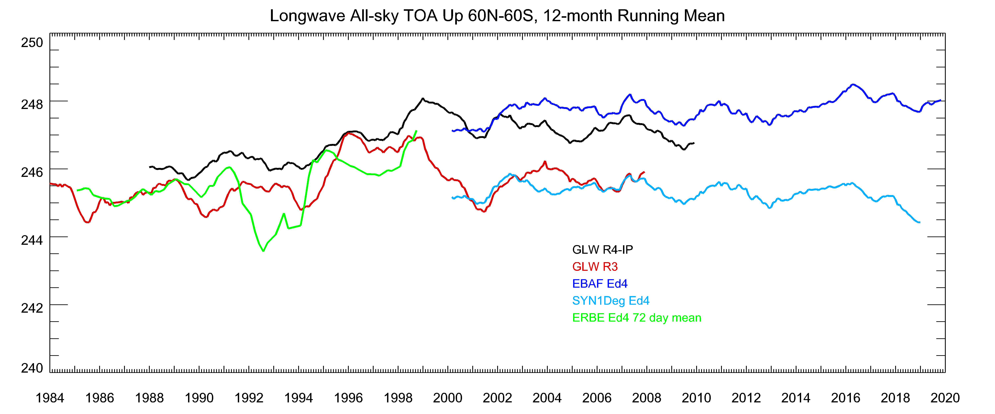
GEWEX SRB Variability: SW/LW TOA (60N-60S)
GEWEX SRB and POWER Applied Sciences
SRB R4-IP SW
SRB R3 SW
CERES EBAF Ed4.1
CERES SYN1Deg
ERBE Ed4 (72 day mean)
SRB R4-IP SW
SRB R3 SW
CERES EBAF Ed4.1
CERES SYN1Deg
ERBE Ed4 (72 day mean)
All-sky TOA SW (left) and LW (right) radiative flux time series for SRB R4-IP averaged over the 60N to 60S region. Fluxes are running 12 month averages. The fluxes for SRB R3, CERES EBAF Ed4 and SYN1Deg Ed4, and the newly reprocessed ERBE MEaSURES are also plotted for comparison. SRB R4-IP within about 2 W m⁻² to CERES EBAF; within absolute uncertainty (closer than CERES Syn1Deg)
The effect of 1992 Pinatubo eruption is captured in the SW (seems to lag ERBE but this may be in part to 72-day mean), but not in the LW; the ISCCP nnHIRS temperature anomalies show no tropospheric cooling as some data products show.
SW has a feature in 2007 and 2016-2017 that differ relative to CERES and this will require more assessment. The LW correlation is only good to within 2 W m⁻².
Both the mean SW and LW values agree within the absolute uncertainty with features.

Slide 24
GEWEX SRB Rel 4-IP: Summary Status
GEWEX SRB Integrated Product Version
  GEWEX global data projects: ISCCP, SRB, LandFlux, SeaFlux, GPCP attempted joint product where key inputs used to tie energy and water cycle global data products
SW Products span July 1983 to June 2017
  Global annual averages consistent but regions of large differences; attributable to cloud fraction changes to first order
  Reduction of polar clouds from new ISCCP HX significant
  All-sky validation relative to BSRN and PMEL Buoys improved
  Long-term variability and anomalies show good correspondence to ERBE and CERES data products
Notes:
General conclusions …

Slide 25
GEWEX SRB: Summary Status
LW processed globally 1988 to 2009 (Land-only 7/83 to 12/87; Open Ocean-only 1/10 – 6/17)
  Annual average map differences show large changes
  Attributable in part to new nnHIRS based T, q profiles
  Surface validation good relative to BSRN, biased high over oceans
Continuing GEWEX SRB Rel 4-IP and 4+
  Continue validation and assessment; relative to CERES and surface observations; other satellite data sets
  Complete Delivery, Documentation, Archive and Distribution and Publish new 1x1 version
Notes:
General conclusions …

Slide 26
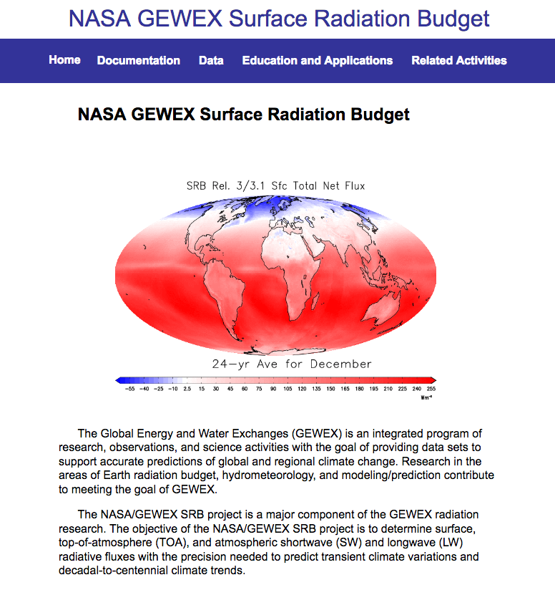
SRB Web Site and Data Sources
http://gewex-srb.larc.nasa.gov
Atmospheric Science Data Center (main archive):
https://eosweb.larc.nasa.gov/project/SRB
2. POWER Applied Science (climatological, monthly, daily; GIS formats)
https://power.larc.nasa.gov

Slide 27
Extras

Slide 28
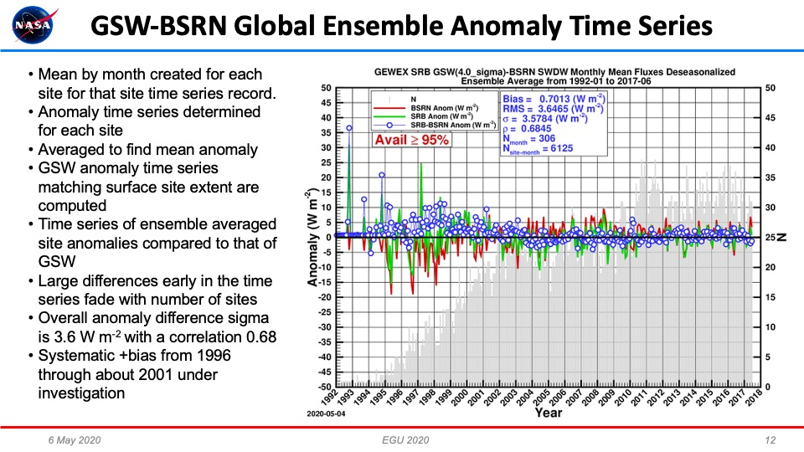
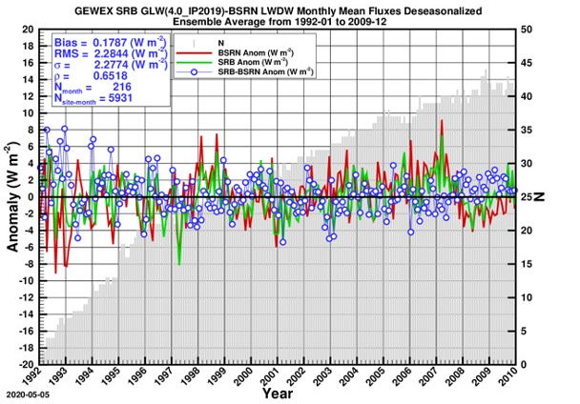
SRB BSRN Temporal Ensemble Validation
Figure 4a-d: Shows the temporal ensemble monthly time series anomaly for all available measurements for each month for BSRN (a) SW, (b) LW and Ocean buoy measurements (c) SW and (d) LW. The relevant statistics are shown in the box.
Procedure: Compute Mean by month created for each site for that site’s time series record. Anomaly time series determined for each site, averaged to find mean ensemble anomaly for each month. SRB SW/LW anomaly time series matching surface site extent are computed and compared to the measurements
Results: Larger monthly anomaly differences early in the time series fade with increasing number of site months in time (see grey histogram and right-side vertical axis). Overall anomaly difference Std Dev for SW/LW is 3.6/2.3 W m⁻² with a correlation 0.68/0.65. SW 1997-1999 periods features larger than normal differences; LW less noisy with easiest period showing larger potential bias. No SW or LW long-term difference trends evident; indicating a stability of overall statistics.
a
b

Slide 29
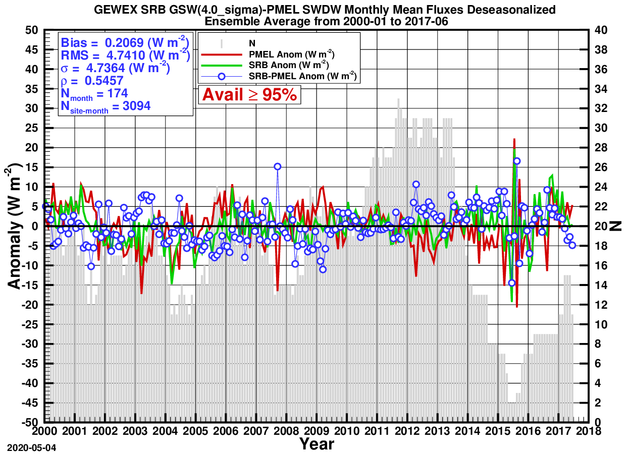
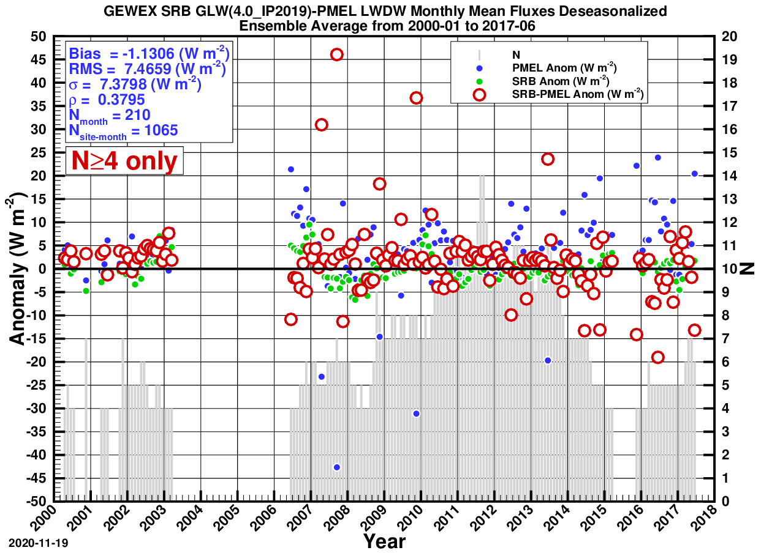
SRB Ocean Buoy Temporal Ensemble Validation
Procedure: Same technique as with BSRN, except for using the various Ocean Buoy (from PMEL) ensemble measurements.
Results: Overall anomaly difference Std Dev for SW/LW is 4.7/7.4 W m⁻² with a correlation 0.55/0.38. LW measurements on buoys are much less than SW, leading to larger month-to-month variation and months with extreme variation; pointing to large systematic mismatches of the meteorological conditions and/or data quality issues at these sites. No SW or LW long-term difference trends evident indicating a stability of overall statistics for oceanic areas sampled with buoys.
c
d

Slide 30
GEWEX SRB Variability: SW/LW TOA (60N-60S)
GEWEX SRB and POWER Applied Sciences
All-sky TOA SW (top) and LW (bottom) Radiative Flux Time Series
60S – 60N
12-month running means compared to ERBE MEaSURES and CERES
SRB R4-IP within about 2 W m⁻² to CERES EBAF; within absolute uncertainty (closer than CERES Syn1Deg)
SW Pinatubo effect captured
LW Pinatubo not captured; not in ISCCP nnHIRS temperature anomalies

Slide 31
Global Land
Global Ocean

Slide 32
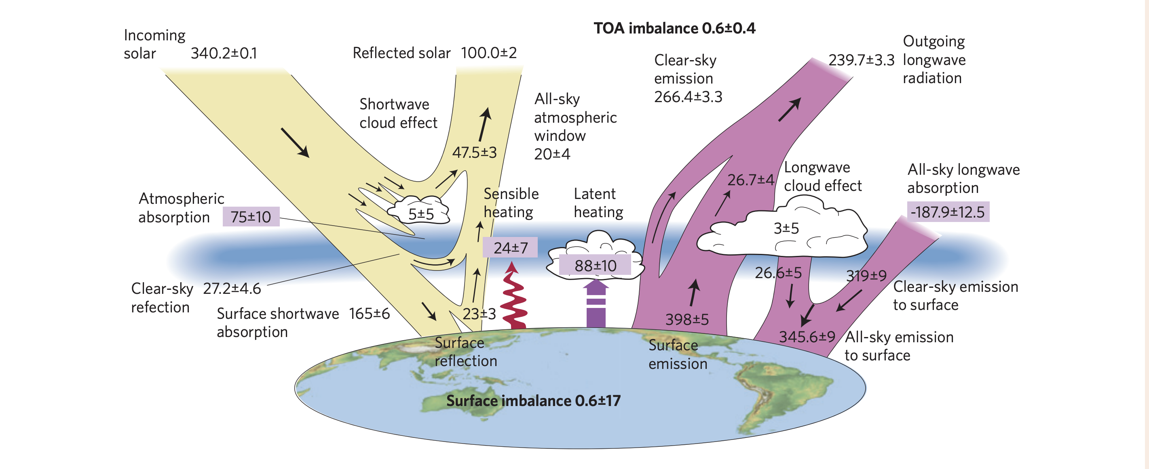
GEWEX SRB and POWER Applied Sciences
Long-term Averaged Radiation Budget Components from SRB R4-IP (1988-2009) Compared to Stephens et al. (2012)
All SRB components at/within stated uncertainty ranges
Replace with new figure (add 1 sigma values)
340.3
100.1
239.2
1.0
262.2
46.3
22.9
-187.7
76.7
8.3
8.6
315.6
163.5
22.1
398.5
31.5
347.0
SRB Fluxes in Blue W m⁻²

Slide 33
Flux Component | Rel 4 IP Shortwave | Rel 4 IP Longwave
Surface total down | 185.6 (1.23) | 347.0 (1.07)
Surface diffuse down | 102.3 (3.45)
Surface clear-sky down | 240.3 (1.10) | 315.6 (1.08)
Surface pristine-sky down | 252.4 (0.616) | 314.2 (0.903)
Surface albedo | 0.130 (0.00274)
Surface net | 163.5 (1.57) | -51.5 (1.14)
Surface cloud radiative effect | -54.7 (0.823) | 31.5 (0.826)
Surface clear-sky aerosol radiative effect | -12.1 (0.634)
Surface all-sky aerosol radiative effect |  | 1.4 (0.0561)
TOA cloud radiative effect | -46.3 (0.676) | 22.9 (0.462)
TOA total up | 100.1 (1.22) | 239.2 (0.491)
TOA clear-sky up | 53.8 (1.18) | 262.2 (0.430)
TOA pristine-sky up | 48.8 (1.11) | 263.5 (0.426)
Atmospheric absorption | 76.7 (0.599) | -187.7 (0.926)
TOA Imbalance 0.961 (1.033)

Slide 34
Level | Flux Component | Rel 4 IP Short-wave | Rel 4 IP Long-wave | Level | Flux Component | Rel 4 IP Short-wave | Rel 4 IP Long-wave
Surface | Surface total down | 185.6 | 347.0 | Top-of-Atmosphere | TOA cloud radiative effect | 46.3 | -22.9
 | Surface clear-sky down | 240.3 | 315.6 |  | TOA total up | 100.1 | 239.2
 | Surface pristine-sky down | 252.4 | 314.2 |  | TOA clear-sky up | 53.8 | 262.2
 | Surface albedo | 0.130 |  |  | TOA pristine-sky up | 48.8 | 263.5
 | Surface net | 163.5 | -51.5 |  | TOA Net | 76.7 | 239.2
 | Surface cloud radiative effect | -54.7 | 31.5 | Whole Atmosphere | Atmospheric absorption | 76.7 | -187.7

