Slide 1
Presenting Model-Based Systems Engineering Information to Non-Modelers
Human Research Program
Exploration Medical Capability Element
IEEE Aerospace Conference
January 2021
J.R. Cohen
S. Arai
T. Rakalina
E. Griffin
J. Heiser
M. Urbina
K. McGuire
D. Rubin
Seigel
A. Shah
S. Ramachandran
A. Dixit
J. Legaspi
M. Kuligowski
J. Mindock
M. Hailey
J. Bardina
“Expanding the Boundaries of Space Medicine and Technology”

Slide 2

Where This Comes From – An Systems Engineer’s View
Exploration Medical Capability (ExMC) Systems Engineering (SE) Tasked with Developing the Level of Care IV Short Duration Lunar Orbit Medical System Foundation
  This Medical System is a Precursor Specification not Tied to a Specific Mission
  ExMC SE Chose to Develop using a Model Based Systems Engineering (MBSE) Approach
  MBSE Model in MagicDraw using Object Management Group (OMG) Systems Modeling Language (SysML)
Issues:
  Not All Stakeholders Have Access to the Modeling Tool (limited licenses)
  Not All Stakeholders Have Access to the Model (Network Access)
  Not All Stakeholders Know the Language
  Stakeholders Use Information from the Model Differently than it is Built (Model Organization)
Goals
  Easy Accessibility for All Stakeholders
  Present Information in the Manner that the Stakeholders Need
    **Same information Presented Different Ways
  Continue to Examine and Improve Usability
Notes:
As background, NASA defines Levels of Care based on the independence the crew has to have.
For this project, Level of Care IV means a trip of Less than 90 days moon orbital flight (distance limits return to definitive care on the ground)

Slide 3
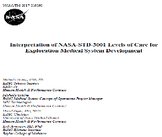
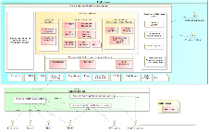
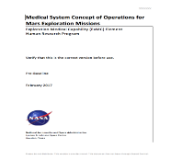
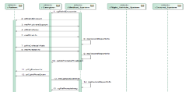
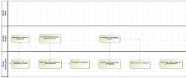
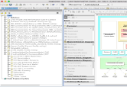
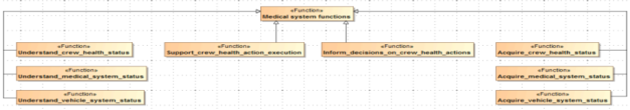
Systems Engineering Approach to Get There
Stakeholder needs, goals
NASA Standards
Program requirements & architecture
System functions & behaviors
System requirements & architecture
Using Model-Based Systems Engineering:
Subsystem requirements & architecture
Characterize system
Do we have the capabilities to meet the needs?
Do we need altered allocations?
Analyze & trade
Design & Build
Notes:
There are multiple ways that Systems Engineering process can be visualized. This is just one of them.
No matter which you use the steps are the same. For each box you see in this waterfall method there are products that are produced. In the past these products were word documents and/or spreadsheets. Our team decided to take a more visual approach to these products. The same content will be presented but how we communicate it will be less “paper” based.

Slide 4
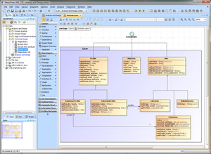

What is MBSE?
Model Based Systems Engineering (MBSE) IS Systems Engineering!
Difference:
Moves from a bunch of separate text based documents to an integrated, visual method for showing information
Notes:
First point - Model based Systems Engineering is Systems Engineering, the difference is that MBSE is more closely aligned with how Engineers and Technical People THINK. Let me give you an example, if I were to toss you a marker and ask you to describe a project you are working on, how many of you would come up to the white board and start writing paragraphs? None of you, of course not. You would draw a bunch of boxes and arrows to explain it. Because that is how we, that is, technical people think.
Second point – a document is out of date as soon as you print it.
Third point – Integrated – all artifacts in one place instead of lots of documents
Bottom line: MBSE is Systems Engineering that moves from a bunch of separate text based documents to an integrated, visual method for showing information

Slide 5
Bridging the Communication Chasm
Questions engineers ask…
What do you need to bring?
How much mass/power/volume/data?
How will you use it? How often?
Who is going to use it?
How do you make a medical decision?
What medical events are you expecting?
What skills do you need for each medical event?
Are you sure you really need all that stuff?
What happens if I take things out of your system?
Questions clinicians ask…
How do we do medicine in Exploration Missions?
What is likely to happen and how often?
What resources do we need and why?
How do we communicate to engineers?
Notes:
“Now what we have here…”
Different disciplines and individuals ask different questions and use different terms. It is the role of the systems engineering to bridge these communication chasms for everyone to have a shared vision and path forward. That we act as a unit.

Slide 6
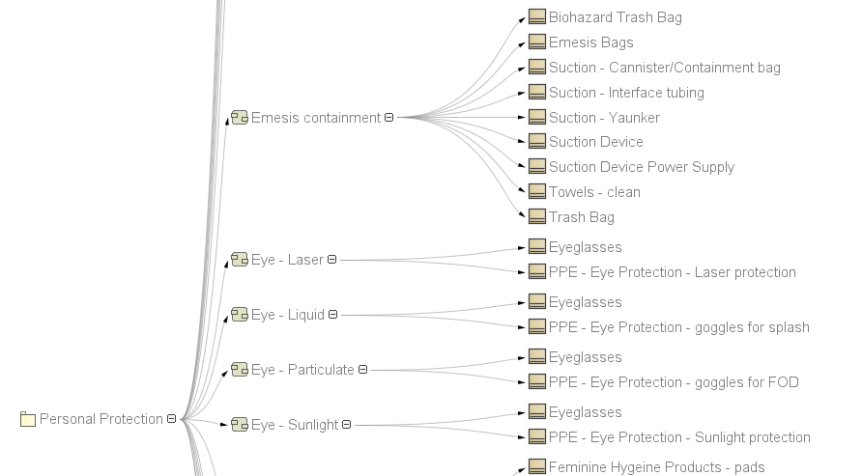
How We Involved and Designed to Users
Goal is to capture and visualize the information provided by subject matter experts (e.g., Clinicians) and other sources to meet the needs of our users.
Clinicians:
Identify the medical conditions
Map the treatment of conditions to the medical capabilities
Identify medical resources needed by those capabilities to treat the conditions
Systems Engineers:
Import information into a model
Show relation maps that visualize the traces
Derive and trace requirements
DISCLAIMER: This is a representative example
Notes:
Before I talk about the findings, let’s talk about how we involved the user community from the beginning.
We involved the CST team early in the process
ConOps – help identify the scenarios, confirm the activities
Identify Conditions/Capabilities/Resources/MEL
Review and consult on views
We involved the Systems Engineers who develop requirements
Discuss reqs at different levels
Discuss traces and how to visualize them
Also had early reviews with Space Medical Operations for how they might use it.
Involved many in ExMC and Greater CHP for review/comment

Slide 7
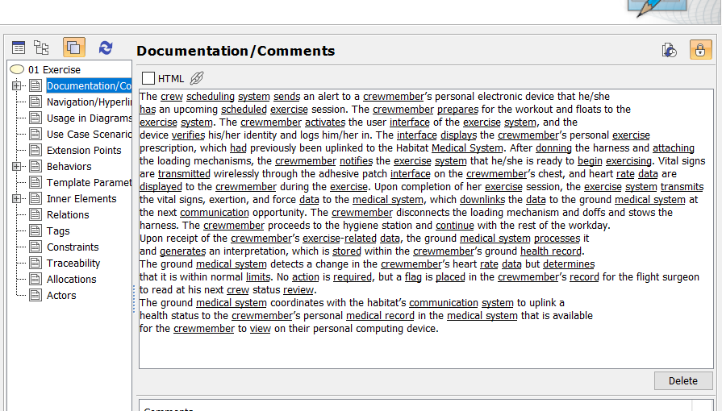
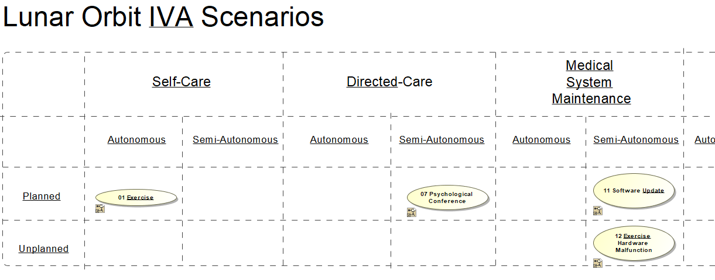
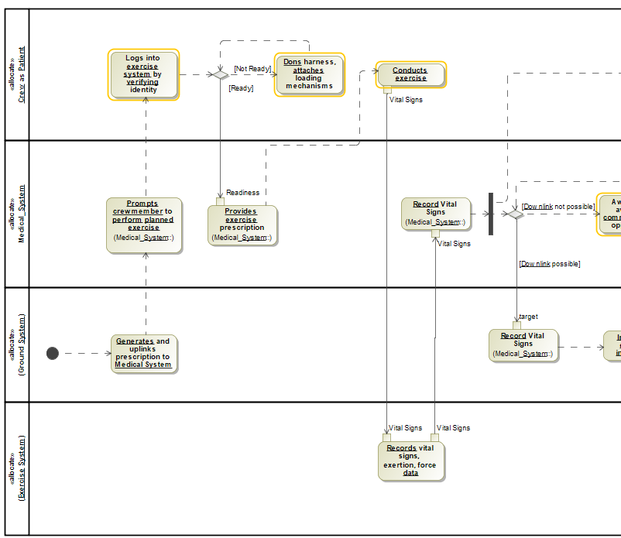
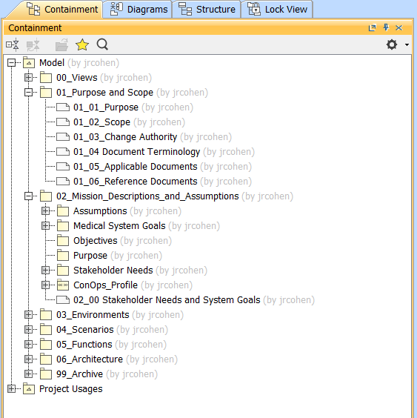
How Do You Visually Represent a ConOps?
Notes:
Let’s talk a little more about our process.
We are modeling the knowledge SMEs provide. In our case, the SMEs are Clinicians – Nurses, Physicians, Pharmacists
There are different ways to organize. This is one. As things change, the organization changes, too. We expect to reorganize, or refactor our models.
We are providing information for the ConOps. Our goal is to provide all of the information one would find in a document-centric ConOps.
We start with the System Needs, Goals, Objectives, Assumptions, and Environments for the Level of Care
We Identify key features/functions that we want the System to be able to perform. Using all of these we identify scenarios that highlight the functionality. We write short narratives that describe the scenario and refine them with Activity diagrams showing step by step what happens.
In parallel, the CST identifies medical conditions we know are statistically likely to occur and develop the list of capabilities the medical system must have to treat those conditions.
From all of these, we define the system requirements.
Something to point out -- our team takes a human-centric approach to design. We use scenarios from the perspective of the user. They portray how the user interacts/uses this systems.

Slide 8
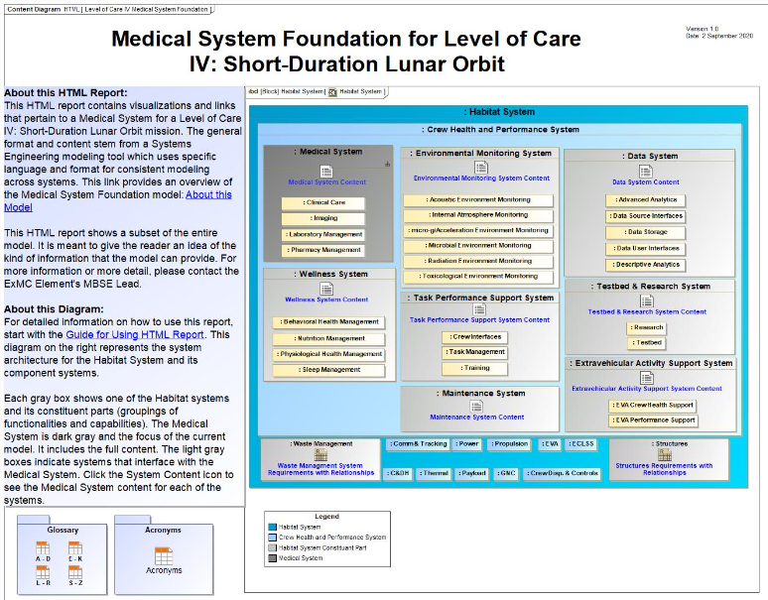
HTML Representation of the Medical System Model
This diagram shows the context of a medical system within the greater ExMC Crew Health and Performance (CHP) system.
The light gray boxes indicate systems that interface with the Medical System (dark gray).
Notes:
This is the landing page when one enters the HTML report.
It has several things on it.
About This HTML Report is guidance specifically suggested in one of our early reviews. We also created a Guide for Using HTML Report document. This document explains basic navigation and SysML to the users.
Similarly, we have a glossary and an acronyms list.
The main section is an IBD that shows the overall architecture and environment hierarchy. It will let us add the other subsystems following a similar process flow later.
But let’s transition to the Medical System Content

Slide 9
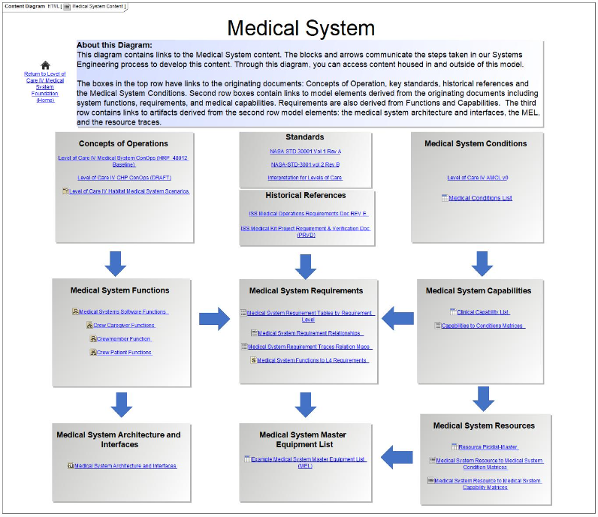
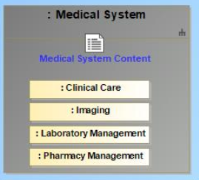
How do I Navigate to the Medical System?
Start on Landing Page
Click “Medical System Content”
Notes:
Here’s an example of the linking.
Clicking the Medical System Content icon on the landing page brings up the Medical System Content
Similarly, clicking on the other subsystem icons brings up the content for that system.
Let’s look more closely at the Medical System Content

Slide 10
The Process
This diagram shows:
Medical system content AND
Systems engineering process
High-level system vision and scope
Functions + Capabilities = Requirements
Resulting Outputs including:
Medical system architecture
Medical system master equipment list
Medical system resources
Notes:
The Medical System Content page does 2 different things
Provide the links to content
Shows the Process step relationships among the Information
IF we look at the rows, we see the content similar to what we saw in the waterfall diagram.
Rows indicate phase: source material, intermediate products, and output products.
In the middle there are the requirements; heart of the system

Slide 11
The Process
This diagram shows:
Medical system content AND
Systems engineering process
Column 1: Systems Engineers
ConOps
Functional Analysis
Scenarios
Column 2: Systems Engineering Requirements
Standards and Historical Specs
System Requirements and Traces
Master Equipment List
Column 3: Medical Clinical Content
Accepted Medical Conditions List
Medical System Capabilities
Medical System Resources
Notes:
While the rows show the phase of development or the hierarchy from source to output products, the columns collect the information by type of user or the user’s purpose in looking at the model.
Col 1: Systems Engineers concerned with the function and architecture.
Col 2: Requirements
Col 3: Clinical Content
Again, we arranged the information with user and the task of the user in mind.

Slide 12
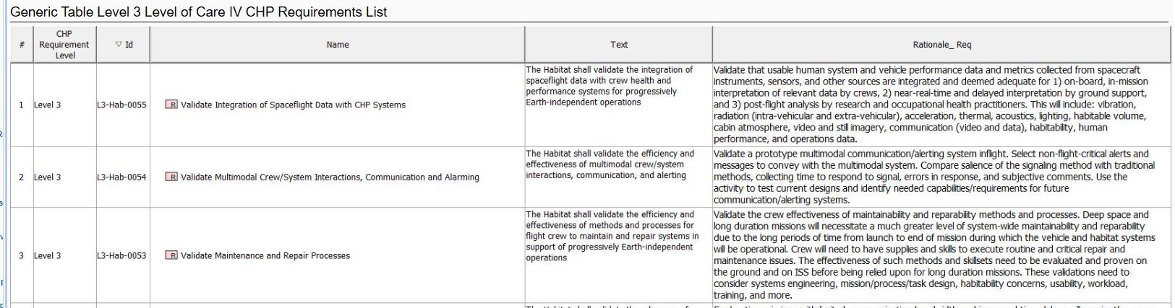
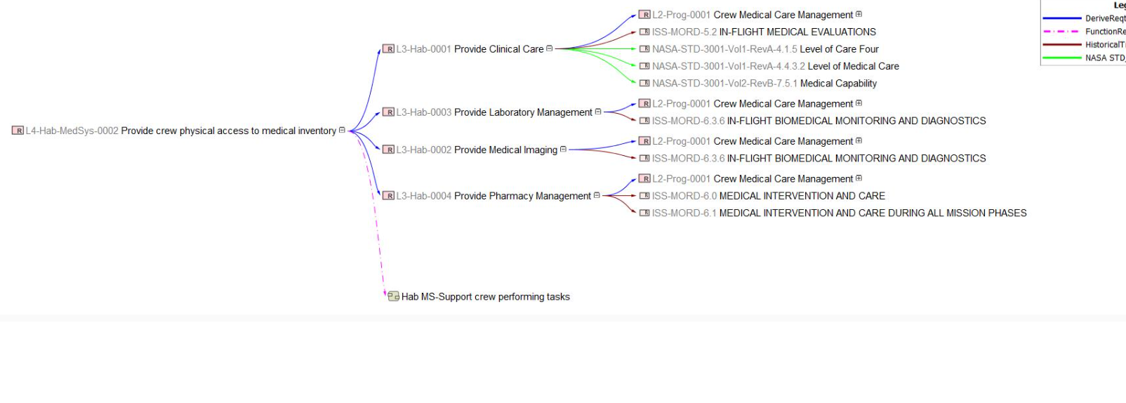
How Do You Model Requirements?
Requirement Sources and Types
NASA-STD-3001
Historical (ISS) Documents
Level 2, Level 3, Level 4, Level 5 Requirements
Tracing
Requirements to Parent Requirement
Functions to Requirement
Clinical Capabilities to Clinical Conditions
Clinical Resources to Clinical Capabilities
Take away = There isn't one way
Notes:
Since Requirements are the heart of the system, let’s focus on how we model requirements.
We have a lot of elements that look and act like requirements.
Agency Level Specification (NASA-std-3001, Historical documents)
Program Level Decisions that feed into the ConOps – Environments, Duration, how long it takes to get back to earth, and scenarios
Medical Conditions and Capabilities
The text-based shall statement requirements
There are many ways to show these requirement elements, along with many ways to show the traces. ExMC focuses on the user and how the information makes most sense to the user performing a specific job. Therefore, we offer several types of tables and graphical representations
Along the same line, we don't tie our model to ONLY one tool or language. The goal is showing the information. The understanding is the key. We chose to use MagicDraw and SysML, but there are other ways to show the information. But you should use what makes sense for your environment.

Slide 13
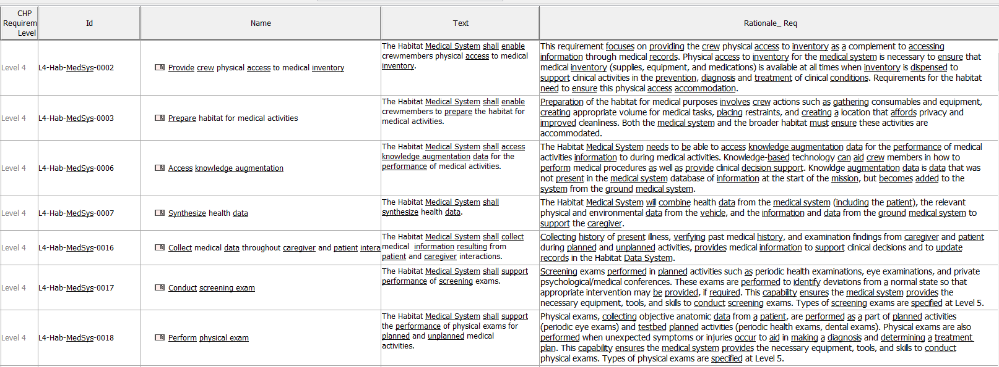
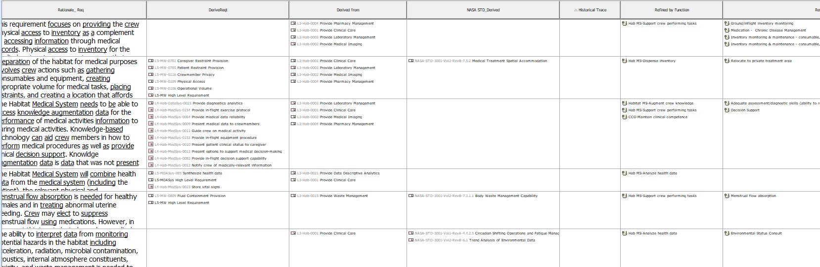
What Requirement Information Is Modeled?
Requirement id, text, rationale
Traces to specifications, requirement levels, clinical data
Notes:
We typically capture requirements in tables or a spread sheet. It is what was easiest for our team. We do not use a specific Requirements Management tool like DOORS or CRADLE, but instead use the model to capture the requirements.
We capture Level 2, 3, and 4 (also 5) requirements.
We trace requirements to specs and to different levels of requirements
In this table, and these images are from the same table, that I broke to fit on the slide, we show the requirement id, text, the rationale for the requirement, and the other requirements that the requirement traces from or to. Not shown in this view are the traces from clinical data to the requirements.
Having these traces makes it easy to see if a requirement or condition is missing. It also makes it easy to see how one requirement or term affects others. In a tool, that is relatively easy. It is much harder in a Word document.

Slide 14
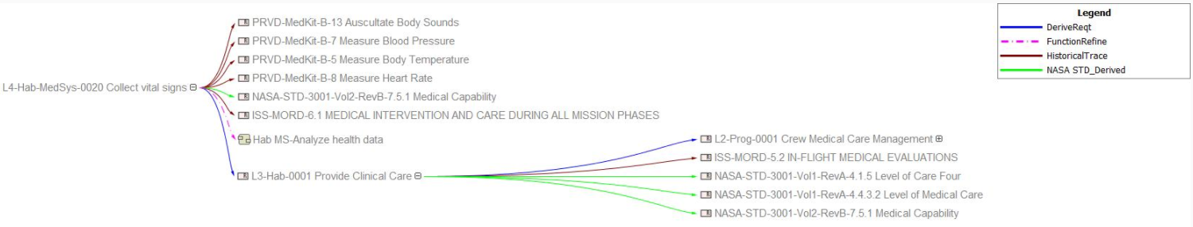
Seeing Requirements Traces Another Way
Relation Maps Show the Traces Among Requirements Graphically
Easier For Quick Checks
Context of Just the Requirements
Show Either Forward or Reverse Trace
Notes:
Sometimes and for some tasks, showing all of the requirements in one table is confusing.
Working with our Clinical and Requirements partners to understand how they wanted to see the information led us to producing Relation Maps
Emphasize – using/including this type of diagram came from discussions with the SE Requirements team. They needed an easy way to see the requirement traces

Slide 15
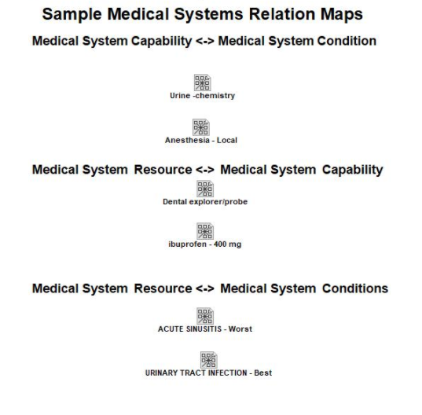
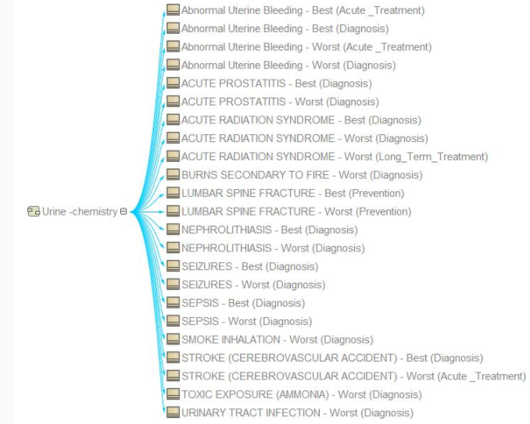
HTML Report – Medical Systems Relation Maps
Notes:
Similar to the previous Relation Map for requirements, the CST folks needed a visual representation of the traces from Medical Conditions to Medical Capabilities and vice versa (as shown in the diagram)
There are a lot of these relationship maps and we felt it was not beneficial for our audience to view all of them. Therefore, the Clinicians recommended a few examples. As you see in the box, there are many others in the model and we can produce others as needed.

Slide 16

Review Process
Review Process:
Create Special Diagrams with Links to Model Elements
Generate HTML Report and Make it Generally Available to Community
Sanity Check to Confirm Links
For Groups that Have not Reviewed Report, Give Short, Introduction to Model and Report Rules
Perform Review
Gather Comments
Disposition
Update Model
Reviews Performed by:
Internal Review by Modeling Team
ExMC Systems Engineers (ConOps, Modeling, CST, Requirements)
ExMC SE Management
Greater ExMC including people not on the project team
ExMC Executive Management and Center Leads
Road Shows to Control Boards for Human Research Program, Medical Operations Group, Space Medical Operations
Notes:
This workflow shows the steps for people reviewing the Model Content. Remember that CST and Requirements SEs have been working directly with the Modeling team, so they have been reviewing bits and pieces along the way.
In addition to the model content review, the model was reviewed for usability, we will get to that later.

Slide 17
Review Overview and Findings Summary
Accepted | 83
Accepted with Modifications | 6
Comment Withdrawn by Reviewer | 0
Do Not Accept | 13
Future Work | 45
Reject | 24
Acknowledge | 5
Total Number of Comments Received | 176
The CR comments generally fell into the following categories:
  Spelling/grammatical changes
  Addition of clarification text to the HTML and User Guide
  Suggestions to make the HTML more navigable
  Suggestions regarding content changes
  Questions regarding Magic Draw-specific symbols/text included in the HTML
  Problems with links not opening
Rejected comments:
  Duplicates
  Comments with suggestions that were not in the scope of the Foundation work
  Things not possible in MagicDraw

Slide 18
Major Changes from Review
Major changes to the HTML report are the following:
  Broke up the large capability matrix
    condition matrix into a series of matrices by capability category to help with problems loading the large matrix
  Added clarifying text where suggested in the “About This Diagram” boxes throughout the HTML report and in the User Guide
  Ensured consistency in color coding in relation maps
  Developed a process document describing the process used to develop the foundation
  Added a Home button where possible throughout the report to facilitate easy access to the landing page
  Defined acronyms
  Added the version numbers for AMCL and ConOps

Slide 19
Findings from Usability Evaluations
Recommendations
  Reduce the amount of text
  Standardize naming conventions
  Convert matrices into tables
  Alphabetize trace list
  Remove arrow cues
  Add icons based on content type
  Consider short-cut tabs specific to user types
Human Factors User Research
  User Satisfaction
  Efficiency
  Cognitive Workload
Findings
  System Usability Score improvements in:
  Ease of use
  Likeliness to use frequently
  Feeling less cumbersome
  Efficiency varied with experience
  Cognitive workload scores still outside the acceptable range on both versions
Notes:
Human-Centered Design
SUS—System Usability Scale
Observing stakeholders performing scenario tasks they would typically have to perform
Setup metrics
User satisfaction=>System Usability Scale
Efficiency=> Timing
Cognitive Workload => Bedford Scale

Slide 20
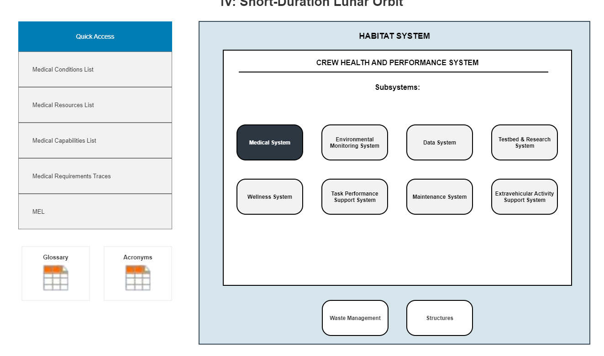
Future Looks
Notes:
Examples of things we will be trying:
Short cut menu to bypass the Medical System Content Diagram. Short cuts may include common tasks such as “View Requirements and Traces” or “View Medical Conditions/Capabilities/Resources”
New landing page. The original was based on an engineering diagram (IBD). Instead, we are considering a custom diagram with less text but links to the information for each subsystem. Again, the idea is to make the general navigation easier.

Slide 21

Lessons Learned
Sharing with non-modelers requires building views specifically for the type of user
People from different disciplines can do the modeling work
Model can be used for multiple purposes and can supply information to different projects, but dependencies must be managed (and planned for)
A Model centric approach and workflow requires training
Expect to reorganize (refactor) the model
Have an architecture that supports future uses
Need good supporting processes (CM, CCM, reviews)
Create and use a model management plan
Notes:
Sharing with Non-Modelers
Who Can Do the Work
Student Interns
Limited Time (typically 2-3 months)
Very Good at Coming Up to Speed, with Guidance
Requirements Engineers
SMEs to Capture/Write Requirements
Modeling Systems Engineers
Supporting Multiple Schedule Demands
Challenging, But Very Doable
SE/Modeler Must be on Each Project Team to Keep Focus and Provide Deliverables
Moving from Document Centric to Model Centric
Some Work is Easier on Paper First
All Systems Engineers Need Some Modeling Training
Expect to Reorganize (Refactor) the Model
Need Good Supporting Processes
Change and Configuration Management
Requirements Management
Reviews

Slide 22
BACKUP

Slide 23
Medical System Concept of Operations,
Functions, and Architecture
Notes:
Next 3 slides show examples of Systems Engineering focused model elements

Slide 24
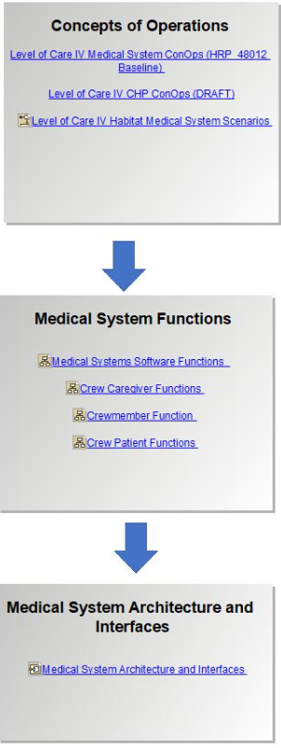
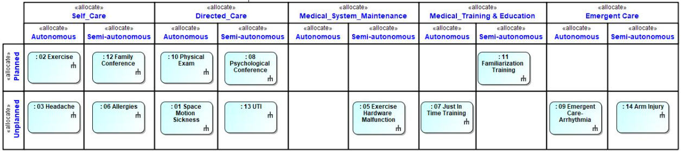
Medical System Concepts of Operations
Links to:
Recommendation for a medical system Concept of Operations (ConOps) for Gateway missions (Level of Care IV)
Crew Health and Performance system ConOps for Gateway missions (Level of Care IV)
Level of Care IV habitat medical system scenarios
.
Notes:
What this diagram shows: This diagram shows the Medical System ConOps scenarios. System Engineers use these scenarios to identify the key features of the Medical System

Slide 25
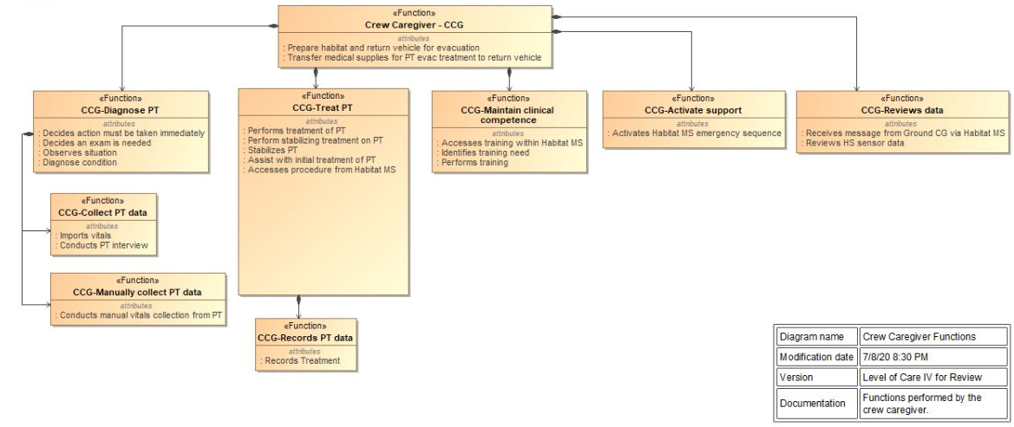
Medical System Functions
Links to:
Medical system functions
Crew caregiver functions
Crewmember functions
Crew patient functions
.
Notes:
What this diagram shows: This diagram shows the functional decomposition and the key operations that the parts perform.

Slide 26
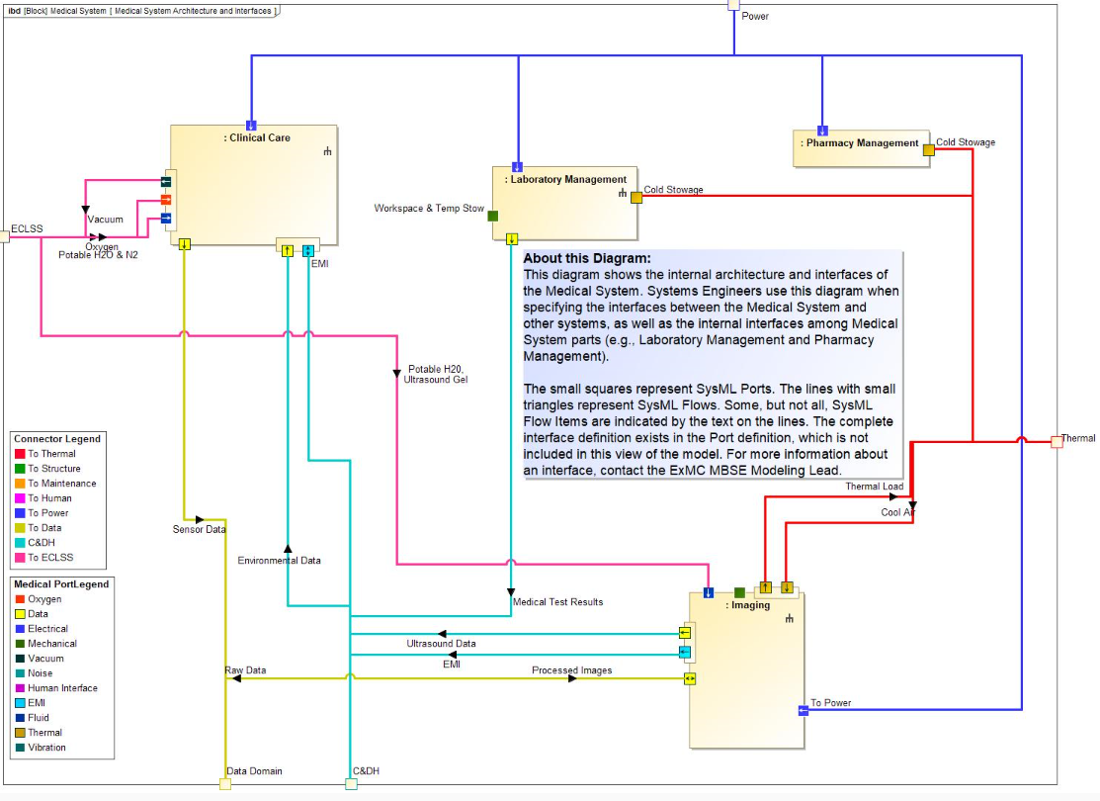
Medical System Architecture and Interfaces
Links to:
Medical system architecture and interfaces
.
Notes:
What the diagram shows: This diagram shows the internal architecture (the parts) of the Medical System and the internal interfaces among them. It is used by Systems Engineers to functionally decompose the Medical System and to define the information, power, cooling, etc. that flow among them.

Slide 27
Medical System Conditions, Capabilities, and Resources
Notes:
Next 3 slides show examples of Medical System Content focused model elements

Slide 28
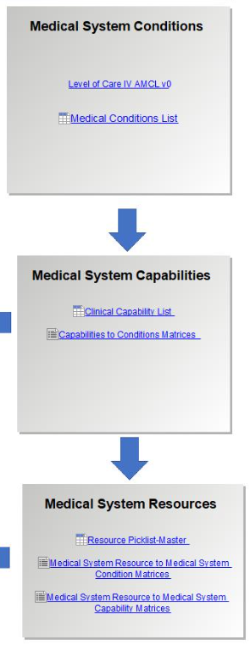
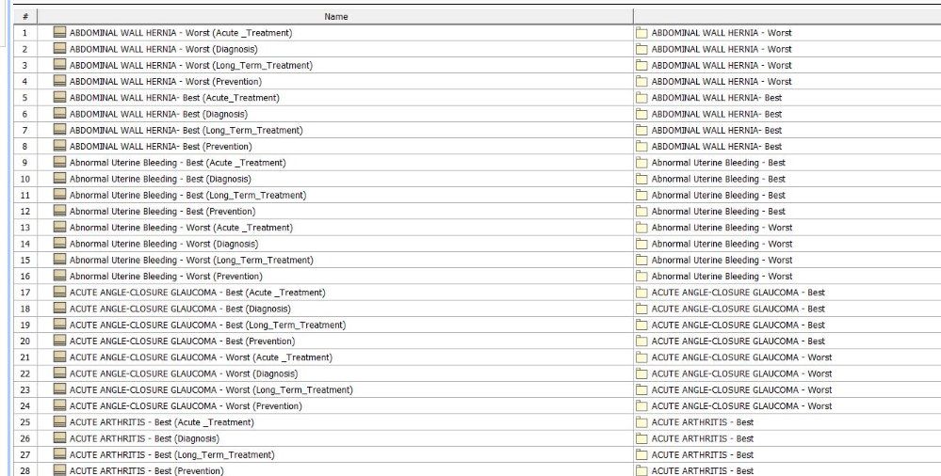
Medical Conditions
Links to:
Accepted Medical Condition List (AMCL) Methodology
List of medical conditions in the model
Notes:
What this diagram shows: This diagram links to the AMCL and the condition list in the model.

Slide 29
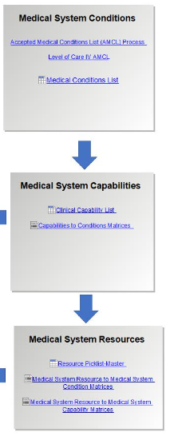
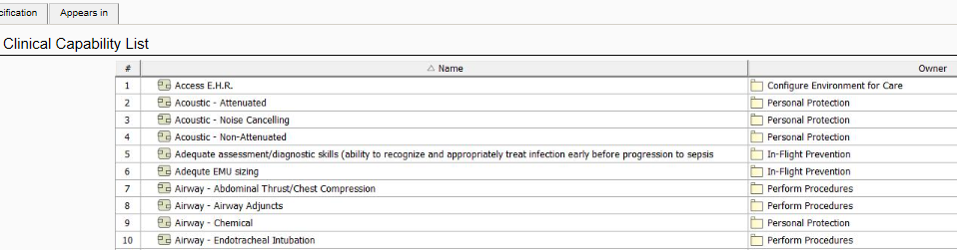
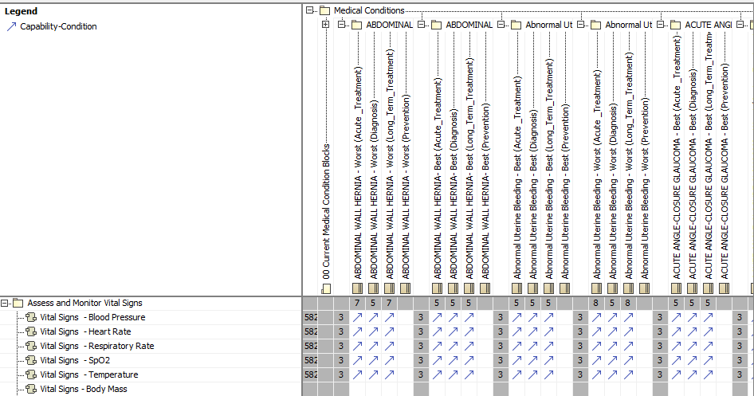
Medical Capabilities
Links to:
Clinical capabilities list
Capability to conditions matrix
Notes:
What this diagram shows: These diagrams show the list of clinical capabilities and the relationship between the capabilities and the conditions. The numbers (in gray) indicate the number of relationship in each category; the blue arrows indicate the relationship.

Slide 30
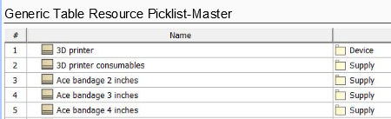
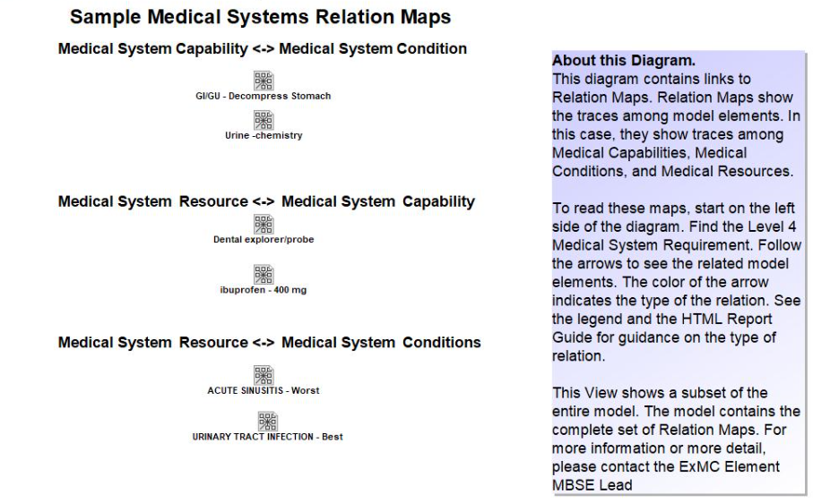
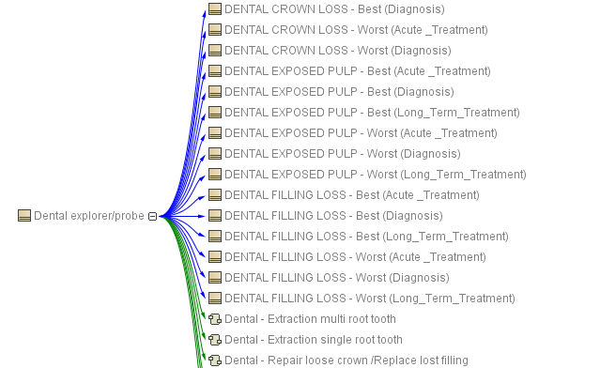
Medical System Requirements – Sample Relation Maps
Master resource picklist
Links to:
Relation maps
Notes:
What this diagram shows: This diagram shows a sample of links to relation maps. The CST use these diagrams to confirm the relationships among conditions, capabilities, and resources.
This link provides only a sample of all of the traces in the model. These traces were chosen by the CST. The decision to provide only these maps was made to keep the size of the report manageable and reduce the time required to generate the report.

Slide 31
Medical System Conditions, Capabilities, and Resources
Notes:
Next 3 slides show examples of Requirements focused model elements

Slide 32
Standards and References
Links to:
NASA-STD-3001 Vol 1 Rev A
NASA-STD-3001 Vol 2 Rev B
Interpretation of NASA-STD-3001 Levels of Care for Exploration Medical System Development
ISS Medical Operation Requirements Document Rev E
Project Requirements & Verifications Document: Plan and Report for the ISS Health Maintenance System Medical Kit Hardware – March 2011
Notes:
Key Point – links to actual documents in their place of record. In this case, SharePoint

Slide 33
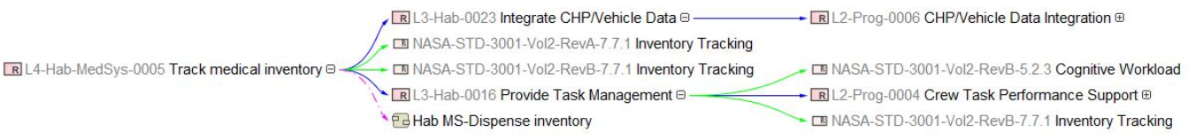
Culmination = Medical System Requirements
Concept of Operations
Medical System Functions
Standards
References
Medical System Conditions
Medical System Capabilities
Medical System Requirements
+
Links to:
Requirements tables and traces, including requirements levied on other systems
Medical system requirement relations
Medical systems functions to requirements
Notes:
This region has links to:
Tables of requirements (just requirement id, requirement text, rationale)
Tables of requirements with traces
Relation Maps for each requirement showing its traces (forward and reverse)
Traces of the Functions (key functionality we want the system to perform) to requirements

Slide 34
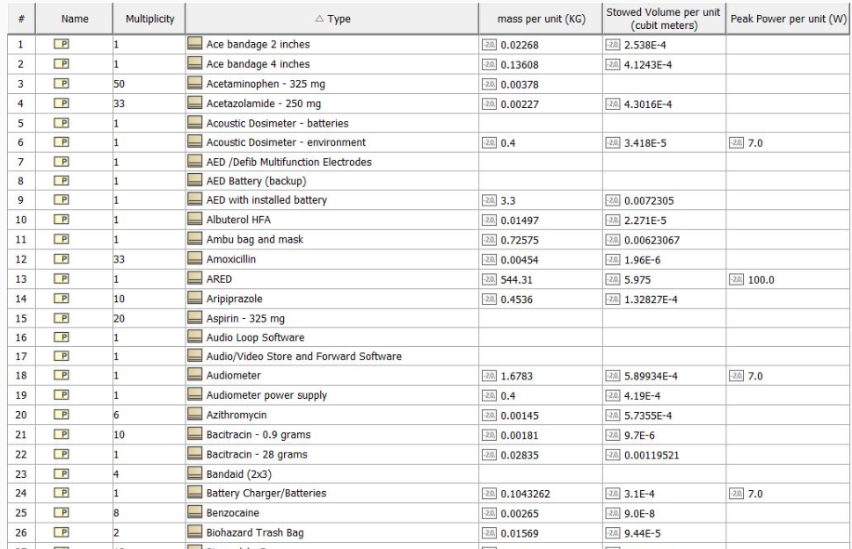
Medical System Master Equipment List
Links to:
Medical system MEL
Notes:
What this diagram shows: The resources in the MEL along with the number of each resource needed, the unit mass, unit volume, and unit peak power. The plan is to show the roll up.

Slide 35
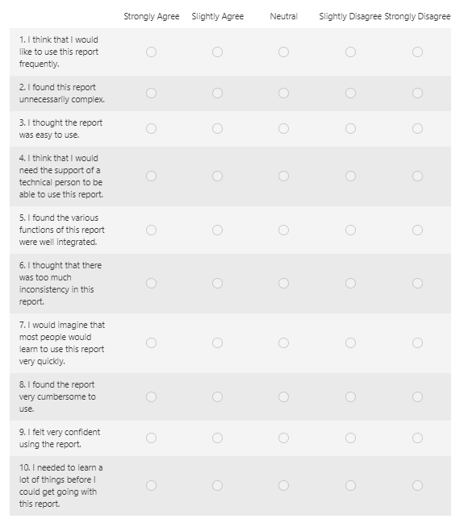
Human Factors Analysis
Usability Study
  User Satisfaction
  Efficiency
  Cognitive Workload
Evaluation Sessions
  Compare current report with wireframe prototype
  System Usability Scale (SUS)
  Bedford Score
  Semi-Structured Interviews
Notes:
In addition to the HTML report review, we had an intern complete a usability study.
The study focused on:
user satisfaction -> will they be willing to use the report for work again
efficiency -> can the user find information in an appropriate amount of time
cognitive workload -> how much of the working memory is need to complete a task.
Evaluations sessions:
The current report vs a wireframe prototype
SUS -> questions shown in photo
Bedford Score -> Task completion, tolerable workload for the task, does workload need to be reduced?
Interviews -> What they liked, what they didn’t like, task difficulty, intuitiveness of navigation

Slide 36
Wireframe Prototype
Wireframe prototype for usability study
Decreased Clutter
Quick access short-cuts
Notes:
Examples of things we will be trying:
Short cut menu to bypass the Medical System Content Diagram. Short cuts may include common tasks such as “View Requirements and Traces” or “View Medical Conditions/Capabilities/Resources”
New landing page. The original was based on an engineering diagram (IBD). Instead, we are considering a custom diagram with less text but links to the information for each subsystem. Again, the idea is to make the general navigation easier.

Slide 37
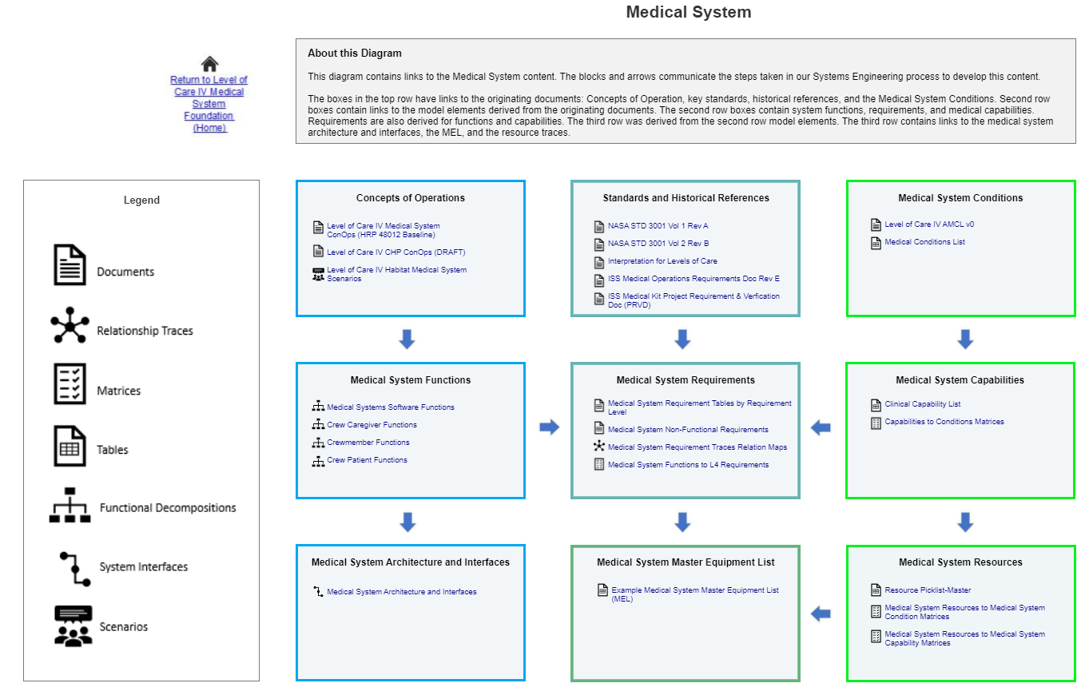
Wireframe Prototype
Color-coded boxes
Intuitive Icons

