Slide 1
Can Reflector Panel Technologies Tame Terrible Lunar Surface Lighting Environments?
JSC Innovation Charge Account Project
Toni A. Clark, P.E.
Max Martell
JSC Lighting Lab

Slide 2
ICA Project Overview
This project investigated passive (non-powered) lighting countermeasures to improve lighting conditions where the Sun’s rays are nearly horizontal with the operational surface.
NASA’s future missions are targeting the Lunar South Pole where “day” lasts for 2 weeks and the Sun is always on the horizon.
The Sun’s collimated light creates harsh working conditions where the light is glaring when facing the sun, and deep long shadows are formed when turned away from the sun.
The goal of this research was to determine if standard Commercial Off The Shelf (COTS) technologies, used by photographers, could increase the usability of an EVA crew member’s immediate surrounding work environment.

Slide 3
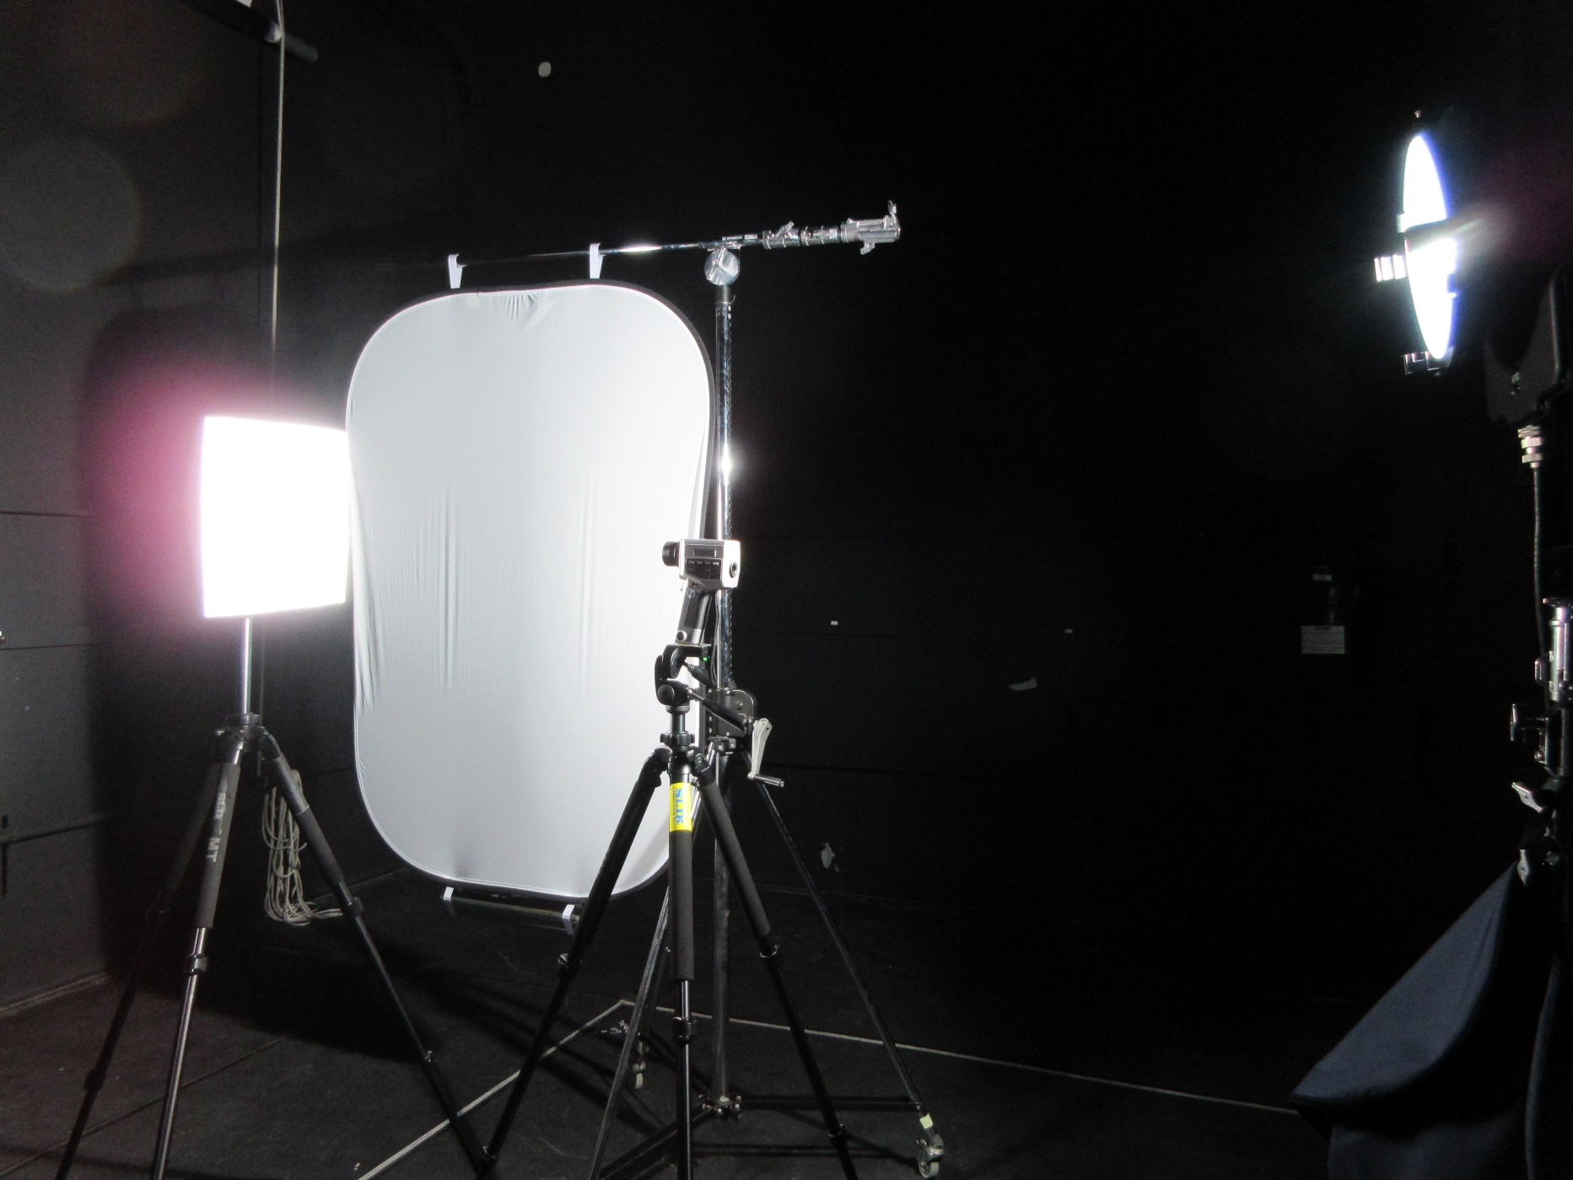
Innovation
Reflector panel technologies, typically used by photographers, are designed to redirect and modify light coming from a much higher intensity light source. The modified light is used to enhance the lighting for the object they are imaging.
Using the orbital light source simulators at the JSC Lighting lab, and physics based optical computer models, this project investigated how different surface reflectance properties, of commercially available reflectance panels, modify worksite lighting conditions.

Slide 4
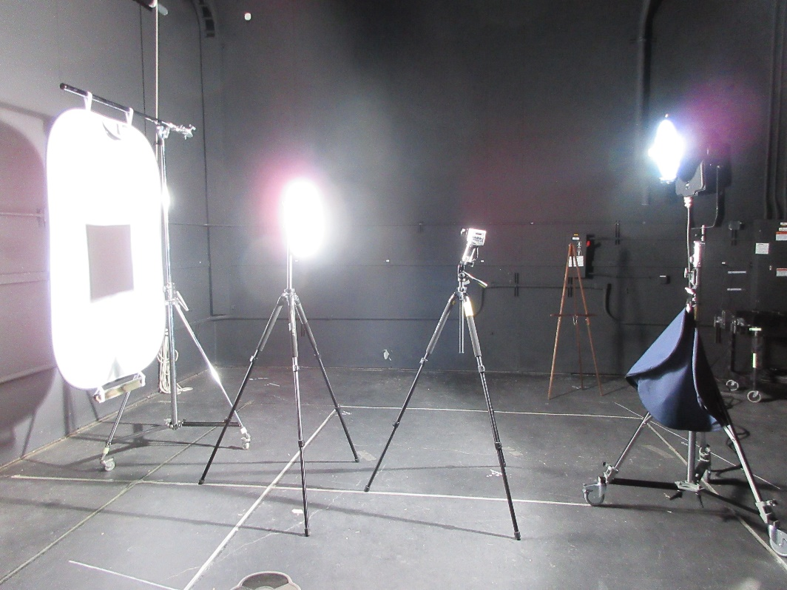
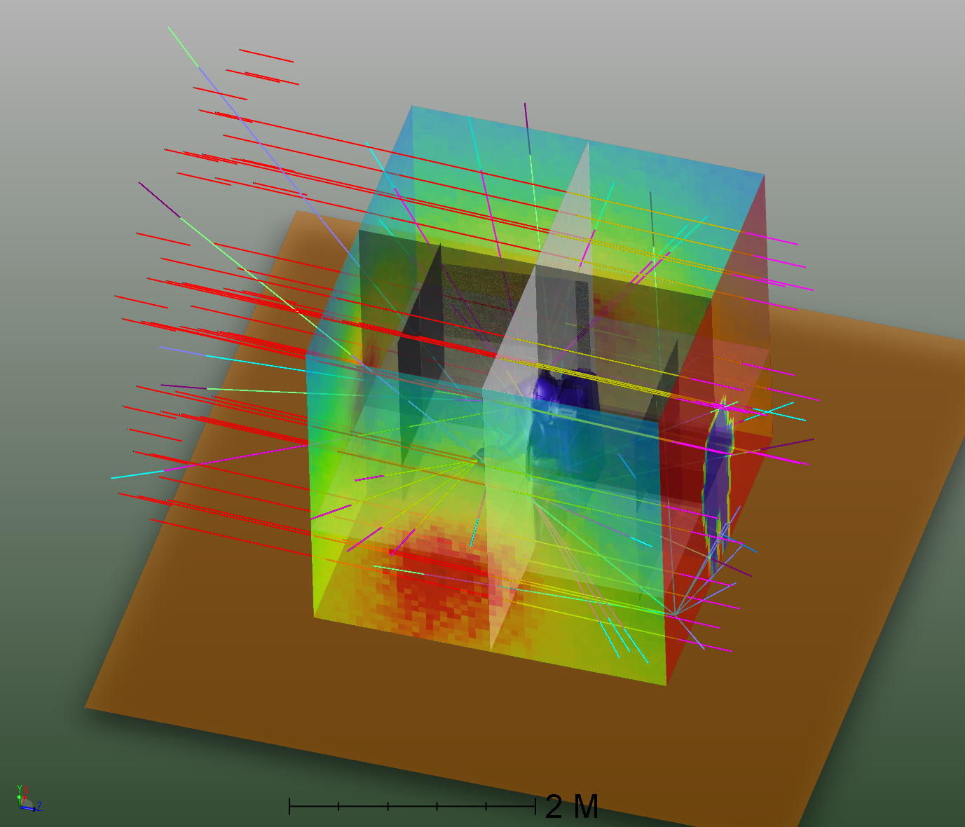
Methods
Computer Model
Computer model generated in Zemax Optics Studio
Modeled impacts from modification of light using diffusers and reflectors
Sun’s light modeled at 5⁰ inclination angle
Software models intensity distribution
Laboratory Test
4’x6’ reflector and diffuser panels
1000W Plasma stage light with 10⁰ beam angle spot and inclined at 5⁰
Illuminance and luminance measured at different angles with respect to the floor to document lighting modification impacts

Slide 5
Computer Model Configuration
Lunar surface modeled with Lambertian scatter
Two different “modifiers”. Translucent diffuser & semi-specular mirror
Sun modeled as collimated light with 130,000 lux on target
Crewmember modeled as an opaque cylinder
Model iterations:
  Sunlight with no modifiers
  Reflector positioned behind crewmember
  Diffuser added in front of the crew member
  Side scatter added by reflector positioned to side of crew member.

Slide 6
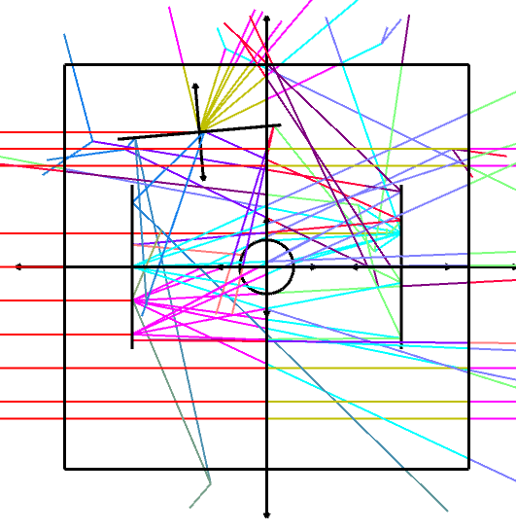
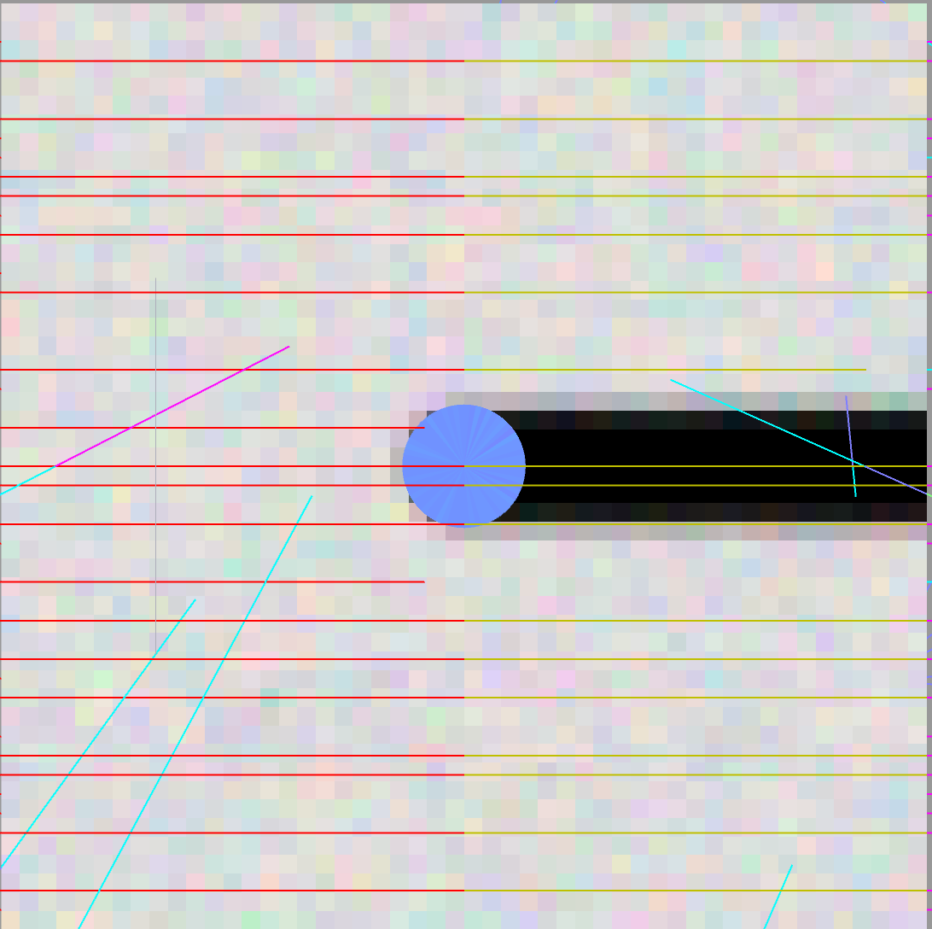
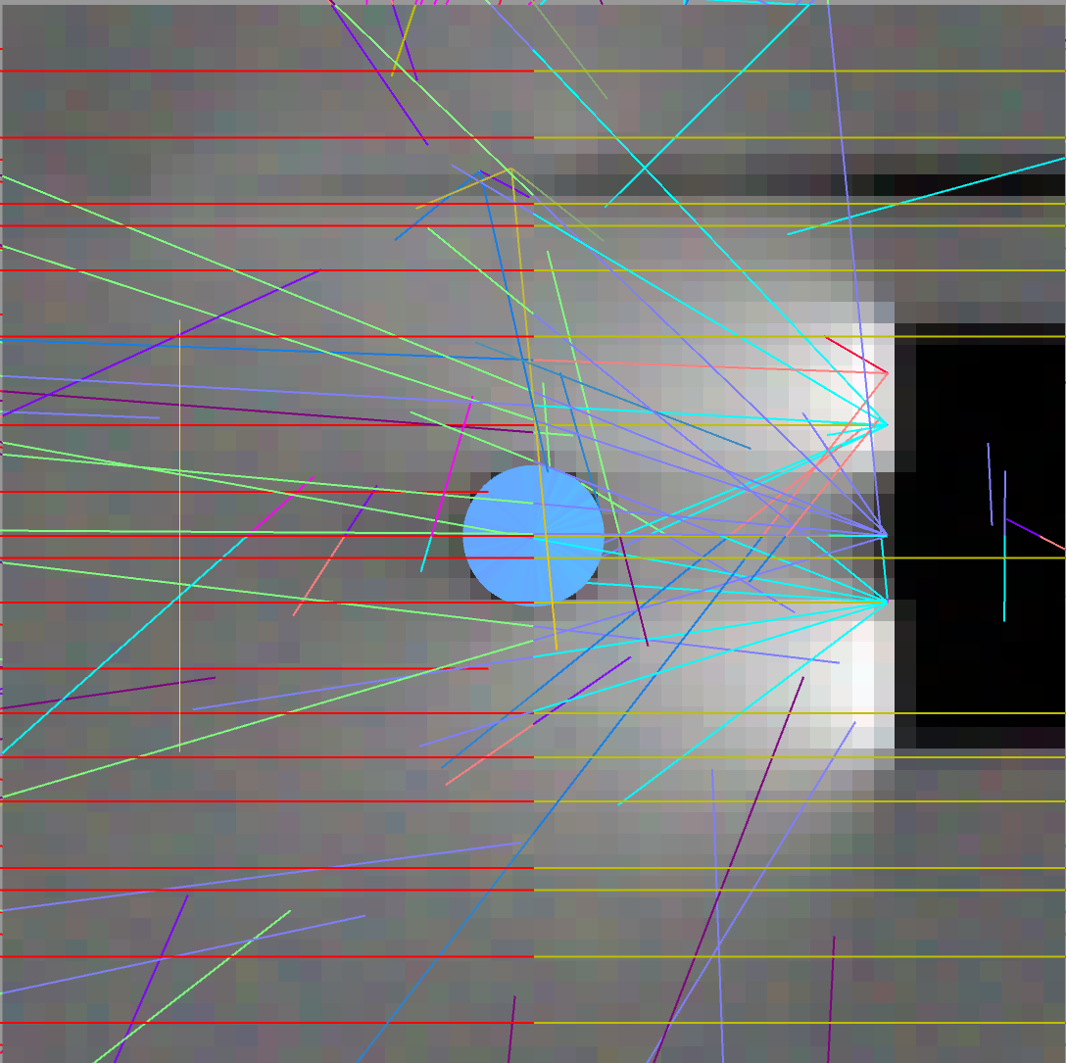
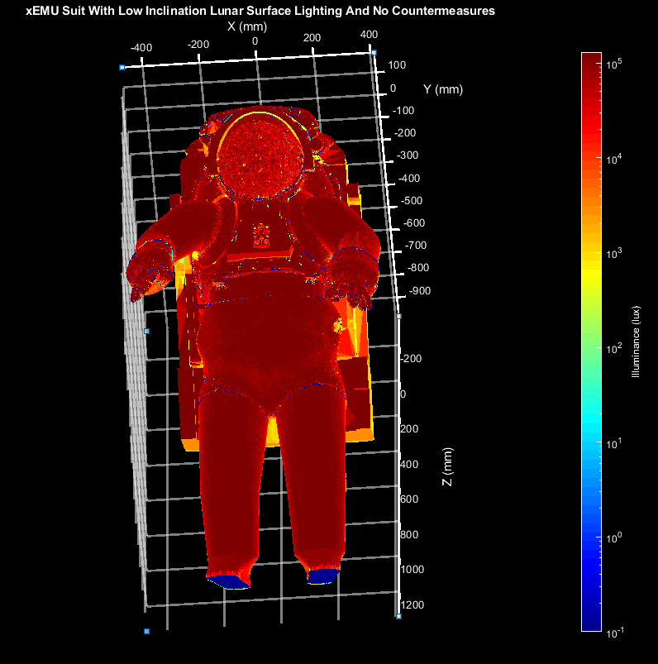
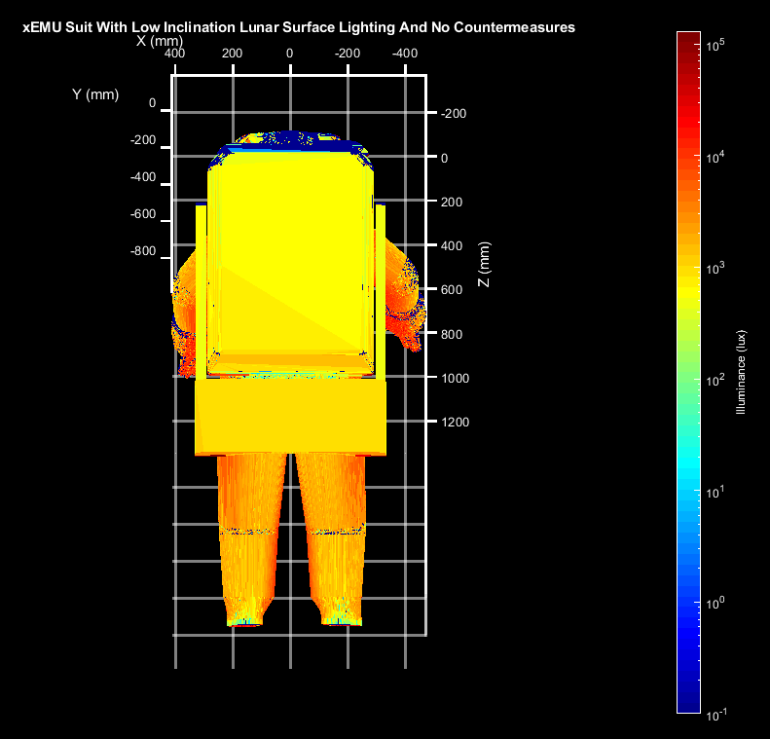
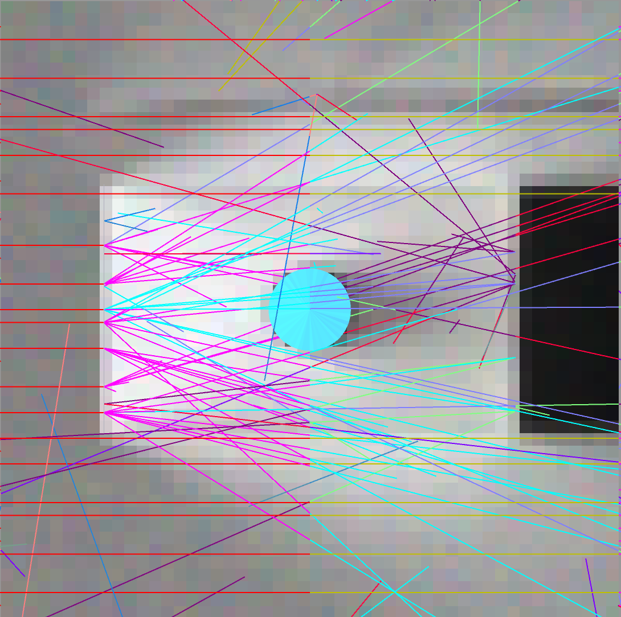
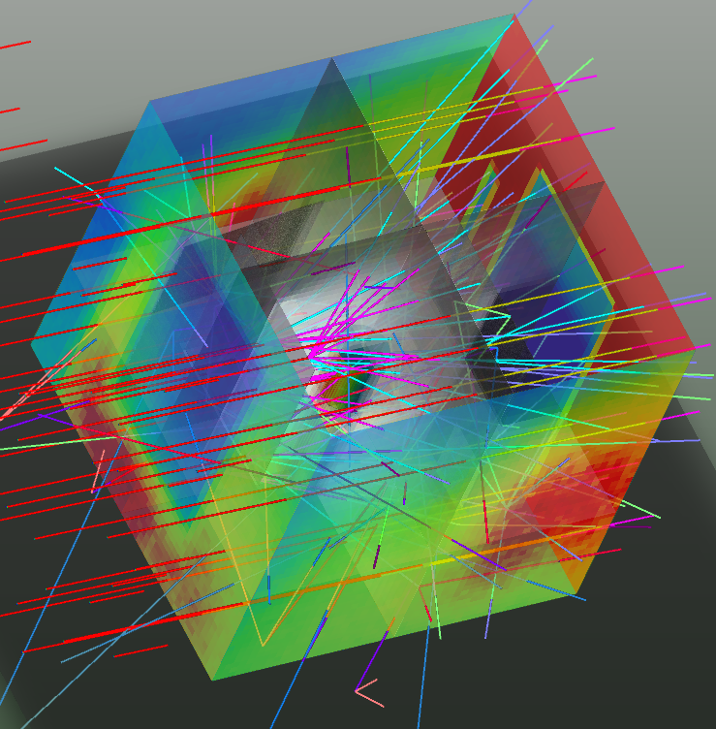
Computer Model Results
Without modification, shadowing is intense.
Reflector bounces light back into shadow.
Addition of diffuser provides diffuse light in front of crew.
Computer shows beneficial scattering from Lunar surface
Layout of Optical System
No Countermeasures
One Reflector Opposite of Sun & One to side
Reflector
Crew
Diffuser
Reflector
SUN
SUN
SUN
Zemax lighting simulation of direct sunlight on xEMU suit at 130,000 lux, where suit is standing on a dark Lambertian scatter type surface and lighting modifiers in use. 130K lux is on front of suit and 1k lux on back. However human vision adjusts to two orders of magnitude. Technically, the back side of the suit would appear dark.
Diffuser Added Between Crew & Sun
3D Light Field Showing Effects from Reflectors & Diffuser
SUN
SUN

Slide 7
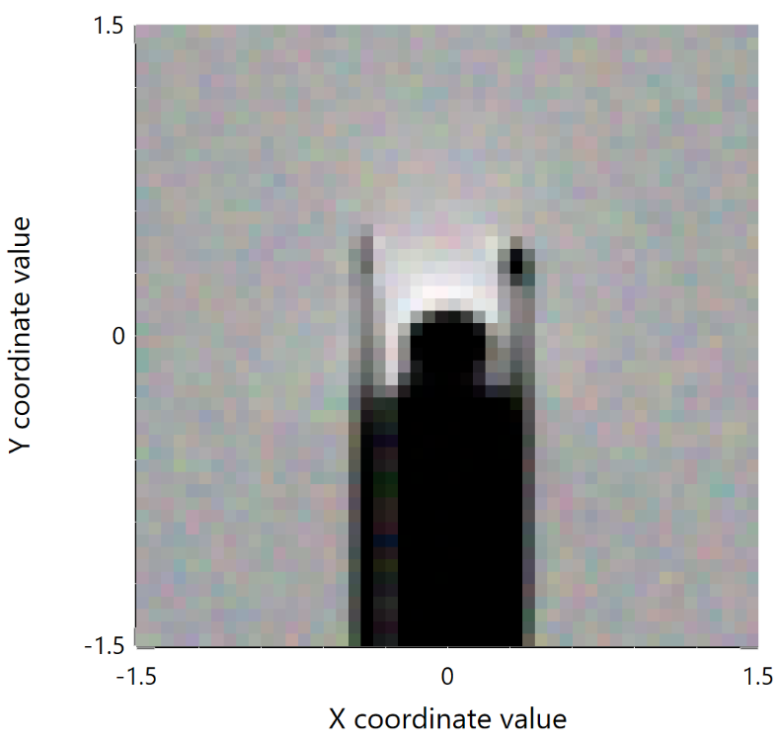
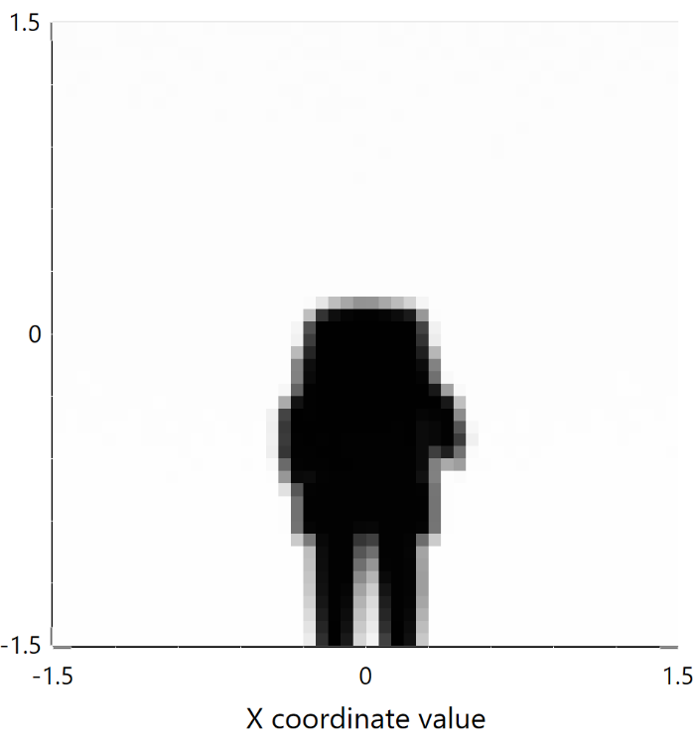
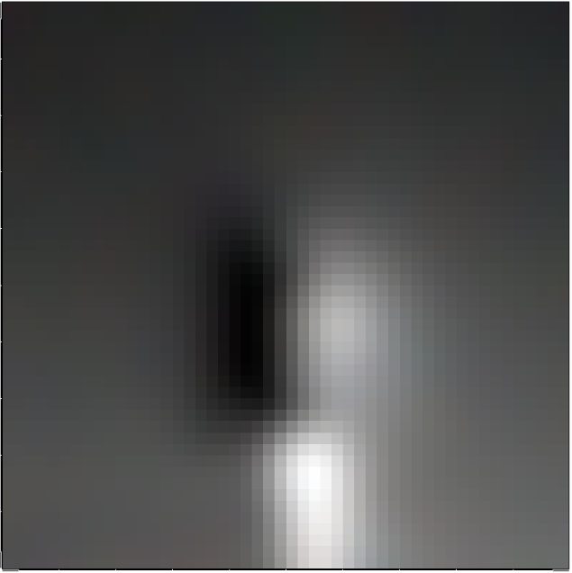
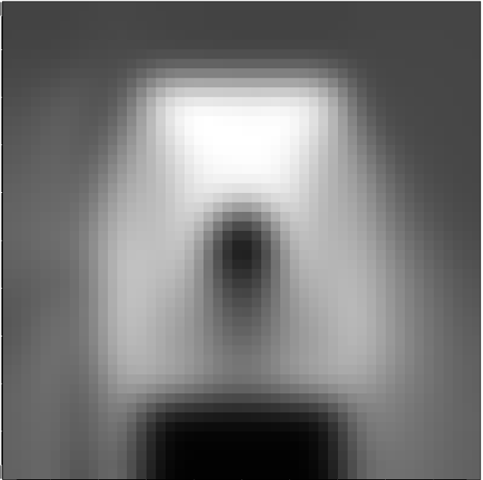

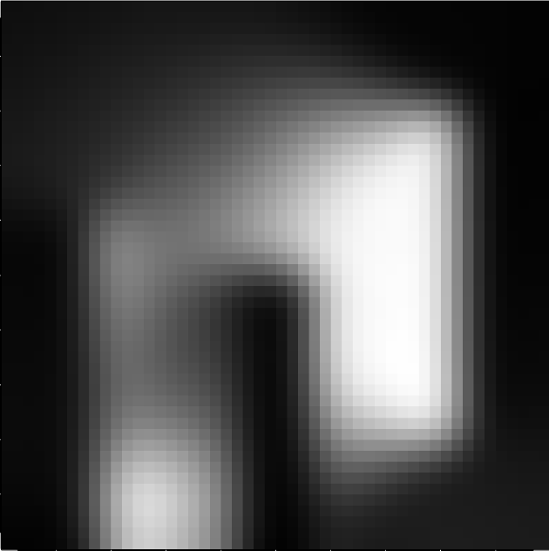
The horizontal and vertical detector data demonstrates how the simple placement of a diffuser in between the sun and the crew member, and addition of a reflector behind them, evens out light distribution.
Horizontal work plane 1M from ground
Vertical Surface 1.5M from Suit Facing Away from Sun
Measurement Vector Normal Towards Crew Right Side & Right Angle from Sun Vector
Lighting in front of crew is harsh
Shadow is unending
Shadow is sharp and not diffused
Bright spots are created by reflected light!
Horizontal work plane 1M from ground
Vertical Surface 1.5M from Suit Facing Away from Sun
Measurement Vector Normal Towards Crew Right Side & Right Angle from Sun Vector
Usable horizontal surfaces surround crew
Shadow is diffused
This shows illumination contributed from the diffuser and the reflectors!

Slide 8
Laboratory Test Configuration
Pop up reflector/diffuser panels which are strategically placed:
  Fabric diffuser between light sensor and orbital light emulator
  Metalized fabric reflector behind light sensor and orbital light emulator
  Metalized fabric reflector at 45⁰ angle with respect to the light source and light sensor
Illuminance/spectral irradiance sensor at different orientations:
  Forward facing “Sun” to represent light levels on objects in front of the crew when they are facing away from the sun
  Reverse from facing “Sun” to represent light levels on objects in front of the crew when they are facing the sun
Luminance meter to document surface brightness/luminosity of white surface object illuminated by “Sun”
1000-Watt Plasma Stage lamp with 10⁰ beam angle illuminating the test rig
Test conductor collecting measurements, represents crew and blocks some of the light

Slide 9
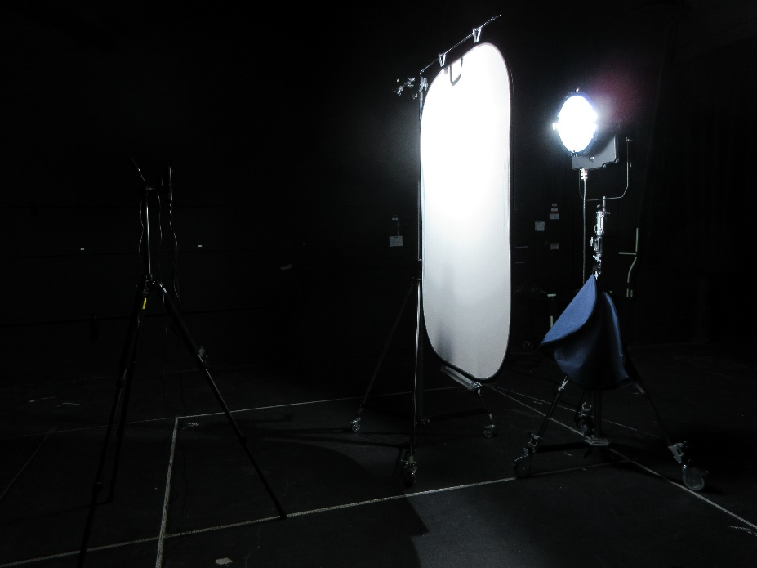
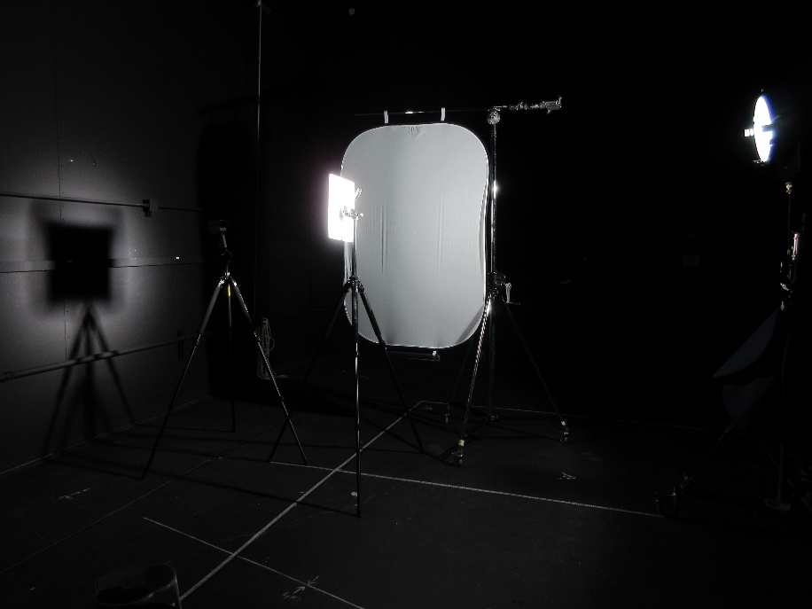
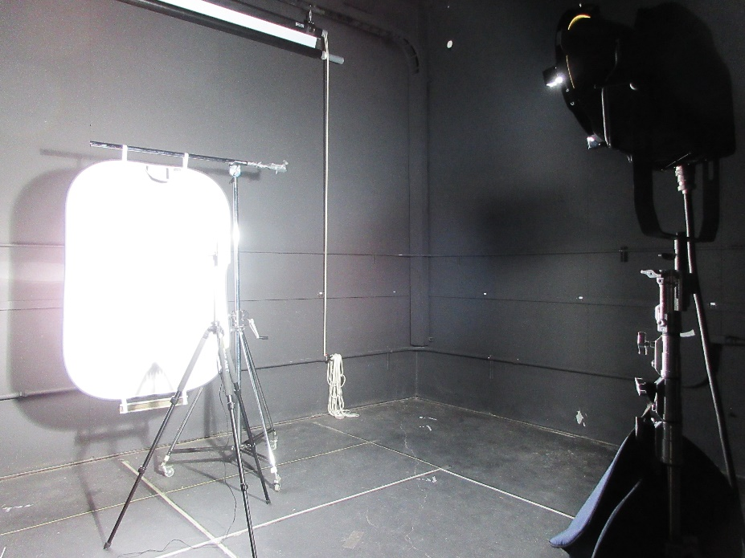
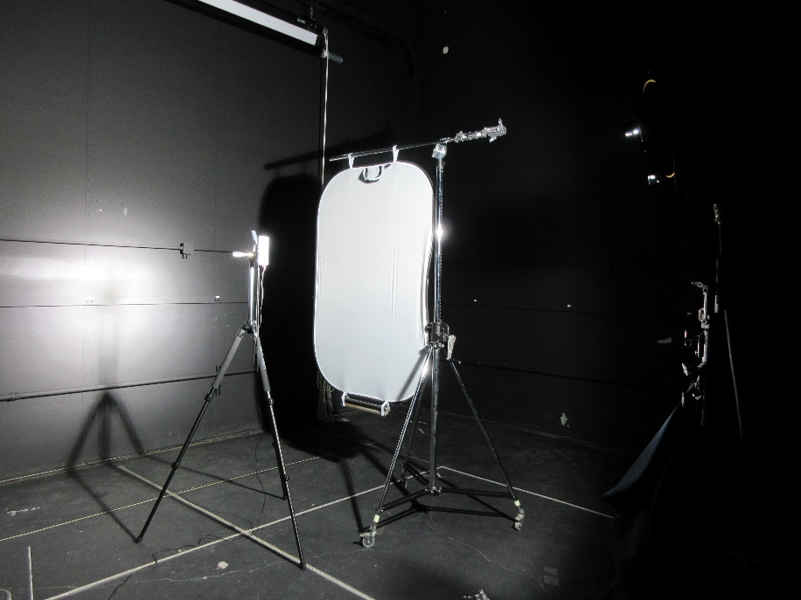
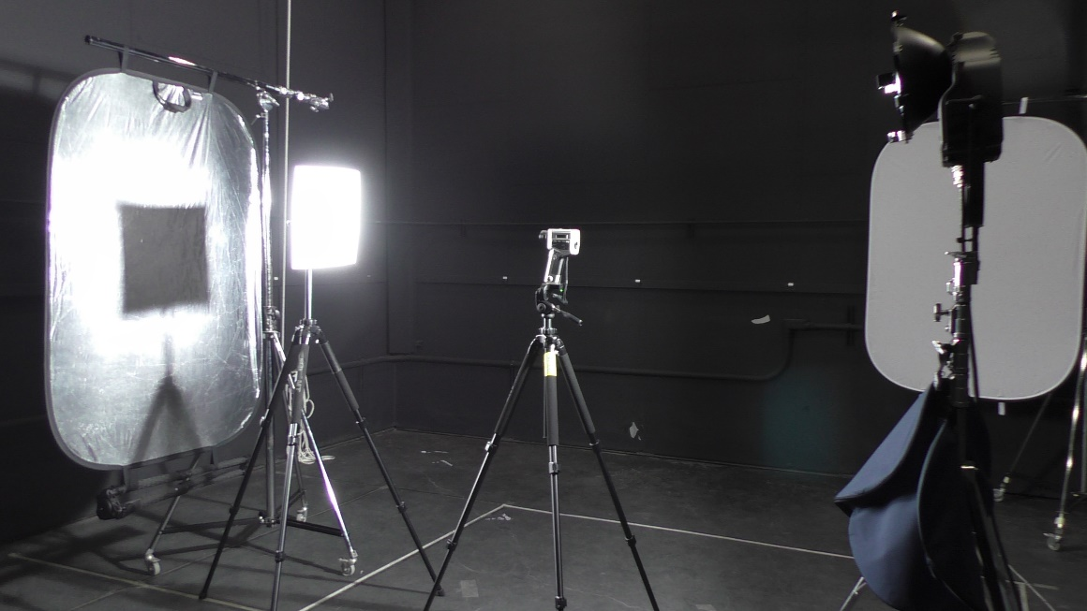
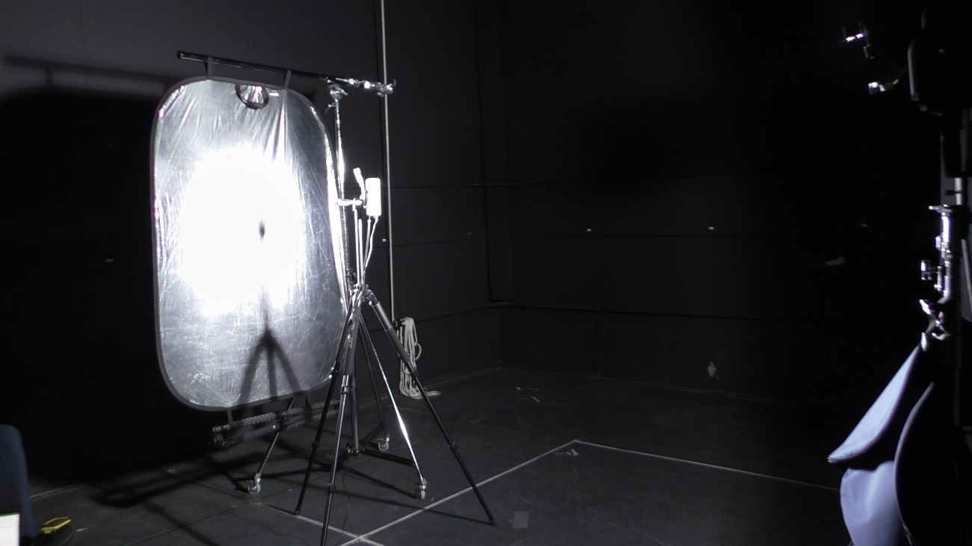

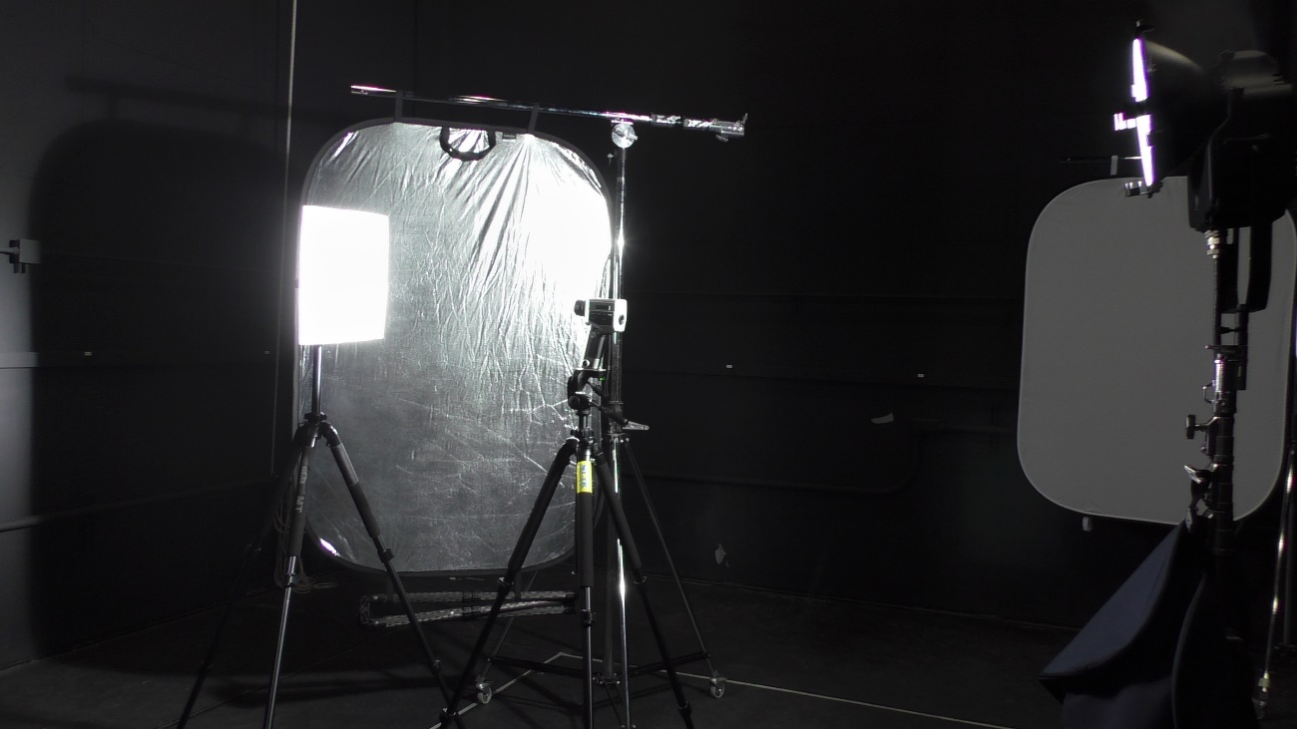
Lighting Lab Testing
Diffuser Illuminance Test
Images document variety of test configurations
Reflector Luminance Test
Reflector Illuminance Test
Reflector Illuminance Test
Reflector Luminance Test
Reflector Illuminance Test
Reflector Luminance Test
Reflector Luminance Test

Slide 10
Lighting Test Terminology
When testing for different lighting performance metrics, it is important to understand the type of data being collected and how that impacts the required geometry for the test.
Illuminance: This is the measurement of light flux impacting a surface over an area. Units are “lux” or “lumens/m²”. Illuminance is used to determine if sufficient light is impacting a surface for a human or camera to see it and resolve differences in contrast across different material surface types. An illuminance sensor is placed on and in the direction of the surface normal vector (away).
Luminance: This is the measurement of light flux emitted or reflected by surface object over an area. Units are “candela/m²”. Luminance is typically used to determine visual contrast for acuity and issues with glare and potential eye hazards. A luminance measurement is directed towards the luminous or light reflecting object.
ILLUMINANCE
Light
Measure
LUMINANCE
Light
Measure

Slide 11
Lighting Lab Test Results
“None” represents default state with no countermeasures.
Luminance values above 10,000 cd/m² are highlighted red as a safety risk.
1
2
1
2
1
2
Forward ←
→ Behind
3
3
3
Panel | Illuminance | Luminance
None | Facing Up: 7350 lux | Top: 2411 cd/m²
1. Diffuser before sensor | Facing Up: 184 lux | Top: 72 cd/m²
2. Reflector behind sensor | Facing Up: 12,300 lux | Top: 2178 cd/m²
3. Reflector @ 45⁰ | Facing Up: 11,800 lux | Top: 2688 cd/m²
Panel | Illuminance | Luminance
None | Forward: 76,900 lux Behind: 66 lux | Forward: 27,210 cd/m² Behind: 12 cd/m²
1. Diffuser before sensor | Forward: 1930 lux Behind: 12 lux | Forward: 895 cd/m² Behind: 6 cd/m²
2. Reflector behind sensor | Forward: 89,000 lux Behind: 13,500 lux | Forward: 26,090 cd/m² Behind: 614 cd/m²
3. Reflector @ 45⁰ | Forward: 89,000 lux Behind: 76 lux | Forward: 26,010 cd/m² Behind: 43 cd/m²
Panel | Illuminance | Luminance
None | Side: 6511 lux | Side: 96 cd/m²
1. Diffuser before sensor | Side: 64 lux | Side: 21 cd/m²
2. Reflector behind sensor | Side: 2990 lux | Side: 131 cd/m²
3. Reflector @ 45⁰ | Side: 1160 lux | Side: 332 cd/m²

Slide 12
Conclusions
The quality of the work lighting conditions are significantly improved through the usage of reflectors and diffusors as compared to conditions without passive countermeasures.
A pop-up diffuser placed in-between the “Sun” and the crew member scatters light, increasing the number of usable view angles to perform work by evening out illuminance levels and by reducing direct and reflected glare.
A reflector placed behind or at an angle to the crew reduces shadowing by reflecting light back onto the work surfaces that were originally shadowed.
The best solution would be to use a combination of diffusing material between the “Sun” and the crew member while placing a reflector directly behind or at an angle behind the crew member.
  The diffusor serves the purpose of removing direct glare from the sun while scattering light for observing objects directly in front of the crew while the crew is facing the sun.
  The diffuser makes usage of a reflector behind the crew tolerable by removing the image of the Sun from the reflector.
  The reflector reduces shadows created by intense directional sunlight.

Slide 13
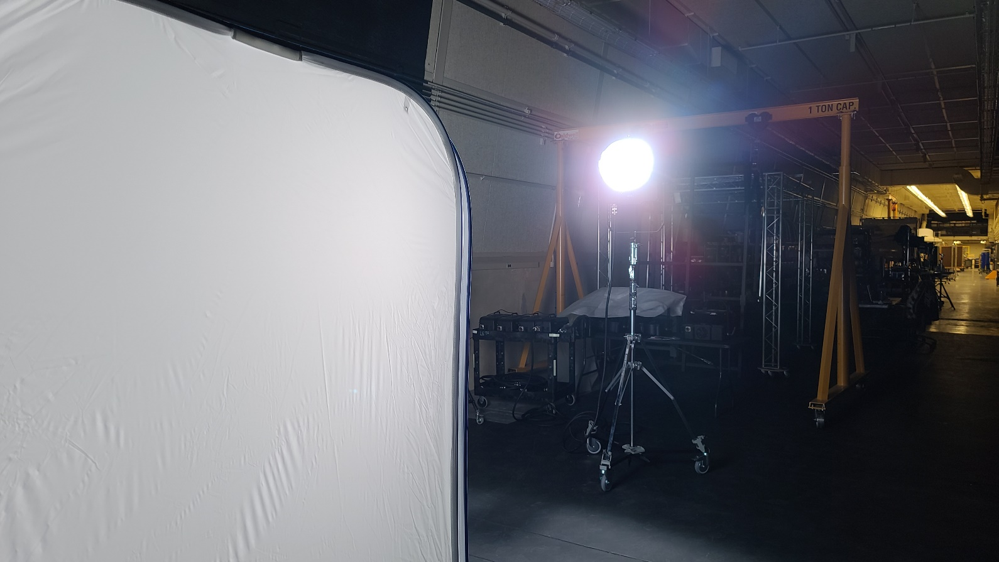
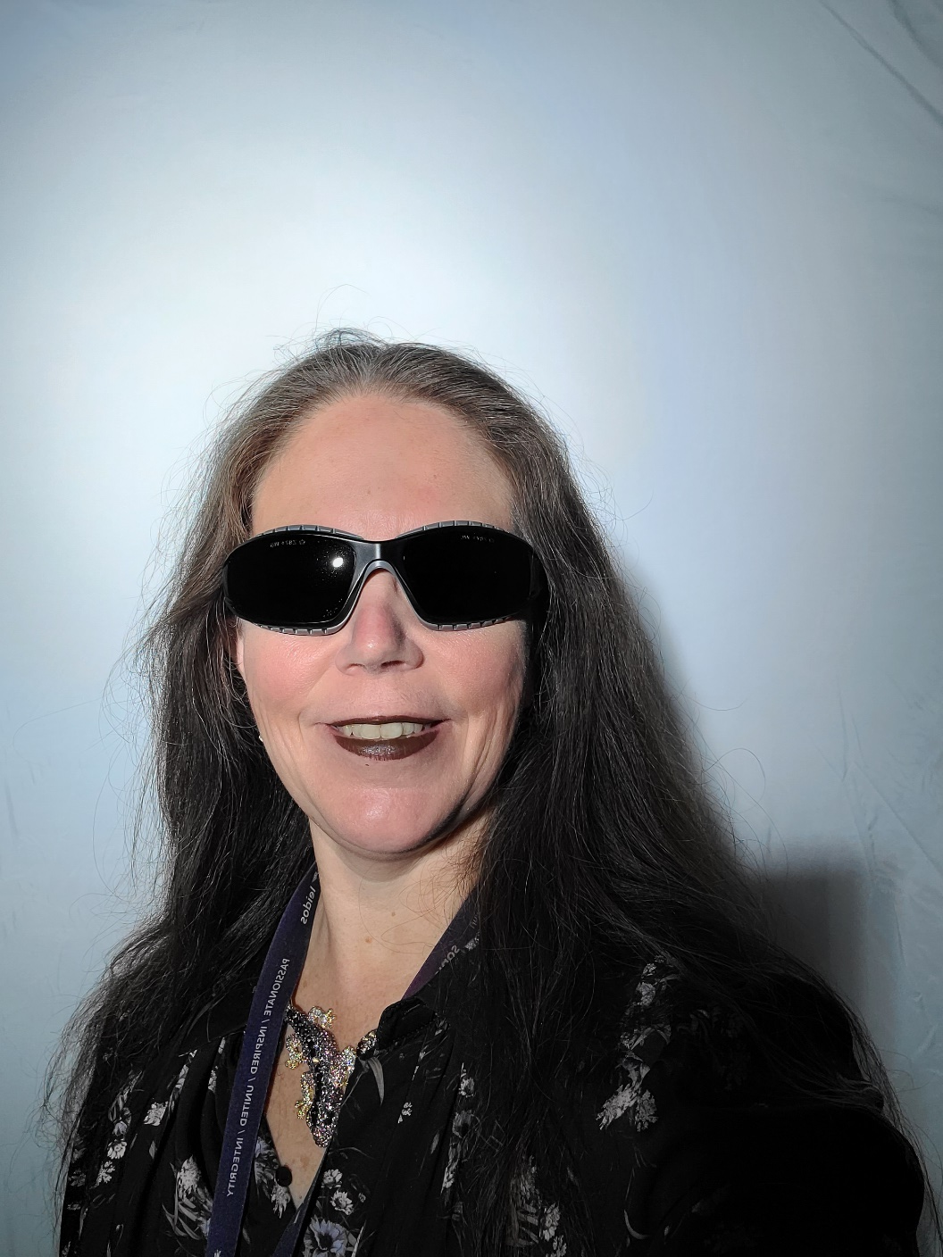
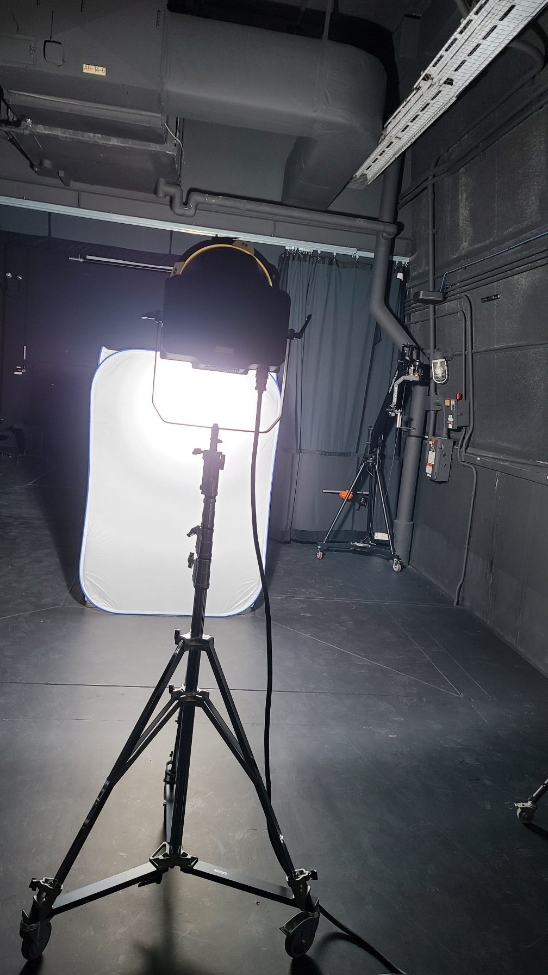
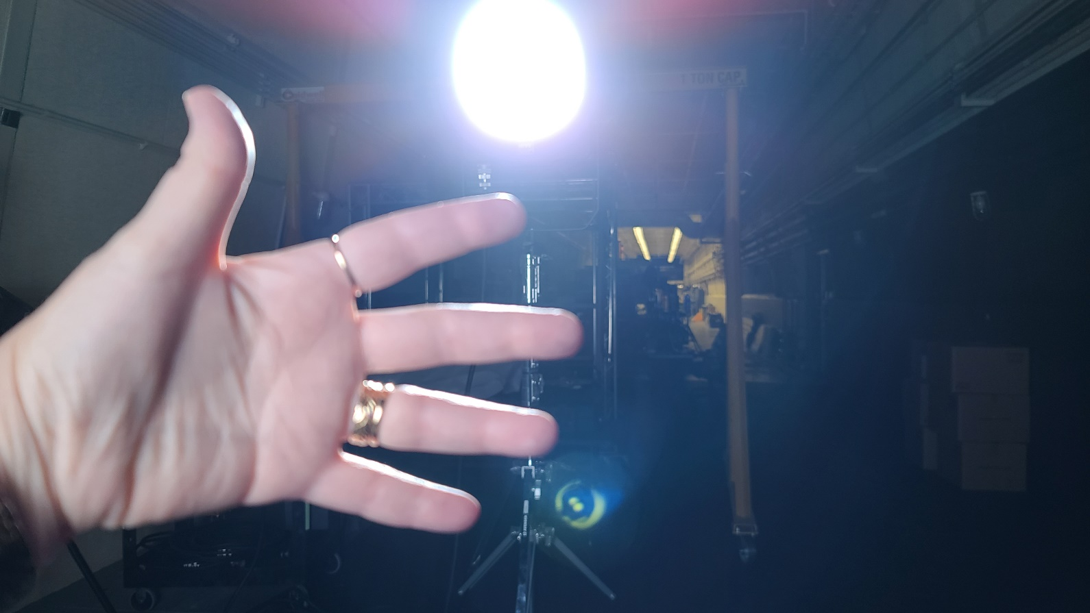
Example of Pop-up Translucent Enclosure
Test and simulation data shows the usage of simple panels are very useful for controlling light.
These images demonstrate a pop-up translucent enclosure and harsh lighting conditions outside of it.
Note the shadowing, contrast issues, and problems if required to work a task directly facing a bright light source.

Slide 14
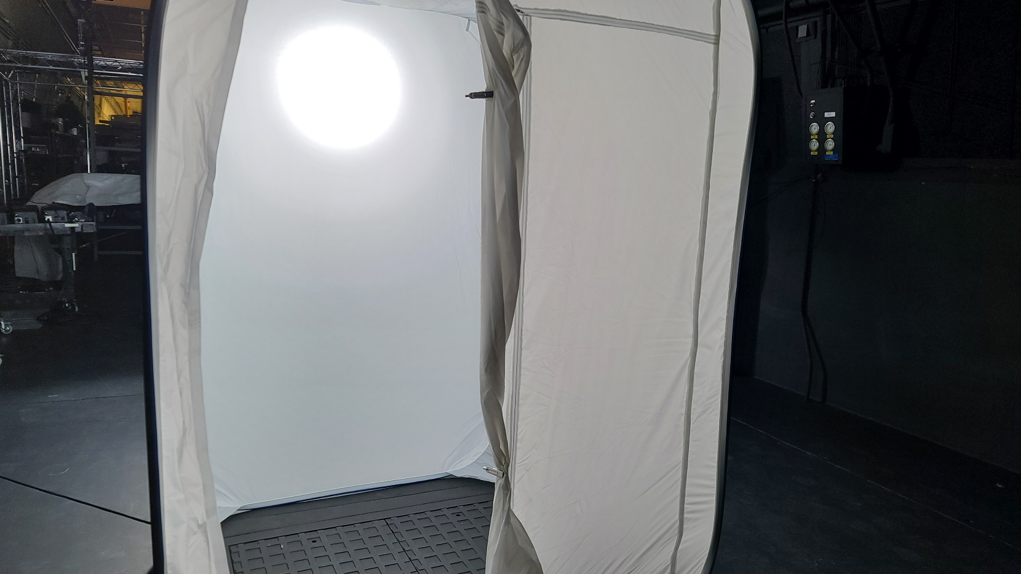
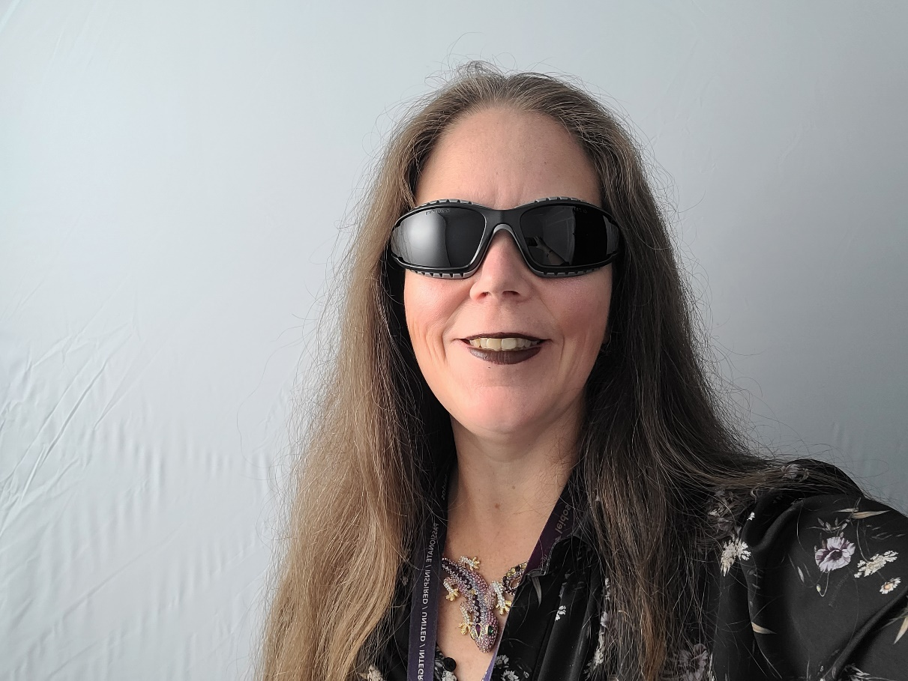
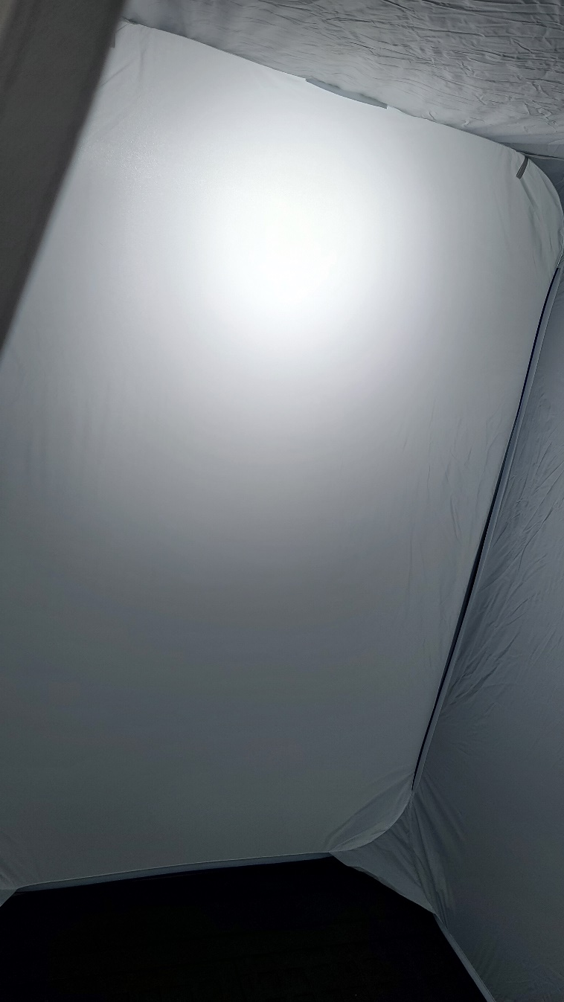
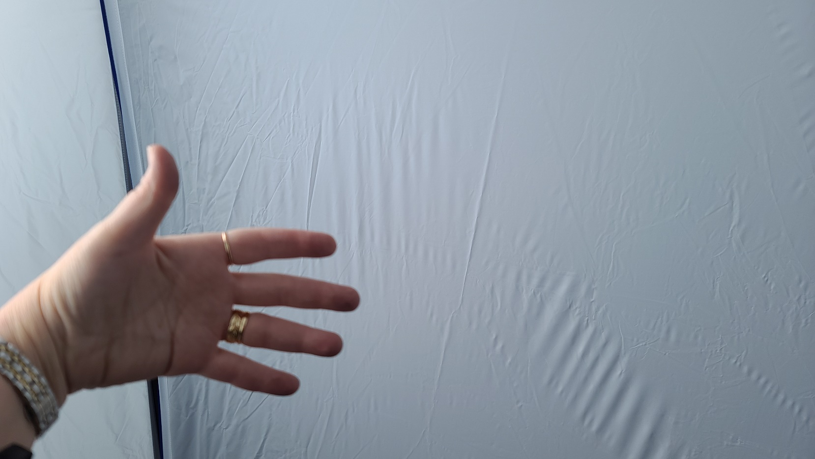
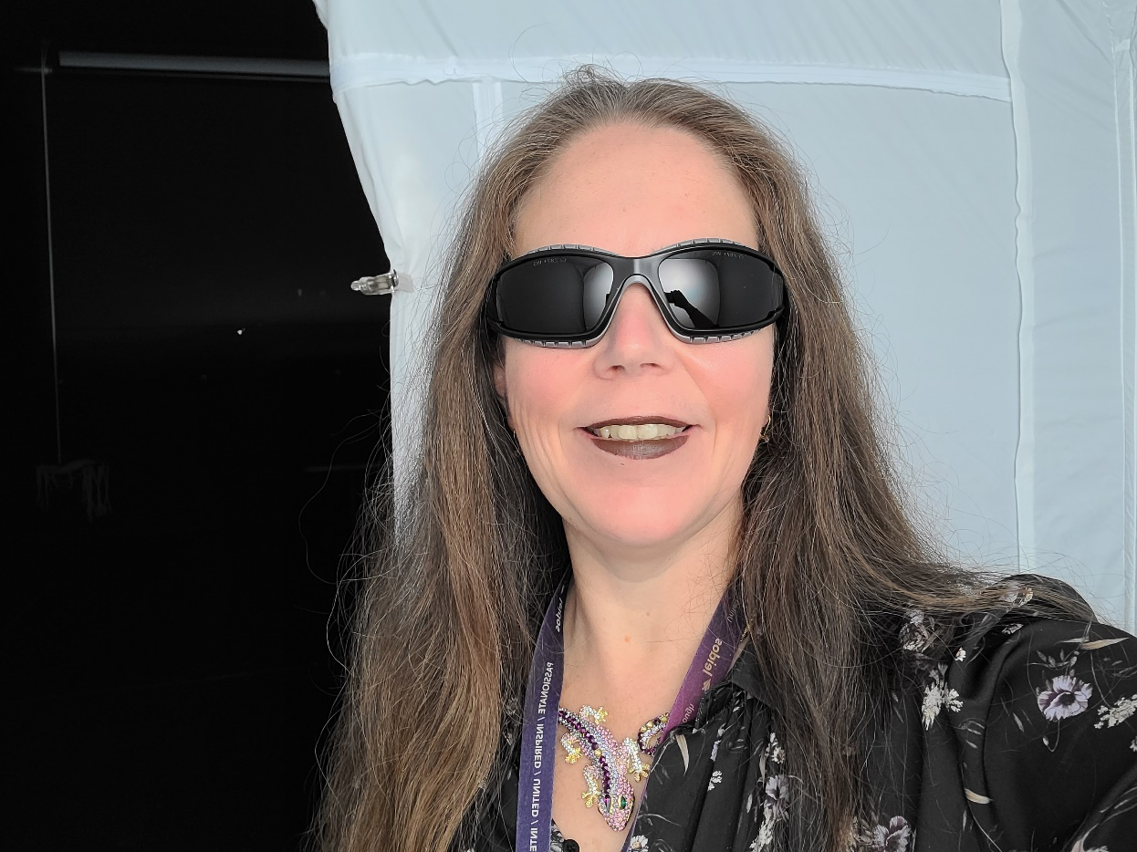
Translucent Enclosure Diffuses Light in Multiple Directions
These images show the lighting conditions inside the pop-up translucent enclosure.
The light is diffused by the first panel directly in view of the sun.
Diffused light bounces around inside the enclosure, significantly muting shadows, while making it possible to work directly facing the extreme light source.
A different deployment mechanism may be necessary in consideration of crew’s reduced mobility and gloved hands.

Slide 15
Application of Innovation
The COTS equipment used for this demonstration were simple popup panels, like popup panels used in car windshields to protect car interiors from heat. They were made with wire and fabric.
It seems that with the simplicity of the solution, the crew could be provided with translucent fabric paneling to position, facing the Sun, in front of EVA workstations on the Moon. The translucent fabric acts as a diffuser to create a bright diffuse luminous wall, while protecting the crew from direct view of the Sun.
Similarly, the crew could be provided with white opaque or metalized fabric paneling they could position opposite a “diffuser wall” to reflect light to the other side of their workstation.
This solution seems portable enough that the crew could bring their own protective pop-up workspace with them, to EVA worksites established away from the safety of habitation elements.

