Slide 1
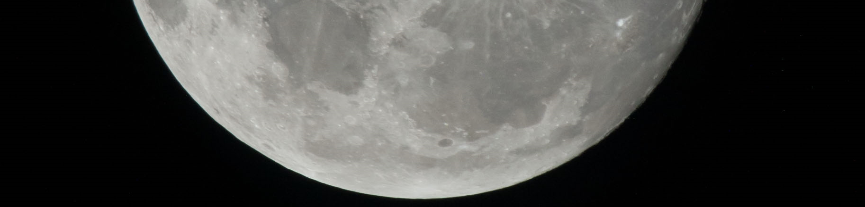

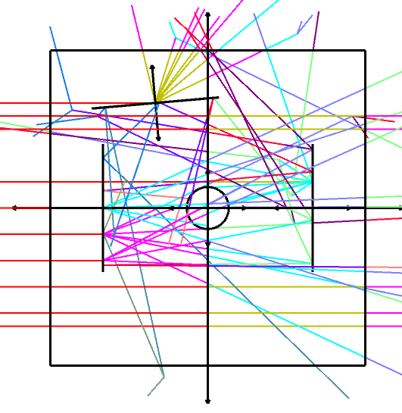
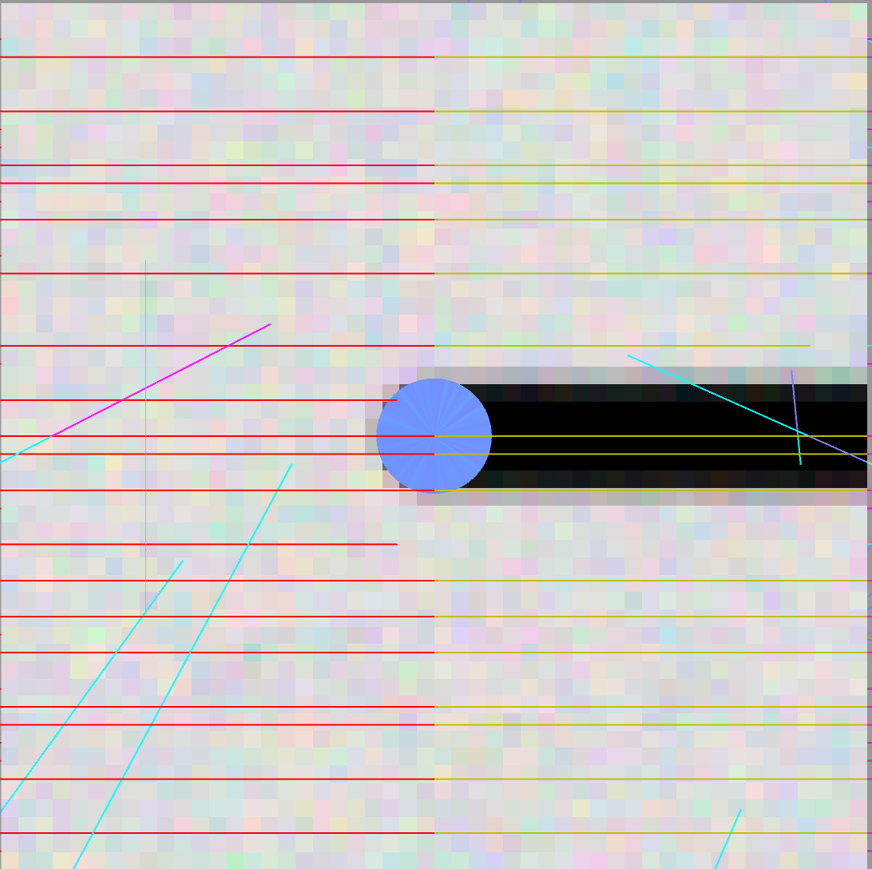
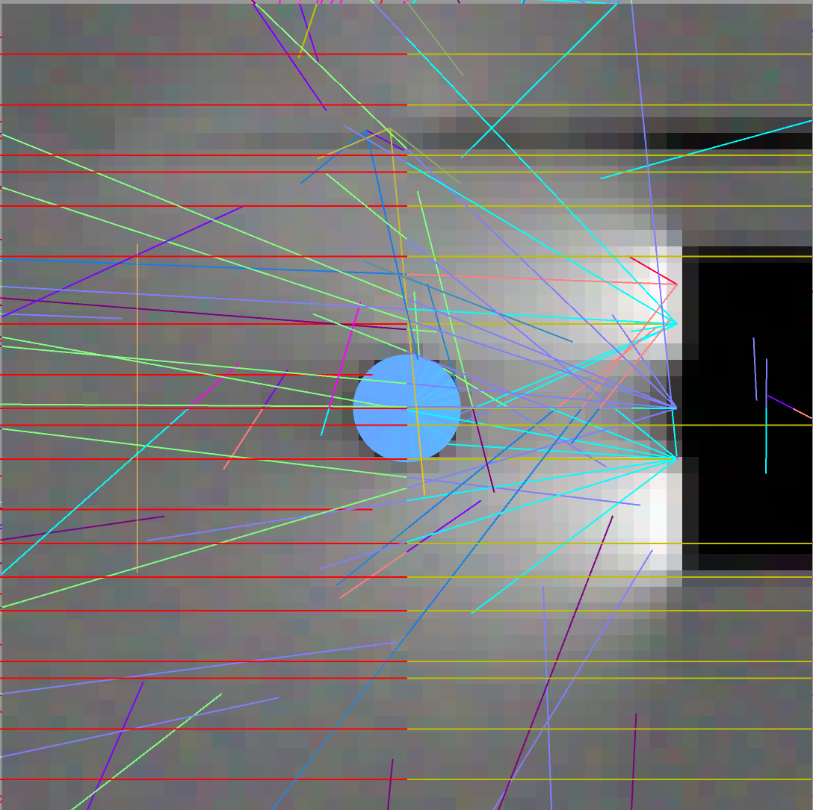
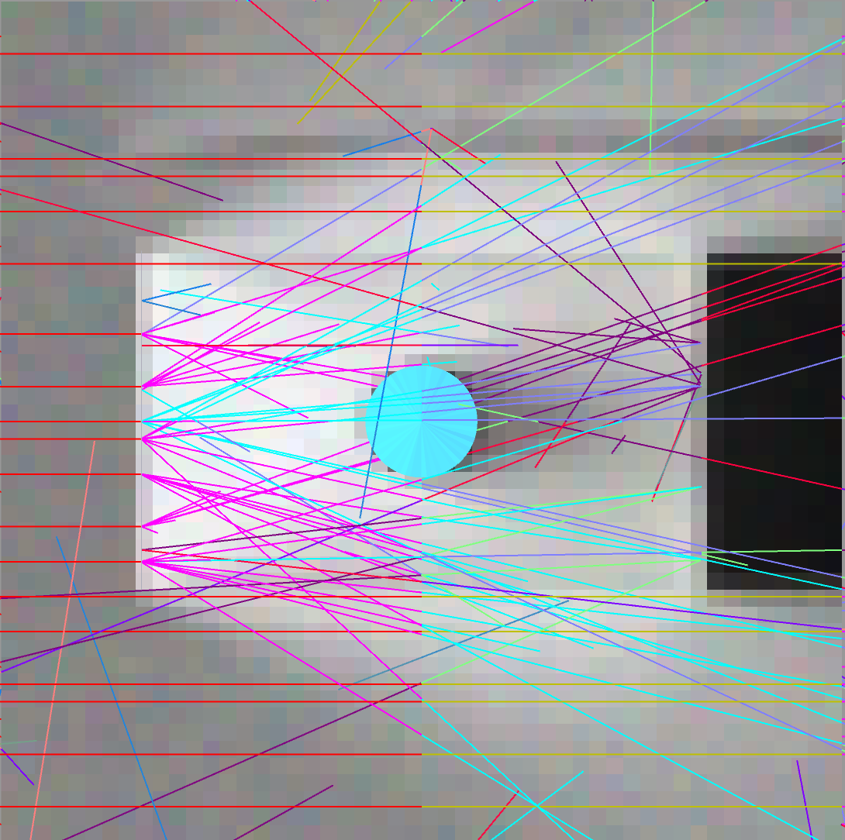
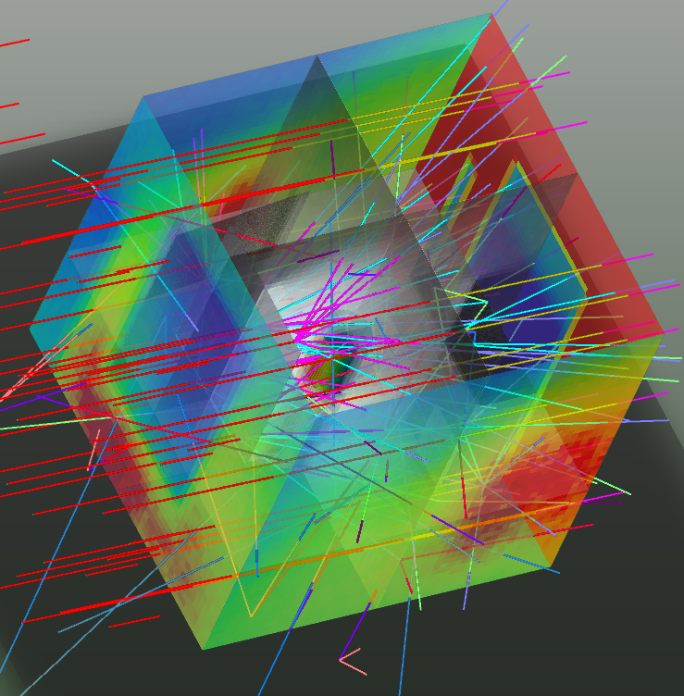
Can Reflector Panel Technologies Tame Terrible Lunar Surface Lighting Environments?
National Aeronautics and Space Administration
Johnson Space Center (JSC) / White Sands Test Facility (WSTF) 2020 JSC Technology Showcase: (select one) FY20 ICA or FY20 CIF IRAD
Toni Clark, P.E. / Toni.Clark-1@nasa.gov, Max Martell
TRL: start 3 / current 5
Technology Area (TA): TX06.6.3 Habitability &Environment
Layout of Optical System
No Countermeasures
FY20 ICA PROJECT Overview
This project investigated the usage of reflector panel technology to redirect collimated sunlight to make it more usable for the lunar surface EVAs. When astronauts travel to the Moon’s South Pole, they will find a terrible exterior work environment to carry out EVA tasks. The location creates a situation where collimated light from the Sun illuminates the surface at low inclination angles, and the problem that the crew will often shadow their own workspace. Artificial lighting countermeasures will be marginally beneficial because the Sun’s illumination level is orders of magnitude higher than intensities possible from battery driven lighting systems. These conditions will persist because the latitude of the polar worksite, and the Moon’s orbit around the Earth. Photographers, on Earth, battle similar problems in their studios and outdoor worksites. To solve this problem, they use large portable reflectors to redirect light towards the object they are imaging.
INNOVATION
Reflector panel technologies, typically used by photographers, are designed to redirect and modify light coming from a much higher intensity light source. The modified light is used to enhance the lighting for the object they are imaging. Different illumination patterns and modifications of light spectrum are achieved using panels with different surface reflectance properties (mirror, diffuse, white, colored, dark). This project investigated the usability of standard portable photographic grade reflectors to improve illumination issues created by shadowing. Using the orbital light source simulators at the JSC Lighting lab, and physics based optical computer models, this project investigated how different surface reflectance properties, of commercially available reflectance panels, modify worksite lighting conditions. Findings from the analysis will be used provide a recommendation on best practices on usage of this technology to improve lunar surface worksite lighting conditions
Outcome
Computer models generated in Zemax for a low inclination illumination angle with collimated light, showed a marked improvement for an increase in usable worksite area with just large reflector panels.
Computer models that added a large diffuser panel between the crew member and the sun greatly enhanced the work area by protecting the observer from direct observation of the sun and by diffusing light such that harsh shadows were minimized.
Laboratory Test Phase observed noticeable improvements in light distribution surrounding a “worksite” through the usage of 4’x8’ COTS portable diffuser and reflector panels, further indicating a potential low-cost countermeasure for harsh lighting conditions.
Infusion Space / Earth
Commercial off the shelf reflector and diffuser fabric panels are lightweight and could be easily deployed using simple clamping mechanisms to boom and structures. Application of these methods can be used to maximize exterior worksite performance for lunar, gateway, and ISS EVA surface operations. It can also be used to enhance nighttime construction environments where light sources are harsh spotlights.
Reflector
Diffuser
Crew
Reflector
One Reflector Opposite of Sun & One to side
Diffuser Added Between Crew & Sun
3D Light Field Showing Effects from Reflectors & Diffuser.
Usability of worksite is enhanced by reducing shadows.
PARTNERSHIPS / collaborations
Since starting this project, we have established a partnership with another ICA/IRAD Project, Gandalf’s Staff.
Future Work
The initial findings from this project predict a significant positive improvement in lighting conditions, that could increase the productivity for an EVA lunar South Pole worksite. We would like to pursue efforts to add this technology to the toolset brought with the crew on their future lunar EVA missions. Implementation of this technology would require a human-in-the-loop study in an integrated lighting environment that establishes success parameters in use of the technology, lighting analysis and testing to further resolve best products to ship with the crew, and engineering design to conform the commercial product for use in lunar surface EVA operations.
MSC-26937-1

