Slide 1
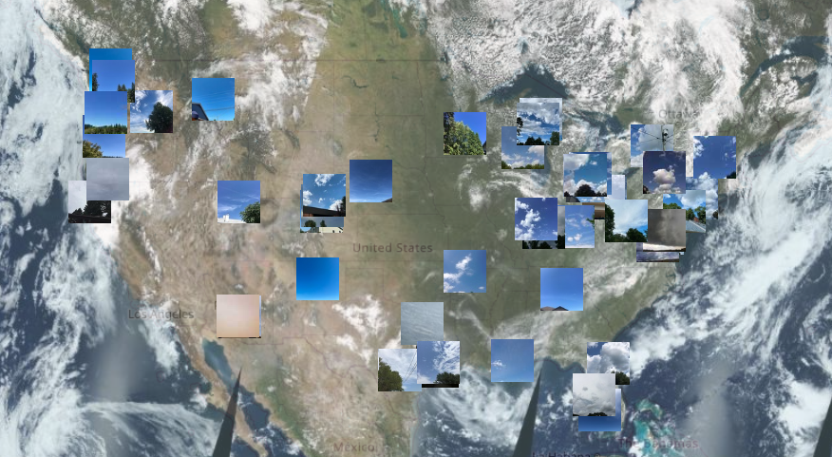
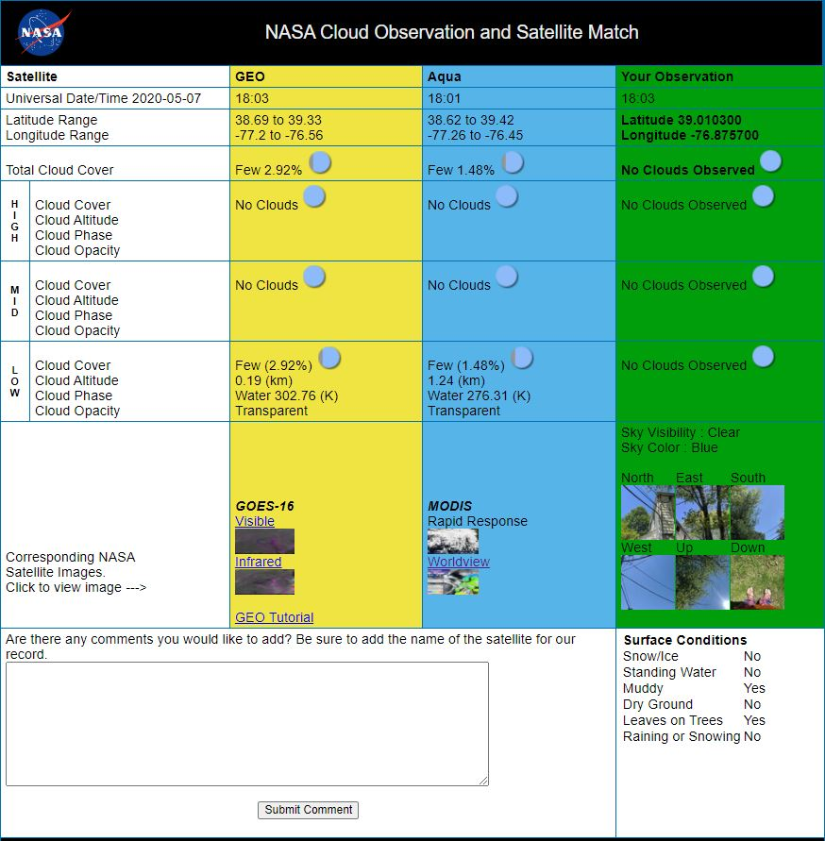

Title: NASA GLOBE Clouds: Matching Your Sky Observations to Multiple-Satellite Data
Host Conference Name: Joint 9 30th Conference on Education - Open Source Tools for Accessing, Displaying, and Analyzing Environmental Satellite Data
Paper Number: Joint 9.2 Presentation Date: Wednesday, 13 January 2021 Start-End Time: 3:45 – 3:50 PM (EST)
Dust
Photographs of sky and clouds with a dust storm reported by citizen scientist in the Southwest US. Seen in GLOBE Data Visualization System with Terra True Color Base Map. https://vis.globe.gov/GLOBE/
Speaker: Marilé Colón Robles¹,
Co-Authors: Tina Rogerson¹, Jessica Taylor², Tina Harte¹, Angela Rizzi¹
¹NASA Langley Research Center / SSAI, ²NASA Langley Research Center

Slide 2
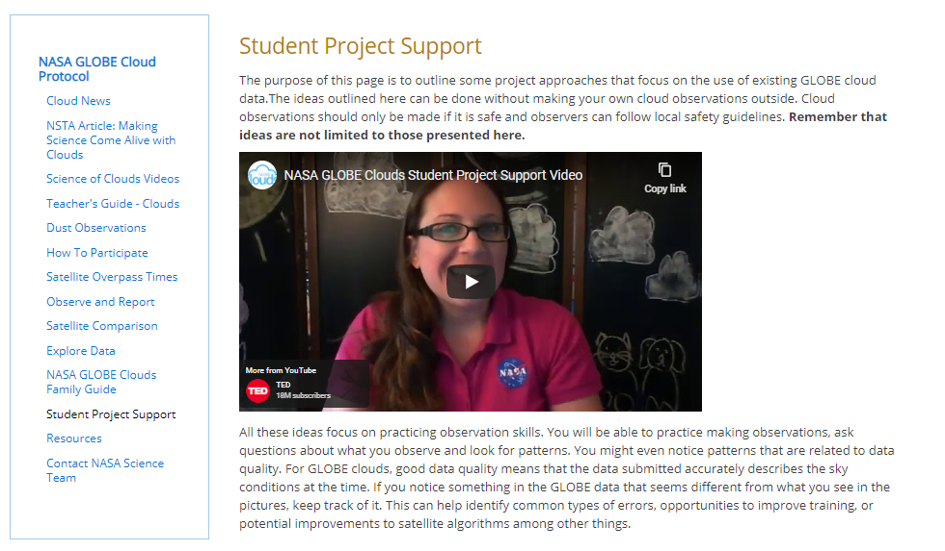
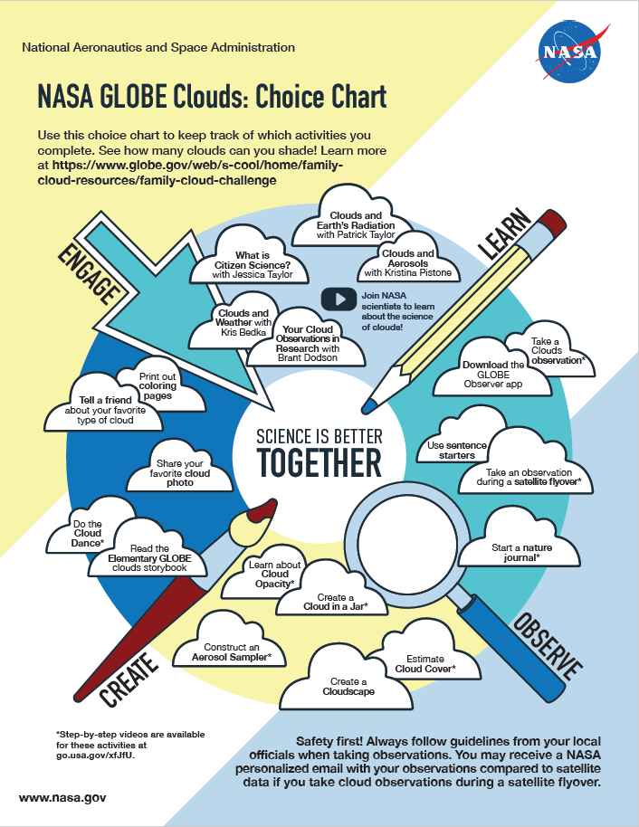
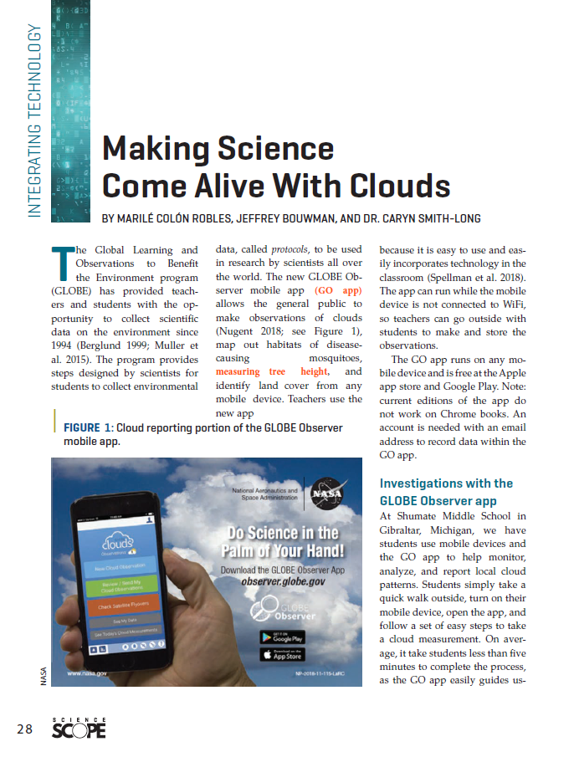
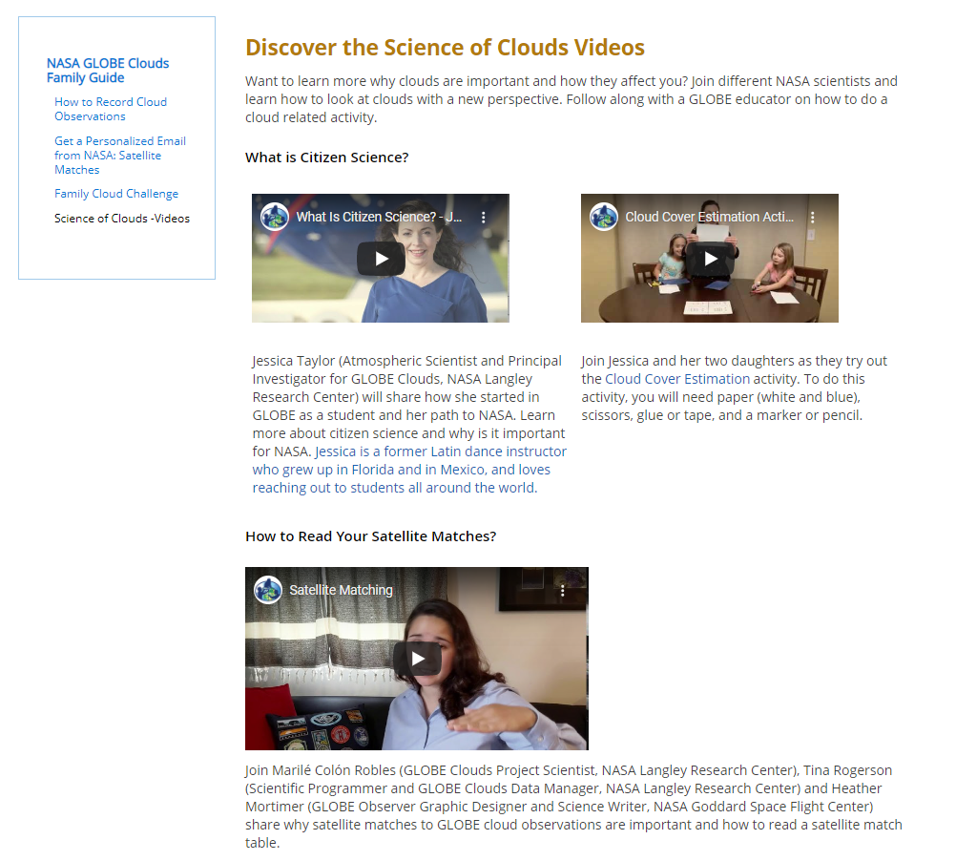
Title: NASA GLOBE Clouds: Matching Your Sky Observations to Multiple-Satellite Data
Host Conference Name: Joint 9 30th Conference on Education - Open Source Tools for Accessing, Displaying, and Analyzing Environmental Satellite Data
Paper Number: Joint 9.2 Presentation Date: Wednesday, 13 January 2021 Start-End Time: 3:45 – 3:50 PM (EST)
Family Cloud Challenge
Choice Chart
Best Practices for
Teachers and Professors
Student Project Support Page
Science of Clouds Videos

Slide 3
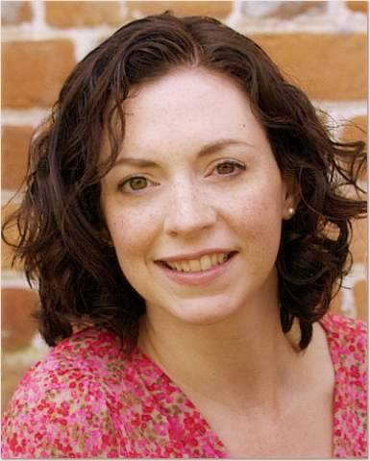
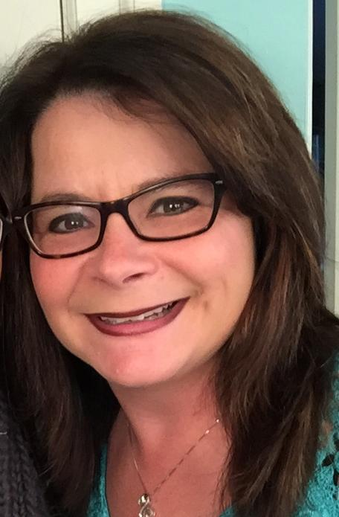
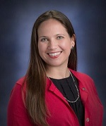



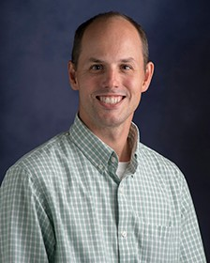
GLOBE Clouds Team
Jessica Taylor
Principal Investigator
Tina Harte
Project Manager
Marilé Colón Robles
Project Scientist
Tina Rogerson
Data Manager
Angie Rizzi
Education Specialist
Research Support
Dr. Brant Dodson (left)
Mr. Kris Bedka (right)

Slide 4

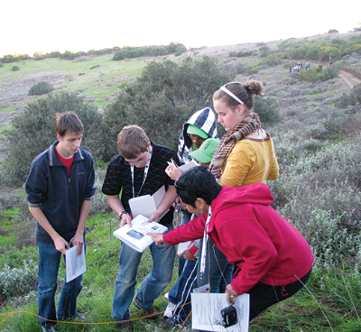
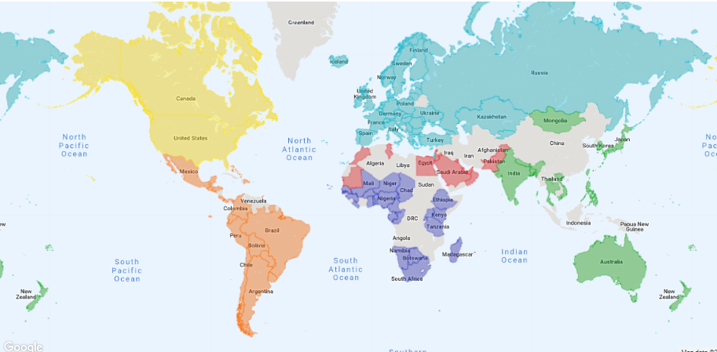





The GLOBE Program
Since 1995
123 countries
34,000 schools
142,000 citizen scientists
400+ publications
globe.gov
Global Learning and Observations to Benefit the Environment (GLOBE)
Sponsored by:
Supported by:
Implemented by:

Slide 5
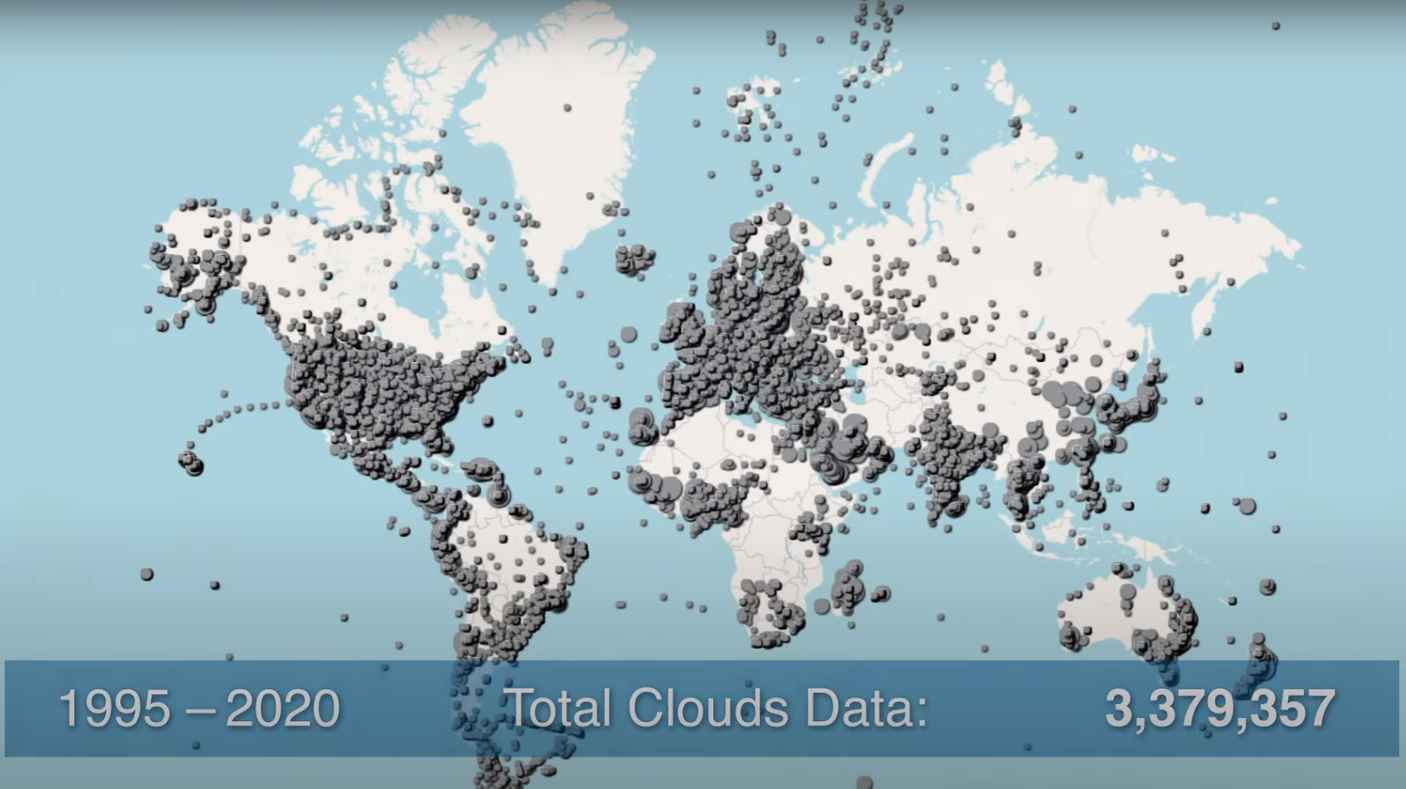
GLOBE Clouds Observations

Slide 6
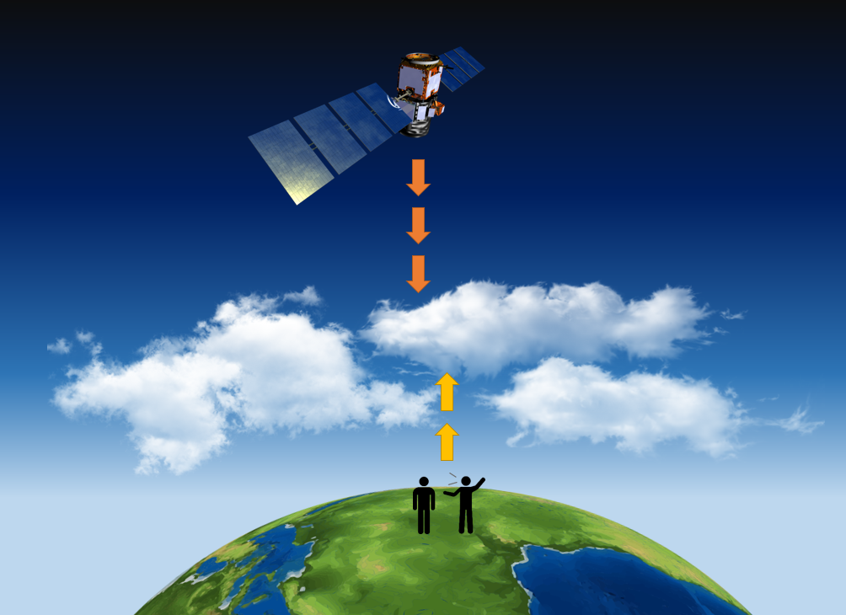
Satellite Matched Observations
Different points of view:
Instruments* on satellites see the top of clouds
We** see the bottom of clouds
* Some instruments may not see lower or high thin clouds.
** We may miss high clouds especially if there are thick low clouds.
Notes:
Marile

Slide 7
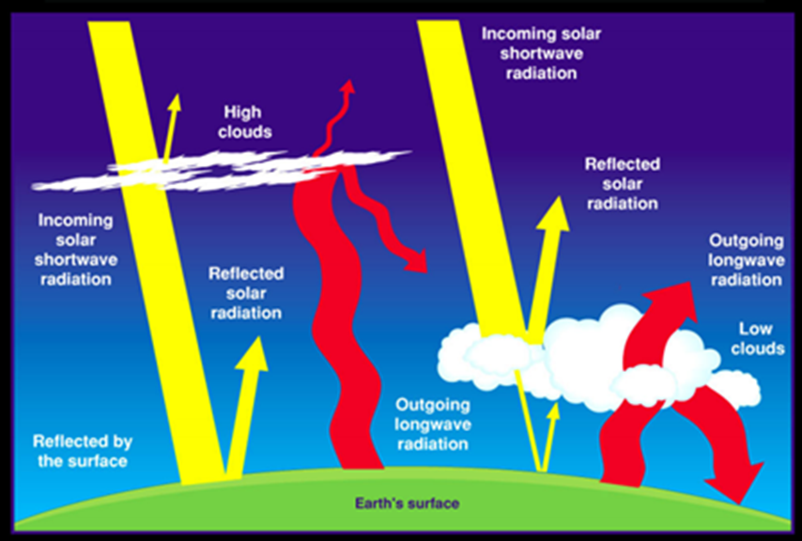
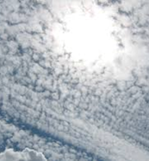
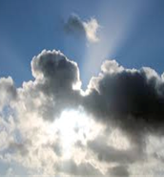
Cloud Effects on Earth’s Energy Budget
Not all cloud types interact with the Sun’s sunlight (yellow straight arrows; shortwave radiation) the same. As well, not all cloud types interact with the energy leaving the Earth (wavy red arrows; longwave radiation).
Notes:
Not all cloud types interact with the Sun’s sunlight (red straight arrows; shortwave radiation) the same. As well, not all cloud types interact with the energy leaving the Earth (wavy red arrows; longwave radiation). The thicker the arrow, the more energy, the thinner the arrow, the less energy. To see how cloud types interact with different types of radiation, look at the thickness of the arrows above the cloud and then below the cloud in the image on this slide. See https://ceres.larc.nasa.gov/ceres_brochure2.php?page=2 for more information.

Slide 8
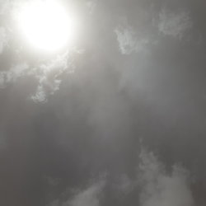
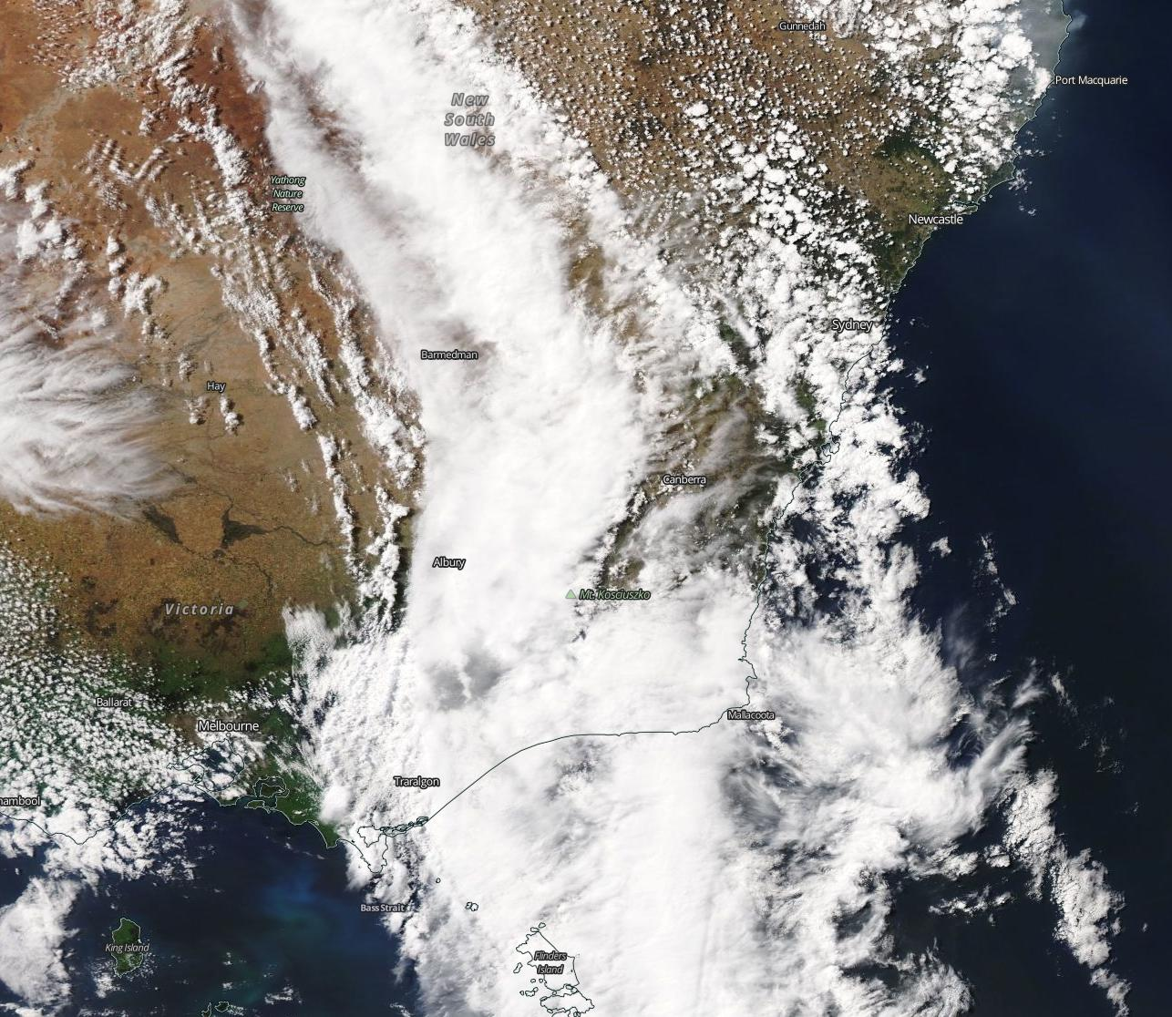
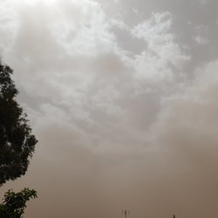
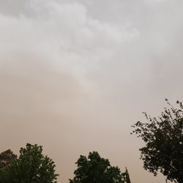
Why are satellite matches important?
Upward
Haboob Reported
New South Wales, Australia
25 October 2019
North
South

Slide 9
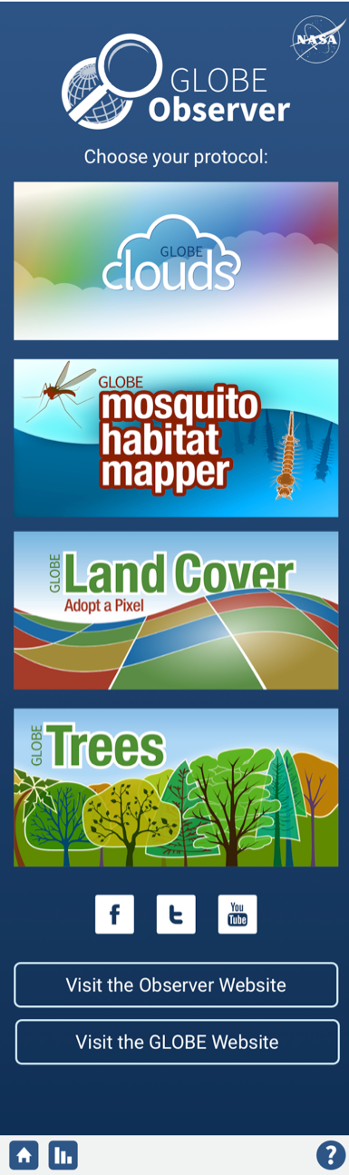
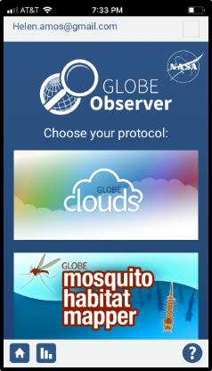
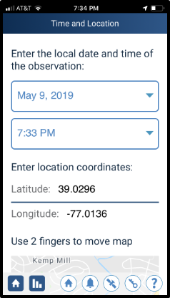
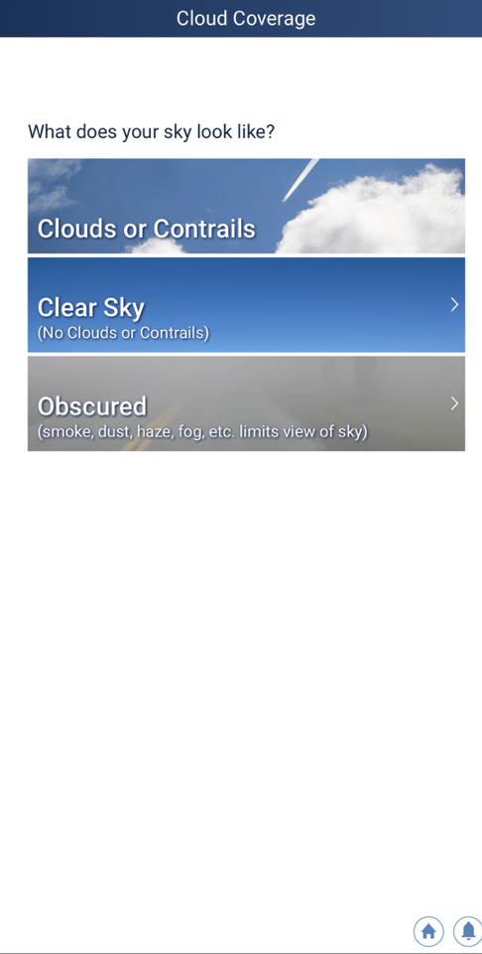
Step 1:
Select clouds
Step 2:
Date & time
Step 3:
Do you see clouds?

Slide 10
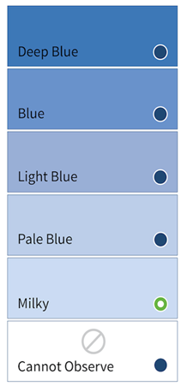
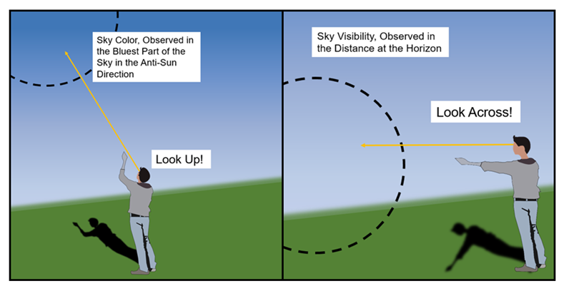
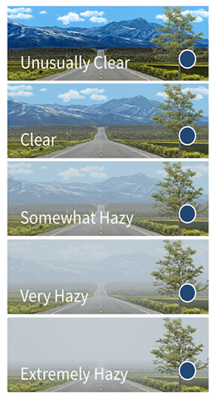
Sky Color and Visibility
Notes:
Deepest blue you see only if total cloud cover is 50% or less.

Slide 11
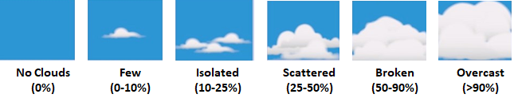
Percentage Cover
Total sky cover
Cover by height (low, middle, high)

Slide 12
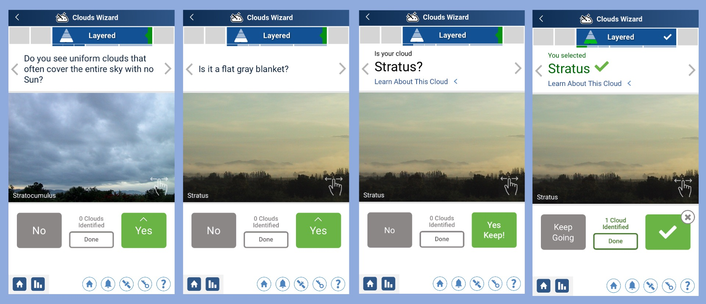
Clouds Wizard

Slide 13



Opacity
Transparent: Thin clouds through which light passes easily, and through which you can even see blue sky.
Translucent: Medium-thickness clouds that let some sunlight through.
Opaque: Thick clouds which do not allow light to pass directly, although light can diffuse through them.
Transparent
Translucent
Opaque
Notes:
Transparent: Thin clouds through which light passes easily, and through which you can even see blue sky. Note the milky bluish-whitish appearance.
Translucent: Medium-thickness clouds that let some sunlight through. There may be some milky bluish-white near the edges, and a very little bit of gray; but these clouds are mostly a bright white.
Opaque: Thick clouds which do not allow light to pass directly, although light can diffuse through them. Clouds look gray. When these clouds are in front of the Sun, it is impossible to tell where the Sun is.

Slide 14
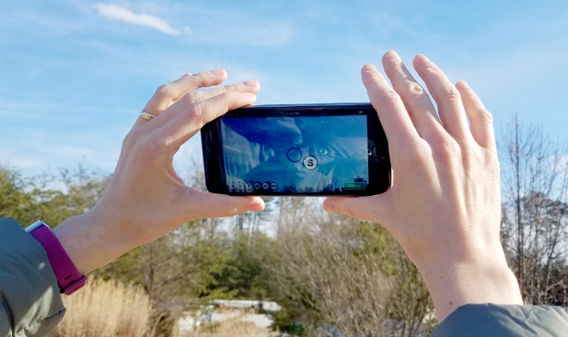
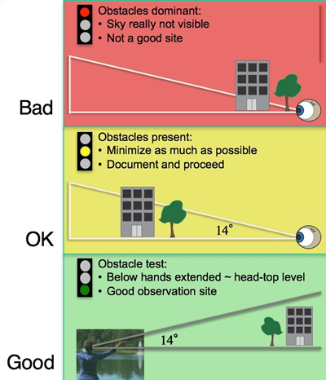
Last Step: Take Pictures!

Slide 15
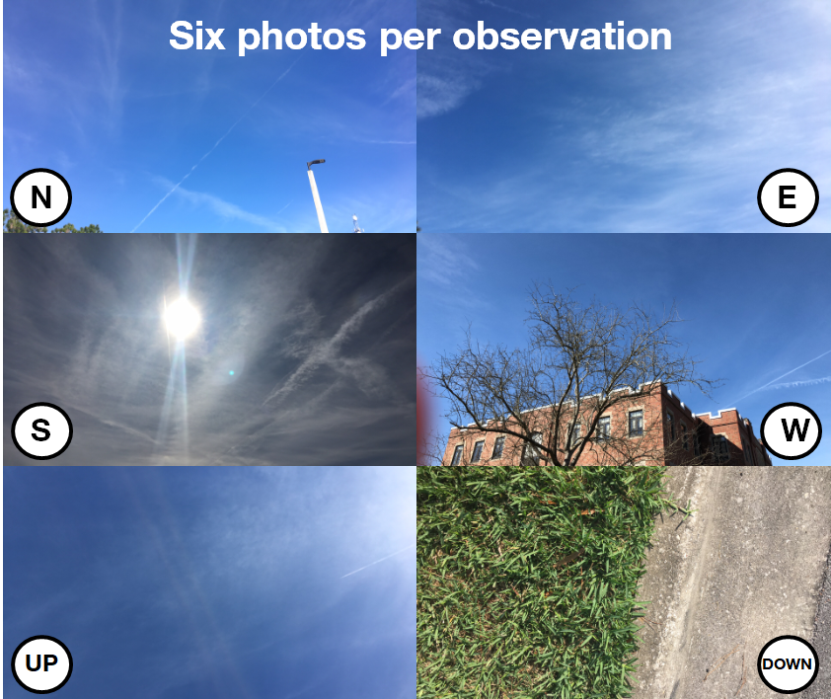

Slide 16

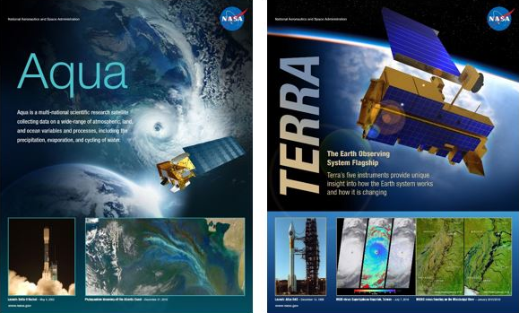
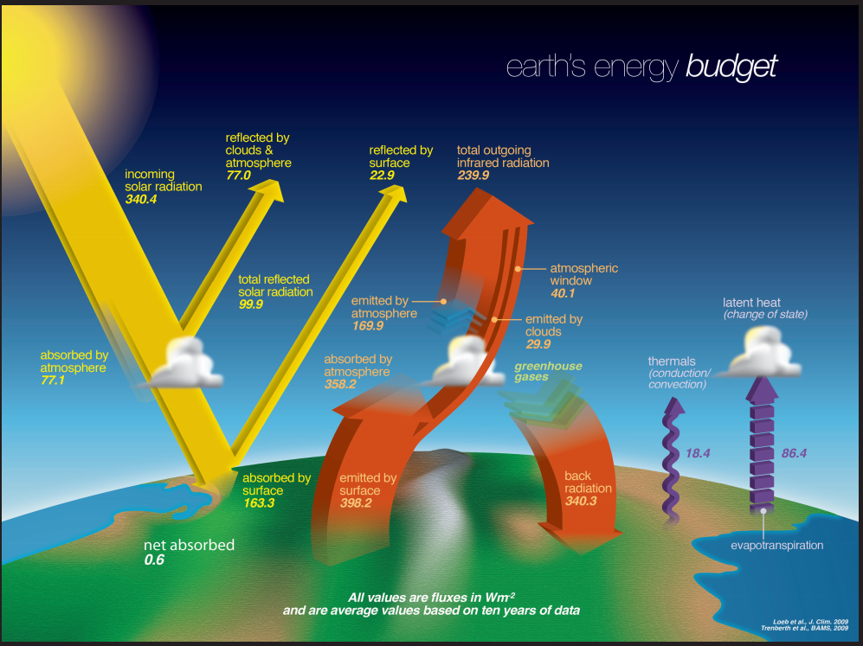
Satellites and Instruments
Clouds and the Earth’s Radiant Energy System

Slide 17

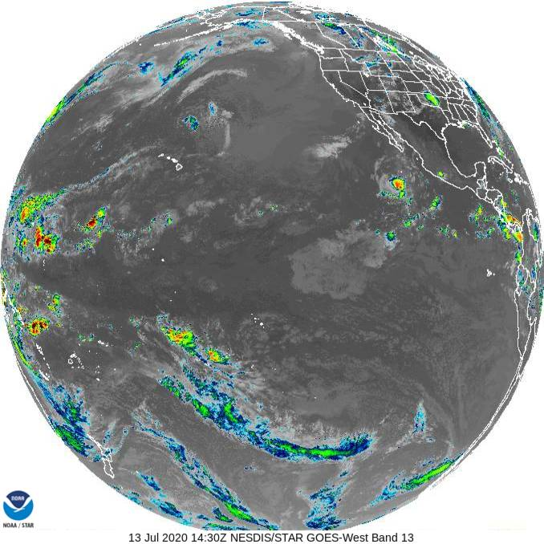
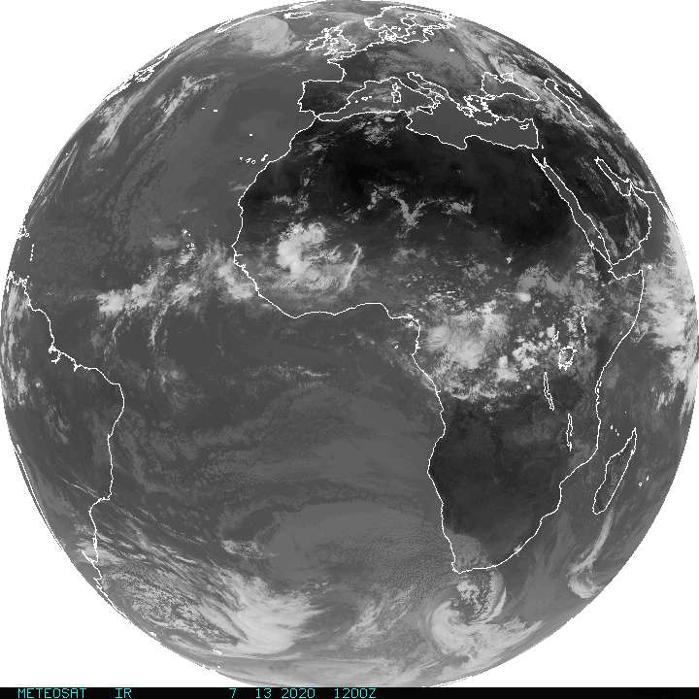
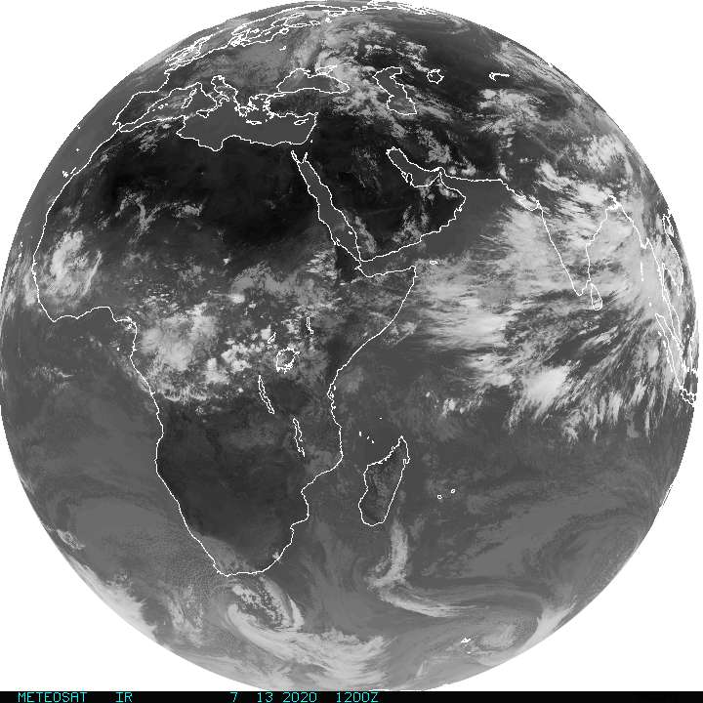
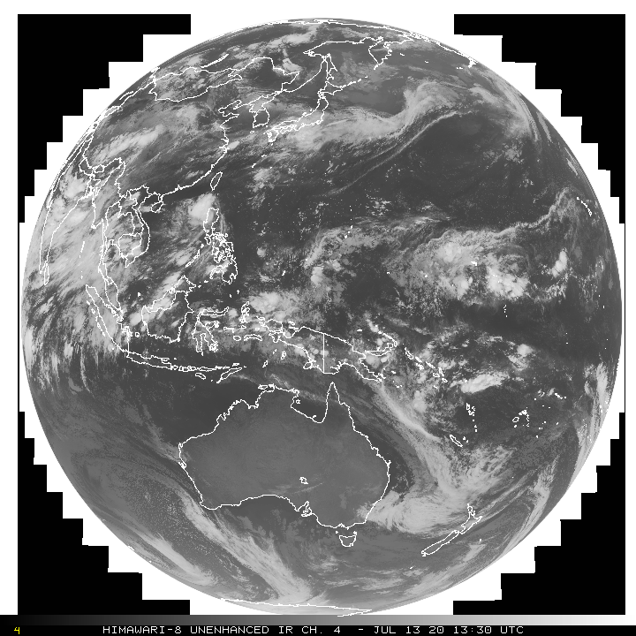
Satellites and Instruments
Meteosat
Himawari
GOES East &
West (pictured)

Slide 18
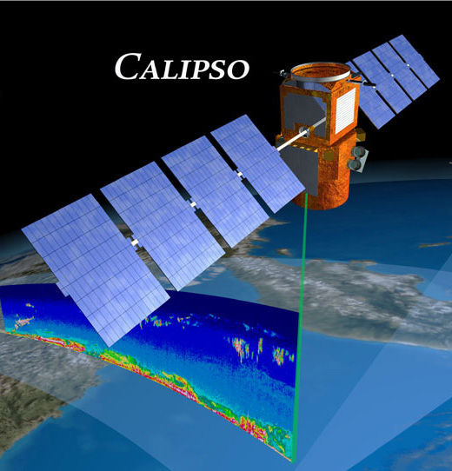
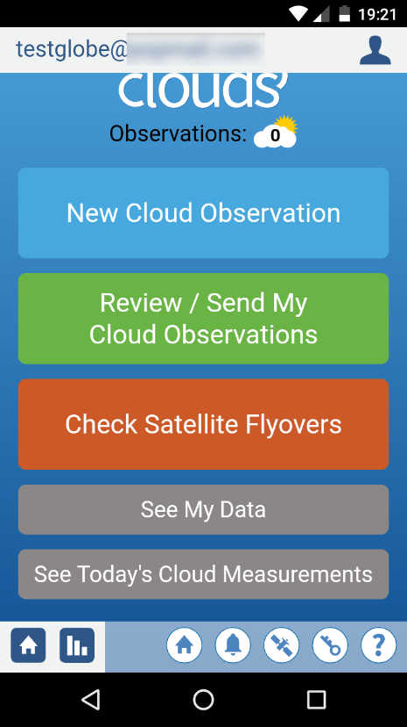
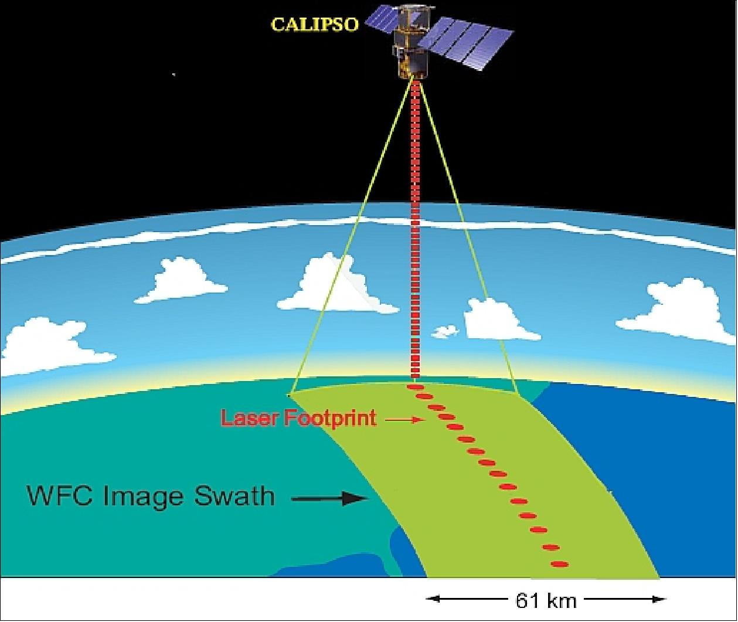
Satellites and Instruments
Notes:
LIDAR - https://oceanservice.noaa.gov/facts/lidar.html

Slide 19
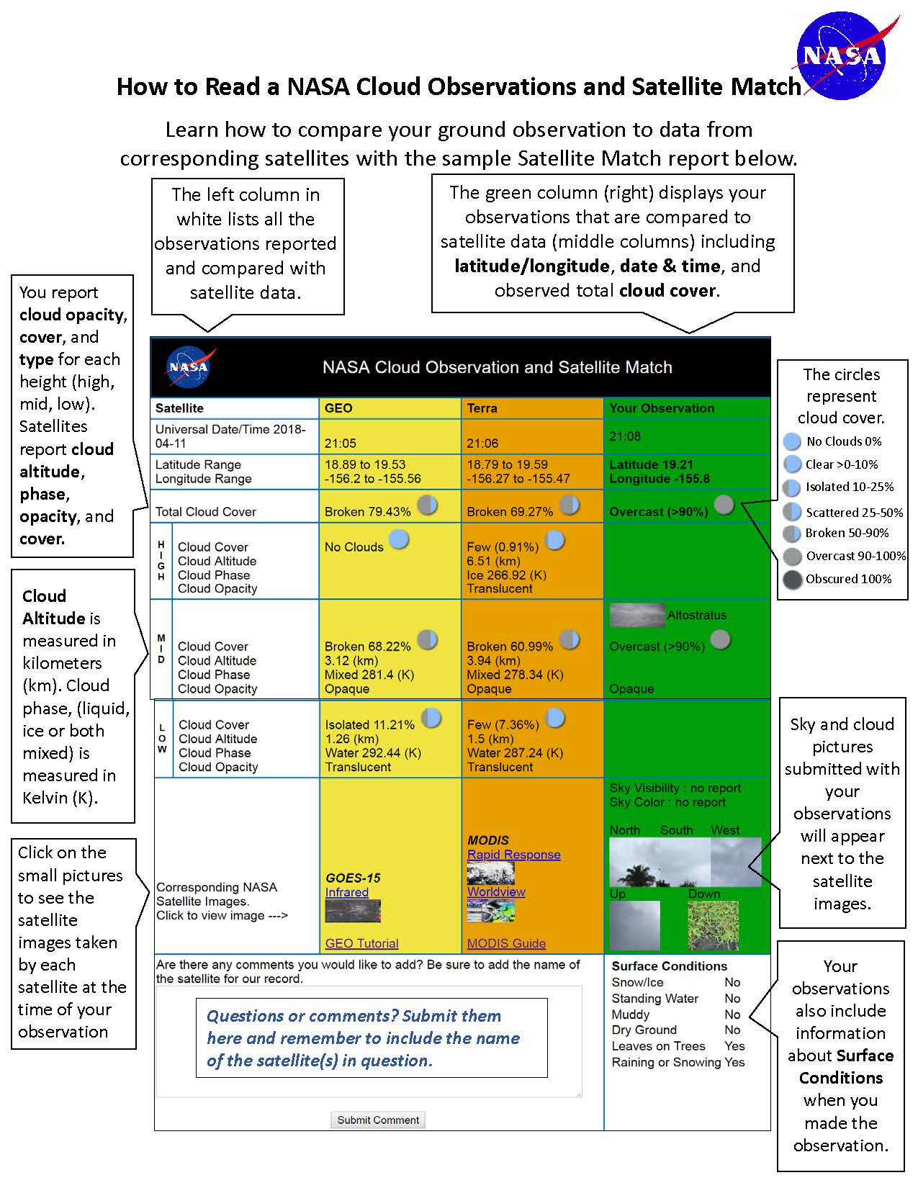
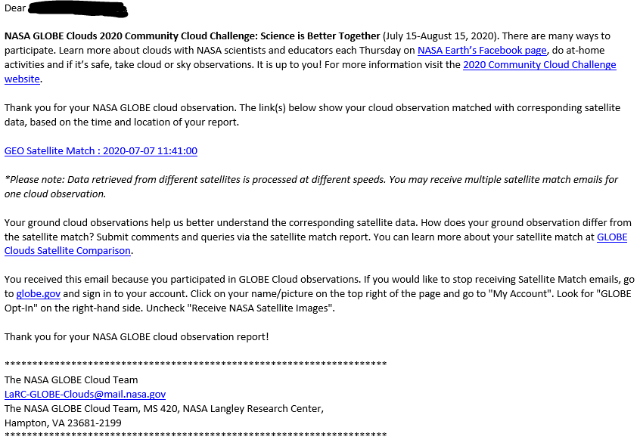
Satellite Match Email and Table

Slide 21
Detailed information per height:
Low
Mid-level
High

Slide 22
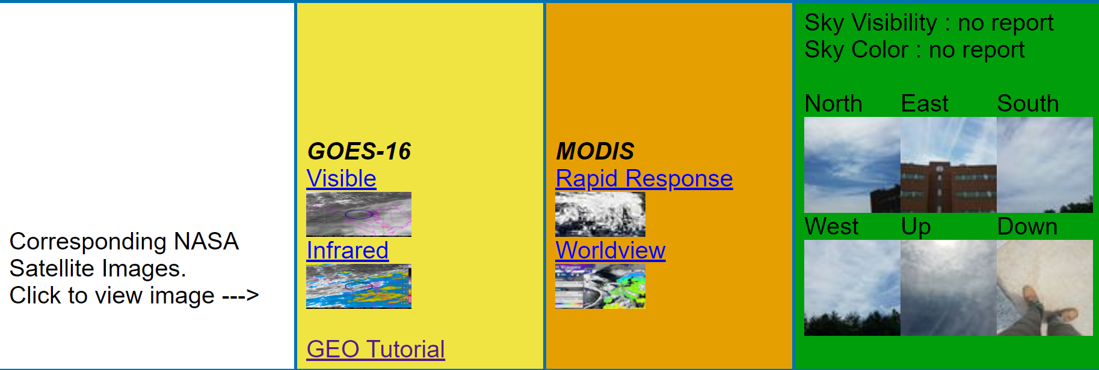
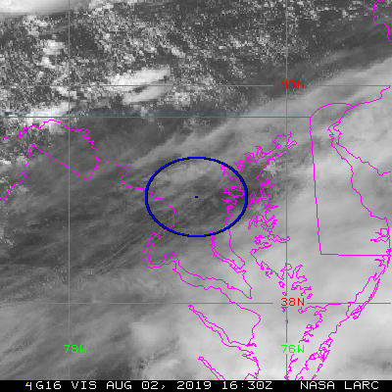
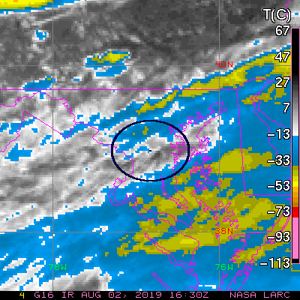
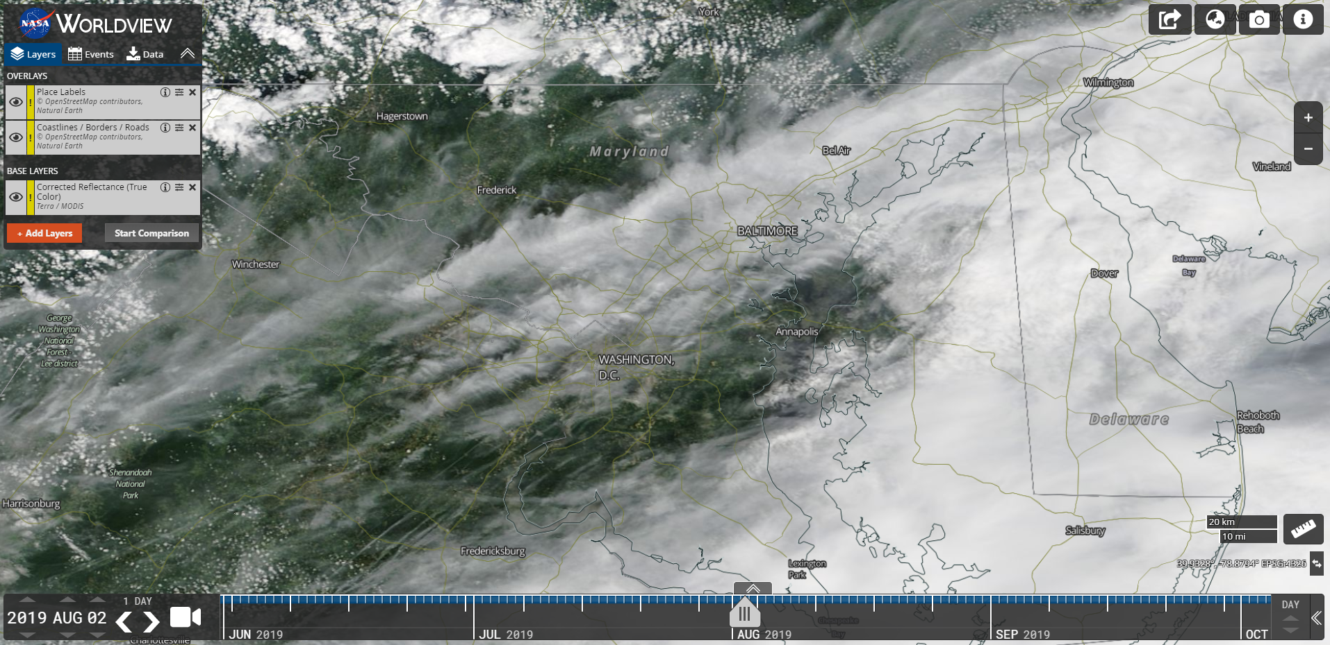
GOES 16 - Visible
GOES 16 - Infrared
MODIS True Color
Notes:
https://scool.larc.nasa.gov/cgi-bin/NASA-GLOBESatMatch.cgi?observation_id=116-150731-47602621-201908021620

Slide 23
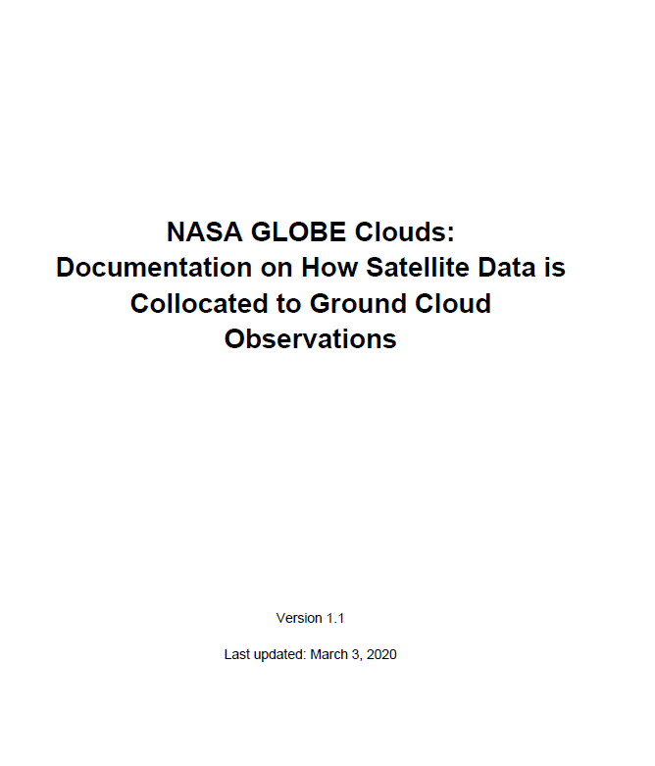
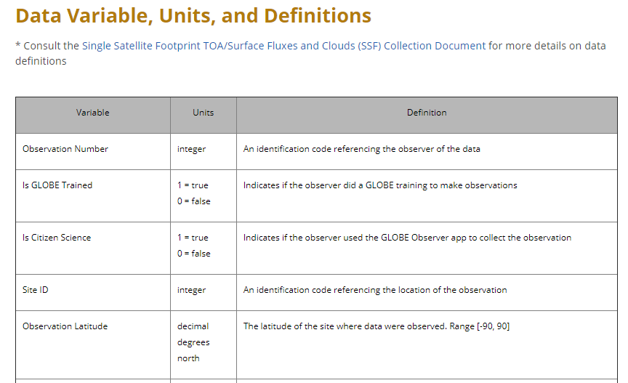
Documentation of Data
https://www.globe.gov/web/s-cool/home/satellite-comparison

Slide 24

Make Comparison Available
Dataset includes all details from ground observer plus all the detailed satellite data (e.g. cloud top height, opacity, total cloud cover).
https://observer.globe.gov/es/get-data/clouds-data

Slide 25






North American Total Solar Eclipse
No Clouds = Big Temperature Change
Dr. Brant Dodson
NASA / SSAI
Overcast = small change in temperature.
Overall result a 40% difference due to clouds.
Dodson et al. (2019). Eclipse Across America: Citizen Science Observations of the 21 August 2017 Total Solar Eclipse. Journal of Applied Meteorology & Climatology, https://doi.org/10.1175/JAMC-D-18-0297.1.

Slide 26

Total Cloud Cover Data
Dr. Brant Dodson
NASA / SSAI
https://youtu.be/epV69N-CNfU

Slide 27



Compare cloud type and cloud cover information with weather and climate computer models.
Photo taken in New Mexico, USA by GLOBE Observer Anne Semrau
https://gmao.gsfc.nasa.gov/pubs/posters/2019/Arnold87.pdf
Project led by Dr. Nathan Arnold, NASA GSFC
College intern
Matthew Starke

Slide 28







Photographs of dust events in spare data collecting regions.
Photo taken in New Mexico, USA by GLOBE Observer Anne Semrau
Photo taken in New Mexico, USA by GLOBE Observer Anne Semrau
Dr. Daniel Tong, HAQAST/George Mason University
Dr. Kerstin Schepanski TROPOS in Leipzig, Germany
https://www.globe.gov/web/s-cool/home/new-dust-observations

Slide 29





Contrail reports are used to study airplane engine efficiency to contrail impacts on Earth’s Energy Balance.

Slide 30

Let’s Look at GLOBE Data Viz
https://www.globe.gov/globe-data/visualize-and-retrieve-data
Notes:
Jessica

Slide 31


Slide 32


Slide 33
GOES 16 - Visible
GOES 16 - Infrared
MODIS True Color
Notes:
https://scool.larc.nasa.gov/cgi-bin/NASA-GLOBESatMatch.cgi?observation_id=116-150731-47602621-201908021620

Slide 34


How to Interpret Satellite Data
https://www.globe.gov/web/s-cool/home/satellite-comparison/interpret-geo-image
https://www.globe.gov/web/s-cool/home/satellite-comparison/modis
Notes:
Marile

Slide 35

Notes:
10 minutes
When they come back ask what type of cloud did they see? What were overall weather conditions like?

Slide 36


Example of Classroom Implementation at Home
Montverde Academy
Observations by Montverde Academy middle school students Dr. Caryn Smith-Long
April 21, 2020

Slide 37





New Resources
Student Project Support Page – Data Literacy
https://www.globe.gov/web/s-cool/home/student-project-support
Simplified data files are available per topic.

Slide 38
Family Cloud Challenge
Learn – videos from NASA SMEs
Create – videos of GLOBE educators
Engage – tell a friends, read GLOBE Elementary book, do the cloud dance, etc.
Observe – sentence starters, nature journal, etc.
https://www.globe.gov/web/s-cool/home/family-cloud-resources/family-cloud-challenge

Slide 39
Science of Clouds Videos
What is Citizen Science?
How to read your satellite matches?
Your observations in research
Clouds and Weather
Clouds and Earth’s Climate
Clouds and Aerosols

Slide 40

NASA GLOBE Clouds Website https://www.globe.gov/web/s-cool
Cloud News/Blog Post
Science of Clouds Videos
Tips and Tricks
Clouds Family Guide
Student Project Support

Slide 41


eTraining and Extended Abstract
https://www.globe.gov/get-trained/protocol-etraining

Slide 42

Thank you!
Marile.ColonRobles@nasa.gov

