Slide 1

The Imaging X-ray Polarimetry Explorer
Martin C. Weisskopf
NASA Marshall Space Flight Center
Presentation to COSPAR
February 2, 2021

Slide 2
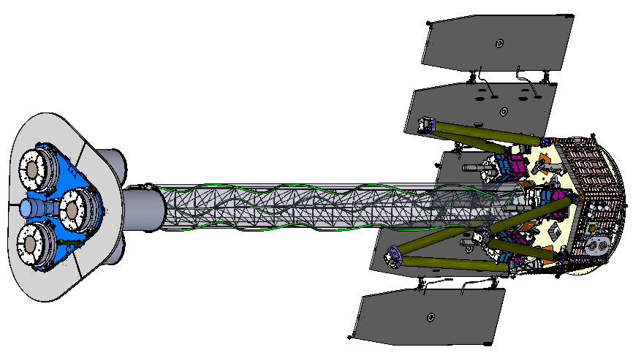
IXPE Deployed
Mirror Module Assembly
(1 of 3)
Detector Unit
(1 of 3)
Forward Star Tracker
5.2 m total length
4.0 m focal length

Slide 3
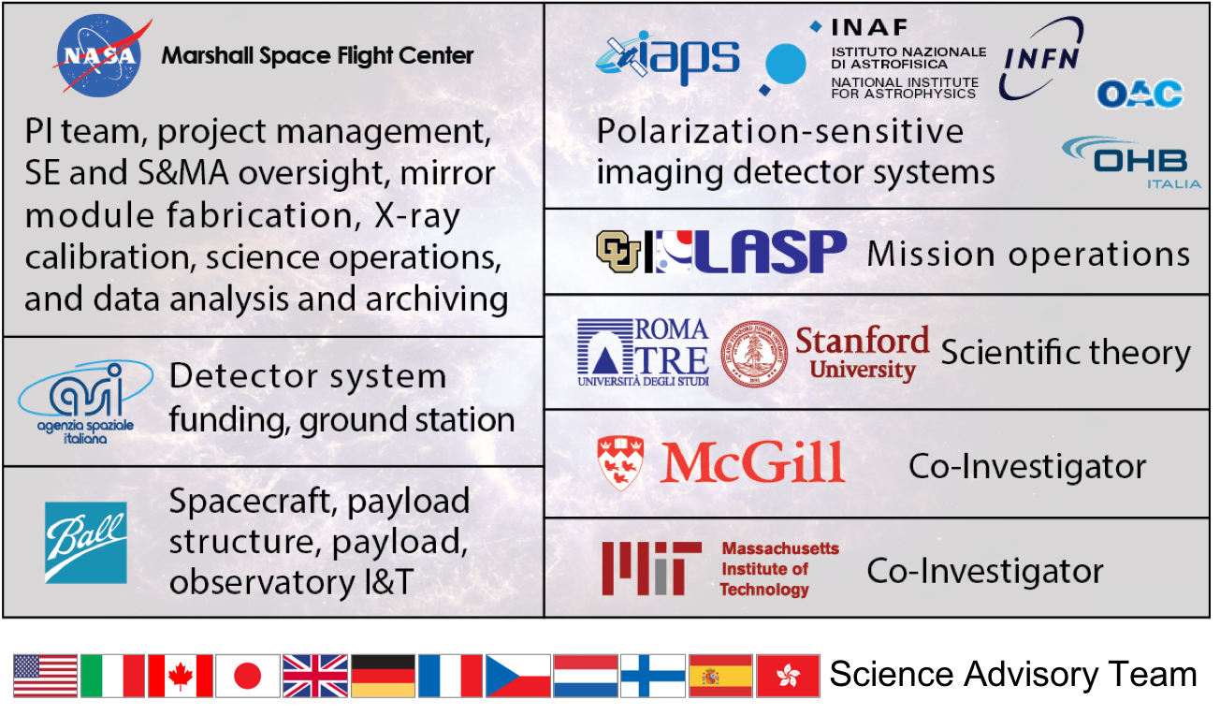
The IXPE Team
Nagoya University Thermal Shields
SAT currently comprises > 90 scientists from 12 countries

Slide 4
Mission Description
Launch late 2021 on a Falcon 9 from KSC
600-km circular orbit at a nominal 0° inclination
2-year baseline mission, optional extension with GO program
Point and stare (with dither) at pre-selected targets
Malindi ground station - primary (Singapore - secondary)
Mission Operations Center (MOC) at the University of Colorado, Laboratory for Atmospheric and Space Physics (LASP)
Sciences Operations Center (SOC) at MSFC
Data archiving at NASA’s HEASARC
  During the first 3 months of the mission, including one month of orbital checkout, all IXPE data shall be made publicly available at the HEASARC within 30 days of the end of an observation, which is defined as when data for 90% of the scheduled observation time are received by the MOC
  After the first 3 months of the mission, data shall be made available to the HEASARC within 1 week of the end of an observation, which is defined as when data for 90% of the scheduled observation time are received by the MOC

Slide 5
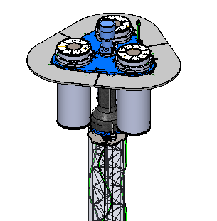
Shield and Collimator Suppress Background
Off-axis background
X-ray shield
Detector unit
On-axis Target
Collimator
X-ray
Shield
Mirror Module Assembly

Slide 6
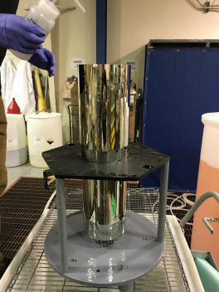
Optics Mirror-Shell Production Process
Mandrel fabrication
1. Machine mandrel from aluminum bar
2. Coat mandrel with electroless nickel (Ni-P)
3. Diamond turn mandrel to sub-micron figure accuracy
4. Polish mandrel to 0.3-0.4 nm RMS
5. Conduct metrology on the mandrel
Mirror-shell forming
6. Passivate mandrel surface to reduce shell adhesion
7. Electroform Nickel/Cobalt shell onto mandrel
8. Separate shell from mandrel in chilled water
Ni/Co electroformed IXPE mirror shell
(+)
(-)
(+)

Slide 7
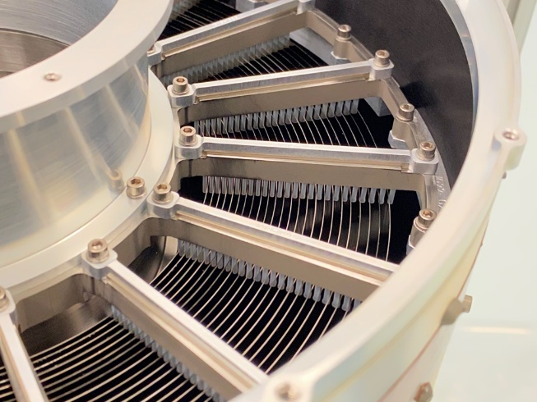
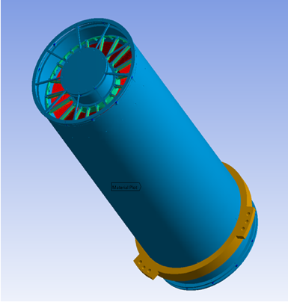
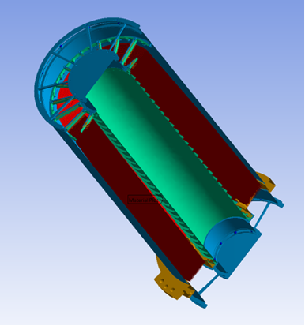
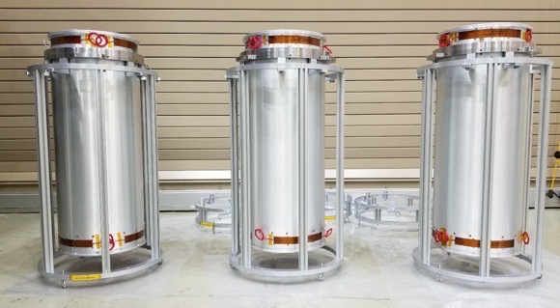
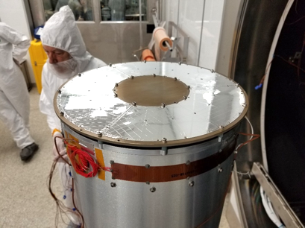
The Optics
Parameter | Value
Number of mirror modules | 3
Number of shells per mirror module | 24
Focal length | 4 m
Total shell length | 600 mm
Range of shell diameters | 162–272 mm
Range of shell thicknesses | 0.16–0.25 mm
Shell material | Electroformed nickel–cobalt alloy
Effective area per mirror module | 167 cm² (@ 2.3 keV); ~ 185 cm² (3–6 keV)
Angular resolution (HPD) | ≤ 27 arcsec
Field of view (detector limited) | 12.9 arcmin square
Rear Spider Assembly
Outer Housing Tube
Front Spider Assembly
MMA, showing 24 shells
X-ray Mirror Shells
Central Support Tube
Three IXPE Mirror Module Assemblies
MMA with Thermal Shield on end

Slide 8
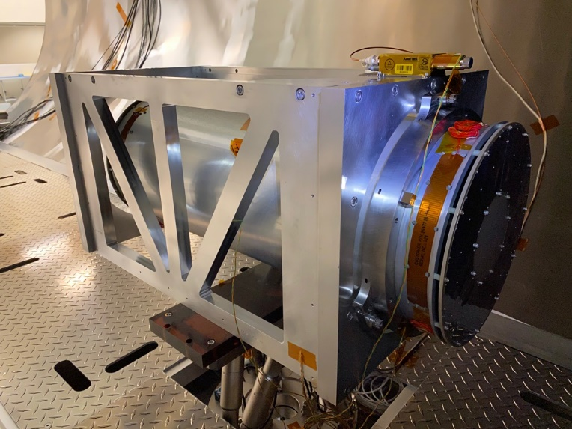
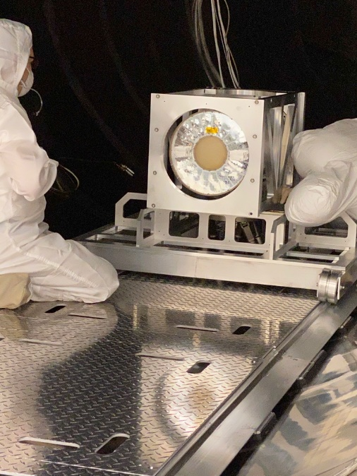
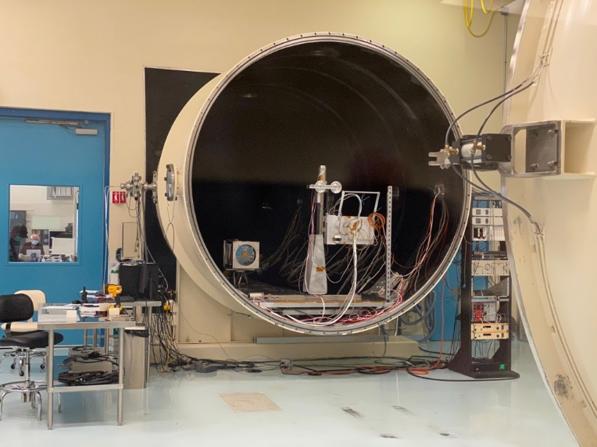
Stray Light Test Facility
X-ray calibration of the optics occurred at MSFC’s 100-m X-ray test facility
Mirror Module Assembly
X-Y stage with detector mounting plate

Slide 9
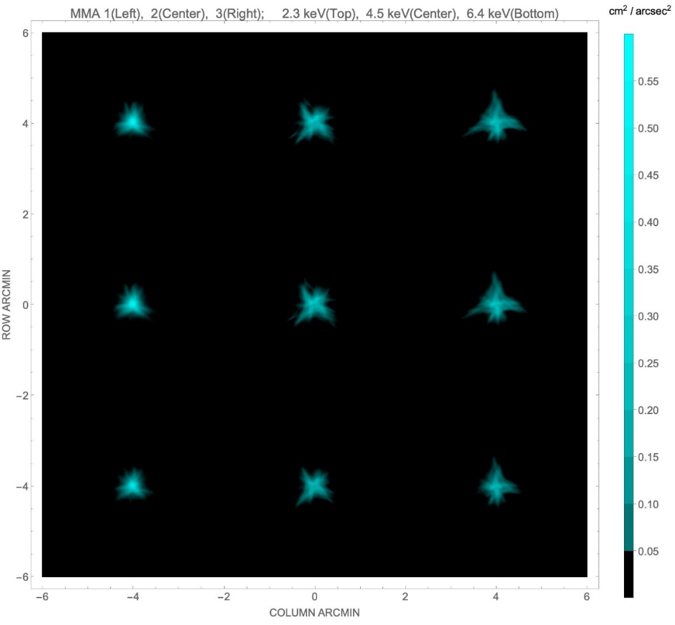
Angular Resolution
MMA | #1 | #2 | #3
6.4 keV | 18.9″ | 24.8″ | 24.2″
4.5 keV | 18.9″ | 25.0″ | 26.9″
2.3 keV | 18.7″ | 24.5″ | 26.7″
Values in the table are half-power diameters (HPDs) for the individual MMAs alone. After adjustment for alignment errors, detector resolution, focus, etc., the on-orbit system-level resolution is 28″.
At-focus images for MMA1, MMA2 and MMA3 (left to right) taken at 2.3 keV, 4.5 keV and 6.4 keV (top to bottom).

Slide 10
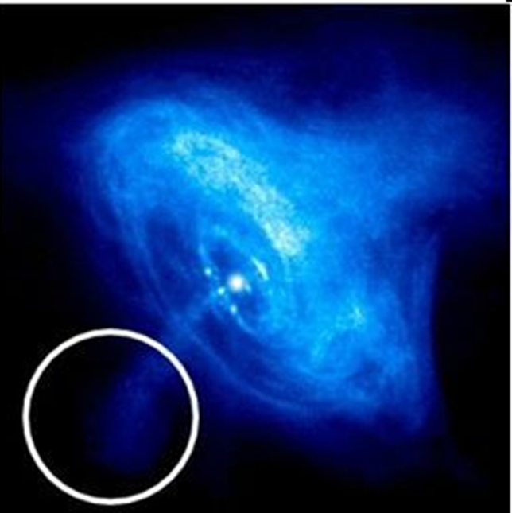
Imaging polarimetry
IXPE 30″ half-power diameter on Chandra image

Slide 11
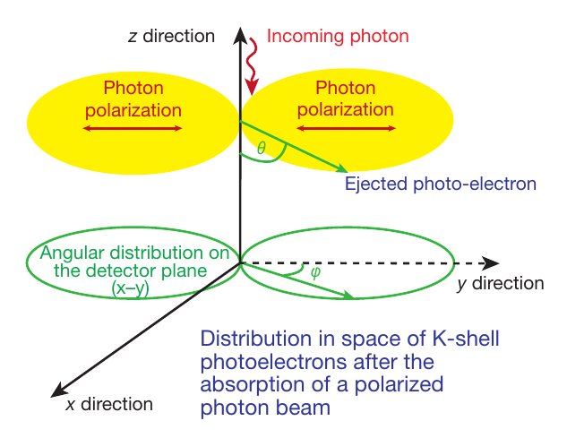
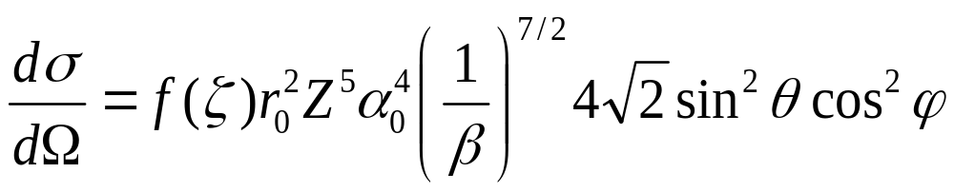
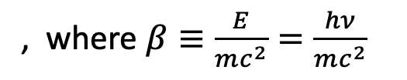
Detection Principle
The detection principle is based upon the photoelectric effect
, where $β≡\frac{E}{mc^{2}}=\frac{hν}{mc^{2}}$

Slide 12
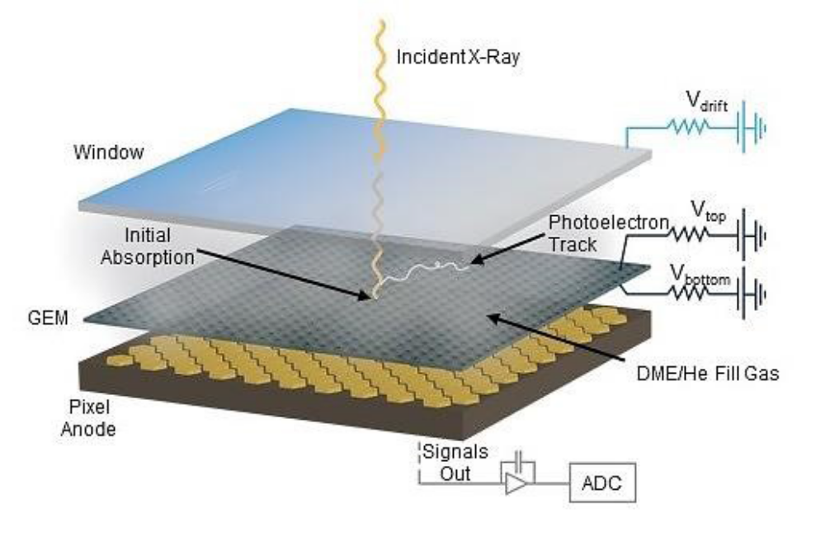
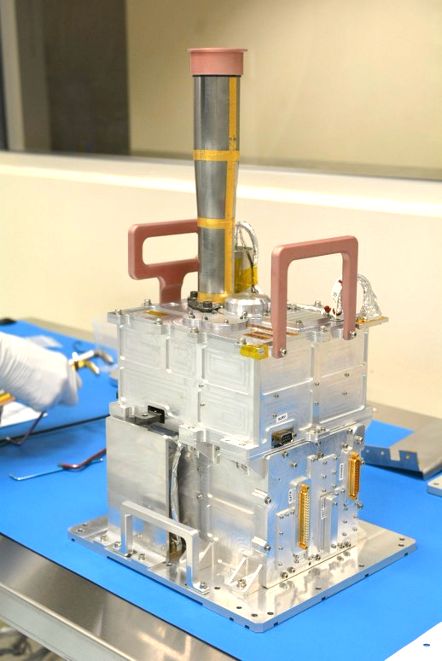
The Detector
The initial direction of the K-shell photoelectron is determined by the orientation of the incident photon’s electric vector
X Rays In
Collimator
Gas Pixel
Detector
Electronics
The distribution of the photoelectron initial directions determines the degree of polarization and the position angle

Slide 13
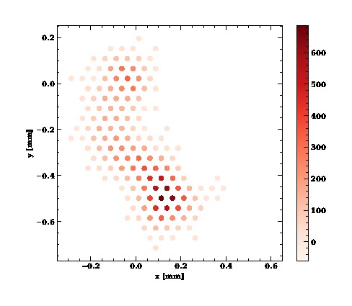

Analysis Based upon Neural Networks
Baseline moments analysis is a simple, effective, long-studied and well-understood method of extracting information from ionization tracks made by a photo-electron in the detector gas
Machine Learning (neural-network) techniques can extract more information from each track
  Improves position-angle (PA) measurements, especially at high energy
  Computes statistical and reconstruction errors for each event
  Mildly improves estimates of the energy and conversion point of each event

Slide 14
Detector Properties
Parameter | Value
Sensitive area | 15 mm × 15 mm (13 x 13 arcmin)
Fill gas and asymptotic pressure | DME @ 0.656 atmosphere
Detector window | 50-µm thick beryllium
Absorption and drift region depth | 10 mm
GEM (gas electron multiplier) | copper-plated 50-µm liquid-crystal polymer
GEM hole pitch | 50 µm triangular lattice
Number ASIC readout pixels | 300 × 352
ASIC pixelated anode | Hexagonal @ 50-µm pitch
Spatial resolution (FWHM) | ≤ 123 µm (6.4 arcsec) @ 2 keV
Energy resolution (FWHM) | 0.57 keV @ 2 keV (∝ √E)
Useful energy range | 2 - 8 keV

Slide 15
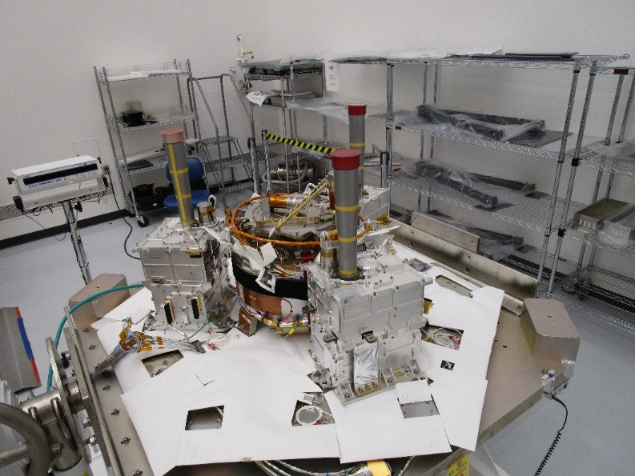
The Detectors
The Detectors mounted to the spacecraft top deck at Ball Aerospace

Slide 16
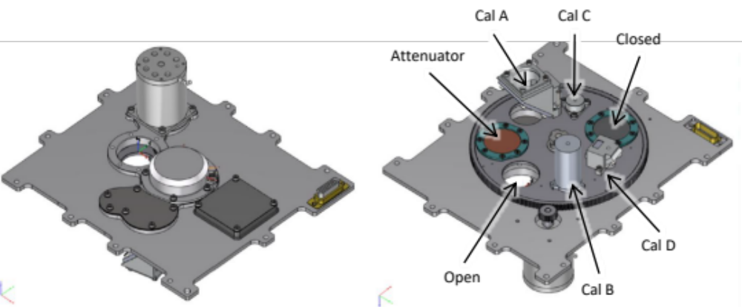
Filter Calibration Wheel Assembly
Filter and Calibration Wheel (FCW), providing open, attenuated, and closed positions, plus four ⁵⁵Fe-powered calibration sources:
  Cal A – Bragg-reflected polarized 2.98-keV (Ag-L𝛼 fluorescence) and 5.89-keV (Mn-K𝛼)
  Cal B – unpolarized 5.89-keV spot
  Cal C – unpolarized 5.89-keV flood
  Cal D – unpolarized 1.74-keV (Si-K𝛼 fluorescence) flood

Slide 17
Minimum Detectable Polarization (MDP)
R_{S} is the observed source counting rate
R_{B} is the observed background counting rate
t is the integration time
M is the modulation factor—i.e., the amplitude of the variation of the ensemble of position angles for a 100% polarized source

Slide 18
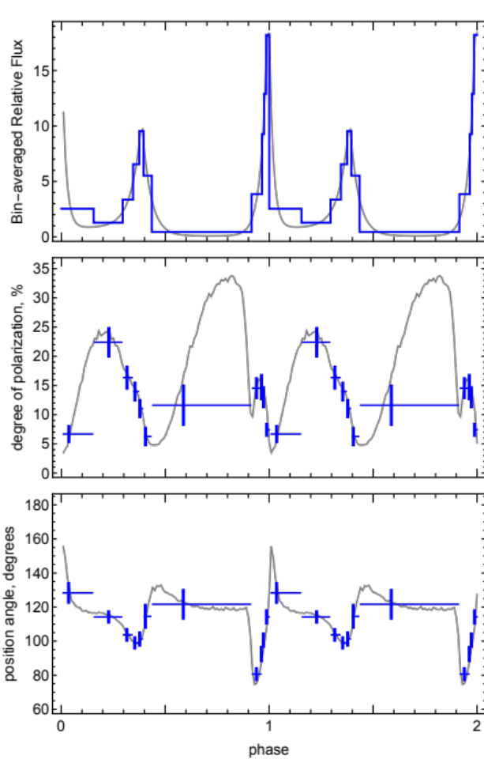
Radio Pulsars
Radio Pulsars
  Perform X-ray phase-resolved polarimetry to test models for a radio pulsar’s
  X-ray emission
    Grey is optical, blue is IXPE
Emission geometry and processes are still unsettled.
Competing models predict differing polarization behavior with pulse phase.
X-rays provide a clean probe of geometry.
Absorption likely more prevalent in visible band.
Radiation process entirely different in radio band.
  Recently discovered no pulse phase-dependent variation in polarization degree and position angle @ 1.4 GHz.
140-ks observation gives ample statistics to track polarization degree and position angle.

Slide 19
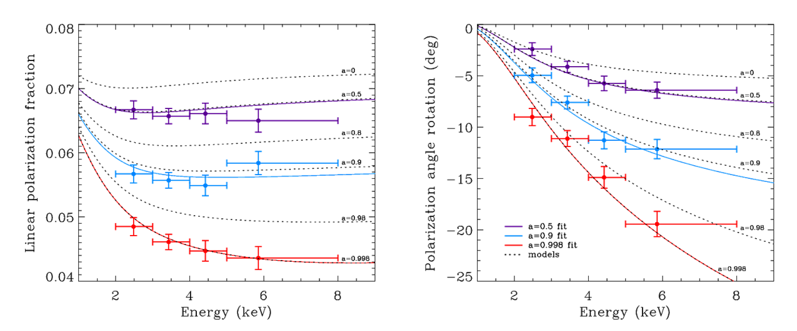
Microquasars
Microquasars
  Perform X-ray spectral polarimetry on microquasars to use the position angle to help localize the emission site (accretion disk, corona, jet)
  For a micro-quasar in an accretion-dominated state, scattering polarizes the disk emission.
  Polarization rotation versus energy is greatest for emission from inner disk.
    Inner disk is hotter, producing higher energy X-rays.
  Disk orientation from other experiments may be used to constrain GRX1915+105 model.
    a = 0.50±0.04; 0.900±0.008; 0.99800±0.00003 (200-ks observation)

Slide 20
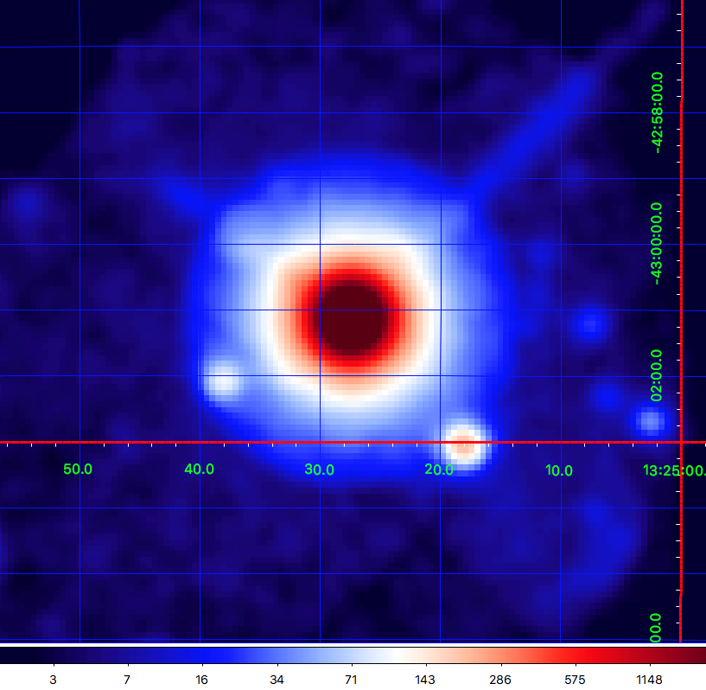
Active Galaxies: Cen A
Active galaxies are powered by supermassive BHs with jets
  Radio polarization implies the magnetic field is aligned with jet
  Different electron-acceleration models predict different dependence in X-rays
Region | MDP₉₉
Core | 1.4%
Knots C+F+G | 21%
ULXs | 25%, 15%
ULX sources

Slide 21
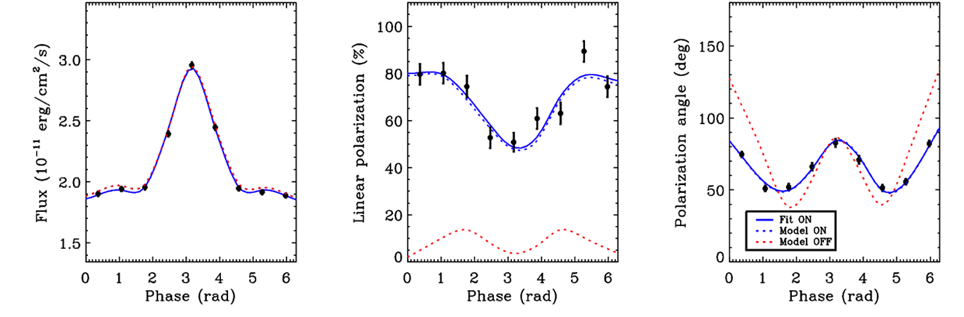
Test QED
Study magnetars (pulsing neutron stars with magnetic fields up to 10¹⁵ Gauss)
  Non-linear QED predicts magnetized-vacuum birefringence
    Refractive indices of the two polarization modes differ from 1 and from each other
    Impacts polarization and position angle as functions of pulse phase, but not the flux
    Example is 1RXS J170849.0-400910, with an 11-s pulse period
    Can exclude QED-off at better than 99.9% confidence in 250-ks observation

Slide 22
Conclusion
    We are all looking forward to opening a new window on the sky by adding image resolved polarimetry to our arsenal of tools to study the X-ray emission from astrophysical sources.

