Slide 1
Integrating Data Sources for Higher Resolution Surface
Air Quality Estimation
Carl Malings^{1,2,3} Stephen E. Cohn¹ K. Emma Knowland^{1,2} Christoph A. Keller^{1,2}
¹Global Modeling and Assimilation Office, Goddard Space Flight Center, Greenbelt, MD, USA
²Universities Space Research Association, Columbia, MD, USA
³NASA Postdoctoral Program Fellow, Goddard Space Flight Center, Greenbelt, MD, USA
American Meteorological Society 101st Annual Meeting, 2021
Notes:
Hello. In this presentation, I will talk about my ongoing work on Integrating Satellite Retrievals of Air Pollutants with Global Atmospheric Chemistry Modeling and Ground Monitoring Data for City-Scale Air Quality Estimation and Short-Term Forecasting.
(0:12; 0:12 Total)

Slide 2
Air Quality
Number of deaths by risk factor, World, 2017
Why is air quality important?
Major risk factor for human mortality
What do we need to know?
real-time (or near real-time) forecasts to warn vulnerable populations
long term estimates for exposure studies
identifying major local sources to guide regulation
tracking impacts of mitigation strategies
How is it regulated, quantified, and tracked?
Total annual number of deaths by risk factor, measured across all age groups and both sexes.
High blood pressure
10.44 million
Smoking
7.1 million
High blood sugar
6.53 million
Air pollution (outdoor & indoor)
4.9 million
Obesity
4.72 million
Outdoor air pollution
3.41 million
Diet high in sodium
3.2 million
Diet low in whole grains
3.07 million
Alcohol use
2.84 million
Diet low in fruits
2.42 million
Diet low in nuts and seeds
2.06 million
Indoor air pollution
1.64 million
Diet low in vegetables
1.46 million
Diet low in seafood omega-3 fatty acids
1.44 million
Low physical activity
1.26 million
Unsafe water source
1.23 million
Secondhand smoke
1.22 million
Low birth weight
1.1 million
Child wasting
1.08 million
Unsafe sex
1.03 million
Diet low in fiber
873,408
Poor sanitation
774,241
No access to handwashing facility
707,248
Drug use
585,348
Diet low in legumes
534,767
Low bone mineral density
327,314
Vitamin-A deficiency
232,777
Child stunting
220,678
Diet low in calcium
184,760
Non-exclusive breastfeeding
160,983
Iron deficiency
59,882
Zinc deficiency
28,595
Diet high in red meat
24,833
Discontinued breastfeeding
10,012
0
2 million
4 million
6 million
8 million
10 million
Source: IHME, Global Burden of Disease (GBD)
CC BY
Notes:
First, why is air quality important? Worldwide, air pollution, both indoor and outdoor, is a leading cause of premature death, and is probably the single greatest environmental (as opposed to behavioral) risk factor for human health. By understanding and quantifying air quality in time and space, we can do many things to mitigate these risks, including issuing advisories to susceptible populations, tracking long-term exposures to better understand the epidemiological issues, identifying major pollutant sources and their relative impacts, and providing guidance for and evaluation of regulatory control efforts. To perform any of these goals, we need a system to measure, quantify, and track air quality. So how is this done?
(0:36; 0:48 Total)

Slide 3
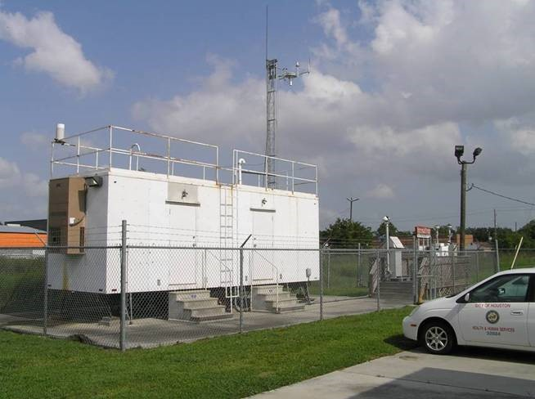
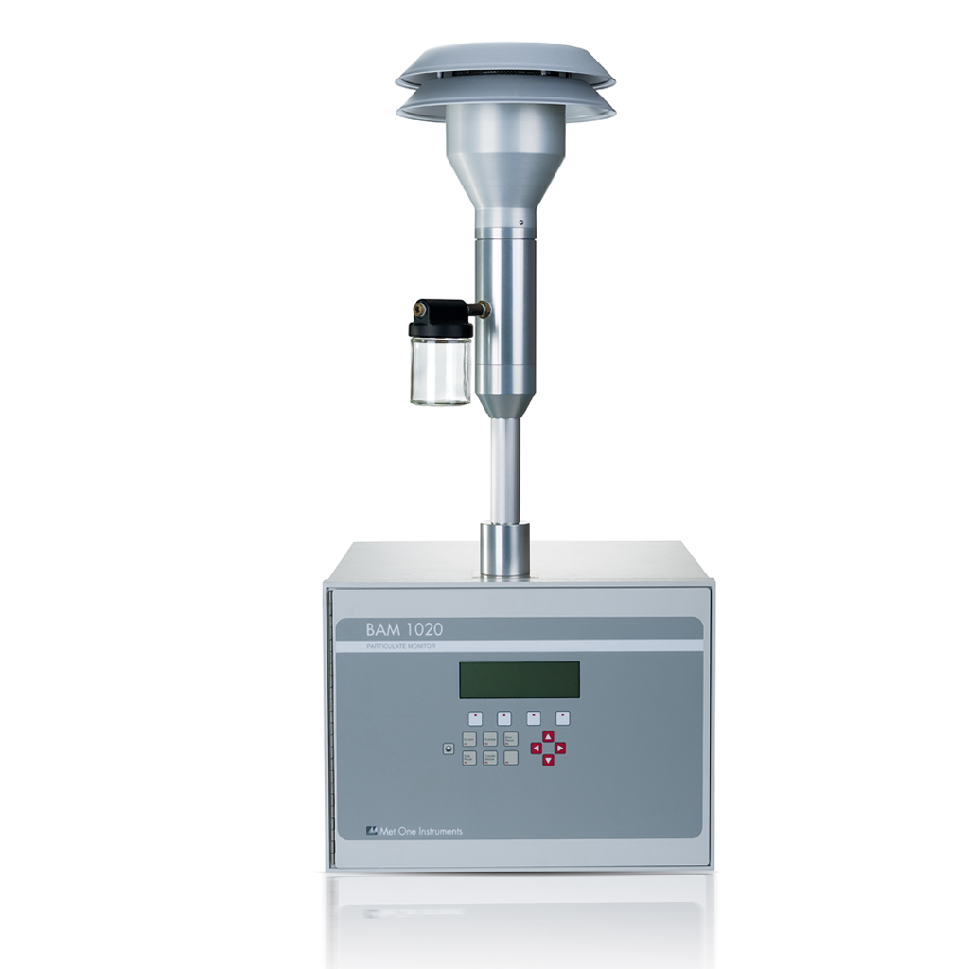
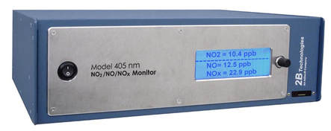
Air Quality Data – Regulatory Monitoring
MetOne BAM-1020 for Particulate Matter, metone.com
2BTech Model 405 for NOx, twobtech.com
+ accurate
- expensive
? representativity
form the “backbone” of the monitoring system, but relatively sparse
air quality monitoring trailer of the Houston Health Department, www.houstontx.gov/health/Environmental
Notes:
The typical method of air quality monitoring is to use ground-based monitoring stations, such as the one shown here. Although the instruments used at such stations are highly accurate, they are also very expensive to operate, meaning that only relatively small numbers of these stations can be used. This leads to the problem of representativity, that is, can a handful of these sites accurately represent the variability in pollution across a large city?
(0:21; 1:09 Total)

Slide 4
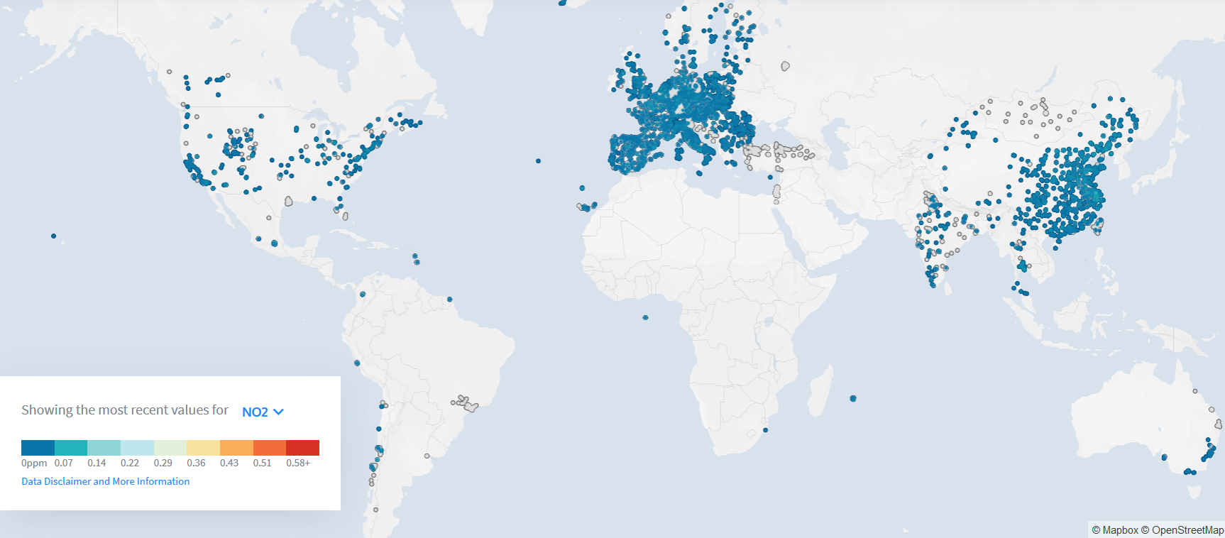
Regulatory Monitoring is Inconsistent & Insufficient
DENSE
Less Dense
sparse or
intermittent
absent
world air quality monitoring snapshot for open-source NO₂ data, 22 Sep 2020, openaq.org
Notes:
This problem is even more extreme at a global scale, where surface monitoring varies from fairly dense in some regions to practically absent in others, as shown here in a map of open-source NO2 monitoring data.
(0:12; 1:21 Total)

Slide 5
Regulatory Monitoring is Inconsistent & Insufficient
Malings et al. 2020
Notes:
In fact, if we plot estimated regional pollutant levels, on the y axis, against the density of surface monitoring, on the x axis, as I’m doing in the plot here for fine particulate matter, we see that there is a clear trend where areas where (we suspect) there is a higher annual average pollution level, there are fewer monitoring stations per capita.
(0:17; 1:38 Total)

Slide 6
Regulatory Monitoring is Inconsistent & Insufficient
Malings et al. 2020
“No one knows which city has the highest [annual average] concentration of fine particulate matter”
- Martin et al. 2019
Notes:
In fact, as noted in a recent study, we don’t even have the data to reliably answer basic questions, like which city in the world has the highest annual average concentration of fine particulate matter.
(0:11; 1:50 Total)

Slide 7
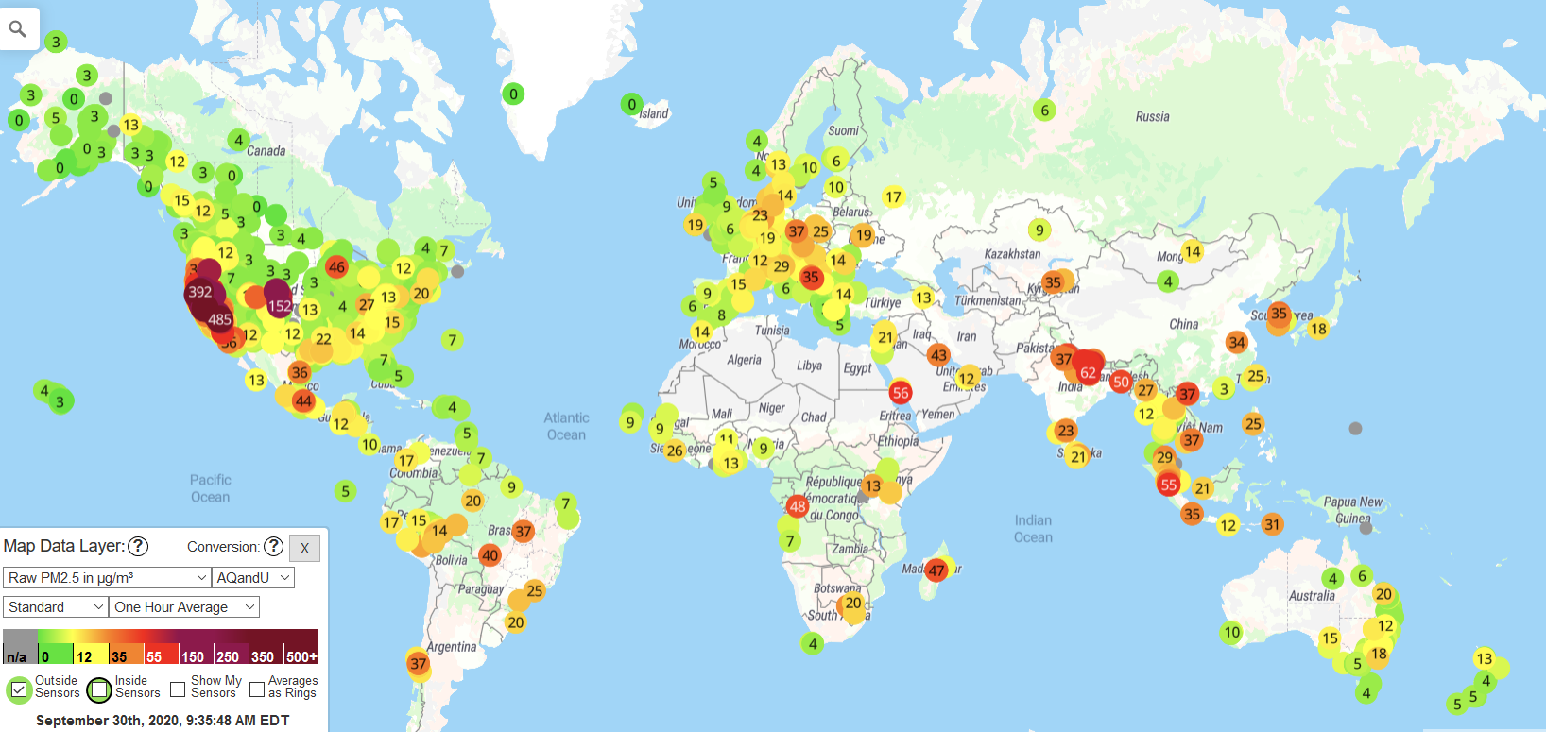
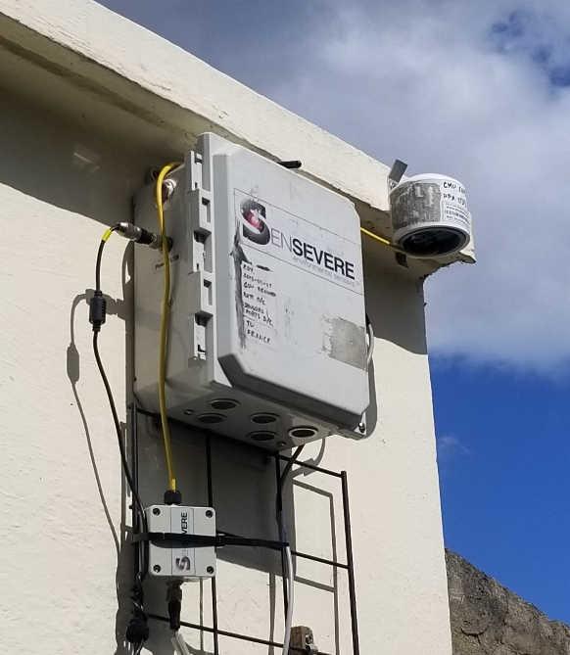
Air Quality Data – Low Cost Monitoring
+ relatively inexpensive
+ dense deployment
+ remote siting
- greater noise and bias
- cross-sensitivity
data snapshot for open-source PM_{2.5} data from “Purple Air” low cost sensor systems, 30 Sep 2020, purpleair.com
Notes:
Fortunately, there are other sources of air quality information which can help to fill in these data gaps. One source are low-cost air quality monitors, and example of which is shown in the picture on the left. Less expensive than the regulatory-grade monitors, these sensors are helping to expand ground-based air quality measurement into regions which have lacked traditional monitoring; you can see an example of this in the plot on the right of the world-wide distribution of the Purple Air low-cost particulate matter sensors. The trade-off for this lower cost is less accuracy and more biases and cross-sensitivities compared to the regulatory instruments. However, with careful calibrations, these issues can be mitigated, and so it is hoped that in the coming years these low-cost sensors will be an important supplement to the regulatory networks for surface data gathering.
(0:40; 2:29 Total)

Slide 8
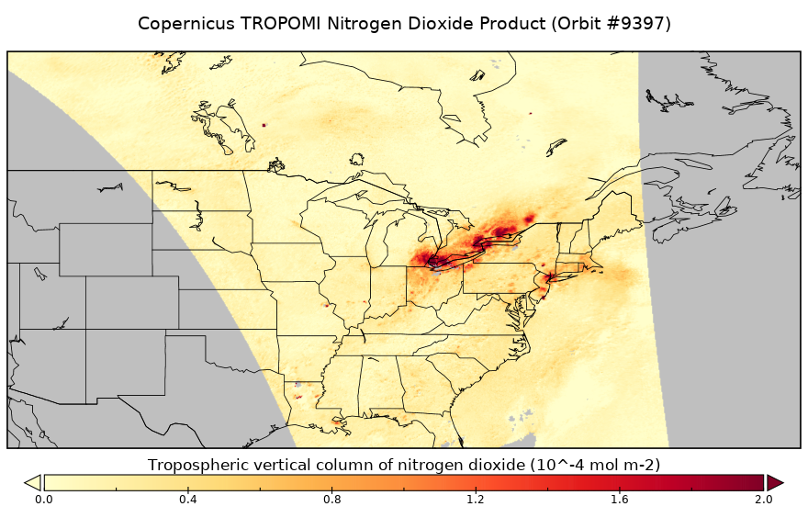
Air Quality Data – Satellite Retrievals
+ global coverage
-­ low time resolution
­ -­ column-integrated
good coverage and frequency, but need to be related to the ground-level situation
example of TROPOMI Nitrogen Dioxide satellite product, tropomi.eu
Notes:
Another source of data is satellites. The main advantage of these is their field of view, covering basically the entire planet for polar-orbiting satellites. On the left, I’m showing example tropospheric column NO2 data from the TROPOMI instrument aboard the European Space Agency’s Sentinel-5 Precursor Satellite. One limitation of satellite data like this is that there are only one or two passes of the satellite per day, providing snapshots of air pollution at specific times, but not the complete picture of how concentrations change throughout the day.
(0:28; 2:56 Total)

Slide 9
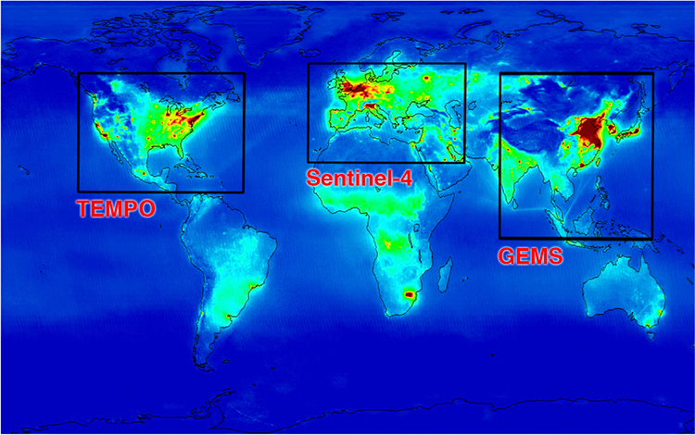
Air Quality Data – Satellite Retrievals
+ global coverage
-­ low time resolution
­ -­ column-integrated
good coverage and frequency, but need to be related to the ground-level situation
Future geo-stationary satellites (e.g. TEMPO) will provide much better time resolution, but only for certain regions of the globe.
proposed global coverage of geostationary satellite missions, overlaid on estimated NO₂ concentrations, http://tempo.si.edu/overview.html
Notes:
This limitation will be somewhat addressed by new geo-stationary satellites, indicated on the map here, but the trade-off is that those satellites won’t provide full global coverage. Another difficulty is that the satellites are measuring concentrations in a column-integrated way, while for air quality applications, only the bottom-most portion of this column is of immediate interest.
(0:19 Minutes; 3:15 Total)

Slide 10
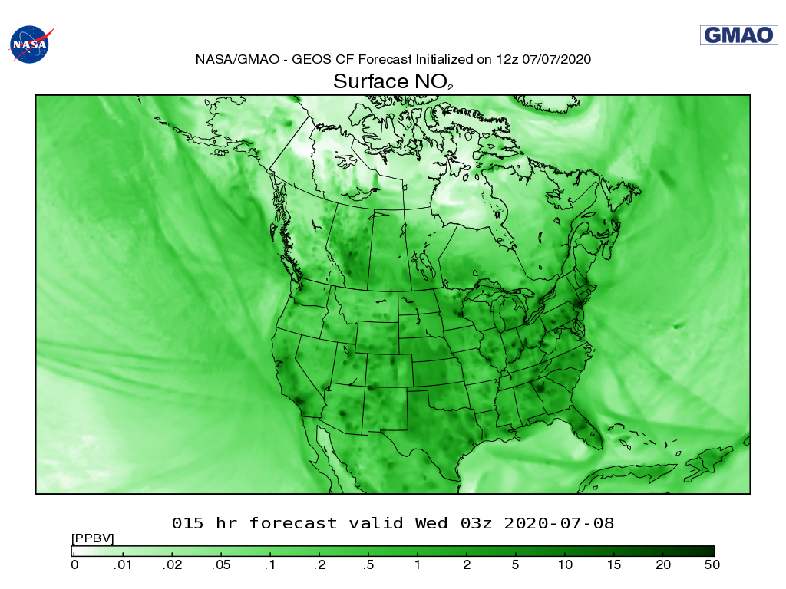
Air Quality Data – Atmospheric Chemistry Simulation Models
+ global coverage
+ forecasting capability
­ -­ limited resolution
­ -­ uncertainties in inputs
The best tool for prediction, but need the support of other data sources for accuracy
example of surface NO₂ from GEOS-CF, fluid.nccs.nasa.gov/cf
Notes:
Finally, we have atmospheric chemistry simulation models, like the GEOS-CF model developed by the Global Modeling and Assimilation Office at NASA Goddard. These provide full global coverage and have the capability of making forecasts into the near future. However, the spatial resolution of these models is limited by computational cost. Also, imperfect knowledge of sources and emissions can bias the results, and verification of model outputs against actual measurements is necessary to ensure they are performing as expected.
(0:27; 3:42 Total)

Slide 11
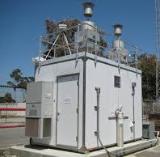
Multiple Sources of Air Quality Data
regulatory monitoring
+ accurate
- expensive
? representativity
form the “backbone” of the monitoring system, but insufficient alone
satellite retrievals
+ global coverage
-­ low time resolution
­ -­ column-integrated
good coverage and frequency, but need to be related to the ground-level situation
low-cost monitoring
+ relatively inexpensive
+ dense/remote deployment
- greater noise and bias
calibration is an open issue, but leveraging network density can offset some of these shortcomings
simulation models
+ global coverage
+ forecasting
­ -­ limited resolution
The best tool for prediction, but need the support of other data sources for accuracy
Notes:
So in summary, there are many sources of information on air quality, each with their own benefits and drawbacks. One goal of my work is to find ways to combine these data sources in a principled way to give a more complete and accurate picture of air quality which can inform localized analysis and decision-making.
(0:16; 3:57 Total)

Slide 12
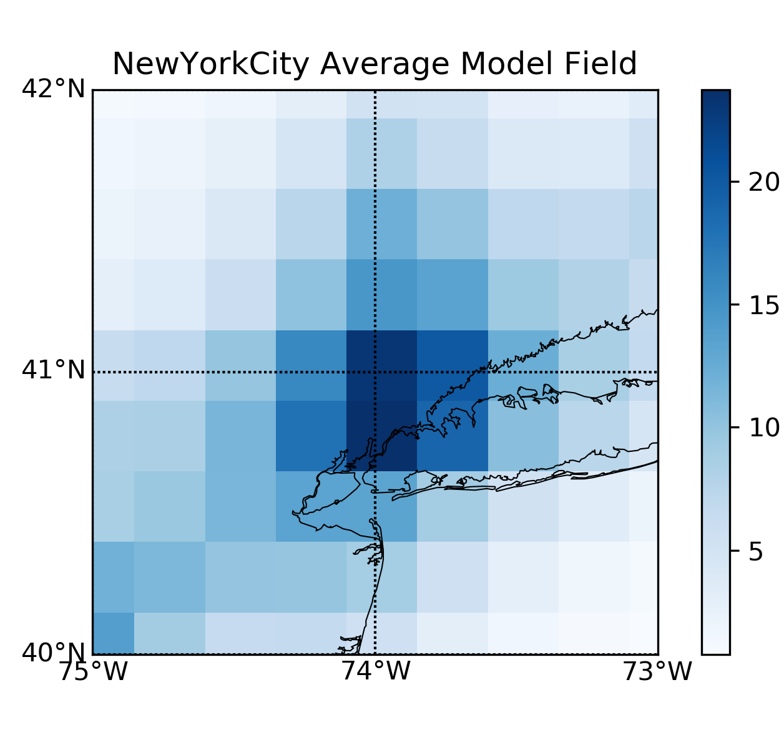


Framework for Integrating Data Sources
$$MODEL$$
time
$$t_{current}$$
$$t_{target}$$
MODEL
New York City: GEOS-CF
Notes:
The basic approach I’m proposing starts with the atmospheric chemistry model, in this case the GEOS-CF model. This provides a good temporal overview of air quality, giving estimates of the present and past conditions as well as predictions of the future. The trade-off to that, as can be seen in the example here over New York City, is a fairly coarse spatial resolution.
(0:20; 4:17 Total)

Slide 13
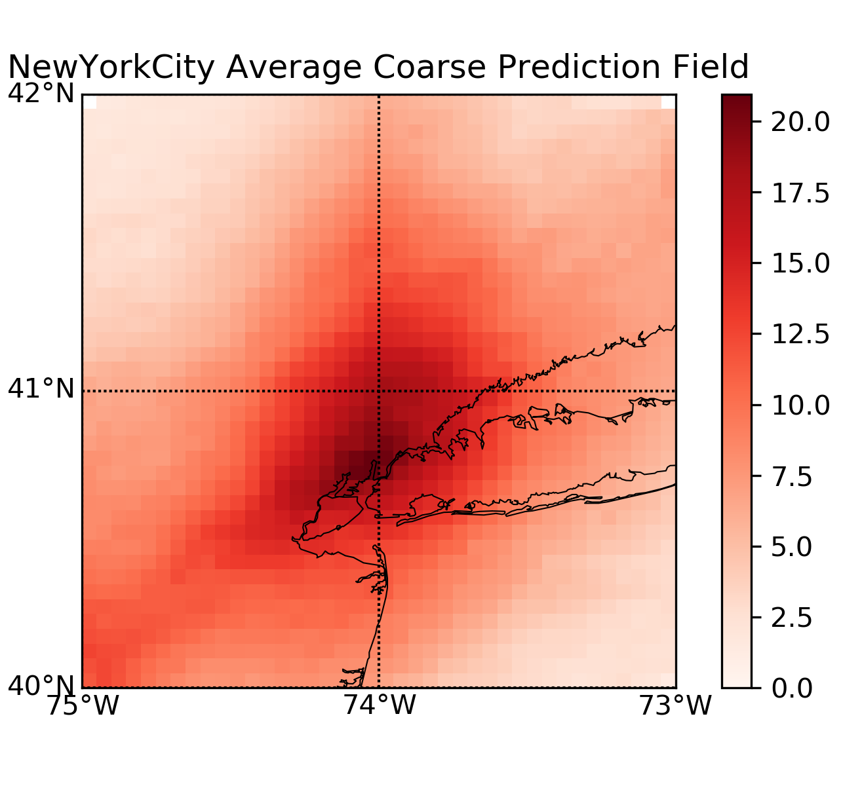

Framework for Integrating Data Sources
$$MODEL$$
$$SATELLITE$$
time
$$t_{current}$$
$$t_{target}$$
MODEL
SATELLITE
New York City: GEOS-CF
New York City: TROPOMI
Notes:
To supplement that, we’re using the next most complete spatial data source, the satellite data. As you can see in the example here, these tend to be of a higher spatial resolution compared to the simulation model, and so can (hopefully) pick up on some of the finer details of the spatial distribution of pollutants. Unlike the model, however, these are not continuous measures.
(0:19; 4:35 Total)

Slide 14
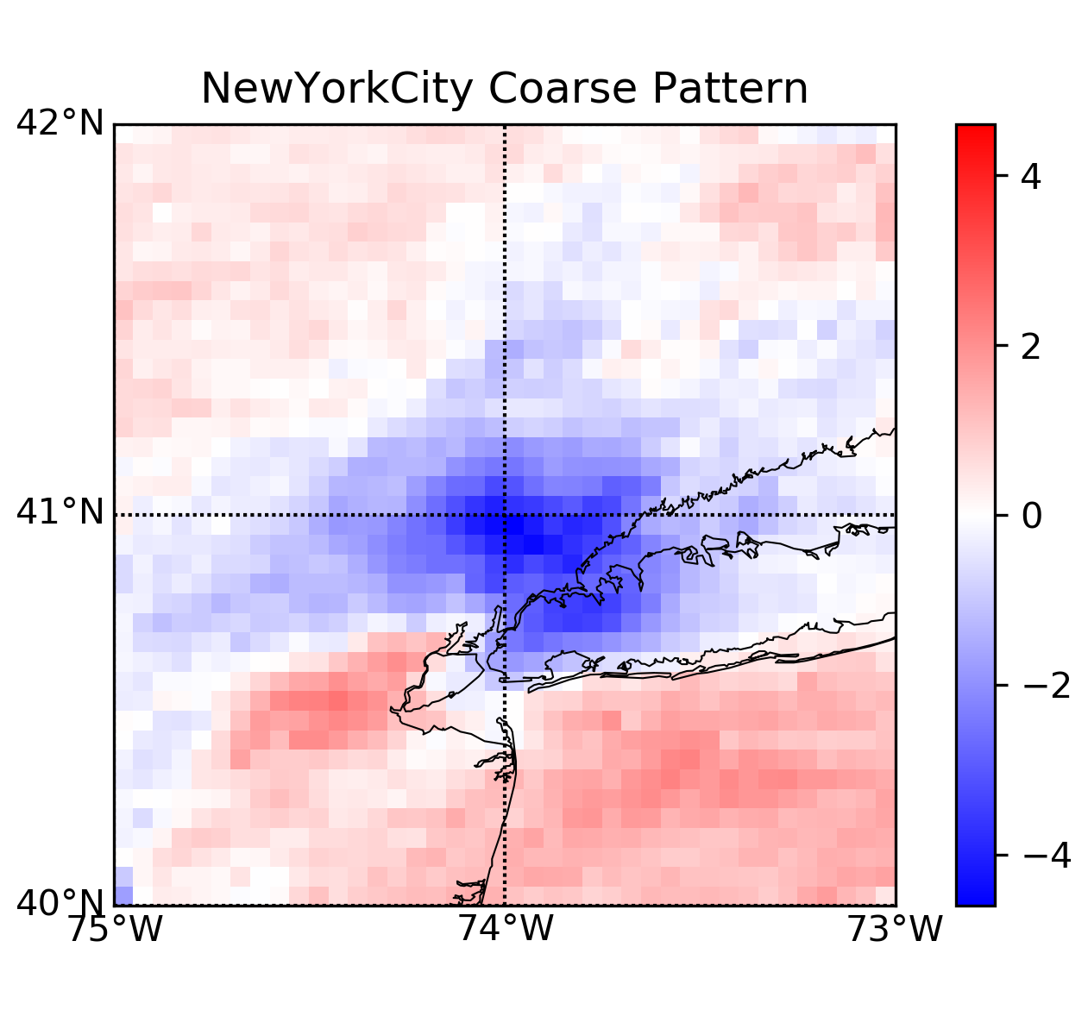

Framework for Integrating Data Sources
$$MODEL$$
$$SATELLITE$$
Typical Satellite Pattern – Model Pattern
time
$$t_{current}$$
$$t_{target}$$
$$T_{calibration}$$
MODEL
+
SATELLITE (PATTERN)
New York City: GEOS-CF
New York City: TROPOMI
Notes:
So instead of using them directly, I take the difference of the satellite “snapshots” and the model’s estimates at the same time, compile these differences from some designated calibration period, for example, the last week, and use these to extract what I’m calling the “typical pattern” in the satellite-to-model differences. I use this pattern as an estimate of the systematic spatial bias of the model due to its lower resolution, and assume this same pattern will hold true throughout the day between satellite passes and into the near future. Just to note here, with future geostationary satellites, we might be able to have a separate pattern for different times of day, and wouldn’t need to make the same assumption that the patterns were constant in time.
(0:36; 5:11 Total)

Slide 15
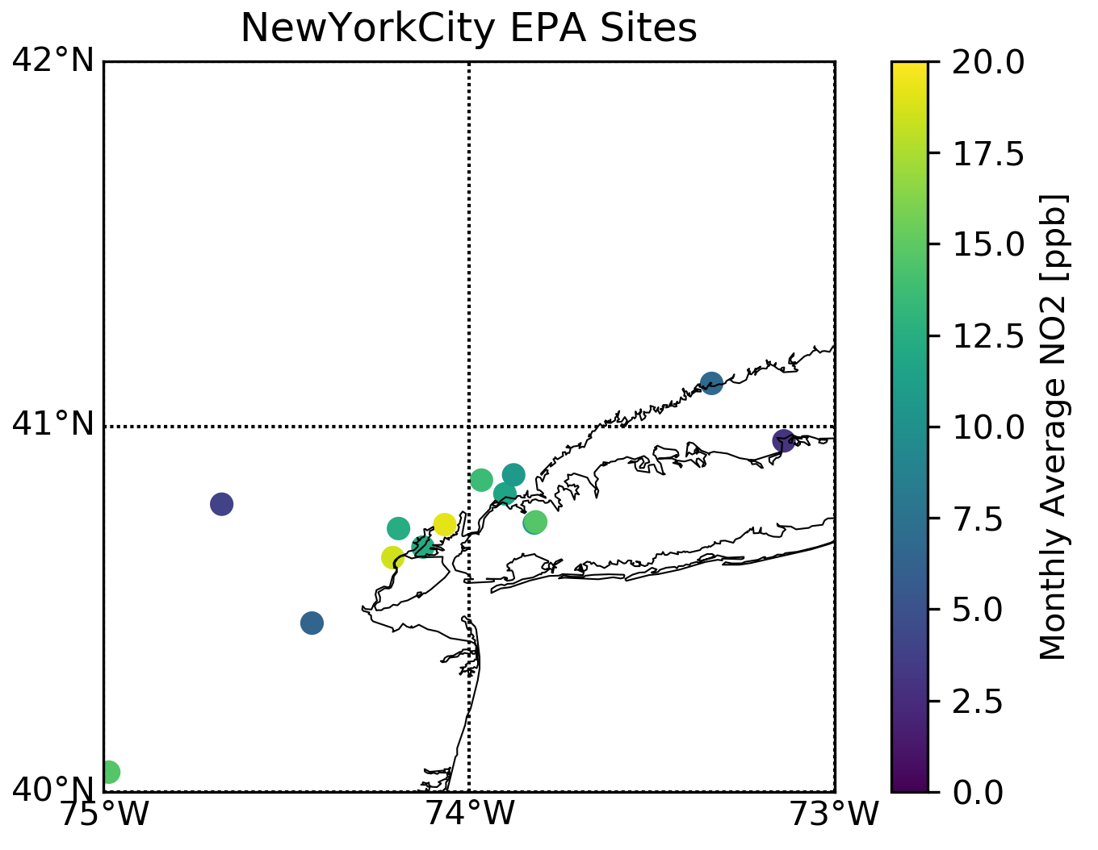

Framework for Integrating Data Sources
$$MODEL$$
$$SATELLITE$$
Typical Satellite Pattern – Model Pattern
$$GROUND$$
time
$$t_{current}$$
$$t_{target}$$
$$T_{calibration}$$
MODEL
+
SATELLITE (PATTERN)
GROUND MEASURES
New York City: GEOS-CF
New York City: TROPOMI
New York City: EPA
Notes:
Finally, I pull in the ground-level monitoring information. Using the data collected during the calibration period…
(0:07; 5:18 Total)

Slide 16
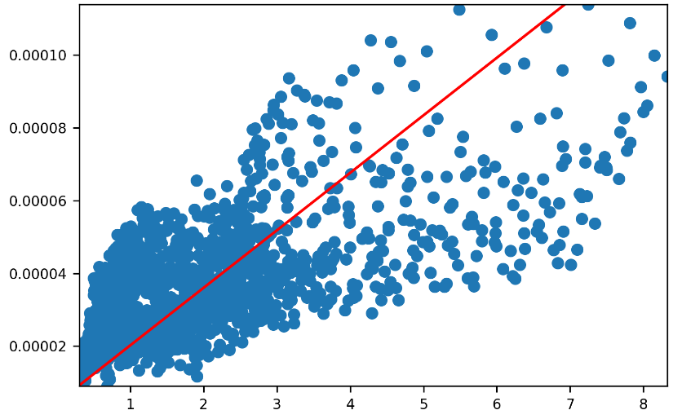
Framework for Integrating Data Sources
$$MODEL$$
Establish Relationships
$$SATELLITE$$
Typical Satellite Pattern – Model Pattern
$$GROUND$$
time
$$t_{current}$$
$$t_{target}$$
$$T_{calibration}$$
MODEL
+
SATELLITE (PATTERN)
↔
GROUND MEASURES (LINEAR FIT)
New York City: GEOS-CF
New York City: TROPOMI
MODEL + SATELLITE
GROUND MEASURES
Notes:
…I try to establish a relationship between, one the one hand, the spatial patterns predicted by the model combined with the typical pattern map from the satellites, and on the other hand, the ground-truth surface monitor data. To do this, I’m making use of linear regression techniques, with different data weightings that vary by time-of-day and forecast lead time, to allow some more flexibility in these relationships. (0:18; 5:36 Total)

Slide 17

Framework for Integrating Data Sources
$$MODEL$$
Establish Relationships
$$SATELLITE$$
Typical Satellite Pattern – Model Pattern
$$GROUND$$
$$?$$
time
$$t_{current}$$
$$t_{target}$$
$$T_{calibration}$$
MODEL
+
SATELLITE (PATTERN)
↔
GROUND MEASURES (LINEAR FIT)
New York City: GEOS-CF
New York City: TROPOMI
MODEL + SATELLITE
GROUND MEASURES
Notes:
Assuming that the relationships identified for the calibration period hold into the near future, I then make a forecast of the future surface air quality. Basically, I am using the model to drive the forecast, but using satellite data to improve the spatial resolution and using ground measurements to correct for any systematic biases due to inaccurate inputs.
(0:18; 5:54 Total)

Slide 18
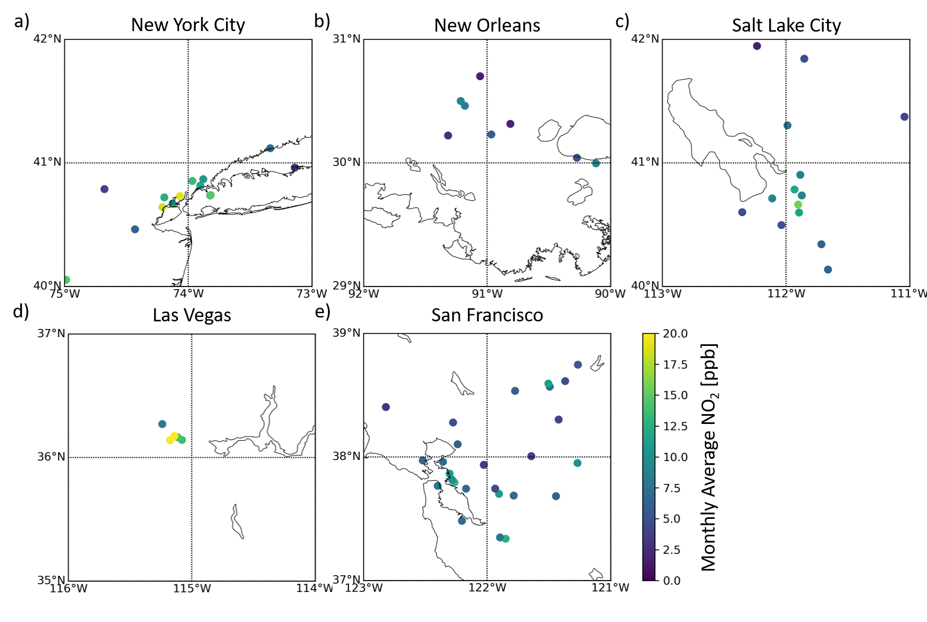
Case Studies: USA Surface NO₂ using GEOS-CF, TROPOMI
14 Sites
8 Sites
15 Sites
5 Sites
27 Sites
Time period: Sept. 2019 (1-week calibration)
Data sources: GEOS-CF, TROPOMI, EPA
Evaluation: cross-validation over ground sites
Notes:
To test out these methods, I looked at some case studies in five US cities for September 2019, and looked at estimating surface NO2 using GOES-CF model data, TROPOMI satellite data, and ground monitoring data from the US EPA. In each city, to evaluate the performance of my method, I leave out one ground station at a time from the method inputs, and use the data from all other sites to sill in that missing data. I then cycle through all the sites, and so come up with performance metrics of the method for each of the ground sites in each area.
(0:30; 6:23 Total)

Slide 19
Proposed Method Outperforms Baselines
Persistence Baseline:
Assume most recent measure of nearest ground station represents current concentration
Best performance at short lead time
Diurnal cycle leads to improvement at 24-hour lead time
best →
Root Mean Square Error [ppb]
Correlation
← best
Lead Time [hrs]
Lead Time [hrs]
Notes:
First, I’m going to present results for a baseline method, to provide a point of reference for what kind of performance might be expected. This is the “persistence baseline”, which assumes that the concentration at a given point in space and time is equal to the most recent measurement taken at the nearest available ground measurement site. This baseline therefore only makes use of the ground data source, not the satellite or model data. I’m tracking performance in terms of the correlation between the estimated and measured concentrations in the left plot and the root mean square error of these estimates in the right plot, as functions of the forecast lead time, on the horizontal axis. As you can see, this method performs better at shorter lead times, and worse at longer ones, as you would expect as the most recent measures become increasingly out of date. There is a slight rebound at 24-hours, due to the daily cycles of pollutant emissions.
(0:44; 7:07 Total)

Slide 20
Proposed Method Outperforms Baselines
Persistence Baseline:
Assume most recent measure of nearest ground station represents current concentration
Best performance at short lead time
Diurnal cycle leads to improvement at 24-hour lead time
The proposed method typically outperforms this baseline
except in terms of correlation at short lead times
Proposed method typically has consistent performance for lead times between 3 and 24 hours
best →
Root Mean Square Error [ppb]
Correlation
← best
Lead Time [hrs]
Lead Time [hrs]
Notes:
Now, here is the performance of the proposed method. Except in terms of correlation at very short lead times, the proposed method outperforms this baseline in all areas. It is also typically giving more consistent performance across lead times from about 3 to 24 hours.
(0:16; 7:23 Total)

Slide 21
Proposed Method Outperforms Baselines
Climatology Baseline:
Assume average time-of-day concentration during calibration period at nearest ground station represents current concentration
Consistent performance regardless of lead time
Absolute Bias [ppb]
Mean Absolute Error [ppb]
Correlation
Root Mean Square Error [ppb]
Notes:
Here is another baseline, this time a kind of short-term “climatology” where the estimated concentration is the average concentration at that time of day during the calibration period for the nearest ground measurement site. The performance of this baseline is very consistent in terms of lead time, since it is based only on the time of day, so here I am only showing performance at the 6-hour lead time as an example. I am plotting the performance with respect to four metrics, the correlation, root mean square error, mean absolute error, and absolute bias, and I’ve arranged these plots so that the best performance is at the center of the figure. I’m denoting the performance for each area with a cross in each plot, where the center of the cross indicates the median by each metric across the ground sites in the city, and the size of the arms denotes the 25 to 75 percentile ranges of the metrics across the ground sites. So, basically, the closer to the center each cross is, the better the performance, and the smaller the cross is, the more consistent the performance is across locations within an area.
(1:00; 8:23 Total)

Slide 22
Proposed Method Outperforms Baselines
Climatology Baseline:
Assume average time-of-day concentration during calibration period at nearest ground station represents current concentration
Consistent performance regardless of lead time
The proposed method typically outperforms this baseline
in terms of median metrics across ground measurement sites
Proposed method typically
reduces variability in metrics
of accuracy (RMSE & MAE) as compared to the baseline
Absolute Bias [ppb]
Mean Absolute Error [ppb]
Correlation
Root Mean Square Error [ppb]
Notes:
And now, here are the results for the proposed method. Note that these results were fairly consistent across lead times, so again, I am only showing the 6-hour lead time performance as an example. The performance has again been improved over the baseline, indicated by the crosses moving closer to the center. Also, in terms of the accuracy metrics of root mean square error and mean absolute error, the consistency of the performance has typically improved, indicated by the shortening of the horizontal bars of the crosses for many areas.
(0:30; 8:53 Total)

Slide 23
Residual Correlations in Surface Concentrations
Residual Correlation:
Errors between estimated and measured concentrations were found to be correlated in space and time.
Simplified models (exponential) for spatial and temporal correlation empirically fit from data
Final Updating Step:
Predictions are updated using estimated spatio-temporal correlations and the latest available ground-based measurement data
Residual Spatial Correlation (New York City, 1hr Lead Time)
Residual Temporal Correlation (New York City, 1hr Lead Time)
Notes:
I also wanted to point out an additional improvement to this result that can be made by looking at the residual correlation structure, that is, by looking at the errors between the predictions made using the proposed method and the ground-truth measurements, and examining correlations in these errors as a function of space and time. From the results here for New York City, you can clearly see trends of higher correlation at shorter spatial distances and for short time differences. By fitting very simple correlation models to these trends and using the most recent ground measurements from the calibration period to perform a final updating step to the model’s predictions, we can further refine them by taking advantage of these correlations.
(0:40; 9:33 Total)

Slide 24
Updating Based on Residual Correlations
Updating of Predictions:
Updating using assumed space and time correlation structures tends to improve performance with respect to use of the proposed method without updating
Most benefit at short lead times,
as temporal correlation is strongest
Slight benefits at longer lead times for some areas.
best →
Root Mean Square Error [ppb]
Correlation
← best
Lead Time [hrs]
Lead Time [hrs]
Notes:
Here are the results of that final updating step, as a function of lead time, in terms of the correlation and root mean square error metrics. The dotted lines indicate the performance of the proposed method without updating, as shown before, and now the solid lines indicate performance with updating. The updating improves performance by both metrics in all areas, with the greatest improvements being seen at short lead times, when the temporal correlations are strongest.
(0:24; 9;57 Total)

Slide 25
Updating Based on Residual Correlations
Updating of Predictions:
Updating using assumed space and time correlation structures tends to improve performance with respect to use of the proposed method without updating
Most benefit at short lead times,
as temporal correlation is strongest
Slight benefits at longer lead times for some areas.
→ best ←
Bias [ppb]
Local Time
Notes:
Looking more closely into these results, we can see some specific impacts of this updating. Here, I am plotting the bias in the one-hour lead time forecasts as a function of the hour of the day, in local time, for which the forecast is being made. You can see here that the method applied without updating had a substantial positive bias from about 6 to 9 AM local time in the New York City and San Francisco areas, which we suspect was due to the method not correctly capturing the rush hour pollution patterns. Note that the TROPOMI satellite passes occur in the afternoon, so there is no satellite measurement of this rush-hour pattern for the method to make use of.

Slide 26
Updating Based on Residual Correlations
Updating of Predictions:
Updating using assumed space and time correlation structures tends to improve performance with respect to use of the proposed method without updating
Most benefit at short lead times,
as temporal correlation is strongest
Slight benefits at longer lead times for some areas.
Temporal effects: bias during morning rush-hour is reduced
Correlation structures capturing
day-to-day correlations may further improve performance
→ best ←
Bias [ppb]
1 hour lead time
Local Time
Notes:
Following updating with the ground data, you can see that the forecast bias has been reduced for these morning hours. The effect of the forecast lead time is also visible, as the earlier bias is still present, whereas later in the morning, when ground measurements taken during that day’s rush hour become available, the bias can be reduced. Future geostationary satellite data might help with this issue, by capturing all or part of the rush hour concentration patterns. More sophisticated temporal correlation structures could also be used, which would allow for measurements of the previous day’s rush hour concentrations to play a role in updating today’s forecasts in order to reduce this bias further.
(1:15; 11:12 Total)

Slide 27
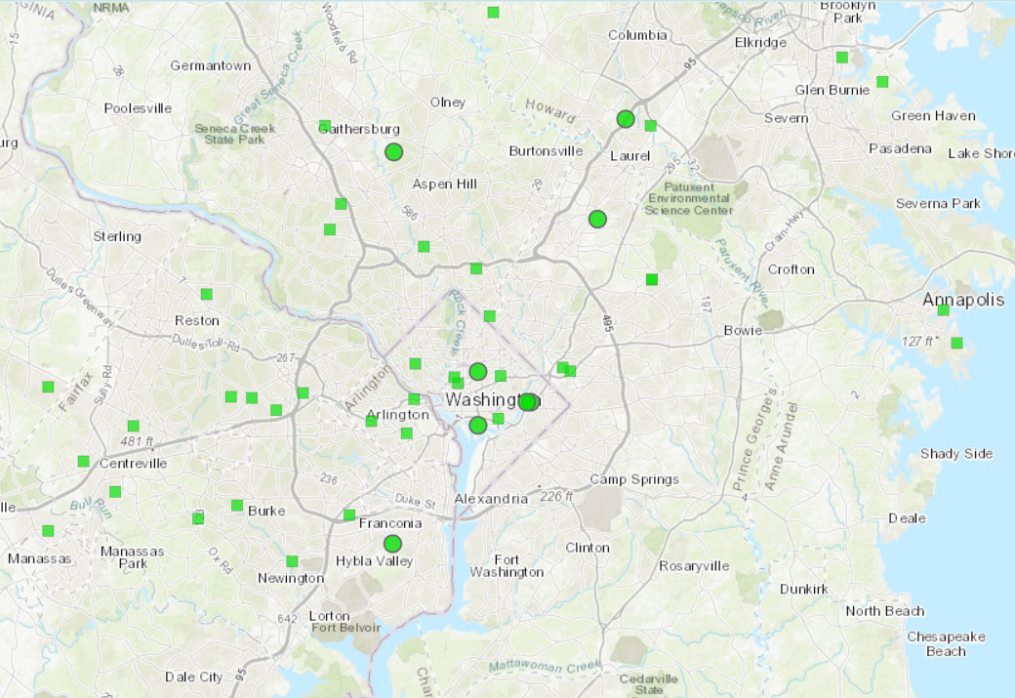
Ongoing and Future Work
Sensitivity analysis
How sensitive is predictive performance to number & placement of ground monitors?
Incorporating low-cost sensor data
Can large numbers of ground stations with lower data quality still improve performance?
Closing the loop to data assimilation
Can these results guide the assimilation of different measurements into models?
Regulatory Monitors: 8
Low-Cost Sensors: 37
PM_{2.5} monitoring data, EPA Fire and Smoke Map, 06 Oct 2020 https://fire.airnow.gov/
Notes:
I’d like to conclude with some next steps for this work. Broadly, it is important to understand the sensitivities of these results to various factors, including applications to different cities in different seasons, and ultimately application to different pollutants besides NO2. More specifically, I am interested in how sensitive the performance is to the number and positioning of the ground stations. I think that, clearly, if the ground measurements are not representative of the area as a whole, this approach will suffer, but determining what if any is the critical density or spacing of these ground stations to achieve good performance is an important question to answer.
This point is also related to the incorporation of low-cost sensor data. As I alluded to earlier, and as you can see from the map here for the Washington DC area, low-cost sensors have the potential to vastly increase the number of ground monitoring sites, which could certainly be a benefit to this method. However, we need to take care when incorporating these data, recognizing that they may not be comparable to regulatory-grade measurements.
Finally, as a long-term goal, we would like to close the loop to data assimilation in terms of incorporating the ground and satellite observations back into the atmospheric chemistry models to help drive them to a more accurate representation of reality. These methods might provide guidance for those efforts, for example by identifying more useful measurements or helping to relate the high-resolution satellite and ground data sources to the lower spatial resolution at which the model operates.
(1:15; 12:27 Total)

Slide 28


Thank You
Live Q&A: Tuesday, January 12th, 2021, 1:10PM Eastern US Time
This research was supported by an appointment to the NASA Postdoctoral Program at the Goddard Space Flight Center, administered by USRA through a contract with NASA.
Notes:
Thank you for your attention. If you have any questions, the live Q&A session is scheduled for 1:10 PM Eastern Time on Tuesday, January 12th.
(0:09; 12:36 Total)

