Slide 1
Uncertainty Quantification of Inducer Eigenvalues using Conditional Assessment of Models and Modal Test of Simpler Systems
Paper #10505
Andy Brown, Jen DeLessio, Tim Wray
NASA/Marshall Space Flight Center
ER41/Propulsion Structural & Dynamic Analysis
February, 2021
IMAC-XXXIX

Slide 2
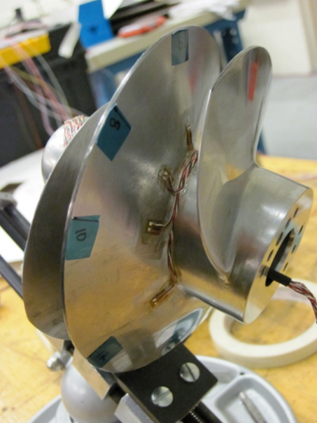
Introduction & Motivation
RS-25 rocket engines powering SLS 1st Stage combust oxygen and hydrogen, stored as liquid (LO2 and LH2).
Inducer in low-pressure fuel pump takes LH2 at tank pressure & increases several hundred psi.
As with any inducer, cavitation exists, but additional high-frequency, “higher-order cavitation (HOC)” generated here.
  causes acoustic wave emanating upstream & downstream at frequency of 6.4-6.7 engine speed.
  magnitude high enough to potentially cause high resonant response on impinging structures such as inducer blades.
Typical Rocket Engine Turbopump Inducer (not to scale)
RS-25 is upgraded SSME, which had >1M sec of testing, but RS-25 has different operating conditions causing significantly more time in HOC.
Structural dynamic assessment therefore required.
Natural frequency of excitable modes have large uncertainty, though, due to many complicating factors.

Slide 3
Complicating Factors cause large Uncertainty in ω_{n}
Factors
  Large adjustment of E_{Ti} due to cryogenic operating temperature.
  Fluid-added mass (FAM) of LH2
  Magnification of FAM due to tight tip clearance.
  Effect of Structural-acoustic interaction with small compressibility.
  Multi-phase fluid density where liquid is cavitating.
Magnitude of effects initially estimated using some available test data and fundamental physics.
Uncertainties in each adjustment based purely on subject confidence level – “low, medium, or high”, which translated to arbitrary percentages.
Actual value of operating ω_{n} cannot
be measured due to environment,
expense of hardware.

Slide 4
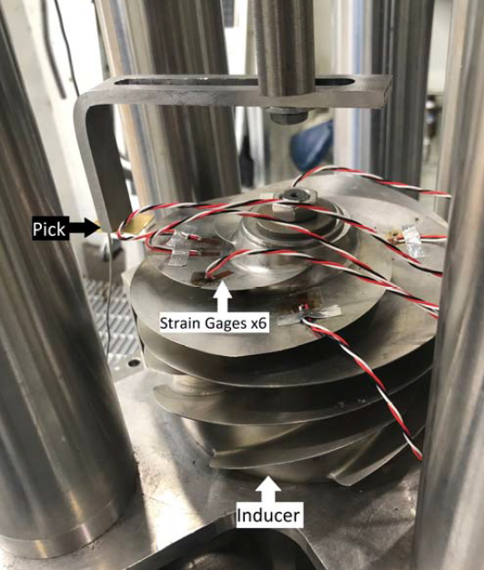
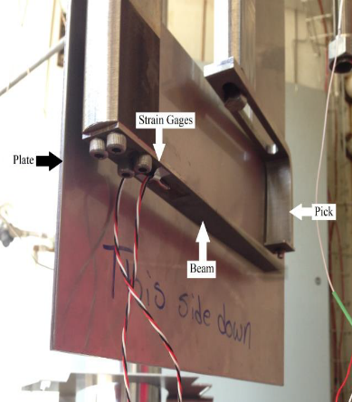
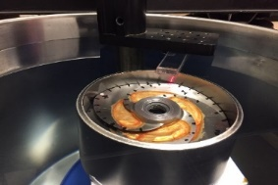
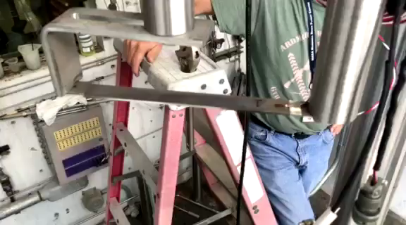
Extensive Test & Analytical Campaign Previously Documented
Ping tests in air and LH2 of cantilever beam (CBeam) made of the same Titanium alloy as the actual inducer.
Ping test of cantilever beam in LH2 with a tight tip clearance.
Modal test of stainless steel sub-scale (SS) inducer with medium tight tip clearance in water.
Modal test of SS inducer with open clearance in water,
ping test in LH2.
Campaign quantified nominal adjustments and improved fluid/structure modeling techniques, yielding test/analysis errors from 0.8-3.7%.

Slide 5
How do you Quantify Uncertainty of Structural Modes in Operation?
Extensive literature survey undertaken to identify approach.
  Atamturktur, Van Buren, Marwala looked at UQ of structural nat. freqs and modes based on correlation to primitive rv’s (updated using modal test), generating new posterior distribution of dynamic characteristics.
Mahadevan developed extensive Bayesian framework incorporating many issues in UQ discipline (aleatory vs epistemic rv propagation, sparse data, using experiment, model-form error) - very advanced, complex.
Motivation here is to only quantify uncertainty of final structural natural frequencies
  Excessively complex to apply above techniques, which focus on updating primitive rv’s and generating non-deterministic models for propagation.
Extended method used by author for UQ of SLS.
  Obtained UQ of launch vehicle primary
  flight mode given single mode from a test
  of SLS ground configuration using Quartile
  Linear Regression.

Slide 6
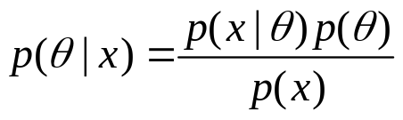
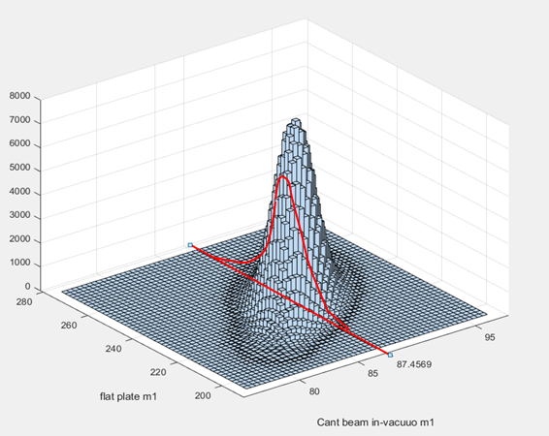
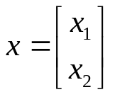
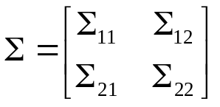


Conditional Covariance
where
Have 4 modal-tested configurations whose resulting dynamic data could be used to improve posterior distribution of full-scale inducer ω_{n}.
Using Bayes theorem:
For multi-variate random distribution, express as
Covariance matrix relating rv’s can be partitioned
Multi-variate Normal Probability Density Function with 2-D slice at given information value
Distribution of x₁ conditional on x₂ equaling a, a known vector (in our case, the vector of modal test natural frequencies) is therefore is multivariate normal (x₁| x₂=a) ~N where
Here, we obtain Covariance of nat frequencies of all models and use for inference to update variance of desired ω_{n}.

Slide 7
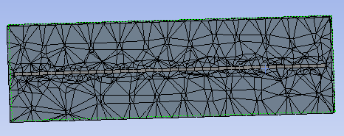
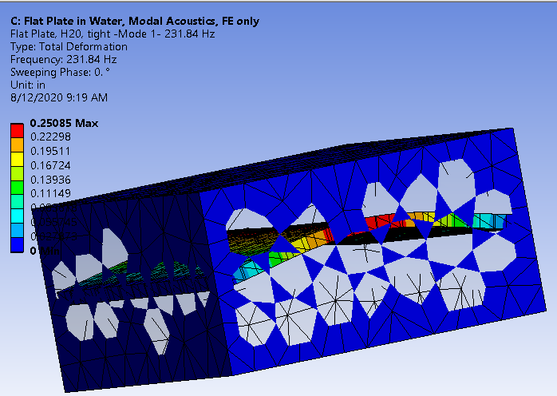
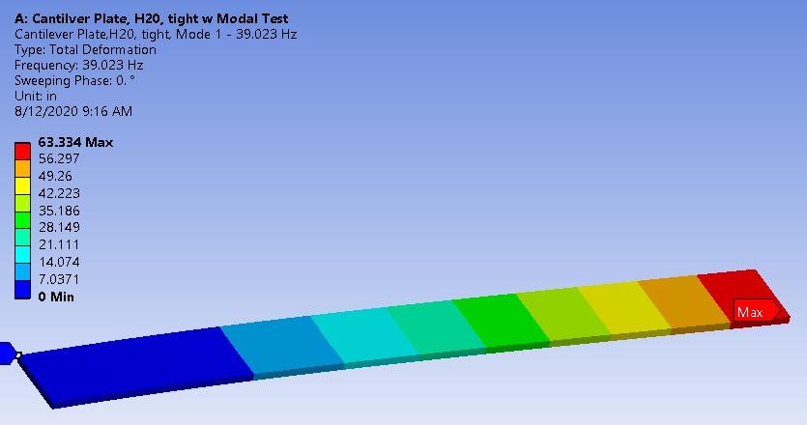
Application to Pathfinder Case
ANSYS Workbench and Six-Sigma toobox used on cantilever plate with pseudo-modal test and simply-supported plate in H20.
Eventually realized that every conceivable source of error in modal-test has to be represented by primitive rv’s, including geometric variations.
RV’s created with means of 1.0 and very large standard deviations of 0.05
  “fluid-added mass (FAM) with tight tip clearance (TC) factor”
  “cantilever plate geometric imperfection factor (GIF)”
  “flat plate geometric imperfection factor”
ANSYS response surface methodology used to
calculate correlation between eigenvalues
Pseudo-modal test results taken as one sample
of prim rv’s.

Slide 8
Pathfinder results
Correlation Matrix of Eigenvalue poor but non-negligible
CP M1 | CP M2 | SSP M1 | SSP M2
1.0 | 1.0 | .3803 | .2995
1.0 | 1.0 | .3565 | .2821
.3803 | .3565 | 1.0 | 1.0
.2995 | .2821 | 1.0 | 1.0
Calculation of Conditional Covariance performed in Matlab. Small but non-neglible improvement, reasonable considering poor correlation.
Mode | Mean | Coeff Variation | Modal Test
Cant Plate mode 1 | 39.02 Hz | 2.56% | 42.991
Cant Plate mode 2 | 258.01 | 2.49% | 278.52
 |  |  | Conditional Coeff Variation
SS Plate mode 1 | 231.9 | 2.79% | 2.40%
SS Plate mode 2 | 434.33 | 2.43% | 2.24%

Slide 9
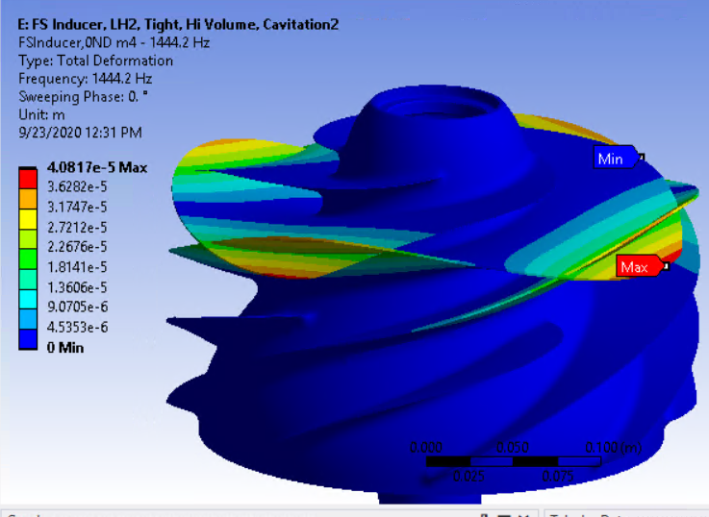
Application to Inducer
5 prim rv’s to represent modal-tested configurations
  FAM effect on liquid density
  Tip Clearance effect on liquid density, assumed to be same for LH2 & H20.
  Cryogenic effect on Ti alloy.
  Geometric imperfection effect on E of sub-scale inducer
  Geometric imperfection effect on E of tight and open Ti Cantilever Beams.
0ND and 1ND modes from SS inducer, 1st & 2nd bending modes of Cbeam chosen for correlation to FS Inducer 0ND mode.
Zero Nodal Diameter, 2nd Bending mode of FS Inducer (illustration warped).

Slide 10

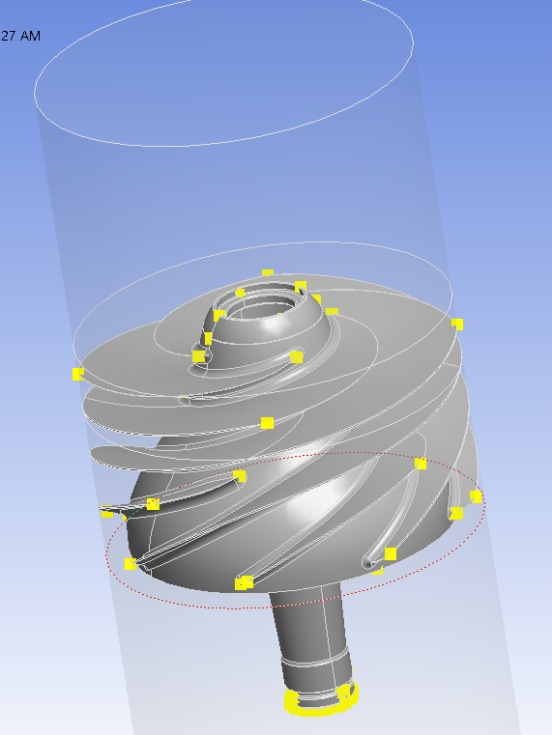






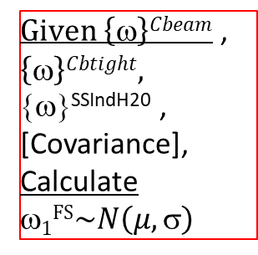

Schematic of Uncertainty Analysis Procedure
Mistakenly not used in final run.
P18,19,60,61,62 ~N($\left(μ,\text{s}\right)$
ρ^{Cbeam}$\sim N\left(μ,\text{s}\right)$
Ε$Cbeam\sim N\left(μ,\text{s}\right)$
ρ^{SSInd}$\sim N\left(μ,\text{s}\right)$
Ε$SSInd\sim N\left(μ,\text{s}\right)\sim$
Ε$FS\sim N\left(μ,\text{s}\right)$
Ansys models of 3 related, modeled, & tested structures
ρ^{FS}$\sim N\left(μ,\text{s}\right)$
54 “Design Points” – unique combinations of rv’s, manual mode tracking.
$Given \left\{\text{w}\right\}Cbeam$ , $\left\{\text{w}\right\}Cbtight,$ {ω}^{SSIndH20} , [Covariance],
Calculate ω$1\text{FS}\sim N\left(μ,\text{s}\right)$
1.000 | 0.871 | 0.465 | 0.464 | 0.590 | 0.573 | 0.716
0.871 | 1.000 | 0.588 | 0.587 | 0.682 | 0.668 | 0.557
0.465 | 0.588 | 1.000 | 1.000 | 0.979 | 0.983 | 0.058
0.464 | 0.587 | 1.000 | 1.000 | 0.979 | 0.983 | 0.058
0.590 | 0.682 | 0.979 | 0.979 | 1.000 | 0.999 | 0.207
0.573 | 0.668 | 0.983 | 0.983 | 0.999 | 1.000 | 0.188
0.716 | 0.557 | 0.058 | 0.058 | 0.207 | 0.188 | 1.000
[Covariance of all ω’s] from Ansys response surface
…

Slide 11
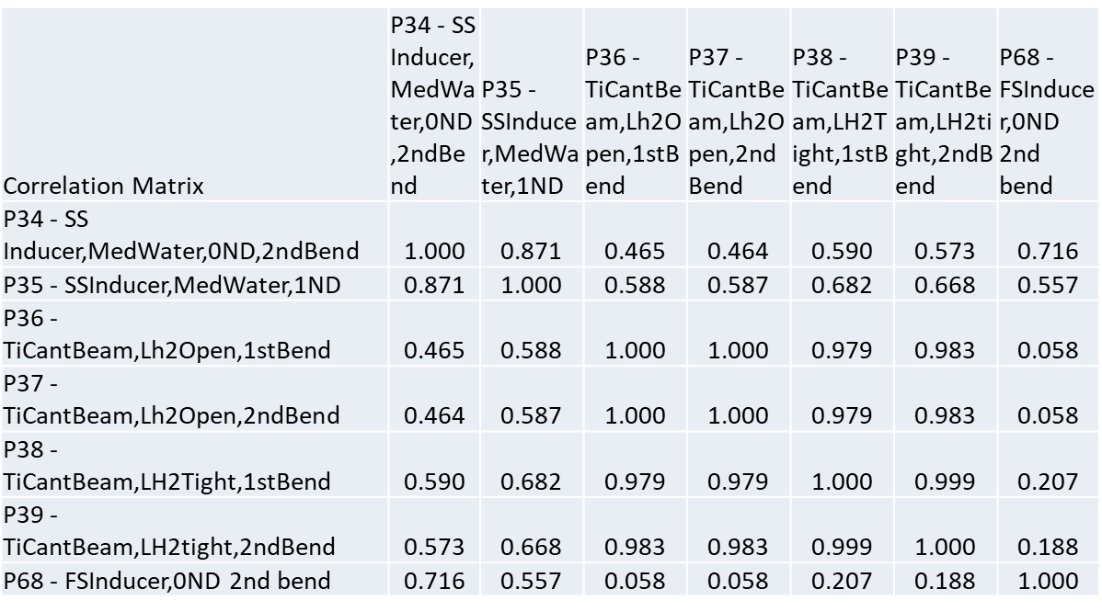
Eigenvalue Correlation
Eigenvalue Correlation Matrix shows good correlations, but not perfect, which would indicate uncertainties are not being captured.

Slide 12
Inducer Covariance Results
Posterior coefficient of variation of the FS Inducer 0ND mode of 0.68%, 3σ range of 2.04%.
  Substantially yet believably improved from the CoVar value obtained directly from propagation of the primitive rv’s of 1.18%.
Because of considerable uncertainties in methodology, this value compared with direct test/analysis errors and rough “upper bound” on uncertainty of 3% chosen for use in inducer assessment.
As this value still reduces original estimated total double-sided 3σ range of +/-4.56% of uncertainty by 3%, is of significant value to program (helps to avoid possible resonance).

Slide 13
Conclusions & Future Work
New methodology for quantifying uncertainty of a fundamental natural frequency of a complex, untested system based upon Bayesian conditional covariance of modal-tested models of simpler systems.
Number of questions remain on accuracy of the final variance value obtained:
  How many and which uncertainties to represent for each configuration
  How this value should relate to test/analysis error
  Theoretical accuracy of methodology in context of Bayesian UQ hierarchy (Mahadevan).
Future work to validate technique, particularly fabrication of simpler set of structures which uncertainty could be measured and compared against.

