Slide 1
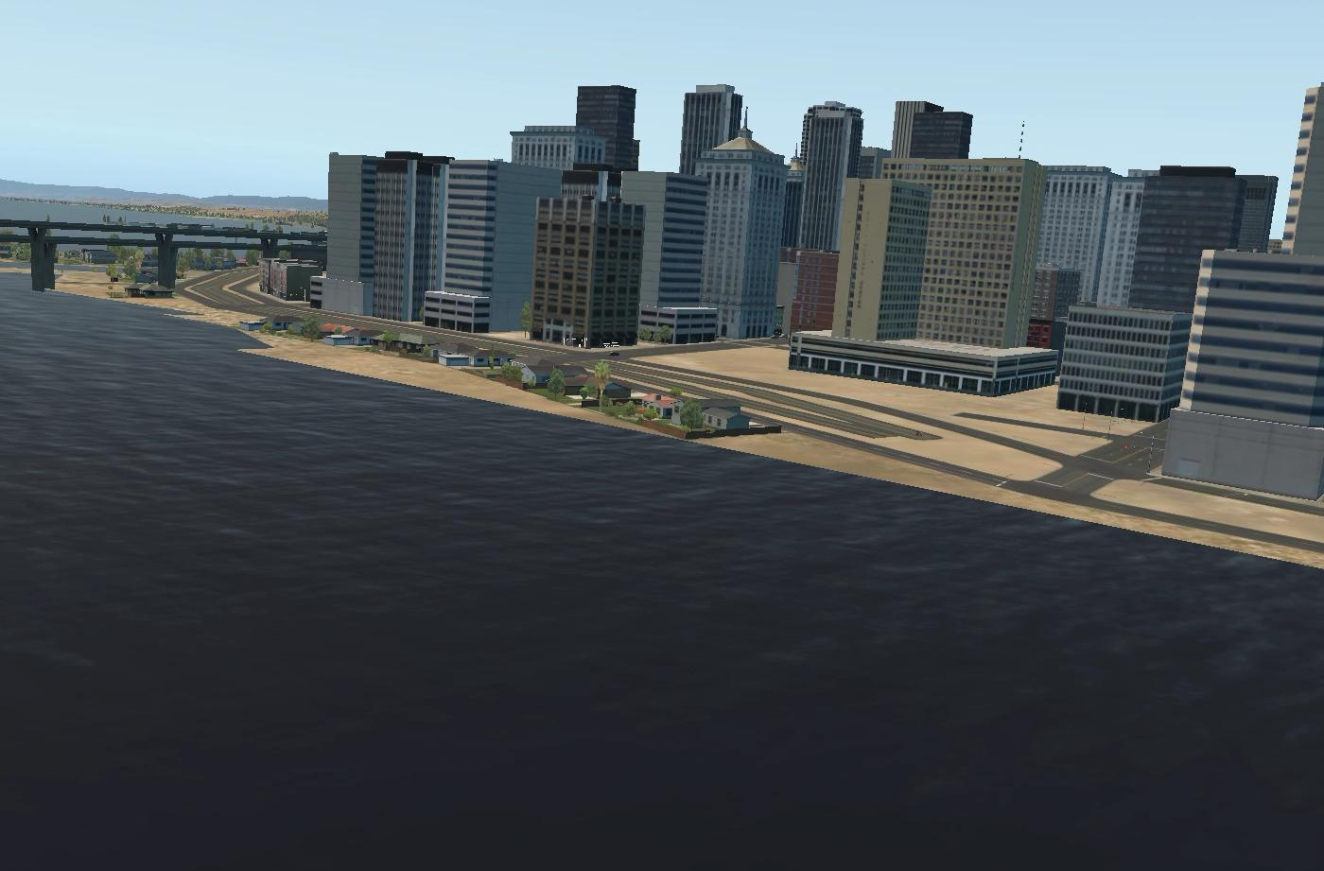


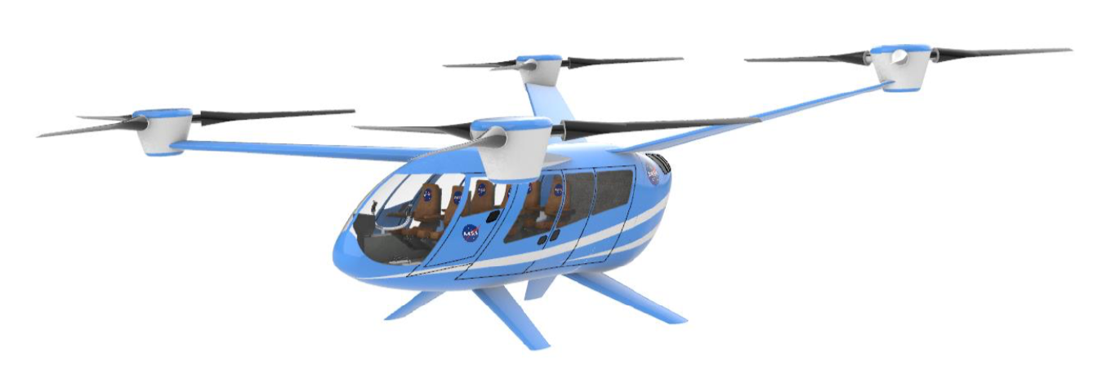

Adaptive Multi-Sensor Localization Information Fusion For Autonomous Urban Air Mobility Operations
AIAA 2021 SciTech Conference, January 11-21, 2021
Vahram Stepanyan, Thomas Lombaerts, Kimberlee Shish, Nicholas Cramer
NASA Ames Research Center
This material is declared a work of the U.S. Government and
is not subject to copyright protection in the United States.

Slide 2
Outline
Problem setup
Information content measure
Application example
Iterated Extended Kalman filter setup
Simulation results
Conclusions and recommendations

Slide 3
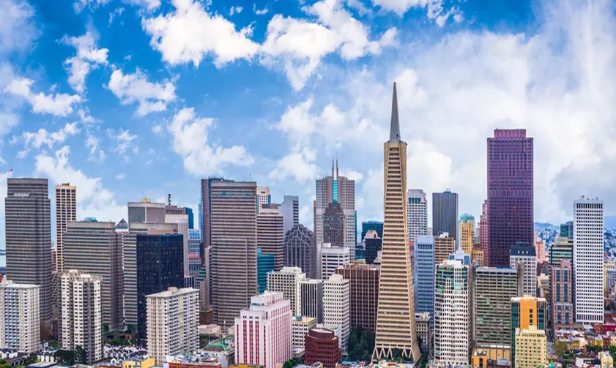
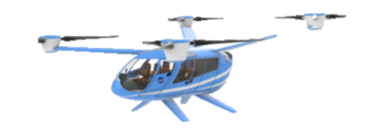
Problem Setup:
Assumption:
  Static map of urban air mobility environment
  Sensors: IMU/INS, GPS, exteroceptive (Visual, LIDAR,RADAR, IR, etc.)
  Uncertainties: bias, noise (uncorrelated zero mean Gaussian)
  Framework: Iterated Extended Kalman Filter
Objective:
  Localize the vehicle in real time adaptively fusing info
Approach:
  What information is reliable?
    Information content measure
  How to process?
    As soon as information becomes available
  Processing type
    Loosely coupled
Problem setup – Information content measure – Application example – IEKF – Simulation results – Conclusions

Slide 4
Information Content Measure
Gray scale visual images
Average intensity
Gradient
Entropy
Selected measures
Both end of gray scale spectrum does not carry much info
  White or black images need not be processed
Not much information on image structural content
  Flying objects on the skyline will not add much info
Gaussian function
of average intensity
Indicates image structural changes directions and magnitudes
  Abrupt gradient change detects edges on the image
Adds computational intensity
  Slows down the processing
Image maximum
gradient magnitude
Measures image content such as texture
  Low entropy means low variance within the image
It is totally blind to image spatial structure
  Random and linear gradient images have same entropy
Entropy of image
directional gradient
Product of selected measures = information content measure
Problem setup – Information content measure – Application example – IEKF – Simulation results – Conclusions

Slide 5
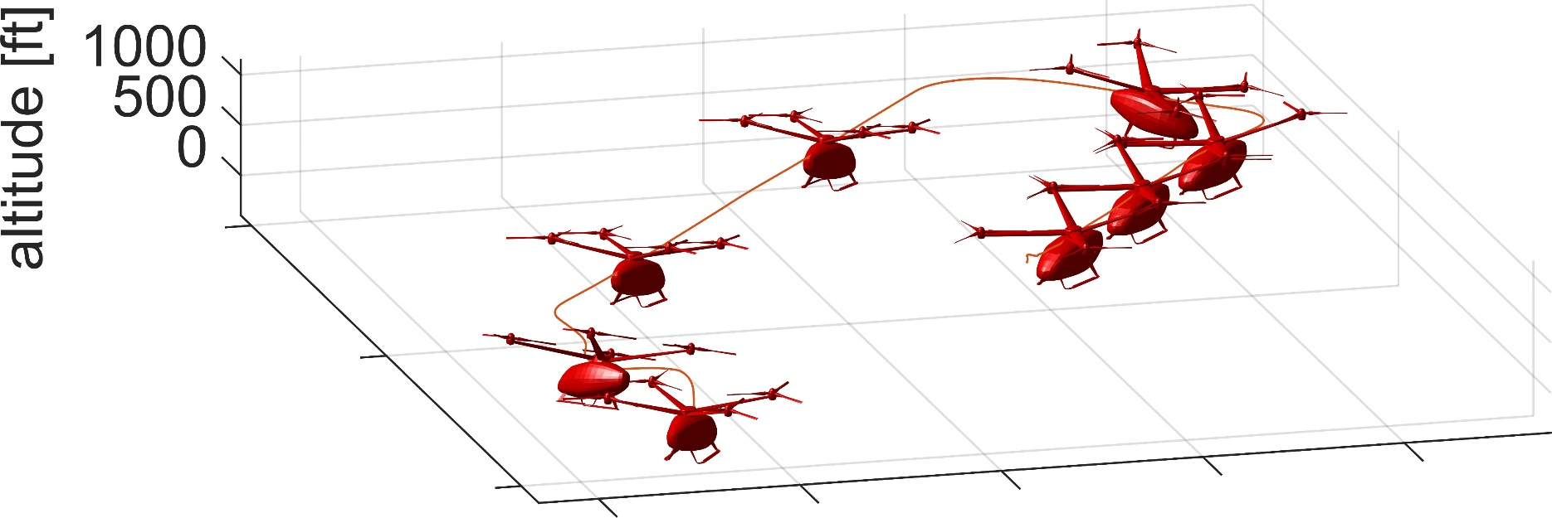
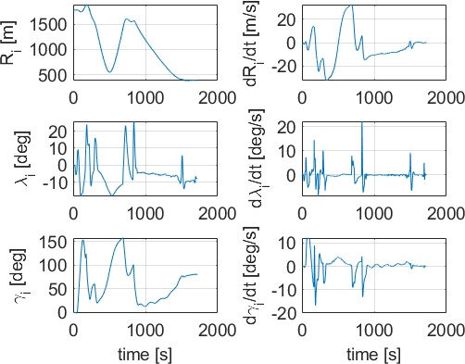
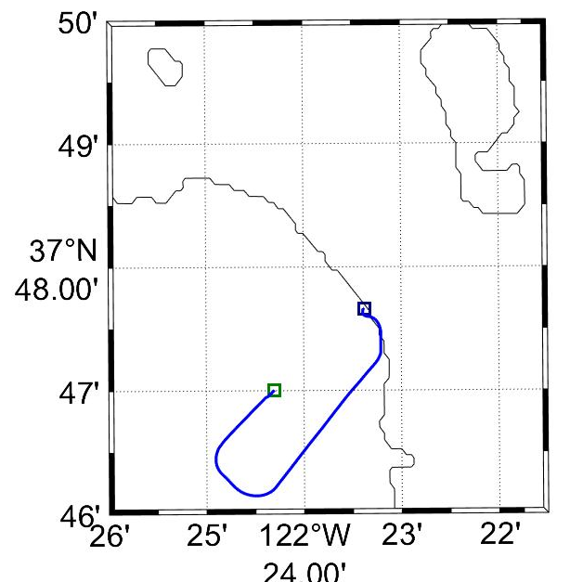
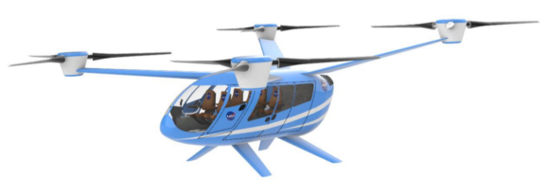
Application Example: Scenario Setup
Optical system measurements:
Vehicle:
6 person quadrotor
Total weight 6480 lbs
Tracked feature point
Problem setup – Information content measure – Application example – IEKF – Simulation results – Conclusions

Slide 6
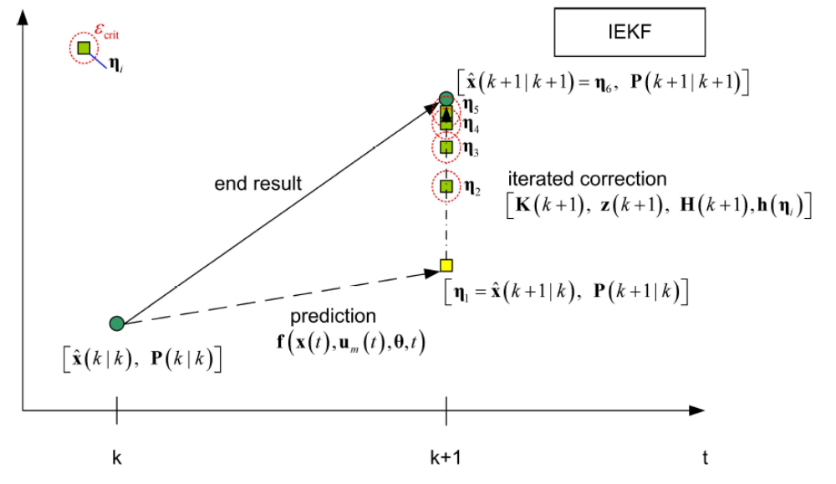
Iterated Extended Kalman Filter
Inputs (higher sampling rate):
Specific forces (accelerometers)
Angular rates (rate gyros)
prediction
States:
Position components
Velocity components
Attitude angles
Inertial biases (accel & rate gyros)
correction
Observations (lower sampling rate):
GPS based:
Position (GPS)
Velocity (GPS)
Optical signal based:
Range + deriv
Azimuth + deriv
Elevation + deriv
Attitude angles (integrating gyros)
Problem setup – Information content measure – Application example – IEKF – Simulation results – Conclusions

Slide 7
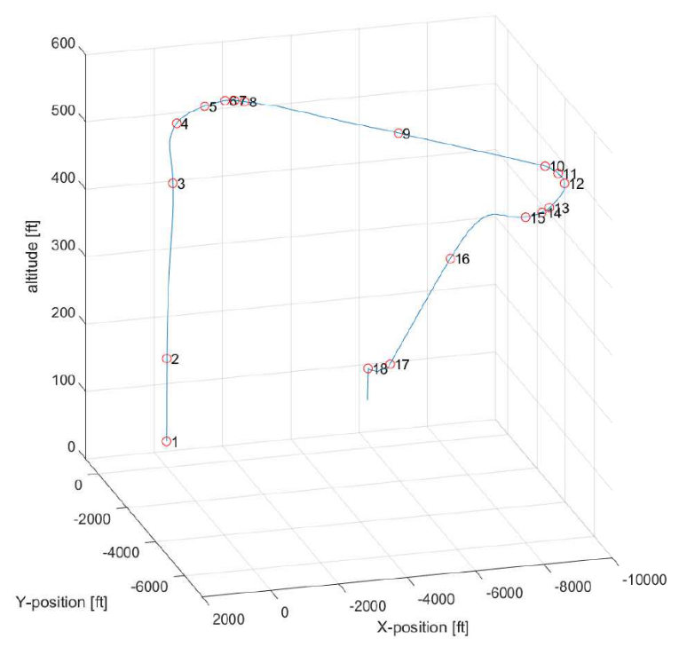
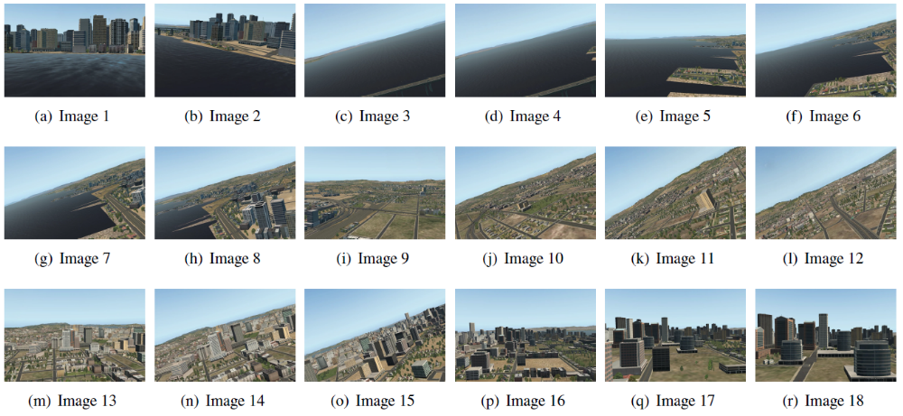
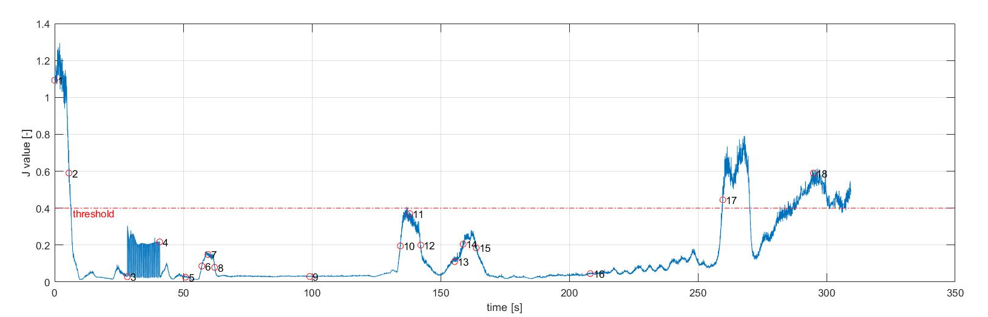
Adaptive Mechanism Performance
Problem setup – Information content measure – Application example – IEKF – Simulation results – Conclusions

Slide 8
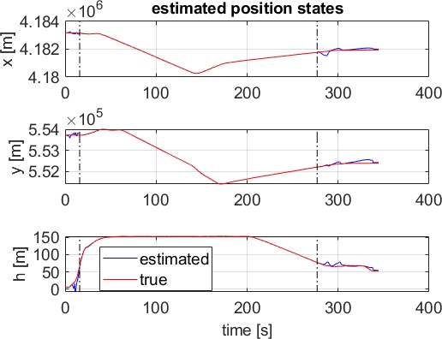
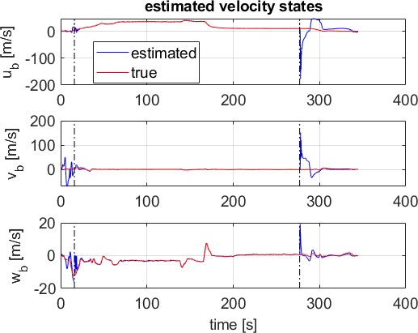
Estimation Results of Switching Kalman Filter
GPS signal based
Optical signal based
GPS signal based
Optical signal based
Problem setup – Information content measure – Application example – IEKF – Simulation results – Conclusions

Slide 9
Conclusions and Recommendations
Adaptive method using information content measure based on optical gradients in images provided by optical sensors.
Switching between two state estimators:
  Based on GPS signals outside urban environment: no GPS signal loss
  Based on images from visual systems inside urban environment: feature rich
Future research:
Bank angle compensation?
Robust and adaptive threshold definition for switching
Combine with object tracking based on images and other sensors (DAA)
Problem setup – Information content measure – Application example – IEKF – Simulation results – Conclusions

Slide 10
Adaptive Multi-Sensor Localization Information Fusion For Autonomous Urban Air Mobility Operations
AIAA 2021 SciTech Conference, January 11-21, 2021
Vahram Stepanyan, Thomas Lombaerts, Kimberlee Shish, Nicholas Cramer
NASA Ames Research Center
AIAA-2021-1115
This material is declared a work of the U.S. Government and
is not subject to copyright protection in the United States.

