Slide 1







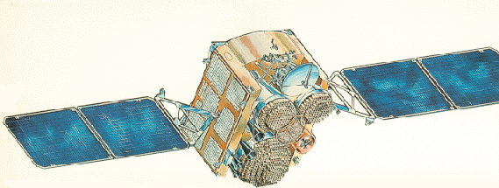





















































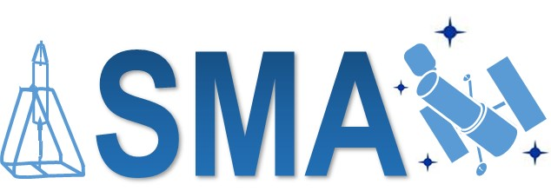
National Aeronautics and Space Administration
www.nasa.gov
Mission Duration
an Historical Perspective
Currently Operating Spacecraft
WIND
* Serviced Mission
** Passive Mission
NASA/DOD have been highly successful and have honed their processes and procedures
to ensure that successful missions are probable, but the only true guarantee of success is the judicious application
of fault tolerant design and implementation based on risk analysis.
GSFC SAFETY and MISSION ASSURANCE DIRECTORATE
Code 300
Notes:
Not All NASA or DOD missions are successful (you will hear more about some of the unsuccessful later in this panel). Some fail in their infancy while others last long into extended operations. Highlight shows those that have major anomaly impacting operations or out of service at the moment; Or has been serviced.
For example: 27 August 2020 CloudSat suffered a failure of one of its three remaining reaction wheels on August 27th, 2020 which automatically puts the spacecraft into standby mode. Radar data collection has ceased until the team determines if operations can continue with two wheels. So it is not a lost mission yet. & GPM RWA failure in 2019 – no impact on mission.
Do parts control programs impact life or failure potential? Maybe some
T3 Space draft paper for NASA EEE Parts, “Summary of Satellite Failures And Initial Correlation To Parts Programs and Space Anomalies,” Zambotti et al, 2005
Level 1 Parts Program Mission’s had a overall 12.1% Overall Failure Rate, L2 18%, L3 30.3% but only about ½ (50-60%) the failures in L1 and L2 seem to be attributable to EEE parts but ¾ (75%) of the L3 mission failures seem to be part related.
NASA has had part failures with military grade L1/L2 (SDO) and Commercial L1/L2 (Aquarius); GSFC’s CE’s opinion is that neither part upscreening or use of MIL-SPEC parts provides protection against a poor or overly-sensitive design
Does Reliability Prediction correlate? Not a true indication of performance or life- to date it is best used for trades and may help evaluate robustness of design but failure analysis is a better assessment and tool for improving robustness.
Use example Ps for AQUA at launch had a 0.13 probability of making its 6yr design life. As of 2019 ~70% of continuing useful operations until 2027 with mission critical instruments (bus 0.90). We can improve these predictions using PoF, Bayesian Inference, and AI.
Does Mission Class and associated processes impact life or failure potential? It depends on risk management and decision making pre-and post-launch. But more likely it’s the desire to not fail and testing that has the most impact. Class A: Failure would have extreme consequences to public safety or high priority national science objectives; Class B: Represents a high priority National asset whose loss would constitute a high impact to public safety (e.g., weather) or national science objectives; Class C: Represents an instrument or spacecraft whose loss would result in a loss or delay of some key national science objectives; Class D: Technical risk is medium by design.
Class A Examples: HST, Cassini, GOESN-P, Chandra,
Class B Examples: Cloudsat, GPM, MAVEN, OSIRIS-Rex, Landsat-8, SNPP, Fermi, JPSS, NOAA-18, Parker Solar
Class C Examples: CALIPSO, ICESat-2, LRO, MMS, TESS, ICON, OCO-2, SMAP, SORCE, ACE, IBEX, Juno, SDO
Class D Examples: CYGNSS, LADEE, NICER, DSCVER,IRIS, NuStar
Testing – Traditional is Performance Testing as you Fly; This must change for 50 year mission life, later in flight life issues may be impossible to test.
Does Space Environments impact life or failure potential? Norm is to ensure the most benign environment possible. But we do see wear (AQUA/AURA SAs)
NASA/DOD has lost missions to surface ESD (DSCSII -1973), radiation (MSTI), MMOD (Olympus, SEDS2, MSTI2) - http://adsabs.harvard.edu/pdf/1998sct..conf....7K
Radiation- NASA, ESA, CNES or JAXA have lost missions or had operational Gaps due to radiation and solar activity in young, mature or ageing spacecraft. More in aging S/C on average (2011 IEEE NSREC Short Course - Robert Ecoffet, CNES). CALIPSO, AQUA, WIND, GOES, DMSP, and more.
Analysis & Testing – Environmental Analysis/Prediction and Test units
Galileo: 02-0220.pdf (nasa.gov), https://trs.jpl.nasa.gov/bitstream/handle/2014/11661/02-0220.pdf?sequence=1, charged particle environment (modelled low) leading to Gyro issues from Solid state S/w radiation impacts, bus resets (SEU) false reset signal, Quartz Oscillator freq shift, and instrument noise. “As predicted, the spacecraft began to suffer major anomalies just as it was exceeding its radiation design dose, but only in a small portion of the circuits that might have failed at this dose. “
MAP: A Space Weather Event on the Microwave Anisotropy Probe (MAP) (nasa.gov); https://nepp.nasa.gov/DocUploads/1ABD387A-4AE6-4347-9F3BA1A9C675D1A1/RADECS02_MAP.pdf; Single Event Transient in C&DH
ANIK: Conclusive evidence for internal dielectric charging anomalies on geosynchronous communications spacecraft (aiaa.org) https://arc.aiaa.org/doi/pdf/10.2514/3.26645; Internal Dielectric Charging causing 57 switch executions
Galaxy 15: Understanding the Potential Dangers of Spacecraft Charging | NASA https://www.nasa.gov/offices/nesc/articles/understanding-the-potential-dangers-of-spacecraft-charging Galaxy 15 telecommunications satellite was set adrift, wandering away from its assigned place in geosynchronous orbit - They were able to establish a work around to recover use of the satellite. ADEOS-II lost 2003
LRO Solid State Recorder Errors: Updated Solid State Recorder (SSR) Radiation Guidelines (nasa.gov) https://nepp.nasa.gov/workshops/etw2012/talks/Tuesday/T03_Ladbury_Updated_SSR_Radiation.pdf SSR SEUs, but Current error mitigation approaches yield robust data integrity for SSR designs used to date

Slide 2


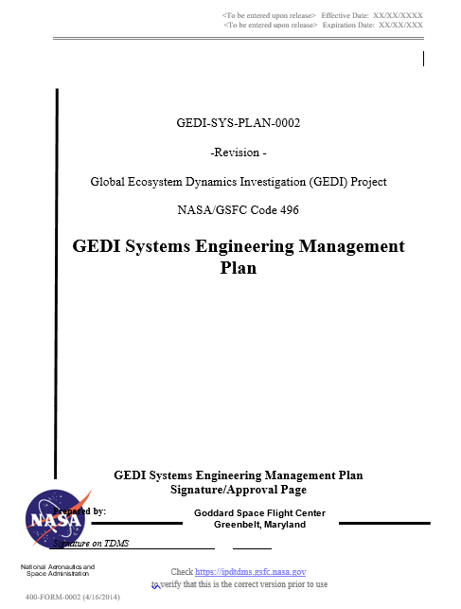
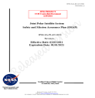
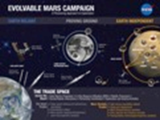
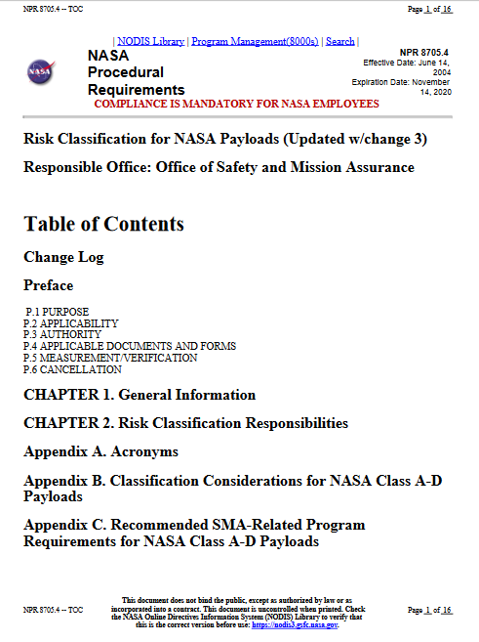
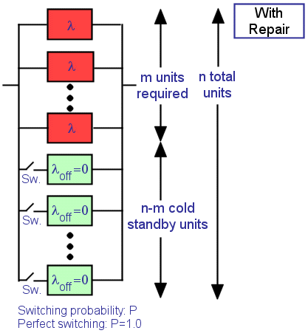
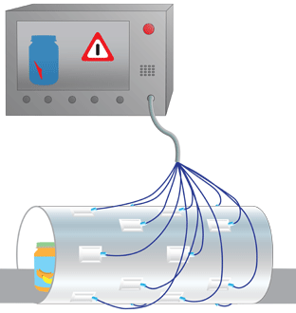
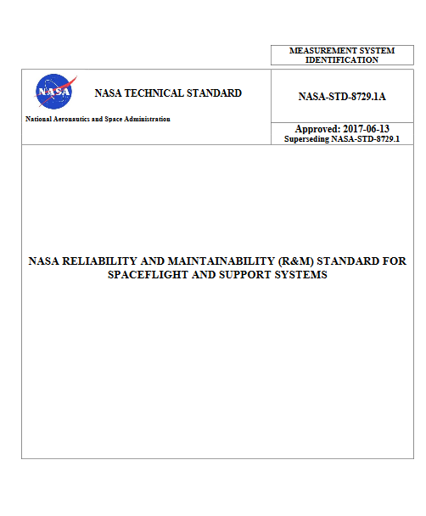
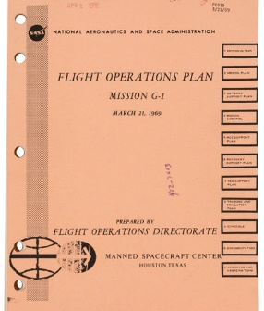
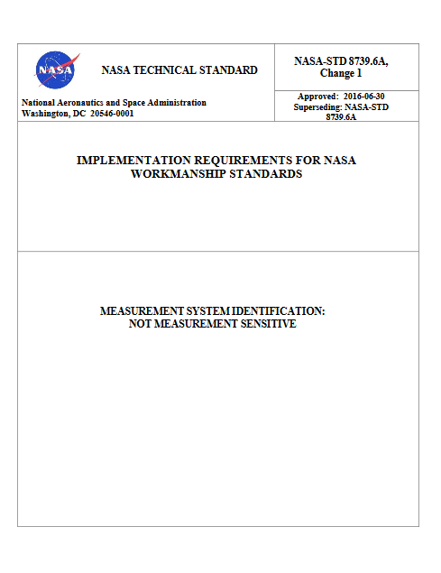
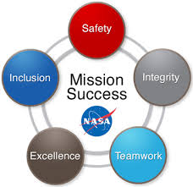
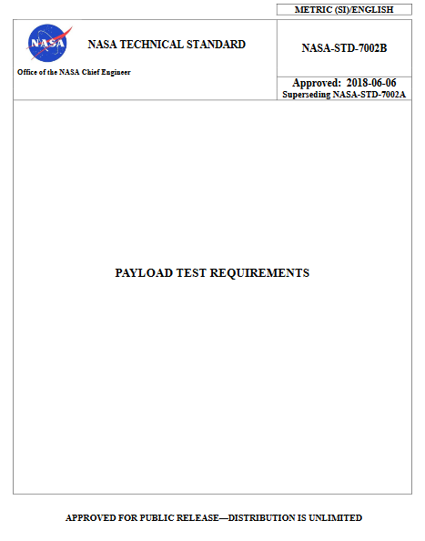

Expanded Mission Assurance Use Case
for Long Duration Missions
Strategic Design/Mission Concept and Mgt
Trade Mission Performance Options
Integrated Maintenance Planning
Flight and Ground sustainment analysis
Tactical Life and Environmental Testing
Use heritage and analysis instead of testing to update life expectancy
Concept Implementation
Failure and life analysis
Considered Assurance/Fault Mgt Application
Mission Integration
50 Year Mission Execution
Re-analyze based on test results
Re-Analyze
Conduct Preventative Maintence and Nominal Operations
Autonomous Fault Management Design
Overall and Segment specific sustainment plan
Tailored but Fully Test as You Fly –
nominal and anomalous operations
Assess and mange risk for meeting plans and mission objectives
Routinely assess Flight and Ground Resiliency
Maintain Ground/Digital Twin
Environmental Forecasting and Sensitivity Analysis
Selection of proven long life items and appropriate redundancy or designs
Consistent Project/Risk Management/RMA Plans (Development -> Operations)
Life test new design concepts
Test environmental protection and sensitive units
Evolvable Mission Campaign
Project Plans and RMA Plans/AIM
Sustainable Sparing Plan
Optimized Sensor and FDIR Plan
Operations and
Maintenance Plan
Complete and balanced information, planning, and implementation ensure success.
Mission Assurance Standards and Capabilities Division
OSMA HQ-GD000
Notes:
A complete Assurance Case needs to address Flight and Ground. A previous panel, “ Organizational Support for Long Duration Missions” (yesterday) covered Ground concerns so while we will mention them here our panel is focused most on the flight segment.
NASA Best Practices:
1. Define/Document “balanced acquisition and development approach for achieving the risk classification level designated”(NPR 8705.4) – Rev A → AIM Assurance Implementation Matrix , SMAP, Objectives Based. Early Planning
2. System Conforms to design intent and performs as planned; System Remains Functional for life; System is fault Tolerant for life; System has acceptable Availability/Maintainability (8729.1)
3. System is manufactured/constructed with quality and Workmanship and Assurance (8739s)
4. System performs as expected under all conditions and for the life of the mission. Tailored approached! “Programs shall set a total hour "failure-free“ performance requirement tailored to hardware classification, criticality, and mission-reliability goals. (7002)
Reinforces other presentations:
Failure Tolerant design/plan – Reduce/eliminate moving parts; Redundancy is not enough, preventive maintenance processes implement where needed (minimize)
Analysis : Traditional and non-traditional PoF and Bayesian/AI update to Probabilities (with conservatism and confidence) and define failure scenarios and FDIR responses/risks; SEE Analysis, Sneak Circuits, FMECA, FT, Maintainability --- resilience/robustness.
Heritage: Is performance, research, mission and space weather monitors/experiment data (Voyager, etc); known sensitive and ultrasensitive components – ie USO
Ops Plans: Nominal and Contingency Operations (including Space Weather and Preventive Actions) for flight and ground.
Plan FDIR: sensor optimization through modeling/analysis, cold spares, FDIR, Autonomy/AI
Balanced = Tailored/Risk based/appropriate/Objectives oriented/Thoughtful

