Slide 1
Quantifying Performance Requirements for Next-Generation Spaceborne Aerosol Lidars
Dave Winker¹, Mark Vaughan¹, Stuart Young², Travis Toth¹,
Kathy Powell¹ and Anne Garnier³
NASA Langley Research Center, Hampton, VA
CISIRO, Aspendale, Australia (retired)
NASA LaRC/SAIC, Hampton, VA
AMS Annual Meeting, 10-14 Jan 2021

Slide 2
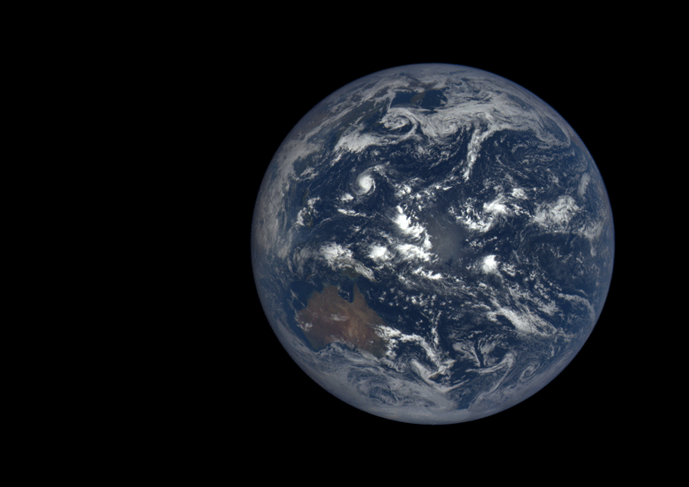

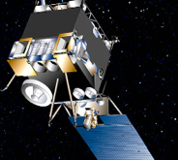
Motivation
A question before the ACCP study team:
How can we improve on CALIOP performance?
  Better SNR → better spatial resolution than CALIOP
    PBL height
  More accurate AOD
    Climate forcing from aerosol radiative effects at TOA and surface
  More accurate near-surface aerosol extinction
    Air Quality
    Model evaluation (surface is an aerosol source)
A few issues
  How to flow science requirements defined for ACCP down to instrument design requirements?
  What are the best performance metrics?
  Better quantify CALIOP performance as a baseline

Slide 3
Current state of global AOD datasets
Global-mean over-ocean AOD
CALIOP biased low due to undetected aerosol
MODIS likely biased high, due to cloud masking biases, 3D scattering
Kim et al (JGR 2017):
Estimate CALIOP daytime global mean AOD bias of 0.036 due to undetected aerosol (25%)
See also:
  Thorsen et al (GRL 2017)
  Toth et al. (AMT 2018)
(Sayer et al., JGR, 2018).

Slide 4
Power-Aperture Product as a Simple Metric
Power aperture product: PxA = J x pps x D²
  Is proportional to signal and is related to SNR
  Useful for a relative ranking of performance, if everything else is the same:
    Orbit altitude, detectors, receiver FOV, pulse rate, solar rejection etc.
LITE CALIOP CATS ATLID
J 0.530 0.110 0.002 0.035
λ(nm) 532 532 532 355
pps 10 20 4000 51
P (W) 5.3 2.2 8.0 1.8
D 1 1 0.60 0.62
PxA 5.3 2.2 2.9 0.69

Slide 5
Power-Aperture Product as a Simple Metric
Power aperture product: PxA = J x pps x D²
  Is proportional to signal and is related to SNR
  Useful for a relative ranking of performance, if everything else is the same:
    Orbit altitude, detectors, receiver FOV, pulse rate, solar rejection etc.
LITE CALIOP CATS ATLID
J 0.530 0.110 0.002 0.035
λ(nm) 532 532 532 355
pps 10 20 4000 51
P (W) 5.3 2.2 8.0 1.8
D 1 1 0.60 0.62
PxA 5.3 2.2 2.9 0.69
R (km) 250 705 550 400
PxAxH² 42.2 2.2 4.8 2.1 range-normalized, H = 705 km/orbit altitude

Slide 6
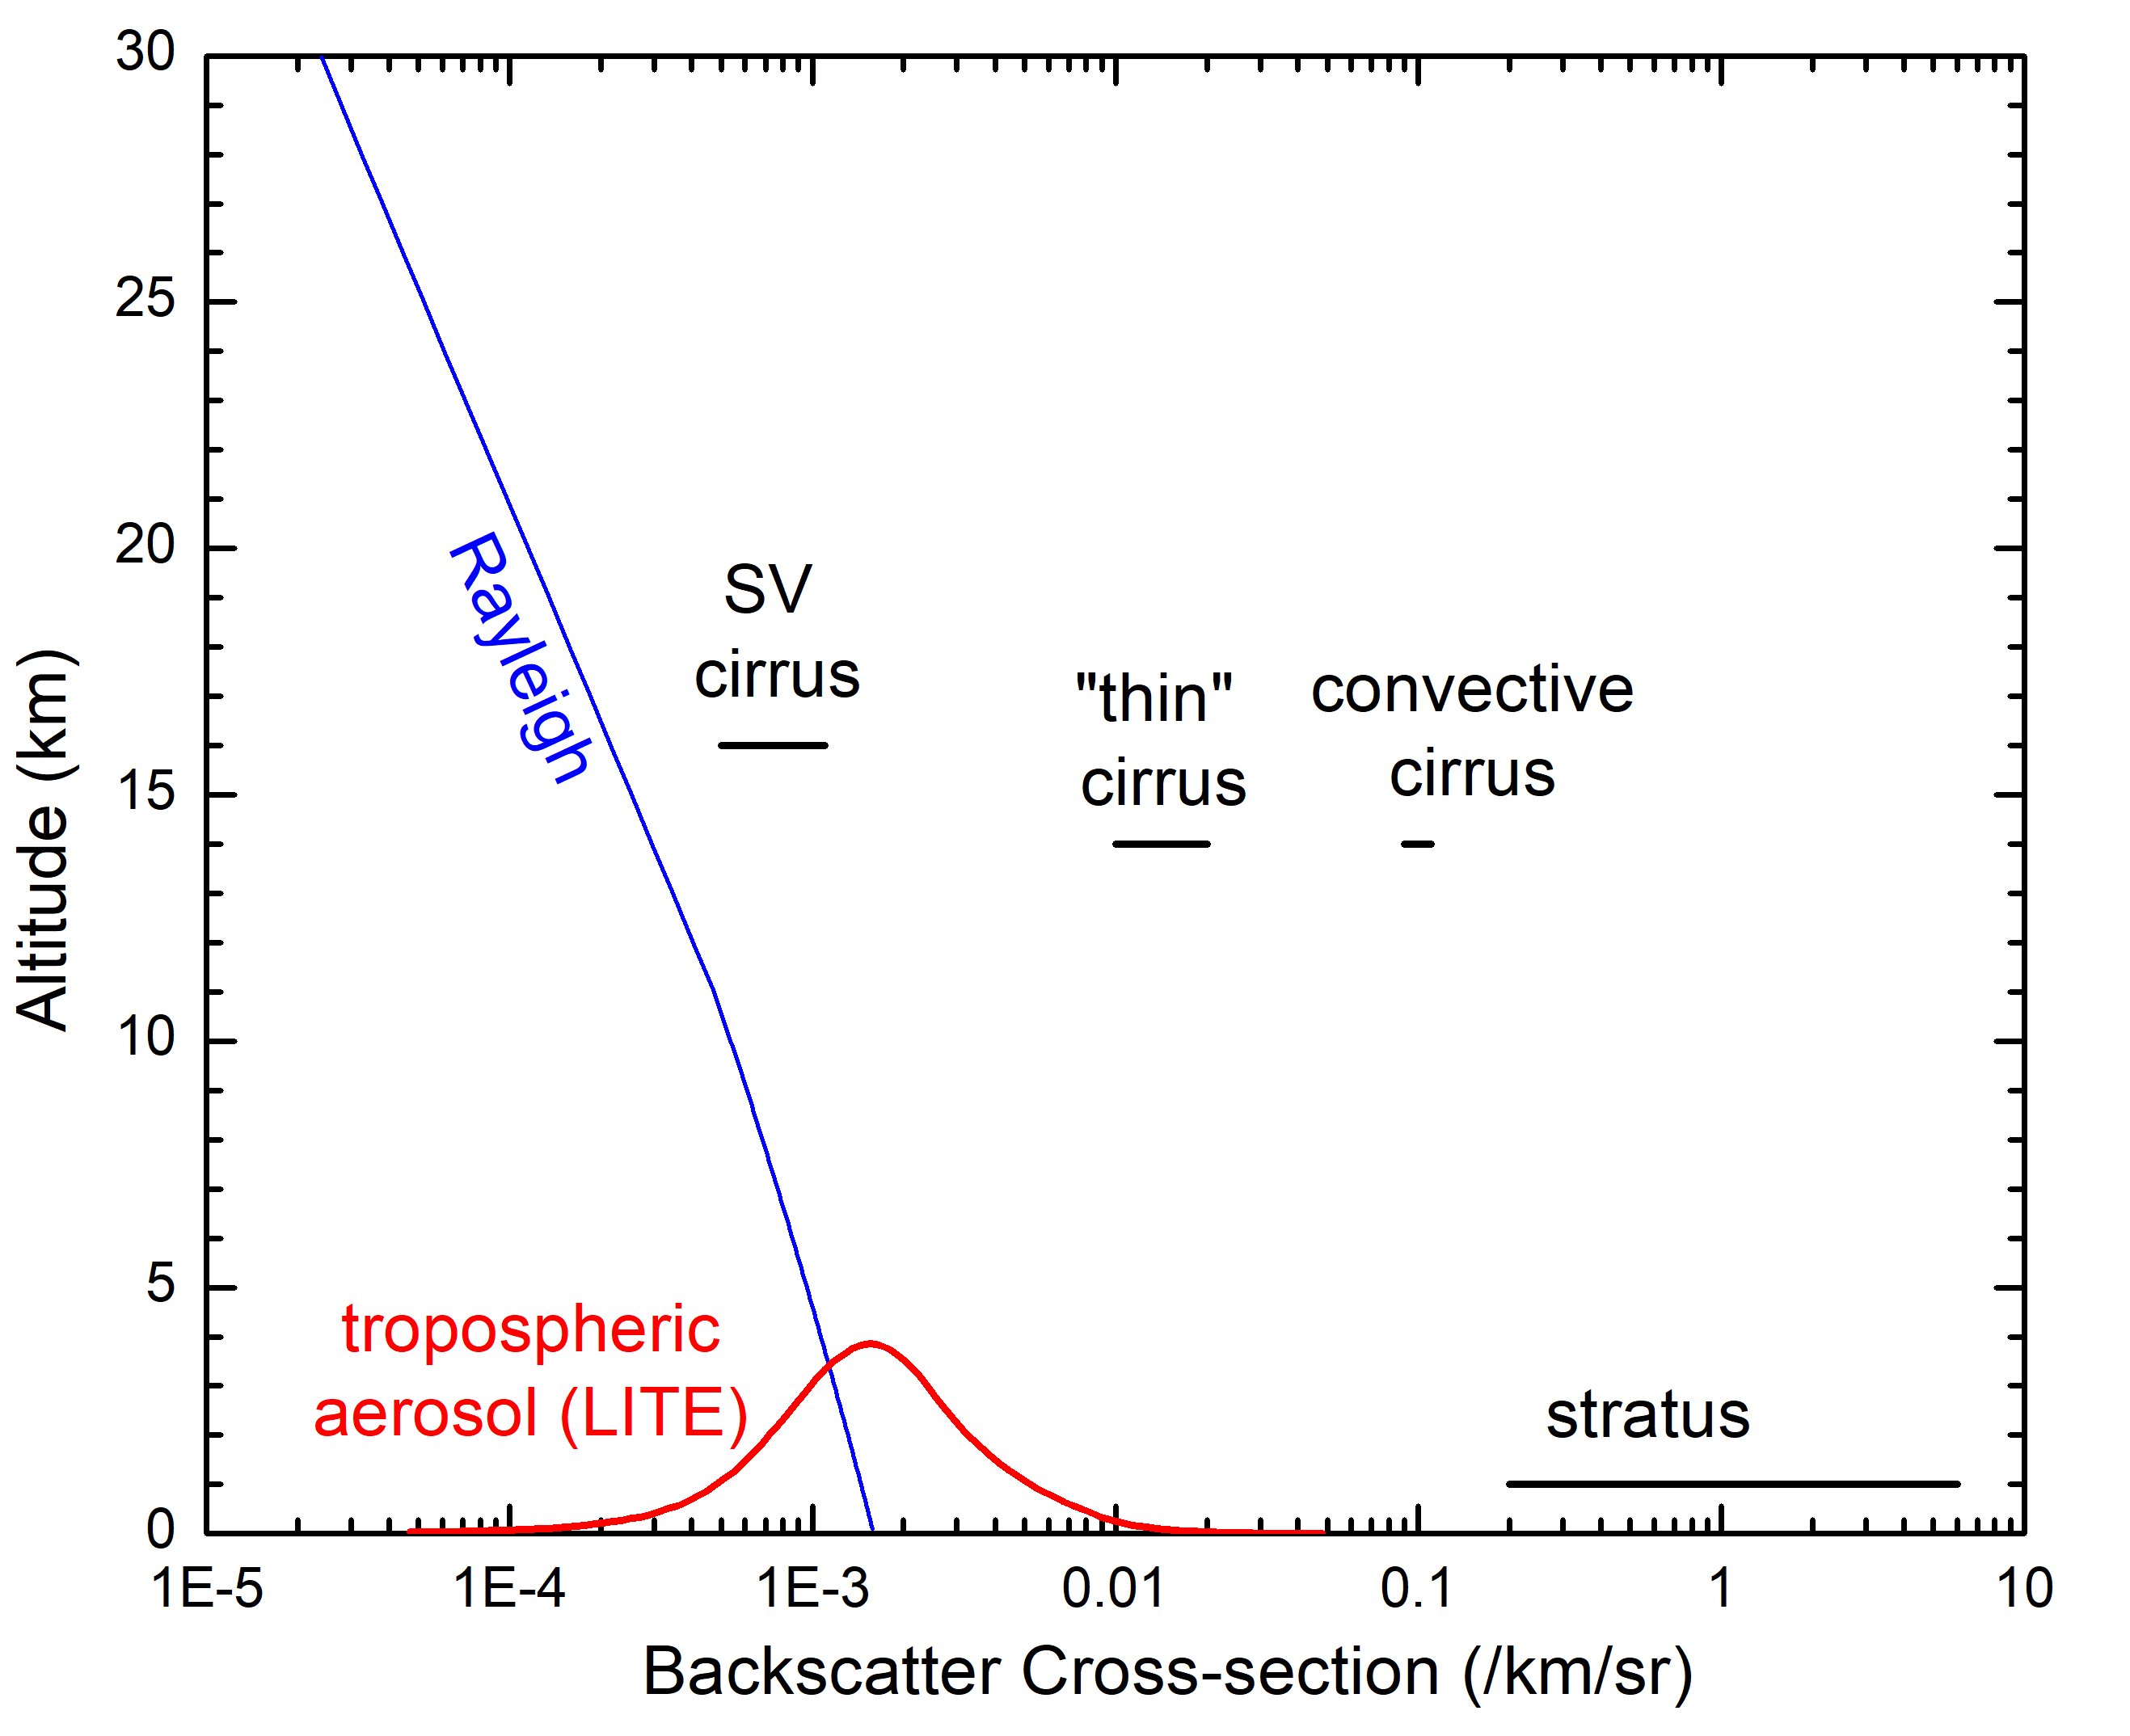
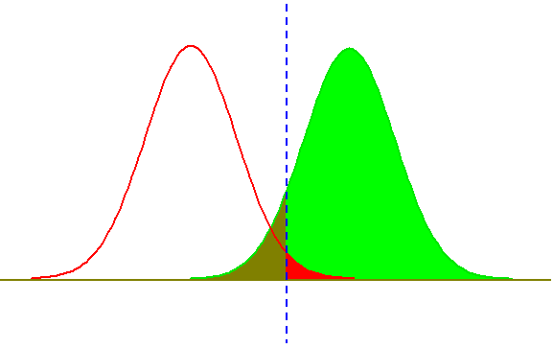
Minimum detectable scattering ratio
- more meaningful than SNR as a simple BSL metric
Notional scattering strengths for various targets
Usefulness of this relation validated starting with McGill et al. (2007)
For reference:
S_{t}
P_{d}
P_{fa}
In the limiting case where background light, detector noise, and dark current are all negligible:
CALIOP dynamic range

Slide 7
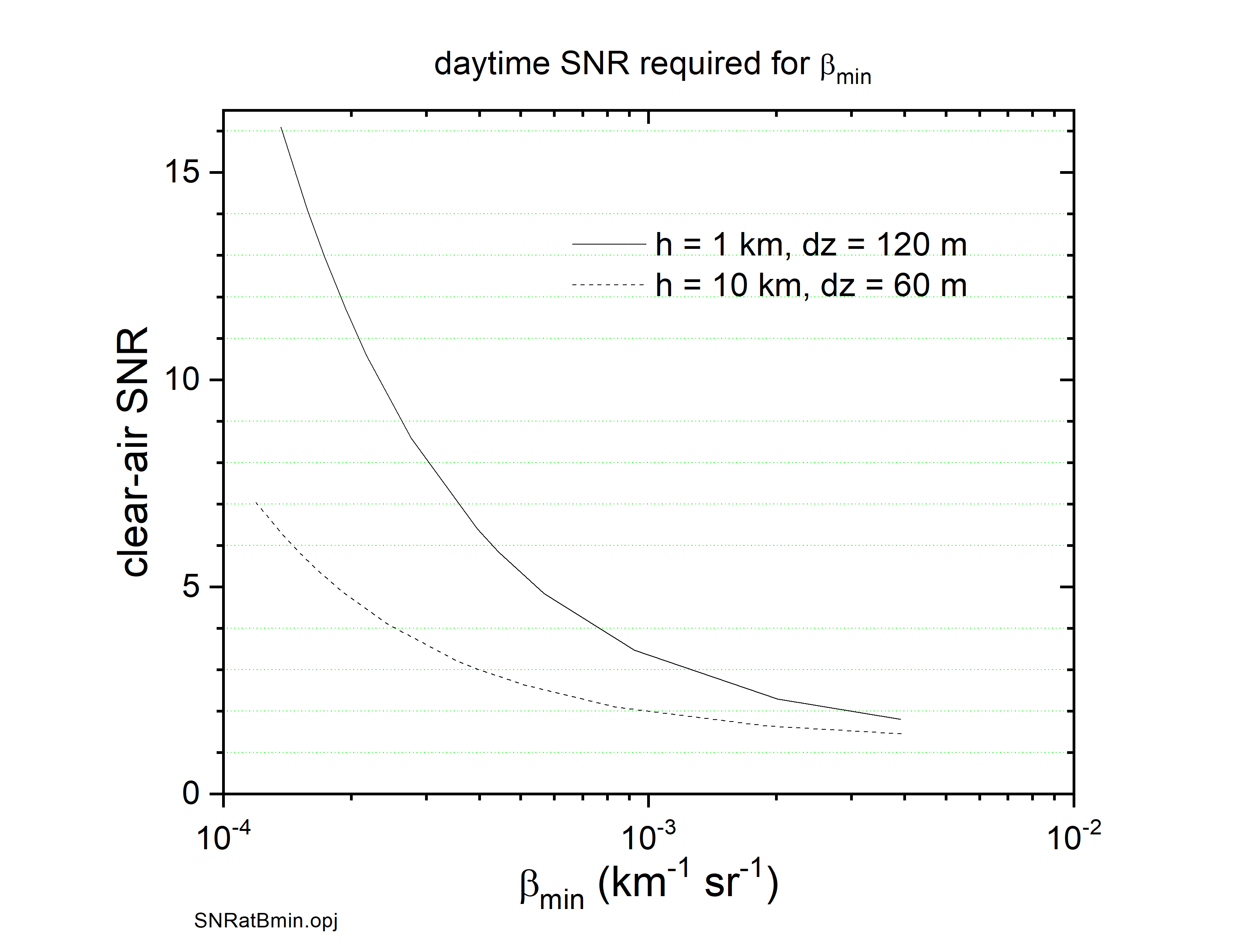
β_{min} vs. SNR (CALIOP, 532 nm)
β_{min} = minimum particulate backscatter detectable against the molecular background
Performance improves with SNR, but SNR does not define “performance”
SNR requirements depend on:
allowable averaging
magnitude of target scattering
required retrieval accuracy
Can always trade resolution for SNR
LITE aerosol

Slide 8
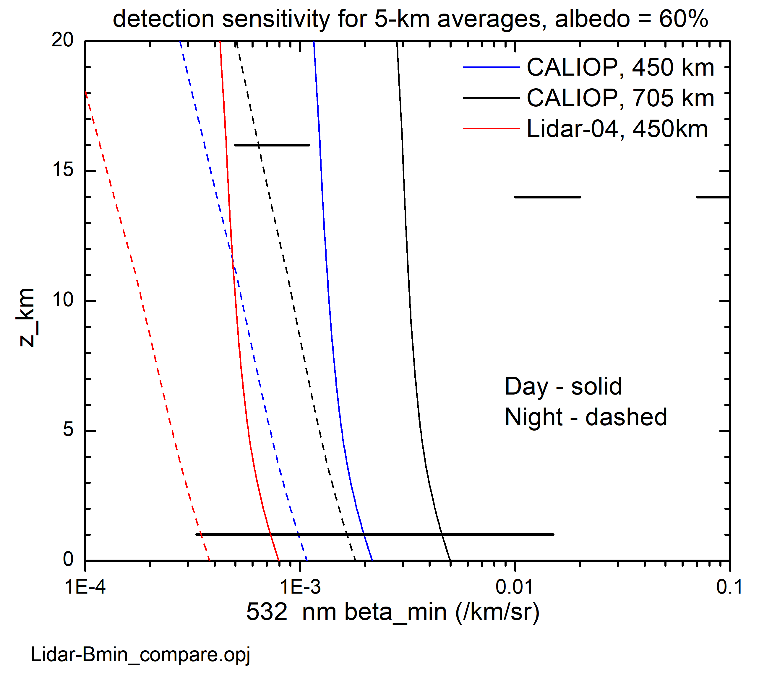
β_{min} for CALIOP and Two Variants
CALIOP at 450 km vs 705 km
Lidar-04 = hi rep rate backscatter lidar
CALIOP 532 nm at 705 km

Slide 9
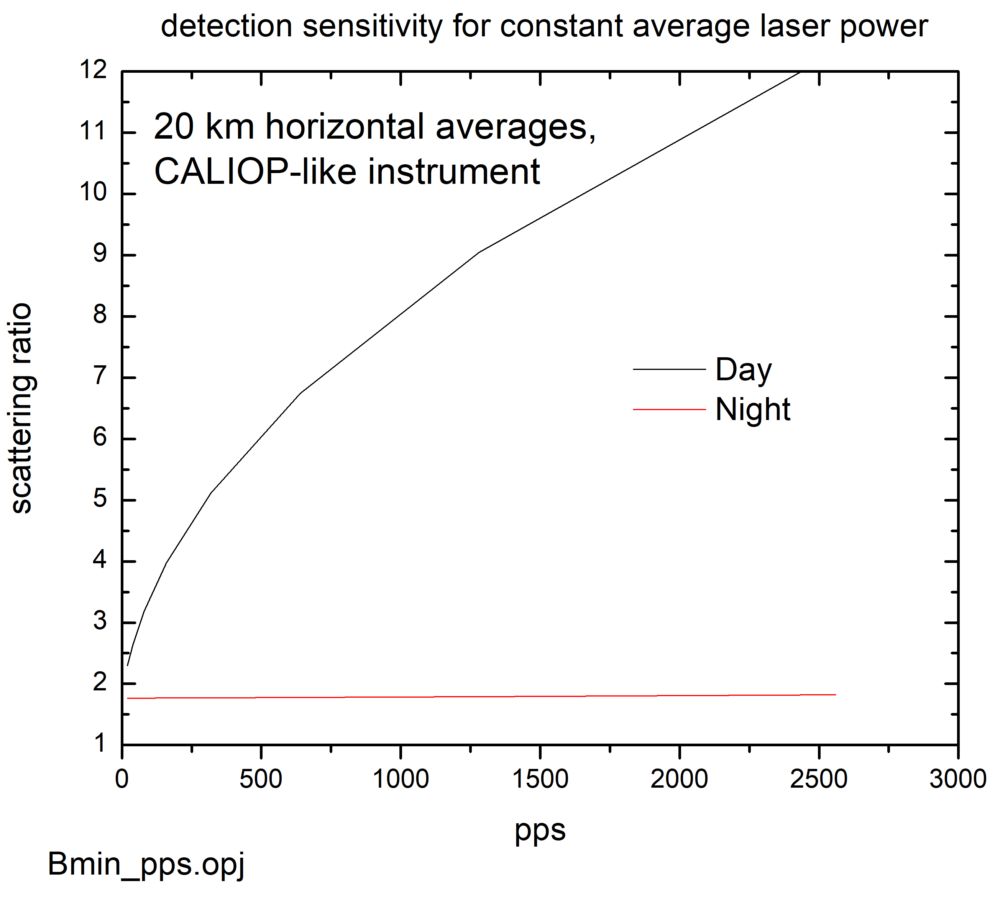
β_{min} for constant average laser power as a function of pulse rate
One design choice: high energy/low rep rate vs low energy/high rep rate
At night – if detectors/electronics are signal-limited there is no penalty to high rep rates
During day – each time a profile is acquired, solar background is integrated into the signal
J x pps
SNR ∝
((J + BG) x pps )^{½}

Slide 10
β_{min} is relevant to detection of layer top
Detection of layer base is a separate issue
An important part of the ‘missing AOD’ issue
  CALIOP only retrieves between detected layer top and estimated layer base
  Layer base is ‘extended’ in some cases, but imperfectly

Slide 11
Analysis of BSL Retrieval Uncertainties
Examine error sources one at a time
Consider idealized case of a single, homogeneous aerosol layer
  lidar ratio and scattering ratio are constant with range
Goal:
  Quantify impact of calibration errors
  Quantify impact of lidar ratio uncertainties
  Quantify impact of errors in retrieval of overlying cirrus

Slide 12
Retrieval errors scale non-linearly with AOD
Contour plots of the relative error in retrieved optical depth as a function of optical depth and error in lidar ratio, for scattering ratio = 1.5.
Magnitude of optical depth error is indicated by the color bar and contour lines.
Young et al. (JTech 2013)

Slide 13
Lidar Ratios retrieved by airborne HSRL as a function of CALIOP type classification
Lidar ratio selected by CALIOP typing algorithm vs measured by HSRL
  Uncertainty in Sa used by CALIOP: 20% at best, more typically 30% - 40%
CALIOP-HSRL discrepancy is also an indicator of limited type information
  HSRL retrievals of Sa provide additional information on aerosol type
Daytime
flights
Figure 11. Daytime histograms of lidar ratio. The numbers in the top row are the means and SDs of the lidar ratios measured by the HSRL.
Rogers et al. (AMT 2014)

Slide 14
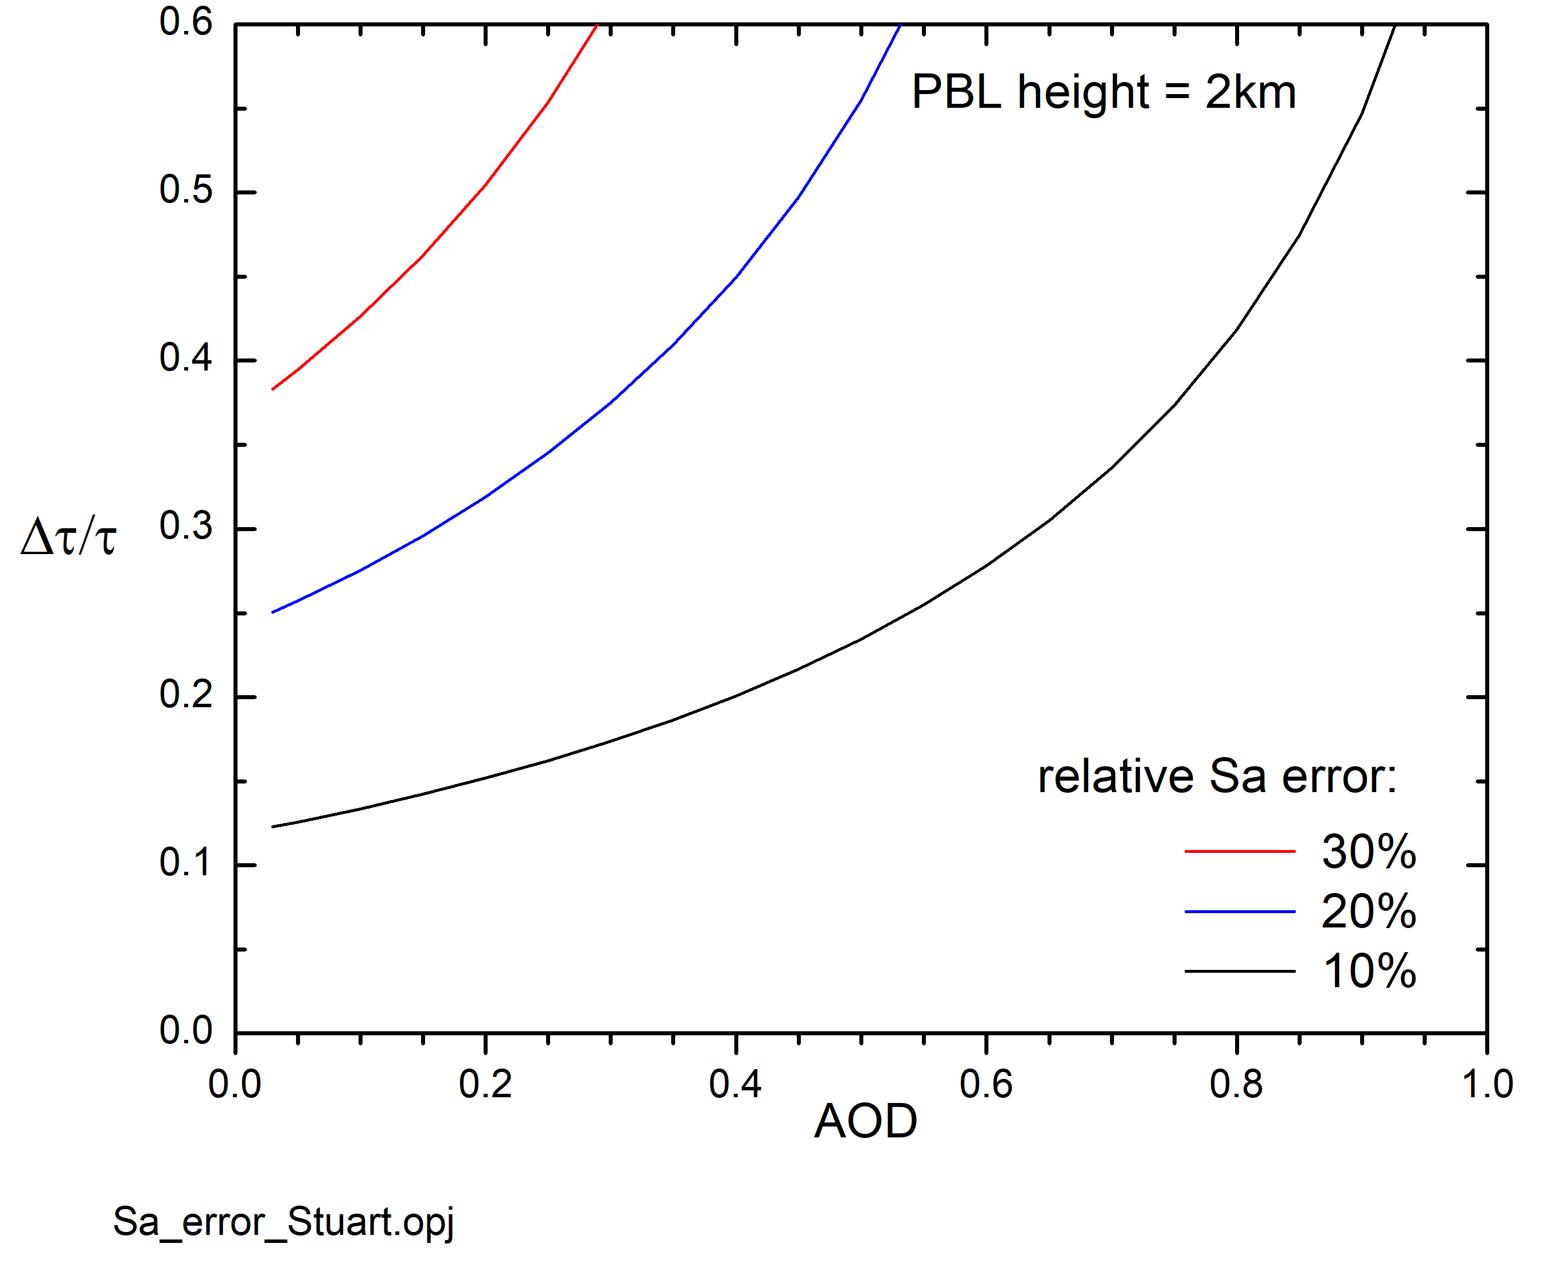
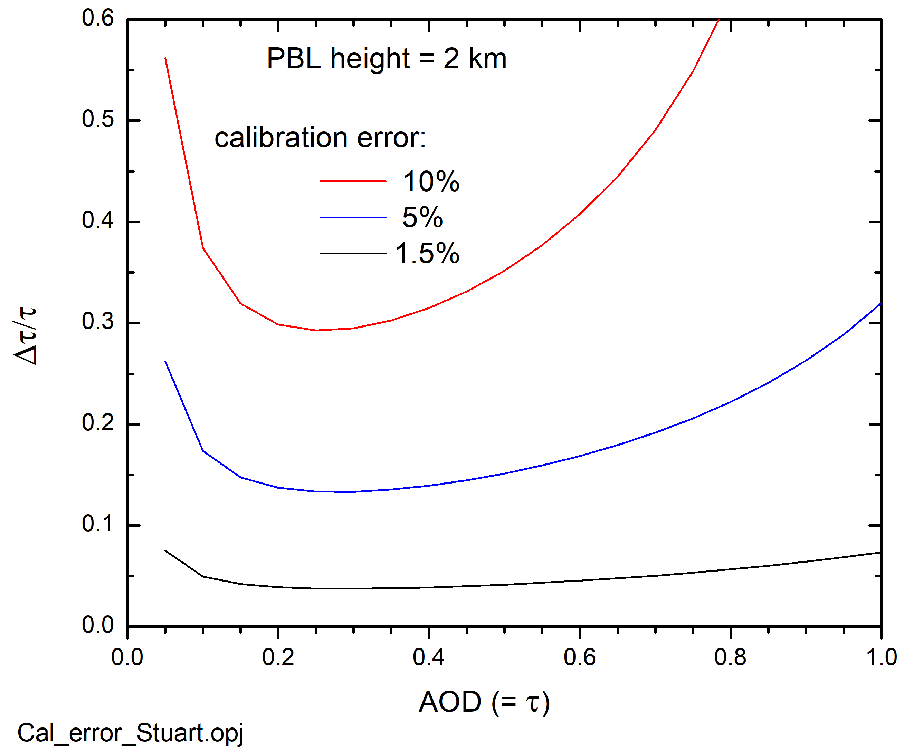
Relative uncertainty in AOD (single layer)
Accurate AOD is important for:
Aerosol climate forcing
An important performance metric for model evaluation
Uncertainty due to lidar ratio uncertainty only
Uncertainty due to calibration error only

Slide 15
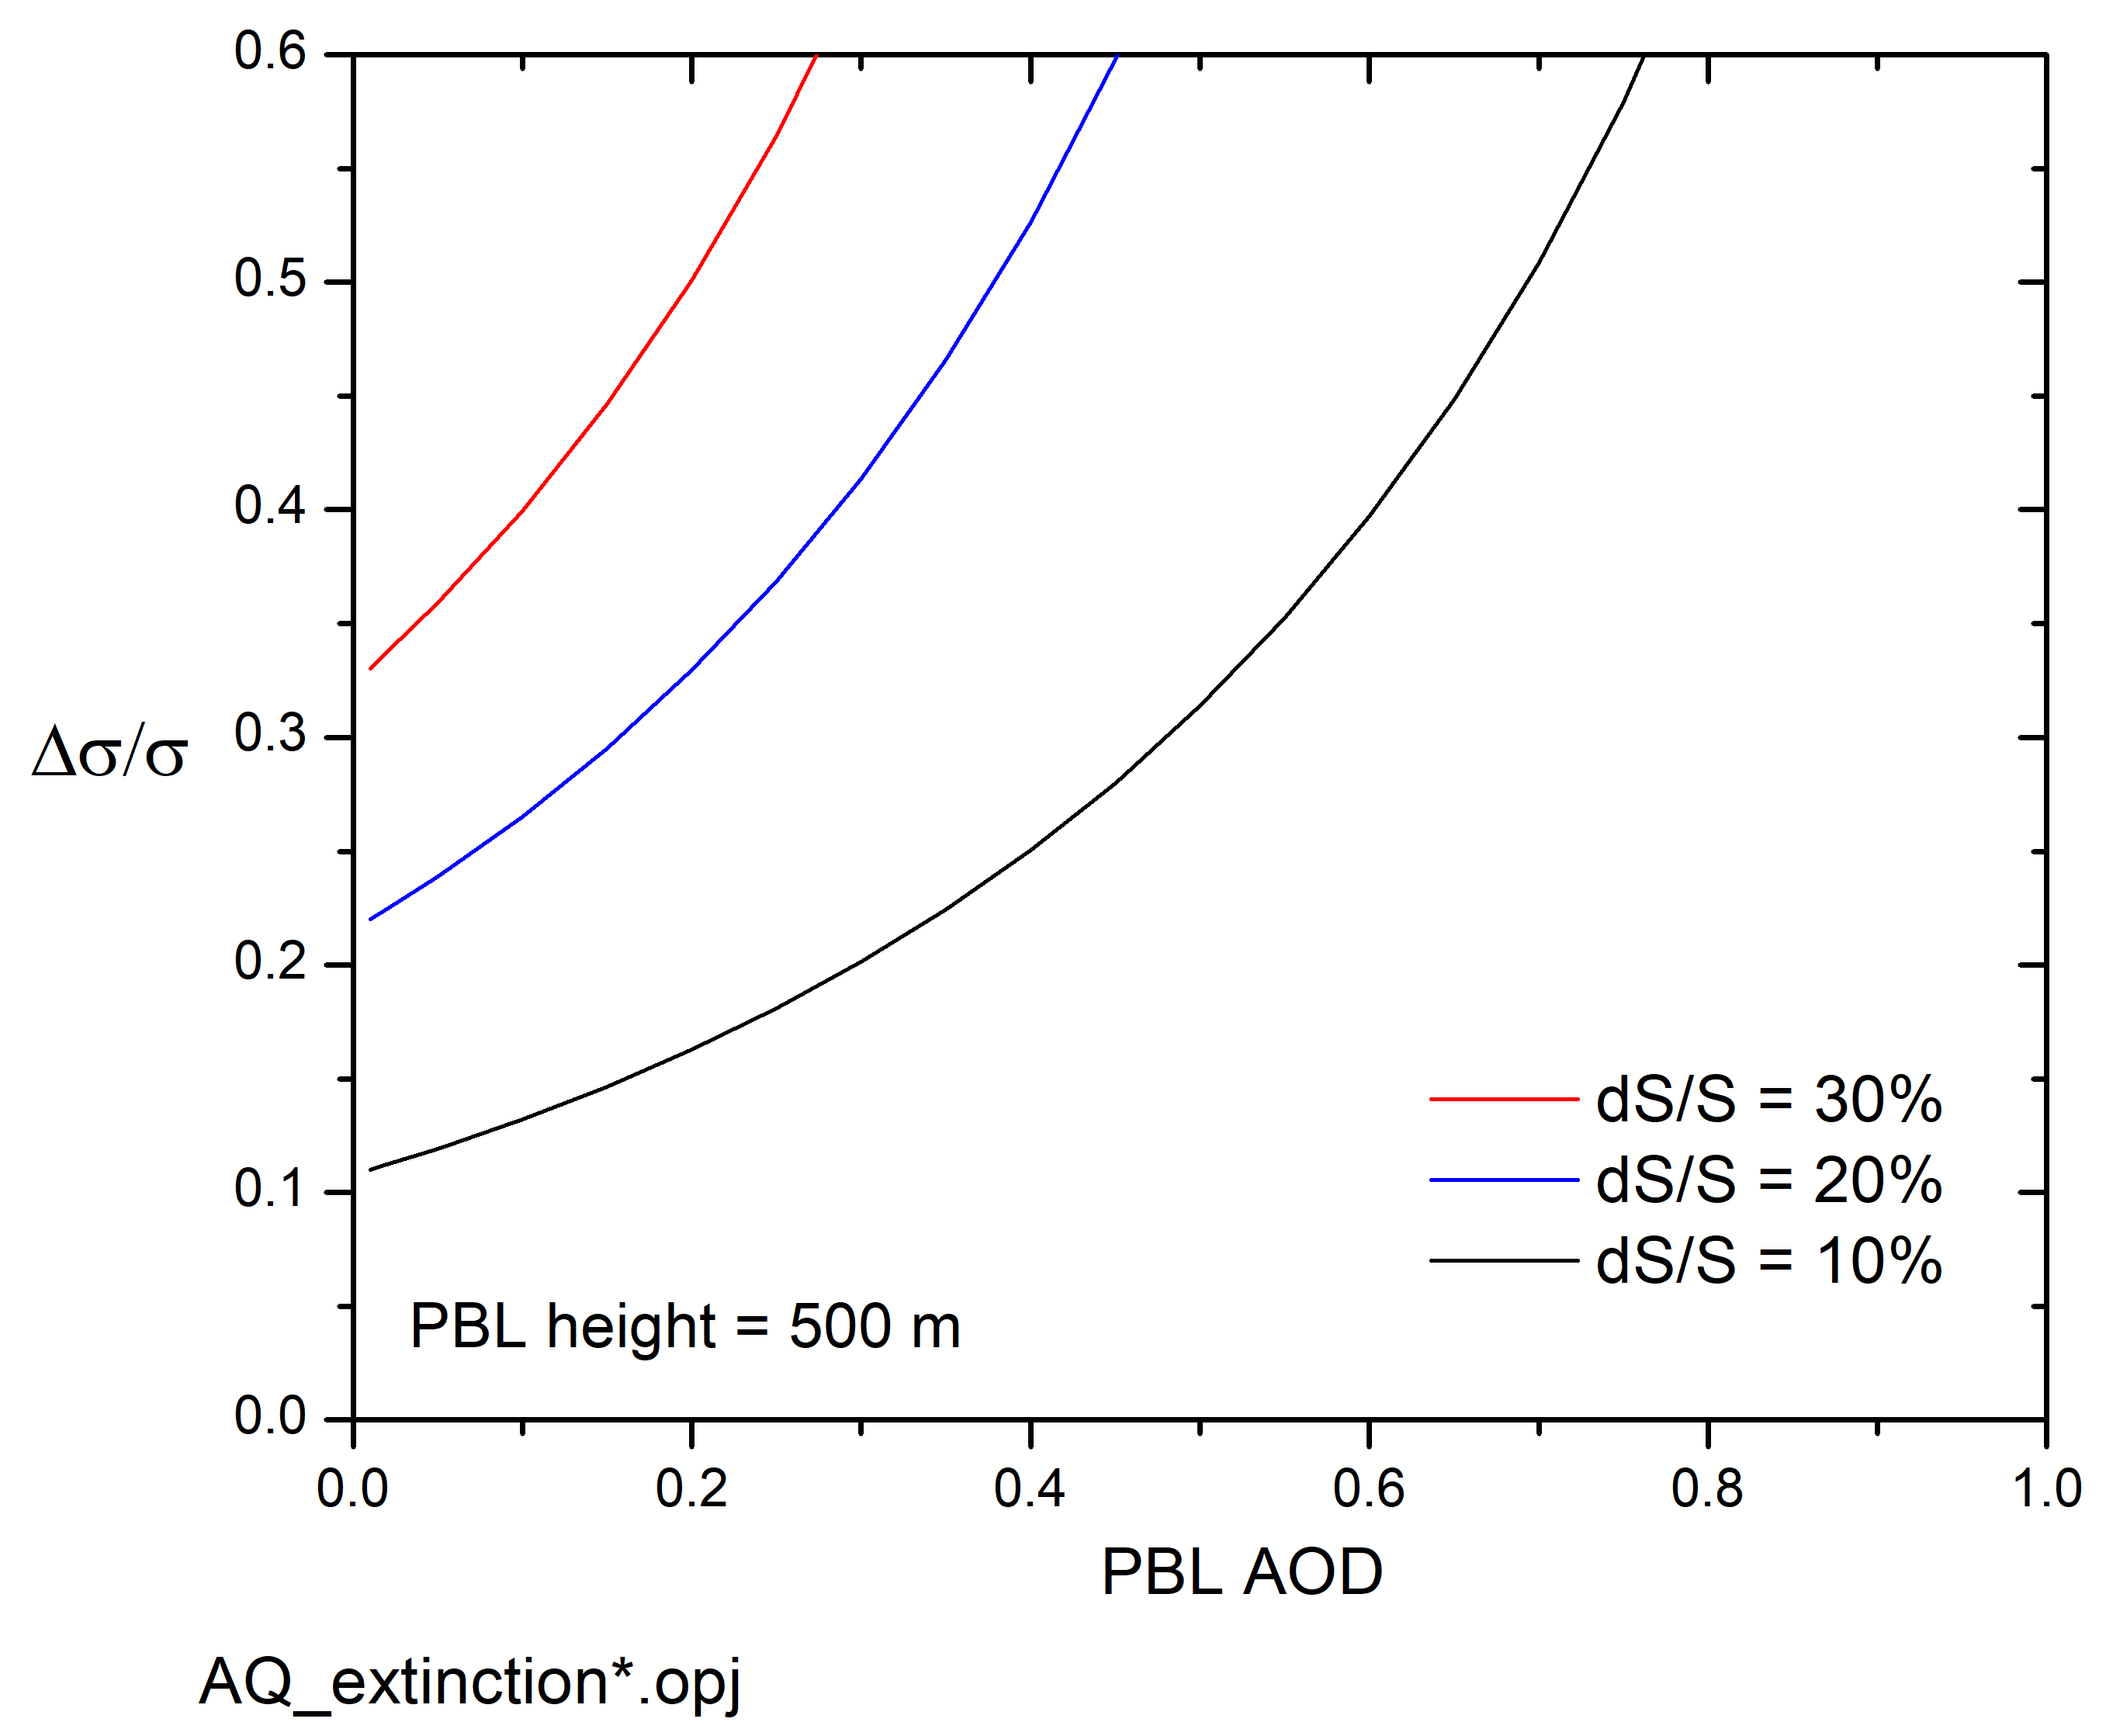
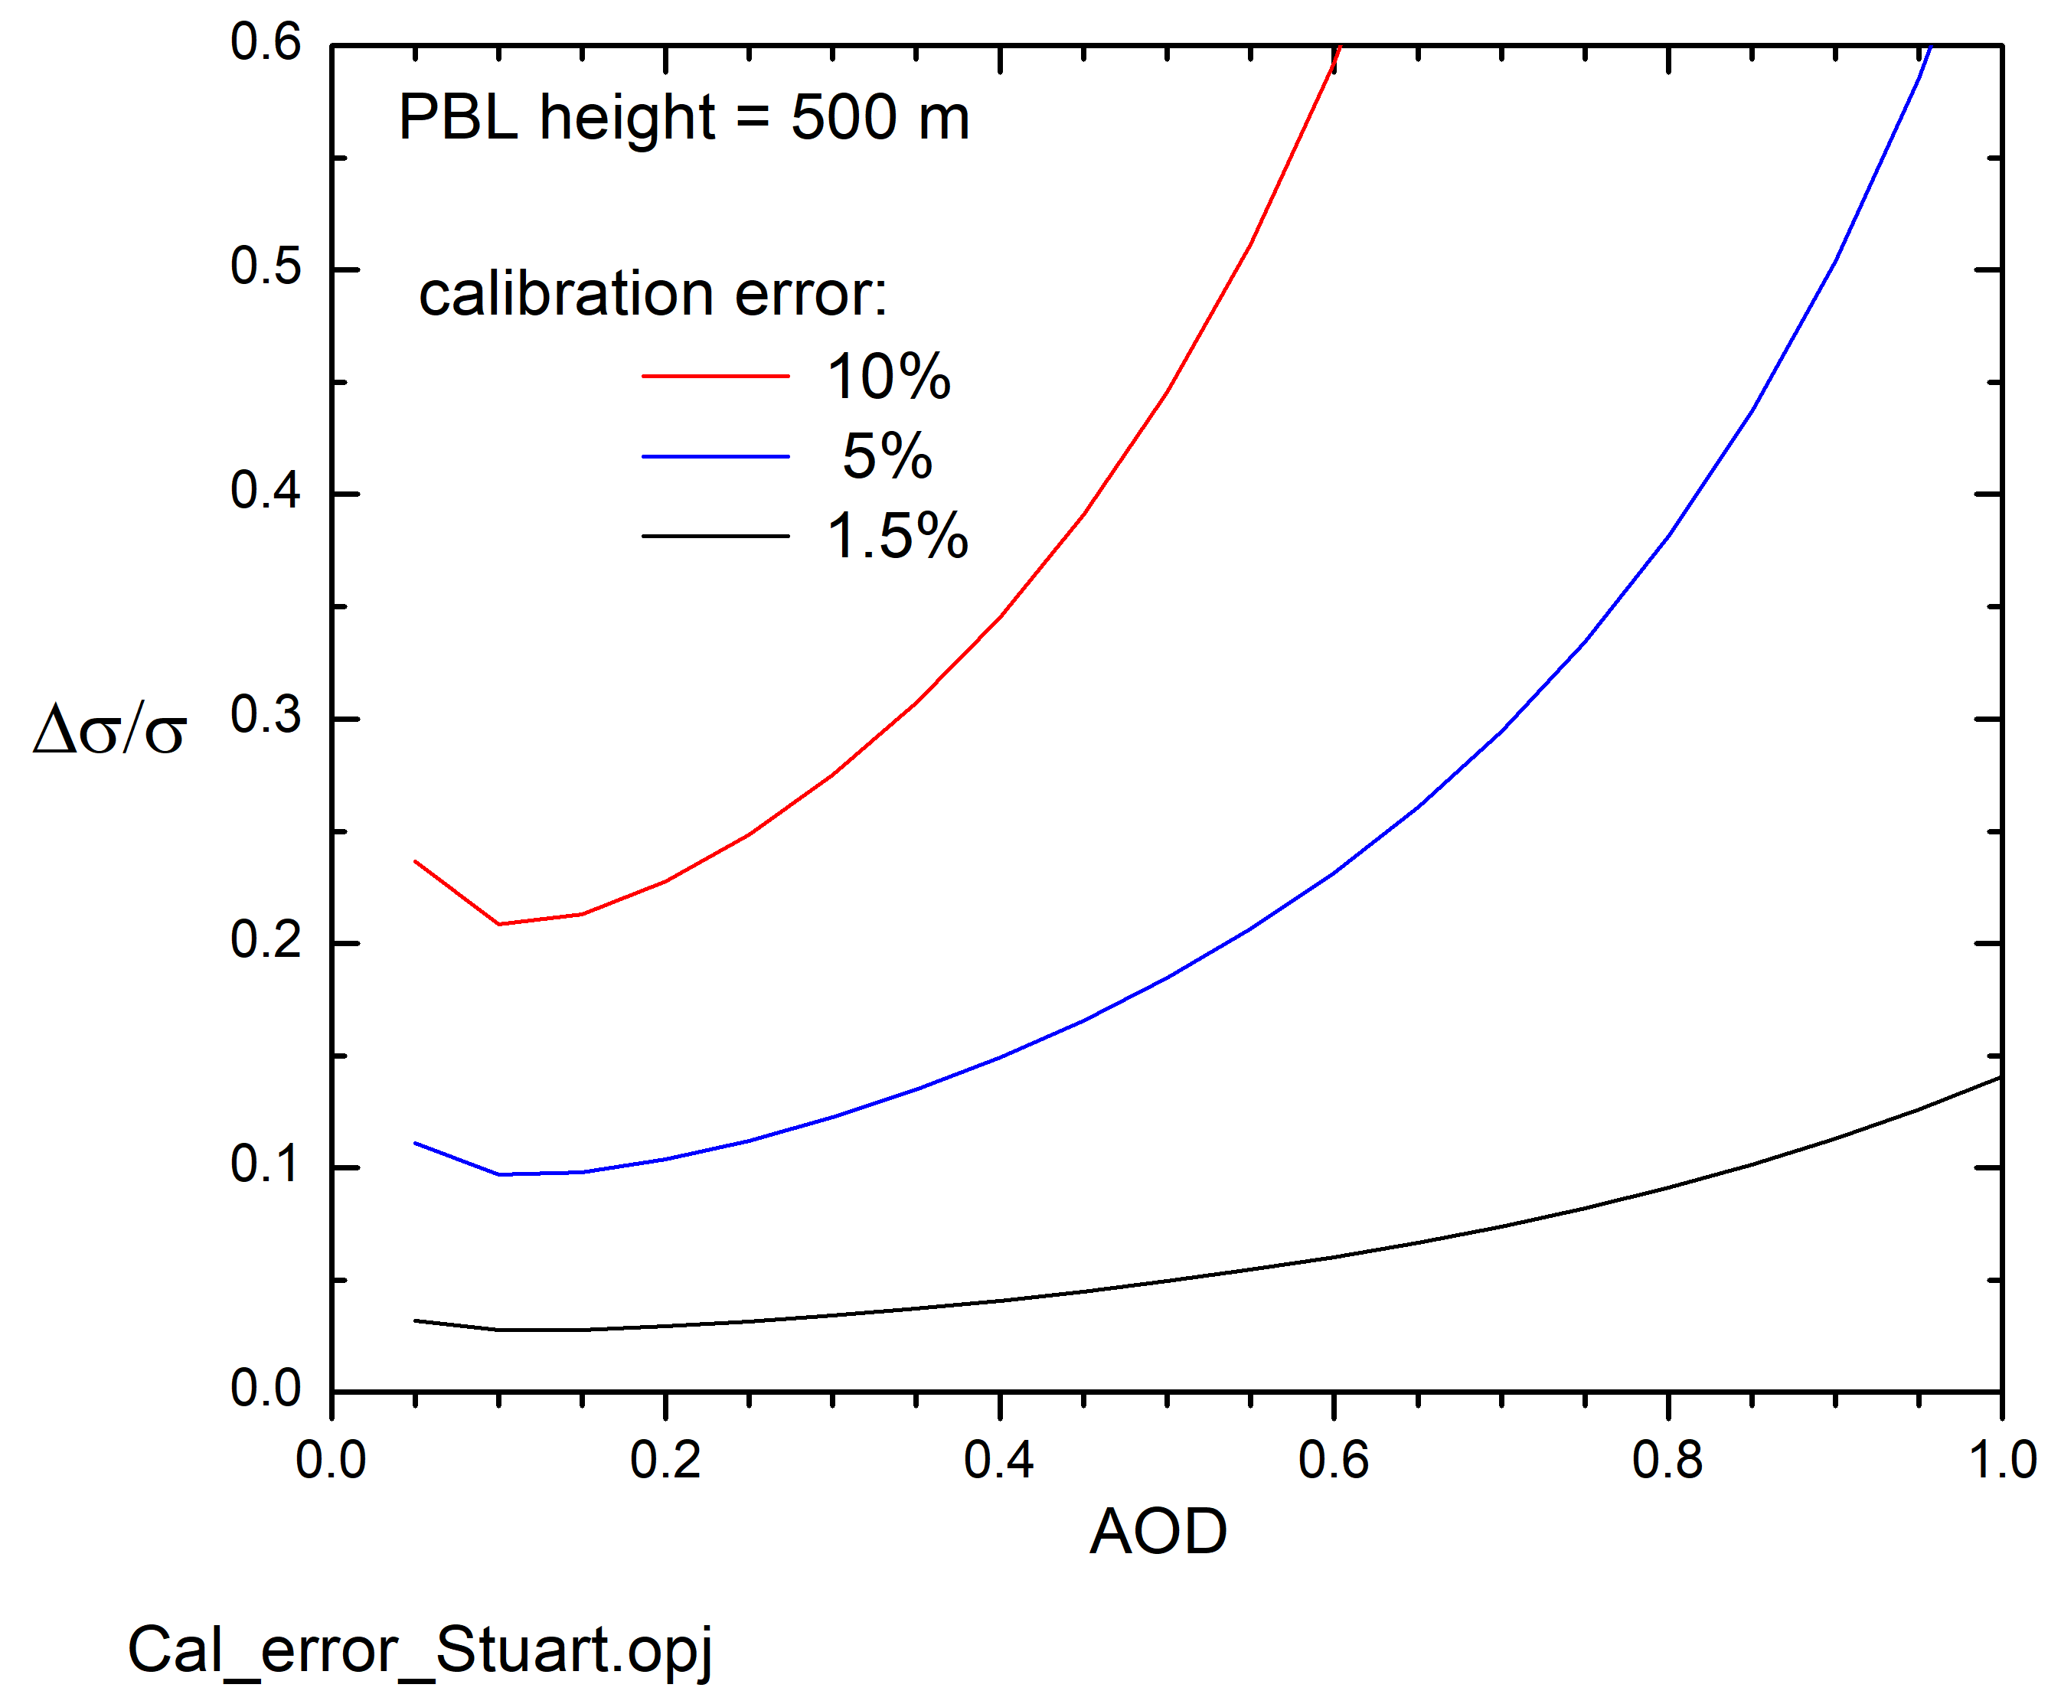
Uncertainty in near-surface aerosol extinction (BSL)
Accurate near-surface extinction (to 20-30%) is important for:
  Air Quality
  Evaluation of models
Uncertainty due to lidar ratio uncertainty only
Uncertainty due to calibration error only

Slide 16
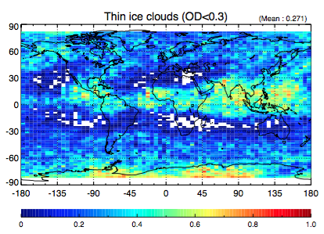
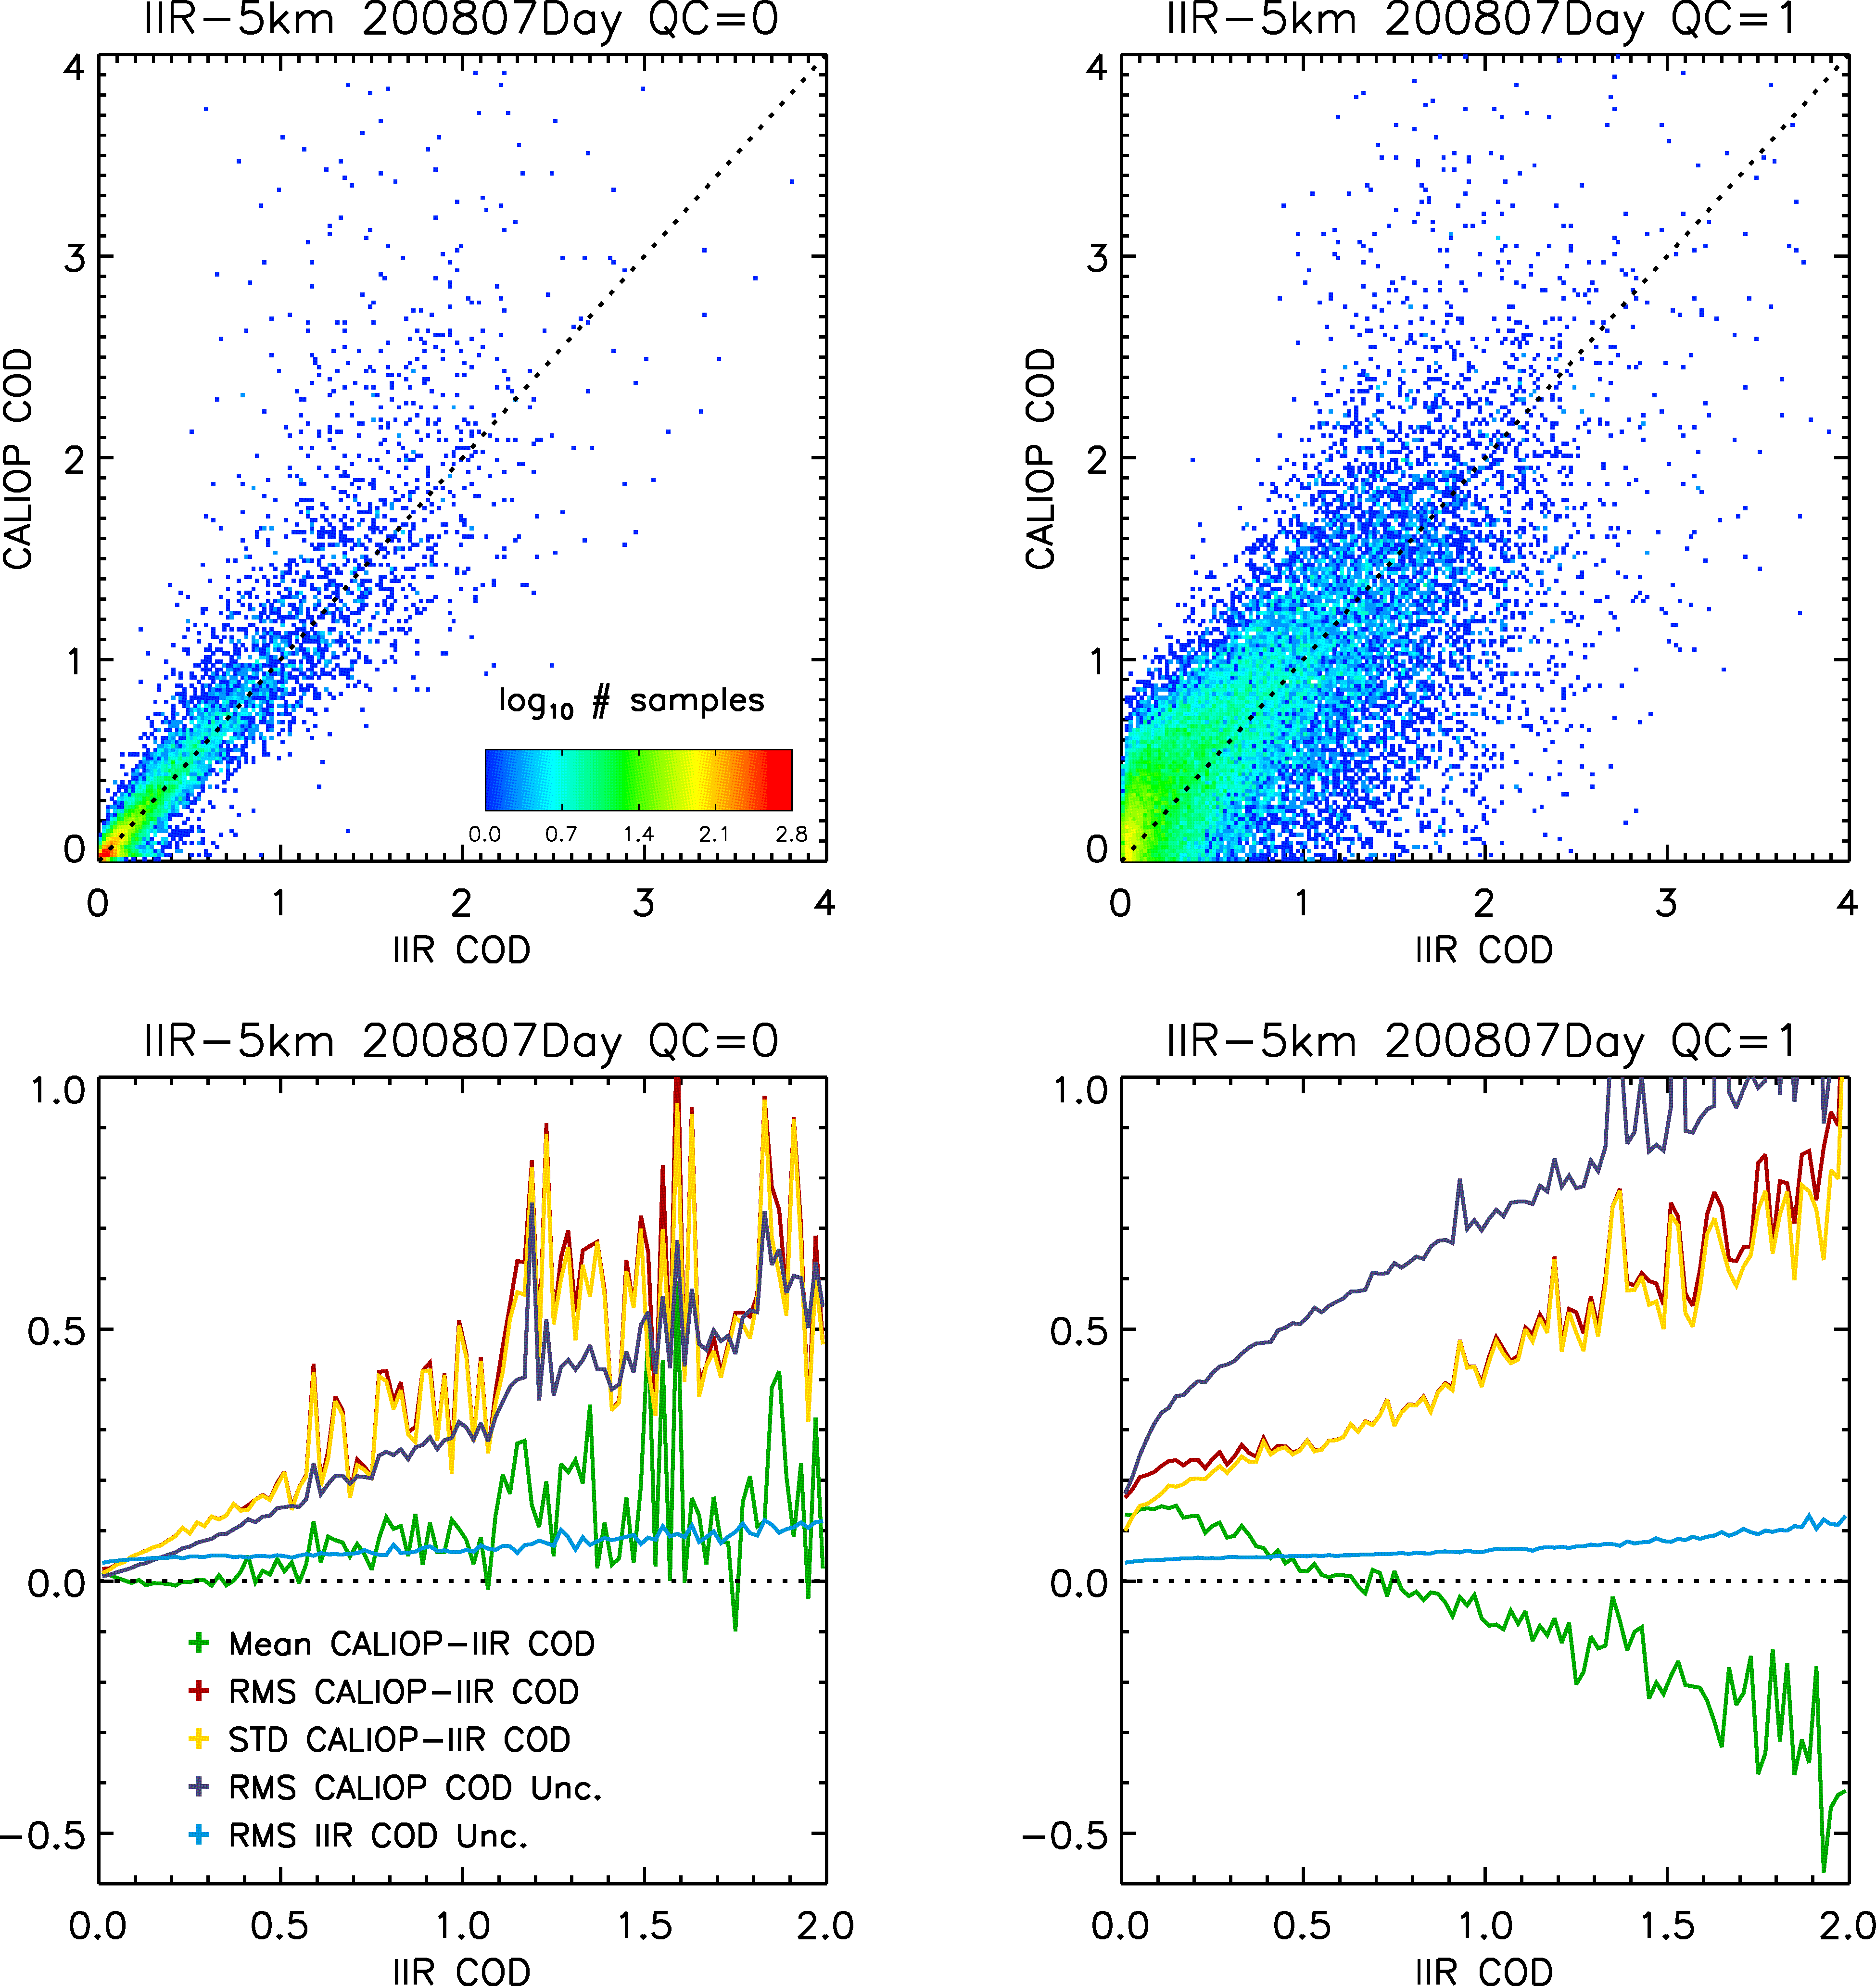
Quantification of CALIOP Cirrus OD Errors
Mostly interested in thinner cirrus
Most cirrus has OD < 1
retrieval errors under dense cirrus are large
CALIOP cirrus OD errors from co-located 5-km IIR OD retrievals
Ocean only, single-layer ROI
unconstrained
constrained
←
rms CALIOP-IIR COD
These results suggest daytime unconstrained retrievals are more accurate than constrained for OD < 0.5
DAY
←
←
mean CALIOP-IIR COD
(analysis by Anne Garnier)

Slide 17
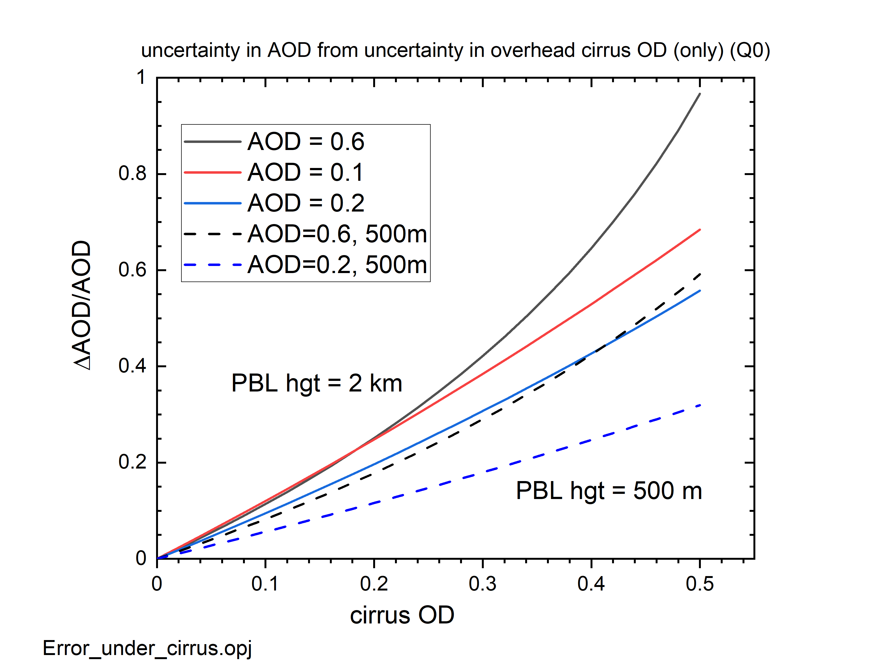
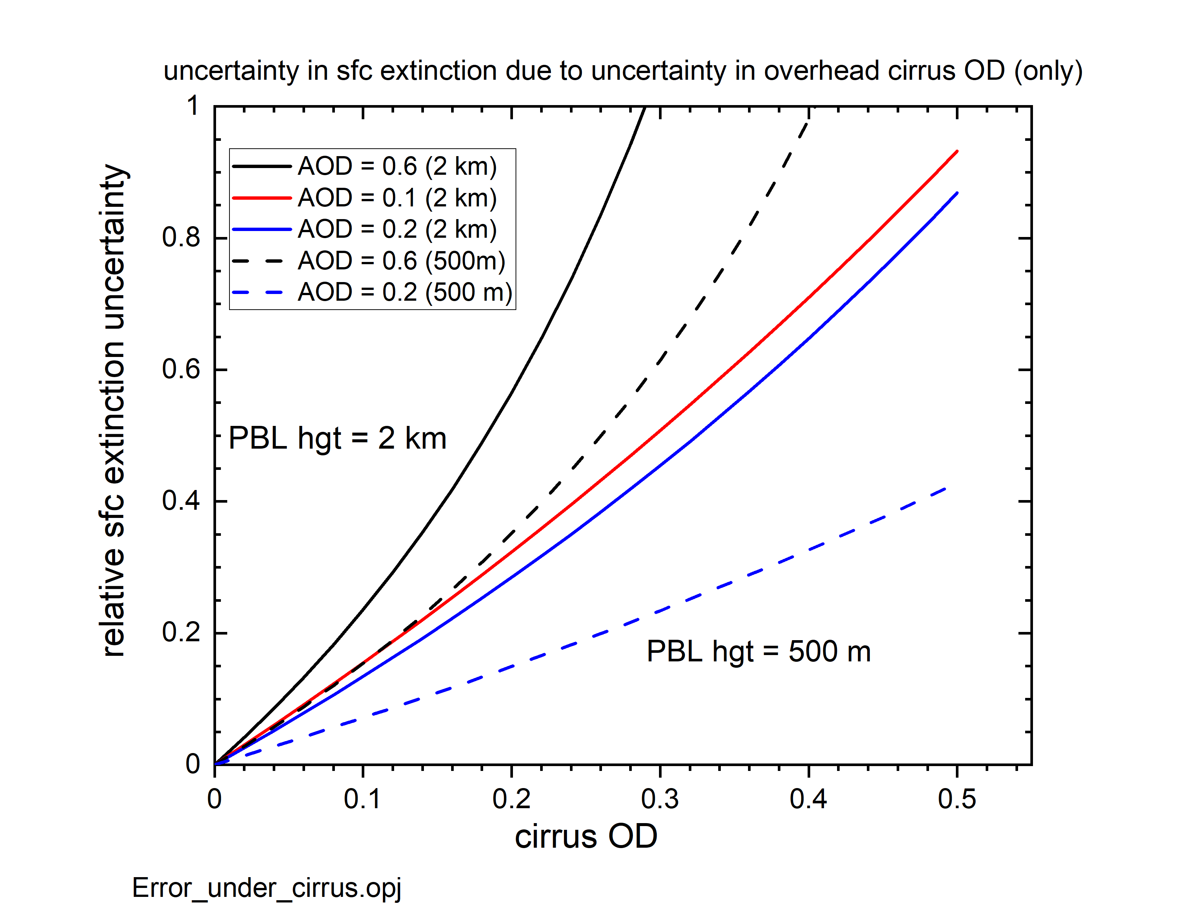
Uncertainty from error in correction of overlying cirrus attenuation
Assumes unconstrained retrievals with perfect lidar calibration and lidar ratio
Using results from Young et al. (2013), the cirrus attenuation correction error is converted into a relative calibration error:
Relative uncertainty in PBL AOD Relative uncertainty in near-surface aerosol extinction
Solid lines: 2 km PBL height
Dashed lines: 500 m PBL height

Slide 18
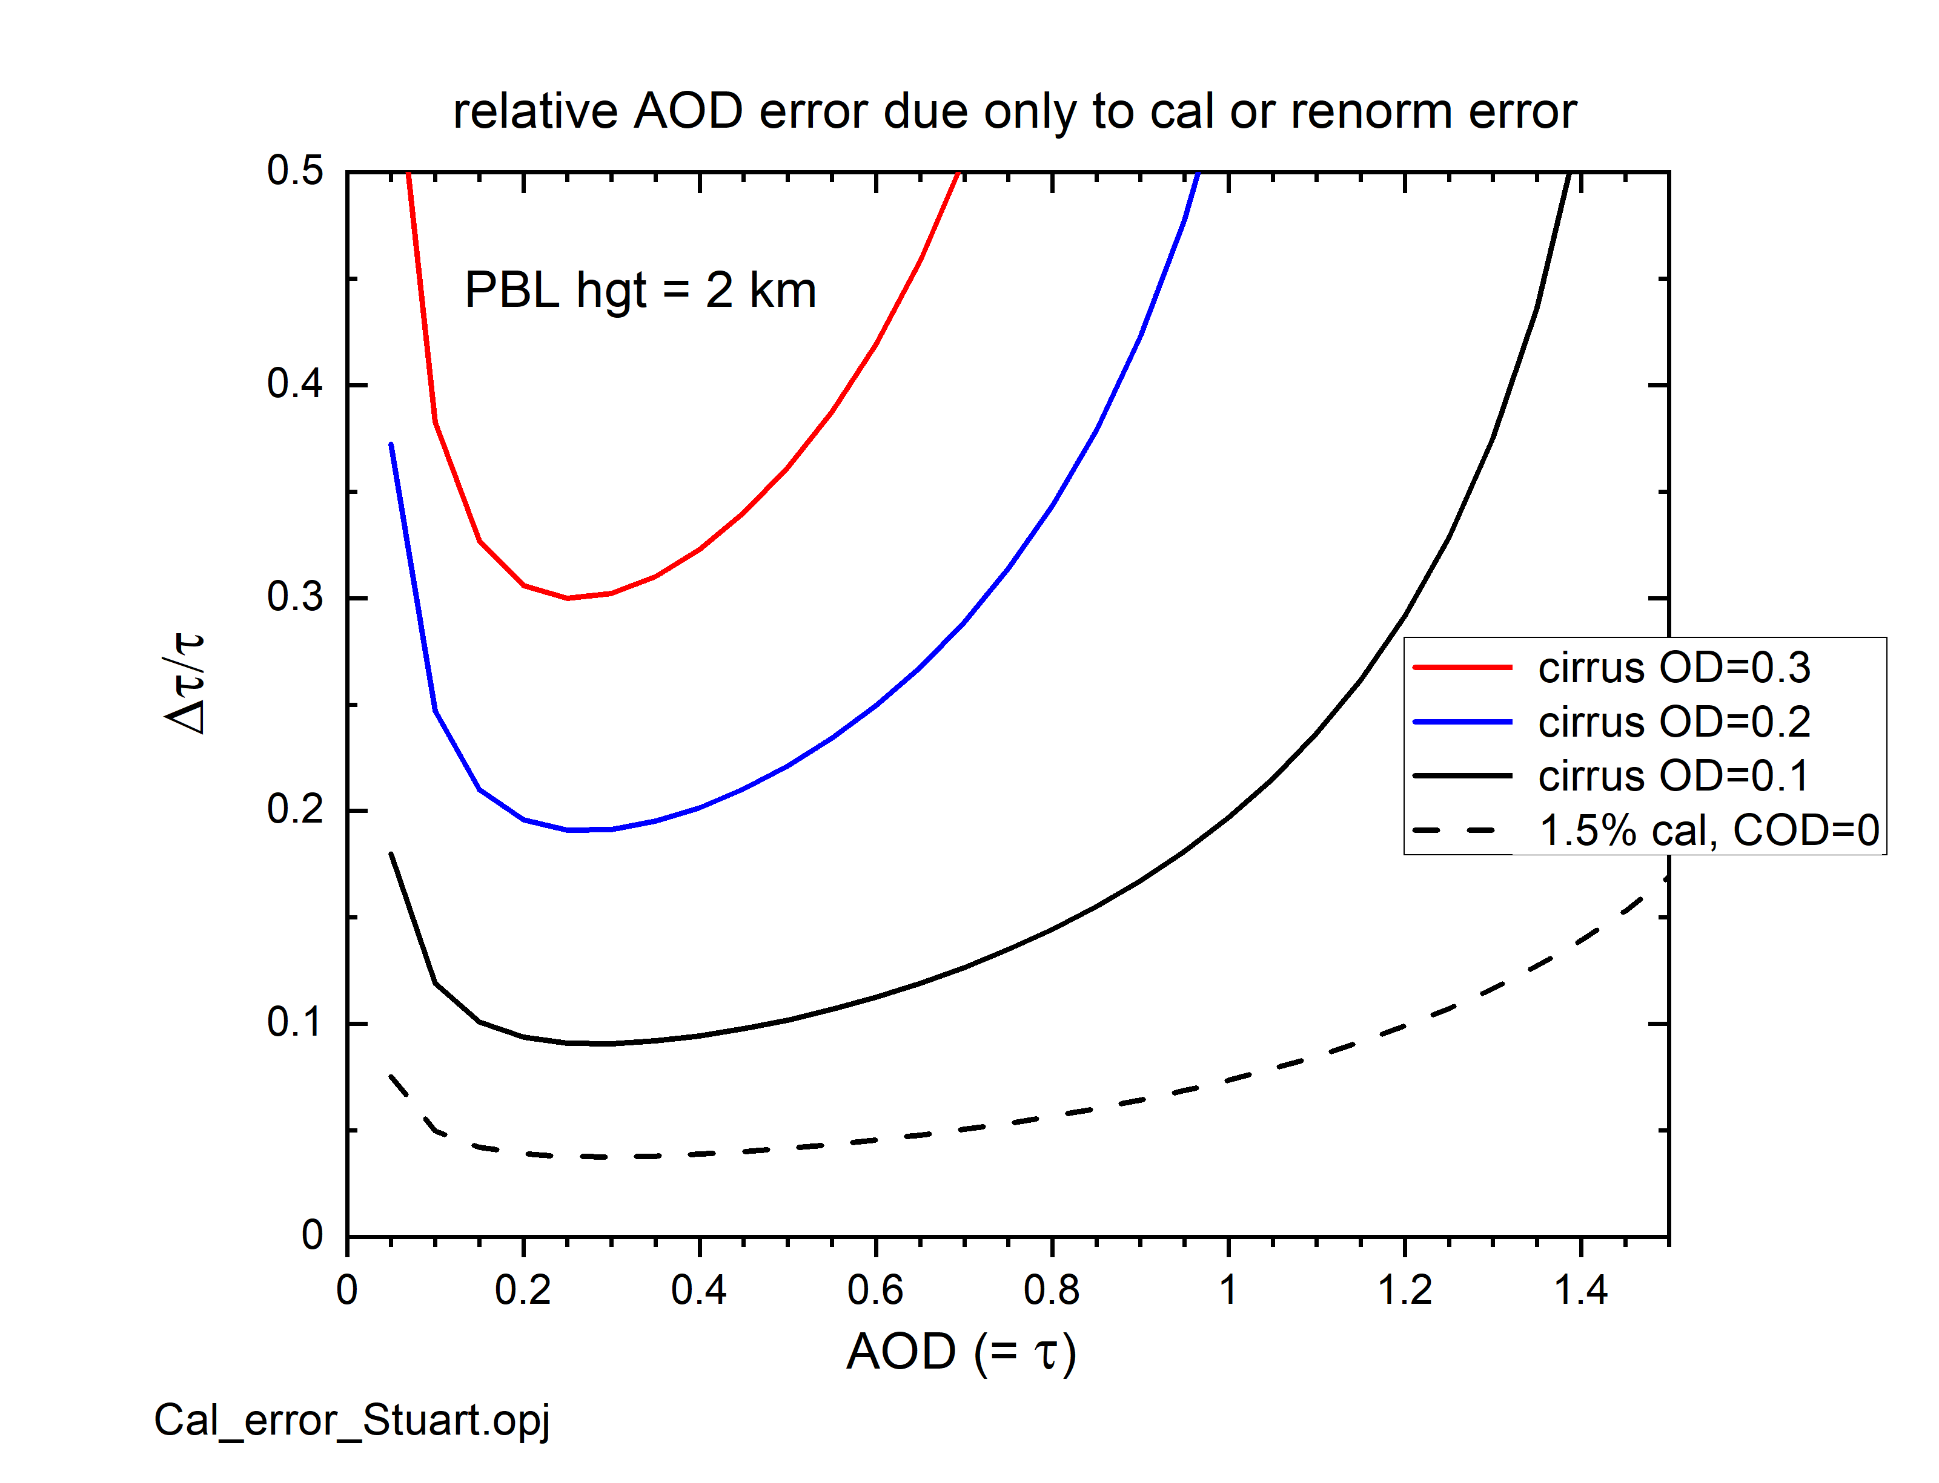
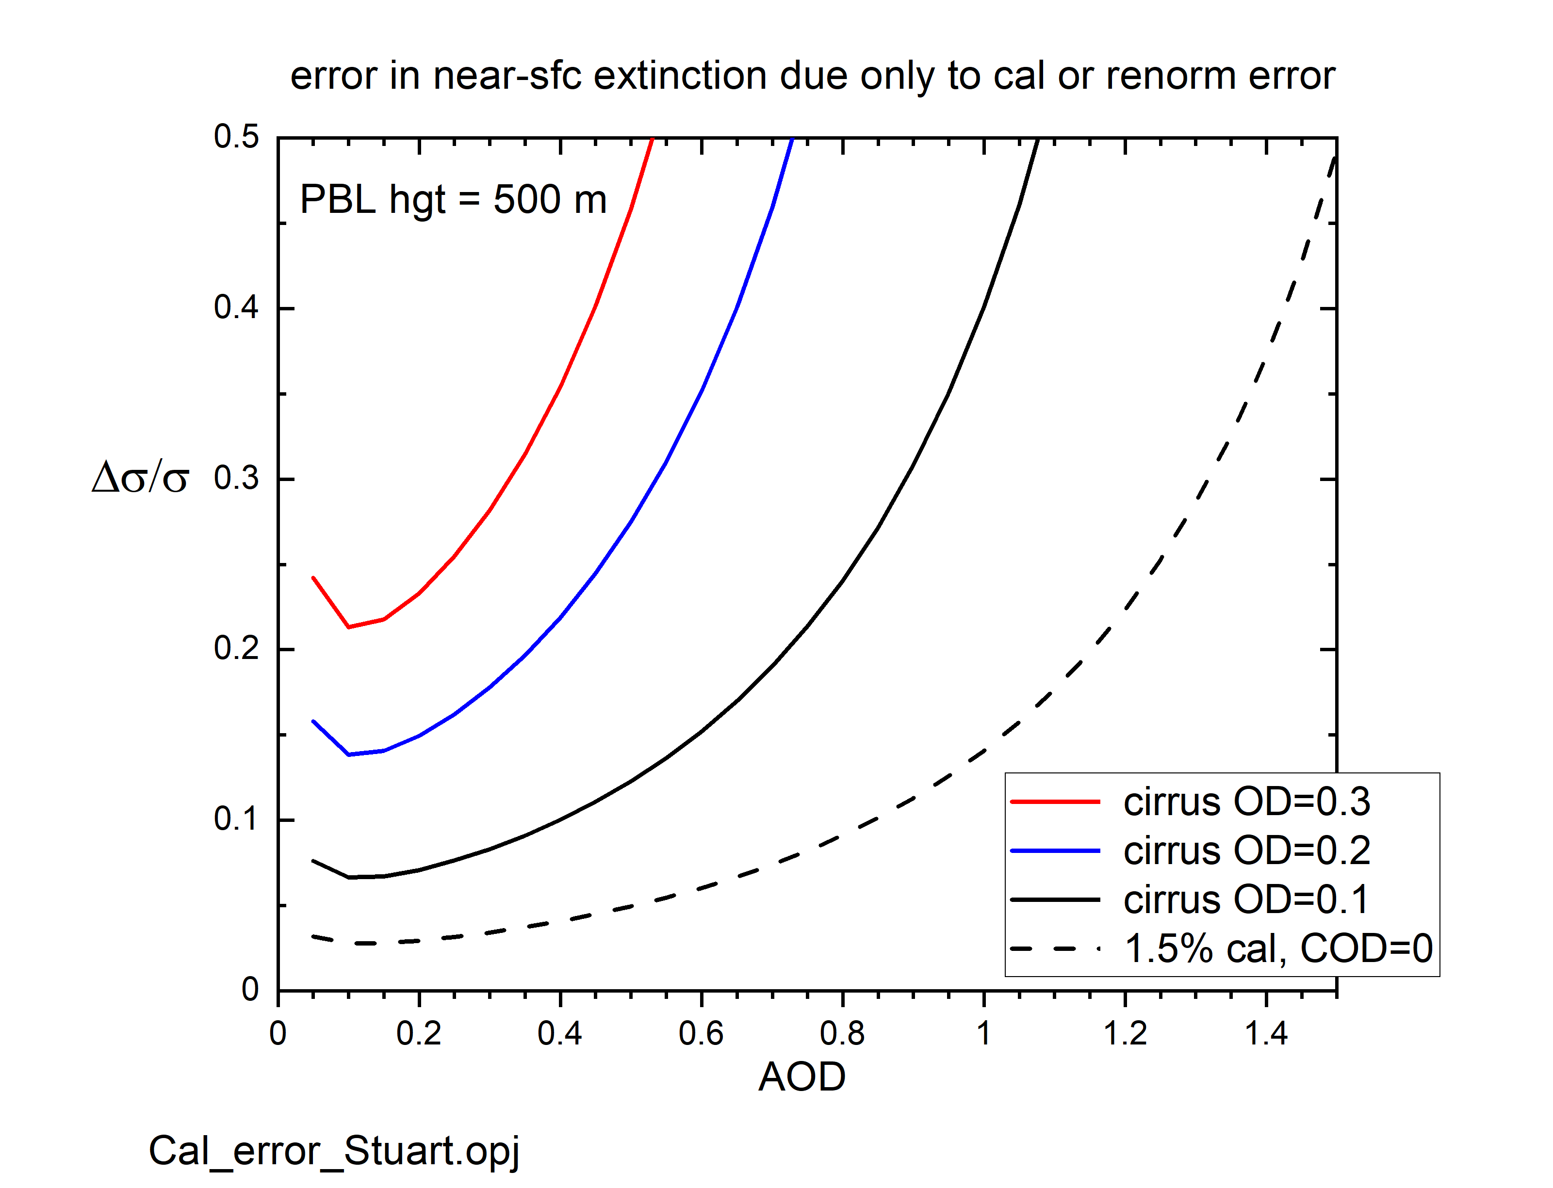
Uncertainty from correction of overlying cirrus attenuation
Assumes perfect calibration and lidar ratio
Plotting previous results as a function of AOD or extinction:
Relative uncertainty in PBL AOD, 2 km PBL height Relative uncertainty in near-surface aerosol extinction, 500 m PBL height
Solid lines: error from correction of overlying attenuation
Dashed lines: error from CALIOP calibration (1.5%) in cloud-free skies

Slide 19

How is HSRL different from backscatter lidar?
A backscatter lidar measures the total attenuated
backscatter signal:
β’ = (β_{p} + β_{m}) e^{-2τ}
and retrieves particulate backscatter:
β_{p} = β’ e^{+2τ} – β_{m}
extinction is then estimated:
σ_{p} = S_{p} β_{p}
Uncertainties propagate downward, largest near the surface
HSRL measures aerosol scattering ratio from attenuated
particulate and molecular backscatter signals:
R = 1 + (β_{p} e^{-2τ} ) / ( β_{m} e^{-2τ} ) = 1 + β_{p} / β_{mol}
HSRL particulate backscatter is computed :
β_{p} = β_{m,mod} (R – 1)
Aerosol extinction is estimated independently from the slope of the (attenuated) molecular channel signal:
Aerosol scattering ratio measured directly, overlying extinction errors do not propagate downward
$σ_{p}=−\frac{1}{2}\frac{∂}{∂r}$ ln $\left[P\left(r\right)r^{2}/β_{m}F\right]$ - $σ_{m}$

Slide 20
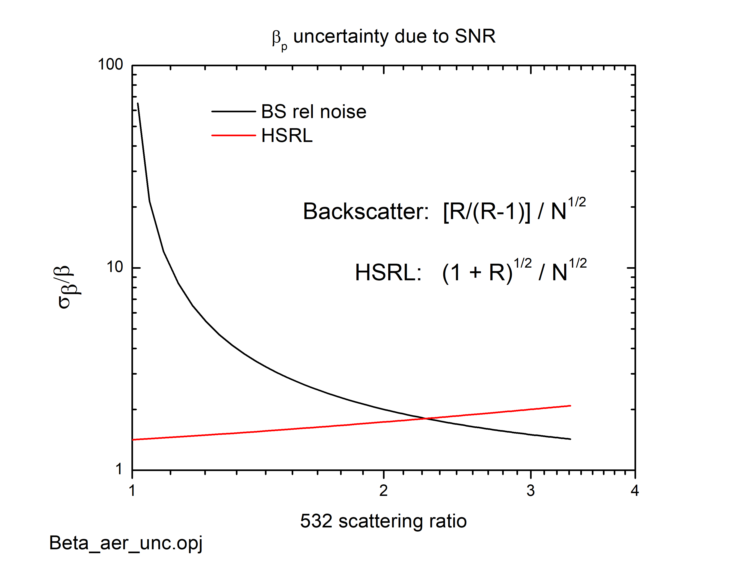
Uncertainty in aerosol backscatter coefficient: BSL vs HSRL
An ideal HSRL measures aerosol and molecular backscatter independently
For a given number of signal photons:
uncertainty in retrieved aerosol backscatter coefficient varies with scattering ratio
HSRL is more sensitive to tenuous aerosol:
- Important for Objective 5
- Important for Objective 8
- Important for evaluation of Aerocom models
in free troposphere
Δβ_{p}/β_{p}
R = particulate scattering ratio
N = photoelectron count in range bin i

Slide 21
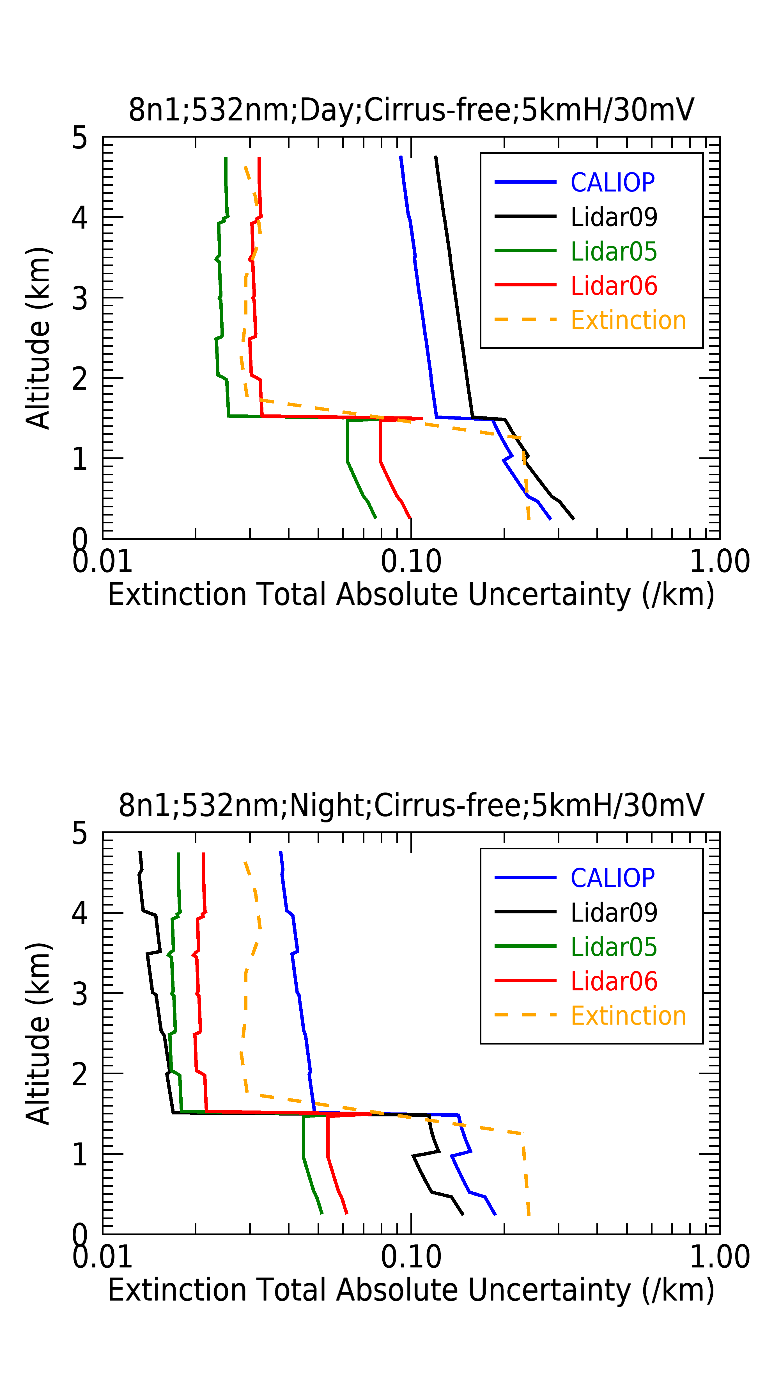
Conclusion: Comprehensive Retrieval Simulations for ACCP
Simulated 532 nm lidar extinction retrieval uncertainties including SNR and systematic calibration and lidar ratio errors
Day
Night
Lidar09 – advanced
backscatter lidar
Lidar05 – HSRL
Lidar06 – HSRL
smoke
(AOD = 0.43)
pollution
Figures courtesy of Travis
Toth and Kathy Powell (ACCP SIT)
Method developed by Mark Vaughan

