Slide 1
Computational Modeling Repository (CMR): User Experience-Designed Web App for HRP Computational Models
HRP Investigators Workshop (IWS) 2021
R. D. Atkins, A.K. Iqbal, A. A. Lyon, M. P. Vorisek, B. Martin

Slide 2





Introduction
Problem | Solution
Research efforts funded by HRP grants and directed work often produce computational models or analytical techniques that are not archived after the research ends. | A model repository that will be accessible by the space flight human health community. Past modeling efforts will be available within the repository along with information on the current status of the model, including development status, model use history, and model credibility.
Approach | Methodology
Capture what is currently available for computational models within the Human Research Program (HRP). Understand and document the status of verification, validation, and credibility (VV&C) compliance with NASA-STD-7009A for the computational models that exist today. Develop a workflow for models and simulations to step through the NASA standard process. Develop a workflow for requesting access to models and simulations. Features to manage the models, simulations, data, and processes described above. | Agile – continuously improve the design and functionality of the application based on user feedback and demonstrations Cloud – early adopters of cloud technologies at GRC for custom web application development DevOps – continuous integration / continuous deployment (CI/CD) pipelines to automatically test code before updates are pushed into production Security – built to current NIST standards for internal NASA applications UX Design – user experience (UX) design concepts for modern look & feel and friendliness
Robyn Atkins
Asad Iqbal
Amy Lyon
Matt Vorisek
Brad Martin

Slide 3
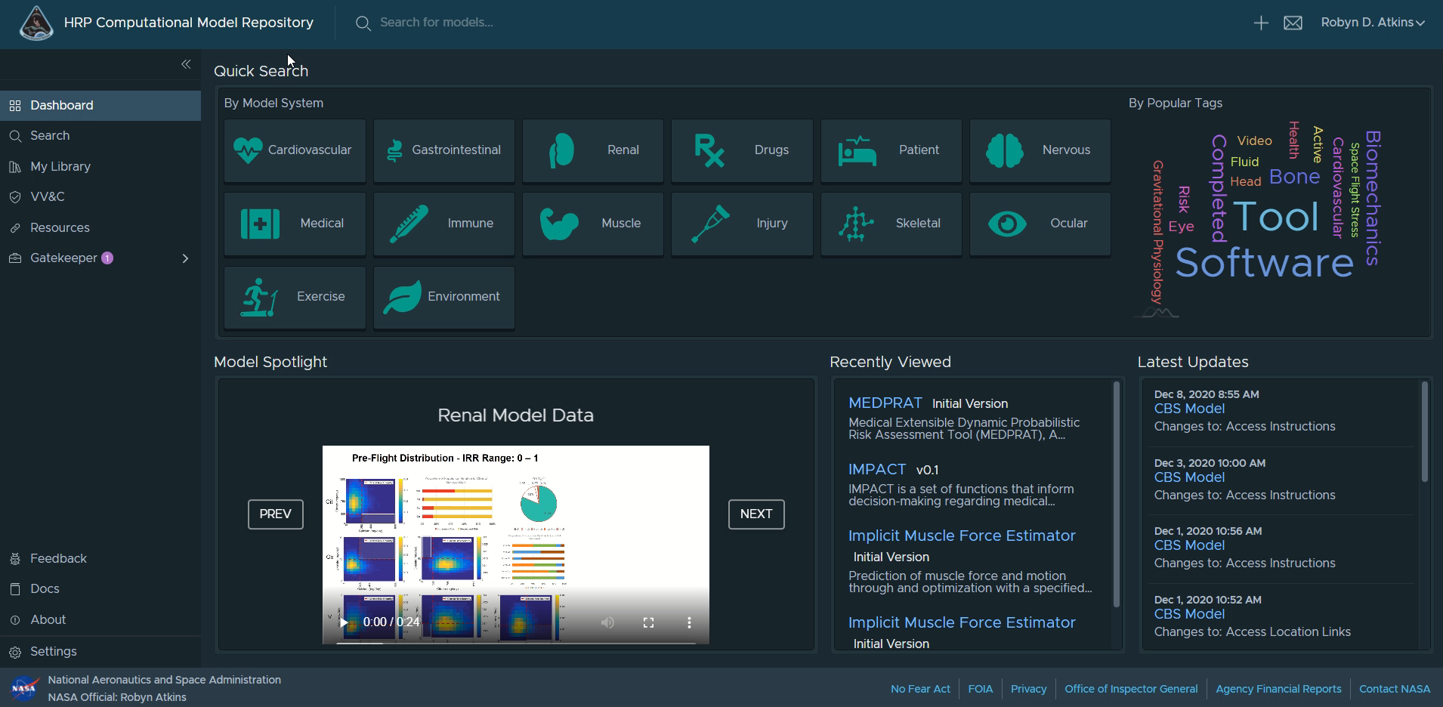
Demonstration

Slide 4
Software Development Roadmap
Version 0.1.0
Functional Prototype
Version 1.0.0
Initial Product
Version 2.0.0
Optimized Product
September 30, 2020
September 30, 2021
March 31, 2020
COMPLETE
COMPLETE
In progress – monthly version releases
Dashboard
Model Repository
Quick view by model system
Search by key word
Search by filtered options
Search by popular tags
Model Wiki Pages
Reference links to access models
User manual
Single Sign-on
Add new model entries
Update existing model entries
Archive model entries
Modify model wiki pages
Initial VV&C workflow
Initial model access request workflow
Updated user manual
Software documentation
Integrated Issue Tracker
User notifications
Enhanced VV&C workflow
Enhanced model relationship visualizations
Model tag ontology
Improved data visualization
New VV&C evidence upload features
Additional user settings
Updated user manual

Slide 5
Discussion and Acknowledgements
Getting Access to HRP’s CMR
Version 1.4.0 is available for use now!
Must have NASA credentials (smartcard badge or AUID/Launchpad)
NASA Access Management System (NAMS)
  https://idmax.nasa.gov
  Search for “HRP Computational Model Repository”
  Workflow number 257907
Request demonstrations by contacting Robyn Atkins robyn.d.atkins@nasa.gov
https://hrpcmr.ndc.nasa.gov
The HRP CMR dev team recognizes the following people and teams for their continued support of this effort:
Kelly Gilkey | Mike Canga | Raj Prabhu
Jerry Myers | Nancy Wilson | John Zoldak
Mona Matar | Cvetan Pavloski | Vishal Butala
Brandon Ruffridge | Drayton Munster | Debra Goodenow
CCMP Team | IMPACT Team | HFPB
ExMC | HHC | SR
LSDA | Gene Lab | PSMO

