Slide 1

Standard Measures during Spaceflight
Principal Investigator: Gilles Clement, PhD, KBR
Science Team: Brian Crucian, PhD, NASA JSC
Stuart Lee, PhD, KBR
Mark Ott, PhD, NASA JSC Millard Reschke, PhD, NASA JSC
Peter Roma, PhD, KBR
Scott Smith, PhD, NASA JSC
Scott Wood, PhD, NASA JSC
Sara Zwart, PhD, UTMB
Support Team: Nicolas Bell, KBR
Scott Humbert, KBR
Carol Mullenax, PhD, KBR
Gwenn Sandoz, KBR
Shelby Weyand, KBR
Notes:
Science Team includes Lead Scientists from the Human Health and Performance Laboratories at the NASA Johnson Space Center.
Support Team is provided by the Research Operation & Integration Element of NASA HRP.

Slide 2
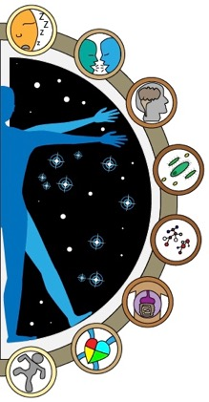
Objective
To ensure that a set of measures, representing the Human Research Program’s key risks and acquired with minimal impact on time and resources, is consistently captured from crewmembers through the end of the ISS Program

Slide 3
Experiment Design Overview
6-month mission
Pre-flight | In-flight | Post-flight
Actigraphy w/ sleep logs (2 weeks each) (L-180, L-90) | Actigraphy (2 weeks each) (bimonthly) | Actigraphy w/ sleep logs (2 weeks) (R+0)
Personality Survey (anytime preflight) | Sleep Quality/Team Questionnaire (monthly) | Cellular Profile Survey (R+15)
Cognition (L-120 fam, L-90) | Cognition (FD30 & R-30) | Cognition (R+10, R+30)
Cellular Profile (ambient blood, saliva) (L-180, L-90) | Cellular Profile (ambient blood, saliva) (Early mission vehicle return, R-0) | Cellular Profile (ambient blood, saliva) (R+30)
Biochemical Markers (blood, urine) (L-180) | Biochemical Markers (blood only) (FD30, R-30) | Biochemical Markers (blood, urine) (R+30)
Microbiome (body, saliva, fecal) (L-90) | Microbiome (body, saliva, fecal) (FD30, R-30) | Microbiome (body, saliva, fecal) (R+30)
Carotid Intima-Media Thickness (cIMT) (L-180) | N/A | Carotid Intima-Media Thickness (cIMT) (R+5, R+30)
Sensorimotor Measures (L-180 , L-90) | N/A | Sensorimotor Measures (R+0 at landing site, R+0 at JSC, R+9)
Crew time: 6.67 hr
Crew time: 18.33 hr
Crew time: 5.75 hr
Notes:
Data collected under the Spaceflight Standard Measures project include assessments of sleep/wake cycles, cognition, immune status and function, general blood and urine chemistry, microbiome composition, cardiovascular structure and function, sensorimotor function, and team processes. Data is collected once or twice before the flight (180 and 90 days before launch), twice during the 6-month missions (fight day 30 and 30 days before return to Earth) with the exception of actigraphy, which is recorded during two-week periods, and sleep quality and team questionnaire which are administered monthly during the mission.

Slide 4
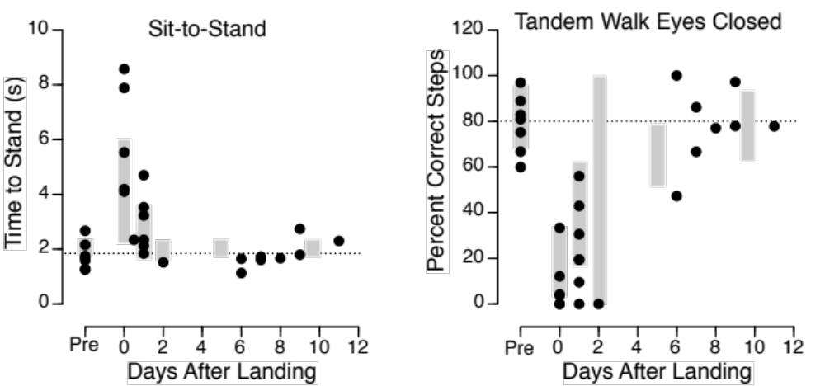
Sensorimotor Measures

Slide 5
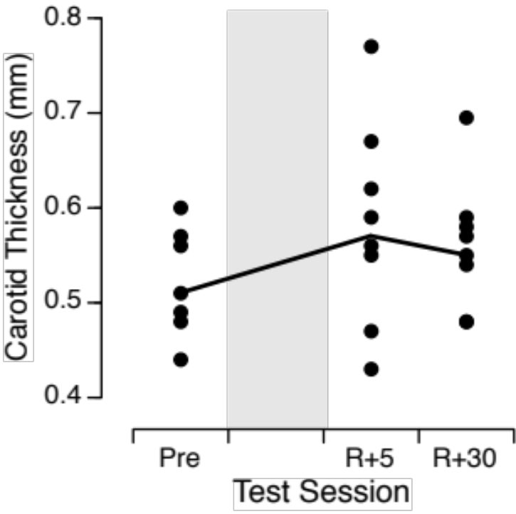
Carotid Intima-Media Thickness

Slide 6
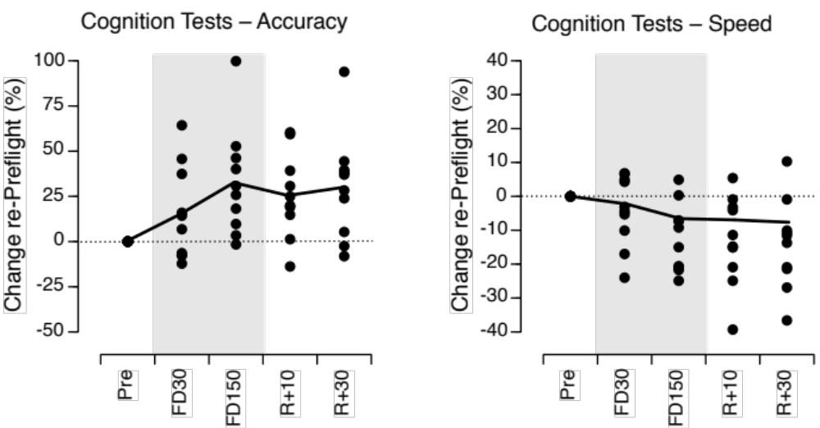
Cognition

Slide 7
Goal
Spaceflight Standard Measures constitute a database for:
  Providing context for data acquired by concurrent experiments
  Supporting or developing hypotheses
  Evaluating the effectiveness of various in-flight countermeasure profiles
  Comparing population responses to various mission durations (6 weeks, 6 months, 1 year)
Notes:
Data from the Standard Measures Project are placed in the NASA Life Sciences Data Archive and are available for occupational surveillance, Institutional Review Board-approved data sharing requests, and retrospective data requests. This data repository enables high-level monitoring of the effectiveness of countermeasures and meaningful interpretation of health and performance outcomes for various mission durations. The knowledge gained from this project informs and supports future hypothesis-driven research that will enable the success of planetary missions.

