Slide 1
Jay Feldman
(Mason & Kaya’s dad)
&
Don Ellerby
NASA, Space,
& Spaceship Heatshield Engineering
January 11, 2021

Slide 2
Anyone know what NASA stands for?

Slide 3
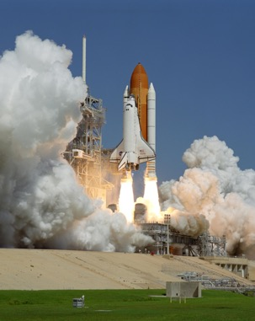
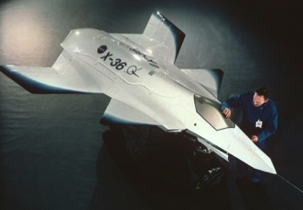
Anyone know what NASA stands for?
National Aeronautics and Space Administration

Slide 4
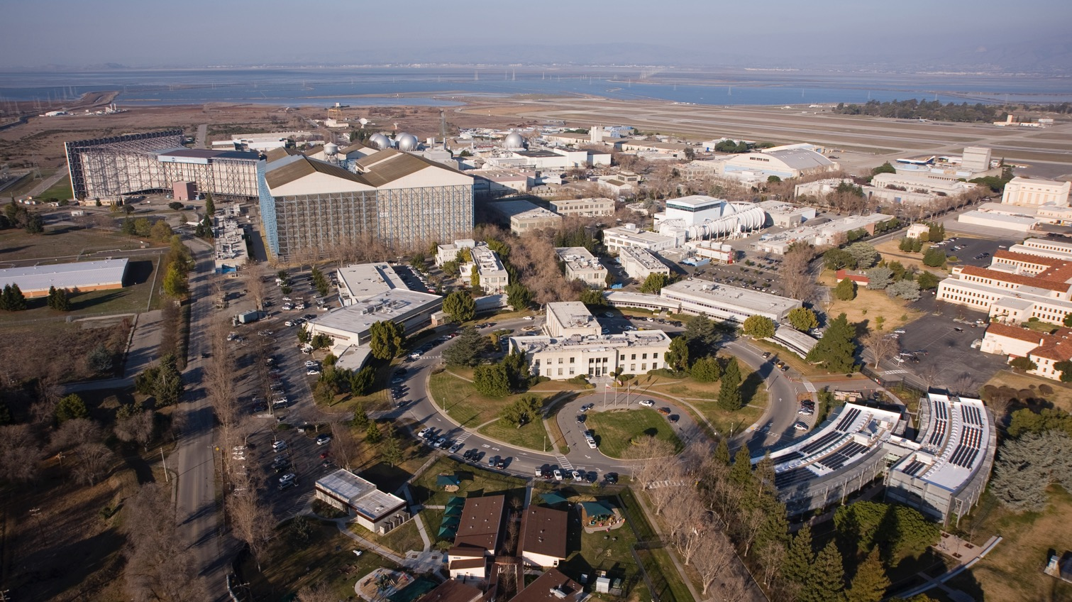
NASA Ames Research Center (SF Bay Area)

Slide 5



NASA Centers
Glenn Research Center
Ames Research Center
Goddard Space Flight Center
Headquarters
Jet Propulsion Laboratory
Kennedy Space Center
Langley Research Center
Armstrong Flight Research Center
Johnson Space Center
Stennis Space Center
Marshall Space Flight Center

Slide 6
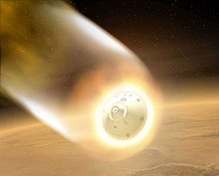
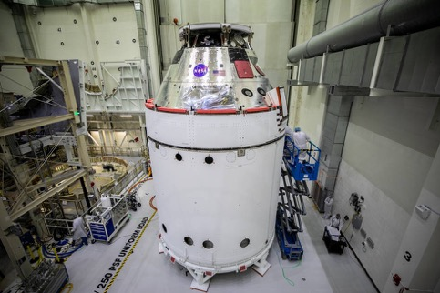
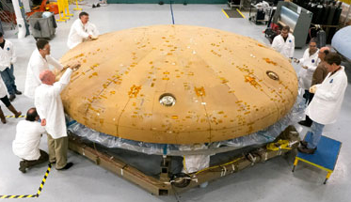
What’s my job?
I’m a Materials Scientist / Engineer
  Materials scientists study stuff/matter/materials
  Materials engineers design materials with specific properties for an application
  I went to college at the University of Washington (Go Huskies!)
I work on Thermal Protection Systems
  Which protect a spacecraft from the extreme heat generated when it enters the atmosphere of a planet or moon
A big part of my job is to create & test new materials for spaceships

Slide 7
Anyone know the name of the program to take humans back to the moon?
Anyone know the name of the NASA spacecraft that is going to replace the Space Shuttle?

Slide 8

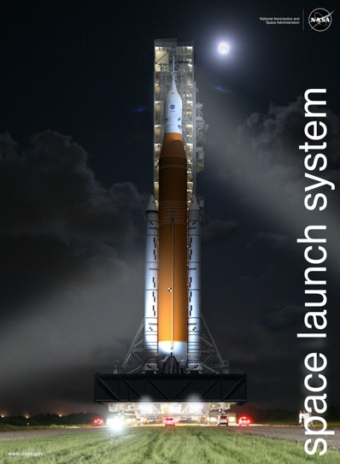
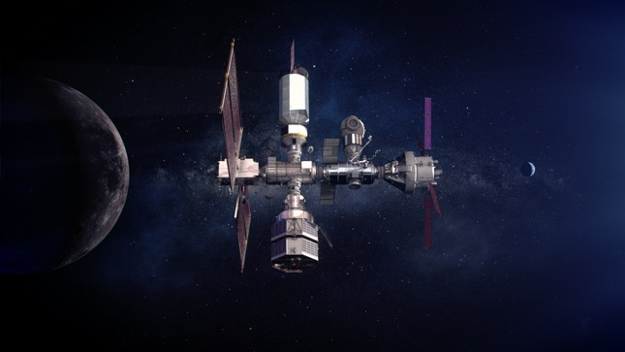
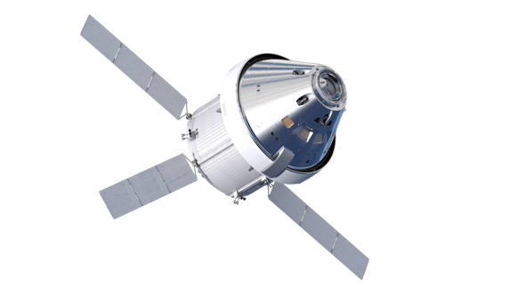
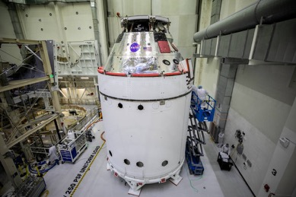
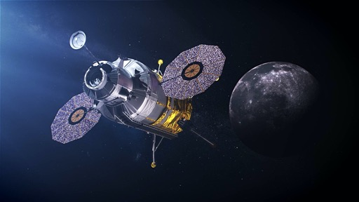
NASA Artemis Program
Gateway
Orion
Lunar Lander
Notes:
SLS: will be most powerful rocket ever, to launch late 2021.
Orion: 4-6 astronauts.
Gateway: outpost orbiting moon to support long term human lunar activity + deep space exploration staging point.

Slide 9
2014 Orion EFT-1 Before and After First Flight

Slide 10
What just celebrated 20 years of having people continuously on board?

Slide 11
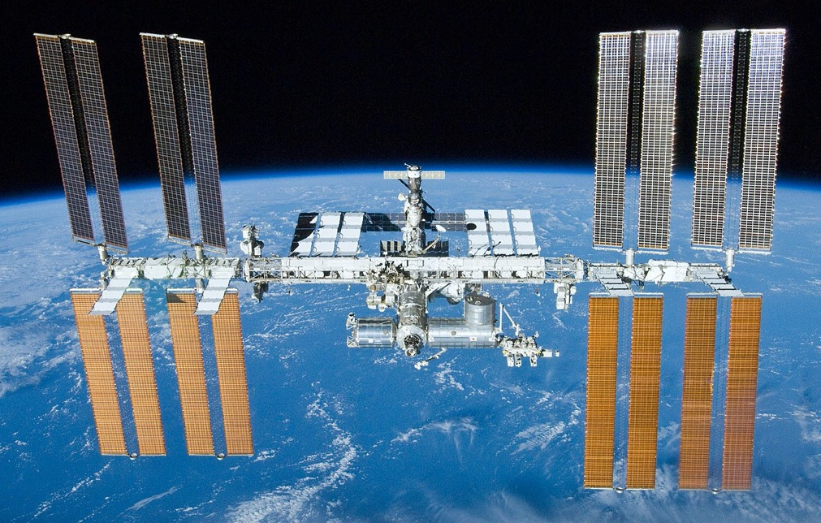
International Space Station

Slide 12
What space vehicle flew dozens of missions to deliver components to build the International Space Station?

Slide 13
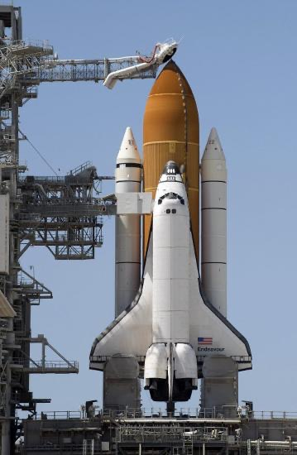
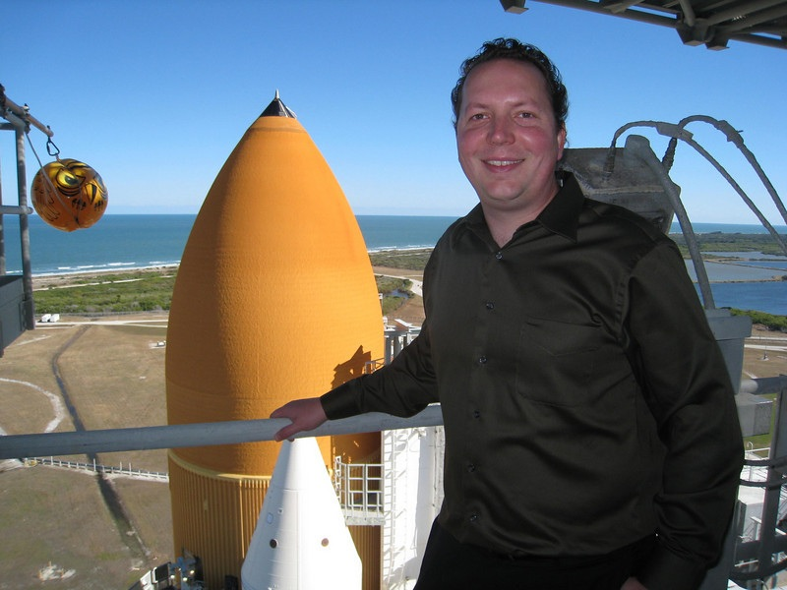
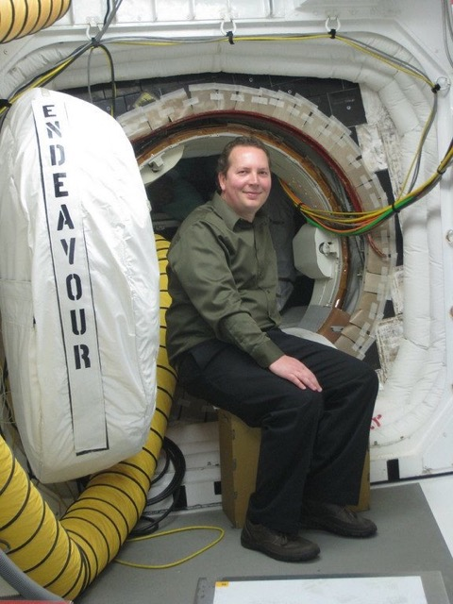
2010 – Space Shuttle Endeavour Visit
Space Shuttle

Slide 14
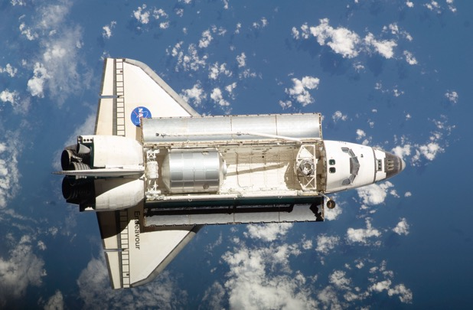
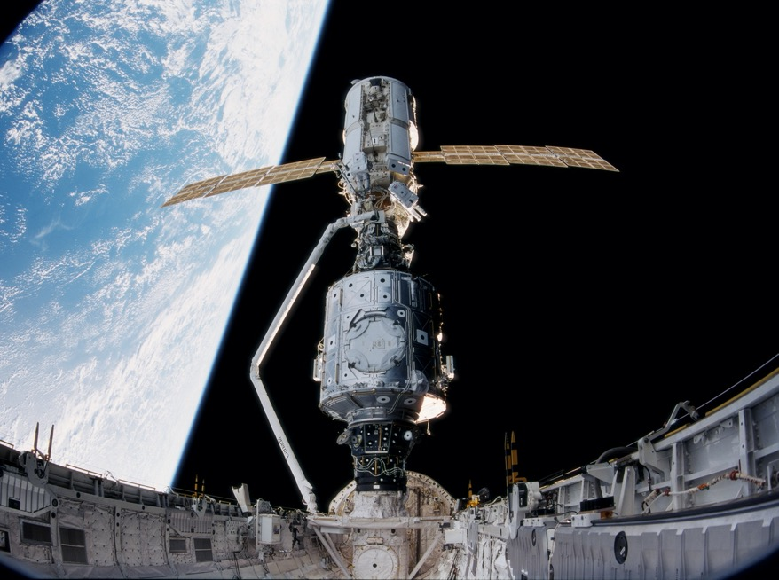
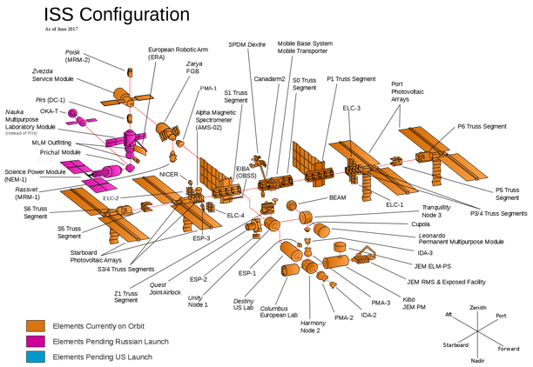
Shuttle Begins ISS Construction
View from Shuttle Cargo Bay

Slide 15
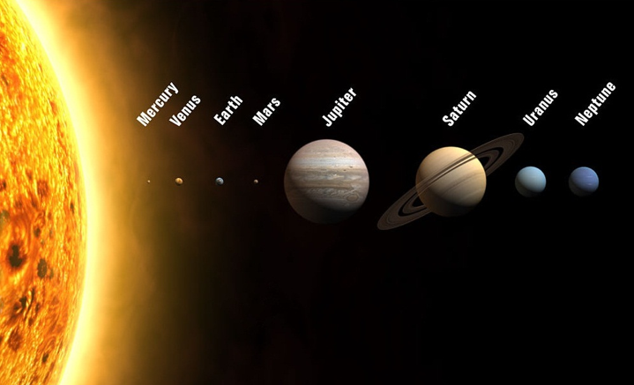
How far are we talking?
1,784M miles
2,800M miles
, 35M miles
, 92M miles
, 483M miles
888M miles
, 67M, miles
, 142M miles
Pluto
4,000M miles
Some of NASA’s Visits to the Solar System
Mercury: MESSENGER
Venus: Pioneer Venus
Mars: Mars 2020, Mars Science Lab, Pathfinder/Sojourner
Jupiter: Galileo Probe, Voyager
Saturn: Cassini, Voyager
Uranus/Neptune: Voyager
Pluto: New Horizons
Note: planet sizes are to scale, distances are not
Notes:
planet sizes are to scale, distances are not

Slide 16
How long will it take to get from Earth to Mars?
(~50 million miles)
  At the speed of an Airplane?
  At the Speed of Space Shuttle?
  At the Speed of Light?
  Think about this…
  If you send a text message to some one on Mars, it will take 5 min to get there and if they replied it will take 5 more min to get back to earth.

Slide 17
How long will it take to get from Earth to Mars?
(~50 million miles)
  At the speed of an Airplane? (600 miles/hour)
    100,000 hrs (4,166 days) (11 years)
  At the Speed of Space Shuttle?
  At the Speed of Light?
  Think about this…
  If you send a text message to some one on Mars, it will take 5 min to get there and if they replied it will take 5 more min to get back to earth.

Slide 18
How long will it take to get from Earth to Mars?
(~50 million miles)
  At the speed of an Airplane? (600 miles/hour)
    100,000 hrs (4,166 days) (11 years)
  At the Speed of Space Shuttle? (17,500 miles/hour)
    2860 hrs. (119 days) (4 months)
  At the Speed of Light?
  Think about this…
  If you send a text message to some one on Mars, it will take 5 min to get there and if they replied it will take 5 more min to get back to earth.

Slide 19
How long will it take to get from Earth to Mars?
(~50 million miles)
  At the speed of an Airplane? (600 miles/hour)
    100,000 hrs (4,166 days) (11 years)
  At the Speed of Space Shuttle? (17,500 miles/hour)
    2860 hrs. (119 days) (4 months)
  At the Speed of Light? (670 million miles/hour)
    5 minutes
  Think about this…
  If you send a text message to some one on Mars, it will take 5 min to get there and if they replied it will take 5 more min to get back to earth.

Slide 20

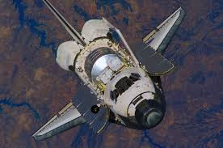
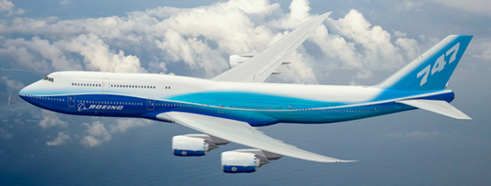
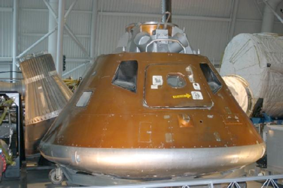
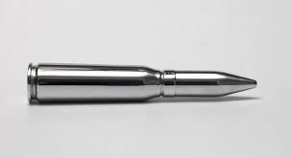
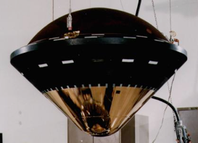
How fast are we talking?
100 mph
17,500 mph
24,600 mph
Apollo
600 mph
Galileo Probe
at Jupiter
105,000 mph
1,800 mph

Slide 21
Does anyone know what Perseverance is?
As it relates to NASA

Slide 22
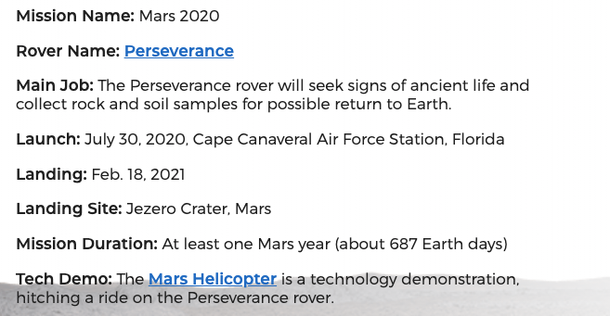
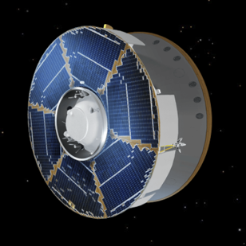
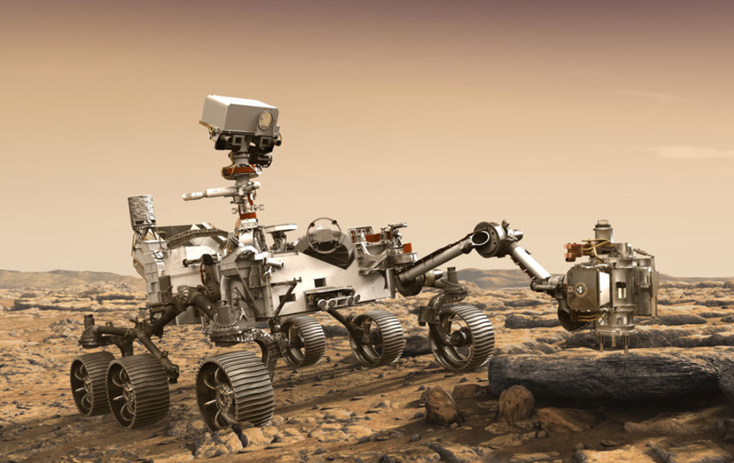
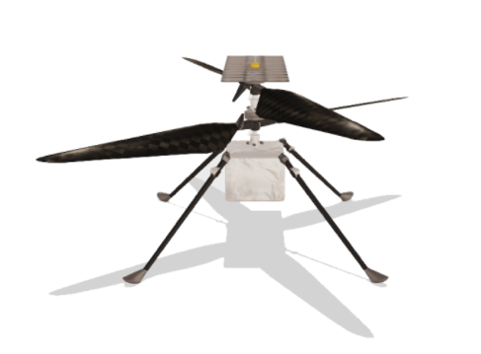
Perseverance Rover
Currently travelling
at ~60,000mph
7th grader named the rover
Ingenuity

Slide 23
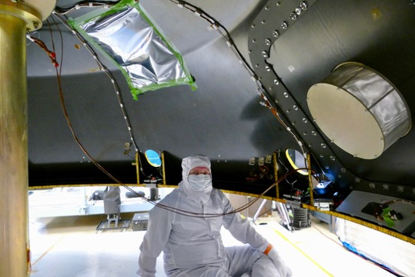
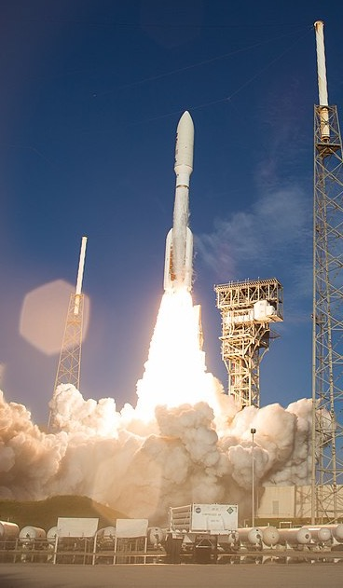
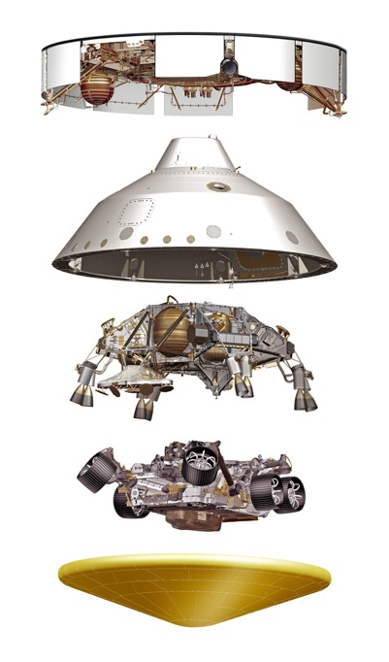
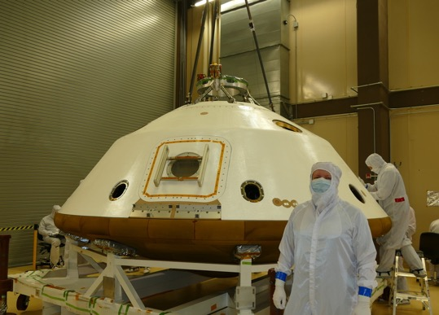
Mars 2020 Spacecraft Preparing for Launch
Left Earth in July 2020
Arrives Mars Feb. 2021

Slide 24
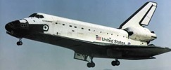
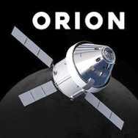
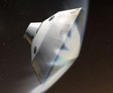
Heatshields protect the interior from overheating.
How hot do Spaceship Heatshields get?
Spaceship | Planet entered | Approximate Speed | Approximate Temperature
Shuttle | Earth | 17,000 mph | 3000 ℉ / 1650 ℃
Orion | Earth | 24,000 mph | 4300 ℉ / 2400 ℃
Perseverance | Mars | 13,000 mph | 2900 ℉ / 1600 ℃

Slide 25
How do we test heatshield materials before flying them?

Slide 26
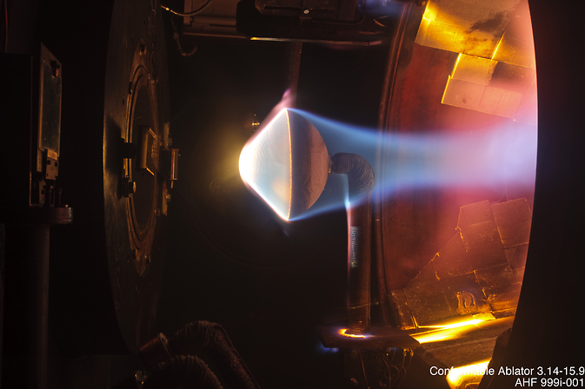
Test them in a special facility called an Arc Jet
12 inches
Hypersonic plasma flows from this nozzle

Slide 27
18 inches

Slide 28
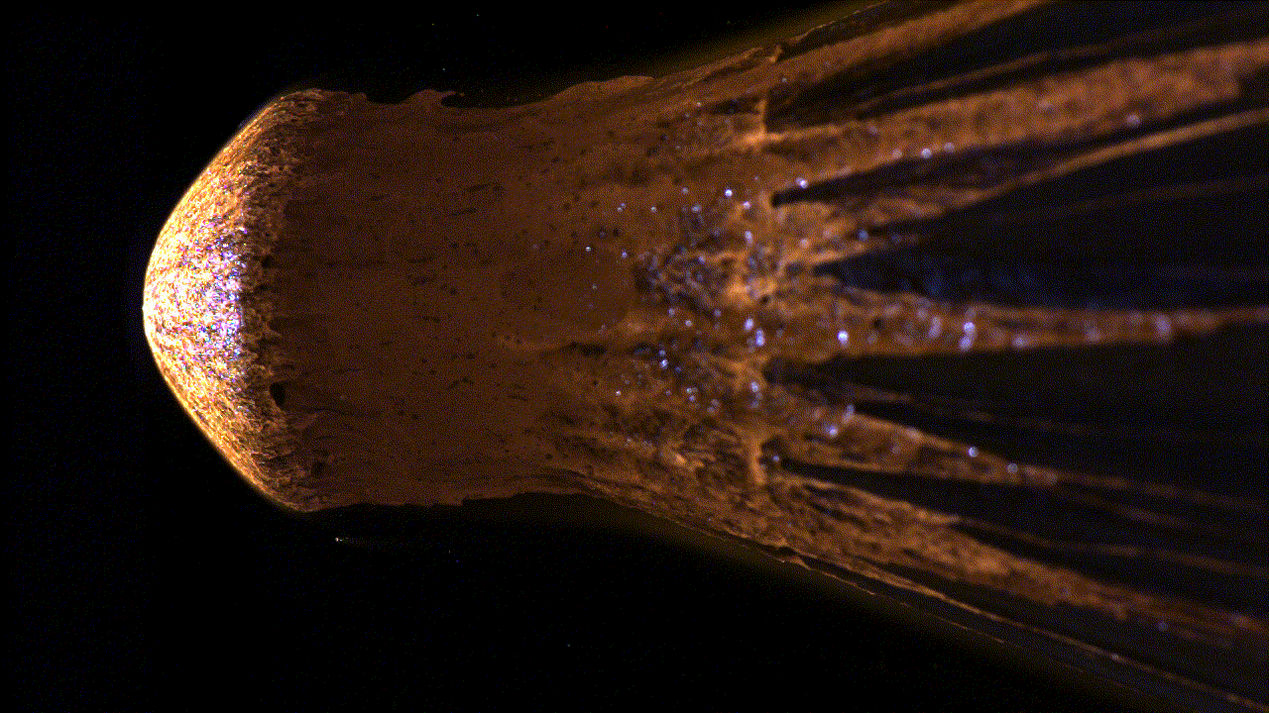
Meteor sample exposed to the arc jet

Slide 29
How much power are we talking about?
Power per area = heat flux
Thing | Heat Flux Watts/cm²
Sunny day on Earth | 0.1
Incandescent light bulb | 0.8
Toaster | 8
Perseverance Mars Entry | 80
Orion returning to Earth from the Moon | 800
Galileo Space Probe Entering Jupiter (2003) | 50,000

Slide 30
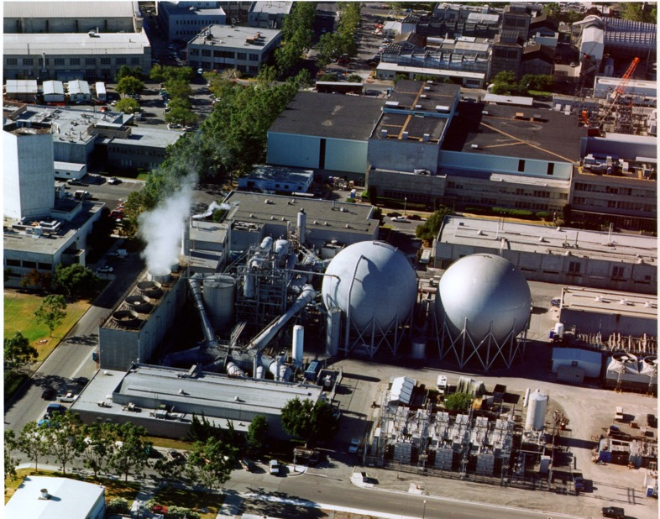
If a hairdryer requires 1,500 Watts of power, how much power do you think an arc jet requires?
Hint: several buildings are required to run all of the equipment
Answer:
Up to 60 Million Watts!!!
That’s enough to power ~50,000 homes
(all houses in Rescue, EDH, Cameron Park, Folsom)

Slide 31
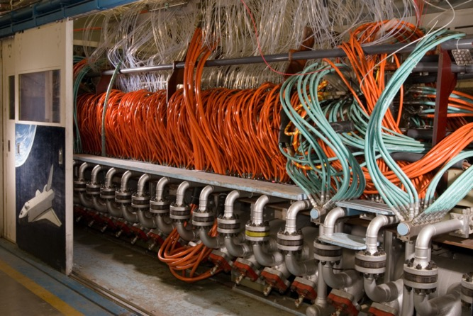
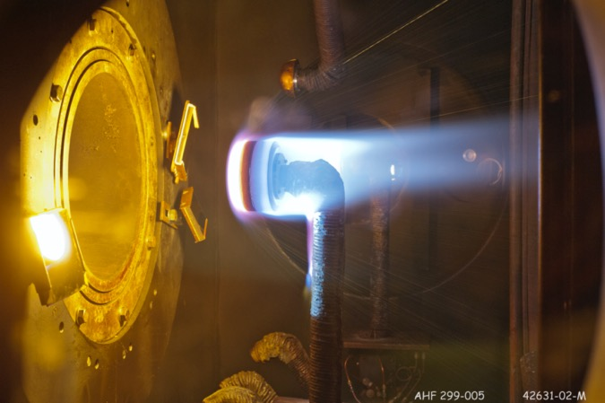
Arc Jet Fun Facts
It requires about 50 people to run and maintain 3 arc jet facilities at NASA Ames
Arc jet testing costs about $50,000 per day where about 4 to 8 tests can be run

Slide 32
What kinds of properties should a heat shield material have?
Should it be heat resistant?
Should it be strong?
Should it be heavy / dense?
Should it conduct heat well, or insulate?
Does the color matter?

Slide 33
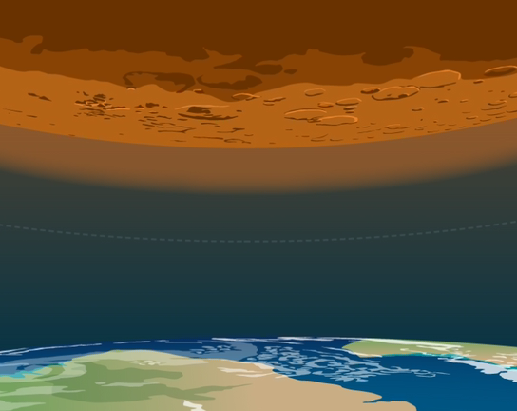
Mars Sample Return Mission
Mission to bring back samples that Perseverance rover will collect on Mars
A new composite material that I and my coworkers invented will be the heatshield on the spacecraft that brings the samples back to Earth

Slide 34

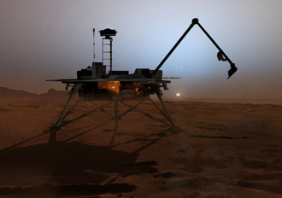


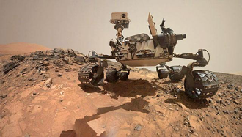
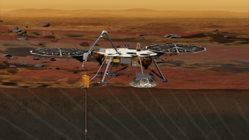

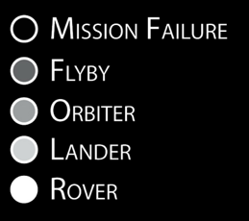
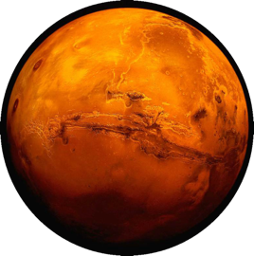
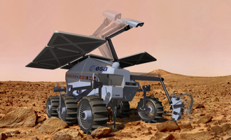
60 Years of Mars Exploration
1960
Soviet Union
United States
Russia
Japan
ESA
India
2007 Phoenix Scout
2011 Curiosity Rover
2018 Insight Lander
2020
2020 EXOMARS Rover (ESA)
Illustration by:
Bryan Christie Design
Updated: 2015

Slide 35
Has anyone heard of Bennu?

Slide 36
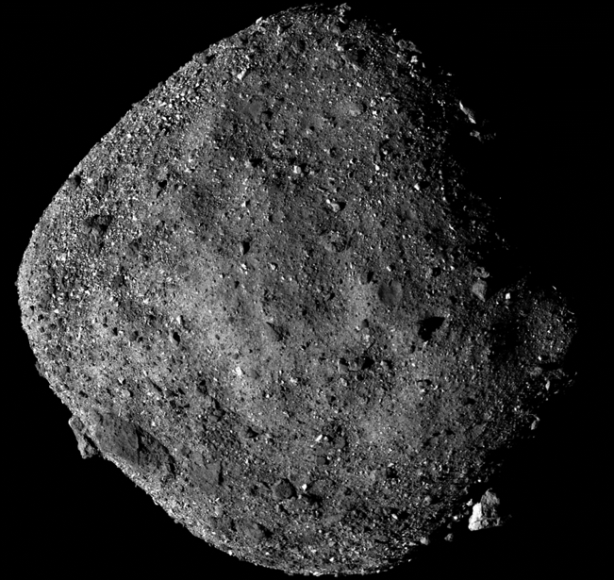
Bennu is a Near Earth Asteroid
~210 million miles from Earth
~2.2 Astronomical Unit
What is an Astronomical Unit?
Text message would take ~19 minutes to get there from Earth
What mission is currently at Bennu?
What is it doing there?

Slide 37
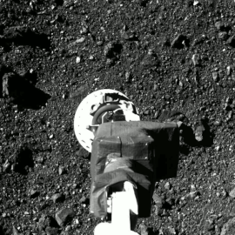
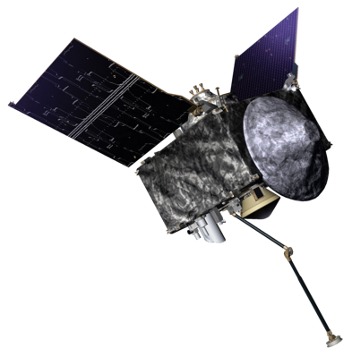




OSIRIS-REX Mission
Mission to bring a sample from Bennu back to Earth
Sample collected on Oct 20, 2020
Launched 2016
Arrived Bennu 2018
Leave Bennu 2021
Arrive Earth 2023
Sample Return Capsule

Slide 38


NASA’s Kepler Mission:
Searching for planets like our own orbiting other stars

Slide 39

How Did Kepler Detect Planets?

Slide 40


Slide 41
The first exoplanet was confirmed in 1992
Today over 4,300 are known

Slide 42



James Webb Space Telescope
Notes:
JWST will provide improved infrared resolution and sensitivity over Hubble, and will enable a broad range of investigations across the fields of astronomyand cosmology, including observing some of the most distant events and objects in the universe, such as the formation of the first galaxies.

Slide 43
Where did the New Horizons Mission Go?

Slide 44



Pluto
Distance from Earth to Pluto:
4670 million miles
It is so far away that it would take a text message ~330 minutes to reach Pluto from the Earth (5.5 hours)
1 Pluto Year = 248 Earth Years
New Horizon’s
Launched: Jan 2006
Arrived at Pluto: July 2015
Launched January 19, 2006
Reached Pluto: July 14, 2015
Speed: 31,500 mph

Slide 45

Saturn
Distance from Earth to Saturn:
746 million miles
It is so far away that it would take a text message ~70 minutes to reach Saturn from the Earth
Saturn has 53 moons
Saturn’s Moon Titan
Dragonfly Mission

Slide 46

Thanks for Attending

Slide 47
Jay and a young child at Gemini spacecraft
(Kennedy Space Center 2010)

Slide 48
Jay’s Path to becoming a NASA Scientist/Engineer
(pursuing interests, working hard, some luck)
Ph.D. in Chemistry
Excellent college professor
mentored me
Interview @ NASA
Graduate school in chemistry
(6 years; UC Berkeley)
Inspirational HS
Chemistry Teacher
Undergraduate research experience
Chemistry Major in college (UC Irvine)
Enjoyed science in school

Slide 49


Black Holes
The image shows a bright ring formed as light bends in the intense gravity around a black hole 6.5 billion times the Sun’s mass.
Credits: Event Horizon Telescope Collaboration

Slide 50
Ultima Thule
Kuiper Belt object
New Horizons is approximately 4.13 billion miles (6.64 billion kilometers) from Earth, operating normally and speeding away from the Sun (and Ultima Thule) at more than 31,500 miles (50,700 kilometers) per hour. At that distance, a radio signal reaches Earth six hours and nine minutes after leaving the spacecraft.

