Slide 1

NASA Radiation operations sources, models, and standards
Cato Milder, MSPH
Space Radiation Analysis Group (SRAG)

Slide 2
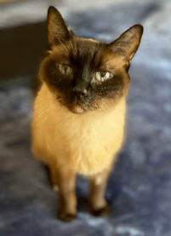
Overview
Exposures in space
  The space radiation environment
  Radiation quality
  Dose and dose-rate
Health risks in humans
  Potential health risks
  NASA limits and standards
  Challenges in risk assessment
Conclusions and lingering questions
Disclaimer: The views, thoughts, and opinions expressed here belong solely to the author, and do not reflect those of the author’s employer, organization, committee or other group or individual.

Slide 3
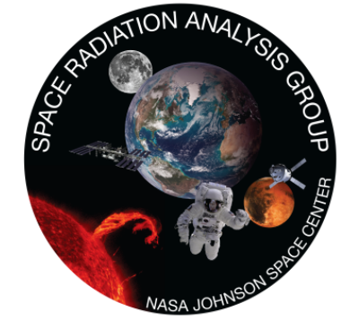
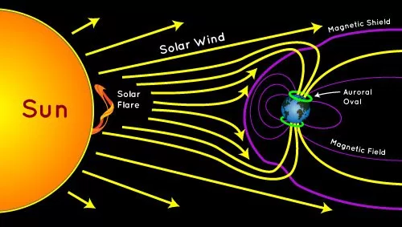
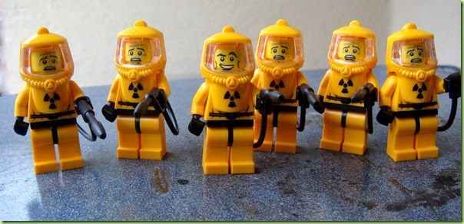
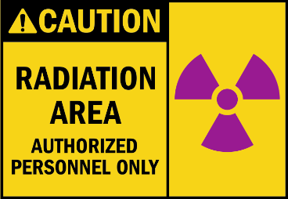
Introduction
NCRP: National Council on Radiation Protection and measurements
CFR: Code of Federal Regulations
Space is a radiation environment
NASA was given the authority by congress “to make, promulgate, issue, rescind, and amend rules and regulations governing the manner of its operations and the exercise of the powers vested in it by law”
  National Aeronautics and Space Act –1958 §203(b)(1)
Astronauts are radiation workers
    NASA limits excessive space radiation exposure
    NCRP 132 (2000) recommendations are the basis for supplementary radiation standards (29 CFR 1960.18)
The Space Radiation Analysis Group (SRAG) is responsible for astronaut radiation protection
Solar
Event

Slide 4
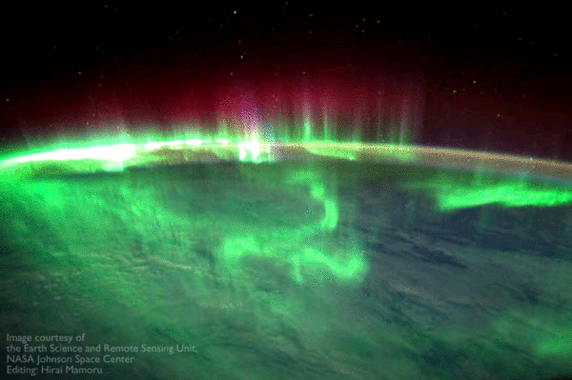
Exposures in space
The space radiation environment
Radiation quality
Dose and dose-rate

Slide 5
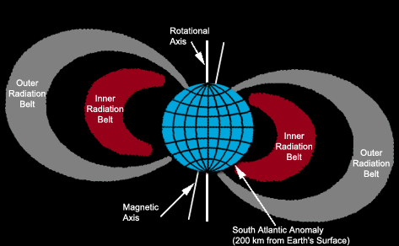
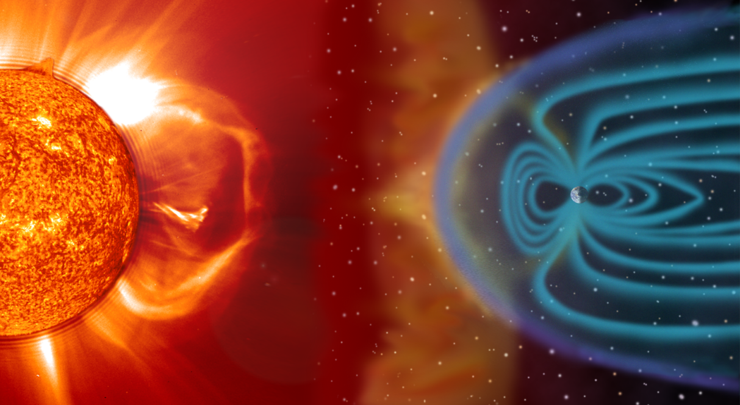
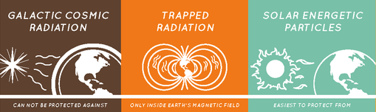

The Space Radiation Environment
GCR: Galactic Cosmic Rays
High energy particles
  Galactic Cosmic Rays (GCR)
    90% protons
    9% helium
    1% heavier particles
    Modulated by solar cycle
    Chronic low exposure
  Trapped Radiation
    Protons and electrons
    “Acute” exposure during transit
  Solar Events
    Protons
    “Acute” exposure during transit
Abundance (black bars) and relative dose contribution (open bars) of galactic cosmic ray particles in free space. Wefel (1979)

Slide 6
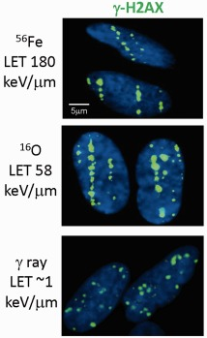
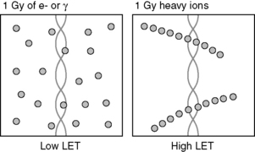

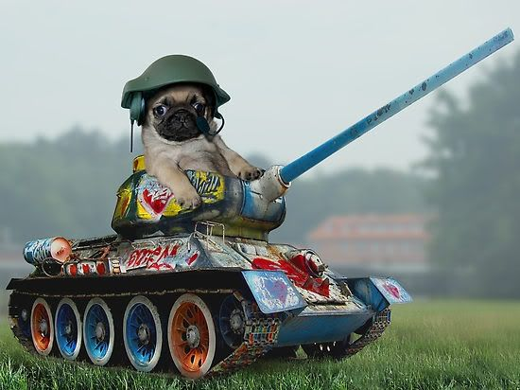
Radiation Quality
LET: Linear Energy Transfer
Energy deposition varies
  Radiation type
    Photons or particles
  Substrate
Biological effectiveness differs
  Damage and repair
  Consequences still under investigation
Adjust absorbed dose to account for differences
  Quality factor
  Equivalent dose
Colin Baker
Wang et al 2012

Slide 7
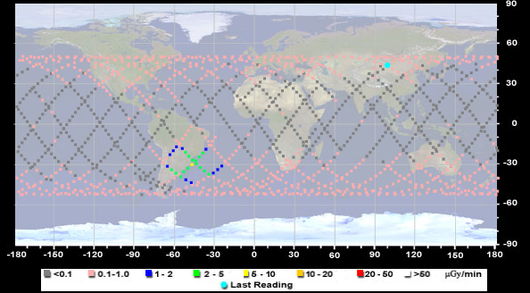
Expected Doses and Dose Rates
GCR: Galactic Cosmic Rays
ISS: International Space Station
IV: IntraVehicular
Depend on mission parameters and solar activity
  Duration
  Trajectory and shielding
    Determine source exposure
      Effects “quality factor”
  Solar cycle
    11 year cycle
    Solar minimum vs. solar maximum
  Each crew member is badged
  Active radiation area monitoring
Exposure Type | Dose Rate or Dose
ISS – IV: 51.6° @ 400 km | 300 – 450 μGy/day
ISS Trapped – IV*** | <0.1 – 20 μGy/min
GCR in “free space” in water CRaTER (2009 to present) | 250 – 550 μGy/day
1972 event – IV “free space” | 200 – 400 mSv
Sheltered 1972 event | ~ 80 mSv
*** Passes are at most ~20 min and only see peak dose rates for a fraction of the pass
Notes:
Duration is a big deal because of GCR, and because it’s the thing we use to control dose the most

Slide 8
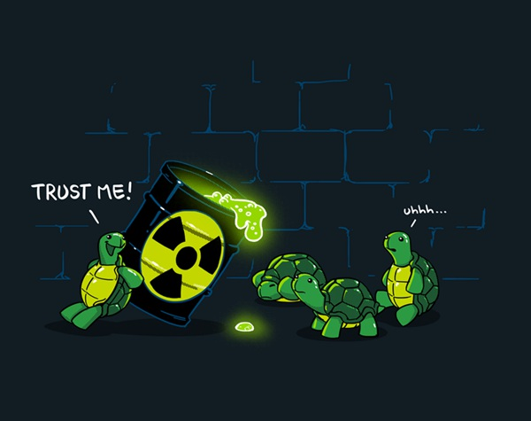
Health risks in humans
Anticipated risks from spaceflight
Limits and standards
Challenges in risk assessment

Slide 9
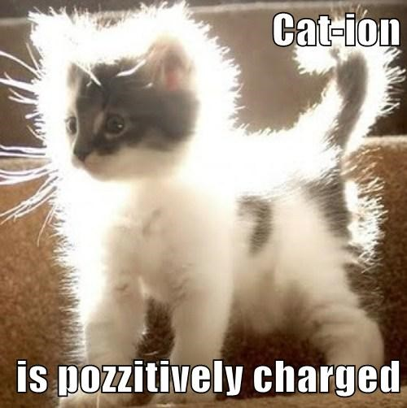
Health Risks for Humans
Mission Success
  Acute effects
    Large doses from high energy solar events
      Estimate ~ 200 – 400 mSv (unsheltered) for 1972 Event
    Potential early neurological effects
      Behavior or memory decrements
      Not observed in humans at these doses to date
Long-term health
  Cancer
    Space radiation may cause unique cancer profile
  Degenerative
    Cardiovascular disease and cataracts
  Potential late neurological decrements
    Neurodegenerative disease

Slide 10
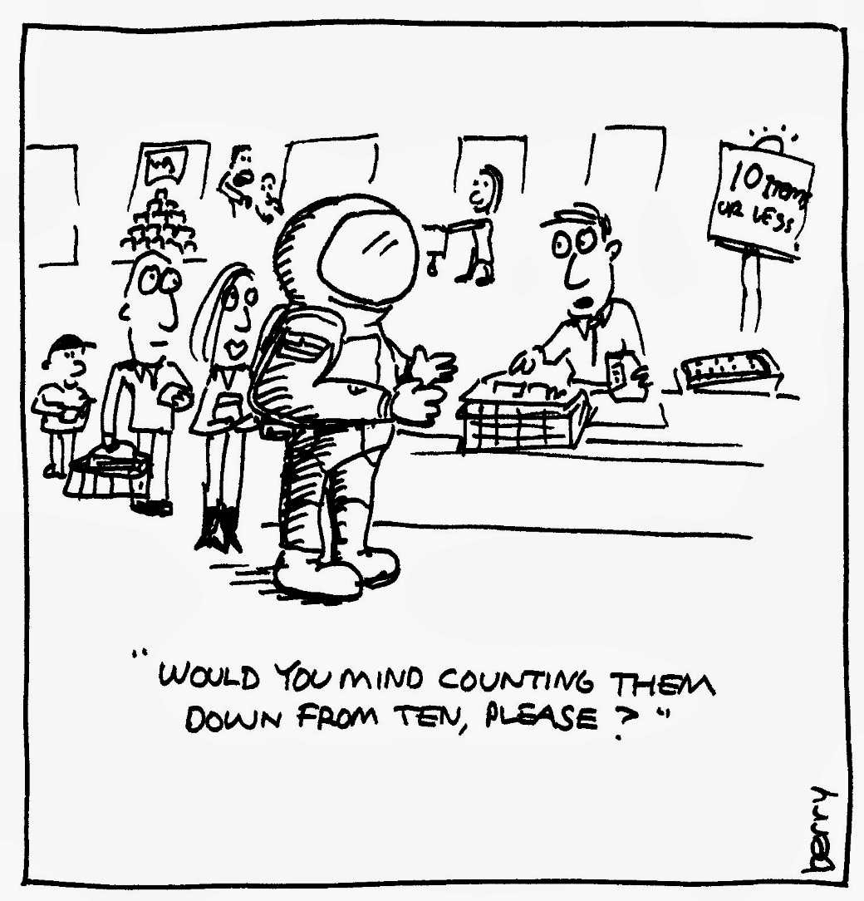
NASA Ionizing Radiation Limits
ALARA: As Low As Reasonably Achievable
SPEL: Space Permissible Exposure Limit
RHO: Radiation Health Officer
Radiation dose and risk limits
  Minimize mission impacts AND long-term health risks
    ALARA
    Exposure unavoidable
  Space Permissible Exposure Levels (SPELs)
    Short-term limits to prevent acute effects
    Career limits to minimize long term effects
      Cancer
      Non-cancer

Slide 11
Ionizing Radiation Dose Limits
Limits dose to specific organs
  Short- and long-term limits
    Weighted by scaling factor
      Accounts for different radiation types
  Prevent deterministic effects
    Clinically significant
    Non-cancer effects
Current Dose Limits – Non-cancer
Organ | 30-Day Limit (mGy-eq) | 1-Year Limit (mGy-eq) | Career Non-Cancer Limit (mGy-eq)
Lens of the eye | 1000 | 2000 | 4000
Skin | 1500 | 3000 | 6000
Blood-forming organs | 250 | 500 | n/a
Circulatory system | 250 | 500 | 1000
Central Nervous System* | 500 mGy | 1000 mGy | 1500 mGy
Central nervous system (heavy particles, Z ≥ 10)* | n/a | 100 mGy | 250 mGy
*mGy used instead of mGy-eq
Notes:
Double check numbers

Slide 12

Ionizing Radiation Risk Limit
REID: Risk of Exposure Induced Death
SPEL: Space Permissible Exposure Limit
Defined in the NASA Space Flight Human-system Standard Volume 1: Crew Health
  4.2.10 Space Permissible Exposure Limit for Space Flight Radiation Exposure Standard
    4.2.10.1 Planned career exposure to ionizing radiation shall not exceed 3 percent Risk of Exposure-Induced Death (REID) for cancer mortality at a 95 percent confidence level to limit the cumulative effective dose (in units of Sievert) received by an astronaut throughout his or her career
Notes:
Explain why CL relevant

Slide 13
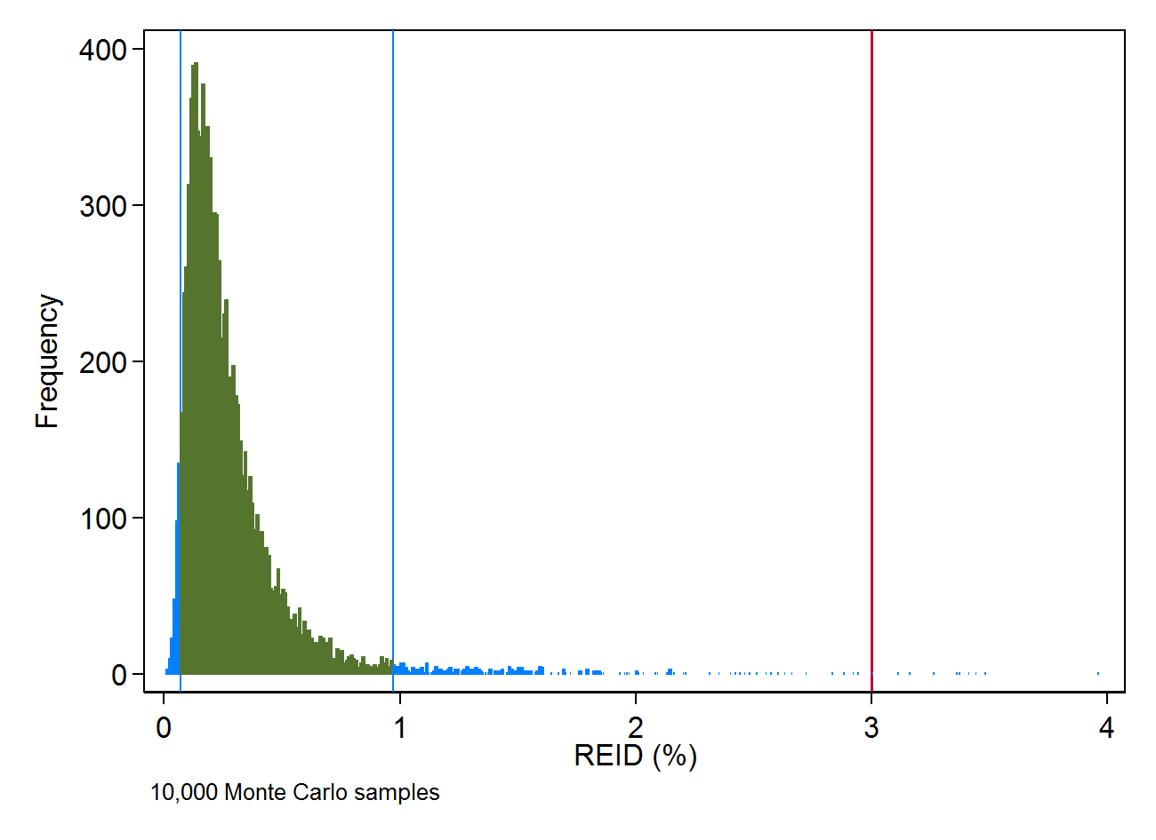
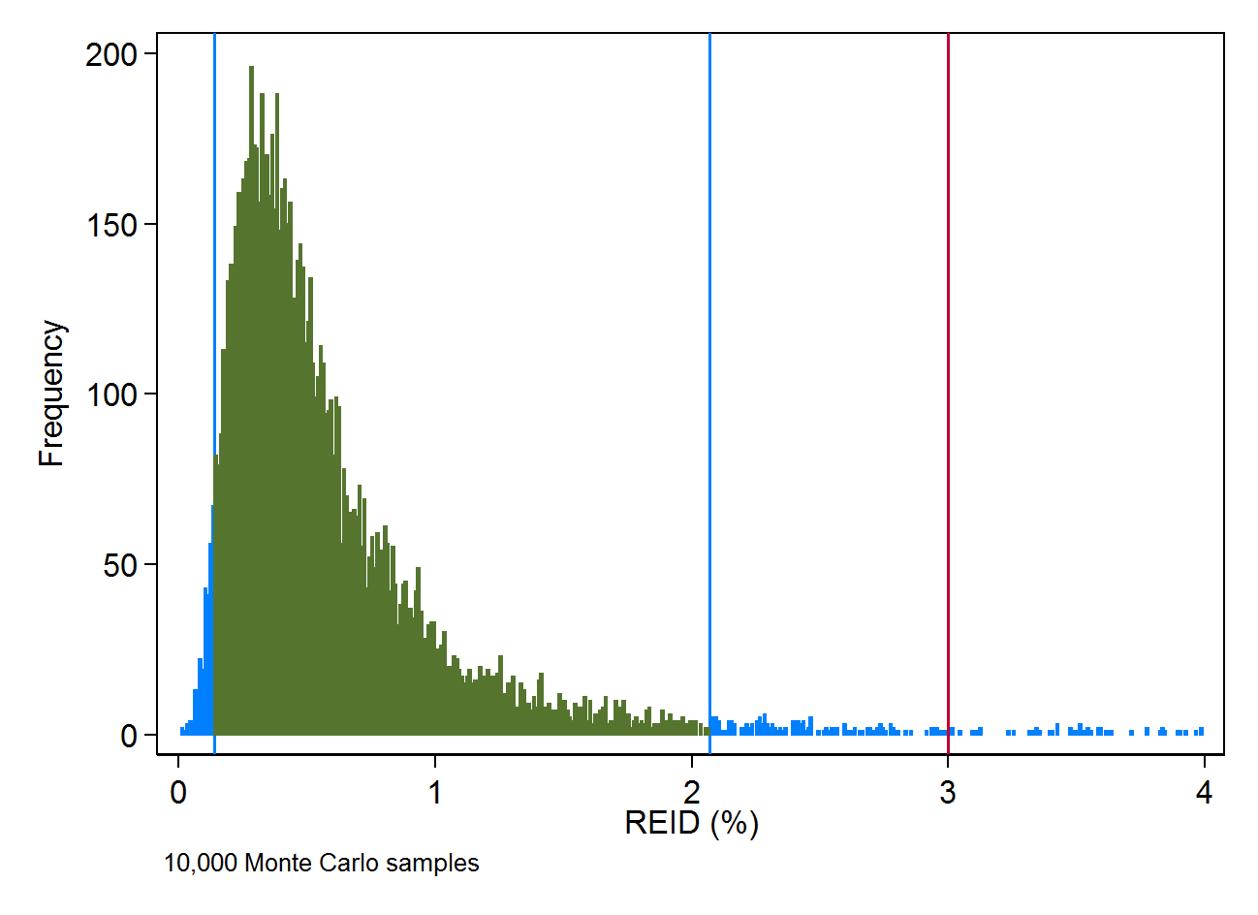
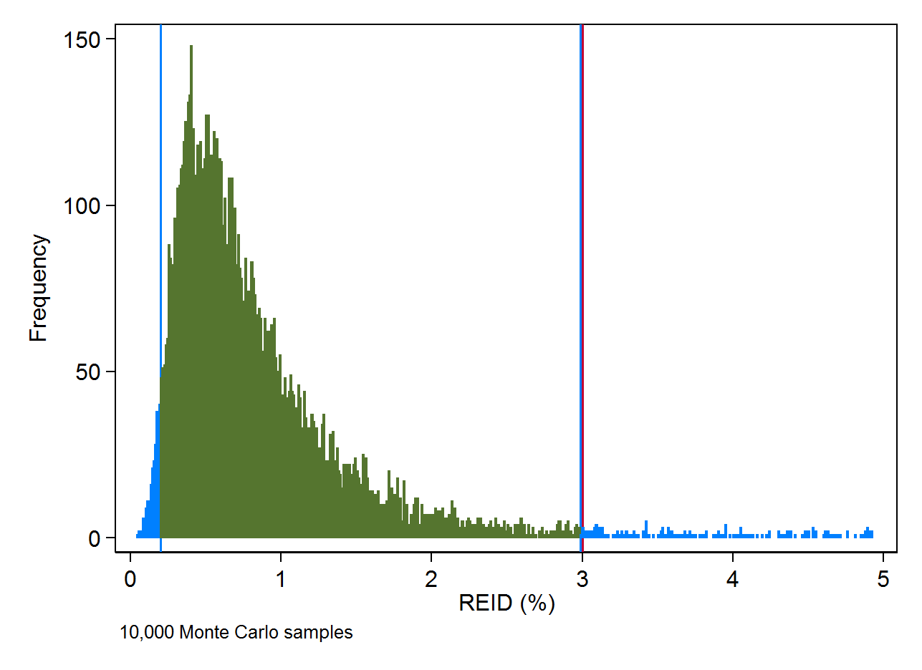
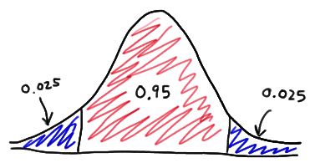
Ionizing Radiation Risk Limit
NSCR: NASA Space Cancer Risk
REID: Risk of Exposure Induced Death
LSS: Life Span Study of Atomic Bomb Survivors
DDREF: Dose and Dose-Rate Effectiveness Factor
NASA Space Cancer Risk (NSCR) model
  Calculate cancer REID distribution using
    Measured (or calculated) dose
    Epidemiological low LET risk models (LSS)
    U.S. site-specific cancer rates
    Physics-based transport and radiation quality models
    Account for low dose-rate using DDREF
  Dose for 3% REID varies by person!
    Heavily dependent on age and sex
    97.5th %tile is 2-3X the central estimate
REID Distribution: Female, Single Mission
40 y.o., Solar Max, Maximum ISS PMD (555d)
Basic Example of Two-Tailed 95% Confidence Level
REID Distribution: Female, Two Missions
1) 40 y.o., Solar Max, 181d ISS mission
2) 50 y.o., Solar Min, 181d ISS mission
REID Distribution: Female, Single Mission
40 y.o., Solar Max, 181day ISS mission
0.95
0.95
0.95
0.025
0.025
0.025
0.025
0.025
0.025
NASA SPEL
NASA SPEL
Notes:
Explain why CL relevant
Actual distributions may not be Gaussian – grab an image of a “real” REID distribution
Explain clearly these numbers represent longer and longer missions

Slide 14
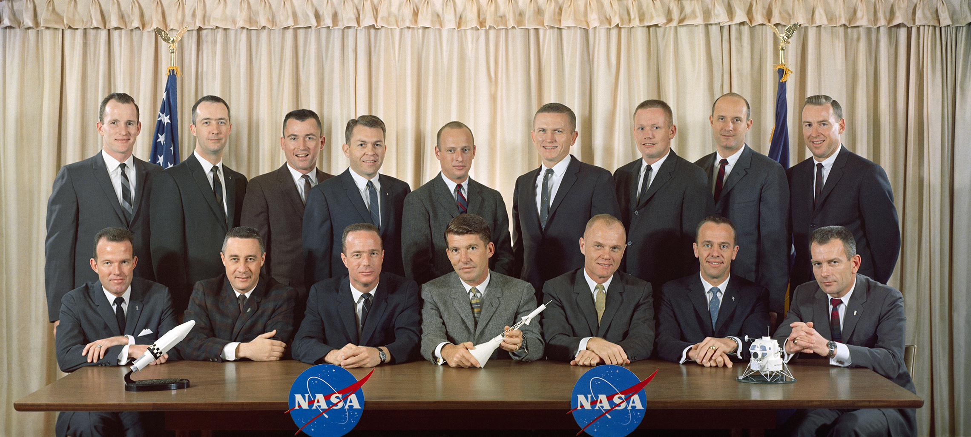
Challenges in Risk Assessment
Limited observed outcomes in astronauts
  VERY small, unique cohort
    Approximately 500 total
    Relatively young cohort
      Effects have not been observed
    Changing demographics
  Generally low exposures
  Healthy worker and generally healthy
    Recent study indicates lower risk of all-cause mortality and other expected outcomes in early NASA astronauts (Elgart et al. 2018)
  MANY competing risks in space
https://humanresearchroadmap.nasa.gov/
Notes:
34 NASA risks identified in the human research roadmap

Slide 15
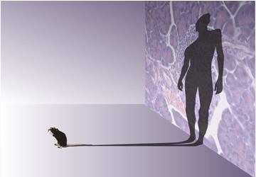
Challenges in Risk Assessment
Limited knowledge of biological effects
  Human cohorts are limited
    Low-doses and low-dose rates of radiation
    High-LET radiation
  Heavy reliance on animal studies
    Harderian gland tumorigenesis
Transfer between studies
  Human to human
    LSS to astronauts
  Animal to human
Broad Institute Communications

Slide 16
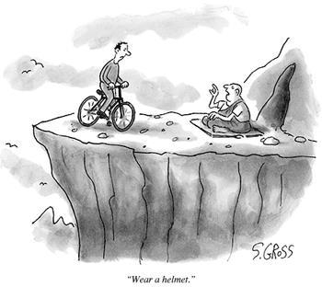
Conclusions and lingering questions
We know some things
We wish we knew more things better
“Wear a helmet.”

Slide 17
The things we know
DDREF: Dose and Dose-Rate Effectiveness Factor
Space radiation is different
Exposure is unavoidable in space
  Doses depend on mission
NASA limits radiation exposures
  Dose limits to prevent deterministic effects
  3% risk limit to minimize cancer risk
    Calculations based on limited epidemiological and experimental data
Understanding of radiation risks is incomplete and still evolving
  Limited data on human response to space radiation
  Requires translation from terrestrial human cohorts and experimental models
  Radiation quality and DDREF are large sources of uncertainty

Slide 18
The things we wish we knew better
LET: Linear Energy Transfer
  How can we best model radiation quality for the unique space radiation environments?
    Low AND high dose
    Protracted, fractionated, AND acute
    Mixed field – low AND high LET
  How can we best use animal and cellular models?
  What human cohorts are best suited for translating terrestrial radiation knowledge to space?
  How can we best use epidemiological data and radiation response models to ACCURATELY estimate risk with high PRECISION?

Slide 19

Thanks so much for your attention! Thoughts?
“Of all the risks encountered by astronauts during space flight, the potential long-term health affects from radiation exposure are among the few which persist after successful landing.” – Ancient SRAG proverb

