Slide 1
Integrated Design for the MSR
DAC-0.0 Mars Ascent Vehicle
Darius Yaghoubi
Peter Ma
NASA Marshall Space Flight Center
March 2021
IEEE Aerospace Conference

Slide 2
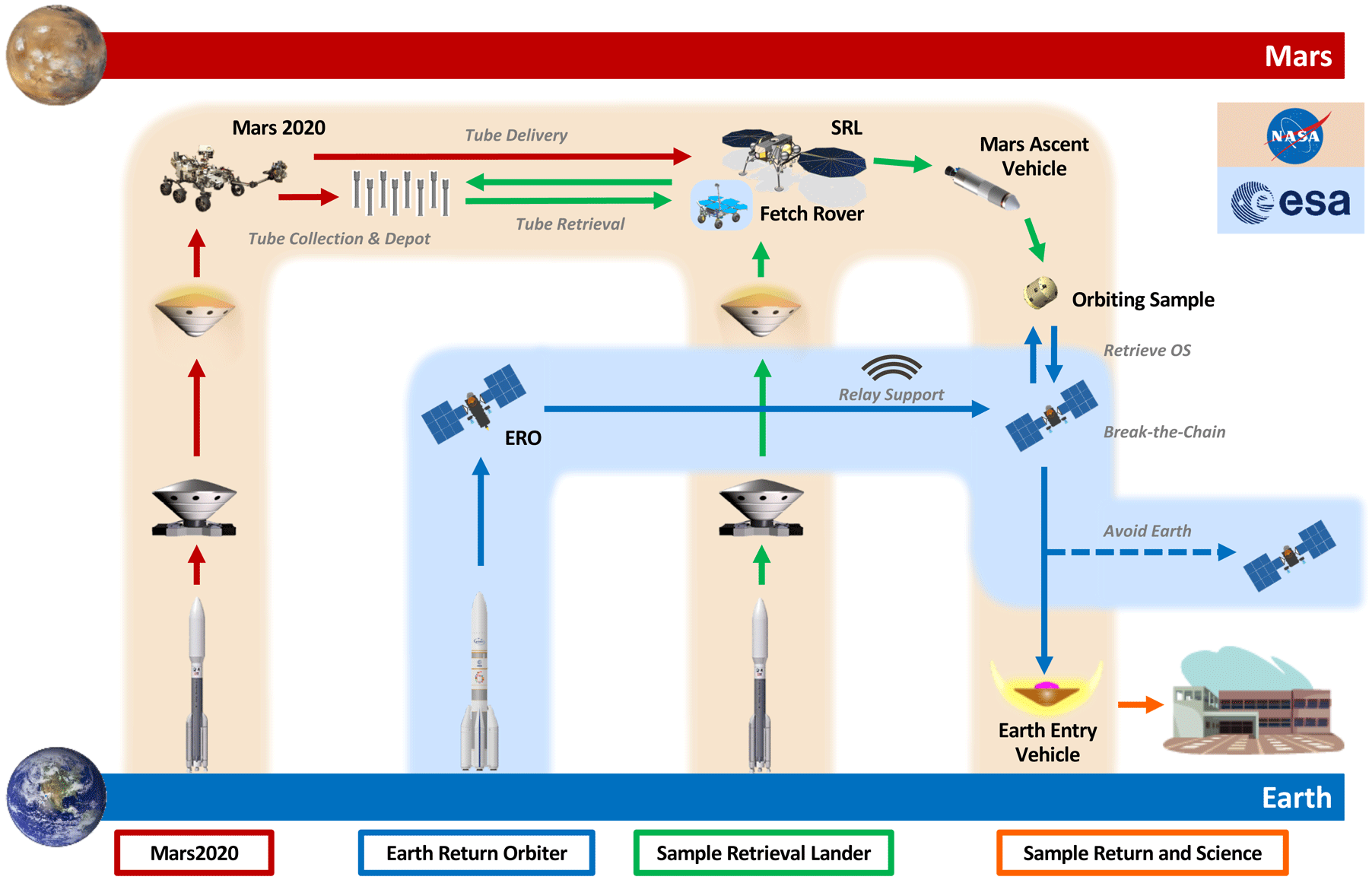
Mars Sample Return and MAV
MAV
Pre-decisional. For planning and discussion purposes only.

Slide 3
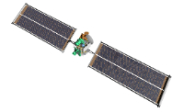









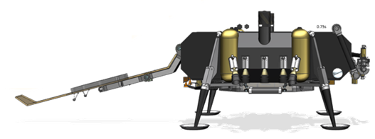

MAV Ascent Profile
3
2nd Burn to Burnout
2nd stage SRM 2 burn
Periapsis raise
SRM 2 burnout
5
OS Payload Delivery
Orient vehicle for OS release
MAV transmit final IMU state
MAV enable telemetry beacon
4
3rd Burn to Cut-off
Post-2nd burnout transients wait*
2nd stage OTT burn
OTT cut-off
OS/ERO Capture
6
2
Coast
Depart sensible atmosphere
Orient vehicle for 1st stage and MPA fairing separation
Separate 1st stage and MPA fairing
Reorient vehicle prior to burn 2
Activate TVC 2
Primary Mission: Deliver OS containing up to 0.5kg of Martian samples to orbit for rendezvous with ERO.
1
Launch and 1st Burn to Burnout
VECTOR launch*
1st stage SRM 1 burn
Max Q at ~T+20-50s
SRM 1 burnout
1st Burn
Coast
2nd Burn
3rd Burn (*incl. trans. wait)
Prep for OS Separation
Loiter
~60 – 80s
~390 – 530s
~20 – 30s
~0 – 130s
~Minutes
~Days

Slide 4
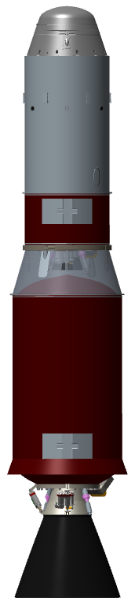
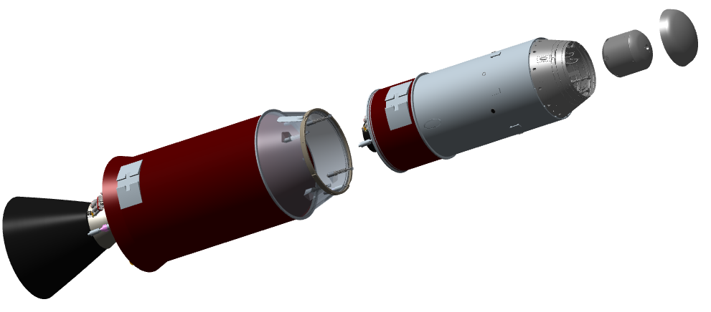
MAV Concept: MAS Overview
Mars Ascent System (MAS) consists of:
Mars Ascent Vehicle (MAV)
  Two-stage (guided, guided) solid motor vehicle
  Pyrotechnic stage separation
  Electrical-mechanical Thrust Vector Control (TVC)
  Monopropellant Reaction Control System (RCS) with orbital trim capability
MAV Payload Adapter (MPA)
  Ejectable fairing
  Orbital Sample (OS)
OS
MPA
Fairing
MPA
2nd Stage
1st Stage

Slide 5
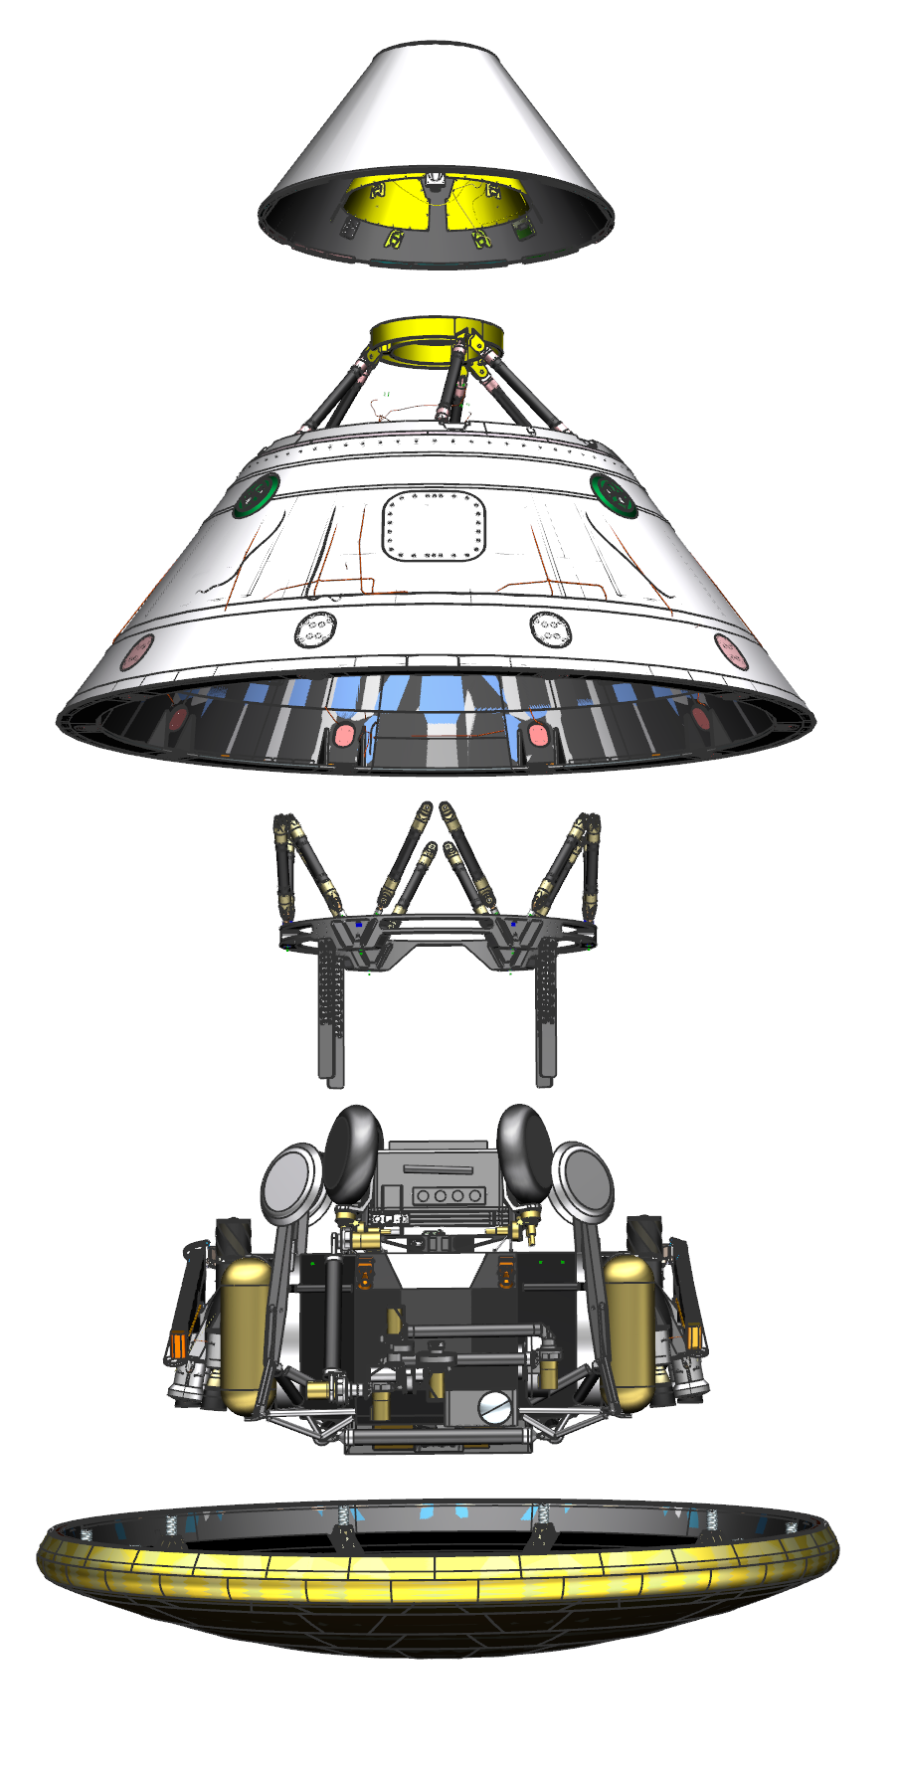
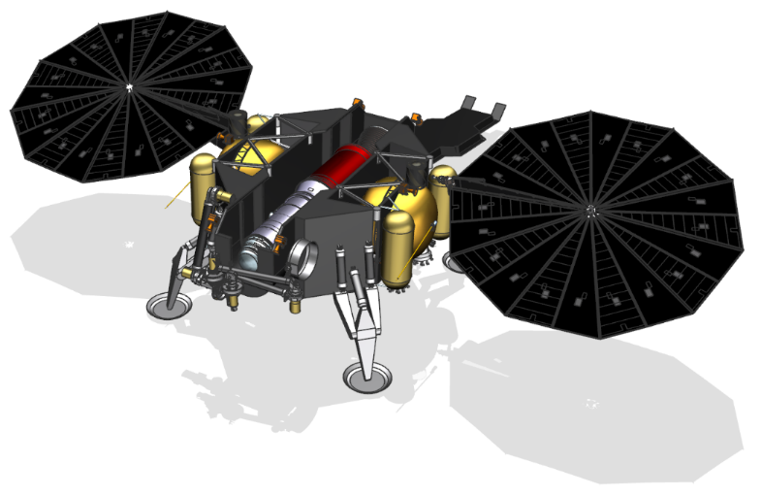
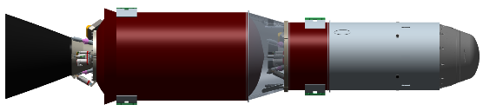
Design Analysis Cycle 0.0
DAC-0.0 performed January - June 2020 to advance fidelity of MAV design for NASA Key Decision Point A (KDP-A).
KDP-A transitions MAV Project from pre-Phase A design – marked by feasibility concept studies – to Phase A design defined by concept and technology development.
KDP-A completed in December 2020 following additional architecture updates.
Parachute Cover
Backshell
Entry Vehicle (EV)
Lander Support Structure
& Guiderails
SRL
Heatshield
MAV Stowed Within Lander Prior to Ejection
VECTOR: Vertically Ejected, Controlled Tip-Off Rate
MAV Integration with Cruise Stage
*Conceptual elements shown.

Slide 6
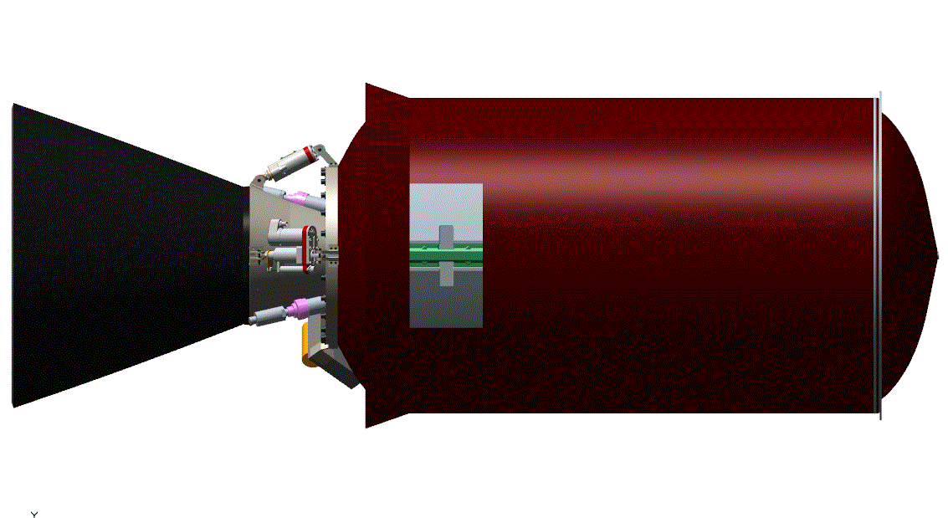
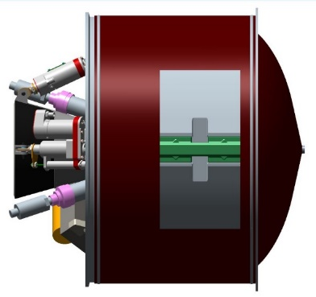
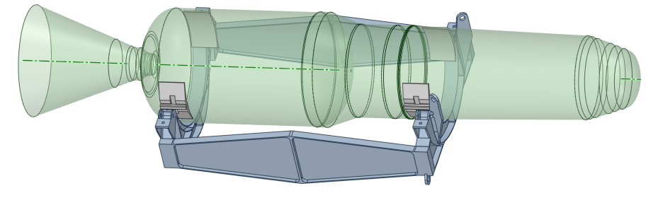
Main Propulsion Design
Main propulsion system consists of two solid rocket motors, using high Technology Readiness Level (TRL) propellant with heritage in Mars missions.*
Computational Fluid Dynamics (CFD) used in nozzle designs for increased performance.
Structural case analysis defined by launch pressures/temperature and Mars Entry, Descent, Landing (EDL)/launch loads. Composite cases for both motors.
Thermal analysis performed to determine affects of asymmetric motor heating during ignition.
Challenge with solid propulsion vehicle in that it is difficult to design to a precise orbit. This presented greater predicted orbital dispersions.
Solid Rocket Motor (SRM) 1
SRM2
VECTOR attach points on SRMs
*TP-H-3062 solid propellant, used in Mars exploration rovers Spirit and Opportunity and Mars Pathfinder Entry/Descent/Landing

Slide 7
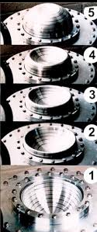
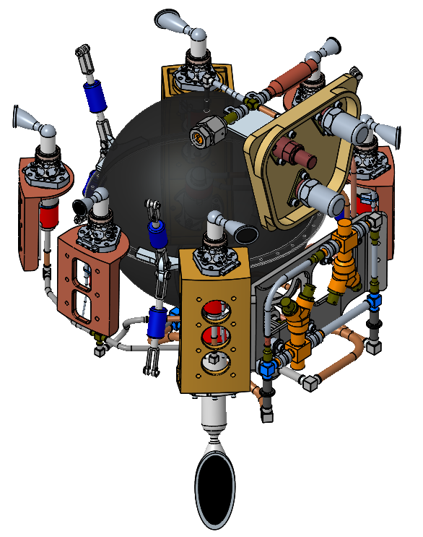
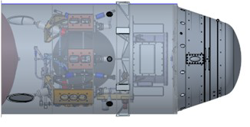
Reaction Control System Design
RCS provides roll control during motor burns and full attitude control during coast. TVC provides pitch and yaw control during burns.
RCS consists of monopropellant hydrazine blowdown system with high TRL commercial hardware.
Comprises six lateral thrusters and two larger Orbit Trim Thrusters (OTTs). OTTs used to improve orbital insertion accuracy.
Propellant stored in a titanium tank with an elastomeric diaphragm to reduce ullage and slosh.
Relatively high freezing point of hydrazine (+2°C) requires additional heaters.
Lateral Thrusters
Axial OTT
RCS Location Within Forward Structure
Example Diaphram

Slide 8
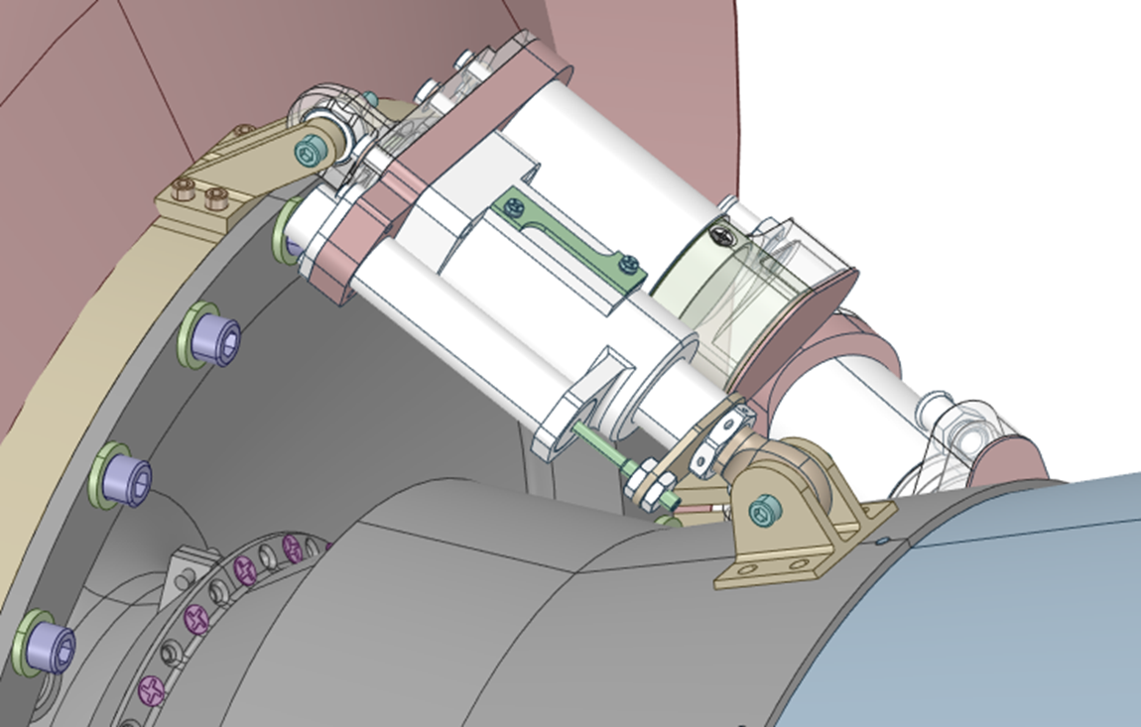
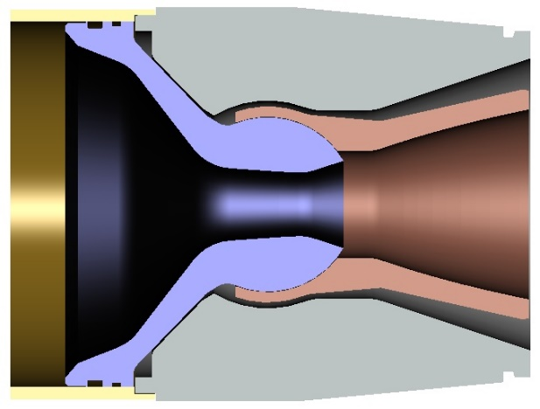
Thrust Vector Control Design
TVC provides pitch and yaw control during motor burns.
Nozzle gimbal performed with traditional ElectroMechanical Actuators (EMAs), mounted on aft end of each SRM.
Each stage has an independent TVC system, featuring two actuators, a controller, and a thermal battery.
Gimbal nozzle features a Supersonic Splitline (SSSL) with a trapped ball design.
  Joint is located downstream of nozzle throat, reducing erosion.
  Typical TVC systems do not operate at such low temperatures due to material incompatibilities. SSSL does not feature any elastomerics.
Controller & Thermal Battery
Actuators
SRM1 TVC System
SRM1 Pitch EMA
Example SSSL Trapped Ball Design

Slide 9
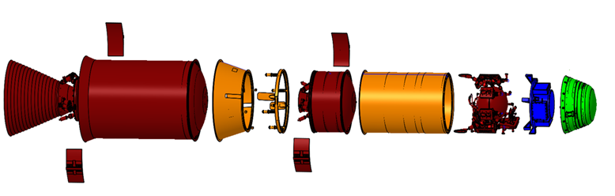
Structural and Mechanical Design
Unique structural design challenge as vehicle must survive approximately 15g lateral loads during Mars EDL.
Non-propulsive structural elements designed of high TRL machined monocoque construction from simple ring forgings.
Finite Element Model (FEM) loads analysis served as input for stress analysis and structural failure mode determination.
Two primary mechanisms examined:
  Stage separation mechanism featured mid-high TRL spring loaded clamp-band.
  Pyrotechnic mechanisms for SRM ignition, TVC thermal battery activation, RCS isolation valves, and separation system release.
Sep System
Forward Structure
Interstage
Monocoque Structural Elements
Sample Clamp-Band Separation System
MAV FEM Mesh

Slide 10
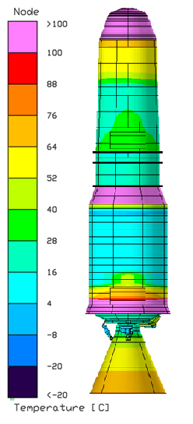
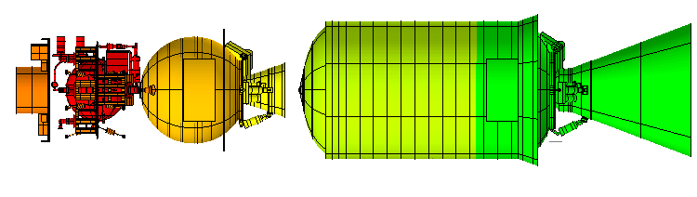
Thermal Design
MAV stored within thermal “igloo” during cruise to Mars and on surface, maintaining constant temperature prior to deployment.
Thermal system makes use of 16 heater zones controlled via heaters and Platinum Resistant Thermometers (PRTs). Each zone has different components with different thermal constraints.
Passive insulation further reduces temperature gradients and provide protection from induced thermal environments.
Mars ascent mission is short, with active thermal control during ascent not needed. High temperatures due to aeroheating does not impact most internal components*.
Zones 1 & 2
Zones 11-16
Zones 8-10
Zones 3-7
Thermal Control Zones
MAV Stored within Lander Igloo
Peak Temperature Profile
During Ascent
*Stage 2 TVC controller exceeded expected upper limit thermal assumptions. To be addressed in future analyses.

Slide 11
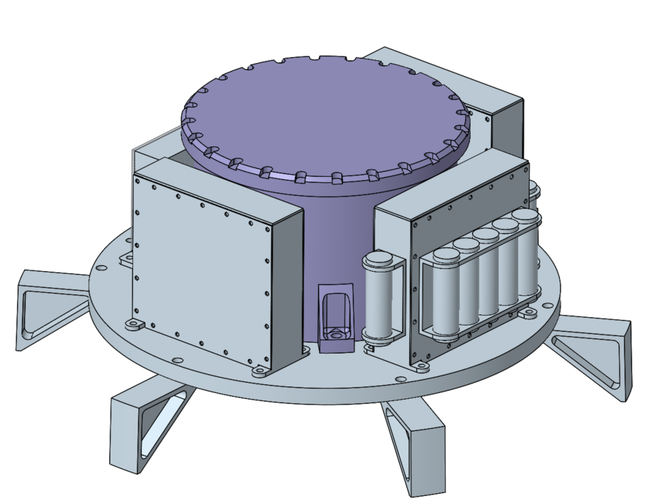
Avionics Design
Avionics consists of three primary functions: Command and Data Handling (CDH), communication, and power.
CDH carried out by flight computer, controllers, IMU.
Flight software algorithms control vehicle response to external stimuli and mitigate off-nominal situations. All flight operations are autonomous.
Unique mission constraints required a highly specialized Inertial Measurement Unit (IMU), allowing for gyrocompassing.
Communications managed by transmitter, antenna, and navigational beacon.
Power managed by batteries, power distribution board, and cabling.
Umbilicals with lander provides power and direct control of several systems while stowed.
All avionics have to function in environments outside of typical design operation.
Beacon and Independent Batteries
IMU
Flight Computer and I/O Board
RCS and Pyro Controllers
Batteries, Power Dist Board, & Transceiver
Avionics Hardware Layout

Slide 12
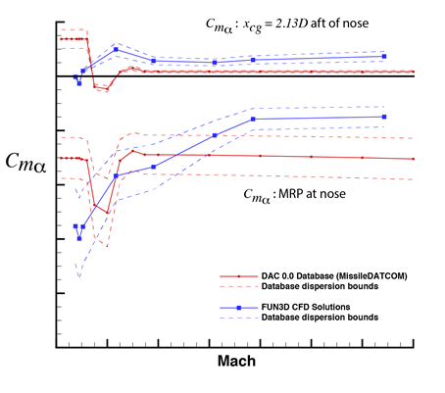
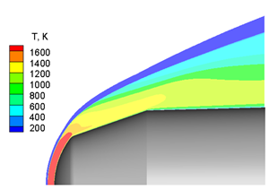
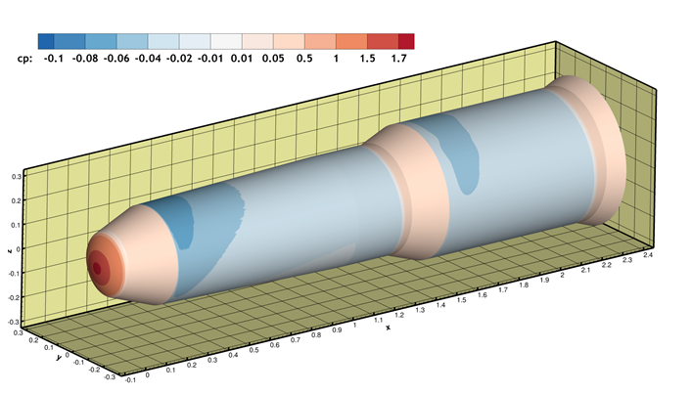
Aeroscience Environments
Vehicle behavior affected by interaction with Martian environment despite low atmosphere. Aerodynamics, aerothermodynamics, and external acoustics analyzed.
CFD performed to assess aerodynamic stability and develop aero coefficients for use in trajectory optimization. Vehicle is aerodynamically unstable for most of ascent.
Aerothermodynamics analysis used for sizing of thermal hardware. Peak heating identified at high pressure region of nose.
Liftoff acoustics, plume-induced acoustics, and ascent aeroacoustics environments used as inputs to integrated vehicle loads model. Acoustics found to not be a significant source of load.
Example Pressure Distribution
Aerodynamic Stability
Nose Flowfield Aeroheating

Slide 13
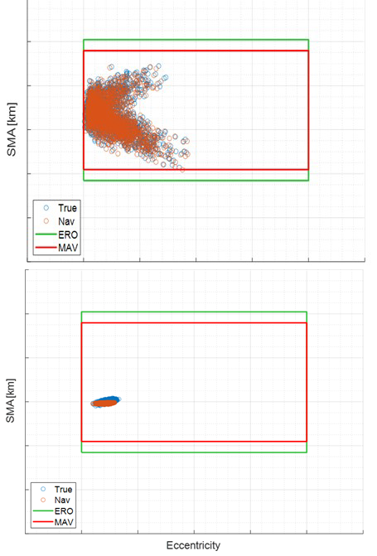
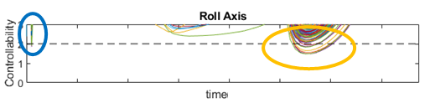
Guidance, Navigation, and Control Design
Vehicle designed to deliver 16kg payload to 343km @ 27º inclination.
Nominal 6DOF trajectory iteratively developed with propulsion sizing and vehicle geometry.
Overall flight plan includes both open- and closed-loop guidance. Energy management maneuver and OTTs used to reduce dispersions in final injected orbit.
Uncertainty parameters addressed via dispersed simulations. Dispersions focused on motor performance, launch conditions, atmosphere, mass/payload variations, and RCS/TVC performance.
RCS/TVC performance are major contributors to vehicle controllability. Stability margins compared to standard 6dB for GM and 30° for PM. Nominal cases well within margins.
Minor Controllability Violations in Roll Axis From Dispersed Cases
Effect of Closed-Loop Guidance, Energy Management, and OTTs on Orbital Dispersions

Slide 14
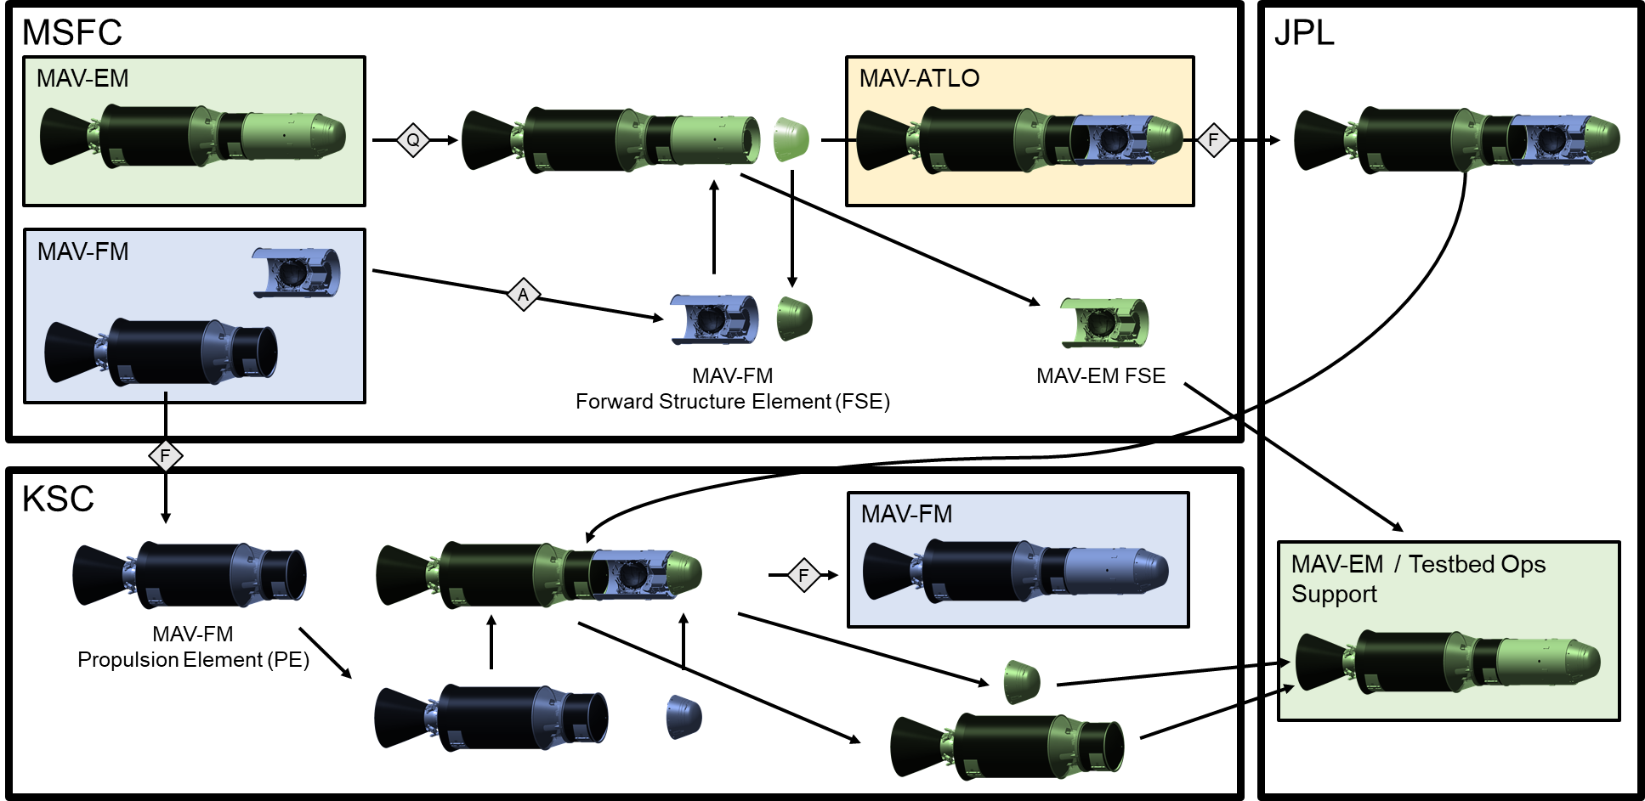
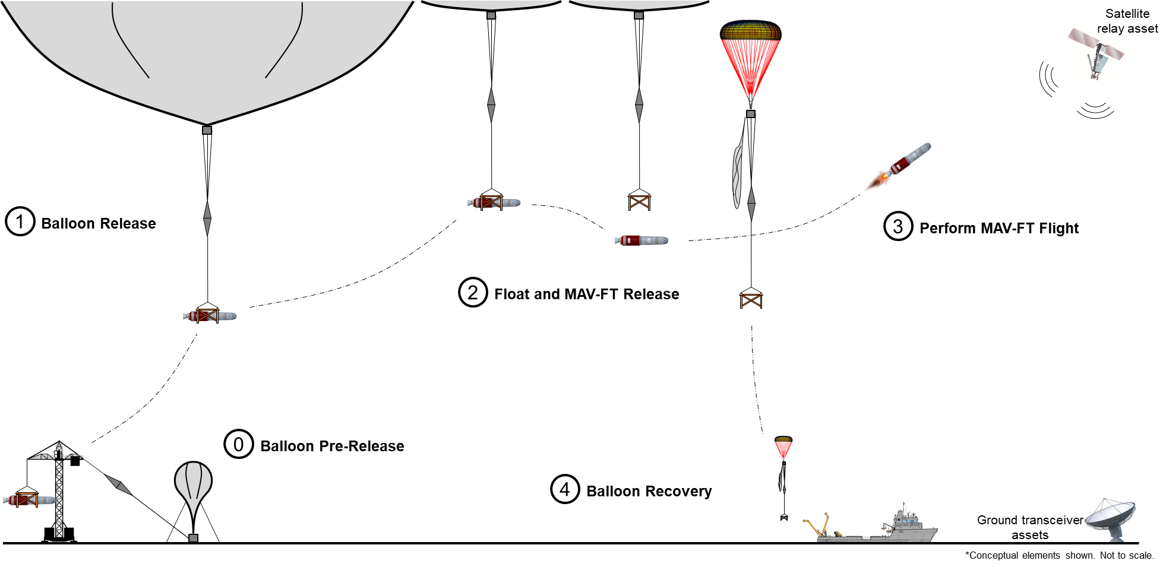
Assembly, Integration, & Testing
AI&T planning included vehicle assembly from subsystem components, verification & validation (V&V) testing, and feasibility assessment of an Earth-based flight test program.
Three MAV units planned: Engineering Model (EM), Flight Test (FT) unit, and Flight Mission (FM) unit.
Rigorous qualification testing planned for individual subsystem assemblies, including hardware-in-the-loop and flight software integration, where applicable.
Integrated vehicle Earth-based flight test planned, launching in high altitude to replicate Martian surface environments.
Assembly & Integration Process for EM and FM units
Notional Earth-based Test Flight

Slide 15
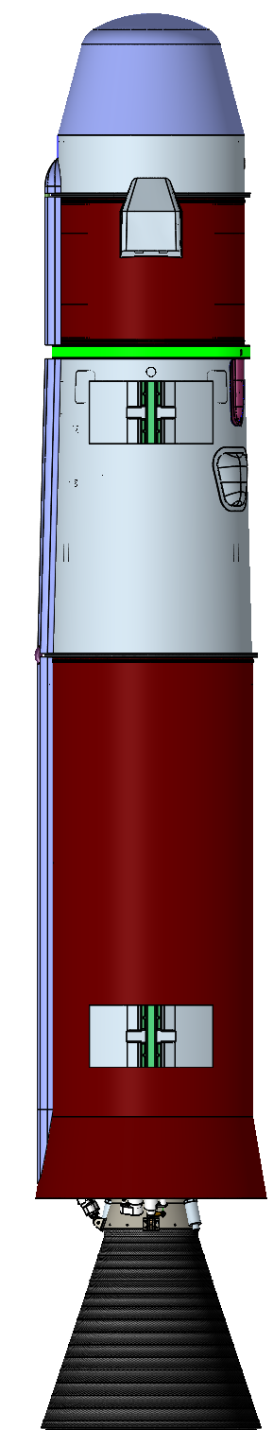
DAC-0.0 Design and Beyond
DAC-0.0 vehicle analysis concluded concept can successfully deliver 16kg payload including 30 sample tubes to target Martian orbit, meeting all Lander stowage size and mass constraints.
Addition of OTTs and tweaking of guidance algorithms significantly reduced orbit dispersions. Monte Carlo simulations helped further identify sensitivities and improve overall design.
After DAC-0.0, MSR campaign determined it had insufficient mass & volume margins within entire lander system based on heritage experience from developing Curiosity rover. Mass allocations were significantly reduced for all elements, including MAV.
Modifications to MAV architecture traded ~145kg at the expense of orbital insertion accuracy.
DAC-0.0 Design
June 2020
Current Design December 2020

Slide 16
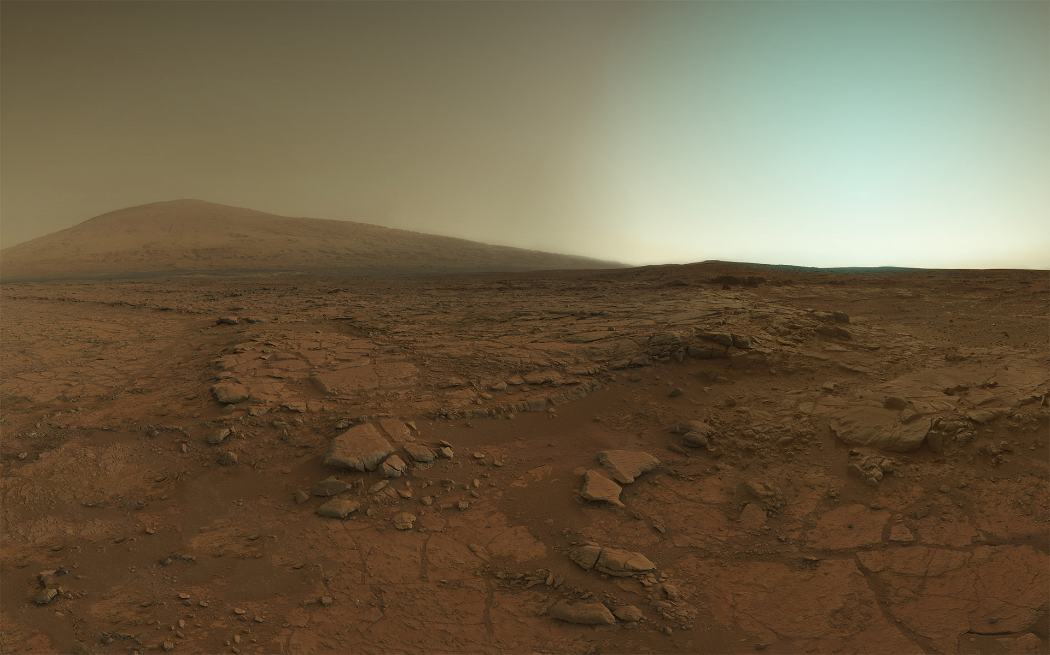
Questions?
Darius Yaghoubi
NASA Marshall Space Flight Center darius.f.yaghoubi@nasa.gov

