Slide 1
Human Systems Risk in Spaceflight
Erik Antonsen MD, PhD, FAAEM, FACEP
Assistant Director, Human Health and Performance
Human System Risk Management
NASA Johnson Space Center
Festival of Genomics
January 28, 2021

Slide 2
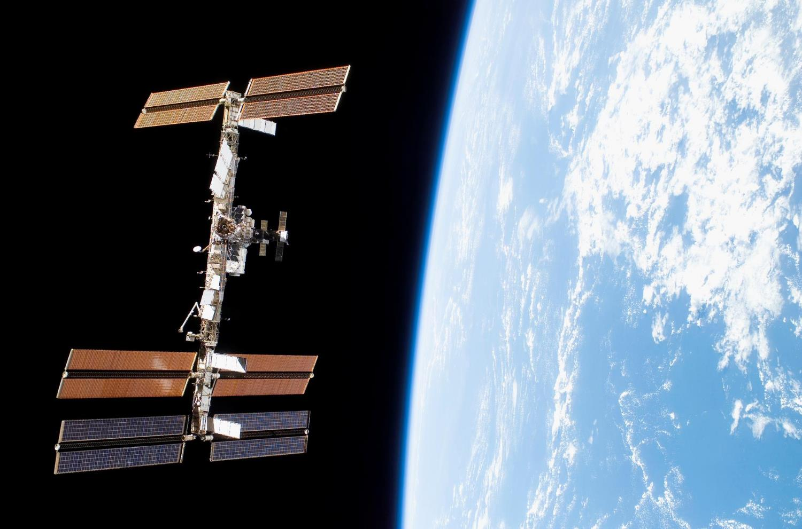
To discover and expand knowledge for the benefit of humanity
NASA’s Mission
Lead an innovative and sustainable program of exploration with commercial and international partners to enable human expansion across the Solar System and bring new knowledge and opportunities back to Earth.
Support growth of the Nation’s economy in space and aeronautics, increase understanding of the Universe and our place in it.
Notes:
As a testbed for deep space exploration, the station is helping us learn how to keep astronauts healthy during long-duration space travel and demonstrating technologies for human and robotic exploration beyond low-Earth orbit, to the Moon and Mars.
Addressing the challenges of moving humanity toward the Moon and Mars focuses and tests the best of our energies and skills to enable future discoveries, providing knowledge to improve life on Earth.
The International Space Station is an accessible space laboratory with unparalleled capability that is increasing knowledge of engineering and physical sciences, biology, the Earth, and the universe through intense research and technology demonstrations and providing the foundation for continuing human spaceflight beyond low-Earth orbit.
As a testbed for deep space exploration, the station is helping us learn how to keep astronauts healthy during long-duration space travel and demonstrating technologies for human and robotic exploration beyond low-Earth orbit, to the Moon and Mars.
NASA is leading discovery of the best methods and technologies to support safe, productive human space travel to the Moon and Mars through human research at ground facilities, analog environments, and the International Space Station.
NASA’s human research is closing the gaps in current scientific understanding of how best to predict, assess, and solve the problems that humans encounter while living and working in space, and extrapolate that knowledge to protect the women and men who will go forward to the Moon and Mars.
The U.S. National Laboratory enables commercial industry, the private sector, academic institutions, non-NASA U.S. government agencies and other diverse users to access a unique research platform for developing and demonstrating new technologies, treatments, and products for improving life on Earth.
The International Space Station is the blueprint for American leadership in global cooperation, enabling a U.S.-led multinational partnership to advance shared goals in space exploration.

Slide 3
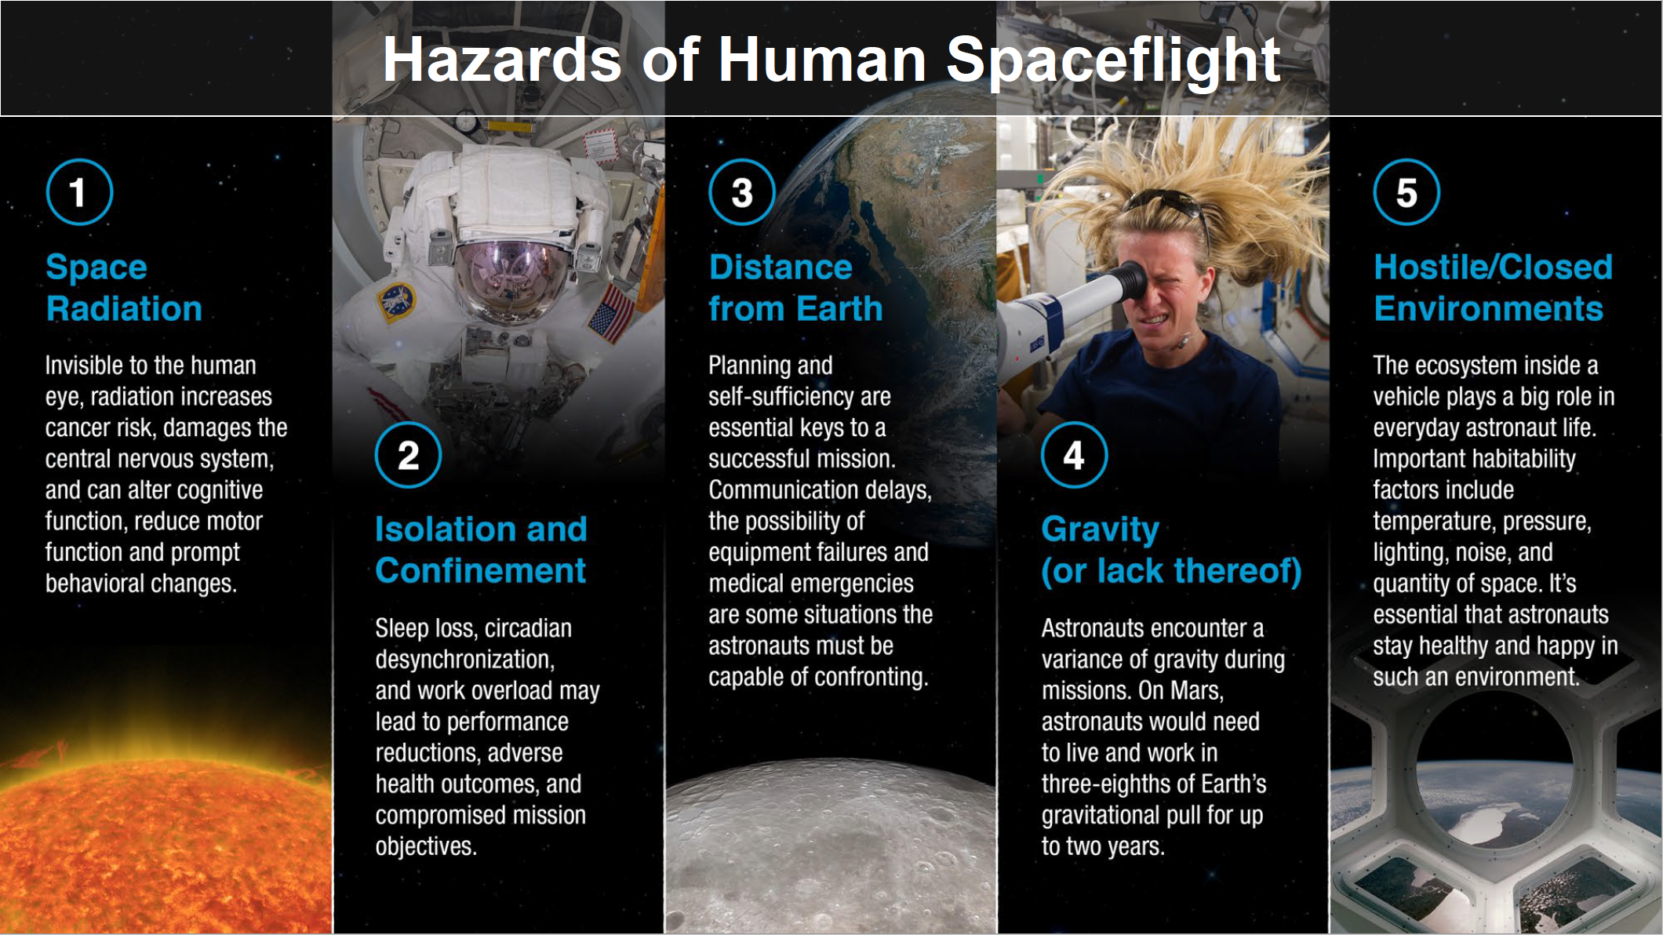

Slide 4
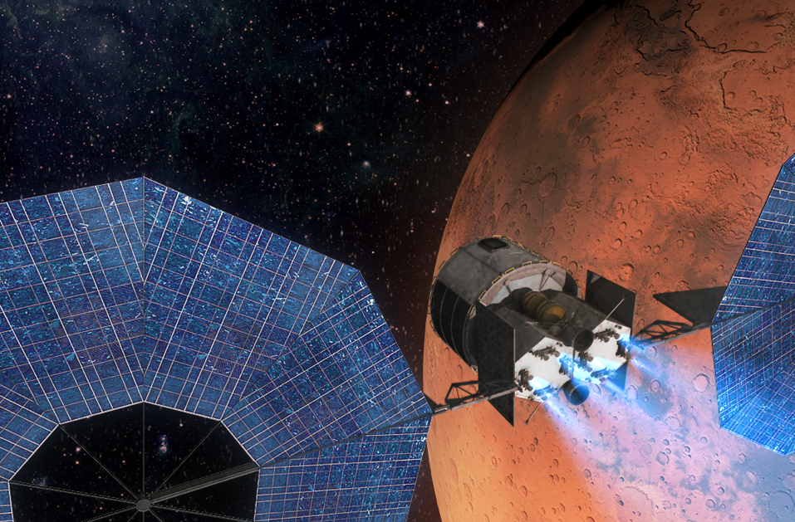
A unique destination
Mars
at start
Mars
at landing
Spacecraft
at landing
Earth
at start
Spacecraft
at start
Earth at landing
The entire experience of our species fits into that blue dot.
Full Mission – 730 - 1200 days
Adapted from S. Love, E. Nelson, Mars Mission Concept of Operations, Aug 2016

Slide 5
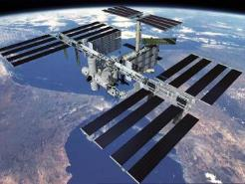
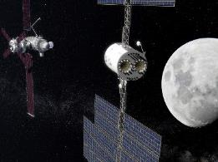

Progressive Earth Independence
Real Time Communications
Evacuation Capability (1.5 – 36 hrs)
Strong Consumables Resupply
Near Real Time Communications
Evacuation Capability (3-11 days)
Limited Consumables Resupply
No Real Time Communications
No Evacuation Capability
No Consumables Resupply
Increasing exposure to Hazards
Increasing need for Autonomy
Notes:
NASA is leading discovery of the best methods and technologies to support safe, productive human space travel to the Moon and Mars through human research at ground facilities, analog environments, and the International Space Station.

Slide 6
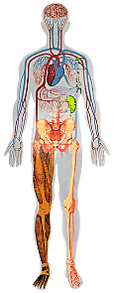
Why does performance matter?
Humans in Extreme Environments
Mitigating Impacts on Human Health & Performance
Enabling Unique Human Capabilities for Earth-Independent Ops
Exposure Sources
Carbon dioxide
Celestial dust
Toxic
Sunlight
Radiation
Isolation
Cognitive, behavioral, psychiatric disorders
Cooperation, coordination, psychosocial adaptation
Anomaly Response
Causal Diagnostics
Altered body function
Immune response
Hypobaric hypoxia
Decompression
Renal stone
Bone fracture
Host-microorganism interactions
Urinary retention
Orthostatic intolerance
Cardiac rhythm
Back pain
Next Worst Outcome Analysis
Work
Sleep loss
Circadian desynchronization
Work overload
Knowledge Integration
Preparedness
Food and nutrition
Inflight medical conditions
Medication
Contingency Planning
Complex Procedure Execution
Reduced capacities
Hearing loss
Intracranial hypertension/vision alteration
Vestibular/sensorimotor alteration
Muscle mass, strength, endurance
Aerobic capacity
Injury sources
Dynamic loads
EVA
Electrical shock
Risk Assessment / Time to Criticality
How Crew Is Impacted by Mission
How Crew Is Impacting Mission
Notes:
NASA’s human research is closing the gaps in current scientific understanding of how best to predict, assess, and solve the problems that humans encounter while living and working in space, and extrapolate that knowledge to protect the women and men who will go forward to the Moon and Mars.

Slide 7
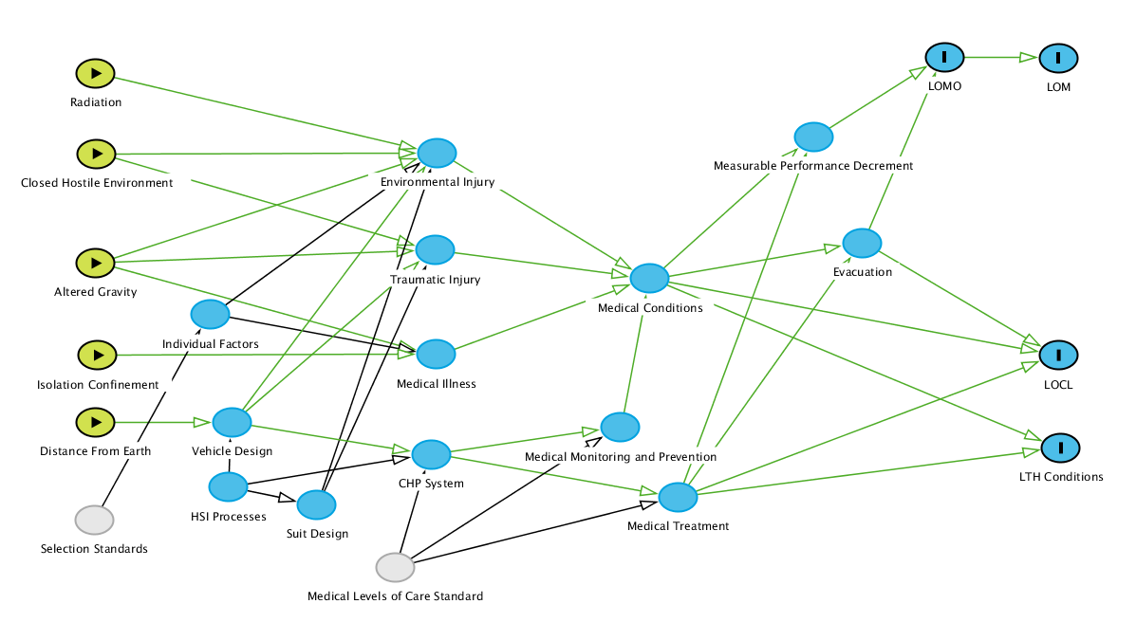
Decreasing Medical Risk in Spaceflight
NASA Selection Standards decrease the likelihood of Medical Illnesses, but don’t mitigate the whole risk

Slide 8
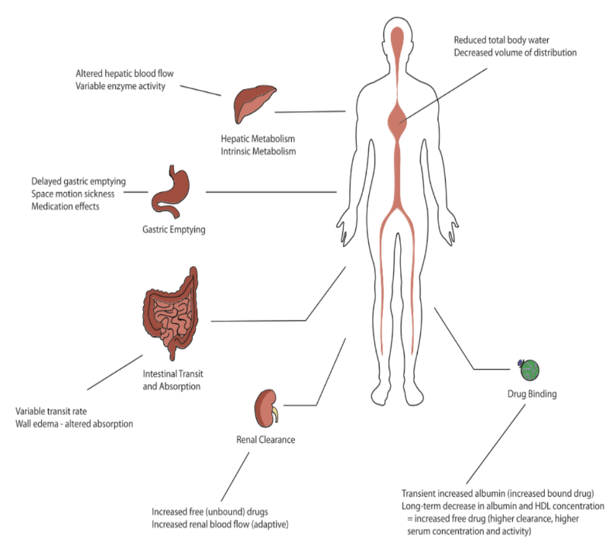
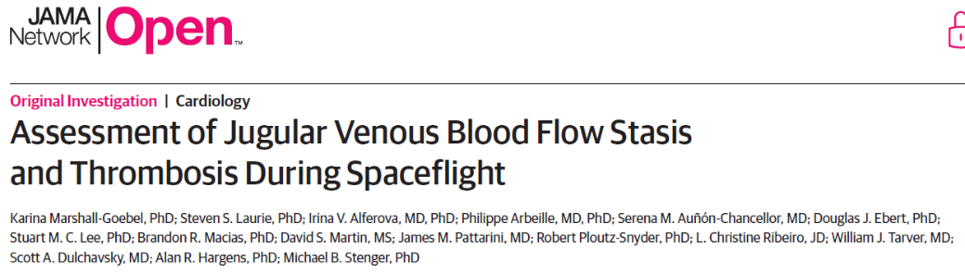


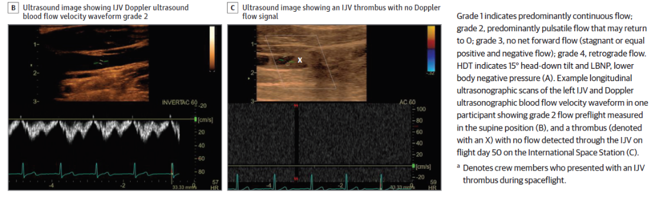
Example: Spaceflight Changes the Body
Alteration of microbiome and bacterial antibiotic resistance
Individualized susceptibility to therapeutic effects
Pharmacogenomics

Slide 9
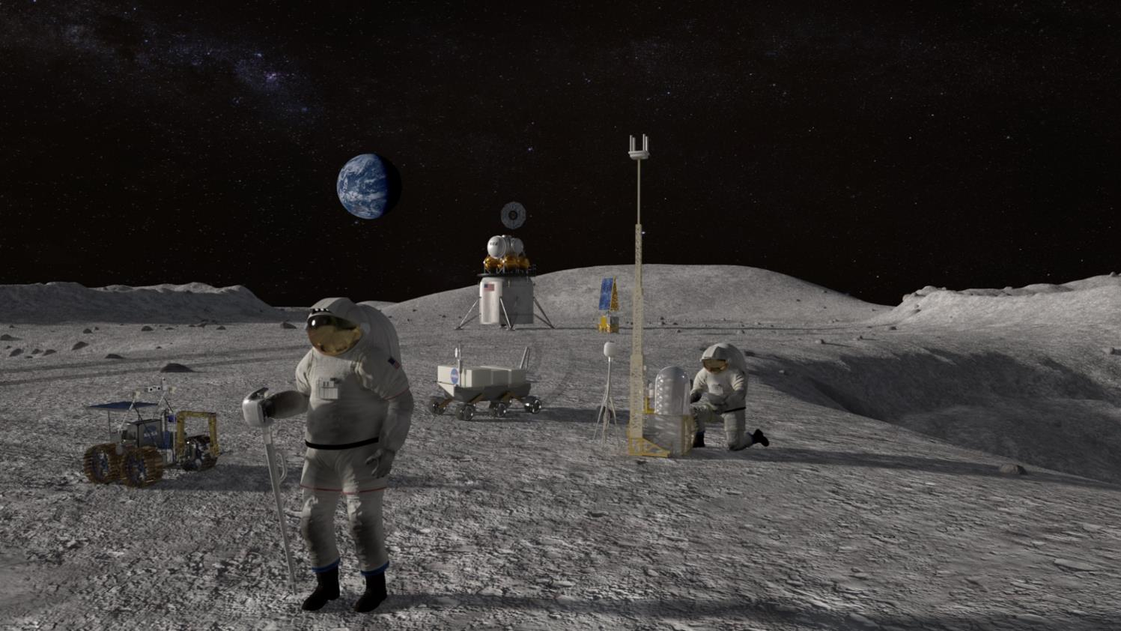
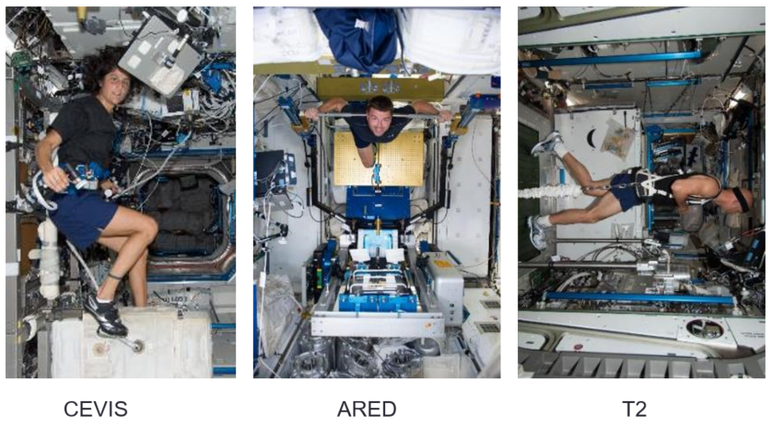
Goal:
Provide a crew that is fit for duty when the mission calls.

Slide 10
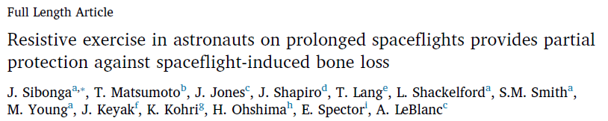
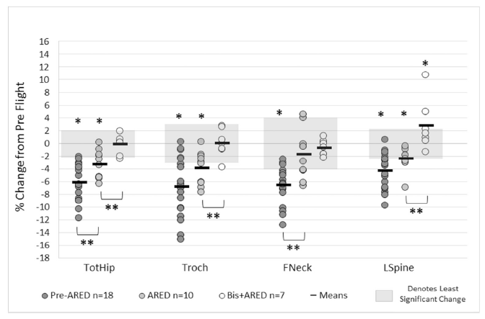
Biologic Variability
Bone, 128, (2019), 112037

Slide 11
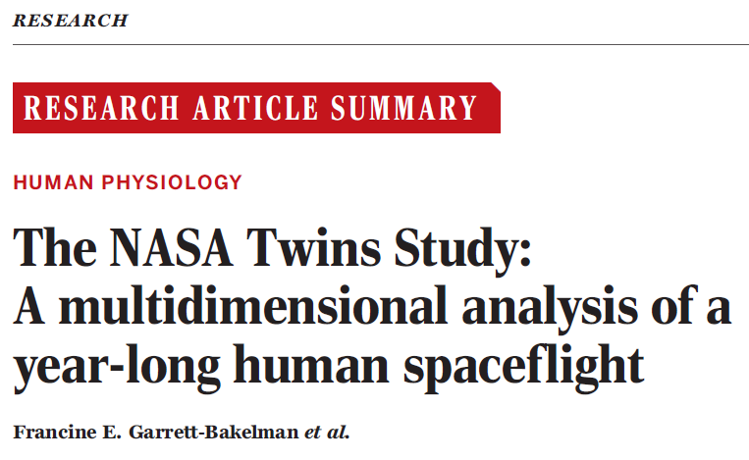
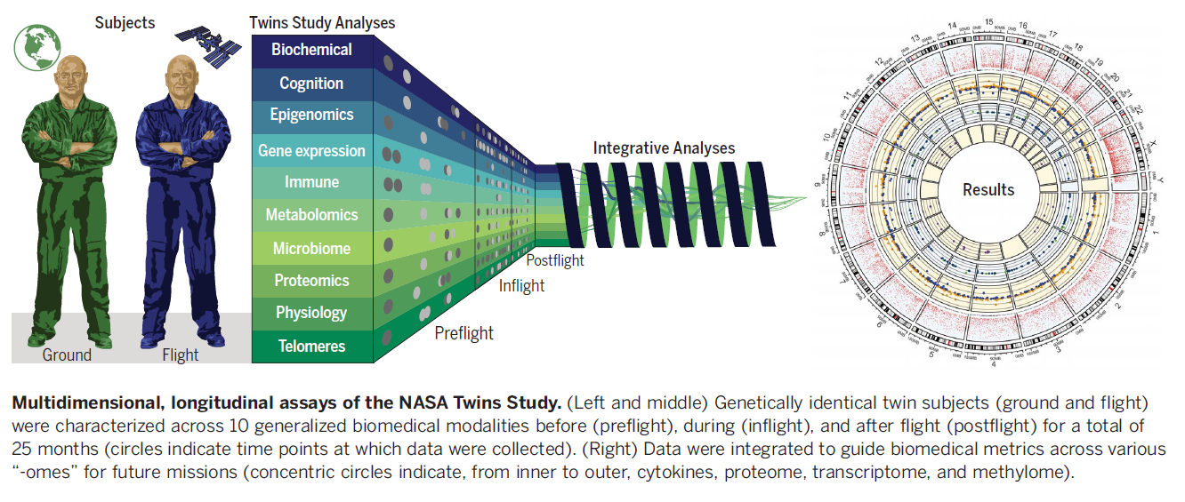
Garrett-Bakelman et al., Science 364, 144 (2019)

Slide 12
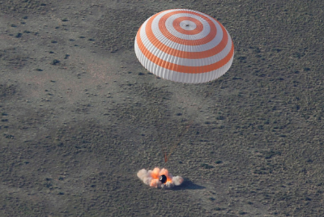
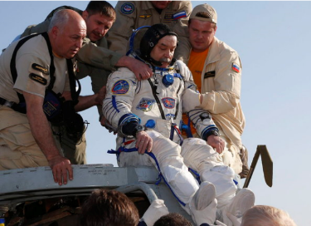
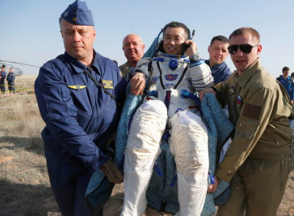
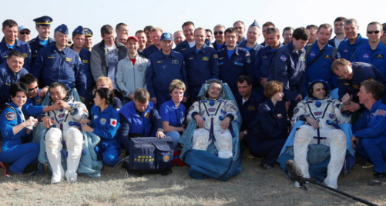
Return to Earth gravity
Some astronauts/cosmonauts must be carried out of the Soyuz after 6 months, others can get up and do tasks on their own.

Slide 13
Take-aways
Human spaceflight is one of the most challenging endeavors that we undertake.
The risk that astronauts carry in space depends in part on their genetics. How much?
The countermeasures we provide to astronauts in space will vary in effectiveness depending on genetics. How much?
We are just at the beginning of unraveling the answers to these questions.
Notes:
Human spaceflight is one of the most challenging endeavors that we undertake.
The risk that astronauts carry in space depends in part on their genetics. How much?
The countermeasures we provide to astronauts in space will vary in effectiveness depending on genetics. How much?
We are just at the beginning of unraveling the answers to these questions.

Slide 14
Questions?

Slide 15
NASA Key Points
Addressing the challenges of moving humanity toward the Moon and Mars focuses and tests the best of our energies and skills to enable future discoveries, providing knowledge to improve life on Earth.
The International Space Station is an accessible space laboratory with unparalleled capability that is increasing knowledge of engineering and physical sciences, biology, the Earth, and the universe through intense research and technology demonstrations and providing the foundation for continuing human spaceflight beyond low-Earth orbit.
As a testbed for deep space exploration, the station is helping us learn how to keep astronauts healthy during long-duration space travel and demonstrating technologies for human and robotic exploration beyond low-Earth orbit, to the Moon and Mars.
NASA is leading discovery of the best methods and technologies to support safe, productive human space travel to the Moon and Mars through human research at ground facilities, analog environments, and the International Space Station.
NASA’s human research is closing the gaps in current scientific understanding of how best to predict, assess, and solve the problems that humans encounter while living and working in space, and extrapolate that knowledge to protect the women and men who will go forward to the Moon and Mars.
The U.S. National Laboratory enables commercial industry, the private sector, academic institutions, non-NASA U.S. government agencies and other diverse users to access a unique research platform for developing and demonstrating new technologies, treatments, and products for improving life on Earth.
The International Space Station is the blueprint for American leadership in global cooperation, enabling a U.S.-led multinational partnership to advance shared goals in space exploration.

