Slide 1

On-orbit Servicing, Assembly and Manufacturing (OSAM)
Near-Term in-Space Developmental Test Persistent Platform:
ESPA-Star Based Implementation
Panel-09 In-Space Development Test: Springboard For Rapid Development
November 16, 2020
1400 – 1600 EST
Bill Doggett and John T. Dorsey
Structural Mechanics and Concepts Branch, NASA Langley Research Center, Hampton, VA, USA
This material is declared a work of the U.S. Government and is not subject to copyright protection in the United States.
www.ascend.events

Slide 2


Near-term Persistent Platform Orbital Testbed: Small Satellite-Based Architecture Option
Terms Used
OSAM: On-orbit Servicing, Assembly and Manufacturing.
Persistent Asset: Any space system that benefits from multiple visits or OSAM.
Persistent Asset Paradigm: Assets designed to leverage OSAM capabilities. A Persistent Platform is an example.
Outline
OSAM Summary
Assembly Approaches
Robotic Approaches for Assembly and Servicing
Persistent Platform Testbed to Validate Technology
Small Satellite Based Persistent Platform

Slide 3
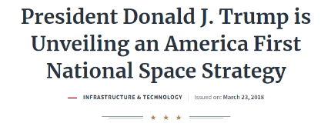



Origin Story For On-orbit Servicing, Assembly and Manufacturing (OSAM)
2017-2019 Space Science and Technology (S&T) Partnership Forum on In-Space Assembly examined the cross-cutting value, potential for collaboration, and technology advancement for multiple government partners.
2018 National Space Strategy identifies NASA and DOD to lead OSAM technology development and demonstration, explore new OSAM capabilities, and enable OSAM activities in U.S. industry.

Slide 4
OSAM National Initiative
OBJECTIVES
Facilitate Relationships
Build and maintain relationships with commercial, US Government, and other stakeholders to ensure an informed, integrated approach
Serve as NASA’s and the nation’s steward for OSAM capability development and mission execution, and as a central hub for engaging the broader OSAM stakeholder community
OSAM MISSION
Develop and Share Technology
Develop solutions to the most demanding technological challenges and seed the growth of US industry through tech development, sourcing, transfer, and collaboration
Advance New Concepts and Capabilities
Design and execute innovative mission concepts that enable breakthroughs in human exploration and science and support broader national objectives
Serve as a Knowledge Center
Develop and maintain a repository of data and relationships to ensure broad and consistent awareness of industry and government activity and capabilities

Slide 5
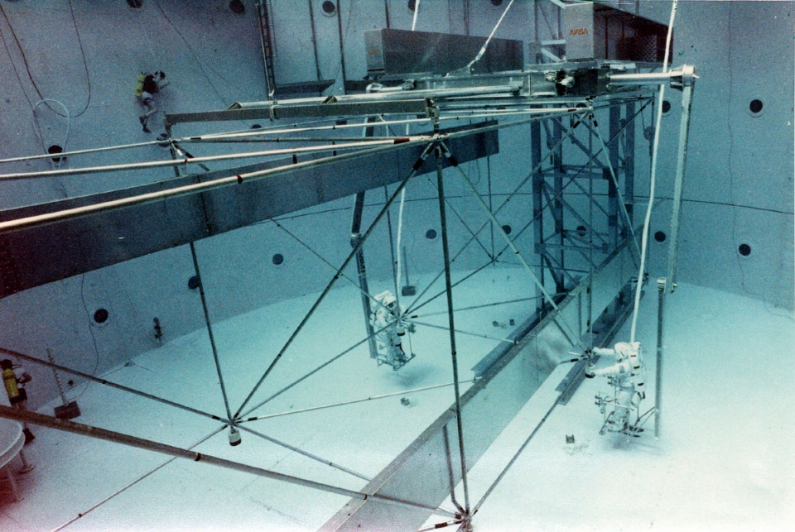
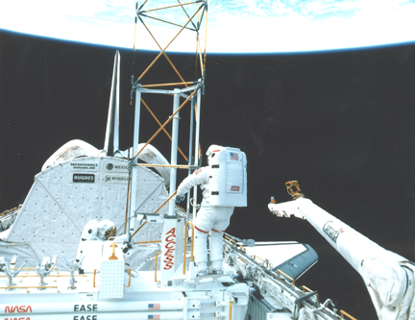
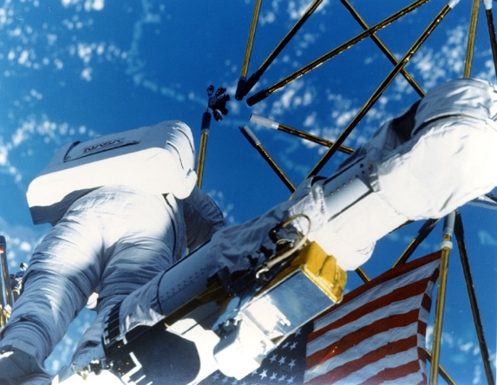
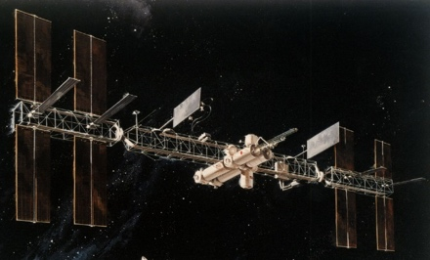
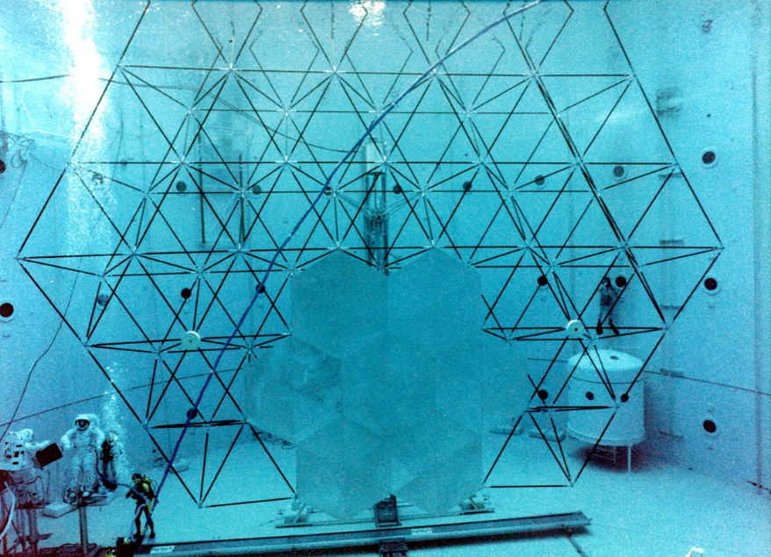
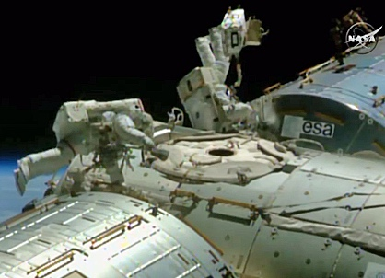
What is Different From Previous Assembly Approaches?
Early work focused on structure, not system
1988
1985
1985
Space Station Freedom
Maintenance and Repair
1992
2015
Space Station relied heavily on astronaut support
LEO EVA International
Space Station
Assembly (1998-2011)
and Servicing(1998-)

Slide 6
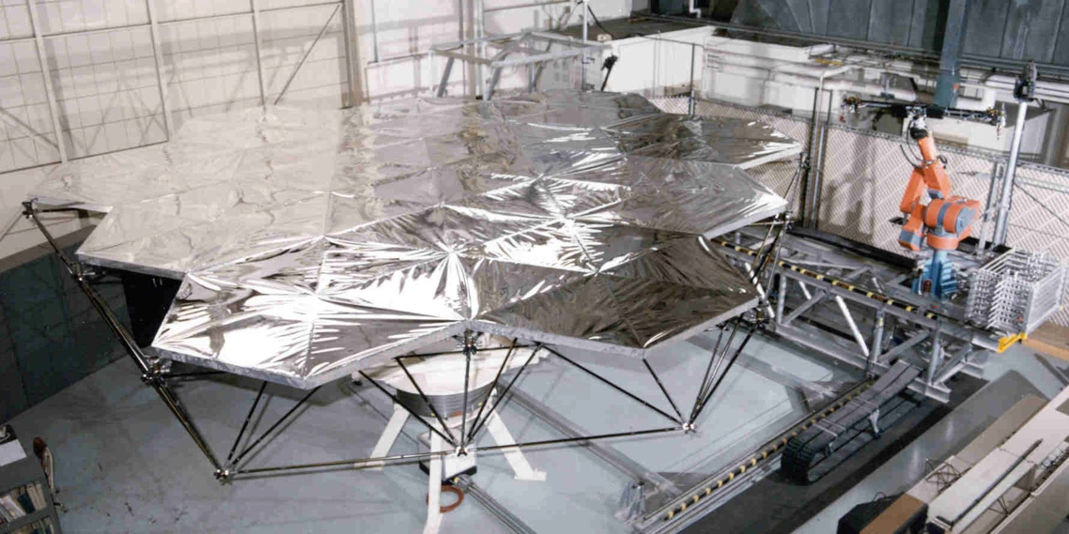
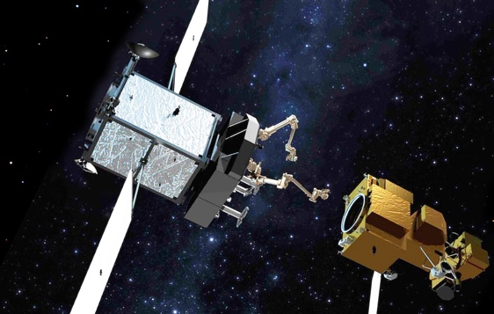
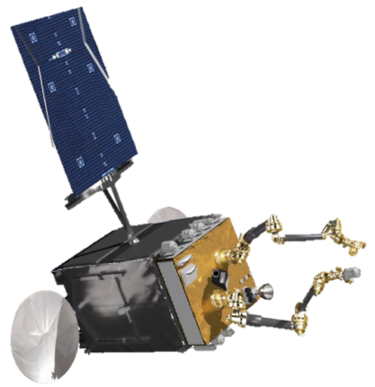
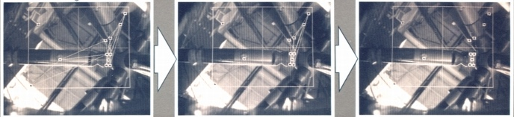
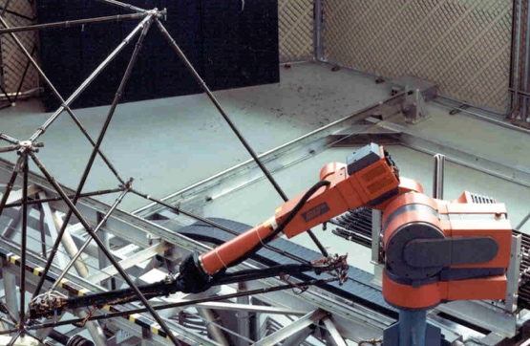
Robotic Approaches Are Viable for Assembly and Servicing
LaRC Automated Assembly Laboratory
1995
Northrop Grumman MEV
NASA Restore L
DARPA/Space Systems Loral RSGS
Environment Feedback
Robotics are viable for space operations
Multiple robotic vehicles and providers entering market
Increasing need for cost effective rapid refresh of systems
Telecommunications
Space and Earth Science
Space Exploration
Persistent Asset
Paradigm
Custom Tools
New Operational Paradigm Needed

Slide 7
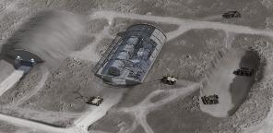
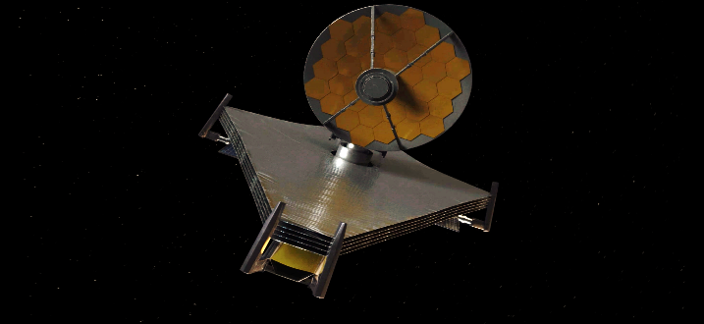
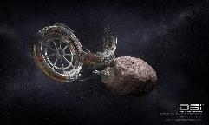
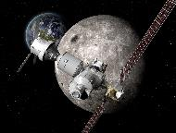
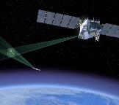
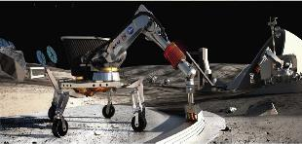
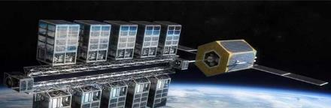
Problem: Lack of Confidence in OSAM Technologies Solution: Persistent Platform Testbed to Validate Tech.
State of the Art “Single Launch and Operate” Paradigm is Uncompetitive and Unsustainable: Need a new Paradigm
Persistent Asset Paradigm (No Technology Showstoppers)
Surface
Outpost
Space
Telescope
Foundational Missions
International Space Station
Hubble Servicing
Robotic Refueling Mission
Raven
Orbital Express
Made-in-Space 3-D Printer
Robotic Servicing of Geosynchronous Satellites (RSGS supported by DARPA)
On-orbit Servicing Assembly and Manufacturing missions: OSAM-1 and OSAM-2
Persistent Platform
Space
Manufacturing
Orbiting
Outpost
Technologies
Matured and Verified
Predictive Modeling
Autonomous Robotics
Autonomous Rendezvous and Docking
Autonomous Berthing
Standard Modular Interfaces
Trusted Autonomy
Situation Awareness
Science
Station
Surface
Construction
Power
Station
Civil
Defense
Commercial
University

Slide 8
Small Satellite Based Platform Evolves with Common Repeating Units based on Commercial Small Satellite
Launch Packaging
Initial Operating Capability: Repeating Unit
3 Repeating Units Packaged as Primary Payload

Slide 9
Small Satellite Based Platform Evolves with Common Repeating Units based on Commercial Small Satellite
Evolution
2
Initial Module Deploys Truss with Robotic Arm
3
Berths to 2nd Module
3rd Module Completes Baseline Configuration with Multiple Payload Locations

Slide 10

www.ascend.events

