Slide 1
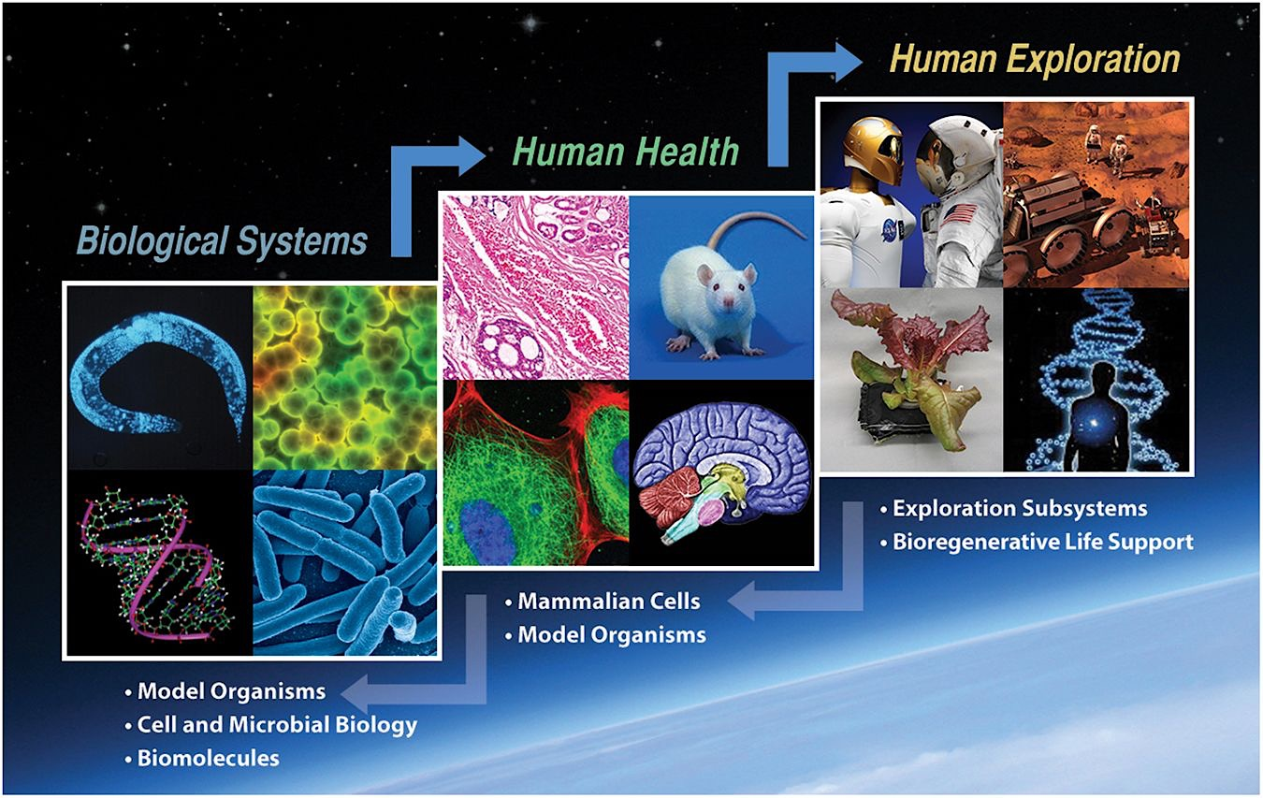

Next Gen Life Science Data Archive
Next Gen LSDA
Macresia Alibaruho, Sandeep Shetye, Truong Le, John Dunn

Slide 2
Background
Original LSDA Tool was deployed in mid-1990s
  Was designed to store various data collections
  Many different formats and origins; LSDA tool provides a collection space for all the unique data sets
  Still uses legacy methods for cataloging of data
Use case for LSDA data has evolved
  Publications versus data
  Limited reuse of data to reuse as standard operating procedure
  Discipline-specific research versus multidisciplinary research
Current technology does not support current use case
  Finding information on the public web site that is difficult to understand and navigate
  Most of the raw data must be manually provided on request
  Labor-intensive Processes
  Data is not integrated
Need for investment
  Leveraging Digital Transformation to improve the capabilities of the Life Science Data Archive (LSDA), Life Science Data Workspace (LSDW) and Web Mirage
  Allow Next Gen LSDA to be the authoritative data source for LSDA, LSDW and Web Mirage
  Reuse of data for translational research and informed decisions

Slide 3

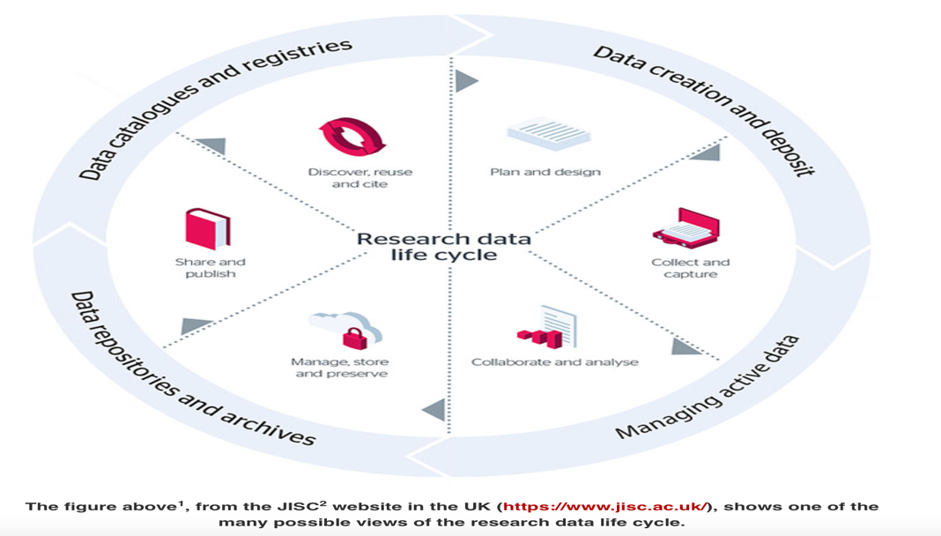

Why Next Gen LSDA?
DRIVE SCIENTIFIC INSIGHT
IMPROVE PROCESS EFFICIENCY
LOWER RISKS
Support HRP goal to increase reuse of data for translational research and informed decisions
Improve data accessibility for analytics and decision making
Encourage collaboration and cooperation to enable cross-discipline scientific discovery
Streamline data acquisition using automated data collection and a data submission portal
Reduce manual efforts in long term data preservation
Establish governance framework and make it an integral part of the data platform
HRP Risk: possibility that the data accessibility and reuse will be compromised
Security and privacy of data
Alignment with federal data strategy and digital transformation
Modernize LSDA Platform
Modernize for digital-forward future

Slide 4




Next Gen LSDA Data Sharing
Findable
Accessible
Interoperable
Reusable
PI data
Data Submission Portal
Discover, Access & Update
PI data
LSDA Data Portal
Insight
PI data
Data Connectors
Data APIs
Analytics Tools
Users
External Systems
Workspace
Automated Workflow
Aggregate Data
Other Data
External Systems
Advances in Computing and Data are fueling Scientific Breakthroughs

Slide 5

Next Gen LSDA Process
Collect
Process
Store
Access
Analyze
Visualize
Record /
Clean/Shift Data
Derive Information
and Decisions
Official Data Source
Study
Role Based Access Control
LSDA
LSDW
Migration
FY22 Q1
IMPALA, ALSDA, & GeneLab
DATA Validator
Crew Consent Module
Connections
ANALOG
Insight Cloud Storage
DB
TSC
Flight
Long Term

Slide 6
Next Gen LSDA Roadmap
FY 23
FY 22
FY 21
Transition of LSDA early/mid 2022
FY 20
Complete integration with external systems
Complete Workspace
Data Governance & Linking
API Access for other customers to see data
Development of analytical and Modeling tools
AI/ML based Smart Search
Full science community engagement
Single entry point for data submission
Establish a process between data collection, archivist review, processing/cleaning data, and cloud storage
Integrated platform across all LSDA data
Integration with external systems and tools
Tailor enhancement plan
Ontology and Provenance Support
Complete Molecular data
Build community via collaborative science
Requirements Baseline
Establish Cloud storage and data migration
Full eDiscovery of LSDA, LSDW and Webmirage
Integrate DevTools features
RBAC for Crew Consent
Jupyter Notebooks
Integrate research related Molecular Data
Build Extraction Standards
Outreach program planning
Requirements level 1
Completed 6 different prototypes
Tools evaluation and selection
Next Gen LSDA data strategy

Slide 7
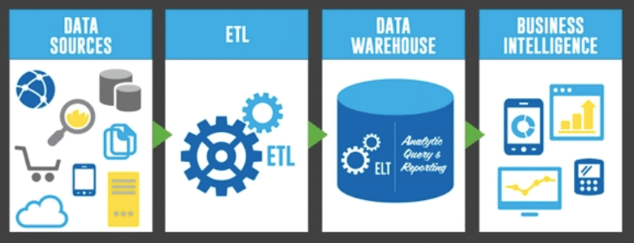
Next Gen LSDA Benefits
Transforming data for scientific use (initial benefits)
  Create highly efficient and effective Life Science Research data infrastructure
  Support development and dissemination of Advance Data Management, Analytics and Visualization tools for LSDA, LSDW, Webmirage data
  Promote modernization of Data ecosystem
  Provide better access to Medical Image files, molecular data (omics)
  Enact appropriate governance and policies
  Move from “Silos” to a Platform to accelerate research…
Opportunities
The opportunity to clean data over time will present itself as data is requested
Prioritization (most relevant and heavily requested) for further data cleaning will be demand based.
Further Improve data integration across platforms
Insight
IMPALA Analytics
Modeling RISKS
Notes:
Promote modernization of Data ecosystem
Will improve findability and categorization of data
Will allow automated data tagging
Will allow opportunity for improved data sets
Will provide better access to Medical Image files, molecular data (omics)

Slide 8

Next Gen LSDA Outreach

Slide 9
Backup

