Slide 1

Spaceflight Standard Measures
Principal Investigator: Gilles Clement, PhD, KBR
Science Team: Brian Crucian, PhD, NASA JSC
Stuart Lee, PhD, KBR
Mark Ott, PhD, NASA JSC Millard Reschke, PhD, NASA JSC
Peter Roma, PhD, KBR
Scott Smith, PhD, NASA JSC
Scott Wood, PhD, NASA JSC
Sara Zwart, PhD, UTMB
Support Team: Nicolas Bell, KBR
Scott Humbert, KBR
Gwenn Sandoz, KBR
Shelby Weyand, KBR

Slide 2
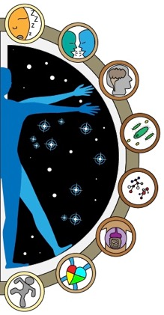
Objectives
To ensure that a minimal set of measures, relevant to human spaceflight risks, is consistently captured from crewmembers until the end of the ISS program
The data from these measures are placed in an archive managed by HRP and made available to studies via data sharing agreements
Spaceflight Standard Measures constitutes a database for:
  Providing context for data acquired by concurrent experiments
  Supporting or developing hypotheses
  Evaluating the effectiveness of various in-flight countermeasure profiles
  Comparing population responses to various mission durations (6 weeks, 6 months, 1 year)

Slide 3
HRP Identified Risks
Altered Gravity Level
Vision alterations
Renal stone formation
Sensorimotor alterations
Bone fracture
Reduced muscle mass, strength
Reduced aerobic capacity
Adverse host-microorganism interactions
Urinary retention
Orthostatic intolerance
Back pain
Cardiac rhythm problems
Radiation
Exposure to space radiation
Environment–Spacecraft Design
Inadequate food/nutrition
Human-system interaction
Injury from dynamic loads
Injury during EVA
Celestial dust exposure
Altered immune response
Hypobaric hypoxia
Sleep loss & work overload
Decompression sickness
Toxic exposure
Hearing loss
Sunlight exposure
Distance from Earth
Limited in-flight medical capabilities
Toxic medications
Isolation
Adverse cognitive or behavioral conditions
Performance & behavioral health decrements
Risks addressed by the Spaceflight Standard Measures project

Slide 4
Experiment Design Overview
6-month mission
Pre-flight | In-flight | Post-flight
Actigraphy w/ sleep logs (2 weeks each) (L-180, L-90) | Actigraphy (2 weeks each) (bimonthly) | Actigraphy w/ sleep logs (2 weeks) (R+0)
Personality Survey (anytime preflight) | Sleep Quality/Team Questionnaire (monthly) | Cellular Profile Survey (R+15)
Cognition (L-120 fam, L-90) | Cognition (FD30 & R-30) | Cognition (R+10, R+30)
Cellular Profile (ambient blood, saliva) (L-180, L-90) | Cellular Profile (ambient blood, saliva) (Early mission vehicle return, R-0) | Cellular Profile (ambient blood, saliva) (R+30)
Biochemical Markers (blood, urine) (L-180) | Biochemical Markers (blood only) (FD30, R-30) | Biochemical Markers (blood, urine) (R+30)
Microbiome (body, saliva, fecal) (L-90) | Microbiome (body, saliva, fecal) (FD30, R-30) | Microbiome (body, saliva, fecal) (R+30)
Carotid Intima-Media Thickness (cIMT) (L-180) | N/A | Carotid Intima-Media Thickness (cIMT) (R+5, R+30)
Sensorimotor Measures (L-180 , L-90) | N/A | Sensorimotor Measures (R+0 at landing site, R+0 at JSC, R+9)
Crew time: 6.67 hr
Crew time: 18.33 hr
Crew time: 5.75 hr
Notes:
Data collected under the Spaceflight Standard Measures project include assessments of sleep/wake cycles, cognition, immune status and function, general blood and urine chemistry, microbiome composition, cardiovascular structure and function, sensorimotor function, and team processes. Data is collected once or twice before the flight (180 and 90 days before launch), twice during the 6-month missions (fight day 30 and 30 days before return to Earth) with the exception of Actigraphy, which is recorded during two-week periods, and sleep quality and team questionnaire which are administered monthly during the mission.

Slide 5
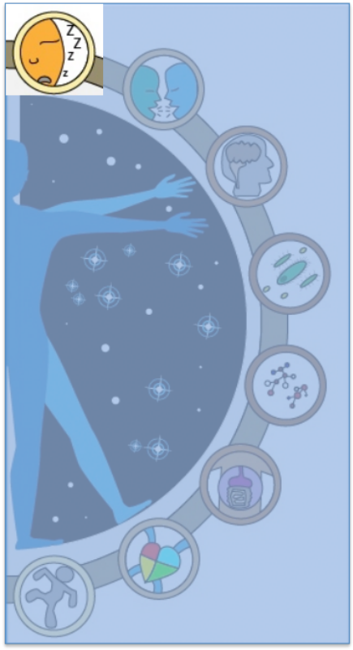
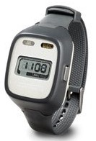
Actigraphy
Actiwatch Spectrum
Wrist watch worn snug against the non-dominant wrist
Tracks movement and light data
Questionnaire
A brief post-sleep survey daily when actigraphy is collected on the ground
Tests Sessions
L-180, L-90 – worn for two 2-week sessions
FD1 to R-0 – bimonthly; worn for 2-week sessions
R+0 – worn for one 2-week session
Measures
Activity level (per min)
Light exposure

Slide 6
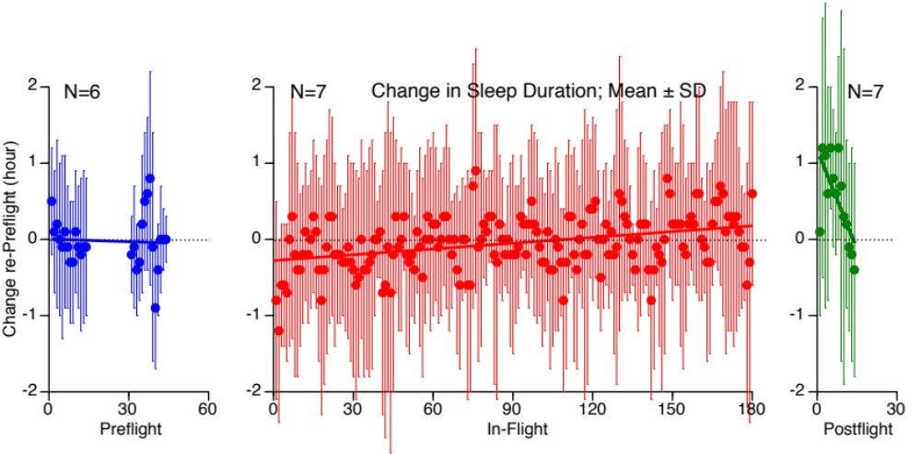
Actigraphy – Sleep Duration

Slide 7
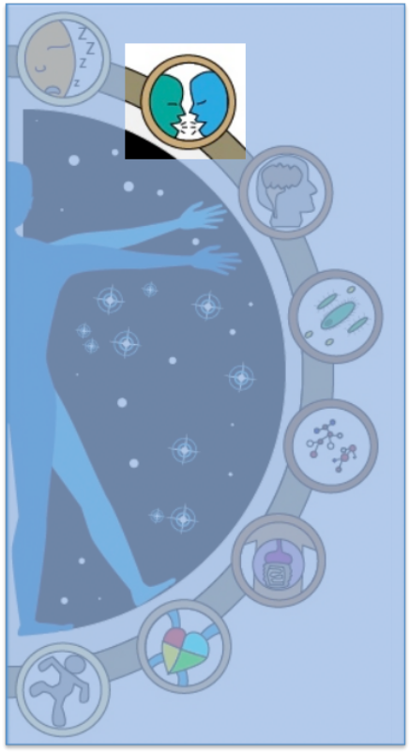
Personality Survey & Sleep Quality/Team Questionnaire
Personality Survey
  International Personality Item Pool, Neuroticism-Extraversion-Openness (IPIP-NEO)
  Paper-based survey
Sleep Quality/Team Questionnaire
  Completed in DCT in-flight
Tests Sessions
Personality Survey – anytime pre-flight
Sleep Quality/Team Questionnaire – monthly in-flight
Measures
Sleep quantity and quality
Mood
Affect
Team cohesion and performance
Crew living/habitability

Slide 8
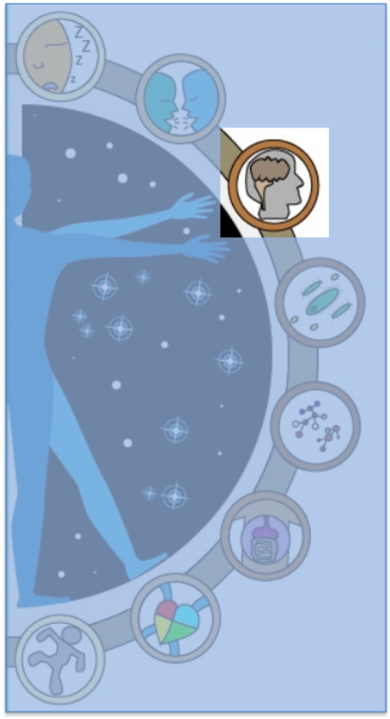
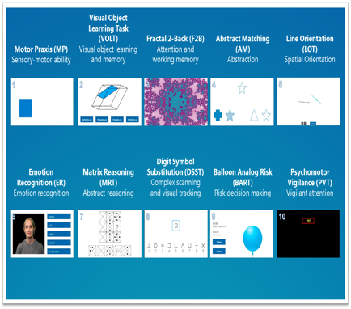



Cognition
A battery of 10 neurocognitive tests that cover a range of cognitive domains relevant for spaceflight
Test Sessions
L-120, L-90
FD30, R-30
R+10, R+30
Measures
Reaction time
Learning
Working memory
Abstraction
Spatial orientation
Emotion recognition
Abstract reasoning
Visual tracking
Risk decision making
Attention

Slide 9
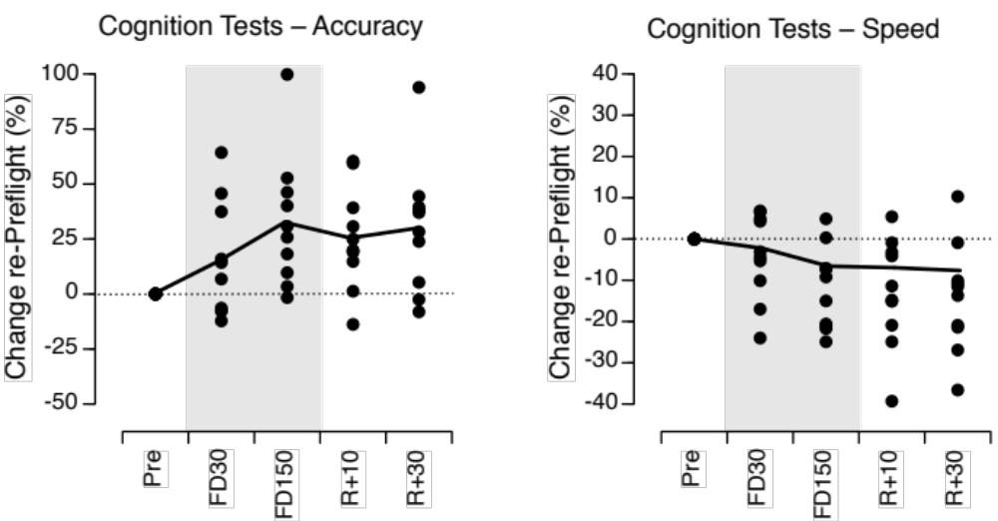
Cognition – Accuracy & Speed
Notes:
These graphs represent the accuracy and speed of crew members’ performance during 10 neurocognitive tests. The accuracy increased during spaceflight, but the speed of the tasks simultaneously decreased throughout the flight. These changes were maintained during the postflight period.

Slide 10
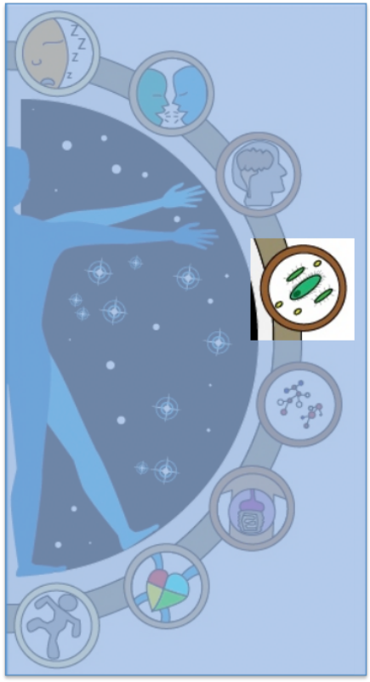
Cellular Profile
Blood Sample
  2 tubes totaling 10 mL per session
  In-flight live blood cells quickly returned to ground
Saliva Collection
  One saliva sample per session (salivette)
  In-flight, stowed in MELFI
Cellular Profile Survey (post-flight only)
  A questionnaire about experiences during flight such as allergies, rashes, infections and wound healing
Test Sessions
L-180, L-90
~FD30, R-30 – Undock of return vehicle
R+30
Measures
Stress hormone levels
Viral shedding
Protein level
Types of blood cells
Notes:
There has not been an ED update to account for it, but we are moving toward collecting only one blood tube per Cellular Profile session. It will total 6 mL. That said, the IRB protocol allows up to 14.5 mL per session…

Slide 11
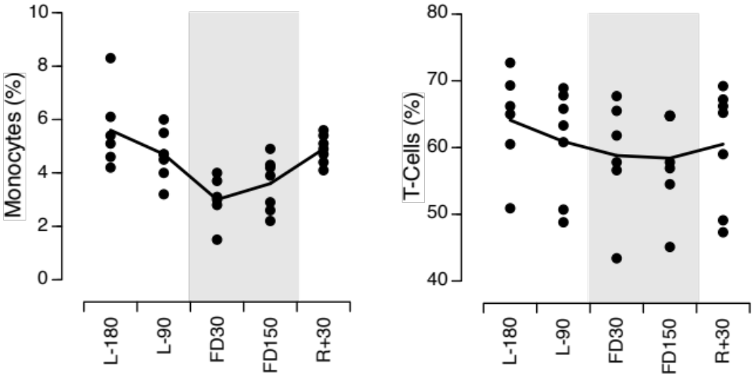
Cellular Profile

Slide 12
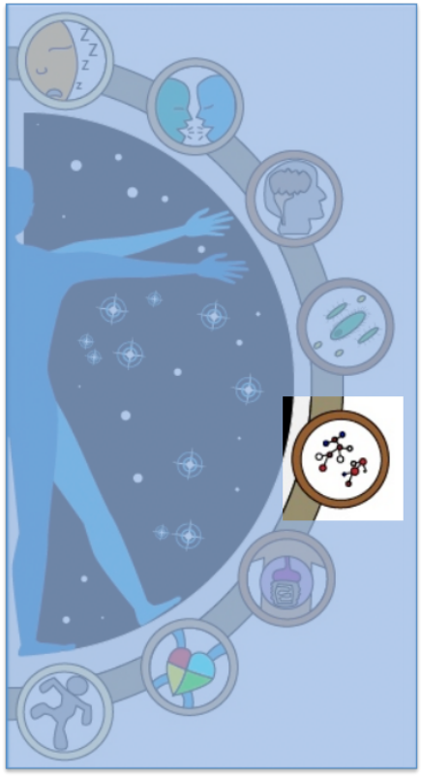
Biochemical Markers
Blood Sample
  Ground: 3 tubes totaling 15.7 mL; collected early morning
  In-flight: 2 tubes totaling 15 mL per session
Urine Collection
  Ground only
  24-hour urine collection–shared with medical collection when feasible
Questionnaire
  Ground only
  Exercise log completed at time of sample collection
Test Sessions
  L-180
  FD30, R-30
  R+30
Measures
Complete blood count
Comprehensive metabolic panel
Comprehensive chemistry panel

Slide 13
Biochemical Analytes
Blood samples
  plasma allergy profile, plasma cytokine levels, VS cell expansion and cytotoxicity, T cell function, peripheral leukocyte distribution, and mitogen stimulated cytokine profiles, iCa, white blood cell count, neutrophils, lymphocytes, monocytes, eosinophils, basophils, red blood cell count, reticulocyte count, platelet count, mean platelet volume, and platelet distribution width
  serum CO2, BUN, bilirubin, glucose, serum 1,25-dihydroxyvitamin D, serum 25-hydroxyvitamin D, BSAP, calcium, ALT, AST, alkaline phosphatase, sodium, potassium, chloride, total protein, albumin, creatinine, osteocalcin, undercarboxylated osteocalcin, intact PTH, osteoprotegerin (OPG), osteoprotegerin ligand/RANKL, leptin, IGF-1, sclerostin, hepcidin, and N-terminal propeptide of type I procollagen (P1NP)
  hemoglobin, hematocrit
Urine samples
  sodium, potassium, creatinine, pH, 24-hour volume, calcium, phosphorus, magnesium, uric acid, citrate, sulfate, calcium oxalate supersaturation, calcium phosphate supersaturation, sodium urate supersaturation, struvite supersaturation, uric acid supersaturation, and oxalate
  Saliva samples
    viral DNA
  Body and fecal samples
    bacterial DNA (gDNA, 16S rDNA)
    microbial differences in community composition among group of samples

Slide 14
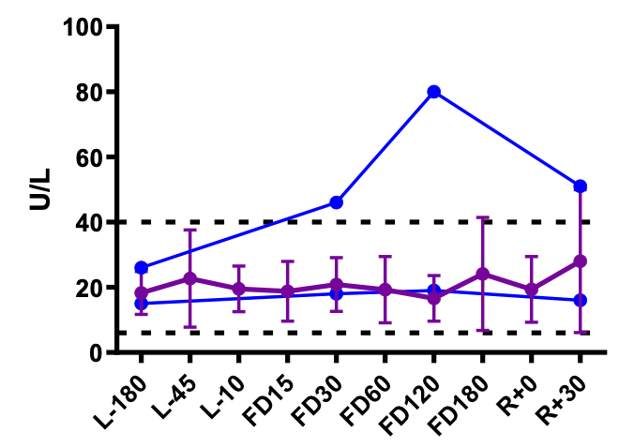
Biochemical Markers
Liver enzyme alanine aminotransferase (ALT) from SSM subjects compared to 64 astronauts (purple line; mean ± SD)

Slide 15
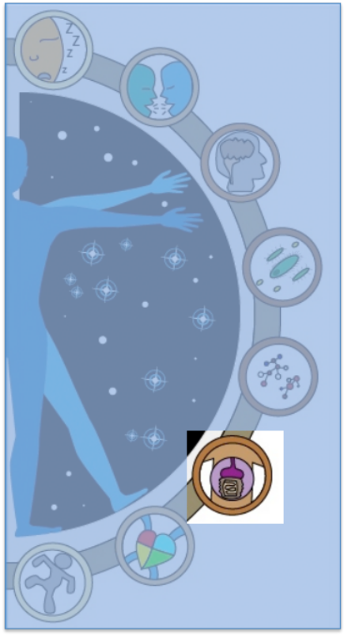
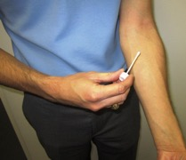
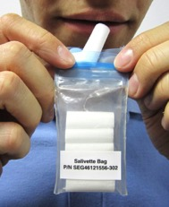
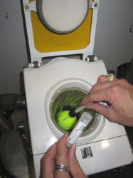
Microbiome
Body Swabs
  Sample forearm, forehead, nostril, and control area using pre-moistened swabs
  Brief environment, health, and hygiene survey completed the day of body swab collection
Saliva Collection
  Sample every day for 4 days (salivette)
Fecal Sampling
  Ground – Human Stool Sampling Kit
  Flight – Swab to collect sample from WHC
Test Sessions
  L-90
  FD30, R-30
  R+30
Measures
Types and concentrations of micro-organisms on the body

Slide 16
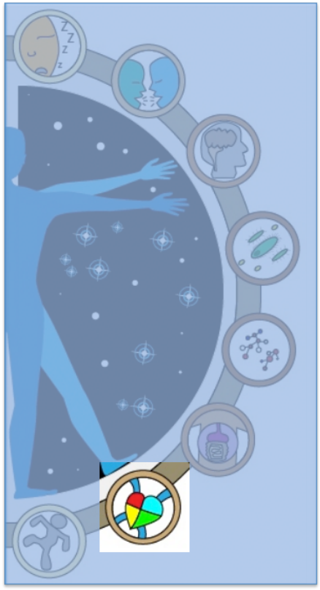
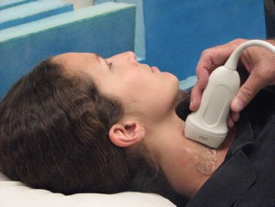
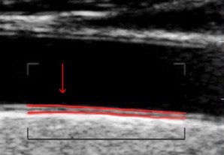
Carotid Intima-Media Thickness
Examination
Ultrasound measure of carotid arterial wall thickness, which is an early indicator of vascular dysfunction (oxidative stress)
Questionnaire
  Short survey conducted during the test regarding exercise, diet, sleep
Test Sessions
  L-180
  R+5, R+30
Measures
Thickness of the intima and media, the two inner layers of the carotid artery

Slide 17
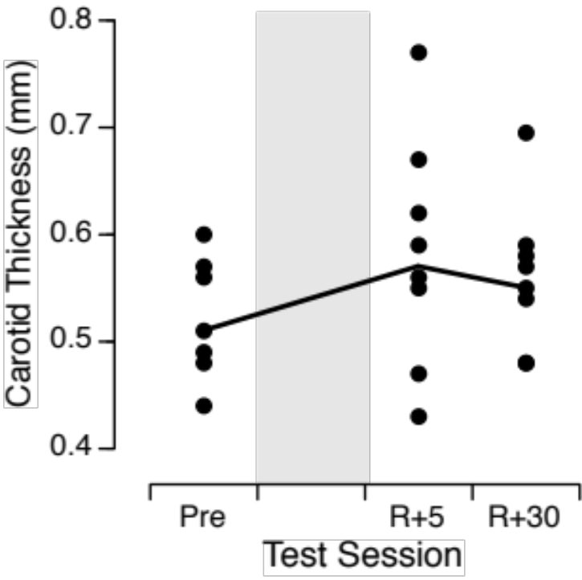
Carotid Intima-Media Thickness
Notes:
In this slide, the filled symbols represent the ultrasound measure of the carotid arterial wall thickness, which is an early indicator of vascular dysfunction. In average, this thickness increased after spaceflight in the 8 crewmembers tested to date, which supports the earlier data published in the literature.

Slide 18
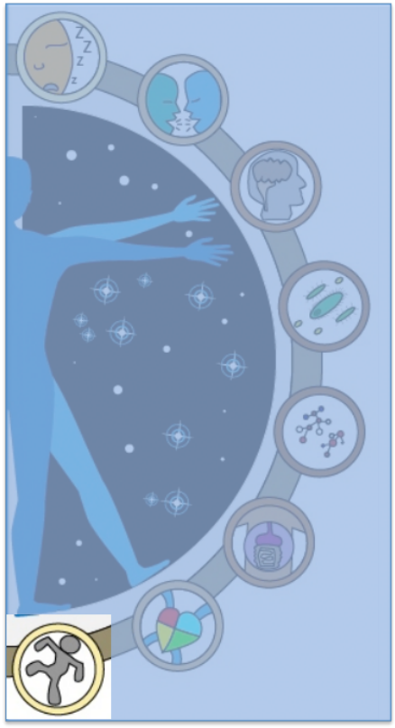
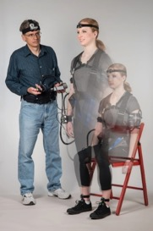
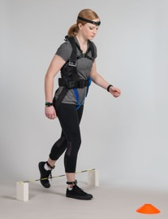
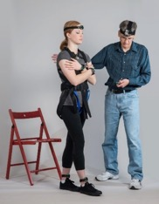
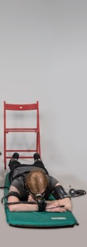
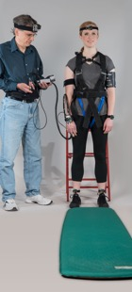
Sensorimotor Measures
Sit-to-Stand and Walk-&-Turn
  Rise from a seated position
  Remain stationary for 10 sec
  Walk as quickly as possible toward and around a cone, then return back to the chair, stepping twice over an obstacle
Tandem Walk Test
  Walk heel-to-toe with eyes open/closed
Recovery from Fall/Stand Test
  Rise from a prone position
  Remain stationary for 3 min
Motion Sickness Questionnaire
Test Sessions
L-180, L-90
R+0 at landing site, R+0 at JSC, R+9
Measures
Body kinematics
Heart rate; Blood pressure

Slide 19
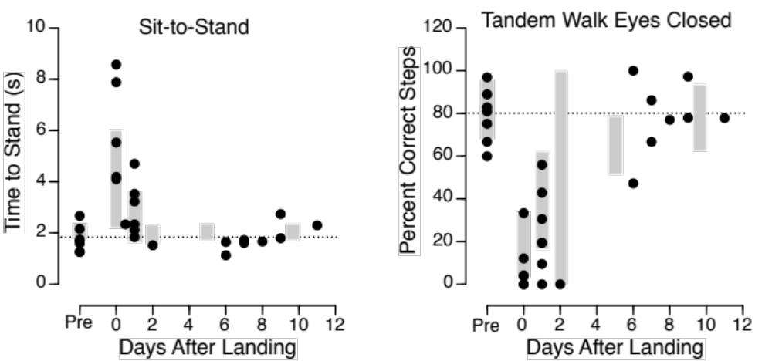
Sensorimotor Measures – Results
Notes:
This is an example of data collected in the Sensorimotor Measures tests. The filled symbols represent the measures from 8 enrolled crew members to date. The time-to-stand from a sitting position increased from 2 to 8 sec immediately after landing and then returned to normal on the following days. Crewmembers were only able to perform a few steps during tandem walk with the eye closed for up to 2 days after landing. These results indicated altered performance and motor behavior immediately after landing. The grey bars represents the standard error in the measurements from 38 other crew members during a previous study called Field Test.

Slide 20
Goal
Spaceflight Standard Measures constitute a database for:
  Providing context for data acquired by concurrent experiments
  Supporting or developing hypotheses
  Evaluating the effectiveness of various in-flight countermeasure profiles
  Comparing population responses to various mission durations (6 weeks, 6 months, 1 year)
Notes:
Data from the Standard Measures Project are placed in the NASA Life Sciences Data Archive and are available for occupational surveillance, Institutional Review Board-approved data sharing requests, and retrospective data requests. This data repository enables high-level monitoring of the effectiveness of countermeasures and meaningful interpretation of health and performance outcomes for various mission durations. The knowledge gained from this project informs and supports future hypothesis-driven research that will enable the success of planetary missions

