Slide 1

Space Crop Production
Gioia Massa
NASA, Kennedy Space Center, FL, USA
Ramon SpaceTech Conference Jan. 25, 2021

Slide 2
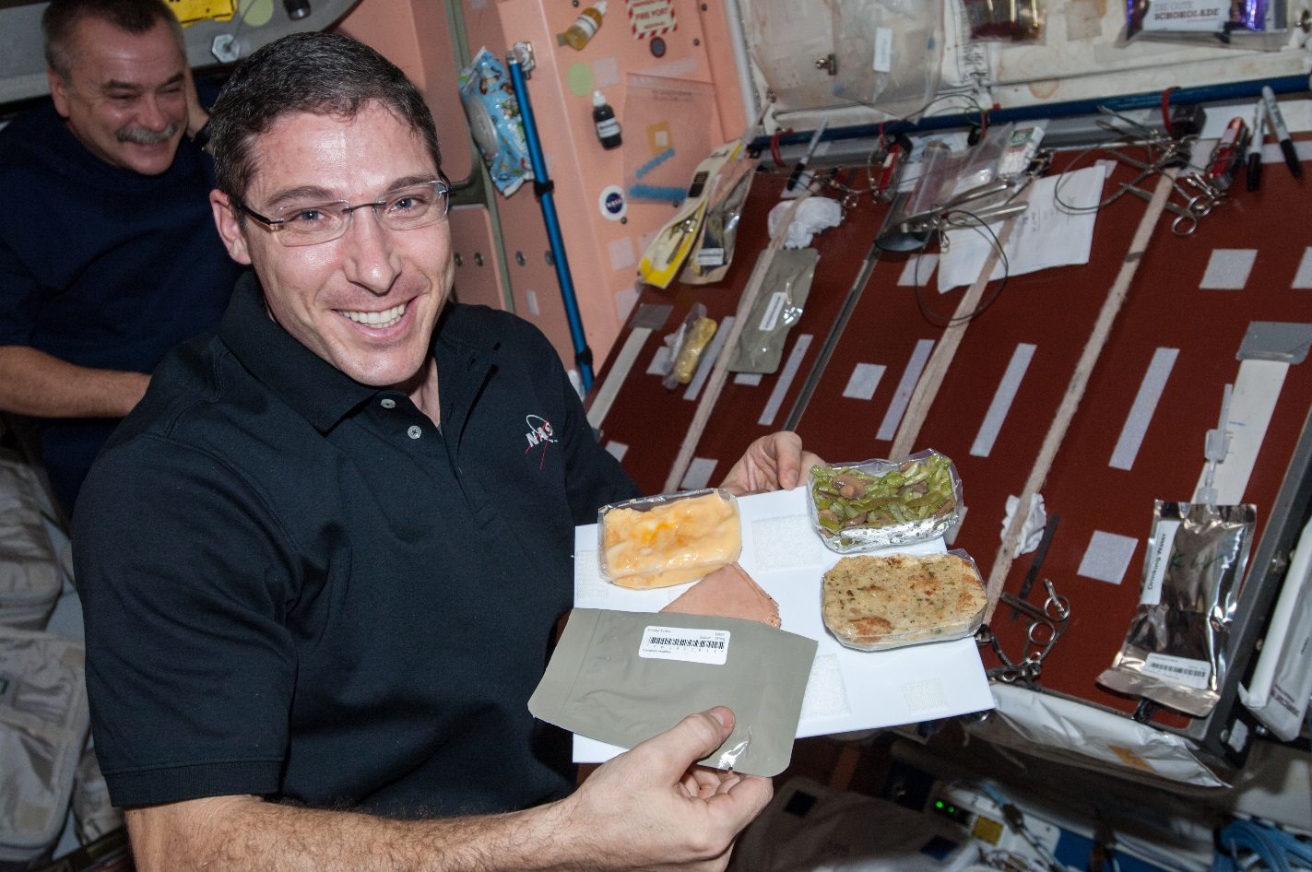
Why grow plants in space?
Food
Psychological well being
Atmosphere
Water

Slide 3
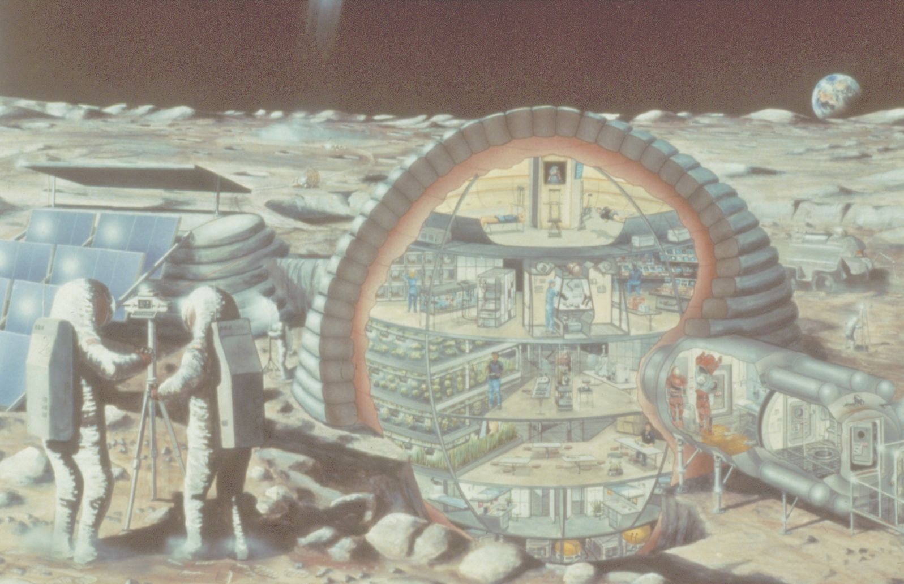

Slide 4
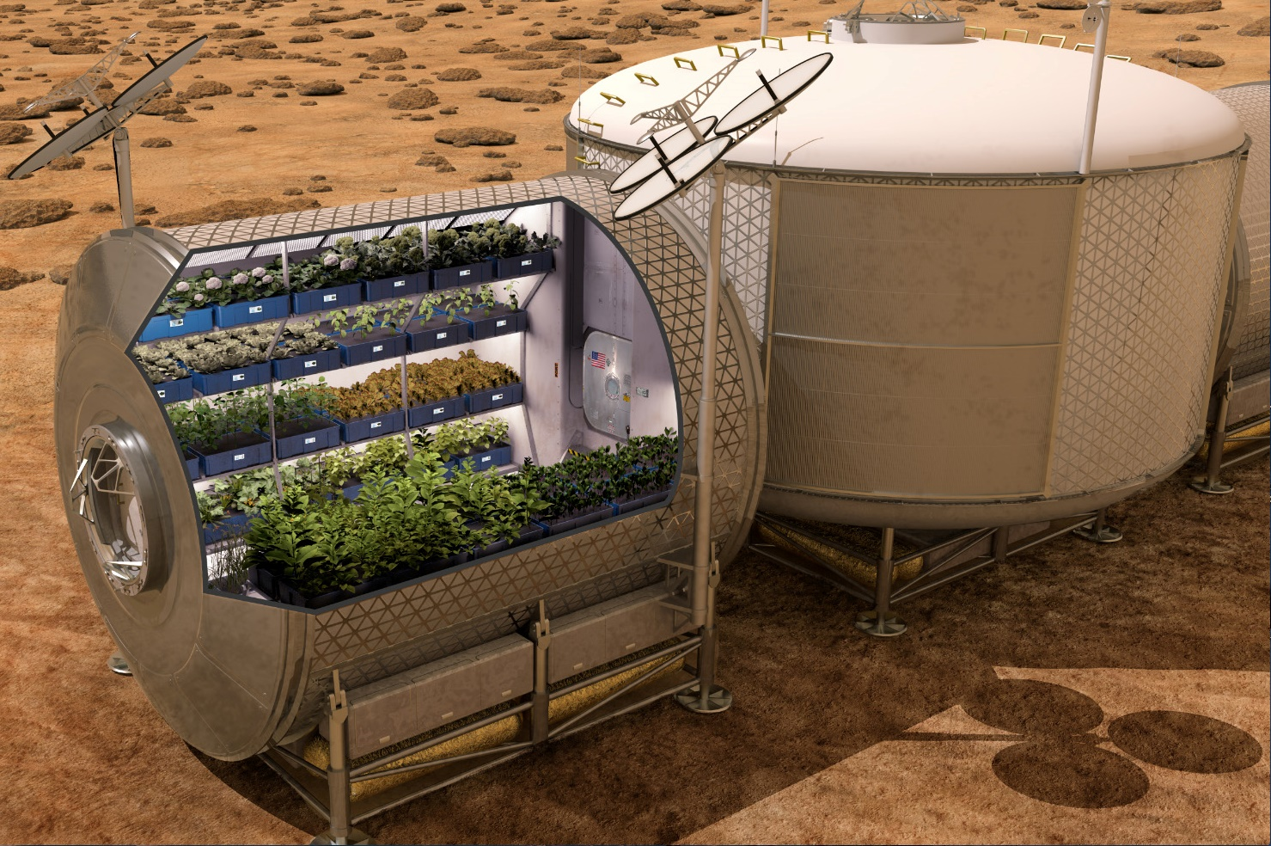

Slide 5
The Space Crop Production Vision
Ensure Food System Security on Long Duration Missions Beyond LEO
Near-Term Goal
Nutrient Supplementation of Prepackaged Food
Long-Term Goal
Caloric Replacement to Facilitate Earth Independence
Notes:
Ralph
Ensure Food System Security on Long Duration Missions Beyond Low Earth Orbit (LEO)
Food and nutrition are the first line of defense for crew health and performance
Provide safe, nutritious and acceptable fresh food
Add variety to crew diet
Enhance morale
* Food security is the condition in which crew have continuous access to sufficient safe and nutritious food which meets both their dietary needs and food preferences in order to maintain peak health and performance.
Nutrient Supplementation of the Prepackaged Food System - Needed for: Deep Space Transport
Fresh produce supplements vitamins (B₁, K, C) and bioactive compounds that degrade in the stored food system on multi-year exploration missions
“Pick-and-Eat” crops that require no processing and minimal preparation will provide variety, customization, and psychological appeal
Enable testing and demonstration of dependable crop production before reliance on system.
Limiting factors are vehicle resources mass, power, volume, water, air, crew time
Caloric Replacement to Facilitate Earth Independence - Needed for: Long duration Surface missions on the Moon and Mars
Reduce up-mass associated with pre-packaged food
In addition to “pick and eat” crops, include staple crops that require processing and preparation
Bioregenerative capability will be required for long duration surface missions

Slide 6

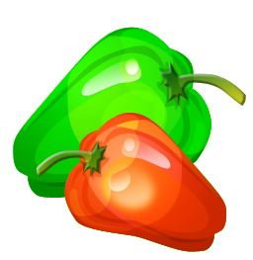
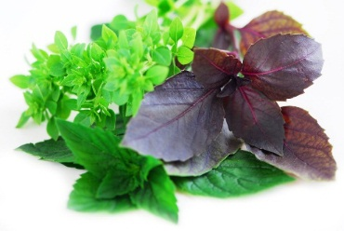
Space Crop Production Candidates
Salad
Leafy Greens
Tomato
Pepper
Radish
Strawberry
Green Onion
Pea
Carrot
Lettuce, Chinese cabbage, Swiss chard, Mizuna, Spinach
Staple Crops
White Potato
Sweet Potato
Rice
Wheat
Dried Bean
Soybean
Peanut
MINIMAL PREPARATION / COOKING
SIGNIFICANT PREPARATION / COOKING
CONSUMED FRESH WITHOUT PROCESSING
Herbs
Basil
Mint
Chives
Dill

Slide 7

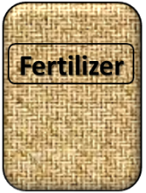

Plant Growth and the Environment
5 Cardinal Factors of Plant Growth…..
O₂

Slide 8
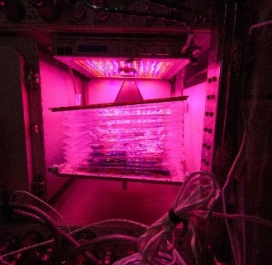
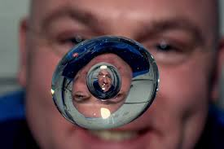

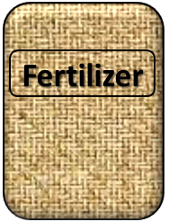
The Space Environment
….and how these work with and without Gravity!
Humans like white light, but plants may grow well with other wavelengths
No convection in space so need to mix the air
O₂
Water forms a ball, and water and air don’t mix well, and roots need both!
Fertilizer is heavy to launch so we need to learn how to recycle plant waste

Slide 9
Space Crop Production Challenges
Deep Space
Water
Recycling
Radiation
Pressure
Micrometeorites
Surface
Microgravity
Fluid movement
No convection
Dust
Partial gravity
Plant Size
High CO₂
Food Safety
Nutrient output
Sustainability
Abiotic stresses
Vehicle resources
Crew time
Waste
Productivity
Stress tolerance
Environmental optimization
Crop scheduling
Crop

Slide 10
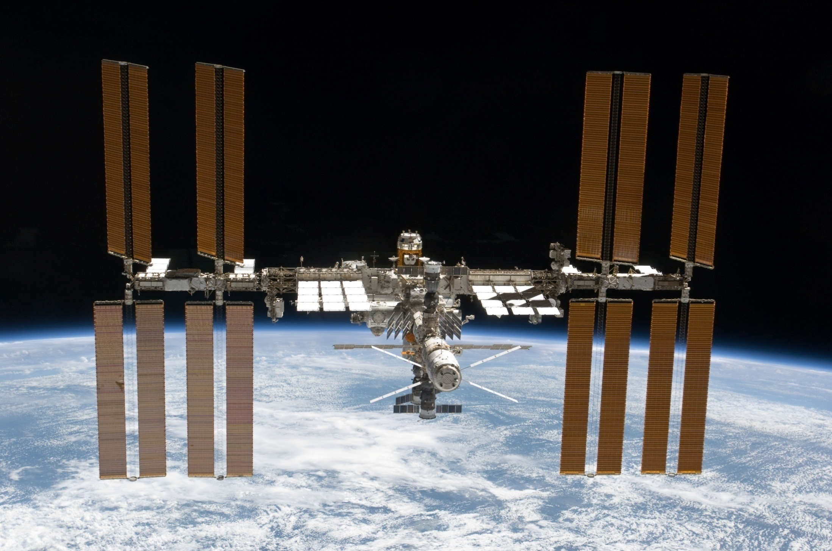
The International Space Station

Slide 11
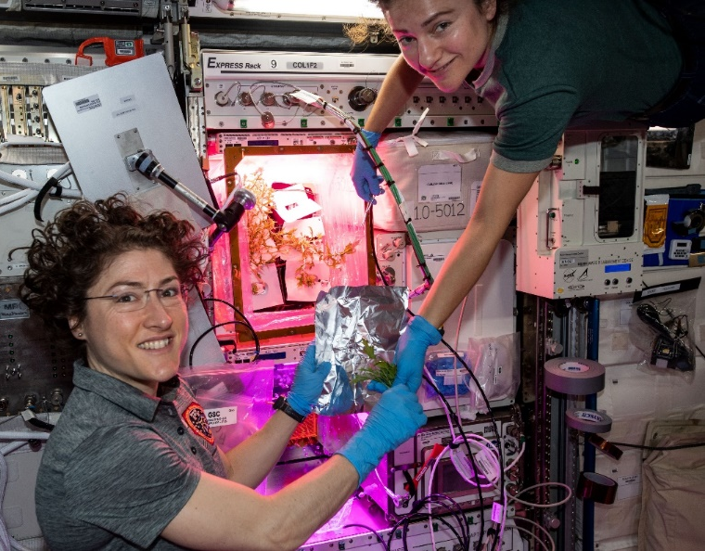
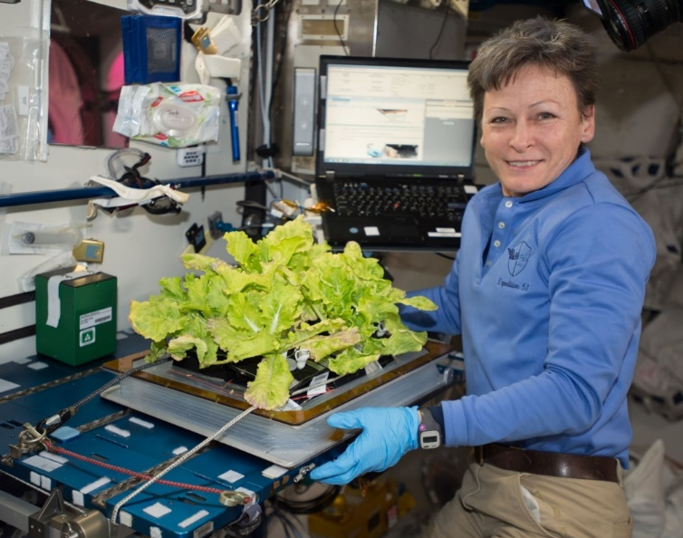

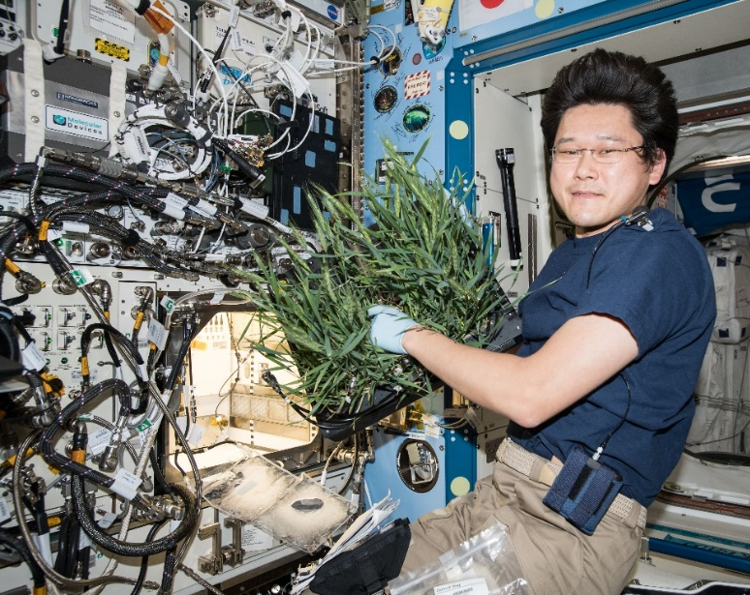
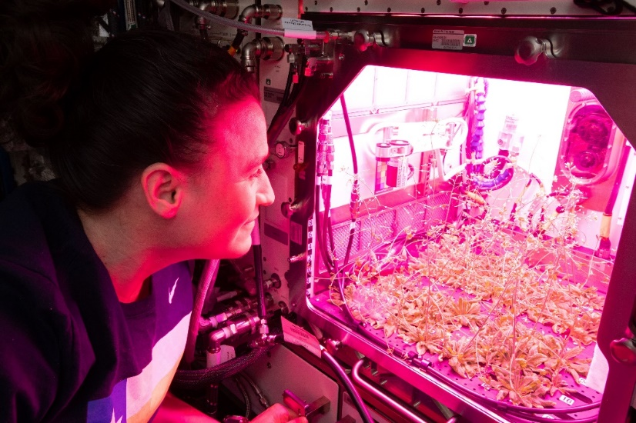

Current NASA Large Plant Research Capabilities
On ISS
Credits: NASA
Notes:
Veggie and the Advanced Plant Habitat

Slide 12
Crop Production Challenge
Identify and demonstrate effective options to provide both water and oxygen to the root zone in microgravity

Slide 13
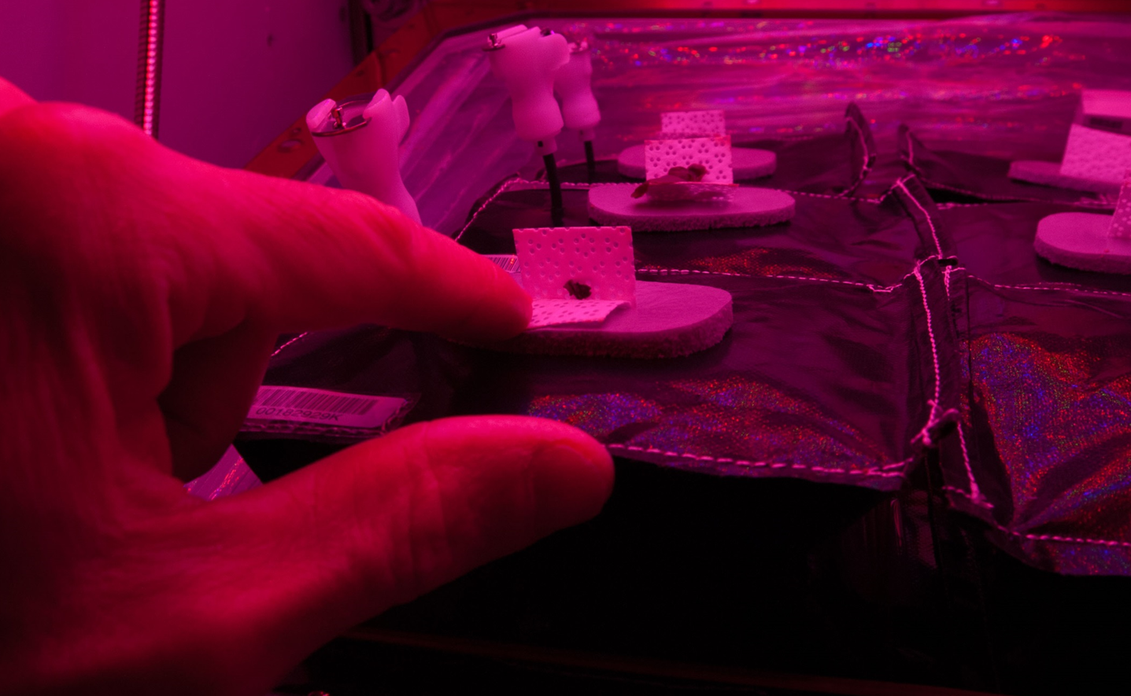
Root Zone Water – Insufficient

Slide 14
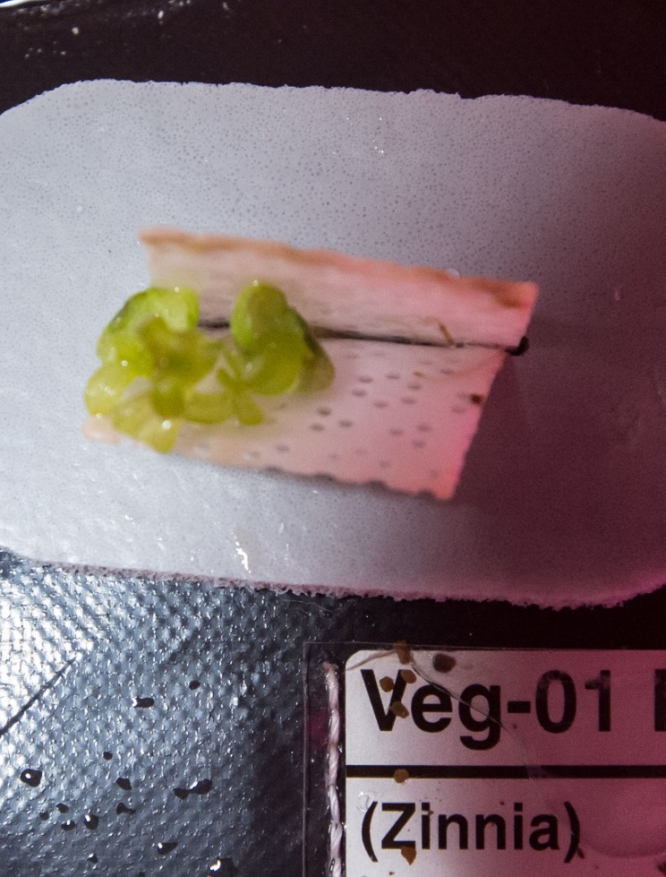
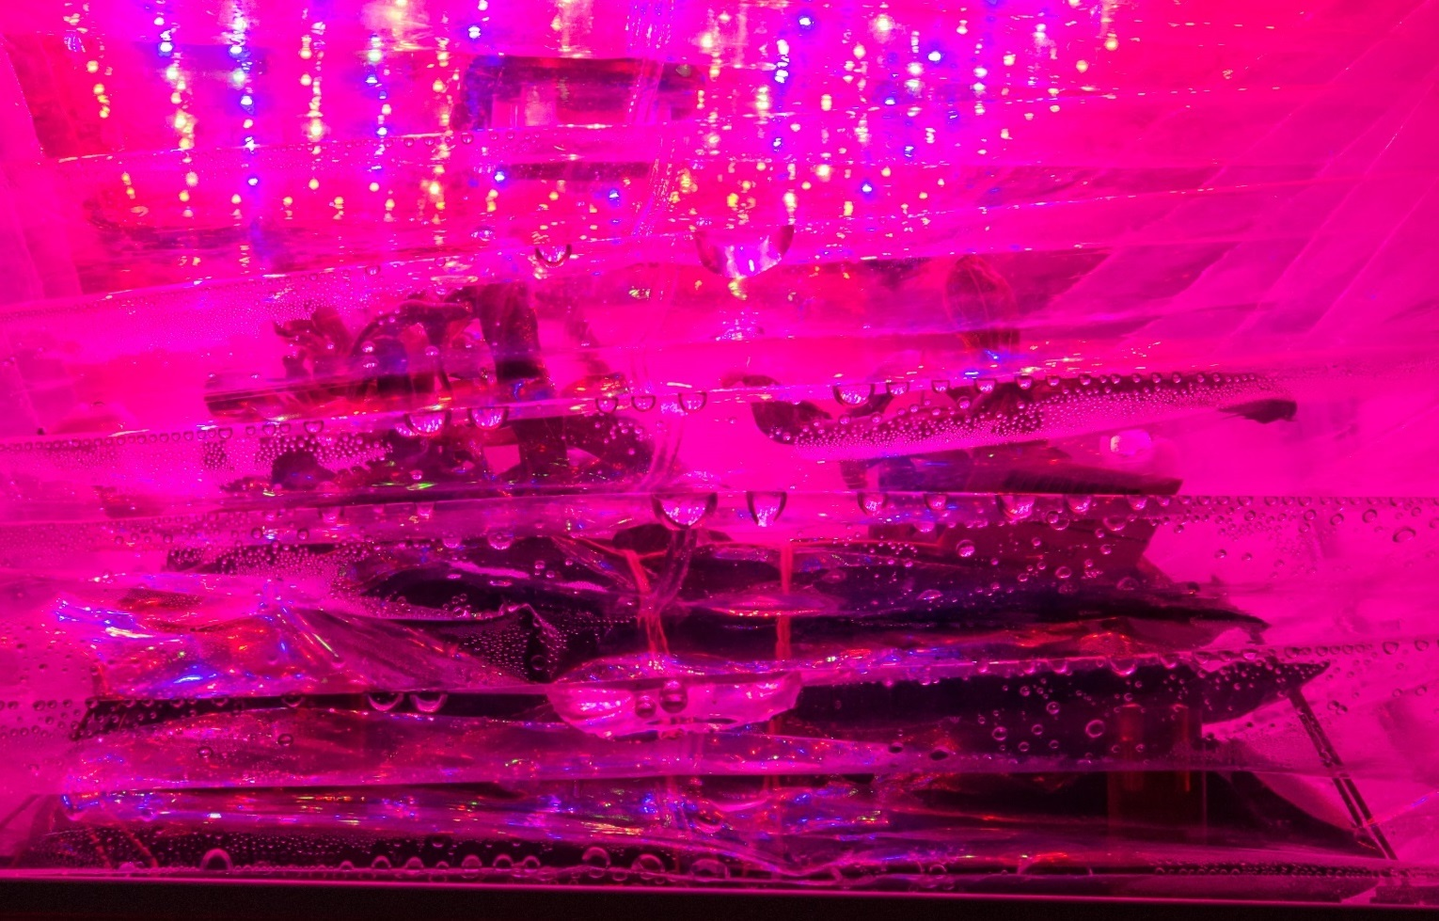
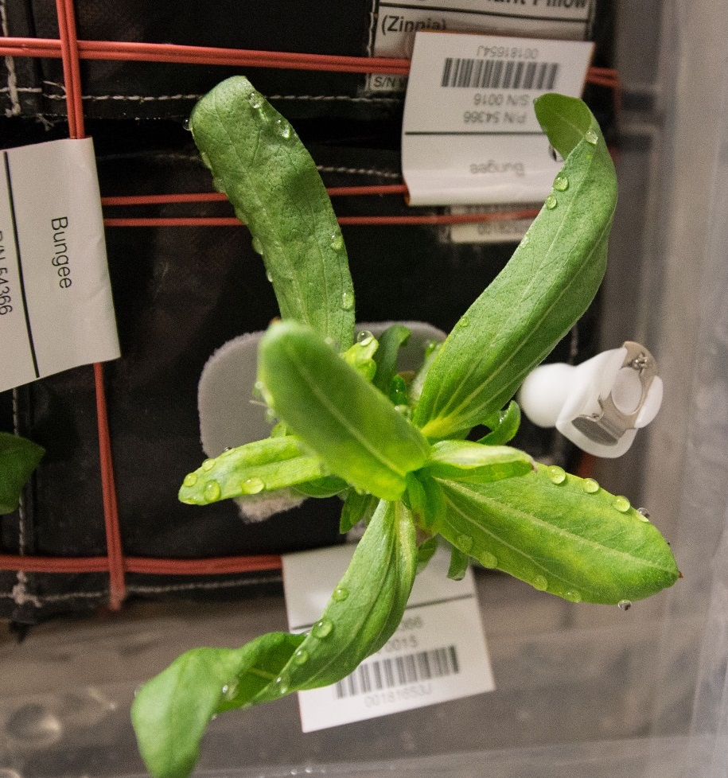
Root Zone Water – Excess
Stunting and Chlorosis
Condensation on Bellows
Guttation and Leaf Curling
Notes:
Condensation on Bellows
Stunting and Chlorosis
Guttation and Leaf Curling
Abnormal Growth
=> Challenge: Identify and demonstrate effective options to provide both water and oxygen to the root zone in microgravity.

Slide 15
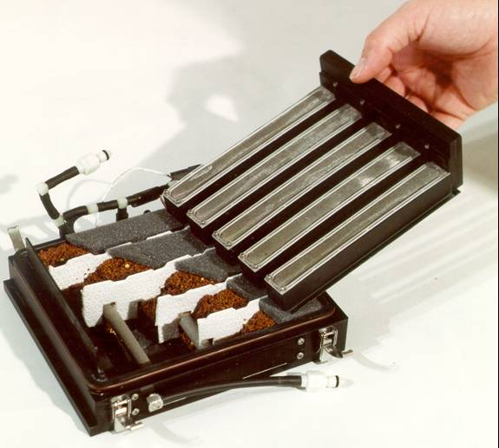
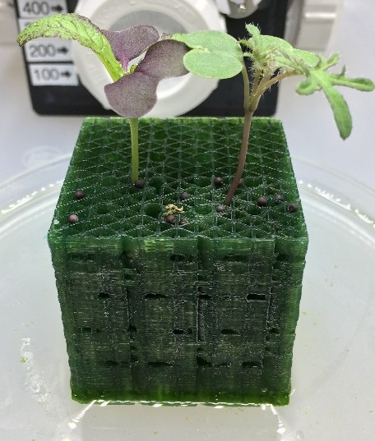
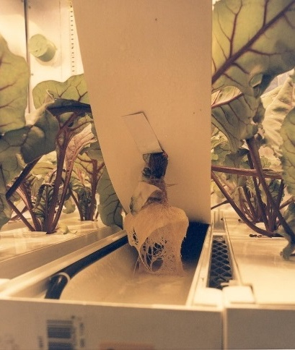
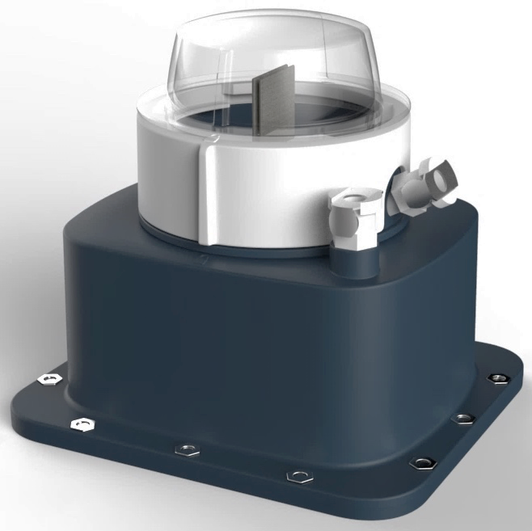
Current and Future Activities
  Testing in ground-based Crop Production Demonstration Unit test bed to evaluate and compare candidate solutions
  Testing active and passive concepts
  Collaborative work between plant scientists, microgravity fluid physicists, and engineers, with student engineering design teams and the maker community also participating
Veggie PONDS
Howard G. Levine PhD, Inventor (Patent Pending)
Image courtesy of Techshot
and Tupperware Brands

Slide 16
Crop Production Challenge
Investigate the relationship between microbiomes and food safety:
  Effectively sanitize produce with few consumables and low inputs
  Monitor and control biotic stresses and pathogens
  Use the microbiome to protect crops or enhance growth

Slide 17
Veggie Microbiology
Food Safety
NASA standards for non-thermostabilized food

Slide 18
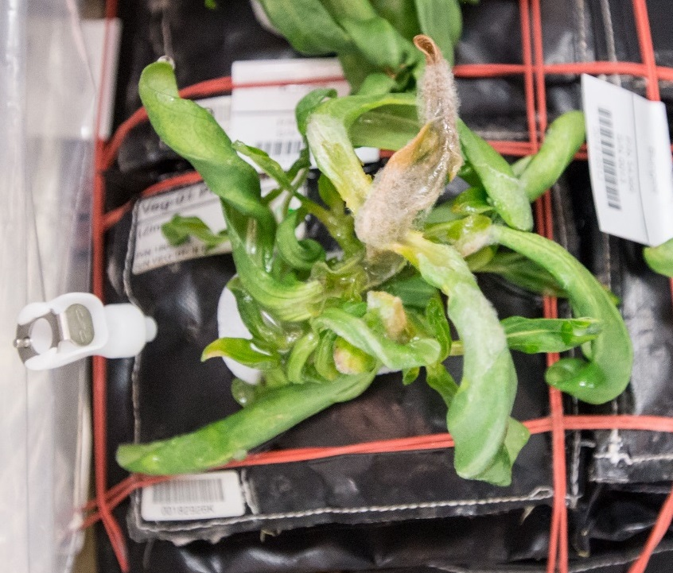
Veggie Microbiology
Plant Pathogenesis

Slide 19
Veggie Microbiology
Microbiome analysis

Slide 20
Current and Future Activities
Conducting ground-based microbial food safety and microbiome testing of candidate crops
Developing fresh produce food safety standards for space
Developing Hazard Analysis Critical Control Points (HACCP) and plant pathology plans for space crop production
Investigating non-destructive remote monitoring methods for plant health and contamination
Looking at use of on orbit resources when applicable
Develop a custom microbiome to promote and protect plants

Slide 21
Crop Production Challenge
Storage and handling of seeds to ensure they are viable, free of contaminants and long-lived

Slide 22
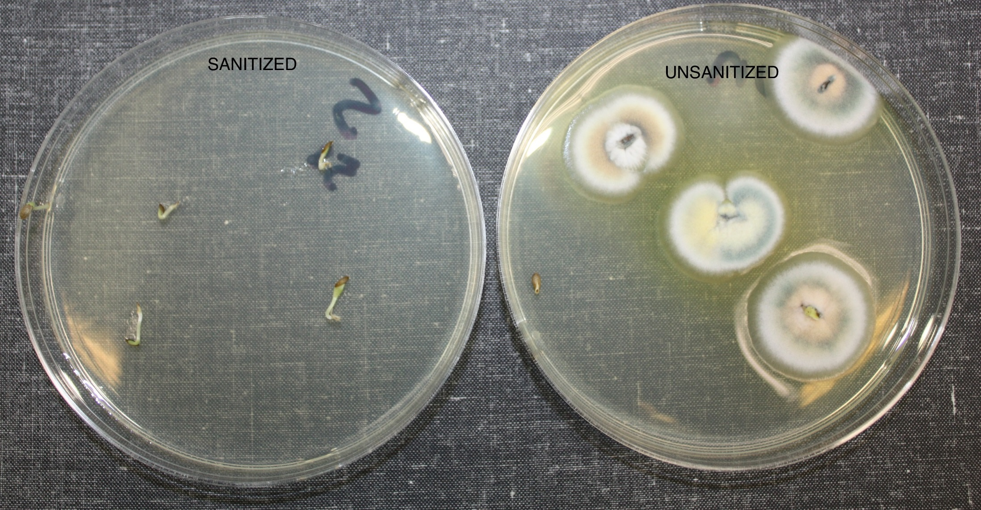
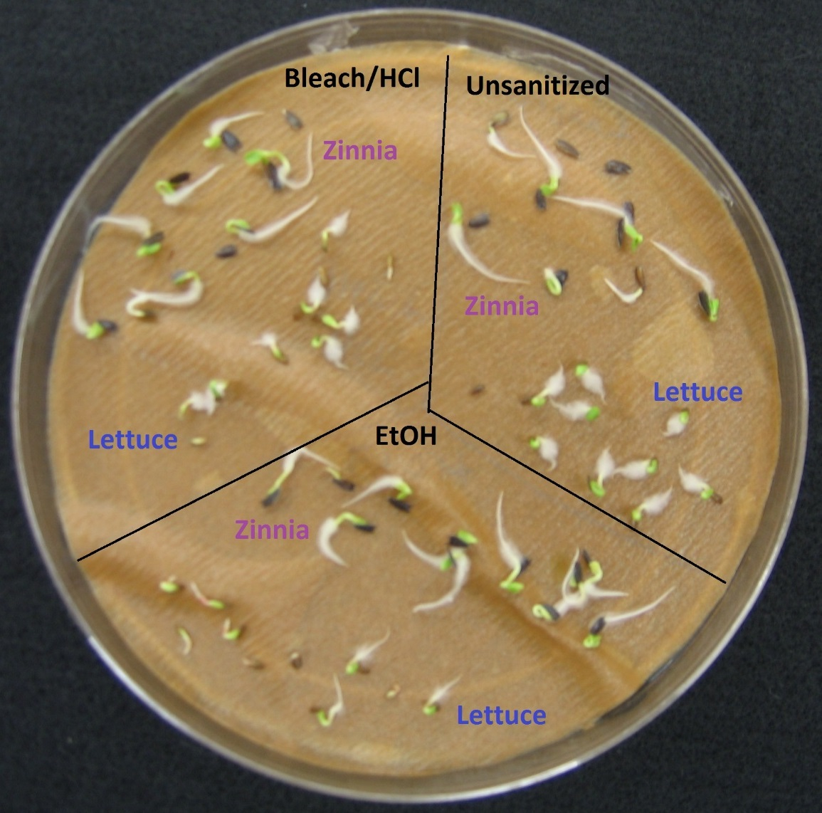
Veggie Microbiology
Seed Sanitizing

Slide 23
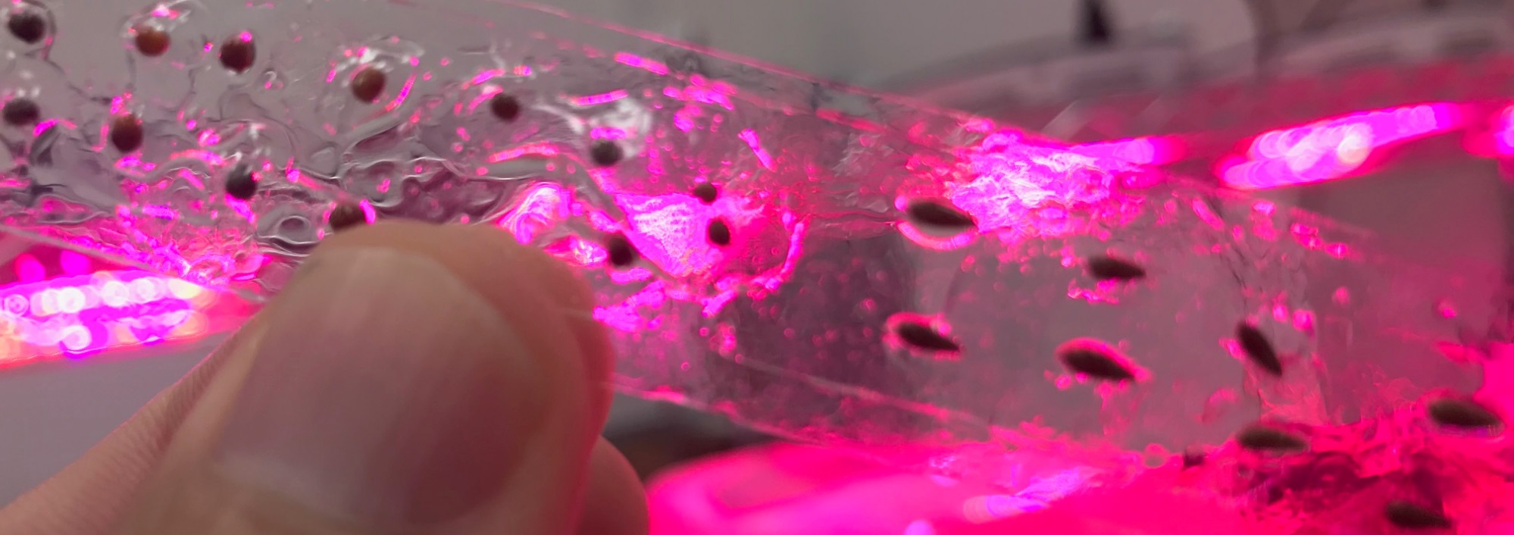
Current and Future Activities
Testing each new seed type with different sanitation approaches (chlorine gas, ethanol, plasma)
Learning from commercial growers and seed producers
Testing methods to handle seeds with ease and store appropriately in microgravity
Seed in films growing now on ISS!

Slide 24
Crop Production Challenge
Identify potential crops:
  Yield, nutrition, organoleptic attributes, psychosocial benefits
  Determine light recipes, elevated CO₂ impacts, fertilizer requirements, etc.

Slide 25
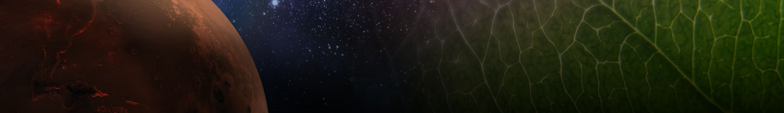
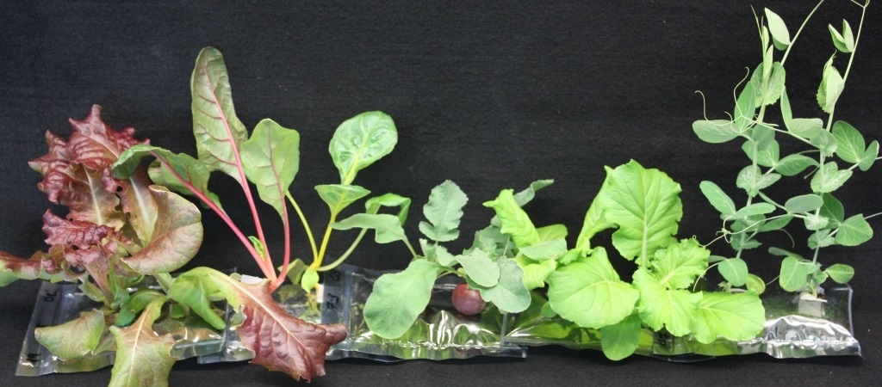
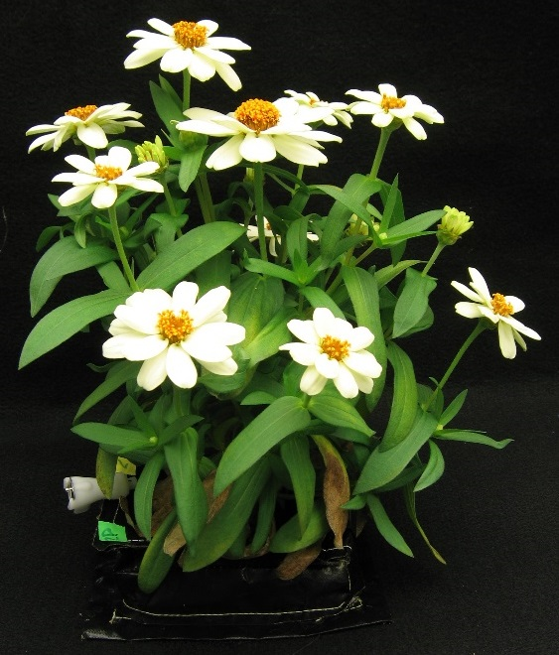
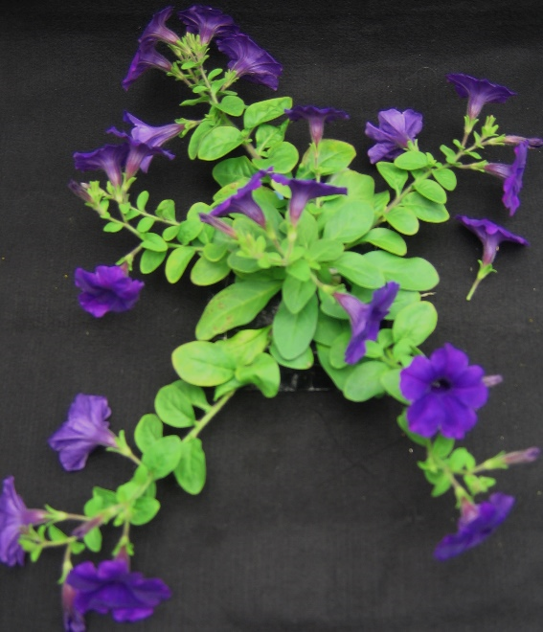
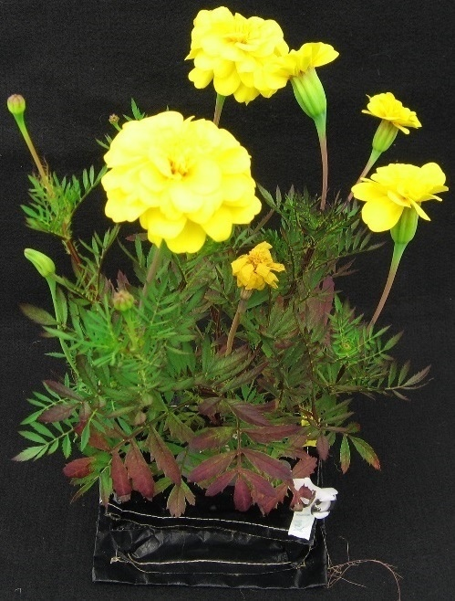
Example crops tested in plant pillows
Snow pea
Swiss chard
Red lettuce
Dwarf
Chinese
cabbage
Radish
Zinnia
Petunia
Marigold

Slide 26
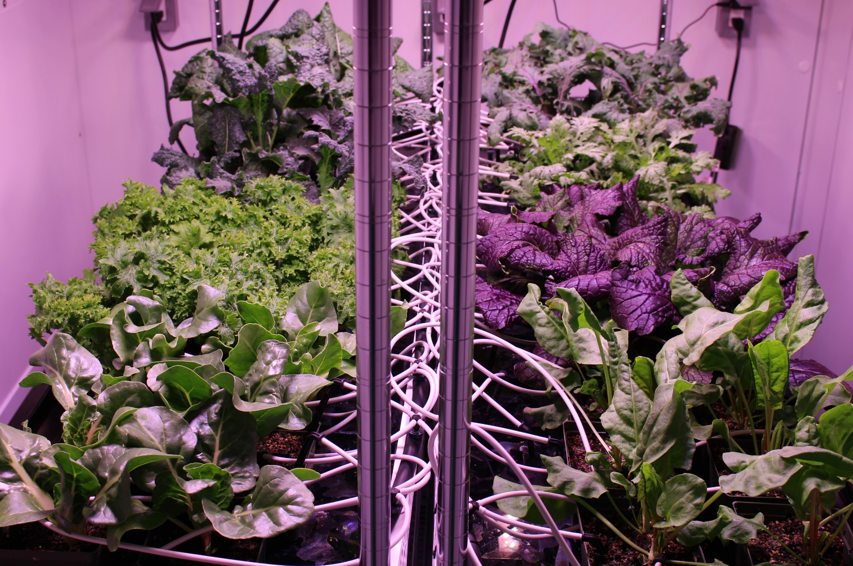
New Crop Testing at KSC

Slide 27
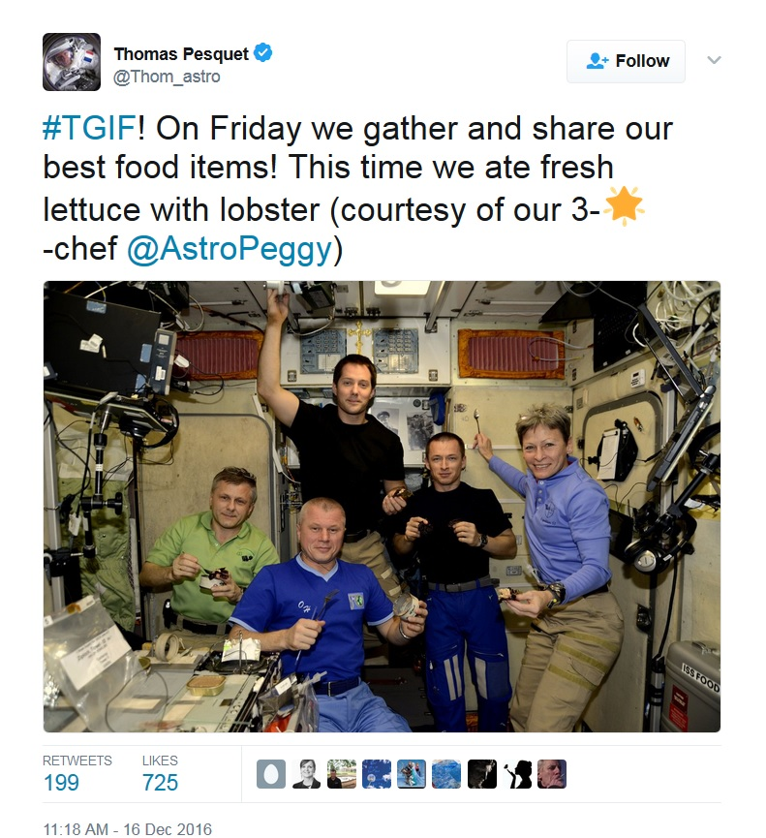
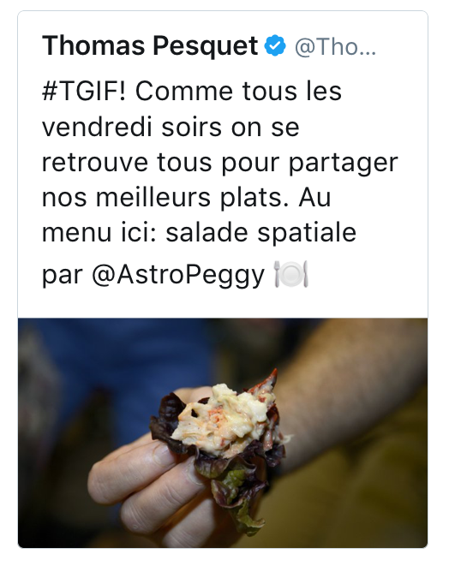
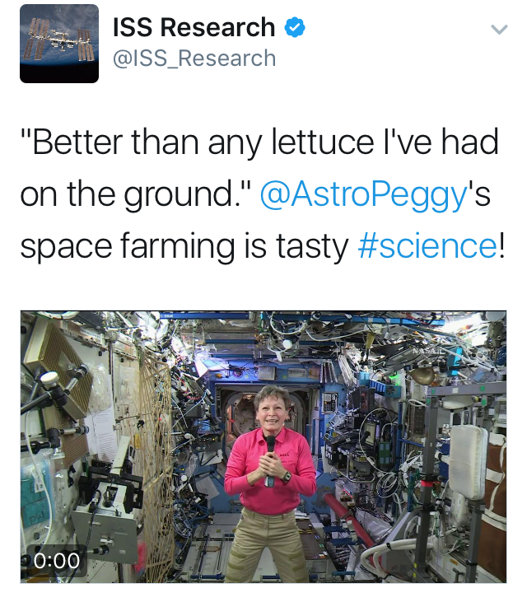
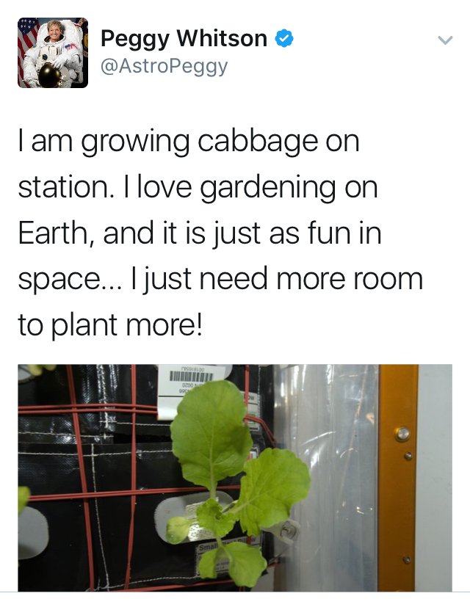
Happy Crew

Slide 28
Current and Future Activities
Assessing new crop candidates:
  Preliminary screening at >230 middle and high schools in Fairchild Garden’s Growing Beyond Earth Challenge
  Down-selected varieties are tested in high-fidelity environments at KSC
  Two student-selected varieties have flown in Veggie
Recent, current, and upcoming experiments (VEG-03, VEG-04, VEG-05, PH-04) include psychosocial and organoleptic evaluations to measure plant and produce impacts on microgravity life
Identifying selection factors and breeding custom space plants

Slide 29
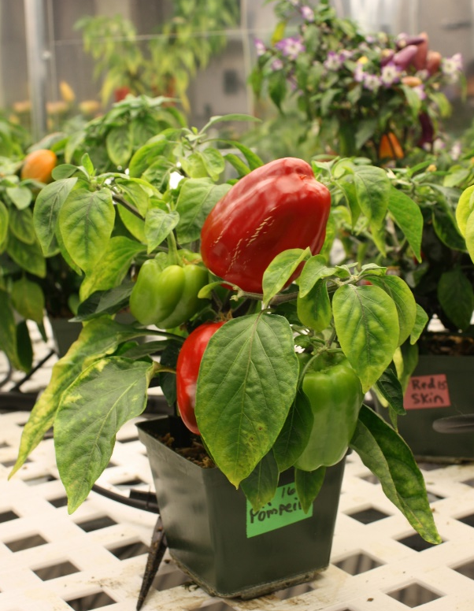
Selection Factors for Space Plants
Targeted breeding areas could fall into several categories:
Plant Growth and Development
Plant Physiology
Produce Nutrition
Produce Organoleptic Acceptability
Postharvest

Slide 30
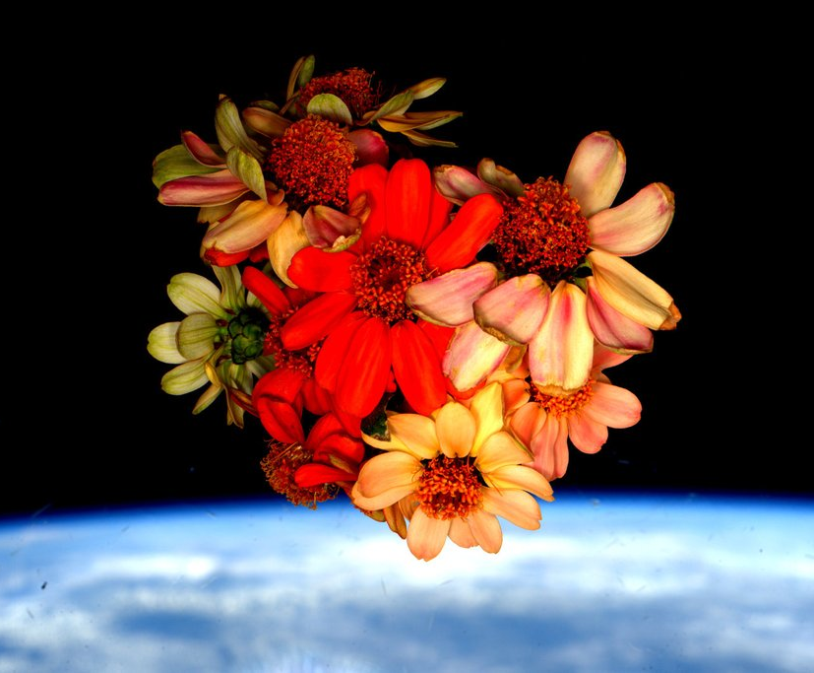
Thank you!
Veggie and Space Crop Production teams
Astronauts Steve Swanson, Rick Mastracchio, Scott Kelly, Kjell Lindgren, Shane Kimbrough, Peggy Whitson, Jack Fischer, Joe Acaba, Scott Tingle, Serena Auñón-Chancellor, Alex Gerst, Anne McClain, David Saint-Jacques, Christina Koch, Nick Hague, Drew Morgan, Jessica Meir, Kate Rubins, Mike Hopkins, Shannon Walker
NASA’s Space Biology Program, ISS Program, Human Research Program

Slide 31

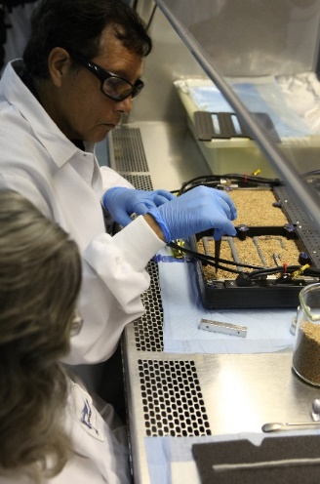

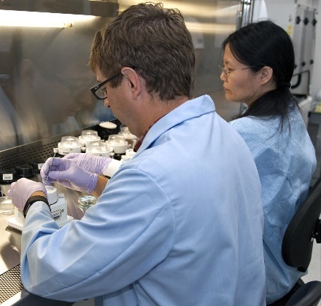
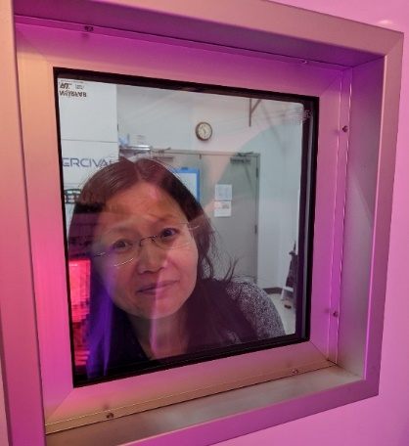
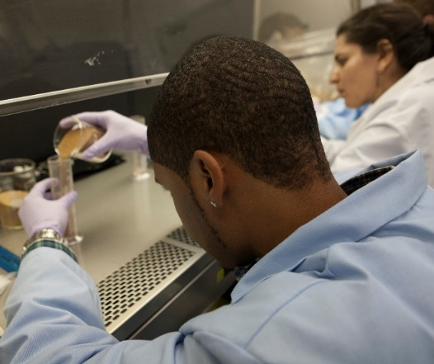
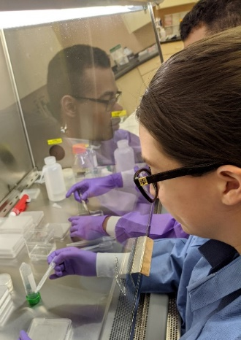
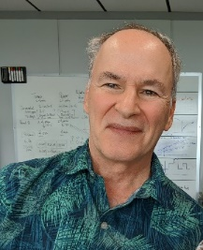
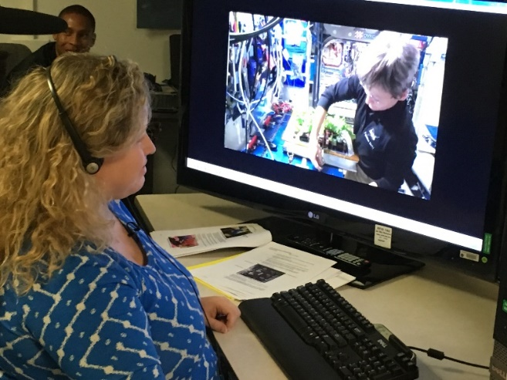
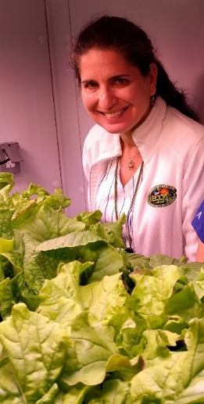
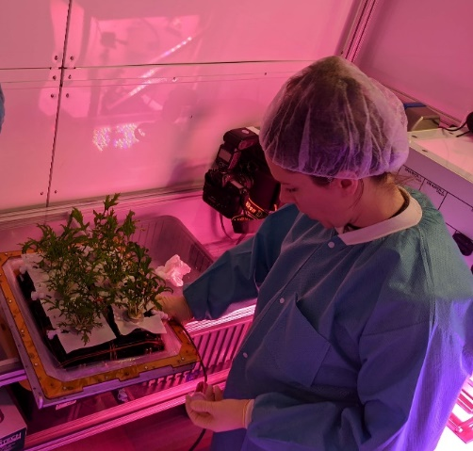
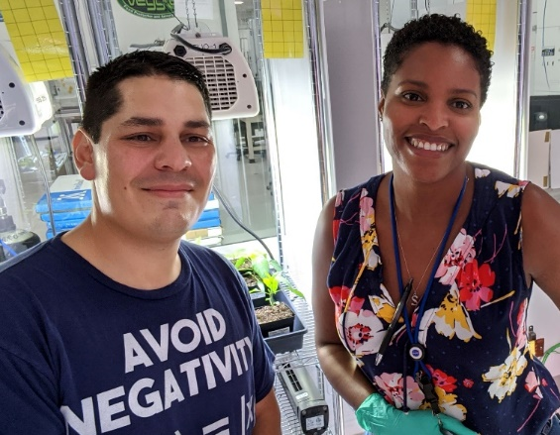
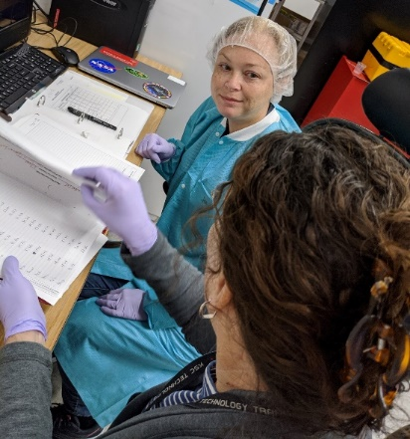

Slide 32
Backup

Slide 33
Plant Growth and Development
Compact size (low height and volume)
High yield
High edible/inedible biomass ratio (harvest index)
Reliable germination
Rapid growth to first yield
Uniform growth and development between individuals
Propagules with long shelf stability (seeds, cuttings)
Sustained production capability over long duration (e.g. repetitive fruiting, or cut-and-recut leafy production)
Low debris formation (leaves, flowers, pollen, seeds, etc., remain attached)
Custom microbiome of plant protective and growth promoting microorganisms

Slide 34
Plant Physiology
Stress tolerance (esp. water stress)
Ability to grow well under conditions of:
  Elevated CO₂
  Low relative humidity
  Uniform temperature of 20-23°C
  Narrow spectrum electric lights
  Short photoperiods (to save lighting energy)
  Tolerance of broad environment range
  Tolerance of reduce pressure
No dormancy requirements
Low or pleasing aroma
Low release of volatile organics
High sodium tolerance (e.g. urine recycling)
Preference for ammonia nitrogen sources (e.g. urine recycling)

Slide 35
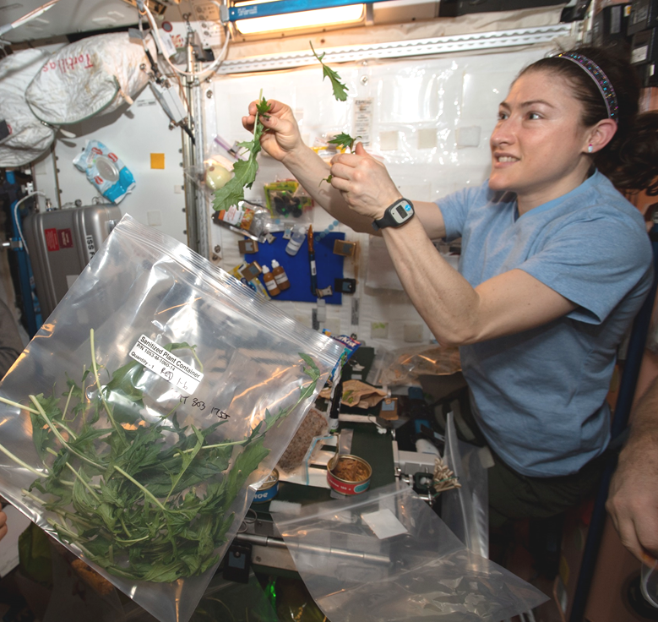
Produce Nutrition
High normal levels of antioxidants
High normal levels of beneficial phytonutrients (e.g. lutein, zeaxanthin, lycopene, phenolics, anthocyanins)
For fresh produce to supplement a packaged diet:
  High normal levels of Potassium and Magnesium
  Low normal levels of Iron
  High normal levels of Vitamins, especially C, B₁, and K
Low levels of antinutrients

Slide 36

Produce Organoleptic Acceptability
Postharvest
Excellent flavor
Intense flavors
Good texture
Good appearance, color, aroma
Good produce shelf life or storage on the plant
Reduced processing – e.g. seeds easy to remove from seed coats
Easy composting/digestion of inedible plant material for nutrient reclamation (and possibly less structure in micro/partial g)
Use of inedible waste as resources for other food system components (e.g. fish, edible fungus, cellular ag feedstocks)
Other useful materials produced from inedible waste (e.g. life support, shielding, building, fuel)

