Slide 1
Candidate Formulary Development For Exploration Missions
Human Research Program
Exploration Medical Capability Element
February 2, 2021
Sincy Kurian, PharmD, RPh
Tina Bayuse, PharmD, RPh
Rebecca Blue, MD
Dana Levin, MD
“Expanding the Boundaries of Space Medicine and Technology”

Slide 2

Agenda
Objective
Background
Approach
Output
Challenges & Limitations
Lessons Learned

Slide 3
Objective
Create a draft exploration formulary, tracing medical conditions and capabilities documented in SysML* models reflecting Level of Care IV and V medical systems
  *SysML – Systems Modeling Language
Notes:
SysML: ‘A model-based systems engineering tool (MBSE) used by the [ExMC] element to enable technical communication through the use of shared mental models of the medical system, consistent notation, and integrated datasets……SysmL specifically is being utilized to provide a controlled common model of the medical system and requirements definition activities.’
Mindock, J., Reilly, J., Rubin, D., et al. Systems Engineering for Space Exploration Medical Capabilities. (2017). AIAA SPACE Forum.
See paragraph B for above quote context and more info – Systems Engineering for Space Exploration Medical Capabilities (nasa.gov) https://hrp.sp.jsc.nasa.gov/exmc/SE/Papers_presentations/Mindock_MedSysEng_AIAASPACE2017.pdf

Slide 4
Background
Design Reference Mission Informs the Medical System “Level of Care”
Level of Care 4:
  “Moderate to high level of potential risk…medical issues beyond routine ambulatory medicine… Preventive strategies shall be used to a greater degree to reduce the overall risk … The ability to support chronic illness is limited…”
  Semi-autonomous operation
  Intended for missions of long duration
  Evacuation is possible but extended (days)
Level of Care 5:
  “A high level of potential risk exists that personnel may experience medical problems…Preventive strategies shall be used to a greater degree to reduce the overall risk. The ability to support chronic illness is limited… including increasing levels of autonomous advanced care…The training and skill of the caregiver shall be at the physician level…
  Autonomous operation
  Long duration missions
  Limited or impossible evacuation

Slide 5
Background
Definitions:
Condition: Medical diagnosis or symptom
Capability: Action provided by a caregiver to address a condition
Resource: Tangible and intangible assets (skills/training/crew time/just in time training) used for the management (diagnosis, treatment, prevention, long term management) of a given condition or of a planned activity.
Notes:
Definitions source: Medical System Foundation for Level of Care IV: Short-Duration Lunar Orbit HTML Report Medical System Level of Care IV Foundation (nasa.gov)

Slide 6
Approach
This effort began by using a subject matter expert (SME) generated Exploration Medical Conditions List and the associated medical system capabilities necessary to treat them
Using the systems engineering software MagicDrawTM and knowledge of pharmaceutical use and efficacy in spaceflight, the team traced appropriate medications to the medical conditions
These traces were used to pilot the process for generating a candidate formulary for level of care 4 and level of care 5 medical systems
The medications in this database will reflect the medications listed in the pharmaceutical information database

Slide 7
Approach
Level of Care 4 & 5 condition → capability → resource allocations were made in Magic Draw by ExMC physicians
SME clinical pharmacy operations team (after collaborative discussion with ExMC physicians) provided input for pharmaceutical care related content by using current clinical practice guidelines and refining the spreadsheet to reflect best practices according to spaceflight

Slide 8
Output
The refined traced lists exported from Magic Draw are used to produce reports showing the following relationships:
  Drug→Condition
  Condition→Drug
  Drug→Capability
  Capability→Drug
Notes:
https://hrp.sp.jsc.nasa.gov/exmc/cst/Pharm%20Documents/Forms/AllItems.aspx?RootFolder=%2Fexmc%2Fcst%2FPharm%20Documents%2FPharm%20FY20%20Deliverables%2FFormulary%20%5FFY20%20Deliverables&FolderCTID=0x01200028C15FD4CF51B1429ABD5C597EF42729&View=%7B2C093AB0%2DF19B%2D48BA%2D8C1B%2DC35E1996219E%7D

Slide 9
Output
Pharmaceutical → Condition
*PARTIAL RELATIONSHIPS PROVIDED FOR EXAMPLE PURPOSES ONLY.

Slide 10
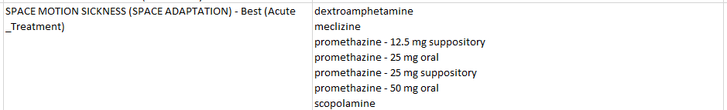
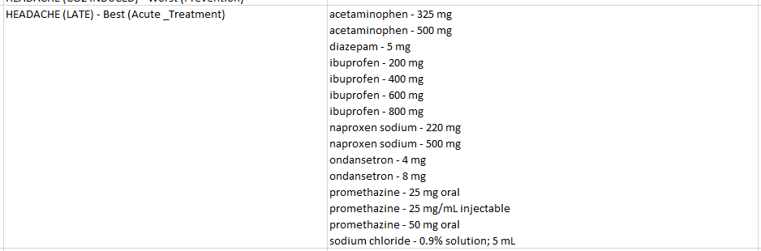
Output
Condition → Pharmaceutical
*PARTIAL RELATIONSHIPS PROVIDED FOR EXAMPLE PURPOSES ONLY.
Notes:
*PARTIAL RELATIONSHIPS PROVIDED FOR EXAMPLE PURPOSES ONLY.

Slide 11
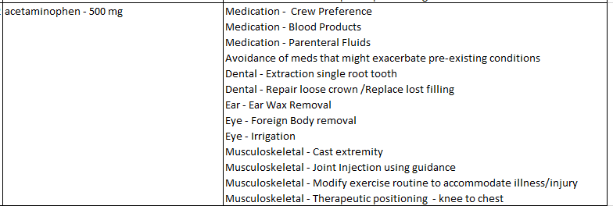
Output
Pharmaceutical
→ Capability
*PARTIAL RELATIONSHIPS PROVIDED FOR EXAMPLE PURPOSES ONLY.

Slide 12
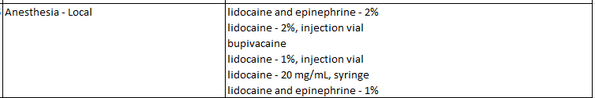
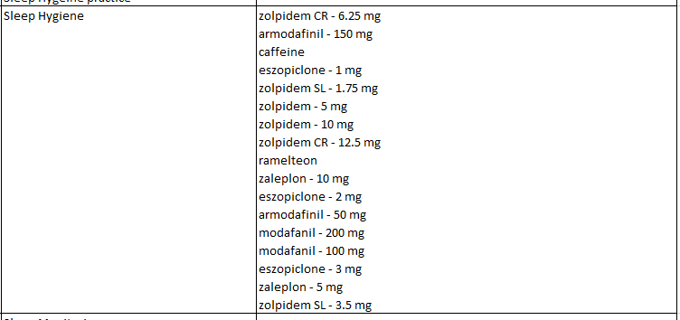
Output
Capability → Pharmaceutical
*PARTIAL RELATIONSHIPS PROVIDED FOR EXAMPLE PURPOSES ONLY.
Notes:
Meds highlighted in red text are LOC V only

Slide 13
Challenges/Limitations
Challenging user interface to assess and input data
Extensive mapping of data resulting in large time commitment and potential for errors
  Existing list contains >100 conditions (with both best & worst cases)
Condition definitions make it difficult to neatly assign medications, especially when the definitions are quite broad
Not all applicable medications were included in the list – SME pharmacist team provided additions accordingly
Split time: the entire SME team of physicians and pharmacists had to work on this separately

Slide 14
Lessons Learned
Inconsistency in recorded data
  (e.g. not every medication has a strength/dosage form listed with it)
Live communication works best
  Working on this simultaneously would have been more productive instead of having to email the large data set back & forth
Multiple disciplines looking at the data made it overall well-rounded (including multiple perspectives)

Slide 15
References
Antonsen, E., Hailey, M., Reyes, D., Urbina, M. Interpretation of NASA-STD-3001 Levels of Care for Exploration Medical System Development. (2017).
Medical System Foundation for Level of Care IV: Short-Duration Lunar Orbit HTML Report Medical System Level of Care IV Foundation (nasa.gov)
Mindock, J., Reilly, J., Rubin, D., et al. Systems Engineering for Space Exploration Medical Capabilities. (2017). AIAA SPACE Forum.

Slide 16

Questions?
https://slidewiki.org/deck/111329/_/slide/726079-4/726079-4:16/view?locale=el

