Slide 1
Assessment of RANS-based Transition Models in NASA’s CFD Codes: FUN3D
Nathaniel Hildebrand, Preethi V. Mysore, Christopher L. Rumsey,
Jan-Reneé Carlson, and Meelan M. Choudhari
Computational AeroSciences Branch
NASA Langley Research Center
Balaji S. Venkatachari
National Institute of Aerospace
1st AIAA CFD Transition Modeling and Prediction Workshop
January 21-22, 2021
Computational AeroSciences Branch

Slide 2
FUN3D transition models
Suite of codes known as FUN3D is a node-centered unstructured-grid upwind-biased RANS code (Anderson & Bonhaus 1994)
RANS-based transition models
Refer to (Langtry & Menter 2009/2015)
Coupled with SST1994, SST2003, and SST-V
LM2009 transition model
Models natural, bypass, and separation-induced transition
LM2015 transition model
Models stationary crossflow using a correlation based on surface roughness
Ongoing work to implement SST2003-LM2009-CFHE transition model
Local helicity approach of (Grabe et al. 2018)
Preliminary results with unstructured grid adaption techniques using the sketch-to-solution code developed by (Park 2008)
2/9

Slide 3
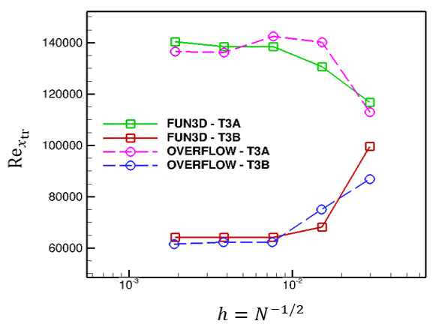
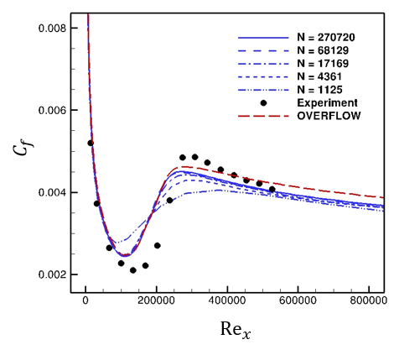
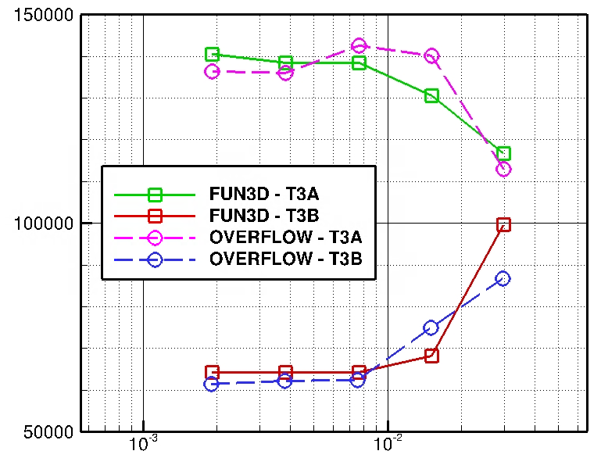
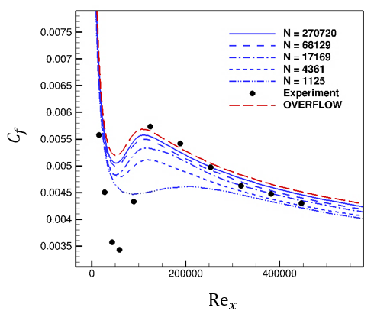
Case 1: Zero-Pressure-Gradient Flat Plate (2D)
FUN3D: SST-V-2003-LM2009
OVERFLOW: SST2003-LM2009
$$M$$ | $$α$$ | unit $Re$ | $$T_{ref}$$
0.2 | 0 | 2e5 | 540 R
T3A
No sustaining turbulence
T3B
$${Re}_{x_{tr}}$$
T3A: $I=5.855\% \&$
$μ/μ_{t}=1$1.9
T3B: $I=7.216\% \&$
$$μ/μ_{t}=99$$
3/9

Slide 4
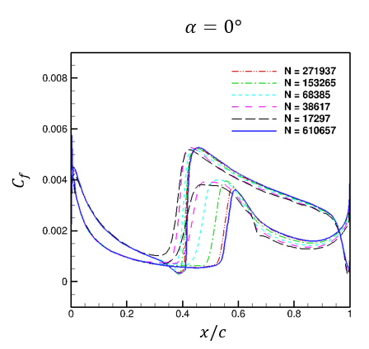
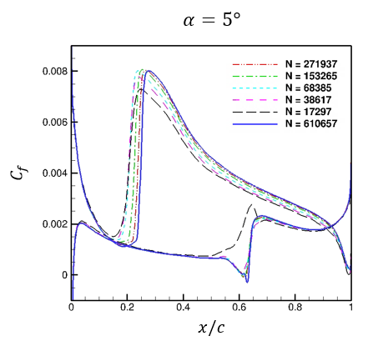
Case 2: NLF(1)-0416 Airfoil (2D)
SST2003-LM2009 transition model
Sustaining turbulence
$I=0.15\% \& μ/μ_{t}=1$
$$M$$ | unit $Re$ | $$T_{ref}$$
0.1 | 4e6 | 540 R
4/9

Slide 5
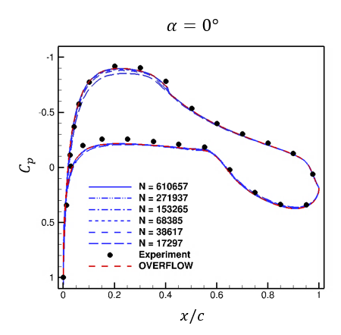
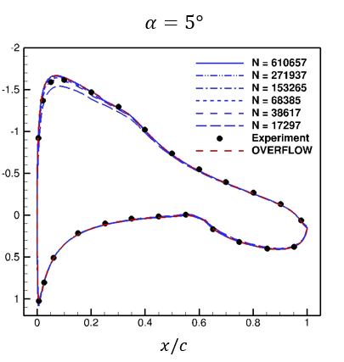
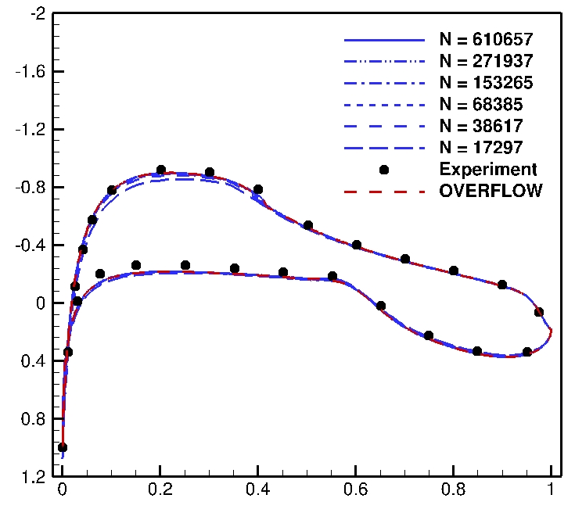
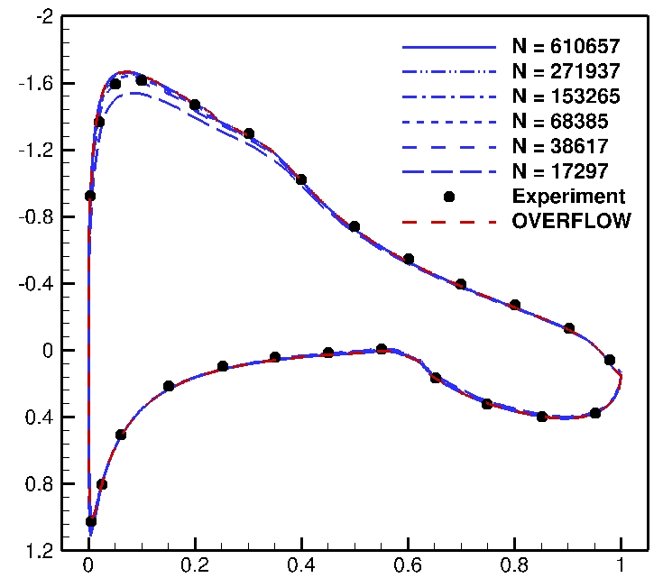
Case 2: NLF(1)-0416 Airfoil (2D)
SST2003-LM2009 transition model
Sustaining turbulence
$I=0.15\% \& μ/μ_{t}=1$
$$M$$ | unit $Re$ | $$T_{ref}$$
0.1 | 4e6 | 540 R
5/9

Slide 6
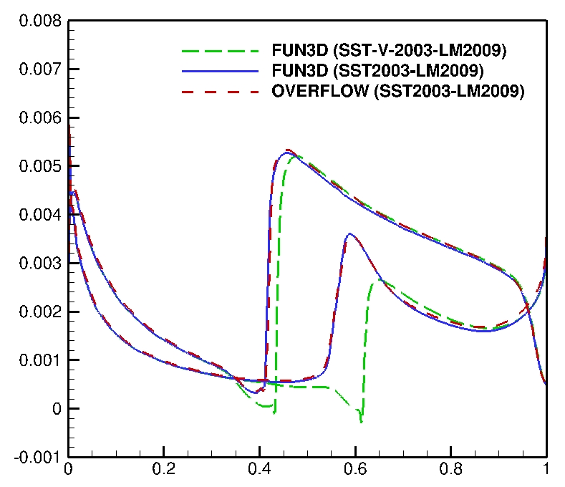
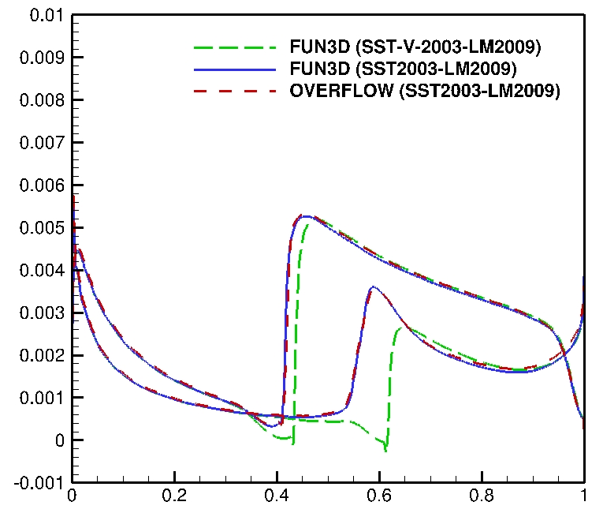
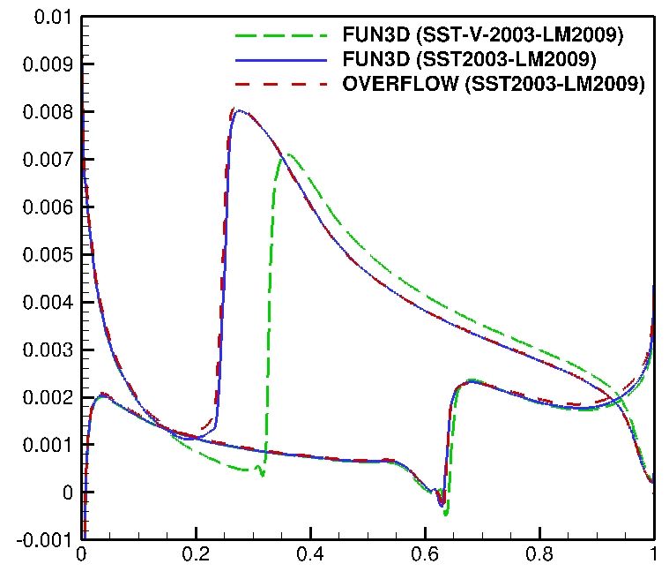
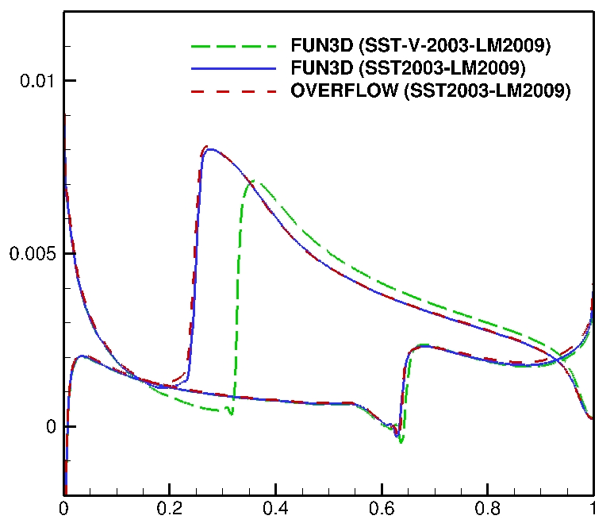
Case 2: NLF(1)-0416 Airfoil (2D)
FUN3D vs OVERFLOW (SST2003-LM2009)
Significant differences between SST2003 and SST-V-2003
$$α=0°$$
$$α=5°$$
$$C_{f}$$
$$C_{f}$$
$$x/c$$
$$x/c$$
6/9

Slide 7
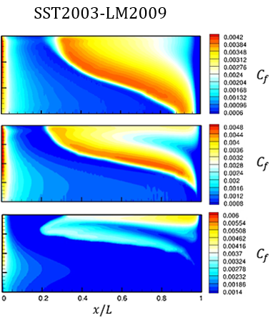
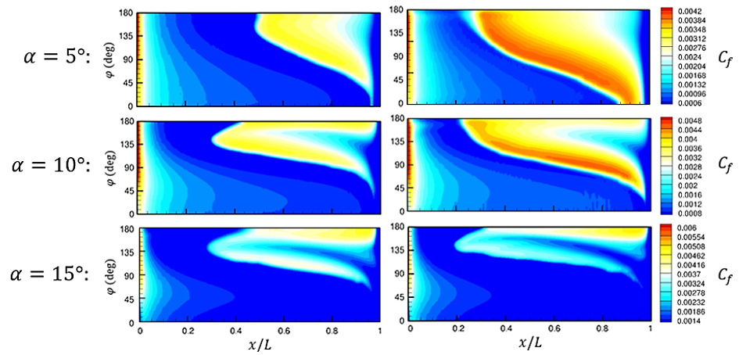
Case 3: 6:1 Prolate Spheroid (3D)
Fine-grid results $\left(N=51507\right)$
Sustaining turbulence$(I=0.15\% \& μ/μ_{t}=1)$
$$M$$ | unit $Re$ | $$T_{ref}$$
0.13 | 6.5e6 | 540 R
SST-V-1994-LM2009
SST-V-2003-LM2009
SST2003-LM2009
7/9

Slide 8
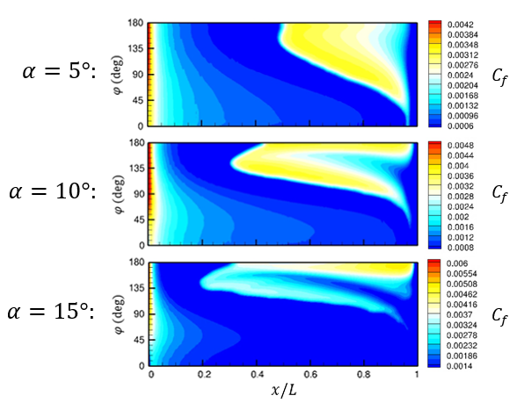
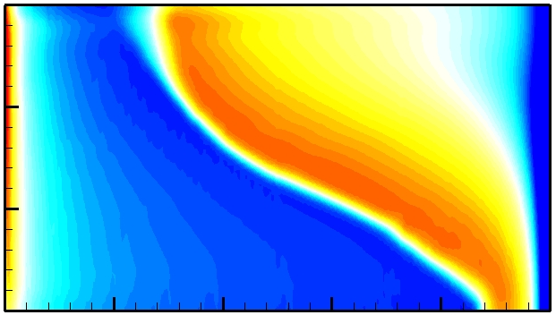
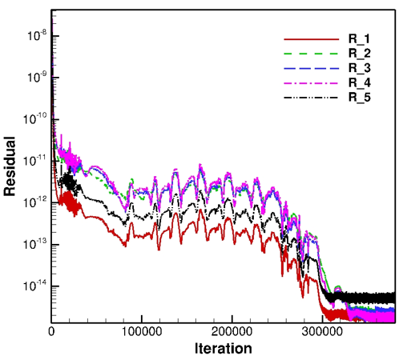
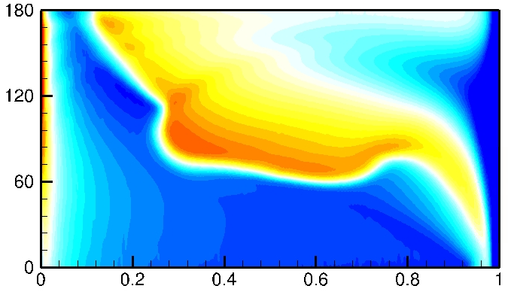
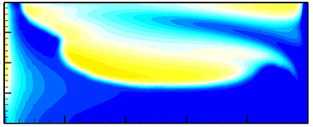
Case 3: 6:1 Prolate Spheroid (3D)
Fine-grid results $\left(N=51507\right)$
Sustaining turbulence$(I=0.15\% \& μ/μ_{t}=1)$
$$M$$ | unit $Re$ | $$T_{ref}$$
0.13 | 6.5e6 | 540 R
SST-V-2003-LM2015
8/9

Slide 9
Summary and Future Work
Successfully implemented SST2003-LM2015 transition model into FUN3D
Also updated LM2009 transition model
FUN3D and OVERFLOW codes produced similar flat-plate and NLF(1)-0416 airfoil results using the Langtry-Menter transition models
Transition location changes whether SST-V-2003 or SST2003 is used as the turbulence model for the NLF(1)-0416 airfoil
Differences between SST-V-1994 and SST-V-2003 for 6:1 prolate spheroid
Create finer grids and obtain convergence for the CRM-NLF with FUN3D
Implement SST2003-LM2009-CFHE transition model into FUN3D
Local helicity approach of (Grabe et al. 2018)
Continue progress with unstructured grid adaption techniques using the sketch-to-solution code developed by (Park 2008)
9/9

