Slide 1
SLS Gateway I-Hab Integration Overview
Presented by
SLS SPIE XP50
JANUARY 2021 IHAB TIM

Slide 2
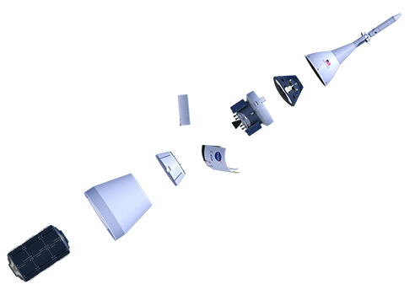
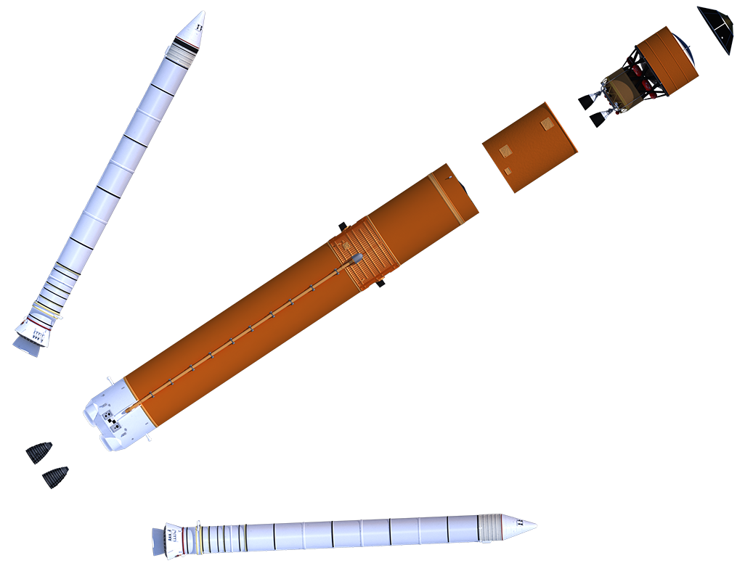
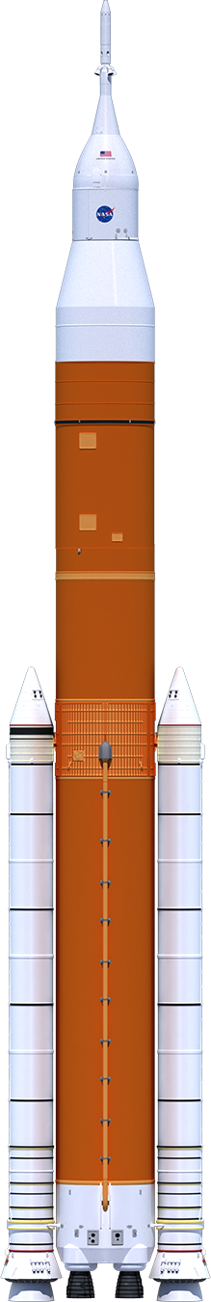
Block 1B Crew Expanded View
Launch Abort System
Crew Module
European Service Module
Service Module Panels
Spacecraft Adapter
Universal Stage Adapter
Orion
Co-manifested Payload
Payload Adapter
Solid Rocket
Booster (2)
Exploration Upper Stage
RL10 Engine (4)
ISPE
Interstage
Core Stage
RS-25
Engine (4)
SLS Block 1B Crew

Slide 3
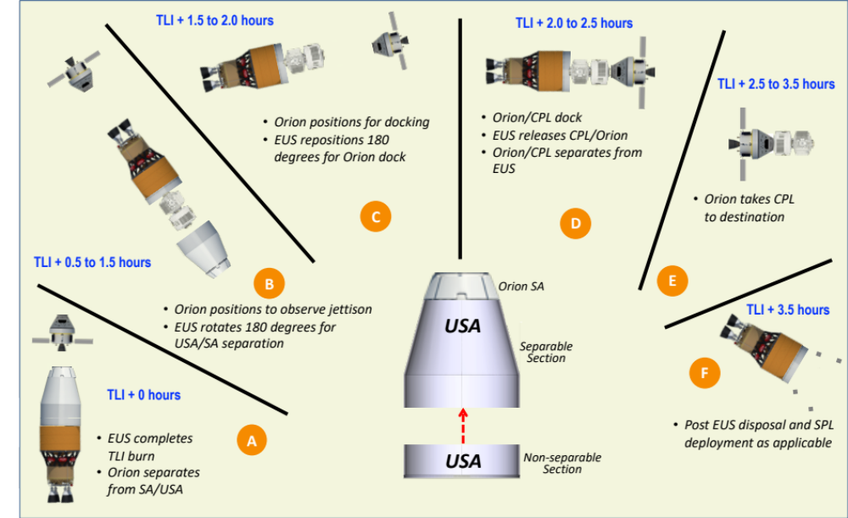
GENERIC CON-OPS TO DEPLOY
SLS payload Integration overview for Gateway Logistics as Co-manifested Payload (CPL)
  SLS CPL performance available in mid to late 2020’s
  SLS Block 1B payload accommodations
  SLS Payload Integration Process
Preliminary SLS-Gateway Next Steps
SLS-CPL Concept of Operations

Slide 4
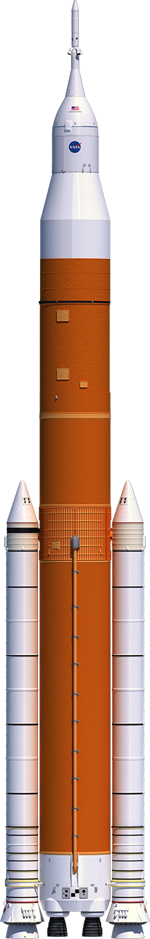



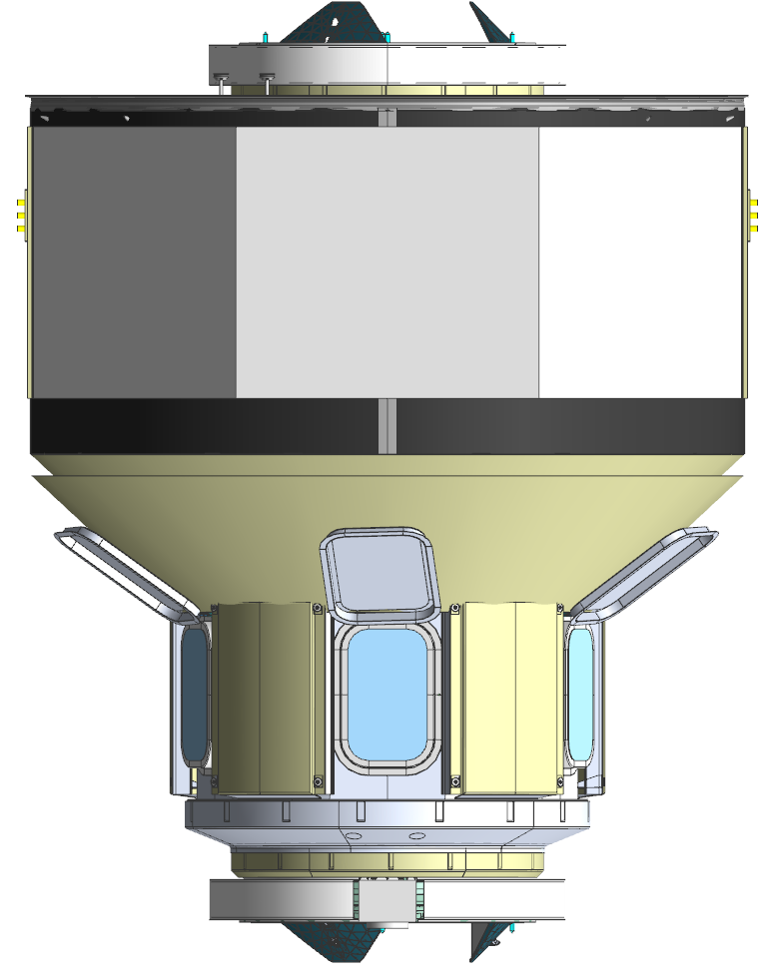


SLS Gateway Mission Phase Configurations
SLS Phase
Off-line
Processing
VAB to
Launch
Ascent to
TLI
Post Orion
Separation
Post USA
Jettison
Orion to PL
Docking
Orion/PL
Separation
ISPE
  USA (sep)
  Gateway
  USA (nsep)
  PLA
Orion
  SA
ISPE
  USA
  Gateway
  PLA
EUS
Orion SA
ISPE
  USA
  Gateway
  PLA
EUS
ISPE
  Gateway
  USA (nsep)
  PLA
EUS
Orion
ISPE
  Gateway
  USA (nsep)
  PLA
EUS
Orion
  Gateway
ISPE
  USA (nsep)
  PLA
EUS
Elements
Range of SLS SPIE Payload Integration Documentation and Support

Slide 5
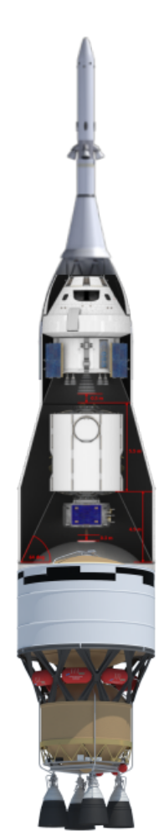
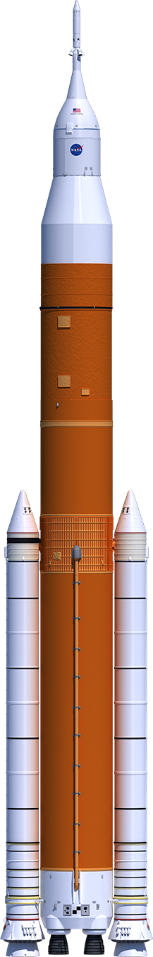
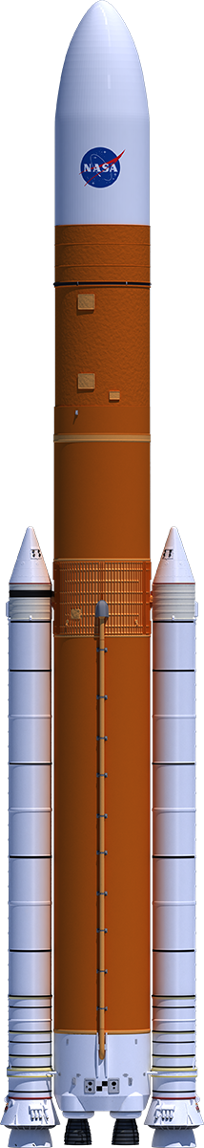
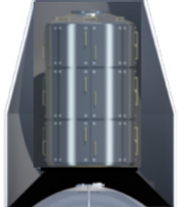
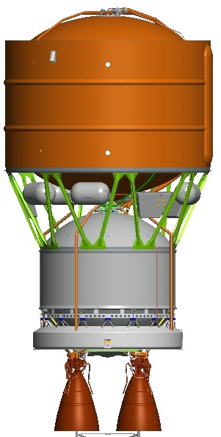
SLS Block 1B Crew/Cargo Integrated Spacecraft/Payload Element (ISPE)
SLS Block 1B
Elements
(Crew Configuration)
SLS Block 1B
Elements
(Cargo Configuration)
SLS Block 1B/2 Payload
Orion
Spacecraft
ISPE
8.4m
Payload Fairing (PLF)
Integrated Spacecraft/Payload
Element
(ISPE)
Stages (EUS)
Stages (EUS)
Co-Manifested Payload
(CPL)
Primary Payload
(PPL)
Universal Stage Adapter (USA)
Secondary Payloads (SPL)
Up to 7 places, ≤27U
Payload Adapter (PLA)
Booster
Booster
Booster
Booster
Stages (Core)
Stages (Core)
Notes:
For both the crew and cargo options the SLS and CPS stack height is 272’. The total height of the stack will depend on what is carried above that plane.

Slide 6
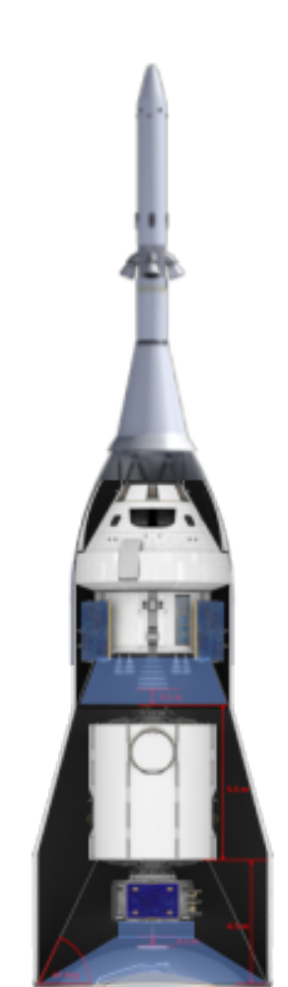
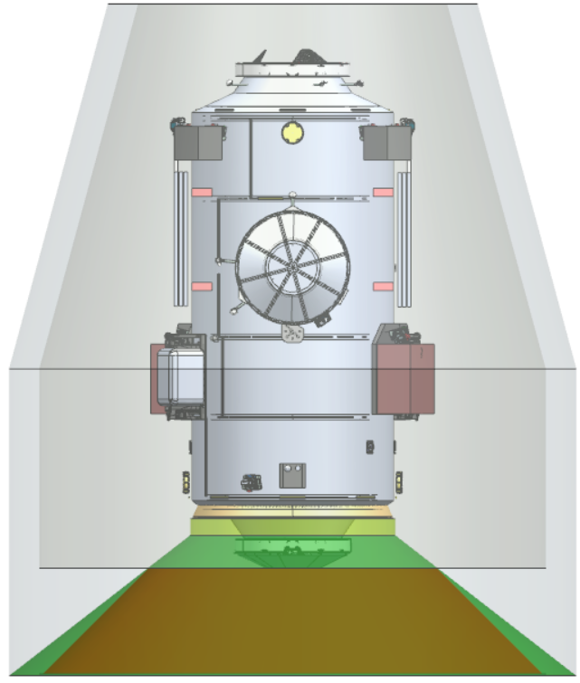
SLS B1B Accommodations: Logistics Concept
Factors that directly impact PLA mass
  PLA frequency requirement: further reduction below 10 Hz could result in lower PLA mass
  CPL payload Center of Gravity offset (CG):
  Interface diameter: increasing interface diameter higher than 3100 mm will result in lower PLA mass
USA Baseline
Representative Logistics Module

Slide 7
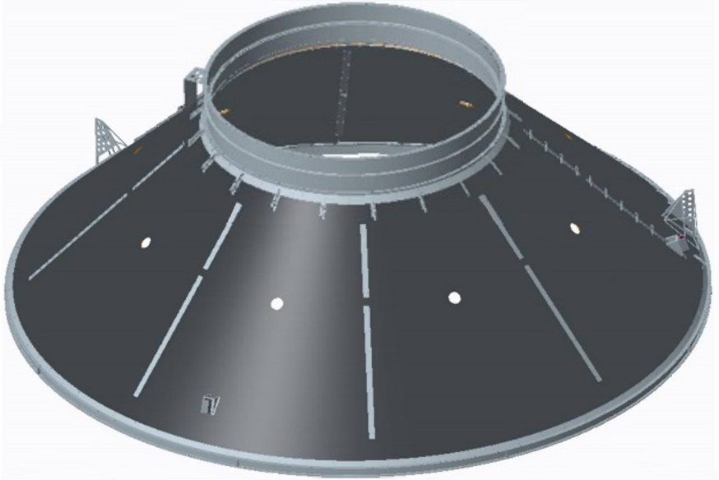
3100-1020 Co-Manifested Payload Adapter (PLA)
3100-1020 PLA characteristics
  3100 mm payload interface
  10.2 metric ton payload capability
  Eight segment conical composite laminate construction with aluminum upper and lower rings
  3100 mm separation system will be incorporated, with trade study in work evaluating two approaches:
    Utilize commercial 3100 mm clamp band separation system
    Apply commercial Non-Explosive Actuators to new separation ring structures
3100-1020 PLA

Slide 8
SLS to Gateway Logistics Needed Design Variables
GENERIC DATA REQUIRED FROM CPL
Gateway CPL Attributes needed (Lv II)
Mass Properties
Payload Envelope
Structural FEM
Axial and Lateral CG Offset
Gateway CPL Separation System (Lv III)
Min and max CPL mass
CPL interface diameter
Max CPL axial CG from the sep plane
Max CPL lateral CG from the centerline
Minimum lateral (Iyy, Izz) inertia
Max dimensions (height and radius) E CPL below the sep plane and nested within the PLA
CPL dynamic constraints for the PSS
    Min and max axial delta V
    Min and max axial acceleration
    Max tip-off angular velocity
EUS Needs
Data needs beyond standard services?
~303” (7.7m) Remaining USA height
PLA3100 CG Limit
140” (3.6m)
CPL height?
~126” (3.2m) PLA3100 height
(reference)
Capabilities
Needed CPL Input

Slide 9
SLS Block 1B ISPE PPL, CPL and SPL Interfaces
Mission Peculiar Equipment, ISPE Provided
Conceptual
Payload
PLF or USA
Services, Ground Provided
Services, SLS EUS Provided
Structural Attachment
PPL or CPL
Separation Plane
PSS
ISPE
CPL - Co-manifested Payload
ECS - Environmental Control System
EUS - Exploration Upper Stage
ISPE - Integrated Spacecraft/Payload Element
PLA - Payload Adapter
PAF - Payload Attach Fitting
PL - Payload
PLF - Payload Fairing
PPL - Primary Payload
PSS - Payload Separation System
USA - Universal Stage Adapter
PSS Initiate
PSS Breakwires
PL RS-422 Serial I/F
PLA (PAF + PSS)
PL Command Channels
PAF
ECS Purge
Ground
Systems
SLS EUS
Instrument Purge
Sensors
EUS Umbilical Plate
RS-422 Serial I/F
Ethernet I/F
DC Power

Slide 10
SLS CPL CAPABILITY
QUESTIONS

Slide 11
SLS PAYLOAD INTEGRATION PROCESS
Presented by
SLS SPIE XP50
JANUARY 2021 IHAB TIM

Slide 12
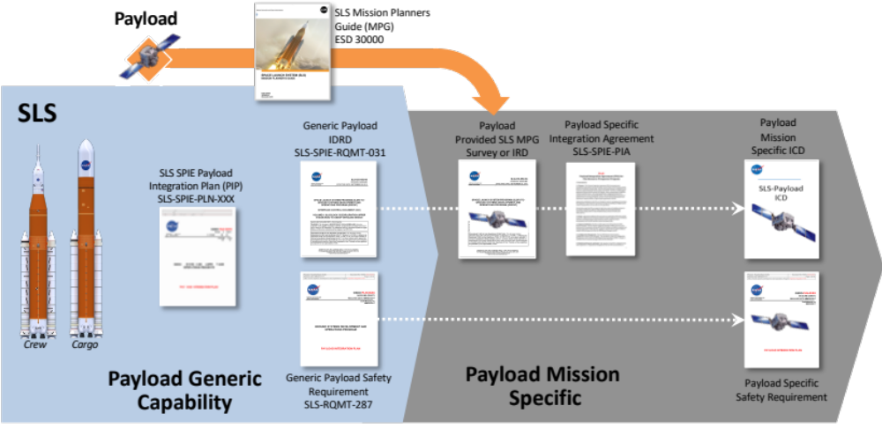
SLS Payload Integration Process
Built on MSFC heritage with Shuttle, Spacelab, and ISS, as well as ELV approaches and industry norms
Provides simplicity and shorter schedule by managing ground and flight interfaces starting at lowest level building towards the highest level (e.g., PL > ISPE > SLS)
All requirements between Enterprise and payload addressing pre-launch through payload separation captured in two mission unique documents (C & D)
A
A
B
C
D

Slide 13
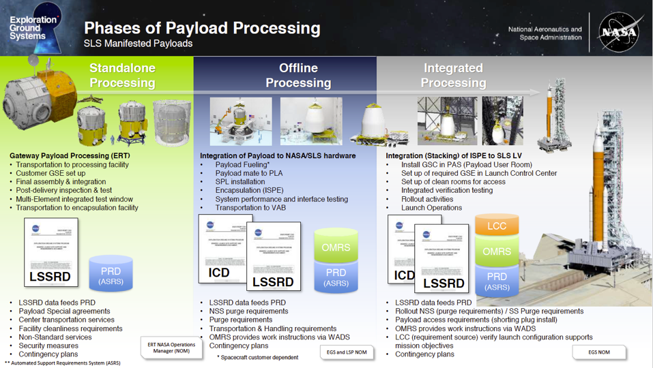
SLS Payload Physical Integration

Slide 14
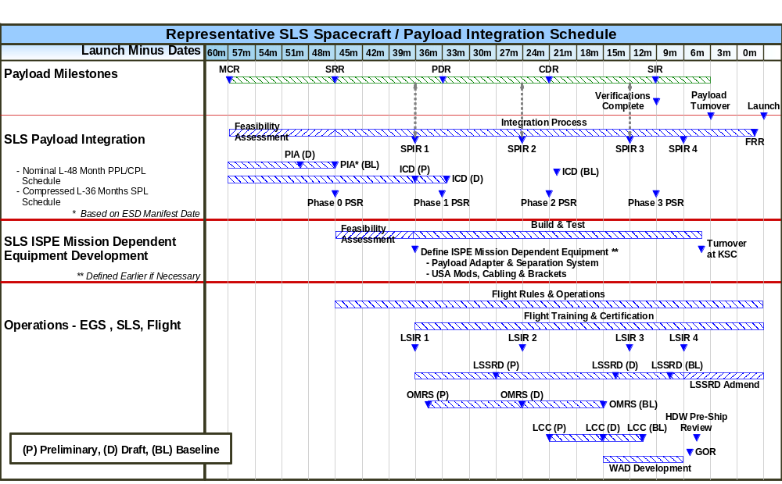
Generic SLS Payload Integration Schedule
To be customized based on IHAB Launch date on SLS; nominally 48 months to launch from formal manifesting
Generic

Slide 15
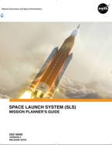
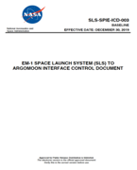
SLS Payload Integration Preliminary Next Steps
Jointly develop preliminary Gateway Logistics payload integration schedule
Review SLS Mission Planner’s Guide (ESD 30000) and fill-in ADMIT survey or provide a launch vehicle Interface Requirement Document (IRD)
SLS SPIE to assess Gateway Logistics to launch vehicle interfaces and requirements based on ADMIT/IRD
SLS SPIE to develop preliminary Gateway Logistics to SLS ICD based on ADMIT/IRD data
Schedule
SLS MPG
Example Artemis I Payload ICD

Slide 16
BACK UP

Slide 17
SLS Payload Integration Documentation Definition
A
SLS Mission Planner’s Guide (MPG)
  Provides developers/users with information to determine payload feasibility of flying on SLS in manner equivalent to established ELVs (i.e., D-IV, Atlas 5)
  Provides payload survey to define preliminary SLS accommodations or SLS uses payload provided Interface Requirements Document (IRD)
  Survey or IRD input is used to develop SLS to Payload unique ICD once manifested to fly on SLS
Payload Specific Integration Agreement (PIA) or equivalent programmatic agreements
  Bilateral agreement between SLS and CPL for negotiating and implementing management and technical integration requirements associated with NASA ESD manifest decision
  Defines SLS and CPL roles & responsibilities, specific interfaces, standard services, any non-standard services, deliverable exchanges, and the overall schedule for successful integration and launch
  Developed and coordinated by SLS/SPIE with revisions negotiated and agreed to by all parties as needed
B

Slide 18
SLS Payload Integration Documentation Definition
C
Payload Specific Interface Control Document (ICD)
  Formally documents interface and requirements between SLS and CPL from initial ISPE/payload integration through ISPE/payload separation
  Agreed to design solution that controls and defines each side of interface (SLS or CPL) developed by SLS/SPIE with baseline approval at ESD JICB
  Defines each requirement success criteria used to close out verification
  Co-developed by SLS/SPIE, with EGS and Orion support as needed, and CPL with revisions negotiated and agreed to by all parties as needed
Payload Specific Safety Requirement Document (SRD)
  Defines safety requirements and establishes safety policy applicable to CPL from delivery at the launch site, through ascent until payload separation
  Defines CPL ground and flight processing hazard requirements
  Payload Safety Review Panel (PSRP)will assess flight and ground operations to determine whether any activities could result in hazards to SLS, EGS or Orion that manifest during prelaunch or flight operations
D

