Slide 1


Jeff Gramling​, MSR Program Director, NASA/HQ
Michael Meyer, Mars Chief Scientist, NASA/HQ
Bobby Braun​, MSR Program Manager, JPL
​
Presentation to the Planetary Science Decadal Survey Mars Steering Committee
January 22, 2021
Notes:
STILL

Slide 2
Introduction
Mars Sample Return has been a priority of the past two National Academy Decadal Surveys
  First “round-trip” to another planet, paving the way for future human exploration
MSR is a complex mission
  Requires a set of capabilities that were not demonstrated 20, or even 10, years ago.
  It is only possible today as a result of the $10+B investment made through the formulation, technology and operational projects of the past decades, coupled with a strong international partnership with ESA
In recognition of the size, complexity, and technological and engineering advances required, SMD employed several processes much earlier in Pre-Phase A
  Commissioned two Independent Cost/Schedule Estimates​
  Had an Independent Review Board (IRB)​ conduct a two-month examination of the program
  Established the program’s Standing Review Board to conduct the MCR as an Agency review
As a result of intense, independent review in 2020, we better understand our challenges forward
  The 2026 launch date is challenging
  The budget phasing requires adjustment
We have the right team and a strong international partnership. We have validated our approach through unprecedented scrutiny in Pre-Phase A. We can launch in 2026 or in 2028. After 2028, the next feasible opportunity is 2035. The time to execute MSR is now

Slide 3

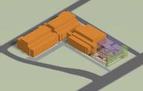
MSR Campaign
Mars Sample Return Program
1 2 3 4
Sample Caching Rover
(Mars 2020) Operations
Sample acquisition/caching
Sample (subset) delivery
Sample Retrieval Lander
Fetch Rover
Orbiting Sample (OS) container
Mars Ascent Vehicle
Earth Return
Orbiter
Capture/Containment System
Earth Return Vehicle
Mars Returned Sample Handling
Sample Receiving Facility
Curation
Sample science investigations
“Initiates the Campaign” “New Element” “New Element” “New Element”
Ground Element
to be reviewed at a future date
The MSR Campaign spans three launches and one ground element
The MSR Program manages development and operations of elements 2 and 3 above and interfaces to elements 1 and 4; program concludes with recovery/containment of samples for transfer to SRF
The MEP Program manages M2020 Phase E operations & will be the home of the future SRF Project

Slide 4
Mars Returned Sample Science
Mars Exploration Program has established the intellectual foundation and the engineering capability to characterize a region on Mars and to scientifically select samples worthy of sample return.
Perseverance is capable of selecting and caching 43 samples. 15 NASA/ESA Returned Sample Scientists have been competitively selected for the Perseverance Science Team.
A team (JPL & JSC) has visited 18 BioSafety Level-4 and contamination-controlled facilities to scope the containment challenges of conducting science with returned Mars samples. Report posted Oct. 2020 <http://hdl.handle.net/2014/50446>
NASA/ESA Mars Sample Return Science Planning Group – Phase 2 (MSPG2)* will develop a Science Management Plan, address science technical issues, propose a working list of high-level requirements for the Sample Return Facility, and develop a timeline of key decision points. Report expected Spring 2021
COSPAR Sample Safety Assessment Protocol Working Group (SSAP) with NASA and ESA members is developing a recommendation for determining when extraterrestrial samples are safe for distribution outside of containment. Report out Jan/Feb 2021
A Sample Caching Strategy Workshop is planned for Jan. 2021.
* MSPG report Nov 2019 <https://mepag.jpl.nasa.gov/reports.cfm?expand=mspg>

Slide 5
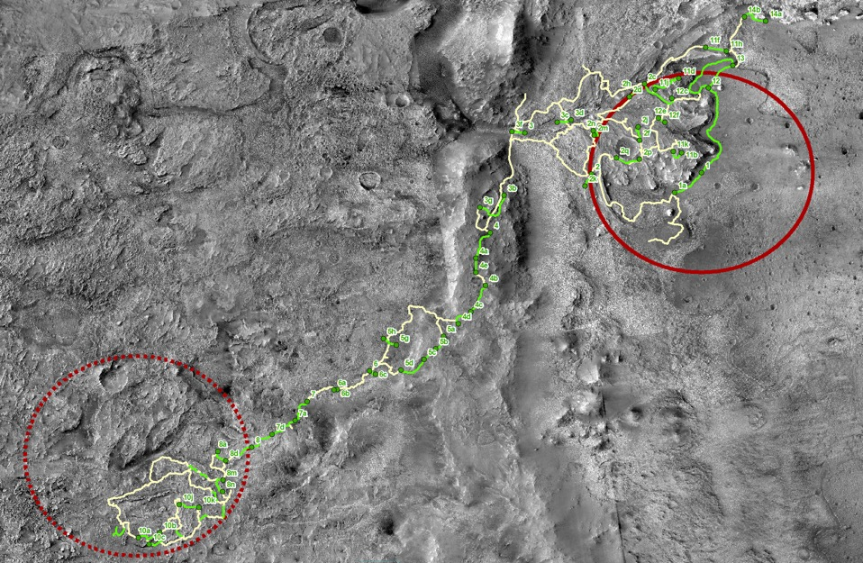
Overview of Green Pathways Across Jezero-Midway Region
M2020 Reference Traverse Paths
Identified SFR Green Pathways
JEZ Landing Ellipse
MDW Ellipse
10km

Slide 6







Diversity of Samples
Inside the Jezero system (20 samples)
Mafic Floor
Typical/Fracture
(HCP-bearing)
Olivine/ Carbonate-Bearing
Floor
Distal Delta/Lake Deposits
(Var. compositions)
Jezero Regolith
Point Bar Unit Deposits
(Olivine/Carbonate /Silica)
Inverted Channel Deposits
(LCP/Clay-bearing)
Marginal
Lake Deposits
Blanks
Outside the Jezero system (17 samples; extended mission, if any)
Megabreccia
Inc. Kaolinite Block
(Jezero Rim)
Capping Unit (Jezero Rim)
Olivine/ Carbonate-Bearing
Unit Outside Jezero
Jezero Crater Rim
Megabreccia
(Midway Ellipse)
LCP-Enriched Basement
Fe/Mg Smectite Basement
Blank
Basement Ridges
Layered Basin-Filling Unit
Capping Unit (Midway Ellipse)
Blank
Adapted from Ken Farley (CAPS, 2019)

Slide 7












MSR Architecture Overview
Mars
Mars 2020
Tube Delivery
SRL
Mars Ascent
Vehicle
Tube Retrieval
Sample Fetch Rover
Tube Collection & Depot
Orbiting Sample
Retrieve OS
Relay Support
ERO
Break-the-Chain
Avoid Earth
Earth Entry Vehicle
Earth
Mars2020
Earth Return Orbiter
Sample Retrieval Lander
Sample Return and Science

Slide 8
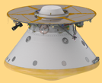
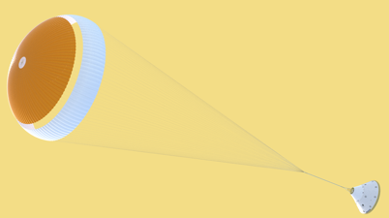
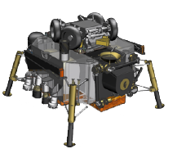
SRL Flight System Vehicle Summary
Cruise Stage (CS)
Heritage Prop/GNC/FSW
Redundant X-Band System with LGA and MGA
Entry Vehicle (EV)
Heritage 4.7m Aeroshell with Backshell Mounted RCS
Guided Entry
23m Parachute
4km Divert Capability for Pinpoint Landing
EDL Communication via UHF System
Propulsive Platform Lander (PPL)
Throttled-Engine Propulsive 4 Leg Platform
Solar and Secondary Battery Power System
Thermal Maintenance of the Mars Ascent Vehicle
SFR Egress, STS and MAS Launch Execution
8 Context/Operational Cameras
UHF Surface Communications

Slide 9
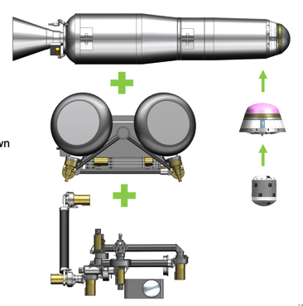
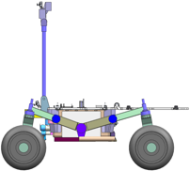
SRL Payloads
MAV
Two stage solid rocket
380kg maximum mass
2.8 m length and 0.5m diameter
-40 deg C non-op and -20 deg C op
SFR
230kg NTE mass with specified volume envelope
4 wheels with 55cm diameter
Umbilical power until power positive on surface
Sample Transfer Assembly (STA)
7 DOF arm to insert sample tubes & install OS
Allow SFR and M2020 operations
Orbiting Sample (OS)
Accommodates 30 sample tubes
OS and MPA each have 8 kg maximum mass (51% and 88% margin, respectively)
MAV
SFR
MPA
OS
STA

Slide 10
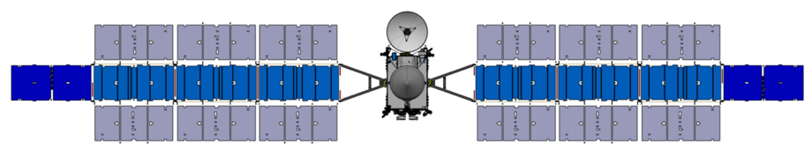
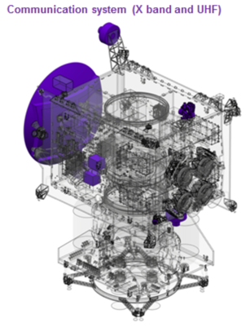
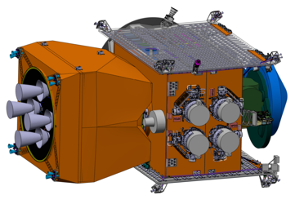
ERO Anatomy
39m
6.6m
Communication system (X band and UHF)
Solar Arrays:
~40 kW (at Earth, BoL), ~150 m²
Electric Propulsion:
3 + 1 (spare)
Isp of 4000s, DeltaV ~10 km/s
Communications:
HGA, 2DoF MGA, LGA (X-band)
UHF surface relay
Bi-Prop Transit Stage:
Isp = 320 s

Slide 11
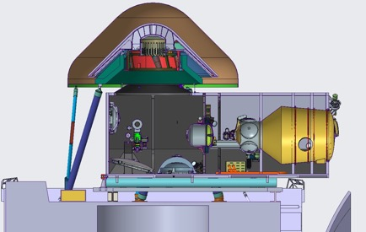

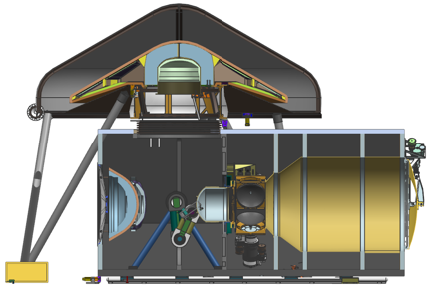
Capture, Containment and Return System (CCRS) Overview
  CCRS is the payload on the ESA ERO
    Capture the OS
    Break-the-Chain and assure Containment
    Deliver EES to UTTR while meeting BPP requirements
  Capture and Containment Module
    Captures, constrains, and orients the OS
    Transfers contained OS to the CCRS clean zone
    Maintain clean zone integrity
  Earth Return Module
    Protects EES from MMOD
    Precision separation of EES
    Passive EEV with carbon-phenolic heatshield
Earth Return Module (ERM)
Earth Entry Vehicle (EEV)
Capture and Containment Module (CCM)
Earth Return Orbiter (ERO) ESA
Orbiting Sample (OS)
Earth Return Module (ERM)
CLEAN ZONE
DIRTY ZONE
RTA ops to integrate encapsulated OS into EEV
Capture, Orient, & Aseptic Transfer
Capture Containment Module (CCM)

Slide 12

Campaign Timeline Overview
2026 |  |  |  |  |  |  |  |  |  |  |  | 2027 |  |  |  |  |  |  |  |  |  |  |  | 2028 |  |  |  |  |  |  |  |  |  |  |  | 2029 |  |  |  |  |  |  |  |  |  |  |  | 2030 |  |  |  |  |  |  |  |  |  |  |  | 2031
J | F | M | A | M | J | J | A | S | O | N | D | J | F | M | A | M | J | J | A | S | O | N | D | J | F | M | A | M | J | J | A | S | O | N | D | J | F | M | A | M | J | J | A | S | O | N | D | J | F | M | A | M | J | J | A | S | O | N | D | J | F | M | A | M | J | J | A | S | O | N | D
 |  |  |  |  |  |  |  |  |  |  |  |  |  |  |  |  |  |  |  | Reg. |  | Dust Storm Season |  |  |  |  |  |  |  | Reg. |  |  |  |  |  |  |  |  |  |  |  | Reg. |  | Dust Storm Season |  |  |  |  |  |  |  | Reg.
 |  |  |  |  |  |  |  |  |  |  |  |  |  |  |  |  |  |  |  |  |  |  |  | N Winter |  |  |  |  |  |  |  |  |  |  |  |  |  |  |  |  |  |  |  |  |  | N Winter
 |  |  |  |  |  |  |  | Earth to Mars |  |  |  |  |  |  |  |  |  |  |  |  |  | Spiral Down |  |  |  |  |  |  |  | Low Mars Orbit (Relay) |  |  |  |  |  |  |  |  |  |  |  |  |  | RDV and Contain |  |  | Spiral Up |  |  |  |  |  |  |  | Mars to Earth
 |  |  |  |  |  | Earth to Mars |  |  |  |  |  |  |  |  |  |  |  |  |  |  |  |  |  |  |  |  |  |  |  |  |  | Surface*
Conj
Conj
ERO
MOI
EES
EDL
M2020
MAV
OS
SRL
SFR
*See zoomed diagram for surface phases
26 – 26 – 31
SRL Launches in 2026
Samples are returned in 2031
ERO launches in 2026
SRL avoids winter and global dust storm season, enabling all-solar SRL/SFR
EDL occurs in a favorable season, enabling significant SRL mass margin
Surface operations timeline has 200% margin relative to peer-reviewed plans
ERO (or another asset) can provide all relay services needed for MSR
Architecture feasible across launch opportunities in the 2026-2028 timeframe.
Next “good” opportunity for this architecture after 2028 is 2035

Slide 13

MSR Launch Opportunities
26/26/31 Reference Design
Slightly Worse than 26/26/31
Worse than 26/26/31
Much Worse than 26/26/31
MSR Launch Opportunity Comparison |  |  | ERO
 |  |  |  | 2026 |  | 2027-28 |  | 2029-30
SRL
 |  | 2026 |  | Return: 2031 |  | Return: 2033 |  | Return: 2037
 |  |  |  | Favorable EDL Atmosphere |  | Favorable EDL Atmosphere |  | Favorable EDL Atmosphere
 |  |  |  | Solar-Only SRL/SFR |  | Solar-Only SRL/SFR |  | Solar-Only SRL/SFR
 |  |  |  | Heavy SRL Launch Vehicle |  | Heavy SRL Launch Vehicle |  | Heavy SRL Launch Vehicle
 |  |  |  | Relay: ERO & MRN |  | Relay: MRN |  | Relay: MRN
 |  |  |  | MAS Launch Observed |  | MAS Launch NOT Observed |  | MAS Launch NOT Observed
 |  |  |  | Reference ERO Traj |  | Similar ERO Traj |  | More Challenging ERO Traj
 |  |  |  | ERO: 5 years |  | ERO: 6 years |  | ERO: 9 years
 |  |  |  | M2020: 7 years |  | M2020: 7 years |  | M2020: 7 years
 |  |  |  | Backup Does Not Require Redesign |  | Backup Requires Redesign |  | Backup Does Not Require Redesign
 |  | 2028 |  | Return: 2033 |  | Return: 2033 |  | Return: 2037
 |  |  |  | Favorable EDL Atmosphere |  | Favorable EDL Atmosphere |  | Favorable EDL Atmosphere
 |  |  |  | Solar-Only SRL/SFR |  | Solar-Only SRL/SFR |  | Solar-Only SRL/SFR
 |  |  |  | Super Heavy SRL Launch Vehicle |  | Super Heavy SRL Launch Vehicle |  | Super Heavy SRL Launch Vehicle
 |  |  |  | Relay: ERO & MRN (+2 years) |  | Relay: ERO & MRN (+2 years) |  | Relay: MRN (+2 years)
 |  |  |  | MAS Launch Observed |  | MAS Launch Observed |  | MAS Launch NOT Observed
 |  |  |  | Easier ERO Traj |  | Similar ERO Traj |  | More Challenging ERO Traj
 |  |  |  | ERO: 7 years |  | ERO: 6 years |  | ERO: 9 years
 |  |  |  | M2020: 9 years |  | M2020: 9 years |  | M2020: 9 years
 |  |  |  | Backup Requires Redesign |  | Backup Requires Redesign |  | Backup Requires Redesign
 |  | 2030 |  | Return: 2037 |  | Return: 2037 |  | Return: 2037
 |  |  |  | Unfavorable EDL Atmosphere |  | Unfavorable EDL Atmosphere |  | Unfavorable EDL Atmosphere
 |  |  |  | Nuclear SRL/SFR |  | Nuclear SRL/SFR |  | Nuclear SRL/SFR
 |  |  |  | Super Heavy SRL Launch Vehicle |  | Super Heavy SRL Launch Vehicle |  | Super Heavy SRL Launch Vehicle
 |  |  |  | Relay: ERO & MRN (+5 years) |  | Relay: ERO & MRN (+5 years) |  | Relay: ERO & MRN (+5 years)
 |  |  |  | MAS Launch Observed |  | MAS Launch Observed |  | MAS Launch Observed
 |  |  |  | Similar ERO Traj |  | Similar ERO Traj |  | More Challenging ERO Traj
 |  |  |  | ERO: 11 years |  | ERO: 10 years |  | ERO: 9 years
 |  |  |  | M2020: 12 years |  | M2020: 12 years |  | M2020: 12 years
 |  |  |  | Backup Does Not Require Redesign |  | Backup Requires Redesign |  | Backup Does Not Require Redesign
Nomenclature: “28/27/33”
  SRL Launches in 2028
  ERO Launches in 2027
  ERO Returns in 2033
The MOU between ESA and NASA targets the launch of both the SRL and ERO missions (on separate launch vehicles) in 2026, utilizing the remaining possibilities as backup launch dates
MSR architecture allows for launch of the NASA SRL mission in either the 2026 or 2028 launch opportunity and the launch of the ESA ERO mission and its NASA CCRS payload in either 2026, 2027 or 2028
The mission architecture provides for return of the samples to the Sample Retrieval Lander via both the ESA Sample Fetch Rover and Perseverance, providing redundancy
  Delays impact the probability of Perseverance remaining operational, reducing surface sample transfer options and adding risk
For this architecture, next “good” opportunity after 2028 is 2035
SRL Launches after 2028 and before 2035 requires architecture modifications
  Need for nuclear power source on SRL and radioisotope heating on SFR
  Further backup options involve costly architecture changes
MRN = Mars Relay Network
  MRO, MAVEN, TGO

Slide 14

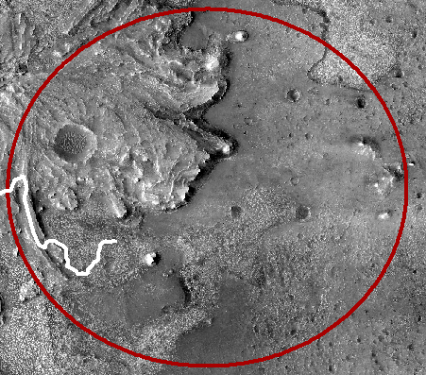
SRL EDL–Extended Divert
SRL will carry enough propellant to fly out the backshell separation ellipse (8 x 8 km) and land at a specific spot (~±20m accuracy)
Enables new capability of landing at a specific site pre-scouted from the Mars surface
8 km Parachute Deploy Ellipse
Powered Descent
Landing Spot

Slide 15
MSR Program Summary Schedule
BLUE: Work Performed by NASA
GREEN: Work Performed by ESA
Program IMS established in pre-Phase A
Program is tracking schedules and critical path margins across integrated system to assure risks are identified and institutional requirements are maintained
Overall margins managed through Program IMS and MSR schedule management process
Schedule margins meet or exceed institutional requirements for 2026 LRD
Plan requires completion of PDR by the end of FY22

Slide 16
Summary
With launch of Perseverance, the MSR Campaign is underway
This is the most important planetary science undertaking in a generation
Organizational responsibilities are defined and team is moving out
  MOU signed; full partnership with ESA; we can’t do this without them
Through the pre-phase A effort, the team has developed a feasible baseline and broad set of options
  Mission is technically constrained to launch in the 2026-2028 timeframe
  M2020 has agreed to place surface samples in green zones enabling our surface operations strategy
Program cost range analyses are aligned with internal and external ICEs
  FY22 and FY23 funding are significant challenges to 2026 LRD
The time is now to leverage MEP investments and technology advances
Team is ready to mature design and solidify baseline in Phase A
  Close trades
  Demonstrate viability on technology and engineering developments
  Refine cost and schedule estimates with institutional commitments and updated FY22 budget profile
  Continue refinement of backup LRD planning
  The MSR team has been approved for Phase A

Slide 17


with us

