Slide 1
MEDPRAT Treatment Clusters: Improving Representation of Mission Medical Risk
February 3, 2021
Lawrence Leinweber, ZIN Technologies, Inc.
Lauren McIntyre, NASA Glenn Research Center
Jerry Myers, NASA Glenn Research Center

Slide 2
MEDPRAT Overview
Medical Condition
Computational model
Characterizes mission medical risk
Provides insight into medical resource utilization
Treatment
Short answer: resources treat medical conditions
Long answer: risk metrics, limited resources, susceptibility between conditions, simulation, optimization, etc.
Resource
Notes:
Human exploration

Slide 3
Goals of a New Feature for MEDPRAT
Better results
  Increased model fidelity
  Less error in results
Broad utility
  Meet more user needs
Simpler organization
  Easier for users to learn
  Less effort to test software
Ease of implementation
  Reduce costs
  More time for other features
Anticipate evidence
  Develop code in tandem with data
  Break code/data deadlock

Slide 4
Evolution of treatment clusters

Slide 5
Old Feature: Treatment Combinations
Resources combine to treat a condition
Example
Condition
Mouth Ulcer
Resource
Resource
Resource
Tylenol
Benzocaine
AgNO₃ Stick

Slide 6
Old Feature: Alternate Treatments
Resources can be substituted within a category
Example
Resource Category
Analgesic Oral, Weak
Primary Resource
Alternate Resource
Alternate Resource
Aspirin
Motrin
Tylenol

Slide 7
Wanted Feature: Treatment Bundles
All dependent resources needed for effective treatment
Example
Treatment Bundle
Ultrasound
Dependent Resource
Dependent Resource
Dependent Resource
Ultrasound Machine
Ultrasound Gel

Slide 8
New Treatment Clusters
Resources combine into clusters to treat conditions
Generalized clusters support old and new features
Attributes generalize and combine subfeatures

Slide 9
Details and attributes

Slide 10
Treatment Cluster Details
Support for combining resources, alternate resources, bundling
Single framework for grouping (clustering) treatments
  More robust software; better testing
More complex treatment trees can be supported
Clusters can be defined and reused for multiple conditions
Old framework is still supported

Slide 11
Non-Alternate Treatment Cluster Attributes
Non-alternate treatment clusters based on old treatment combinations
Each component of non-alternate cluster has attributes:
  Contribution
    number to represent importance of component relative to others in cluster
    generalization of old essential/not essential feature
  Necessity
    percentage to represent degree to which benefit of other components depend on this one
    100% necessity of all components represents “absolute” bundling

Slide 12
Alternate Treatment Cluster Attributes
Only one component of alternate clusters is applied at a time
Generalization of old alternate treatment categories
Each component of alternate cluster has attributes:
  Equivalence
    number to scale dosage amount for this component
  Rank
    number to indicate priority that this component should be selected before others
    alternates are chosen by: (1) availability, (2) rank, (3) random

Slide 13
Other Treatment Cluster Attributes
All cluster components also have attributes:
  Efficacy
    Percentage to indicate degree to which component provides benefit when fully available
  Dosage
    Rate
      amount of treatment component to apply, or amount per unit time
    Duration
      time over which to apply treatment component
      duration also can be “momentarily” or “indefinitely”
    Each PATH in the treatment cluster NETWORK has exactly one dosage

Slide 14
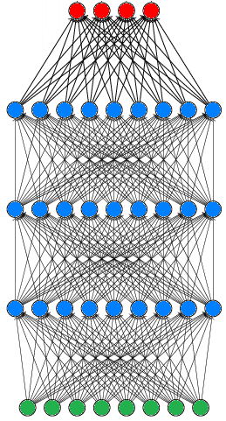
Network of Cluster Components
Conditions
A complete collection of treatment clusters forms a complex network, which is always directed from resources to conditions
Based on the simple idea of combining components
Treatment Clusters
Resources

Slide 15
Examples and results

Slide 16
Treatment Cluster Example
c = contribution
eq = equivalence
ef = efficacy
r = rank
n = necessity
Paper Cut
c = 0.8
c = 0.2
Bandage
Pain Pills
combination
alternates
bundle
ef = 100%
ef = 10%
eq = 1 r = 1
eq = 2 r = 2
Good Bandage
Duct Tape
Tylenol
Motrin
n = 100%
n = 10%
Bandaid Strip
Bacitracin
Defaults: c = 1, ef = 100%, n = 0%, eq = 1, r = 1

Slide 17
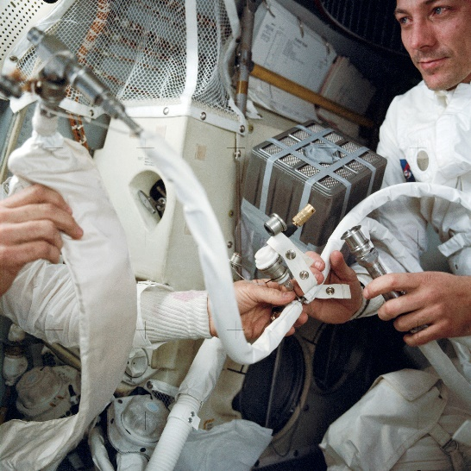
Apollo 13 Example
Highly-stylized example
CM CO₂ cartridge improvised from:
  LM CO₂ cartridge – 100% necessity
    Without it, no benefit
  Duct Tape – 50% necessity
    Without it, benefit cut in 1/2,
    and 1/3 reduced from total
  Headache Pill – 0% necessity
    Without it, 1/3 reduced from total
CM Hypercapnia
r = 1
r = 2
LM Improvisation
CM CO₂ Cartridge
n = 100%
n = 50%
n = 0%
LM CO₂ Cartridge
Duct Tape
Headache Pill

Slide 18
IMPACT Bundling Demonstration Study
IMPACT Project recently performed preliminary study
  7 bundles, representing IV, used to treat 28 conditions
  Effect on set selection from having absolute bundles vs. not
    Make sure that there are no “orphaned” items in the final medical set without the rest of the absolute bundle being present
    Make sure that partial treatment credit for reducing risk no longer exists for individual items of an absolute bundle
Finding: when comparing baseline vs. absolute bundles
  Due to bundling, all risk factors increased with the elimination of partial credit

Slide 19
Lessons – Summary
Clusters give a broader, simpler, more powerful representation
Mimicking real-world organization tends to improve model fidelity
Bundles are a good example of customer feedback
  Inspired by a question at IWS from 2 years ago
Looking for other ways to cluster treatment
  Welcome more ideas for attributes to represent treatment organization

Slide 20

Questions?

