Slide 1
Food Acceptability, Menu Fatigue, and Aversion on ISS Missions
Grace L. Douglas¹, Peter G. Roma², Millennia Young¹
¹NASA, Johnson Space Center, Houston, TX;
²KBR, Houston, TX

Slide 2


Introduction: Importance of Food Acceptability
Food acceptability is as important as nutrition to support adequate food intake, health, and performance
Some ISS crew members have noted in debriefs that they would prefer more food variety and they tire of certain foods
“Menu fatigue” may lead to decreased acceptability and consumption of available foods, contributing to body mass loss

Slide 3
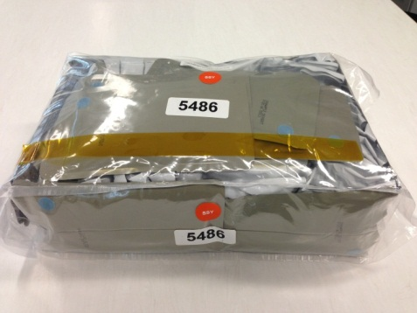
Objective: Evaluate to Inform Future Systems
A systematic evaluation of the impact of repeat food consumption on acceptability within the current spaceflight food system is needed
This information will be critical to inform composition and design of both current and future food systems, especially as restrictions increase with mission length and distance from Earth
CURRENT FOOD SYSTEM
Eight standard category containers
Feeds a crew of 3 for 9 days
Contains up to 200 options; limited servings of each
FUTURE CONSIDERATIONS
Up to 3 year missions
No resupply
Food may be prepositioned
5 year shelf life required
Limited or no personal preference
Restricted resources
Restricted food preparation
Supplemented with crew preference, condiments and fresh foods (up to 25% of intake)
1.5 year minimum shelf life at room temperature
Food Prep: Addition of hot or ambient water, food warmer (no cooking), small chiller
3

Slide 4
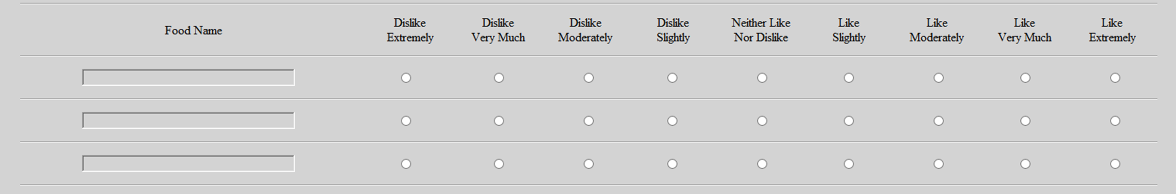
Methods
Implementation
N= 13 crewmembers, minimum 6 month missions
Questionnaire presented through the ISS Data Collection Tool
One meal a week
Overall acceptability on a 9-pt hedonic scale
Open-ended feedback
Analysis
Repeated measures techniques to quantify acceptability trends over time
Content analysis of additional feedback collected on the open-ended statements and debrief interviews
Evaluate how these may relate to preference and variety of current system design
Notes:
The weekly timeline is intended to target repeat consumption ratings of foods and capture start of menu fatigue or changes in food consumption patterns (e.g. restriction to favorites or trying foods would not normally try)

Slide 5
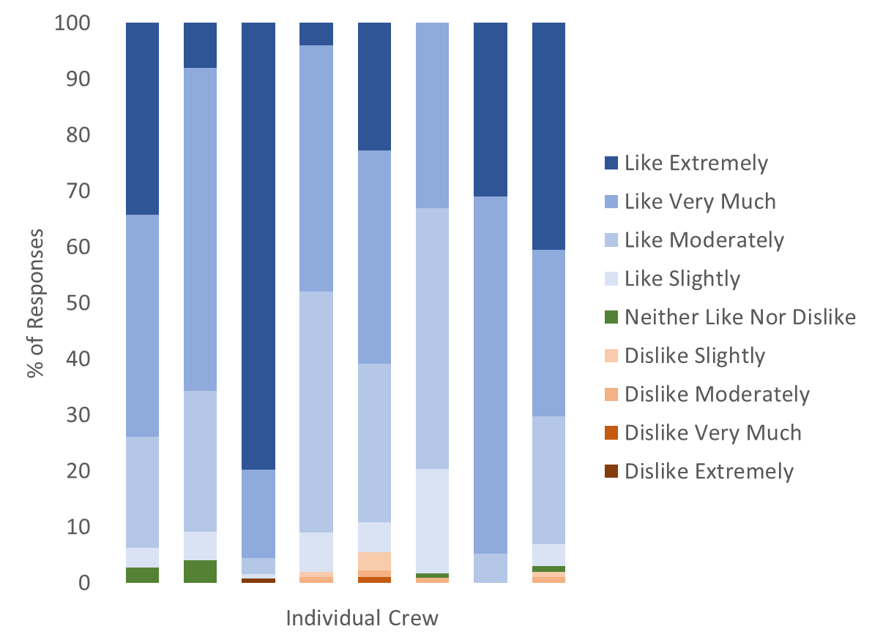
Preliminary Results
Crew limit selections to favorites early in the mission
Selected foods continue to be acceptable through mission
Comments indicating onset of menu fatigue varies widely between individuals
Preference is important; variety in general is key
Breakfast foods and vegetables are the most inadequate in variety and quantity
The consistent theme related to variety may indicate some menu strategies for long duration missions where preference foods will not be available
Notes:
fresh food deliveries, and International Partner foods important, but because so different - need variety

Slide 6
Acknowledgements
ISS Crewmembers
Research Operations and Integration for assistance with procedures and survey implementation on ISS
NASA Human Research Program Human Health Countermeasures Element for funding

