Slide 1
MECHANISTICALLY-BASED MODEL DEVELOPMENT FOR SPACE RADIATION RISK ASSESSMENT:
MODELING SPACE RADIATION INDUCED CARCINOGENESIS USING TARGETED AND NON-TARGETED EFFECTS
David J. Brenner¹, Igor Shuryak¹, Albert J. Fornace², Shubhankar Suman², Bhaskar V.S. Kallakury², Tony C. Slaba³, Steven R. Blattnig³, Ryan B. Norman³, and Ianik Plante⁴
¹Center for Radiological Research, Columbia University Irving Medical Center, NY, ²Georgetown University, Washington DC, ³NASA Langley Research Center, Hampton VA, ⁴ KBR, Houston TX.

Slide 2
Astronauts exploring other planets (like Mars) will be exposed to complex mixed radiation fields. Such radiations (especially densely ionizing heavy ions) can be much more carcinogenic per unit dose than ɣ rays
Role of Non-Targeted (Bystander) Effects (NTE):
At low doses of high-LET radiation, like heavy ions in space, not every cell nucleus is traversed by a particle track
NTE can play an important role in such situations because unirradiated cells respond to signals emitted by irradiated cells
This process can cause a prolonged stressed state and potentially increase cancer risk
It is therefore important to include NTE in quantitative models of space radiation carcinogenesis, along with targeted effects (TE)
Here we applied this approach to data from Fornace et al. on tumors in APC^{1638N/+} mice exposed at NSRL to space radiations: Protons (50 to 120 cGy; 0.22 keV/µm); ⁴He (5 to 50 cGy;1.57 keV/µm); ¹²C (10 to 200 cGy; 13 keV/µm); ¹⁶O (5 to 50 cGy; 22 keV/µm); ²⁸Si (5 to 140 cGy; 69 keV/µm); ⁵⁶Fe (5 to 160 cGy; 148 keV/µm); γ rays (5-200 cGy)

Slide 3
Modeling approach
Number of tumors/mouse (M) as function of radiation dose (D) is described by the following formula:
M = (B + NTE × (1 - exp[-NTE_{s}×D]) + TE × D) × exp[-α×D]
B = background tumor parameter.
Blue = non-targeted effects (NTE) contribution.
NTE = maximum excess tumors due to non-targeted effects.
NTE_{S} = NTE slope (exponential, Gy⁻¹).
Red = targeted effects (TE) contribution.
TE = dose response slope (Gy⁻¹). Quadratic term not supported.
Green = cell killing by radiation.
α = exponential slope (Gy⁻¹). Turns out ~0, discarded
Error distribution = customized weighted negative binomial.
Either under- or over-dispersion relative to Poisson are allowed.

Slide 4
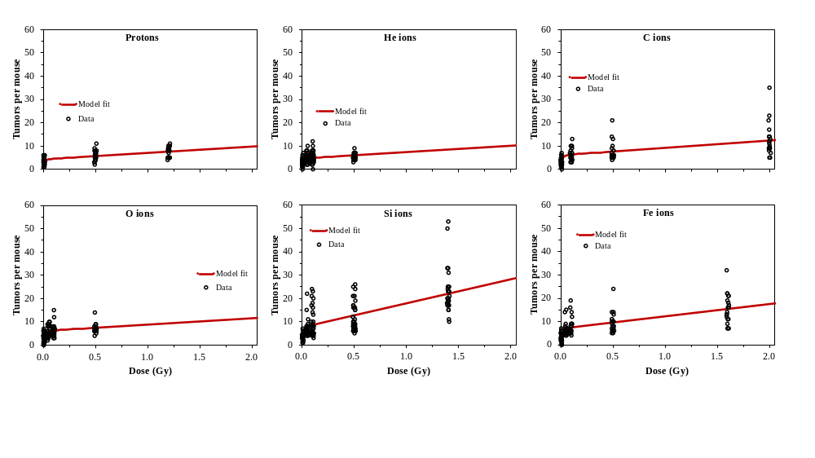
Model Fits to APC^{1638N/+} Mouse Data
A “bump” in tumor yield at low doses is attributed to NTE by the model

Slide 5
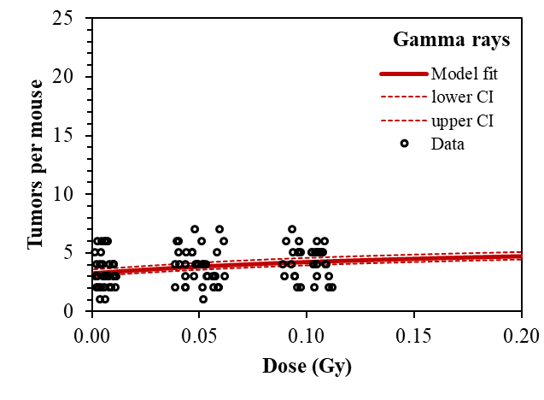
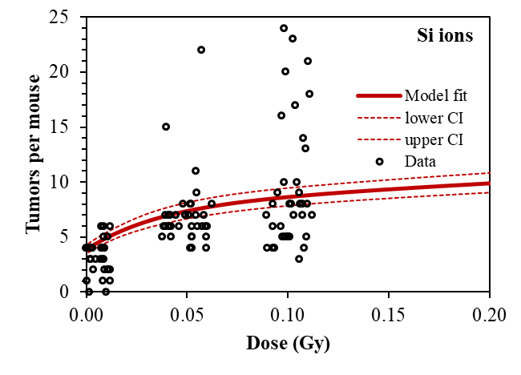
Look More Closely at Low Doses
Compare gamma rays (reference) with Si ions (most carcinogenic)
Controls: mean = 3.28 tumors/mouse, SD = 1.63, var/mean = 0.81
0.05 Gy gamma rays: mean = 3.84, SD = 1.48, var/mean = 0.57
0.05 Gy Si ions: mean = 7.11, SD = 3.30, var/mean = 1.53
0.1 Gy gamma rays: mean = 4.26, SD = 1.36, var/mean = 0.42
0.1 Gy Si ions: mean = 9.35, SD = 5.38, var/mean = 3.10

Slide 6
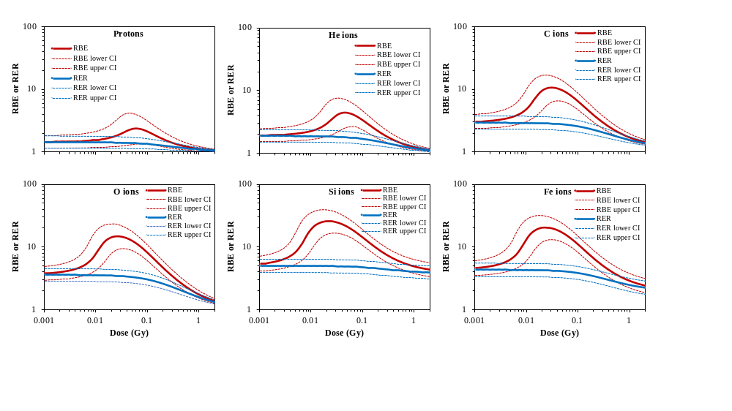
Relative biological effectiveness (RBE) and radiation effects ratio (RER)

