Slide 1
National Aeronautics and Space Administration
BRAVING THE FINAL FRONTIER: MATERIALS CHALLENGES IN SPACE
ASM World Class Speaker Series
Jennifer Domanowski
NASA Goddard Space Flight Center
Materials Engineering Branch, Code 541
ASM International Ontario Chapter, February 2021

Slide 2
PRESENTATION OUTLINE
About Me
Overview of Spaceflight Projects, Space, and How Materials Fit in the Big Picture
NASA Missions & Highlights
NASA Centers
NASA Project Life Cycle
Space Environment
Material Selection
Spacecraft and Environmental Testing
Environmental Testing
Thermal Vacuum Testing
How Can We Address Organic Contamination?
Outgassing/Outgassing Testing
Non-volatile Residue
Fourier Transform Infrared Spectroscopy
Gas Chromatography/Mass Spectrometry
Thermal Desorption
Spinoff Technologies
Conclusions

Slide 3
ABOUT ME

Slide 4
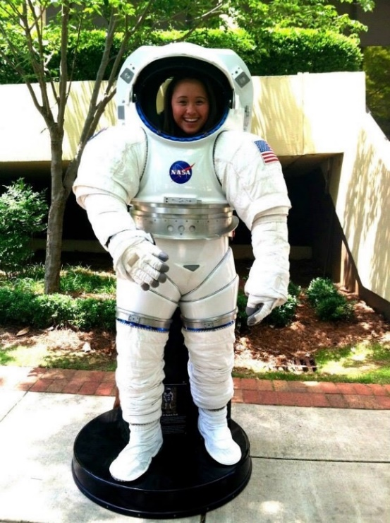
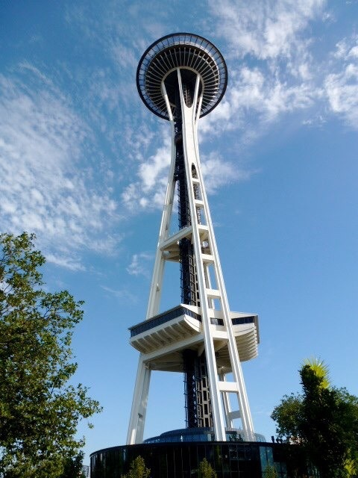
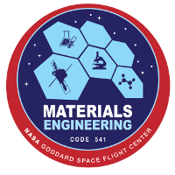
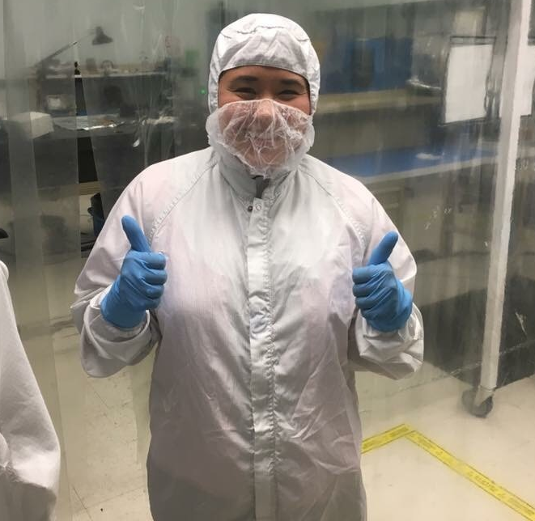
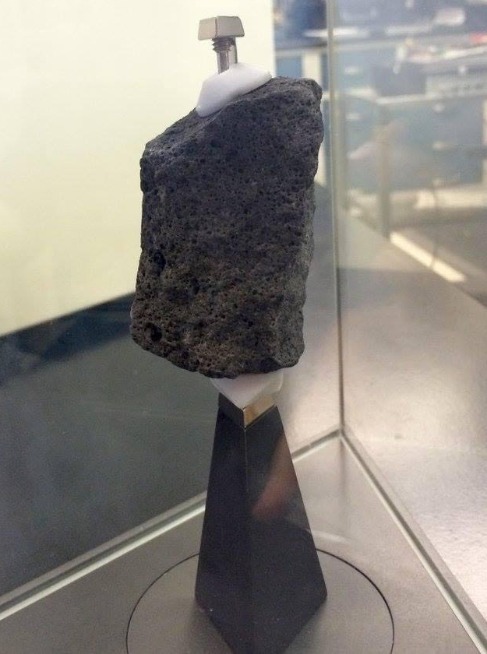
ABOUT ME – JENNIFER DOMANOWSKI
Originally from Seattle, WA area
B.S. in Materials Science and Engineering at Boise State University with a Certificate in Elementary Korean
Internships at NASA Marshall Space Flight Center (MSFC) and NASA Glenn Research Center (GRC)
Materials Engineer at NASA Goddard Space Flight Center (GSFC)
Lab Manager for Thermal Spectroscopy & Analysis and Mass Spectrometry Labs
¹IMAGE CREDIT: NASA/GSFC

Slide 5
OVERVIEW OF SPACEFLIGHT PROJECTS, SPACE, AND HOW MATERIALS FIT IN THE BIG PICTURE

Slide 6
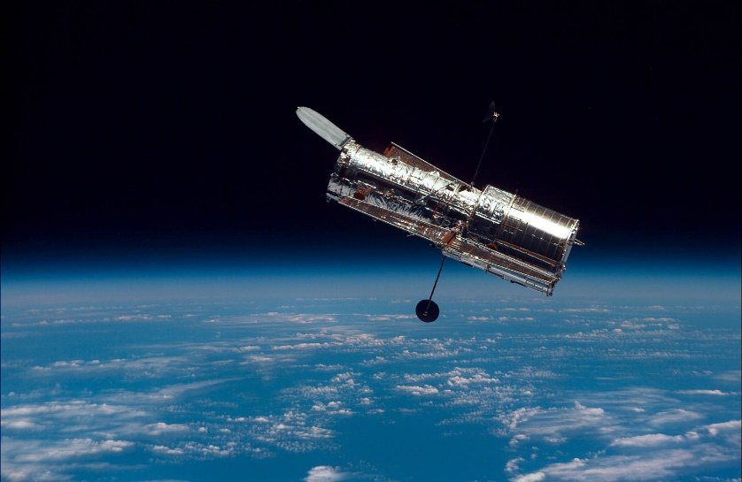
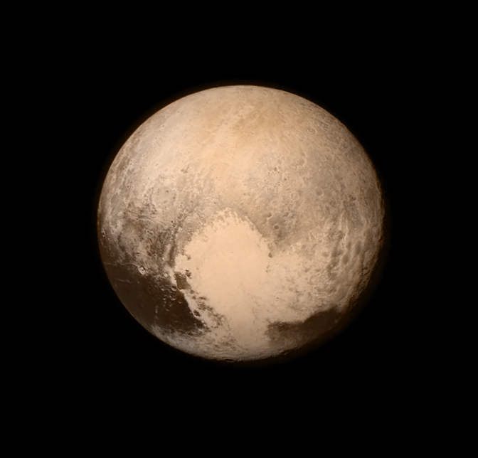
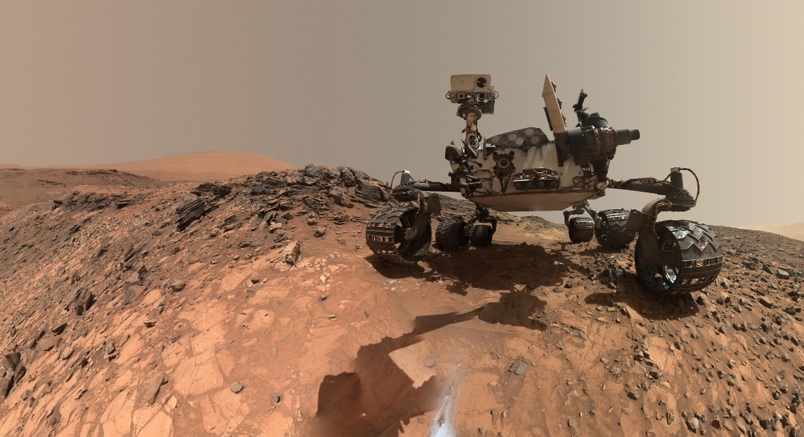
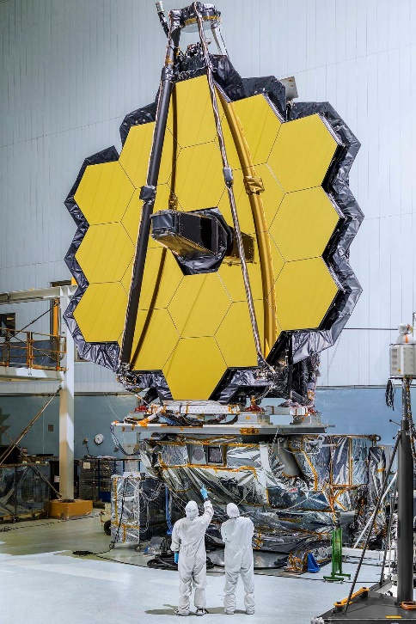
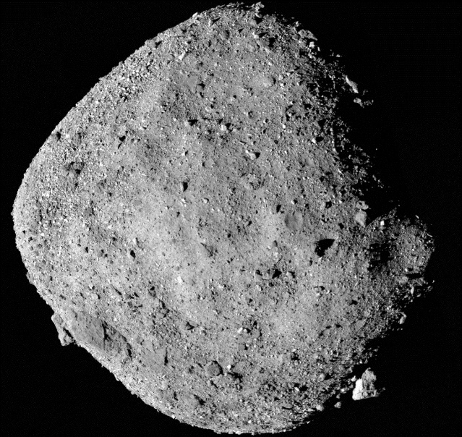
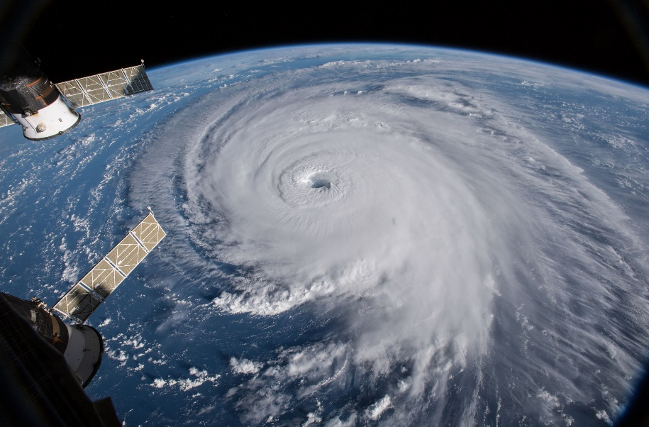
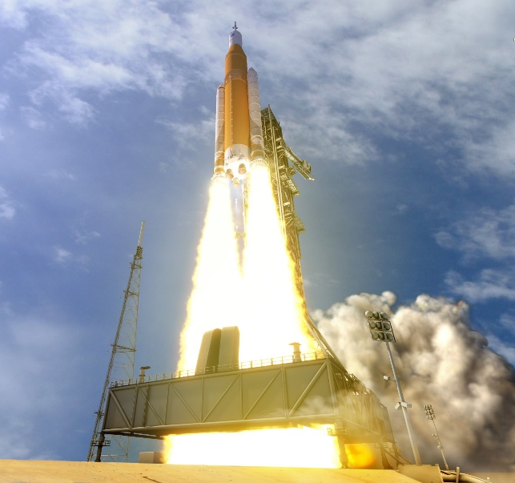
NASA MISSIONS & HIGHLIGHTS
²IMAGE CREDIT: NASA/GSFC
³IMAGE CREDIT: NASA/MSFC
⁴IMAGE CREDIT: NASA/JPL-CALTECH/MSSS
⁵IMAGE CREDIT: NASA/CHRIS GUNN
⁶IMAGE CREDIT: NASA/GODDARD/UNIVERSITY OF ARIZONA
⁷IMAGE CREDIT: NASA/GSFC
⁸IMAGE CREDIT: NASA/MSFC
Notes:
Purpose of this slide is to highlight some NASA missions to give context about some of the current projects that NASA is doing.

Slide 7
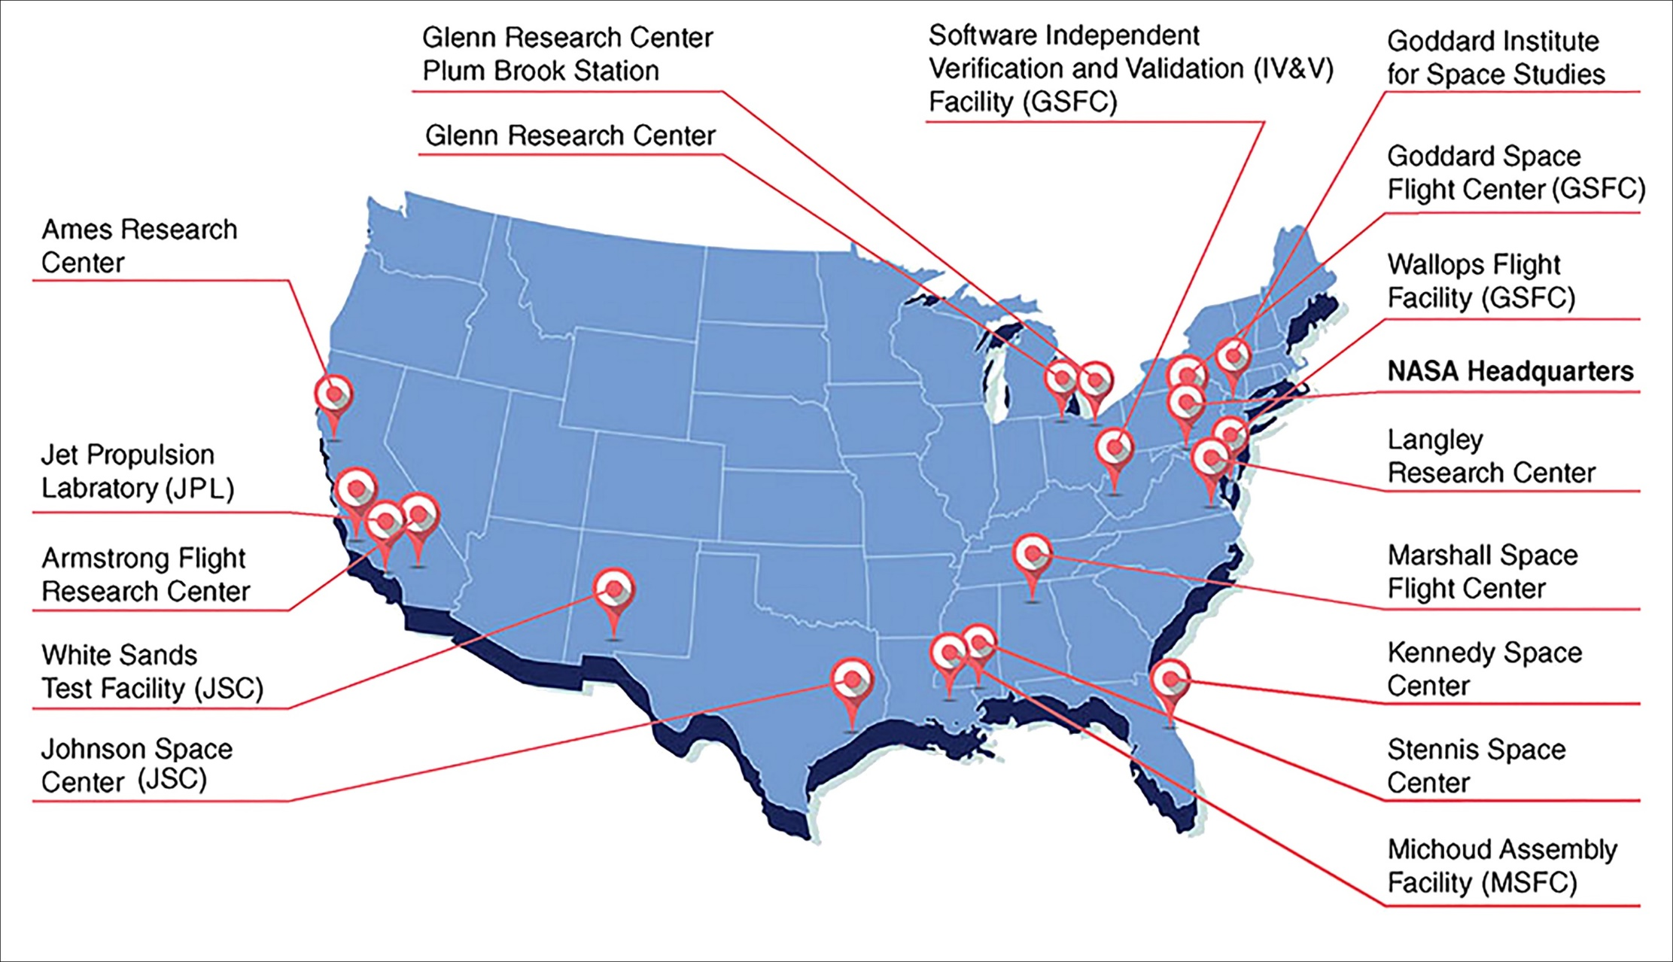
NASA CENTERS
⁹IMAGE CREDIT: NASA
Notes:
Purpose of this slide is to show that NASA centers are located throughout the US. I am highlighting the centers I have worked/interned at.

Slide 8
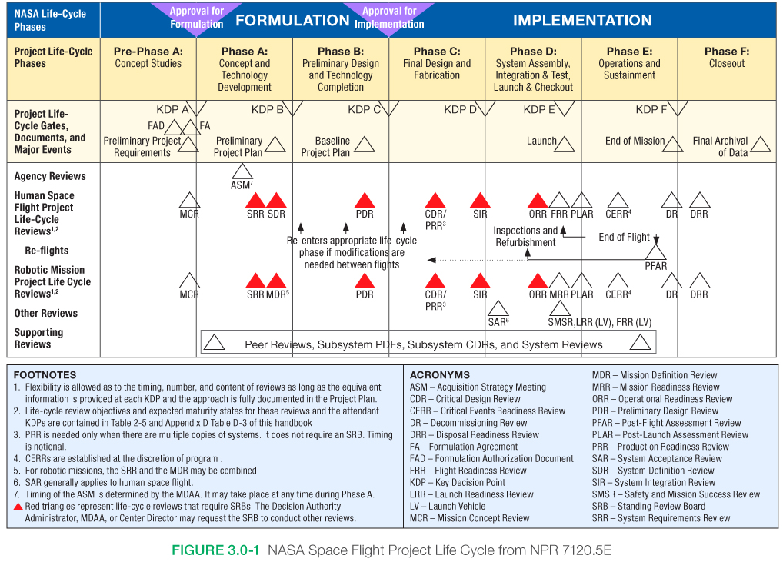
NASA PROJECT LIFE CYCLE
Pre-Phase A and Phase A
Concept Studies Concept and Technology Development
Phase B
Preliminary Design Technology Completion
Phase C
Final Design and Fabrication
Phase D
System Assembly Integration & Test (I&T) Launch & Checkout
Phase E
Operations and Sustainment
Phase F
Closeout
Materials Lab Testing & Analysis Support
¹⁰IMAGE CREDIT: NASA
Notes:
Purpose of this slide is to give an overview of what it takes to carry out a NASA mission. Main takeaway is that there are a lot of components, and it’s very complex. Trying to show where materials fits in this big picture.

Slide 9
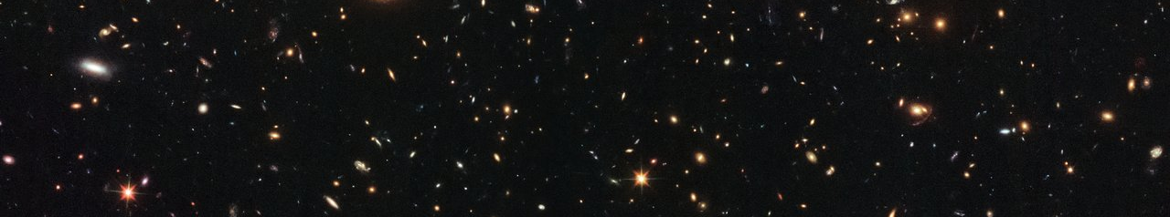
SPACE ENVIRONMENT
Space
Vacuum: “A space entirely devoid of matter” from Oxford Languages Dictionary
Extreme temperatures
Radiation
Magnetic fields
Space weather (solar wind, solar flares)
Atomic oxygen
Micrometeoroid and orbital debris
Orbits
Examples: Low Earth Orbit (LEO), Geostationary Earth Orbit (GEO)
GEO
LEO
160-2,000 km
36,000 km
¹¹IMAGE CREDIT: ESA/Hubble & NASA, RELICS
Notes:
Constituents: Baryons (~ 5%), Dark matter (~20%), Dark energy (~75%)

Slide 10
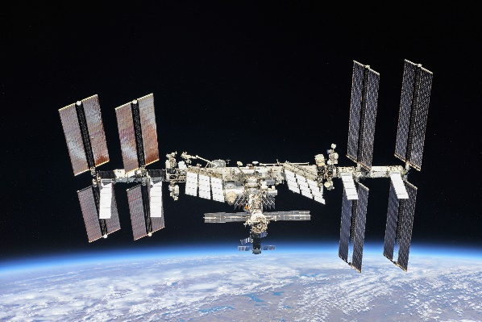
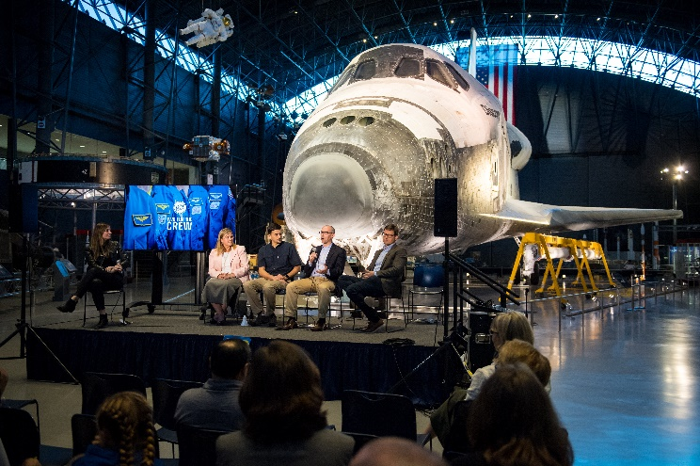
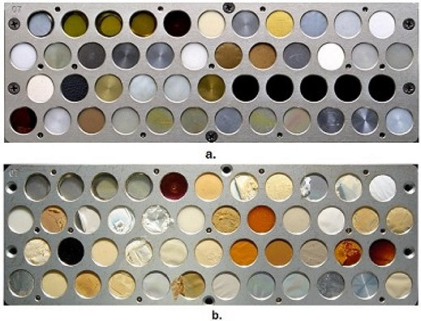
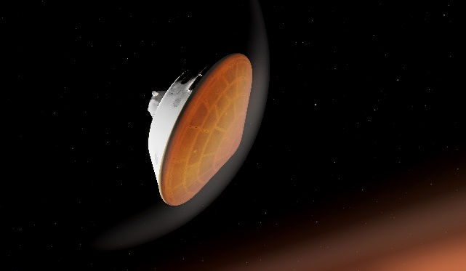
MATERIAL SELECTION
Material selection is based primarily on properties and application:
Strength
Weight
Maximum/minimum temperatures
Radiation resistance
Vacuum stability (outgassing)
Conductivity (electrical and thermal)
Thermomechanical stability
Compatibility with other materials
Cost, lead times, flight heritage
METALS
GLASS & CERAMICS
POLYMERS
COMPOSITES
Structural applications
Ex: structures, fasteners, etc.
Optical & high temperature applications
Ex: mirrors, coatings, thermal protection, etc.
Bonding applications
Ex: adhesives, staking, etc.
Structural & high temperature applications
Ex: structures, heat shields, etc.
¹²IMAGE CREDIT: NASA
¹³IMAGE CREDIT: NASA/AUBREY GEMIGNANI
¹⁴IMAGE CREDIT: NASA
¹⁵IMAGE CREDIT: NASA/JPL-CALTECH
Notes:
Purpose of this slide is to give a broad overview of material selection for projects.

Slide 11
SPACECRAFT AND ENVIRONMENTAL TESTING

Slide 12
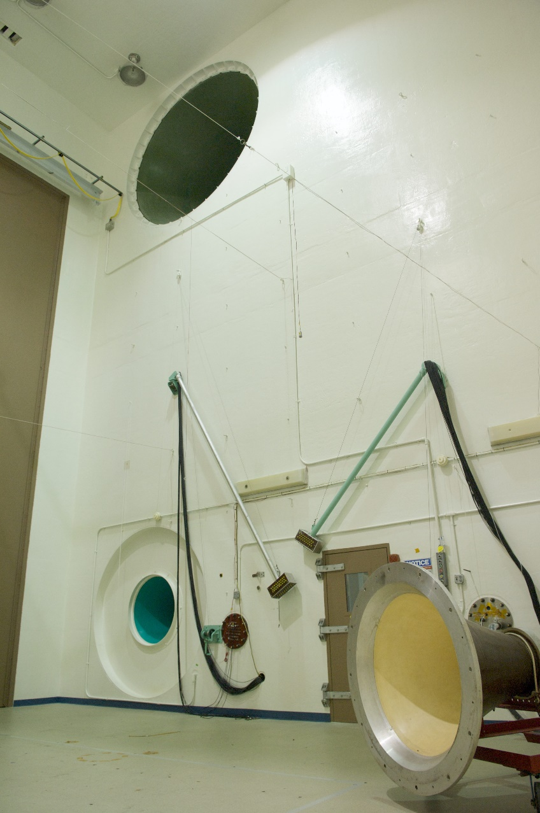
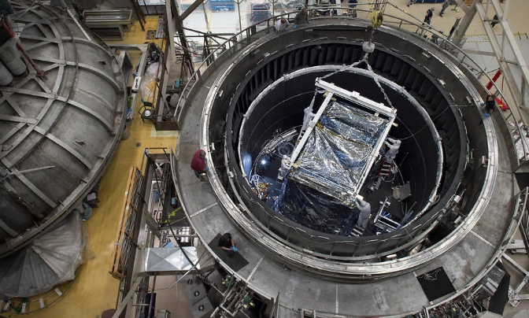
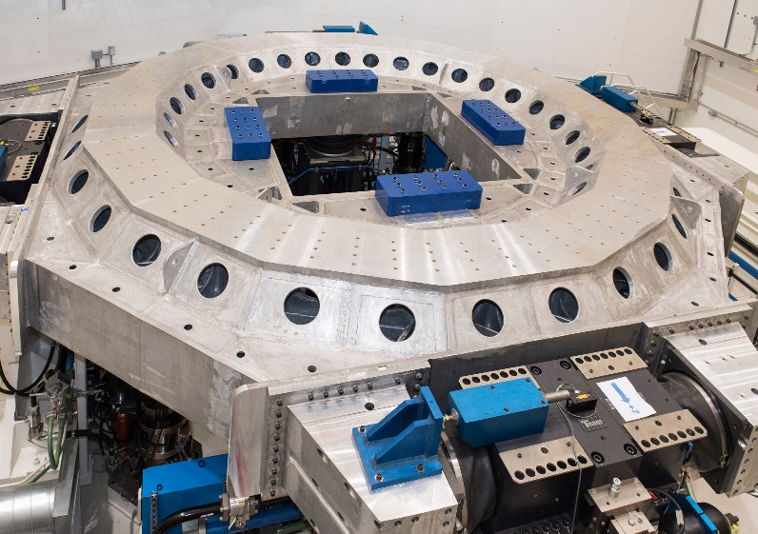
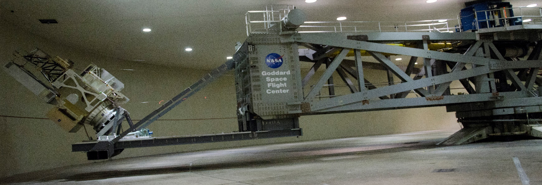
ENVIRONMENTAL TESTING
ACOUSTIC TEST CHAMBER
SPACE ENVIRONMENT SIMULATOR CHAMBER
SHAKER TABLE
¹⁷IMAGE CREDIT: NASA/GSFC/CHRIS GUNN
CENTRIFUGE
¹⁸IMAGE CREDIT: NASA/PLUM BROOK STATION/SEC
¹⁶IMAGE CREDIT: NASA/GSFC/CHRIS GUNN
¹⁹IMAGE CREDIT: NASA/GSFC/REBECCA ROTH
Notes:
Put picture of acoustic chamber, centrifuge, SES chamber
https://www.nasa.gov/centers/goddard/about/unique_resources.html

Slide 13
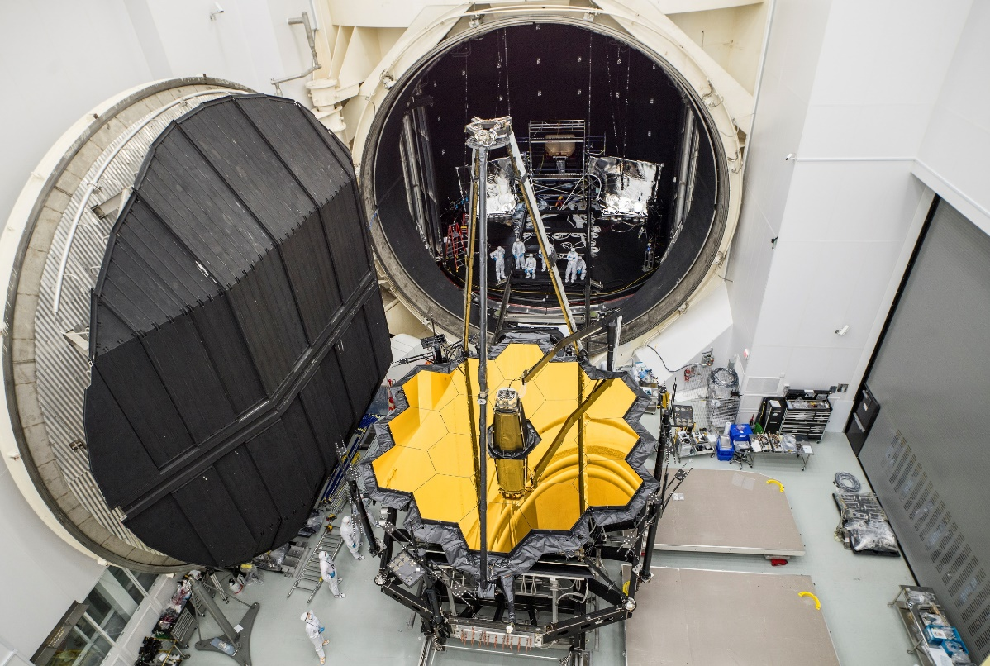
THERMAL VACUUM TESTING
Example: Spacecraft Temperature Swings in Orbit
Thermal vacuum (TVAC) testing is crucial for simulating severe temperature swings in space and vacuum environment
Determines if hardware will function properly in vacuum and can withstand extreme environment; for example: working electronics, no CTE mismatch, no delamination, no cracking, or contamination of sensitive components
Bake-outs are performed on contamination sensitive hardware to bring outgassing components to an acceptable level
Scavenger plates and cold fingers in the chamber monitor the condensable species coming from the hardware that are present during the test
The collected condensed materials can then be rinsed with solvent and undergo chemical analysis to identify species
-150°C
100°C
²⁰IMAGE CREDIT: NASA/CHRIS GUNN
Notes:
Purpose of this slide is to explain the challenge of extreme temperature and how we can test materials to ensure that they will survive/operate properly.
Purpose is to also talk about bake-outs, which can mitigate outgassing concerns.

Slide 14
HOW CAN WE ADDRESS ORGANIC CONTAMINATION?

Slide 15
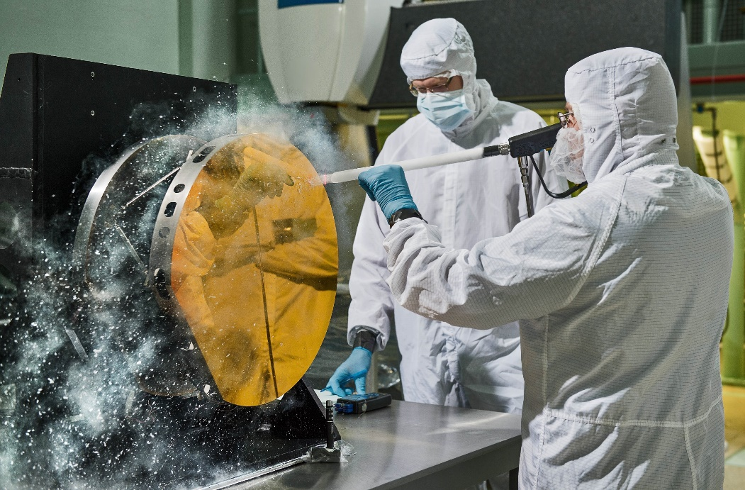
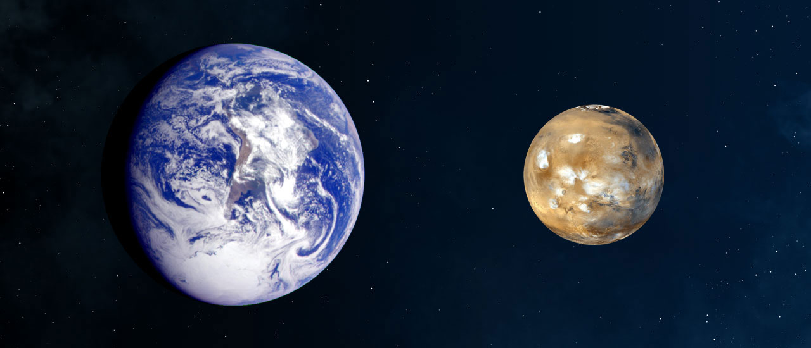
ORGANIC CONTAMINATION
Organic contamination consists of organic compounds (contain C—H bonds) and can originate from a multitude of sources:
Adhesives
Bagging
Greases
Handling
Inks
Lubricants
Oils
Compound of most concern are silicones, plasticizers, and hydrocarbon greases
O-rings
Paint
Pump oil
Purge gas
Purge gas lines
Sealants
Tapes
²¹IMAGE CREDIT: NASA/CHRIS GUNN
Particulate
Organic impurities
Adsorbed molecules
Hardware surface
²²IMAGE CREDIT: NASA/MSFC
Notes:
Purpose of this slide is to define organic contamination and explain where it can originate. Want to highlight that organic contamination often comes from unexpected sources. Will also touch on the importance of cleanliness when sending missions to other planets where we are searching for life.

Slide 16
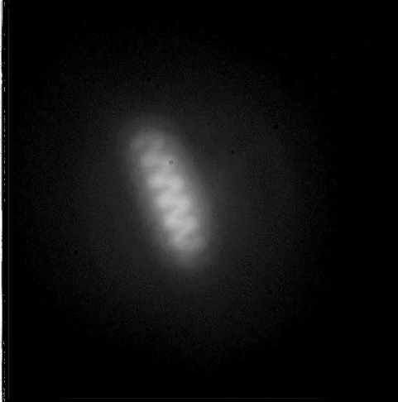
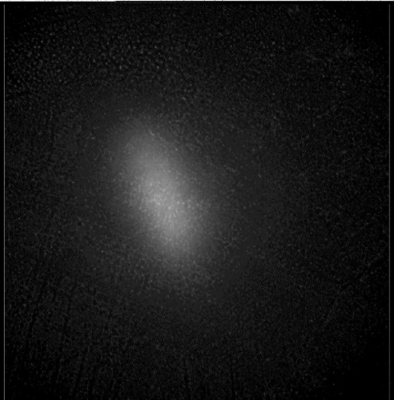
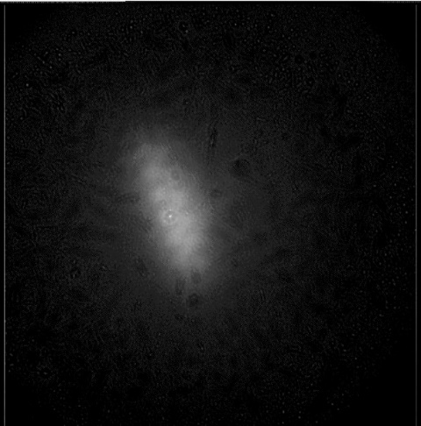
OUTGASSING
Outgassing is a phenomena where solid materials release gas that is trapped within the material. Materials that don’t normally offgas can start to release gases under vacuum or extreme temperatures
Coatings, sealants, lubricants, and adhesives are the most common sources for concern, especially in enclosed environments where released gases can deposit on sensitive surfaces
This can result in a multitude of problems, including electrical arcing of electronics, loss of adhesion for coatings, and degradation of optics and detectors, resulting in loss of data, misalignment, and interference with measurements
STARDUST Navigation Camera (NC) Calibration Lamp
Pre-Launch (clean)
Post-Launch (contaminated)
Post-Heating (clean up)
²³IMAGE CREDIT: NASA/JPL-CALTECH
PRE-LAUNCH (CLEAN)
POST-LAUNCH (CONTAM.)
POST-HEATING (CLEAN UP)
²³IMAGE CREDIT: NASA/JPL-CALTECH
²³IMAGE CREDIT: NASA/JPL-CALTECH
Notes:
Purpose of this slide is to explain the challenge of outgassing: what is it and why it is a concern

Slide 17
OUTGASSING TESTING
Outgassing testing per ASTM E595 is performed to determine the amount of volatile content in a material:
Sample is pre-conditioned at 25°C, 50% relative humidity, standard atmospheric pressure for 24 hours
Initial weight is taken
Placed under vacuum at 125°C for 24 hours
Final weight is taken
Heated Copper
Bar (125°C)
Sample Holder
NASA OUTGASSING CRITERIA
Total Mass Loss (TML): mass loss of sample
Collected Volatile Condensable Materials (CVCM): mass of condensed material on collector plate
Water Vapor Regained (WVR): amount of water re-adsorbed/re-absorbed at 25°C for 24 hours, performed after TML/CVCM values are obtained
Sample
PASS
CVCM <0.1% and TML < 1%
or
CVCM <0.1% and TML > 1 % if TML-WVR <1%
FAIL
CVCM > 0.1%
or
TML-WVR > 1%
Chromium-plated collector plate (25°C)
Outgassing Test Set Up Schematic
POST-LAUNCH (CONTAM.)
POST-HEATING (CLEAN UP)
Notes:
Purpose of this slide is to explain how we test materials for outgassing.

Slide 18
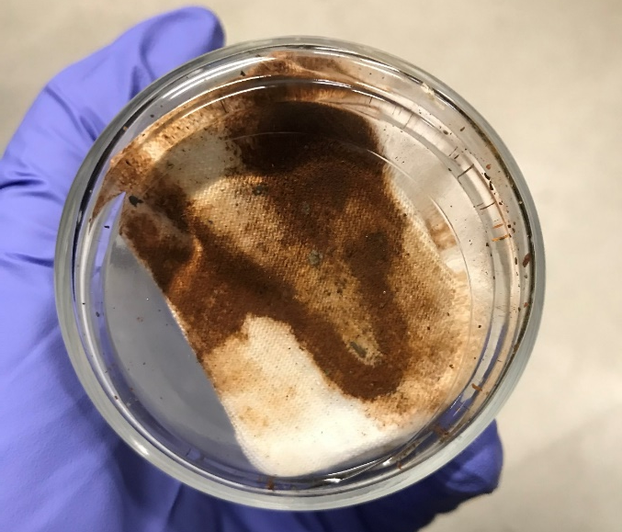
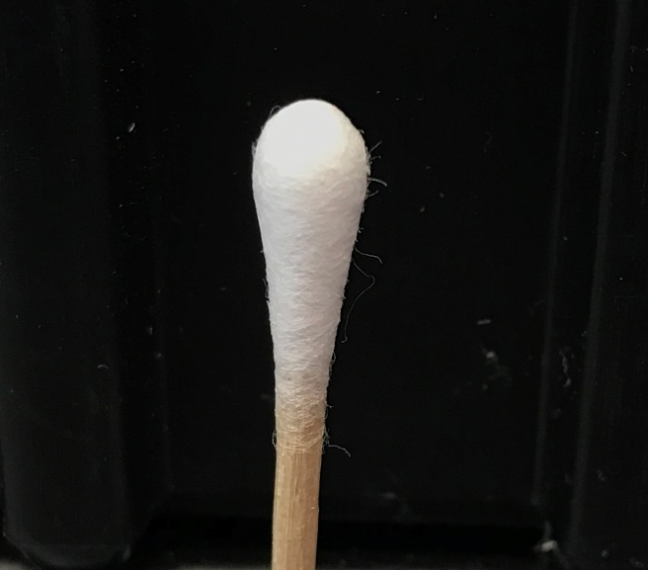
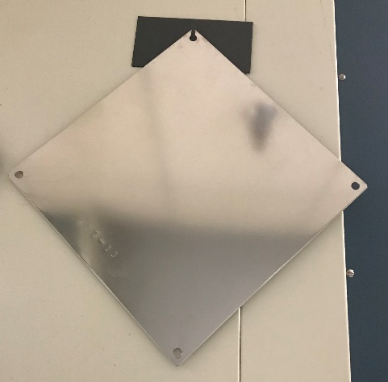
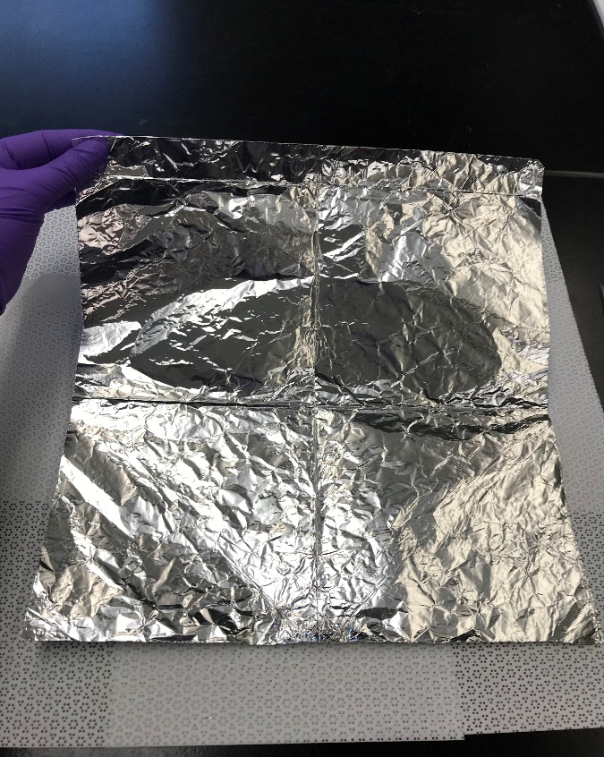
NON-VOLATILE RESIDUE
Non-volatile residue (NVR) consists of organic compounds that remain after evaporation of a liquid
NVR can also be transferred to surfaces via dry handling
Cleanliness levels, which indicate the amount of contamination (NVR) per unit area, are determined via IEST-STD-CC1246E: Product Cleanliness Levels – Applications, Requirements, and Determination
Many different types of tests to determine NVR:
Direct rinse of flight hardware
Witness foils and witness plates
Cold fingers and scavenger plates
Contact transfer tests
Wipes and swabs sampling

Slide 19
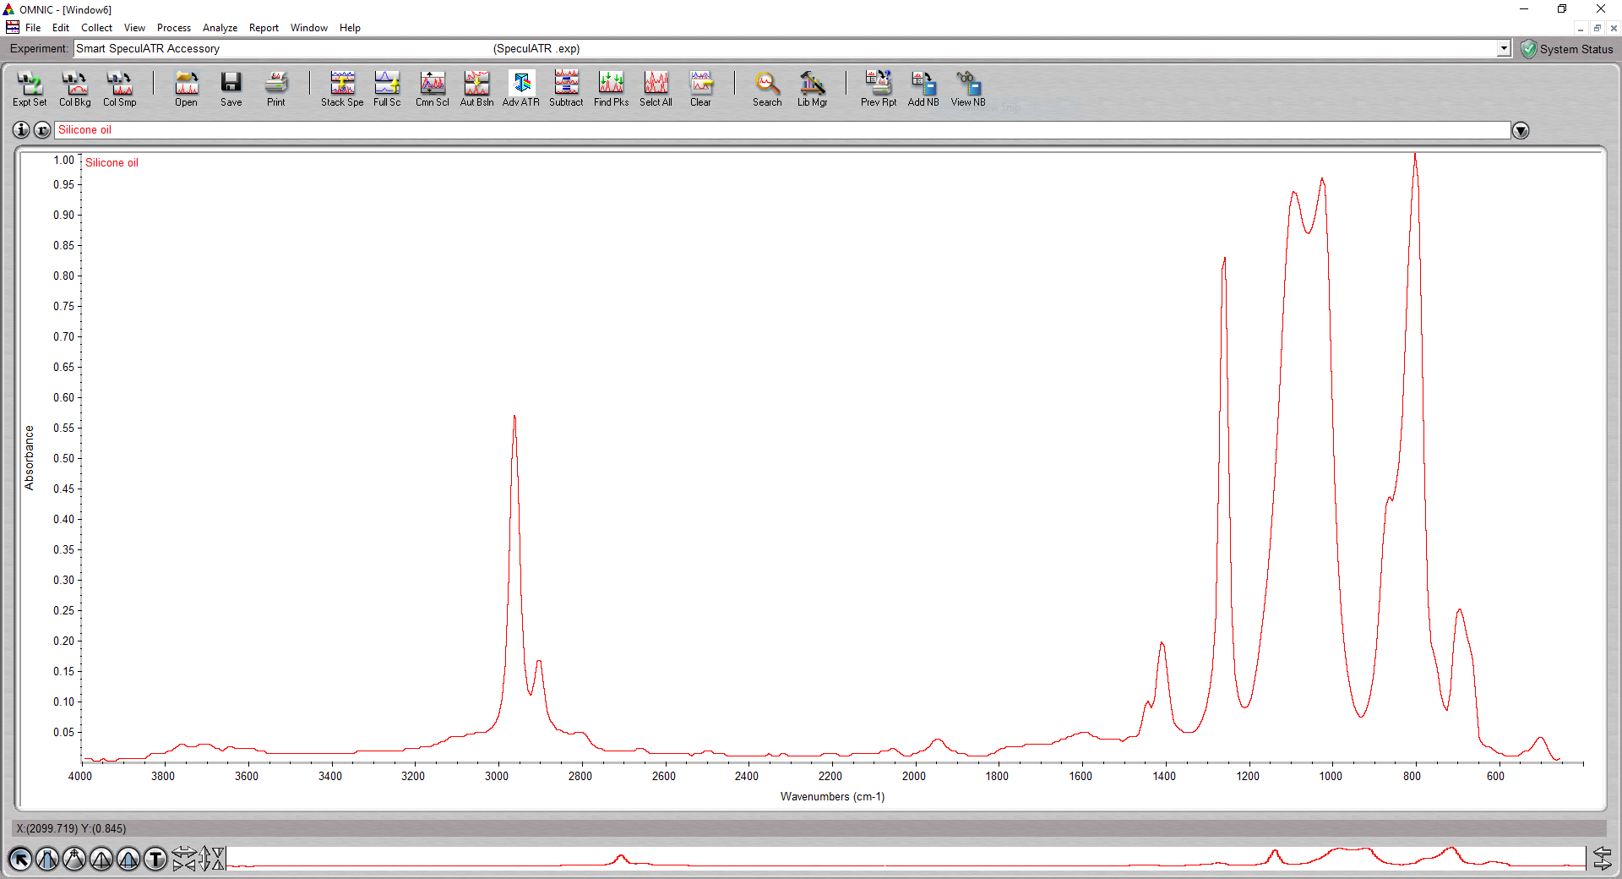
FOURIER TRANSFORM INFRARED SPECTROSCOPY
Fourier Transform Infrared (FTIR) Spectroscopy is a chemical analysis technique used to identify functional groups that are present in organic samples
FTIR uses infrared light to determine what bonds are present in a sample: the type of bond and the number of each type of bond will affect how much light is absorbed/transmitted
Small amount of sample and minimal sample preparation make FTIR a quick, easy-to-run analysis technique that can provide answers for:
Material identification
Material verification
Cleanliness verification
Silicone oil
Si-O-Si
Si-CH₃
CH₃
Si-CH₃

Slide 20
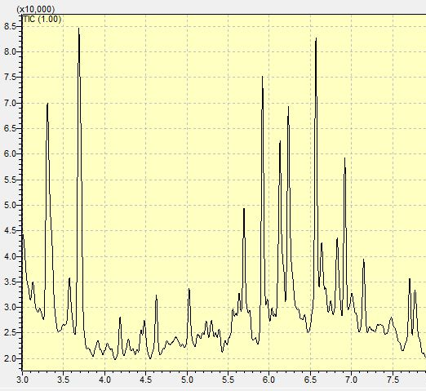
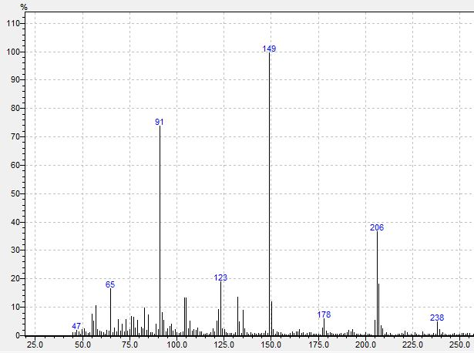
GAS CHROMATOGRAPHY/MASS SPECTROMETRY
Gas Chromatography/Mass Spectrometry (GC/MS) is a chemical analysis technique used to identify organic compounds that are present in a sample
Complex mixtures are physically separated into individual compounds in the GC column and then are ionized in the MS to obtain a mass spectrum, which acts as a “unique fingerprint ID”
6.
Ion Detector
1.
5.
2.
Sample
injection
3.
-
+
+
-
4.
Carrier gas
(helium)
Gas Chromatograph (GC)
Capillary column in oven
Mass Spectrometer (MS)
EI ion source with quadrupole mass filter
Total Ion Count (TIC) chromatogram
Counts vs. Retention Time
Mass spectrum of a single peak
relative intensity (%) vs. m/z

Slide 21
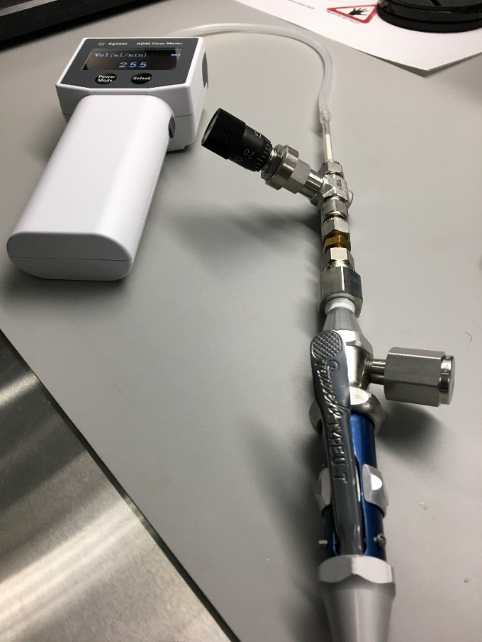
THERMAL DESORPTION
Thermal desorption is a sample introduction technique for GC/MS that is used to collect volatile and semi-volatile organics on an adsorbent material
Typically used to collect purge gas samples
Compounds are retained inside the porous adsorbent until exposed to thermal energy (heat)
Silanized glass wool
Heated zone of tube
Thermal desorption
sample tube
Adsorbent
material
Compounds are released into GC/MS
Sample is collected as gas flows through adsorbent material
GC column

Slide 22
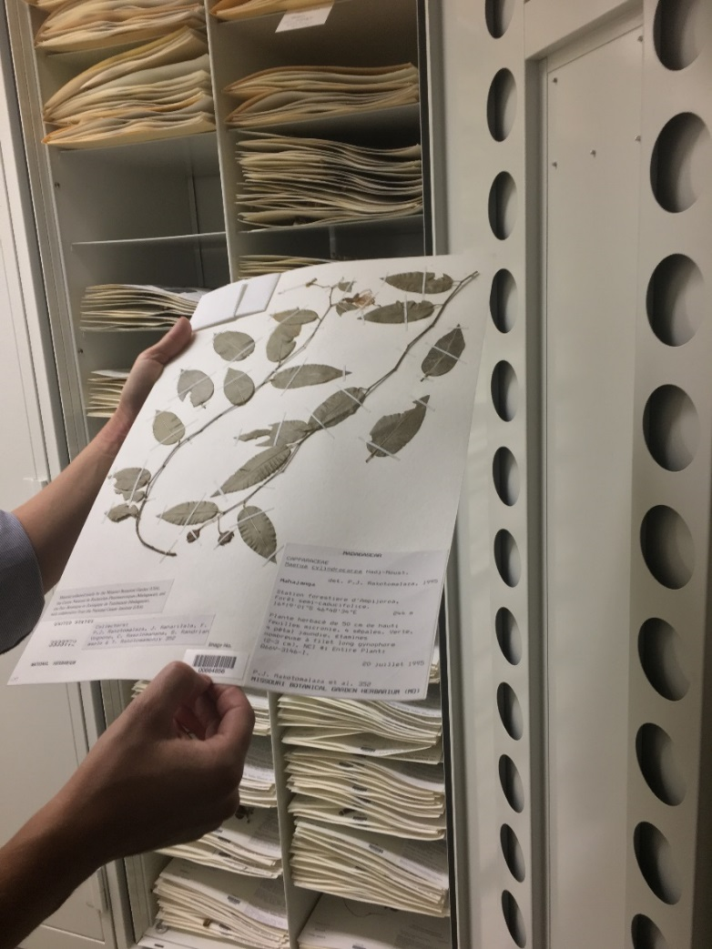
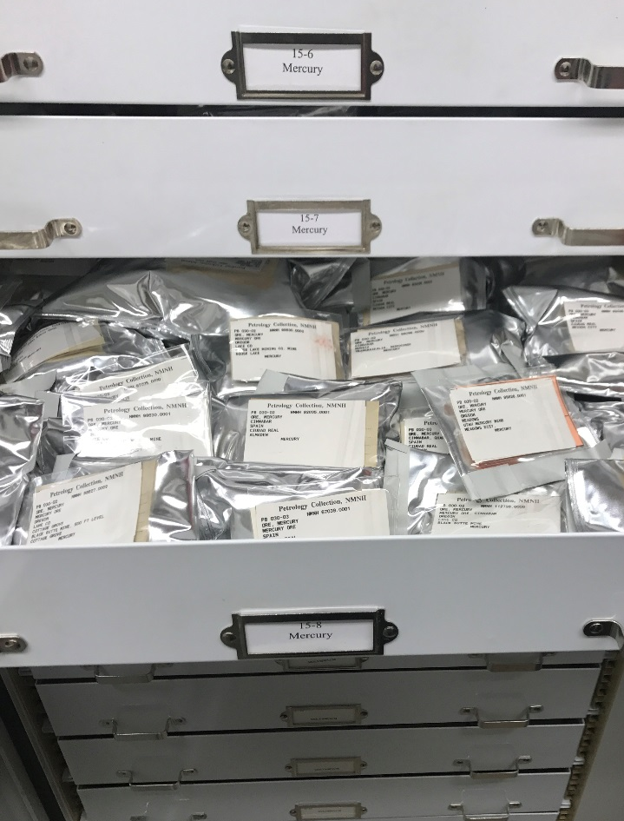
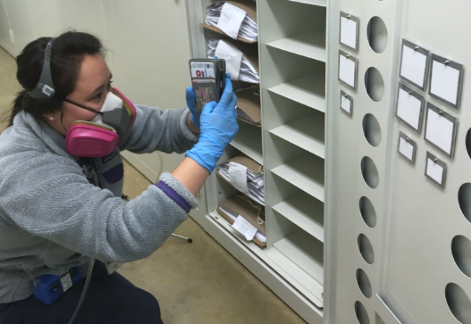
THERMAL DESORPTION AT THE MUSEUM
The Smithsonian Institution’s National Museum of Natural History (NMNH) was interested in studying the use of NASA’s Molecular Adsorber Coating (MAC) technology to protect museum resources and artifacts
Originally developed for vacuum environments to minimize outgassing contamination in space, the purpose of this collaboration was to determine MAC’s effectiveness with mitigating offgassing contamination on Earth (ambient, non-vacuum environment)
Botany Specimens
Mineral Ore Specimens
MAC
Notes:
NASA Technical Report Server: https://ntrs.nasa.gov/citations/20190025149
NASA feature: https://www.nasa.gov/feature/goddard/2018/nasa-developed-coating-investigated-for-protecting-smithsonian-specimens

Slide 23
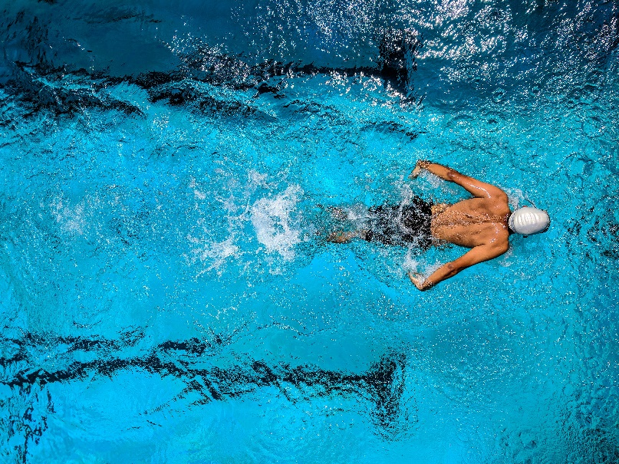

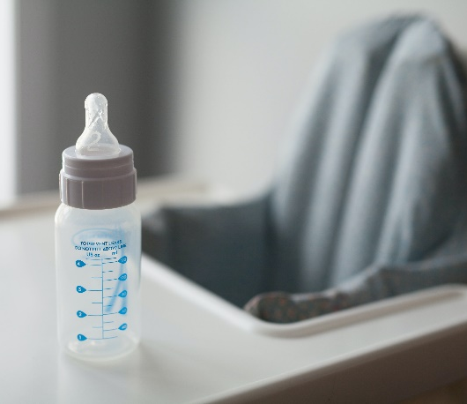
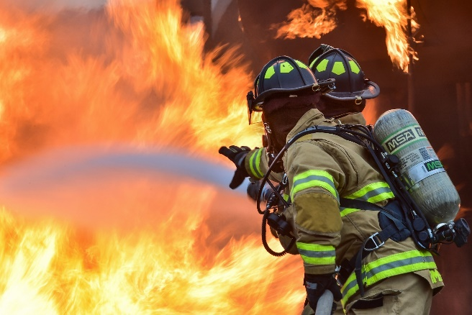
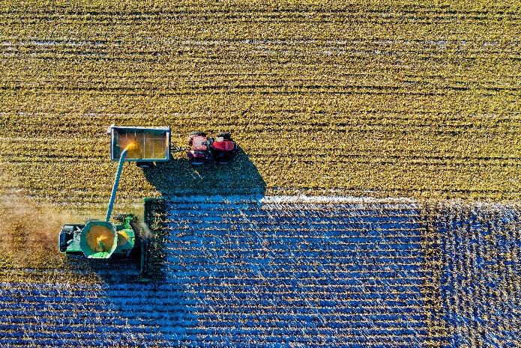
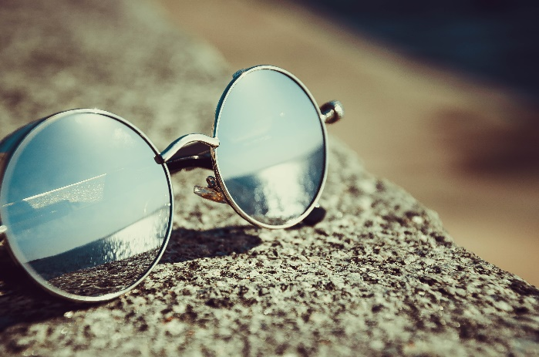
SPINOFF TECHNOLOGIES
NASA spinoffs are technologies, products, and processes that were developed using NASA technology, funding, and/or expertise and are now available as commercial products that benefit everyday life
²⁴IMAGE CREDIT: PEXELS.COM/GUDURU AJAY BHARGAV
²⁵IMAGE CREDIT: PEXELS.COM/CASTORLY STOCK
²⁶IMAGE CREDIT: PEXELS.COM/BURST
²⁷IMAGE CREDIT: PEXELS.COM/PIXABAY
²⁸IMAGE CREDIT: PEXELS.COM/TOM FISK
²⁹IMAGE CREDIT: PEXELS.COM/ASIM ALNAMAT
Notes:
Purpose of this slide is to talk about some more spinoff technologies that are pretty common but people may not realize it stemmed from a NASA spinoff. For example, the Speedo LZR Racer suit (which I used to wear when I competed!), memory foam, baby formula, firefighter uniforms, satellite use for farming/crop predictions, coating on sunglasses

Slide 24
CONCLUSIONS

Slide 25
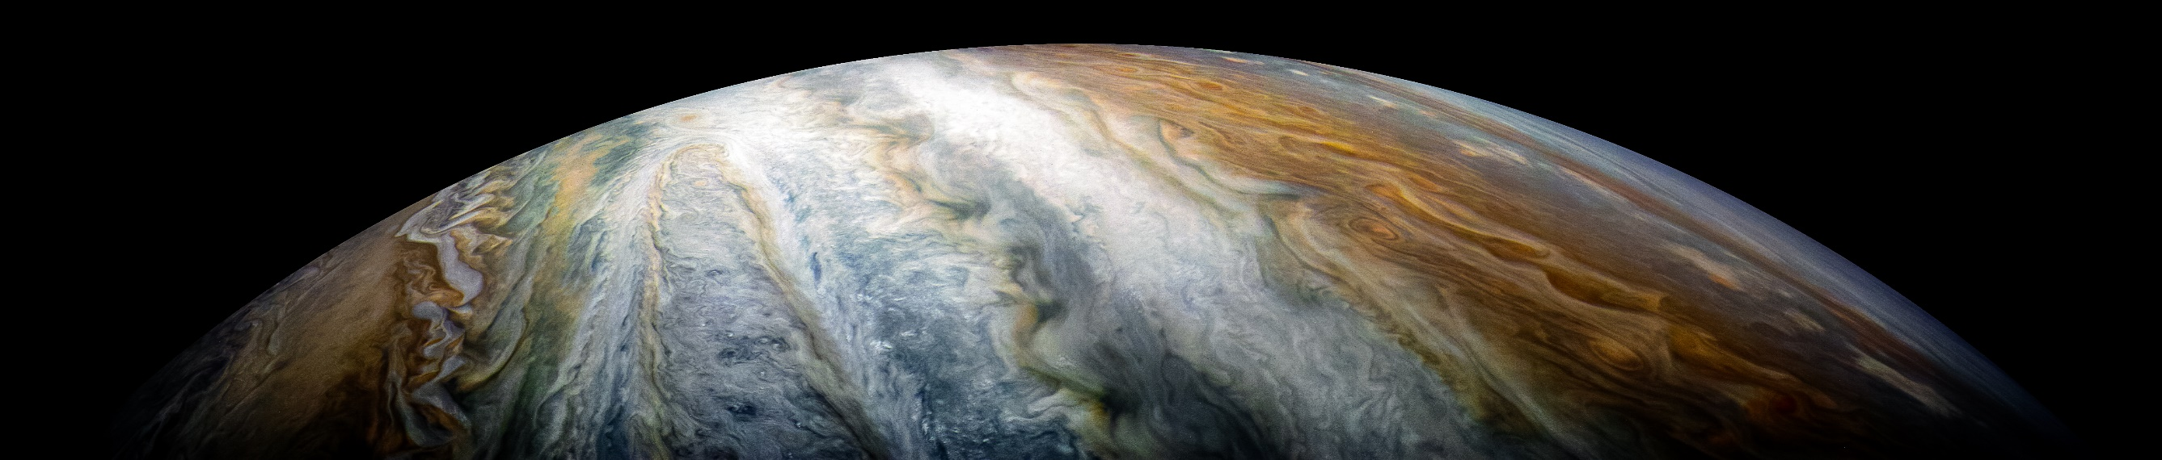
FINAL THOUGHTS
Selecting the right materials to use for spaceflight missions is very complicated: the extreme environment poses numerous unique challenges, and extensive testing must be performed to prove that the materials can survive the harsh conditions while successfully executing mission requirements
Although space has its unique materials challenges, the technologies, products, and processes developed in overcoming these challenges also benefit our life here on Earth
Even though space exploration and missions can seem distant from everyday life, it’s a lot closer to home than most realize
³⁰IMAGE CREDIT: NASA/JPL-CALTECH/SwRI/MSSS/KEVIN M. GILL
Notes:
Want to emphasize that all the cool work that we do at NASA does have an impact on day-to-day life.

Slide 26
QUESTIONS?

Slide 27
ACRONYM LIST

Slide 28
ACRONYM LIST
CTE: Coefficient of Thermal Expansion
CME: Coronal Mass Ejections
FTIR Spectroscopy: Fourier Transform Infrared Spectroscopy
GC/MS: Gas Chromatography/Mass Spectrometry
GEO: Geostationary Earth Orbit
GSFC: Goddard Space Flight Center
LEO: Low Earth Orbit
MSFC: Marshall Space Flight Center
MAC: Molecular Adsorber Coating
NMNH: National Museum of Natural History
NC: Navigation Camera
NVR: Non-volatile Residue
TVAC: Thermal Vacuum

Slide 29
MEDIA REFERENCES

Slide 30
MEDIA REFERENCES
Materials Engineering Branch Logo, Image Credit: NASA/GSFC, Image Link: https://code541.gsfc.nasa.gov/, Media Use Guidelines: https://www.nasa.gov/multimedia/guidelines/index.html
Hubble Servicing Missi#2583, Image Credit: NASA/MSFC, Image Link: https://www.flickr.com/photos/gsfc/44403346890/in/album-72157676449694808/, License: https://creativecommons.org/licenses/by/2.0/legalcode
SNEAK PEEK of gorgeous Pluto!, Image Credit: NASA/MSFC, Image Link: https://www.flickr.com/photos/nasamarshall/19505220089/in/gallery-trphotoguy-72157656017865971/, License: https://creativecommons.org/licenses/by-nc/2.0/legalcode
Self-Portrait of NASA’s Curiosity Mars Rover, Image Credit: NASA/JPL-Caltech/MSSS, Image Link: https://www.flickr.com/photos/nasamarshall/27906151057/in/album-72157667410014672/, License: https://creativecommons.org/licenses/by-nc/2.0/legalcode
James Webb Space Telescope Mirrors, Image Credit: NASA/Chris Gunn, Image Link: https://www.flickr.com/photos/nasawebbtelescope/30116152713/in/album-72157711864057113/, License: https://creativecommons.org/licenses/by/2.0/legalcode
Bennu, Image Credit: NASA/Goddard/University of Arizona, Image Link: https://www.flickr.com/photos/nasamarshall/46313010811/in/album-72157667410014672/, License: https://creativecommons.org/licenses/by-nc/2.0/legalcode
Hurricane Florence, Image Credit: NASA GSFC, Image Link: https://www.flickr.com/photos/gsfc/42828603210/in/album-72157697980438442/, License: https://creativecommons.org/licenses/by/2.0/legalcode
Space Launch System Launch, Image Credit: NASA/MSFC, Image Link: https://www.flickr.com/photos/nasamarshall/22391614955/in/album-72157627559536895/, License: https://creativecommons.org/licenses/by-nc/2.0/legalcode
NASA Center Map, Image Credit: NASA, Image Link: https://www.nasa.gov/partnerships/center-capabilities.html, Media Use Guidelines: https://www.nasa.gov/multimedia/guidelines/index.html
NASA Project Life Cycle from NPR 7120.5E, Image Credit: NASA, Image Link: https://www.nasa.gov/seh/3-project-life-cycle, Media Use Guidelines: https://www.nasa.gov/multimedia/guidelines/index.html

Slide 31
MEDIA REFERENCES
Hubble Image of “El Gordo” Galaxy Cluster, Image Credit: ESA/Hubble & NASA, RELICS, Image Link: https://www.flickr.com/photos/nasamarshall/39199406624/in/album-72157667410014672/, License: https://creativecommons.org/licenses/by-nc/2.0/legalcode
International Space Station, Image Credit: NASA, Image Link: https://www.flickr.com/photos/nasamarshall/50563418511/in/photolist-2k37JHM-2467nuU-6X7ij8-21kJjoW-CKjGsv-FSXmKV-T8vNDG-p4c6pq-oLJprW-p3XCT4-oLJSYY-p4e5b2-p2caRC-2j35kzR-oLJ5WZ-oLJgGs-oLJNbR-p4e63n-oLJTh3-oLJTGF-p4dZs4-oLJU4n-p3XHPX-oLJhDh-oLJMNN-oLJU1X-p2cb3E-oLJbrg-oLJLpf-p4bYZG-oLJTHo-oLJNDe-oLJTn3-oLJNqt-oLJi3U-oLJiYw-p3XJ1D-oLJan2-oLJMSV-p2caCb-oLJa9X-oLJPda-p2c3gY-p4dWSK-p3XK52-2iF9Pn7-oLJN2x-p4bZwd-p2c4am-oLJMBq , License: https://creativecommons.org/licenses/by-nc/2.0/legalcode
NASA SOLVE Challenge Event, Image Credit: Aubrey Gemignani, Image Link: https://www.flickr.com/photos/nasahqphoto/36540872214/in/photolist-XEZwfb-fgdQMh-pP47oB-pjuZbP-qvv4ZF-2fGNYi5-2h6sAmo-2eosYsn-26p3KYg-pkKa3M-qUqB96-7fXMSe-2ia1enD-7gg2oz-7gjWzd-7fXMKx-ecLmQ2-qmVbnT-XEZvq5-fgdK4Y-q6fX9i-nZc5Bj-Y4wiiB-ffYyii-XZkwSY-YH8T9Y-2iVdKSF-XEZsxS-nJKaaL-YH8WXj-ffYk9M-2iiqJsc-WR9hHv-2fGNYof-2fGNYjY-YH8YRQ-JxYXcW-cnDV6A-7fXLyn-pcNEHf-J8nqcw-2h6szWR-QR1T5J-YH8Ygm-YH8U7E-2fMrt94-2fGNYvE-XEZtjb-YH8Xzw-2fMrtj4, License: https://creativecommons.org/licenses/by-nc-nd/2.0/legalcode
MISSE 2 PEACE Polymers Experiment (Before and After), Image Credit: NASA, Image Link: https://www.flickr.com/photos/nasamarshall/15650444629/in/photolist-pQYBWe-cXNxJE-pR1xbY-TAdgqb-2jbZPvH-8eMAbP-qmVx6r-9NCzNg-cXN5kU-21zkofC-fNJnqg-MeEMFk-UY2CYs-dG47QR-22DQcks-2hL7sog-eQRM5i-MpYAuc-nw3JHn-M9r6jf-M9mCsN-MeH4iZ-M7xpbn-M9r6Xu-nNxqcB-GZEkjC-HTWGNc-HsQKRN-H93QSu-GCRvBe-HyoMBn-Hk62Ty-hWCLNY-uwQ8w-nNfjA6-24tAMsu-at6zP-8kiMc3-8kfzxx-24cih8t-SCLkNM-SQAz9u-24tALMG-SCNDvX-XuJpM3-N5CpYi-Mfv3VR-M2FVgY-M7xqKz-MtY1YW, License: https://creativecommons.org/licenses/by-nc/2.0/legalcode
Entering the Martian Atmosphere with the Perseverance Rover (Illustration), Image Credit: NASA/JPL-Caltech, Image Link: https://mars.nasa.gov/resources/25444/entering-the-martian-atmosphere-with-the-perseverance-rover-illustration/, Media Use Guidelines: https://www.nasa.gov/multimedia/guidelines/index.html
Acoustic Test Chamber, Image Credit: NASA/GSFC/Chris Gunn, Image Link: https://www.nasa.gov/centers/goddard/about/unique_resources.html, Media Use Guidelines: https://www.nasa.gov/multimedia/guidelines/index.html

Slide 32
MEDIA REFERENCES
JWST ISIM Emerges from TVAC Testing in SES Chamber, Image Credit: NASA/GSFC/Chris Gunn, Image Link: https://www.nasa.gov/centers/goddard/about/unique_resources.html, Media Use Guidelines: https://www.nasa.gov/multimedia/guidelines/index.html
The Space Environments Complex (SEC)’s Mechanical Vibration Table, Image Credit: NASA/Plum Brook Station/SEC, Image Link: https://www.nasa.gov/feature/glenn/2020/tours/see-where-nasa-simulates-space-at-plum-brook-station/, Media Use Guidelines: https://www.nasa.gov/multimedia/guidelines/index.html
GSFC’s High-Capacity Centrifuge, Image Credit: NASA/GSFC/Rebecca Roth, Image Link: https://www.nasa.gov/centers/goddard/about/unique_resources.html, Media Use Guidelines: https://www.nasa.gov/multimedia/guidelines/index.html
Webb Telescope Emerges from Chamber A After Cryogenic Testing, Image Credit: NASA/Chris Gunn, Image Link: https://www.flickr.com/photos/nasawebbtelescope/25003831358/in/album-72157711864057113/, License: https://creativecommons.org/licenses/by/2.0/legalcode
Engineers Clean Mirror with Carbon Dioxide Snow, Image Credit: NASA/Chris Gunn, Image Link: https://www.flickr.com/photos/nasawebbtelescope/17406589981/in/album-72157629134274763/, License: https://creativecommons.org/licenses/by/2.0/legalcode
Mars/Earth Comparison, Image Credit: NASA/MSFC, Image Link: https://www.flickr.com/photos/nasamarshall/21517041108/in/album-72157656747539994/, License: https://creativecommons.org/licenses/by-nc/2.0/legalcode
Images of STARDUST NC Calibration Lamp, Image Credit: NASA/JPL-Caltech, Image Link: https://stardust.jpl.nasa.gov/news/vision.html, Media Use Guidelines: https://www.nasa.gov/multimedia/guidelines/index.html
Person Swimming on Body of Water, Image Credit: Pexels.com/Guduru Ajay bhargav, Image Link: https://www.pexels.com/photo/person-swimming-on-body-of-water-863988/, License: https://www.pexels.com/license/
White Pillows on a Bed, Image Credit: Pexels.com/Castorly Stock, Image Link: https://www.pexels.com/photo/white-pillows-on-a-bed-3682240/, License: https://www.pexels.com/license/

Slide 33
MEDIA REFERENCES
Feeding Bottle on Table, Image Credit: Pexels.com/Burst, Image Link: https://www.pexels.com/photo/bottle-container-high-chair-macro-374756/, License: https://www.pexels.com/creative-commons-images/
Fireman Illustration, Image Credit: Pexels.com/Pixabay, Image Link: https://www.pexels.com/photo/accident-action-danger-emergency-260367/, License: https://www.pexels.com/creative-commons-images/
Top View of Green Field, Image Credit: Pexels.com/Tom Fisk, Image Link: https://www.pexels.com/photo/top-view-of-green-field-1595104/, License: https://www.pexels.com/license/
Silver Framed Hippie Sunglasses on Concrete, Image Credit: Pexels.com/asim alnamat, Image Link: https://www.pexels.com/photo/ball-shaped-beach-blur-close-up-343720/, License: https://www.pexels.com/license/
Jupiter’s Colorful Cloud Belts, Image Credit: NASA/JPL-Caltech/SwRI/MSSS/Kevin M. Gill, Image Link: https://www.flickr.com/photos/nasamarshall/39842488552/in/album-72157667410014672/, License: https://creativecommons.org/licenses/by-nc/2.0/legalcode

