Slide 1
Using Assume-Guarantee Contracts in
Autonomous Spacecraft
James B. Dabney, University of Houston – Clear Lake
Pavan Rajagopal, CACI
Julia M. Badger, NASA JSC
8 February 2021

Slide 2
Overview
  Background
    Traditional Verification-V
    Cost-to-Fix Escalation
  Assume-Guarantee Contracts
  Development Implementation
  Operational Implementation
  Future Work

Slide 3
Introduction
Spacecraft systems becoming more complex and more autonomous
Gateway Vehicle System Manager
  Manage spacecraft for extended unattended operations
  Coordinate among numerous subsystems and modules
  Diverse levels of autonomy depending on crew and ground-based contact

Slide 4
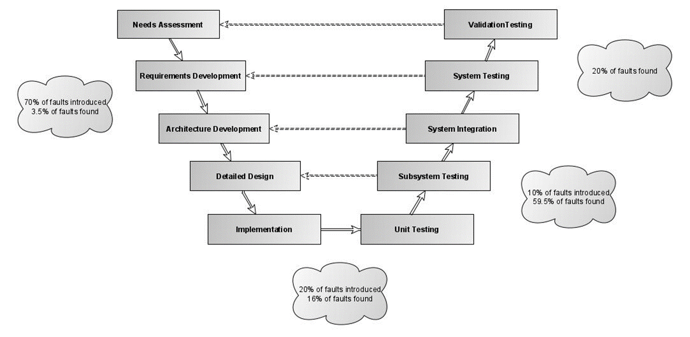
Verification V – Legacy Approach to Verification

Slide 5
Cost to Fix Escalation across Lifecycle
Issue Type | Phase Issue Found
 | Requirement | Design | Code | Test | Integration | Operations
Requirement | 1 | 5 | 10 | 50 | 130 | 368
Design |  | 1 | 2 | 10 | 26 | 64
Code |  |  | 1 | 5 | 13 | 37
Test |  |  |  | 1 | 3 | 7
Integration |  |  |  |  | 1 | 3
Notes:
Units?

Slide 6
Assume-Guarantee Contracts
Assume-Guarantee contracts define expected behavior of systems, subsystems, components
The assumptions or pre-conditions on the subsystem’s inputs bound the conditions in which the contract applies
The guarantees or post-conditions of a subsystem’s contract declare the conditions that the subsystem’s outputs must satisfy and can serve as verification goals
Contracts can be used to define safety properties or hazard controls:
  For example, a car should not start unless the transmission is in park mode
  Can be converted to a mathematical specification and model checked to ensure that specified system has the desired behavior and safety properties

Slide 7
Contract Levels and Flow Down
Assume-guarantee contracts can be expressed for subsystems and components.
During design and implementation, subsystem contracts are decomposed or flowed down to component level contracts.
Flow down can simplify verification by focusing on one component at a time
Decomposition can be checked using assertions in model checker
Model checker determines if a finite-state model satisfies a given specification
System Manager
Model Checker
Contracts
Internal Subsystem
External Subsystem

Slide 8
Contract Template Format
variables:.. | inputs: values supplied to function
 | outputs: values returned from function
types: | data types (can be custom) of each input and output
assumptions: | conditions and constraints on inputs under which contract is valid
guarantees: | conditions on outputs when contract is valid
C₁ :

Slide 9
Generating Contracts
Develop textual requirement
  When Executive receives a task command, Executive shall respond with accept/reject within 5 seconds
  Executive shall provide task updates at 0.1 Hz
  After accepting command, Executive shall respond with completion message within 10 seconds

Slide 10
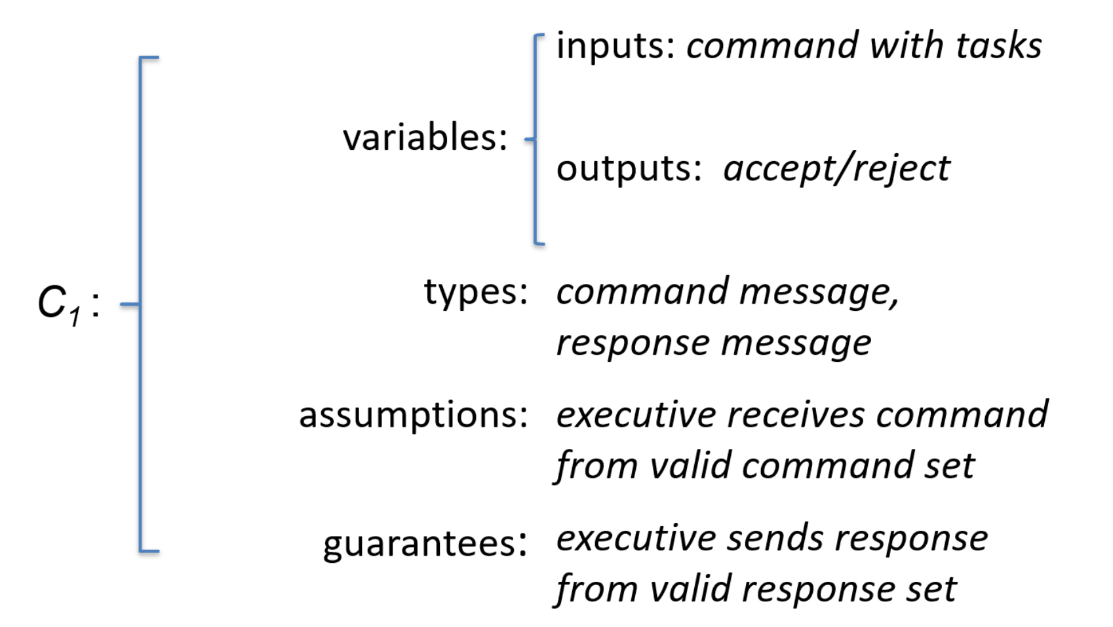
Contract 1 Specification

Slide 11
Development and Operational Verification
Developmental contract verification
  For contracts that can be represented as state machine-type functions
  Specified in modeling language such as Promela or PlusCal/TLA+
  Checked using model checker such as Spin or TLC
  Contract violation may indicate specification issue
Operational contracts
  Used to protect from divergence, deadlocks, livelocks
  Restricted in number due to computational overhead
  Implemented using lightweight checker such as R2U2
  Contract failure triggers corrective response

Slide 12
Development Contract Generation Workflow
For each in-scope contract
Identify all inputs (external from subsystem, operator, cooperating internal capability)
  Explicitly enumerate each in-scope input, such as each command accepted
Identify all outputs
Define types – many will be special such as command, report
Identify assumptions – what must be true for the rule to apply
Identify guarantees in terms of maps from inputs to outputs
Implement contract as formal specification in PlusCal/TLA+
Verify specification using model checking
Verified models can be used to drive code generation
Formal Specification
(e.g. TLA +)
Model
Model Checking
Verified Model
Code

Slide 13
Use Formal Specification to develop test cases
Formal specification and model checking can also be used to develop unit or integration tests which drive testing of the functional code to ensure compliance.
Formal Specification
(e.g. TLA +)
Goal or Coverage metric
Code
Test Case Generation
Test Case Execution
Verified Code

Slide 14
Language/Environment for Development Contracts
Most are research-quality; a few are operational quality and adaptable mission needs
Best option identified was PlusCal/TLA+
Has been successfully adapted for Assume-Guarantee Contracts
Very easy to learn –
  Ample training including very good course from L. Lamport
  Reports of production-quality work in 2 – 3 weeks
  Easy to read
Open source with large support community
Includes a research-quality symbolic model checker
Probably the best experience base in real world; standard tool at MSFT, Google, etc
Notes:
k specifications.

Slide 15
Operational Model Checking
Runtime model checking of assume-guarantee contracts is a form of runtime verification (RV)
Feasible RV tool approaches
  Check current state or traces using temporal logic (looking back)
  Check future state trace with finite time horizon (looking forward)
    Linear state propagator
    Streamlined model checking tool
With careful tailoring of contracts and use of optimized tools, computational cost of RV can be minimized.

Slide 16
Candidate RV Tools
Relatively few high TRL candidates
VSM Design piloting R2U2/LOLA hybrid approach
Tool | Intrusive | Real World Use | Other Features
COPILOT (Langley) | Yes | Small UAV | NA
LOLA (DLR) | No | UAV | Reasons on data streams; Integrates with R2U2
R2U2 (Ames) | No | UAV/ Robonaut | Future Projections; Very Lightweight

Slide 17
Summary
Assume-guarantee contracts and formal specifications are a precise mechanism for behavioral specification and verification
Model checking formal specifications using PlusCal/TLA+ is high-payoff approach to
  Verify behavioral specification through complete coverage of state space
  Identify and correct hard to detect deficiencies early in lifecycle
  Generate integration tests for code verification
Operational assume-guarantee contracts
  Most effective form of runtime verification where applicable
  Operational experience on NASA projects
  Efficient tools available but small user base at present
Notes:
with these tools.

Slide 18
Future Work
Development contracts
  Expand scope of state machines and contracts
  Develop templates and training
Operational contracts
  Add symbolic variables names
  Add robustness to make flight software quality
  Develop template & flow from development to operational

